Slide 1
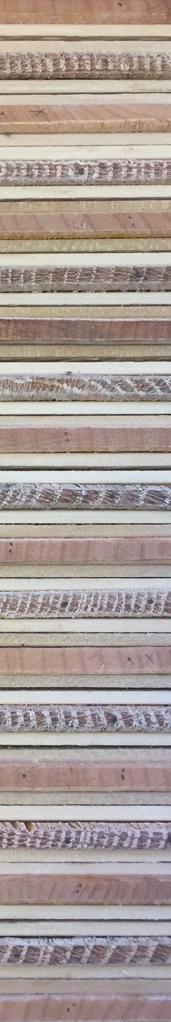
Evaluating trends and climate drivers of sugar maple and red oak growth in the state of Vermont
Rebecca L. Stern ¹, Paul G. Schaberg ², Paula F. Murakami ², Shelly A. Rayback ³,
Christopher F. Hansen ¹, Gary J. Hawley ¹
¹Rubenstein School of Environment and Natural Resources, University of Vermont, Burlington, VT, USA
²USDA Forest Service, Burlington, VT, USA
³Department of Geography, University of Vermont, Burlington, VT, USA
Forest Ecosystem Monitoring Conference
December 2017
University of Vermont

Slide 2



Acknowledgements
Forest Ecology Research Group
    Paul Schaberg
    Shelly Rayback
    Paula Murakami
    Chris Hansen
    Ali Kosiba
    Gary Hawley
Staff and interns:
Jeremy Gerber Elizabeth Bannar
Becca Rossell Jack Kilbride
Isabel Molina Sarah Erskine
Marissa Ng Michelle Deslauriers
Jordan Davis
McIntire-Stennis

Slide 3
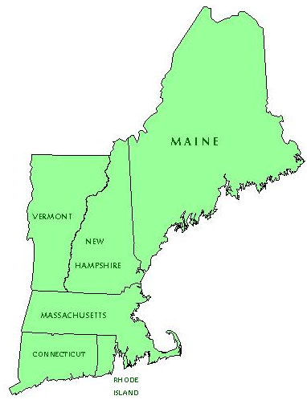
Mass.Gov
Notes:
As you are all aware, climate change is causing increases in temperature and precipitation in the northeast.

Slide 4
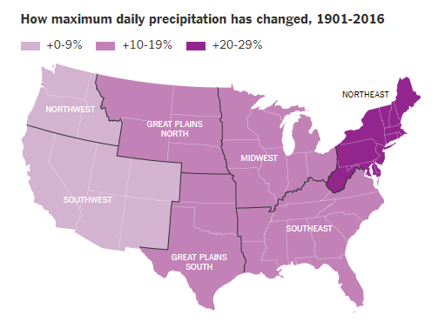
Image: NYTimes, Aug. 2017
Wuebbles et al. (2017)
U.S. Global Change Research Program Climate Science Special Report
Notes:
This increase in precipitation has actually been greater in the northeast than in other regions of the country over the past century.

Slide 5
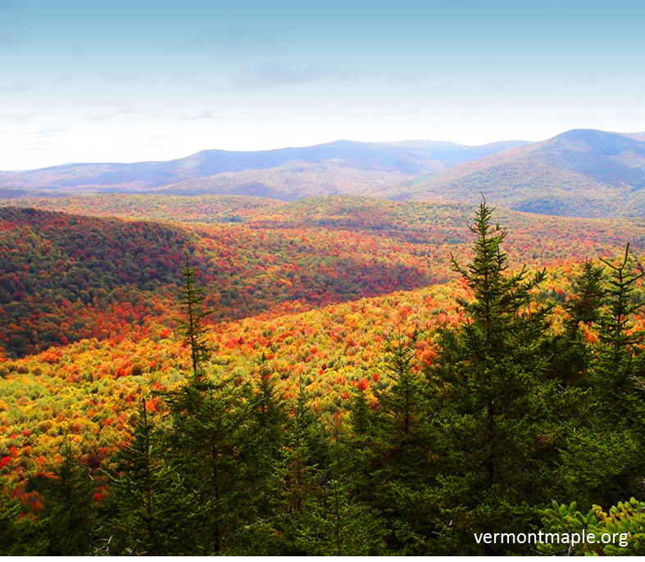
?
Uncertainties: forest responses to climate variability and its complex consequences (Likens and Franklin 2009, Babst et al. 2014)
Notes:
-While we are certain of the changes taking place in weather and climate
-<click>There are many uncertainties about how forests will responds to climate variability and its complex consequences
-yet understanding the response and resilience of Northern Forest species to a changing climate is critical for future management.

Slide 6
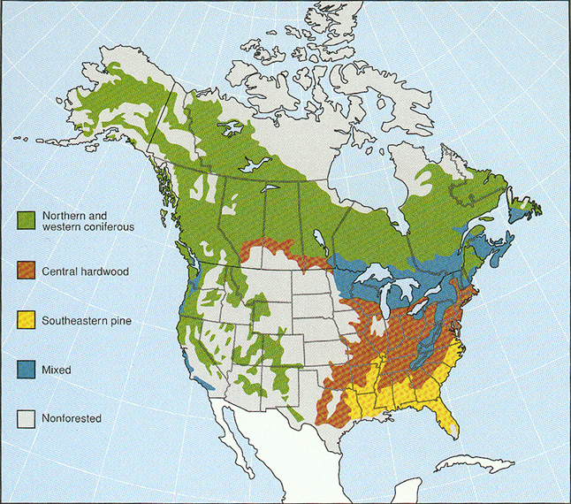
geo.msu.edu
Notes:
VT is in an interesting climatic zone- where the Central Hardwood and Northern hardwood forests come together. Climate change will affect these forest types, and there are many endeavors underway to understand how these changes will occur.

Slide 7
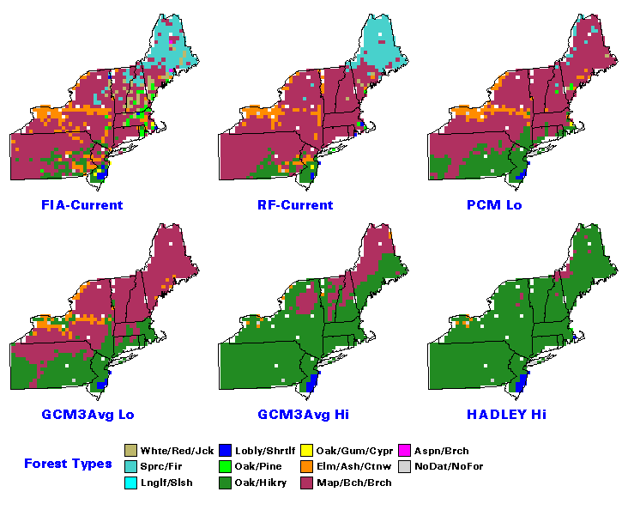
Projections of Potential Forest Type Changes: 2100
Habitat suitability
Prasad et al. (2007-ongoing)
Notes:
-Projections exist for how these forest types will change, such as the Climate Change Tree Atlas, which shows the oak-hickory forest moving into this region.
-Is there evidence that this is happening?

Slide 8
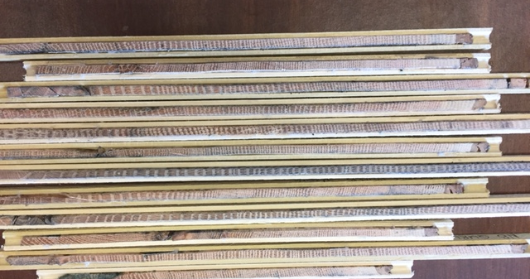
Our Future Forests
Multiple types of data required
One important metric: tree growth
red oak and sugar maple
Notes:
How forest types will change is dependent on multiple types of data.

Slide 9
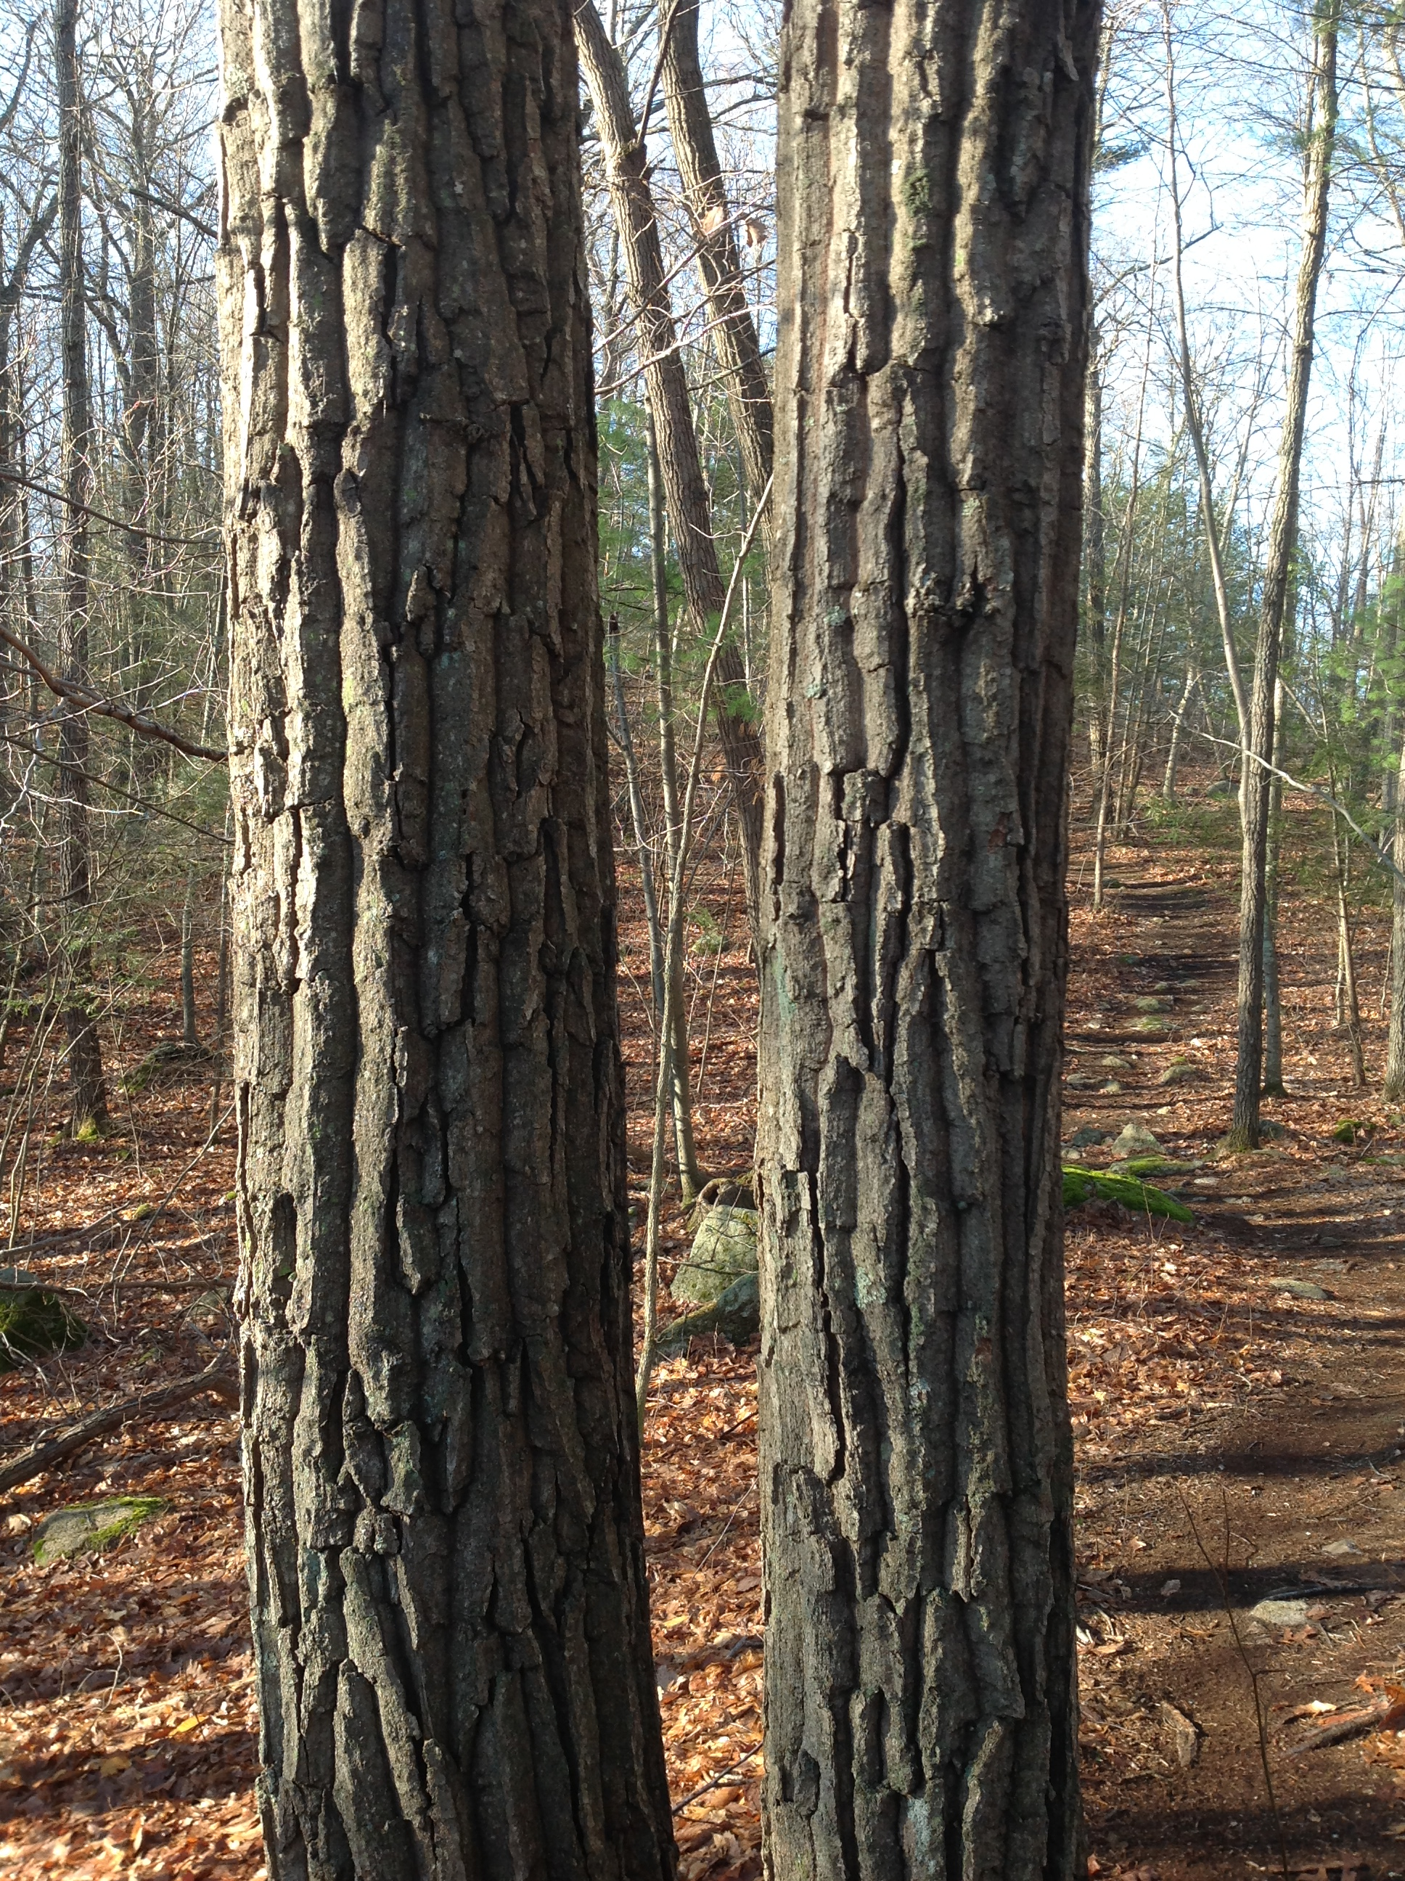
Research Questions
What growth patterns are evident in these species during the last century?
Which climate variables are best associated with red oak and sugar maple growth in Vermont?
New England Wildlife Center

Slide 10
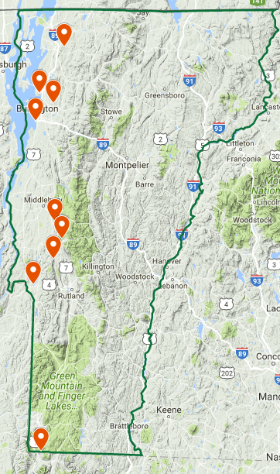
Red oak sampling
* indicates FEMC plot
1
Site | Location | # trees sampled
1) St. Albans Town Forest | St. Albans | 17
2) Niquette Bay State Park | Colchester | 19
3) Indian Brook Reservoir | Essex | 15
4) Red Rocks Park | South Burlington | 16
5) Green Mountain National Forest* | Salisbury | 14
6) Moosalamoo Recreation and Education Area* | Ripton | 15
7) Green Mountain National Forest | Goshen | 18
8) High Pond Natural Area* | Pittsford | 15
9) VT Fish & Wildlife Land* | Castleton | 20
10) Dome Research Center 1 | Pownal | 33
11) Dome Research Center 2 | Pownal | 31
TOTAL |  | 213
2
3
4
5
6
7
8
9
10
11
10
Notes:
The western side is more likely to experience a shift in oak-hickory forest

Slide 11
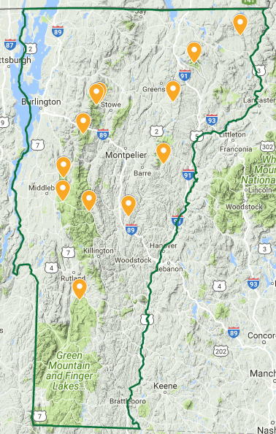
Sugar maple sampling
* indicates FEMC plot
1
Site | Location | # trees sampled
1) VMC593* | Essex County | 17
2) Willoughby State Forest | Lake Willoughby | 13
3) North American Maple Project Site* | Caledonia | 20
4) Groton State Forest/ North American Maple Project Site* | West Topsham | 18
5) Mt. Mansfield* | Stowe | 15
6) Mt. Mansfield* | Stowe | 14
7) Camel’s Hump* | Waterbury | 20
8) Bristol Cliffs Wilderness* | Bristol | 15
9) Moosalamoo Recreation and Education Area* | Ripton | 11
10) VMC 1063* | Hancock | 20
11) HHSG19A05* | Tunbridge | 20
12) LEMP16* | Wallingford | 19
TOTAL |  | 202
2
5
3
6
7
4
8
9
10
11
12
11

Slide 12
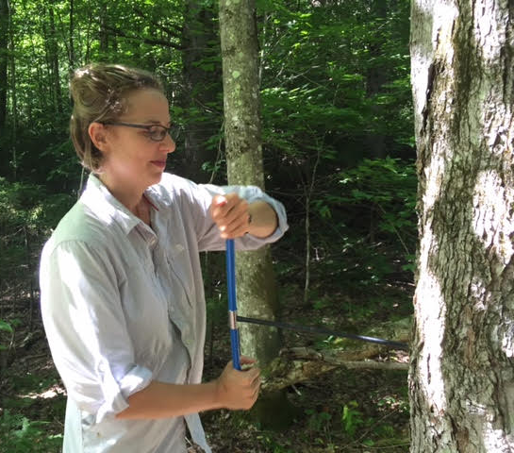
Methods
-Standard dendrochronological techniques (Stokes and Smiley 1968)
-Two increment cores per tree
-Cores: 180° to each other and perpendicular to dominant slope
Notes:
-All selected trees were cored following standard dendrochronological techniques
-Site-based chronologies were constructed for each plot in order to get at stand-wide signals, rather than a signal dominated by individual trees.

Slide 13
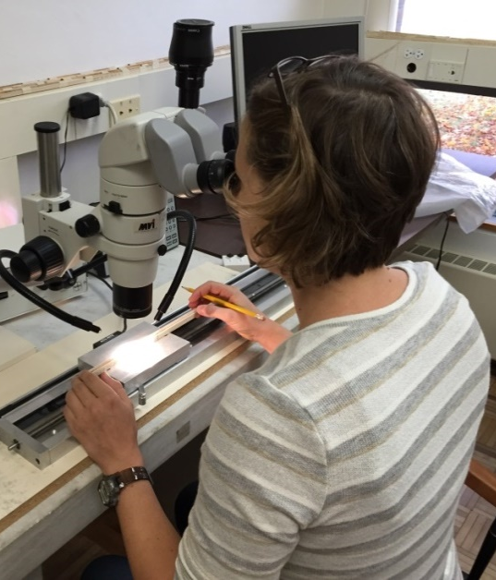
Methods
-Visually crossdated using the list method (Yamaguchi 1991)
-Microscopically measured (MeasureJ2X software)
-Program COFECHA for crossdating (Holmes 1983, Grissino-Mayer 2001)

Slide 14
Methods
-Standardized through two methods:
a. basal area increment (BAI): to evaluate growth trends
b. 2/3 cubic smoothing spline with 0.5 frequency cutoff
(Cook and Peters 1981): to correlate with environmental variables
-created mean growth chronology across all sites

Slide 15
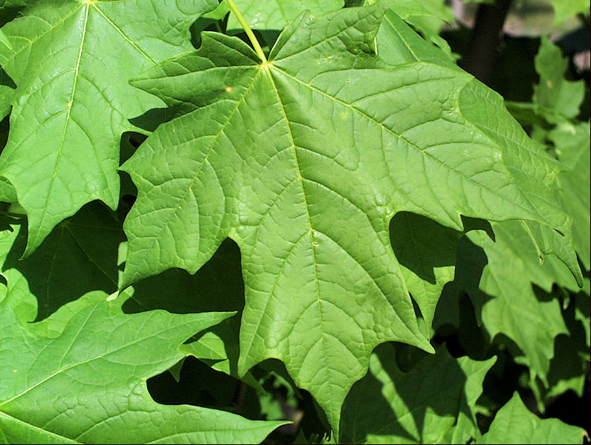
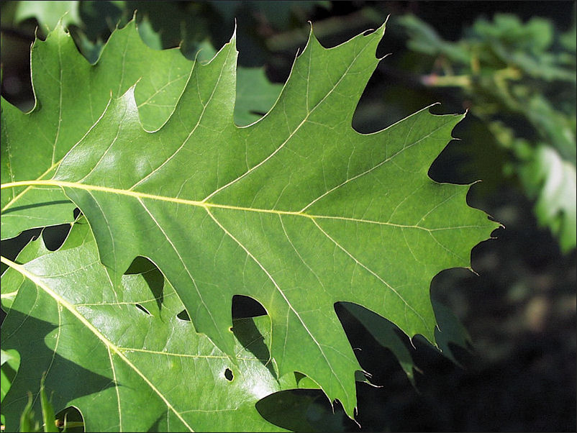
Growth
Trends
iastate.edu

Slide 16
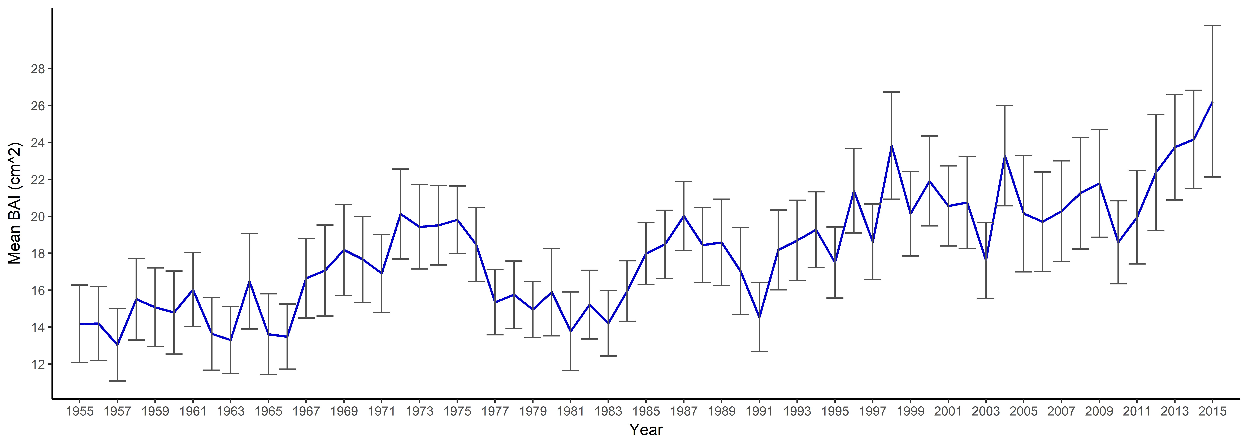
Red Oak Growth: basal area increment (BAI)
2010
late spring
frost event
1991
Gypsy Moth defoliation
26.2 cm²
1977
Gypsy Moth defoliation
Post-1998
ice storm
11 sites, 213 cores
Notes:
-From annual VT FPR, Forest insect and disease conditions in VT

Slide 17
Red Oak Growth: basal area increment (BAI)
-No difference in growth based on site age
-Sites with smaller trees are growing marginally less than sites with larger trees (t=-1.9, p=0.05)
-Higher elevation sites (>236m) are growing marginally less than lower elevation sites (t=-1.7, p=0.07)

Slide 18
Red Oak Growth: basal area increment (BAI)
Slope of 1st half of chronology not significantly different than 2nd half

Slide 19
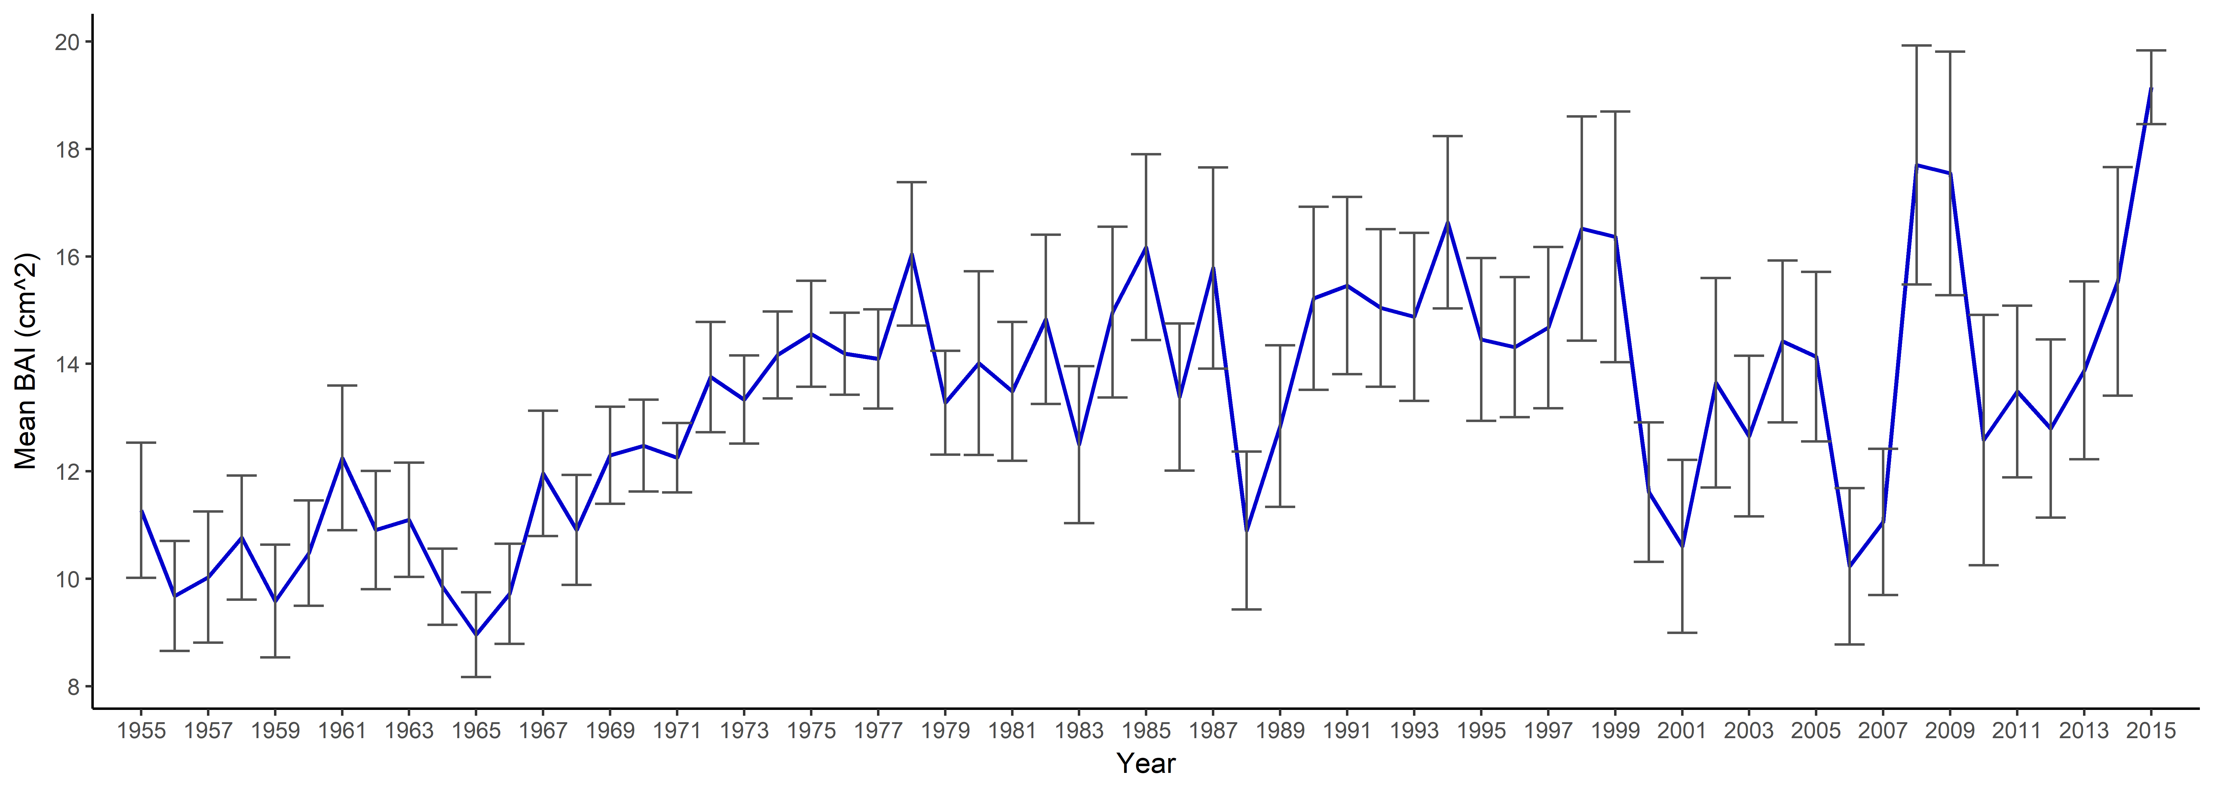
Sugar Maple Growth: basal area increment (BAI)
2010
late spring
frost event
2000-2001
Maple Leaf Cutter
19.1 cm²
1988
Pear Thrips
2006
Forest Tent Caterpillar
12 sites, 202 cores
Notes:
-1988: Pear Thrips defoliation
-2000: Anthracnose fungus buildup, Maple Leaf Cutter outbreak, Maple Trumpet Skeletonizer
-2001: drought conditions throughout growing season, continuation of Maple Leaf Cutter Outbreak. Some moderate damage in some areas by Pear Thrips, although most trees with damage refoliated by early summer.
-2006: Forest Tent Caterpillar outbreak, in addition to defoliation by other pests in previous years (Pear Thrips, Maple Leaf Cutter)
-2010: spring frost damage due to below-freezing temperatures that occurred statewide during the week of May 9. With an early spring that included sugar maples leafing out several weeks earlier than normal, many trees were vulnerable. As a result, 414,901 acres of damage were recorded. Sugar maple was widely affected.
-Although most trees refoliated shortly after the freeze event, new growth did not fully expand. Some trees did not refoliate at all, and retained damaged leaves all summer. Intermittent dry periods may have been responsible for the incomplete refoliation.

Slide 20
Sugar Maple Growth: basal area increment (BAI)
No differences in growth among sites
based on age, size, or elevation class
Notes:
-1988: Pear Thrips defoliation
-2000: Anthracnose fungus buildup, Maple Leaf Cutter outbreak, Maple Trumpet Skeletonizer
-2001: drought conditions throughout growing season, continuation of Maple Leaf Cutter Outbreak. Some moderate damage in some areas by Pear Thrips, although most trees with damage refoliated by early summer.
-2006: Forest Tent Caterpillar outbreak, in addition to defoliation by other pests in previous years (Pear Thrips, Maple Leaf Cutter)
-2010: spring frost damage due to below-freezing temperatures that occurred statewide during the week of May 9. With an early spring that included sugar maples leafing out several weeks earlier than normal, many trees were vulnerable. As a result, 414,901 acres of damage were recorded. Sugar maple was widely affected.
-Although most trees refoliated shortly after the freeze event, new growth did not fully expand. Some trees did not refoliate at all, and retained damaged leaves all summer. Intermittent dry periods may have been responsible for the incomplete refoliation.

Slide 21
Sugar Maple Growth: basal area increment (BAI)
Significantly less growth in second half of chronology (t= -2.32, p=0.03)
Notes:
-this is consistent with patterns seen across the region due to effects of acid deposition, post-1980

Slide 22
Sugar Maple Growth: basal area increment (BAI)
variability among sites: what is driving this?
Within 1985-2014 period: no differences in growth among sites based on elevation, age, or size class.
Next steps: statistical shift in slope, significant differences of SE between the two time periods, other explanations for variability?
Notes:
-what stands out is the amount of variability: year to year variability, and also variability among sites, as evident with the error bars
-what could explain this variability?

Slide 23
Summary of Growth
Absolute growth:
red oak (26.2 cm²) > sugar maple (19.1 cm²)
Species | Significant growth trends
red oak | -Sites with smaller trees are growing marginally less than sites with larger trees (t=-1.9, p=0.05) -Higher elevation sites (>236m) are growing marginally less than lower elevation sites(t=-1.7, p=0.07)
sugar maple | -Second half of chronology (1985-2014) significantly less growth than first half of chronology (1955-1948; t= -2.32, p=0.03)
Notes:
-red oak is growing better than sugar maple
-red oak: higher elevation sites growing significantly less than lower elevation sites. This could suggest that this species is temperature limited, since we are in the northern part of the species’ range.

Slide 24
Climate-Growth
Relationships

Slide 25
Ring width index (RWI)
-Two-thirds cubic smoothing spline (Cook and Peters 1981): detrended and standardized to a dimensionless index (ring-width index; RWI)
-Autoregressive modeling performed on standardized series to:
1) reduce the influence of endogenous disturbances
2) remove the effects of temporal autocorrelation
3) enhance the common signal
→ created prewhitened (residual) chronologies (Cook 1985)
RWI used in analyses of climate-growth relationships
Notes:
-The goal of detrending is to preserve as much long-term variation in ring widths as possible, which can be difficult in closed-canopy forests, where competition and stand disturbance may obscure climate signals (Cook and Peters 1981).
-frequency response is 0.50 at a wavelength of 0.67 * “series length in years”
-residual RWI chronologies were then used in subsequent analyses of climate-growth relationships

Slide 26
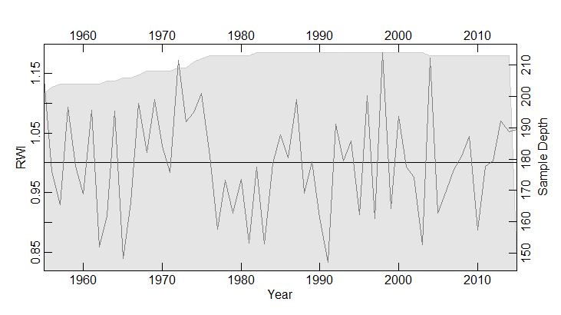
Red oak growth (RWI) in VT
Notes:
-explain the two axes
-however, when we standardize to a dimensionless index (RWI), we don’t see an increasing trend, but rather a steady trend.
-BAI detrending method still includes age- and size-related growth trends, so that may be what we are seeing with BAI growth.

Slide 27
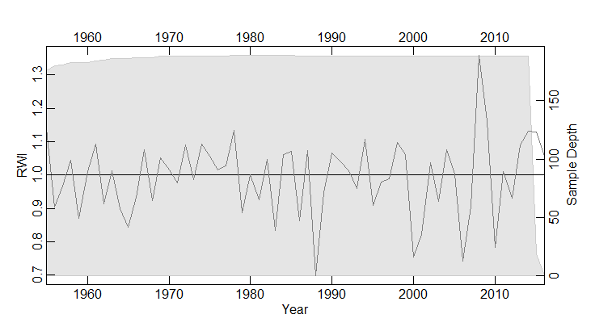
Sugar maple growth (RWI) in VT
Which climate variables can best explain this growth?
Notes:
-explain the two axes
-however, when we standardize to a dimensionless index (RWI), we don’t see an increasing trend, but rather a steady trend.
-BAI detrending method still includes age- and size-related growth trends, so that may be what we are seeing with BAI growth.

Slide 28
Data Source | Variables | Spatial Coverage | Temporal Coverage
PRISM¹ | Monthly Tmin Monthly Tmax Monthly total precipitation | 4 km x 4 km | 1895-2015
Global Standardized Precipitation-Evapotranspiration Index (SPEI) database² | SPEI-01 (Jan-Sep) SPEI-03 (Mar-Sep) SPEI-06 (June-Sep) SPEI-09 (Jul-Sep) | 0.5° | 1901-2015
NOAA^{3,4} | Atmospheric CO₂ | Global | 1975-2015
National Atmospheric Deposition Program | SO₄⁻ NO₃⁻ NH₄⁺ rainfall pH | Average of three regional stations (2 VT & 1 NH) | 1978-2015
¹ PRISM Climate Group, Oregon State University, http://prism.oregonstate.edu, created 14 Jul 2017
² Vicente-Serrano et al. (2010)
³NOAA ESRL Global Monitoring Division. 2015, updated annually
⁴ Etheridge, D.M., et al. 2010
⁵National Atmospheric Deposition Program (2016) NADP/NTN Monitoring. US Geological Survey.[accessed 18 July 2017]
Notes:
-SPEI: a moisture index, looked at four different time scales
-values for current and previous year, although today just talking about current year

Slide 29
Significant red oak climate-growth relationships
Notes:
-Graph of significant bootstrapped climate- and deposition-growth correlations (r) with mean RWI by variable type
-all variables related to precipitation or moisture are in blue/green
-Jun tmax is in red
-What clearly stands out is the importance of precipitation. Red oak have tap roots, and can access

Slide 30
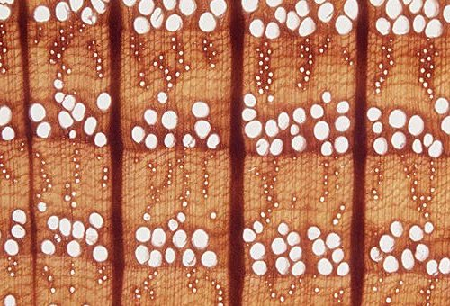
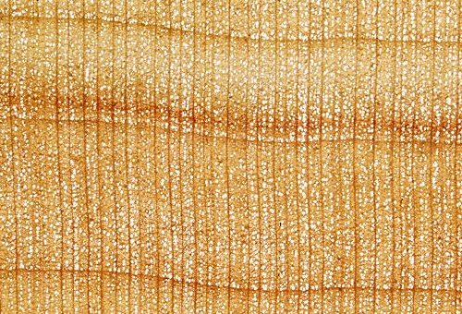
Physiology of red oak
Ring-porous: e.g., Quercus
Diffuse-porous: e.g., Acer
eeb.utoronto.ca
Notes:
-ring-porous woods have wide and long vessels in the earlywood, which allows for the movement of impressive quantities of water
-red oak also has tap roots to access more water, so the vessels are highly efficient at transporting water even in drought conditions.
-However, these large vessels are at greater risk of air bubbles.

Slide 31
-Columns of water in vessels cannot contain any air- a broken column is not able to lift water
-Wide tubes: less friction from the walls compared to the volume of water → less help in holding the water column together
Thomas (2000)
Notes:
-red oak also has tap roots to access more water, so the vessels are highly efficient at transporting water even in drought conditions.
-However, trees have to ensure that the columns of water in their vessels do not contain any air- a broken column is not able to lift water.
-In wide tubes, there is less friction from the walls compared to the volume of water, so there is less help in holding the water column together
-this can cause vessels to cavitate under hot dry conditions

Slide 32
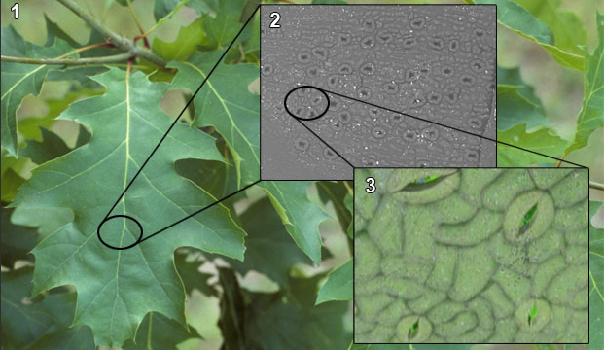
Physiology of red oak
1. Botanical Garden of Montreal (Normand Fleury) 2. Yann Vergriete 3. Dr. Lawrence Jensen
Notes:
-To prevent this, ring-porous trees will close their stomata so as to prevent losing too much water through transpiration, so leaves are not reaching net photosynthesis. June is also still during the period of leaf-out, so the trees are losing critical time for leaf infrastructure.
-This is a likely explanation for why we see negative relationship with summer temperatures.
-oaks tend to have a lower leaf water potential threshold for stomatal closure relative to co-occurring trees of other genera (Abrams 1990, Elliott 2015), so it may be interesting to compare these results to how co-occurring species are faring.

Slide 33
Significant sugar maple climate-growth relationships
Notes:
-Jun SPEI01, Aug SPEI03 speak to the drought intolerance of this species, due to shallow root system- the species grows better when the growing season has more precipitation.
-June Tmin: positive correlation. Higher minimum June temp.’s allows for a longer growing season- this is at the time of leaf-out.

Slide 34
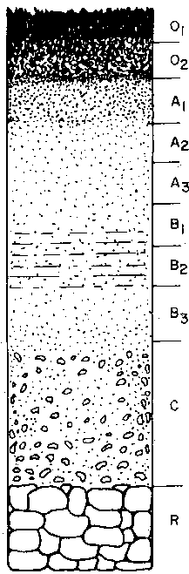
Physiology of sugar maple
High proportion of roots in shallow soil horizons (Fahey & Hughes, 1994)
fao.org
Notes:
-Increased frequency of soil freezing events could alter fine root dynamics within the northern hardwood forest disrupting the normally tight coupling between nutrient mineralization and uptake (Tierney 2001)
-This species is not drought tolerant.

Slide 35
Significant sugar maple climate-growth relationships
Early leaf out, spring frost
Notes:
-Jun SPEI01, Aug SPEI03 speak to the drought intolerance of this species, due to shallow root system- the species grows better when the growing season has more precipitation.
-June Tmin: positive correlation. Higher minimum June temp.’s allows for a longer growing season- this is at the time of leaf-out.

Slide 36
Significant sugar maple climate-growth relationships
SPEI-03: moisture index for 3 months:
December (of previous year), January & February
Notes:
-SPEI-03: moisture index for three months. One possible explanation for Feb SPEI-03 and March Min T could be the importance of snow in insulating the roots of sugar maple, and protection from freezing (citation)

Slide 37
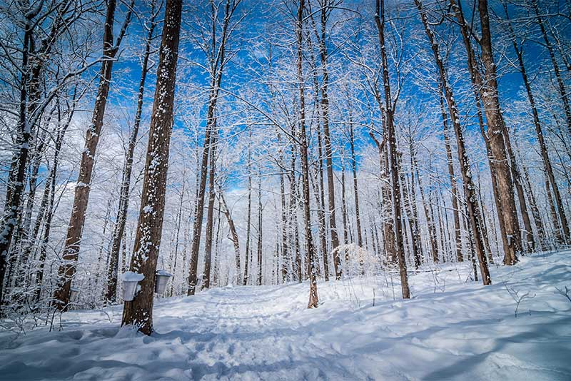
Physiology of sugar maple
Susceptible to root damage due to soil freezing (Tierney et al. 2001, Comerford et al. 2013)
bu.edu
Notes:
-Increased frequency of soil freezing events could alter fine root dynamics within the northern hardwood forest disrupting the normally tight coupling between nutrient mineralization and uptake (Tierney 2001)
-This species is not drought tolerant.

Slide 38
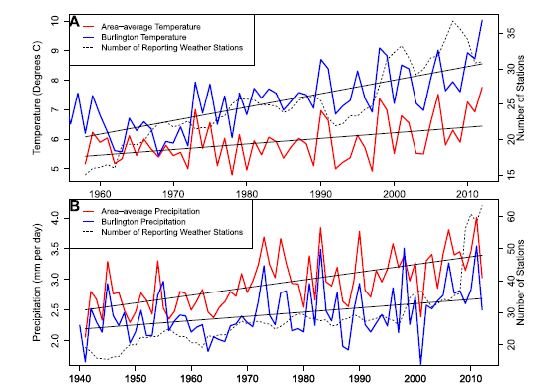
Discussion of results
Guilbert et al. (2014)
Weather stations across the Lake Champlain basin (VT)

Slide 39
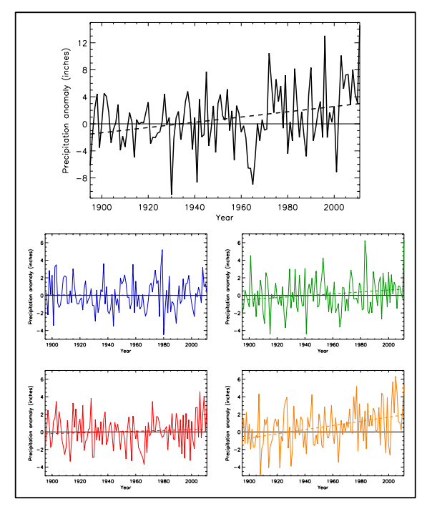
Precipitation anomalies (deviations from the 1901-1960 average, inches)
Northeast US
annual
*
winter
spring
red oak and sugar maple: + correlation with summer precip, SPEI
summer
fall
*
Kunkel et al. (2013)
Notes:
-NOAA technical report on climate of the northeast
-Precipitation anomalies (deviations from the 1901-1960 average, inches), for annual (black), winter (blue), spring (green), summer (red), and fall (orange). For the Northeast US. Only annual and fall are significantly increasing.
-so although annual precipitation is in increasing, it’s not increasing during the months that appear to be beneficial for red oak growth.

Slide 40
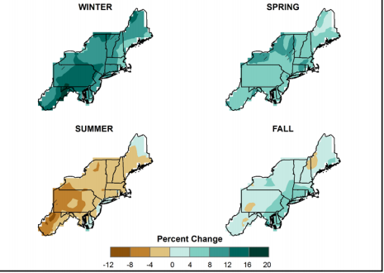
Projections: simulated difference in seasonal mean precipitation for 2041-2070 with respect to the reference period of 1971-2000
Snow or rain?
high (A2) emissions scenario
Kunkel et al. (2013)
Notes:
-Simulated difference in seasonal mean precipitation (%) for the Northeast region, for 2041-2070 with respect to the reference period of 1971-2000. Note that these projections are uncertain.
-These are multi-model means from 11 NARCCAP regional climate simulations for the high (A2) emissions scenario.
-If red oak has exhibited a positive relationship with summer precipitation, rather than months in which precipitation is projected to increase, then this species may not actually benefit from both observed and projected changes in seasonal precipitation.

Slide 41
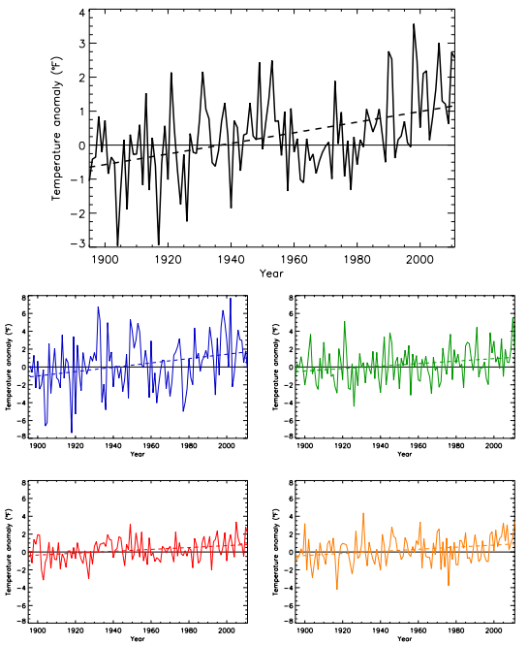
annual
*
Temperature anomalies (deviations from the 1901-1960 average, °F)
Northeast US
winter
*
spring
*
summer
*
fall
*
red oak: - correlation with June Tmax
Kunkel et al. (2013)
Notes:
Temperature anomaly (deviations from the 1901-1960 average, °F) for annual (black), winter (blue), spring (green), summer (red), and fall (orange), for the Northeast U.S.

Slide 42
annual
*
Temperature anomalies (deviations from the 1901-1960 average, °F)
Northeast US
winter
*
spring
*
sugar maple: + correlation with June Tmin
summer
*
fall
*
Kunkel et al. (2013)
Notes:
Temperature anomaly (deviations from the 1901-1960 average, °F) for annual (black), winter (blue), spring (green), summer (red), and fall (orange), for the Northeast U.S.

Slide 43
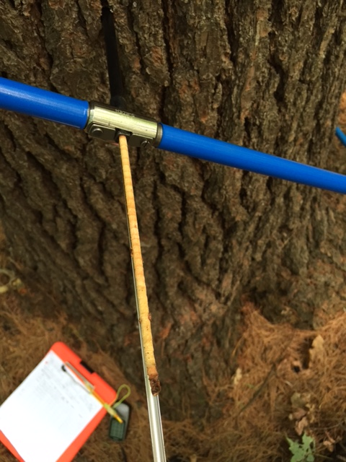
Questions?
Rebecca Stern
rstern1@uvm.edu

