Slide 1
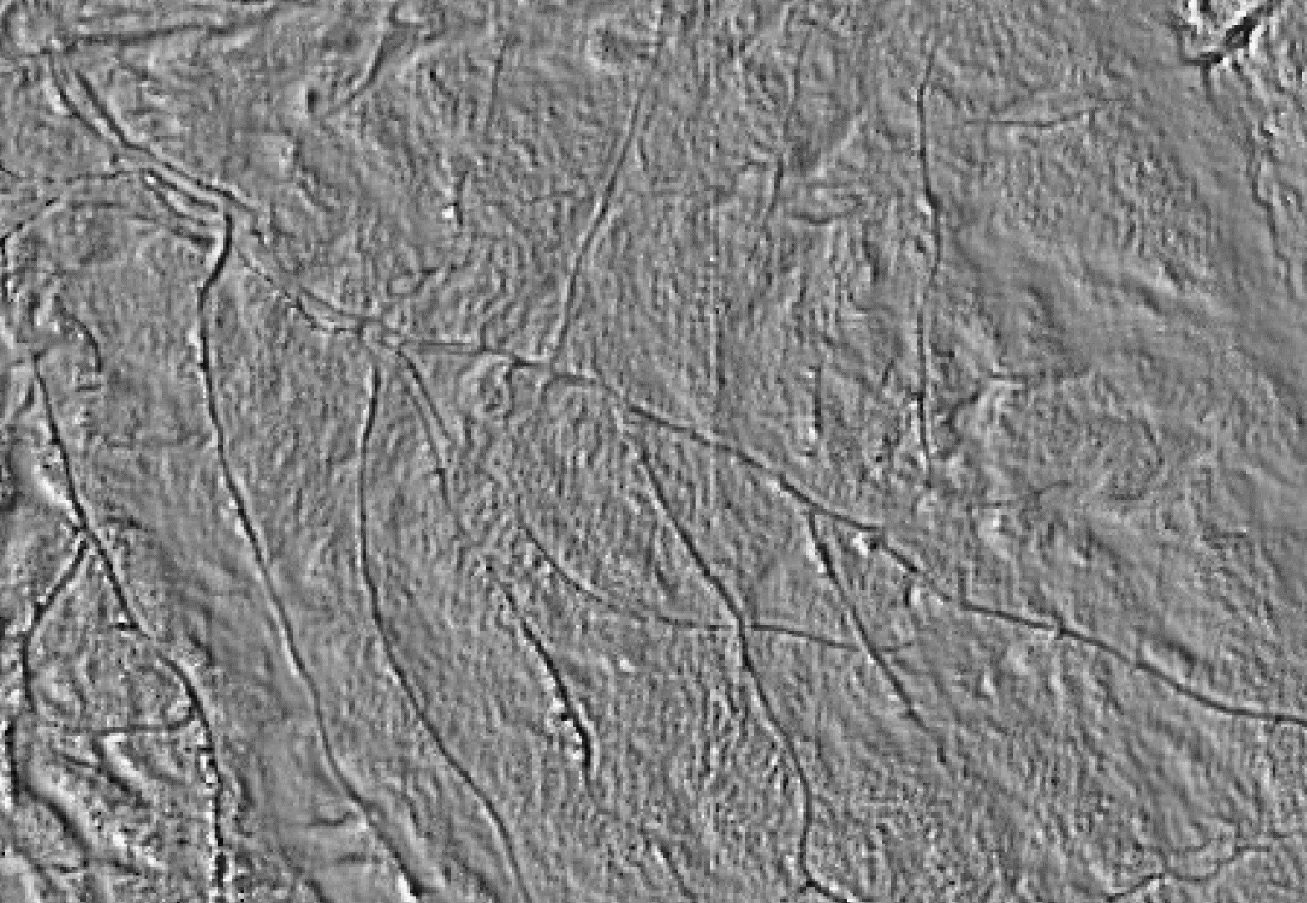


Using LiDAR to Map Eroded Forest Roads in the Lake Champlain Basin, Vermont
Sean MacFaden, Jarlath O’Neil-Dunne, Mary Nealon,* Alexandra Marcucci*
University of Vermont Spatial Analysis Laboratory
*Bear Creek Environmental, LLC
Project funded by the US Department of Agriculture Natural Resources
Conservation Service and the Vermont Ecosystem Restoration Program

Slide 2
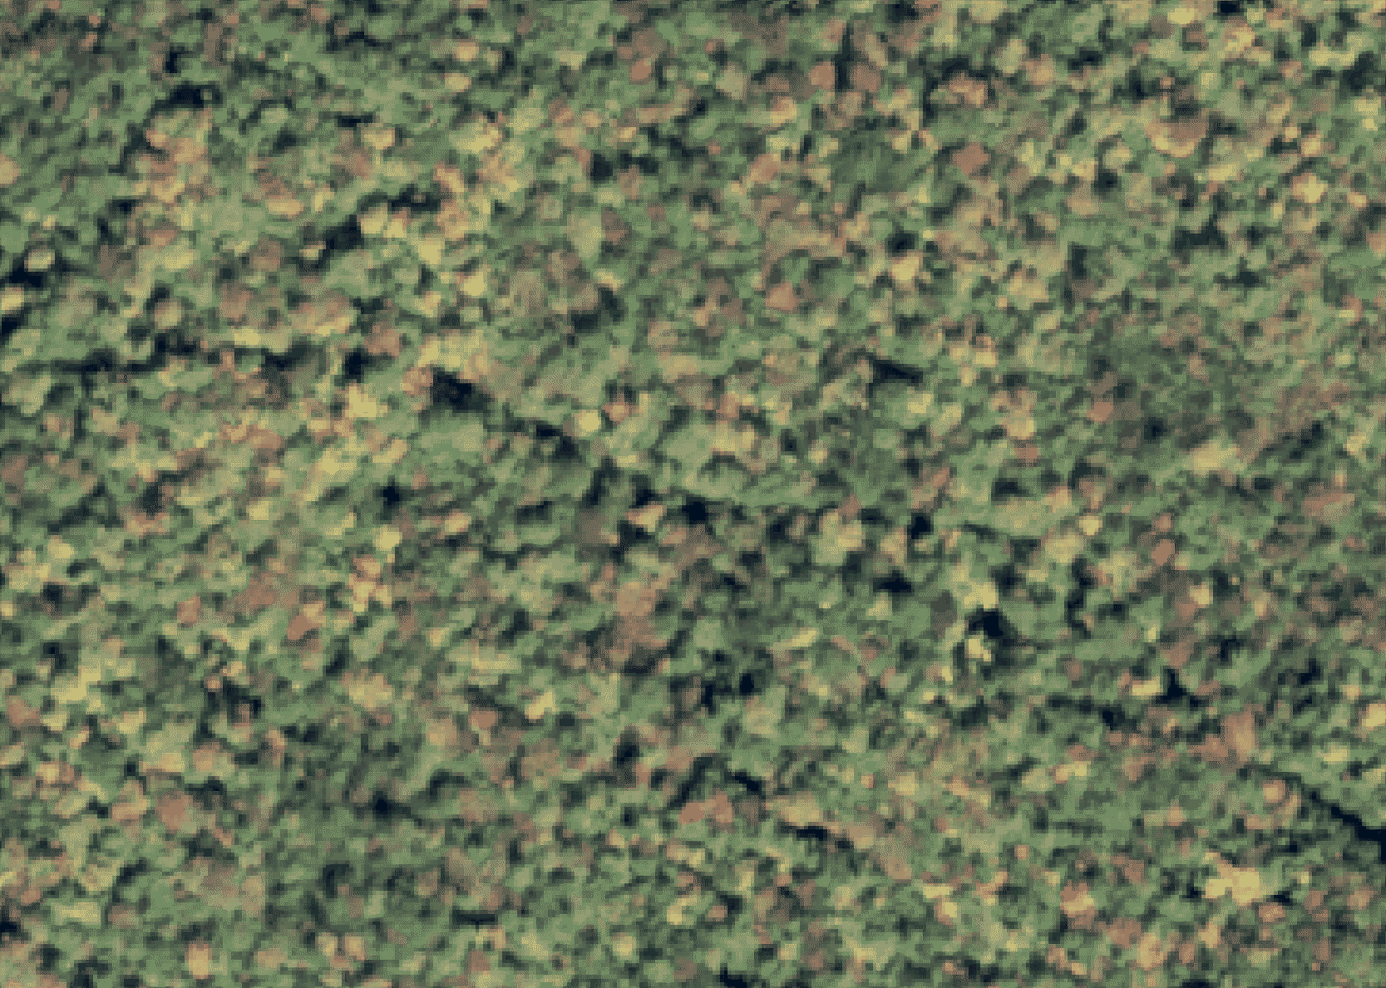
Need
Many Forest Roads and Trails Not Represented in Available GIS Datasets
Erosion From Forest Roads May Contribute to Pollutant Loading

Slide 3
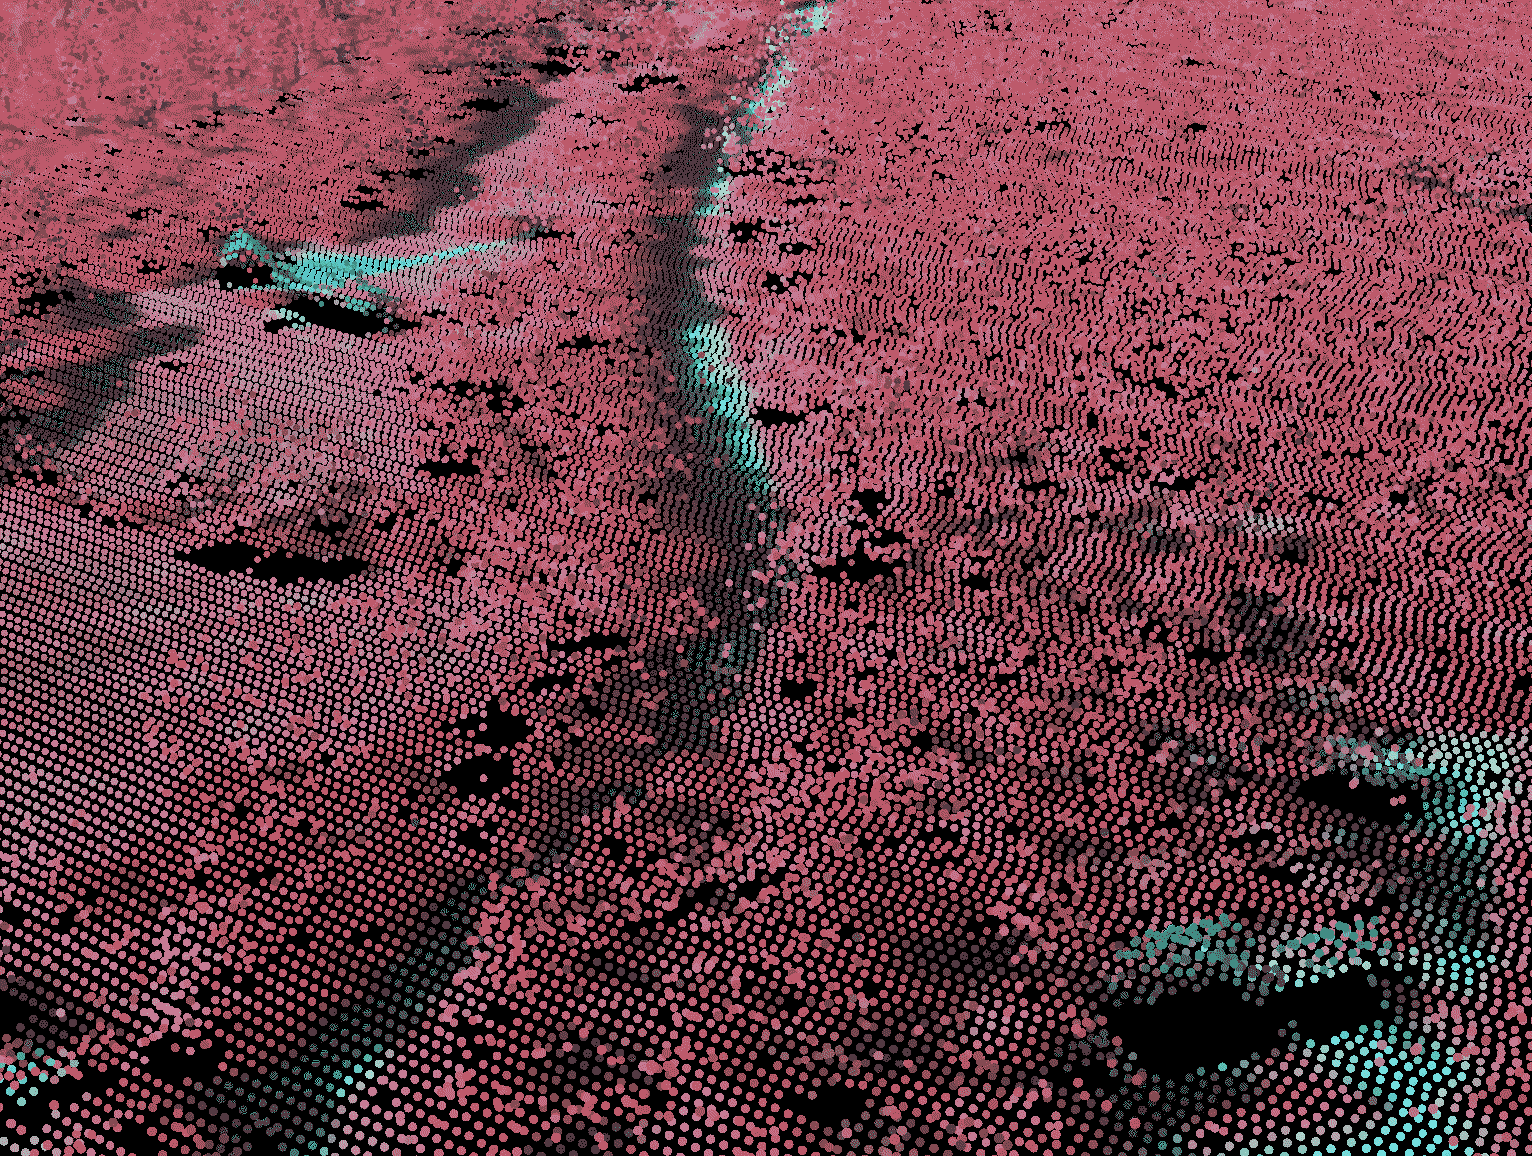
Opportunity
LiDAR Increasingly Available
Improved Processing Methods
Object-based Image Analysis (eCognition)

Slide 4
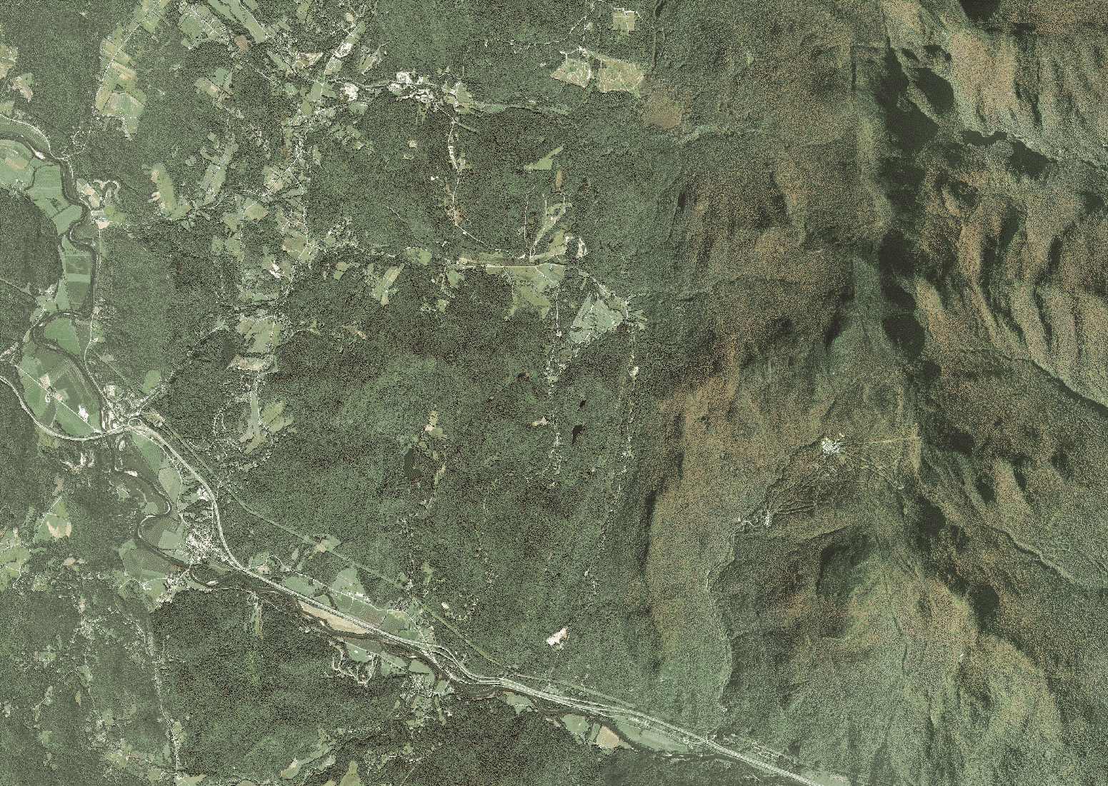
Approach
Automated Mapping Combining OBIA with LiDAR and Other High-resolution Inputs
Export Results to Widely-used Formats
Pilot Sites: Rutland County, Upper Missisquoi

Slide 5
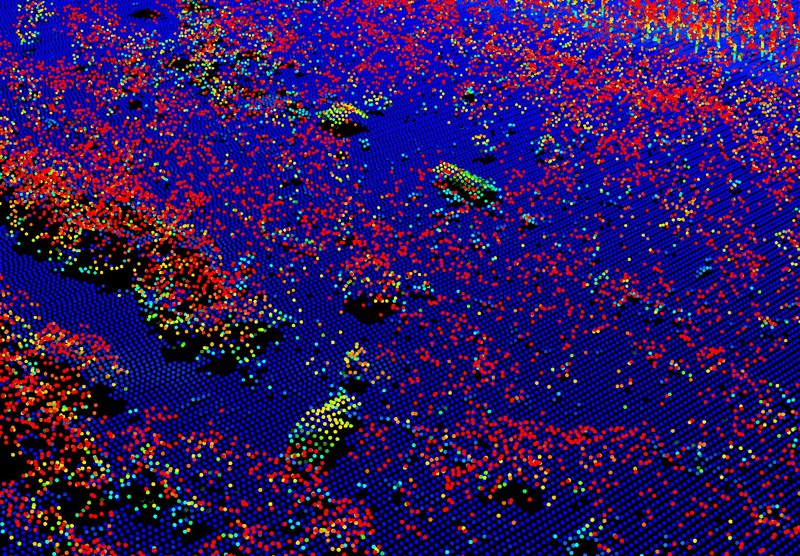
Original LiDAR Point Cloud

Slide 6

LiDAR-derived Digital
Surface Model (DEM)

Slide 7
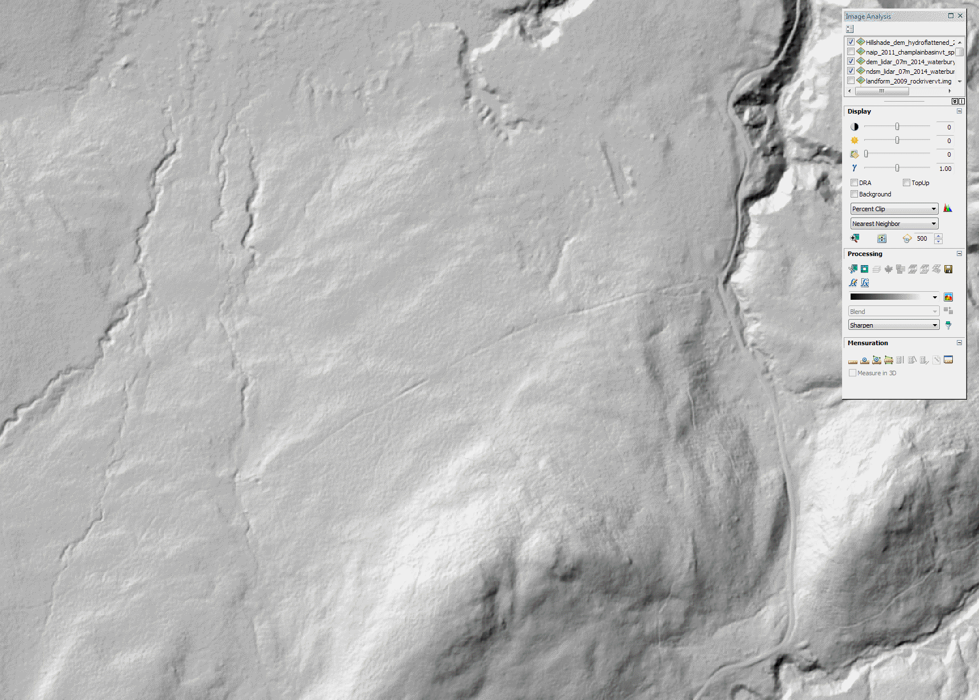
How to create objects for subsequent analysis?

Slide 8
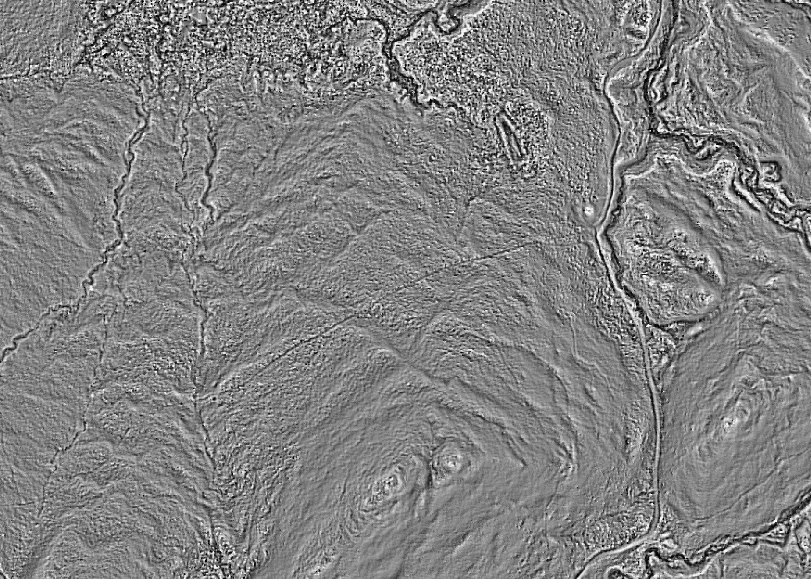
DEM-derived Dissection

Slide 9
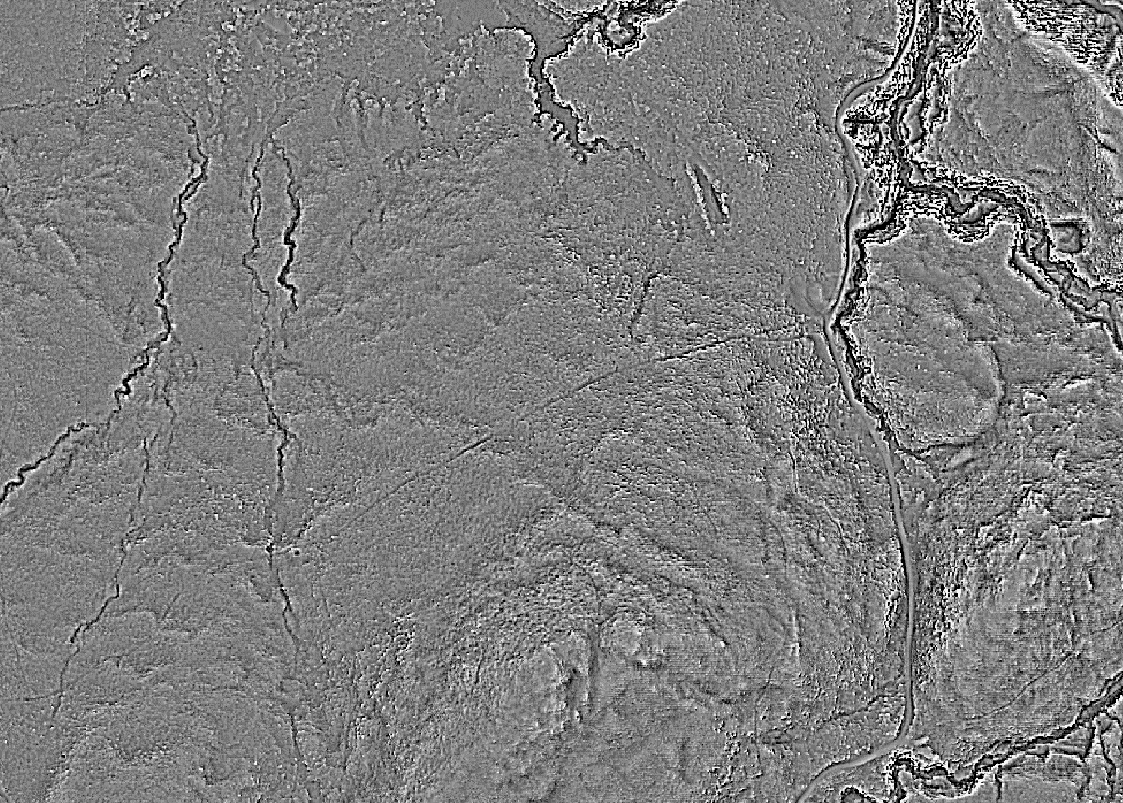
DEM-derived Landform

Slide 10
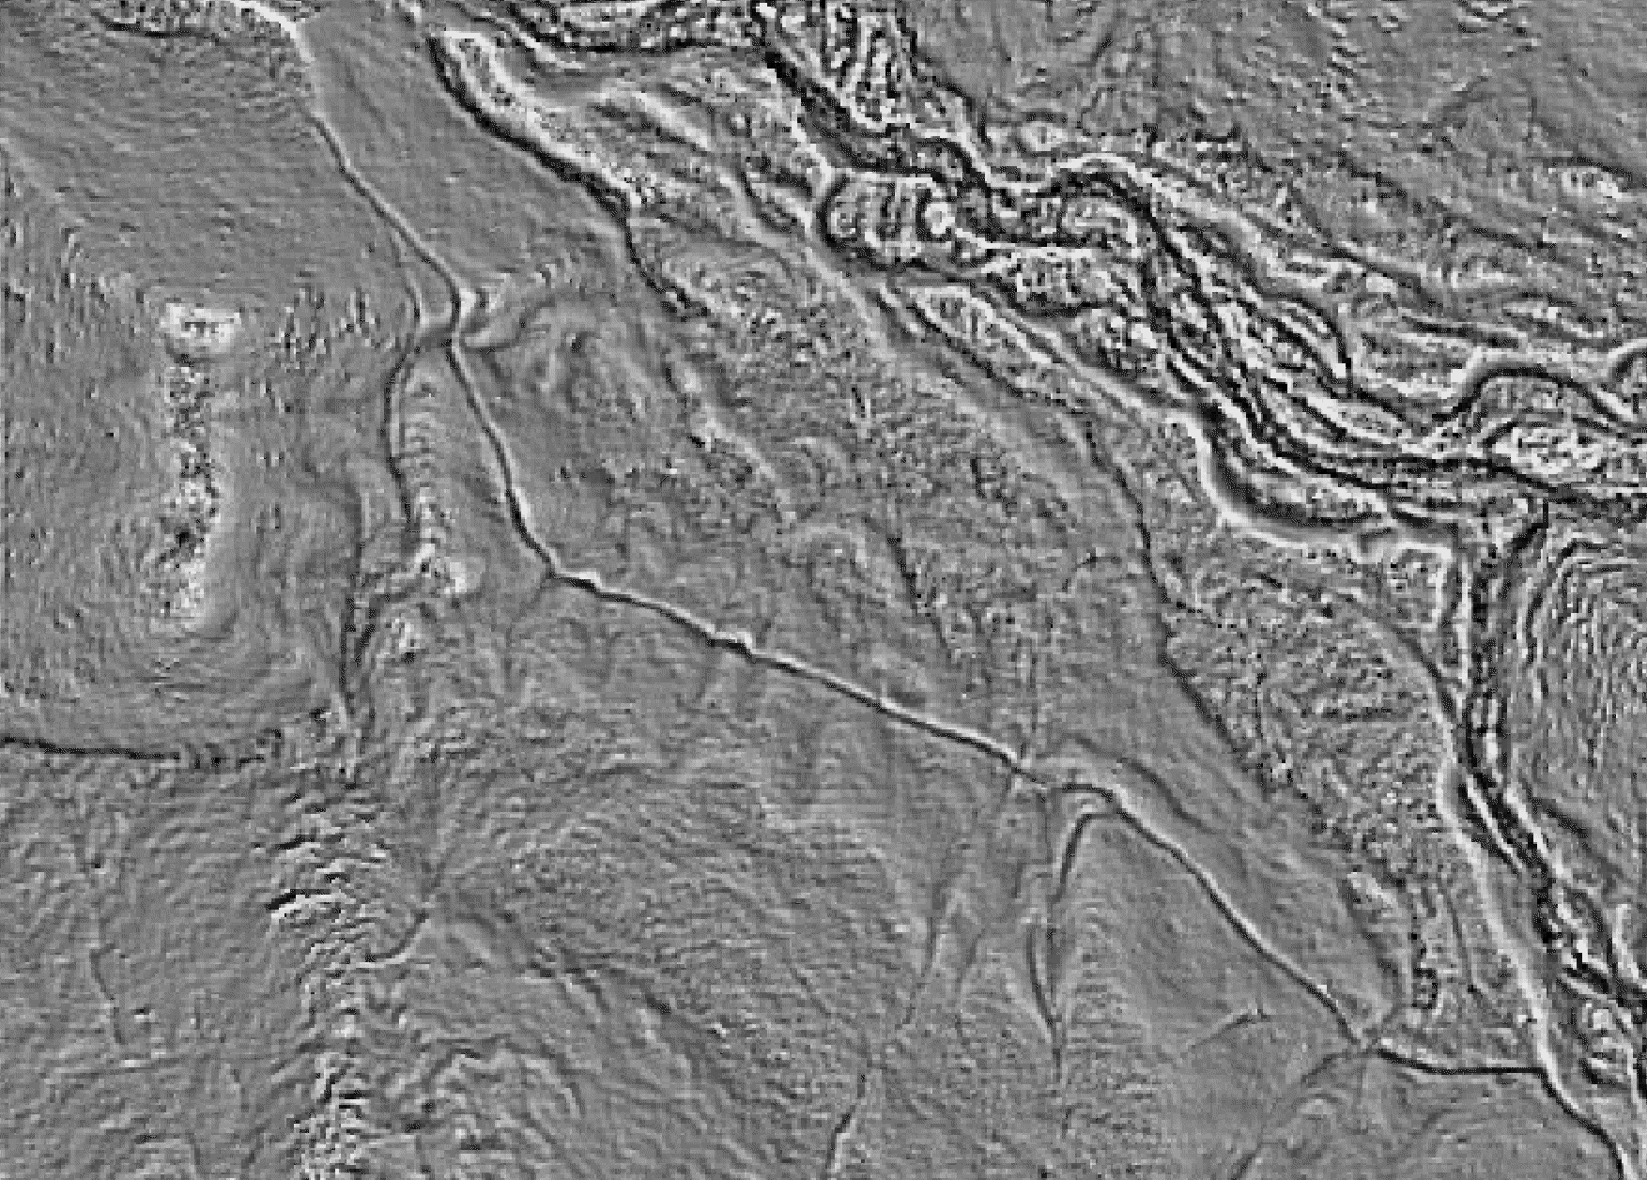
Automated Feature Extraction (OBIA)

Slide 11
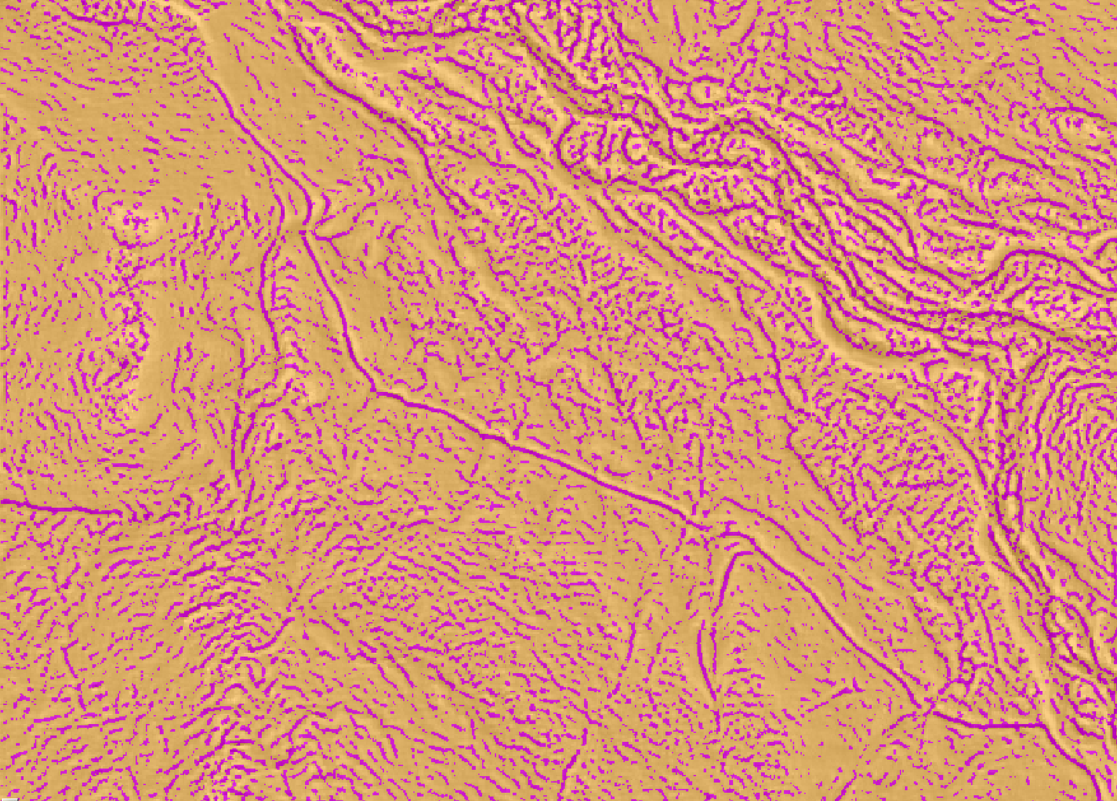
Modeling Approach - Roads
Step 1: Segment
Step 2: Preliminary Selection
Step 3: Connect Fragments
Step 4. Reduce False Positives
Step 5. Final Classification

Slide 12
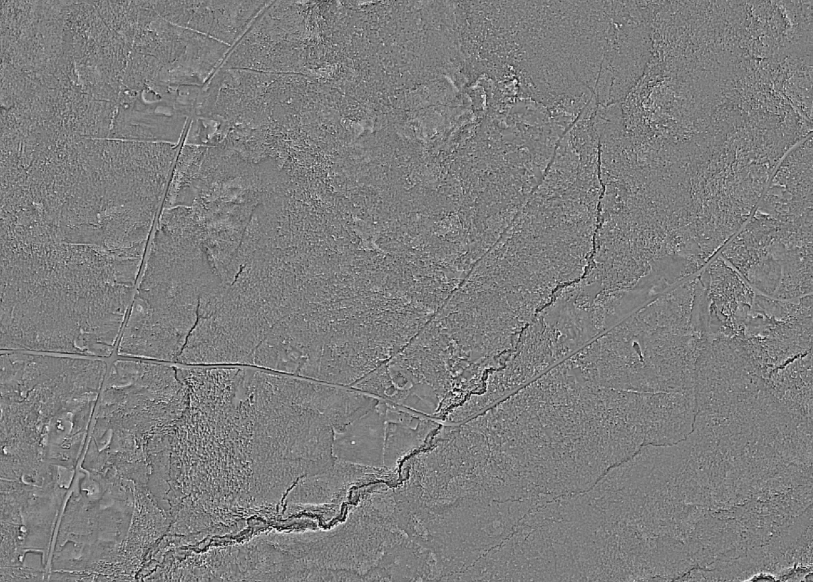
Step 1 – Segment

Slide 13
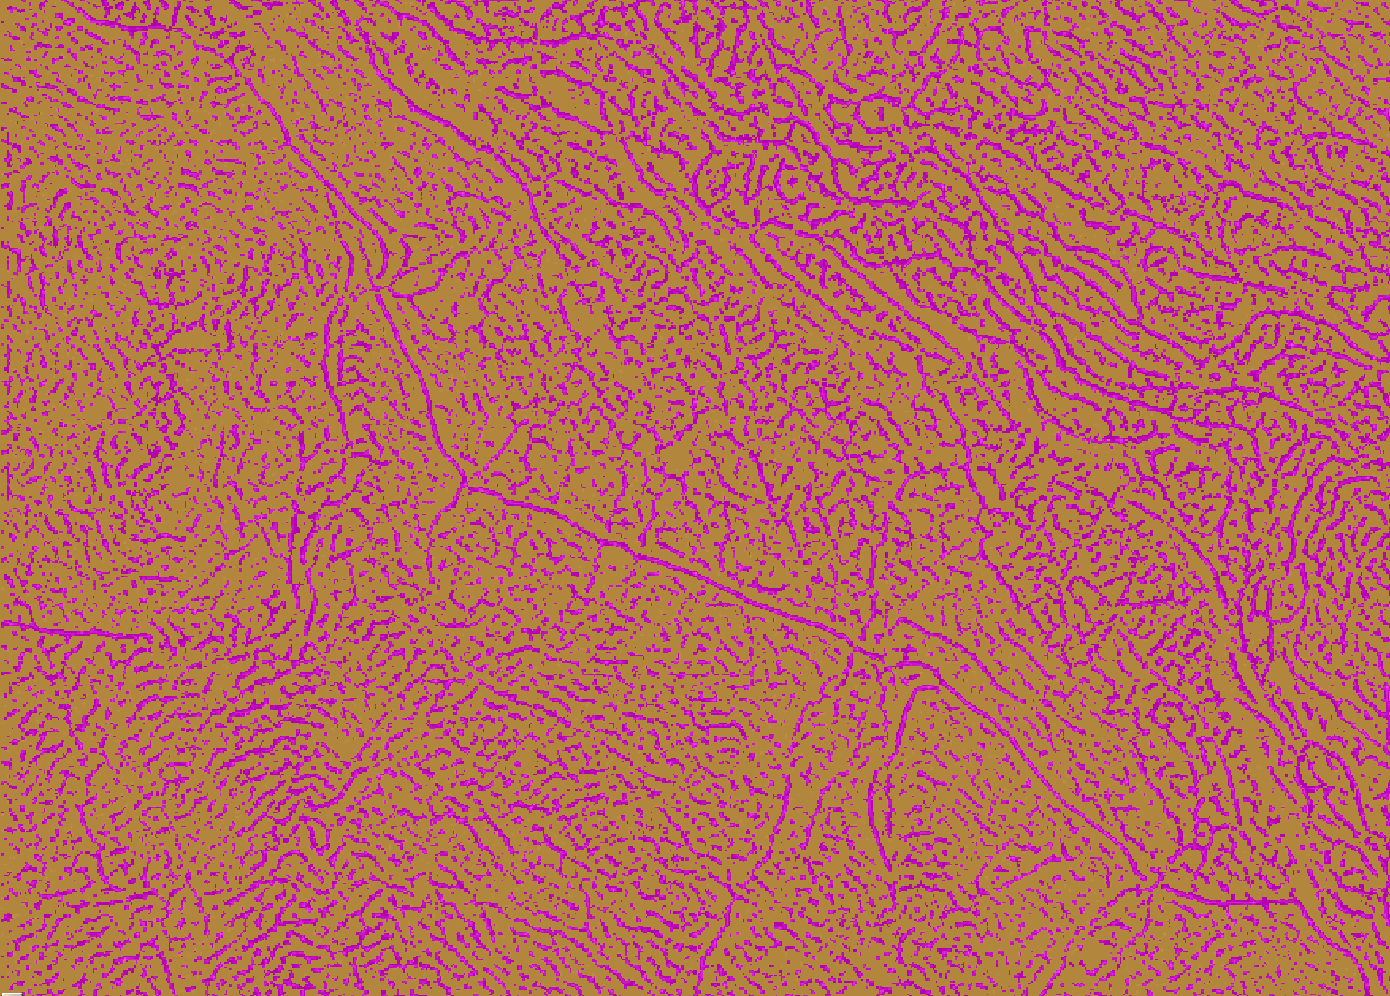
Segment by Dissection and Landform

Slide 14
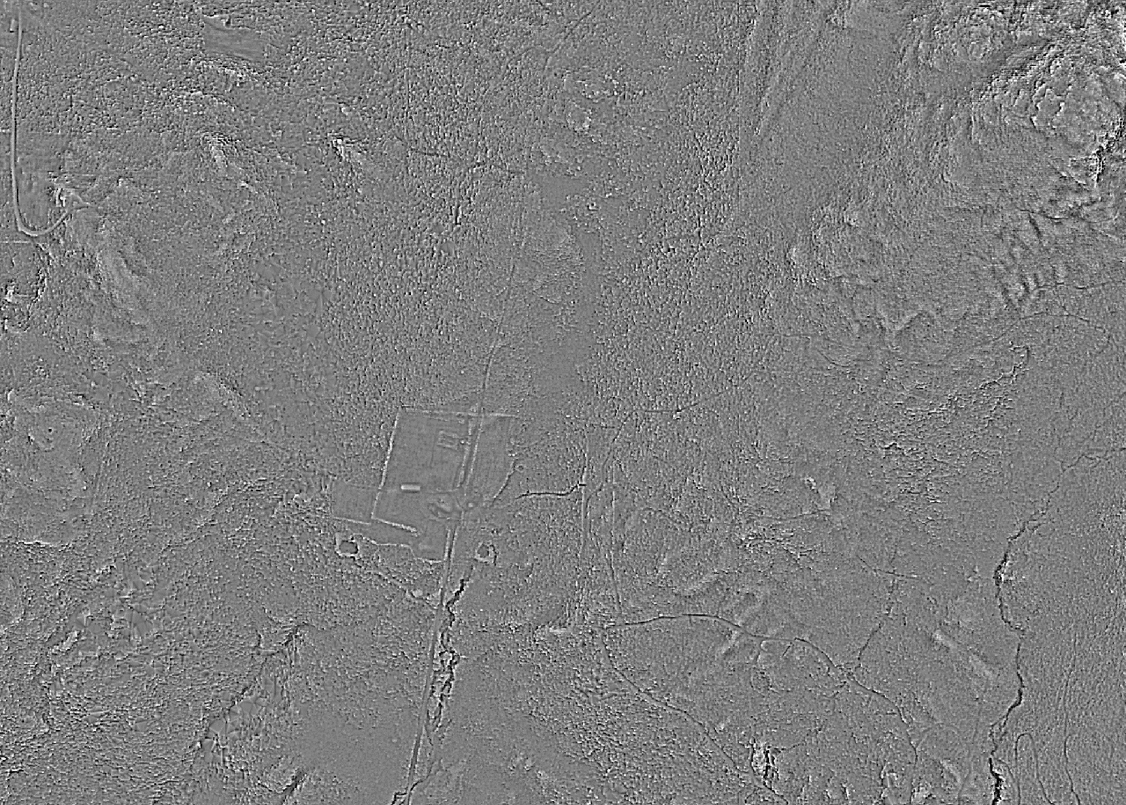
Step 2 – Identify Candidate Roads

Slide 15
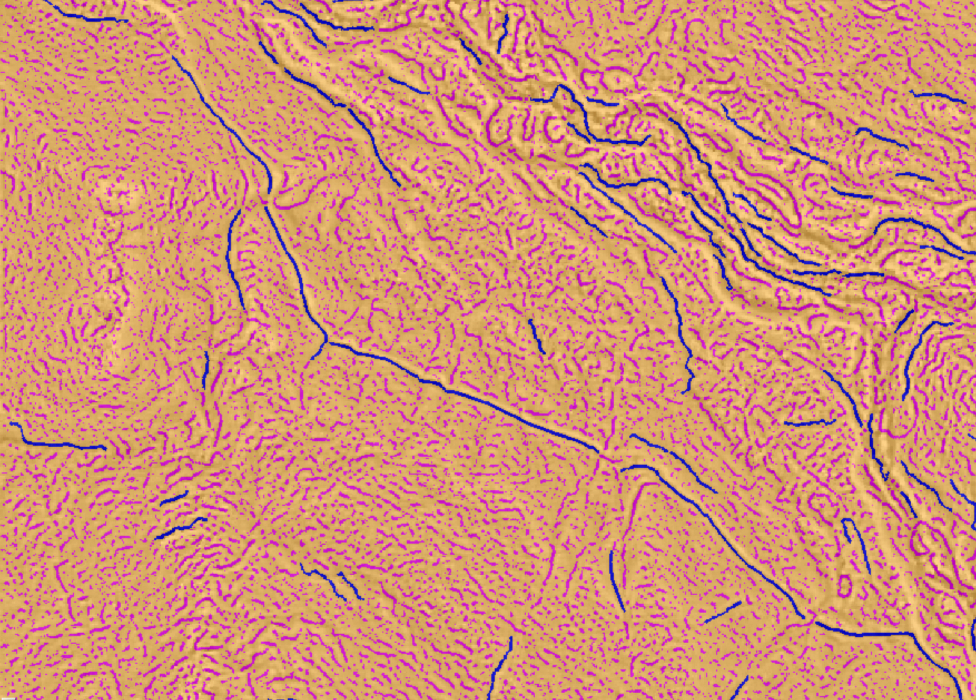
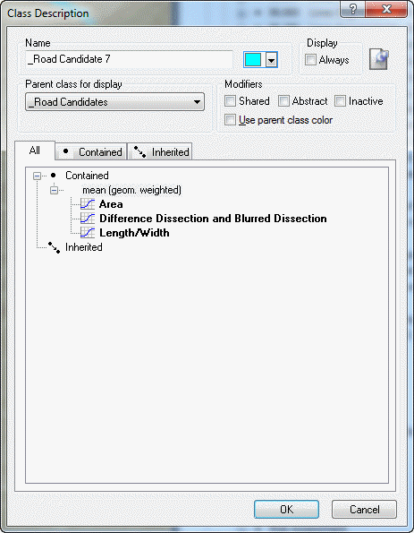
Initial Classification

Slide 16
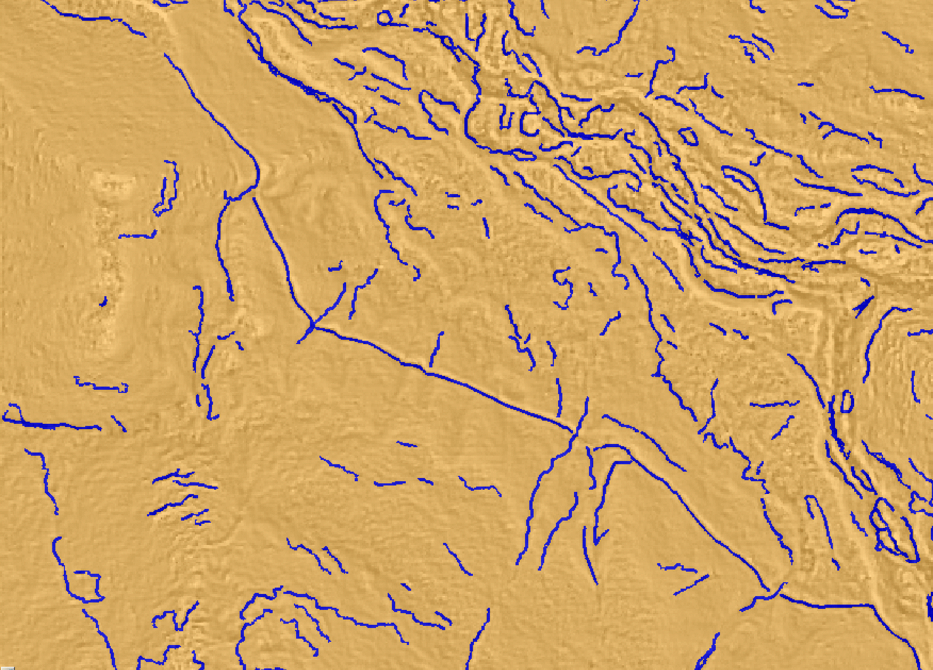
Initial Set of Candidate Roads

Slide 17
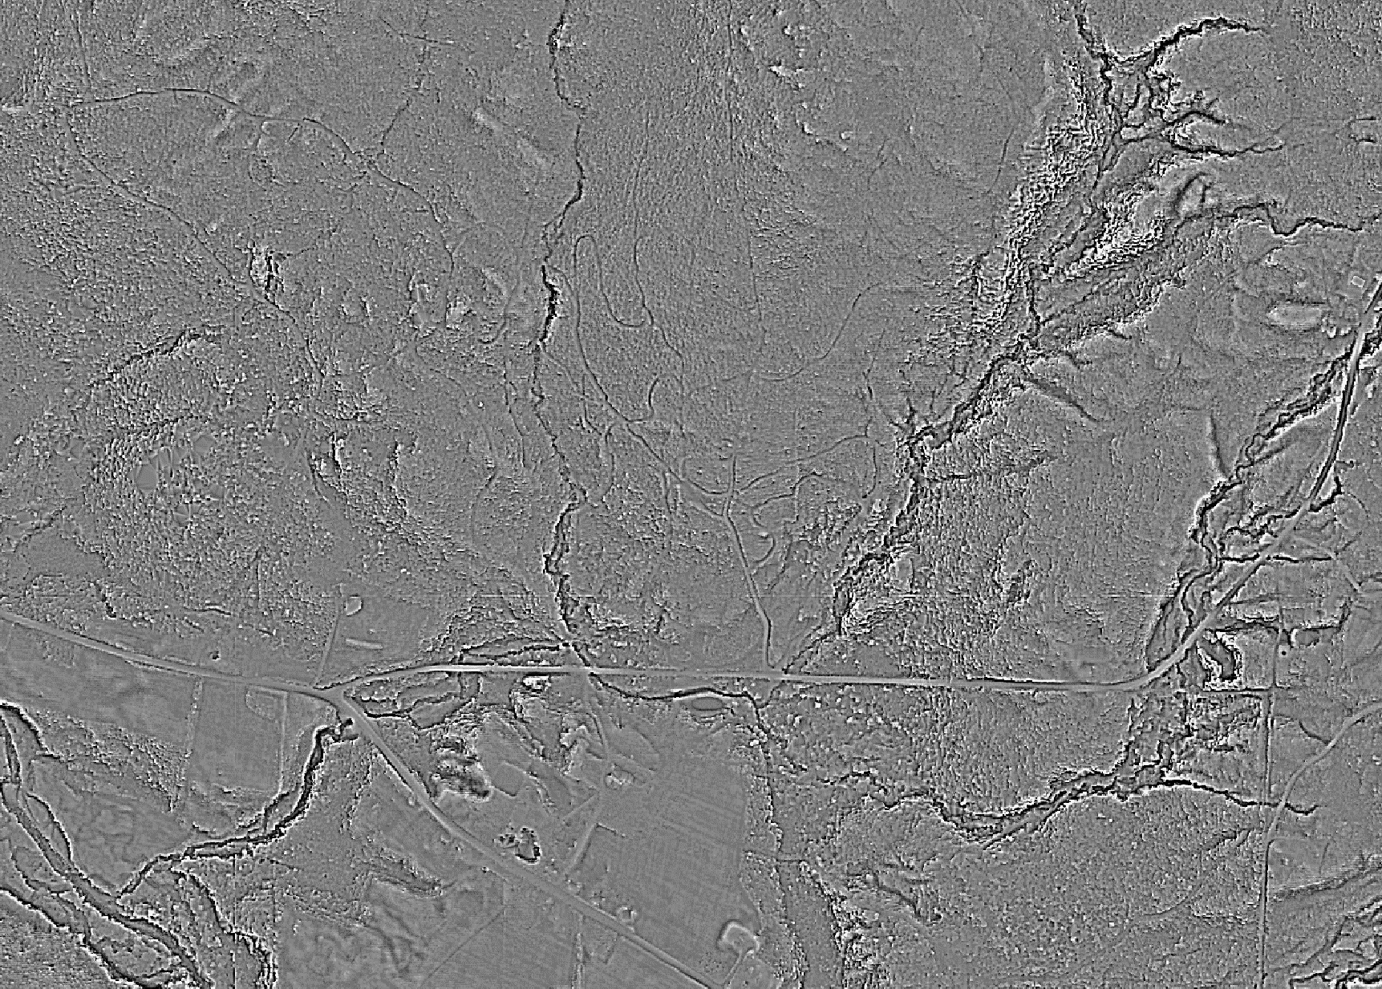
Step 3 – Connect Fragments

Slide 18
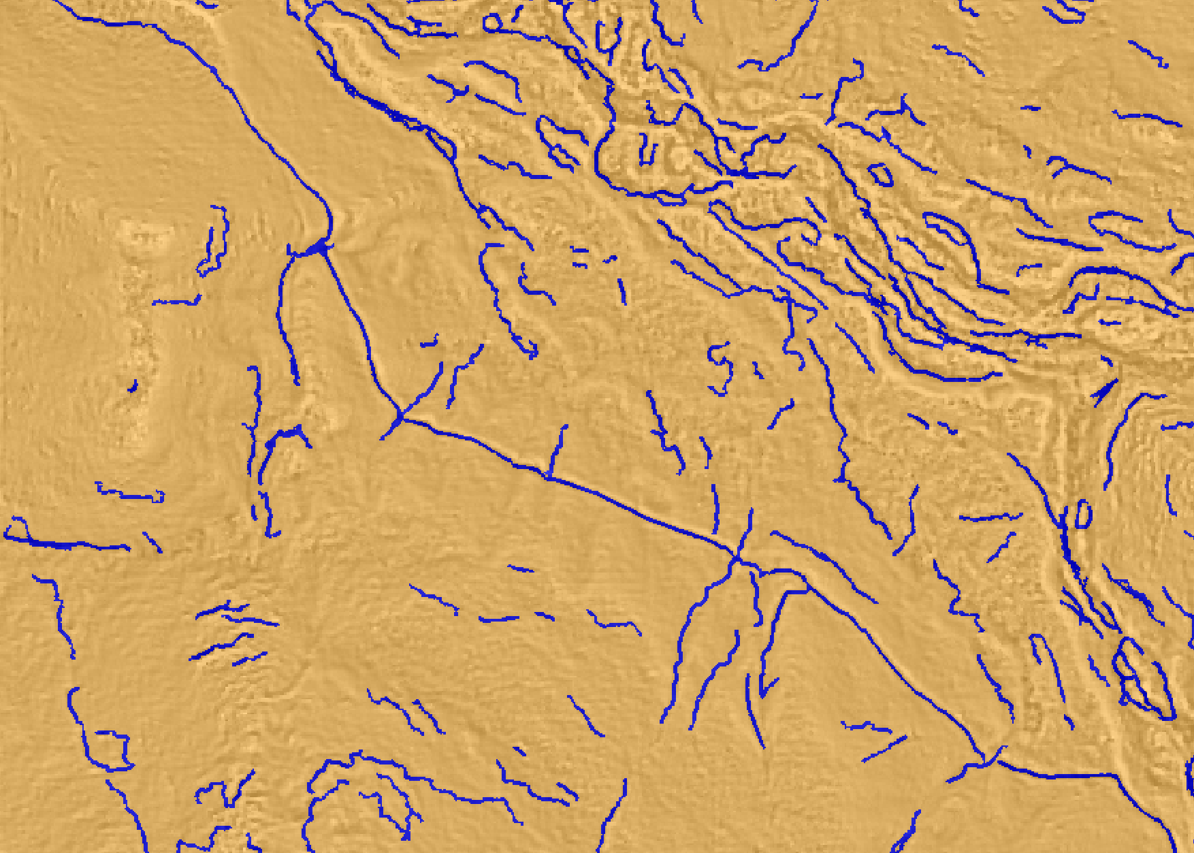
Connect Nearby Segments

Slide 19
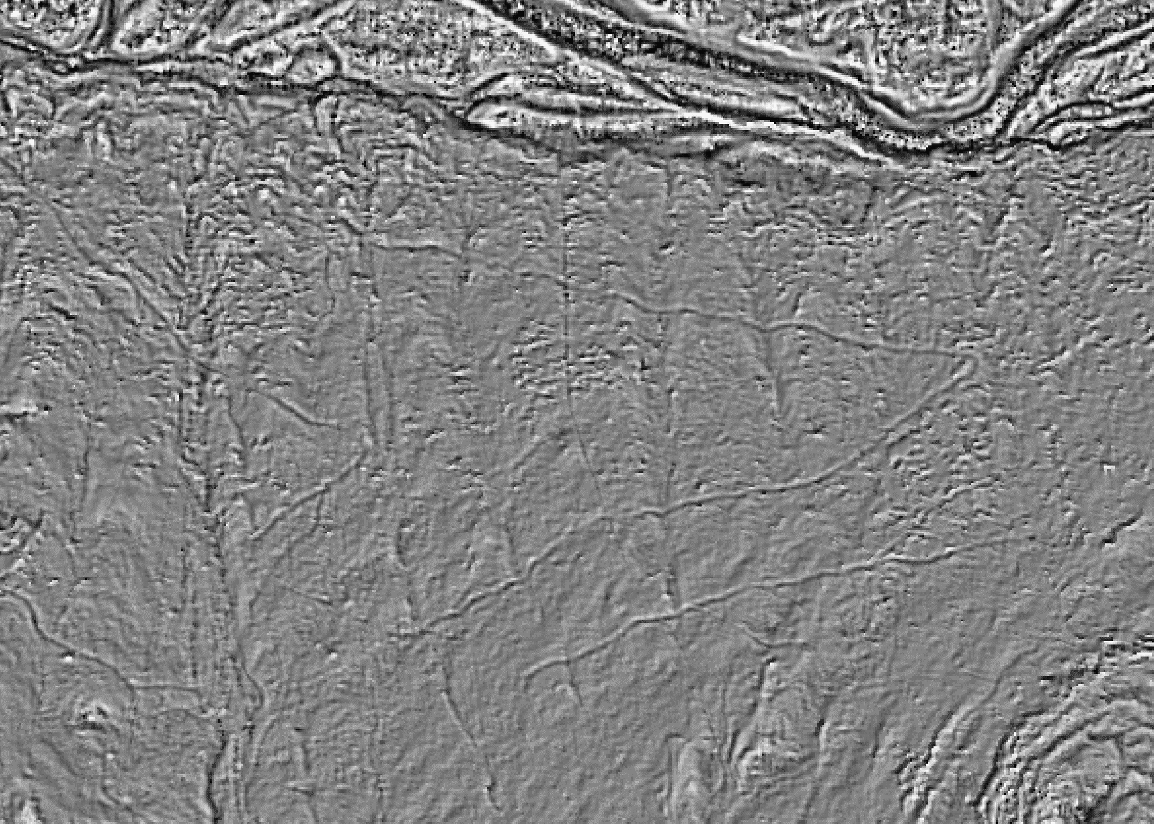
Step 4 – Reduce False Positives

Slide 20
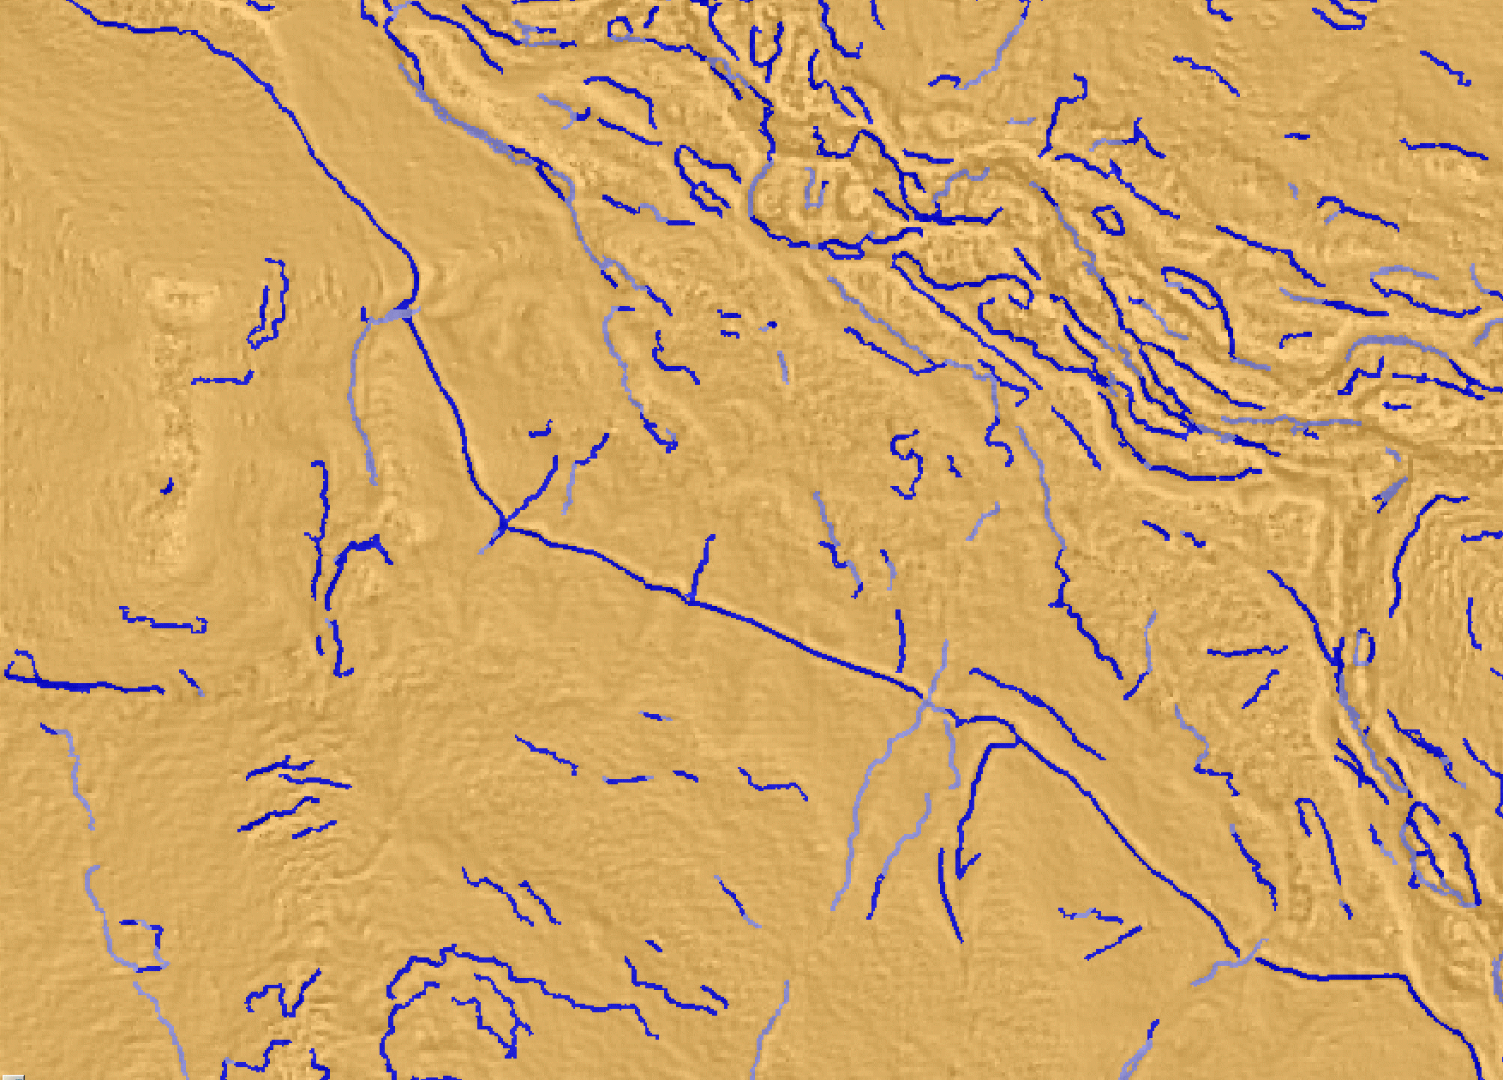
Identify Streams

Slide 21
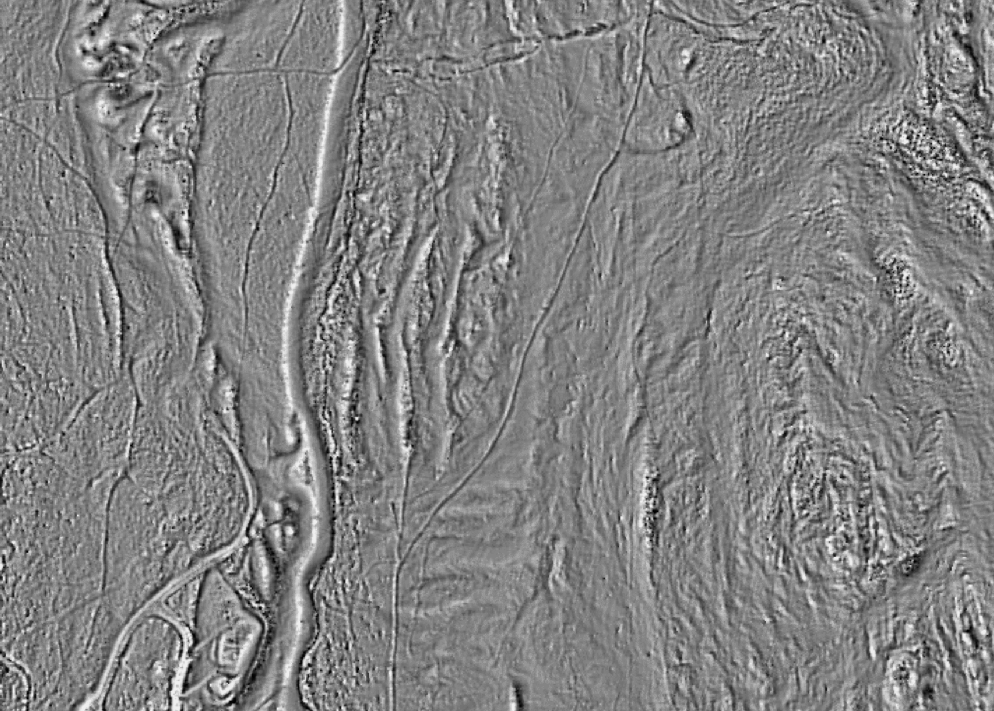
Step 5 – Final Classification

Slide 22
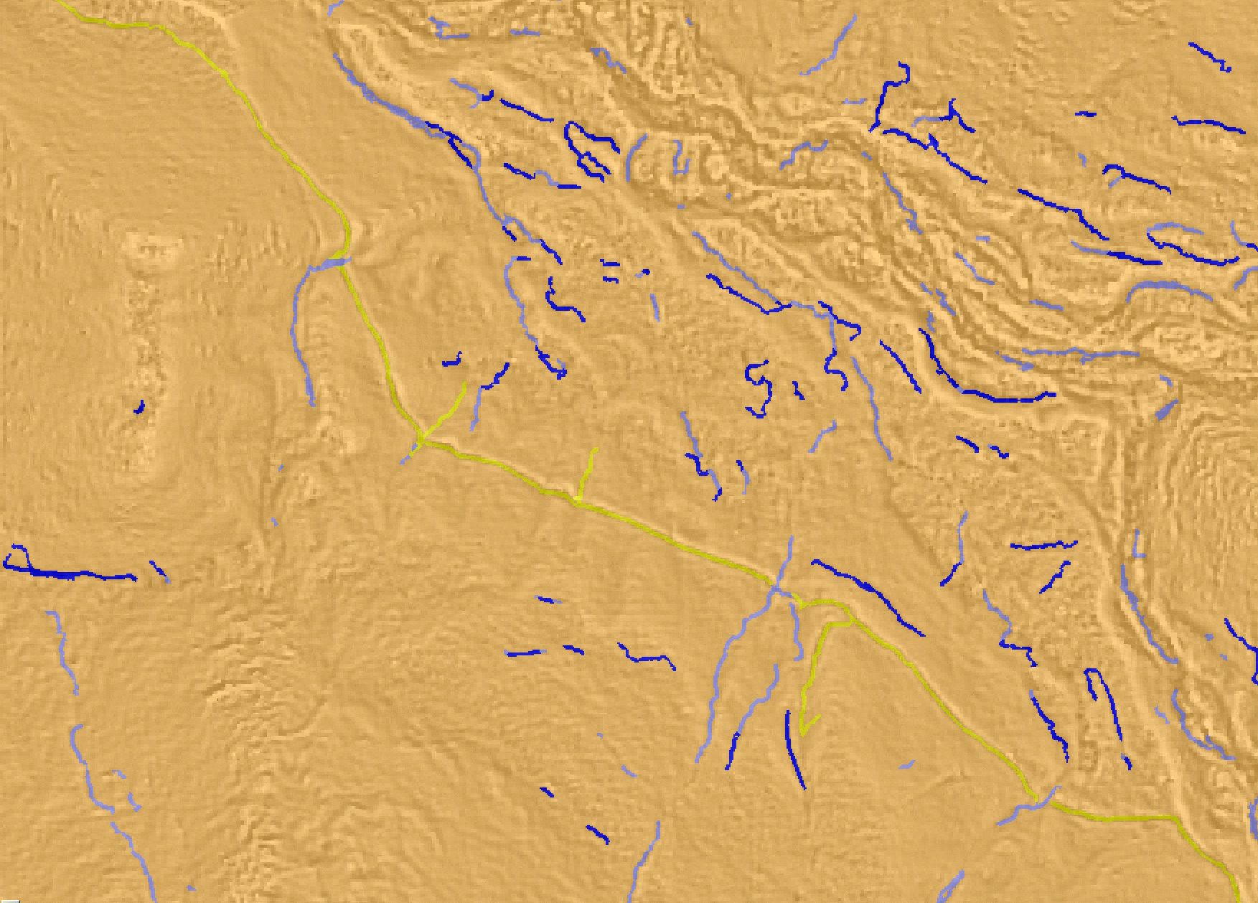
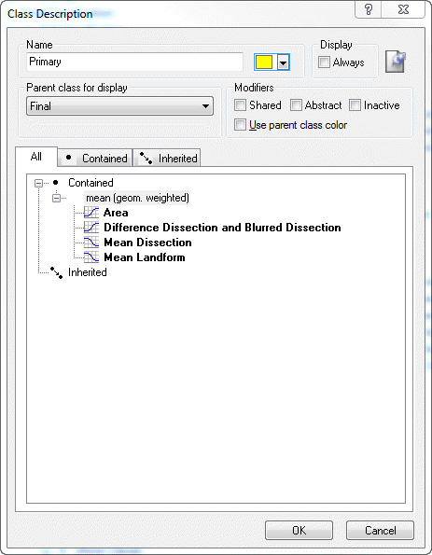
Final Classification – Primary

Slide 23
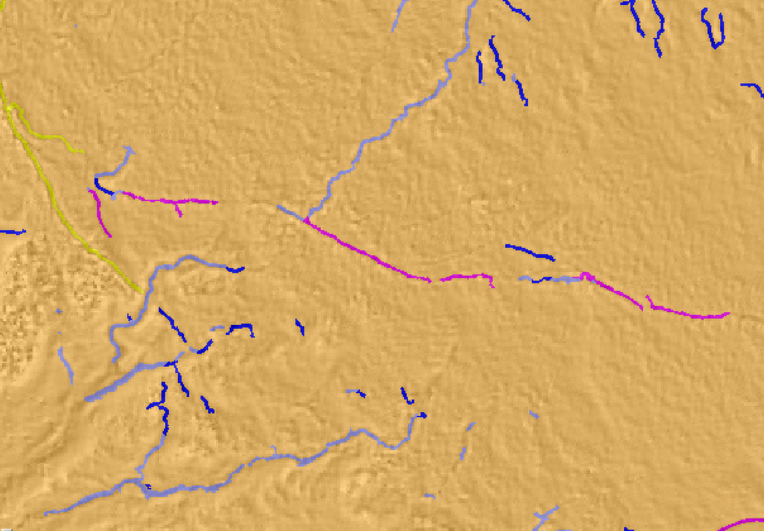
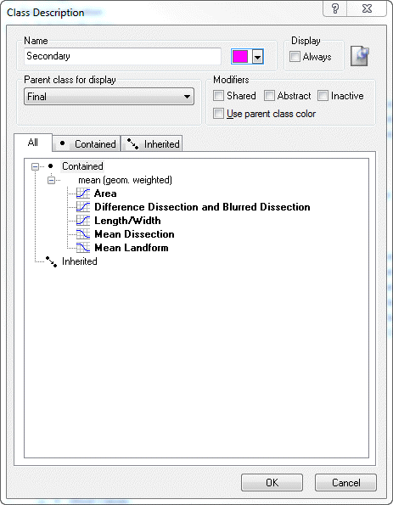
Final Classification – Secondary

Slide 24
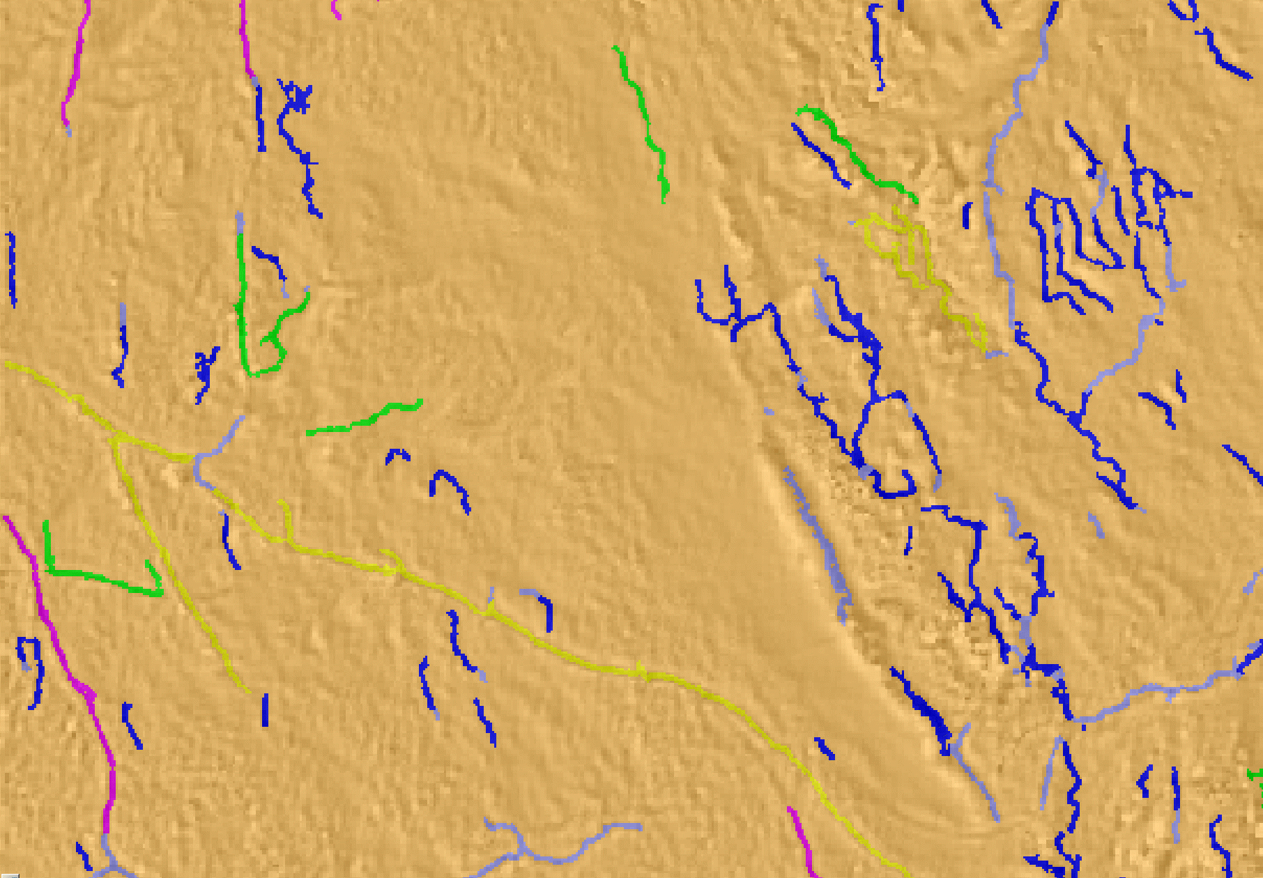
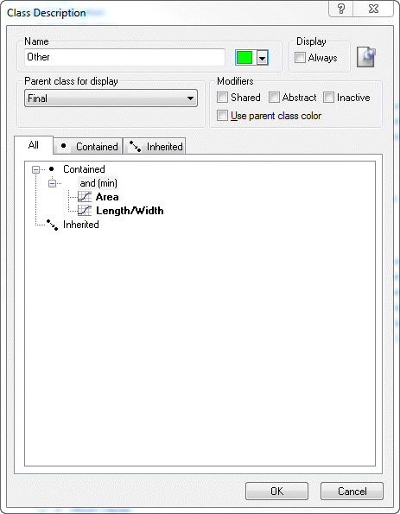
Final Classification – Other

Slide 25
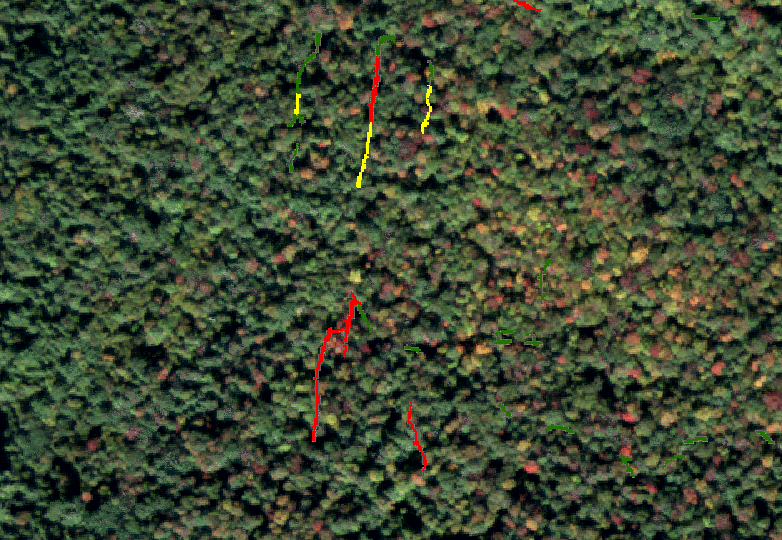
Modeling Approach – Erosion Hotspots
Step 1: Calculate Stream Power Index
Step 2: Segment Roads by SPI
Step 3: Fill Gaps and Consolidate
Step 4. Incorporate Soils Data (K)
Step 5. Classify

Slide 26
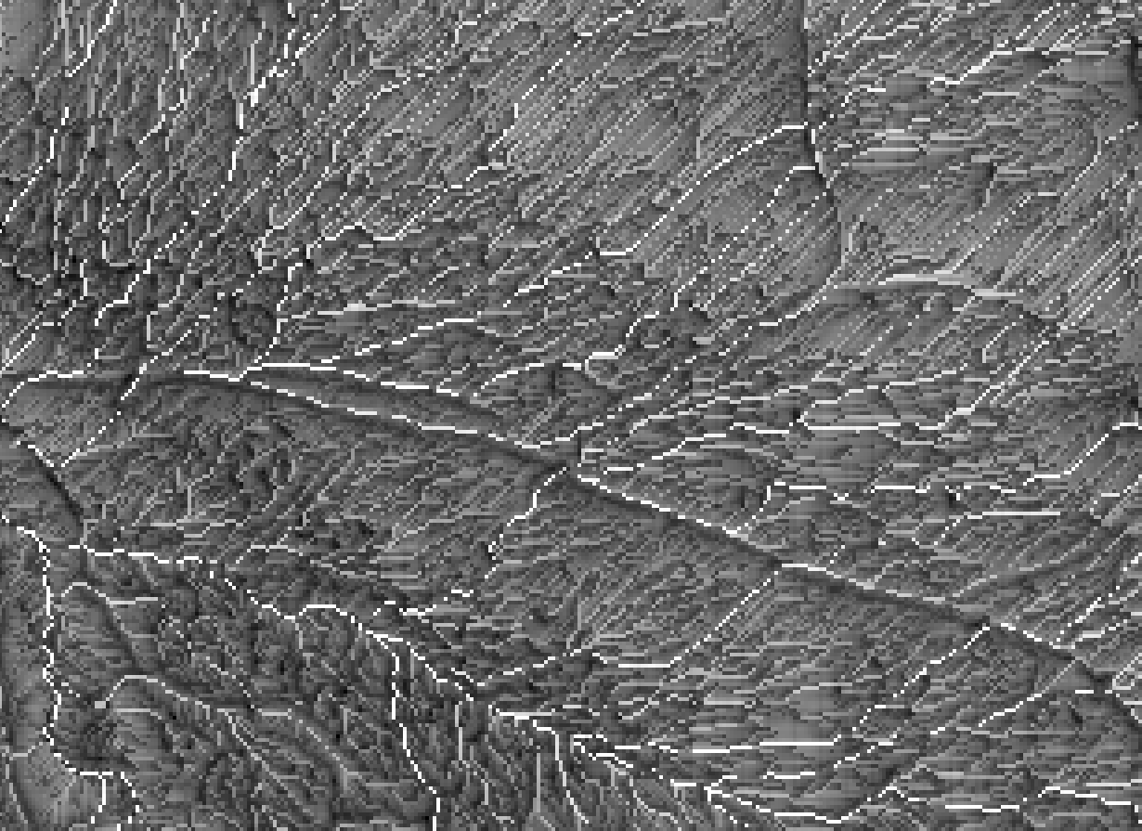
SPI = LN((Flow Accumulation)+0.001)
*(Slope/100+0.001))
Calculate SPI

Slide 27
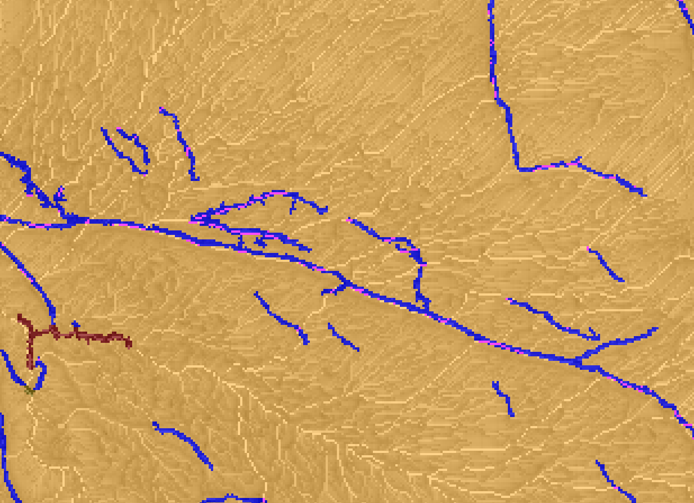
Segment by SPI

Slide 28
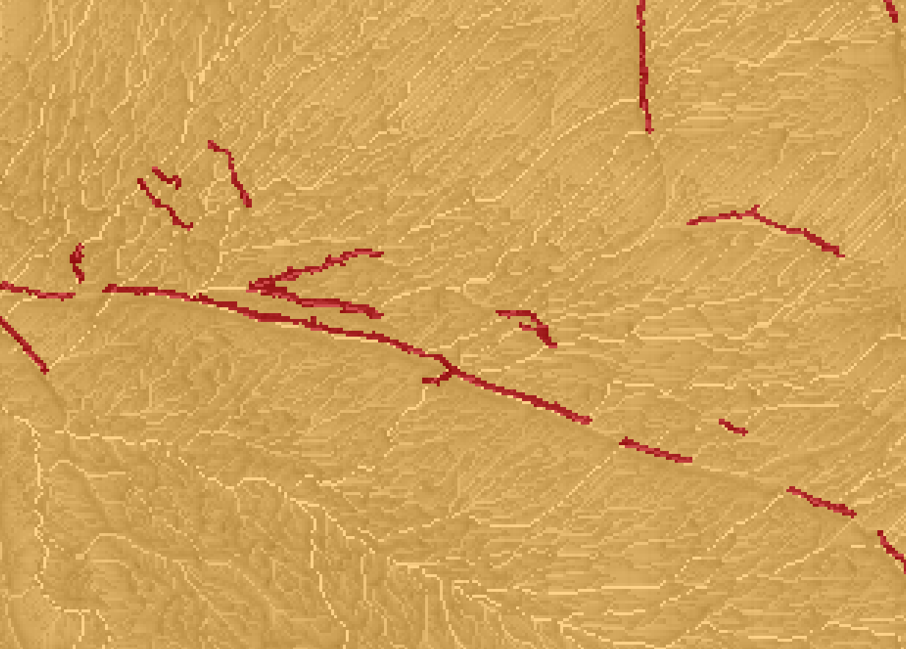
Fill Gaps and Consolidate

Slide 29
K Factor = 0.32
Add K Factor from SSURGO

Slide 30
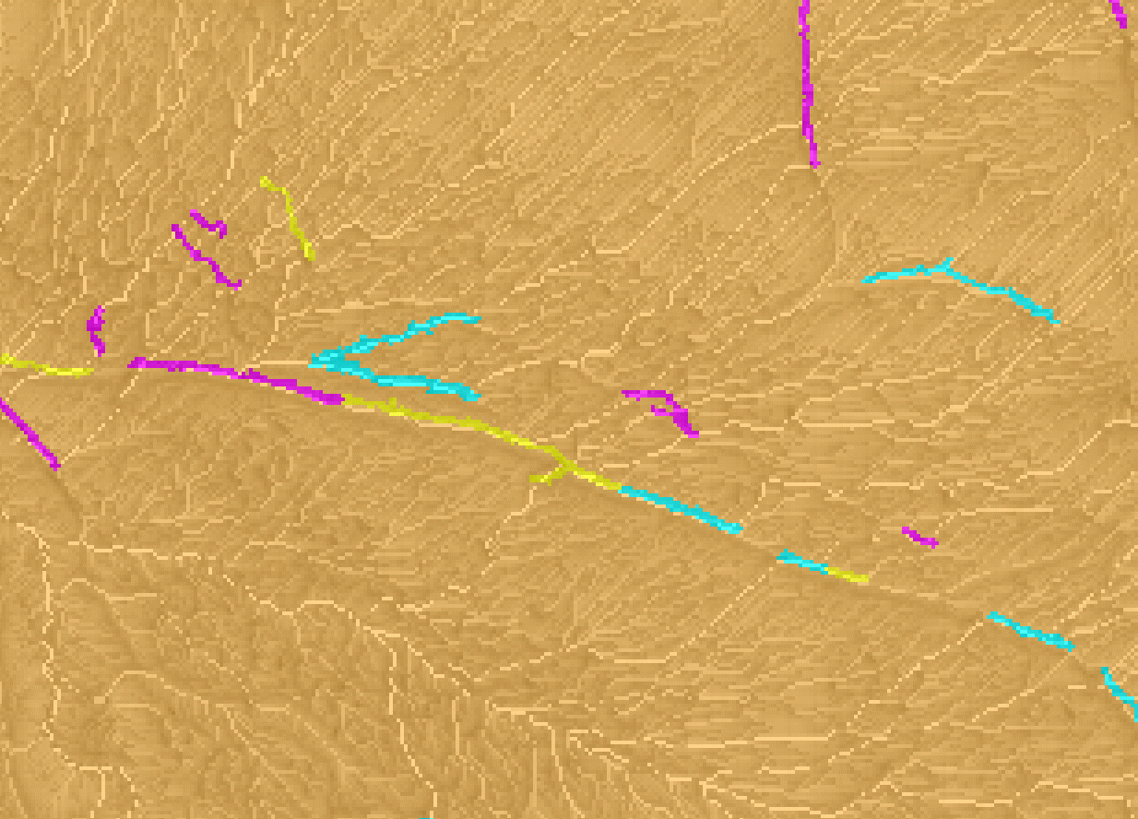
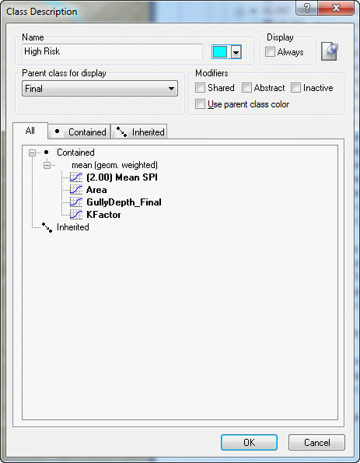
High Risk
Moderate Risk
Low Risk
Erosion Hotspot Classification

Slide 31
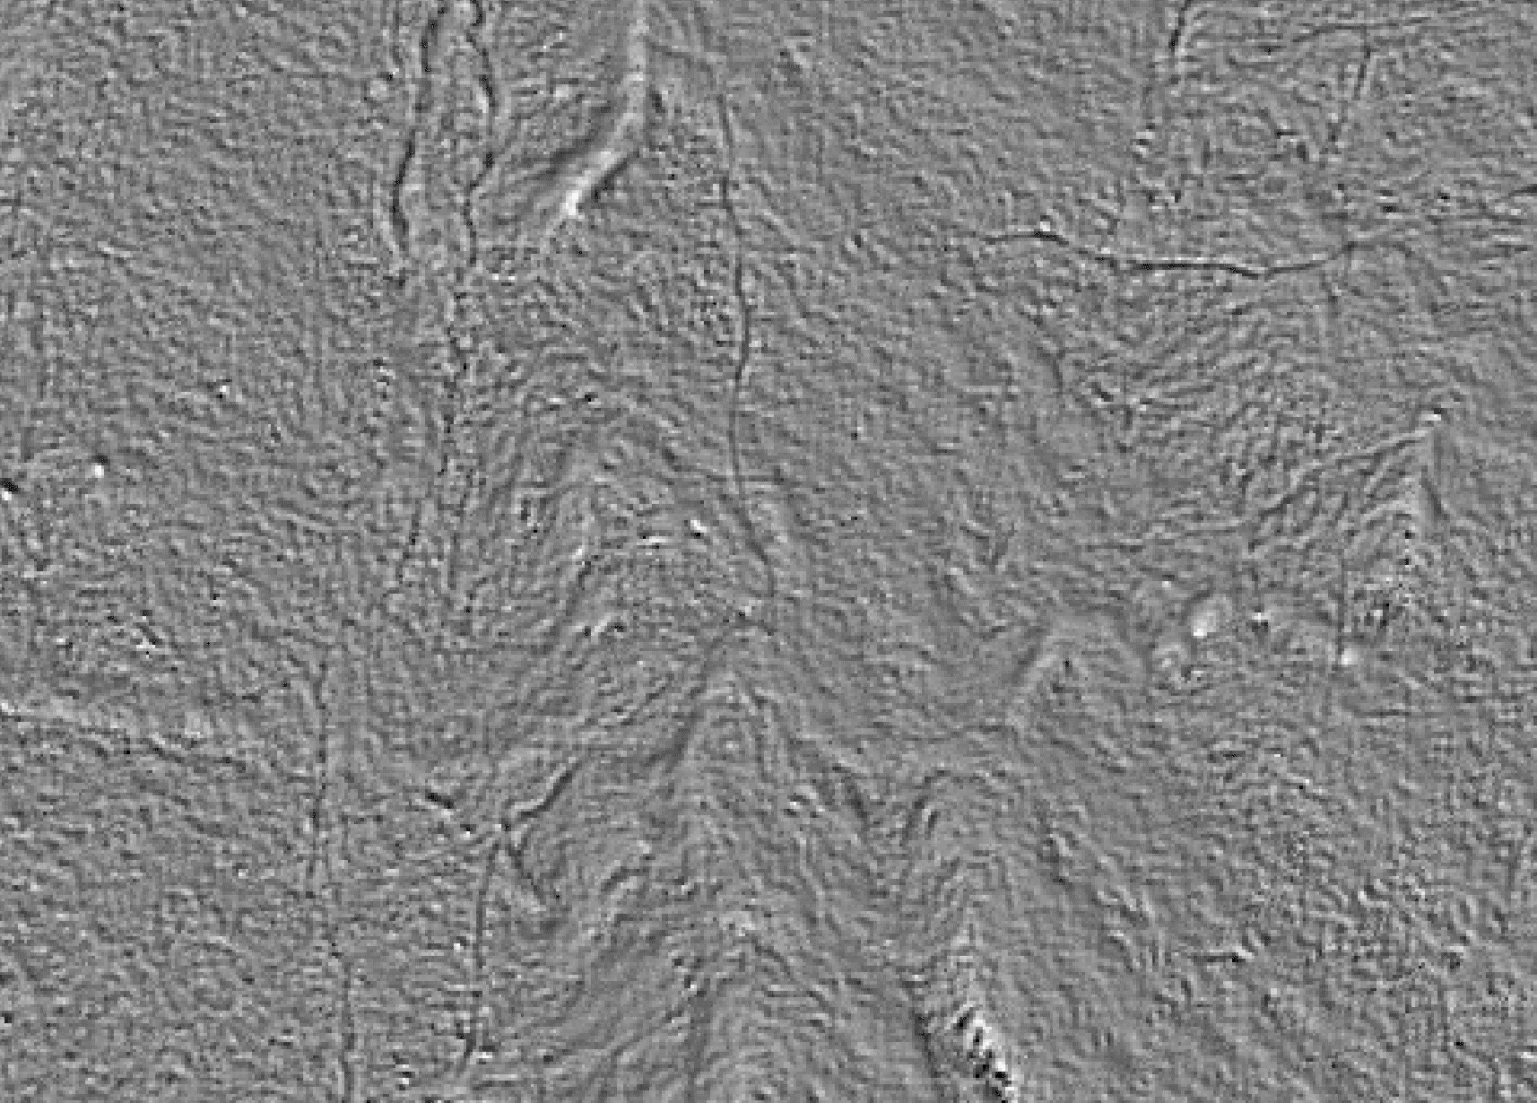
GIS Output

Slide 32
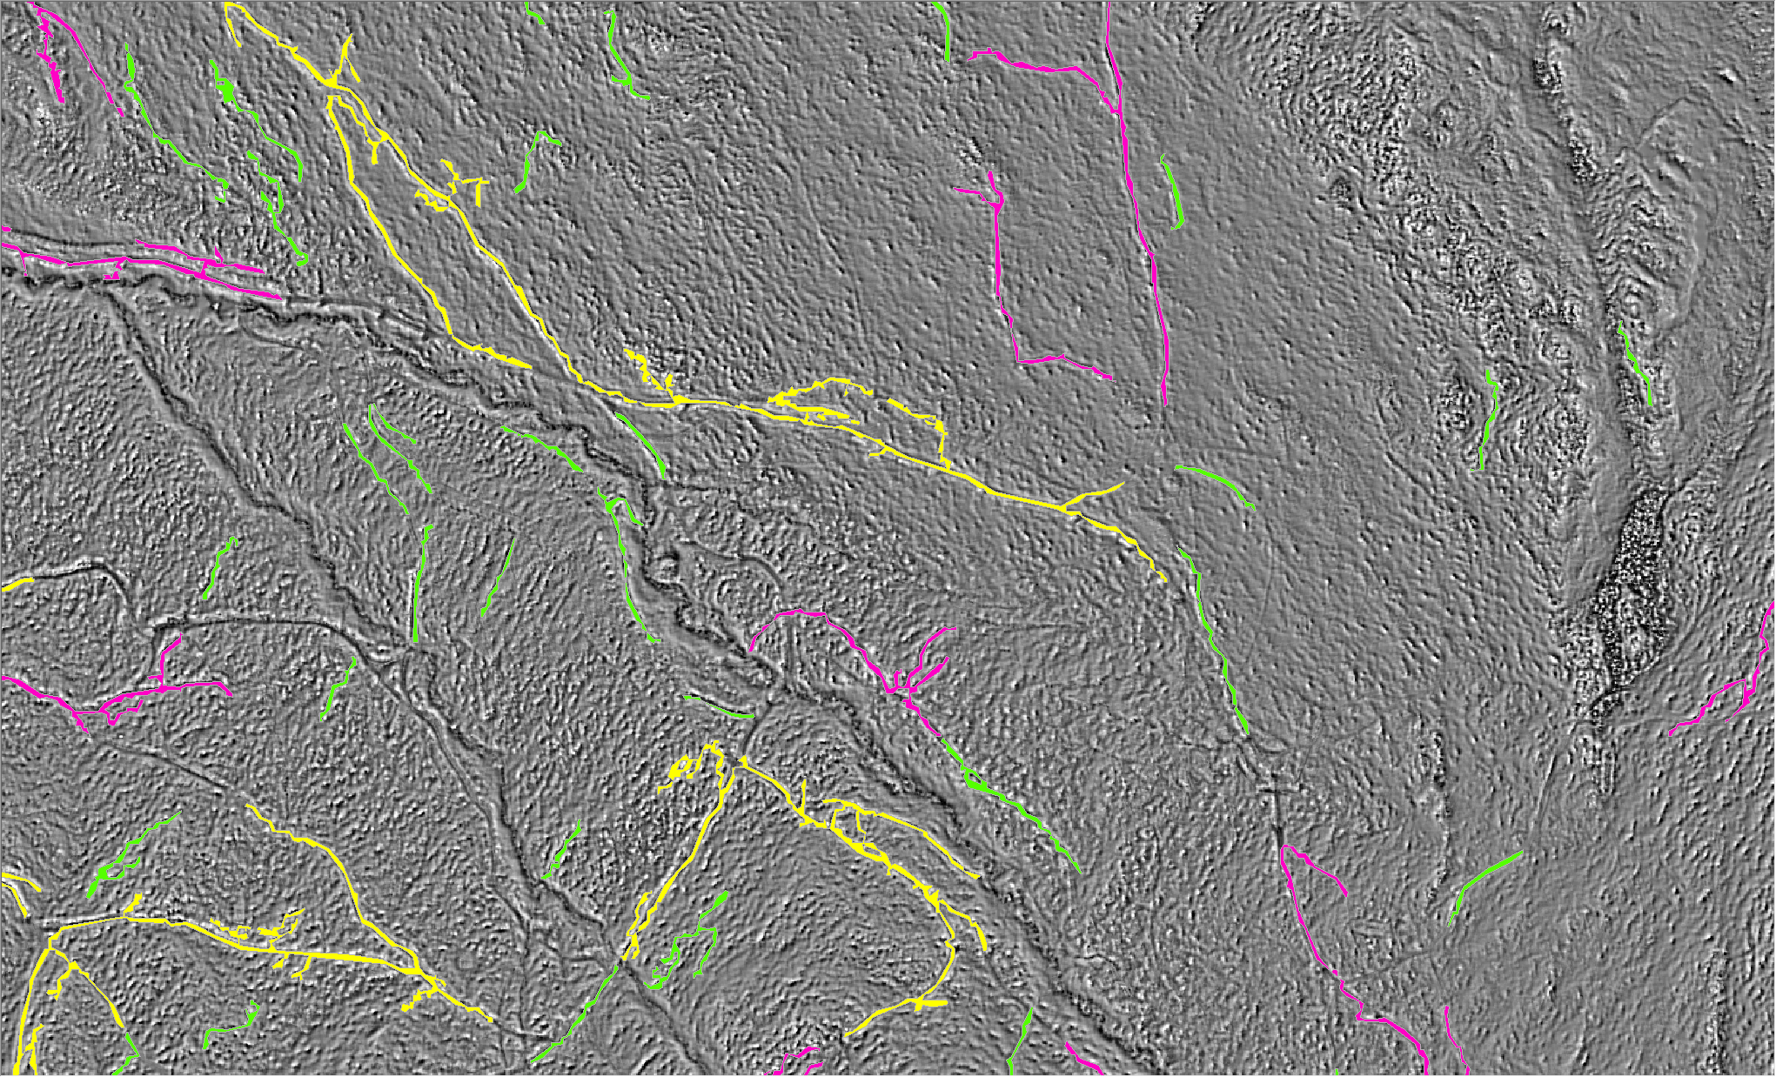
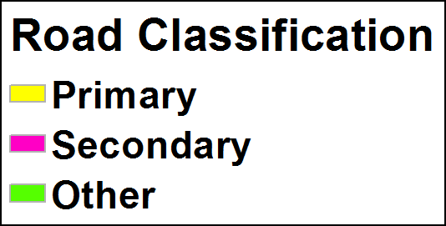

Slide 33
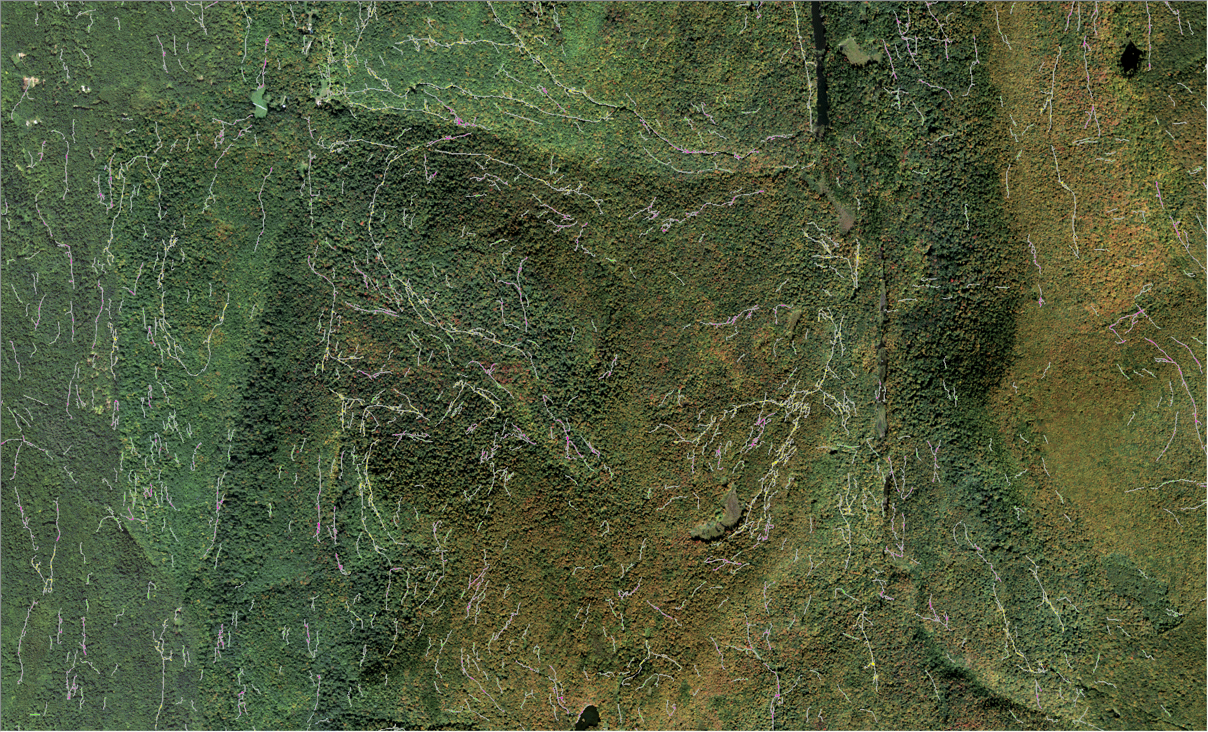

Slide 34
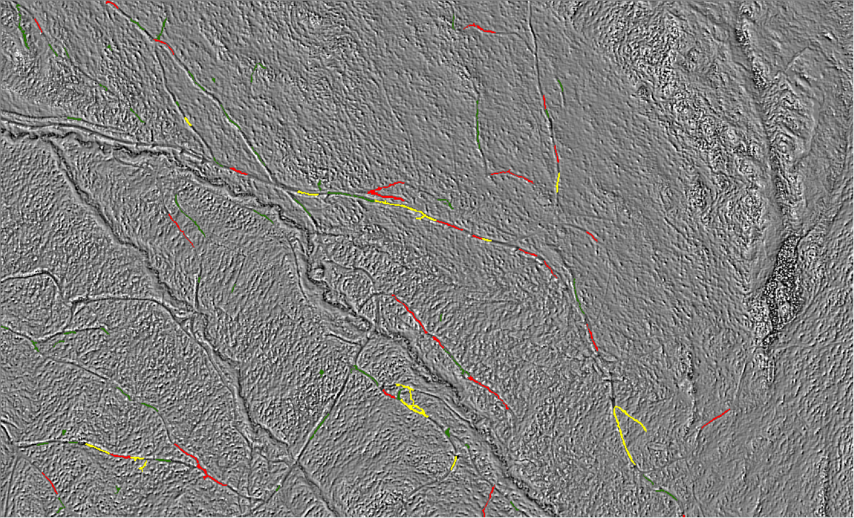
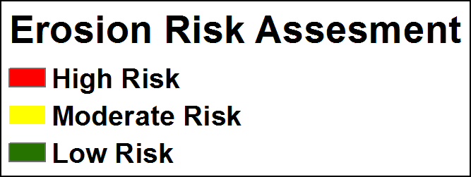

Slide 35
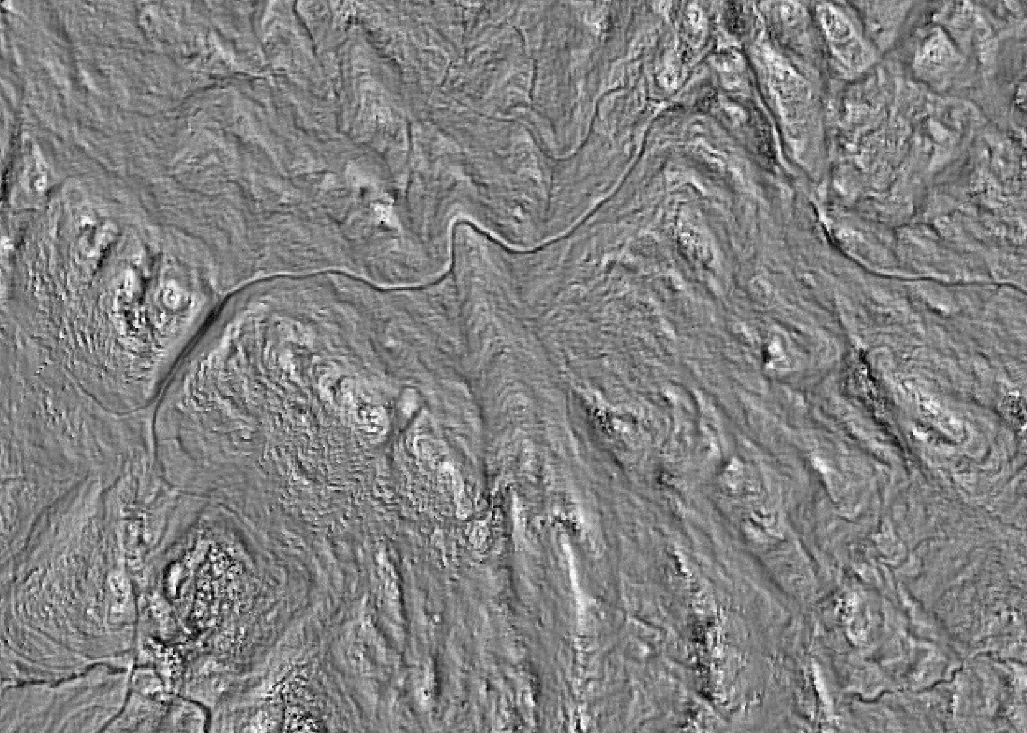
Accuracy Assessment

Slide 36
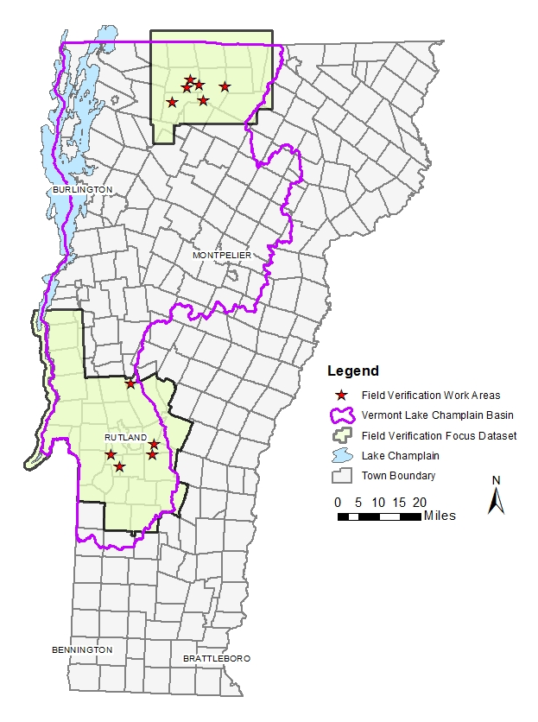

Slide 37
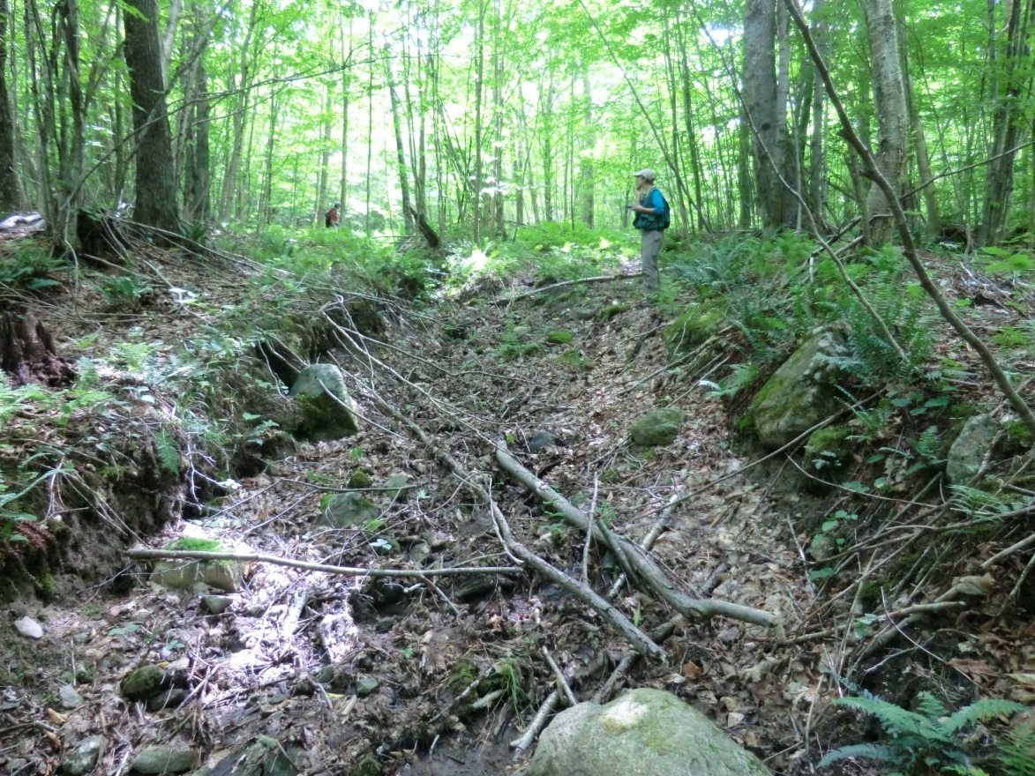
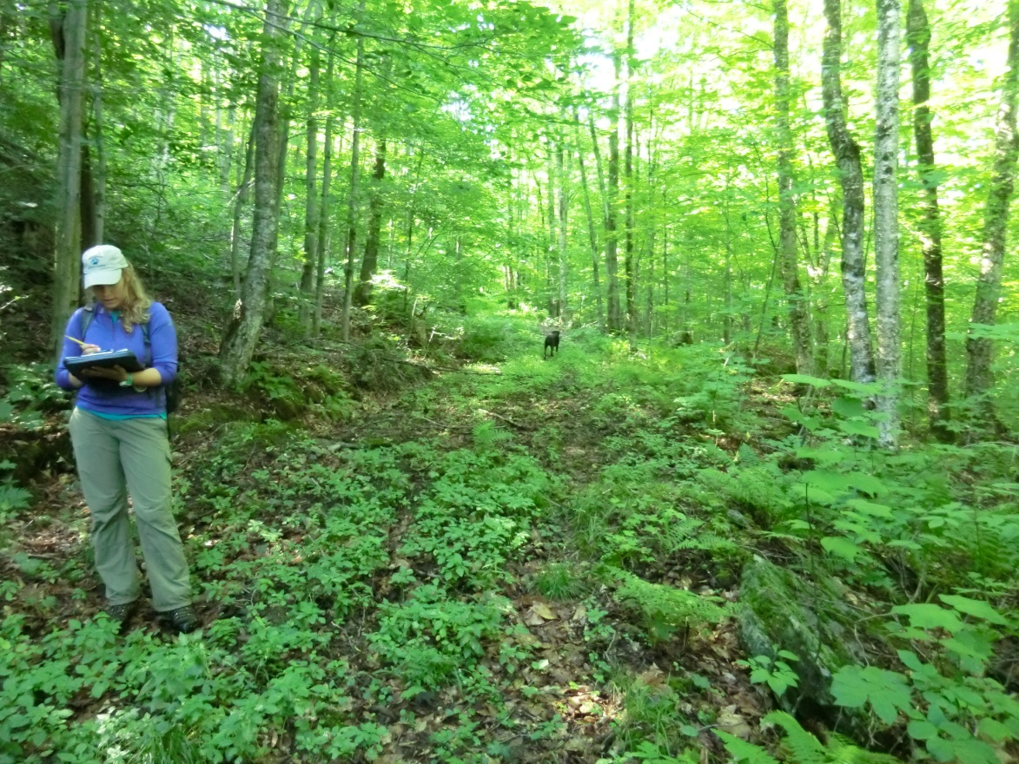
Alex Marcucci

Slide 38
Roads Classification
 | Field-verified Roads |  | Modeled Roads (July 2016) |  |  | Modeled Roads (Final – August 2017)
Parcel | Number | Length (m) | Number | Length (m) | % Capture | Number | Length (m) | % Capture
1 | 24 | 12,111 | 9 | 1,565 | 13% | 15 | 4,085 | 34%
2 | 8 | 4,572 | 6 | 2,578 | 56% | 8 | 3,733 | 82%
3 | 11 | 4,879 | 10 | 1,679 | 34% | 11 | 2,685 | 55%
4 | 13 | 4,335 | 9 | 1,264 | 29% | 12 | 2,309 | 53%
5 | 6 | 4,439 | 6 | 1,877 | 42% | 6 | 2,806 | 63%
Total | 62 | 30,337 | 40 | 8,964 | 30% | 52 | 15,618 | 51%
Rutland County (0.7-m GSD)

Slide 39
Roads Classification
 | Field-verified Roads |  | Modeled Roads (June 2016) |  |  | Modeled Roads (Final – August 2017)
Parcel | Number | Length (m) | Number | Length (m) | % Capture | Number | Length (m) | % Capture
1 | 9 | 6,527 | 9 | 3,793 | 58% | 9 | 4,314 | 66%
2 | 20 | 6,514 | 16 | 3,943 | 61% | 17 | 3,878 | 60%
3 | 10 | 2,946 | 6 | 748 | 25% | 3 | 389 | 13%
4 | 5 | 1,929 | 4 | 998 | 52% | 5 | 936 | 49%
5 | 6 | 1,163 | 4 | 211 | 18% | 3 | 137 | 12%
6 | 12 | 3,595 | 2 | 49 | 1% | 2 | 152 | 4%
7 | 2 | 454 | 0 | 0 | 0% | 0 | 0 | 0%
8 | 3 | 985 | 2 | 203 | 21% | 2 | 286 | 29%
9 | 4 | 1,615 | 3 | 209 | 13% | 3 | 147 | 9%
10 | 2 | 392 | 0 | 0 | 0% | 0 | 0 | 0%
11 | 1 | 832 | 1 | 151 | 18% | 0 | 0 | 0%
Total | 74 | 26,951 | 47 | 10,305 | 38% | 44 | 10,239 | 38%
Upper Missisquoi (1.6-m GSD)

Slide 40
Erosion Hotspot Classification
 | Field-verified Erosion Hotspots |  | Modeled Erosion Hotspots (June 2017) |  |  | Modeled Erosion Hotspots (Final – August 2017)
Site | Number | Length (m) | Number | Length (m) | % Capture | Number | Length (m) | % Capture
4-A | 1 | 45 | 1 | 35 | 77% | 1 | 35 | 79%
4-H | 2 | 55 | 1 | 27 | 49% | 1 | 27 | 49%
4-J | 1 | 47 | 0 | 0 | 0% | 0 | 0 | 0%
4-K | 2 | 101 | 1 | 28 | 28% | 0 | 0 | 0%
4-M | 7 | 141 | 4 | 58 | 41% | 6 | 90 | 64%
5-B | 7 | 209 | 5 | 141 | 67% | 6 | 147 | 70%
5-C | 1 | 10 | 0 | 0 | 0% | 0 | 0 | 0%
5-D | 4 | 183 | 3 | 157 | 86% | 3 | 156 | 85%
5-E | 2 | 87 | 1 | 36 | 42% | 2 | 73 | 84%
5-F | 1 | 129 | 1 | 129 | 100% | 1 | 129 | 100%
Total | 28 | 1,007 | 17 | 611 | 61% | 20 | 658 | 65%
Rutland County (0.7-m GSD)

Slide 41
Erosion Hotspot Classification
 | Field-verified Erosion Hotspots |  | Modeled Erosion Hotspots (June 2017) |  |  | Modeled Erosion Hotspots (Final – August 2017)
Site | Number | Length (m) | Number | Length (m) | % Capture | Number | Length (m) | % Capture
1-B | 2 | 152 | 0 | 0 | 0% | 0 | 0 | 0%
1-C | 1 | 29 | 0 | 0 | 0% | 0 | 0 | 0%
1-E | 1 | 16 | 0 | 0 | 0% | 0 | 0 | 0%
1-F | 2 | 278 | 1 | 94 | 34% | 1 | 104 | 37%
1-I | 6 | 329 | 6 | 226 | 69% | 6 | 236 | 72%
2-A | 1 | 14 | 1 | 14 | 100% | 1 | 14 | 100%
2-C | 2 | 46 | 1 | 26 | 56% | 2 | 46 | 100%
2-D | 1 | 23 | 0 | 0 | 0% | 0 | 0 | 0%
2-H | 1 | 24 | 0 | 0 | 0% | 0 | 0 | 0%
2-I | 1 | 16 | 1 | 16 | 100% | 1 | 16 | 100%
2-J | 1 | 13 | 0 | 0 | 0% | 0 | 0 | 0%
2-N | 1 | 13 | 0 | 0 | 0% | 0 | 0 | 0%
2-V | 2 | 35 | 0 | 0 | 0% | 0 | 0 | 0%
3-B | 1 | 28 | 0 | 0 | 0% | 0 | 0 | 0%
4-D | 2 | 33 | 1 | 18 | 55% | 1 | 18 | 55%
5-D | 2 | 35 | 0 | 0 | 0% | 0 | 0 | 0%
6-B | 1 | 18 | 0 | 0 | 0% | 0 | 0 | 0%
6-C | 1 | 80 | 0 | 0 | 0% | 0 | 0 | 0%
6-J | 3 | 132 | 0 | 0 | 0% | 1 | 18 | 14%
Total | 32 | 1,315 | 11 | 395 | 30% | 13 | 453 | 34%
Upper Missisquoi (1.6-m GSD)

Slide 42
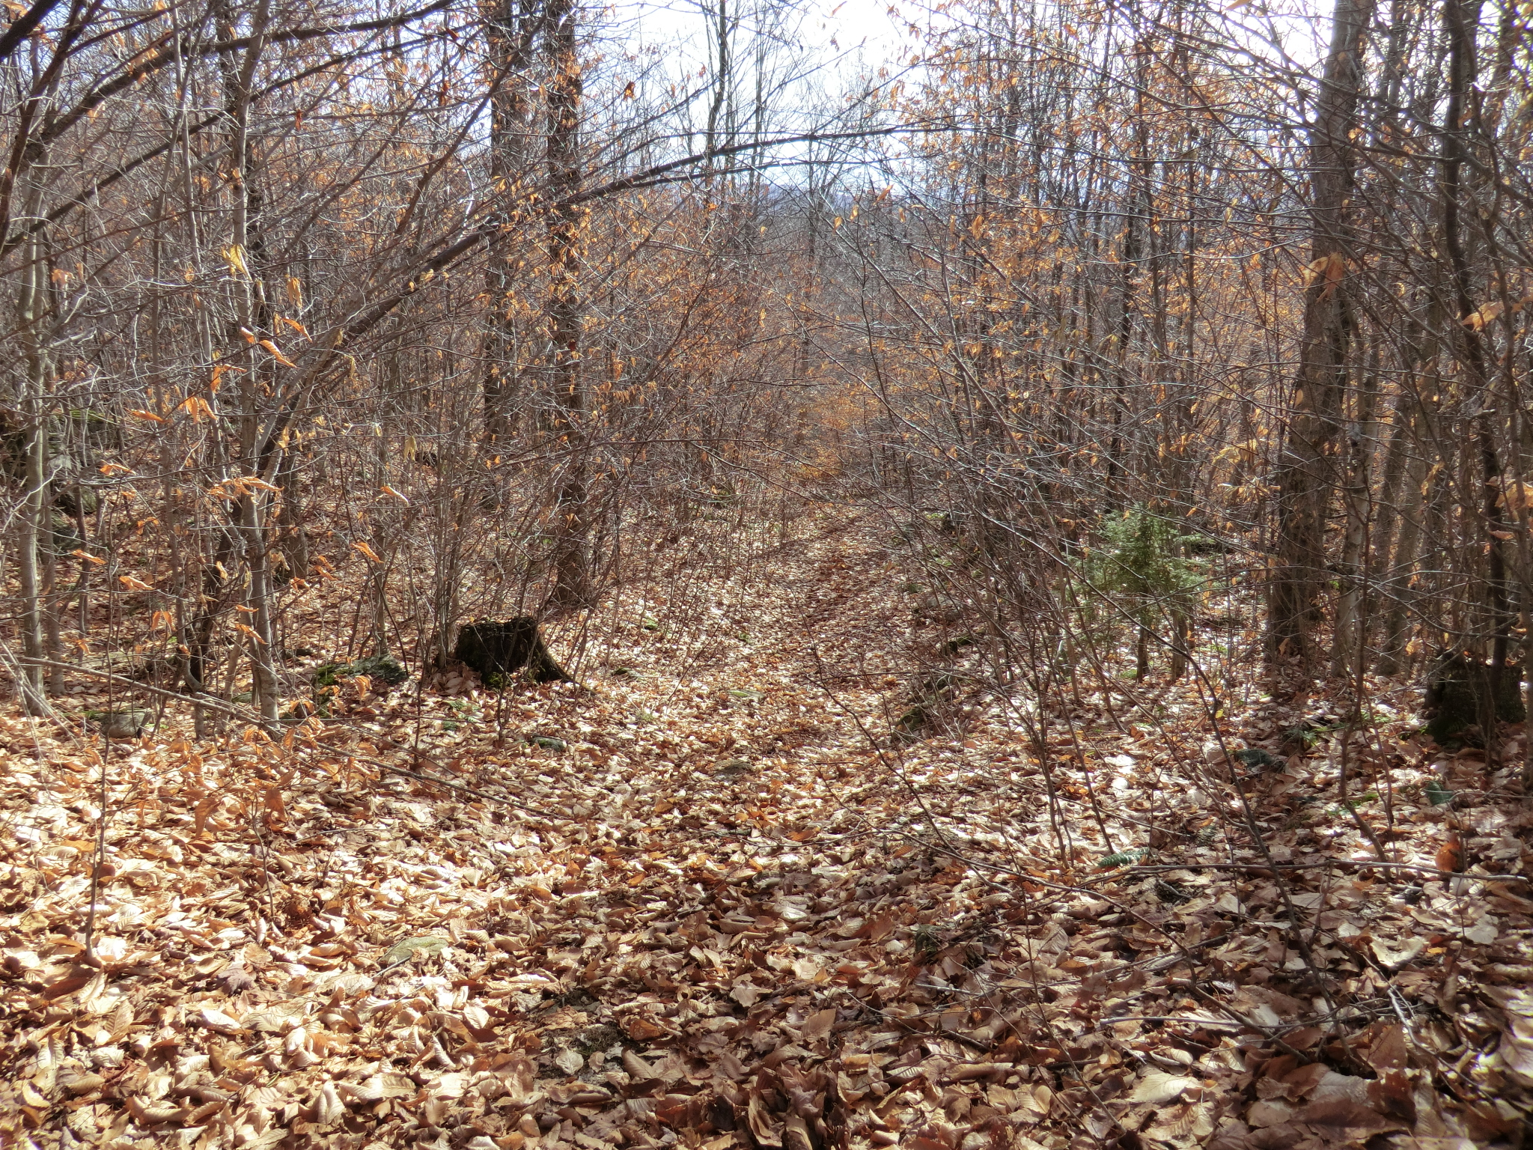
Sources of Error
Alex Marcucci

Slide 43
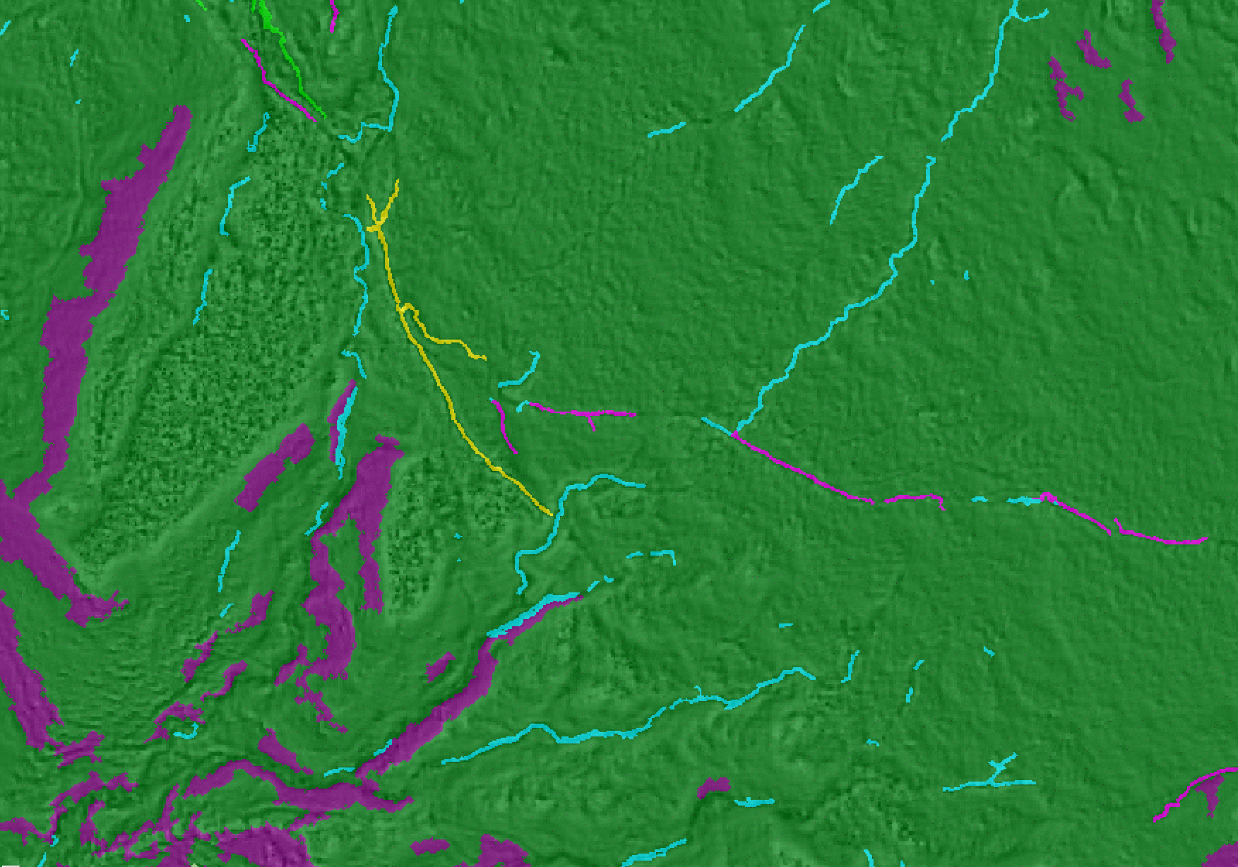
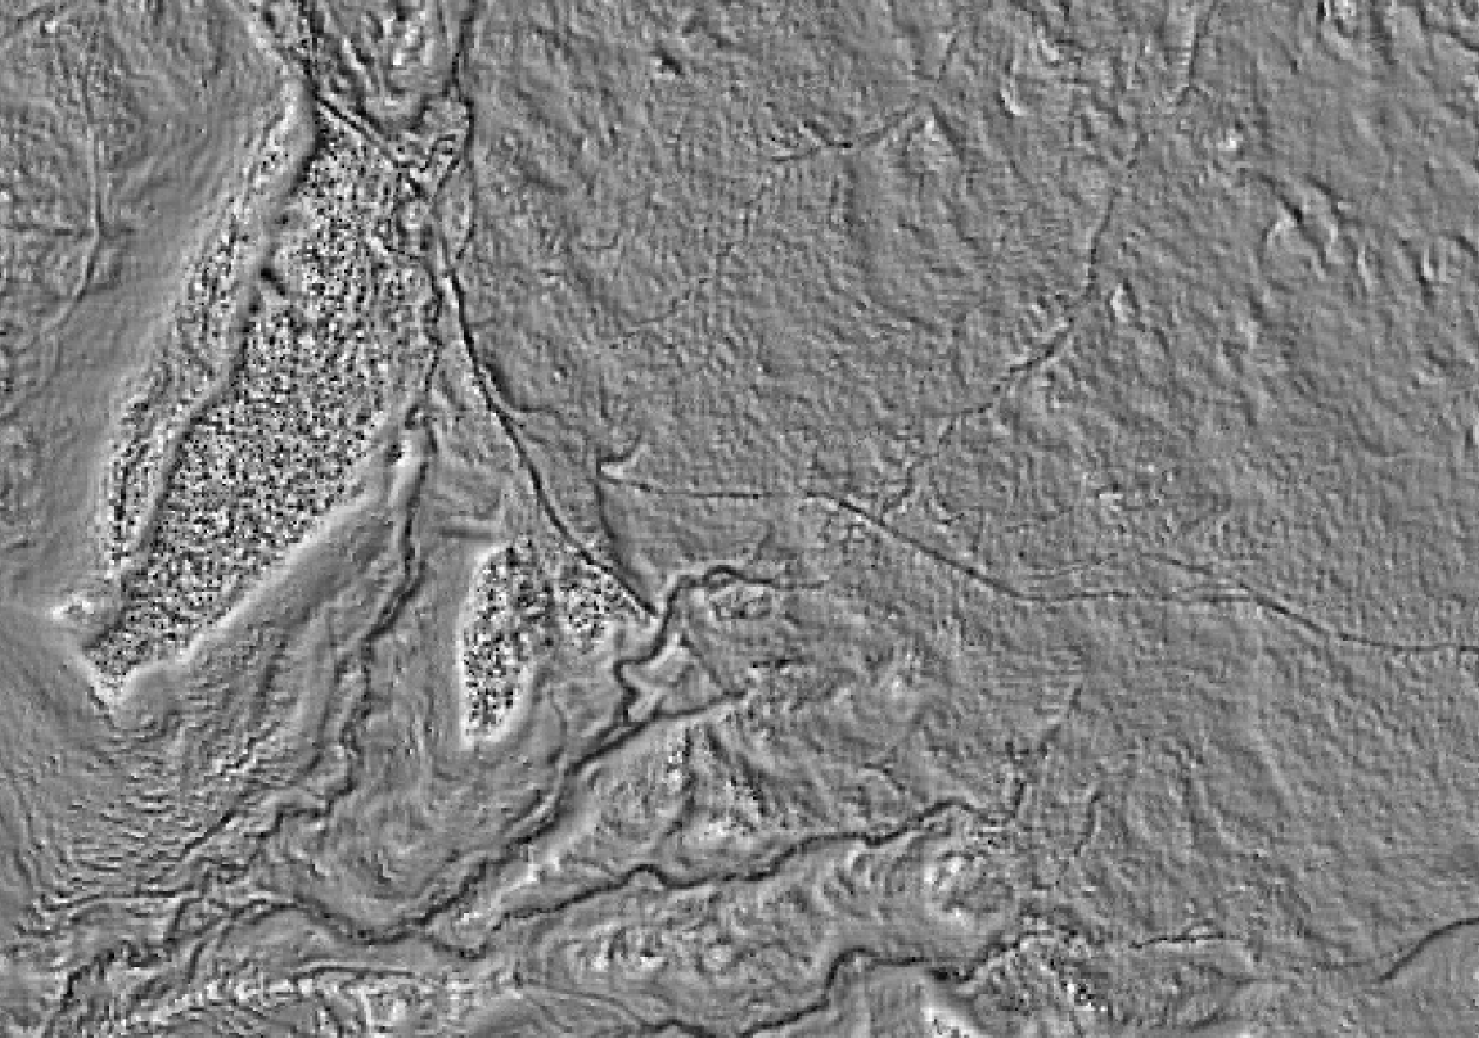
Line Attenuation

Slide 44
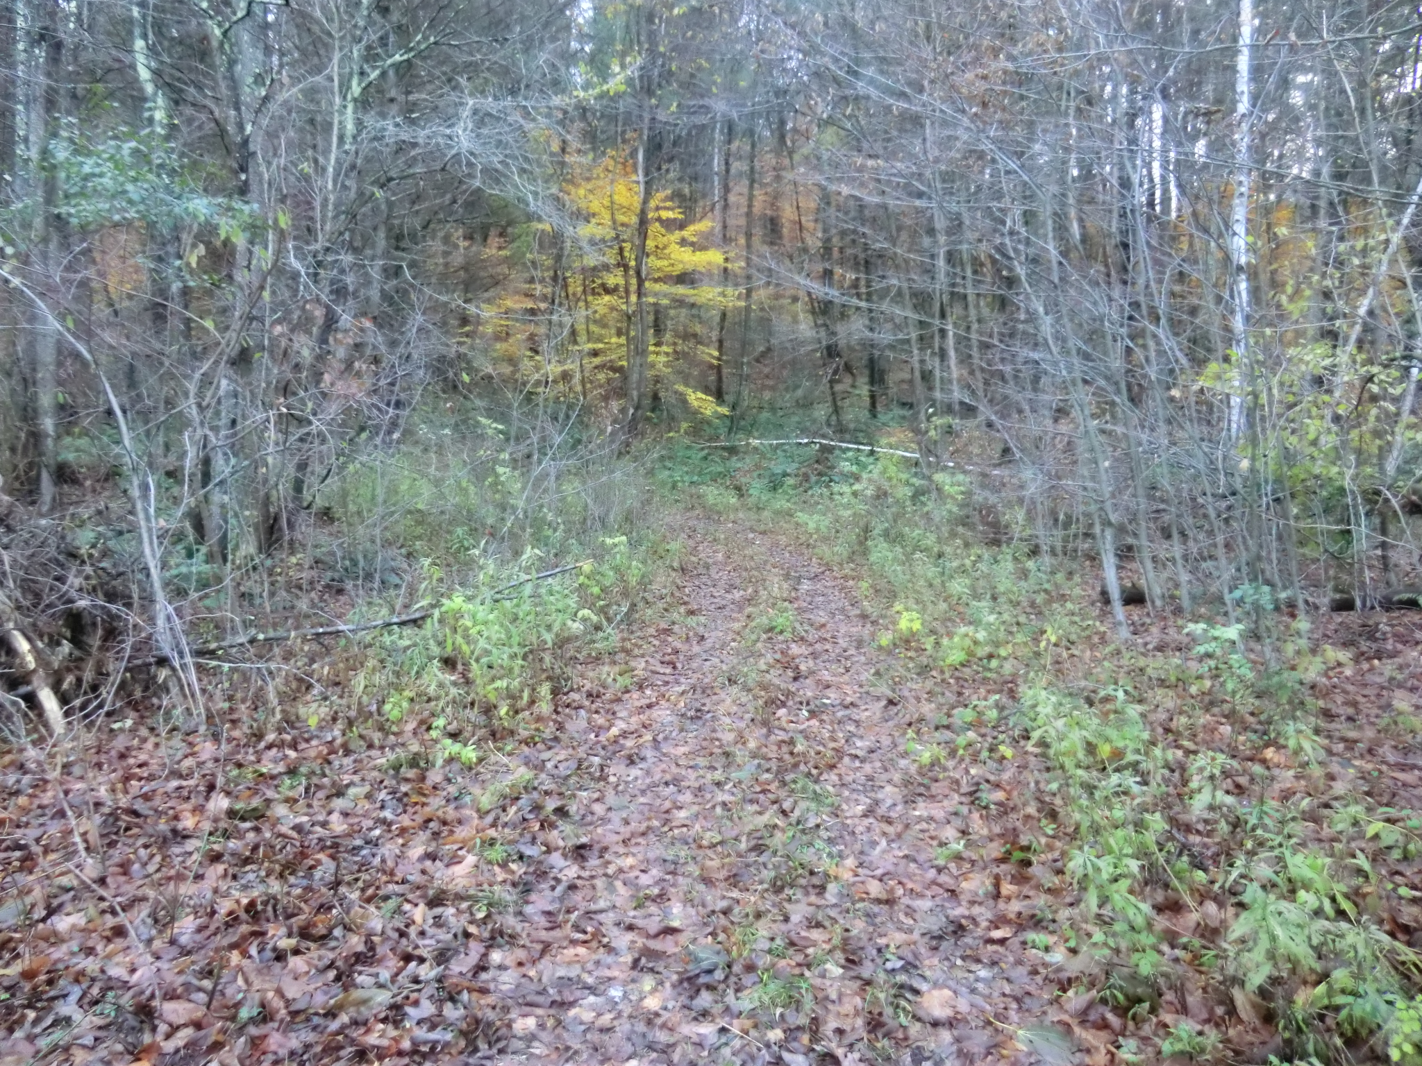
Alex Marcucci

Slide 45
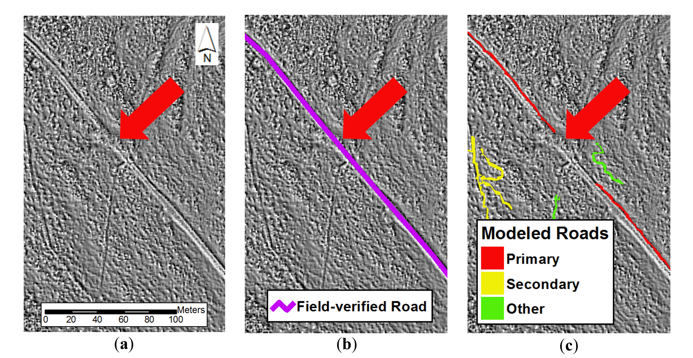
Gaps in Road Network

Slide 46
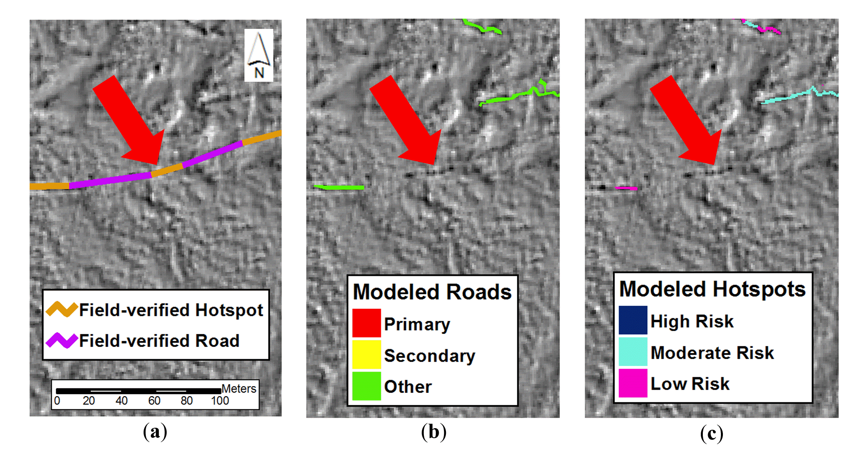
Missing Erosion Site – No Mapped Road

Slide 47
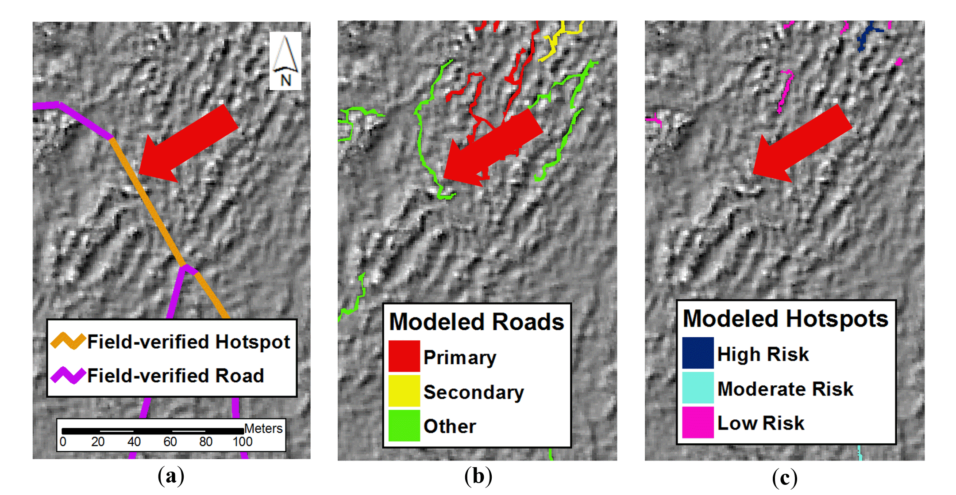
Missing Erosion Site – Mapped Road Not Selected

Slide 48
Phosphorus Loading Estimates

Slide 49

Volume of Eroded Segments (m³)
Bulk Density Rate – 1,500 kg/m³ (Wemple et al. 2013)
Total P Rate – 250 mg/kg (Wemple et al. 2013)
Apportioned Over 30 Years
Alex Marcucci

Slide 50

HUC 12 Watersheds

Slide 51

Lessons
Comprehensive Networks Difficult
Resolution Matters
Eroded Sites Easier to Map
SPI-based Approach Promising
Comparative P Estimates Informative

Slide 52

Future Research
2-Part Study
Individual Watershed
Refined Automated Modeling
Field Measurements (Road Networks, Site Characteristics, P Estimates for Different Road Types
Alex Marcucci

Slide 53

Acknowledgments
Matches (CIG, BCE, Cold Hollow to Canada, Pitney Bowes)
Reed Sims, Kip Potter (NRCS)
Beverley Wemple (UVM)
Gary Sabourin, Nancy Patch, Chris Stone, Jim Ryan (VT ANR)
Alex Marcucci

Slide 54
Using LiDAR to Identify and Map Forest Roads in Trails in Vermont
Sean MacFaden, 802-656-3007, Sean.MacFaden@uvm.edu
Jarlath O’Neil-Dunne, 802-656-3324, Jarlath.Oneil-Dunne@uvm.edu
Mary Nealon, 802-223-5140, Mary@BearCreekEnvironmental.com
Alex Marcucci, 802-223-5140, Alex@BearCreekEnvironmental.com

