Slide 1
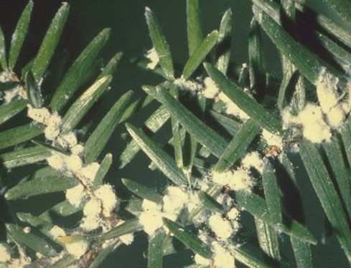
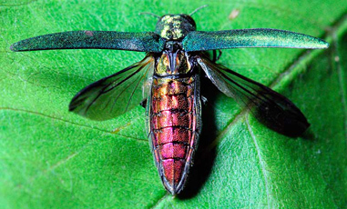
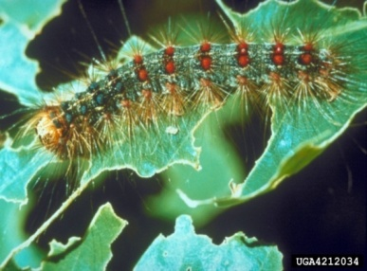
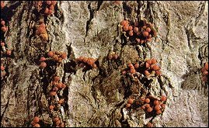
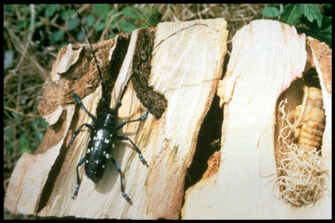





Imported Forest Pests:
Science Applied to Policy
Gary Lovett
Kathy Fallon Lambert
Marissa Weiss
Thanks to our funders:

Slide 2
The Rogue’s Gallery
(A Partial List)
Chestnut blight
Dutch elm disease
Emerald ash borer
Hemlock woolly adelgid
Gypsy moth
Beech bark disease
Balsam woolly adelgid
White pine blister rust
Dogwood anthracnose
  Asian longhorned beetle
  Butternut canker
  Oak wilt
  Sirex wood wasp
  Viburnum leaf beetle
  Spotted lanternfly
  Beech leaf disease
  And the list goes on and on…

Slide 3
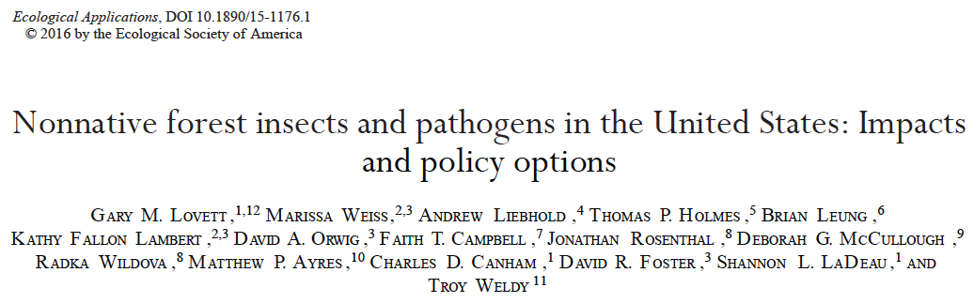

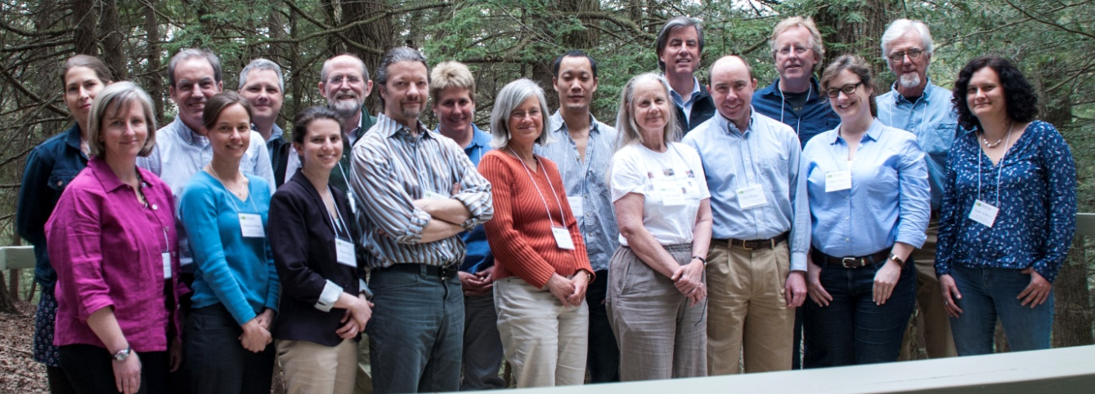
Comprehensive Synthesis of Forest Pest Issue:
Links Science and Policy
26:1437-1455
Interdisciplinary team of ecologists, entomologists, economists and policy experts
Notes:
This is a very informed audience, amd most of you already know the primary literature on this.

Slide 4
Bottom Line Messages
Imported forest pests are the most urgent and under-appreciated forest health threat in the U.S.

Slide 5
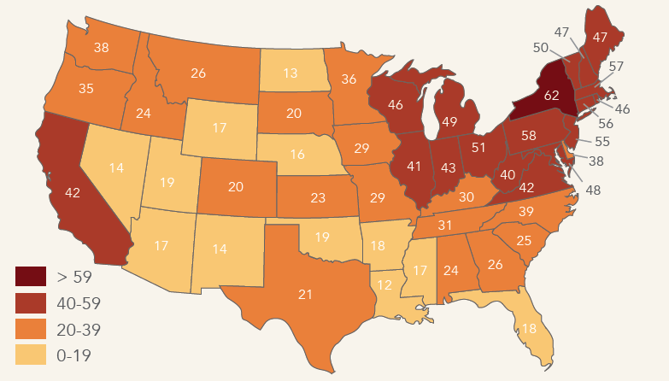
Bottom Line Messages
Imported forest pests are the most urgent and under-appreciated forest health threat in the U.S.
This is a growing problem that affects forests and communities in all 50 states
Number of Imported Forest Pests per State
Data from US Forest Service

Slide 6
Bottom Line Messages
Imported forest pests are the most urgent and under-appreciated forest health threat in the U.S.
This is a growing problem that affects forests and communities in all 50 states
Economic impacts are substantial and fall mostly on homeowners and municipalities

Slide 7
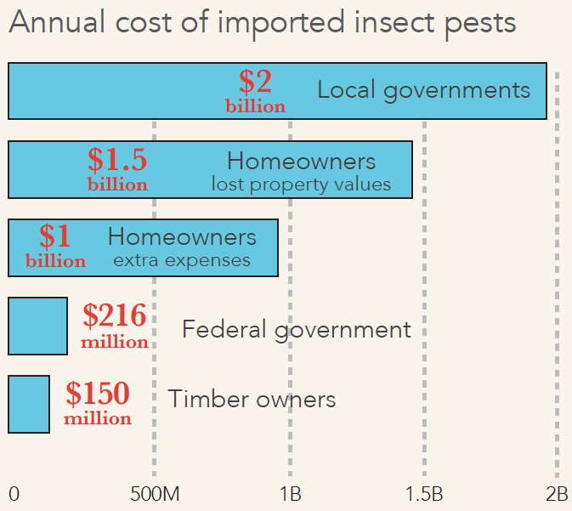
Economic Impacts in the U.S.
Data from J. Aukema et al. 2011, PLOS One 6(9): e24587
…and this is an underestimate of true costs of imported pests.

Slide 8
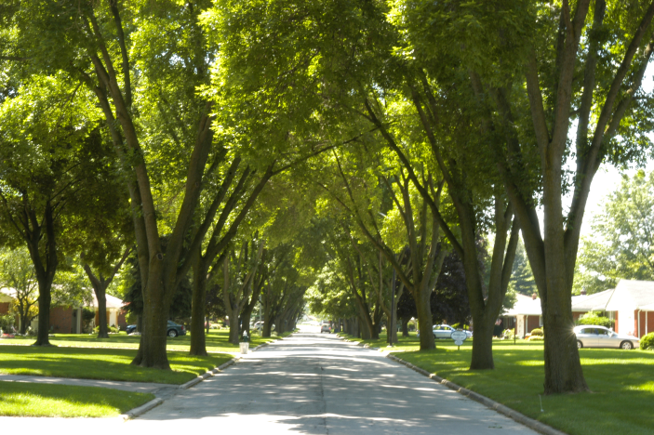
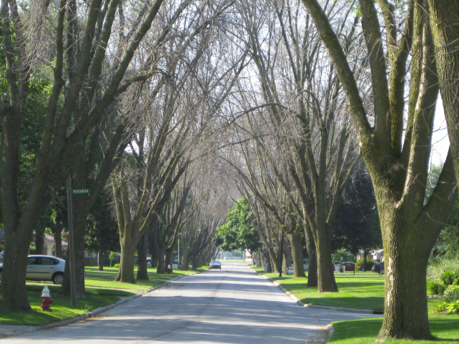
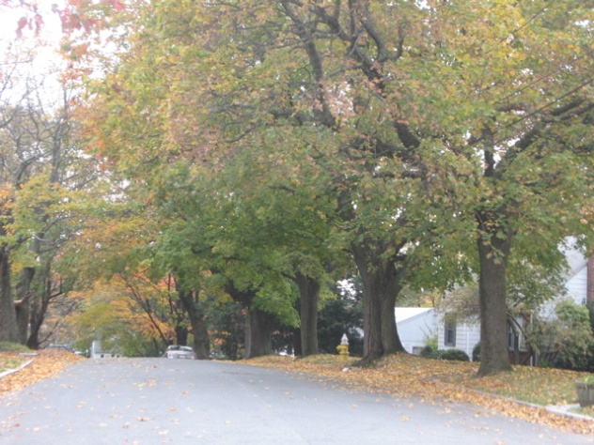
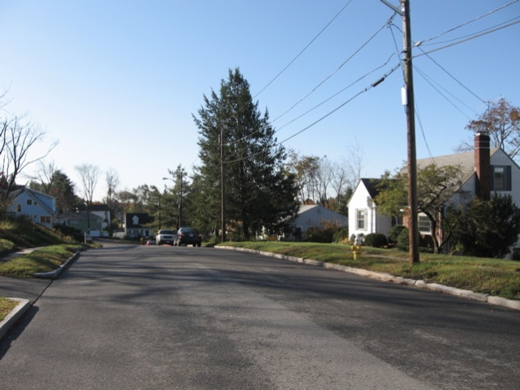
Impacts on Communities
A street in Toledo before and after emerald ash borer attack
Photo: Dan Herms
A neighborhood in Worcester , MA before and after Asian longhorned beetle eradication

Slide 9
Bottom Line Messages
Imported forest pests are the most urgent and under-appreciated forest health threat in the U.S.
This is a growing problem that affects forests and communities in all 50 states
Economic impacts are substantial and fall mostly on homeowners and municipalities
Ecological impacts are severe and can be very long-term

Slide 10
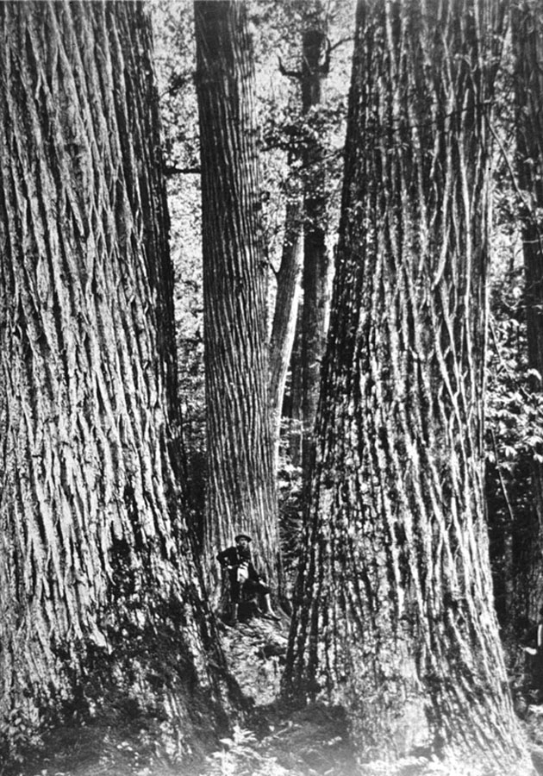
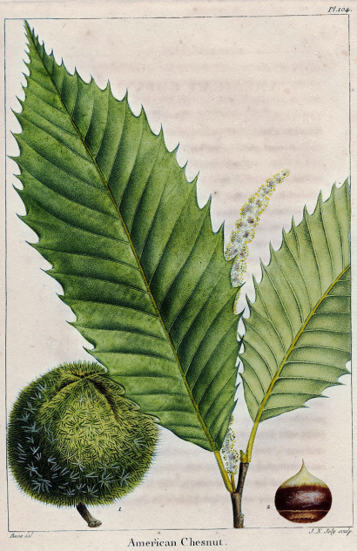
Ecological Impacts
Introduced pests are the only threat that can reduce major canopy species to ecological insignificance in a matter of decades
American chestnut
Chestnut grove in North Carolina, ca. 1910
Notes:
Chestnut example reminds us of what we have to lose

Slide 11
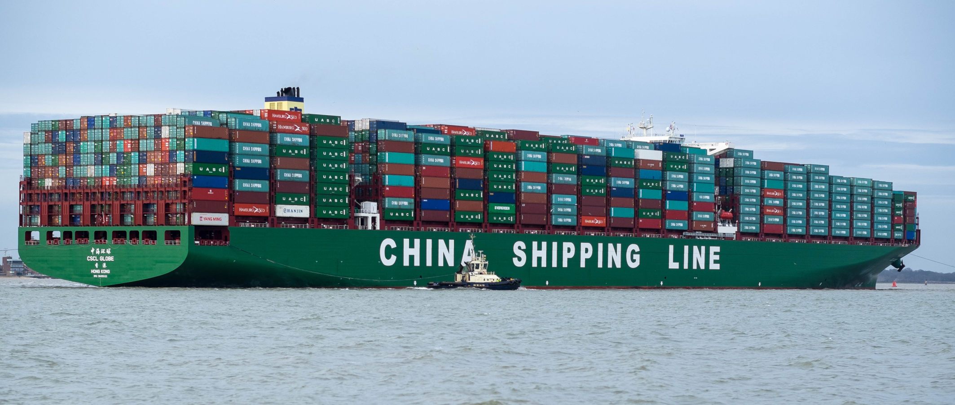
Bottom Line Messages
Imported forest pests are the most urgent and under-appreciated forest health threat in the U.S.
This is a growing problem that affects forests and communities in all 50 states
Economic impacts are substantial and fall mostly on homeowners and municipalities
Ecological impacts are severe and very long-term
Current policies are not providing adequate protection in the face of burgeoning global trade

Slide 12
Bottom Line Messages
Imported forest pests are the most urgent and under-appreciated forest health threat in the U.S.
This is a growing problem that affects forests and communities in all 50 states
Economic impacts are substantial and fall mostly on homeowners and municipalities
Ecological impacts are severe and very long-term
Current policies are not providing adequate protection in the face of burgeoning global trade
There are many possible policy options for reducing importation and establishment of new pests

Slide 13
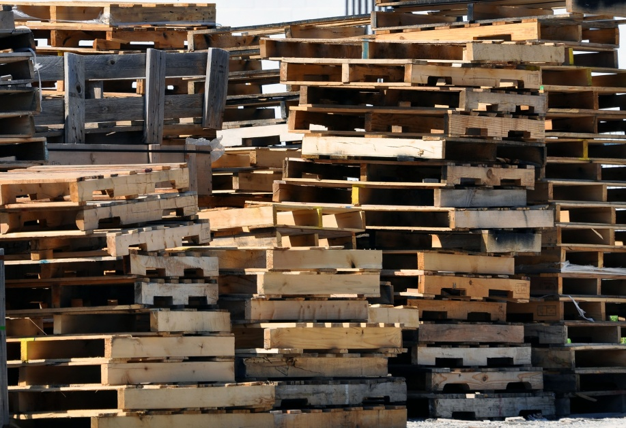
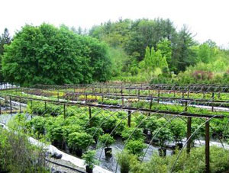
Policy Priorities
Focus on preventing importation and establishment
Focus on major pathways of introduction
Solid wood packaging material
Live woody plants for landscaping
Notes:
Impossible to know every pest that is possible to import, so we need to focus on pathways. Current regulations are found to be not up to the task. Efficiency of inspections for more cryptic insects and fungi is unknown, probably less than 28%
Current regulations require heat treatment or fumigation of wood packing materialCurrent regulations for most plants require a certificate from country of origin and an inspection upon entry
Current practices for both pathways have been shown to be inadequate
Inspection at ports of entry is not a viable control strategy (but it is valuable for data collection and deterrence)

Slide 14

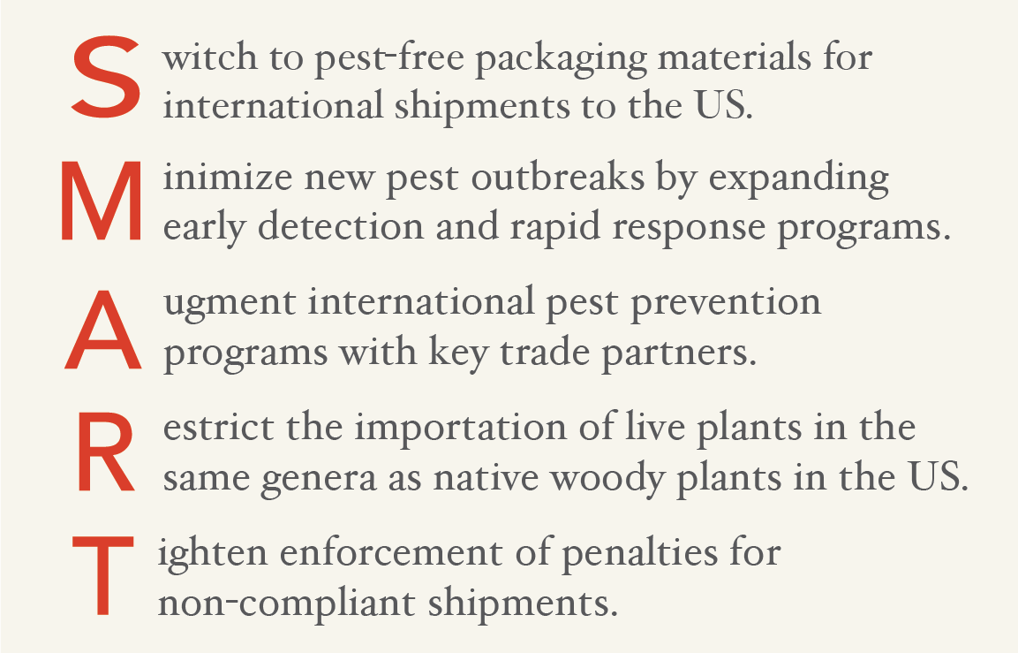
Tree-SMART Trade
Five high-priority actions to reduce importation of forest pests
www.caryinstitute.org/tree-smart-trade

Slide 15
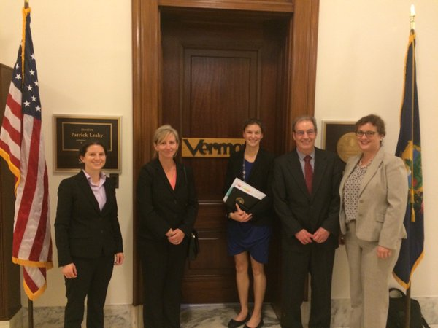




Policy and Communication Activities
Three Congressional briefings and many, many meetings with legislative offices and federal agencies
Hundreds of articles in earned media; also Op-Eds and blog posts
Working with private corporations through The Sustainability Consortium
Working with NY State Invasive Species Council
The Boston Globe

Slide 16
We need scientists and natural resource professionals to speak up about the importance of the issue!
www.caryinstitute.org/tree-smart-trade
lovettg@caryinstitute.org

