Slide 1

Regional spatiotemporal patterns of forest disturbance using aerial detection surveys
Alexandra M. Kosiba¹², Garrett W. Meigs¹³⁴, James A. Duncan¹², Jennifer A. Pontius¹²⁵, William S. Keeton¹³, and Emma R. Tait¹²
¹ University of Vermont, Rubenstein School of Environment and Natural Resources, Burlington, VT
² Forest Ecosystem Monitoring Cooperative, South Burlington, VT
³ University of Vermont, Gund Institute for Environment, Burlington, VT
⁴ Oregon State University, College of Forestry, Corvallis, OR
⁵ USDA Forest Service, Northern Research Station, Burlington

Slide 2
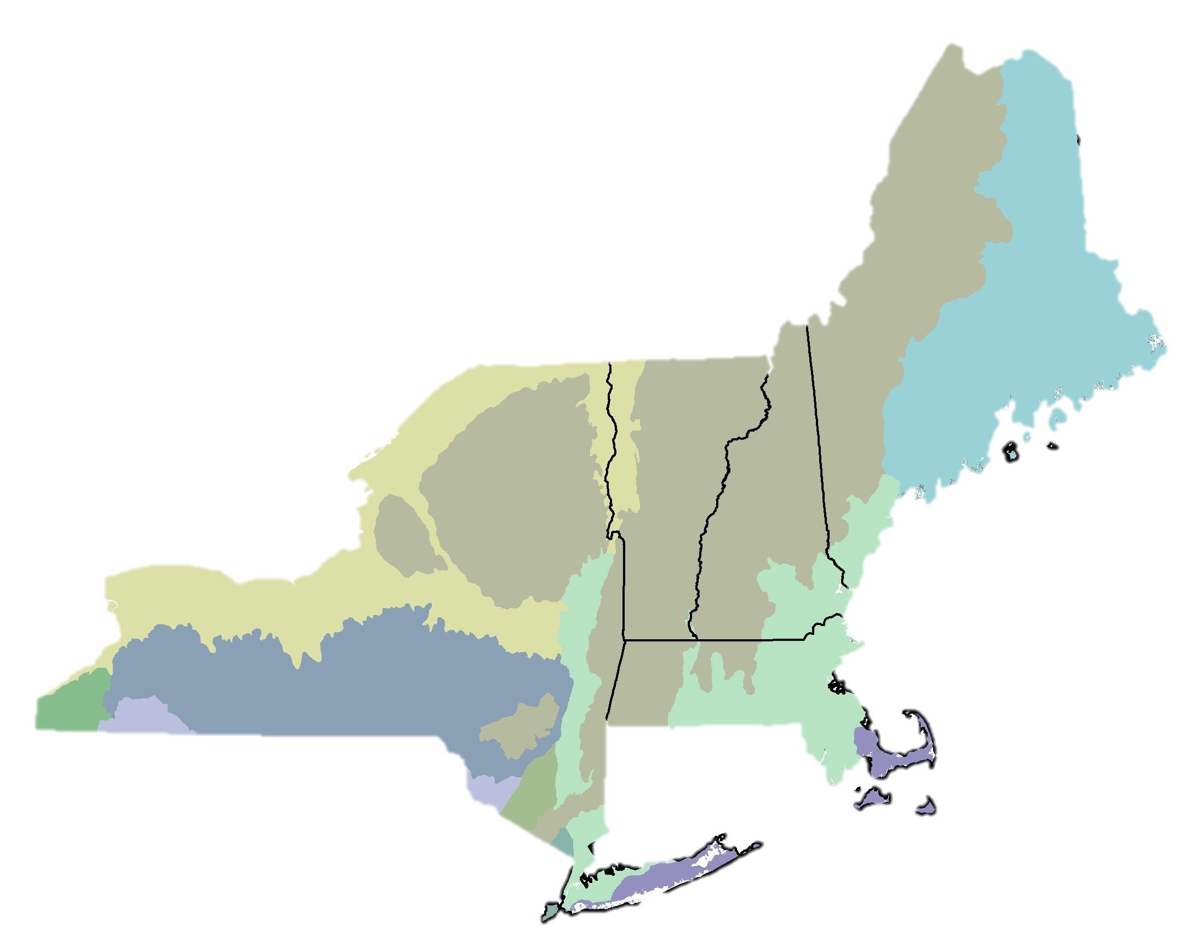
The Northern Forest Region
28 million hectares
~68% forested
Heterogeneous forest

Slide 3
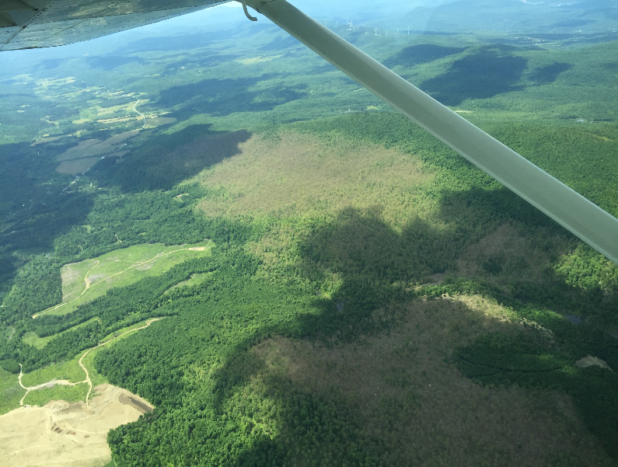
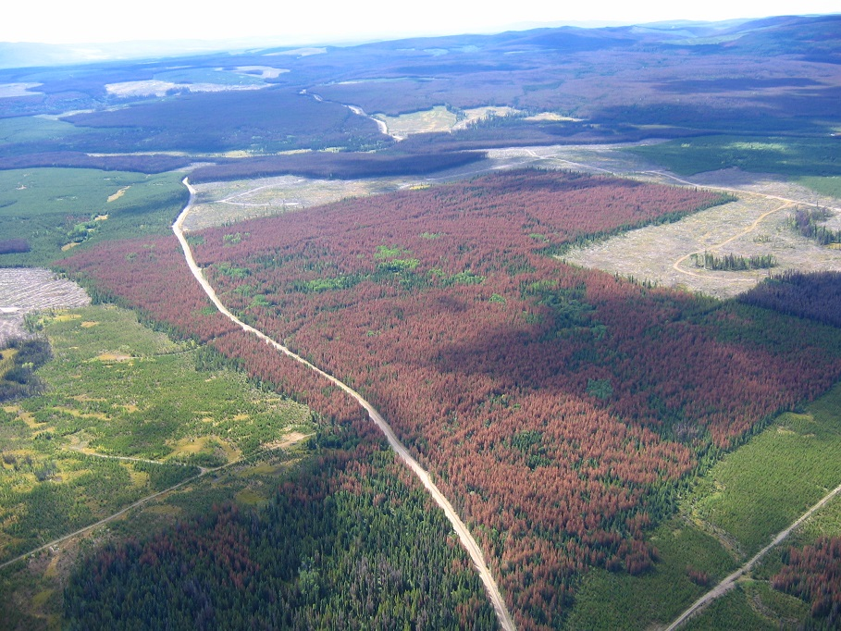
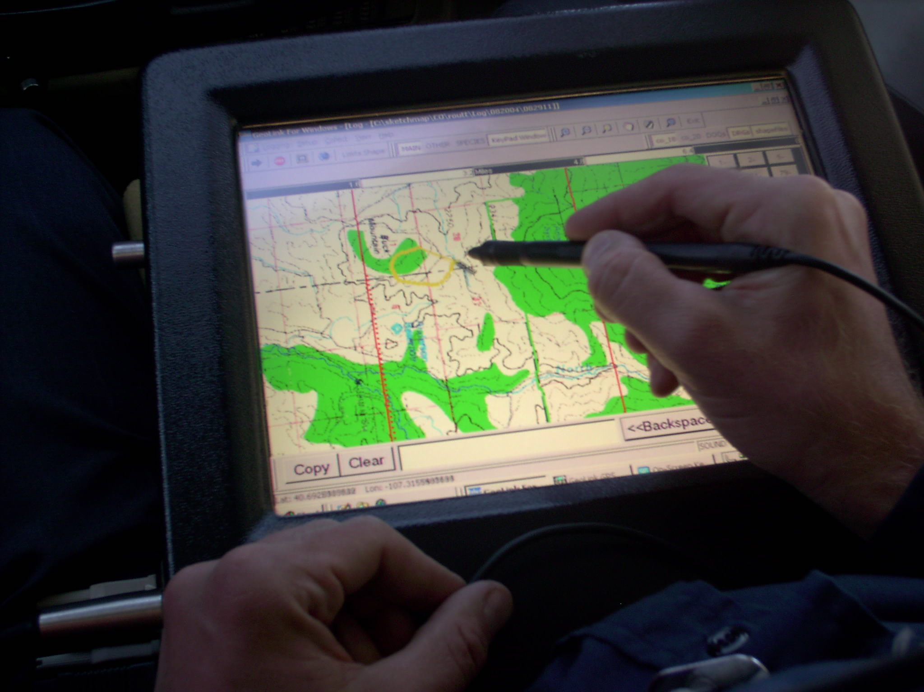
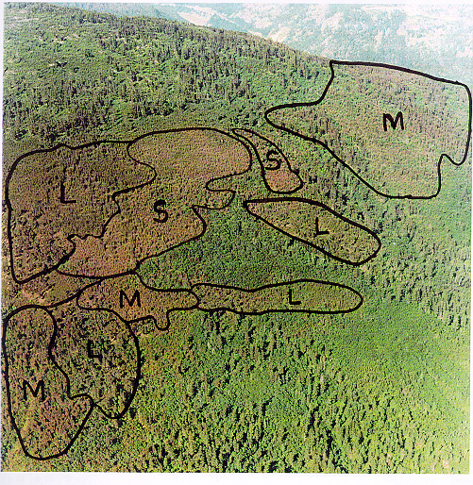
Aerial Detection Survey Data
Methods and standards set by US Forest Service Forest Health Monitoring Program
Annually, crews map the cause, extent, severity, type of forest damage
Conducted for 50+ years
Typically used at the state level on annual basis
Photo courtesy of FEMC
Photo courtesy of Forest Invasives
Photo courtesy of the USDA Forest Service
Photo courtesy of Providnece of Brittish Colmbia

Slide 4
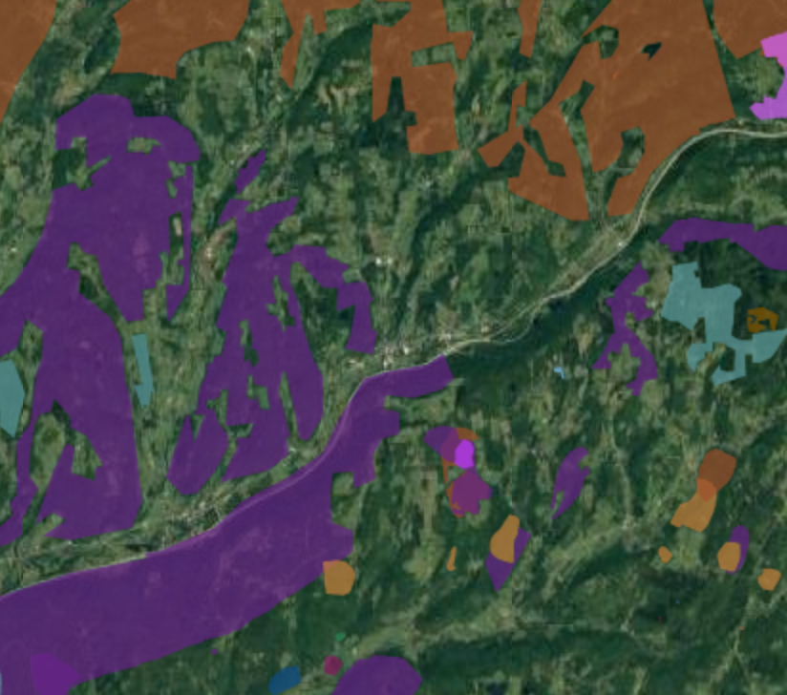
Limitations to ADS data
Data is acquired at speeds of >100 mph
Subject to variations due to weather, observers, tree phenology, time of year, and program priorities
Can not capture small scale disturbance or subtle decline
States were not always flown in entirety
Not possible to “ground-truth” all locations
Yet, contains a great deal of useful information on the nature and extent of forest disturbances in the region

Slide 5
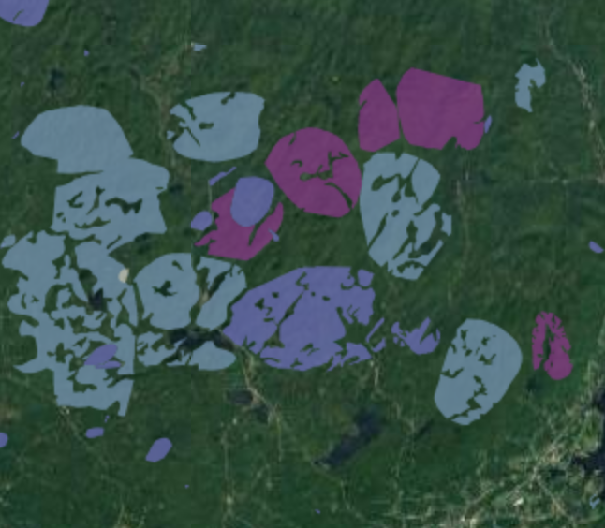
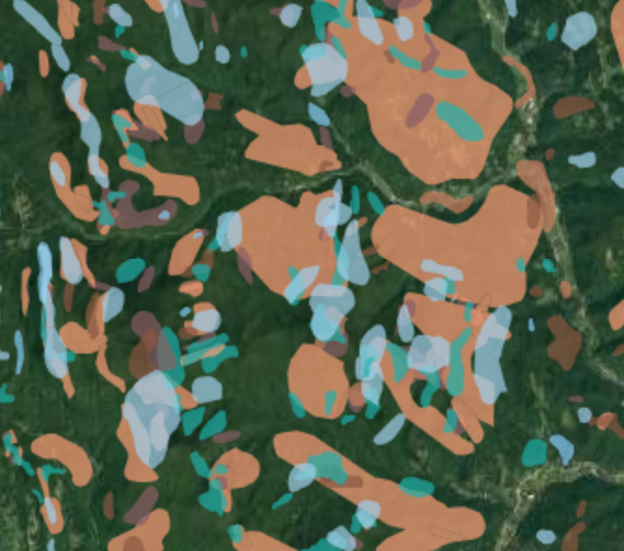
Our Analysis
Limited to 1995-2015 due to inconsistencies in earlier data
QA/QC
Unified dataset for region
Created online disturbance mapping portal
  Northeastern Forest Health Atlas (NEFHA)
Adding newly acquired data, and historical data

Slide 6
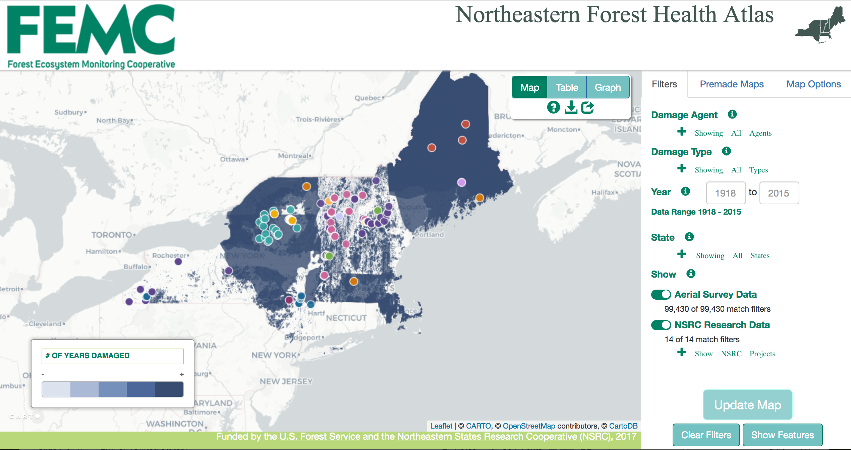
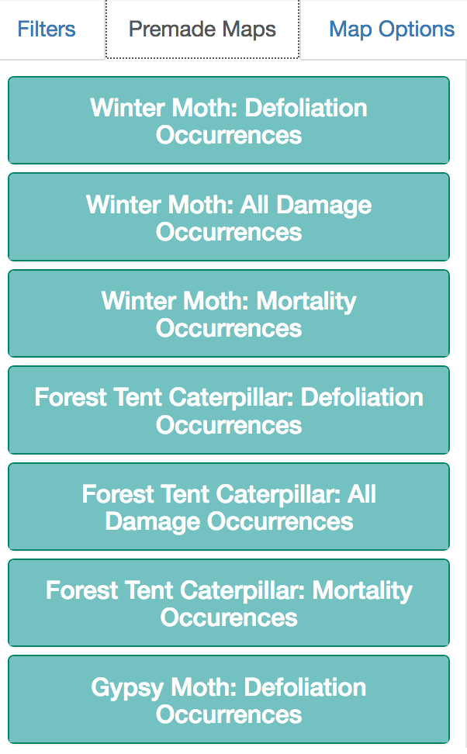
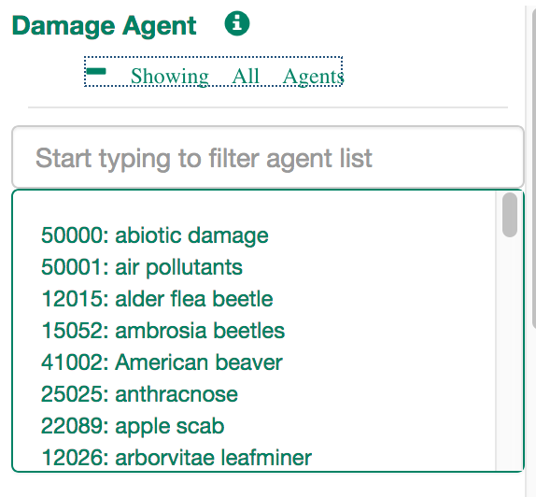
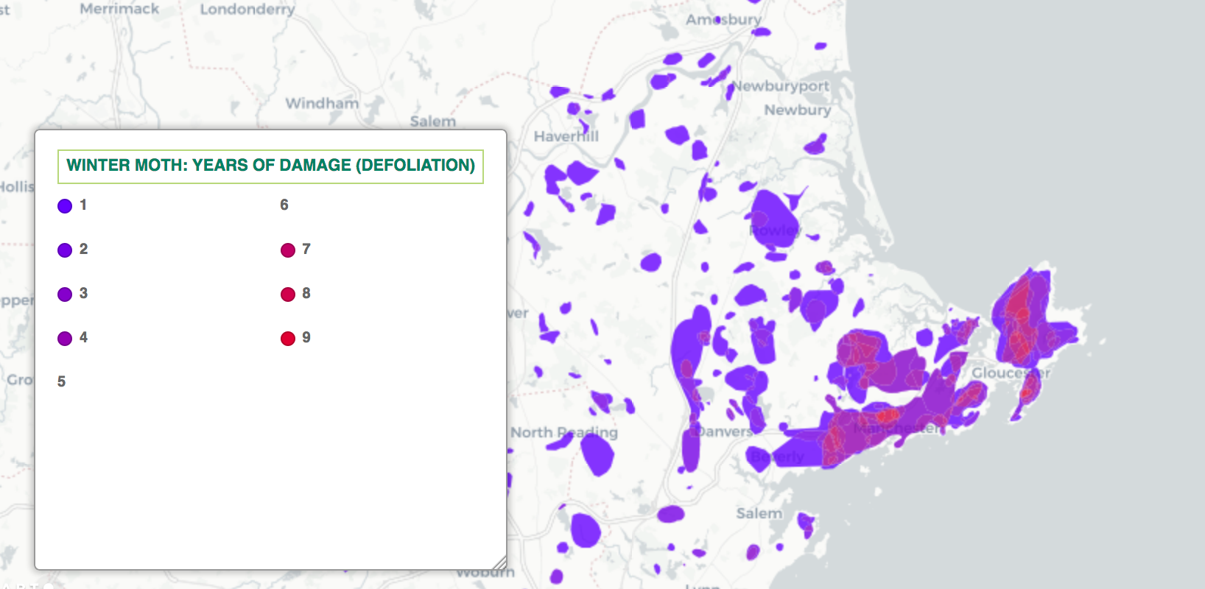
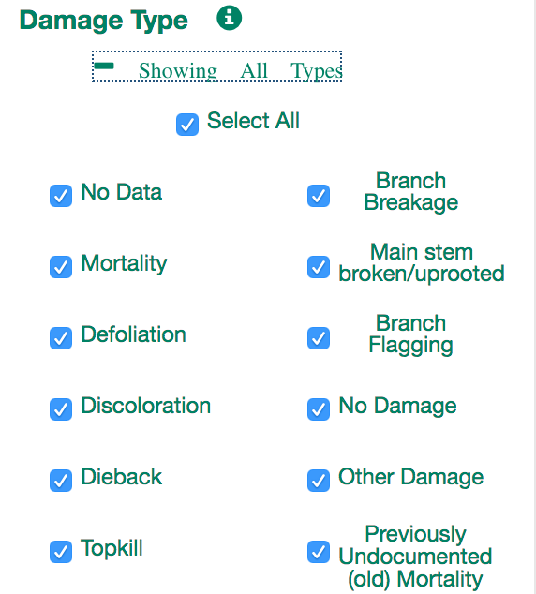

Slide 7
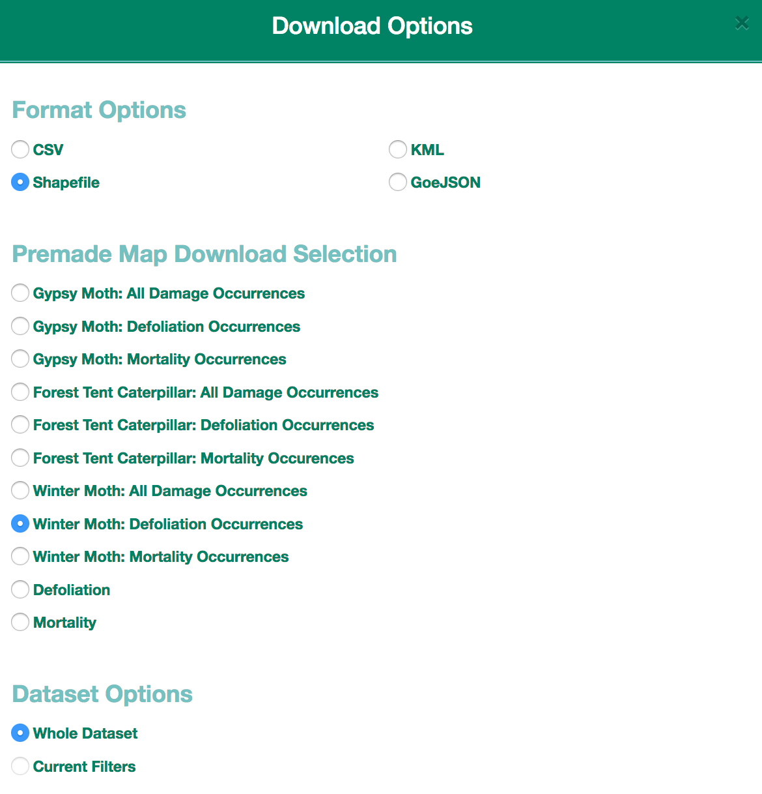
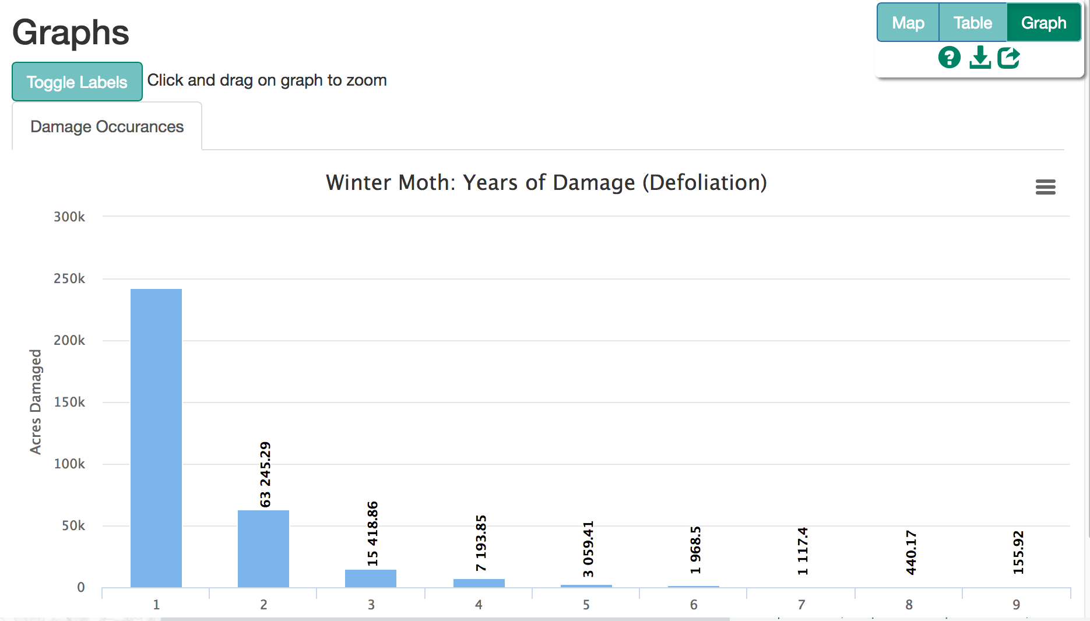

Slide 8
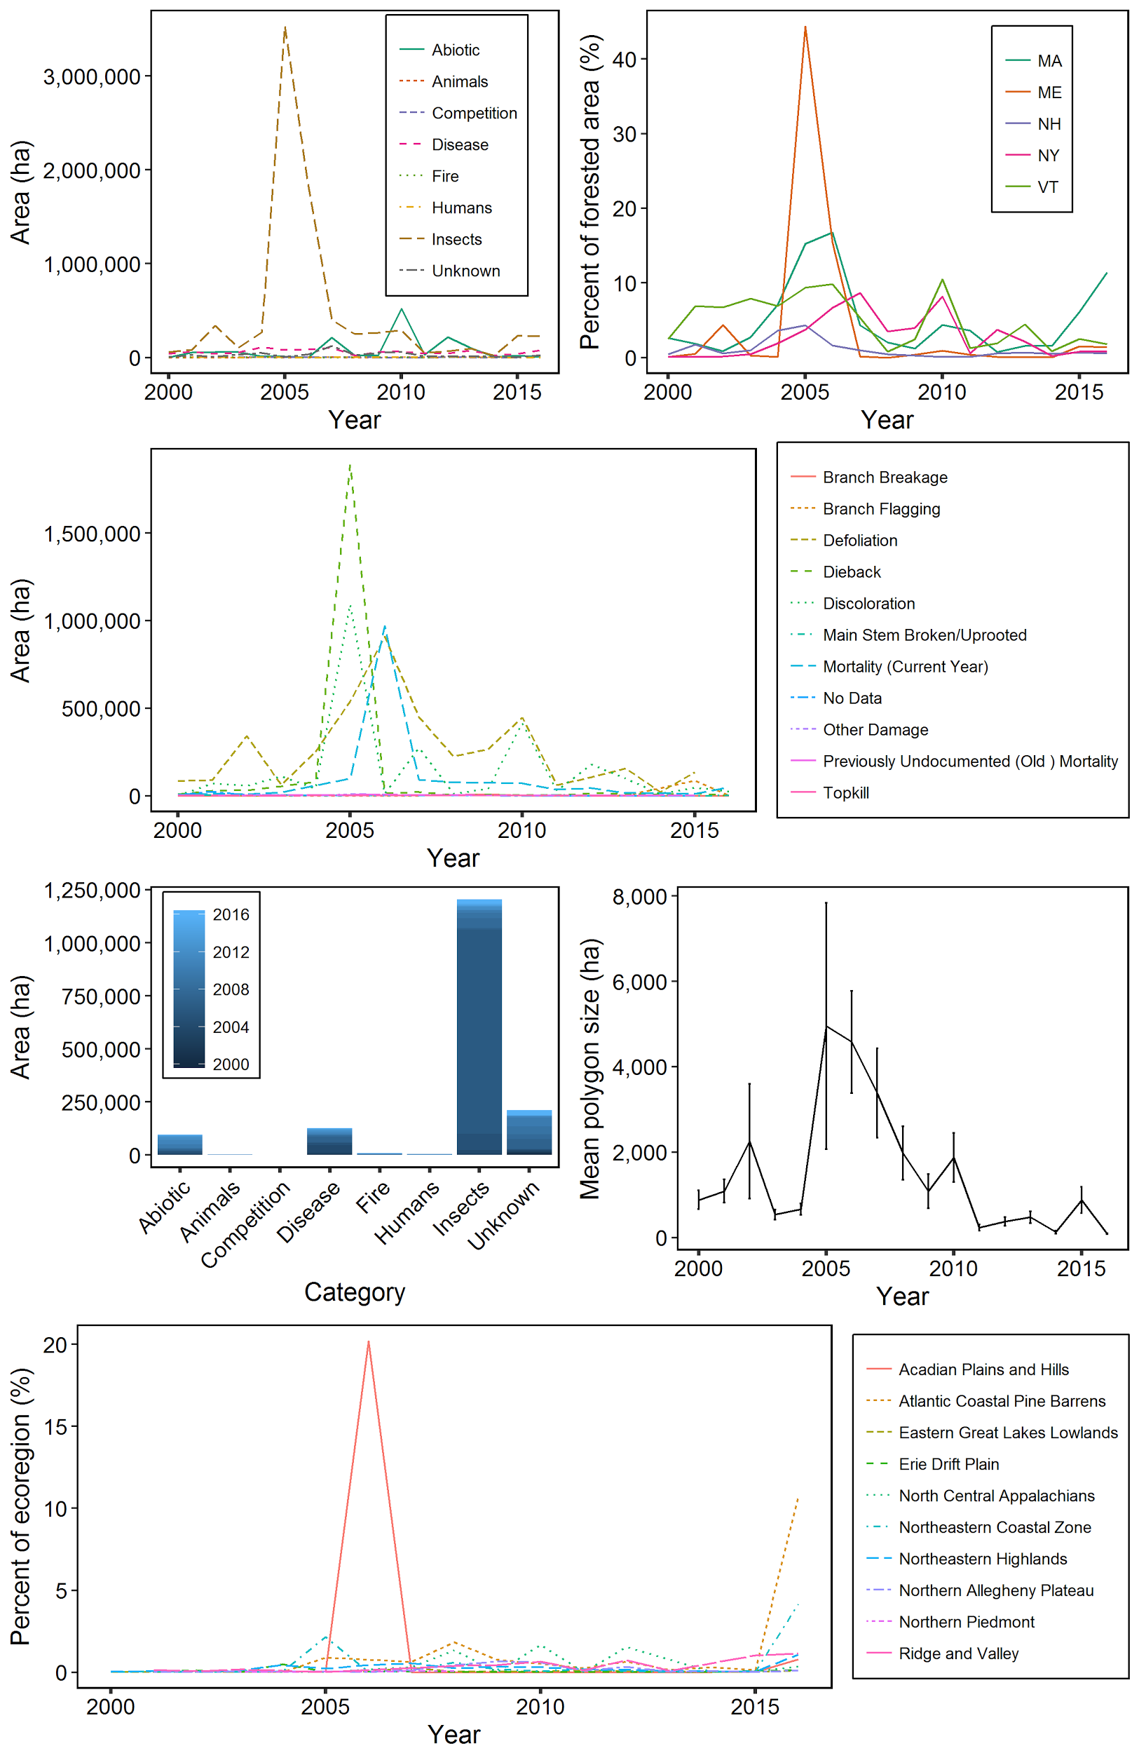
Insect outbreaks dominate
2005-2007 peaks
balsam woolly adelgid, forest tent caterpillar, skeletonizer, gypsy moth, winter moth
By Disturbance Agent Category
By State
Notes:
Between 2000 and 2016, forest disturbances have been mapped every year and in all 10 ecoregions of northern New England and New York. While most disturbance agents were recorded only a few times in the 17-year record, there were notable exceptions that caused damage nearly every year
Insect disturbances were the most common and widespread.
Annually, they affected approximately 3.4% of the region’s forestland.

Slide 9
By Disturbance Type

Slide 10
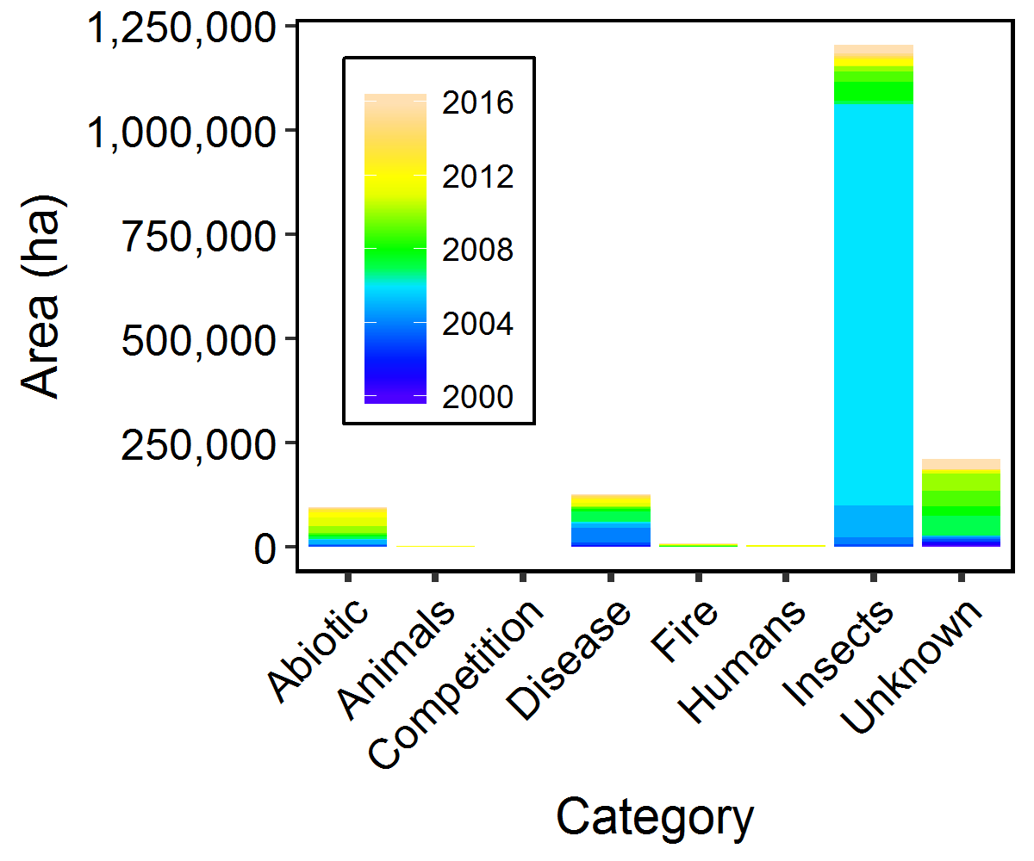
Insects are the primary caused for mapped mortality
Mortality (Current Year) Area By Disturbance Agent Category

Slide 11
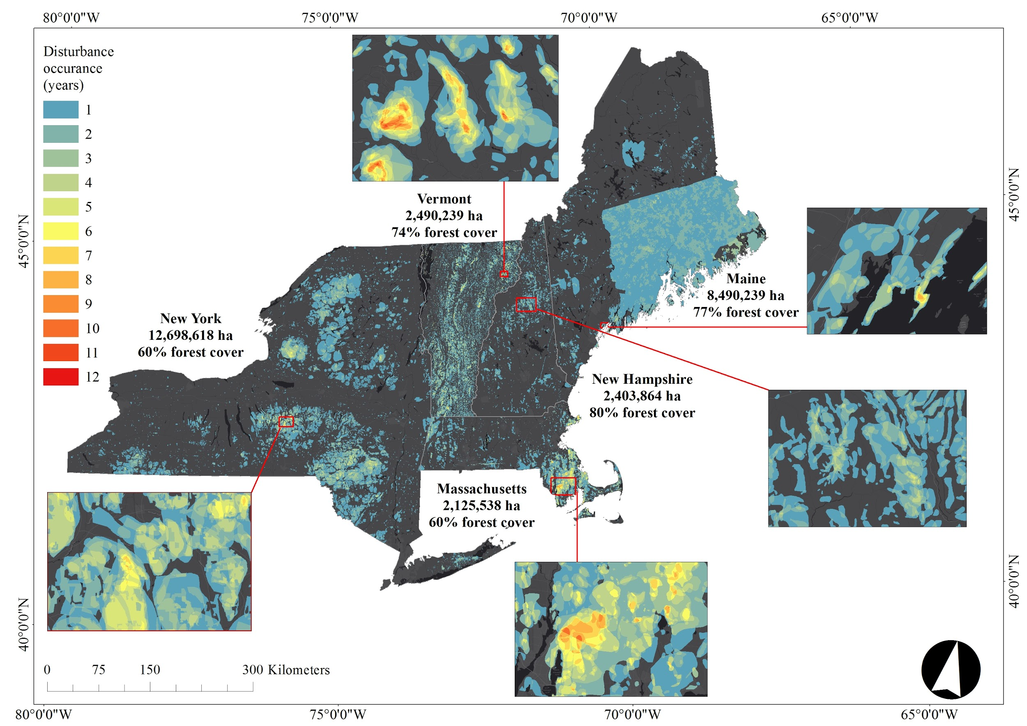
Hotspots of Disturbance
~ 10% of the forests in the region have experienced one or more disturbance events in the 17-year ADS record
~3% have experienced multiple disturbances (>1 occurrence)
Notes:
Approximately 10% of the forests in the region have experienced one or more disturbance events in the 17-year ADS record. Yet, 3% have experienced multiple disturbances (>1 occurrence; Fig. 8) during this same period. While some forest disturbances allow for recruitment of early successional species, can increase beta diversity, and facilitate nutrient cycling from flora to soils (McCarthy et al., 2006), multiple disturbances to the same forest stand can limit carbon sequestration and the provision of ecosystem services, such as timber and non-timber forest products (e.g., maple syrup), depending on the timing between and synergies among disturbances (Reyes and Kneeshaw, 2008; Meigs et al., 2016). On the other hand, compounded disturbances and interactive effects can create multiple pathways of potential forest development (Mladenoff and Pastor, 1993; McLachlan et al., 2000; Meigs et al., 2017). While we did not detect temporal trends in the amount of disturbance since 2000, many episodic, stochastic disturbances, like wind, fire, and ice storms, have return intervals longer than the current record. As a result, the period of record used here is too short to capture the full array of disturbance trends and episodes.

Slide 12
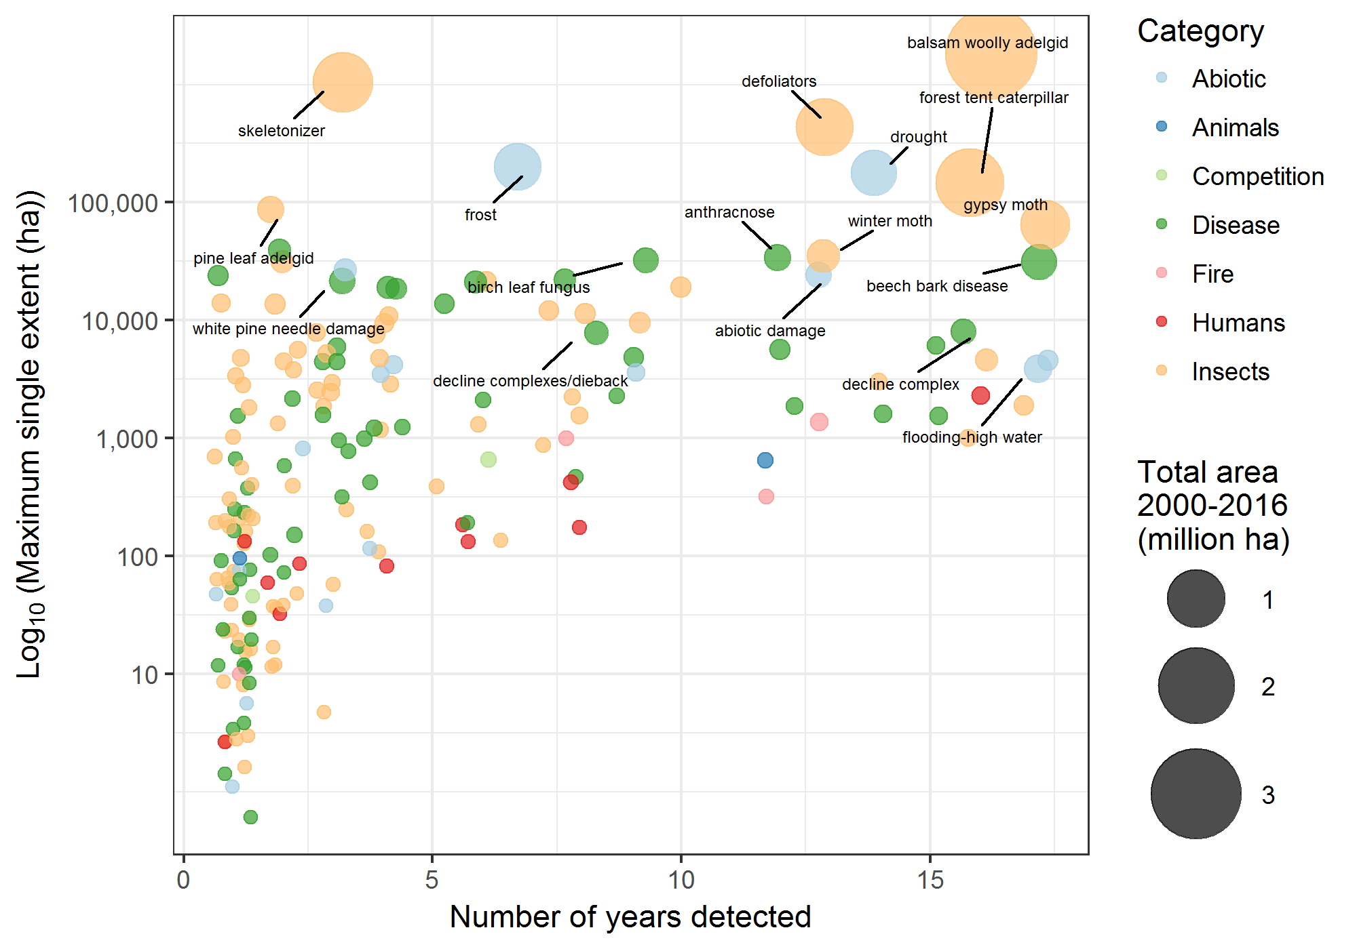
CHRONIC
EPISODIC
MINOR
Notes:
Although insects have caused the most disturbance, both in total area affected and by the size of individual disturbance polygons, most insects have caused only minor damage and do not typically result in tree mortality. However, there are several insects that have caused considerable damage to the region’s forests, leading to elevated defoliation and mortality during severe outbreaks, such as forest tent caterpillar, balsam woolly adelgid, and gypsy moth – the former, native to the region, the latter two, introduced. In some locations, more than one of these insects have been present concurrently.
While most abiotic disturbances are minor or episodic, drought has been a persistent agent affecting the region’s forests. Although drought has been associated with low mortality, it has occurred nearly every year in the record. Climate projections for the northeastern US include increased precipitation, but these changes may not be uniform throughout the seasons. In summer, this region may see no change, a slight increase, or a decline, in rainfall. When coupled with elevated air temperature, some locations may experience increased frequency and/or intensity of summer drought – which can in turn increase the susceptibility of insect damage. Alternatively, increasing summer moisture may increase forest susceptibility to pathogens.

Slide 13
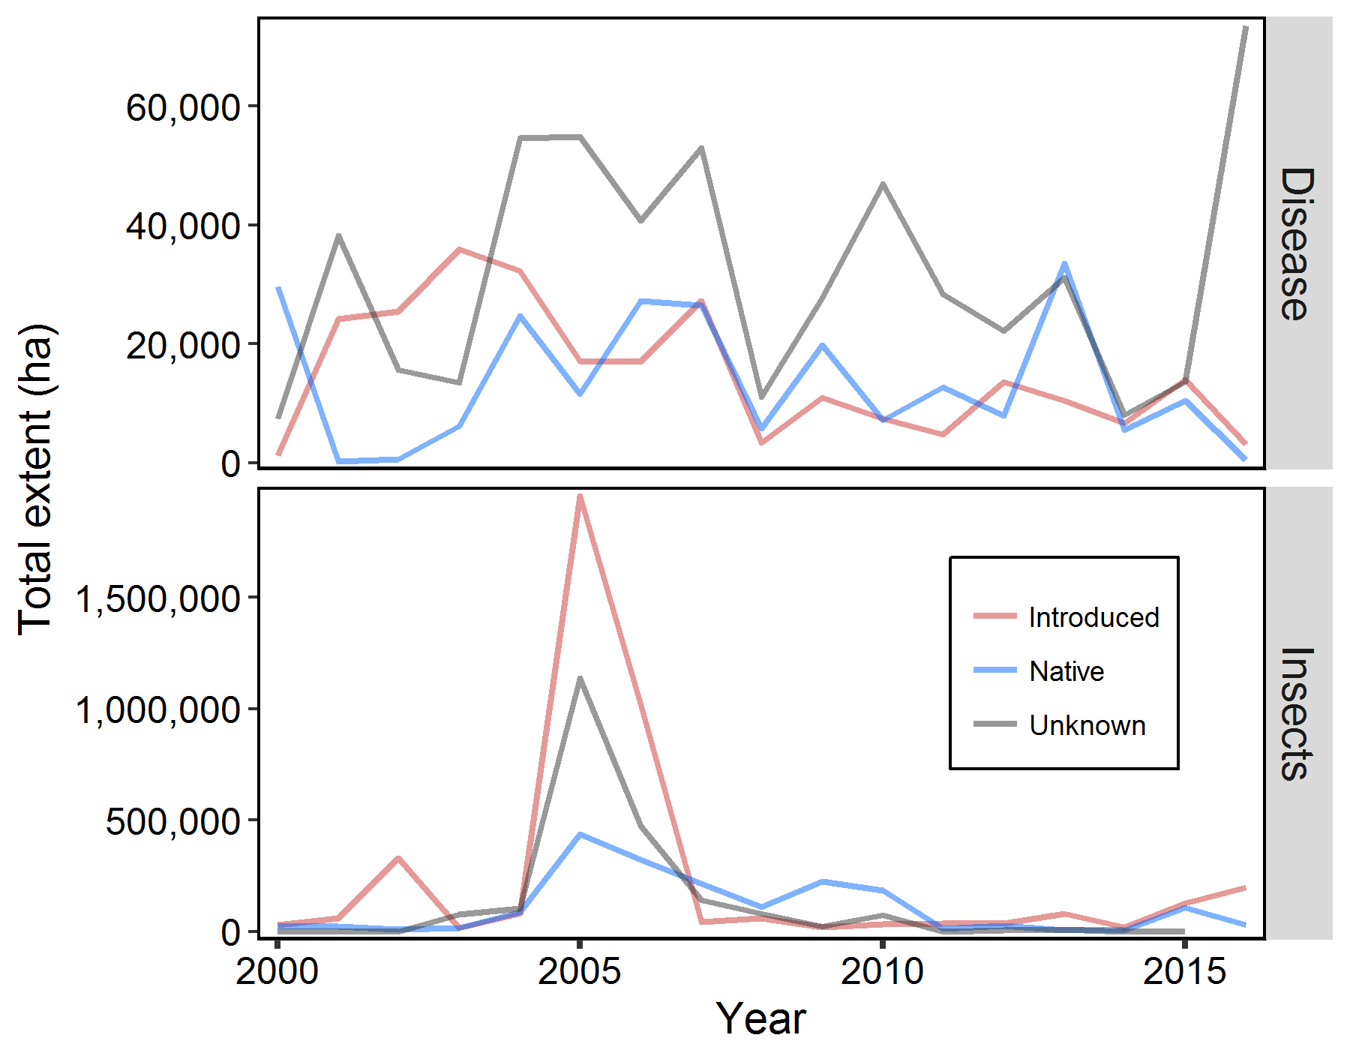
No detectable pattern in disturbance by introduced vs. native species
Introduced pathogens (n=9)
Native pathogens (n=29)
Pathogens of unknown origin (n=22)
Introduced insects (n=19)
Native insects (n=53)
Insects of unknown origin (n=16)
Notes:
The relative extent affected by introduced insects and diseases compared to native pests and pathogens is cause for concern. ADS data suggest that introduced pests and pathogens, while outnumbered by native species, have caused a larger amount of forest disturbance than those of native origin. One limitation of this analysis, however, is that the species or origin of many pests and pathogens remain unresolved (see Table S2), particularly as new agents are introduced to the region.

Slide 14
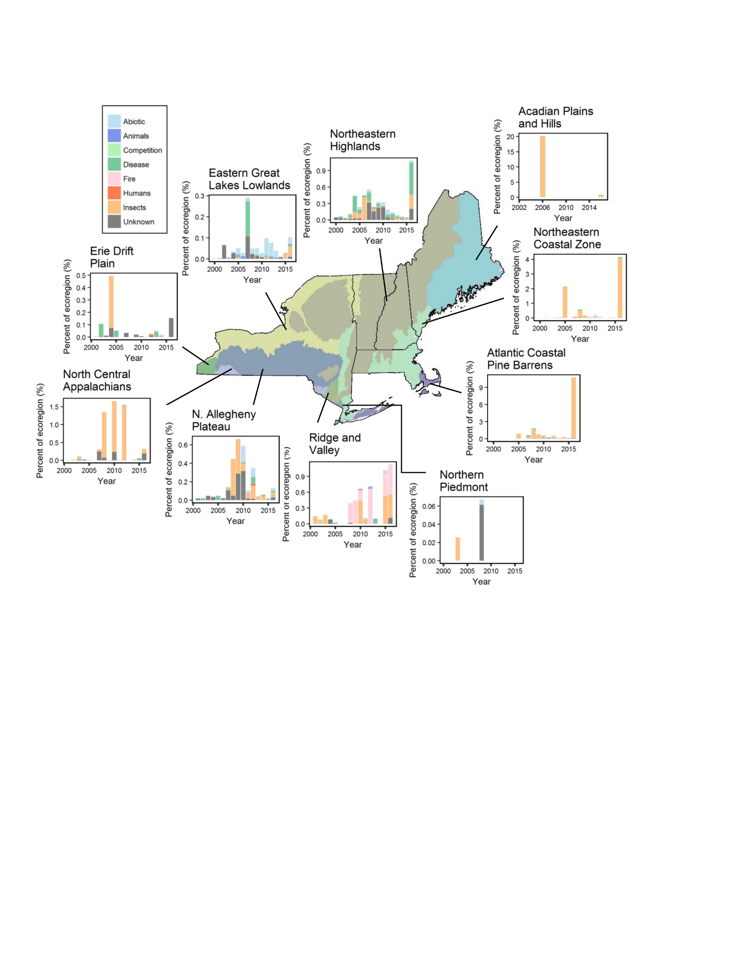
The ecoregions with the highest proportion of forest disturbance were also those most impacted by non-native insect outbreaks
BWA
Winter and gypsy moths
Notes:
The ecoregions with the highest proportion of forest disturbance were those most impacted by non-native insect outbreaks. This may be due to the presence of suitable host species for these pests at these locations or the proximity to initial introductions.
While balsam woolly adelgid was likely introduced in the early 1900s to southeastern Canada, according to the ADS data spanning 2000-2016, it had a more severe effect on coastal balsam fir forests in ME than other locations, perhaps due to the high percentage of fir located there. The Atlantic Coastal Pine Barren ecoregion, the location of the MA hotspot, experienced multiple disturbance events in the 17-year record. While recent outbreaks of gypsy moth and winter moth have caused widespread damage, there is some indication that a suite of variables may predispose this location to damage, particularly the high concentration of masting oaks (Quercus spp.) prior to the outbreak.

Slide 15
Key Findings
Regional annual rate of forest disturbance (± SE) was 647,425 ± 215,482 ha
  3.4% ± 1.3% of the forestland year⁻¹
  No significant temporal trends
~10% of the region’s forest had 1+ event over the 17-yr period
  ~3% of the region experienced 2+ events
Insects were the most widespread disturbance agent
  Non-native insects accounted >50% of total insect damage
“Hotspots” and the ecoregions with the most disturbance were concentrated in areas with non-native insects

Slide 16



We appreciate the support from:
Forest health staff from Massachusetts Department of Conservation and Recreation, Maine Forest Service, New Hampshire Division of Forest and Lands, New York State Division of Lands and Forests, and Vermont Department of Forest, Parks, and Recreation.
USDA Forest Service Northeastern Area State and Private Forestry Forest Health team
Forest Ecosystem Management Cooperative (FEMC)
USDA Forest Service’s Northeastern States Research Cooperative (NSRC)

Slide 17
Questions?

