Slide 1
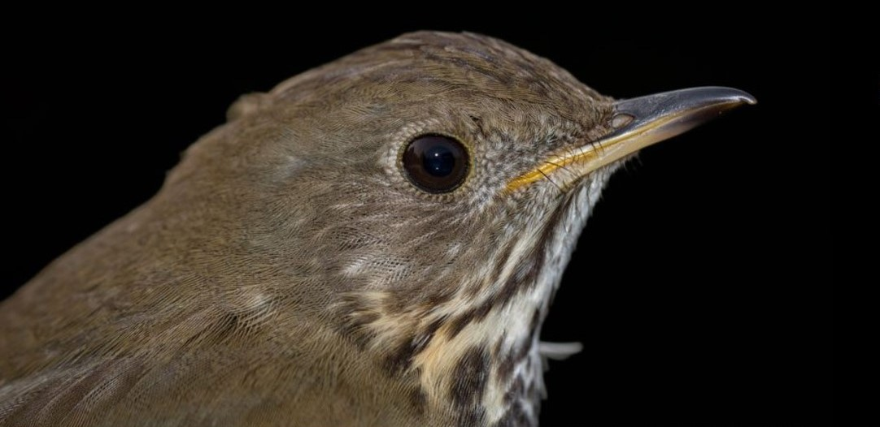
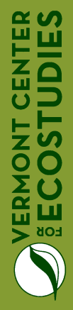
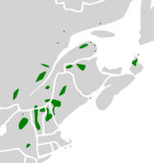
From Vermont to the Dominican Republic:
factors driving variation in apparent survival of Bicknell's Thrush
on the breeding and wintering grounds
Jason Hill, John Lloyd, Kent McFarland, Chris Rimmer
© Kent McFarland
COSEWIC 2009
Notes:
Bicknell’s Thrush, is one of the most range-restricted bird species in North America, and one of the Nearactic-Neotropical migrants at greatest risk for extinction, breeding only in spruce-fir montane forests of the Northeast US and Southeast Canada, and overwintering mainly on the island of Hispaniola.
In parts of their breeding range (shown in green) Bicknell’s Thrush populations have likely declined over the last 30 years, and these declines have produced local extinctions and consequent range contractions.

Slide 2
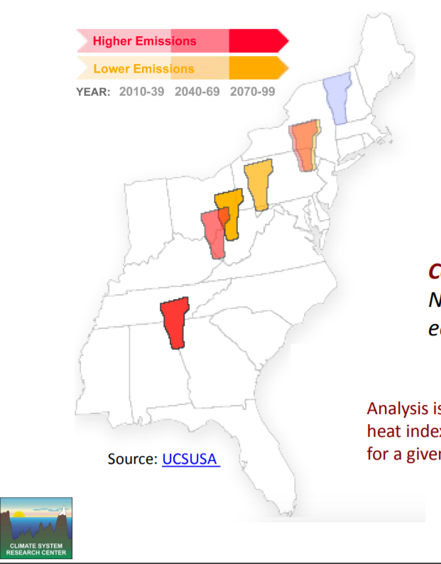
Challenges from a changing climate
Notes:
The climate is already changing in the mountains of the Northeast, and will continue to change no matter what we do at this point. It’s possible that summer in Vermont, by the end of this century, could feel like a present-day typical summer in Tennessee or Alabama.

Slide 3
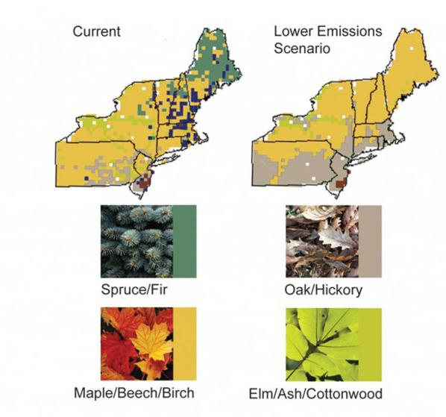
Challenges from a changing climate
Iverson et al. 2008
Wang et al. 2016
Notes:
And of course these climatic changes will likely have profound effects on our flora and fauna. Via climate change over the next 300 years, we expect >50% of the Northeast spruce-fir community (shown in green) to be replaced by the upslope movement of maple-beech forests (shown in brown). It is most probable, that we will see a corresponding long-term negative change in the Bicknell’s Thrush population in the U.S.

Slide 4
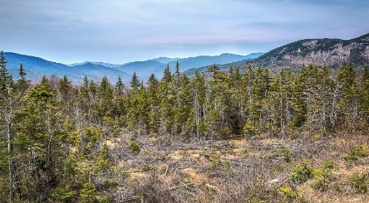
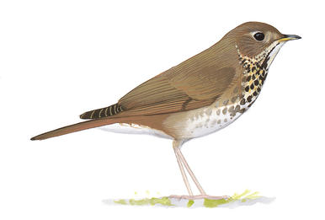
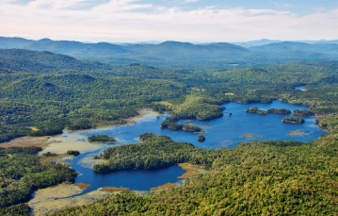
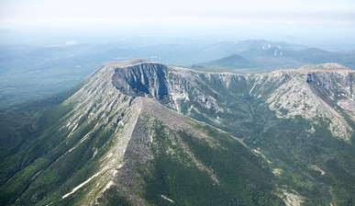
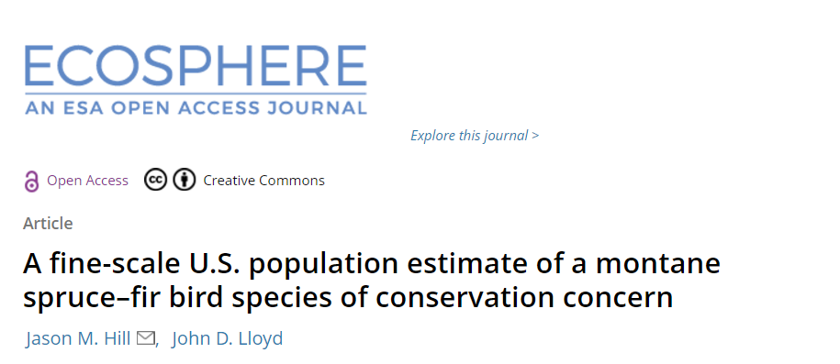
2016 U.S. Bicknell’s Thrush
population estimate
71,318 (95% CRI: 56,080 – 89,748)
Katahdin, Maine
White Mountain NF, NH
High Peaks, NY
Baxter State Park, ME
© David Sibley
Harboring 53% of U.S. BITH population
Notes:
However, BITH already face substantial challenges. In a recent Ecosphere paper, we estimated that there are only ~70,000 BITH in the U.S., less than 120,000 globally, and that ~53% of the entire US population resides on just three public lands (Baxter SP, White Mountains NF, and the High Peaks Wilderness in NY).

Slide 5
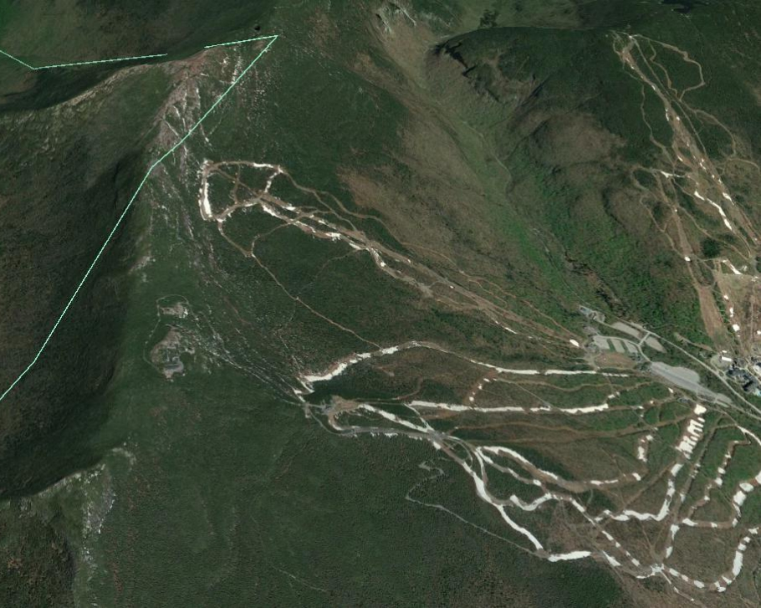
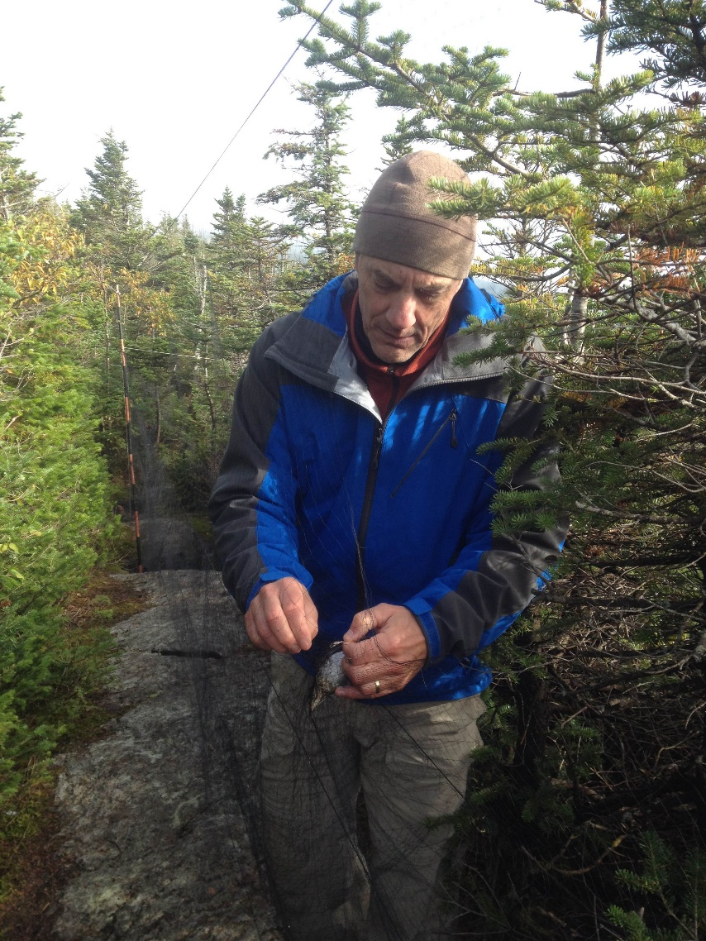
Apparent survival & data collection
Banding area,
Mt. Mansfield, VT
Notes:
Given the status of BITH populations now, and the expected climate-associated changes to the spruce-fir community, it is critical that we establish baseline estimates of demographic rates for BITH so we can quantify demographic changes in the future. To do so, we used CJS models to estimate apparent survivorship from our long-term banding data on Mt. Mansfield. We analyzed mark-recapture data collected during May-July of 2001-2015 for 178 adult BITH. We compared models in an information theoretical framework. Remember, that in CJS models, apparent survivorship is a combination of true survivorship and movement out of the study area—we cannot easily separate the two components.

Slide 6
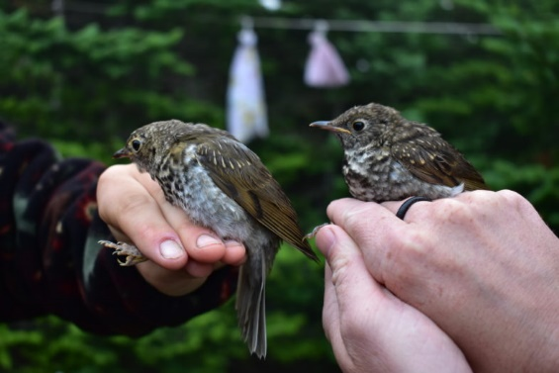
Apparent survival hypotheses
Swainson’s Thrush relative abundance
  Sensu Freeman and Montgomery (2015)
Mt. Mansfield banding data
Bicknell’s
Thrush
Swainson’s
Thrush
Notes:
So let’s run through our various hypotheses, and I should mention that all of these hypotheses were tested with year-specific covariate data. So there’s some research to suggest that the slightly larger and more aggressive SWTH may displace BITH from breeding areas (resulting in lower apparent survivorship), and we have seen a steady increase in SWTH atop Mt. Mansfield over the last two decades, so we should see a corresponding decline in BITH apparent survivorship with time if SWTH displace BITH. As a covariate, we used the # of uniquely captured SWTH in our banding area each summer.

Slide 7
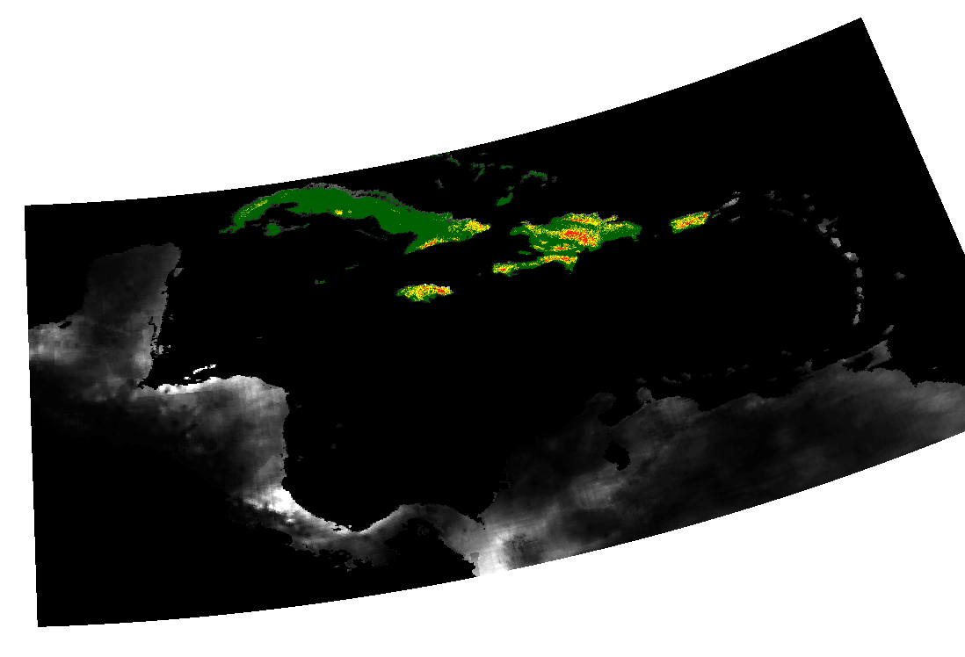
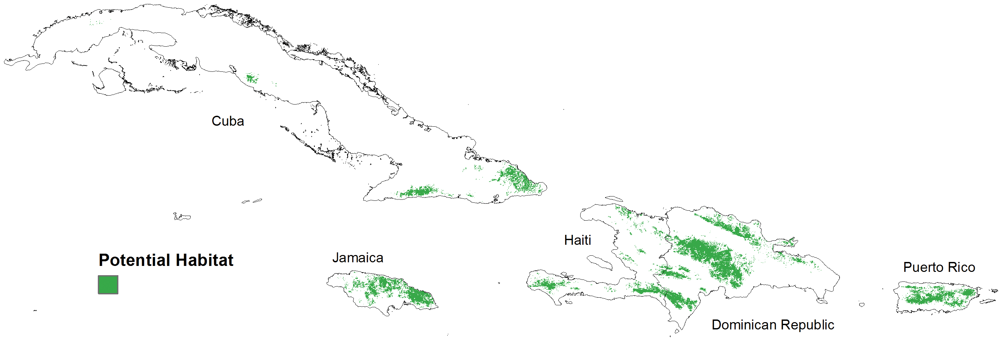
Apparent survival hypotheses
Swainson’s Thrush relative abundance
Drought stress on nonbreeding grounds
  Rainfall (CHIRPS) [September-March]
McFarland et al. 2013
CHIPRS rainfall data
Notes:
The next three covariates all have to do with moisture and weather on the wintering grounds, and we predicted that BITH survivorship would increase in wet years. Winter rainfall is correlated with overwinter survival in some Nearctic-Neotropical migrants that winter in the Greater Antilles, presumably via effects of moisture on insect populations, and we predicted the same pattern for BITH. McFarland et al. developed a model that predicted the nonbreeding range of BITH (which you see here in green), and they predicted that most BITH overwinter in the Dominican Republic. Therefore, we quantified the annual rainfall just within the green nonbreeding range on Hispaniola. CHIRPS is a fine-scale satellite-derived estimate of daily rainfall across the world.

Slide 8
Apparent survival hypotheses
Swainson’s Thrush relative abundance
Drought stress on nonbreeding grounds
  Rainfall (CHIRPS)
  Southern Oscillation Index (SOI) [September-March, Hispaniola]
Notes:
We also examined the El Niño Southern Oscillation (ENSO), which is a key driver of winter rainfall and weather patterns in the Caribbean, and the SOI is a measure of El Niño intensity which has been linked to survival in migrant warbler populations, particularly in Jamaica.

Slide 9
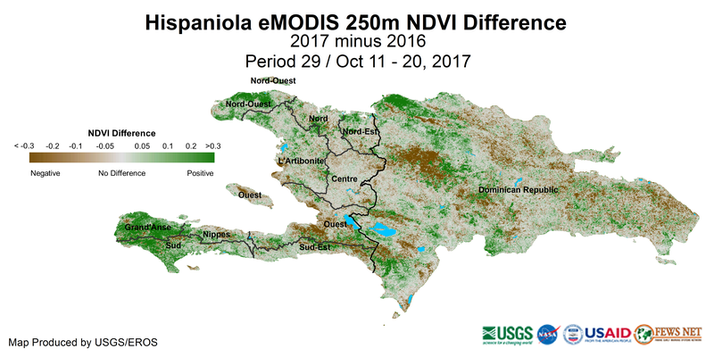
Apparent survival hypotheses
Swainson’s Thrush relative abundance
Drought stress on nonbreeding grounds
  Rainfall (CHIRPS)
  Southern Oscillation Index (SOI)
  Normalized Difference Vegetation Index (NDVI) [December-March]
McFarland et al. 2013
Notes:
Finally, the NDVI is a remotely sensed measure of the greenness of Earth’s landscape, and can be used to quantify temporal and spatial variation in drought stress independently of El Nino events. A low NDVI in wintering areas indicates a relatively “brown” or “dry” landscape that year. And again, we were able to measure NDVI just within the winter BITH range.

Slide 10
Apparent survival hypotheses
Swainson’s Thrush relative abundance
Drought stress on nonbreeding grounds
  Rainfall (CHIRPS)
  Southern Oscillation Index (SOI)
  Normalized Difference Vegetation Index (NDVI)
Deforestation on Hispaniola [January-December]
  -Global Forest Cover, Hansen et al. (2013) dataset
Notes:
Logically, we predicted that remotely-sensed deforestation amounts on Hispaniola would be negatively related to BITH apparent survivorship. However, these global data are aggregated in such a way, that we can’t just measure deforestation within BITH habitat.

Slide 11
Apparent survival hypotheses
Swainson’s Thrush relative abundance
Drought stress on nonbreeding grounds
  Rainfall (CHIRPS)
  Southern Oscillation Index (SOI)
  Normalized Difference Vegetation Index (NDVI)
Deforestation on Hispaniola
Mast status [year before recapture]
Notes:
Now in some years, Balsam Fir produce enormous amounts of cones or mast, and in response, Red Squirrels move upslope into Bicknell’s habitat and substantially increase the rates of predation on Bicknell’s nests the following year, which could conceivably lead to territory abandonment. Therefore, we predicted a reduction in apparent survival following mast years via this trophic cascade.

Slide 12
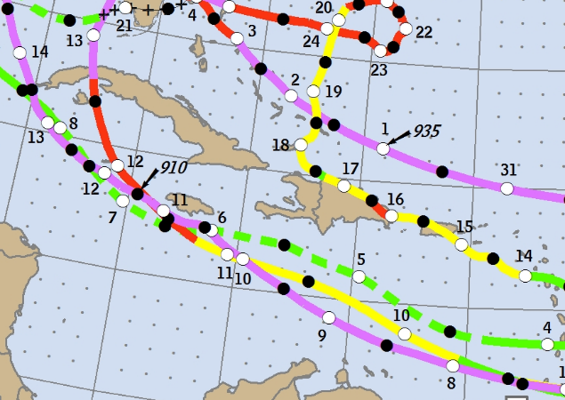
Apparent survival hypotheses
Swainson’s Thrush relative abundance
Drought stress on nonbreeding grounds
  Rainfall (CHIRPS)
  Southern Oscillation Index (SOI)
  Normalized Difference Vegetation Index (NDVI)
Deforestation on Hispaniola
Mast status
Tropical storm frequency
  [October-December]
Notes:
A number of researchers have proposed that severe Caribbean weather is a significant source of indirect and direct mortality for migrants. Although we lack a way to directly measure amount of storm-caused habitat damage in Bicknell’s wintering habitat, we used data from NOAA to determine the number of tropical storms and hurricanes that passed within 250 km of the center of Hispaniola, as a proxy of winter habitat destruction.
We predicted that Bicknell’s Thrush apparent survival would be negatively affected by tropical storm frequency from October through December when the birds are migrating to and arriving in the Caribbean.

Slide 13
Apparent survival hypotheses
Swainson’s Thrush relative abundance
Drought stress on nonbreeding grounds
  Rainfall (CHIRPS)
  Southern Oscillation Index (SOI)
  Normalized Difference Vegetation Index (NDVI)
Deforestation on Hispaniola
Mast status
Tropical storm frequency
Age & sex
Notes:
And lastly we examined age and sex differences in survival, as many researchers have documented higher survival for OLDER BIRDS & MALES.

Slide 14
Increasing recapture probability
Notes:
Recapture probability atop of Mt. Mansfield was high and increased over time. Not surprisingly, recapture probability was linearly and positively related to our banding efforts—SHOCKING. But appropriately modeling recapture probability is a necessary first step to generate quality estimates of apparent survival.

Slide 15
Steady apparent survival
M
M
M
M
M
M
M
Notes:
Survival was relatively stable over 15 years, and rather uncertain within any given year (these are large confidence intervals). Surprisingly, survival was ~12% higher after a mast year compared to a non-mast year, which was not our hypothesis, and quite honestly I’m not sure why this pattern comes through. I suppose that insect populations might increase post-mast years, but I don’t generally think of adult bird populations as being limited by food availability on the breeding grounds.

Slide 16
Higher survival in “brown” (NDVI) & El Niño years (SOI)
BROWN GREEN
Notes:
Completely against our hypos, BITH apparent survival was higher in relatively brown years and in El Nino years, which usually means lower rainfall in the Caribbean. However, in our dataset, there was no correlation between SOI and actual rainfall and only a weak non-significant correlation between NDVI and rainfall. So these indices don’t appear to represent moisture very well, at least not on Hispaniola. And of course these two indices are proxies for dozens of individual weather components beside just rainfall. So it seems likely that the non-moisture components of NDVI and SOI (like temperature) are actually what’s important to BITH on the wintering grounds.

Slide 17
Higher survival in “brown” (NDVI) & El Niño years (SOI)
BROWN GREEN
Notes:
I’m not terribly surprised that are results are at odds with previous bird survival research in the Caribbean. We know that the effects of ENSO vary between Caribbean islands (for example, strong effects in Jamaican forests, weak effects in Cuban forests) and El Nino effects on the same species of bird can even vary between nearby different forest types. And I assume that ENSO effects likely vary between species as well, based on how those species’ food sources respond to El Nino events.
http://www.weather.gov/sju/climo_enso

Slide 18
Apparent survival hypotheses revisited
Swainson’s Thrush relative abundance
Drought stress on nonbreeding grounds
  Normalized Difference Vegetation Index (NDVI)
  Southern Oscillation Index (SOI)
  Rainfall (CHIRPS)
Deforestation on Hispaniola
Mast status
Tropical storm frequency
Age & sex
Notes:
SWTH: maybe SWTH don’t cause BITH territory abandonment or the SWTH density might not be high enough to see an effect yet.
Rainfall: I was surprised that a local direct measure of rainfall wasn’t predictive, especially when two hemispheric-wide indices of weather were predictive of survival. Our rainfall data were just from predicted BITH habitat in Hispaniola, so it’s possible that 1) our winter distribution model for BITH needs tweaking, 2) rainfall isn’t a good predictor in-and-of-itself.
Deforestation covariate wasn’t specific to BITH distribution in Hispaniola, so deforestation may be taking place outside of BITH habitat or deforestation simply isn’t happening at a high enough rate yet to see an effect.

Slide 19
Apparent survival hypotheses revisited
Swainson’s Thrush relative abundance
Drought stress on nonbreeding grounds
  Normalized Difference Vegetation Index (NDVI)
  Southern Oscillation Index (SOI)
  Rainfall (CHIRPS)
Deforestation on Hispaniola
Mast status
Tropical storm frequency
Age & sex
Notes:
Tropical storms: I guess I’m not surprised that Caribbean storm frequency wasn’t predictive. BITH are a species that has obviously evolved to occupy winter habitat that is periodically thrashed by winter storms. On the other hand, our simple count of nearby winter storms may just be do a poor job of predicting habitat destruction caused by winter storms.
And no age and sex differences. I suspect that female BITH have lower survival than males, as many researchers have documented. However, females represented only 30% of our banding dataset and coupled with the overall uncertain estimates of survival, it seems likely that our models simply can’t tease out any sex-specific effect.

Slide 20
Next steps for Bicknell’s Thrush research
Understanding migratory connectivity
Vs.
Notes:
Right now our model essentially assumes that most BITH overwinter in specific areas of Hispaniola, and while that may be true for the global population, it may not be true for our Mt. Mansfield population (remember, our data come from just a single mountain). If Mt. Mansfield BITH predominantly winter in Cuba, for example, then our choice of winter covariates may be spatially mismatched.

Slide 21
Next steps for Bicknell’s Thrush research
Understanding migratory connectivity
Separating survival from emigration on the breeding grounds
Notes:
I’m intimately familiar with open-population models that model survival separately from emigration, but our data (and study design) are not well-suited for those models. What we really need is to directly measure the inter-annual movements of BITH on the breeding grounds to directly incorporate into a state-based model that estimates TRUE survival as a latent variable.

Slide 22
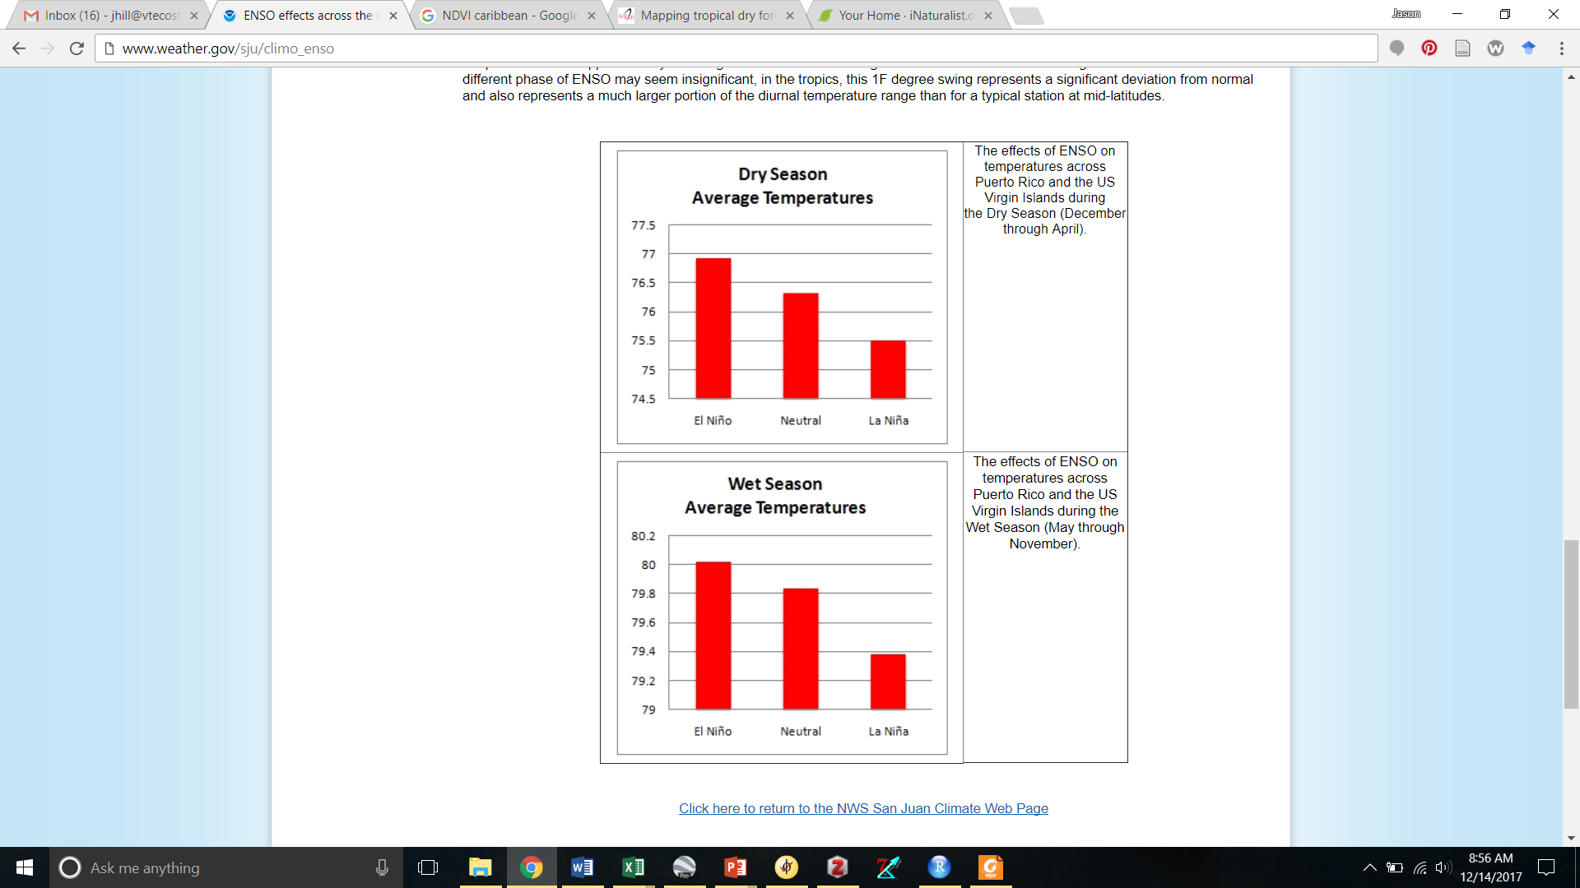
Next steps for Bicknell’s Thrush research
Understanding migratory connectivity
Separating survival from emigration on the breeding grounds
Teasing out non-moisture signals from SOI and NDVI
National Weather Service data
(Puerto Rico + US Virgin Islands)
Notes:
We know that SOI and NDVI are proxies for dozens of weather covariates, like temperature, which can vary predictably with the ENSO cycle. The challenge is finding or creating those covariates from remotely-sensed data. Unlike the US, countries like the DR and Cuba do not have an army of weather stations, let alone, climate data going back 20 years.

Slide 23
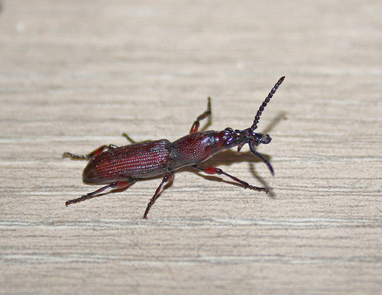
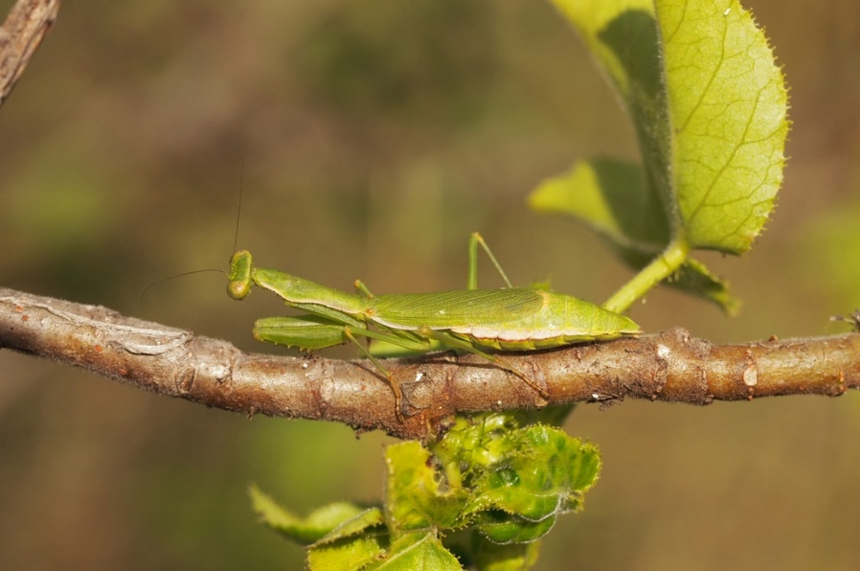
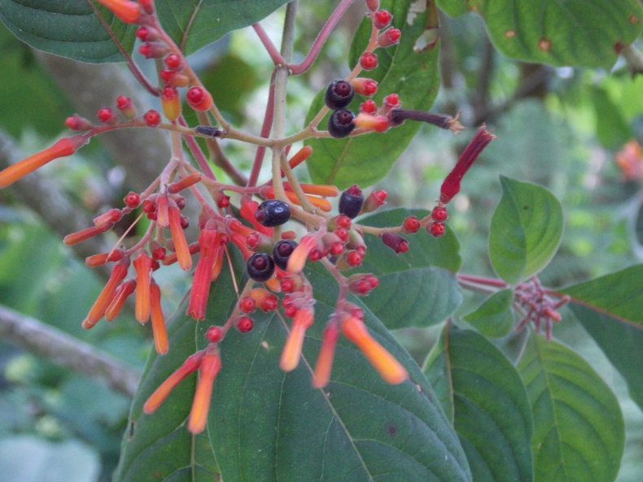
Next steps for Bicknell’s Thrush research
Understanding migratory connectivity
Separating survival from emigration on the breeding grounds
Teasing out non-moisture signals from SOI and NDVI
Direct measurements of food availability and weather on the wintering grounds
Notes:
Right now in our survival analyses, we, the ornithological community, are using hemispheric indices of weather as a proxy for insect abundance. However, like BITH, for most of these NearArctic-Neotropical migrant bird species, we don’t know what fruit and insects they are eating on the winter grounds, let alone, do we understand what factors drive variation in abundance of those prey items from year to year. So to me, the greatest gains into understanding BITH demographics will come from on-the-ground research in the Caribbean.

Slide 24
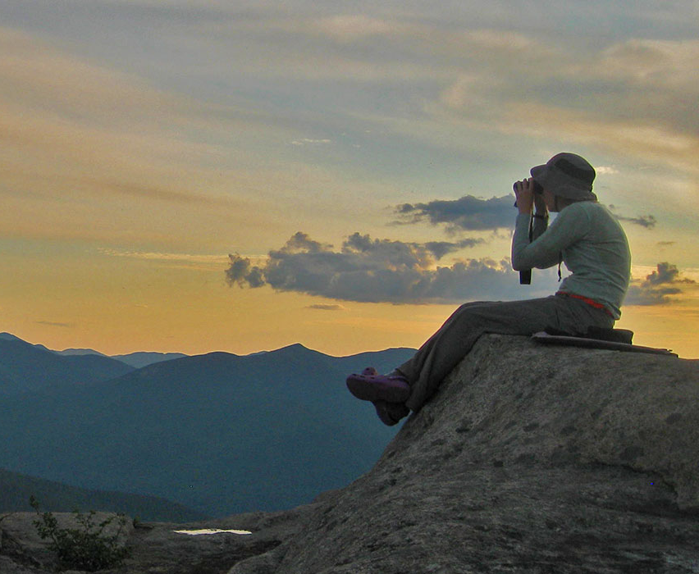

Contact me at jhill@vtecostudies.org
for data, R code, shapefiles & collaboration
Funding generously provided: FEMC and the Mt. Mansfield Company and the generous gifts of private individuals.
Thank you to the ESRI Conservation GIS Program for software and support.
Thank you to the International Bicknell’s Thrush Conservation Group (IBTCG) for prioritizing MBW as a key conservation action.

