Slide 1
Dealing with Nondetects: Using Censored Data Wisely
Rebecca Harvey, PhD
Phillip Jones, Heather Pembrook, Jim Kellogg

Slide 2
Censored Data ≠ Missing Data
LOD
LOD
Measured Value
<
Range of
Detection
<
Measured Value
Pollutant concentrations
< 0.05 ppm
Wind speed measurements
> 100 m/s
Censored data are good, meaningful, valuable, REAL data
If mistreated, they can introduce alien trends and/or misleading summary statistics.
Notes:
In environmental applications, it is not always possible to record the exact values of variables of interested due to limitations in the measuring equipment. For example, in water or air quality monitoring studies, sensors may not be able to detect pollutant concentrations below some threshold value (the limit of detection). On the other end of the scale measuring equipment may fail at particularly high values, like high wind speed measurements during high wind events or stream flows during storm events.
When a measurement falls within the LOD, a numerical value can be assigned to the measurement. But values outside this range are often recorded merely as “less than” or “greater than” the appropriate threshold. Such data values are considered “censored”.
Note that censored data are not the same as missing data. Censored data still carry a great deal of value in our analyses, if handled correctly.
The concept of censored data and the approaches that I’ll describe in the following slides are not new, they’ve been important in the medical field for years, and several techniques for treating them have been developed, vetted and applied in that field. Only recently, however have these approaches begun to cross into our discipline.

Slide 3
Historical Approaches to Using Censored Data
Substitution
Arbitrary multiple of the reporting limit (i.e. ½ the RL)
When < 10% of your data are censored, it can be OK
Can introduce misleading/false summary statistics and alien trends
ANOVA
p-value = 0.749
RL = 5 ppb
Notes:
One common practice with dealing with non detects is to substitute censored data with an arbitrary multiple of the detection limit. For example, half the RL, the RL itself, or 1/the square root of 2 times the RL, sometimes even zero.
When less than 10% of your data set is censored, these substitutions can be OK but this will depend on the specific data set.
As a hypothetical example, let’s consider three ponds in which chloride concentrations have been measured for several years. These ponds may represent different geographical regions, levels of development, you name it. We’re interested in knowing whether or not the chloride concentrations differ between the three ponds. Censored data have been reported at 5 ppb. Performing an analysis of variance (ANOVA) test yields a p-value sufficiently high to indicate that there is no statistical difference between the three ponds. BUT considering the degree of censorship here (something like 80% of the data in round pond are censored) this analysis does not tell the whole story.
Instead…

Slide 4
Historical Approaches to Using Censored Data
A Better Approach
18%
55%
91%
Notes:
…what we can do is to compare the proportion of data that are above the RL of 5 ppb. Literally taking the number of points above 5 ppb for each pond, dividing by the total number of data points collected at that pond and compare this fraction between ponds.
Now, we can see that there is a significant and quantifiable difference in chloride concentrations between these ponds. This approach is an example of a non-parametric test that uses the censored data wisely.

Slide 5
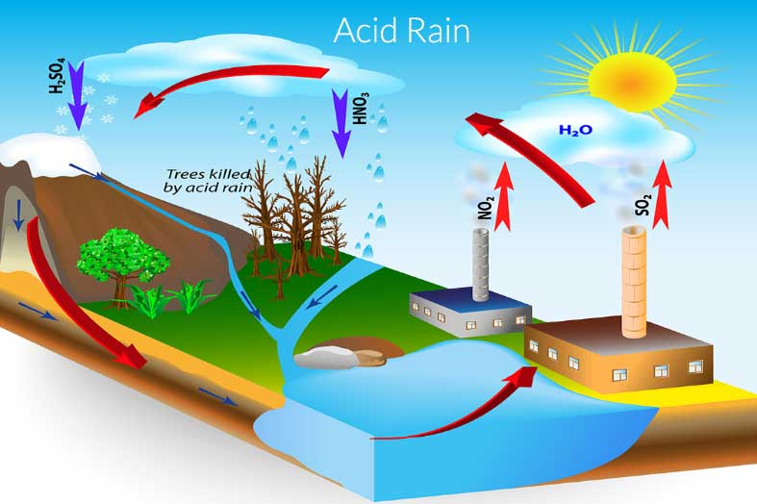
Vermont’s Acid Lakes
pH and alkalinity of many VT waters reduced, some to pH < 5 and ANC < 2.5 mg/L
The Clean Air Act (and amendments) reduced industrial emissions of acid rain precursors, thereby reducing acid precipitation
Vermont DEC continues to monitor the recovery of many acid impaired lakes
Notes:
I’m sure many of you are familiar with “acid rain,” which became a household term in the 1970s.
Acid rain is formed when sulfur dioxide and nitrogen oxide emissions are released from industrial processes and motor vehicles and react in the atmosphere to produce nitric acid and sulfuric acid. These acids are then delivered to the to earth’s surface (often hundreds of miles from their source) in rain, snow, fog, on particles or are deposited
Acid precipitation has had a large impact on the water chemistry of Vermont waters. In 1983, Vermont DEC joined the EPA to establish the Vermont long-term monitoring program, which monitors the acid neutralizing capacity of lakes throughout the state. Later, in 1990, the clean air act and its amendments greatly reduced the amount of acid rain precursors emitted by factories, thereby reducing the acidity of precipitation.

Slide 6
Notes:
Since then, we have continued to monitor the recovery of many acid impaired or stressed lakes and ponds and have seen great improvements in pH, alkalinity and other important parameters.

Slide 7
Vermont’s Acid Lakes
Is the Clean Air Act Working?
Sulfate – sulfuric acid
Nitrate – nitric acid
Notes:
Do we observe sulfate and nitrate concentrations decreasing??

Slide 8
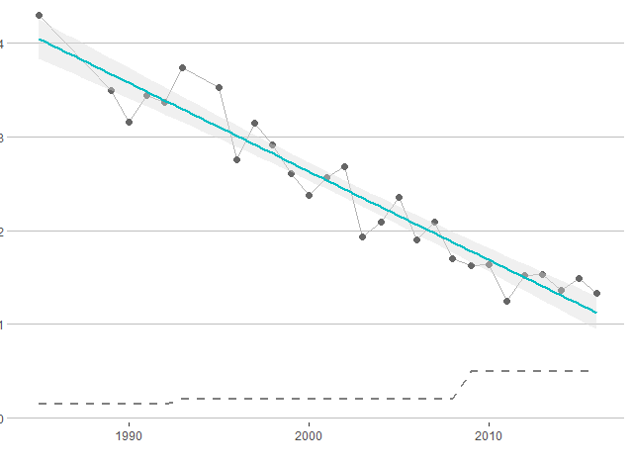
Vermont’s Acid Lakes
Chemical Parameters of interest
Sulfate – sulfuric acid
4
3
Sulfate (mg/L)
2
1
0
1990
2000
2010
Notes:
Clear downward trend in sulfate concentration in Bourne pond, which agrees well with what we’ve observed in pH and alkalinity
NADP precipitation station in Underhill shows a sulfate reduction in precipitation of about the same magnitude, average of about 2.5 mg/L in 1980s to about 0.5 mg/L 2016.
This trend in precipitation is also echoed in Nitrate concentrations, in the early 1980s Nitrate concentrations measured in Underhill where about 2 mg/L and today they’re about 0.5 mg/L

Slide 9
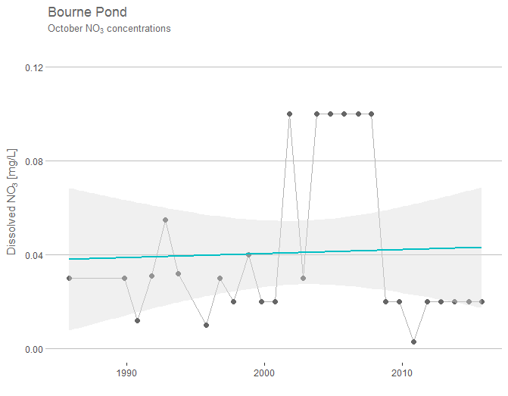
Vermont’s Acid Lakes
Chemical Parameters of interest
Nitrate – nitric acid
0.12
0.08
Nitrate (mg/L)
0.04
0.00
1990
2000
2010
Notes:
4 RLs! Ranging from 0.003 to 0.1 mg/L 58% of data are censored!!
(0.02, 0.01, 0.003, 0.01)
Most common approach to testing for trends is the Seasonal Kendall Tau, which requires ONE DL!!
We must re-censor everything to the highest DL…

Slide 10
Vermont’s Acid Lakes
0.12
RL = 0.10 mg/L
0.08
Nitrate (mg/L)
0.04
0.00
1990
2000
2010
Notes:
October values with censored observations recoded to highest reported detection limit and linear trend line.
Some traditional methods (Seasonal Kendal Tau) require that there only be ONE RL, so we must re-censor our data to the greatest/highest DL.
Doing this, our data point to an increasing trend in NO₃!! This contradicts trends we observe in the precipitation that we monitor in southern Vermont and clearly demonstrates the pitfalls of substituting an arbitrary value for censored data.
Instead….we’ve taken a different approach with our dataset… it’s a substitution method but uses a more robust statistical analysis to choose values

Slide 11
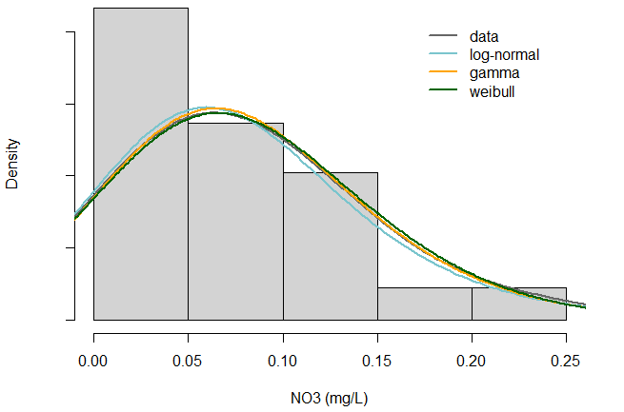
One Approach…
Plot of the distribution of the non-censored data and fit distribution with a model and check goodness of fit
Notes:
For each data point below the RL, pick one randomly from the modeled distribution to replace it Use this distribution to iterate statistically likely values below the DL,
This approach allows you to use multiple RLs (i.e.

Slide 12
Vermont’s Acid Lakes
Chemical Parameters of interest
Nitrate – nitric acid
0.12
0.08
Nitrate (mg/L)
0.04
0.00
1990
2000
2010
Notes:
4 RLs! Ranging from 0.003 to 0.1 mg/L 58% of data are censored!!
(0.02, 0.01, 0.003, 0.01)
Most common approach to testing for trends is the Seasonal Kendall Tau, which requires ONE DL!!
We must re-censor everything to the highest DL…

Slide 13
One Approach…
Substitute a modeled value for each censored data point below the respective RL
RL = 0.10 mg/L
Notes:
For each data point below the RL, pick one randomly from the modeled distribution to replace it Use this distribution to iterate statistically likely values below the DL,
This approach allows you to use multiple RLs (i.e.

Slide 14
Vermont’s Acid Lakes
Chemical Parameters of interest
Nitrate – nitric acid
0.12
0.08
Nitrate (mg/L)
0.04
0.00
1990
2000
2010
Notes:
4 RLs! Ranging from 0.003 to 0.1 mg/L 58% of data are censored!!
(0.02, 0.01, 0.003, 0.01)
Most common approach to testing for trends is the Seasonal Kendall Tau, which requires ONE DL!!
We must re-censor everything to the highest DL…

Slide 15
One Approach…
Substitute a modeled value for each censored data point below the respective RL
RL = 0.02
Notes:
For each data point below the RL, pick one randomly from the modeled distribution to replace it Use this distribution to iterate statistically likely values below the DL,
This approach allows you to use multiple RLs (i.e.

Slide 16
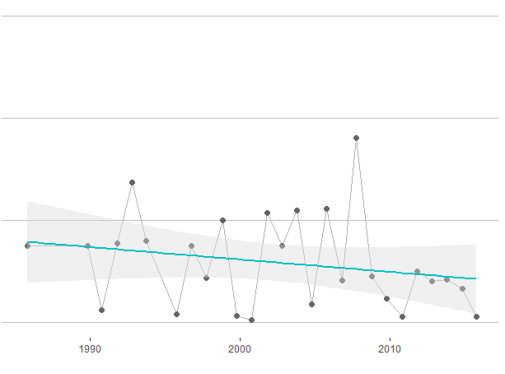
Vermont’s Acid Lakes
0.12
SKT p-value = 0.04
0.08
Nitrate (mg/L)
0.04
0.00
1990
2000
2010
Apply SKT trend analysis
Repeat 200 times
Notes:
Doing this, our data point to a decreasing trend in NO₃!!
We have accounted for the multiple RLs and we have technically performed a substitution but it based on a statistical distribution of the non-censored data, it is more informed than using an arbitrary multiple of the RL.
This is just one iteration, though, who’s to say it’s the right one?? For each censored data point we could have substituted in any number of values below the RL. In order to capture this variability , we repeat this 200 times (you could 500, 1000, depending on how long you want to wait in front of your computer) to get a better representation of what’s going on. We can then look at the distribution of the results of the SKT for each iteration to determine if there is a trend…

Slide 17
Scenario 1
Scenario 2
Density
Density
0.05
0.05
measured
z-statistic p-value
measured
z-statistic p-value
Notes:
For example, we can plot a histogram of the p-values from each SKT
Scenario 1 Most of the p-values fall below 0.05; trend is statistically significant at the 95% CI
Scenario 2 most of the p-values are ABOVE 0.05; cannot say that the trend is significant at the 95% CI
In other words, in scenario 1 we would have confidence in the trend, while in scenario 2 we would not have any

Slide 18
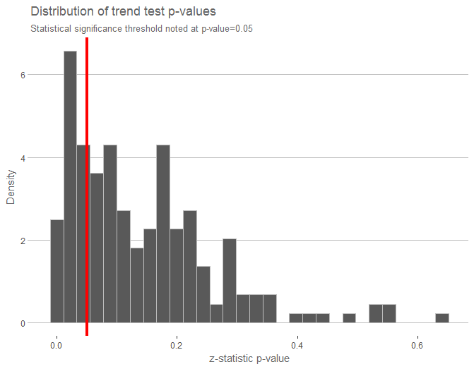
Our Scenario
Some evidence to suggest there is a decreasing trend in nitrate
Notes:
In our scenario a good portion of the p-values lie above our threshold (0.05) (albeit not all of the p-values) which tells us that there is Some evidence to suggest that there is a decreasing trend in nitrate

Slide 19
Vermont’s Acid Lakes
0.12
0.08
Nitrate (mg/L)
0.04
0.00
1990
2000
2010
Notes:
The picture isn’t back and white but we have more confidence knowing that our data were treated wisely.

Slide 20
Conclusions
Mistreatment of censored data can result in
Alien trends
Misleading and false summary statistics
There is no one magic tool for every application, need to consider:
Degree of censorship
Ultimate goal
There is a wealth of knowledge out there!

Slide 21
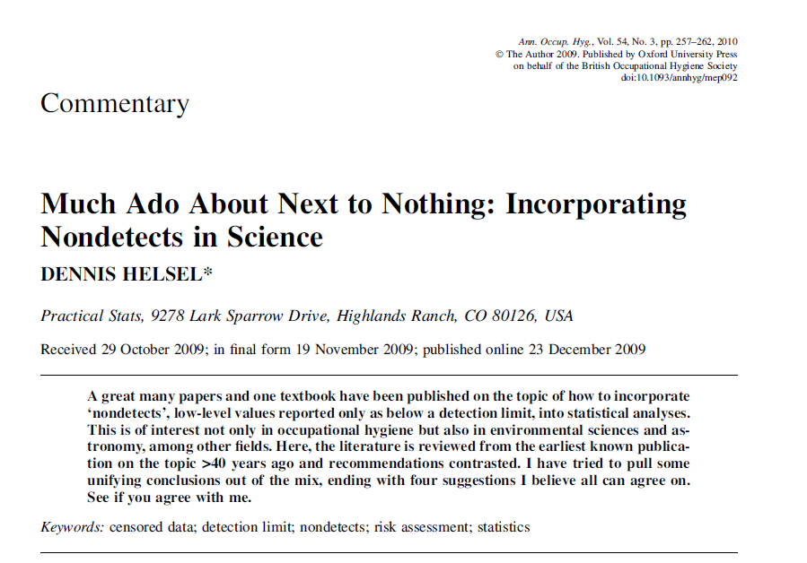
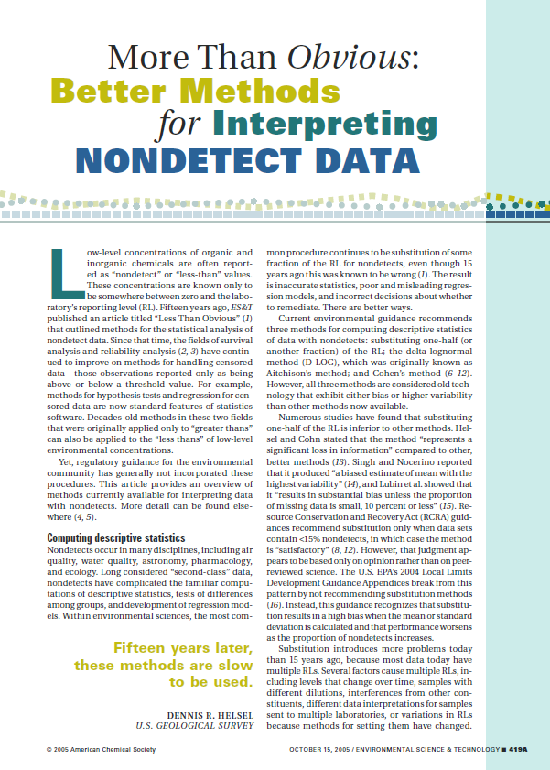
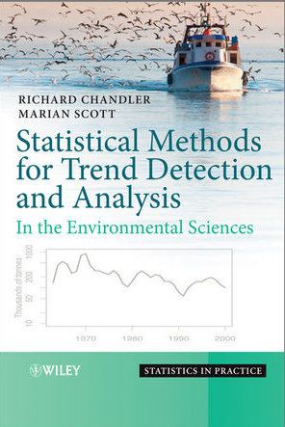
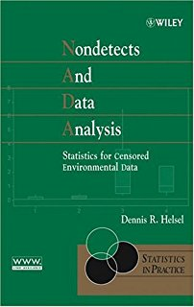
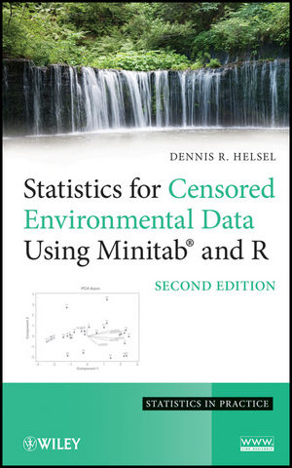

Slide 22
Dealing with Nondetects: Using Censored Data Wisely
Rebecca Harvey, PhD
rebecca.harvey@vermont.gov
Phillip Jones, Heather Pembrook, Jim Kellogg

Slide 24
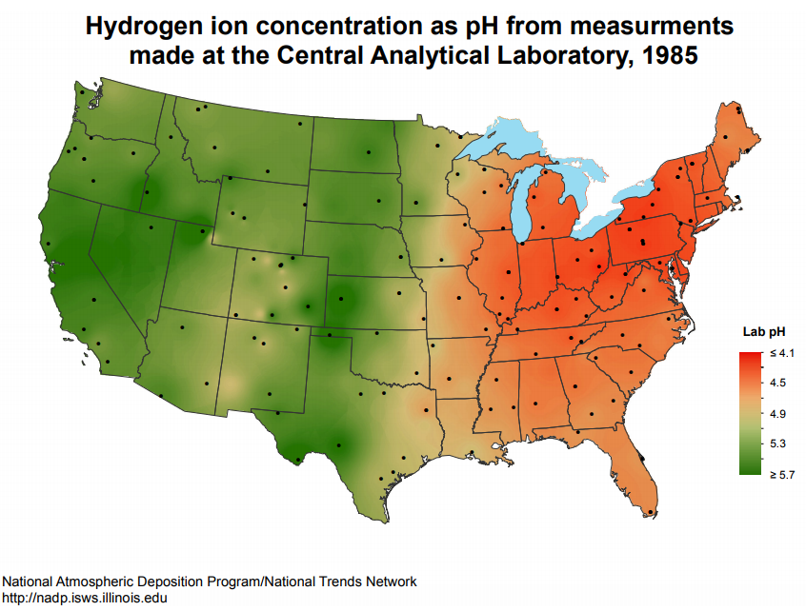
Notes:
As a result of this realization, the national atmospheric deposition program was developed to monitor acid precipitation in the US. Here we have a map showing the pH of precipitation collected throughout the country, showing precipitation pH of about 4.1-4.5 throughout the northeast.
Normal precipitation has a pH of about 5.6 but acid precipitation can have pHs as low as 2 or 3 pH units!

Slide 25
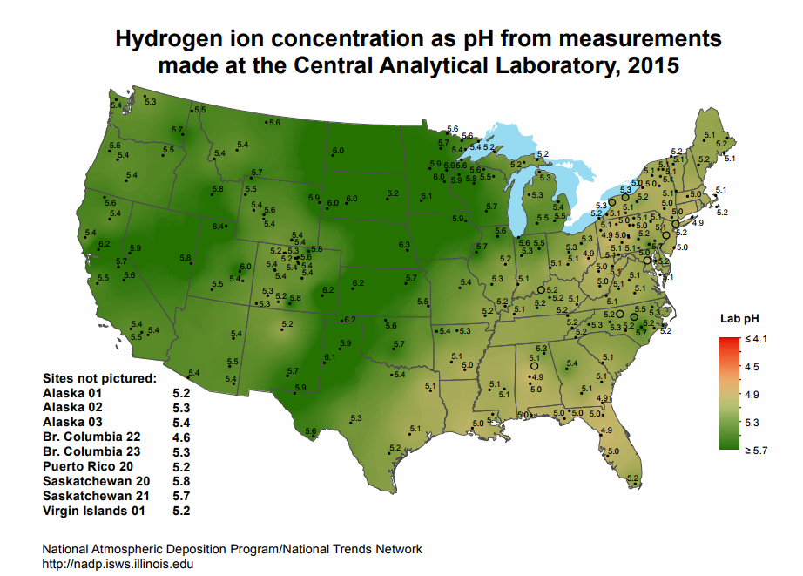
Notes:
In 1990, The Clean Air Act, and its amendments passed and resulting in large reductions in sulfur dioxide emissions, reducing the prevalence of acid rain, especially in the northeast. And, for many of us, acid rain has dropped off the radar
But the impact of acid precipitation is

Slide 26
Historical Approaches to Using Censored Data
Notes:
Another example demonstrates one pitfall to using historical approaches to censored data to do trend analyses. Here we have a hypothetical data set that shows MTBE concentrations in ground water as a function of time. At first glance, it appears that something happened between 2000 and 2001 to reduce concentrations considerably. However, upon further inspection, we see that lab doing these analyses improved their technique and was able to lower their RL from 50 ppb down to 20 ppb. So censored data that were being reported at the RL of 50 are now censored at 20 ppb, introducing an alien trend.
Who’s to say that the data don’t really look like this…

Slide 27
Historical Approaches to Using Censored Data
We’ll talk about better approaches shortly
Notes:
…who’s to say that the data don’t really look like this…
We’ll talk about better approaches shortly, within the context of some real data (not fake data) that have been collected as part of Vermont’s Long Term monitoring program to track the recovery of our lakes and ponds to the impacts of acid rain.
Let’s just take a moment to review the causes and impacts of acid precipitation

