Slide 1
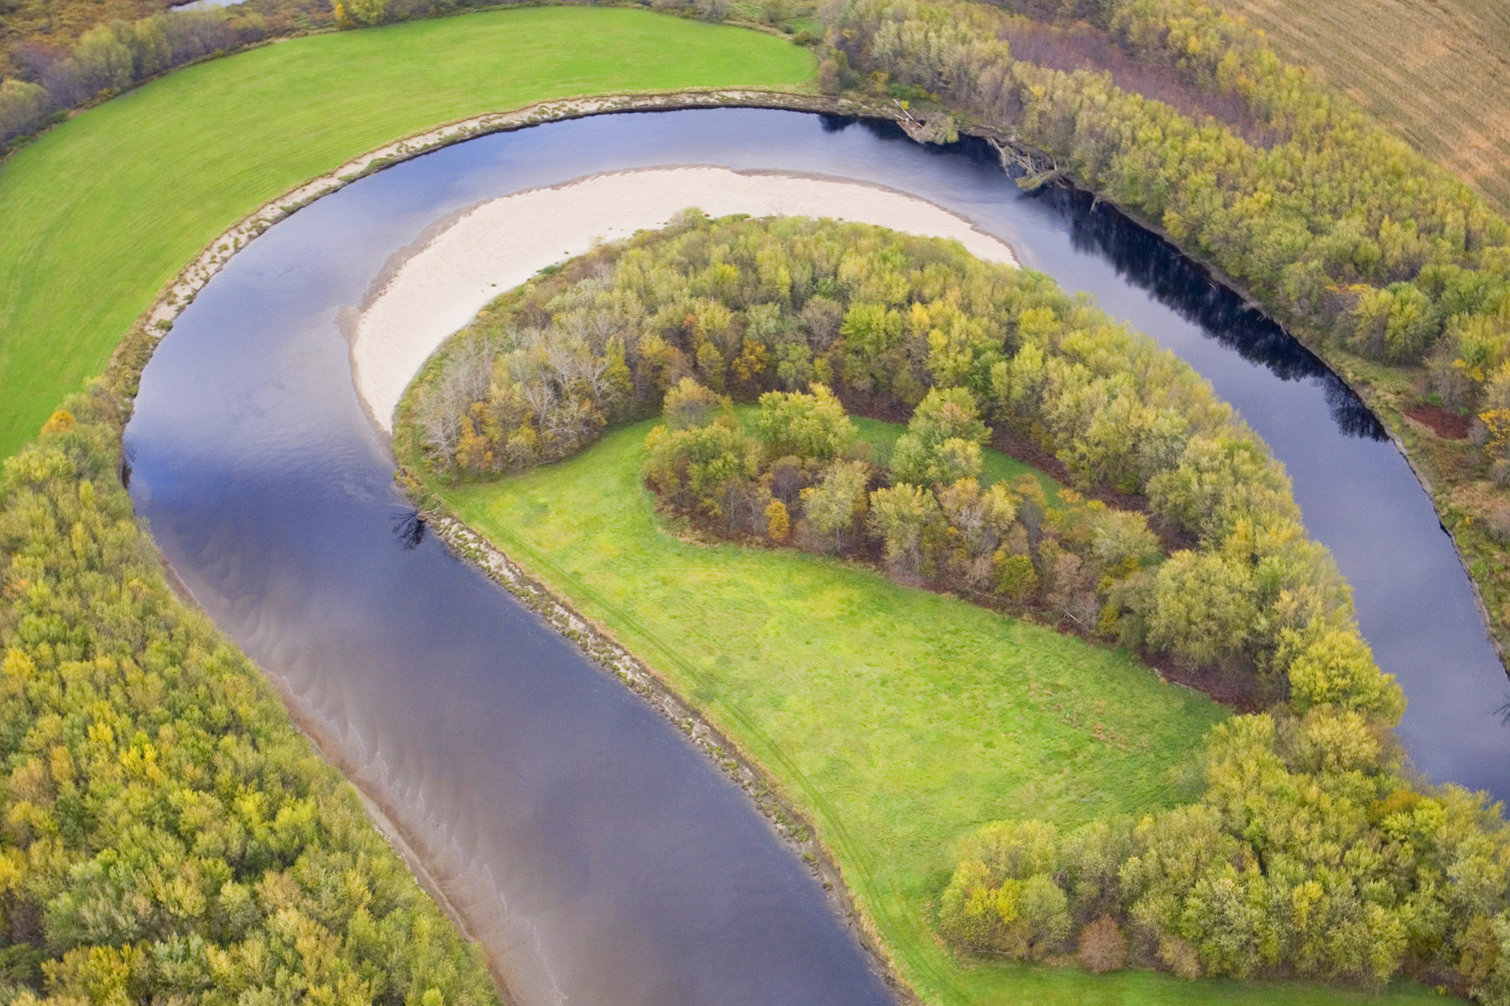
The Nature Conservancy Water Quality Blueprint for the Lake Champlain Basin Nature-based solutions for water quality challenges
Dan Farrell
Rose Paul
Shayne Jaquith
Ann Ingerson
With support from Keurig Green Mountain
December 15, 2017
Notes:
Most people associate The Nature Conservancy with land conservation, and, indeed, TNC has been conserving land in Vermont for about 60 years. But TNC also strives to develop science and science-based tools to help solve environmental problems. The Water Quality Blueprint is an example of such a tool, which we developed to guide conservation decisions in support of water quality.

Slide 2
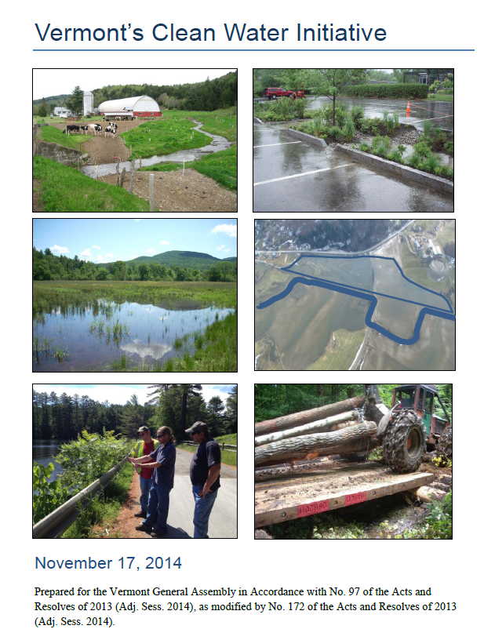
VT’s Clean Water Initiative 2014
Notes:
We were inspired to create the Water Quality Blueprint when we reviewed the report to the Vermont Legislature called Vermont’s Clean Water Initiative. In the report, restoration and protection of river corridors, floodplains, wetlands, and forests is listed as a critical priority for improving water quality. It is estimated that 22% of the phosphorous in Lake Champlain comes from eroding stream banks and the loss of floodplain function.

Slide 3
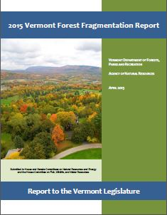
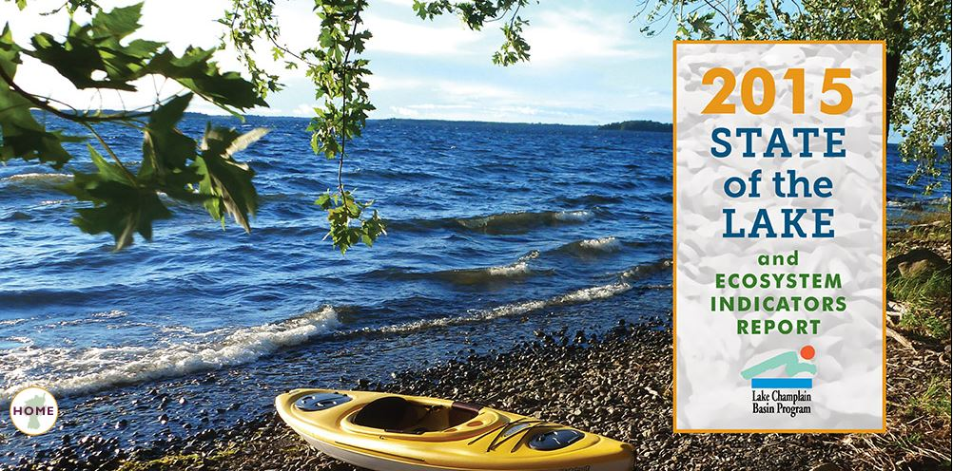
VT’s Clean Water Initiative 2014
Notes:
Other recent important reports reinforce the relationship between natural systems and water quality.

Slide 4
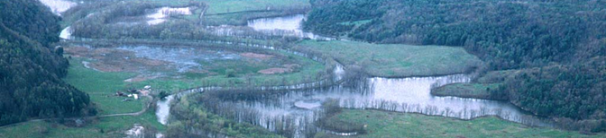
Water Quality Blueprint for the Lake Champlain Basin
Goal:
A tool that helps conservation practitioners focus on areas that provide the most benefit to water quality and conservation goals.
A prioritization of floodplains and other river, lake, and wetland related areas for conservation and water quality improvement.
Notes:
By restoring and protecting natural systems we serve both habitat protection and water quality goals. The Water Quality Blueprint is a prioritization of floodplains and other river, lake, and wetland-related areas for conservation value and water quality impact.
And we wanted to provide a solution not just for The Nature Conservancy, but for the many others doing this kind of work. We’ve made our analysis available via an online planning tool.

Slide 5
Water Quality Blueprint for the Lake Champlain Basin
Advisory Committee
Ben Gabos (NRCS)
Crea Lintilhac (Lintilhac Foundation)
Dan Farrell (TNC)
Eric Sorenson (DFW)
Kari Dolan (DEC)
Keri Watson (Gund Institute) Laura Lapierre (DEC)
Liz Thompson (VLT)
Michael Middleman (DAFM)
Mike Kline (DEC)
Neil Kamman (DEC)
Perry Thomas (DEC)
Reed Sims (NRCS)
Rose Paul (TNC)
Roy Schiff (MMI)
Shayne Jaquith (TNC)
Tim Clear (DEC)
Tina Bosch Ladd (Keurig)
Todd Redder (LimnoTech)
Wendy Larson (LimnoTech)
Notes:
We got great guidance from our advisory committee, which included people from state and federal government agencies, local non-profits, and environmental consultants.

Slide 6
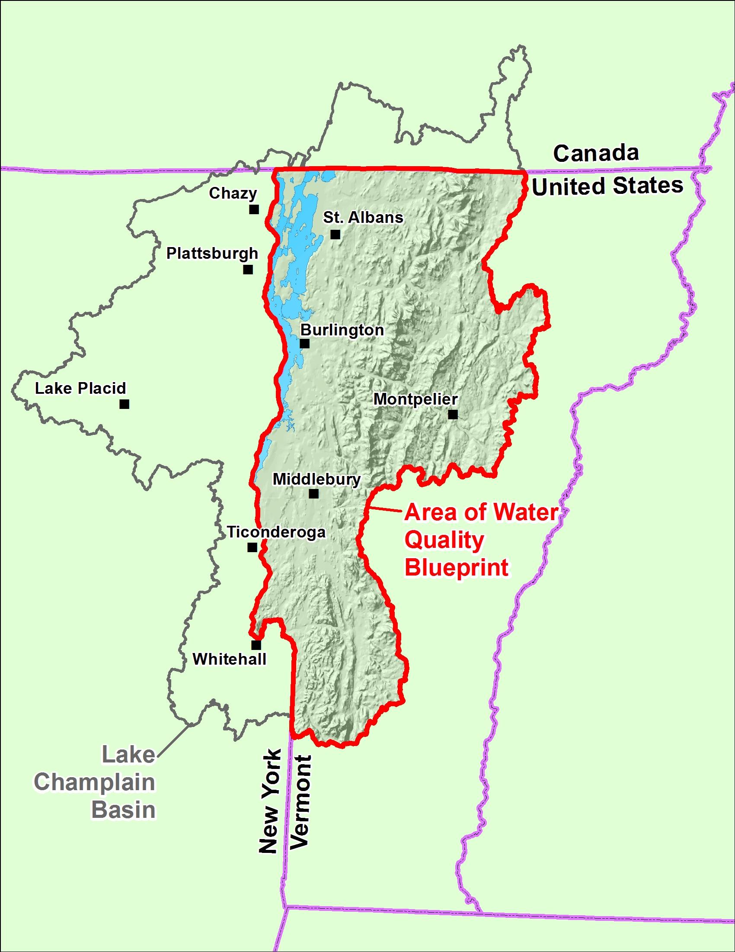
Water Quality Blueprint
Lake Champlain Basin
Vermont, New York, Canada
56% of the Basin is in Vermont
Blueprint: only the VT portion of the Basin
Notes:
Now, how did we put the Blueprint together. First, note that it only covers the Vermont portion of the Lake Champlain Basin.

Slide 7
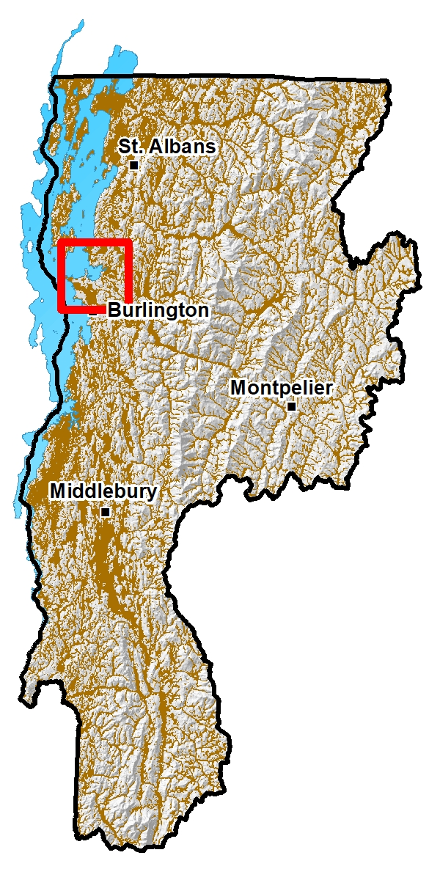
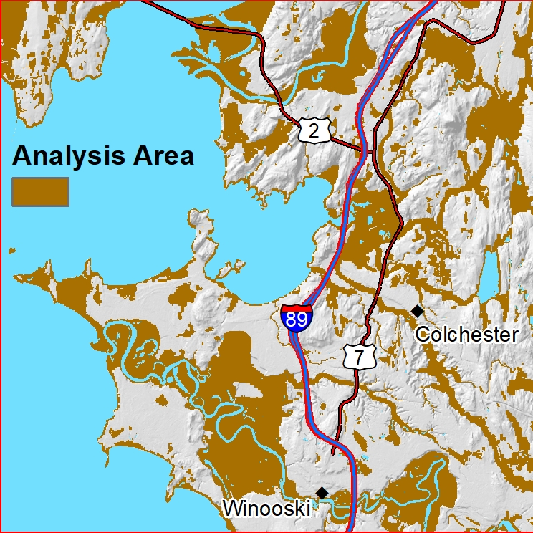
Water Quality Blueprint
Analysis Area
Riparian area, wetlands, converted wetlands
Notes:
Also, we did not analyze all the land area. We only analyzed the riparian zone in the broadest sense as well as existing and converted wetlands. The analysis area is shown in brown. The grey area was not included in the analysis. This is how we focus on some of the natural systems that are most critical to water quality. We know that the rest of the basin is important, but we wanted to focus on the key features that are most impaired, areas that are close to water and have increased storage capacity.

Slide 8
Water Quality Blueprint
Three Products:
Conservation Value
Water Quality Impact
Combination Layer
Notes:
The Blueprint consists of three final products: a conservation value layer, a water quality impact layer, and a layer that combines the two.
The Conservation Value layer represents natural assets that will benefit from protection and restoration. It incorporates important habitat and natural processes.
The Water Quality Impact layer represents areas that are impaired, at risk of impairment, or that might attenuate such impairments.

Slide 9
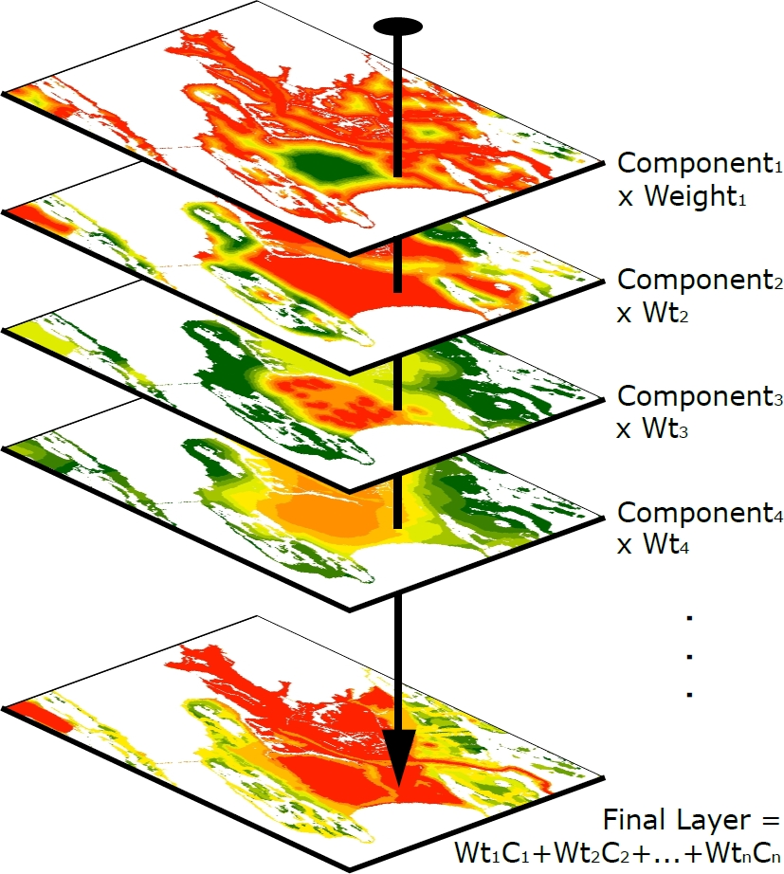
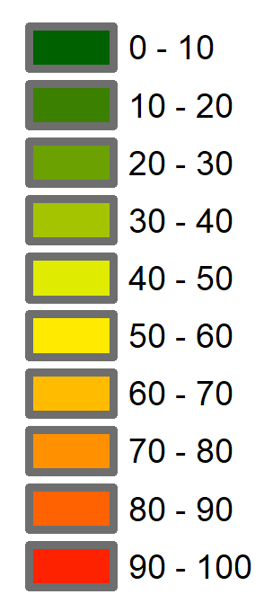
A weighted combination of prioritized areas
Notes:
Each of these final products is based on multiple geographic components. Components include continuous, discrete, and binary (i.e. presence/absence) datasets. Weights were chosen, based on professional judgement, to represent their relative importance to habitat or water quality. The resolution of components and the final products is 30 meters. So approximately every quarter-acre in the analysis area has individual values for each layer.
Our method allows people to use the Blueprint to help evaluate any area (a parcel or buffer area, for example) for its importance to conservation or water quality.

Slide 10
Conservation Value Data Layers and Weights
• Proximity to Natural Community Occurrences: 15
• Proximity to Rare, Threatened and Uncommon Species: 15
• Proximity to TNC Terrestrial Portfolio: 15
• Natural Landcover in the Vicinity: 7
• Wetlands: 7
• Proximity to Conserved Land: 7
• Proximity to TNC Freshwater Portfolio: 7
• Valley Walls: 6
• Riparian Connectivity between Habitat Blocks: 6
• River Corridors: 5
• Riparian Connectivity: 4
• Floodable Soils: 3
• Healthy Trout Catchments: 3
Notes:
There are 13 components for the Conservation Value layer. They all represent places we want to protect. The weights for each component are listed here. They add up to 100. Some source datasets were used almost as-is, others required more analysis.

Slide 11
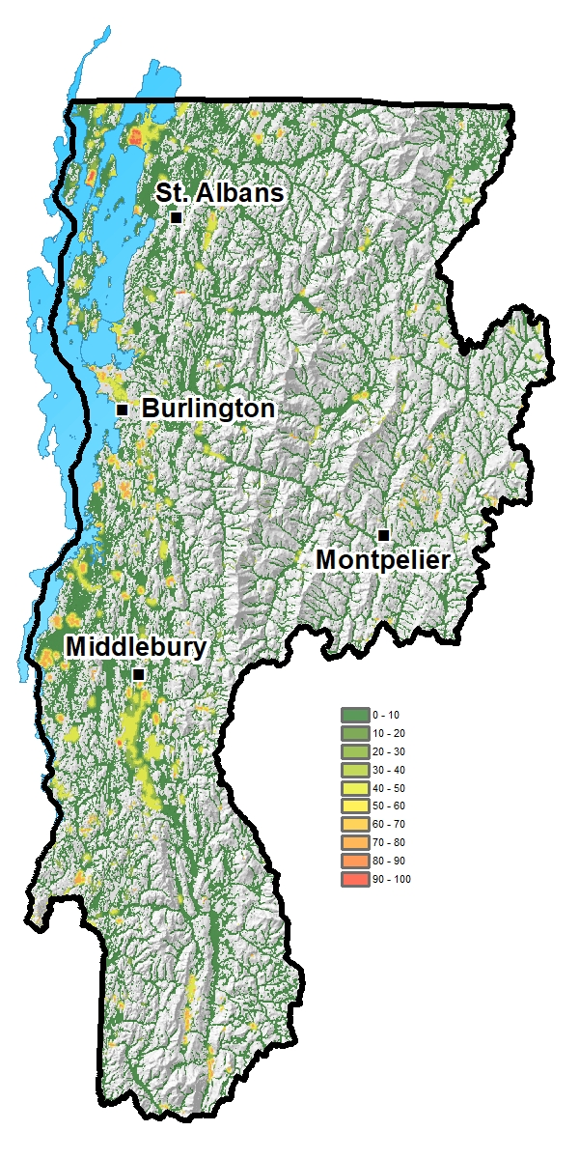
Conservation Value
Proximity to Natural Community Occurrences
(VTDFW)
Weight = 15
Notes:
I’ll go through the conservation value components quickly. The first is proximity to state-significant river, lake, and wetland-associated natural communities identified by the Natural Heritage Inventory at the Vermont Department of Fish and Wildlife.

Slide 12
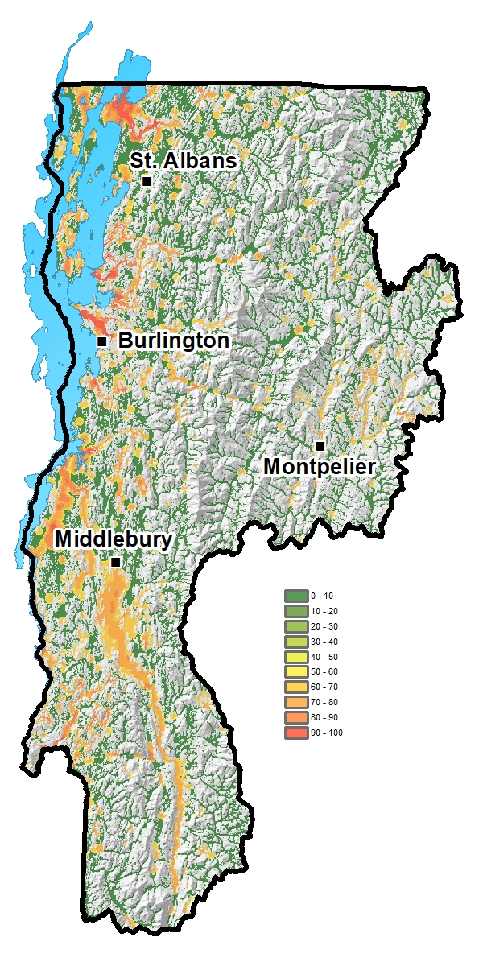
Conservation Value
Proximity to Rare, Threatened, Endangered and Uncommon Species
(VTDFW)
Weight = 15
Notes:
Proximity to state rare and uncommon river, lake, and wetland-associated species mapped by the Natural Heritage Inventory.

Slide 13
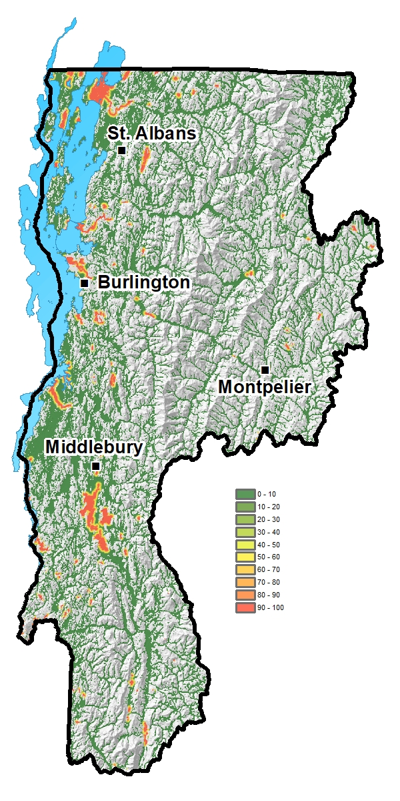
Conservation Value
Proximity to TNC Terrestrial Portfolio
Weight = 15
Notes:
Proximity to terrestrial sites identified by the Nature Conservancy as regional priorities for conservation.

Slide 14
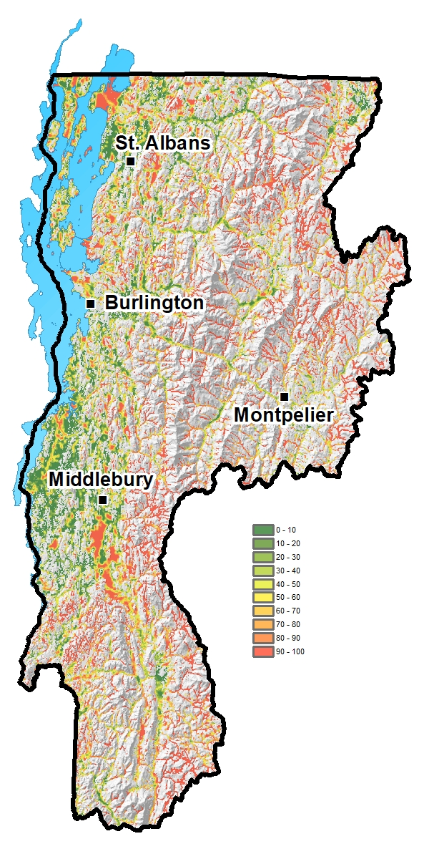
Conservation Value
Natural Landcover in the Vicinity
(TNC, NLCD)
Weight = 7
Notes:
The percent natural cover in a 100-acre circle around each grid cell.

Slide 15
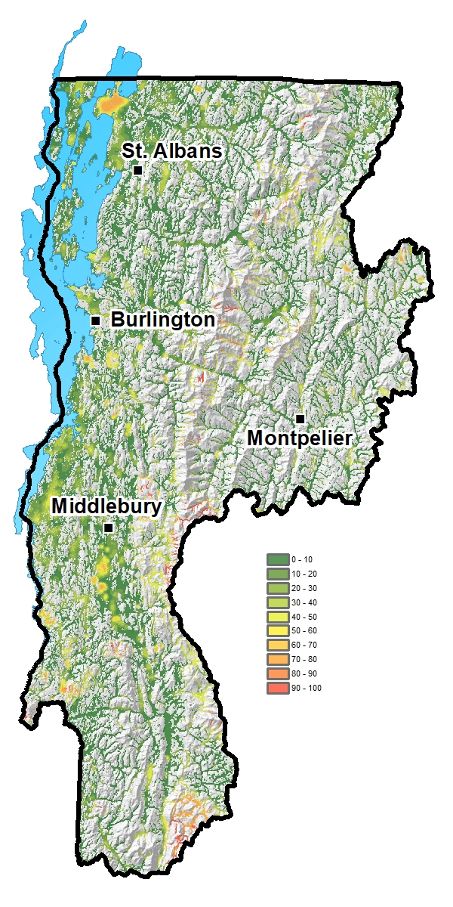
Conservation Value
Proximity to Conserved Land
(TNC)
Weight = 7
Notes:
Proximity to conserved lands.

Slide 16
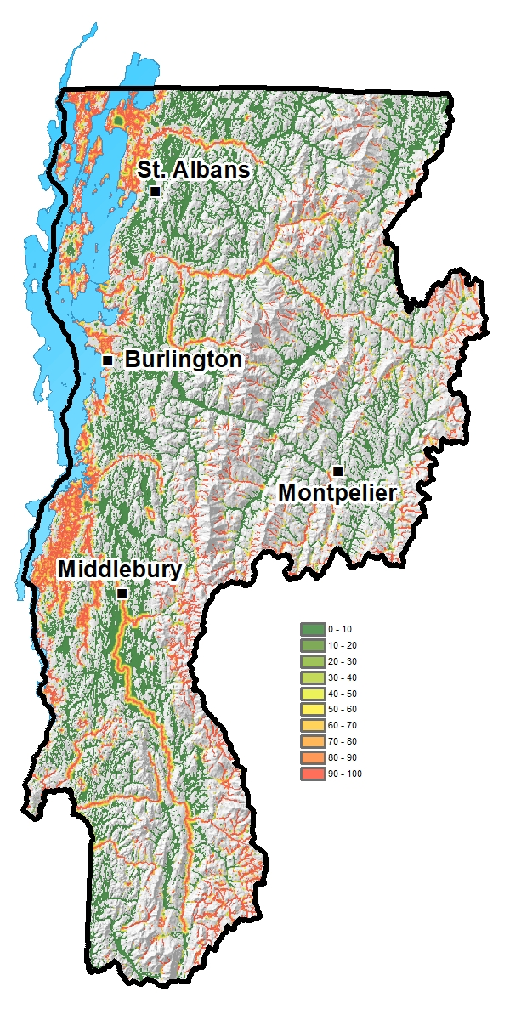
Conservation Value
Proximity to TNC Freshwater Portfolio
Weight = 7
Notes:
Proximity to water bodies identified as priorities by the Nature Conservancy.

Slide 17
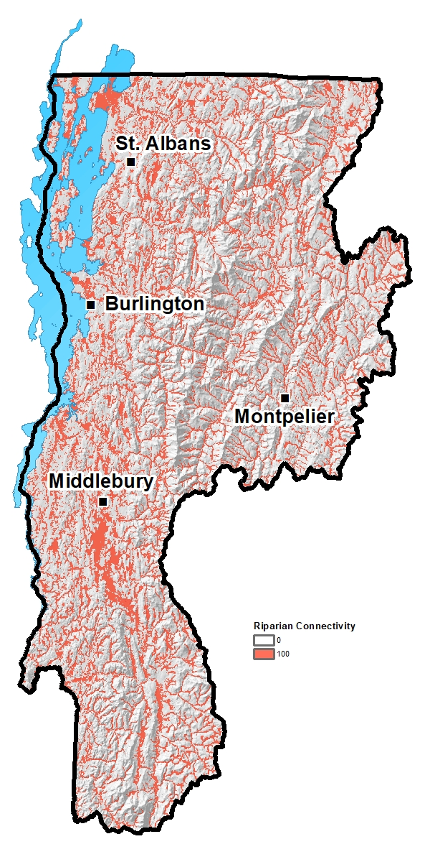
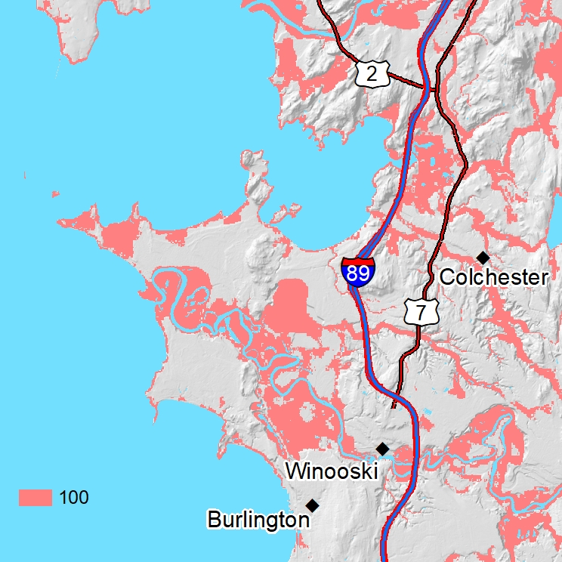
Conservation Value
Riparian Connectivity (VTDFW)
Weight = 4
Notes:
Riparian areas with natural vegetation from the BioFinder tool created by Fish and Wildlife to represent wildlife movement areas. This component and the rest of them are presence/absence datasets.

Slide 18
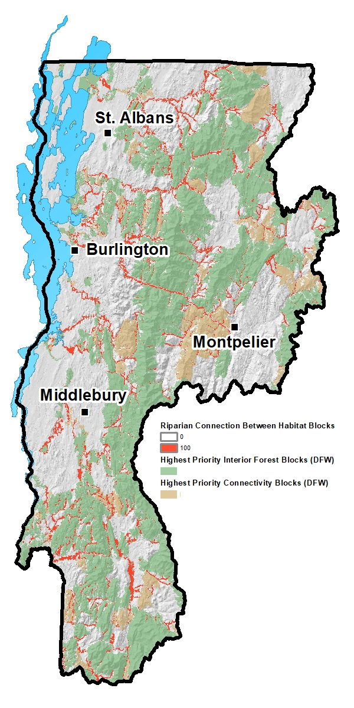
Conservation Value
Riparian Connectivity between Habitat Blocks
(VTDFW)
Weight = 6
Notes:
A selection of those vegetated riparian areas (shown in red) that can allow wildlife to move between key wildlife habitat blocks (shown in green and brown) from Fish and Wildlife’s Vermont Conservation Design.

Slide 19
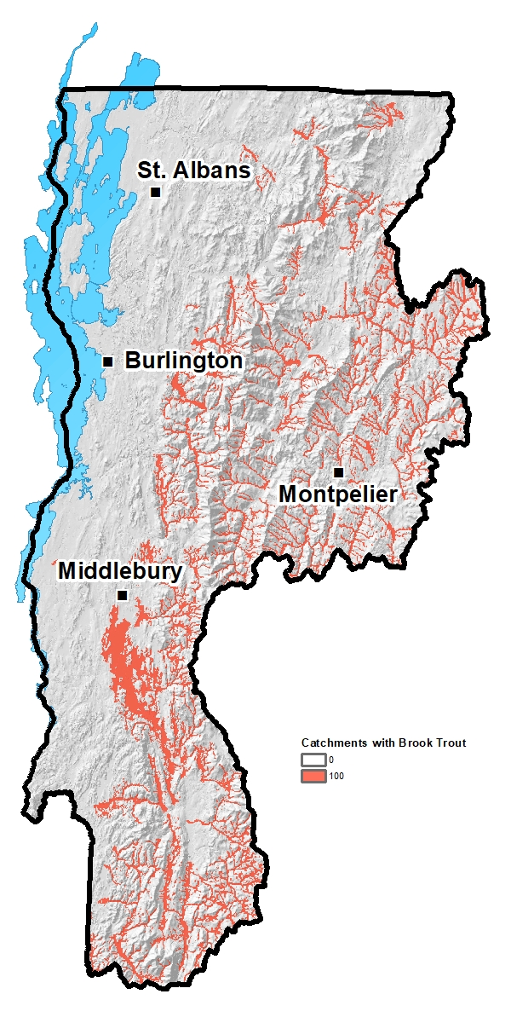
Conservation Value
Healthy Brook Trout Catchments
(EBTJV)
Weight = 3
Notes:
Healthy Brook Trout habitat identified by the Eastern Brook Trout Joint Venture.

Slide 20
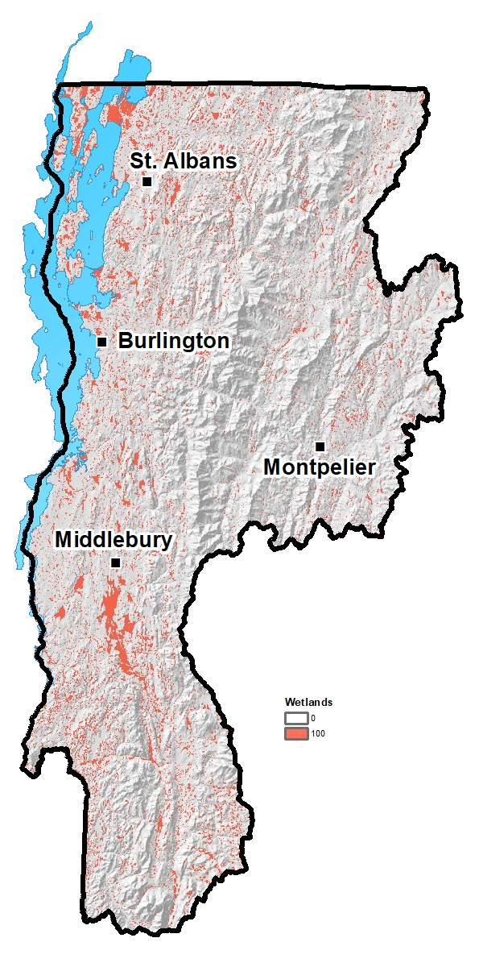
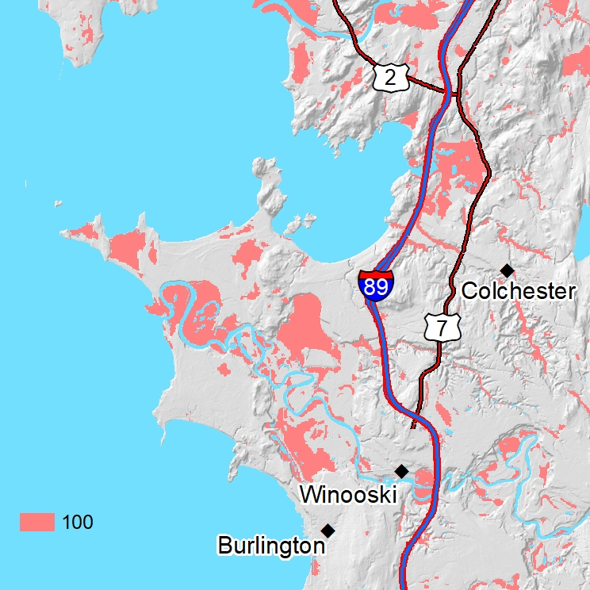
Conservation Value
Wetlands (VTDEC)
Weight = 7
Notes:
Wetlands.

Slide 21
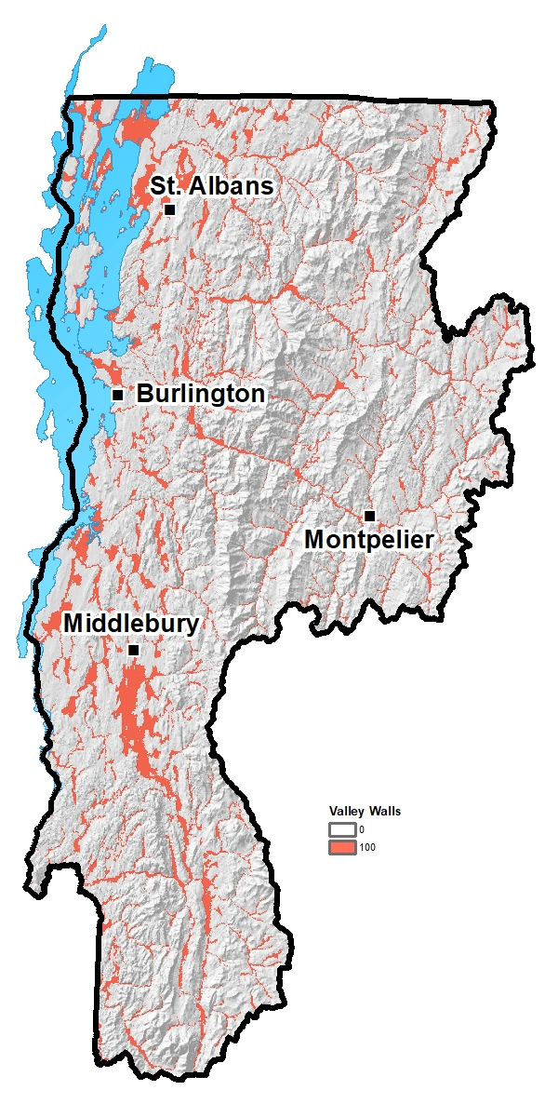
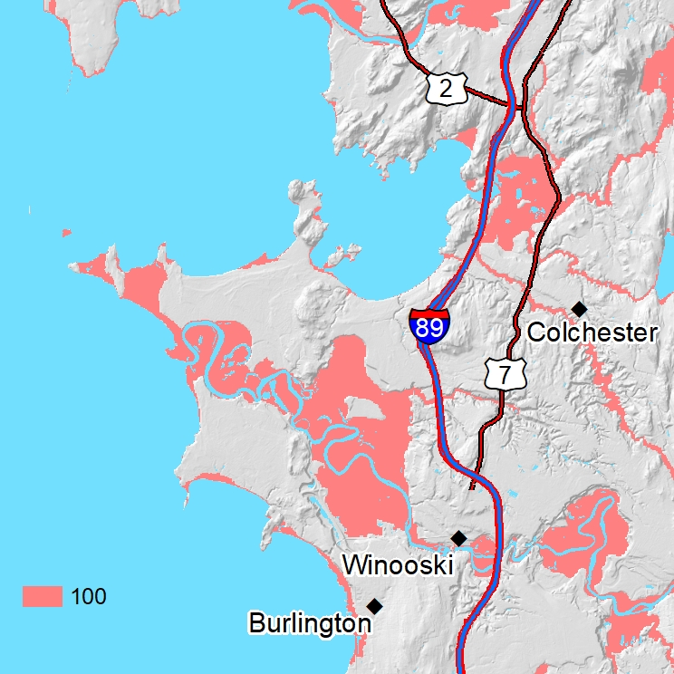
Conservation Value
Valley Walls (VTDEC)
Weight = 6
Notes:
Valley Walls mapped by the River Management Program at the Vermont Department of Environmental Conservation.

Slide 22
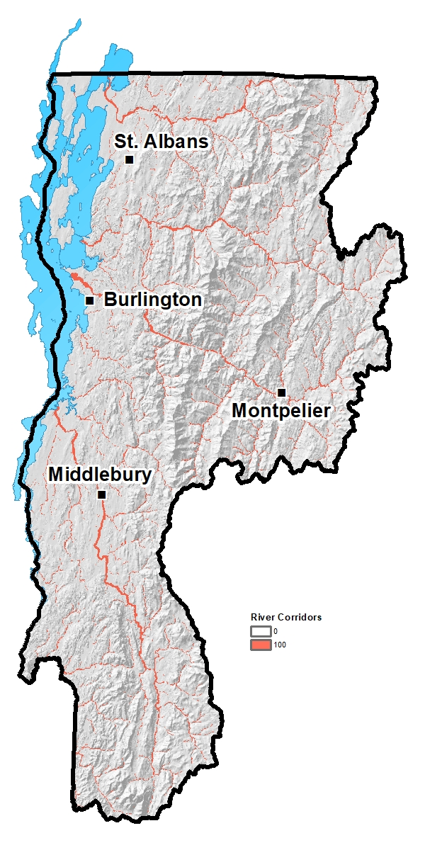
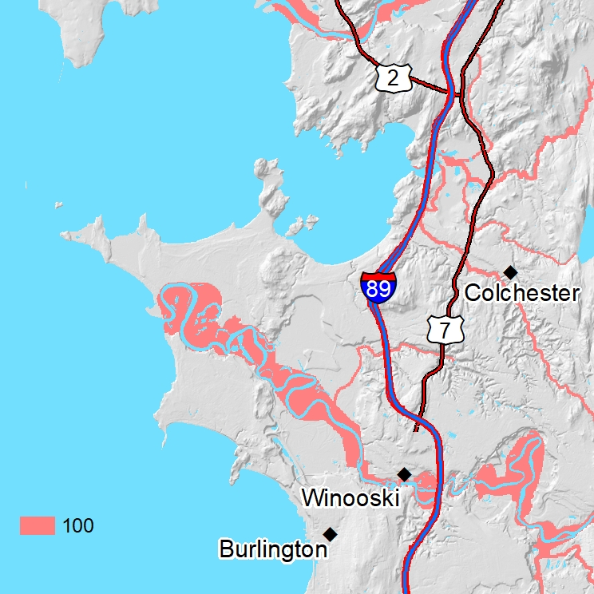
Conservation Value
River Corridors (VTDEC)
Weight = 5
Notes:
River Corridors mapped by the River Management Program.

Slide 23

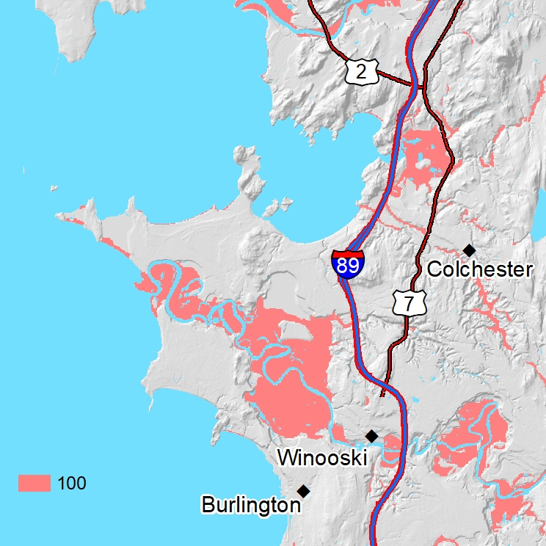
Conservation Value
Floodable Soils (NRCS)
Weight = 3
Notes:
Soils that can be flooded according to soil surveys from the Natural Resources Conservation Service.

Slide 24
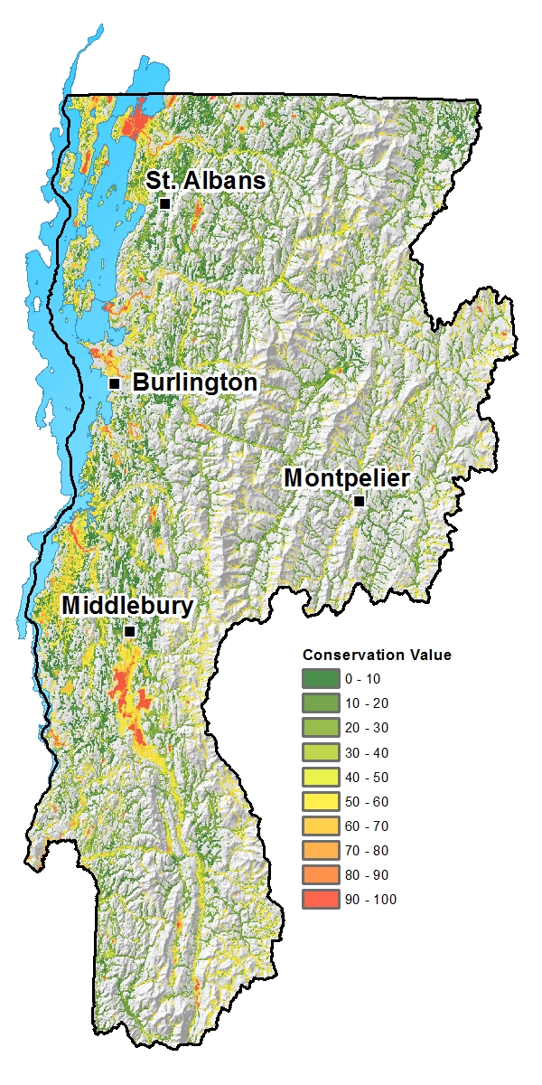
Water Quality Blueprint
Conservation Value
Notes:
And this is the outcome of the weighted combination. The Conservation Value layer. Red areas have high conservation value, green areas have low value, and yellow areas are in between. High priority areas stand out as expected: the Missisquoi Delta, Otter Creek Swamps, and the lower reaches of the major rivers. But you can see a lot of smaller sites that have high value like the lower Rock River and the area around Shelburne Pond.

Slide 25
Water Quality Impact Data Layers and Weighting Scheme
• Floodplain Restoration Potential (Fluvial Process): 30
• Modeled Phosphorus Yields: 20
• Possible Impaired and Stressed Water Source and Abatement Areas: 20
Potential Wetland Restoration Sites: 20
• VT River Sensitivity Coarse Screen: 10
Notes:
The Water Quality Impact Layer is a weighted combination of 5 components. These layers indicate areas that are at risk, have some sort of impairment, or could attenuate such impairments. The weights are shown on the right.

Slide 26
Water Quality Impact Data Layers and Weighting Scheme
• Floodplain Restoration Potential (Fluvial Process):
• Modeled Phosphorus Yields: 25
• Possible Impaired and Stressed Water Source and Abatement Areas: 25
Potential Wetland Restoration Sites: 25
• VT River Sensitivity Coarse Screen: 25
Notes:
But the Floodplain Restoration Potential data is not available for all streams. In such cases, we gave each of the 4 remaining layers a weight of 25.

Slide 27
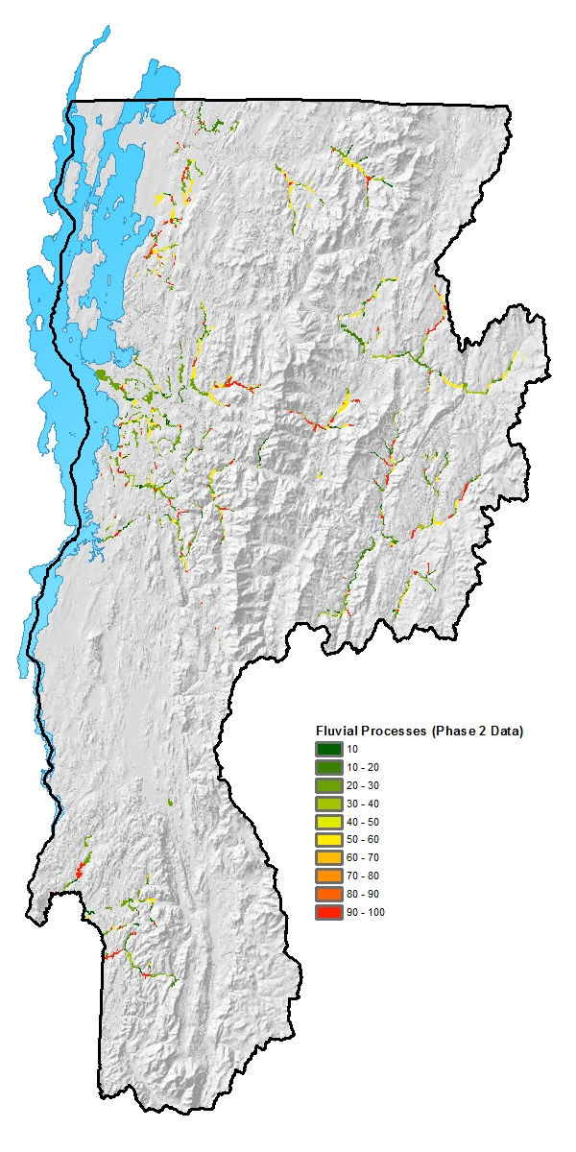
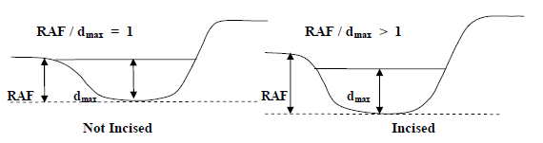
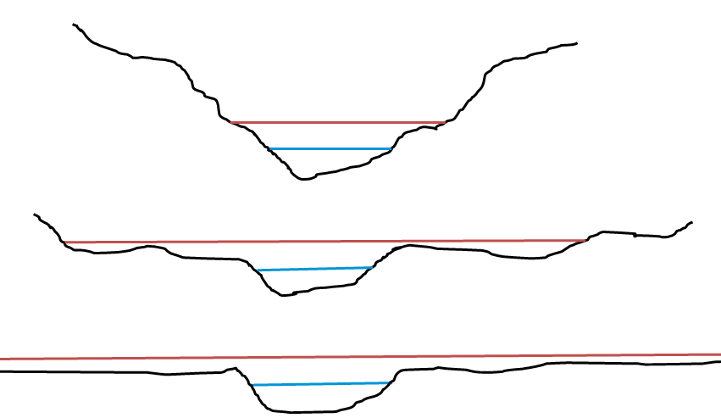
Water Quality Impact
Floodplain Restoration Potential (Fluvial Process)
(VTDEC, TNC)
Weight = 30
Confined Valley
Unconfined Valley
Notes:
The Floodplain Restoration Potential component prioritizes opportunities for hydrological restoration of floodplains that would increase flood resilience and phosphorous attenuation. Incised streams in broad valleys offer opportunities to reduce channel incision to increase deposition of sediment and nutrients on the floodplain. Incised streams in unconfined valleys get higher values. This metric was created in coordination with the Rivers Management Program.

Slide 28
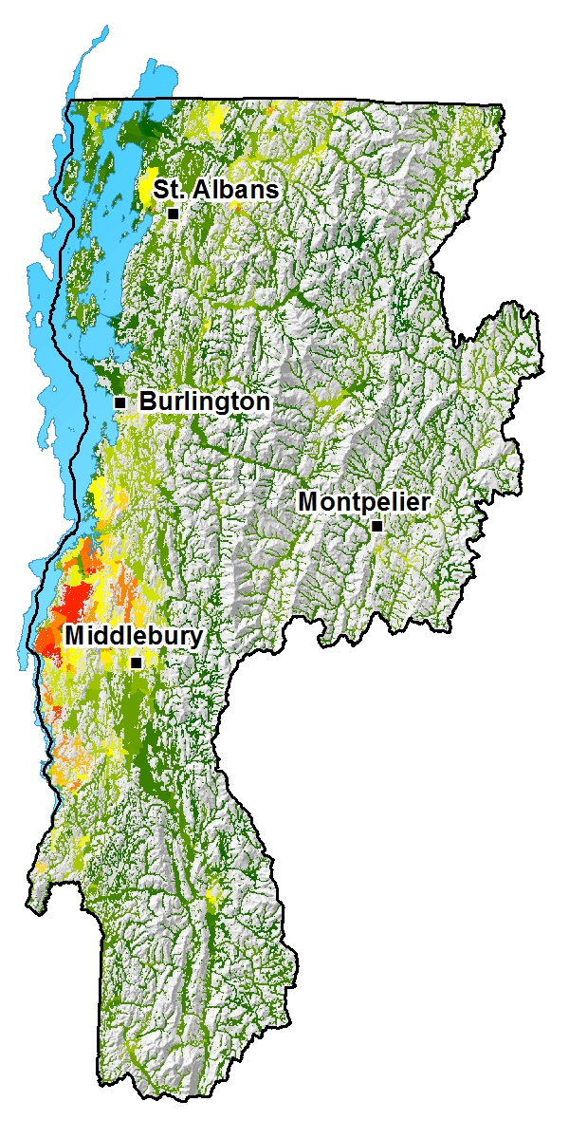
Water Quality Impact
Modeled Phosphorus Yield
(VTDEC, EPA)
Weight = 20
Notes:
Modeled phosphorous yield is a downscaled version of the Lake Champlain SWAT model from the EPA produced by the DEC.

Slide 29
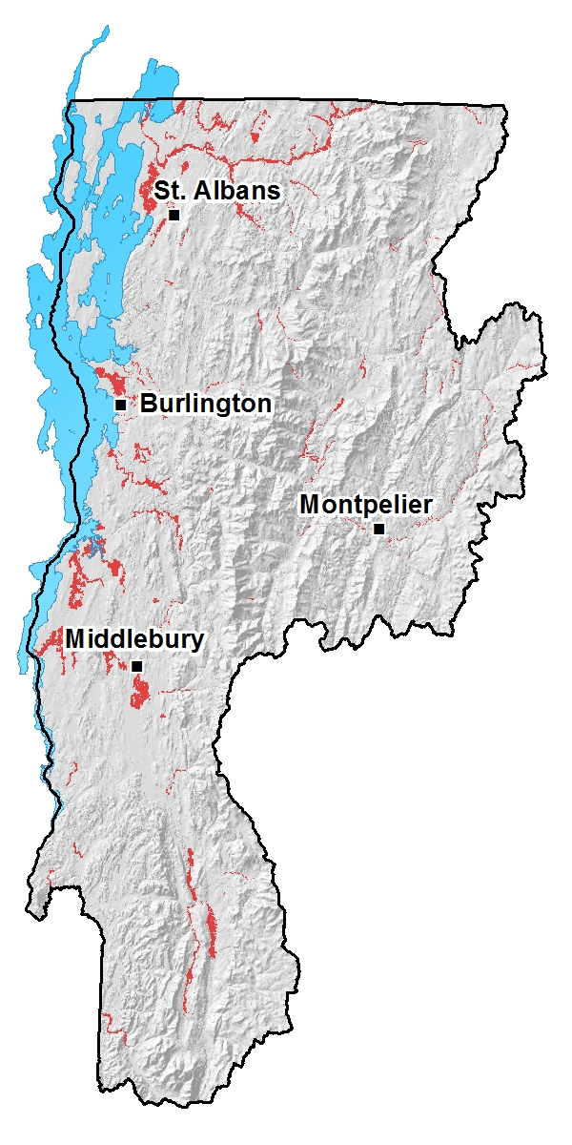
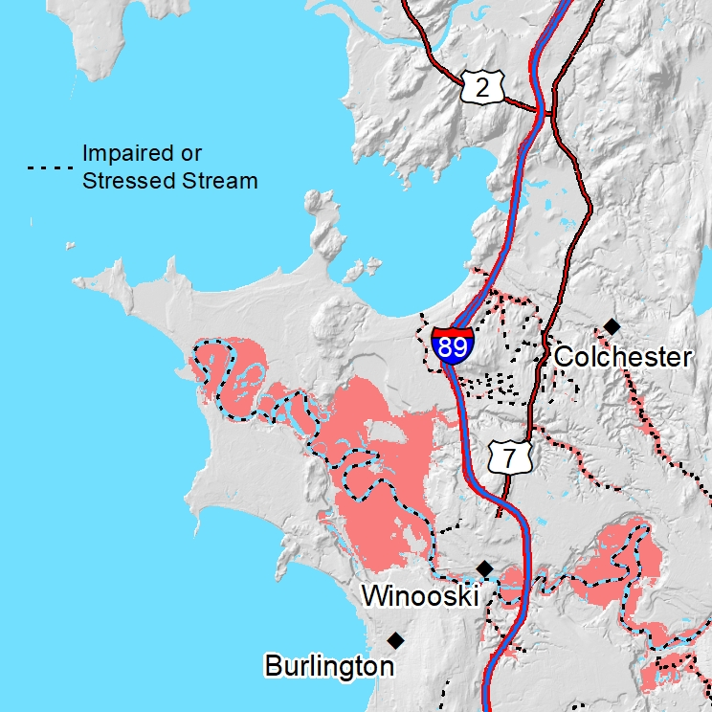
Water Quality Impact
Possible Impaired and Stressed Water Source and Abatement Areas
(VTDEC, TNC)
Weight = 20
Notes:
We modeled possible sources of pollution for impaired and stressed waters that were identified by the DEC as well as natural areas that could attenuate that pollution.

Slide 30
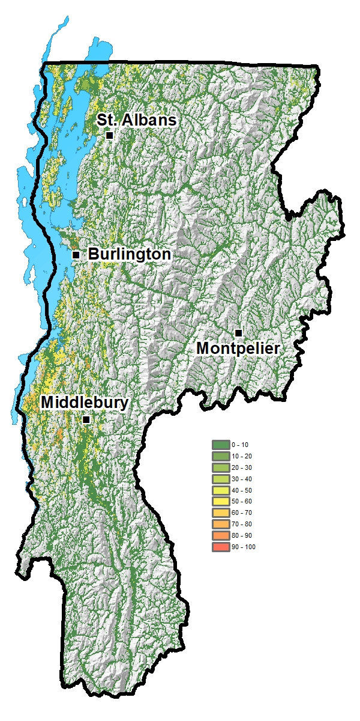
Water Quality Impact
Potential Wetland Restoration Sites
(VTDFPR)
Weight = 20
Notes:
Restorable wetlands modeled by the Vermont Department of Forests, Parks, and Recreation.

Slide 31
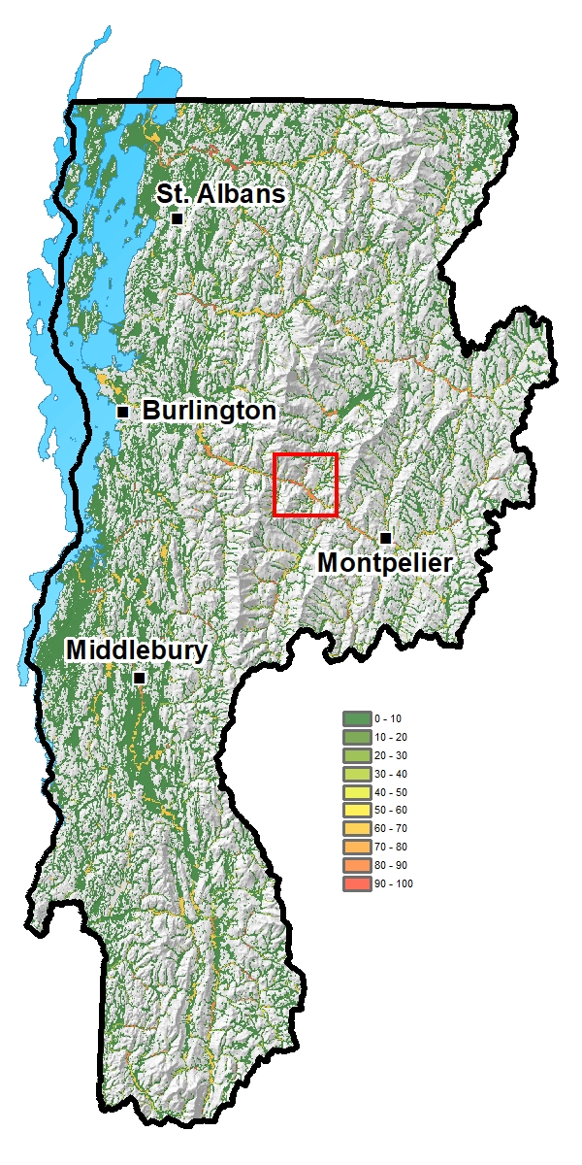
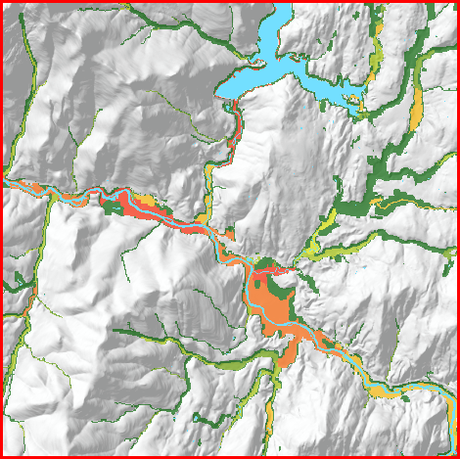
Water Quality Impact
River Sensitivity Coarse Screen
(VLT, MMI)
Weight = 10
Notes:
The River Sensitivity Coarse Screen developed by Milone and MacBroome for the Vermont Land Trust. It identifies erosion and sedimentation risk.

Slide 32
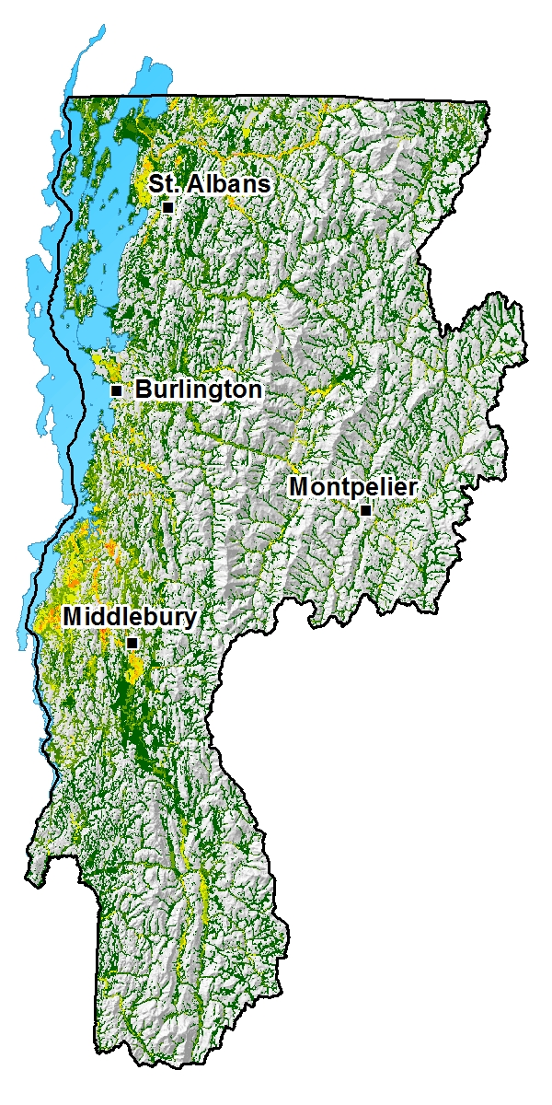
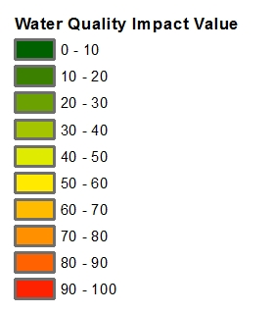
Water Quality Blueprint
Water Quality Impact
Notes:
And here is the resulting Water Quality Impact layer. There are very few high scoring areas. There is a lot of green and yellow, but red and orange are barely visible at this scale. This is because the high scoring portions of the component layers did not overlap very often to create the highest scores of Water Quality Impact. But it does highlight areas known to be important to water quality.

Slide 33
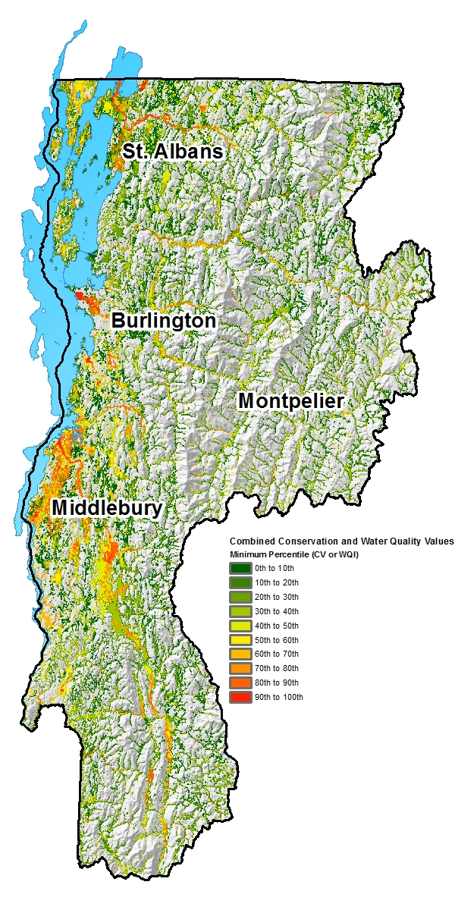
Water Quality Blueprint
Combined
Water Quality Impact
and
Conservation Value
Notes:
We combined the Water Quality Impact Layer and the Conservation Value layer into one layer that highlights opportunities for both.
All three final products should make sense to people with experience in conservation and water quality. The maps should light up with the most important places to protect and restore.
It is important to note that all projects in the Analysis Area are important for conservation and water quality. In each of the final products, low scoring areas are not irrelevant. High scoring areas indicate the presence of features and processes that add value to projects.

Slide 34
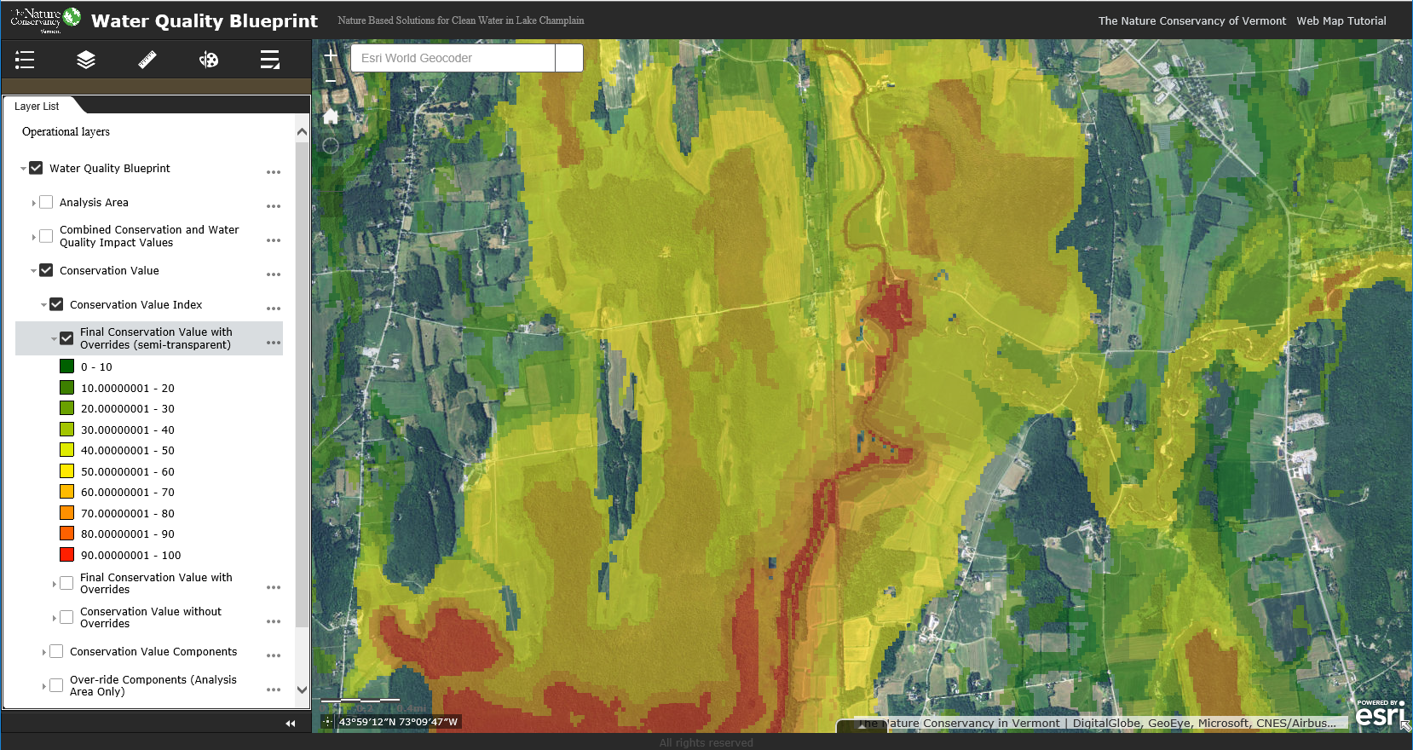
Online Planning Tool
www.nature.org/vtcleanwater/
Notes:
We developed an interactive webmap where other conservation organizations and the public can zoom to areas of interest and view the final products as well as components, source data, and other relevant data.

Slide 35
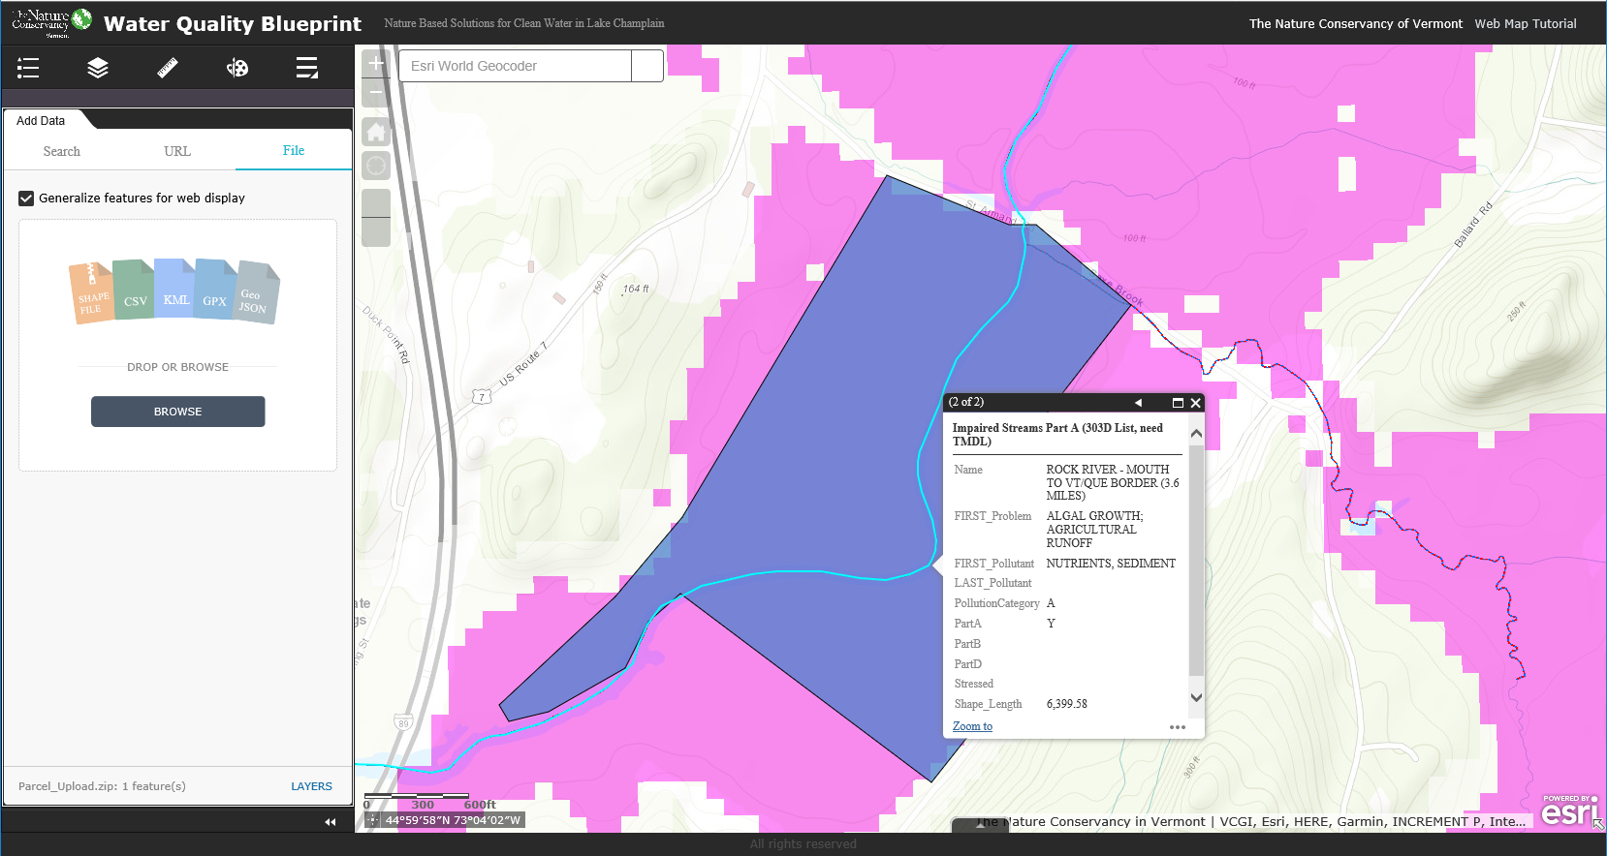
Online Planning Tool
www.nature.org/vtcleanwater/
Notes:
You can upload shapefiles and other GIS data to help track projects, etc. Web services and additional ArcGIS Online basemaps may also be loaded.

Slide 36
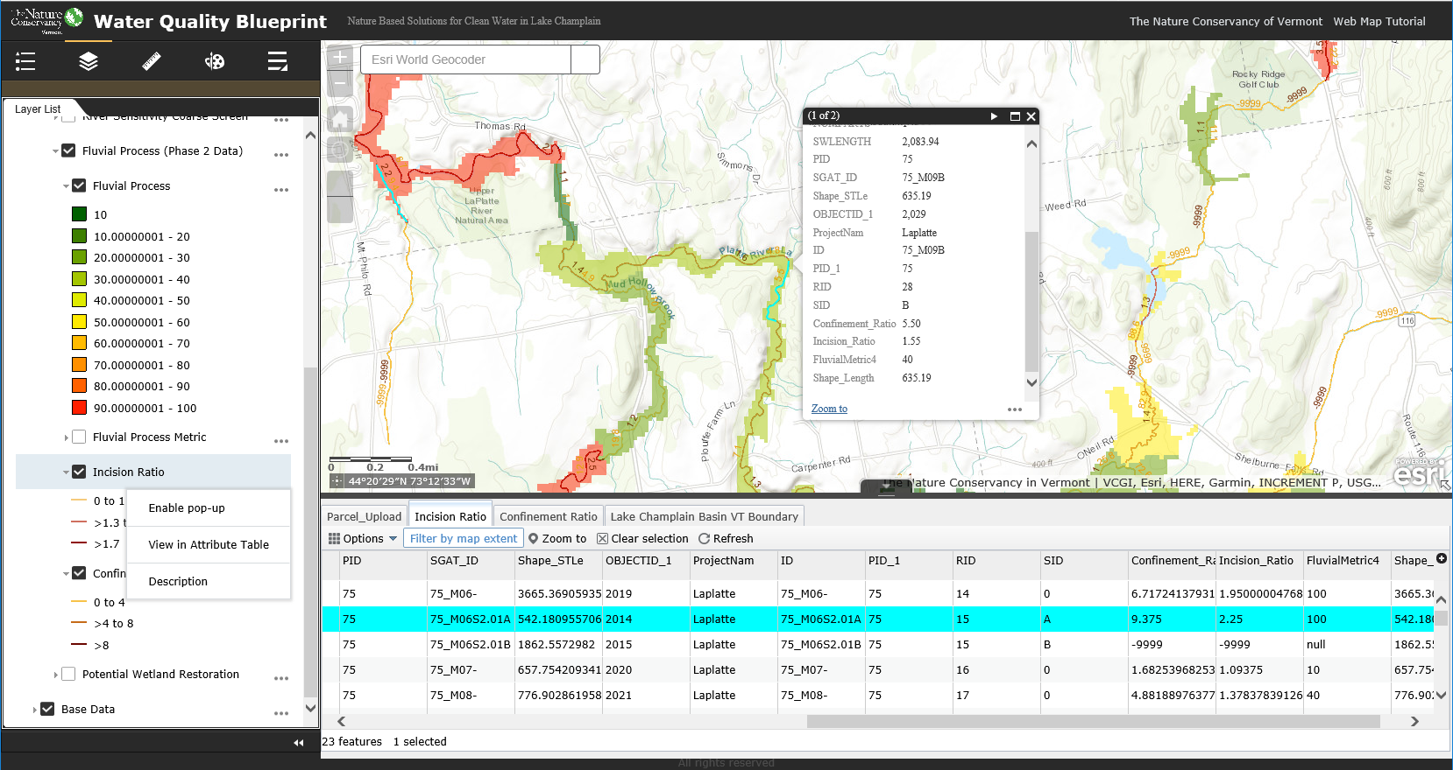
Online Planning Tool
www.nature.org/vtcleanwater/
Notes:
Source datasets include multiple attributes, which can be viewed in pop-ups and tables.
We believe the Blueprint will be very useful to watershed groups and other environmental organizations around the state, and this kind of webmap will be the best way for them to interact with the data, since not everyone has GIS.

Slide 37
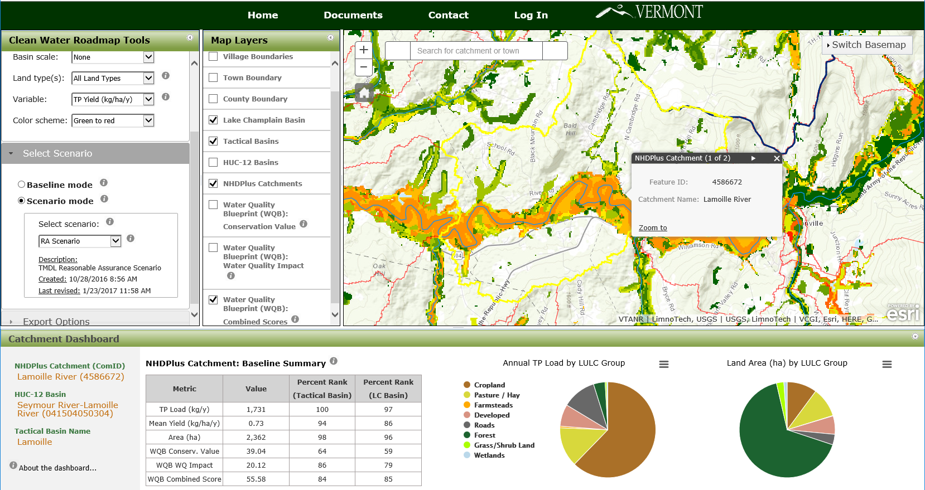
Clean Water Roadmap (VTDEC)
Notes:
And the final Blueprint products are also available as layers in the Clean Water Road Map an online tool created by the Department of Environmental Conservation with support from Keurig Green Mountain to support the DEC’s efforts to reduce phosphorous in Lake Champlain.

Slide 38
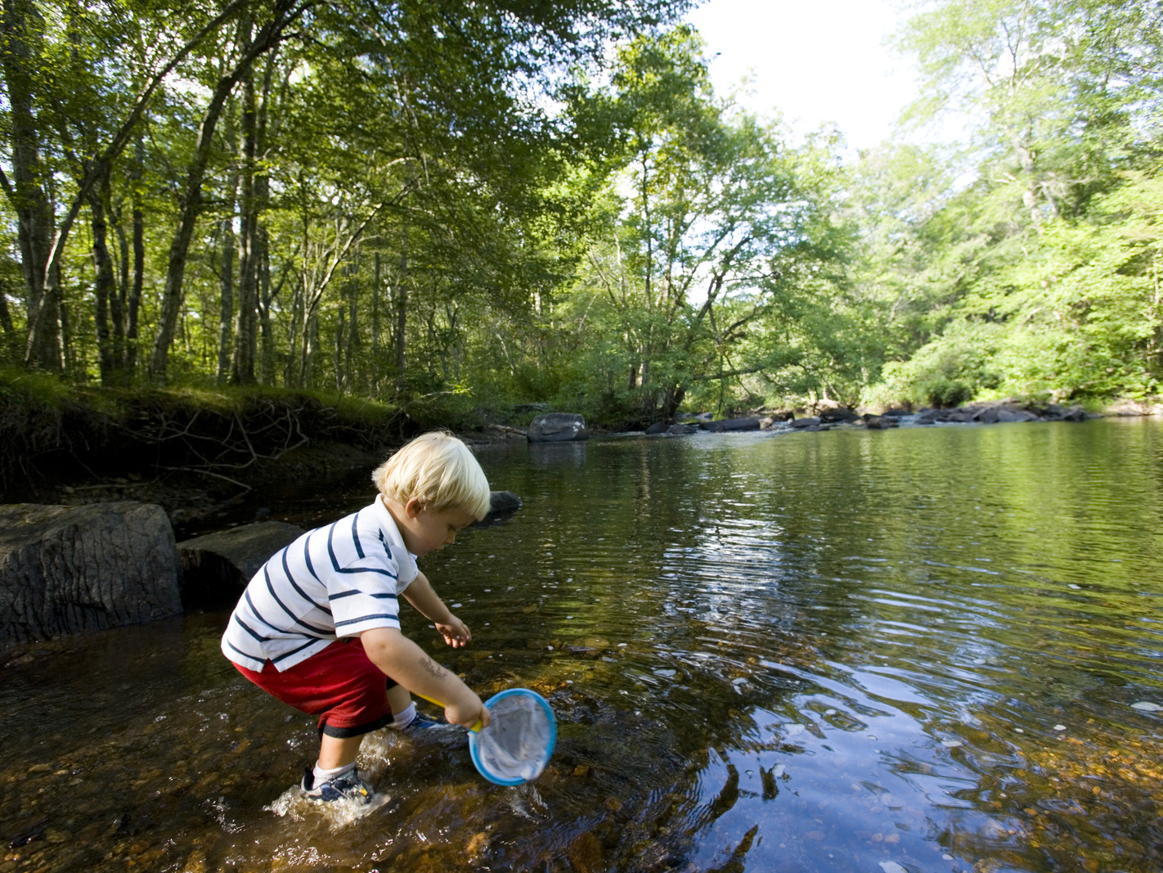
Questions?
Dan Farrell
Rose Paul
Ann Ingerson
With support from Keurig Green Mountain
November 5, 2016

