Slide 1
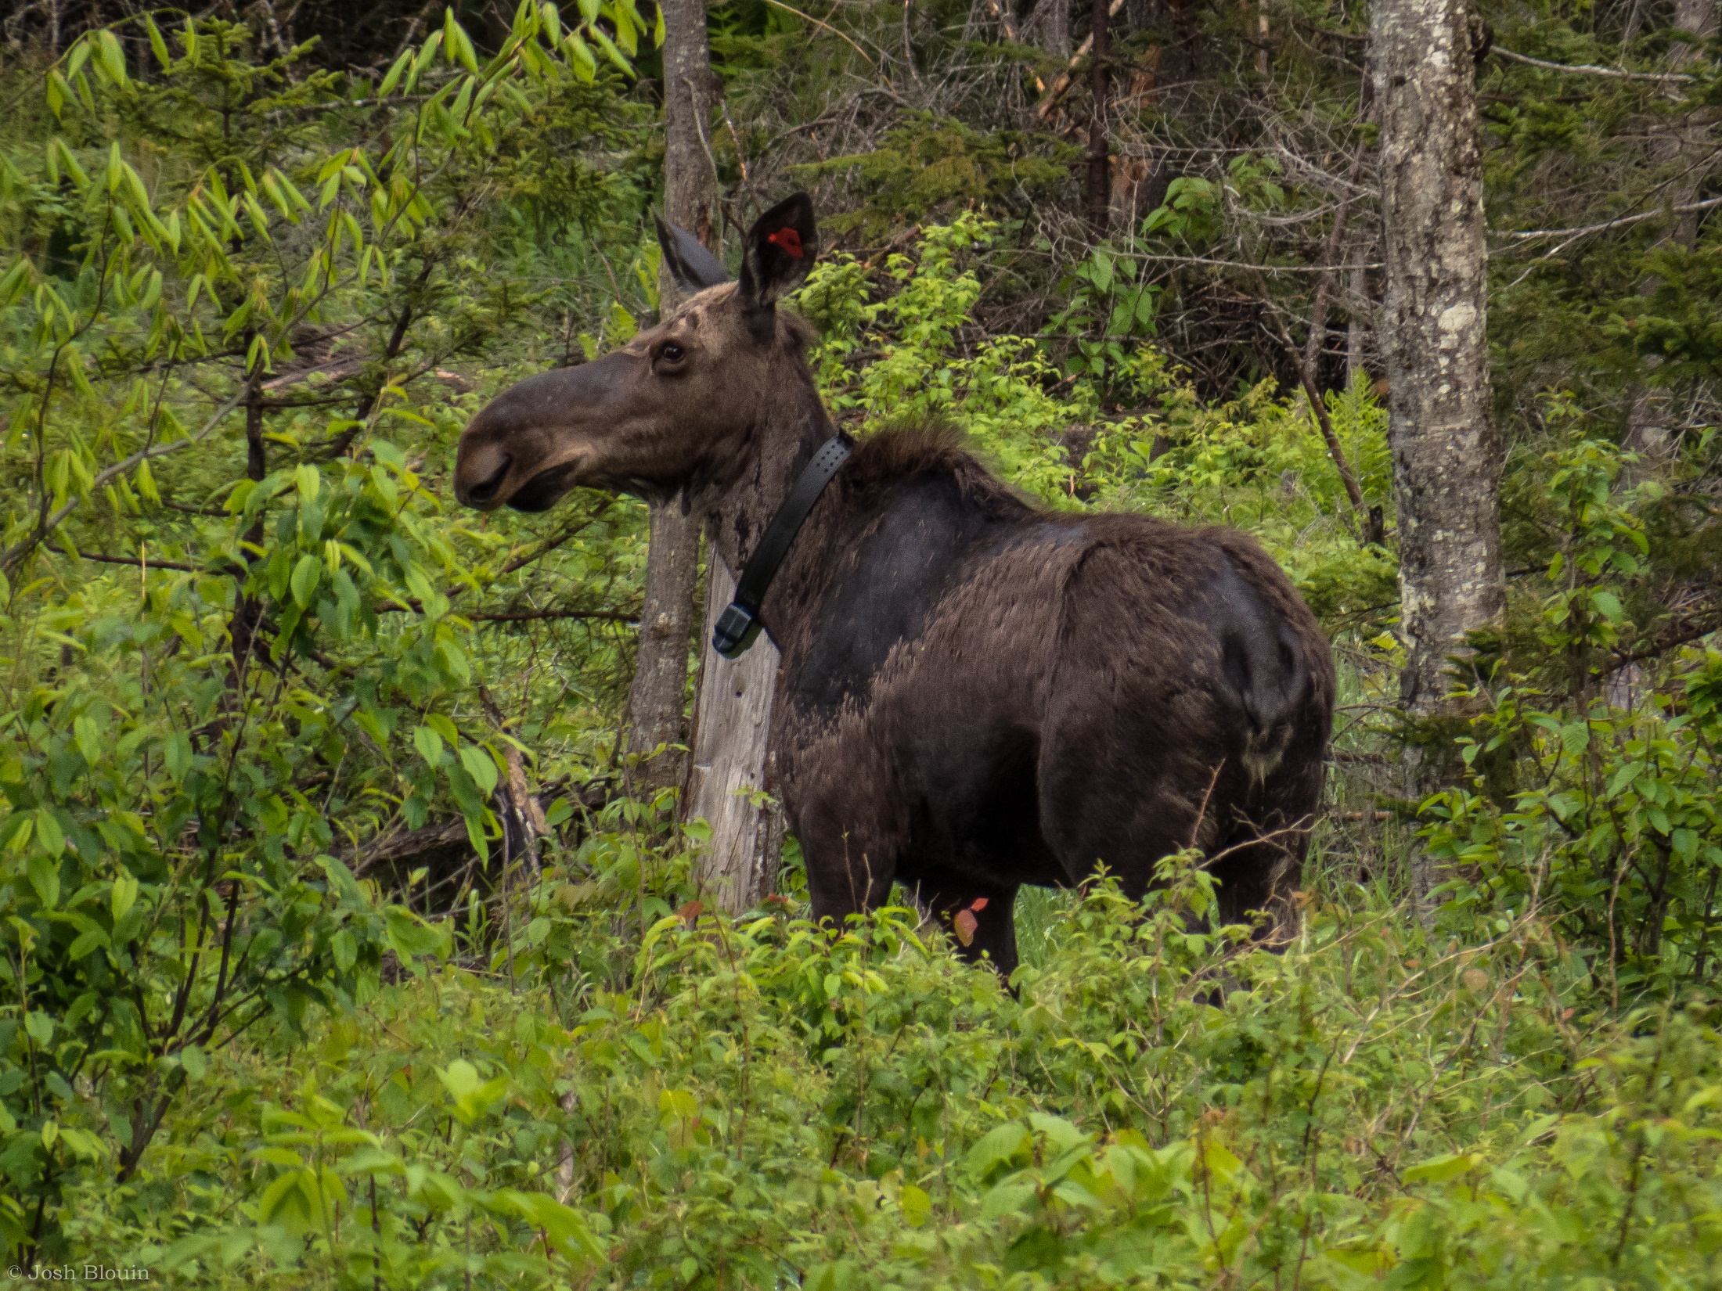
An Overview of Ongoing Moose Mortality and Productivity Research in Northern Vermont.
Jacob DeBow, Cedric Alexander, James D. Murdoch, Therese Donovan

Slide 2
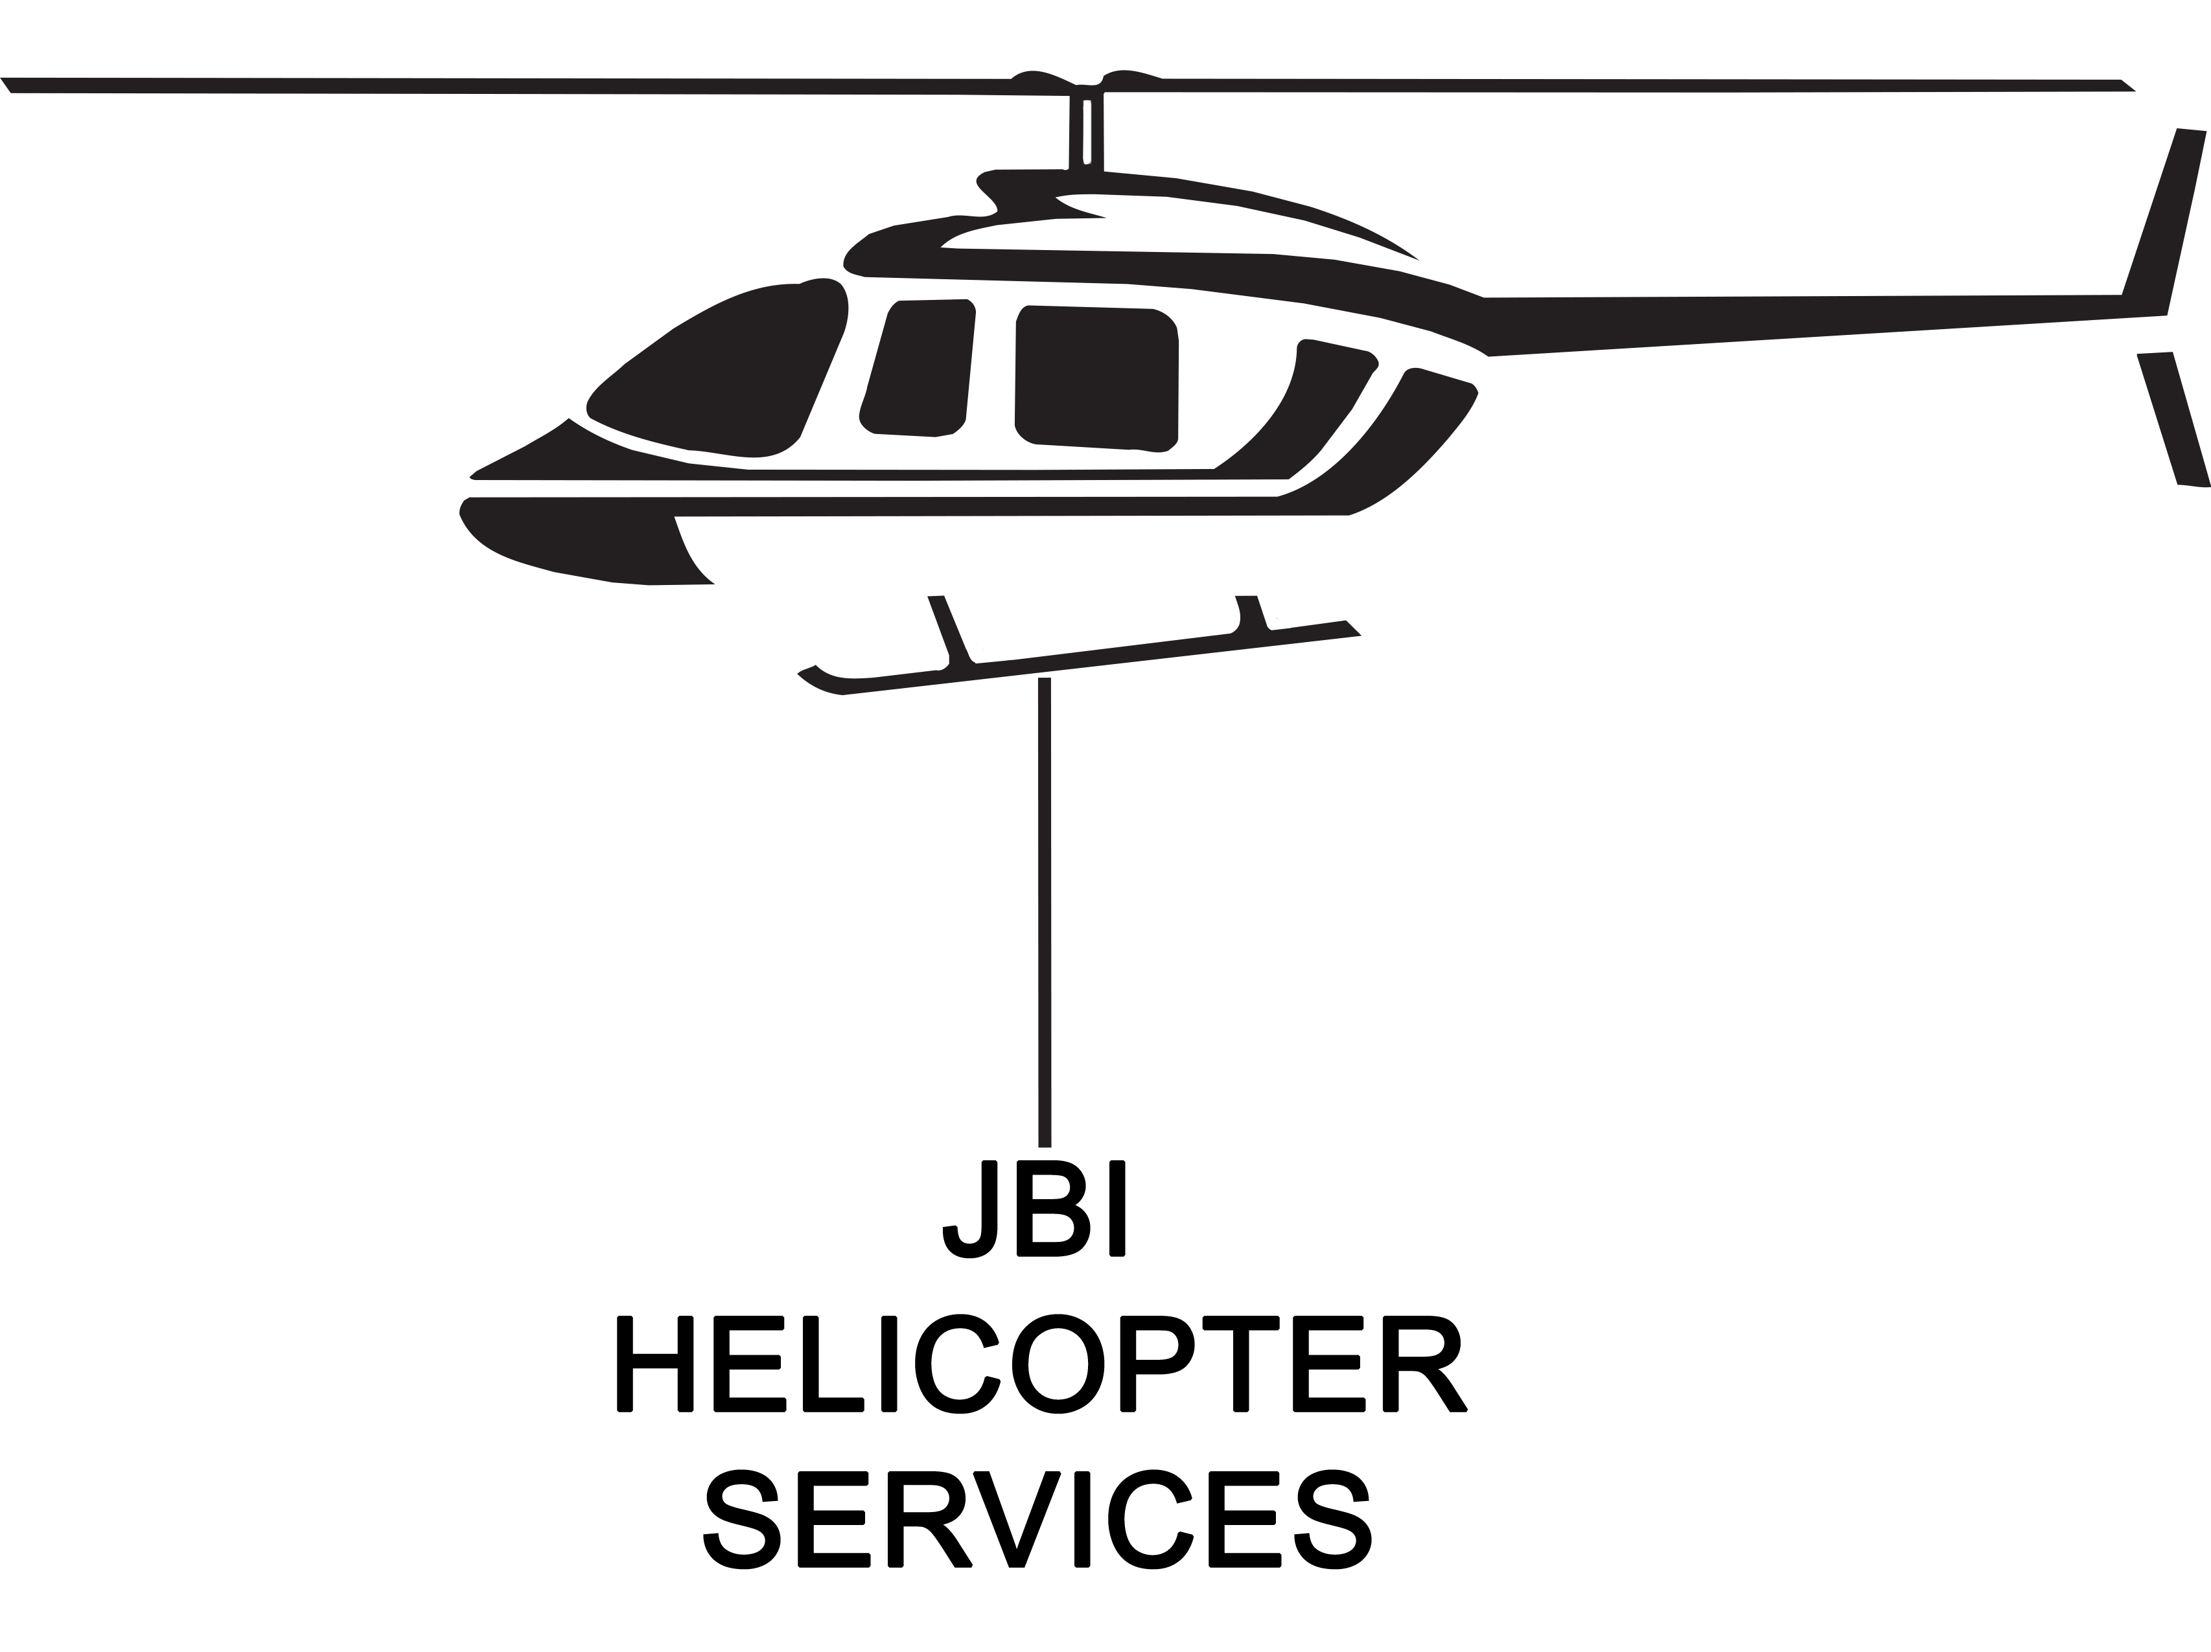
Acknowledgements
VELCO
New Hampshire moose project leaders
JBI Helicopter Services
University of Vermont
Vermont Cooperative Fish and Wildlife Research Unit
All technicians and volunteers who made the data collection possible

Slide 3
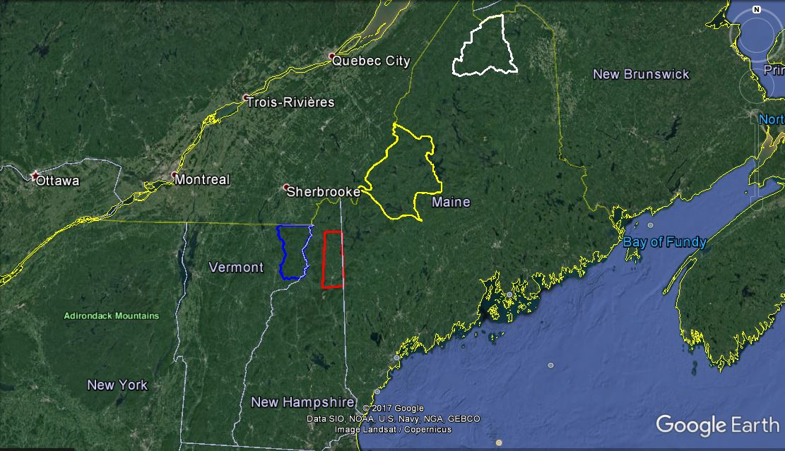
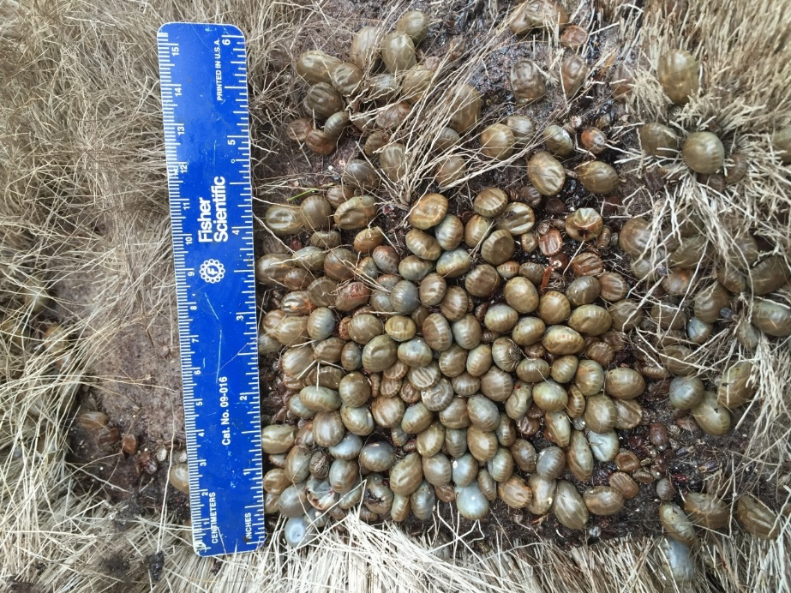
Moose Decline in New England
Similar studies in surrounding states are showing population decline
60-80% mortality of calves 2014-2016
Majority of mortality due to presence of winter ticks
Notes:
Similar studies have been conducted in NH and ME since 2014
Both NH and ME have documented extreme calf mortality and decreased productivity due to winter ticks
Vermont was the missing link as our population seemed to be declining but not as rapidly as surrounding states

Slide 4
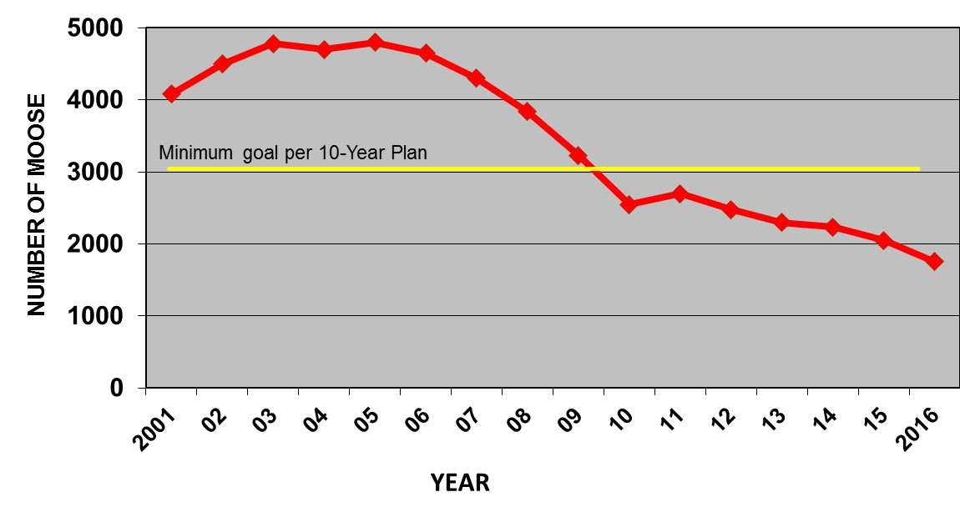
Moose Decline in Vermont
Vermont Moose Population Estimate: 2001-2016
Graph courtesy Cedric Alexander, VDFW
Overall reduced sightings from the public
Initial reduction of moose intended through hunter harvest
Decline post 2010 unintended

Slide 5
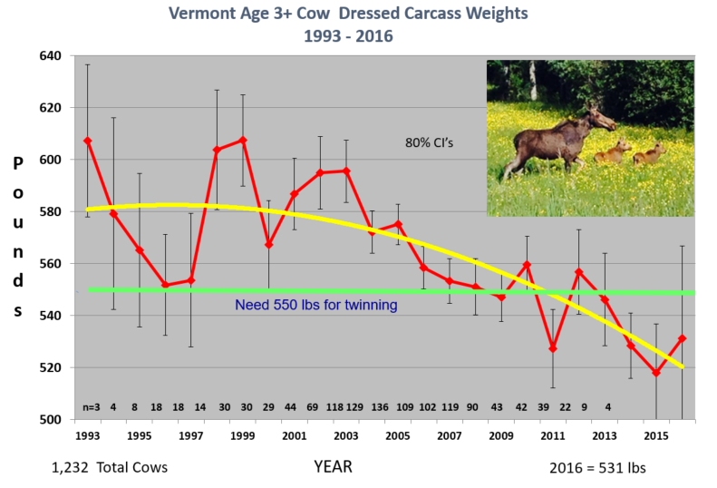
Moose Decline in Vermont
Trends in Vermont moose heard have shown declining density and health
Decreased size of harvest animals
Decreased ovulation rate
Recent decline coincides with marked epizootics in neighboring states
Graph courtesy Cedric Alexander, VDFW
Notes:
Vermont intentionally reduced moose numbers in the early 2000’s for both biological and social reasons

Slide 6
Study Area: WMU E1 and E2
Northeast Kingdom of VT
Wildlife Management Units E1 and E2
Approx. 1,738 Square Kilometers
Route 2 north to Canadian Border
Route 114 east to New Hampshire border
Notes:
Aprox. 670 Square Miles

Slide 7
Objectives
Analyze results from blood screening at capture to obtain a general health assessment of collared individuals;
Analyze snow urine samples from collared calves to monitor changes in winter nutritional plane;
Determine cause and rate of mortality of adults, yearlings, and calves;
Measure productivity of yearling and adult cows and determine timing and cause of death of neonatal calves.

Slide 8
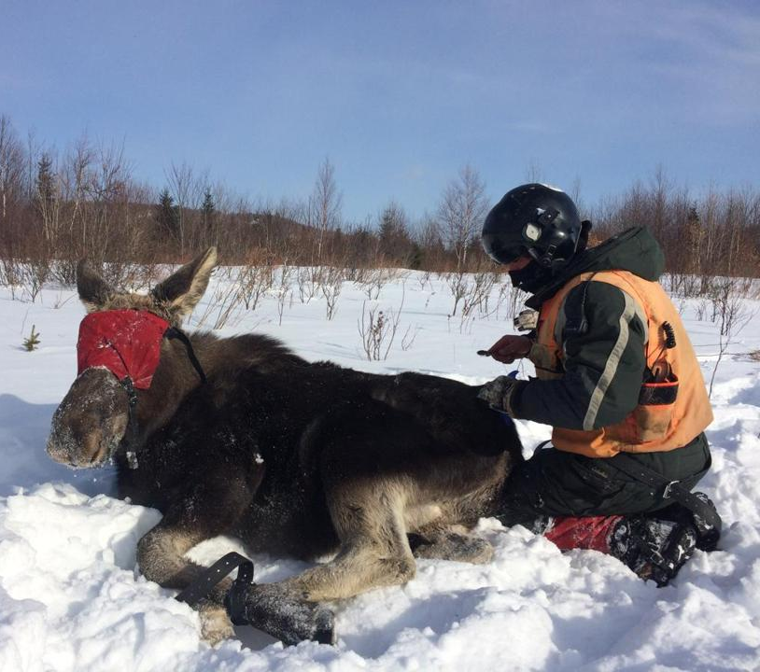
2017 Capture
Contracted with Native Range Capture Services
Use helicopters and net guns to capture moose
Crew takes biological samples and affix collars/ ear tags
Release moose in under 10 minutes
All capture related activities abide by IACUC standards

Slide 9
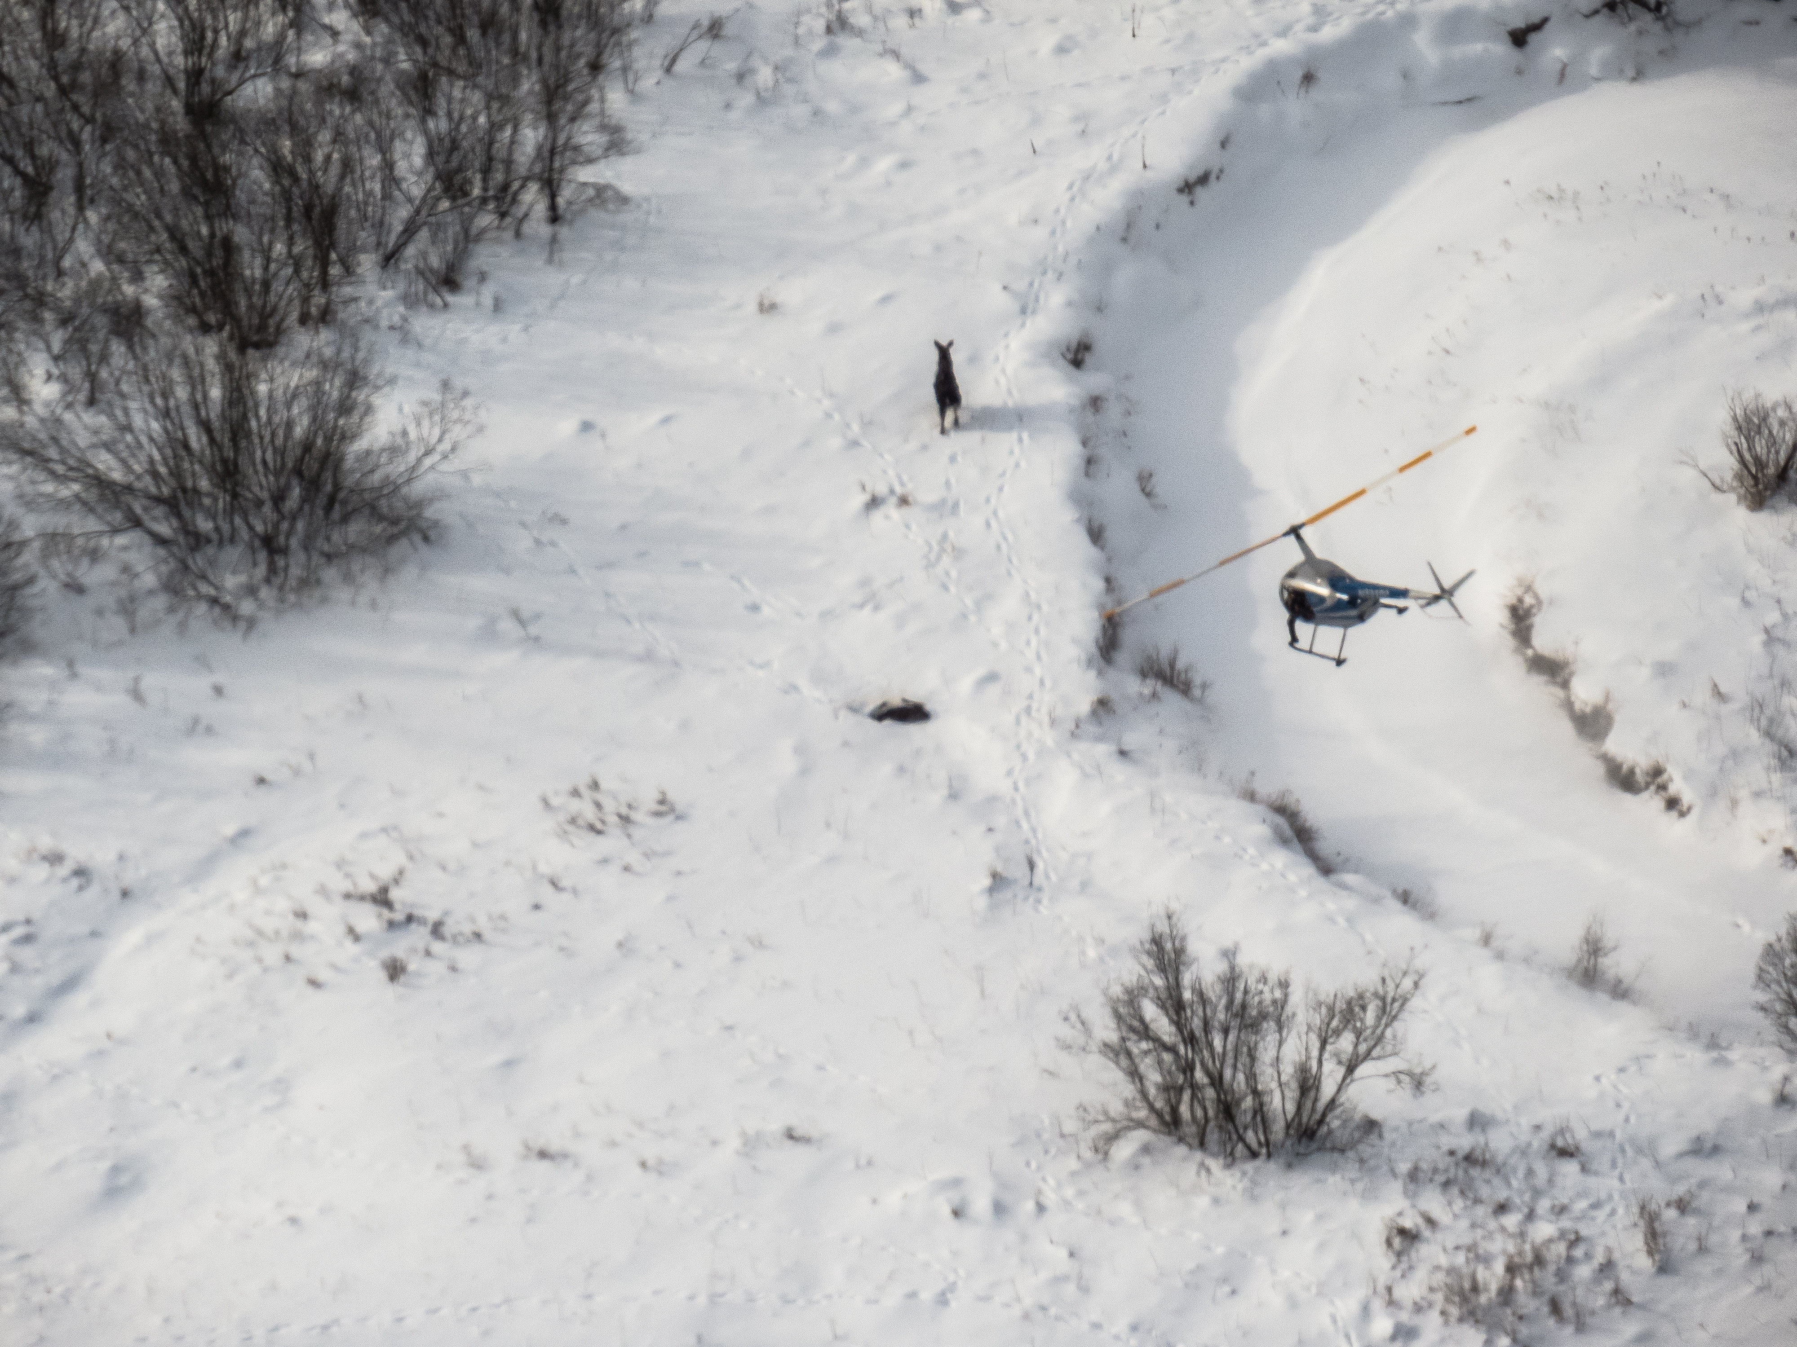
Captured 30 cows and 30 calves

Slide 10
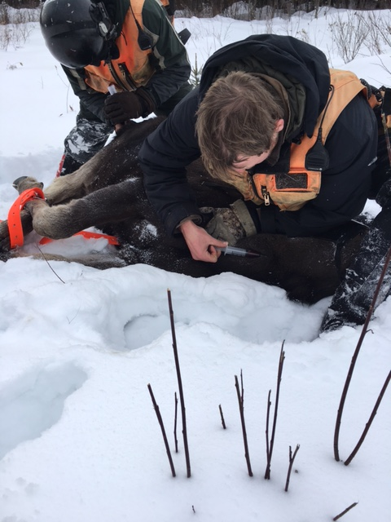
Capture Sample Processing
Objective One
Samples Collected
Hair
Feces
Winter ticks
Whole blood
10ml in anti-clot tubes
20ml in red top tubes to be spun for serum
Weight of calves

Slide 11
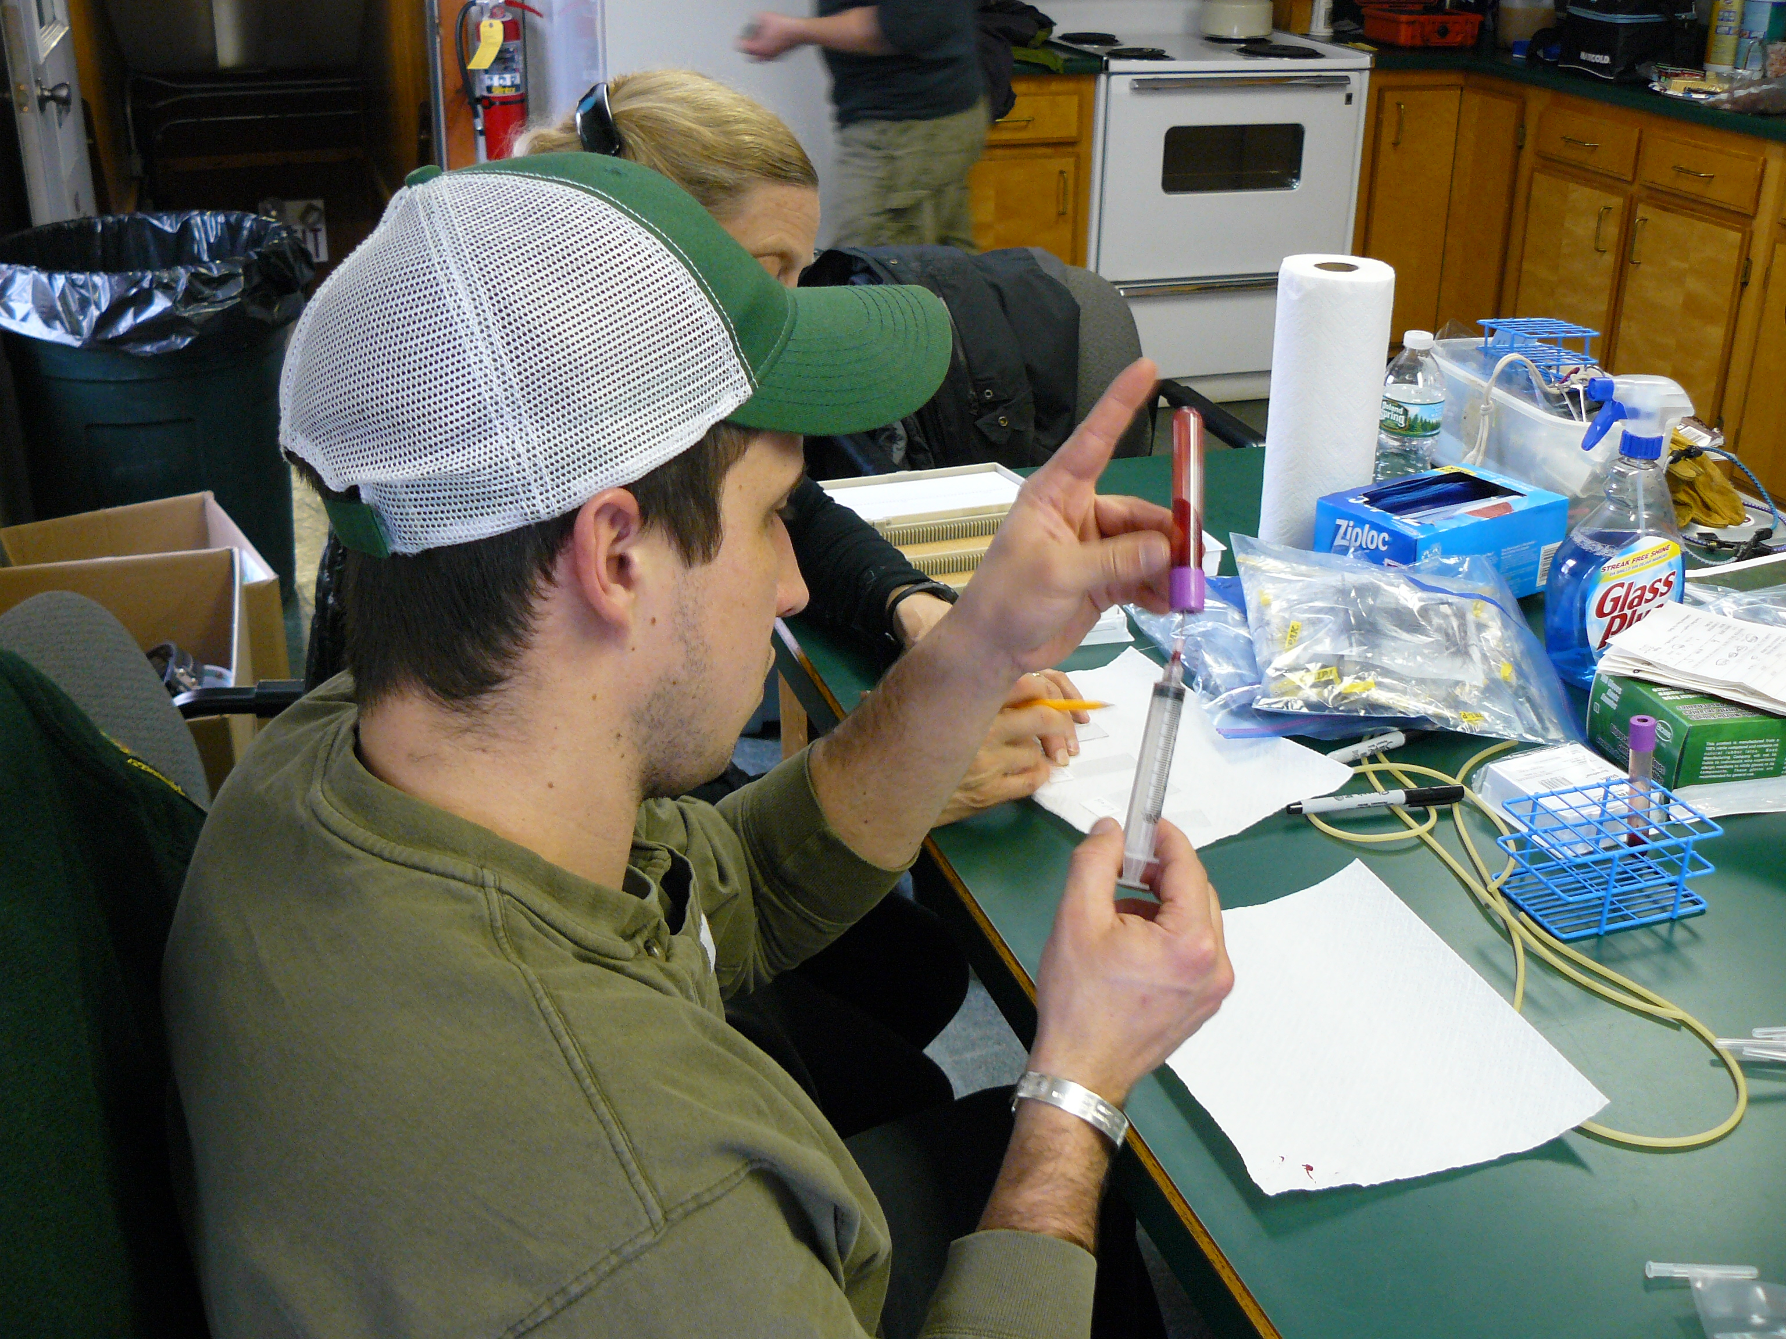
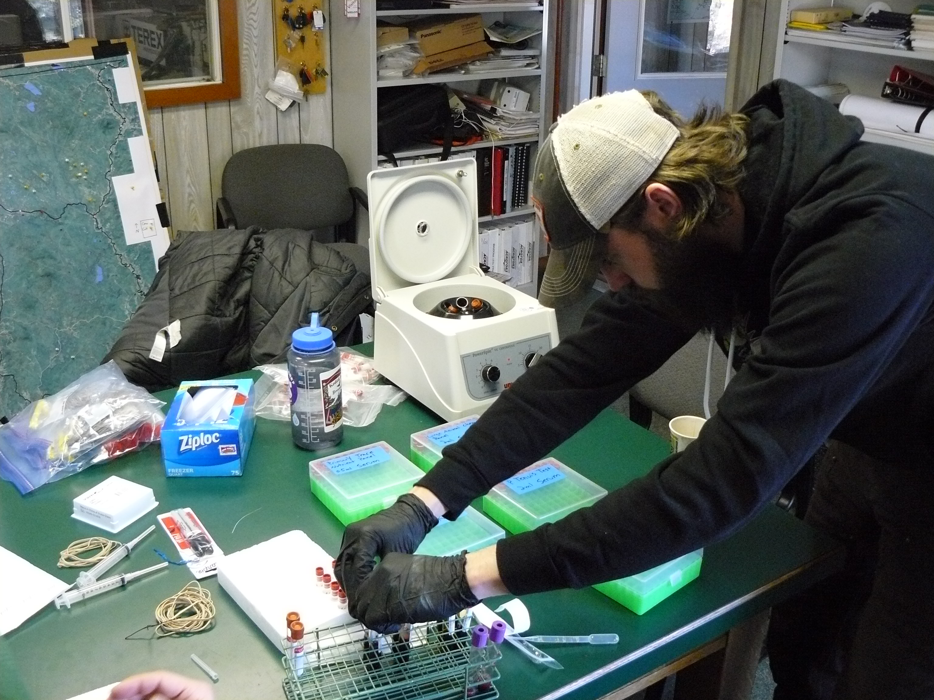
Capture Sample Processing
Objective One
Blood Work Tests
Complete Blood Count
Large animal Chemistry Panel
Primary Trace Nutrient Panel
Toxic Elements
Pregnancy Test
Adult Cows only
Bank all extra whole blood and serum

Slide 12
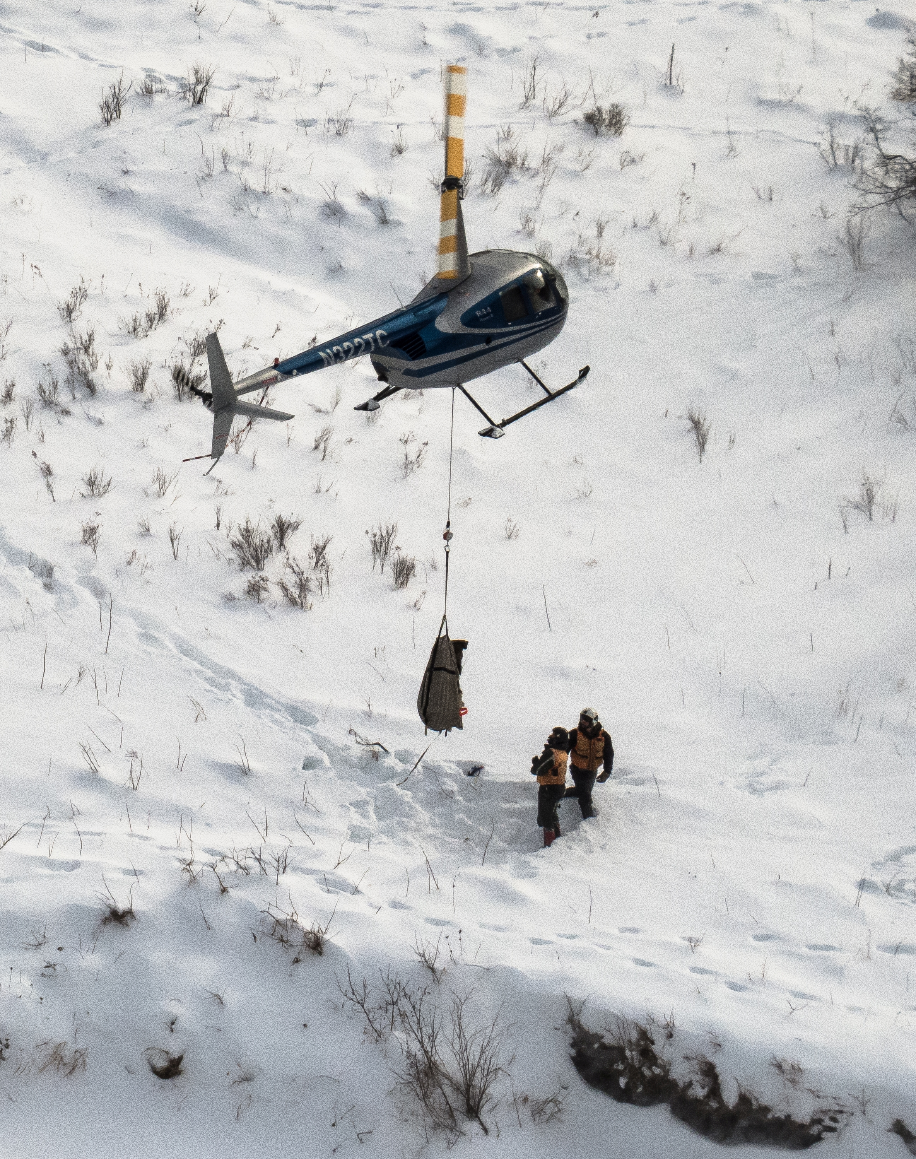
Calf Weights (kg):
Average – 174
Range – 109 – 231
Tick Count
Averages:
Shoulder - 16.3
Rump - 6.8
Total - 23.1
Notes:
Average: Aprox 383 pounds s

Slide 13
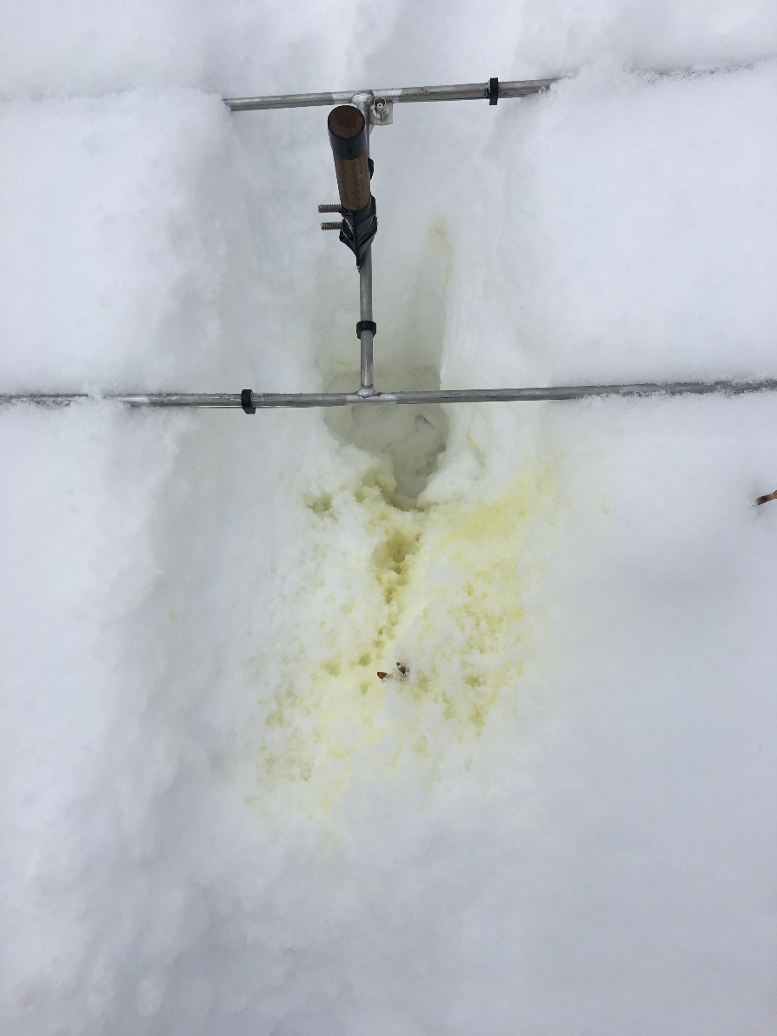
Winter Field Work: Snow Urine Collection
Objective Two
Collect Urine from all 30 calves on a biweekly basis
Attempt to monitor Urea Nitrogen and Creatinine rations (UN:C)
UN:C ratios during winter and early spring can tell us when a moose begins to metabolize muscle
Samples have not yet been sent for testing

Slide 14
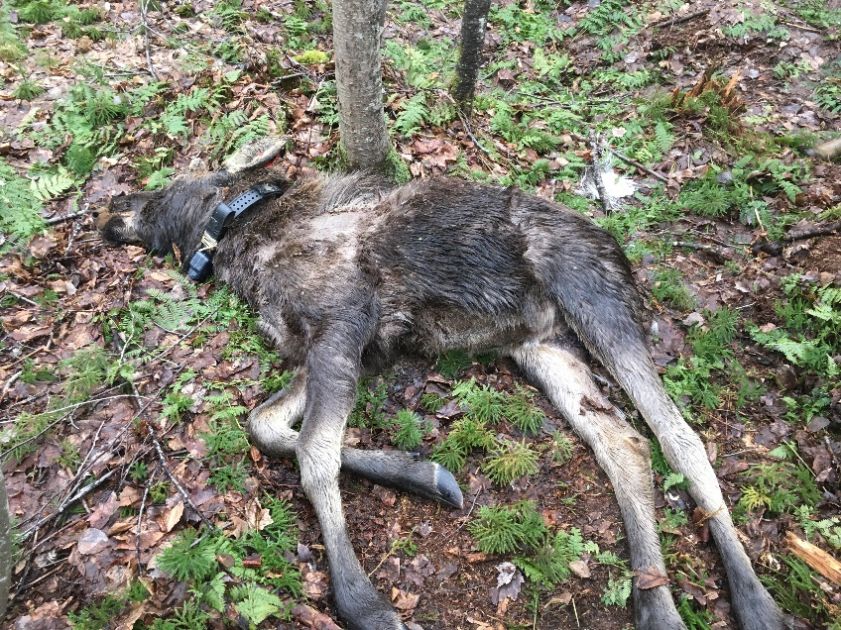
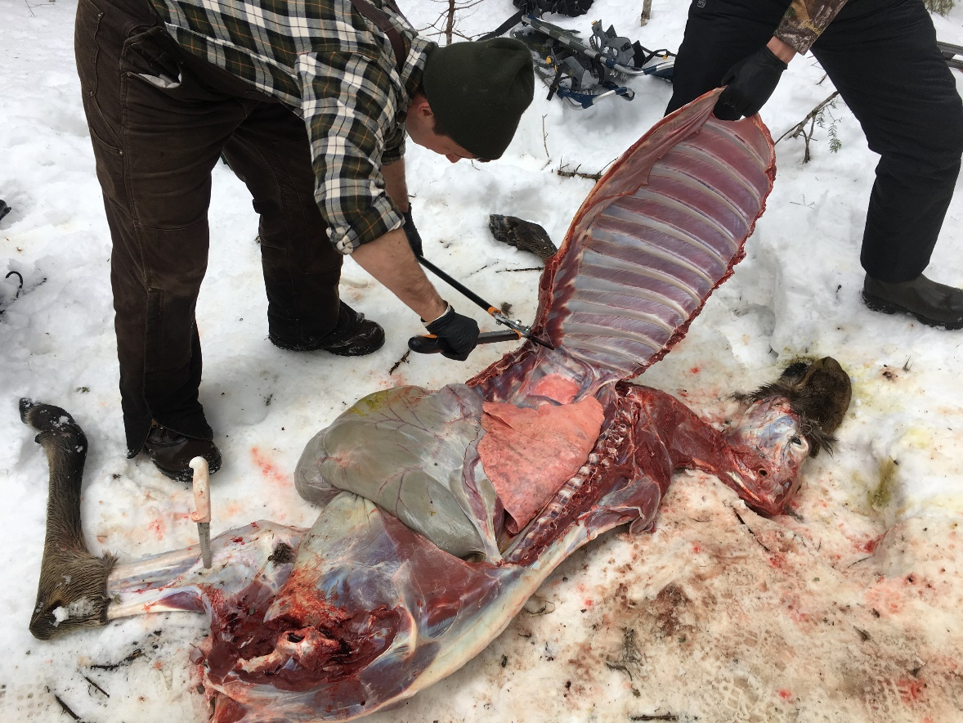
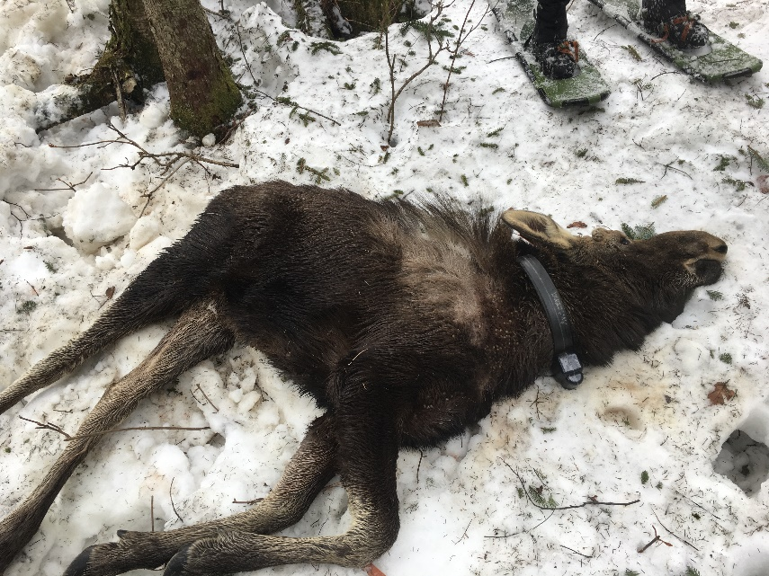
Spring Field Work: Necropsies
Objective Three
February – April
Perform complete field necropsies
Tissue samples sent to the UNH Diagnostics Lab for pathology

Slide 15
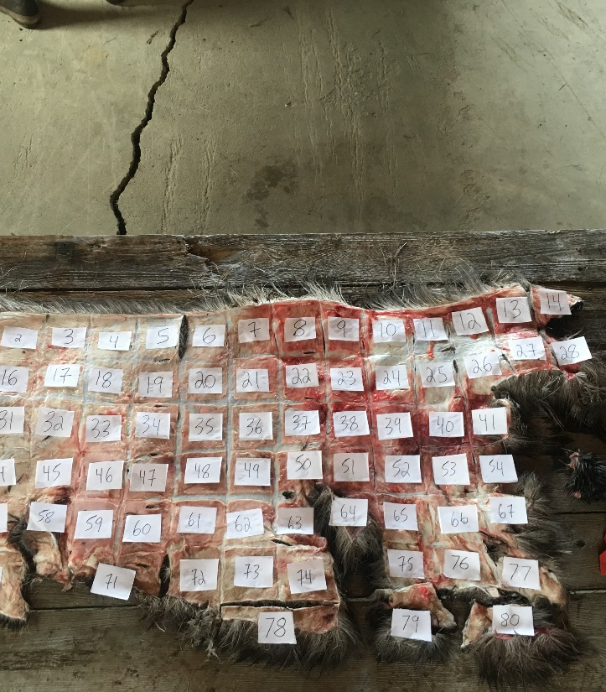
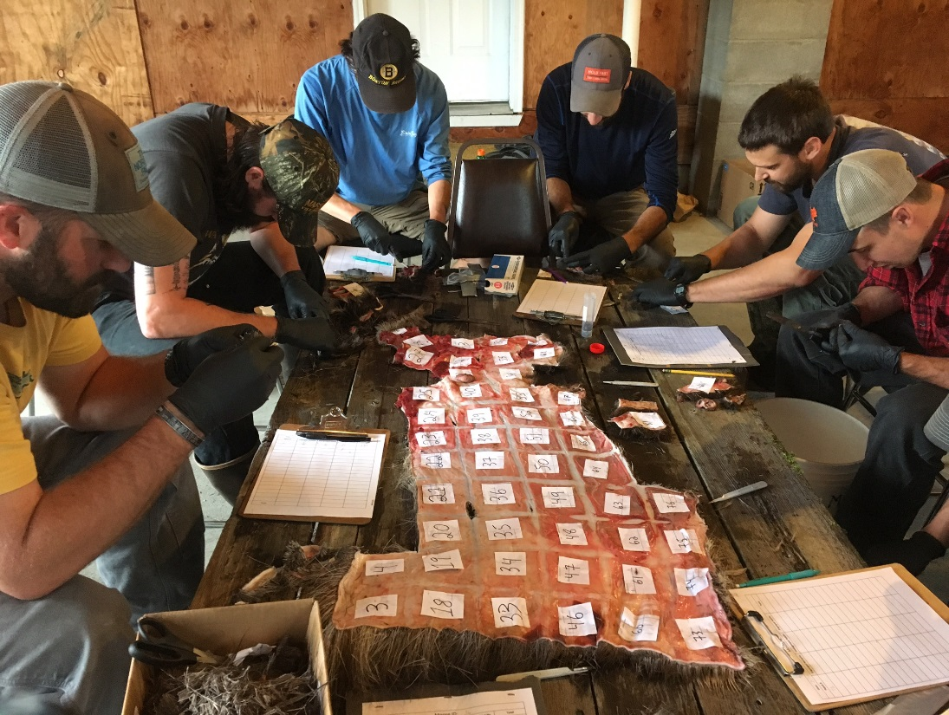
Summer Field Work: Tick Counts
Performed half hide counts on 4 calves
Multiply half hide total by two for whole hide average
Following methods used by NH in previous years of tick counts

Slide 16
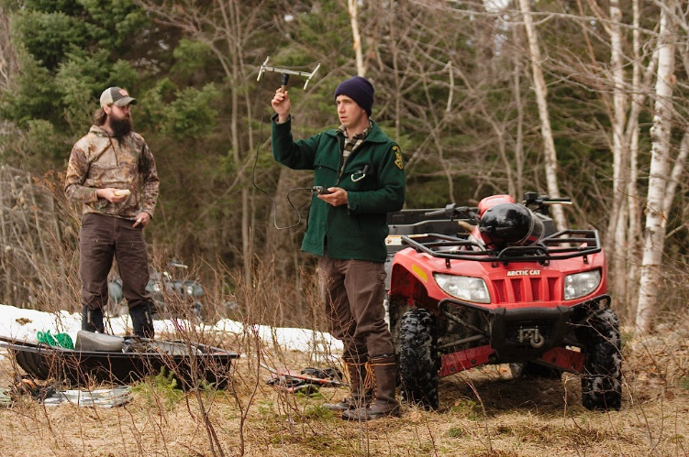
Summer Field Work: Cow/ Calf Walkins
Objective Four
Obtain a visual of known pregnant collared cows every other day during peak calving months (May/June)
2017: 19 of 30 cows pregnant
Obtain a visual of non-pregnant moose once weekly to rule out false negatives
Intensive field work to find:
Exact calving dates
Percent neonate survivorship
Cause of death of deceased neonates

Slide 17
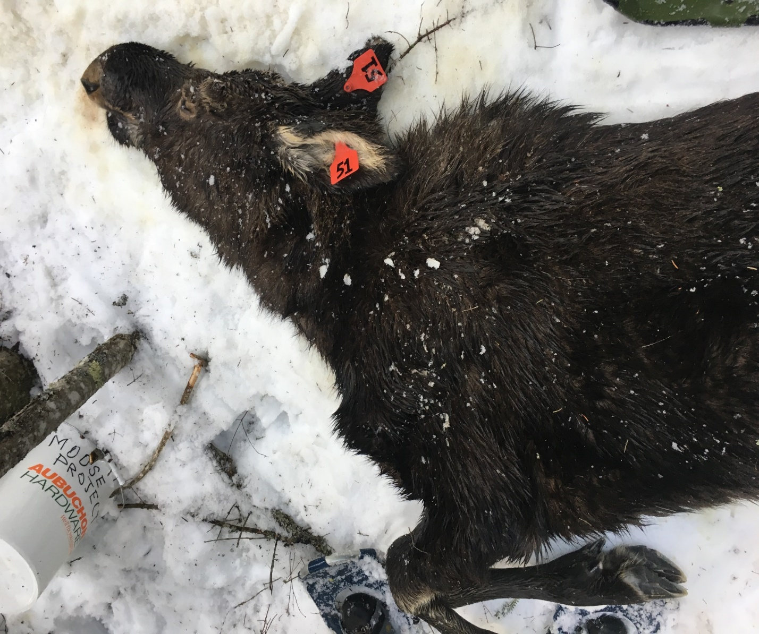
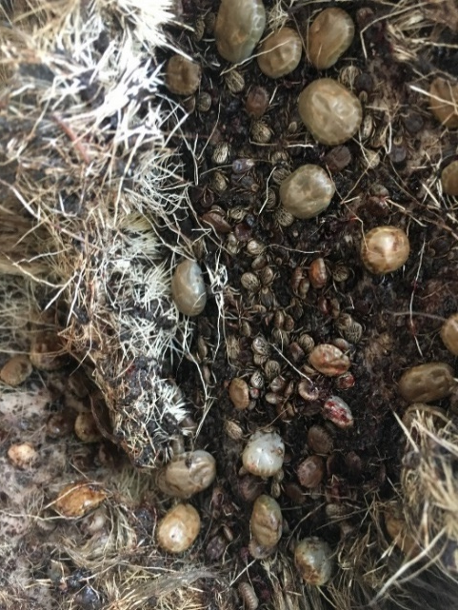
Results: Winter Calf Mortality
Objective Three
12 of 30 calves died (40%)
Pathology reports showed severe atrophy and emaciation in 9 of 12 calves analyzed
While other symptoms of poor health were noted, emaciation from ticks appears to be the leading cause of death

Slide 18
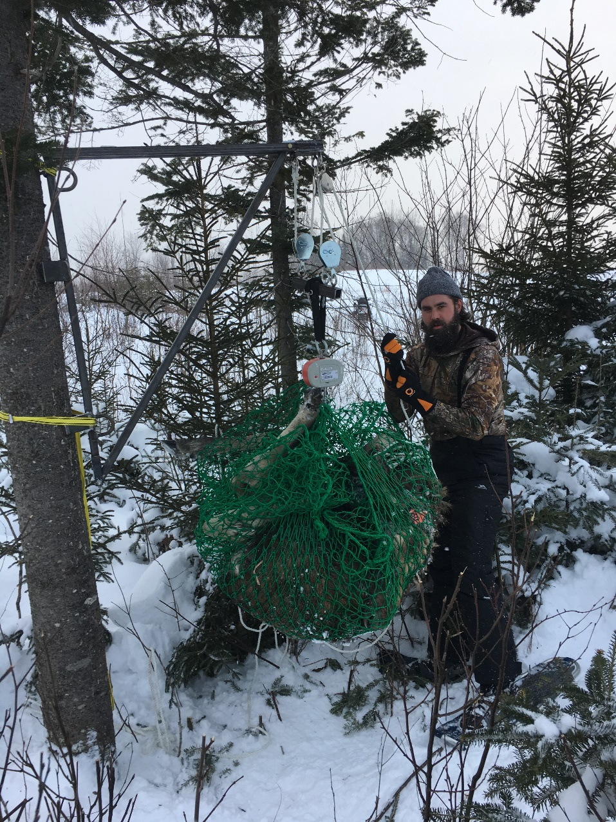
Results: Winter Calf Mortality
Objective Three
Death weights from 8 of 12 calves:
January – March/April
Average weight loss: 37kg
22.6% of capture body weight
Range: 22 – 48.5kg

Slide 19
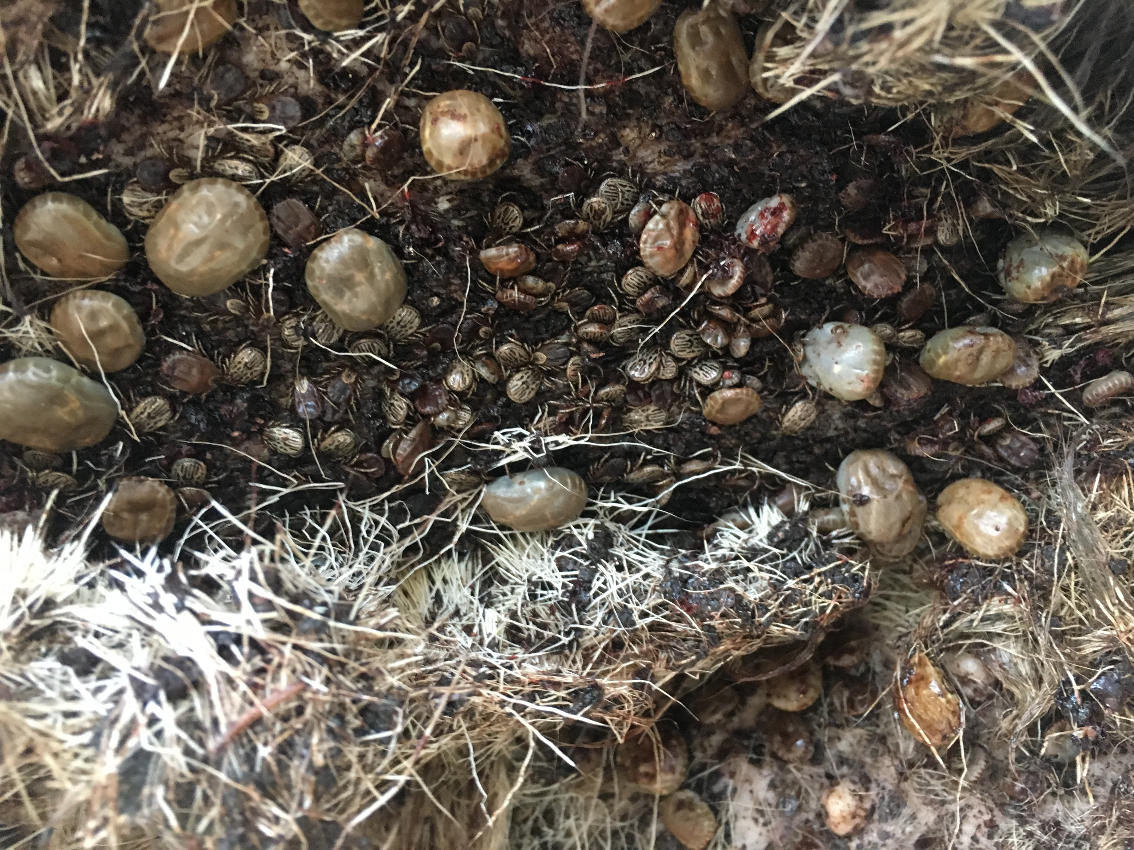
Vermont #51, male calf died 4/09/17 Weighed 292 lbs.

Slide 20
Results: Tick Count
Objective Three
Moose ID | D.O.D | Engorged Nymphs | Adults | Engorged Adults | Total
36 | 3/15/2017 | 1,250 | 8,668 | 592 | 10,510
6 | 4/4/2017 | 312 | 20,454 | 692 | 21,458
51 | 4/9/2017 | 434 | 26,086 | 866 | 27,386
33 | 4/10/2017 | 430 | 24,284 | 468 | 25,182
Total Average: 21,134
Significantly lower than NH’s previous tick counts recorded in epizootic winters.
Tick counts most likely conservative estimates

Slide 21
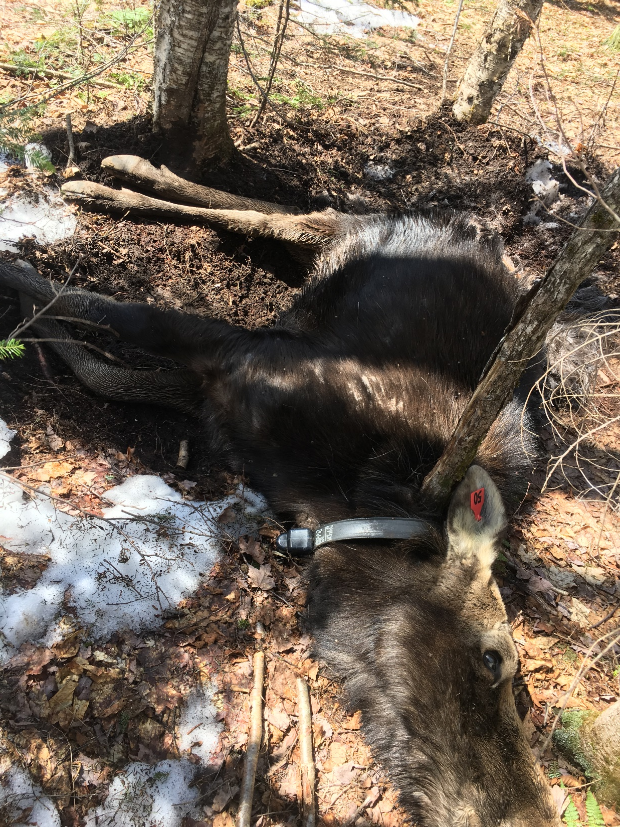
Results: Winter Cow Mortality
3 of 30 cows died (10%)
Emaciation and net caloric debt sighted for two
P. tenuis sighted in other
10% mortality is considered normal

Slide 22
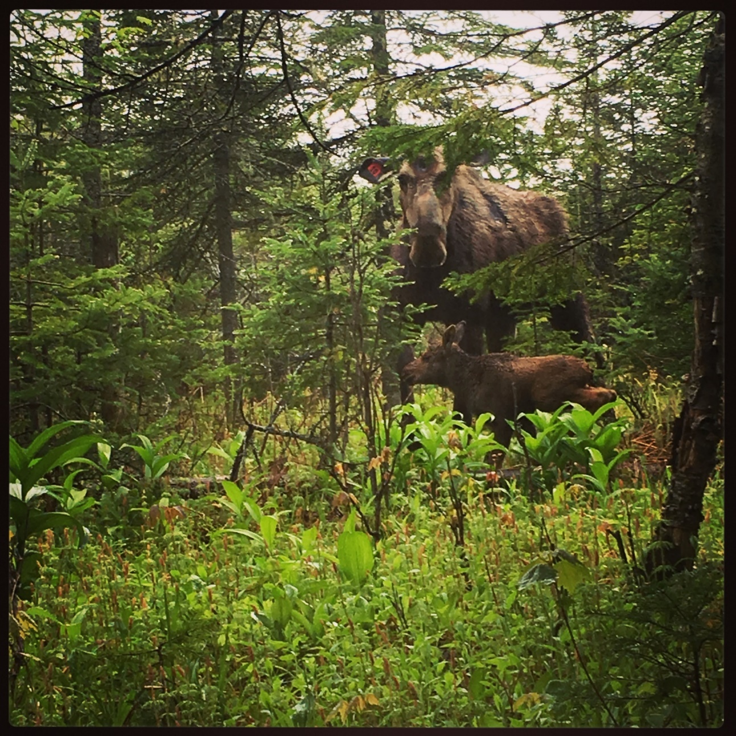
Results: Calving
Objective Four
15 of 30 cows calved (50%)
15 of 19 pregnant cows calved (79%)
16 calves total were seen due to one set of twins
10 of 16 calves still alive as of now

Slide 23
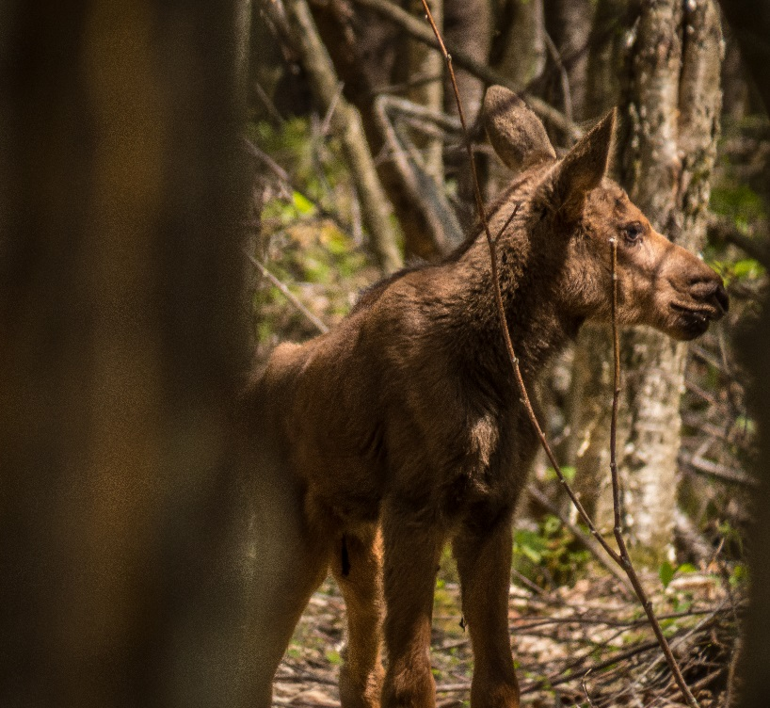
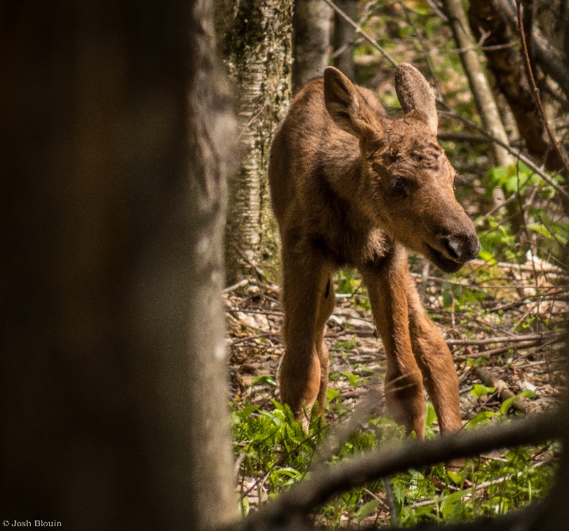
Results: Calving
Objective Four
Calf survivorship (62%)
Average calving date: 5/18/2017
10 calves born to 30 viable cows (33% fecundity)

Slide 24
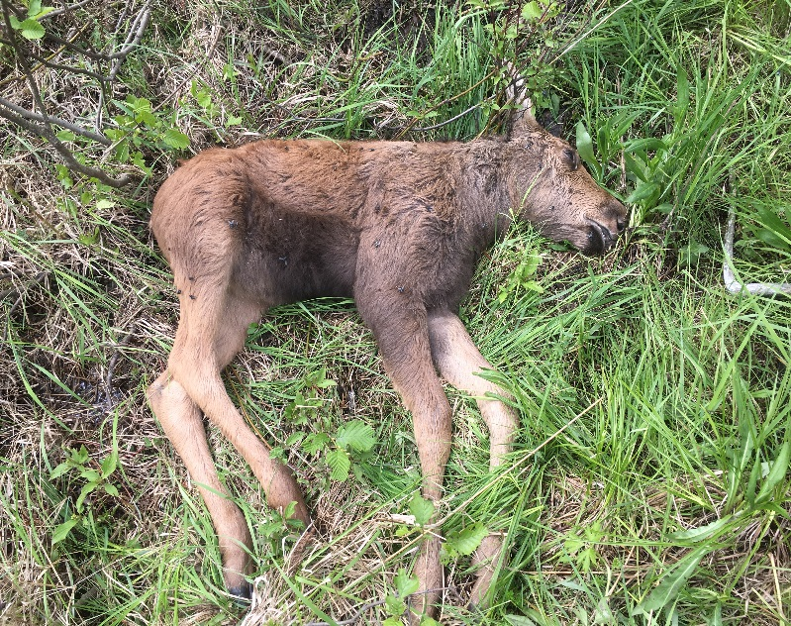
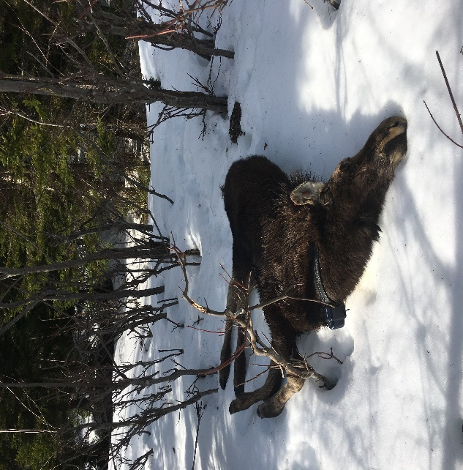
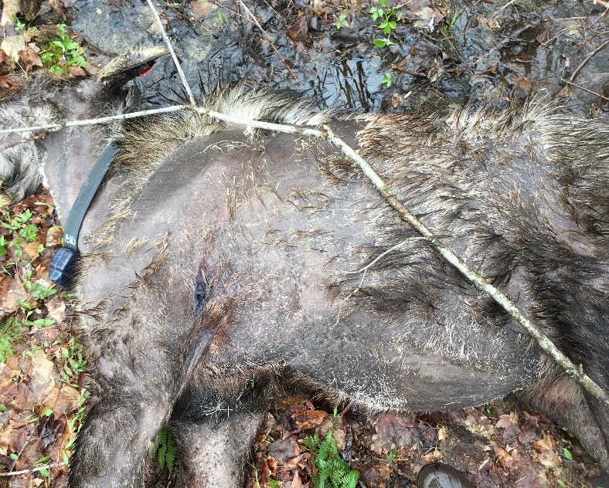
2017 Comparison by State
State | Calf Mortality | Adult Mortality | Calving Rate | Neonate Survivorship
ME WMD 2 | 24% | 6% | 46% | 80%
ME WMD 8 | 58% | 9% | 46% | 79%
NH | 30% | 14% | 76% | 80%
VT | 40% | 10% | 50% | 62%

Slide 25
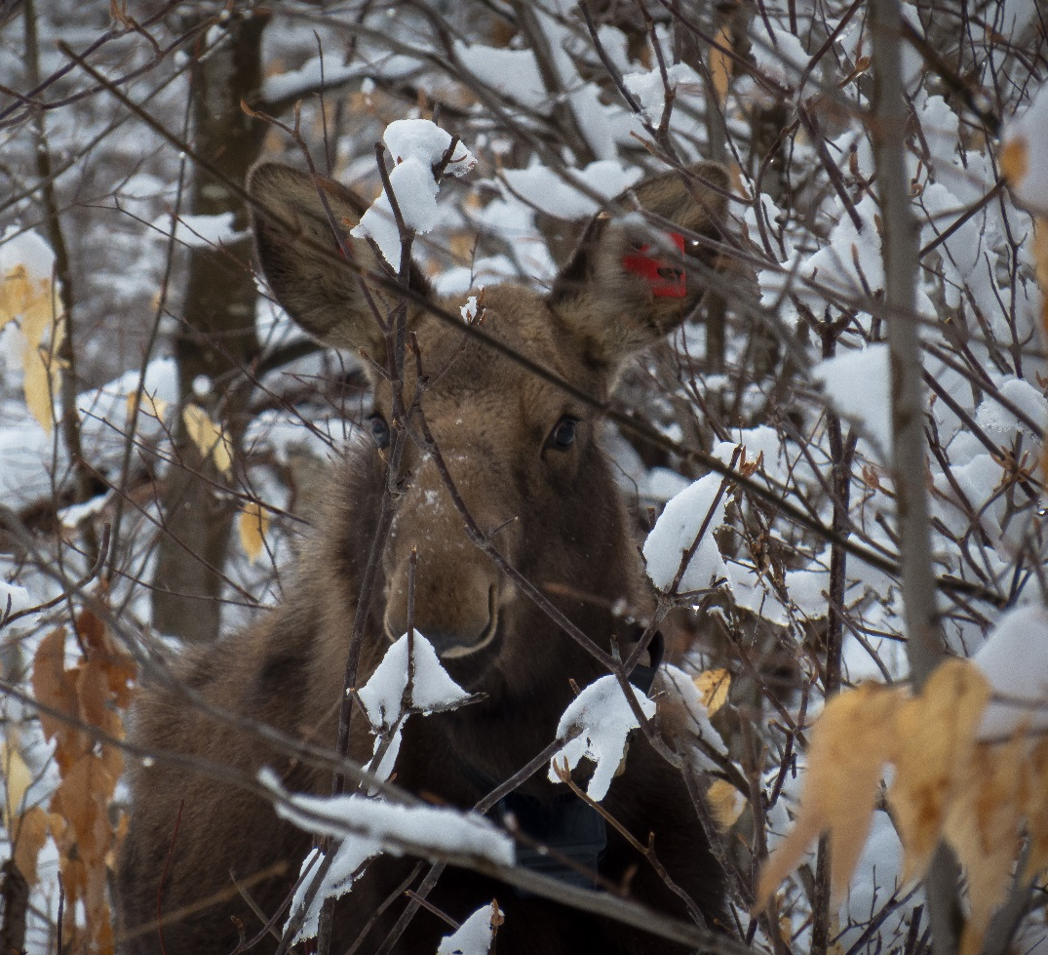
Year One of Three
Two more captures/ field seasons planned
Maintain 30 collared calves and approximately 30 collared cows on the landscape
Plan to capture 35 moose this January

Slide 26
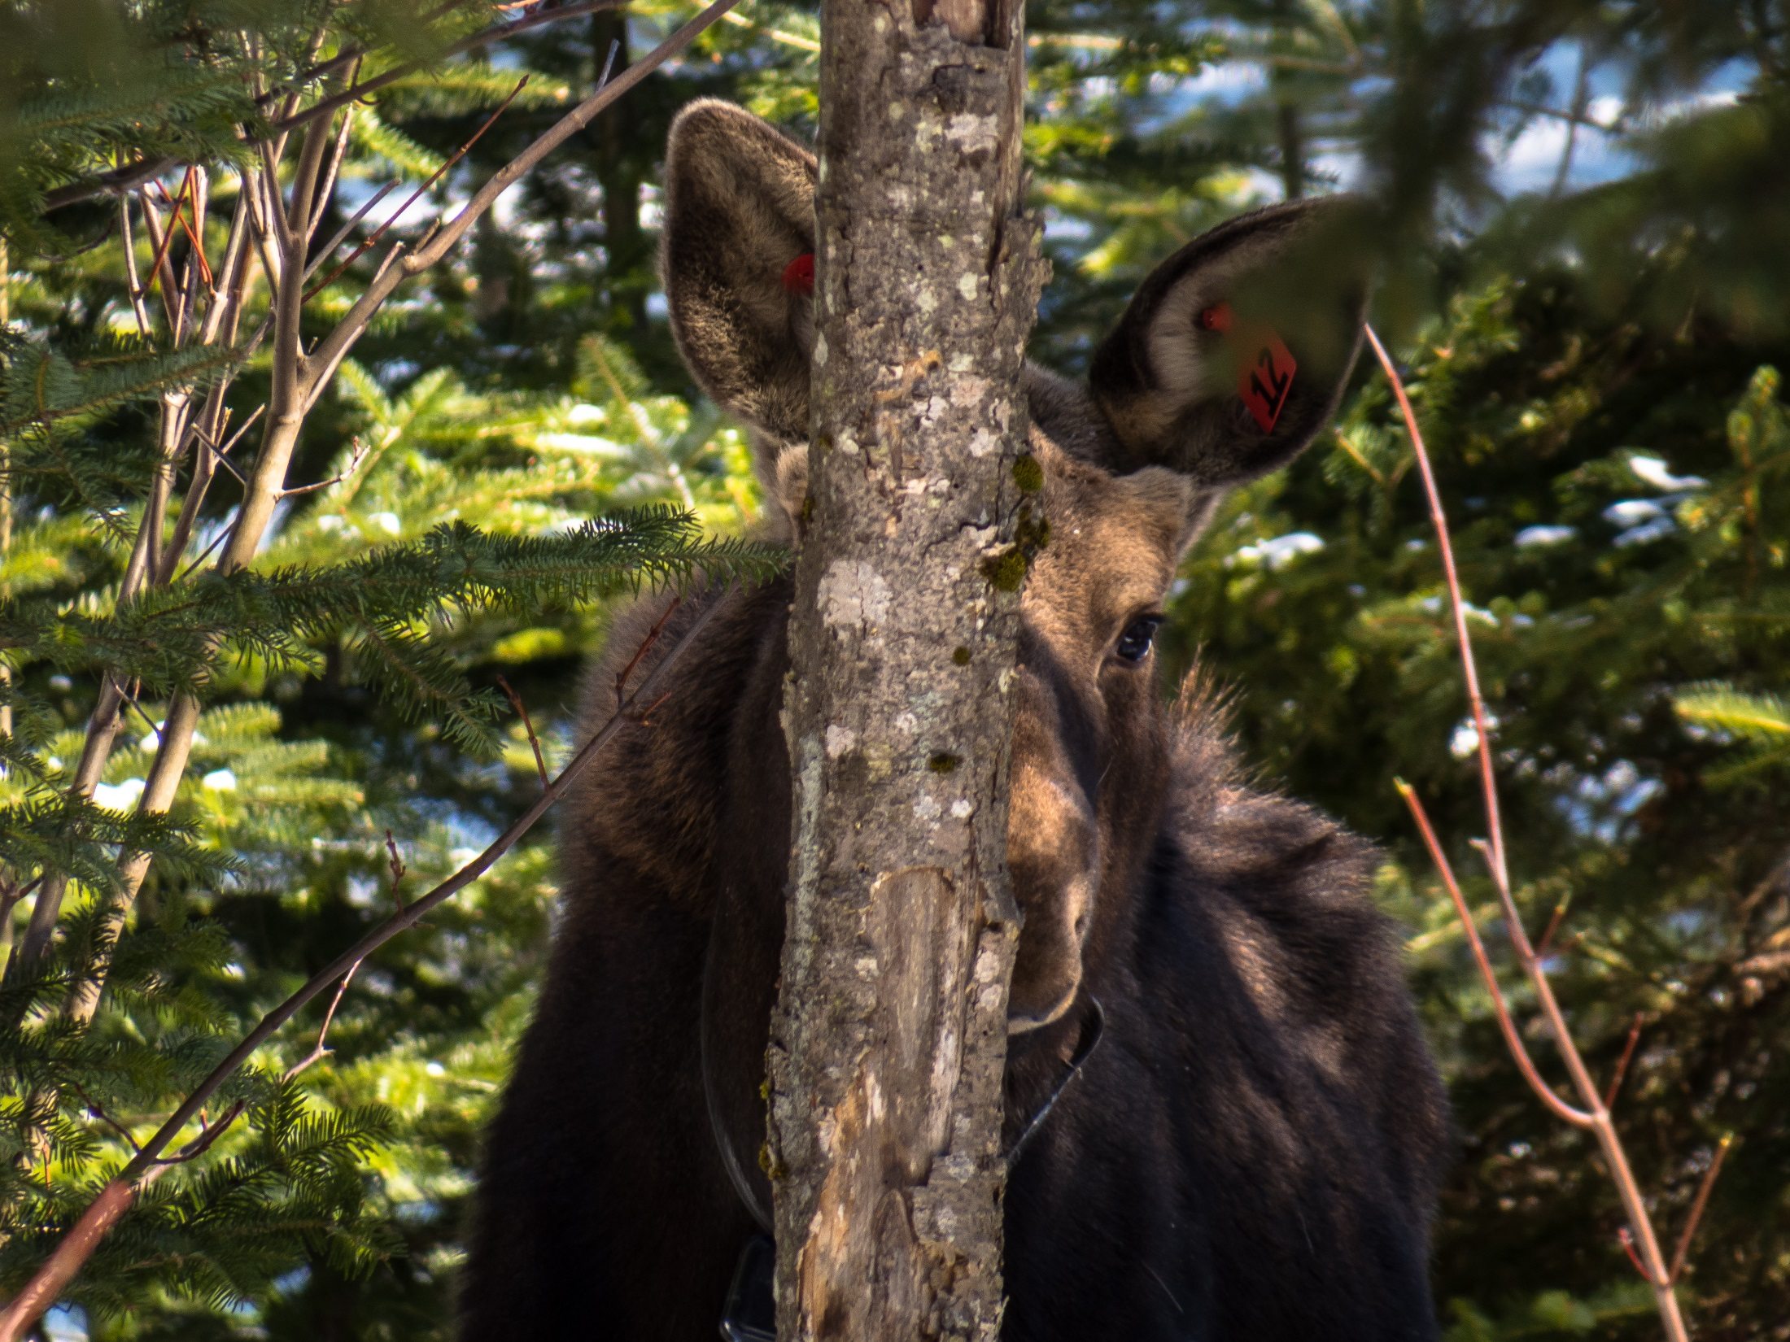
Questions?
Live Moose Photos courtesy:
Josh Blouin

