Slide 1


The NSRC and FEMC as partners for a better future in the Northern Forest Lands
William B. Bowden¹, Anthea Lavallee², William McDowell³, David Newman⁴, Aaron Weiskittel⁵, and Chris Woodall⁶
FEMC Annual Meeting
15 December 2017
¹ Rubenstein School of Environment and Natural Resources, University of Vermont, Burlington, VT
² Hubbard Brook Research Foundation, Woodstock, VT
³ Department of Natural Resources and the Environment, University of New Hampshire, Durham, NH
⁴ Forest and Natural Resources Management, SUNY-ESF, Syracuse, NY
⁵ School of Forest Resources, University of Maine, Orono, ME
⁶ Northern Research Station, Center for Research on Ecosystem Change, USDA Forest Service, Durham, NH

Slide 2
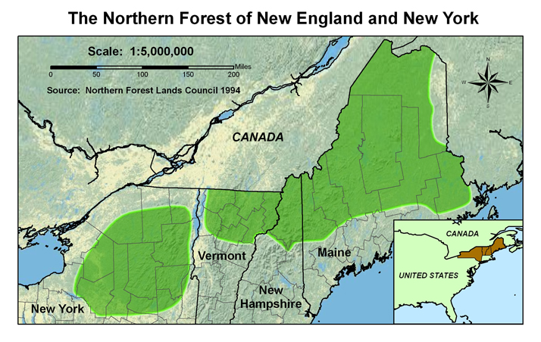
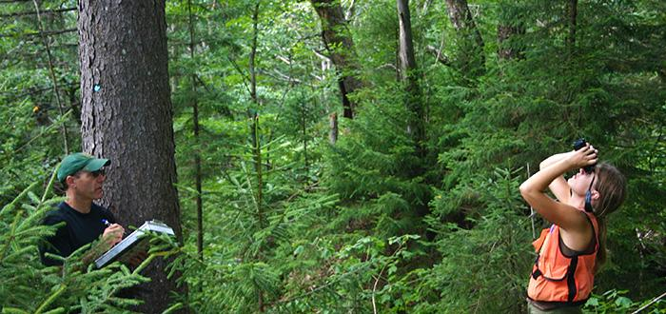
NSRC Mission
The NSRC addresses the importance of the Northern Forest to society and the need for research to have relevance and benefit to the people who live there, work with its resources, use its products, visit it, and care about it.
Public Law 105-185

Slide 3
NSRC Scope
Interest Areas
Atmospheric Pollution
Climate Change
Community & Landowner Engagement
Conservation & Biodiversity
Ecology
Economy of the Northern Forest
Energy & Carbon
Forest Health & Invasive Species
Forest Management & Productivity
Forest Products
Land Use Planning & Development
Recreation & Tourism
Water & Watersheds
Wildlife
Thematic Areas
Sustaining productive communities
Sustaining ecosystem health
Sustaining productivity and products
Sustaining biodiversity
NSRC
See: https://nsrcforest.org/

Slide 4
NSRC Partnerships
Businesses
Land Owners
New
Hampshire
Vermont
Northern Forest Lands
NGOs
New
York
Communities
Maine
Forest
Service
HBRF
Agencies
Institutions

Slide 5
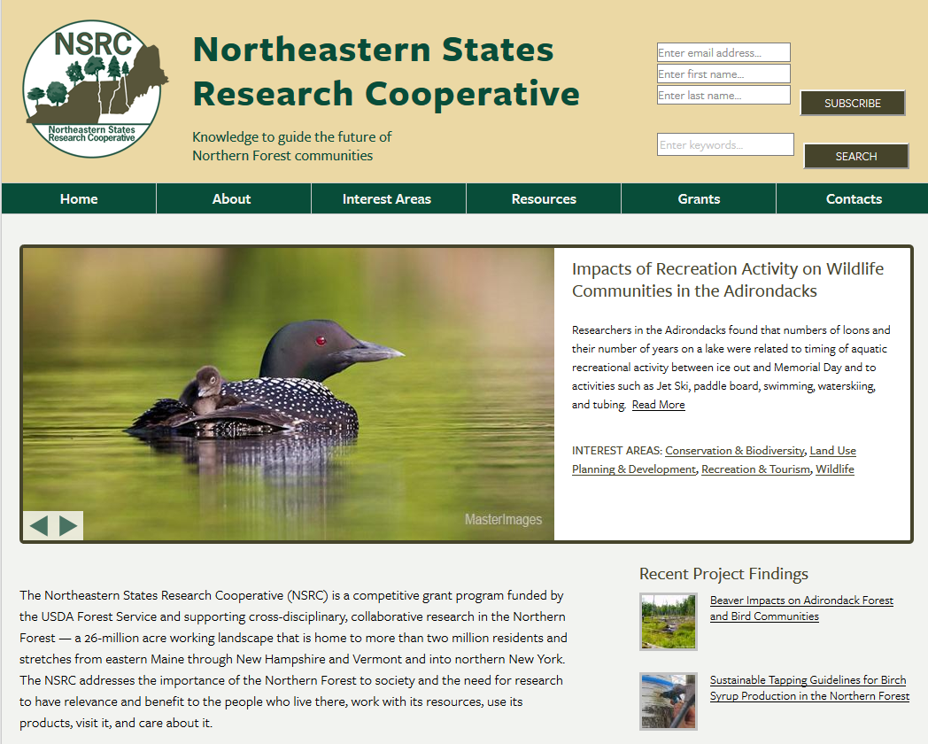
To learn more
See poster and…
https://nsrcforest.org/

Slide 6
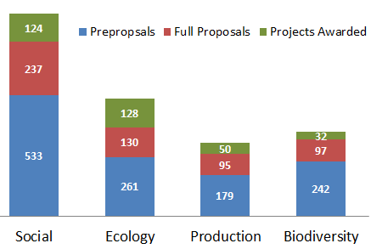
NSRC Competitiveness
1,215 Pre-Proposals
559 Full Proposals
334 Awards
27% Success Rate

Slide 7
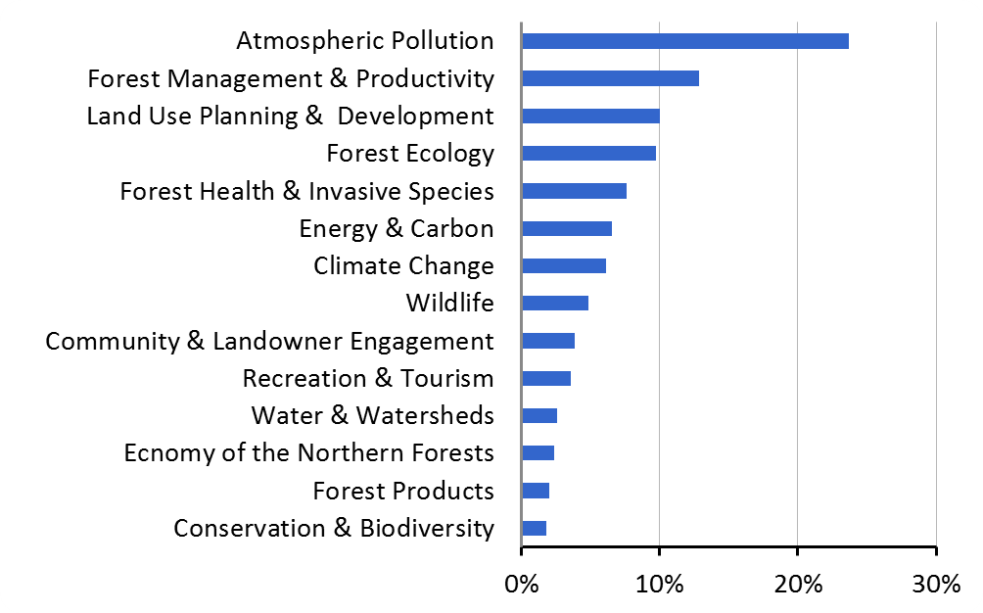
NSRC Investments
By Interest Area

Slide 8
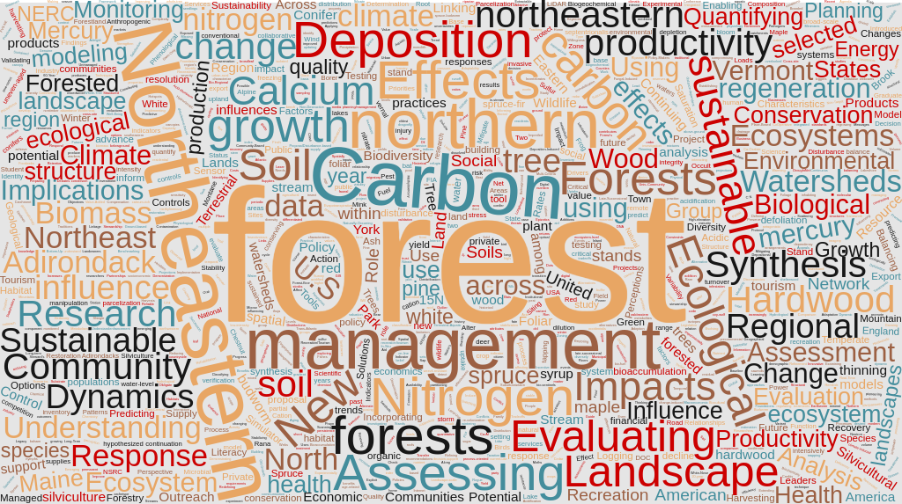
NSRC in words
Based on NSRC project titles (2001-2016)

Slide 9





NSRC by the Numbers
53 Institutions
334 Awards
176 PIs
1,000+ Collaborators
300+ Publications

Slide 10
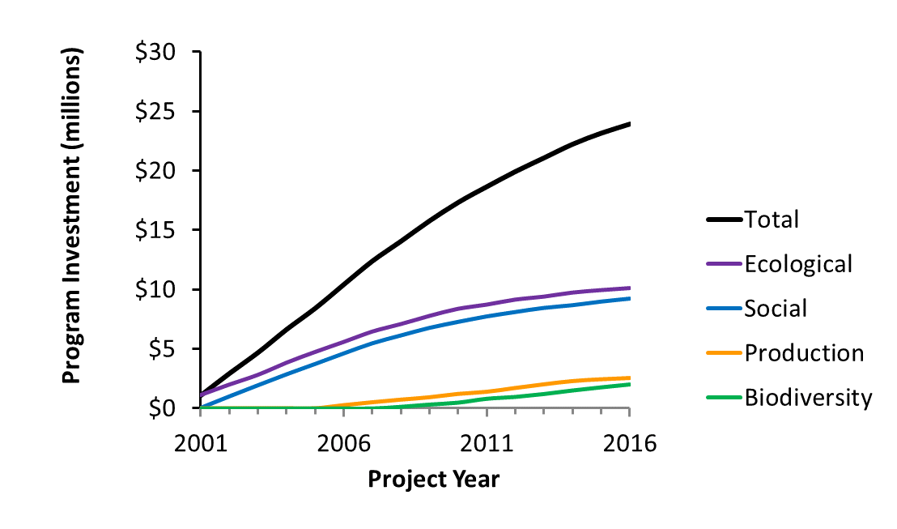
NSRC Investments
Over Years by Thematic Area

Slide 11
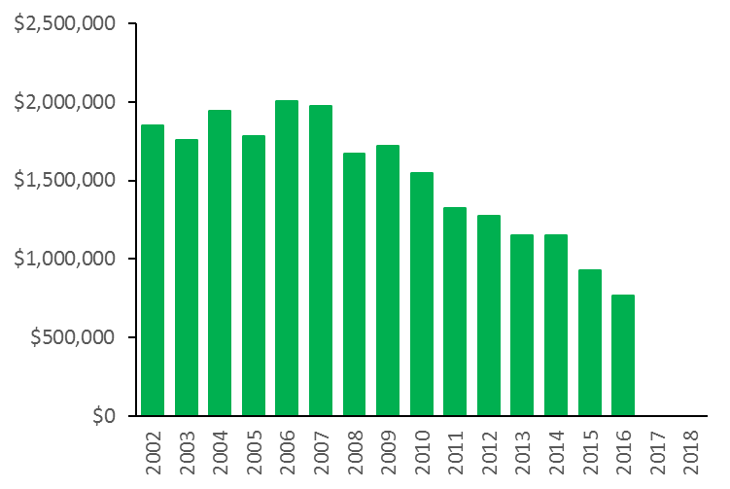
NSRC Total Investments
Historical Trend
?? >

Slide 12
2017 Community Survey
81% Researchers satisfied with NSRC transparency
81% Researchers satisfied with NSRC scope
63% Stakeholders who find NSRC results useful
64% Stakeholders who would regret loss of NSRC
92% Graduate students employed in NSRC fields
97% Respondents who think NSRC should continue
Many thoughtful comments about how NSRC should change to be more responsive and valuable

Slide 13
Summary observations
There has always been a higher demand for NSRC support than we could possibly provide
Previous funding has supported a diverse array of research projects relevant to the future of the Northern Forest Lands
The connection between research and implementation has not always been obvious
NSRC funding fulfills a niche for which there are few other sources of funding
A diverse group of stakeholders think it is important that some form of NSRC continue in the future

Slide 14

NSRC and FEMC
Complementary parts of a whole?
FEMC: State and Private Forestry
To serve the northeast temperate forest region through improved understanding of long-term trends, annual conditions, and interdisciplinary relationships of the physical, chemical, and biological components of forested ecosystems.
NSRC: Forest Service Research
To support cross-disciplinary, collaborative research in the Northern Forest that is relevant to and benefits the people who live within its boundaries, work with its resources, use its products, visit it, and care about it.

Slide 15
A potential collaboration serving the Northern Forest Communities
Northern Forest Communities
FEMC
Forest Service
Research and Outreach
Support and Guidance
NSRC
2.0
Monitoring and Synthesis
Solutions
Challenges and Needs
There are other components in this complex machine!

Slide 16
What’s next?
As of FY2017 the NSRC is in a funding hiatus
Currently funded projects will continue
We have drafted a summary report (can share)
Invited “visioning” workshop (January 2018)
Final summary report (February 2018)
Strategic Plan for “NSRC2.0”
Explore new funding opportunities

Slide 17
What can you do?
We need to hear from you!
Has the NSRC helped to facilitate your research?
Have NSRC findings informed your work?
How could a new NSRC2.0 best serve the Northern Forest community?
Should an NSRC2.0 invest in a broad spectrum of diverse research projects or focus one or two narrow but critical research topics?
How should an NSRC2.0 by governed?
What should be do to ensure productive collaborations between researchers and end-users?

Slide 18
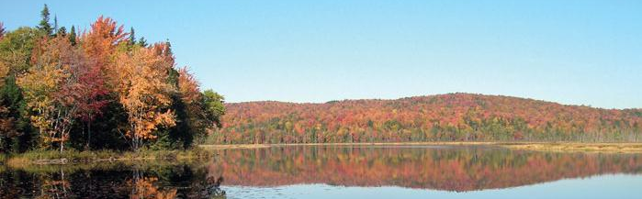
Thank you!
Breck Bowden (breck.bowden@uvm.edu)
Bill McDowell (bill.mcdowell@unh.edu)
Aaron Weiskittel (aaron.weiskittel@maine.edu)
Dave Newman (dnewman@esf.edu)
Anthea Lavallee (alavallee@hubbardbrookfoundation.org)
Chris Woodall (cwoodall@fs.fed.us)
The Wilderness Society

