Slide 1



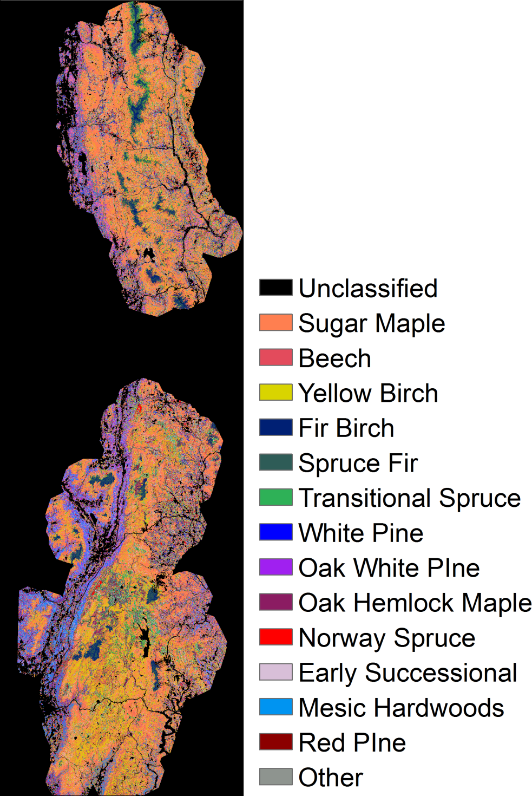
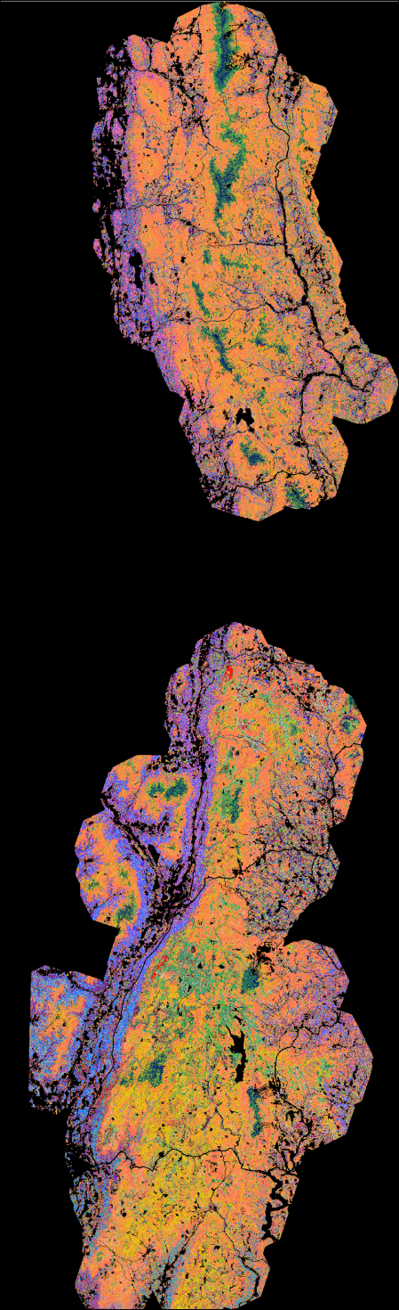
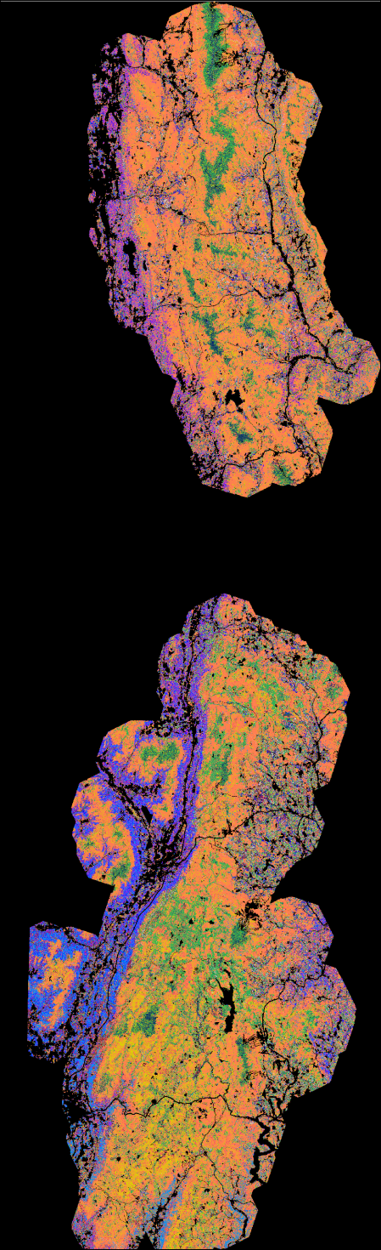
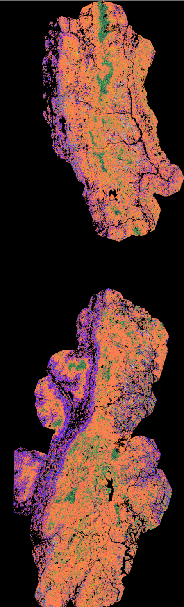
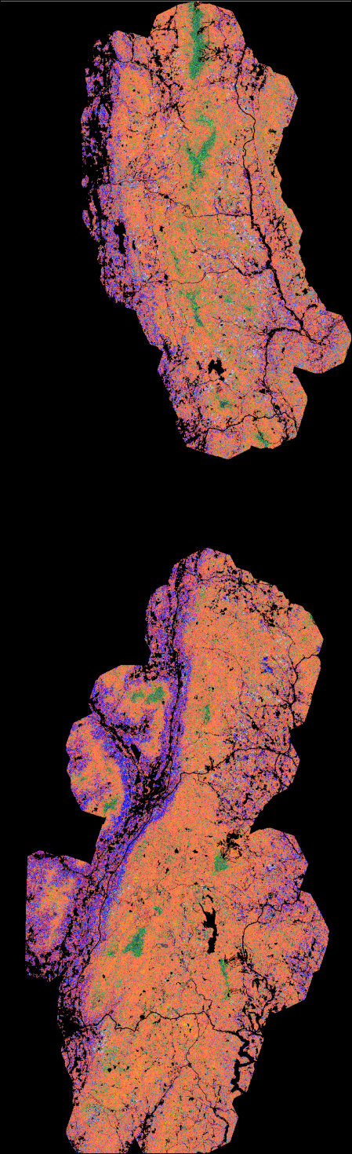
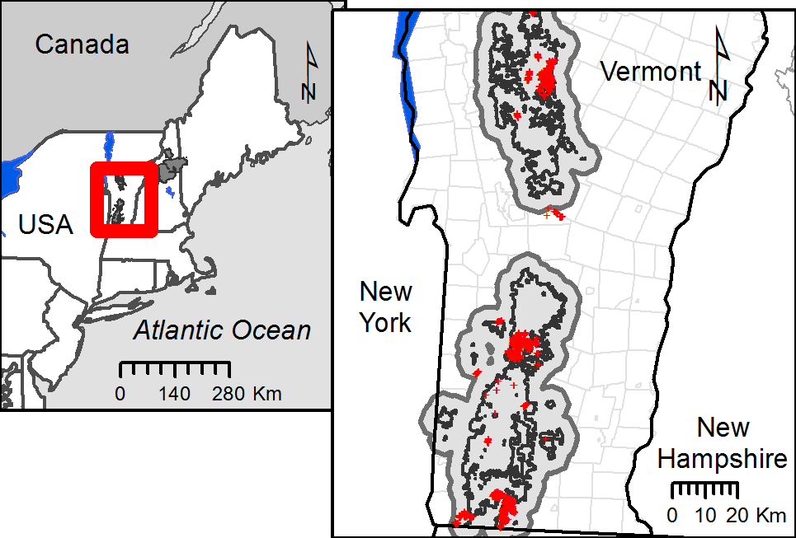
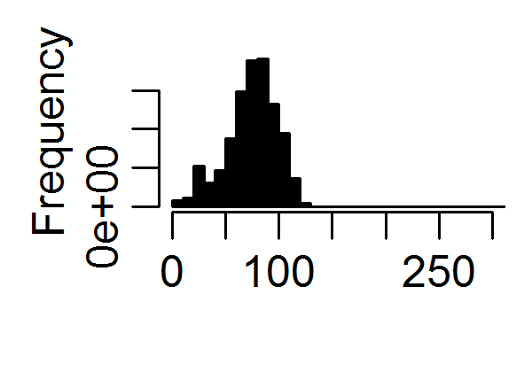
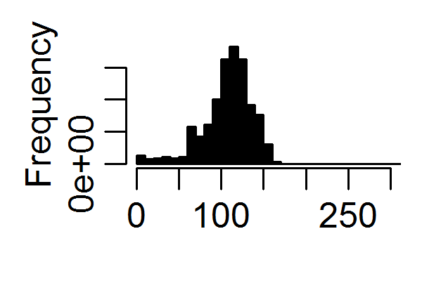
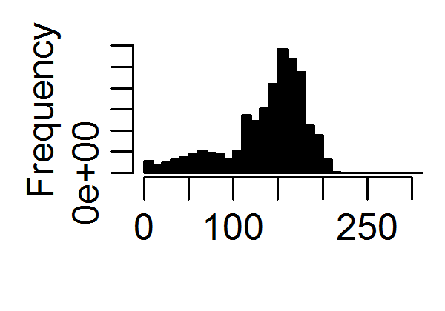
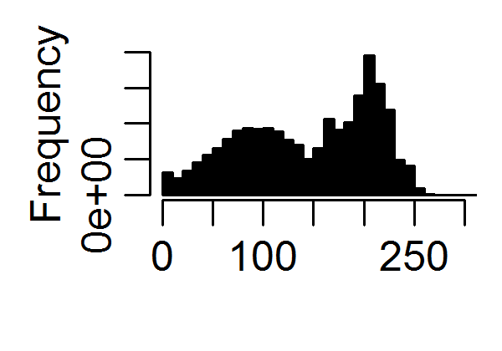
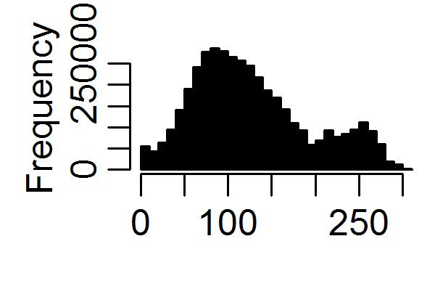
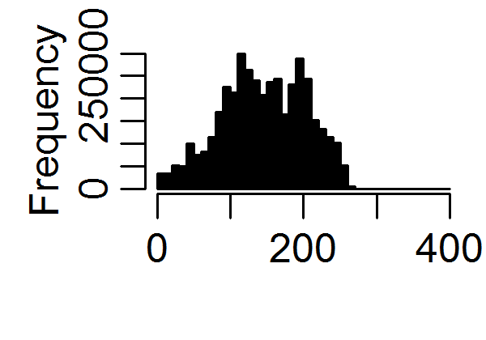
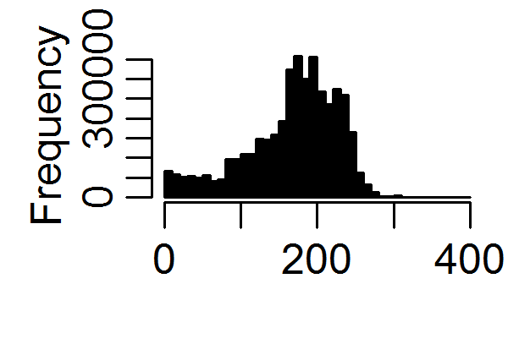
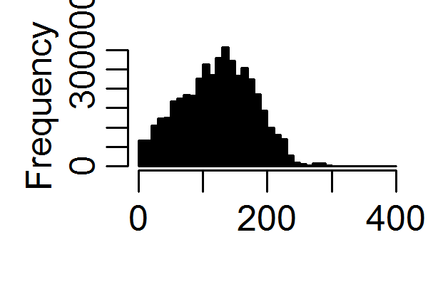
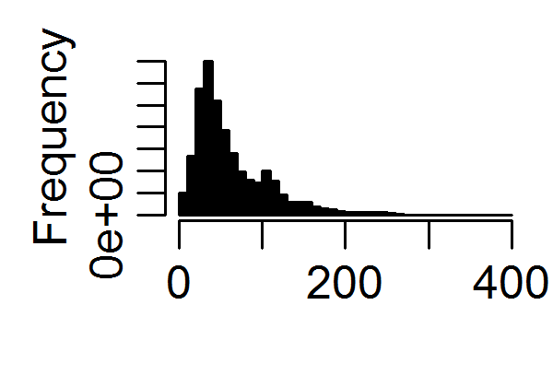
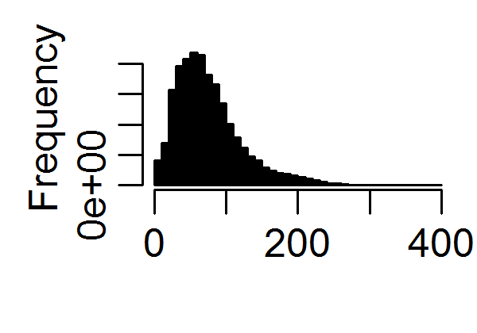
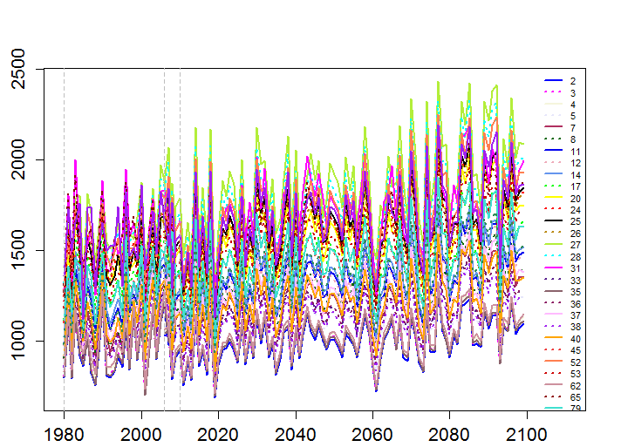
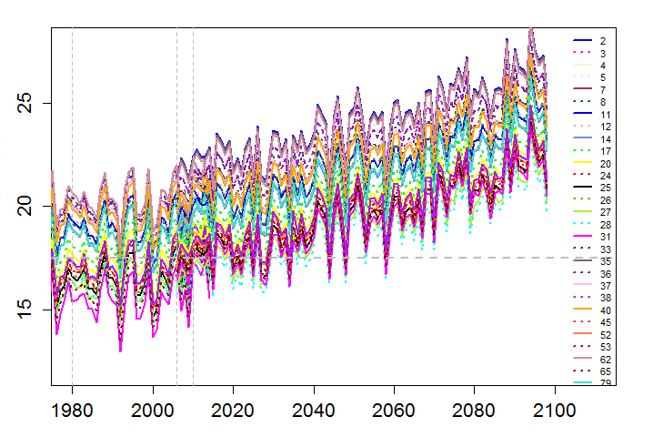
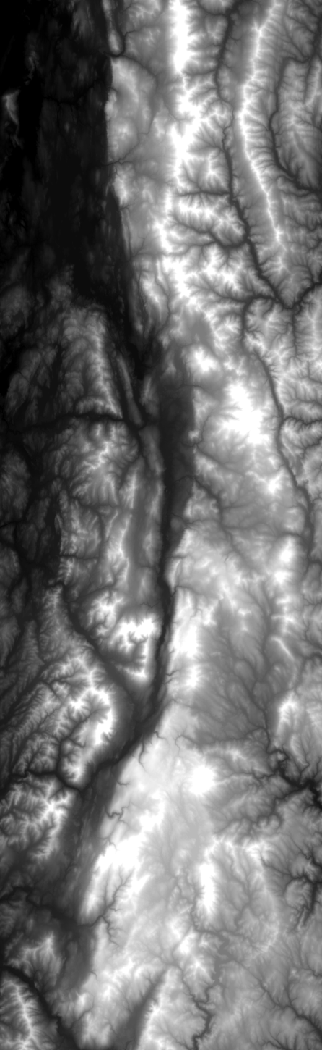
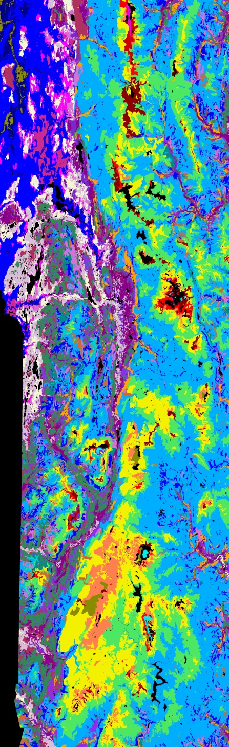
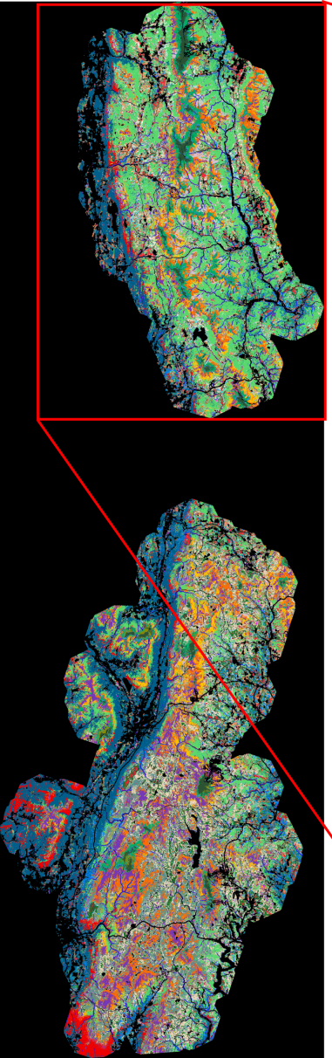
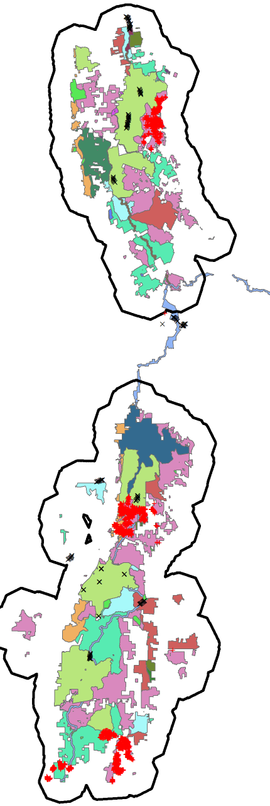
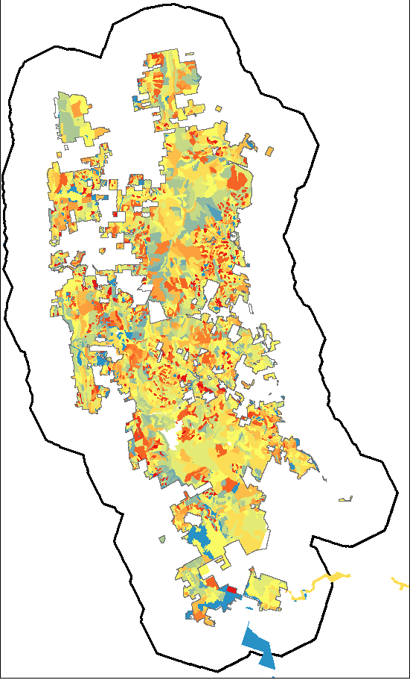
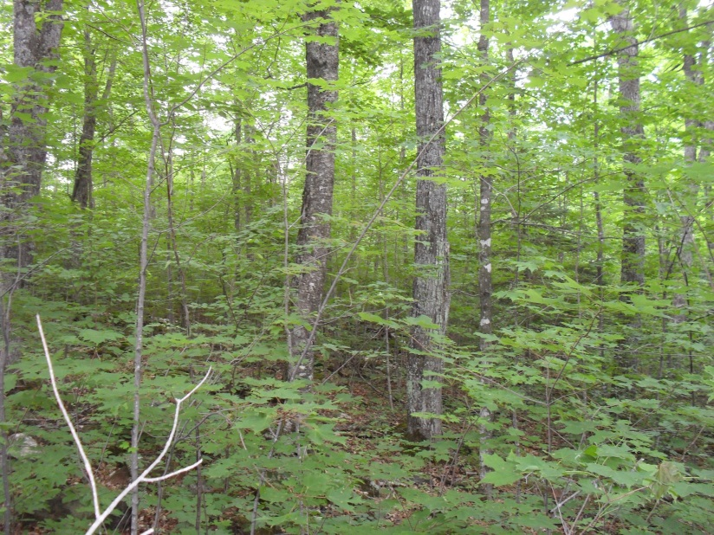
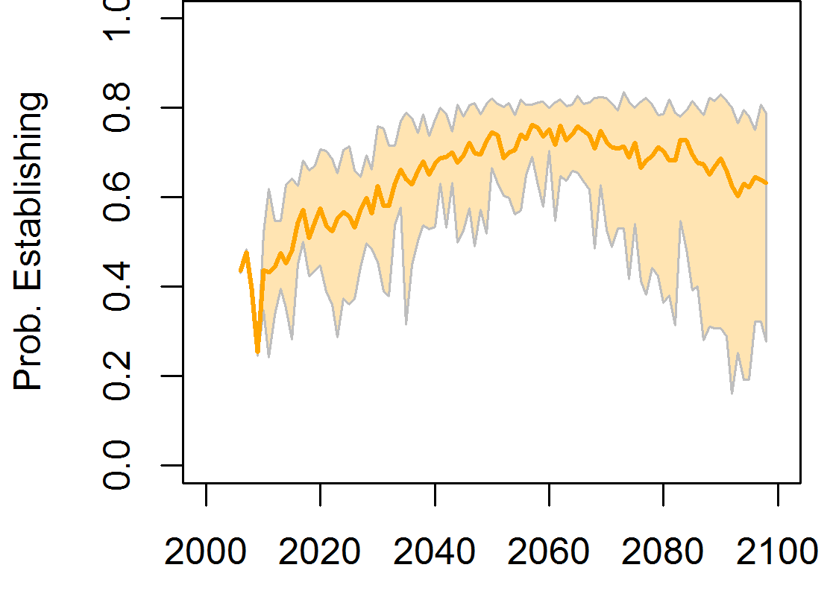
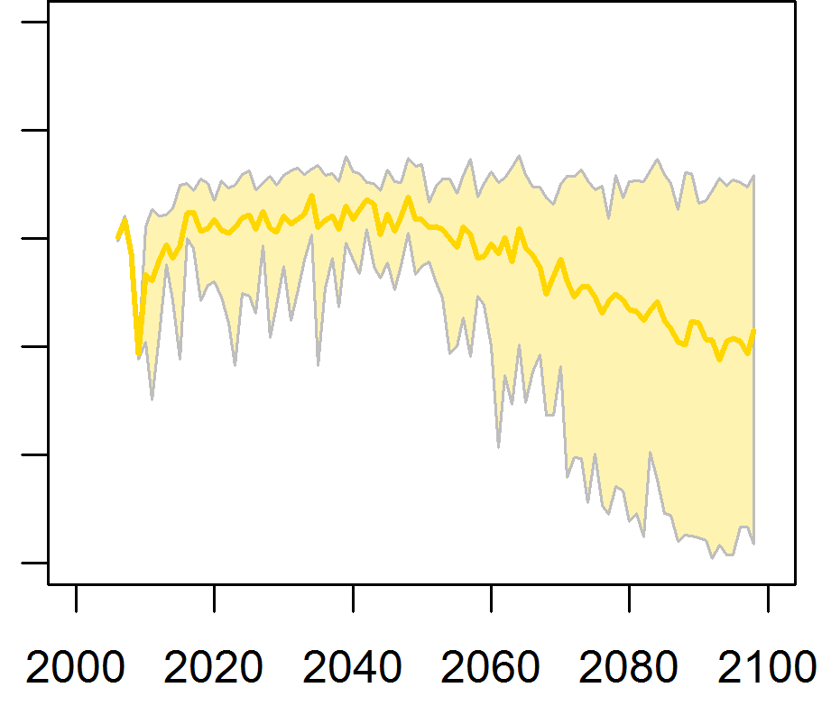
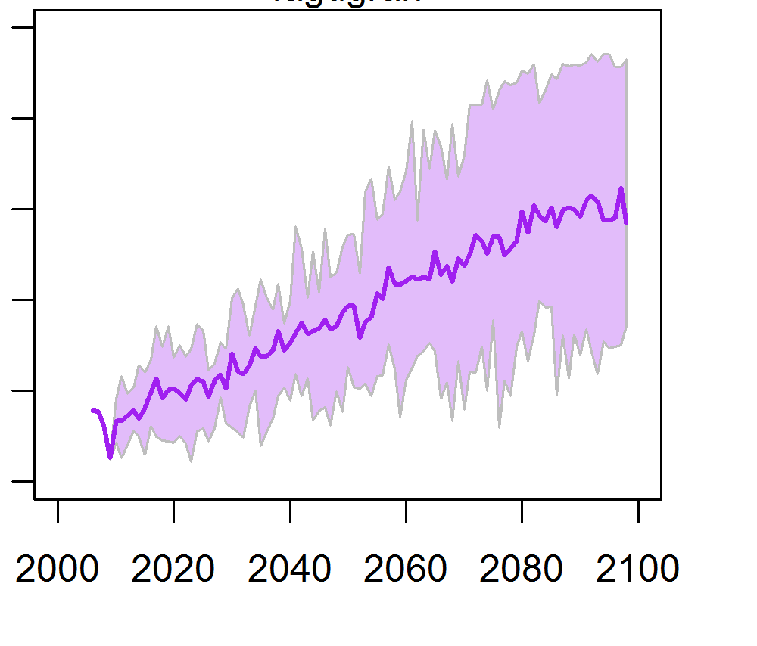
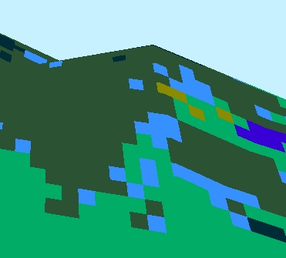
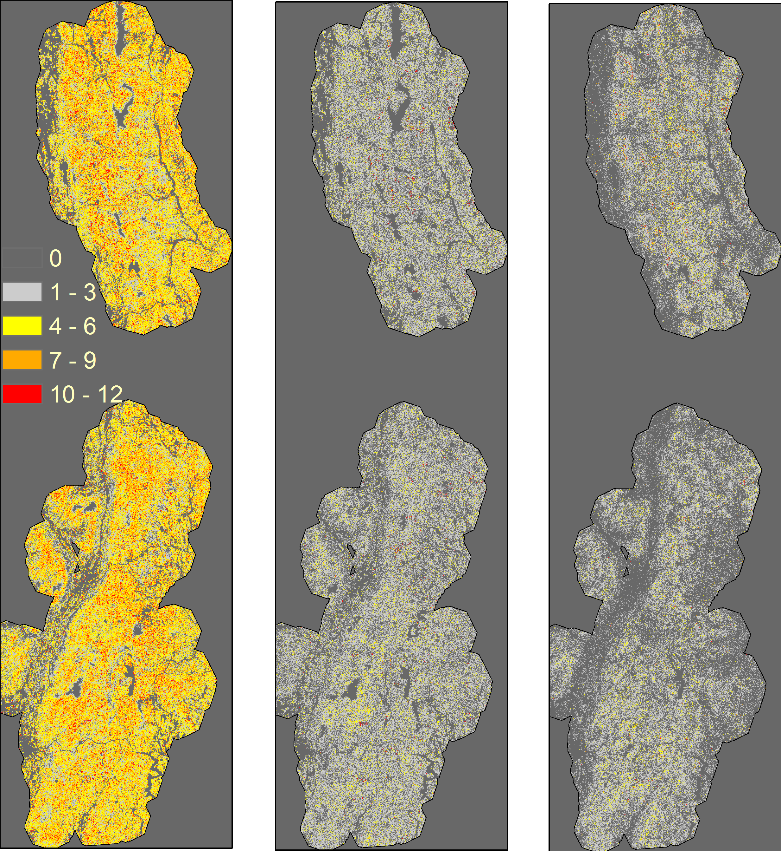
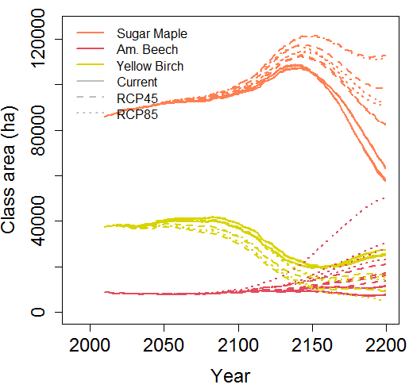
Future distribution of sugar-maple dominated forests on the Green Mountain National Forest under climate change
Jane R. Foster¹ and Anthony W. D’Amato¹
¹Rubenstein School of Environment and Natural Resources, University of Vermont
MOTIVATION
A need to estimate future distribution and abundance of Sugar Maple in Vermont under climate change.
Sugar maple (Acer saccharum) is the dominant overstory tree species for much of Vermont, giving it significant ecological, cultural, and economic importance for forest-based industries. This study examined the future distribution of sugar maple-dominated forests in response to projected changes in climate and disturbance across a 500,000 ha landscape centered on the Green Mountain National Forest (GMNF) using the landscape simulation model, LANDIS-II.
RESULTS
Distribution of Sugar Maple forest in GMNF circa 2010- 2200 for 1 scenario
2010
2050
2100
2150
2200
Fig.1 The Green Mountains National Forest (GMNF) study area in northeastern USA. National forest boundaries (black) are surrounded by the forest area simulated with LANDIS-II model (light and dark gray), which extends beyond borders by 5 km. Distribution of > 1500 forest inventory plots (2007-2012) from National Forest FSVeg data and Mountain Birdwatch data are also shown (red crosses).
Fig. 4 Maps of species dominance by biomass over 200 years with associated frequency distributions of median cohort age and total live aboveground biomass (Rcp8.5 – CESM1-BGC).
Median Cohort Age
Live Aboveground Biomass (Mg/ha)
Changes in climate drove changes in species vital rates by soil class.
We ran the model from 2010-2200 with downscaled climate data from 4 GCMs (CCSM4, CESM1-BGC, HadGEM2-ES, MPI-ESM-LR), under RCP 4.5, 8.5, and with baseline climate randomized from 1980-2009.
METHODS
Analyze data from NRCS SSURGO soils database, forest inventory plots, and multi-season Landsat data to map soils and forest classes
Fig. 5 Observed and projected changes in annual precipitation and mean July temperature across 25 soil classes for one of the climate scenarios (Rcp8.5 – CESM1-BGC).
Annual Precipitation (mm)
1000 1500 2000 2500
Mean July Temp. (C)
15 20 25
Current
CMIP5 CESM1-BGC – Rcp 8.5
Current
CMIP5 CESM1-BGC – Rcp 8.5
Green Mountains
2010
Forest stands
1980 2000 2020 2040 2060 2080 2100
1980 2000 2020 2040 2060 2080 2100
Fig. 6 Changes in species establishment rates shown by multi-model range and mean from 12 climate scenarios. Rates are derived from the LINKAGES model birth routine and drive establishment in LANDIS-II.
Fig. 2 Digital elevation model (DEM) and spatial data created(*) or used as inputs for the LANDIS-II forest simulation model in the Green Mountains National Forest study area.
Sugar maple
Yellow birch
American Beech
Probability of Establishing
0.0 0.2 0.4 0.6 0.8 1.0
Elevation 25-1290 m
Soils class map*
Forest classes*
Management zones
Year
Run LANDIS-II forest landscape simulation model
Models forest growth on a raster grid.
Grid-cells populated by tree cohorts of different species, age, biomass, & life history traits.
Within grid-cells, cohorts establish, grow, compete, survive disturbances, and/or die.
Among grid cells, mature cohorts disperse seeds
The probability that new sugar maple or yellow birch cohorts can establish increases between 2010 and 2060 across all climate change scenarios, then tends to decline through 2100, while establishment of American beech increases steadily.
30 m
Sugar Maple
Yellow Birch
Am. Beech
Fig. 8 Area of species dominance by biomass for northern hardwood competitors sugar maple, yellow birch, and American beech realized in each of 12 climate scenarios in LANDIS-II. Divergence among climate scenarios is delayed until 2050 or 2100.
Fig. 3 Visualization of how tree species cohorts coexist, compete and progress through succession within grid-cells in LANDIS-II model, and disperse through space or respond to disturbances that spread dynamically.
and disturbances spread with varying effects.
Climate change affects establishment and growth rates of each species differently, based on ecosystem models LINKAGES and PNET-II.
Disturbance regime includes wind events, forest tent caterpillar defoliation, and GMNF forest management as prescribed by forest plan.
Sugar maple forest is projected to continue as the most dominant type by area, but as the forests age over 200 years, mortality increases and total biomass declines, leading to structural changes with implications for forest industries.
Fig. 7 Frequency of species dominance across 12 climate scenarios in year 2200. More area is dominated by sugar maple forest over multiple climate scenarios than by yellow birch or American beech.

