Slide 1
Science for impact? Know your audience.
Beyond Communication:
Advocating for Science and our Forests
2017 Forest Ecosystem and Monitoring Cooperative Conference
Julianna White
Low emissions development research, CGIAR Research Program on Climate Change, Agriculture and Food Security (CCAFS)
Gund Institute for Environment and Rubenstein School of Environment and Natural Resources, University of Vermont

Slide 2
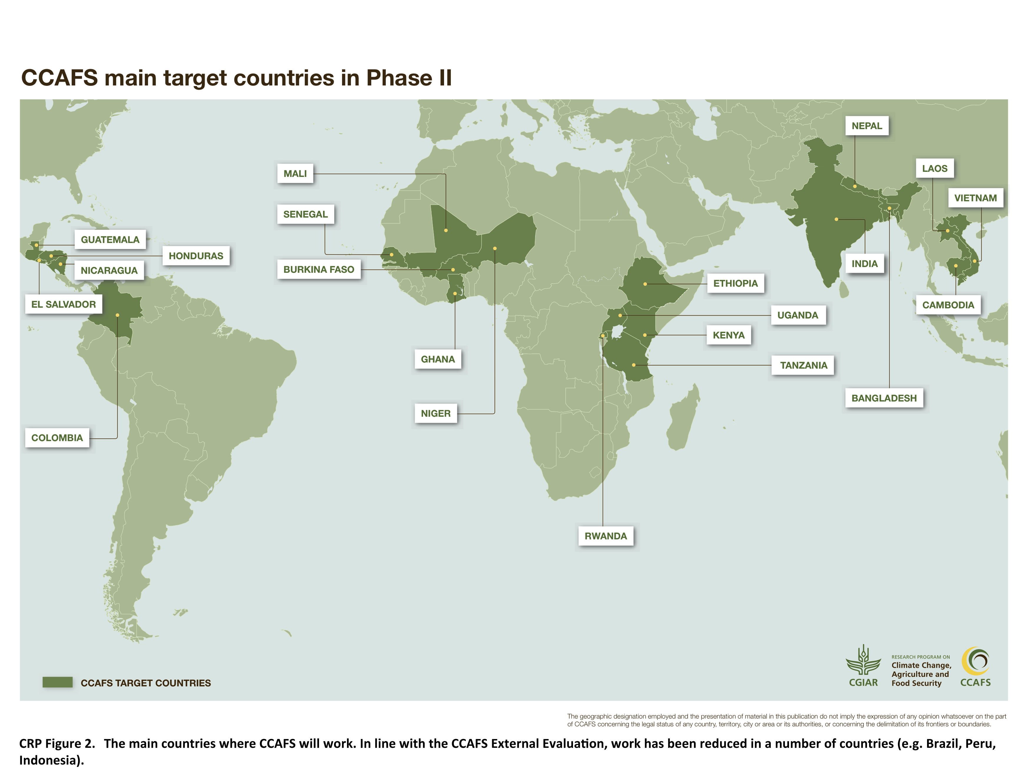
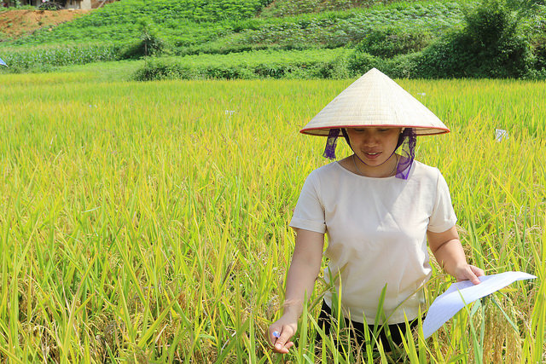
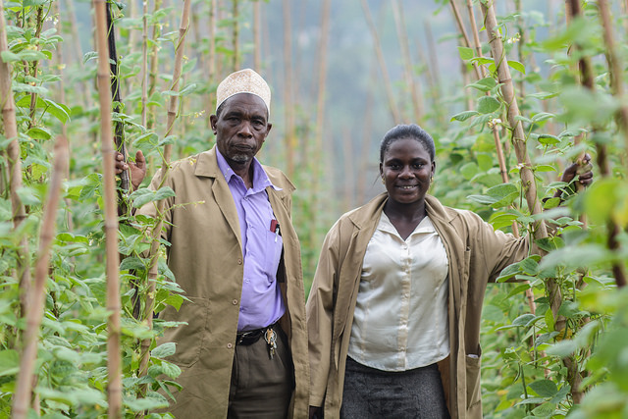
Low emissions development in agriculture

Slide 3
Impact pathway
Impact pathway
Shows your plan for how your work will have effects and upon whom, and what will need to happen next and with whom.
Outputs
Journal articles, tools, data bases
Reports, briefs, info notes, media pieces – key messages refined for stakeholders
Infographics, figures – immediately understandable and identifiable
USE – by stakeholders
Research users – Scientists, experts
Next users – National research institutions, extension organizations, NGOs, etc.
End users – Farmers
Stakeholder meetings and engagement – at all stages of the research process

Slide 4
Case study: Nutrient management using optical sensors (1)
Nutrient management optical sensors help farmers calculate how much and what kind of fertilizers to use in fields.
Developed in the U.S. in the 1990s, they are used widely in large-scale industrial agriculture.
Fertilizer use has grown quickly in some countries – and fertilizer became over-used in some places, such as India and China.
Result = profitability down and ghg emissions & water pollution up
Researchers in India and Mexico tested the use of handheld optical sensors.
Released a journal article showing that the sensors had promise.

Slide 5
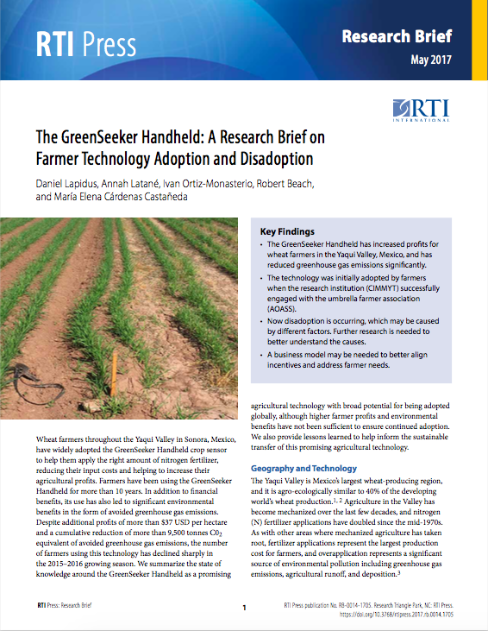
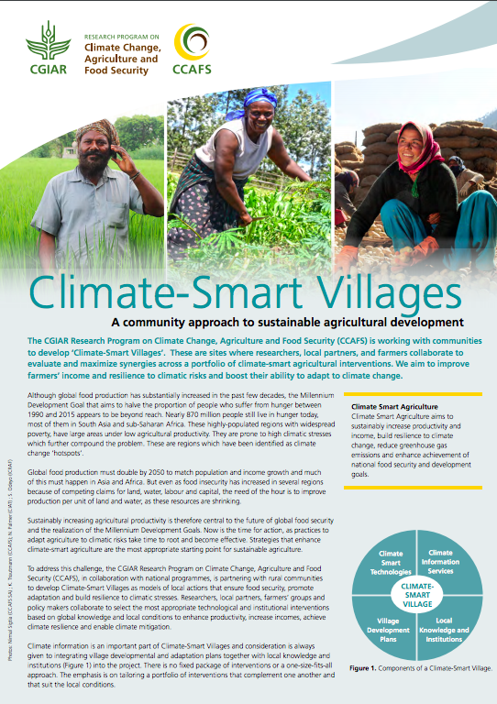
Case (2): Bring the science to next users
Build on peer-reviewed scientific evidence to provide key messages to policy-makers and investors
Feasibility analysis and business case for investors, private sector leaders, extension organizations, farm associations. Show users’ access to equipment and Internet, calibrated for local nutrient, crop and region.
Support research activity for farmer trials, document production and socio-economic results, focus on development organizations, research stations, extension organizations

Slide 6
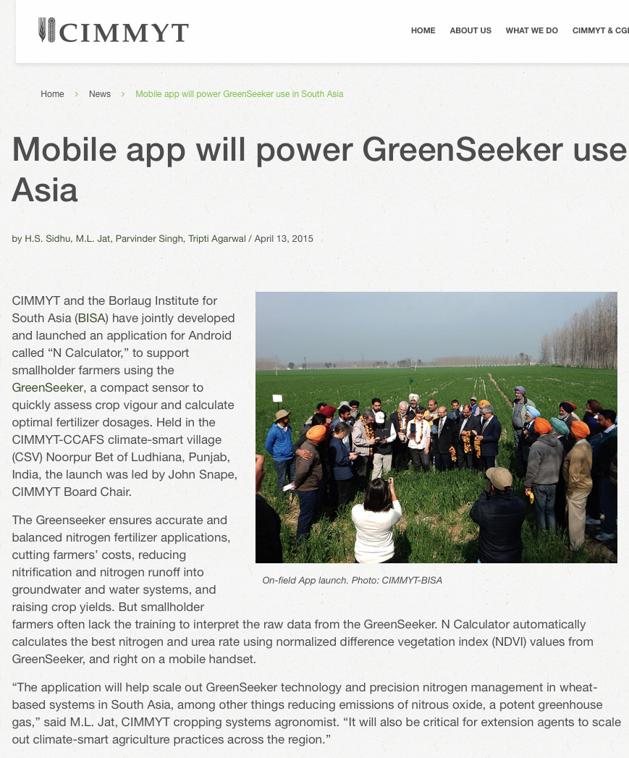
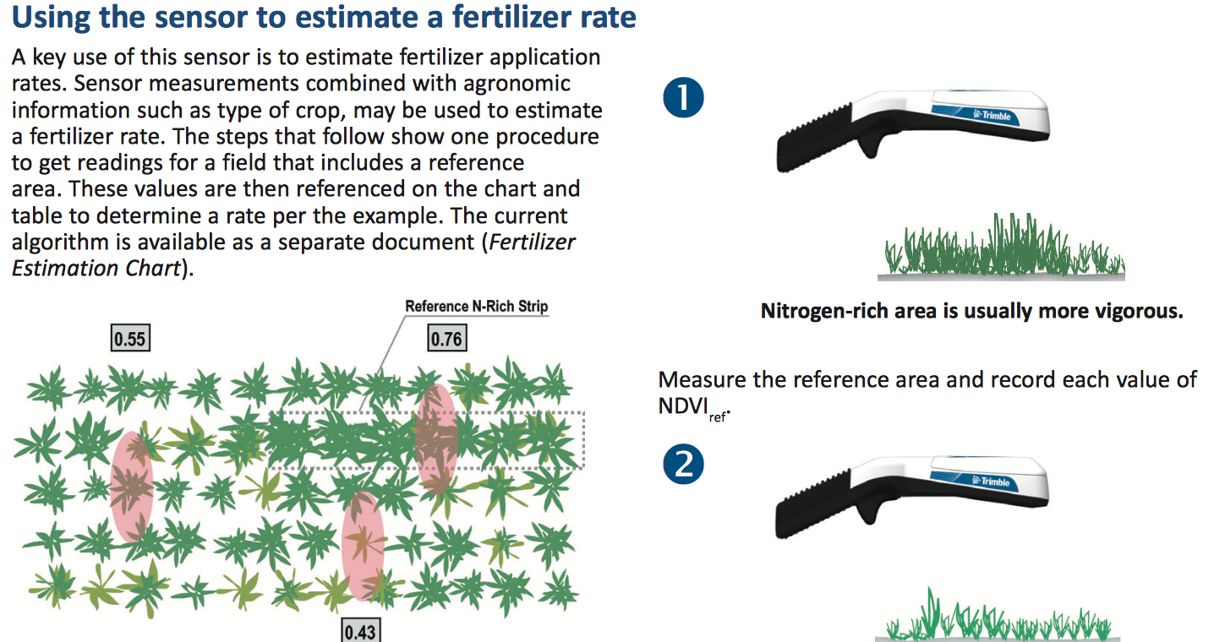
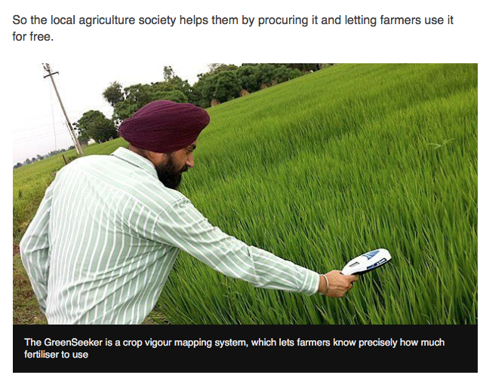
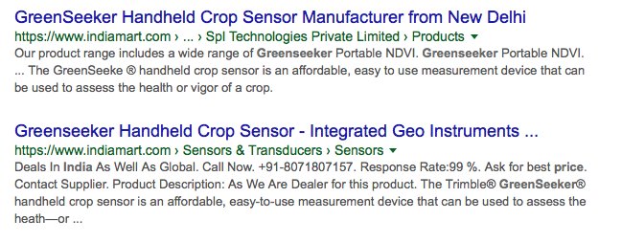
Case (3): Bring the science to end users
Collaboration with government and private sector to provide services (device, smart technology), Local innovation
How-to guides,
Availability via entrepreneurs, media, testimonials
Impact
Farmers increase productivity – and profits
Farmers decrease N2O emissions, water pollution
Thank you! Questions or comments?
Julianna.m.white@uvm.edu
https://ccafs.cgiar.org/flagships/low-emissions-development

