Slide 1
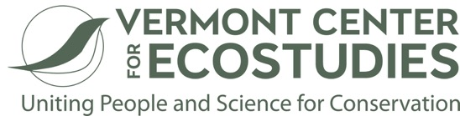
Sara Zahendra and Kent McFarland, co-hosts
Chris Albertine, Producer/Sound Engineer
Franny Bastian, Producer
Notes:
Natural history and science needs story

Slide 2
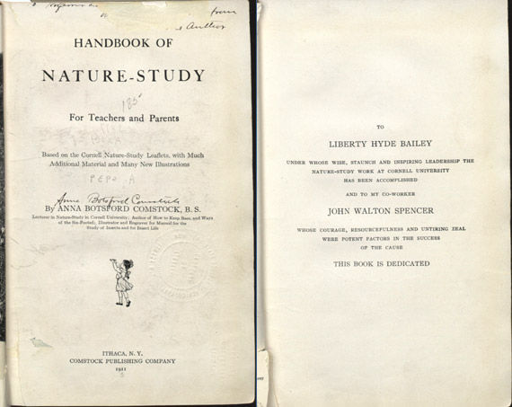
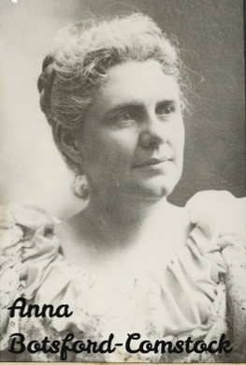
Notes:
Comstock is most famous for being one of the first to bring her students and other teachers out-of-doors to study nature. In 1895, Comstock was appointed to the New York State Committee for the Promotion of Agriculture. In this position, she planned and implemented an experimental course of nature study for the public schools. The program was approved for statewide use through the extension service of Cornell. She then wrote and spoke on behalf of the program, helped train teachers, and prepared classroom materials. Starting in 1897, she taught nature study at Cornell. Comstock was the first female professor at Cornell.

Slide 3
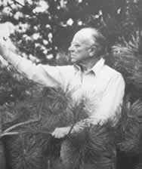
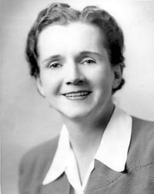
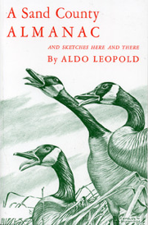
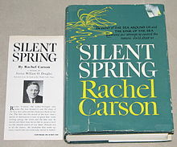
Notes:
Nature-study era gave rise to Aldo Leopold and Rachel Carson

Slide 4
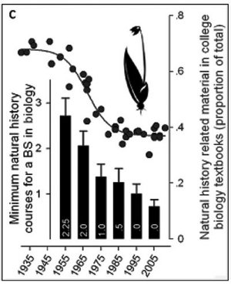
Natural History’s Place in Science and Society
Tewksbury et al. BioScience (April 2014) 64 (4): 300-310. doi: 10.1093/biosci/biu032

Slide 5
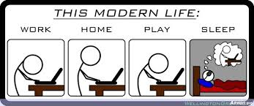
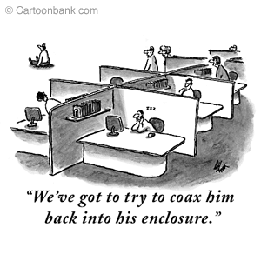
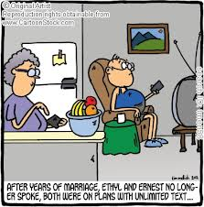
Notes:
During the progressive era in education, nature study was harshly repudiated by prominent science educators. In their efforts to replace nature study with the program described as "elementary science," such writer as Ralph S. Powers and Gordon Craig of Teachers College, Columbia, accused nature study advocates of sentimentalism and Romanticism.

Slide 7
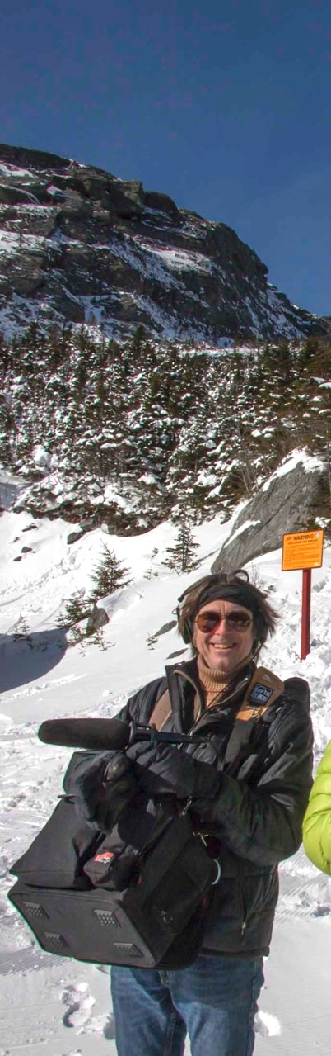
Notes:
Chris Albertine VPR – a beginning, a middle, and an end

Slide 8
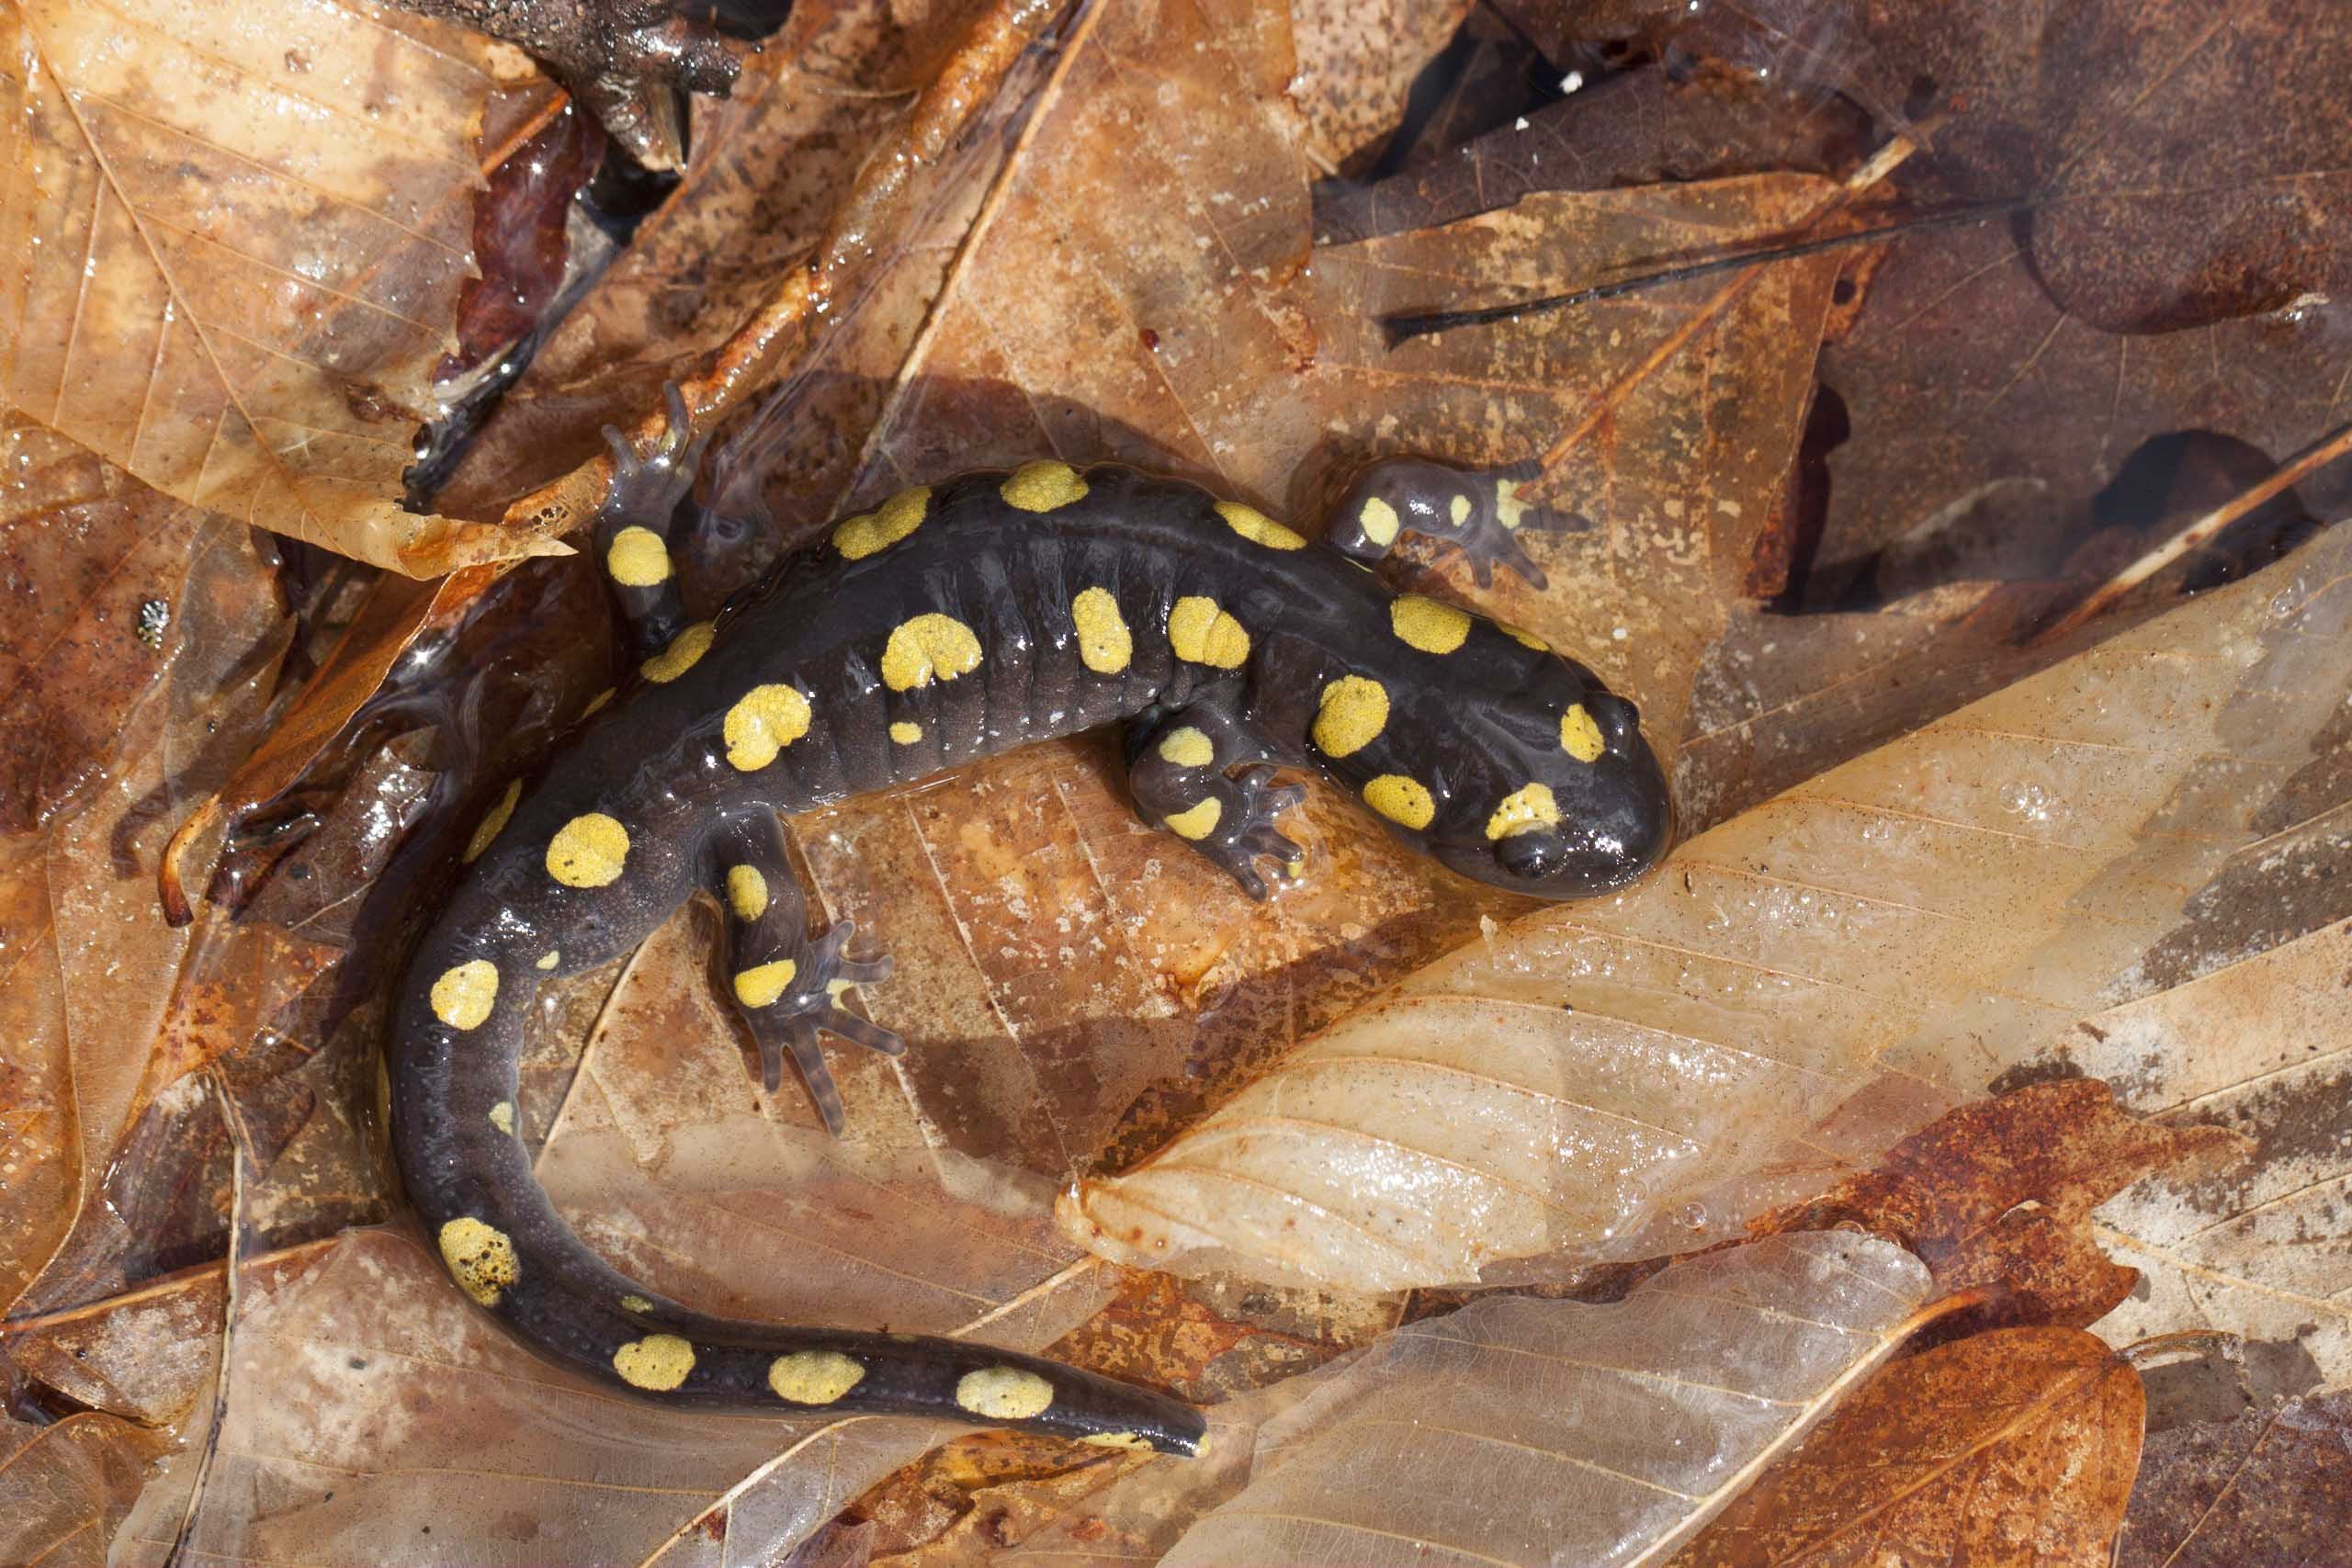
And then, and then, and then, and then……
Notes:
And then, and then, and then. And then……

Slide 9
Narrative Structure

Slide 10
Notes:
Do you have a story? We’d like to help you tell it.

