Slide 1
















SO WHAT?
How to Grab & Hold People’s Attention About Science
With Bird Diva, Bridget Butler
www.birddiva.com

Slide 2

Notes:
Ask to see if folks can retrieve images from first panel
The magic number is 4 both for memory and retrieval of information. We tend to over do it and cram a lot into our presentations, interviews etc.
KNOW THE BIG 4 for your work and then CHUNK IT
That means then no more than 4 items for each CHUNK
Turkey Vulture interview – Migrate (when typically leave, where they are, type of migrant, where they go)

Slide 3
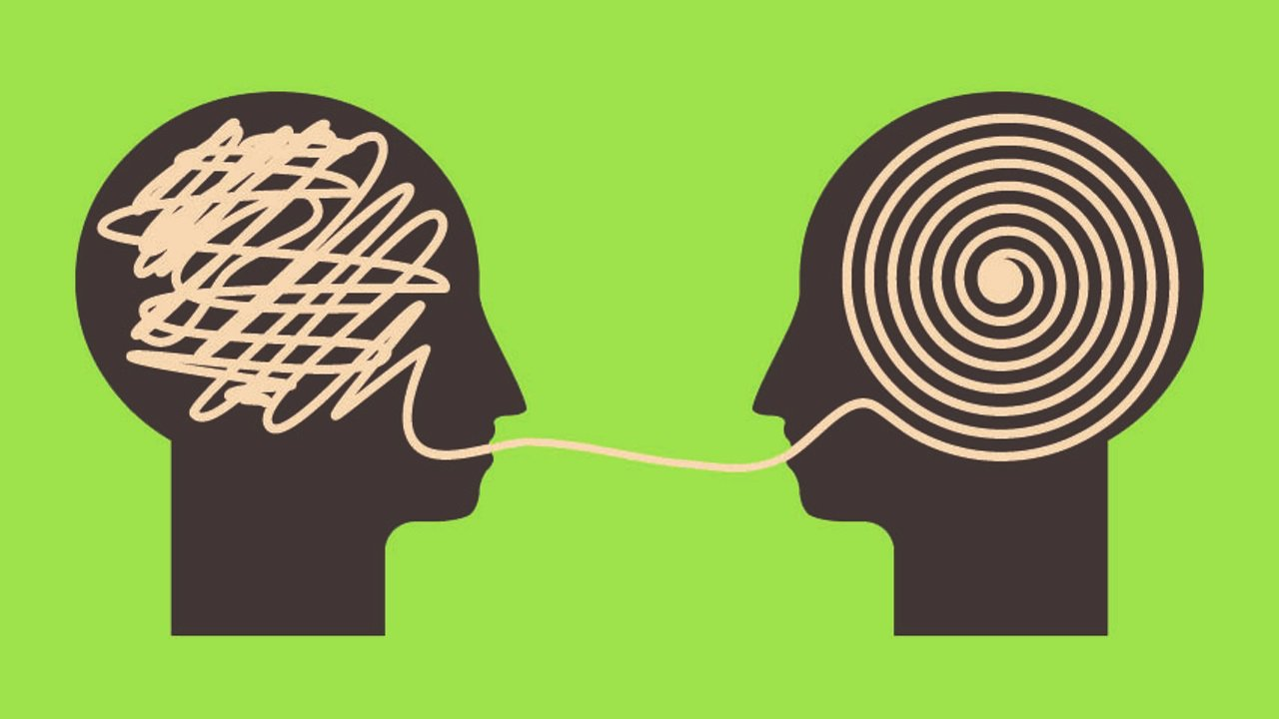
Notes:
AUDIENCE – know how they talk and how they listen Hansel & Gretel Walk in the FOREST, landowners walk in the WOODS
GET RID JARGON – WTPZ writing scripts stewardship, conservation, preservation, TOTAL MAXIMUM DAILY LOAD
TALK CASUAL – As a reporter, cueing people to just have a conversation, Jane Lindholm, Kent & Sara
PRACTICE TALKING IN CHUNKS – like 10-20 sec chunks

Slide 4
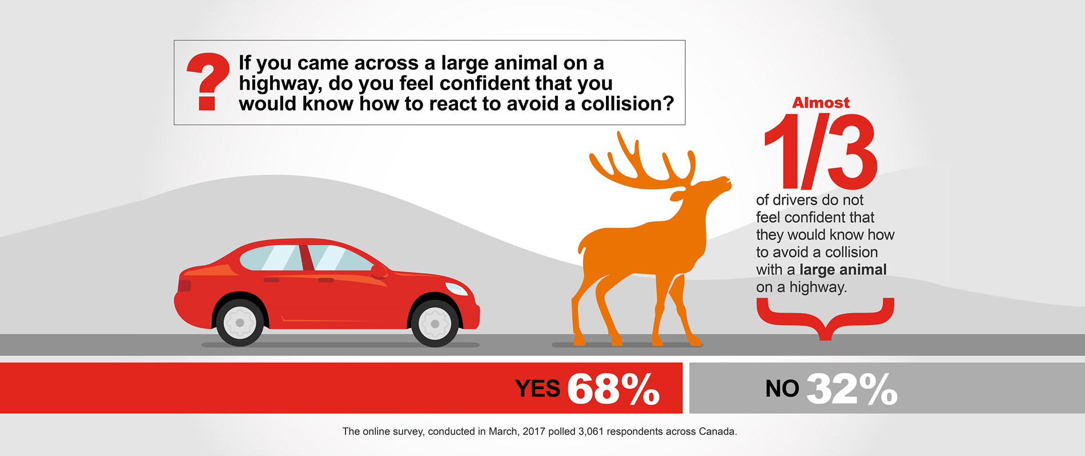
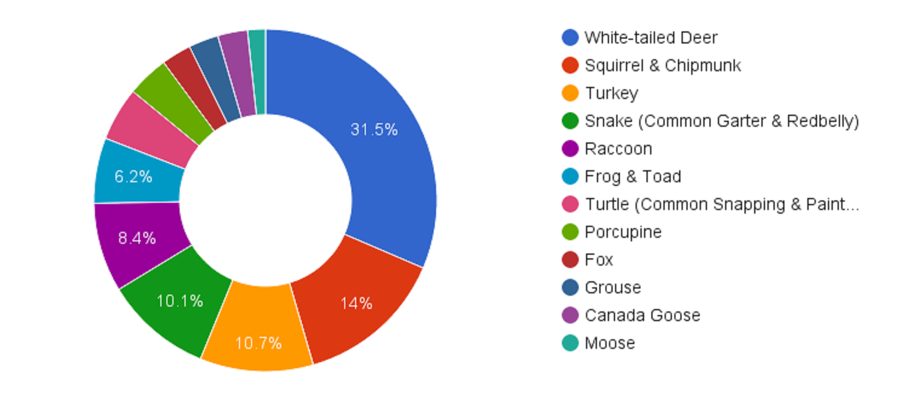
Notes:
How can we adapt our data to the ravenous pace with which people devour online images?
Welcome to the 8 SECOND ATTENTION SPAN! Apparently that’s a shorter attention span than a goldfish and why we need to transform our data from THIS to THIS
VISUALS TRUMP ALL OTHER SENSES…half your brain power is reserved for seeing stuff & interpreting it. Keep your notes in your notes and have visuals that support what you’re saying.
I’m just going to say that again because you were probably reading the slide…

Slide 5
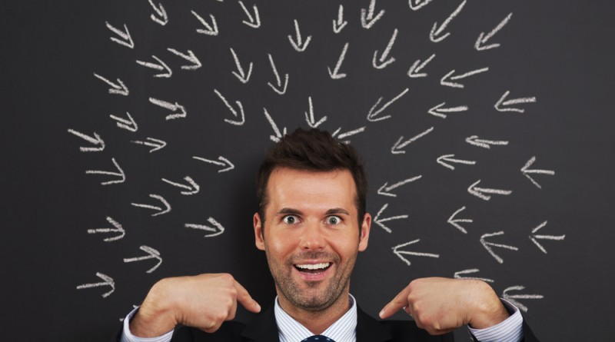
Notes:
ANSWER YOUR AUDIENCES’ WIIFM
This is where you go back to your points that we talked about in the beginning. And you need to ask yourself, based on who I’m talking to how does this affect them and what do I want them to do. WHYYYYYY?
WildPaths…understanding where animals cross safety for people and the environment. Cost in insurance, # of crashes per year.
Culvert replacement good for people, fish & wildlife

Slide 6
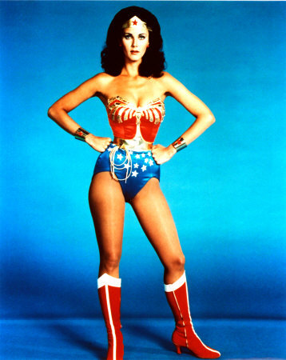
Notes:
FEEDBACK that I get most is that I’m passionate, energetic that it’s inspiring and it engages people…they’re ready to go do whatever needs to be done.
THINK about how you talk with your colleagues when you’re excited about findings and bring that to your interviews, writing, presenting etc. along with
PRACTICE being bright…in your face with your body. VIDEO TAPE YOURSELF talking through your BIG FOUR points OR PRACTICE IN MIRROR.
STAND UP…strike a pose. Harvard Professor Amy Cuddy, power-posing TED –talk. Increases assertive hormones and decreases stress hormones.

Slide 7
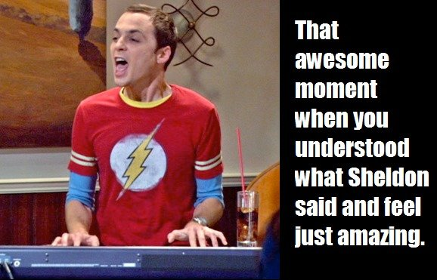
Notes:
FIND YOUR BIG 4 & CHUNK IT
FIND YOUR CONVERSATIONAL TONE & LINGO THAT FITS YOUR AUDIENCE
KEEP VISUALS SIMPLE AND BOLD
SATISFY THE WIIFM
TAP INTO YOUR PASSION FOR THE TOPIC & SHARE IT

