Slide 1
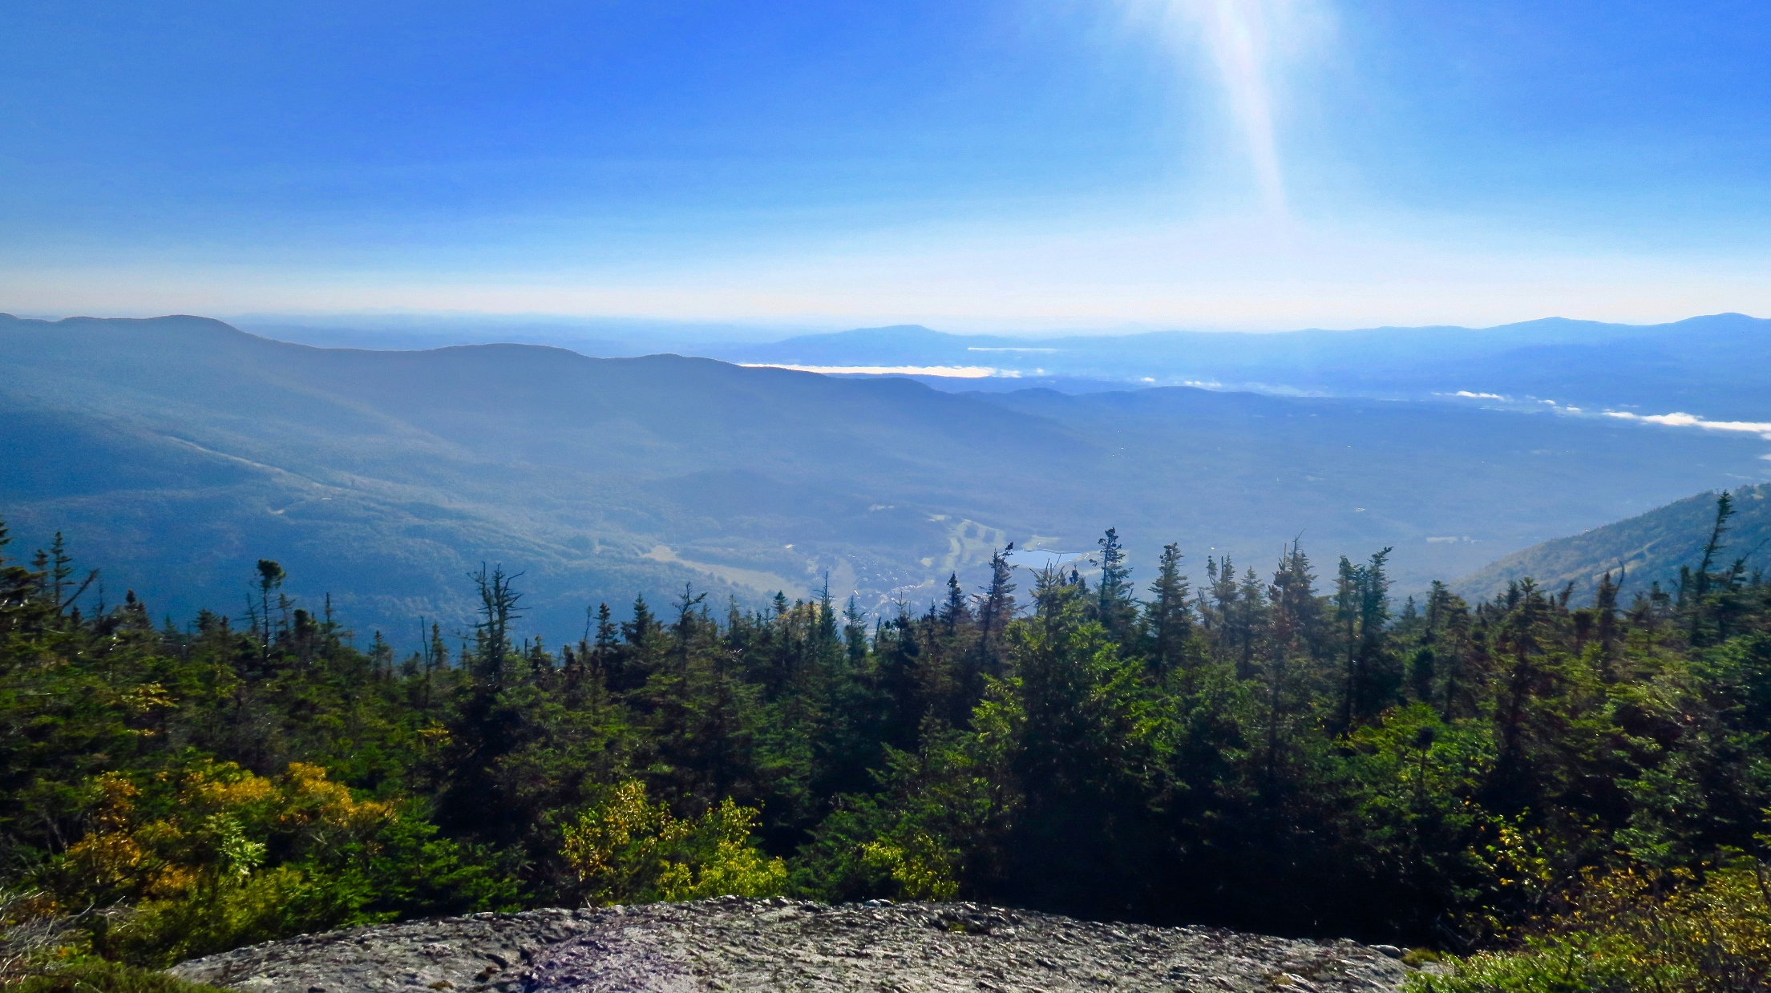




2017 Forest Ecosystem Monitoring Cooperative Conference
Beyond Communication: Advocating for Science and our Forests
December 15, 2017 – Davis Center – University of Vermont

Slide 2
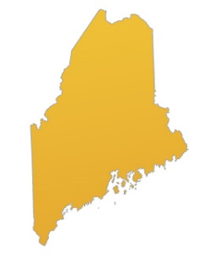
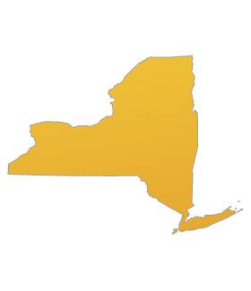
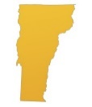
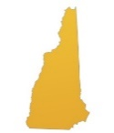
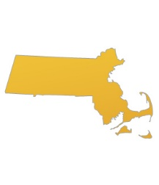
The Forest Ecosystem Monitoring Cooperative (FEMC)
A cooperative effort to gather and synthesize trends in forest ecosystem health across the region…
By providing unique, nimble, high-quality analytical and monitoring services
Notes:
Jigsaw piece and people by Yoel Ben-Avraham link: https://www.flickr.com/photos/epublicist/8718123610/in/photolist-ehoEq3-dEy8gj-6MtBEu-aNxPcP-8QJjZH-67tit6-ak8hgN-gkUTrJ-dXGPx3-rxKjHf-5ugeqj-ds6MG3-qnq957-7UQXbQ-7vEVv7-7j3c1-bxHVka-8QMq4b-edrtNS-8Nqnvv-7T8nft-q2KALd-9tpZJb-aKpWiz-jBjfM1-qaHwqK-9M5H7L-8tixm-a5E3tn-8KadYU-BtE67-6JB6sD-78aisf-4XxQF3-hHqbh-8cj2Kj-oGrQrW-6M9nNP-8QMqgj-5EpEkU-5RSP6E-5xJT9V-c5nHu3-8rg1nz-yfSvt-8Yf1jc-5s7AQJ-8QMq9u-5kNdDL-HVCw2
Colorful circle of people by Yoel Ben-Avraham link: https://www.flickr.com/photos/epublicist/3545251137/in/photolist-6phkDB-HMWseE-aoRRUW-dQRkLj-821FeM-jtxX8x-fMSW16-jq33gL-dhZYAt-msKo8-7SHeo-cKHQyf-fefx8R-GWHfNS-ioMHVR-9c1rDB-kEhh-3b1dhJ-4pUyRS-9GZGPY-fK9M5m-wTVvDs-9kd6eQ-wU3XPi-DwNDms-jCBk4r-uiF6v-6qFiGW-nKY8Z2-dzJs7X-DhjaT9-xaLZRJ-dEcFQi-acHUFE-59yhc9-8kTwtT-4oYv6f-cZHYzy-bV67KW-brK2Lq-d1cjmm-9x6zJw-6zBKS7-ayvEkj-fmMXfn-zyJd1-n3Ydwz-77kq7B-7q3v8k-GJEcNB
Colorful people with jigsaw puzzle by AJ Cann link: https://www.flickr.com/photos/ajc1/13059415974/in/photolist-kU1Voo-bLkkX8-brdqET-9TbhtS-cSZuhq-JDzcM-eRGr17-6Er1Pr-cVV7em-dRnzdP-4jFUbM-a1a3gf-auBzVF-87UBWg-6SGVKv-dSPND3-9ZTe2k-m3XDc7-fH8fnF-dQk8n8-qo6bR9-nPxEuD-abUPDG-oFkt1L-9Y3k5W-6jJkuU-6LuBRB-6HTMEv-gtgAYR-5yjcUb-8wNeNw-NyhFw-dgqnND-bV6t7D-buKSFF-ohVn47-nHUSJq-7NrsEa-25Cwr7-cDoxgE-9ZmC2N-9ewer-cQQ7oS-ouC7DK-dvv5Mf-9hxm4t-4cURfv-63cAYM-cRQqU9-kCqNNP

Slide 3
Key Values
Nimble
  We can easily mobilize resources and skills for a wide range of activities, including data analysis, synthesis, field work and project support
Dynamic
  Beyond the diverse skills of our team, we can bring in experts and student labor for a variety of uses.
Unique niche
  Mandate for working across agencies and disciplines to support and knit together monitoring programs

Slide 4
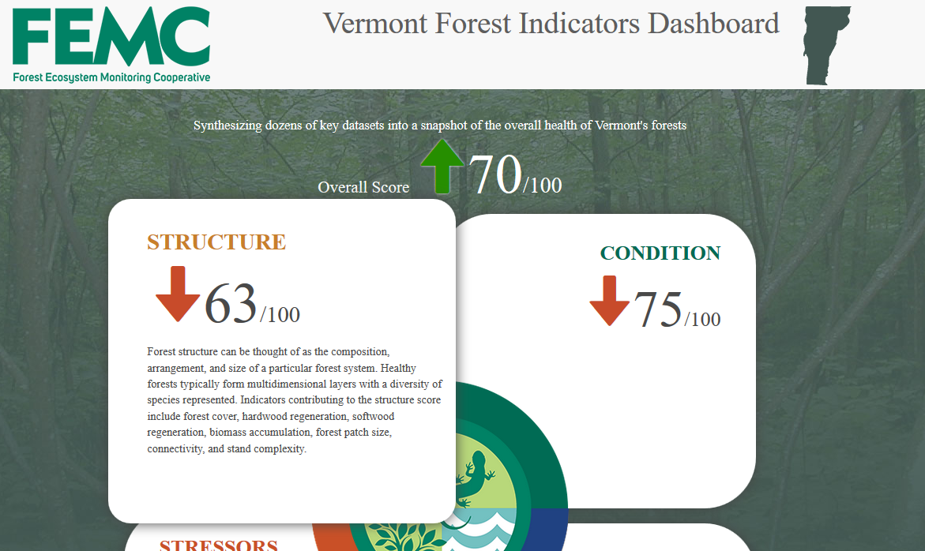
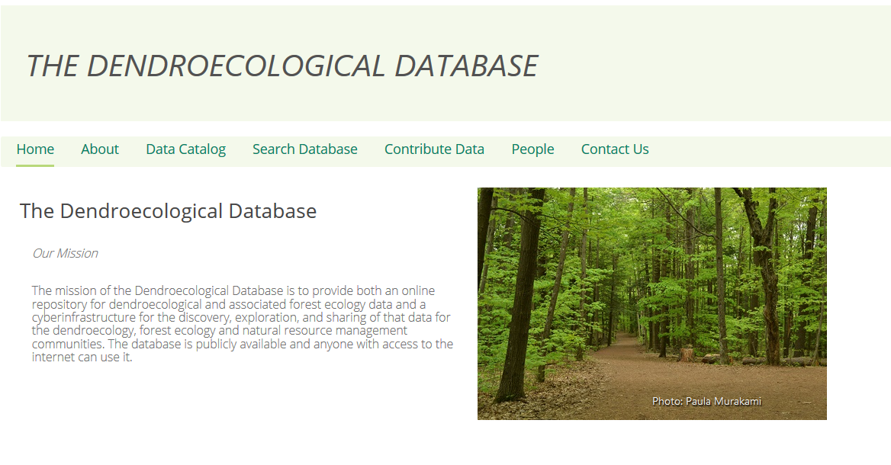
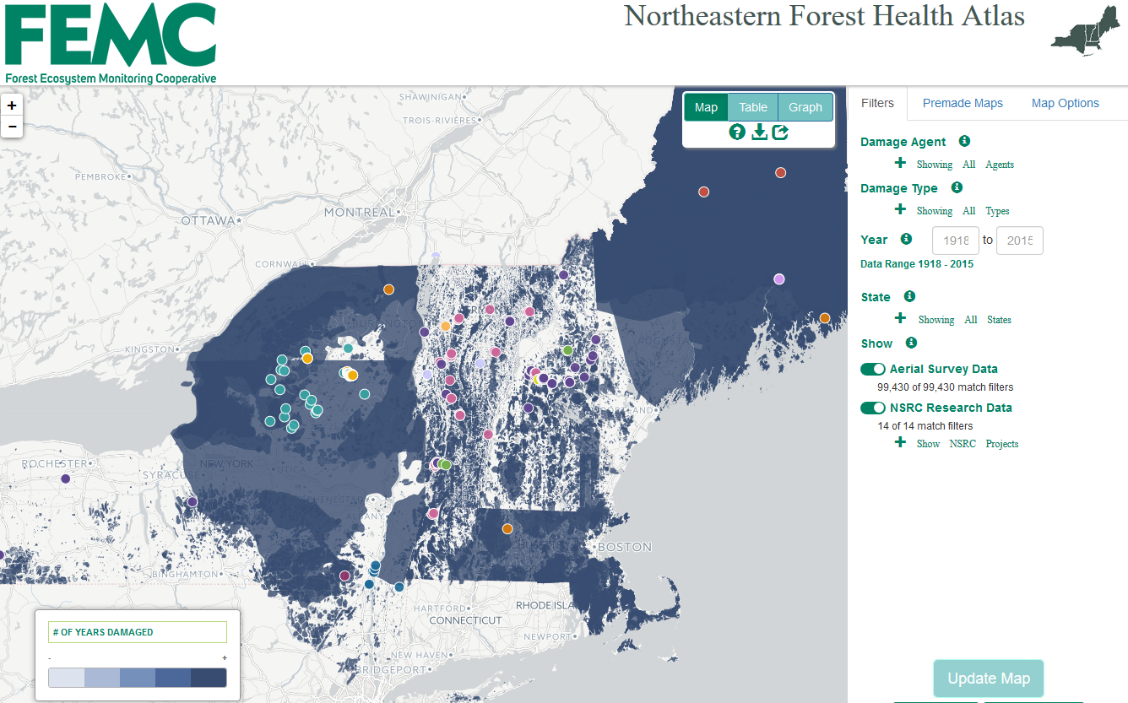
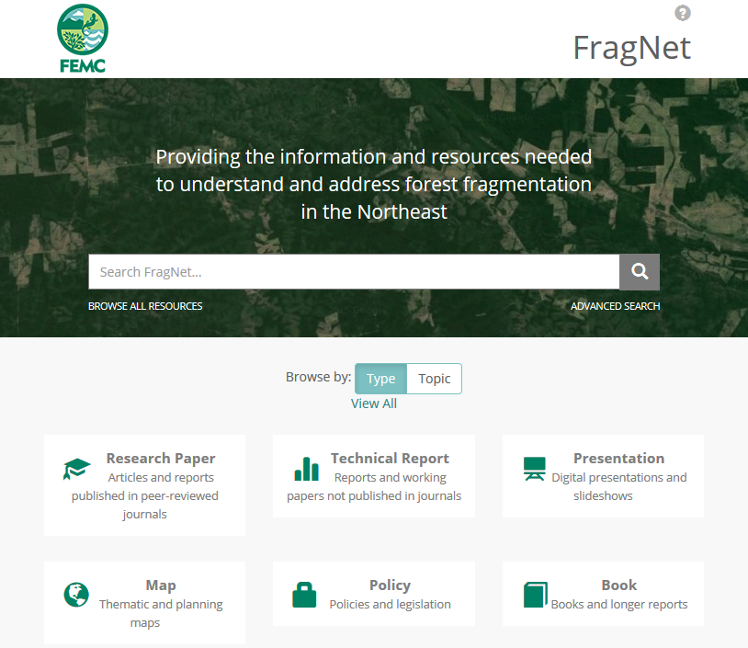
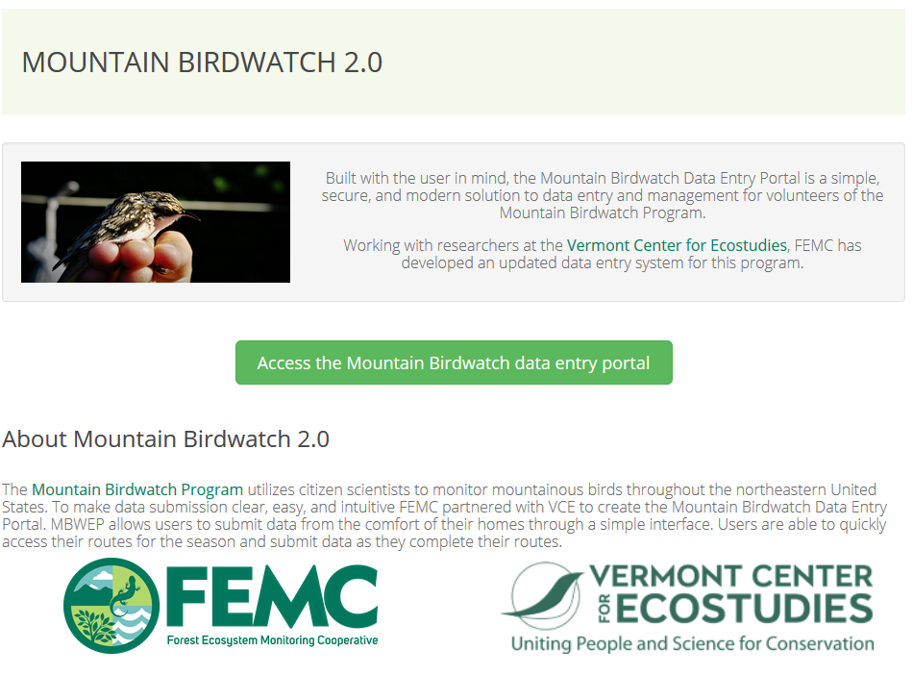
Data Archive, Access and Synthesis
Apps and Dashboards
Forest Indicators Dashboard
Dendroecological Database
Northeastern Forest Health Atlas
FragNet: Forest Fragmentation Information Network
Mountain Birdwatch 2.0 Data Entry

Slide 5
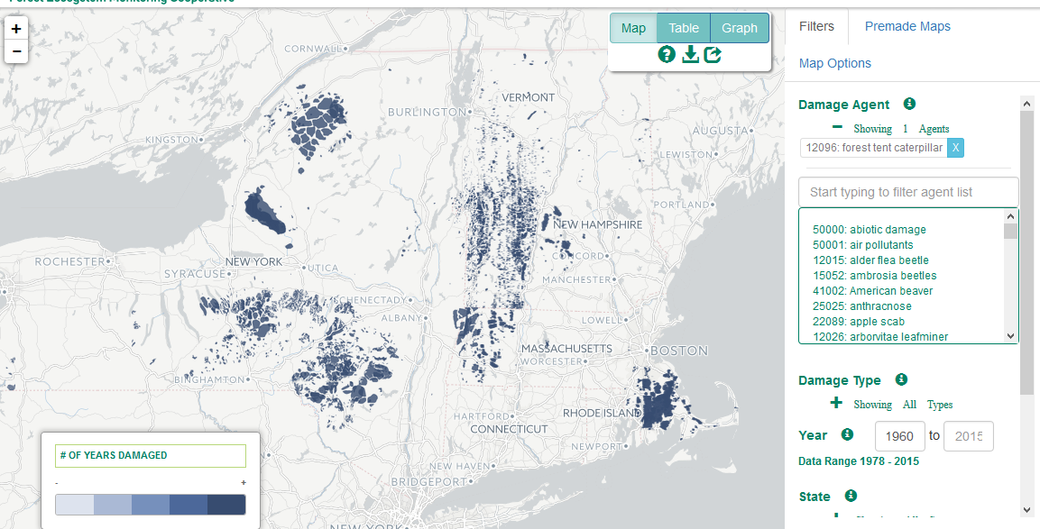
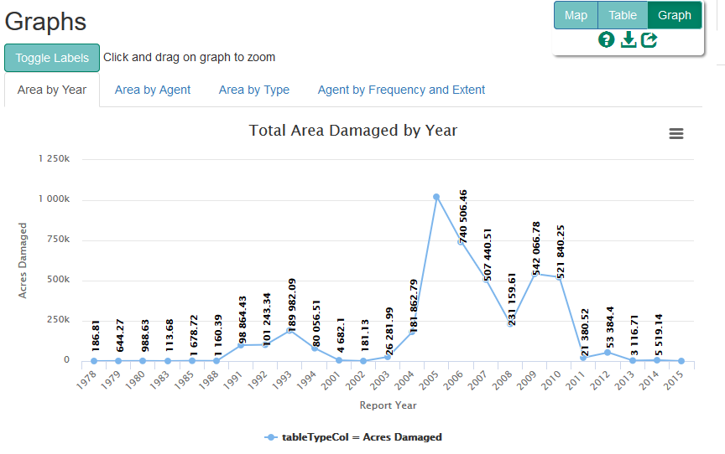
Forest Health Atlas

Slide 6
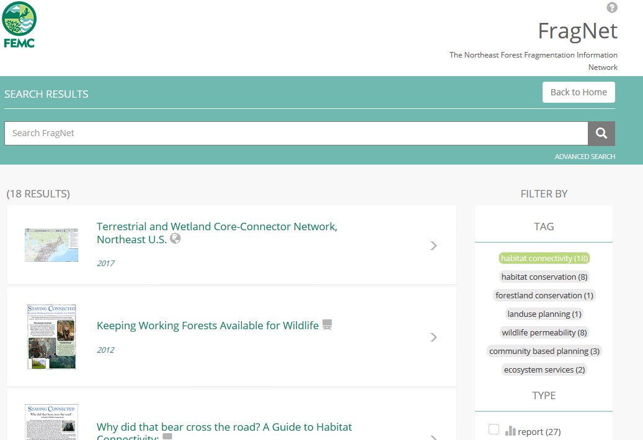
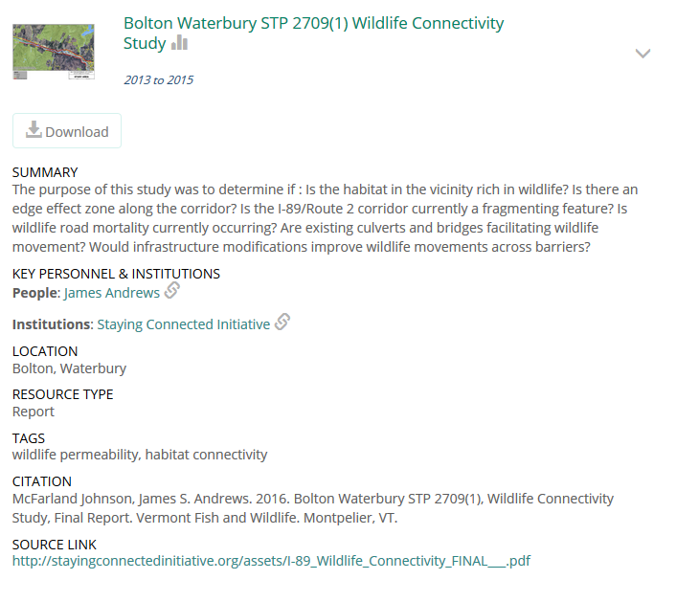
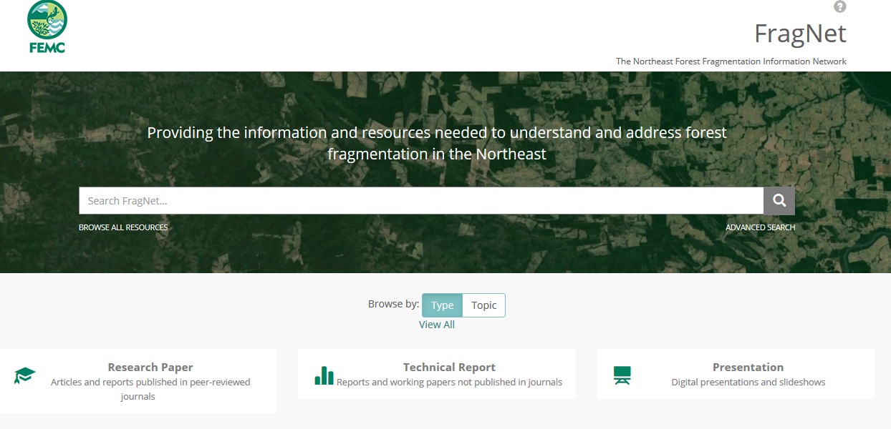
Fragnet
The Northeast Forest Fragmentation Information Network

Slide 7
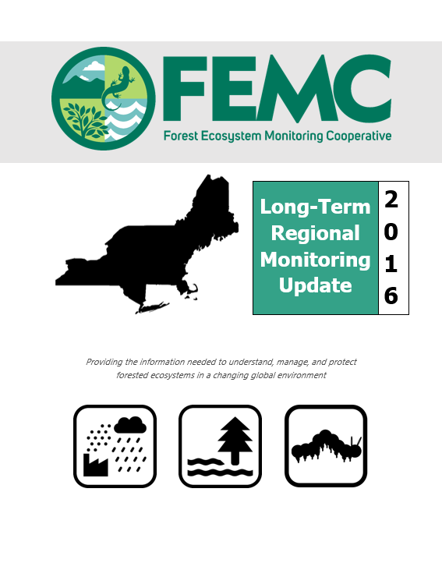
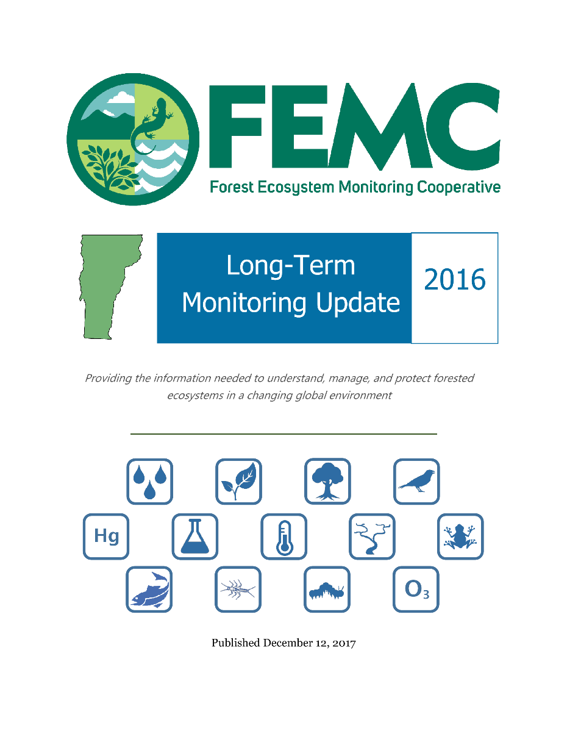
Data Synthesis
Long-term Monitoring updates
Yearly summaries and long-term trends
    Forest Health
    Aerial Detection Surveys
    Forest Phenology
    Acid Deposition
    Mercury Deposition
    Ozone
    Climate
    Trout
    Forest Birds
    Amphibians
    Sentinel Streams
    Watershed Hydrology
    Water Quality

Slide 8
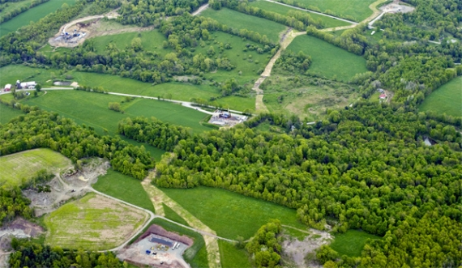
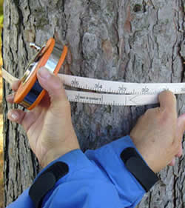
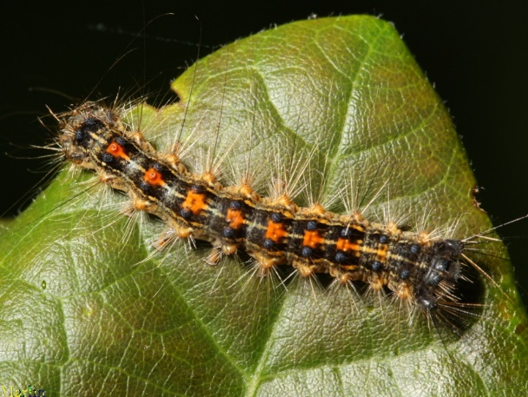
Key Regional Efforts
#1 Tracking of fragmentation and the impacts of fragmentation
#3 Climate variables and climate change
#2 Standardization of methods and measurement

Slide 9
How to get involved
Contributing data and content to the FEMC archive
Suggesting needs for monitoring and coordination
Identifying gaps in decision-making support
Providing input and feedback on FEMC tools, products and efforts

Slide 10


Acknowledgments – Core Funding
Notes:
USFS Forest Health Monitoring and Northeastern Area State and Private Forestry – Core funding
VT Forests Parks and Rec – Conference and partnership support
UVM RSENR – Administrative and partnership support

Slide 11
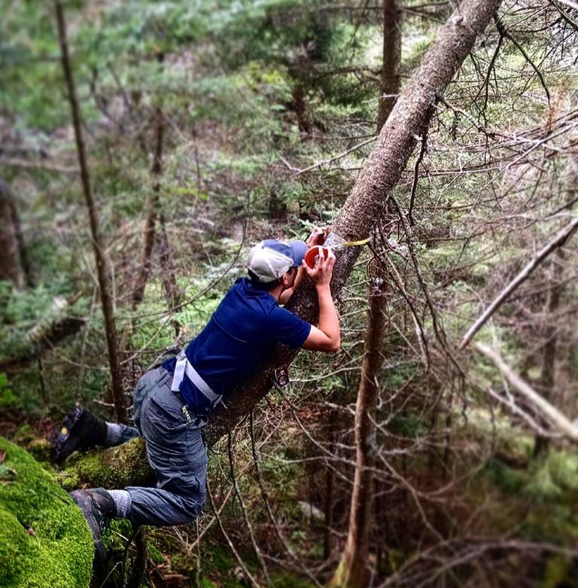

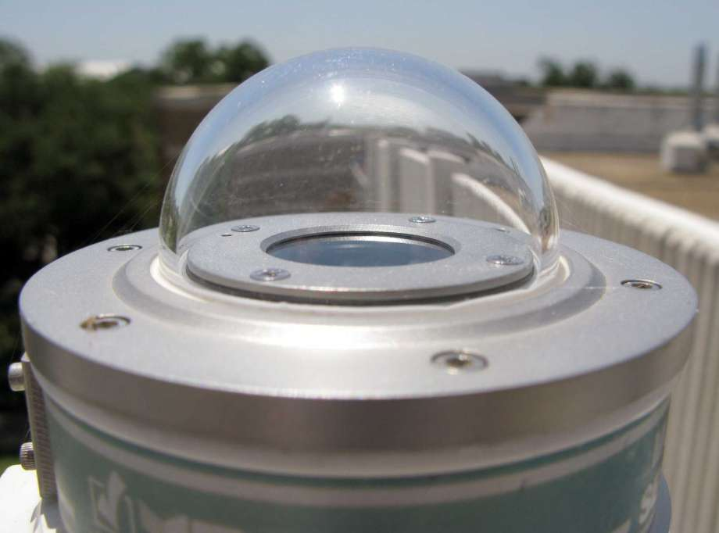


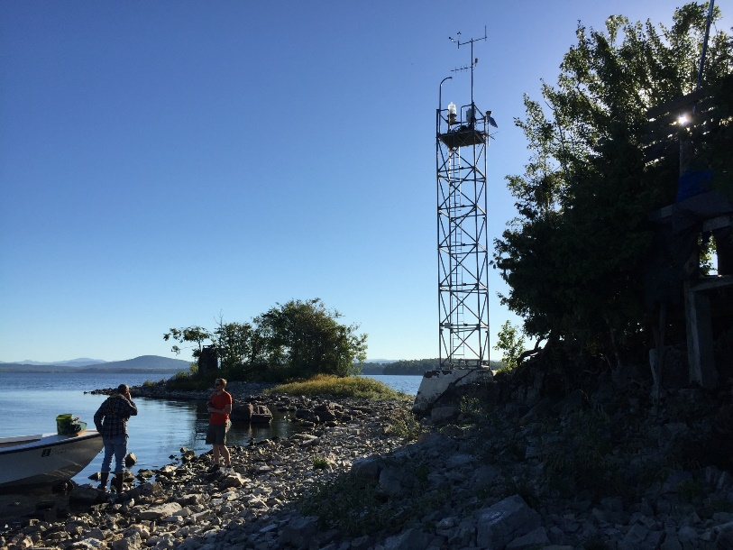


Acknowledgments - Additional Funding
Green Mountain and Finger Lakes National Forests

Slide 12
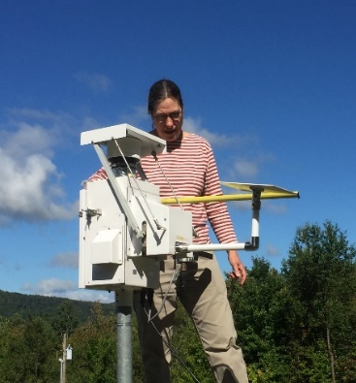
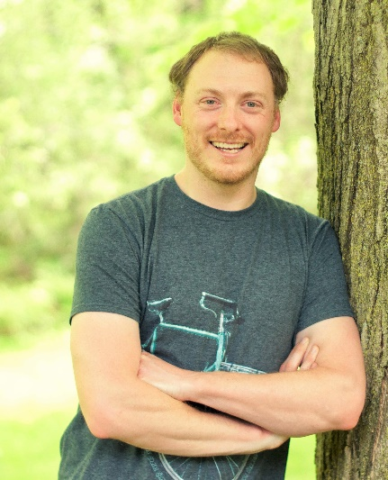
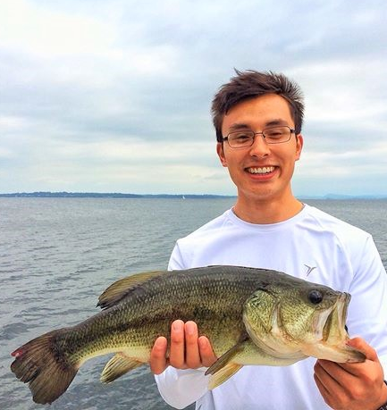
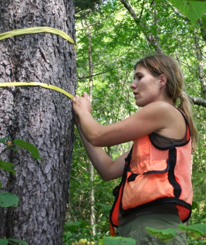
Thank You to the FEMC Staff
Mim
Mike
John
Ali
Along with Emma Tait, Judy Rosovsky, Ismar Biberovic and Caroline Drayton
and our 2017 Field Season Rock Stars

Slide 13
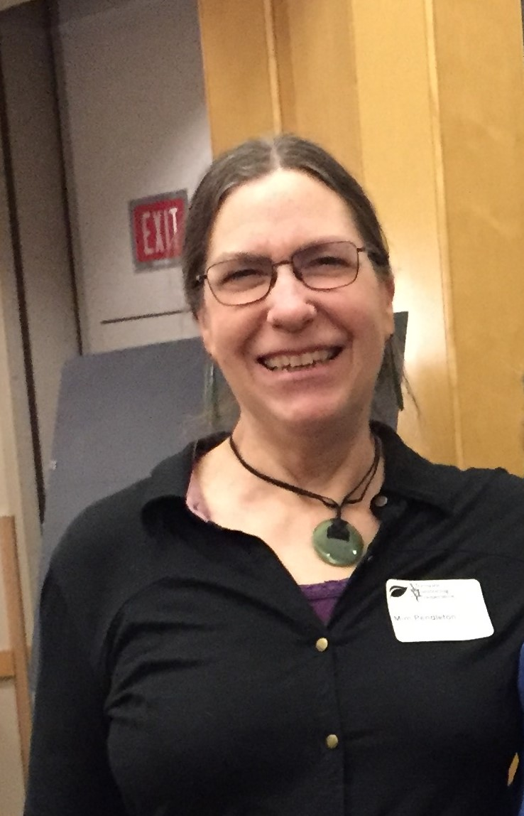
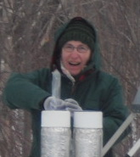
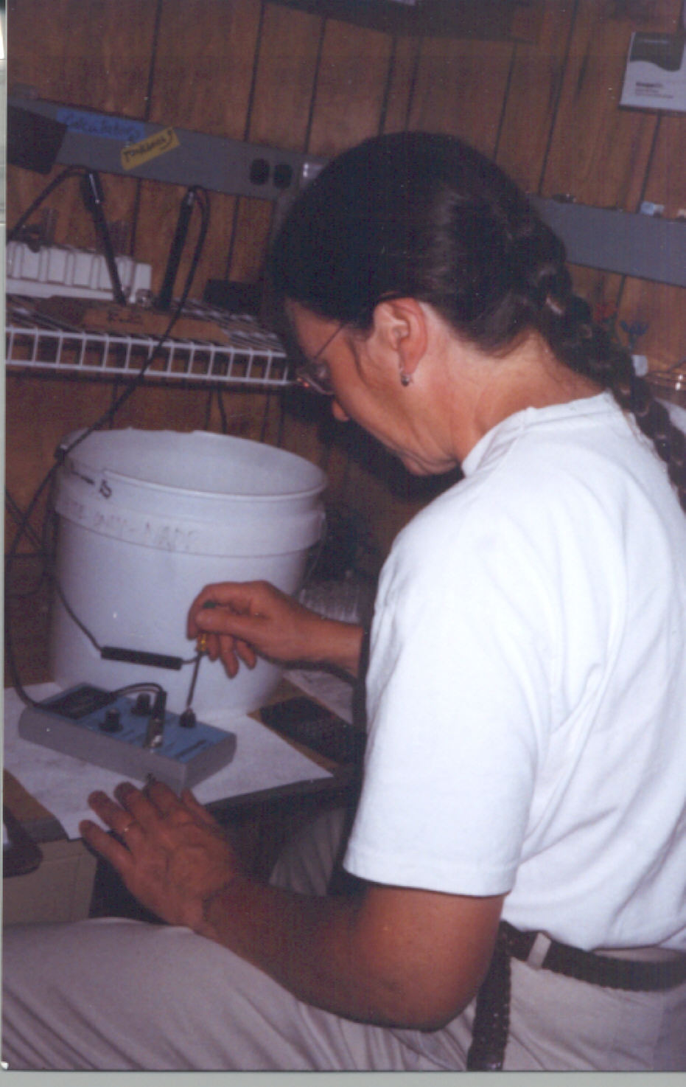
And one special thank you in particular

