Slide 1
Communicating Science Effectively
2015 VMC Annual Conference

Slide 2
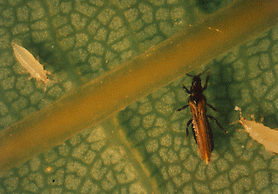
“Insect eats it’s way across Vermont!”
Pear thrips defoliating sugar maple forests
Notes:
When I first started working for the Department, it was the year of the pear thrips outbreak.
I spoke at 12 meetings of Vermont sugar makers association in one month. I thought my audience wanted to know every detail about the insect, what we knew, what we didn’t know, and the science we were conducting. That first year they seemed to all bear with me as I showed slide after slide of details of this insect pest. They already knew the challenge: destroy our sugar maple trees and our syrup production will plummet.
But we don’t always study a topic that is in the public eye, that they perceive as an issue, and especially when we accumulate information through long-term monitoring. Some of our VMC Cooperators have excellent communication skills. They have found what resonates with people and use this to their advantage. Over the past few years our Agency has devoted time and trainings to improve how we communicate science that we know to be valuable.

Slide 3
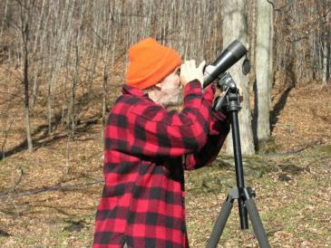
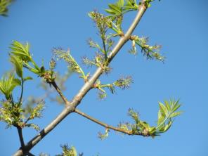
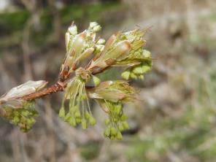
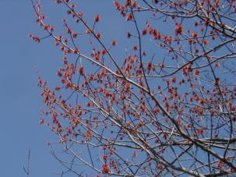
Spring phenology monitoring
Notes:
In the early years of the VMC, cooperating organizations spent big chunks of time taking measurements.

Slide 4
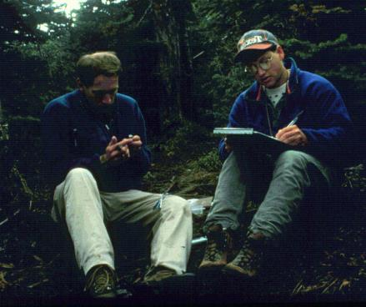
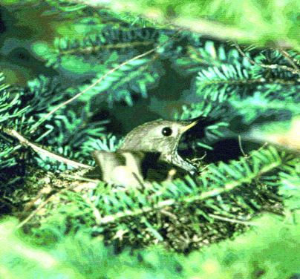
Forest songbirds
Notes:
Establishing protocols, expanding sites.

Slide 5
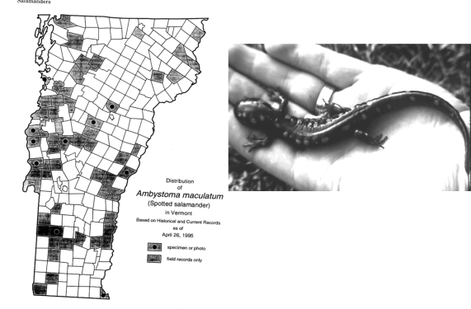
Distribution of amphibians and reptiles
Notes:
Creating catalogs of where we had information, and the gaps that needed fillling

Slide 6
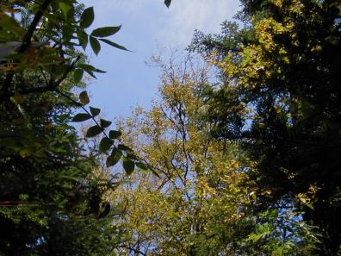
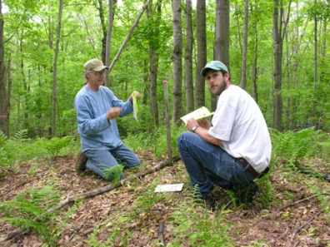
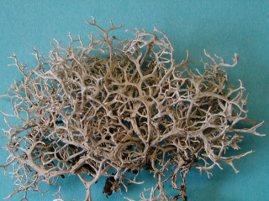
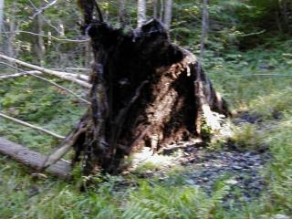
FPR Monitoring
Notes:
Understanding what was important.

Slide 7
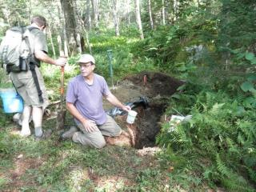
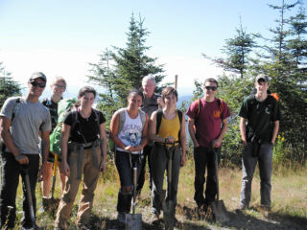
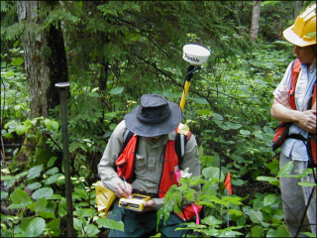
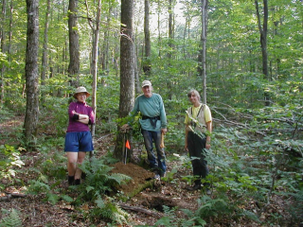
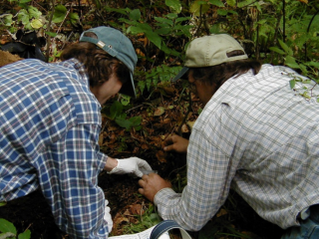
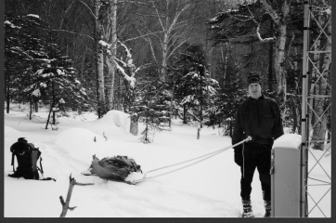
Soil monitoring partnerships
Notes:
Buildng partnerships and a banks of seasoned and new scientists. Now the stories need to be told.

Slide 8
Vermonters value nature
Notes:
Our audience in Vermont is interested, but can be overwhelmed with information and lacking time to digest it. Time plays a huge role in what information gets absorbed. They are more likely to listen if you speak to something they value. Emotions speak louder than words.

Slide 9
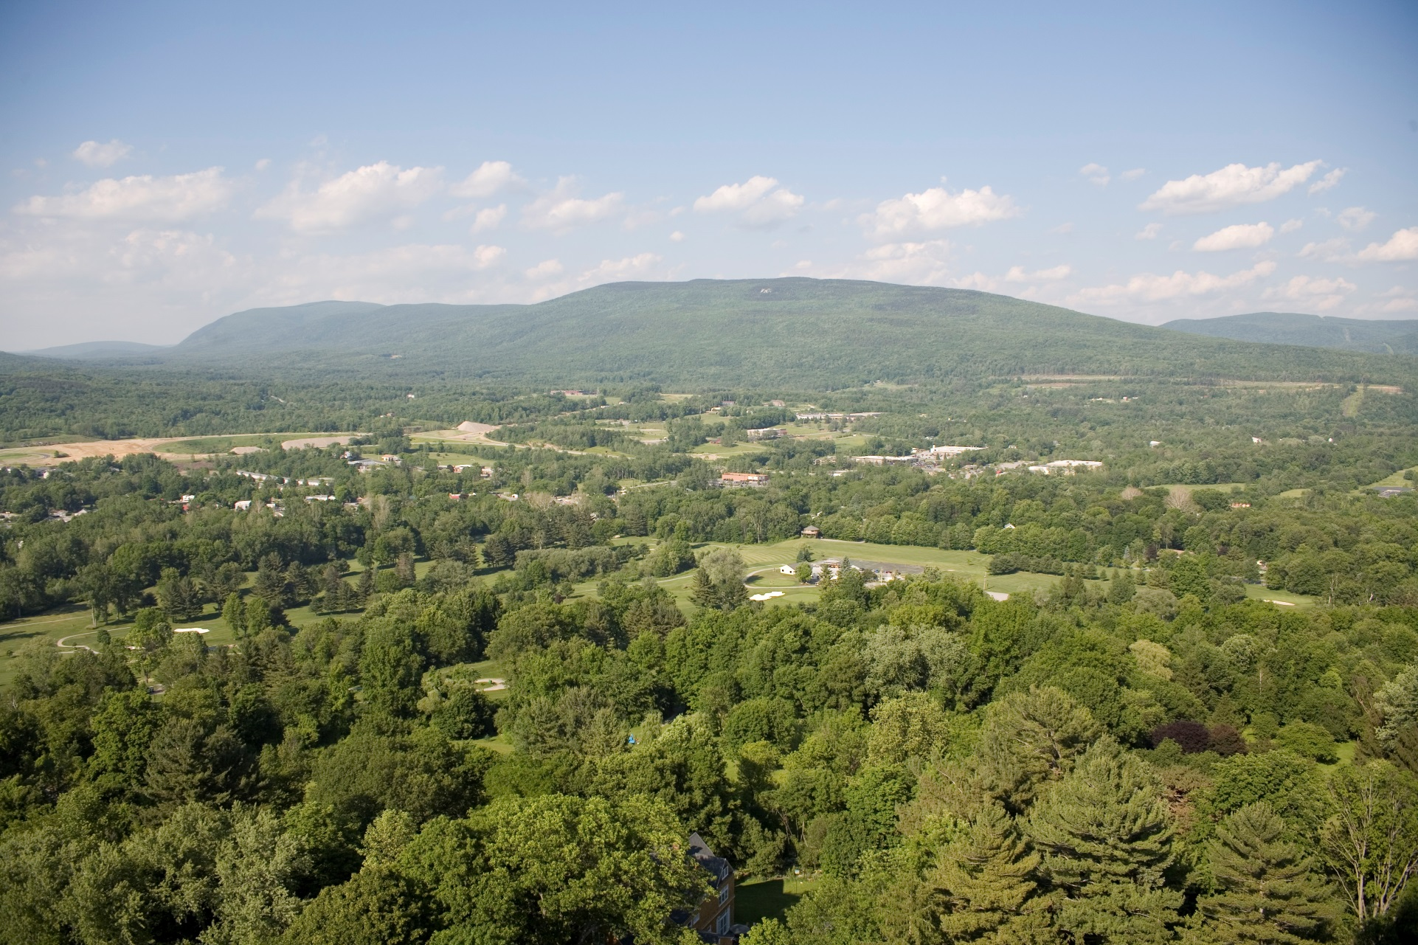
FOREST FRAGMENTATION
“A Snapshot of the Northeastern Forests,” USDA Forest Service publication, October 2005
Notes:
For example, forest fragmentation is a topic that needs explanation.

Slide 10
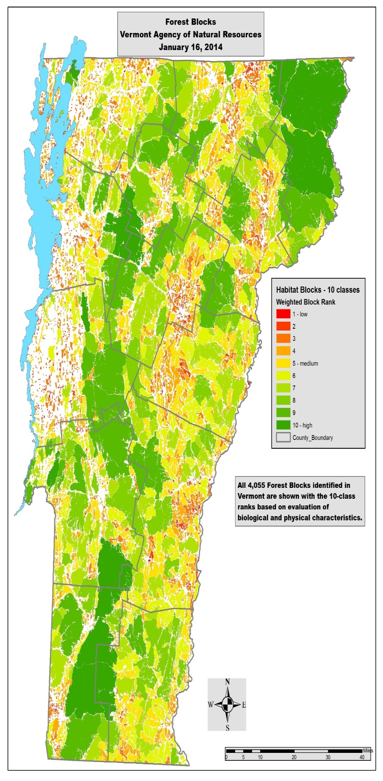
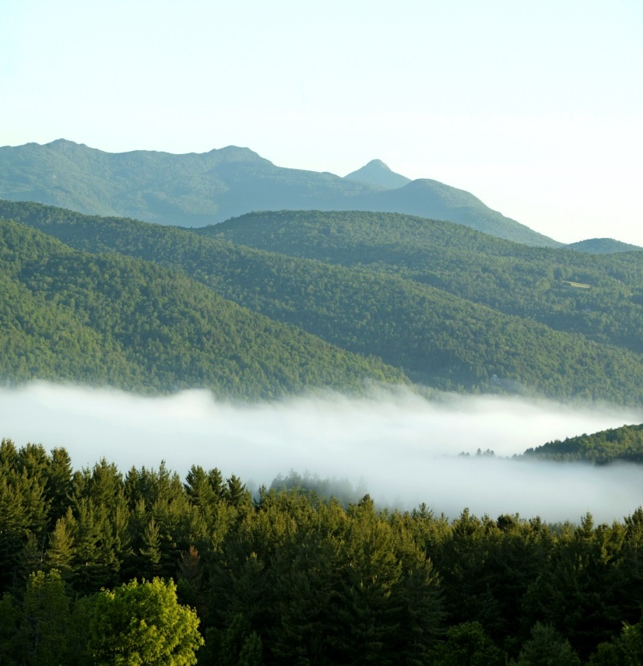
FOREST BLOCKS
Large areas of contiguous forest and other natural habitats, often spanning multiple ownerships and frequently un-fragmented by roads, development, or agriculture. Vermont’s forest blocks are primarily forests, but can also include wetlands, rivers and streams, lakes and ponds, cliffs, and rock outcrops.

Slide 11
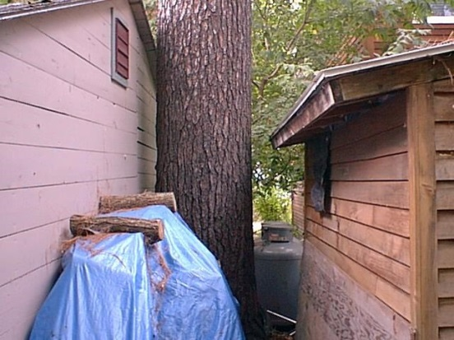
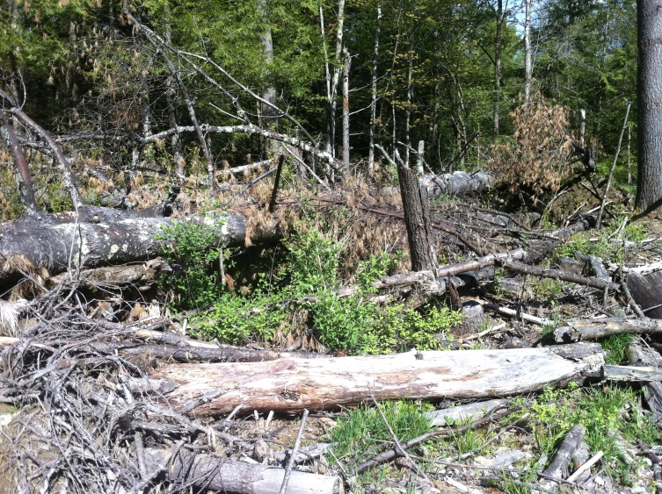
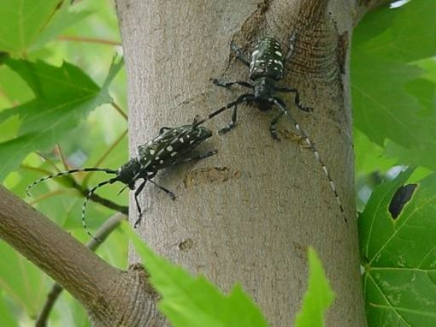
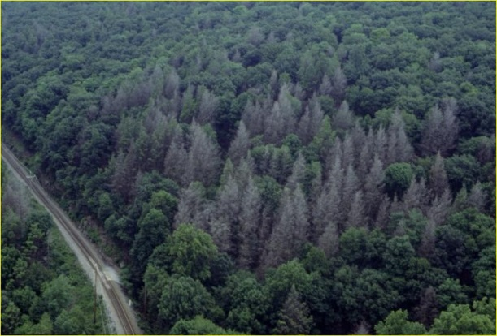
IMPACTS AND EFFECTS OF FRAGEMENTATION
Loss of biodiversity
Increase of incidence of invasive plants, pests, and pathogens
Reduces natural resilience
Reduces water quality
Impact to wildlife

Slide 12
Landscape Conservation Saves Money
Trees prevent 6.8 billion dollars in health costs annually
Annual expenditure in the US for wildlife is far more than for spectator sports and casinos
In Vermont, 39% of Vermonters participate in birding
The northeast will double the rate of development over the next 50 years so we will loose 70% of our forests
Gund Institute
Notes:
Another way to address this is to support this with a different approach.

Slide 13
A wetland in Middlebury saved the town $2.5 million by preventing damages during Tropical Storm Irene
Notes:
Success stories are important to illustrate the value of nature in terms that people can relate to.

Slide 14
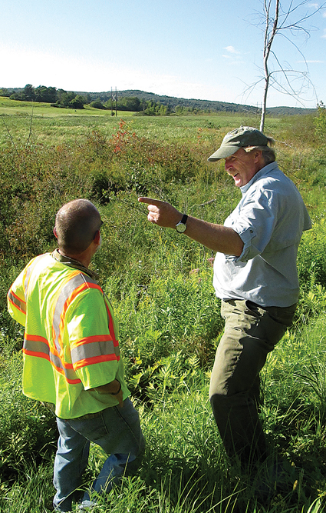
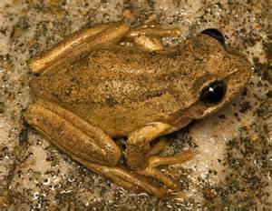
Some scientists are passionate
Jim Andrews
Notes:
Some people have carisma, and are able to lure in people of all sorts to get passionate about something, even the number of toes on a frog. When frog deformity was first observed in Vermont, Jim Andrews had a decade of monitoring amphibians at the VMC study sites and could say that this was not an issue in these remote forested areas. These are the stories that make people believe in the value of monitoring. You don’t always know the ways that monitoring data will become valuable. But we aren’t all able to captivate an audience like Jim can. But we can learn techniques that help.

Slide 15
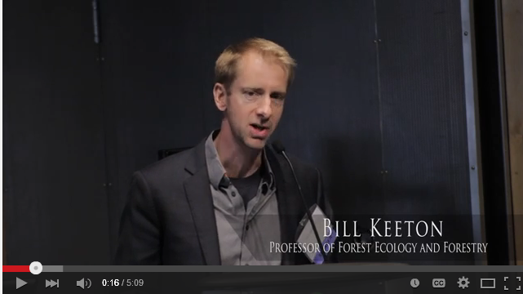
One simple message…
Notes:
It is really hard to give a quick talk on a subject as complex as forest carbon offsets in the world carbon markets. He has worked to focus his message.

Slide 16
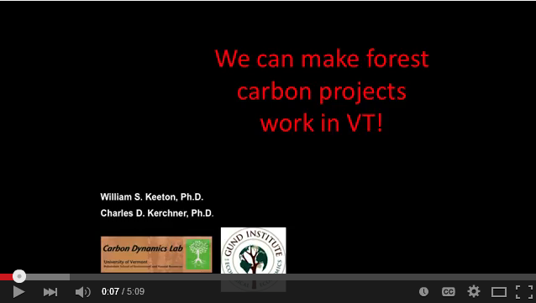
Notes:
This is a 5 minute video that works with this message.

Slide 17
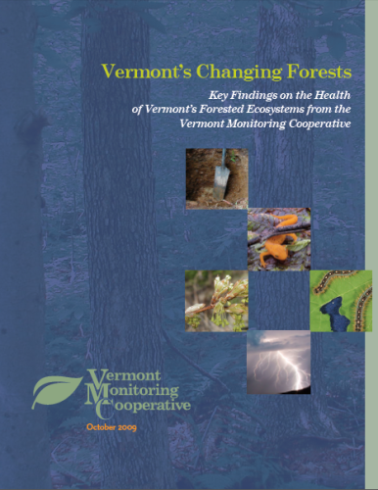
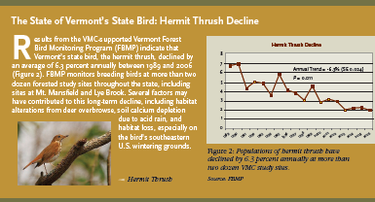
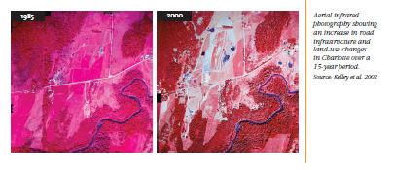
Synthesizing information learned

Slide 18
Strengthening Science at the
Agency of Natural Resources
Effectively Tell Our Stories
Train scientists on effective communication
Create a bank of science talking points for staff to use in conversations with the public
Communicate and highlight science on our web sites
Notes:
Scoping process led by Larry Becker and Agency scientists. Recommendations now being implemented. An ANR Science Advisory Committee has been formed to take action including communication.

Slide 19
Recipe For Effective Communication
Climate Access
1. Challenge
  What are the problems we’re facing and the context they’re happening in?
2. Choice
  What action must be taken, by whom, and why now?
3. Opportunity
  What are the benefits of taking action?

Slide 20
Public Opinion Surveys
70% of people in the US reported experiencing extreme weather in the past year (2012-2013)
30% of these respondents had suffered harm as a result of extreme weather
  40% experienced high winds
  28% experienced extreme rainstorm
  32% experienced extreme heat
Surveys by Yale and George Mason University
Notes:
More than half of the American public believes weather in the US has gotten worse over the past several years.

Slide 21
More than half of the American public believes weather in the US has gotten worse over the past several years.
50% of Americans think it’s likely that extreme weather will cause a natural disaster in their community in the next year
Surveys by Yale and George Mason University

Slide 22
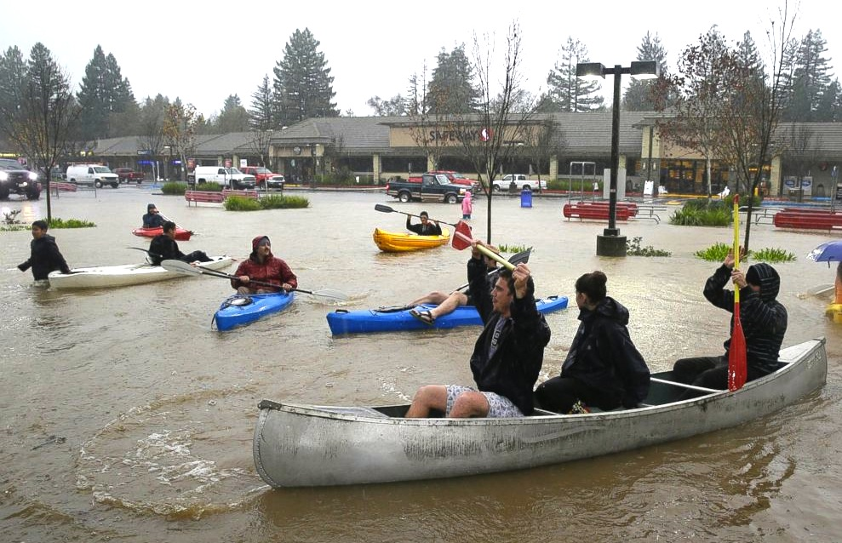
Start with what they know –
Extreme Weather Is Affecting Peoples Lives

Slide 23
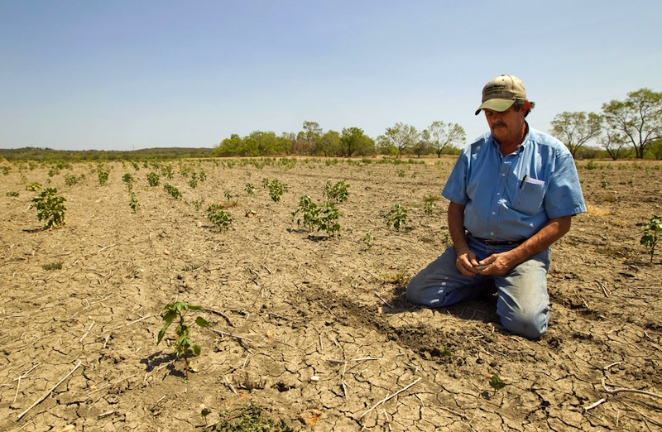
Local Climate Change Impacts

Slide 24
What Resonates With People …
  Being prepared
    Protection and safety
  Being responsible
    Stewardship
Notes:
One of the reasons people don’t take action against climate change is a sense of fatalism, a sense that it is too late to do anything about climate change. Technical arguments don’t really reach their emotional core where values reside. Using arguments that speak to their values and using terms that sound more hopeful are likely to be more effective. Describing how positive actions can benefit people and places can provide tangible things for people to act on.

Slide 25
Climate Change Terminology
Climate Disruption
Adaptation
Sounds natural and gradual
Mitigation
Public is unclear of meaning
Resilience
Can imply maintaining status quo

Slide 26
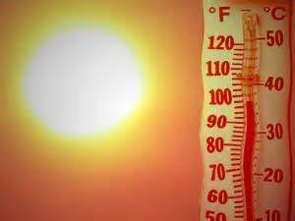
Notes:
One of the main reasons that people don’t take action is that they feel defeated. One of the reasons people don’t take action against climate change is a sense of fatalism, a sense that it is too late to do anything about climate change. Technical arguments don’t really reach their emotional core where values reside. Using arguments that speak to their values and using terms that sound more hopeful are likely to be more effective. Describing how positive actions can benefit people and places can provide tangible things for people to act on.

Slide 27
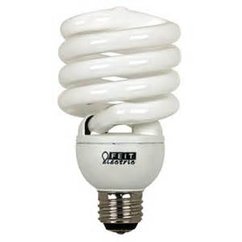
Save The Planet

Slide 28
Relate to peoples emotional needs
Motivating terms: “preparedness”, “preparation”, and “readiness”
  Rather than: “adapting” or “adjusting”
Emphasize current and local impacts
Explore trends, don’t argue science
Address uncertainty as a reason to take action
Notes:
Use terms like: “preparedness”, “preparation”, and “readiness” are more likely to resonate with people rather than “adapting” or “adjusting” and are more likely to motivate people to action than “resilience”, which can sound to some like a return to what was in place before.

Slide 29
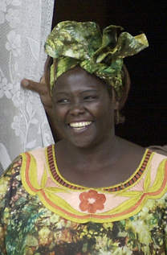
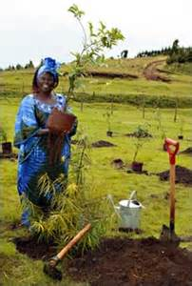
Can We Make A Difference?
Environmental degradation was at the heart of social and economic issues in Kenya
“A tree is worth more than its wood.”
Wangari Maathai
Wangari Maathai
Nobel Peace Prize 2004
Founded the Green Belt Movement in Kenya for environmental conservation.
Notes:
A contemporary Aftrican, Wangari Maathai made a difference, one tree at a time. I believe that together each of us can make a difference, one forest, one project, and one day at a time. We need to communicate with the public on this issue in whatever way is effective. We need to address this issue in ways that move beyond communication barriers. If people understand “more storms” or “longer growing seasons” then start to adapt forests centered on these topics. That’s the way to be effective. We need to act on this now, using whatever path is open to us.

Slide 30
RESOURCES
PUBLIC NARRATIVE
Marshall Ganz – Harvard Kennedy School
http://www.hks.harvard.edu/about/faculty-staff-directory/marshall-ganz
STORYTELLING BEST PRACTICES
Andy Goodman – The Goodman Center
www.thegoodmancenter.com
VISUAL STORYTELLING
Seeing is Believing – Resource Media
http://www.resource-media.org/visual-story-lab/report/
COLLECTION OF STORYTELLING RESOURCES
Climate Access
http://www.climateaccess.org/storytelling-resources
STORYTELLING VIDEO
Free Range Studio – Winning the Story Wars: The Hero’s Journey
http://vimeo.com/50791810

Slide 31
Understanding Audiences
  1. Are there particular stakeholders within your audience category that you need to reach?
  2. What values do they hold?
  3. What opportunities exist to connect your audience’s concerns to climate issues?
  4. What barriers must be overcome?

Slide 32
FRAMING THE CHALLENGE
  1. What challenge will your audience respond to most? (i.e. climate concern, extreme weather events, economics, etc.)
  2. What is at stake for your audience in the near term and future due to this threat?

Slide 33
FRAMING THE CHOICE
  1. What solutions would resonate most with your target audience?
  2. What role can your target audience play to advance these solutions?

Slide 34
FRAMING THE OPPORTUNITY
  1. What are the benefits of taking action from your audience’s perspective?
  2. What will improve in the short term and long term?

