Slide 1
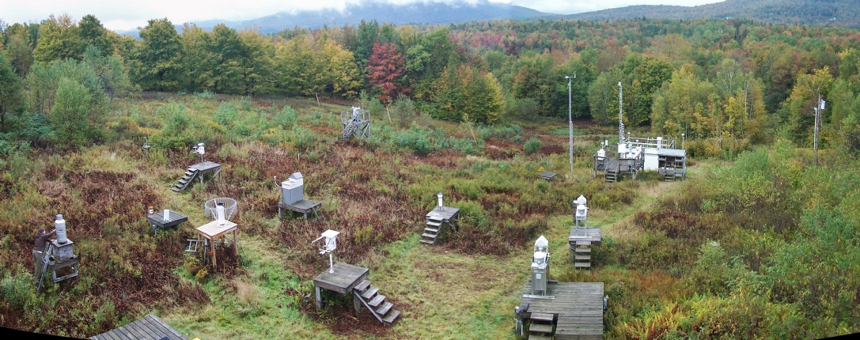
25+ Years of Acid Deposition Monitoring in Vermont
  (2) Citizen Acid Rain Monitoring Networks (LCC+UVM and Audubon)
  Vermont Acid Precipitation Monitoring Program
  Utility Acid Precipitation Study Program
  EPRI Operational Evaluation Network
  Atmospheric Integrated Research Monitoring Network (Wet & Dry)
  Clean Air Status and Trends Network (Dry)
  National Atmospheric Deposition Program - National Trends Network

Slide 2
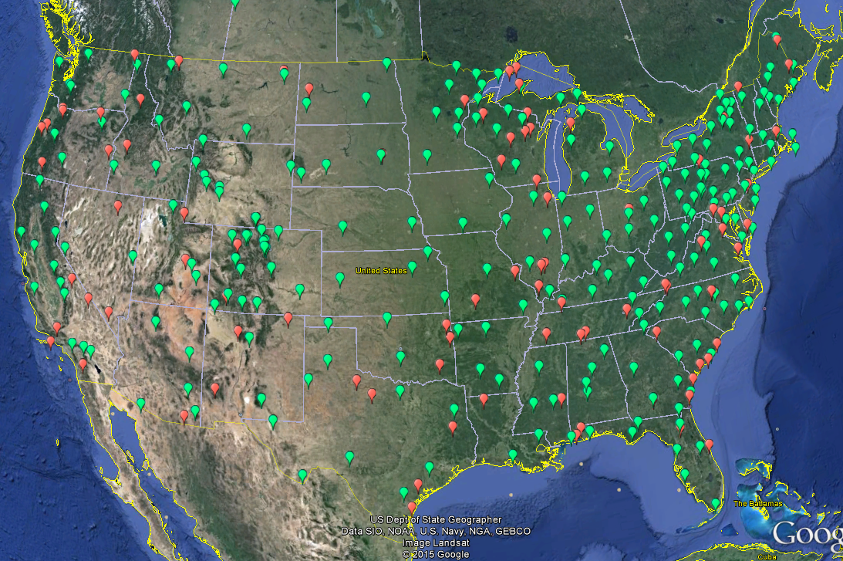
  National Atmospheric Deposition Program - National Trends Network
  263 Currently Active Sites, Primarily in US, but also Canada, V.I. P.R., Argentina

Slide 3
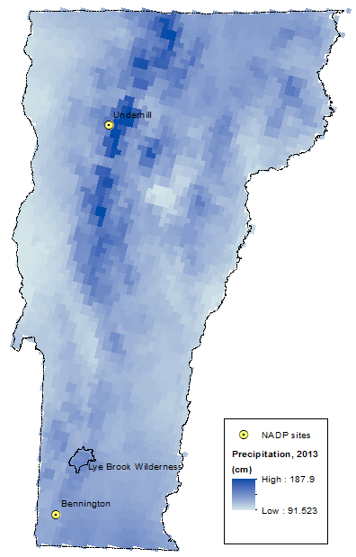
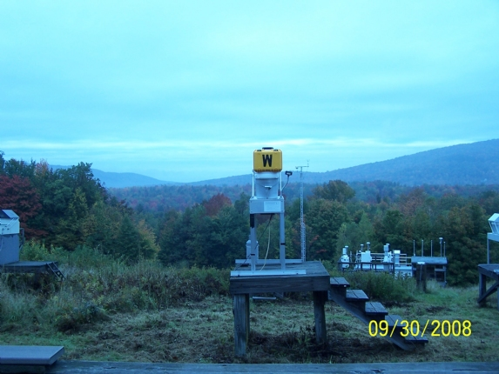
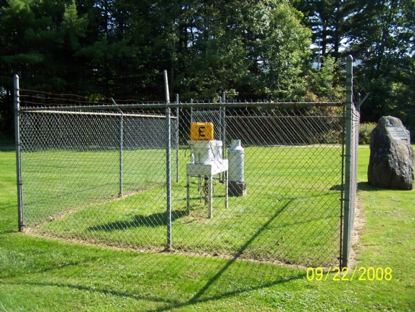
Underhill NADP Site VT99
Established 6/12/1984
Bennington NADP Site VT01
Established 4/28/1981
PRISM Model Estimated 2013 Precipitation Amount (Parameter-elevation Relationships on Independent Slopes)

Slide 4
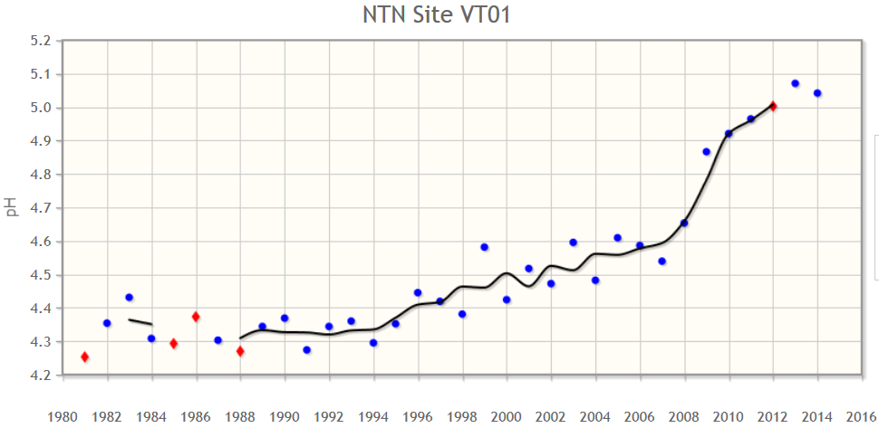
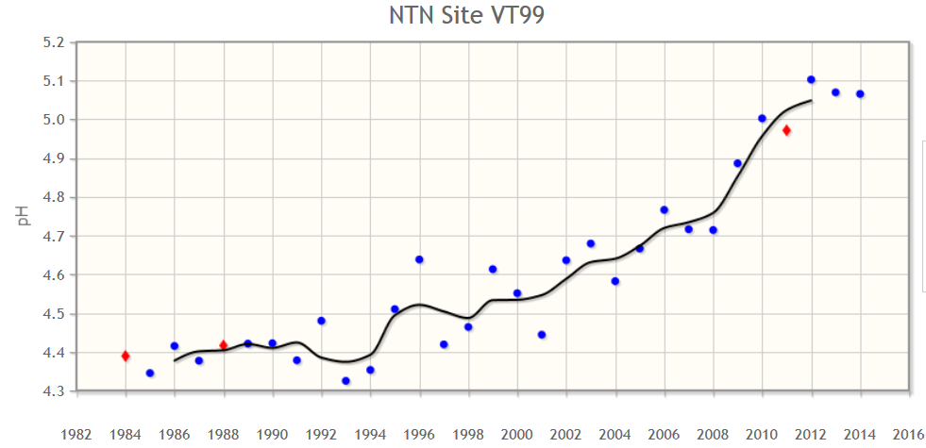
The pH of VT precipitation has increased from
4.3 to 4.4
in the 1980s
To
5.0-5.1
in 2014
An 80% reduction
of acidity in the past 30 years

Slide 5
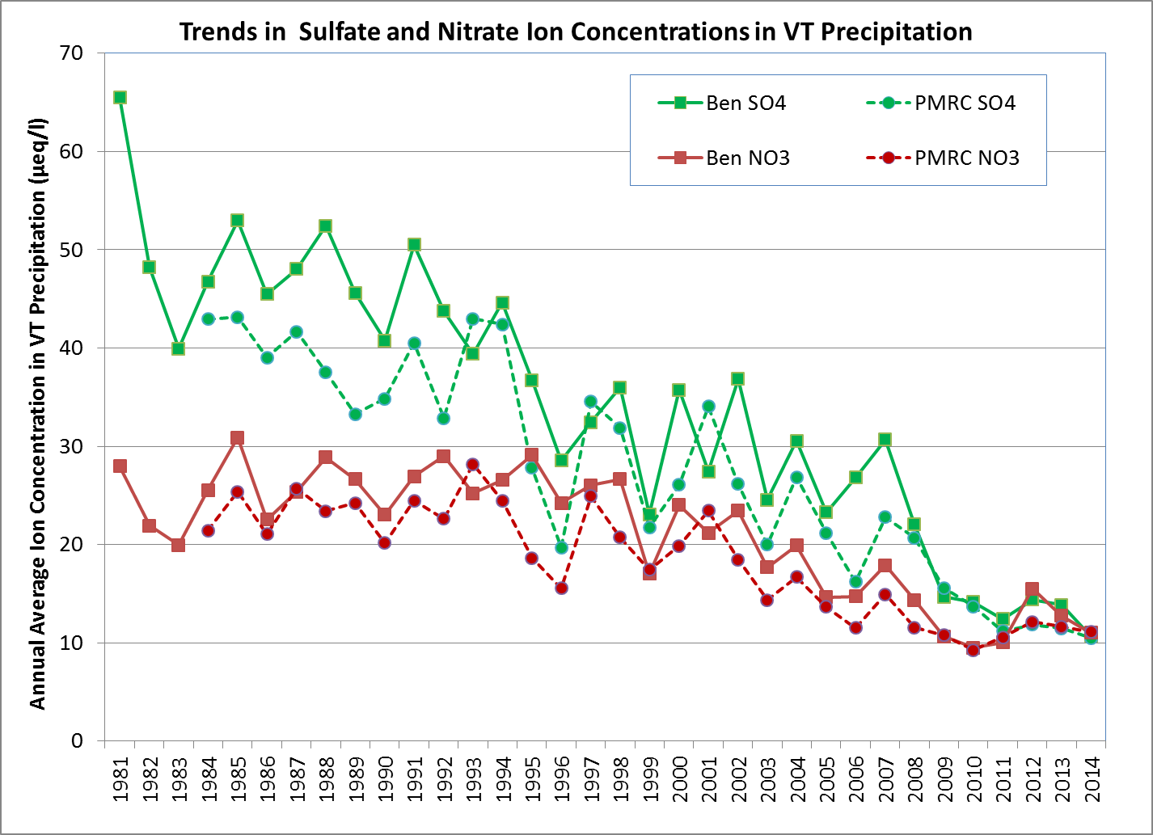

Slide 6
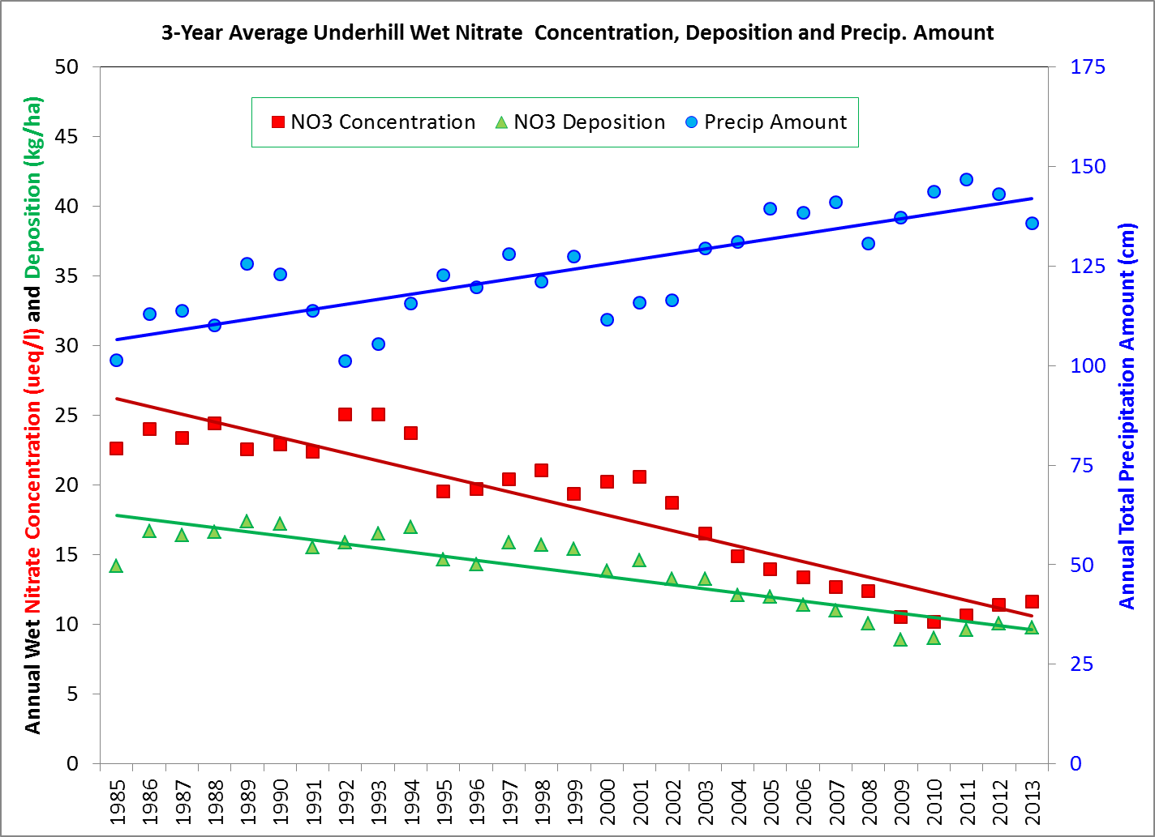

Slide 8
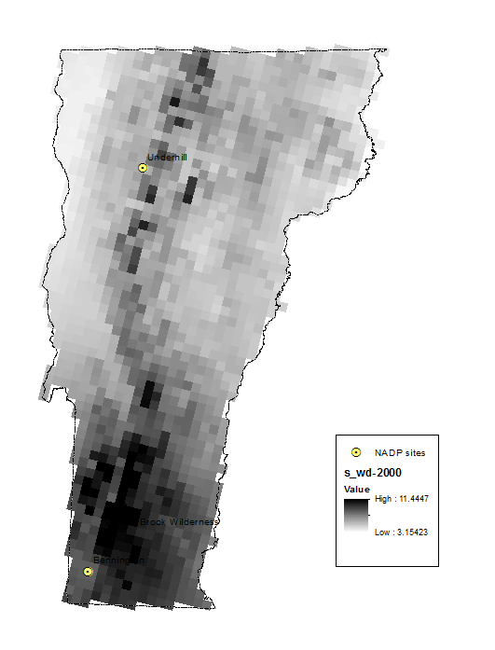
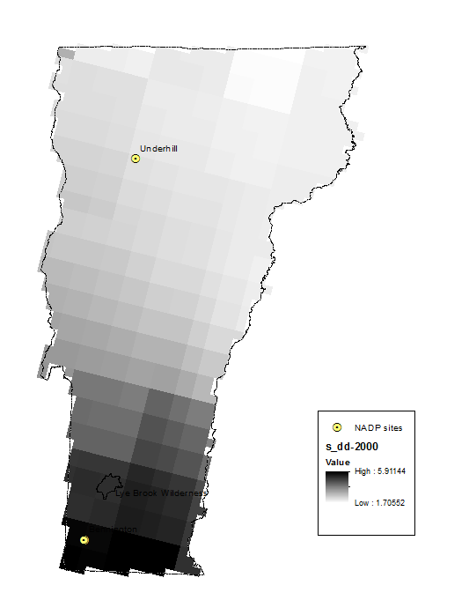

NADP Concentrations Combined with PRISM Topo-enhanced Precip. Volume to produce Gridded (4 km) Wet S & N Deposition Data
Available 1985-2014
CMAQ Modeled S & N Dry Deposition Data enhance/adjusted to (sparse) measurements for Gridded (12 km) Dry S & N Deposition Data Available 2000-2013
Combined Gridded (4 km) Total Deposition Data
S: 55% to 81% Wet in 2000
S: 36% to 71% Wet in 2013
N: 36% to 71% Wet in 2000
N: 36% to 79% Wet in 2013
Available 2000-2013
2000 Wet S Deposition + 2000 Dry S Deposition = 2000 Total S Deposition

Slide 9
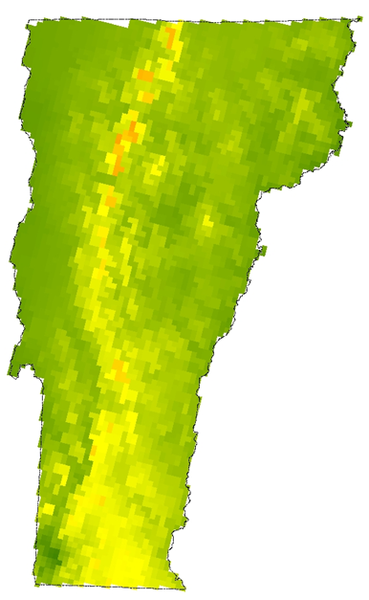
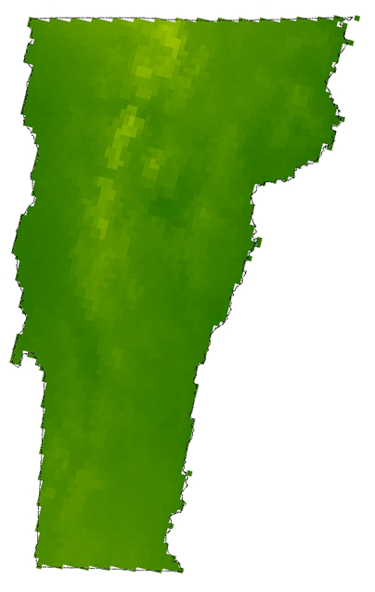
1985 Wet NO₃ Deposition 2013 Wet NO₃ Deposition

Slide 10
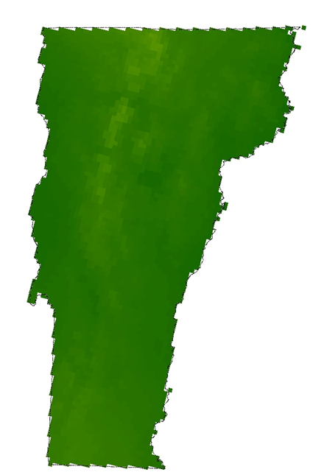
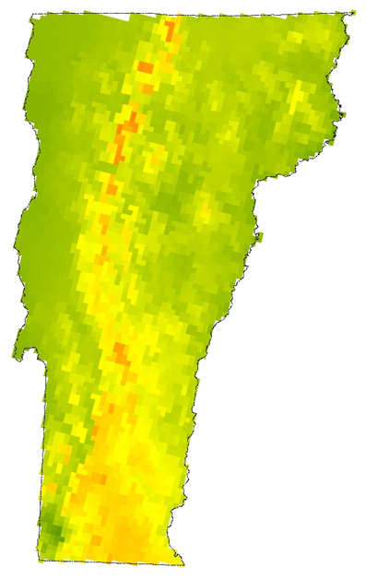
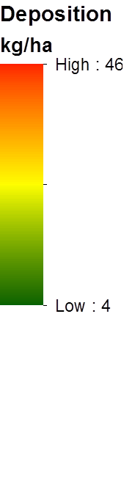
1985 Wet SO₄ Deposition 2013 Wet SO₄ Deposition
Thanks to Bennet Lyon (the New Bennington NADP Site Supervisor) for the Maps!

