Slide 1

Cave-Bat Population Trends and White-nose Syndrome in Vermont
Alyssa bennett
Vermont fish & wildlife department

Slide 2
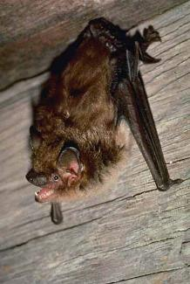
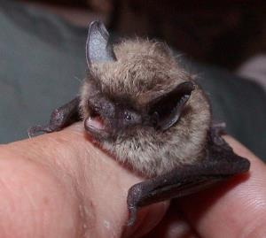
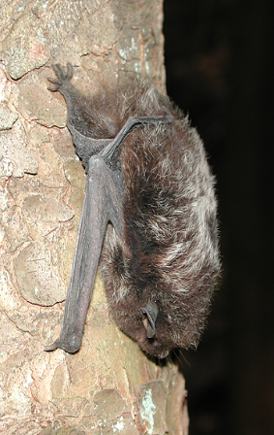
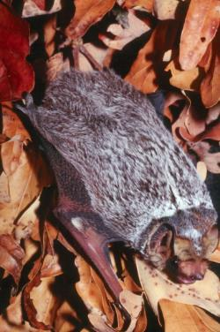
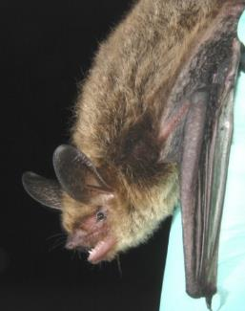
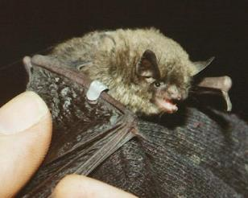
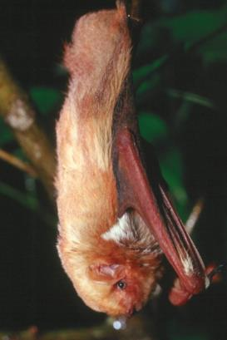
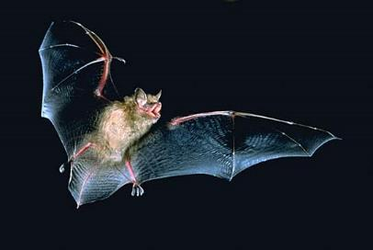
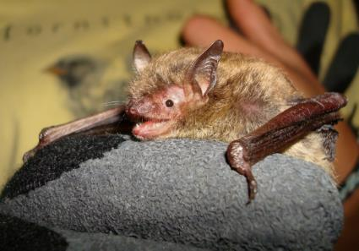
Cave Bats
Migratory Tree Bats
State Threatened
Eastern small-footed bat
Silver-haired bat
Big brown bat
Federally Threatened
Indiana bat
Northern long-eared bat
Federally Endangered
J Chenger
J Kiser
Little brown bat
Hoary bat
Tri-colored bat
State Endangered
State Endangered
Eastern red bat
J Kiser
Vermont Bat Species

Slide 3
Bat Monitoring History in Vermont
1930s to 60s WH Davis and HB Hitchcock, Middlebury College
1980s forward VT Fish &Wildlife with assistance from the organized Caving Community
Green Mountain National Forest, Army Corps of Engineers, Consultants,
2008-2010 White-nose Syndrome monitoring and population assessment
2011-Present Conservation and Recovery planning, National Wildlife Refuges
2016 North American Bat Monitoring Project

Slide 4
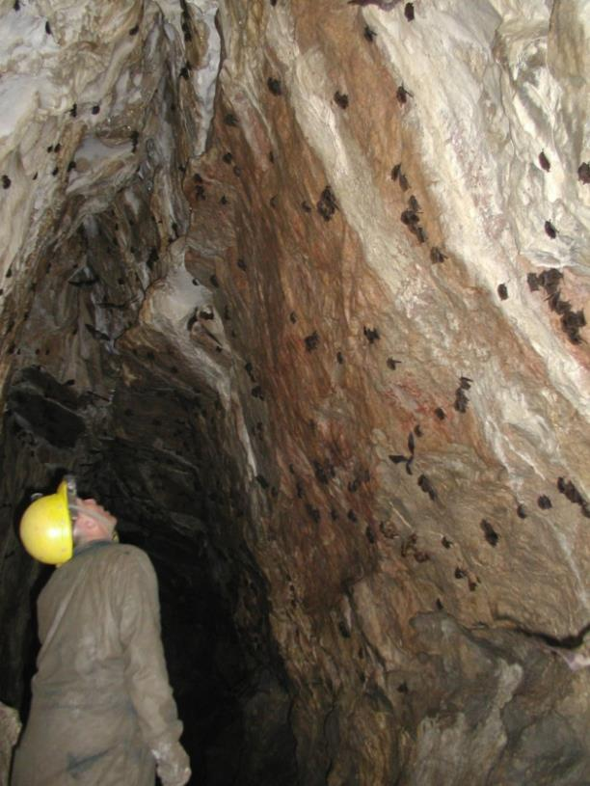
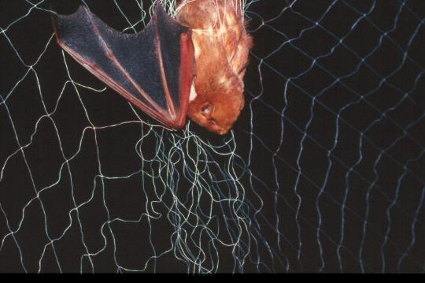
Population Monitoring Tools
Colony monitoring
  Winter hibernacula surveys
  Summer maternity roost surveys
Incidental reports
  Health Department rabies submissions
  Citizen reports of sightings and colonies
Capture surveys
  Summer mist net surveys
  Fall swarm surveys
  Spring emergence surveys
Acoustic surveys
  Stationary
  Driving Transect

Slide 5
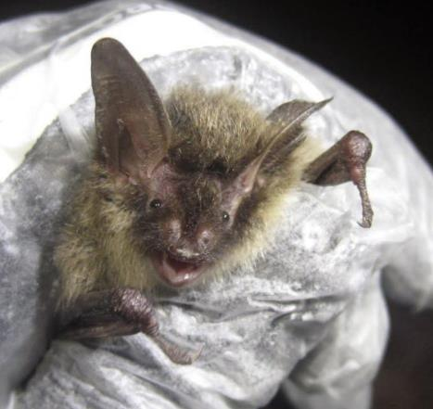
Population Viability Factors
Major threats:
Natural history limitations:
White-nose Syndrome
Wind energy development
Loss of habitat and connectivity
Human disturbance
Biodiversity decline (insects)
Climate change?
Low reproductive rate
High site-fidelity
Limited suitable habitat (hibernacula)
Vulnerability to disturbance when flightless, when hibernating, and when in torpor
Migratory

Slide 6
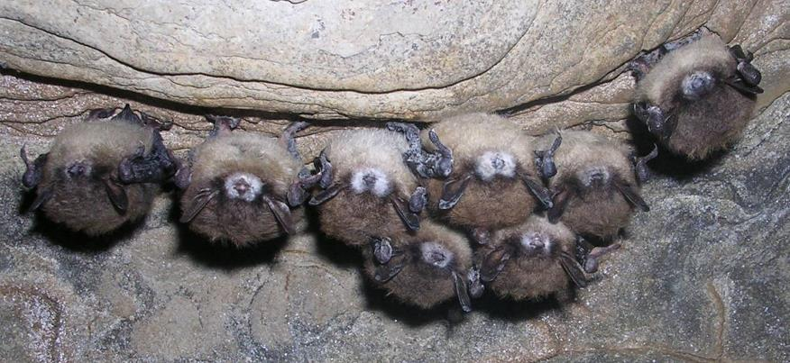
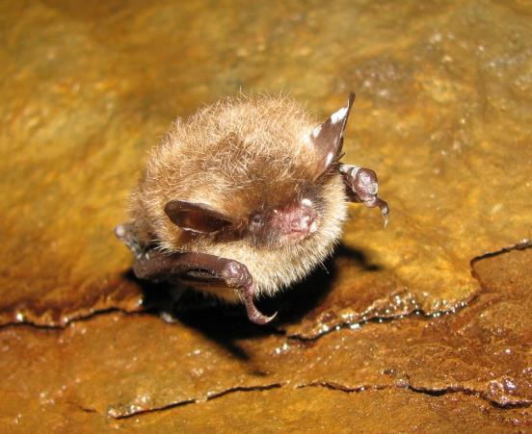
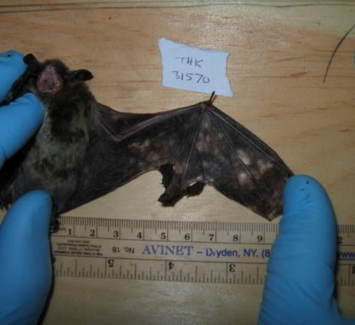
White-nose Syndrome
Fungal disease
Psychrophilic
Invasive
Differential mortality among species
Persists without bats
N. Heaslip, NYDEC
WNS is in
27 states
5 Canadian provinces
Bats can heal
Studying survivors
Notes:
Photo:

Slide 8
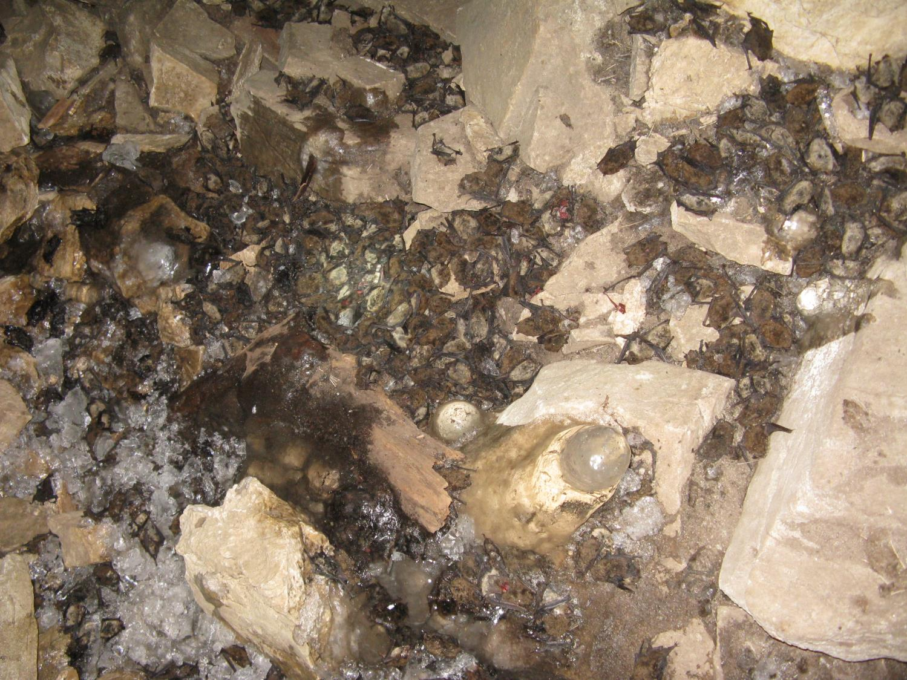
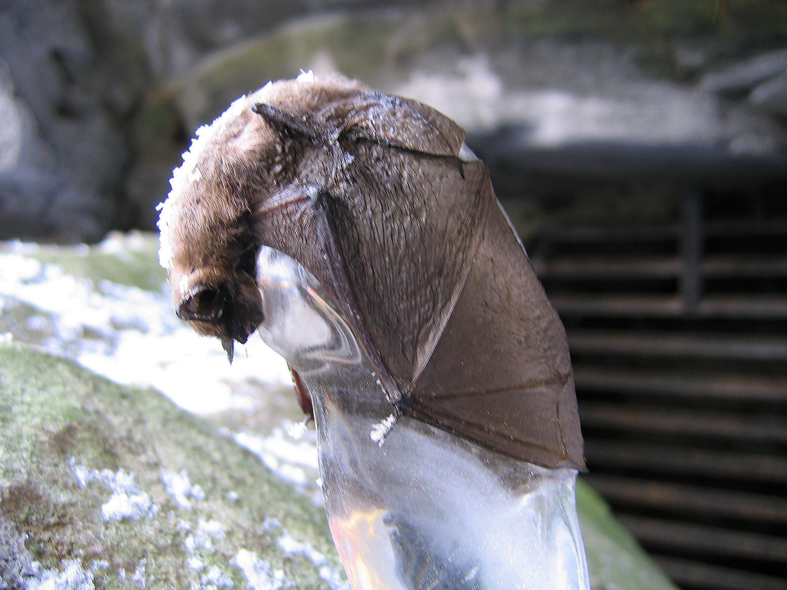

Slide 9
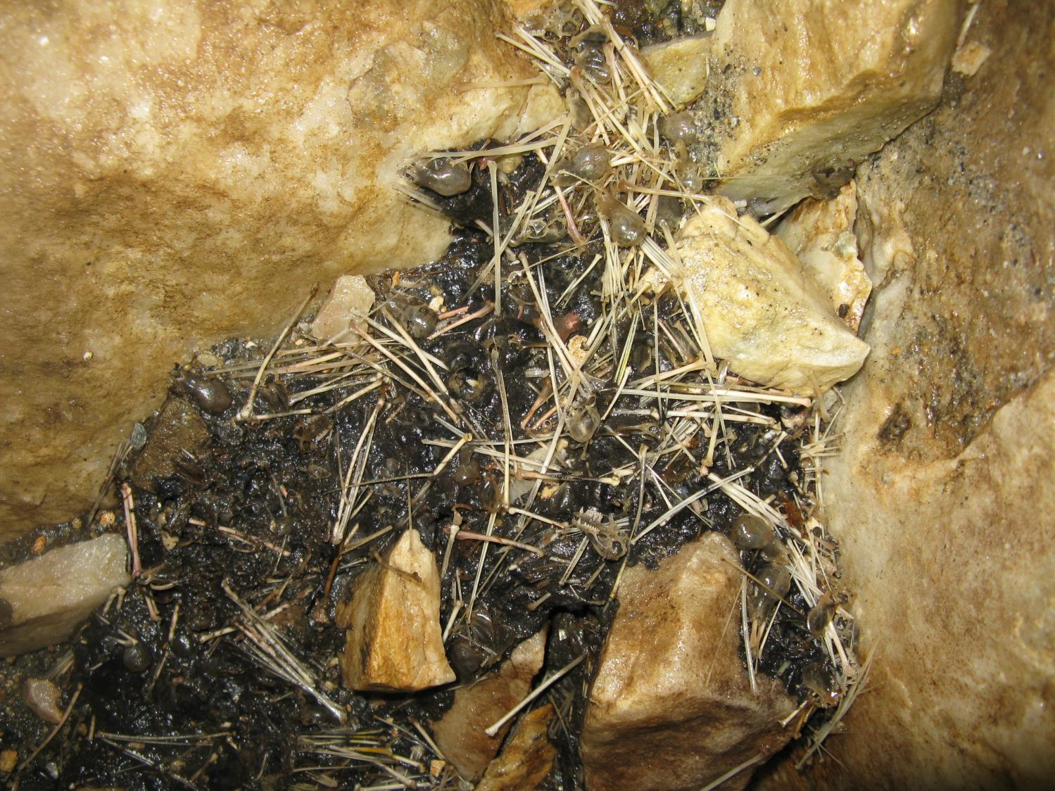

Slide 10
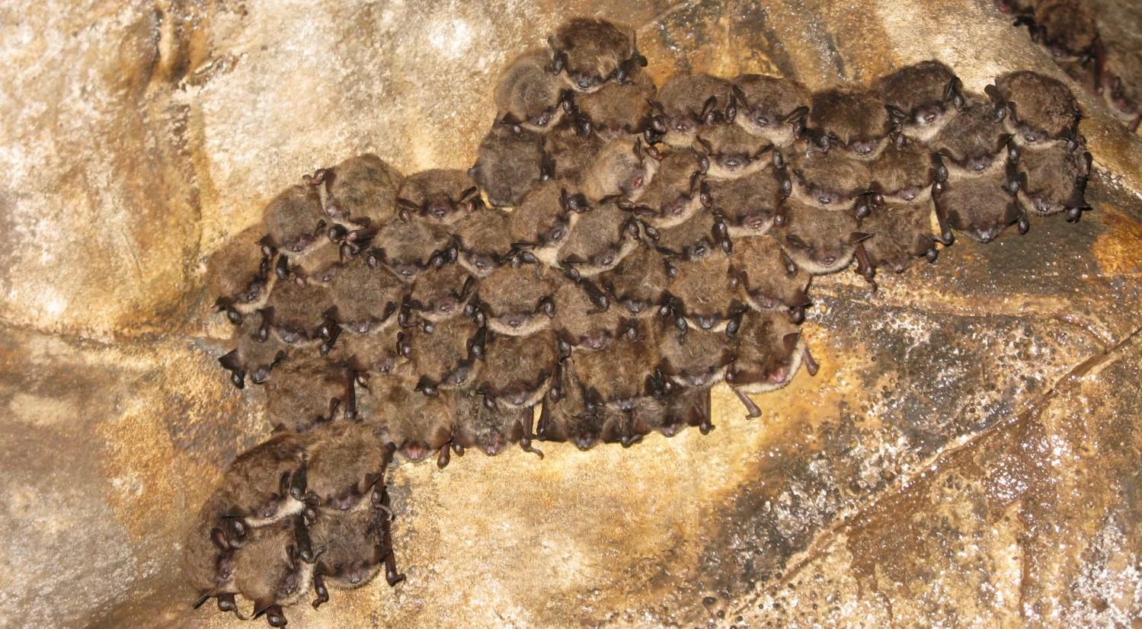
2010 Cave-Bat Population Assessment

Slide 11
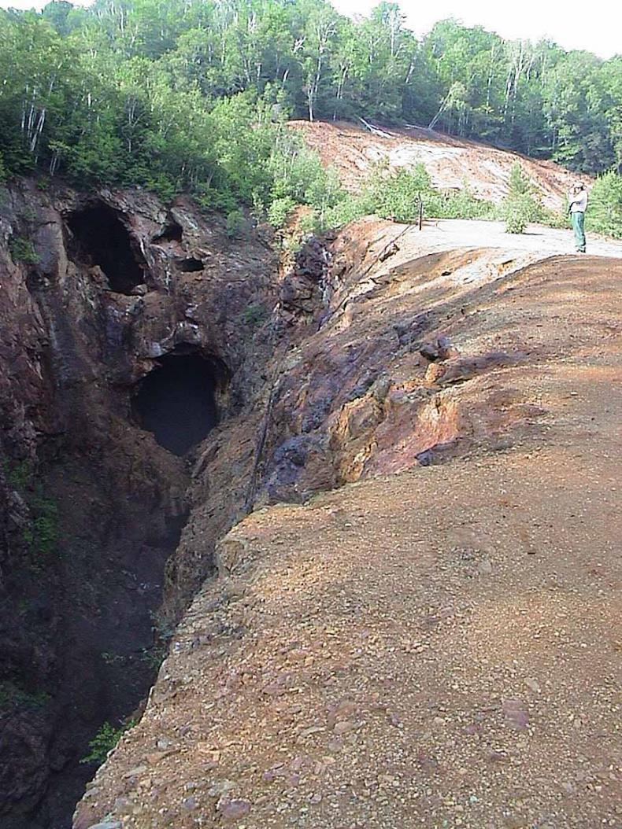

Fall Swarm Surveys
Mine in Strafford
Year | Myotis lucifugus | Myotis septentrionalis | Bats/Trap Hour
2002 | 707 | 132 | 58.1
2005 | 160 | 156 | 73.1
2006 | 721 | 205 | 163.1
2008 | 87 | 6 | 25.7
2009 | 1 | 0 | 0.2

Slide 12
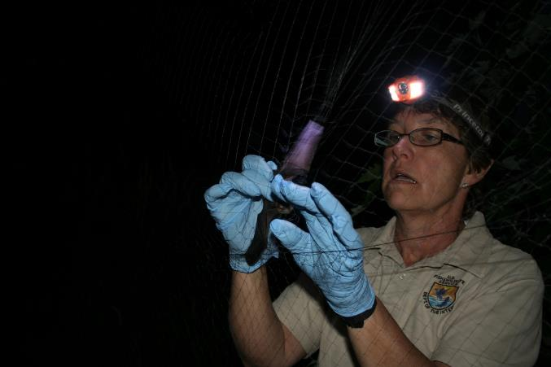
Summer Mist Net Surveys
 | No. Sites | Myotis lucifugus Captured | Myotis septentrionalis Captured
Pre-WNS | 30 | 339 | 82
Post WNS (2010) | 28 | 2 | 5

Slide 13
Acoustic Bat Calls
Rutland County 2007 - 2010
Myotis septentrionalis Myotis lucifugus

Slide 14
2010 Survey Results
Survey Type | Mylu | Myse | Myle | Myso | Pesu | Epfu
Hibernacula Surveys | -76% | -97% | +85% | +11% | +18% | +39%
Spring Emergence | -81% | - | - | - | - | -
Summer Mist-Net ¹ | -99% | -93% | -54% | -75% | - | -40%
Maternity Colony Exit Counts | -75% | - | - | - | - | -
Grandpa’s Knob Acoustic | -84% | -99% | -75% | +121% | +430% | -
VFWD Acoustic ² | -88% | - | - | - | - | 0%
Camp Johnson ² Acoustic | -91% | - | - | - | - | -
Middlebury Acoustic
Fall Swarm | -99% | -100% | -100% | - | - | -

Slide 16
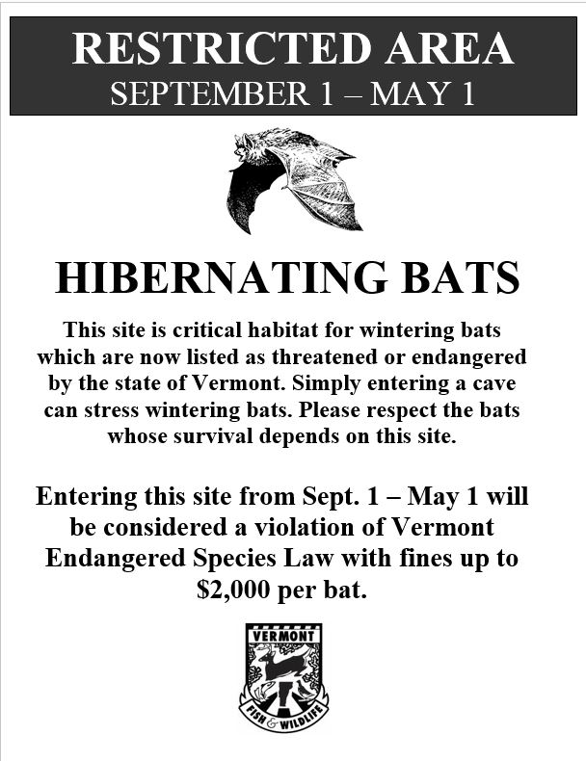
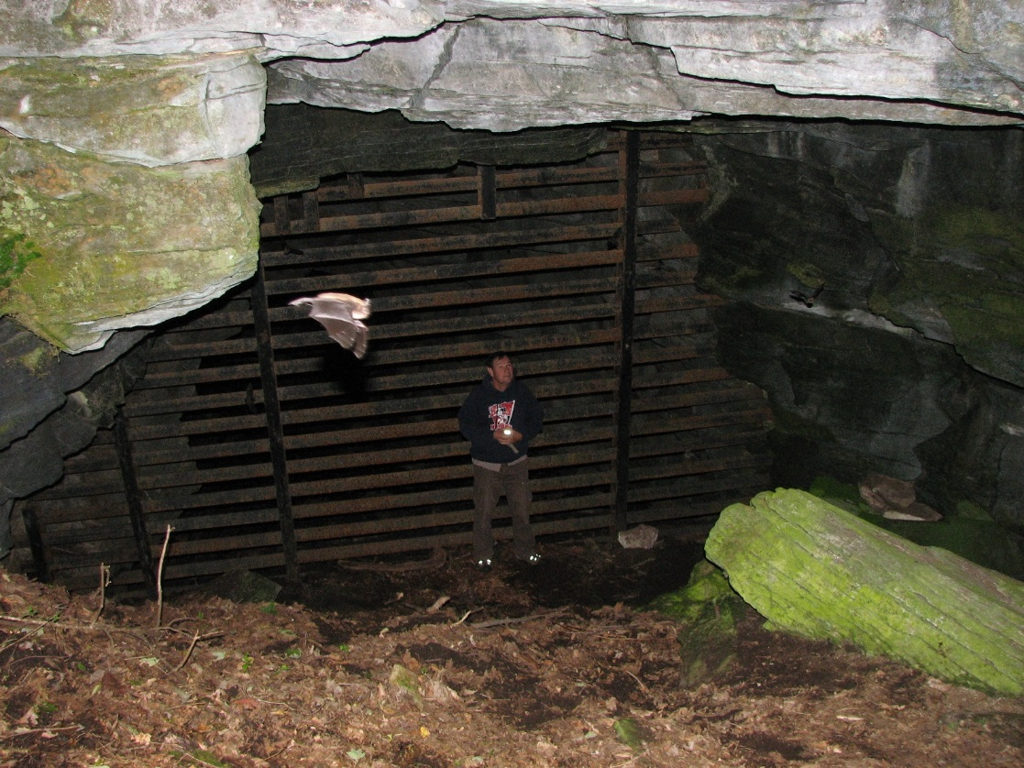
Human Disturbance

Slide 19
Year | Little Brown (Myotis lucifugus) | Northern Long-eared (Myotis septentrionalis) | Indiana (Myotis sodalis) | Eastern small-footed (Myotis leibii) | Tri-colored/ eastern pipistrelle (Perymyotis subflavus) | Big Brown (Eptesicus fuscus) | Unknown Myotis species | TOTAL COUNT
2015 | 75 | 1 dead | 0 | 0 | 4 | 0 | 0 | 79
2014 | 79 | 0 | 0 | 0 | 4 | 0 | 0 | 83
2013 | 78 | 0 | 0 | 0 | 3 | 0 | 0 | 81
2012 | 103 | 0 | 0 | 0 | 2 | 0 | 0 | 105
2011 | 72 | 0 | 0 | 0 | 1 | 0 | 10 | 83
2010 | 174 | 3 | 0 | 0 | 8 | 0 | 0 | 185
2009 | 608 | 4 | 0 | 0 | 5 | 0 | 0 | 617
2007 | 594 | 21 | 0 | 0 | 9 | 0 | 3 | 627
2004 | 457 | 32 | 0 | 0 | 7 | 0 | 31 | 527
2001 | 344 | 11 | 0 | 0 | 13 | 0 | 44 | 412
1998 | 276 | 0 | 0 | 0 | 23 | 0 | 1 | 300
1994 | 212 | 10 | 0 | 0 | 5 | 0 | 0 | 227
1992 | 244 | 11 | 0 | 0 | 3 | 0 | 0 | 258
1991 | 194 | 7 | 0 | 16 | 0 | 0 | 7 | 224
1986 | 180 | 17 | 0 | 3 | 0 | 0 | 0 | 200
1946 | 61 | 14 | 2 | 0 | 0 | 0 | 0 | 77

Slide 20
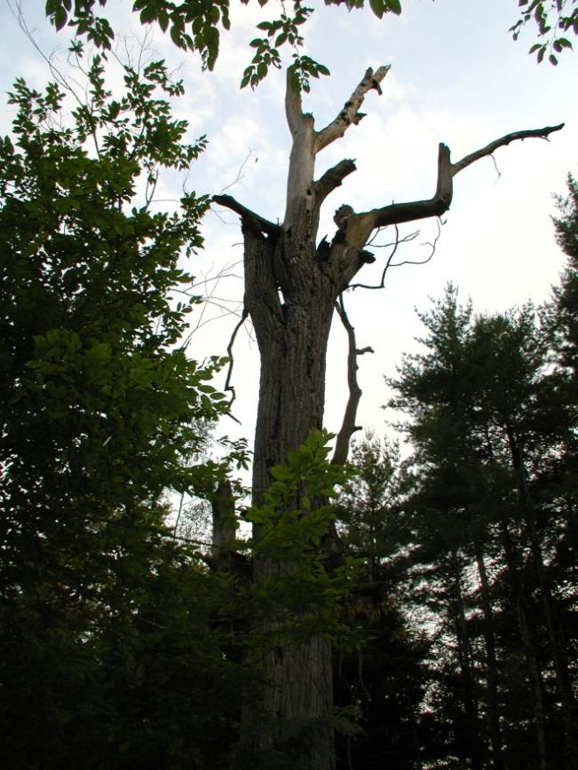
Ecosystem Implications
Bats are the main predator of nocturnal insects
Eat up to half their weight in insects each night
Research demonstrates increased crop damage when bats are excluded
Prey include agricultural, human, and forest pests
  Lepidoptera
  Coleoptera
Not all bats are equal: Different species forage on different prey
Great information gaps
Most ecosystem implications are yet unknown

