Slide 1
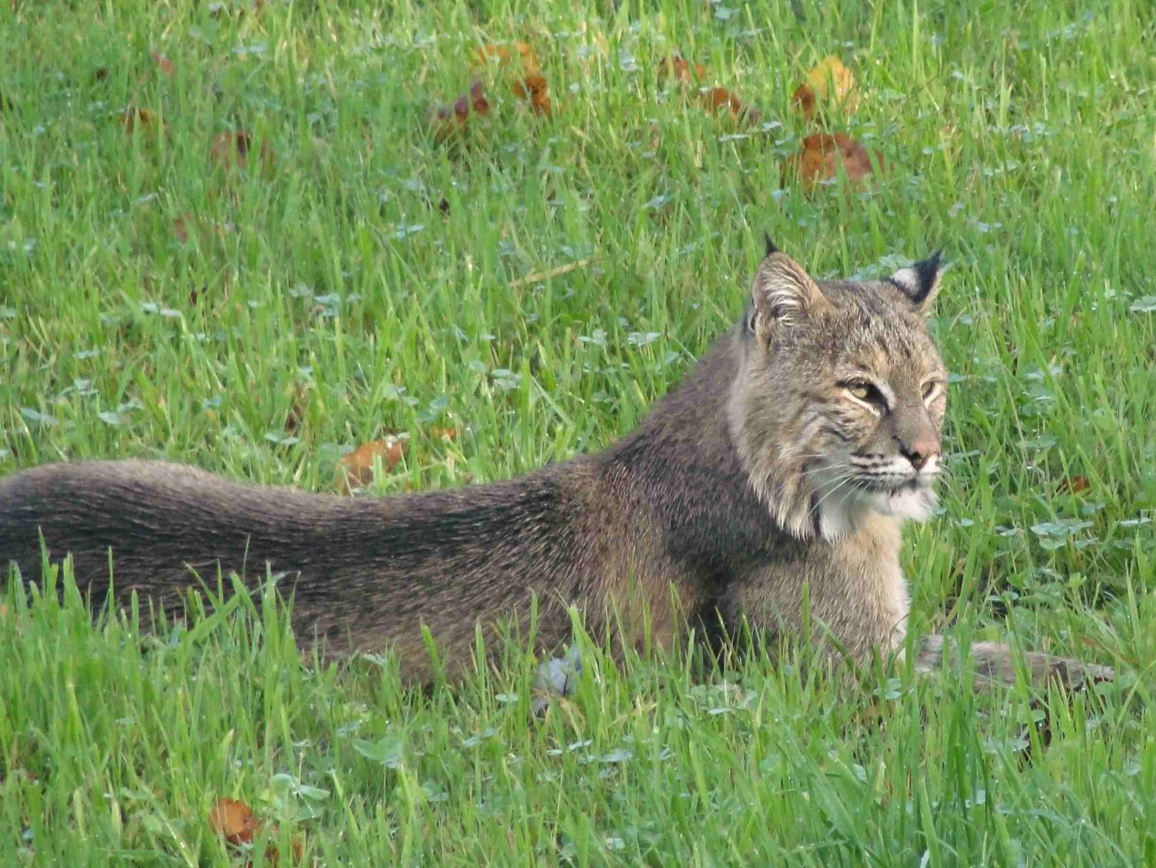
Effects of landscape development on bobcat carrying capacity in Vermont
Wendy Cole¹, Therese Donovan²,
Michelle Brown³, James Murdoch¹
¹ Rubenstein School of Environment and Natural Resources, University of Vermont
² U.S. Geological Survey, Vermont Cooperative Fish and Wildlife Research Unit, University of Vermont
³ Vermont Cooperative Fish and Wildlife Research Unit, University of Vermont

Slide 2
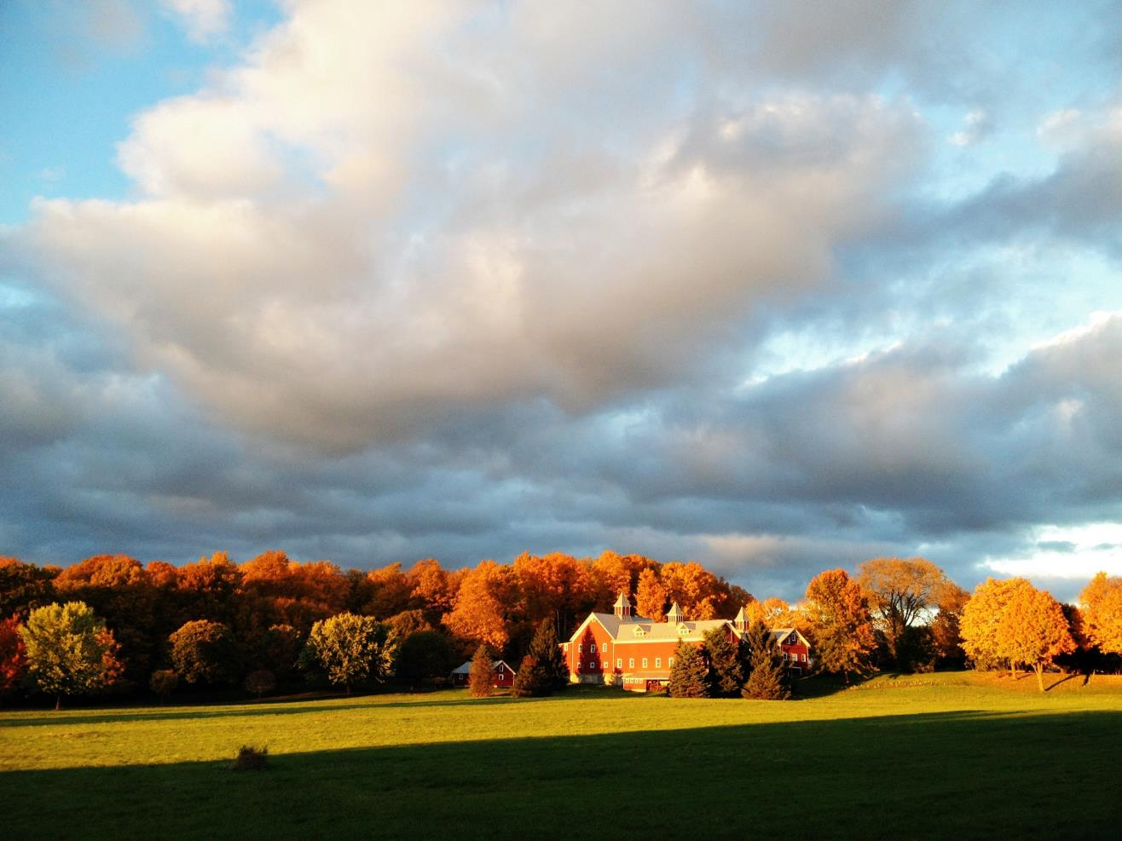

Slide 3
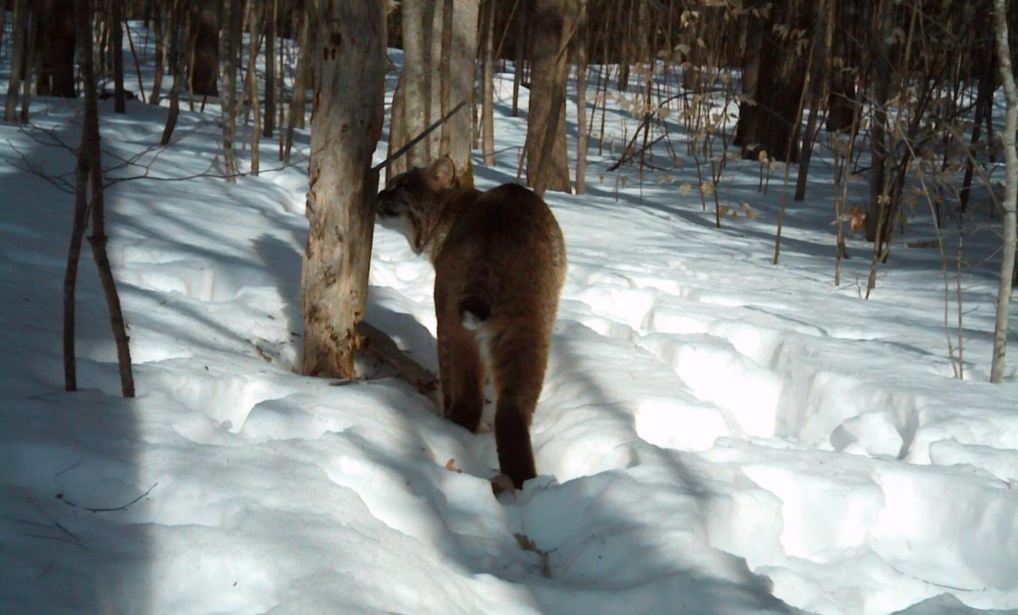
Bobcat – Lynx rufus

Slide 4
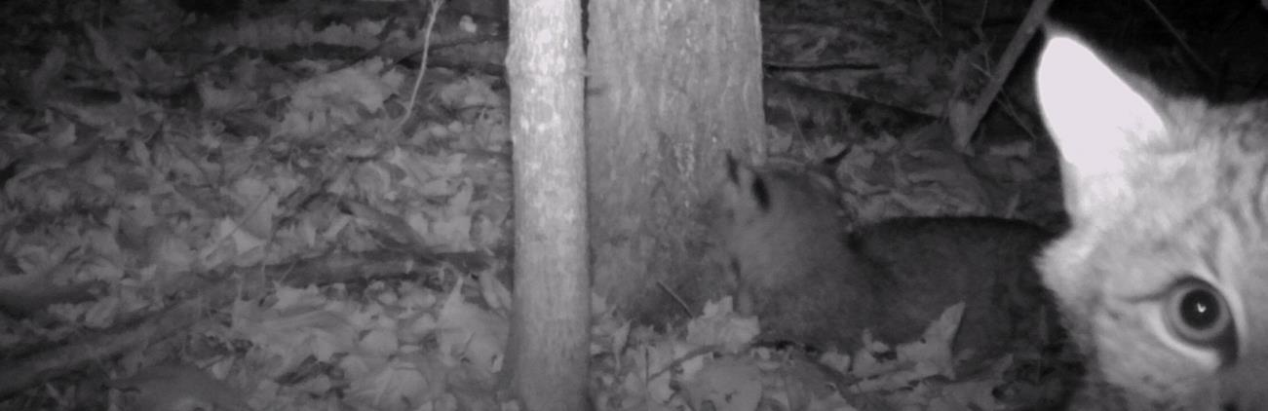
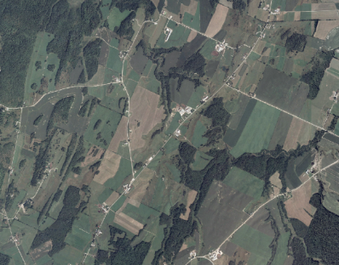
Objectives
What is the maximum carrying capacity for bobcats in Vermont?
How will carrying capacity change between 2000 and 2050 given housing/road development?

Slide 5
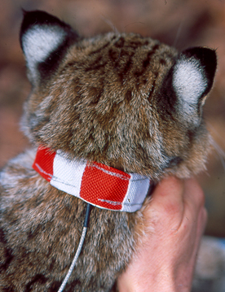
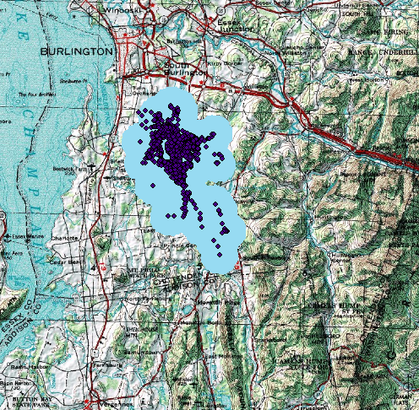
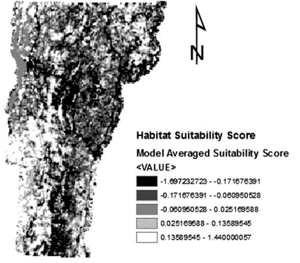
Methods
Home range data
Habitat suitability map
Estimate carrying capacity

Slide 6
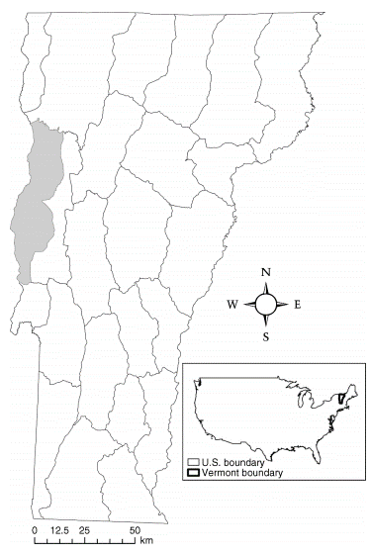
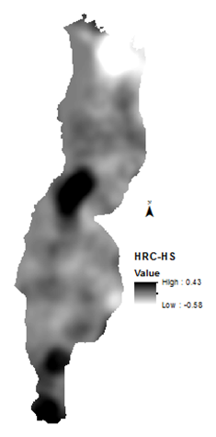
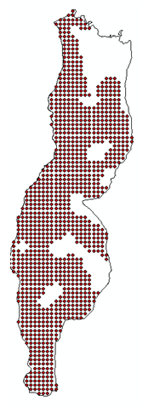
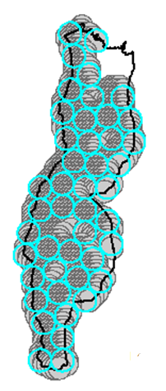
Maximum clique analysis

Slide 7
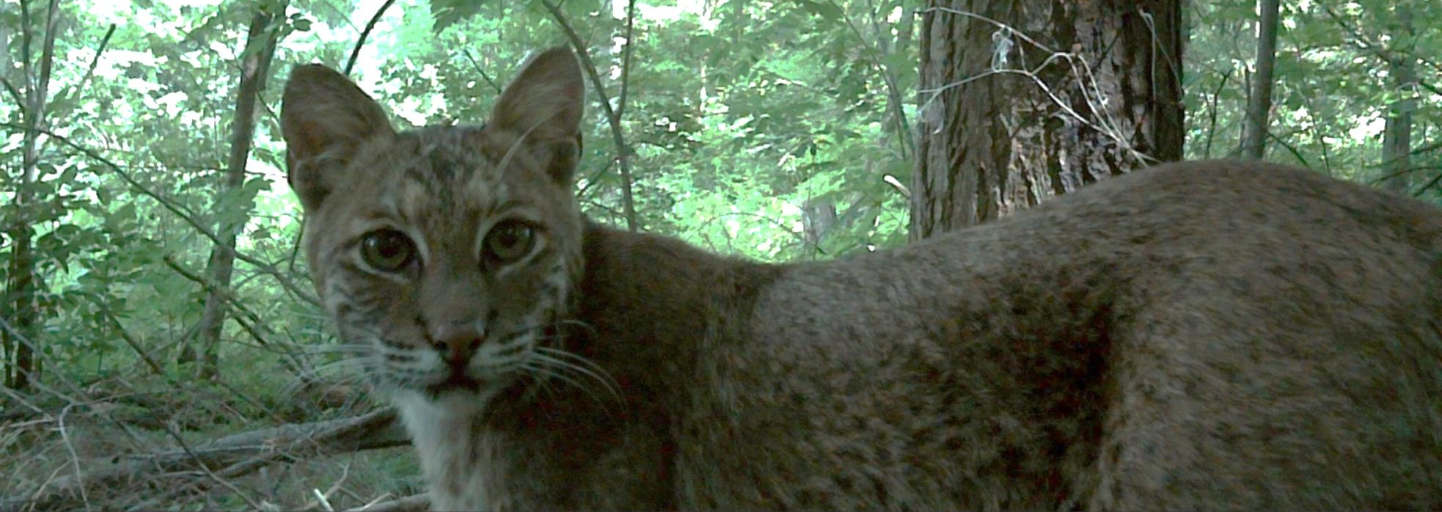
Habitat suitability map in 2050 given projected housing and road development.
Estimated carrying capacity.

Slide 8
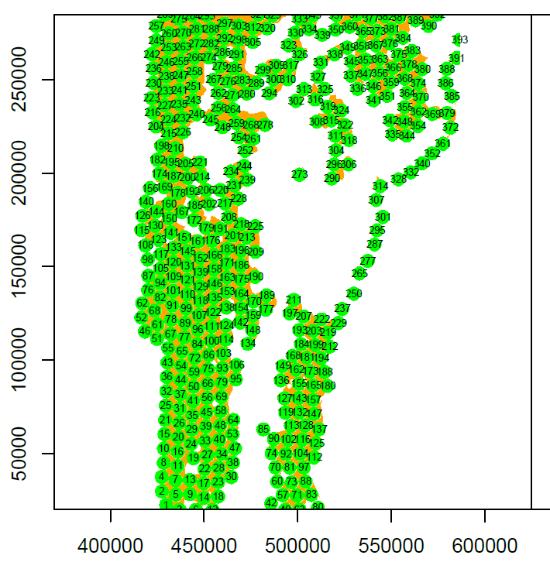
Results
Radio-collared 4 females and 10 males.
Shrub, deciduous, mixed, wetland, evergreen, roads.
2000
Females: 835 (±120)
Males: 316 (±145)
Total: 1150
2050
Females: 804 (±117)
Males: 367 (±141)
Total: 1171

Slide 9
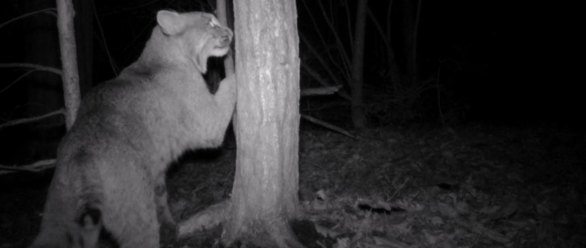
Conclusions
First statewide estimates of bobcat carrying capacity.
Urban development and roads exerts little change.
Caveats: data, modeling, and future projections.

Slide 10
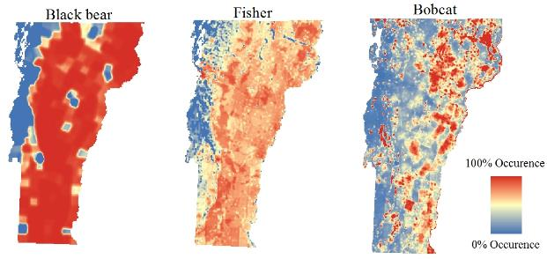
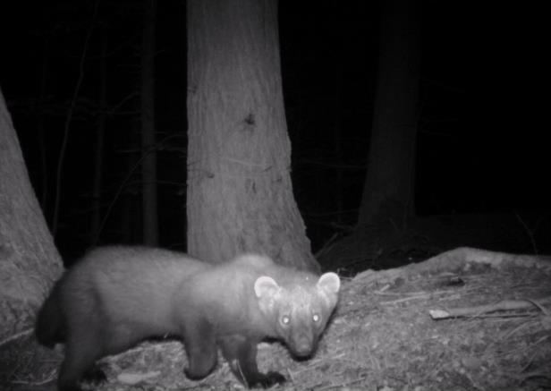
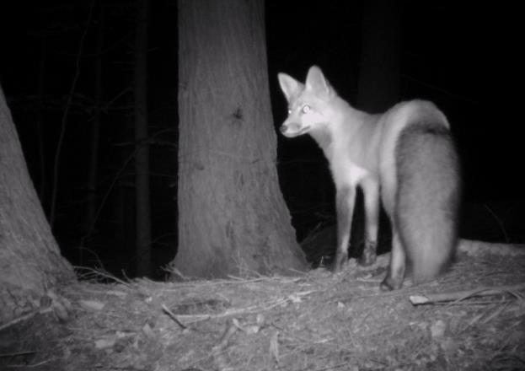
Applications
Approach can be used for other territorial species.
Means to assess any kind of landscape change.

Slide 11
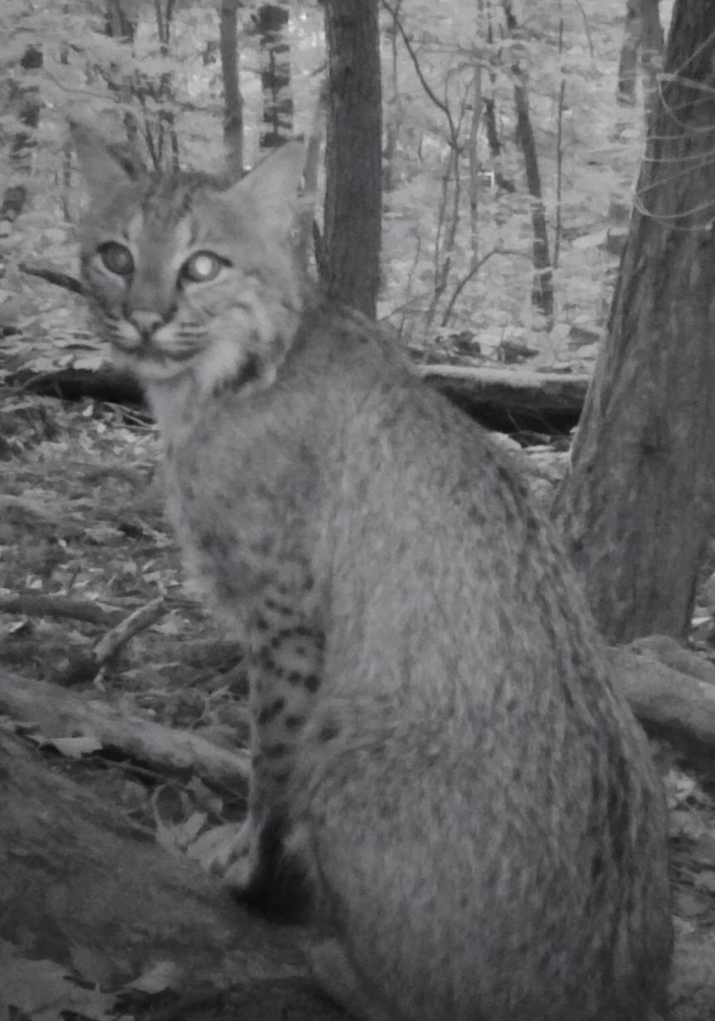
Acknowledgements
Organizations
Vermont Fish and Wildlife Department
Vermont Cooperative Fish and Wildlife Research Unit
U.S. Geological Survey
Wildlife Management Institute
University of Vermont
Rubenstein School of Environment and Natural Resources
Hafner Consulting
Individuals
Mark Freeman
Hanem Abouelezz
Kim Royar
Alan Howard
Ruth Mickey
Greg Warrington
Scott Schwenk
Jeffrey Dinitz
Sasha Hafner

Slide 12
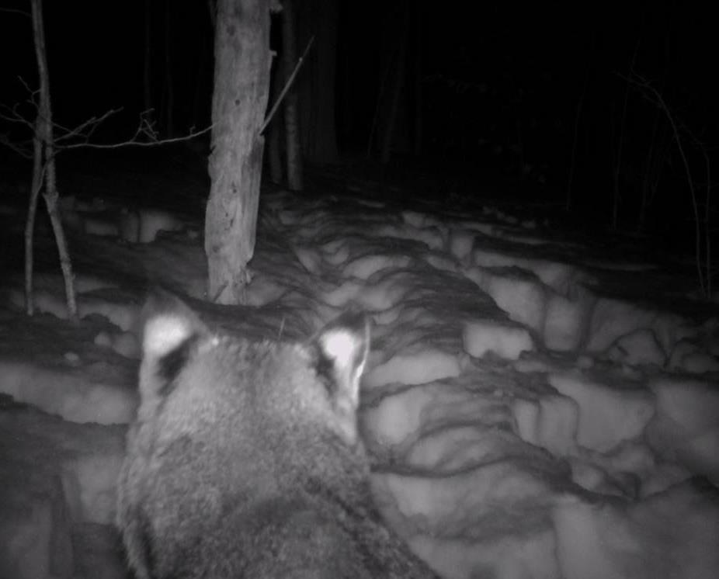
Thank you

