Slide 1
Putting Tree Inventories and Canopy Assessments to Work: Translating data into actionable plans
Elise Schadler, VT Urban & Community Forestry Program
VMC Annual Meeting
December 11, 2014

Slide 2
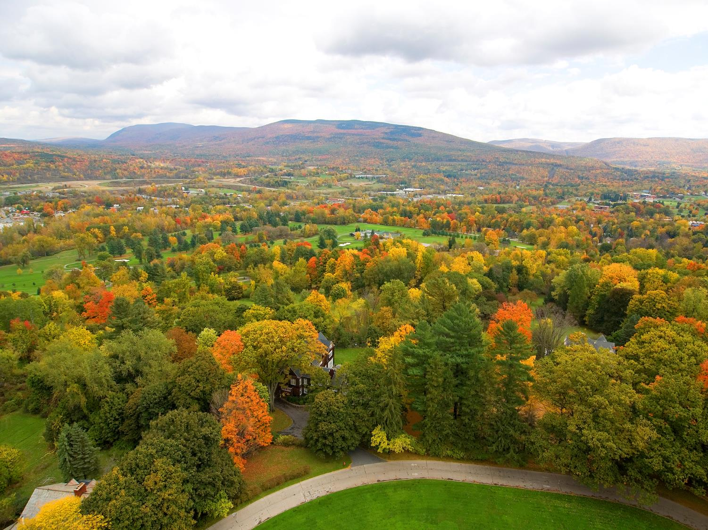
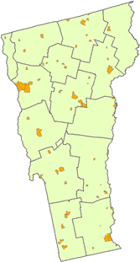
Urban Forests Are A Big Deal: Even in VT
Urban land only <2% of state land area – yet urban trees provide $25 mil in carbon storage value, $800 K/yr carbon sequestration & $6.6 mil/year air pollution removal.
Notes:
Urban Population 232,448
Percent Urban Population Change from 199028.3%
Percent of Total State Population38.2%
Percent Urban Land of State Land Area1.6%
Percent Urban Land Change from 1990 -3.7%
Urban Population Density 616.8
Percent Urban Population Density Change from 1990 33.2%
Percent Urban Tree Canopy Cover of Urban Land 30.8%
Tree Canopy Cover Per Capita (square meters/person) 498.5
Urban Carbon Storage (metric tons) 1,100,000
Urban Carbon Storage Value ($)$25,100,000
Urban Carbon Sequestration of Urban Trees(metric tons/year)35,000
Urban Carbon Sequestration of Urban Trees ($/year) $798,000
Total Air Pollution Removal from Urban Trees (CO, NO2, SO2, PM10 in metric tons/year) 750
Total Air Pollution Removal Value from Urban Trees ($/year)$6,600,000

Slide 3
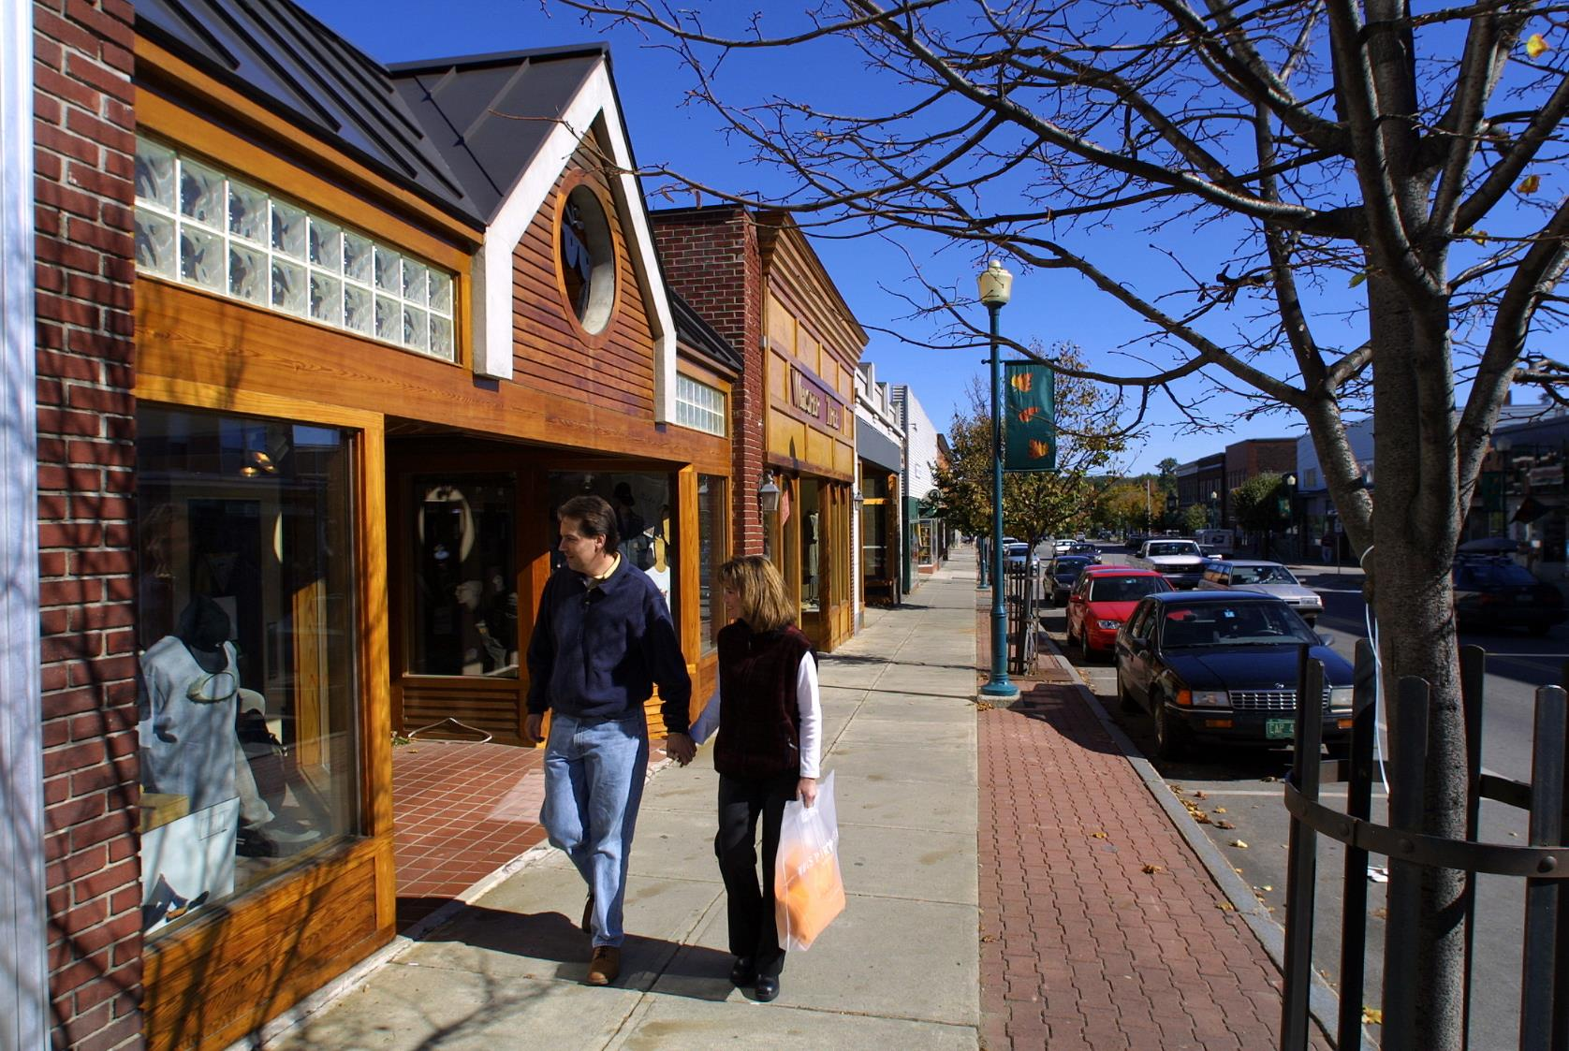
Notes:
Some of VT’s urban forests are being neglected to due to a lack of municipal capacity to assess, plan, and implement forest management activities.
Many communities also lack program sustainability: dedicated staffing, management plan, policies and advocacy group.
Photo: Newport – lack of systematic pruning.

Slide 4
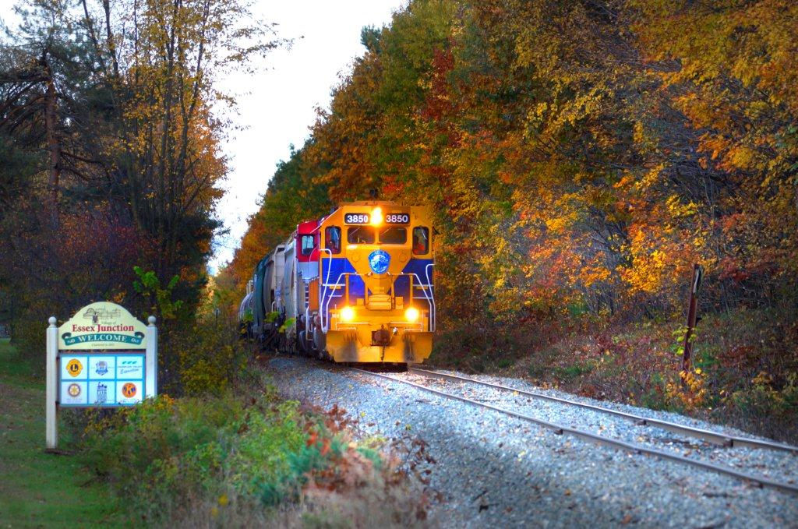
Essex Junction
4.9 sq. mi
pop approx. 9,000
Notes:
Essex Junction:
Essex Junction: [Maybe pull some facts from report – population]
Three years ago: Essex Junction lacked many the elements of a sustainable program to plan and care for their public trees.
They didn’t know what they had
The value of the forest
No plan to manage what they had or strategic planting
Lack of staff technical knowledge
Policies to protect trees and public safety
An oversight committee

Slide 5
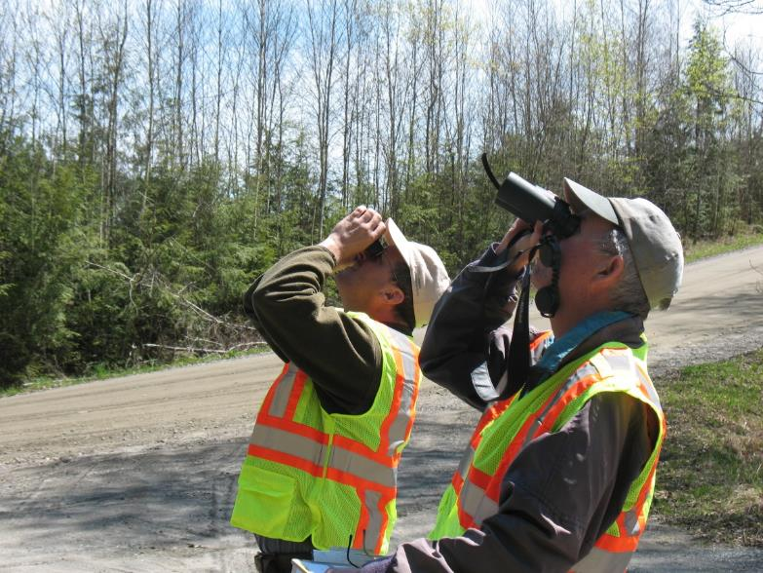
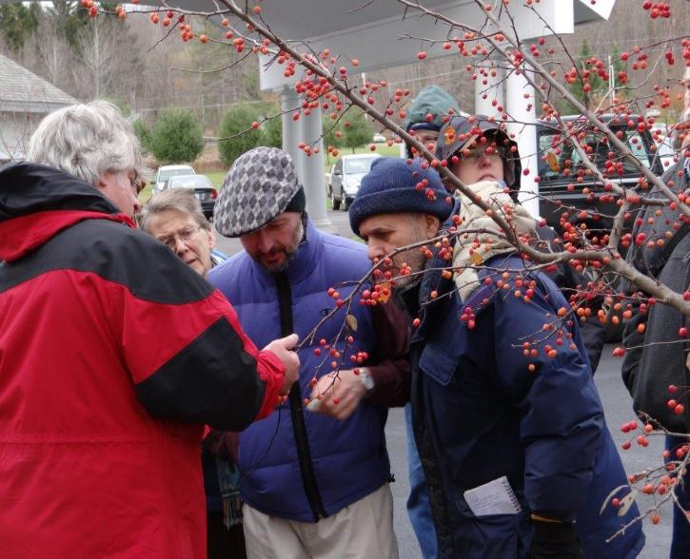
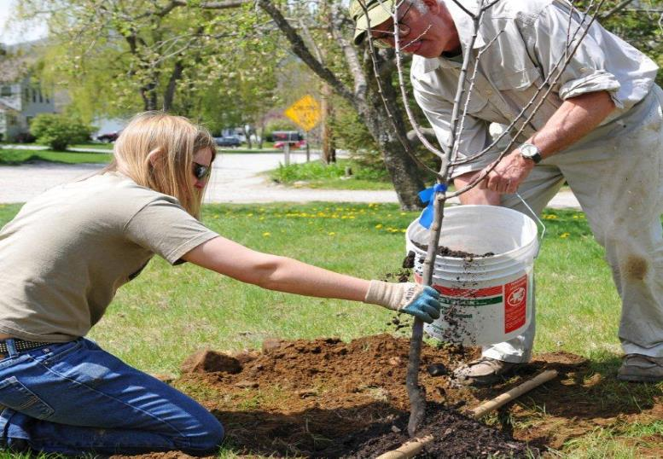
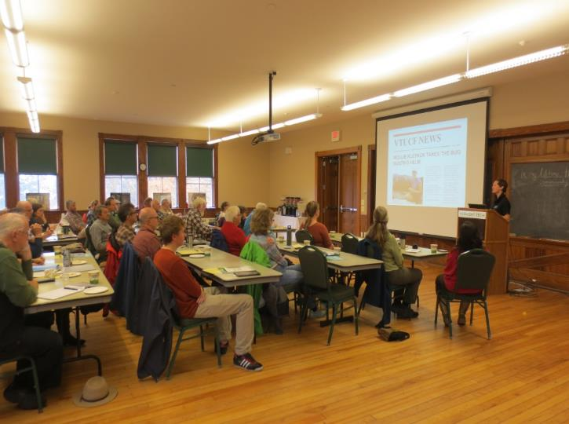
Notes:
We (UCF Program) works to promote the value of the urban forest.
We train citizen volunteers (SOUL & FPFD) to promote and protect them and engage in their planning and care.
We provide training, publications and grant dollars to stimulate communities caring for their urban forests.
Yet, the on ground impacts were varied, limited and not always sustained.

Slide 6
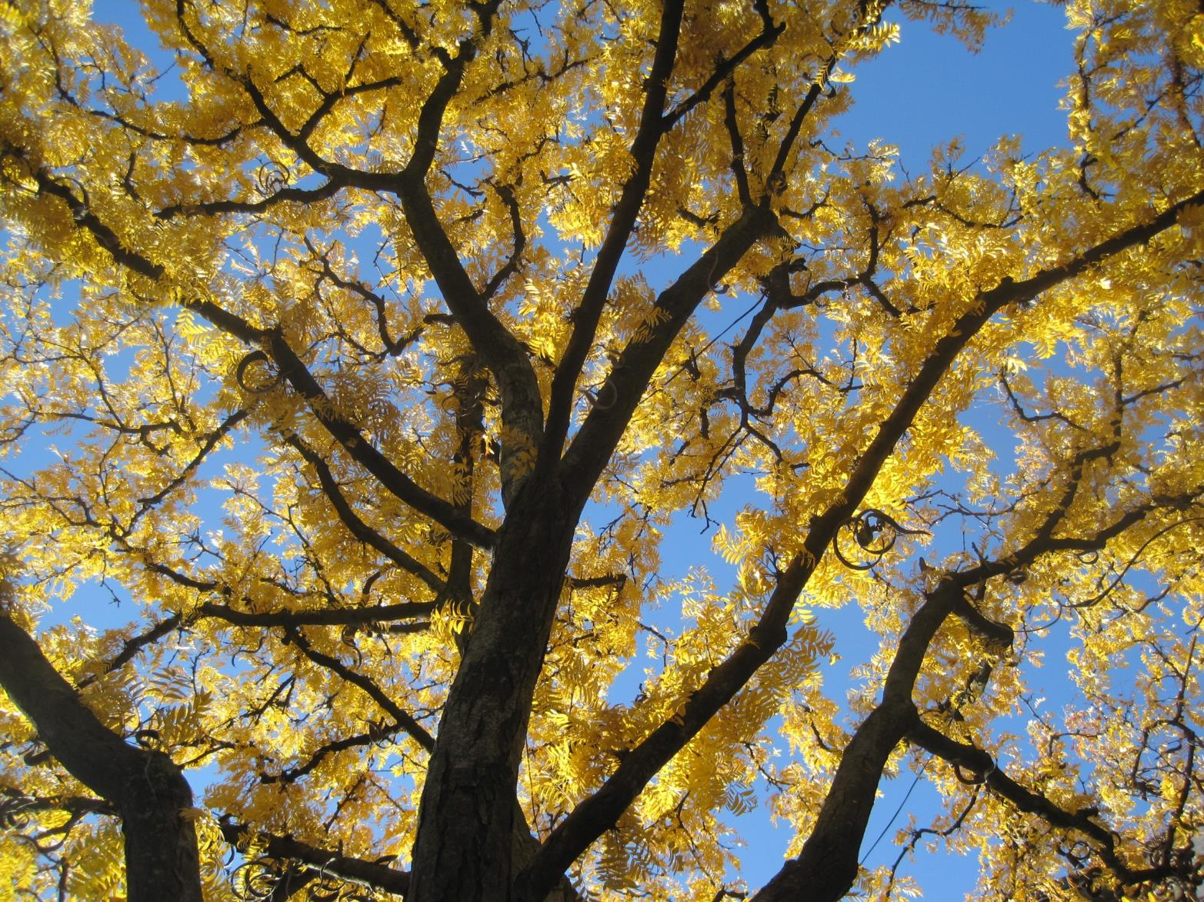
Strategic Program Delivery
Notes:
We decided to make a shift in our approach that would serve the Program (lets face it we have a small staff that is stretched) and VT communities (not all of them are our priority or need our assistance) better by being strategic in where and how we make investments of our limited time and resources so we can make the most v
We wrote it up, the USDA Forest Service bought in with a grant that is allowing us to invest in 20 high priority communities –these are communities that we identified where our work would matter most – by providing them street tree inventories which will include assessment of forest health so they know what they have, development of achievable management plans, and municipal staff training to help get the work donealuable and sustaining impact.

Slide 7
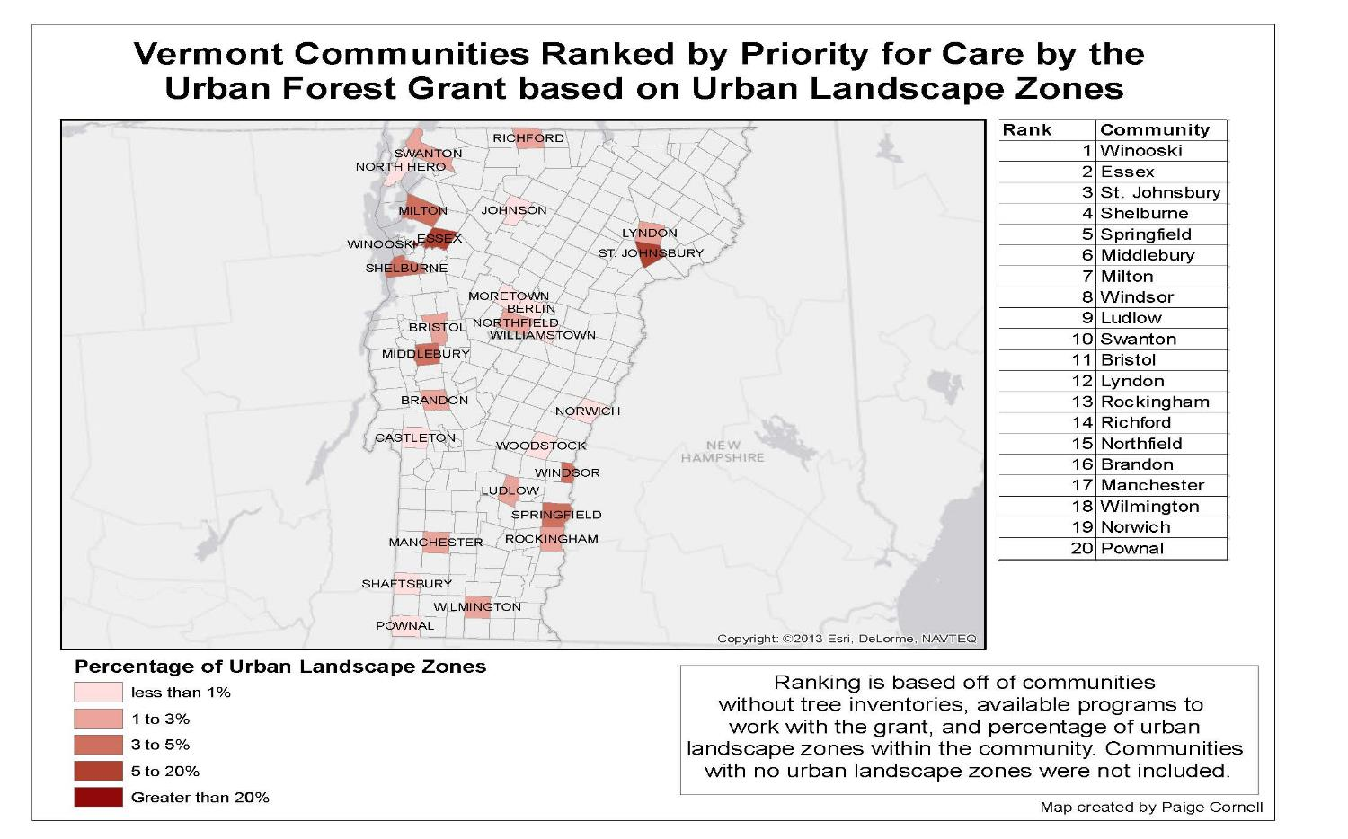
Where to Focus: Impact and Need
Greatest need for urban forest enhancement and protection, and local capacity.
Notes:
Greatest urban forests need, high population, high impervious areas, low tree cover.
Greatest need to increase local capacity: staff, plans, advocacy group, and policies.
Combined greatest impact.
GIS MAP

Slide 8
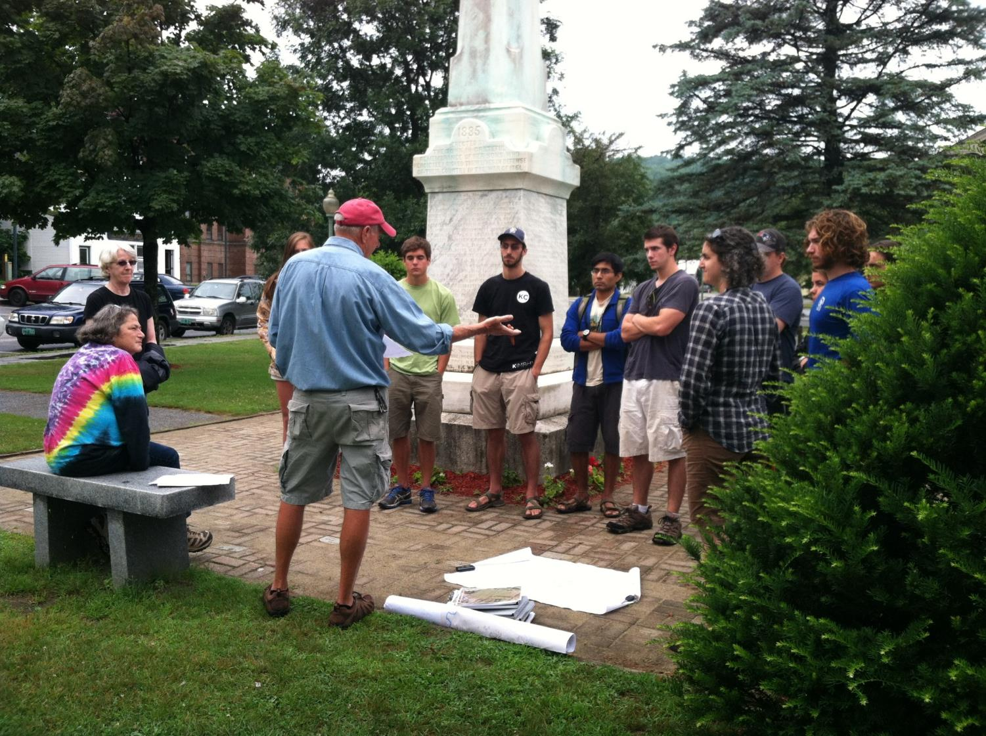
Building Strong Community Relationships
Communities buy in and make the commitment.
Notes:
We now strategically invest our time to build strong relationships with communities to help them understand their urban forest, and make long-term investments to effectively manage their forest today and into the future.
They buy in and make the commitment with us – have them sign an MOU
Picture: May be a little corny.

Slide 9
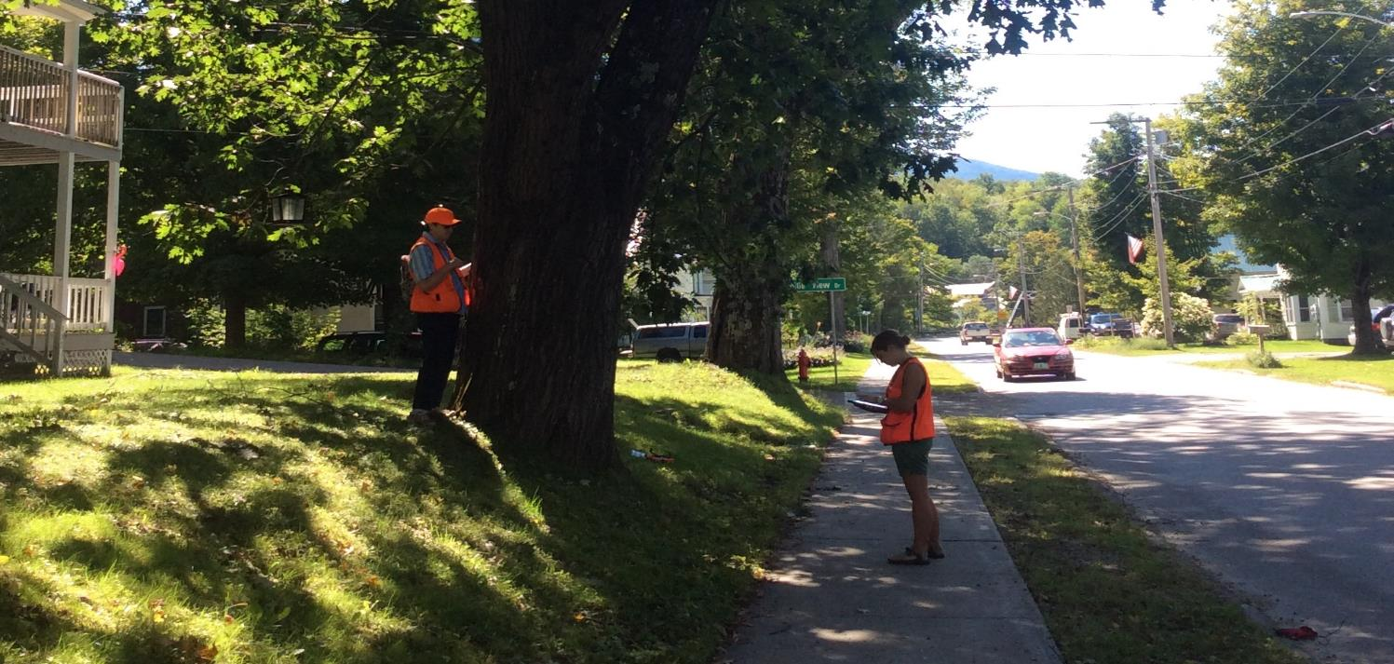
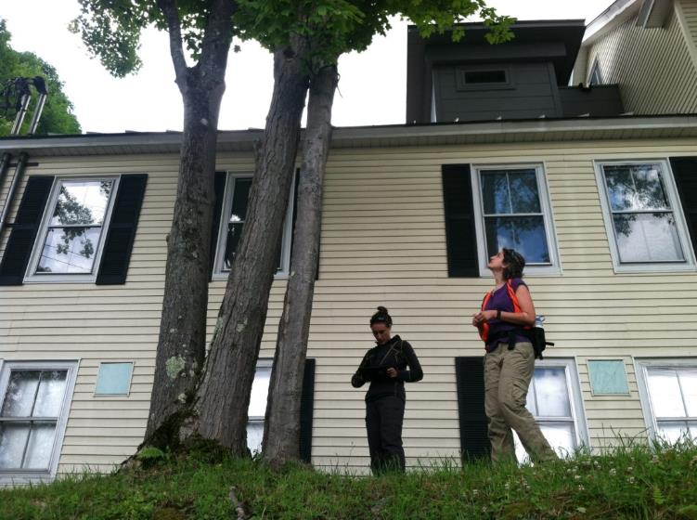
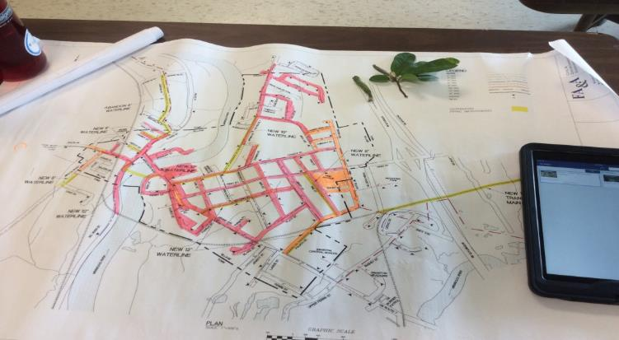
Notes:
We developed our own tree inventory system that works off of an ESRI Arc GIS application – we use iPads in the field.
We work with interns to assist with community tree inventories
This also facilitates work-based knowledge transfer to future managers and leaders.
Photo: COOL student pick of inventory system and iPads

Slide 10
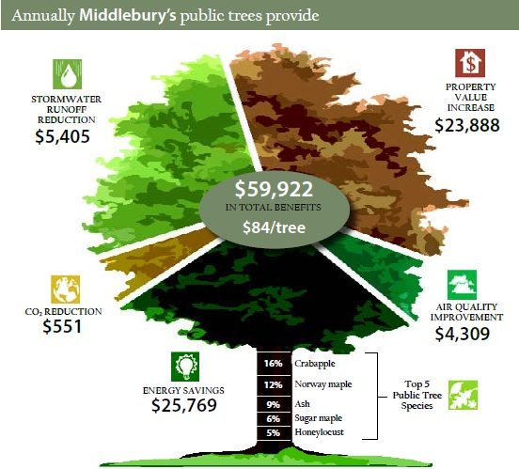
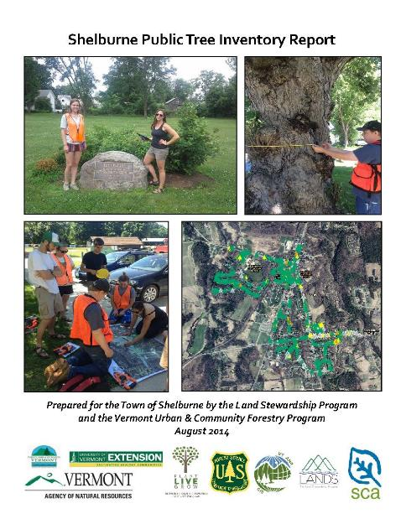
Notes:
We provide a detailed inventory report.
Example of data collected.
Example of charts.
Dollar value of forest
Urban tree canopy
Some data ‘ah has’
Picture: Maybe one of the tree and the benefits.

Slide 11
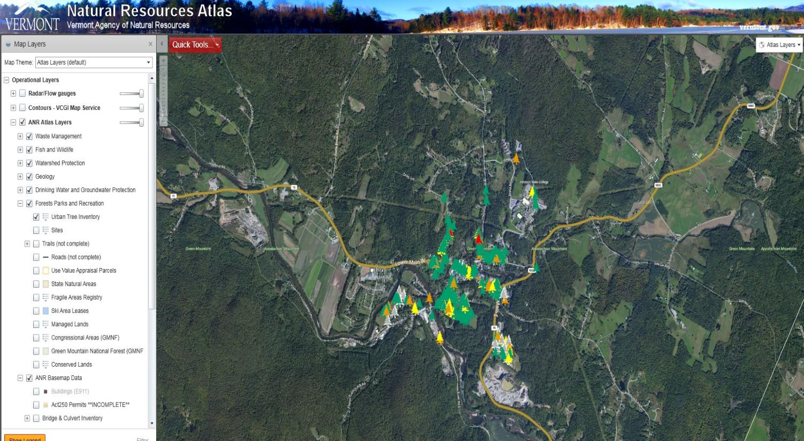
ANR Atlas
Notes:
We have a urban tree inventory layer on ANRs GIS Atlas to view the data
We have a management plan template that helps communities move from inventory to action.
Screen shot of Atlas.

Slide 12
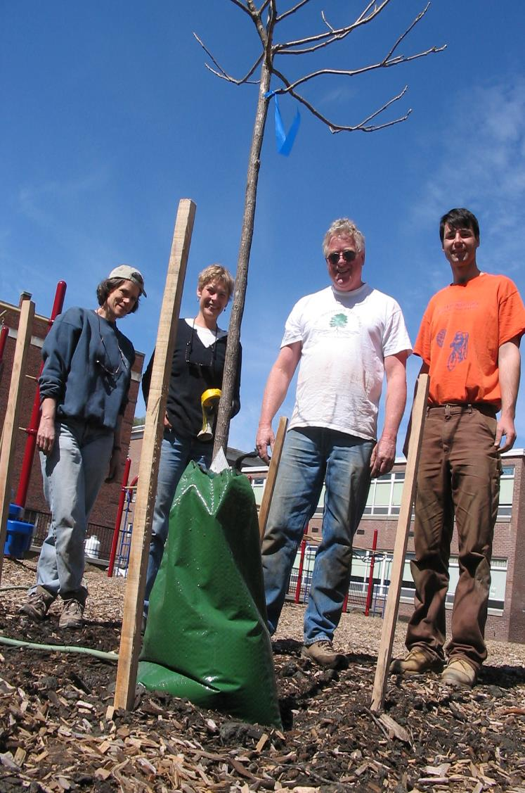
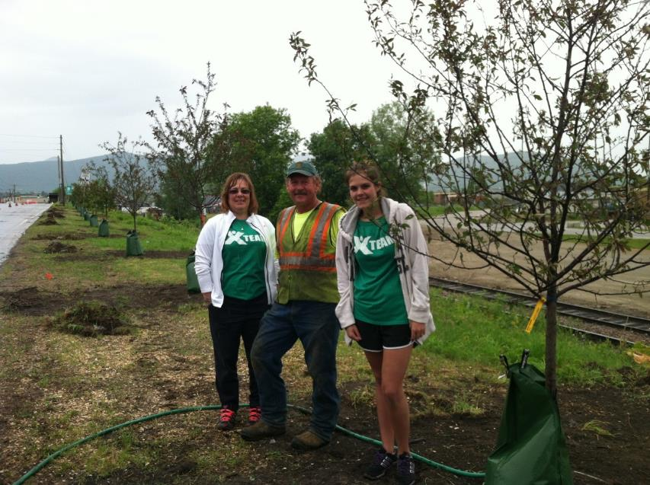
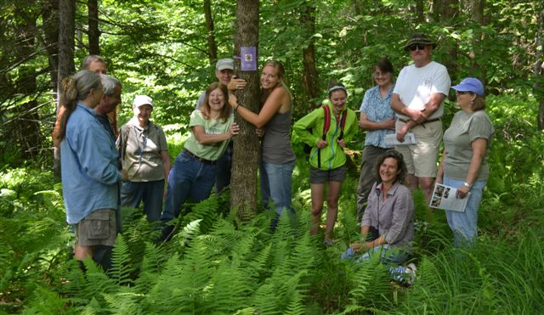
Notes:
Slide 13: We are witnessing communities build viable, relevant and supported tree management programs.
Volunteer tree groups are forming or focusing (CCs) on their urban forests.
Tree policies are being established.
Tree budgets are established or increasing.
Community members are more aware and engaged.
Public officials are informed and supportive.
Students are learning, and getting hands on field work and experience working within a community – selectboard meetings.
In the end: TREES are being managed!
They are using the data to priority prune and remove.
TREES are being planted!
They are using the data to build a re
and identify where trees are needed most!
TREES are being protected!
During developing
From invasive pests.
Communities are recognizing and that urban forests do matter and help make vibrant, sustainable and resilient communities, and our work in strategically providing high-priority communities with the support, information, and resources is making a difference one community at a time.
Photo: This Montpelier – not great. Probably a cool inventory photo again.

Slide 13
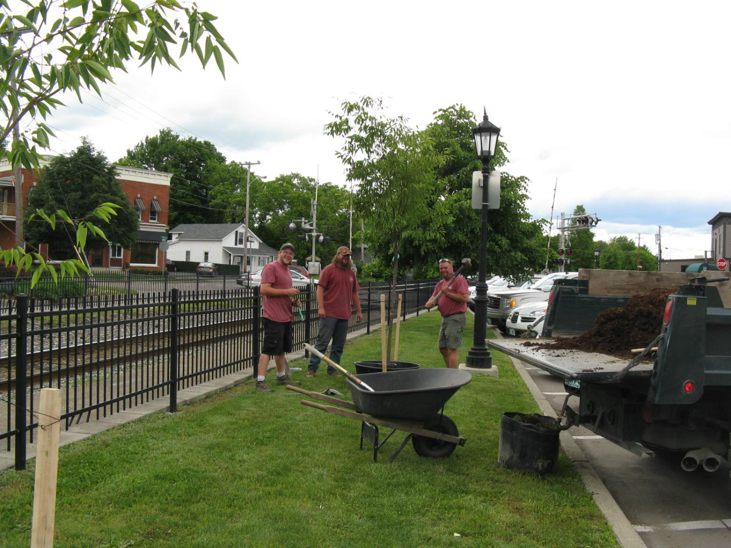
Essex Junction: A Transforming Community
Notes:
Essex Junction today:
The inventory identified
Maintenance needs
Planting opportunities
Composition considerations
They have a new tree committee that has just completed a management plan
Management pieces – They will….
They passed a tree policy that
Their new committee received a $10,000 budget – without asking – because they were able to show the VALUE, the NEEDS, and offered SOLUTIONS to care for their urban forest.
Photo: This is a photo Nick sent to me.

Slide 14
Elise.Schadler@uvm.edu

