Slide 1
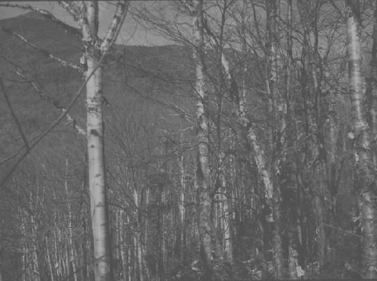
Twelfth-Year Update on a 200-yr Soil Monitoring Study
Don Ross, University of Vermont
Thom Villars, USDA NRCS
Scott Bailey, USFS Northern Res. Sta.
Nancy Burt, Angie Quintana-Jones, USFS
Sandy Wilmot, Vermont Dept. of Forest, Parks and Recreation
Deane Wang, University of Vermont
Jamie Shanley, USGS

Slide 2
Project Goals:
Establish five 50 x 50 m relatively uniform plots in sites associated with the VMC.
Sample plots at 0, 5, 10, 20, 50, 100, 150 and 200 years. Year 0 = 2002
Archive samples for later comparisons.
Analyze initial samples to determine baseline values.
Protect the plots for future monitoring.

Slide 3
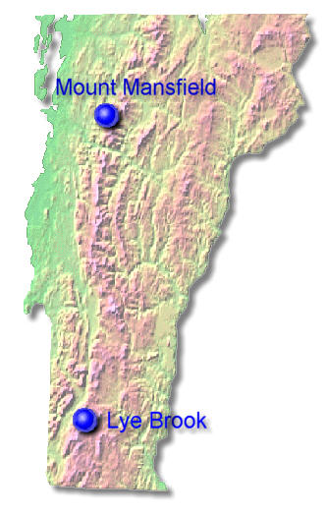
Sites:
Mt. Mansfield Ranch Brook
  northern hardwood
Mt. Mansfield Forehead
  high elevation spruce/fir
Mt. Mansfield Underhill State Forest
  transitional
  SCAN site
Lye Brook “Road”
  northern hardwood
  SCAN site
Lye Brook “Trail”
  transitional

Slide 4
 |  |  |  | Mansfield Forehead
NW |  |  |  |  |  |  |  |  |  |  | NE
 | 91 | 92 | 93 | 94 | 95 | 96 | 97 | 98 | 99 | 100
 | 81 | 82 | 83 | 84 | 85 | 86 | 87 | 88 | 89 | 90
 | 71 | 72 | 73 | 74 | 75 | 76 | 77 | 78 | 79 | 80
 | 61 | 62 | 63 | 64 | 65 | 66 | 67 | 68 | 69 | 70
 | 51 | 52 | 53 | 54 | 55 | 56 | 57 | 58 | 59 | 60
 | 41 | 42 | 43 | 44 | 45 | 46 | 47 | 48 | 49 | 50
 | 31 | 32 | 33 | 34 | 35 | 36 | 37 | 38 | 39 | 40
 | 21 | 22 | 23 | 24 | 25 | 26 | 27 | 28 | 29 | 30
 | 11 | 12 | 13 | 14 | 15 | 16 | 17 | 18 | 19 | 20
SW | 1 | 2 | 3 | 4 | 5 | 6 | 7 | 8 | 9 | 10 | SE
50 m
5m
A typical plot plan.
Plots with red numbers were sampled in 2002 (Year 0).
50 m

Slide 5
Sampling Scheme
2002: All samples taken by horizon (no depth increments)
2007, 2012: 4 large samples from each pit
  Litter layer (Oi)
  Oa or A (near-surface humified horizon)
  Top 10 cm of B horizon
  60-70 cm (usually C horizon)
  (Also small samples of each genetic horizon)

Slide 6
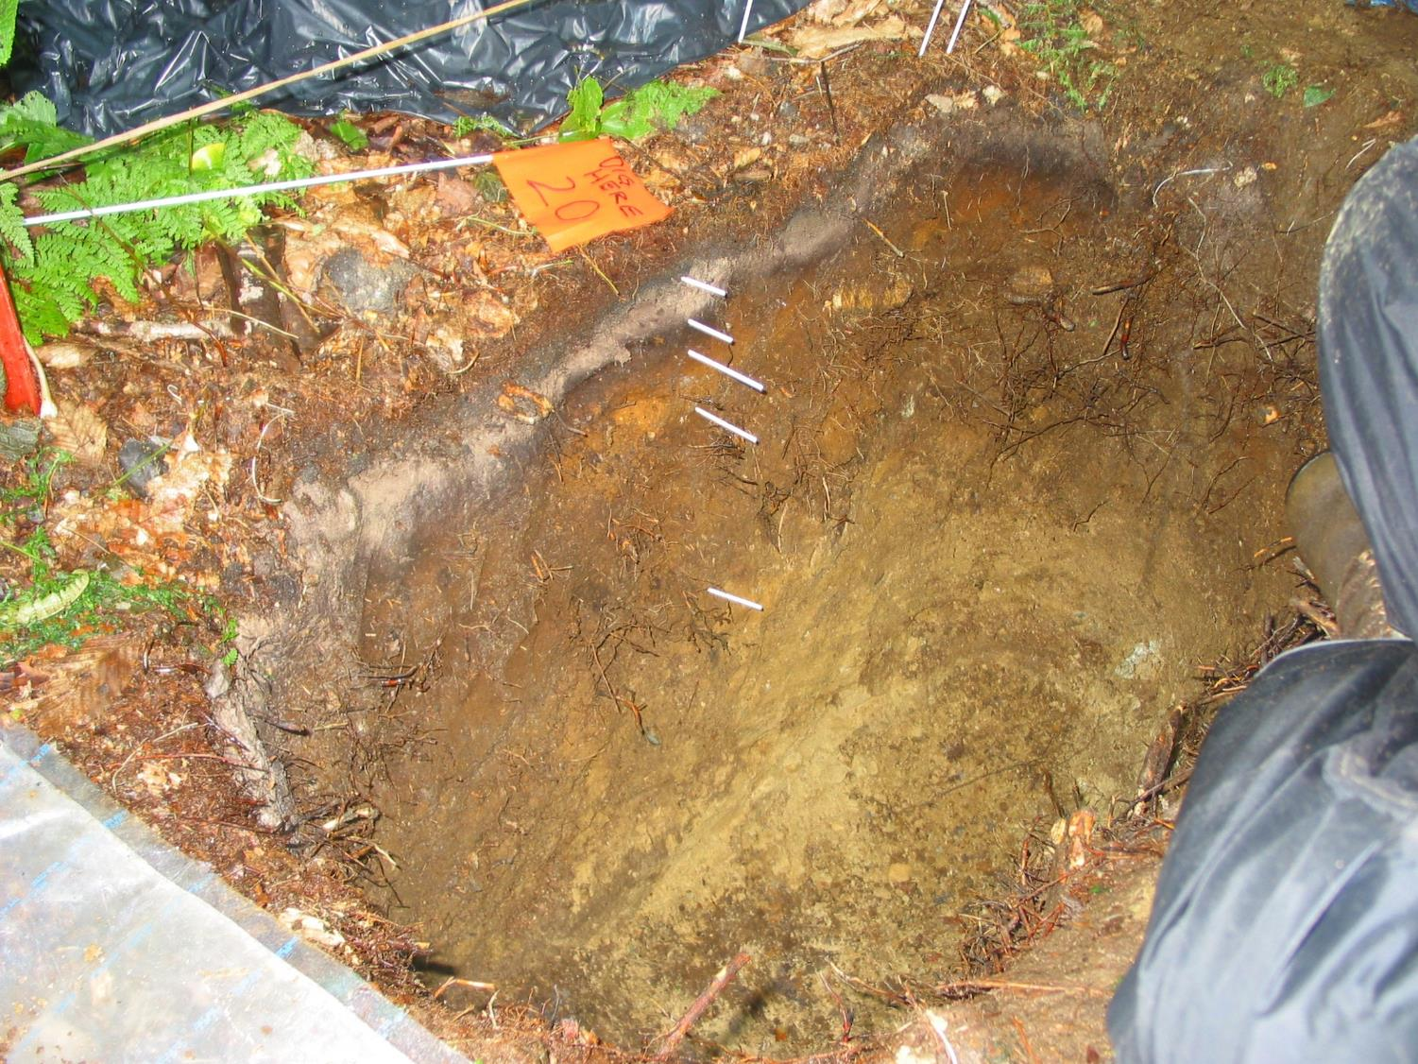
Lye Road

Slide 7
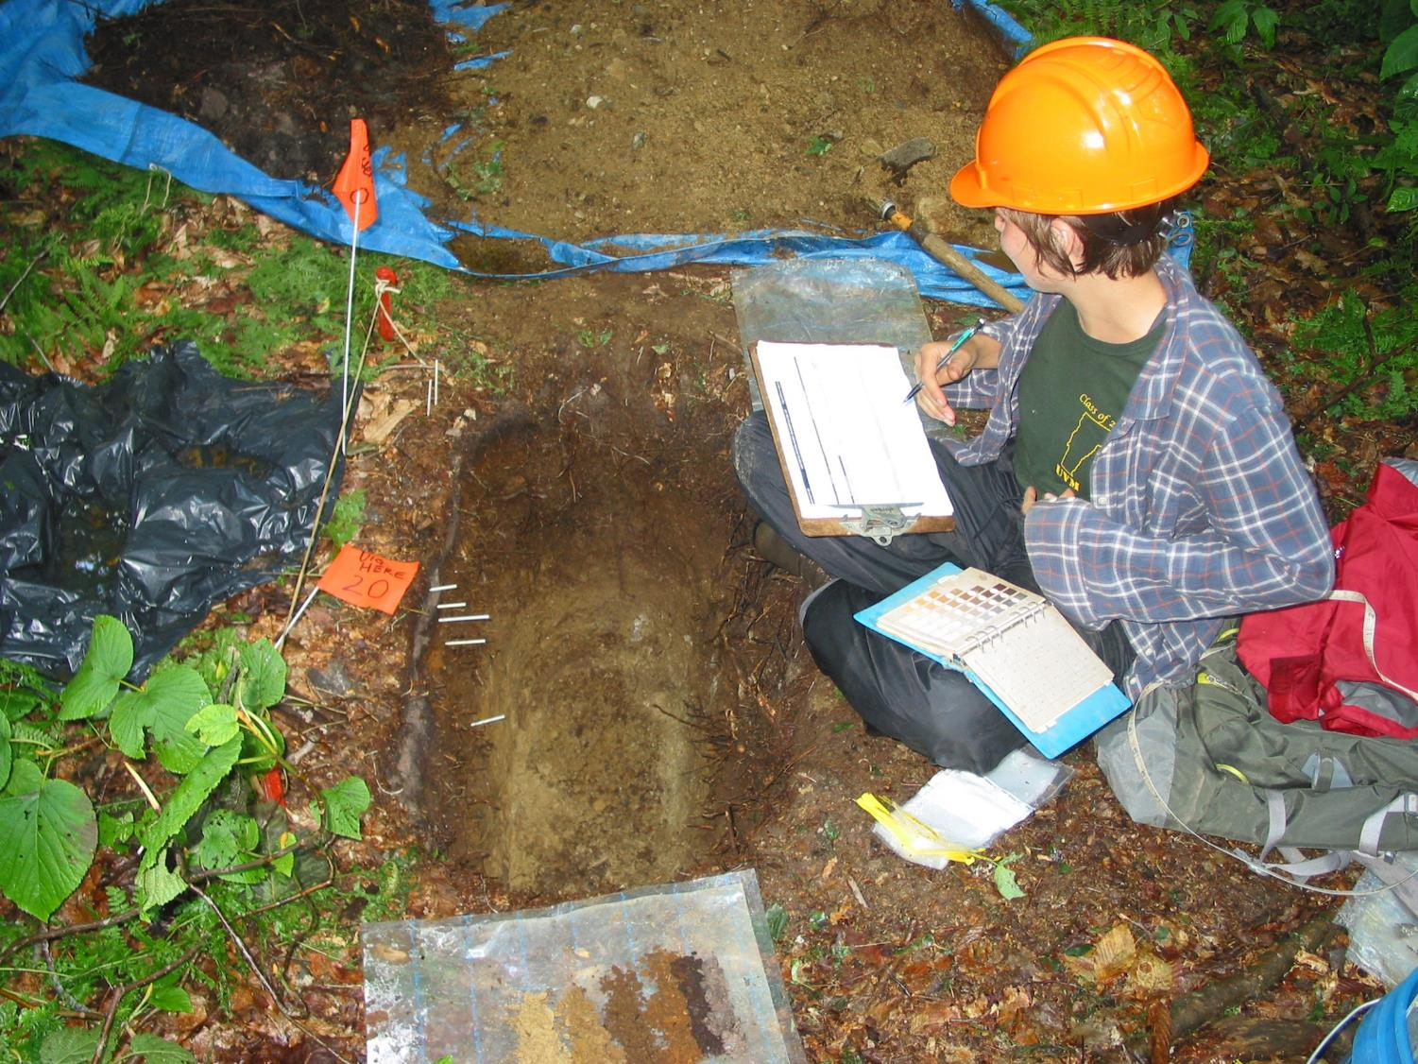
Lye Road

Slide 8
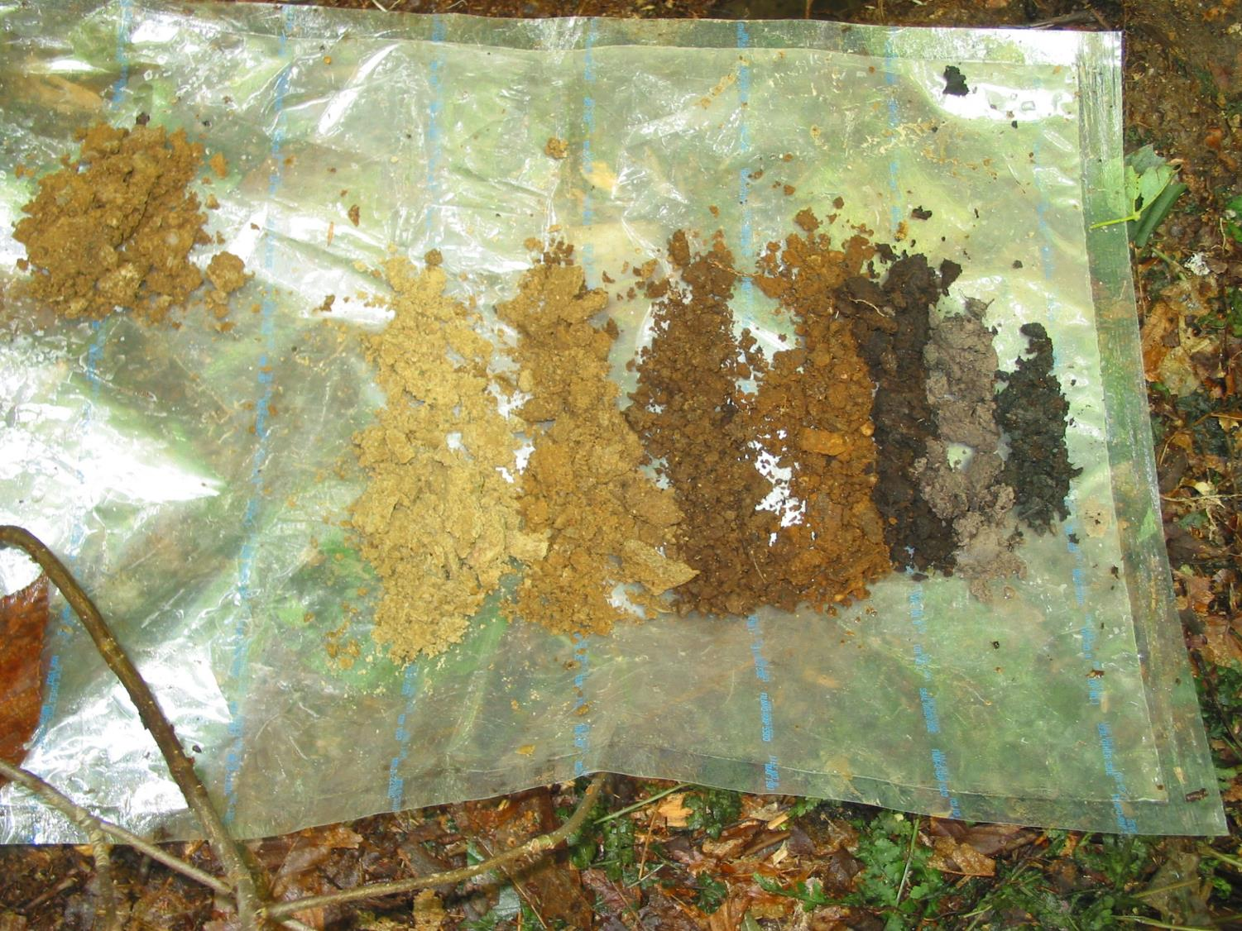
Lye Road

Slide 9
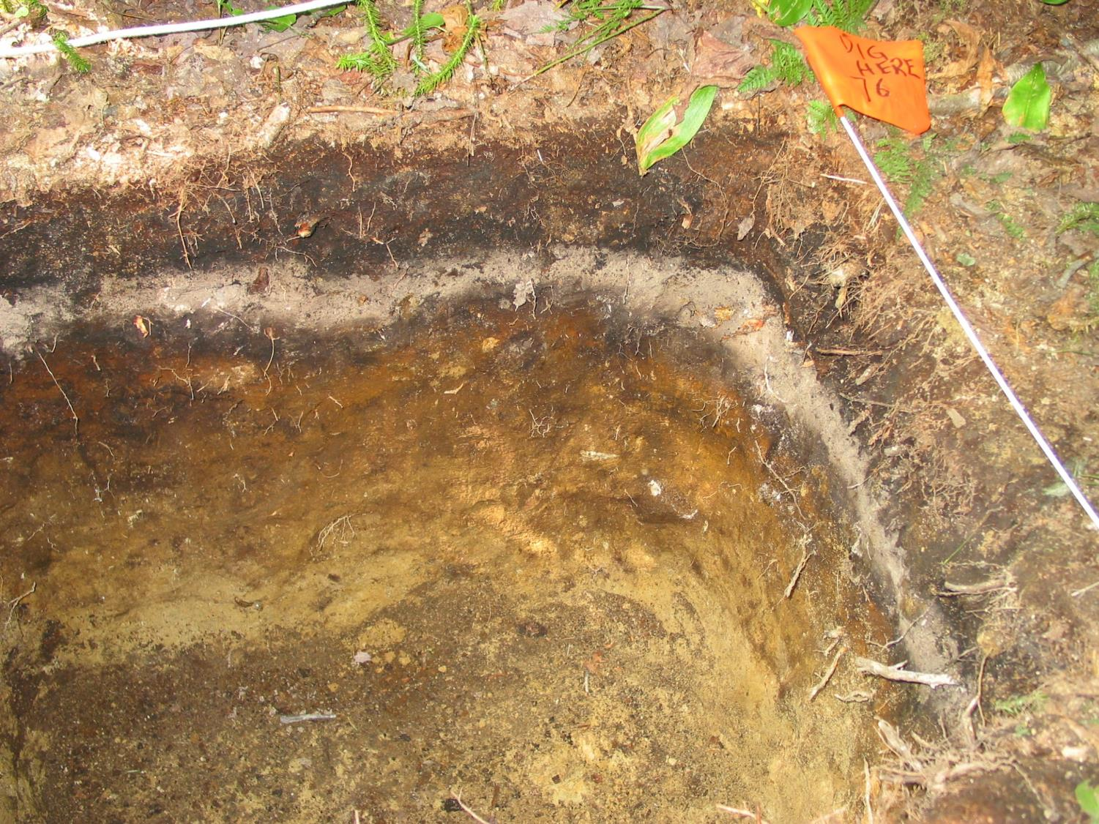
Lye Trail

Slide 10
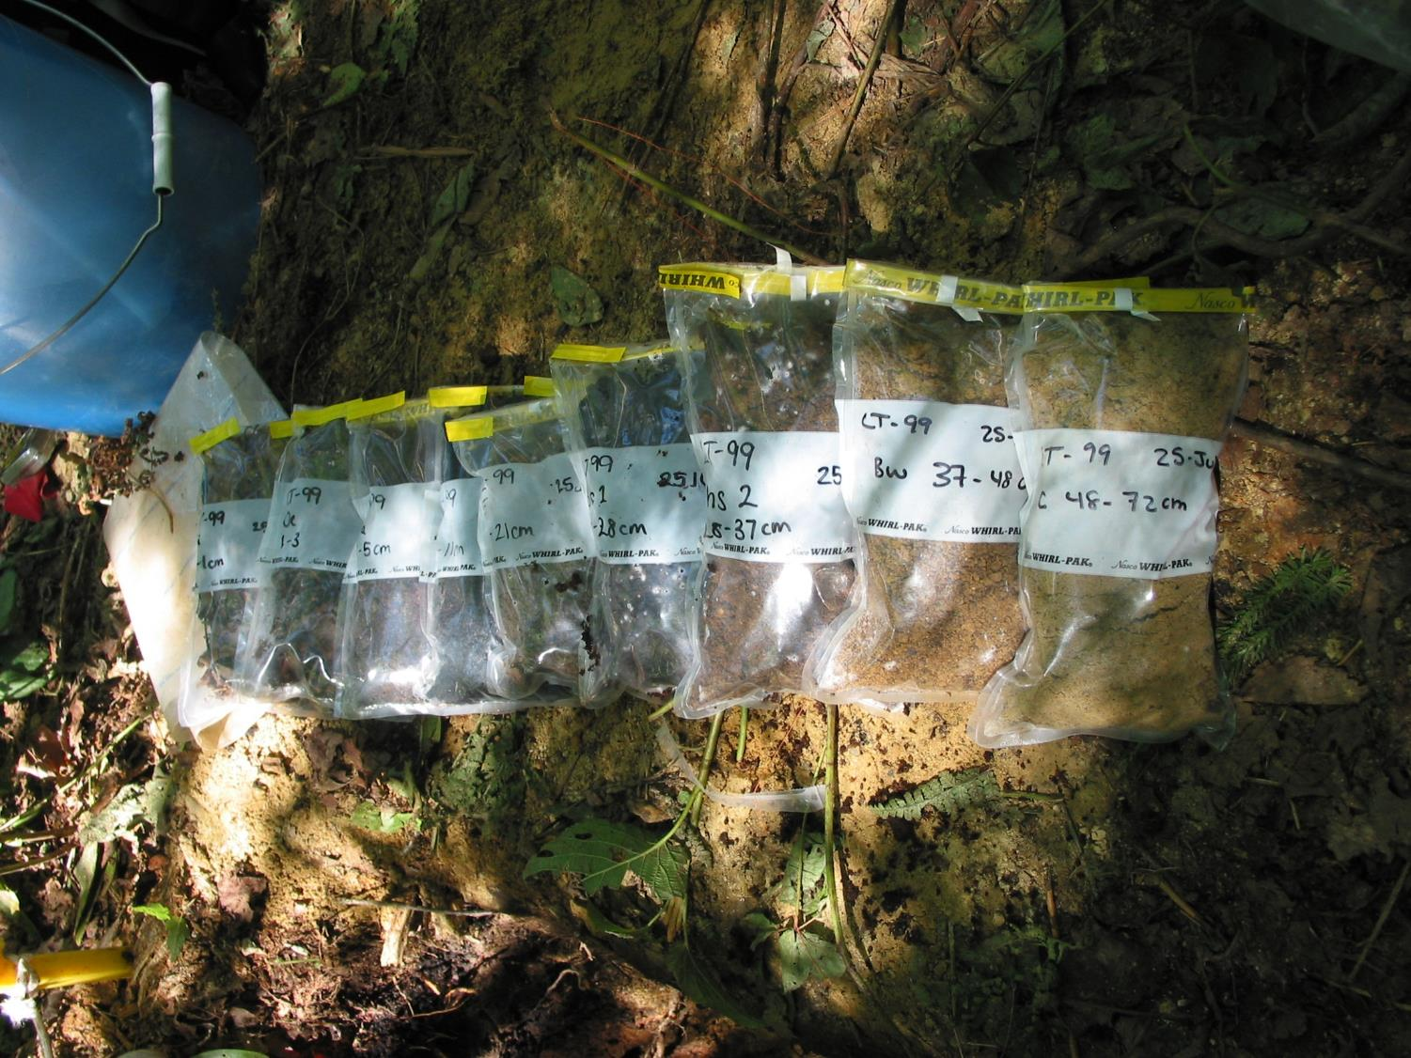
Lye Trail

Slide 11
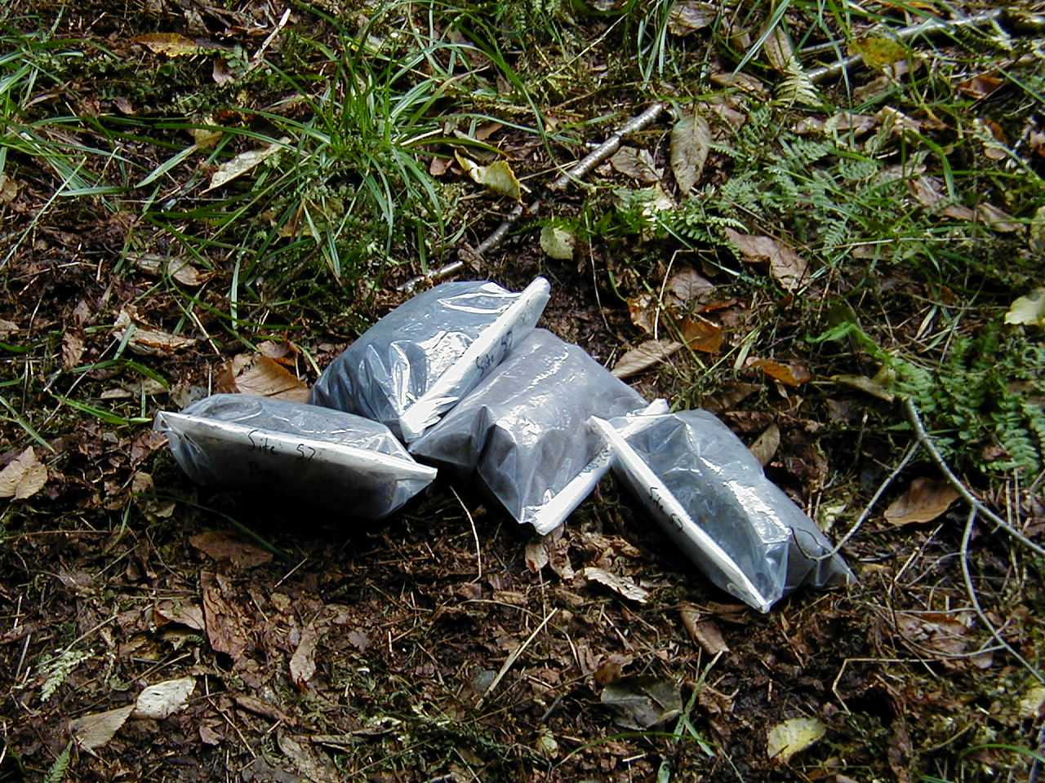

Slide 12
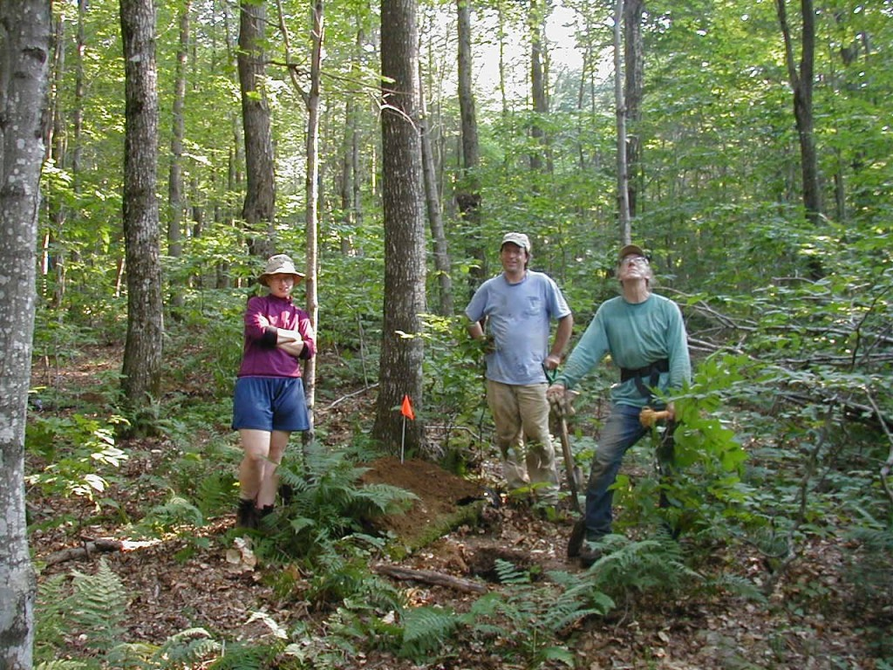
Ranch Brook 2002

Slide 13
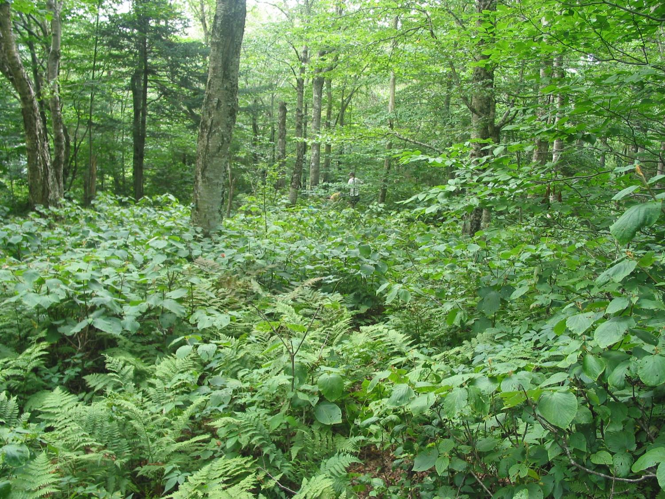
Underhill State Park or ‘Polka-Dot’, 2400’

Slide 14
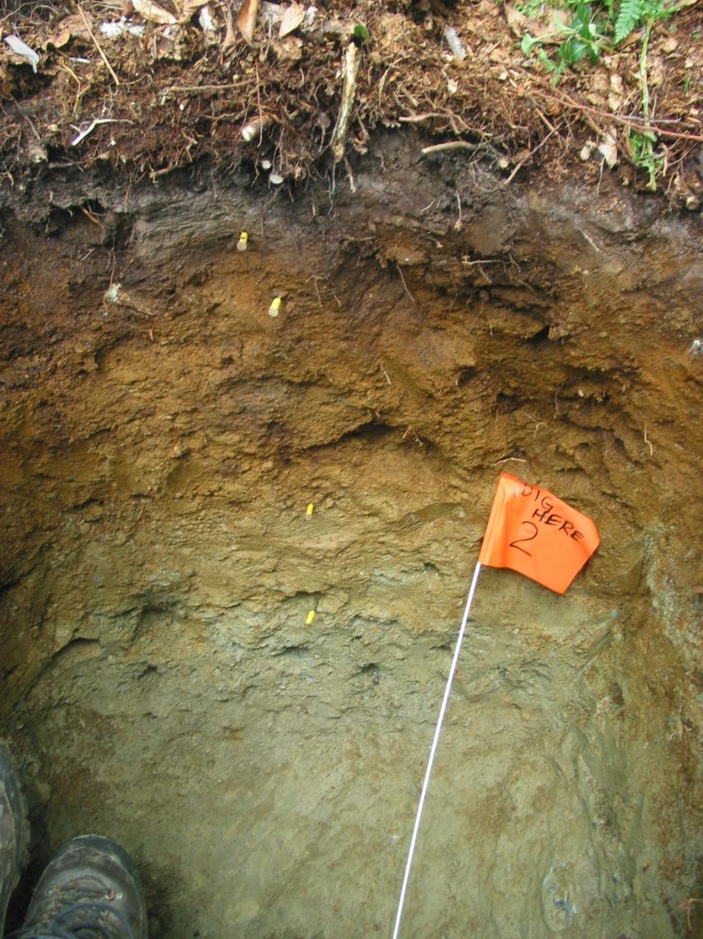
Polka-dot

Slide 15
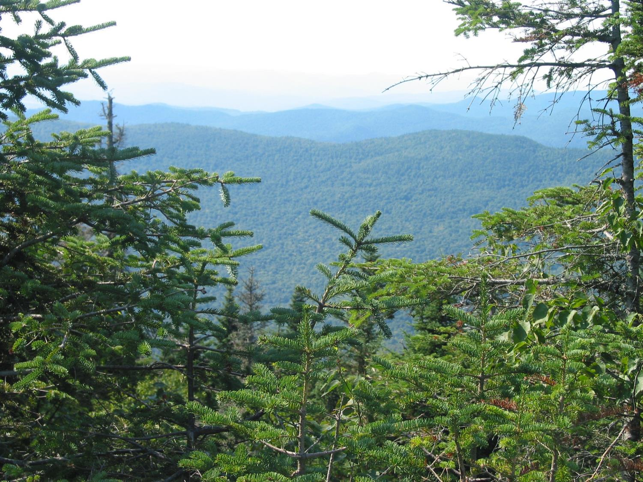
Forehead, 3600’

Slide 16
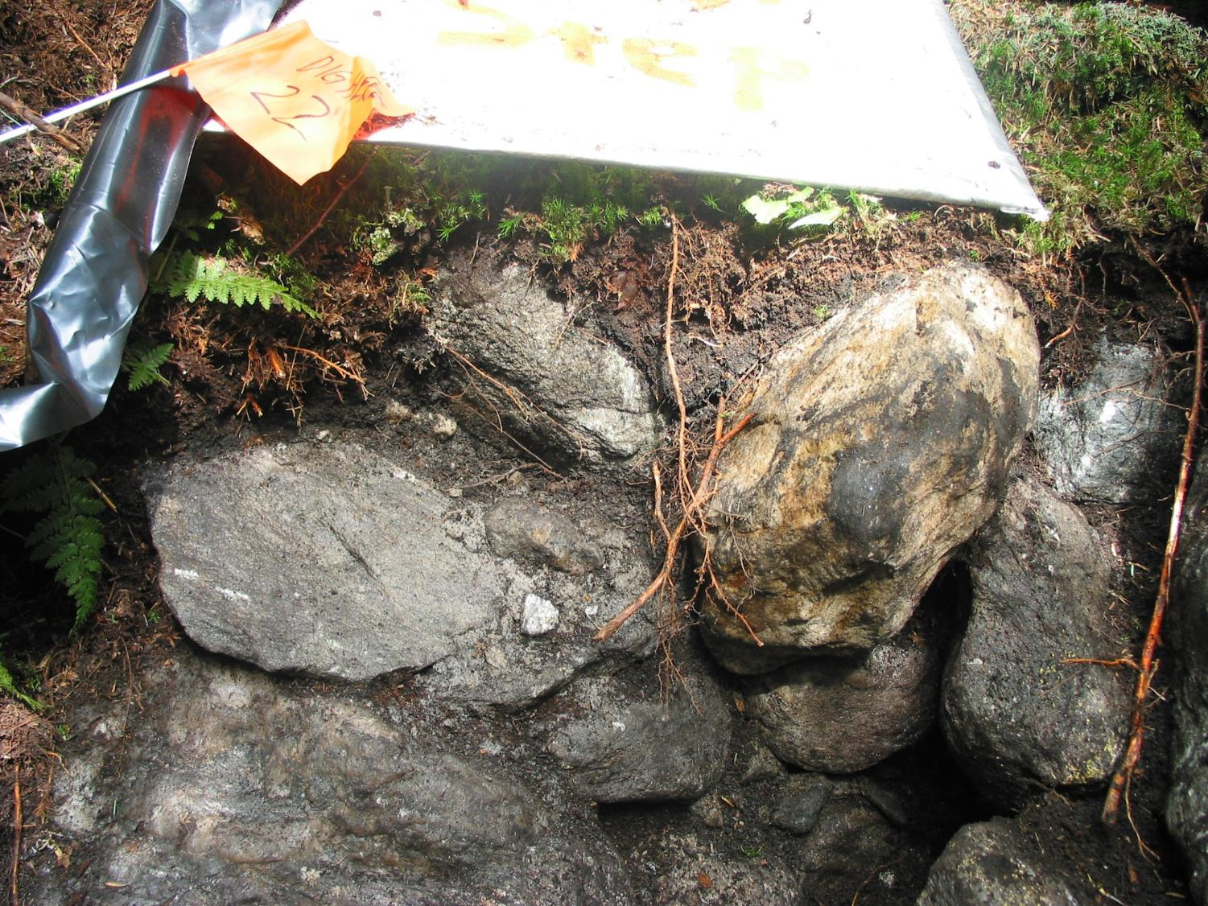
Forehead

Slide 18
60-70 cm particle size from 2012
(only one sample from Forehead)
All averages are fine sandy loam

Slide 19
60-70 cm total elemental analysis 2012
(only one sample from Forehead)

Slide 20
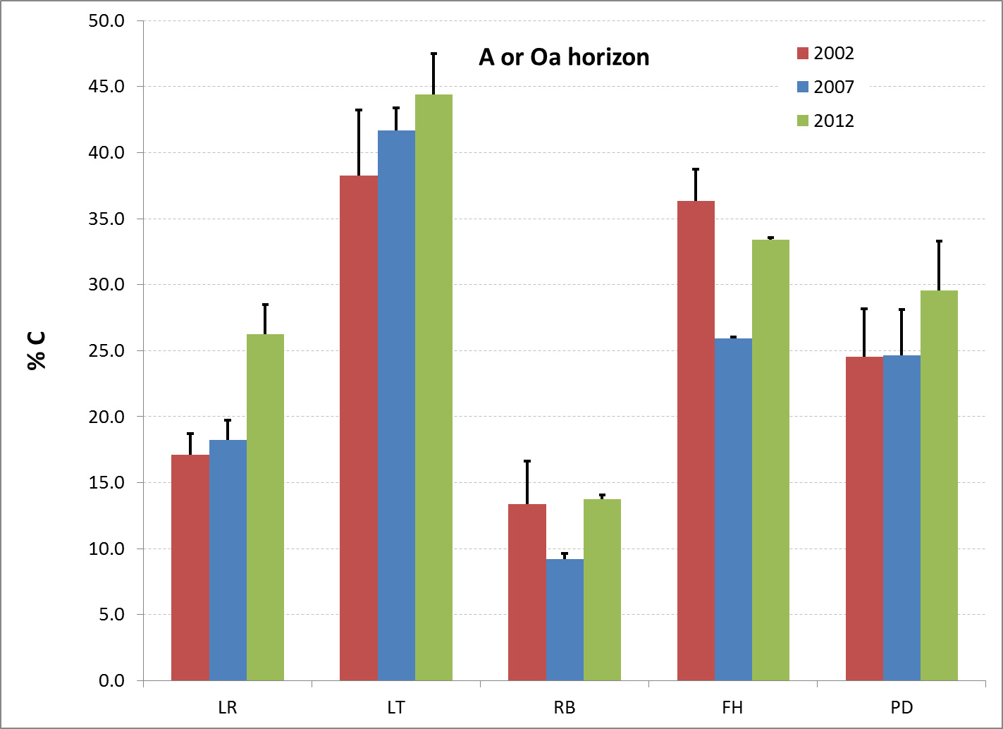
Carbon in the Oa/A horizon

Slide 21
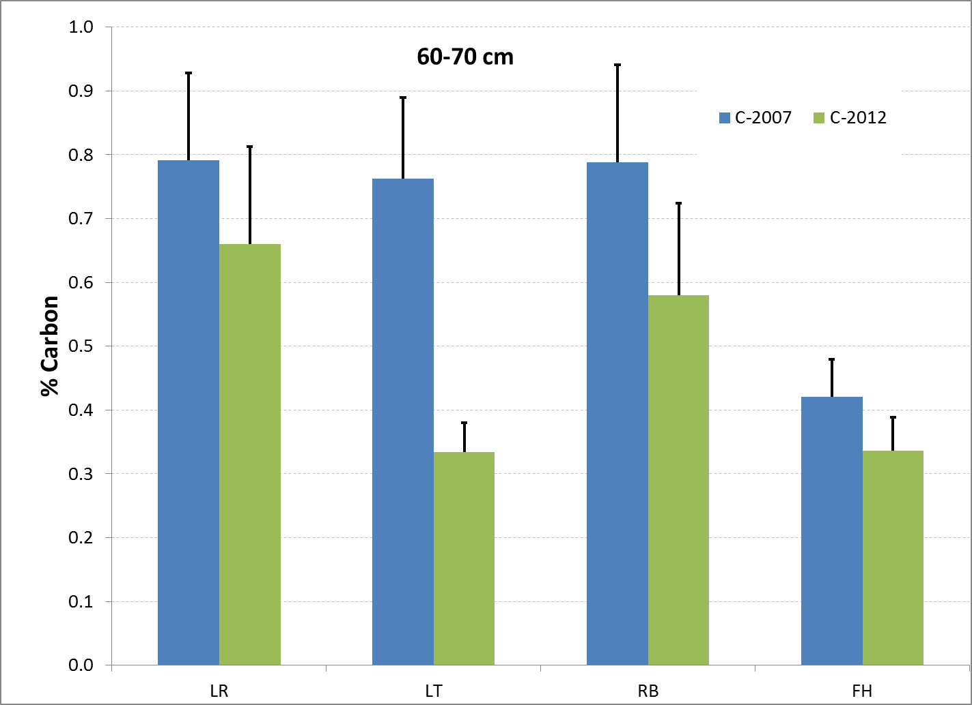
Carbon in the 60-70 cm samples

Slide 22
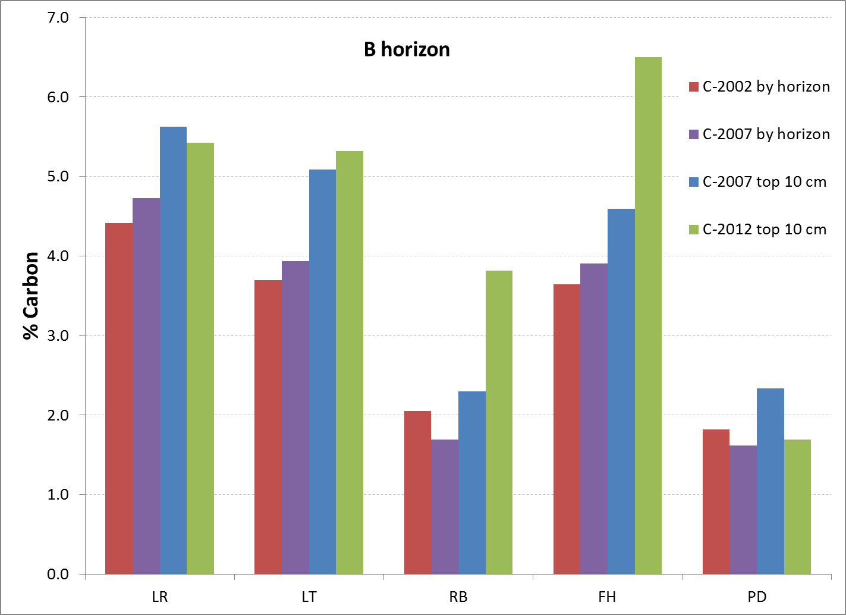
Carbon in the B horizons

Slide 23
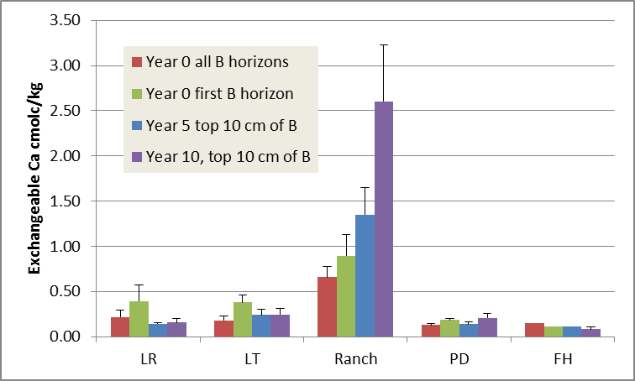
Exchangeable Ca in B horizons

Slide 24
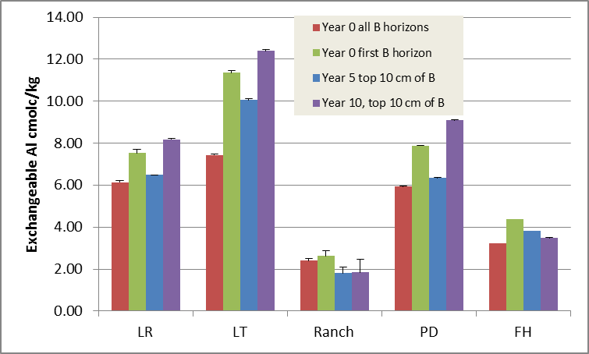

Slide 25
Ranch exchangeable Ca in the uppermost B horizon red = 2002, blue = 2007, green = 2012
N

Slide 26
Challenges facing the project:
Separating natural soil variation from actual long-term changes
Developing a permanent archive plan
Funding for lab work and unsupported personnel costs
200 years??? - Institutionalizing the program into agencies and passing on the project to a new generation of scientists

Slide 27
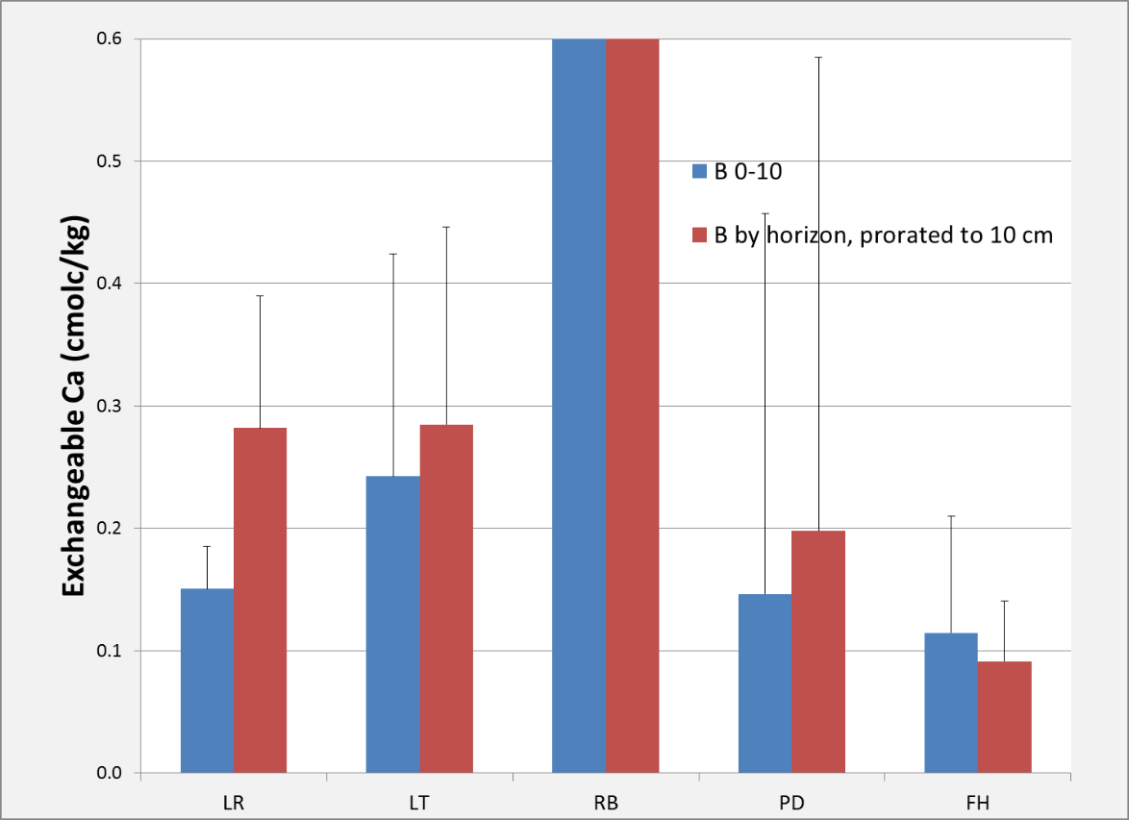
Power analysis
Lye Road B 0-10 cm
Exchangeable Ca cmolc/kg

Slide 28
Detecting change

Slide 29
Detecting change

Slide 30
(Almost) everyone involved in 2012:
Ashley Walker, UVM
Ben Dillner, Vermont Forest, Parks and Rec
Charlotte Ford, UVM
Courtney Dyche, UVM
Dana Andrews, UVM
Deane Wang, UVM
Don Ross, UVM
Doug Morin, UVM
Emily Piche, UVM
Meghan Knowles, UVM
Nancy Burt, US Forest Service
Noah Ahles, UVM
Rebecca Bourgault, UVM
Ryan Melnichuk, UVM
Ryan Morra, UVM
Sandy Wilmot, Vermont Forest, Parks and Rec
Scott Bailey, US Forest Service
Thom Villars, NRCS
Vermont Youth Conservation Corp
Funding generousy provided by VMC and Green Mountain and Finger Lakes National Forests
Thanks Carl Waite and Nancy Burt!

Slide 31
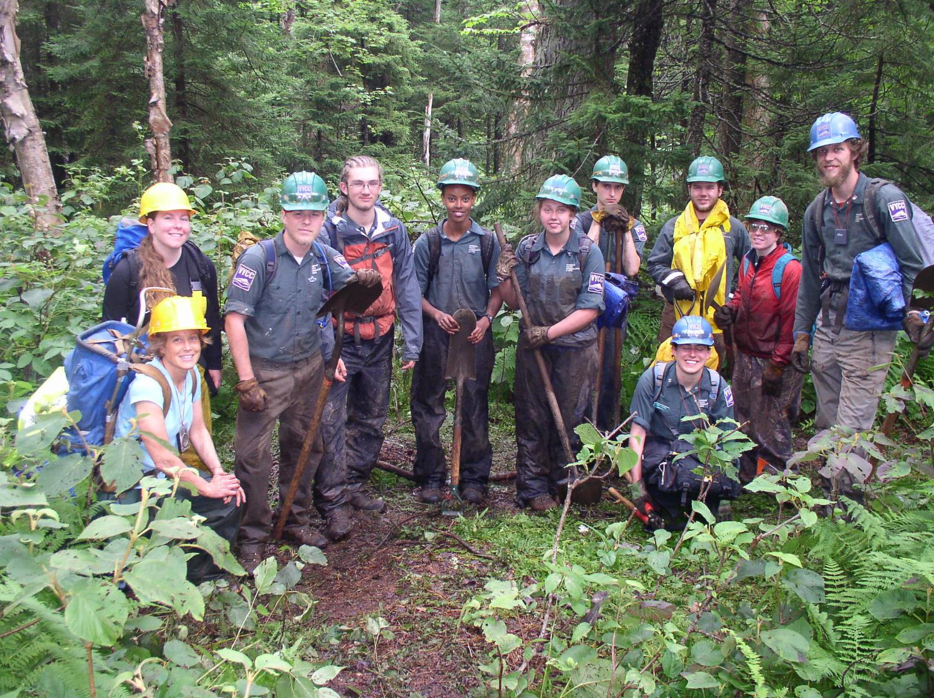
Lye Trail

Slide 32
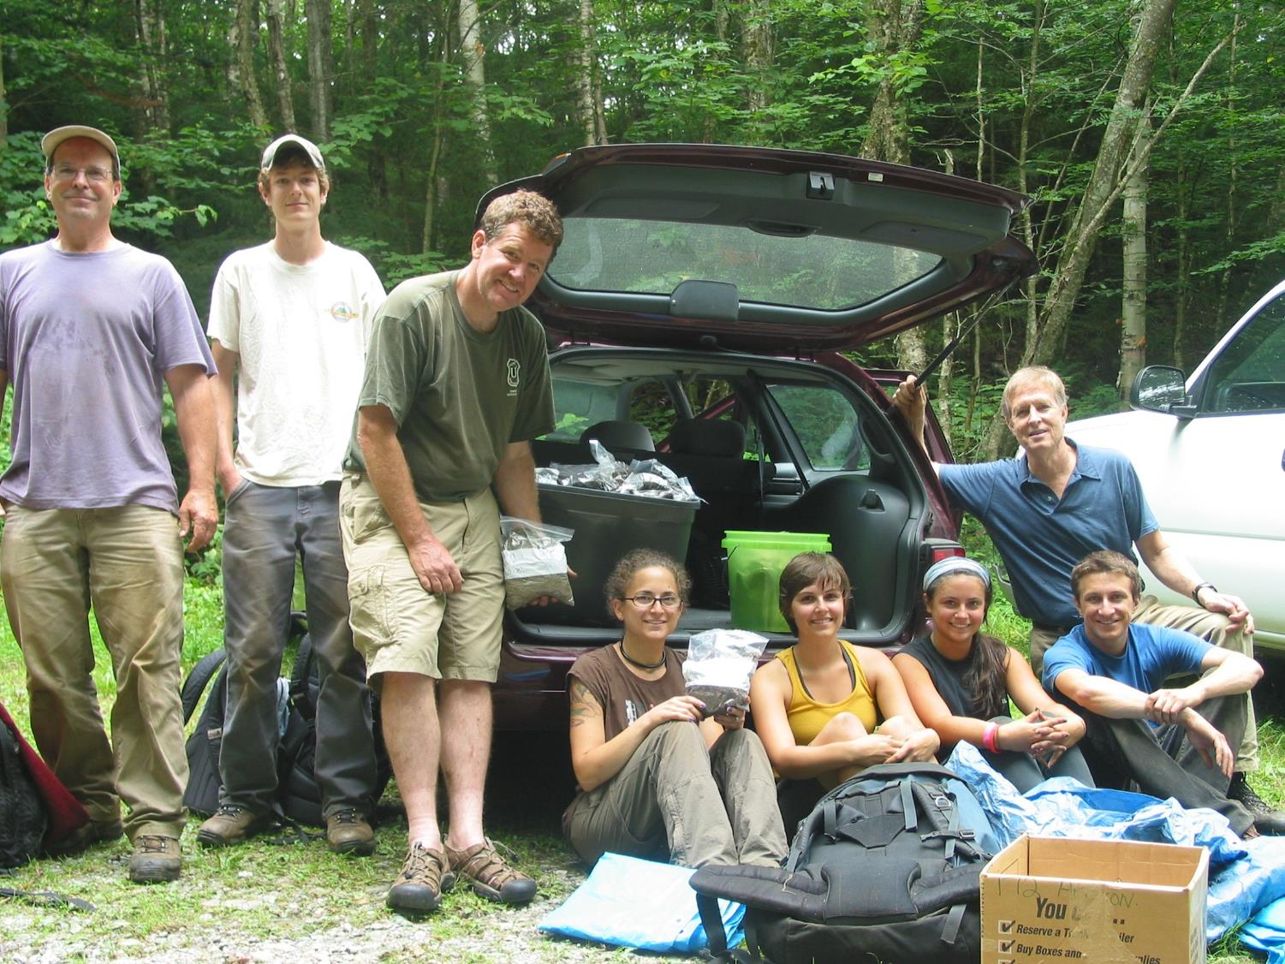
Polka-dot

Slide 33
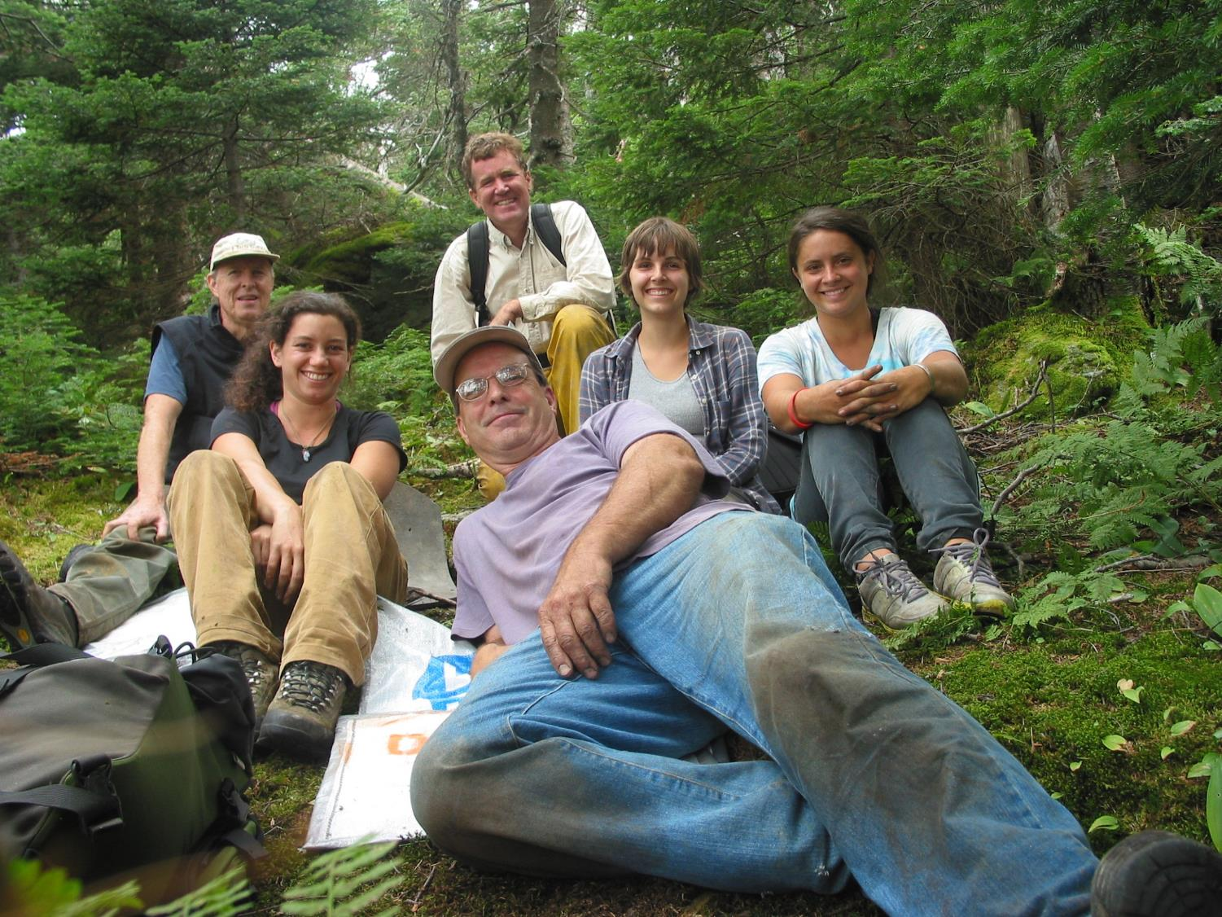
Forehead

Slide 34
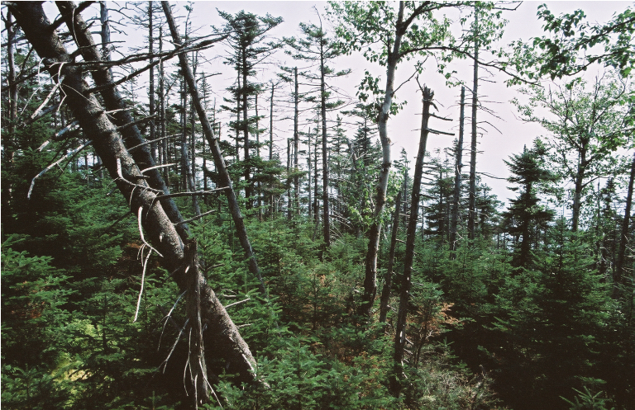
Young volunteers needed!

