Slide 1




Optimizing climate data for use in climate-forest health studies
Dr. Evan M. Oswald; UCAR postdoc
Dr. Lesley-Ann Dupigny-Giroux; VT State Climatologist

Slide 2



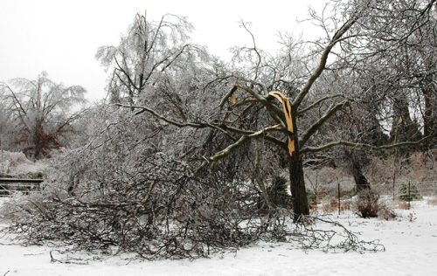
Collaborations
  Forest health indicators (short term)
  Tree rings (long term)
Climate data considerations
  Domains
  Resolutions
  Strengths/limitations
Climate indices
  Quantifying important weather
  Quantifying uncertainties
Empirical relationships
  Supporting theories
  Uncertainty translates into interpretation
Photo: Bert Cregg, MSU.
Notes:
The State Climate Office has been active in collaborative effort, and today I’m going to discuss our work on the linkages between forests and climate. The short term focus is on forest health indicators such as crown conditions, and the long term focus is on tree rings. When selecting climate datasets we look at numerous factors because the success of the investigation is dependent on the data. We use climate indices to quantify weather that theoretically should impact trees and forests. Quantifying the uncertainty is important because it complicates the interpretation of the results of the empirical relationships.

Slide 3
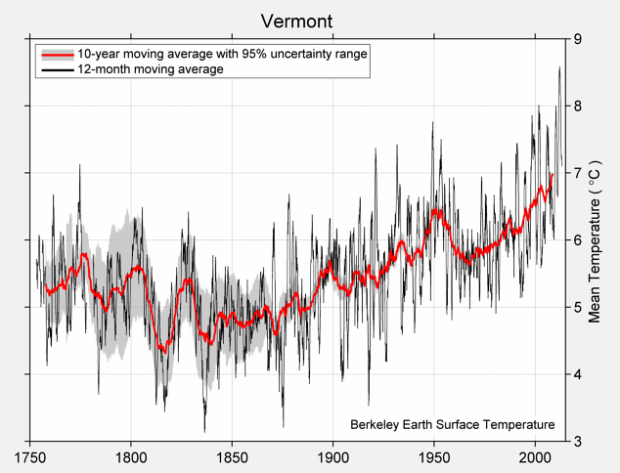
http://berkeleyearth.lbl.gov/regions/vermont
Notes:
Here is the time series of Vermont’s state average monthly temperature for the past 250 + years….decadal changes are in red and sub-decadal changes are in black. The sub-decadal variability facilitates establishing relationships, the long term variability is more aligned with future climate change impact.

Slide 4
Focus on forest health indicators
  Partners: Sandy Wilmot and Dr. Jen Pontius
  Since early 1980’s
  Climate forcing
    Annual climate indices
    Spatially continuous raster
Climate data
  Daily temperature extremes, precipitation
  Spatially continuous, serially complete, 4km-grid
  Spatial resolution not high enough
  Response
    Spatial resolution increased
    Secondary climate dataset
Notes:
The short term focus of this collaboration is on forest health indicators such as crown conditions. The forest health partners are Sandy Wilmot and Dr. Jen Pontius. This study is about 30 years long, and the climate forcings we’re relating to these observed indicators are annual time series of climate indicators. These indicators are seasonal to daily scale meteorological features that we suspect have links with forest health. Indicators reflecting winter thaw events, heat waves, to seasonal temperatures and rainfall totals. Spatially continuous data.
The climate dataset we used here is the PRISM dataset by Chris Daly. It’s spatially continuous, with no missing dates and it is gridded to a 4km spatial resolution. These are daily values of temperature and precipitation. However we feel that the spatial resolution is too coarse and so we devised a “resource light” method to increase the spatial resolution. This is done by using another climate dataset that is 1) higher spatial resolution (800m) and 2) contains 30-year averages

Slide 5
Notes:
This map depicts the intersection of the Chittenden, Lamoile and Washington counties …. So this is mount mansfield.
2) The black circles are grid centroids to the 4km grid of the daily climate dataset (timeseries)
3) The black x’s are grid centroids of the secondary climate dataset (high resolution, not time series), which we used to increase the spatial resolution
4) The three green stars are VMC monitoring sites (Mansfield West, Mansfield Summit and Mansfield East). The observations from these stations were used to demonstrate the improvements of our method.

Slide 6
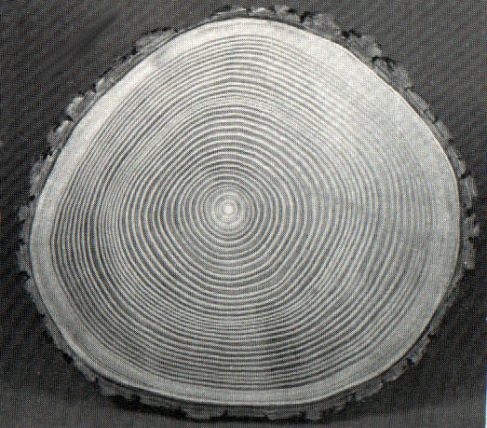
Focus on tree rings
  Partnered with Dr. Shelly Rayback
  81 locations; 1915-2011
  Climate forcings
    Annual climate indices
    Locations time series
Climate data
  Spatially continuous, serially complete, 6km-grid
  Long-term daily temperature extremes, precipitation
  Temporal discontinuities
  Solution
    Offset discontinuities
    Secondary climate dataset
Notes:
The long term focus of this collaboration is on tree rings. We have numerous potential partners (who have tree ring data) and they are organized by Dr. Shelly Rayback.
This study is a little under 100 years long, and again the climate forcings we’re relating to these observed tree rings are annual climate indicators. These indicators are again seasonal to daily scale meteorological features that we suspect have links with tree rings. Here we are creating a finite number of time series at specific locations in space.
The climate dataset we used here is the 2013 Livneh dataset which is an update to the 2002 Maurer dataset. It’s spatially continuous, with no missing dates and it is gridded to a 6km spatial resolution. These are long term daily values of temperature and precipitation.
Unfortunately, while these datasets provide data over long periods of time, they are not suited for long term analysis because they have erroneous “jumps” in the time series of any given location. In response we devised a “resource light” method to correct these jumps in the time series of the potential tree ring locations. This was done using another dataset suitable for long term analysis called the United States Historical Climate Network-monthly v2.5 dataset

Slide 7
Notes:
This is a map of vermont showing
Black tree symbols where 67 locations of tree-ring observations have been taken that we MIGHT examine the relationship between climate and tree rings.
The star symbols are USHCN stations (black stars had no matches with extracted tree-ring location time series)
Each tree-ring location is matched-up with one USHCN station using correlation of the time series, and this facilitates the adjusting of the extracted time series to match the long term changes of the USHCN stations.

Slide 8
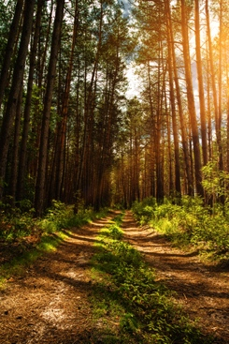
Summary
  VSCO/UCAR Postdoc collaborating with forest health scientists
  Demonstrated “resource light” methods
    Spatial resolution increase
    Long term changes (increase trust)
  Publications:
    Methods: Earth and Space Sciences
    Results: TBD
Climate data
  Publications
    C. Daly’s, 2008, Int. J. of Climatology
    B. Livneh’s, 2013, J. of Climate
    E. Maurer’s, 2002, J. of Climate
    M. Menne’s 2009, Bulletin of American Met. Society
Notes:
In conclusion, I am a postdoc from University Corporation for Atmospheric Research working through the State Climate Office and with the help of some VMC observations….I’ve developed some easy tools to better optimize climate data that supports climate-forest health studies.
These tools will be published soon in the new Earth and Space Sciences journal, and the results of the climate-forest health studies will also be published somewhere. Below are where you can find more about the climate datasets we’ve mentioned today.

