Slide 1
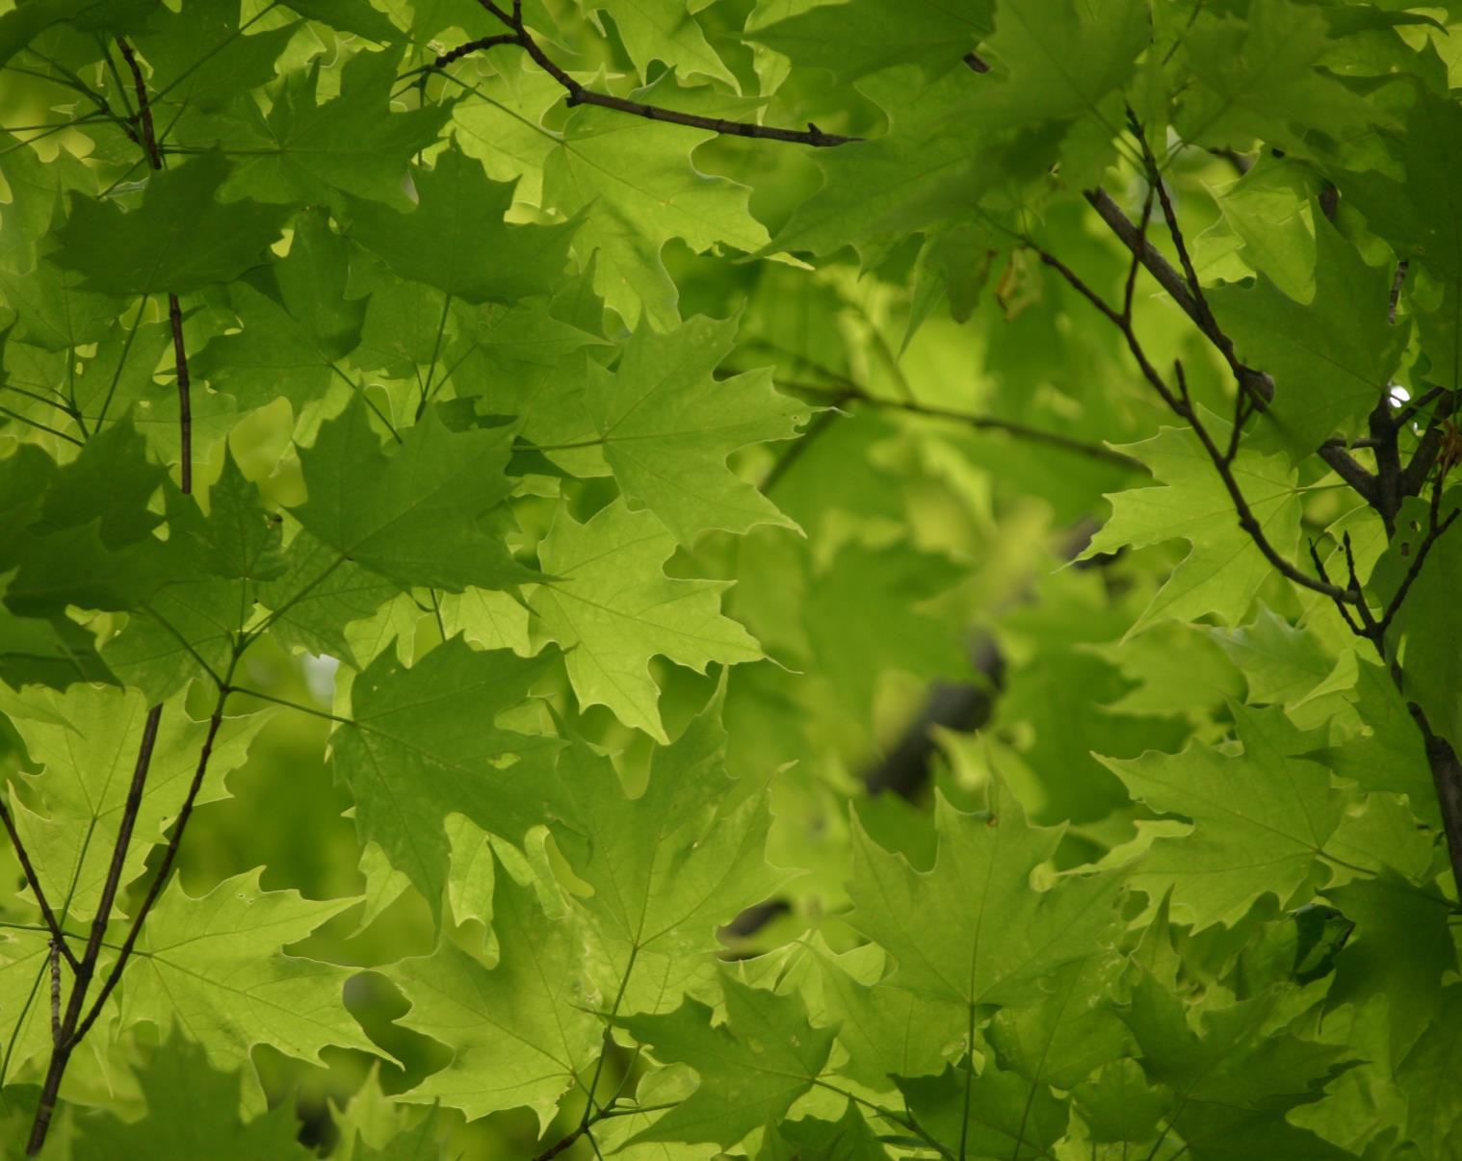
Using dendroecological techniques to interpret the response of trees to environmental change at the Vermont Monitoring Cooperative’s Mount Mansfield study site
Alexandra M. Kosiba¹
Paul G. Schaberg²
Gary J. Hawley¹
Shelly A. Rayback³
December 11th, 2014
¹Rubenstein School of the Environment & Natural Resources, University of Vermont
²USDA Forest Service, Northern Research Station
³Dept. of Geography, University of Vermont

Slide 2
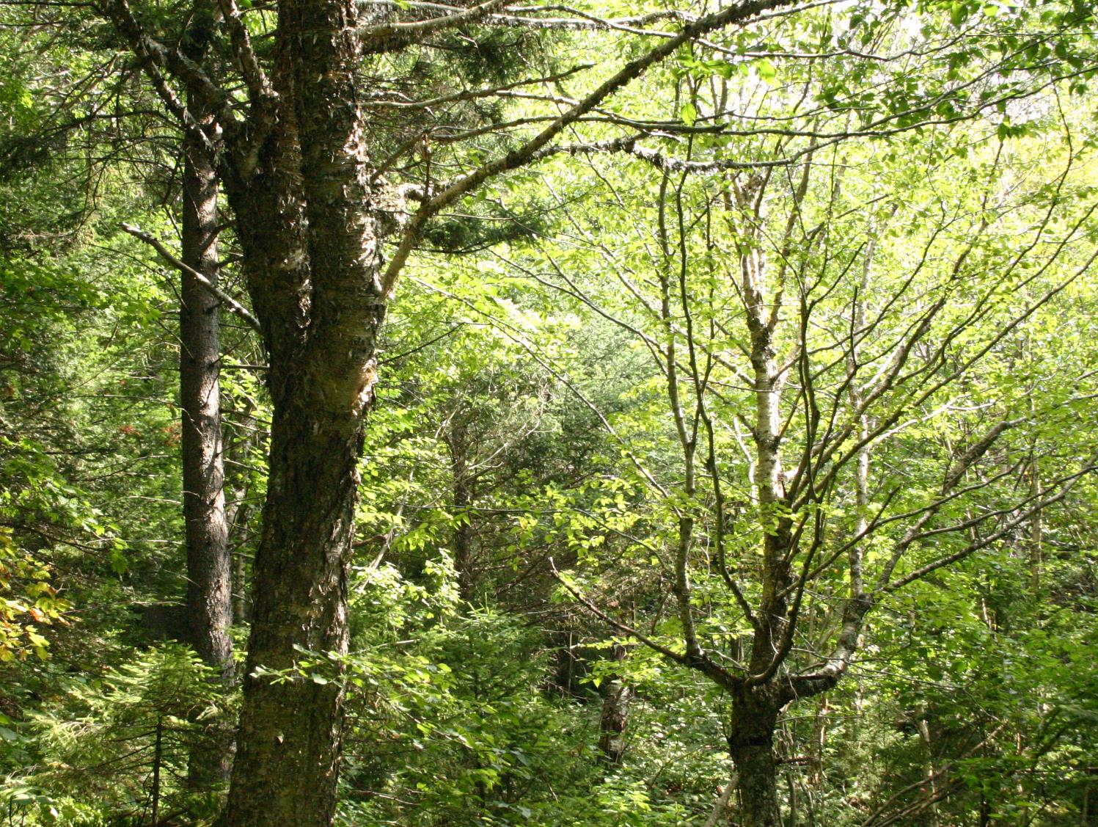
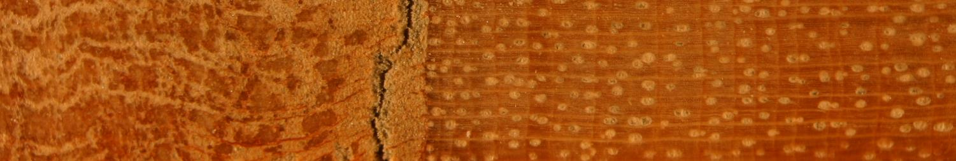
Observed changes in the region
Growth declines, decreased vigor, increased mortality for some tree species in VT
    Red spruce
    Sugar maple
Other species appear to be stable
Possible growth increases
    Red spruce
Anthropogenic stresses
    Changes in climate
    Acid deposition, land-use change
Notes:
Some tree species in Vermont have experienced growth declines, decreased vigor, and increased mortality in recent decades. Well-documented health and productivity declines of red spruce and sugar maple have been associated with anthropogenic acidic deposition and associated calcium depletion. However, other species are notable as being stable or only exhibiting periods of limited decline. There are is also indication that some species, even those like red spruce that had undergone long periods of decline, maybe experiencing a novel growth surge. Added to this uncertainty in forest response, the region is experiencing changes in climate that falls on a backdrop of other human-induced disturbances to our forests, such as acid deposition and deforestation.

Slide 3
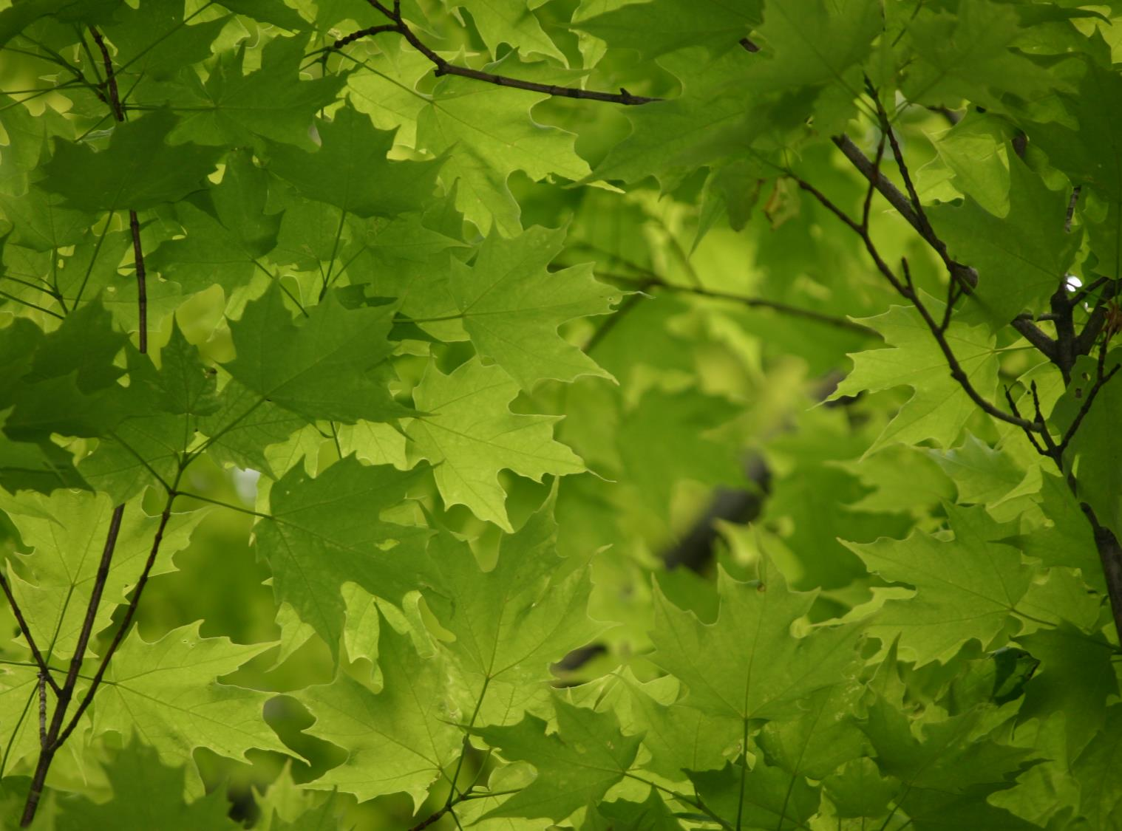
Project Goal
Assess recent patterns and trends in growth for 5 key forest tree species:
Sugar maple (Acer saccharum)
Red maple (Acer rubrum)
Yellow birch (Betula alleghaniensis)
Red spruce (Picea rubens)
Balsam fir (Abies balsamea)
Notes:
The overall goal of this project was to assess recent patterns and trends in forest growth on the VMC long-term study site located in Mt. Mansfield State Forest, using xylem growth measurements for five key forest tree species: sugar maple, red maple, yellow birch, red spruce, and balsam fir. The methods and results I’m presenting here is one part of the overall project.

Slide 4
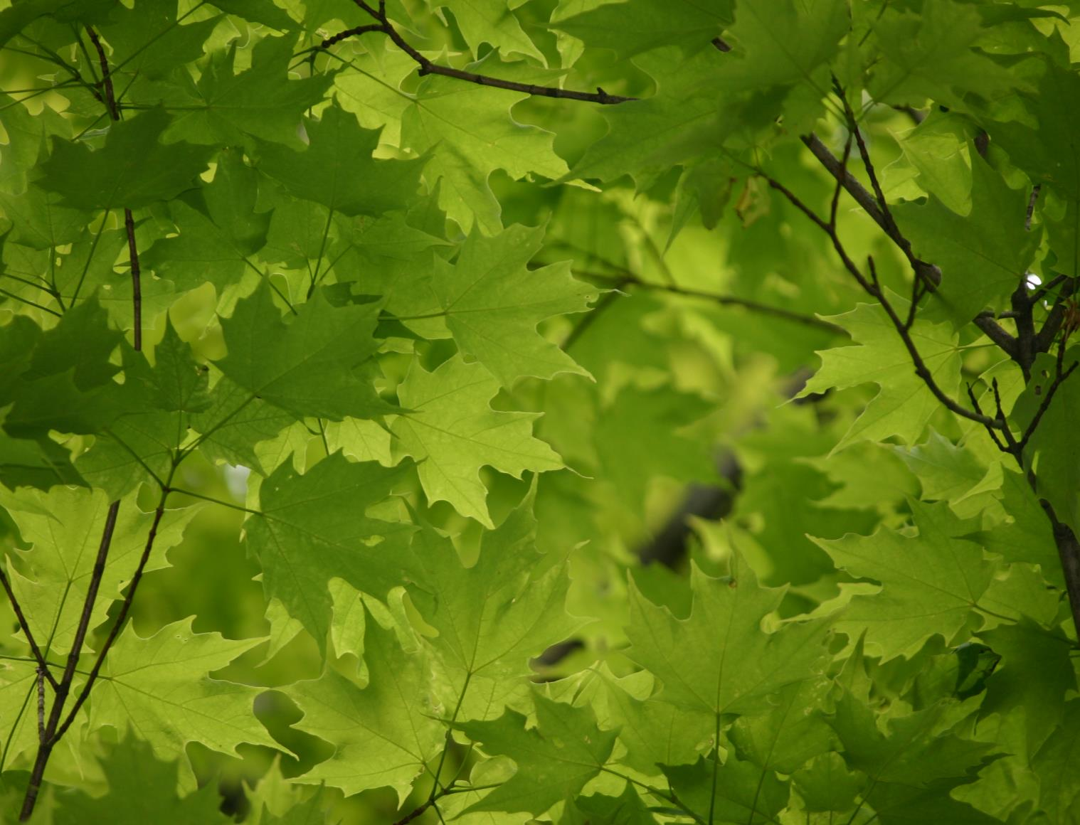
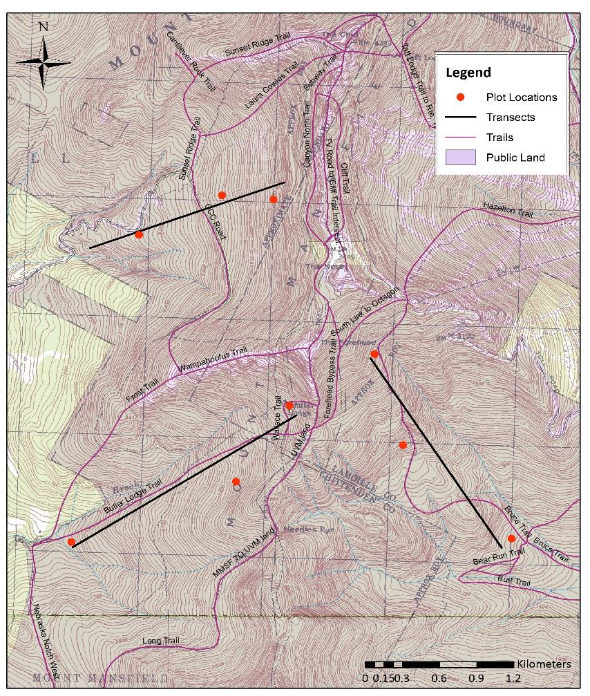
Map of Mt. Mansfield: sampling transects
Brown’s River Watershed
Stevensville Brook Watershed
Ranch Brook Watershed
Notes:
Elevational transects were set up in three of the four watersheds on Mt. Mansfield: Brown’s River, Stevensville Brook, and Ranch Brook. No transect was established in the fourth watershed because this area has experienced anthropogenic disturbance associated with a commercial ski area.

Slide 5

Sampling scheme
HIGH
ELEVATION
Balsam fir
Boreal Forest
(>880 m)
Red spruce
Yellow birch
MID
ELEVATION
Transition Forest
(760 – 880 m)
Sugar maple
Red spruce
LOW ELEVATION
Red maple
Northern Hardwood
Forest (< 760 m)
Sugar maple
Red spruce
Notes:
Along each transect, 3 plots were selected at different elevations. At low elevations, we sampled red maple, sugar maple, and red spruce; at mid elevations we sampled, sugar maple, yellow birch, and red spruce; and at high elevations we sampled red spruce and balsam fir. A minimum of 12 trees per species per plot were selected.

Slide 6
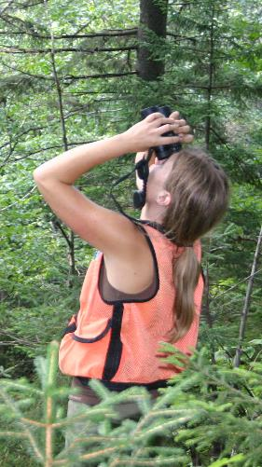
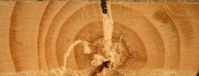
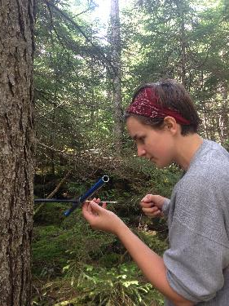
Methods
9 plots
  3 elevations, 3 watersheds
  12+ trees per species per plot (n trees = 265)
Standard dendrochronological techniques
Converted linear growth measurements → area [BAI]
Standardized BAI (Z-score)
    Mean & SD for species/plot
Chronology: 1980-2012
Notes:
The selected 265 trees were increment cored following standard dendrochronological techniques in the fall of 2012. Linear measurements of radial growth were converted into basal area increment. To compare across species, mean BAI per species per plot was converted to a standard score (Z-score) using species-specific plot mean and sd for the focus period, 1980-2012. An additional benefit of this standardization technique is that it allows easy visualization of positive and negative growth trends relative to the species’ average growth at that site.

Slide 7
Low elevation: comparison of standardized BAI
Notes:
Here is the standardized BAI data from the low elevation plots. Sugar maple low elevation began with higher than average growth in the 1980s and had below-average growth by the end of the chronology.
Sugar maple appeared to be affected by a number of abiotic and biotic stressers that we looked at. For example, we see a downturn in growth coincident with the late spring frost in May 2010 that affected sugar maple at low elevation, but not as dramatically at mid elevation for either sugar maple or yellow birch.

Slide 8
Low elevation: comparison of standardized BAI
Notes:
At all three low elevation plots where red maple was sampled, standardized growth was around the mean in 1980, but above the mean by 2012 (> 2 standard deviations above the mean).

Slide 9
Low elevation: comparison of standardized BAI
Notes:
For red spruce, standardized growth began below the mean in 1980 and finished well above it in 2012 -- this trend was obvious for all 9 red spruce plots regardless of elevation.

Slide 10
Mid elevation: comparison of standardized BAI
Notes:
Growth for sugar maple at mid elevations appears fairly stable over the 32 years and the trees here do not seem to have been impacted by the 2010 late spring frost, for example.

Slide 11
Mid elevation: comparison of standardized BAI
Notes:
Yellow birch appears fairly stable, with growth from year to year and between plots, being quite variable.

Slide 12
Mid elevation: comparison of standardized BAI
Notes:
Again, you can see that red spruce shows protracted growth increases compared to the other species.

Slide 13
High elevation: comparison of standardized BAI
Notes:
Balsam fir, on the other hand, appeared to have experienced some recent decreases in growth compared to its average for this time period.

Slide 14
High elevation: comparison of standardized BAI
Notes:
At all three high elevation plots, red spruce was growing relatively faster than balsam fir for the last decade or so.

Slide 15
Mean standardized basal area increment 2008-2012
A
AB
BC
C
C
* Different letters denote significant differences (ANOVA w/ Tukey-Kramer LSD, P < 0.05)
Notes:
Examining recent growth for the five years prior to sampling, from 2008-2012, red spruce had significantly higher standardized growth than sugar maple, balsam fir, and yellow birch, but not red maple. Red maple had significantly higher growth than both sugar maple and balsam fir. When we tested recent growth by species to see if recent growth differed from the mean of zero, we found that for red maple (P < 0.03), sugar maple (P < 0.002), and red spruce (P < 0.001) recent mean growth was significantly different from zero. Since these were standardized values, with a mean of zero for the time period 1980-2012, this indicated that both red maple and red spruce were growing better than average for this time period, while sugar maple was growing less than average, and balsam fir and yellow birch were not growing differently from their 32-year mean.

Slide 16
Red spruce chronology
Mean BAI (cm²)
Year
P < 0.0001, adjusted R² = 0.84
Notes:
We compared red spruce growth from this study with red spruce growing at a wide range of plots in Vermont, New Hampshire, and Massachusetts (N trees = 452). It is clear that red spruce growth at the Mt. Mansfield study plots correspond well with red spruce growth region-wide. It is interesting that the period of most divergent growth between Mt. Mansfield and regional red spruce is the period from roughly 1980 through 2008 – a period interspersed with a series of winter injury events that affected red spruce. The better than average growth at Mt. Mansfield relative to the regional chronology could indicate that red spruce on Mt. Mansfield were, on average, injured less than the regional norm. The similarity of response across locations and years suggests that broad-scale factors are the primary drivers of growth for red spruce, rather then more localized disturbance patterns, and this is likely true with recent increases in growth, too.

Slide 17
Sugar maple chronology
Mean BAI (cm²)
P < 0.0001 , adjusted R² = 0.41
HBEF data from C. Hansen (2014)
Notes:
We also compared sugar maple from this study to those species sampled from the Hubbard Brook Experimental Forest. The two chronologies were significantly related (P < 0.0001, adjusted R² = 0.41), but sugar maple growing in HBEF had significantly higher growth than those at Mt. Mansfield. After 1982, the two chronologies were not significantly different in any year and both chronologies show a decline in growth in the late 1980’s, which aligns with other reports of sugar maple declines in BAI that coincided with a period of regional decline for the species that was attributed to the combined effects of acid deposition-induced Ca depletion and the influences of various secondary stressor.

Slide 18
Yellow birch chronology
Mean BAI (cm²)
Year
P < 0.02, adjusted R² = 0.077
HBEF data from C. Hansen (2014)
Notes:
For yellow birch the similarity of growth relationships between Mt. Mansfield and HBEF was not as strong as for the red spruce and sugar maple chronologies, though the yellow birch chronologies were still significantly related. One possible reason for the weaker relationship between Mt. Mansfield and HBEF yellow birch compared to that detected for sugar maple could be the lower sample size for birch. A small sample size and limited spatial scale results in chronologies that can be more dominated by local forces. Because we had relatively few trees for the yellow birch chronology (N = 34), the lack of relationship with yellow birch growing at HBEF may indicate that the former chronology was driven by site-specific factors (also evident by the large standard error bars around the means which indicate large variation in response among trees and watersheds). While yellow birch in this study contained a high degree of between-watershed and between-year variation, the trees have remained fairly constant in their growth over time at Mt. Mansfield and when compared to HBEF.

Slide 19
Key findings
Timing of max growth varied among the species:
    Sugar maple + yellow birch = 1960s-80s
    Red spruce + red maple = recent
    Balsam fir = no peak
Compared to species-specific means, in past 5 years…
    Red spruce + red maple ⬆
    Balsam fir + yellow birch ➔
    Sugar maple ⬇
Red spruce had the highest growth that has occurred in the last 100 years → region wide pattern
Comparisons of growth at Mt. Mansfield similar to trends at other locations
Notes:
The timing of maximum growth also varied among the species, with sugar maple and yellow birch growing best in the 1960s-80s, and red spruce and red maple showing the greatest growth only very recently. For the 5 years preceding collection, red spruce and red maple were growing significantly better, balsam fir and yellow birch were growing same, and sugar maple growing significantly worse than species-specific means since 1980.In contrast to the major document decline reported for the 1970s and 1980s, red spruce had the highest growth that has occurred in the last 100 years. Comparisons of growth patterns for Mt. Mansfield to datasets from elsewhere suggest that, at least for some species, growth at Mt Mansfield was similar to regional trends.

Slide 20




Acknowledgements
Heather Bromberg, Ken Brown, Ben Engle,
Kim Conway (USFS), Jim Duncan (VMC), Josh Halman,
Chris Hansen, Gary Hawley, Kindle Loomis,
Allyson Makuch, Sam Wallace, Carl Waite (VMC)
Funding
Vermont Monitoring Cooperative

Slide 21
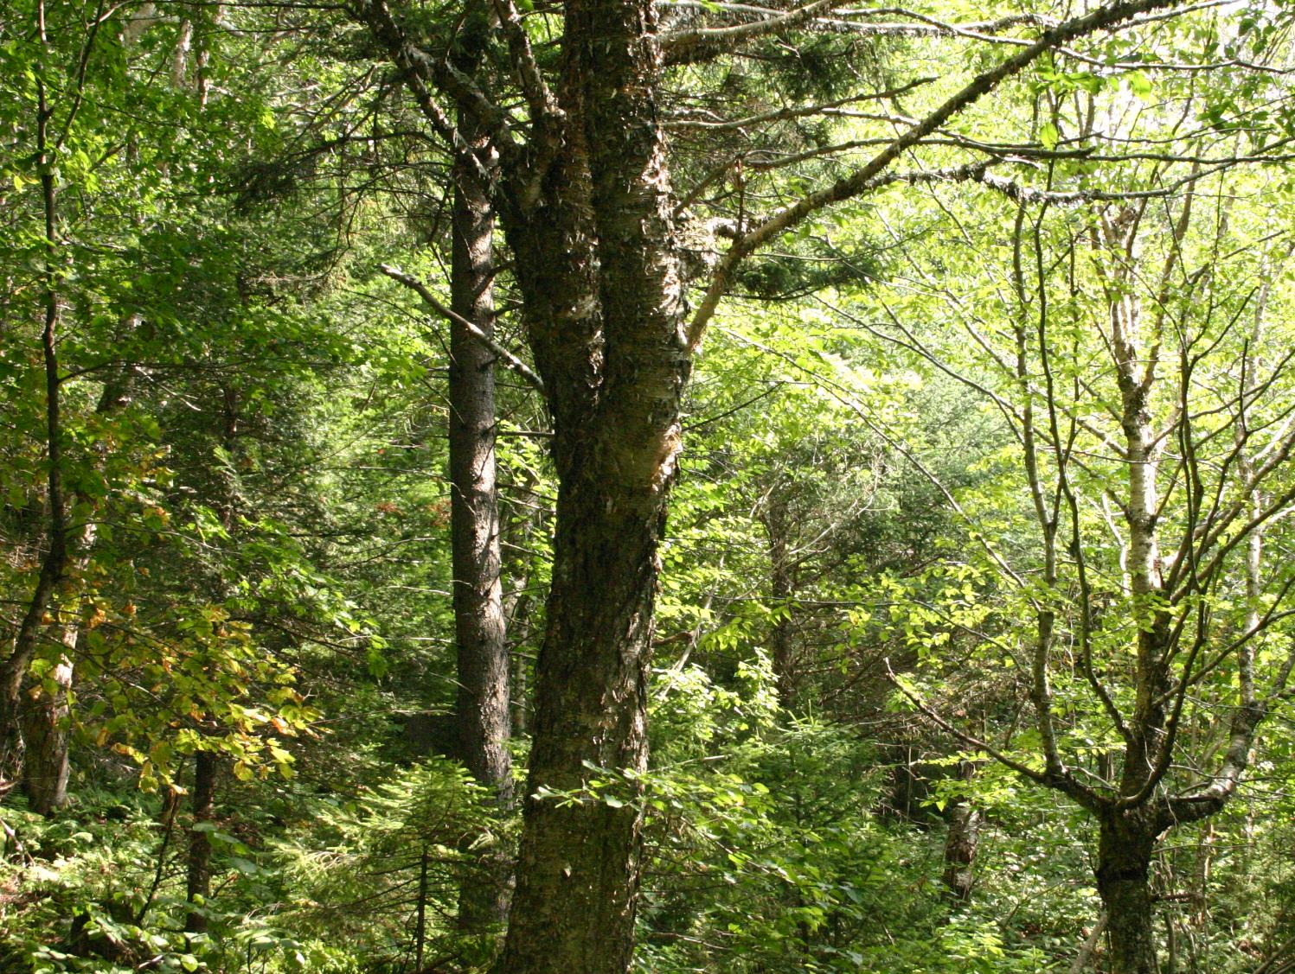
Questions?

Slide 22
Low elevation (<760m)
N trees
Basal area increment (BAI) cm²
Notes:
Mean BAI (± standard error [SE] of the mean) per species per elevational band from 1895-2012, with the number of trees (N) contributing to the mean (sample depth) on the z-axis.
depicts possible causes for some of the changes in growth due to biotic and abiotic factors based on available data. Some of the factors that may have contributed to low growth in a given year are speculative, based on synchronous declines across plots for a species and known defoliation or stress events in the region for that time period (i.e., based on published research in the region or annual reports and over-flight images produced by Vermont Agency of Natural Resources Department of Forest Parks & Recreation). Comparisons of the chronologies depicted in Figure 3 highlight that the five species often experienced changes in growth that were either species- or elevation-specific. As a preliminary assessment of possible causes of the more obvious deviations in growth, we compared the timing of these changes to historic forest health data. For example, sugar maple at low elevation had low growth in 2010 possibly due to the late spring frost that occurred that year in May (+ in Figure 3) (Vermont Agency of Natural Resources Department of Forest Parks & Recreation 2010, Hufkens et al. 2012), while this decrease in growth was not as dramatic for sugar maple at mid elevation. This aligns with the elevational patterns associated with the spring frost in 2010: the most severe frost damage occurred at 573 ± 157 m asl (Hufkens et al. 2012), which is below our mid elevational zone (760-880 m). While yellow birch may have been affected by this frost (Hufkens et al. 2012), deceases in growth were not as uniform across plots as we see in sugar maple at low elevation, most likely as these trees were above the band of highest frost damage and because leaf expansion in yellow birch occurs after sugar maple (Hufkens et al. 2012).
For some species, such as sugar maple at low elevation, the repeated stress of abiotic and biotic factors in succession may help explain prolonged growth declines. Sugar maple at both low and mid elevations appears to have somewhat reduced growth. Although growth measurements reported here for sugar maple are low compared to the other target species, they are not atypical when compared to other dendrochronological studies in eastern North America
Evaluation of sample depth illustrates differences among the species and elevations. At high elevation, red spruce and balsam fir had similar sample depths, with both species maintaining half of the trees contributing to the mean in the early 1930s. In 1895, red spruce retained less than 1% of the trees used for this study; balsam fir had none. In 1895 at mid elevation, however, red spruce preserved ~65% of the trees contributing to the mean, while for yellow birch and sugar maple it was only 12%. In contrast, in 1895 at low elevation, red spruce retained 4% of trees, while for red maple and sugar maple it was less than 1%.

Slide 23
Mid elevation (760-880m)
N trees
Basal area increment (BAI) cm²
Notes:
Mean (± SE) basal area increment (BAI, cm², solid line) per species per elevational zone (low < 760, mid 760-880, and high > 880 m asl) from 1895-2012. Number of trees contributing the mean shown with dashed line. Symbols represent abiotic and biotic stresses that were reported for the region and may help explain growth declines in given years (Dupigny-Giroux 1999, Lazarus et al. 2004, Hufkens et al. 2012, Vermont Agency of Natural Resources Department of Forest Parks & Recreation 2013).

Slide 24
High elevation (<880m)
Basal area increment (BAI) cm²
N trees
Year

