Slide 1
Modeling the Impacts of Climate Change on Water Quality in Lake Champlain: IAM Design using Pegasus
Dr. Ahmed Abdeen Hamed, Ph.D.
University of Vermont, EPSCoR
Research on Adaptation to Climate Change (RACC)
Burlington Vermont
USA

Slide 2
CO-Authors
University of Vermont, EPSCoR
  Asim Zia, Ph.D.
  Ibrahim Mohammed, Ph.D.
  Gabriela Bucini, Ph.D.
  Yushiou Tsai, Ph.D.
  Peter Isles, Ph.D. Candidate
  Scott Turnbull
University of Southern California, ISI
    Mats Rynge

Slide 3
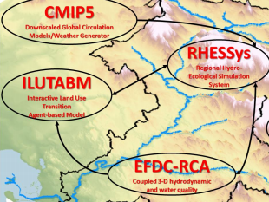
RACC Big Picture

Slide 4
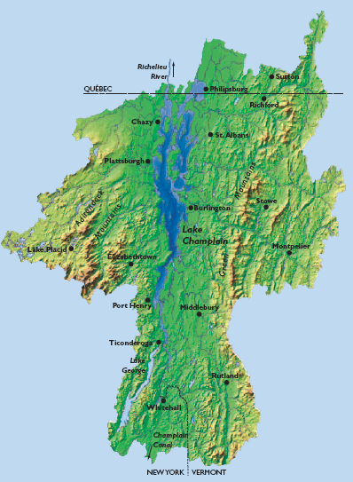
Area of Study
Lake Champlain Basin

Slide 5
Pegasus Workflow MGMT SYSTM
NSF Funded since 2001 in collaboration with USC + ISI + HTCondor UW-Madison
Built on top of HTCondor DAGMan
  (Directed Acyclic Graph Manager) is a meta-scheduler for HTCondor
Abstract Workflows - Pegasus input workflow description
  Workflow “high-level language”
    Python, Java, and Perl
Pegasus is a workflow “compiler” (plan/map)
  Target is DAGMan DAGs and HTCondor submit files
  Transforms the workflow for performance and reliability
  Automatically locates physical locations for both workflow
  components and data
  Collects runtime provenance

Slide 6
Pegasus WMS Architecture

Slide 7
Resources Catalogs
Pegasus uses 3 catalogs to fill in the blanks of the abstract workflow
Site catalog
  Defines the execution environment and potential data staging resources
  Simple in the case of Condor pool, but can be more complex when running on grid resources
Transformation catalog
  Defines executables used by the workflow
  Executables can be installed in different locations at different sites
Replica catalog
  Locations of existing data products – input files and intermediate files from previous runs

Slide 8
Workflow Restructuring Performance
Cluster small running jobs together in achieve better performance
Why?
  Each job has scheduling overhead – need to make this overhead worthwhile
  Ideally users should run a job on the grid that takes at least 10/30/60/? minutes to execute
  Clustered tasks can reuse common input data – less data transfers
Level-based clustering

Slide 9
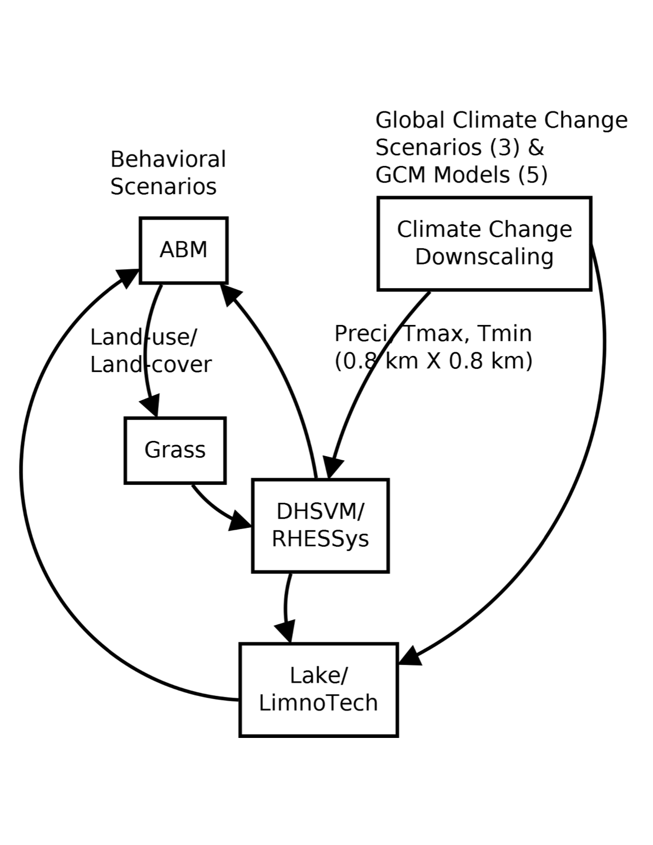
RACC-IAM Architecture

Slide 10
ABM+Hydrology Integration Steps
Reading Raster files produced by ABM
Classification to produce vegetation and land cover maps needed by New Worldfile
Creating (Leaf Area Index) LAI map needed by New Worldfile
Creating watershed maps needed by New Worldfile
Creating New Untrained Worldfile
Creating Merge Worldfile (Scott Utility)
Adjusting base files
Simulating the scenario (produce all variables RHYSSys produces)
  ascii File

Slide 11
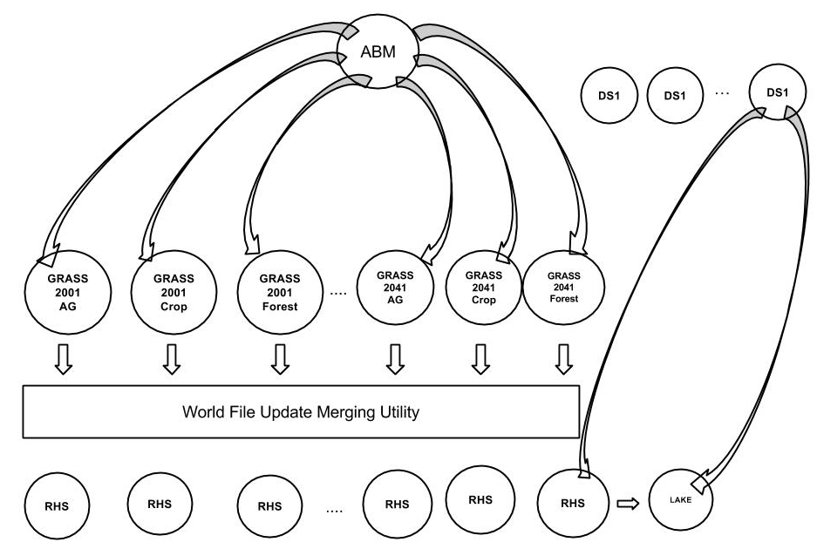
ABM + Hydrology Pegasus WFMS

Slide 12
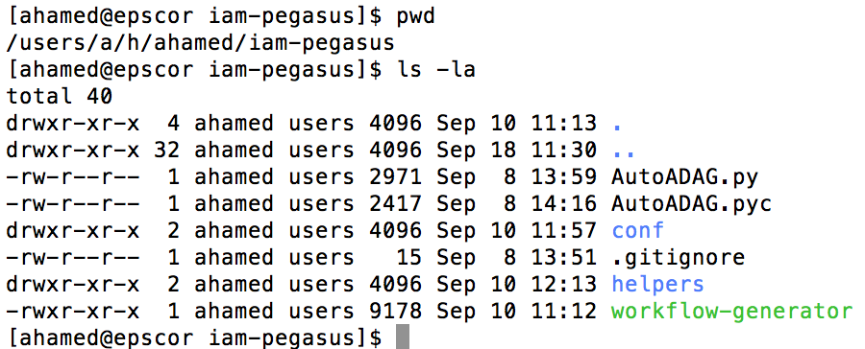
Workflow Design on EPSCoR Server

Slide 13
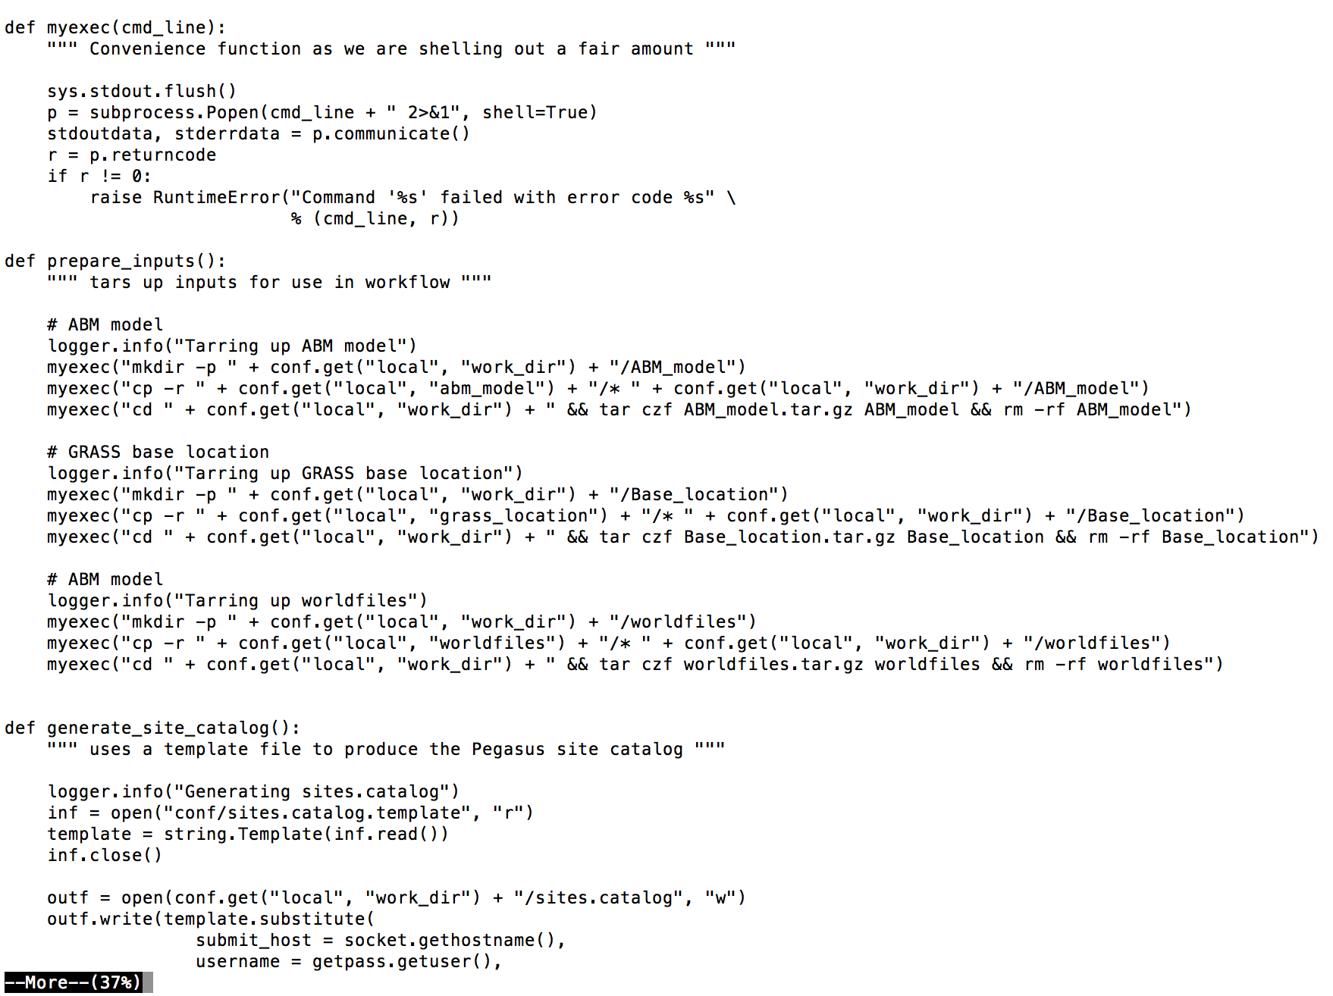
Workflow-Generator Python Code

Slide 14
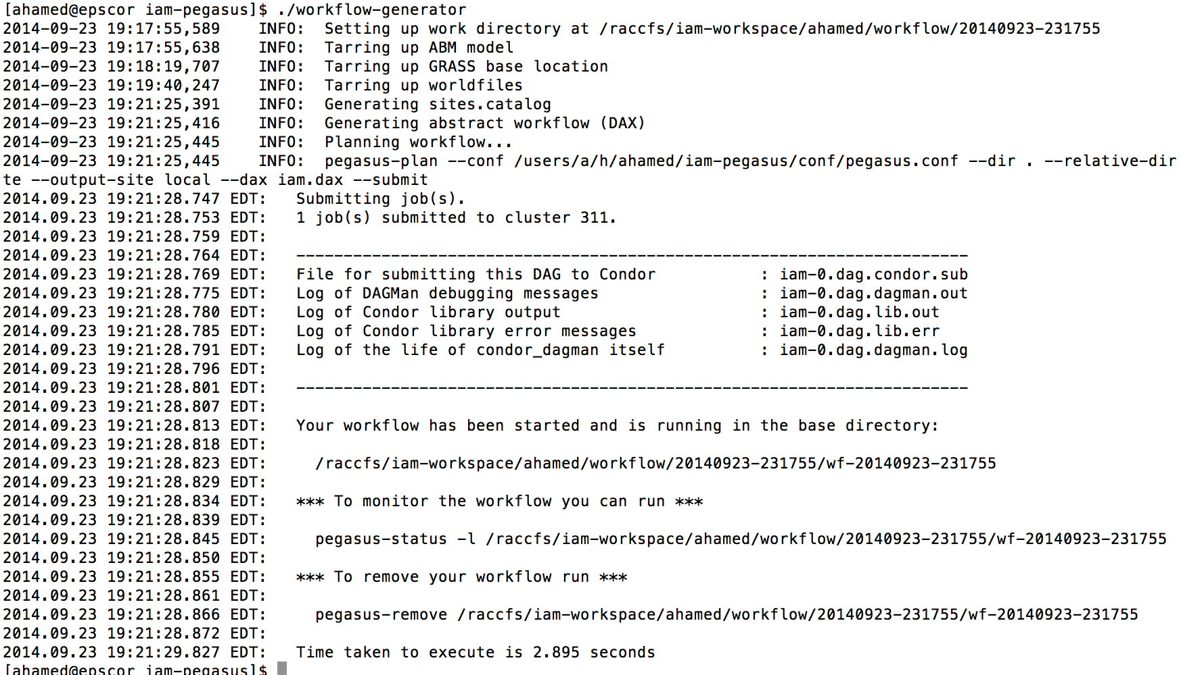
Running The Workflow

Slide 15
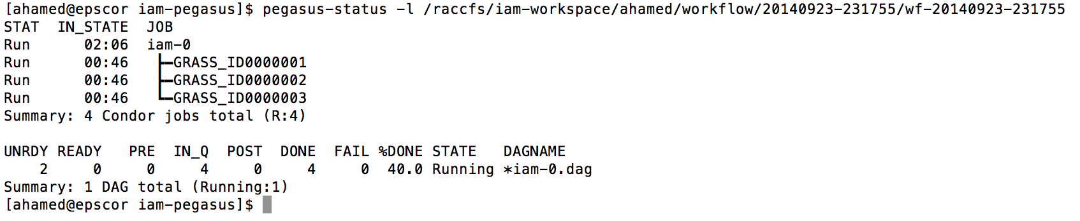
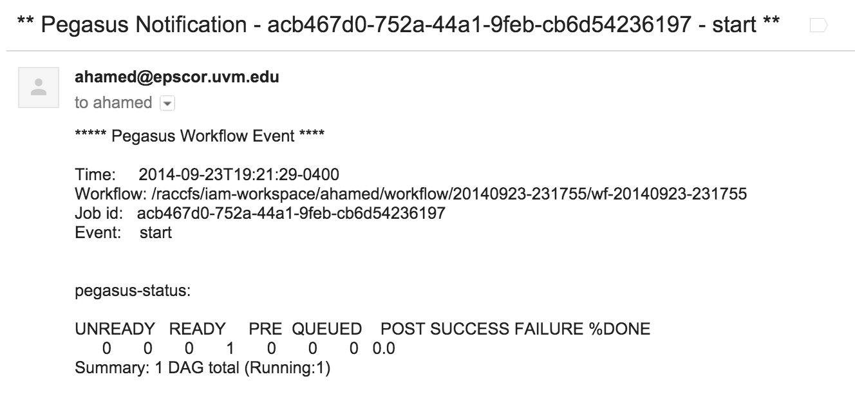
Monitoring The Workflow

Slide 16
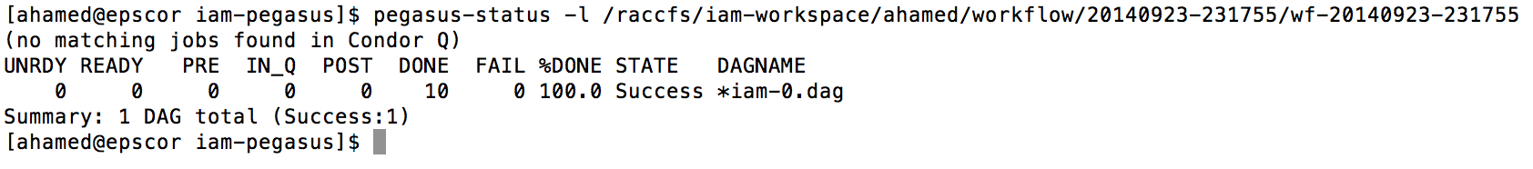
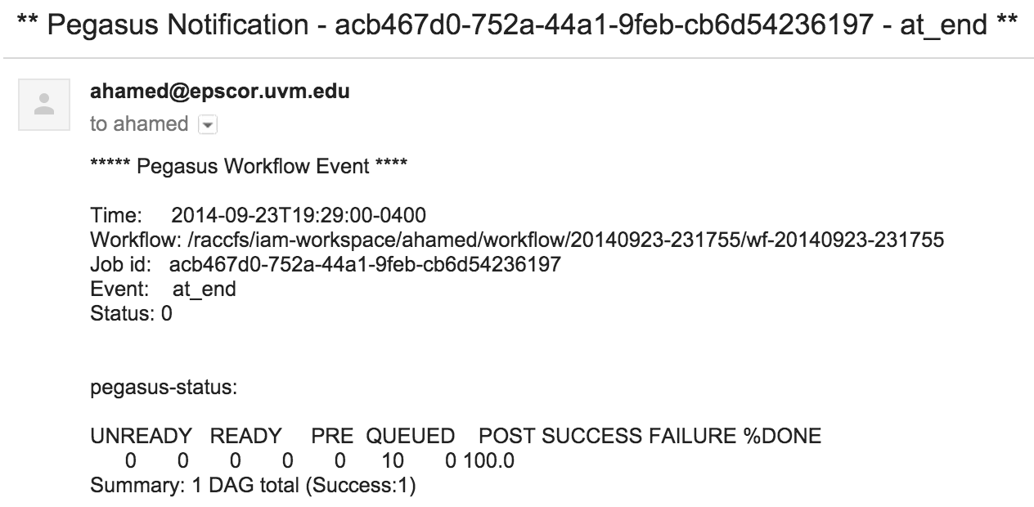
Monitoring The Workflow

Slide 17
Future Implementation Recs
Naming convention
  Hydrology ML
Default File Location
Code refactoring
  Removing all hard coded parameters
  Making the code compliant with the ML
  Designing a versioning system

Slide 18


Acknowledgement
Dr. Patrick Clemins (EPSCoR)
Steven Exler (EPSCoR)
Dr. Ewa Deelman (USC-ISI)
This research was partially funded by NSF + Vermont EPSCoR Award ID: EPS-1101713

Slide 19
Questions
Thanks you!

