Slide 1
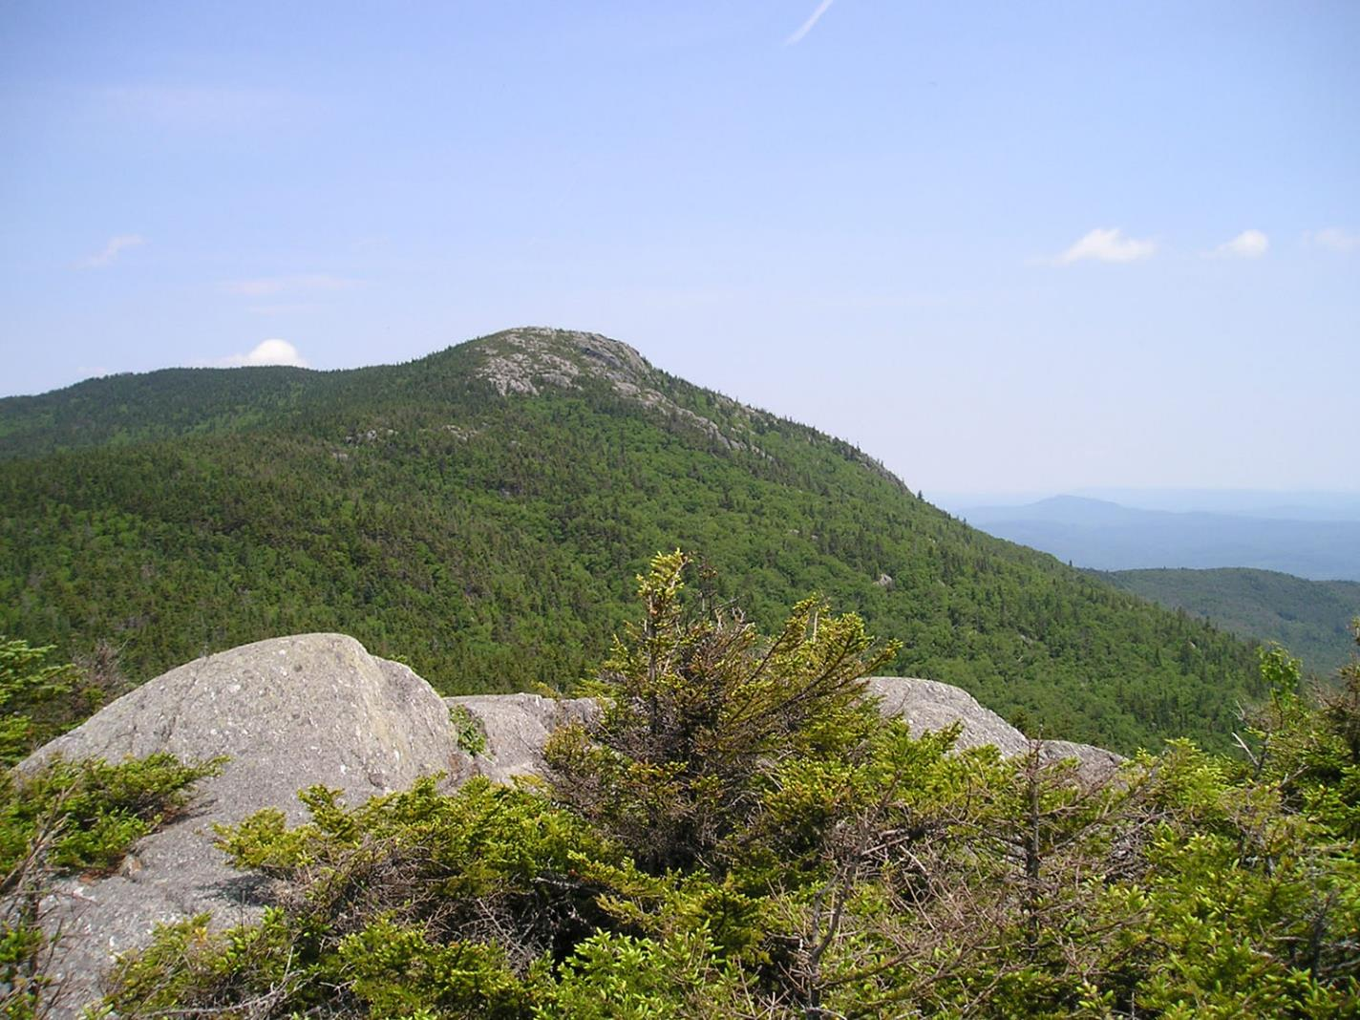
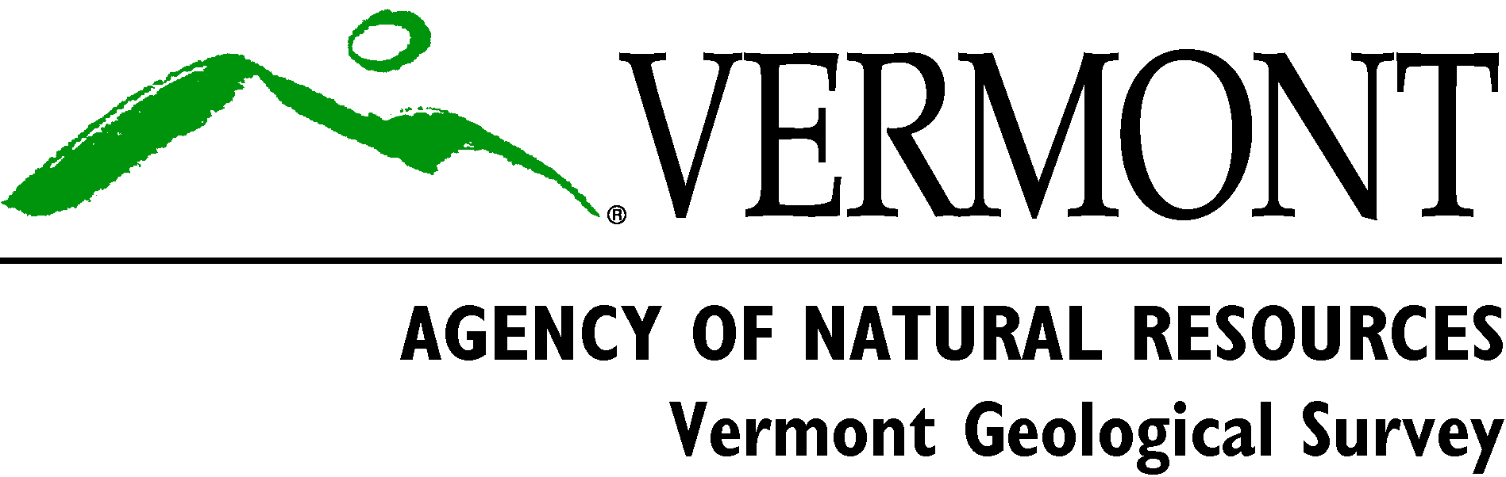
GEOLOGY AND ECOLOGY:
Building Studies from the Base Map
By
Laurence Becker and Marjorie Gale
Vermont Geological Survey, VT DEC
View northeast from White Rocks, Worcester Mtns.

Slide 2
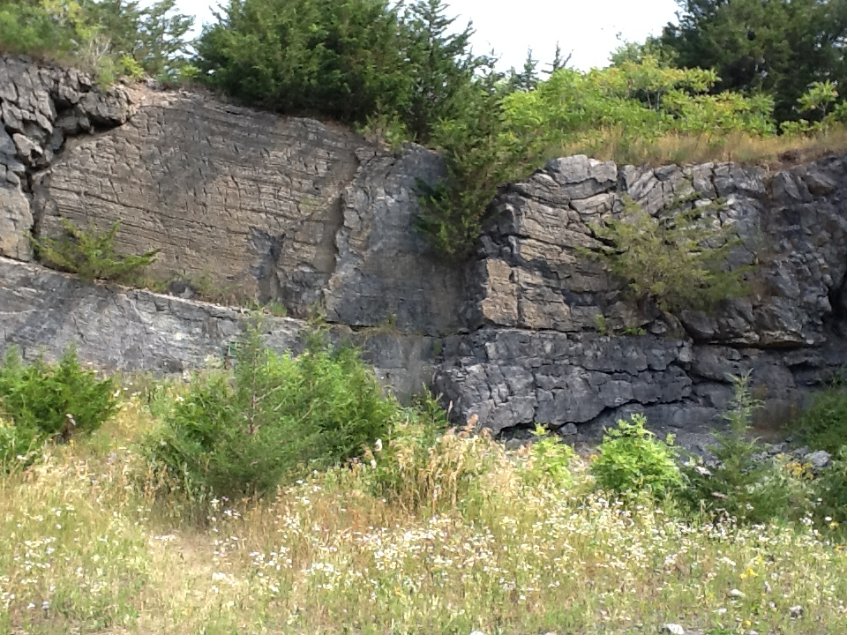
Bedrock Geologic Map of Vermont, 2011
by N.M. Ratcliffe, R.S. Stanley, M.H. Gale, P.J. Thompson, & G.J. Walsh
With contributions by: Hatch Jr., Rankin, Doolan, Kim, Mehrtens, Aleinikoff, & McHone
USGS Scientific Investigations Map 3184.
Introduction
Tectonic Map
Example of what’s new
Applications and studies
Lessors Quarry, Glens Falls Limestone, South Hero

Slide 3
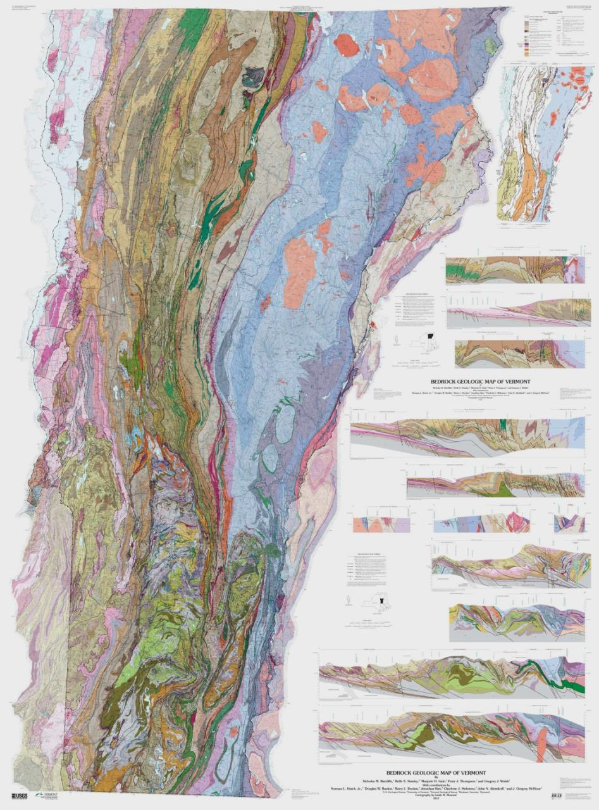
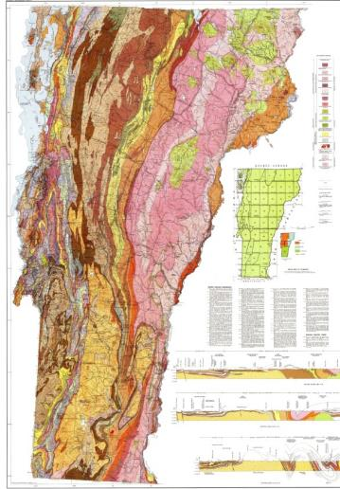
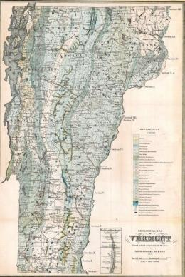
1961 -Stratigraphy
137 rock units
1:62,500 scale maps
Compiled at 1:250,000
1861 - Ores
24 map units
Scale 1:400,000
2011- Plate tectonics
486 rock units
1:24,000 scale maps
Compiled at 1:100,000
Geology represents fault-bounded slices of rock
2011

Slide 4
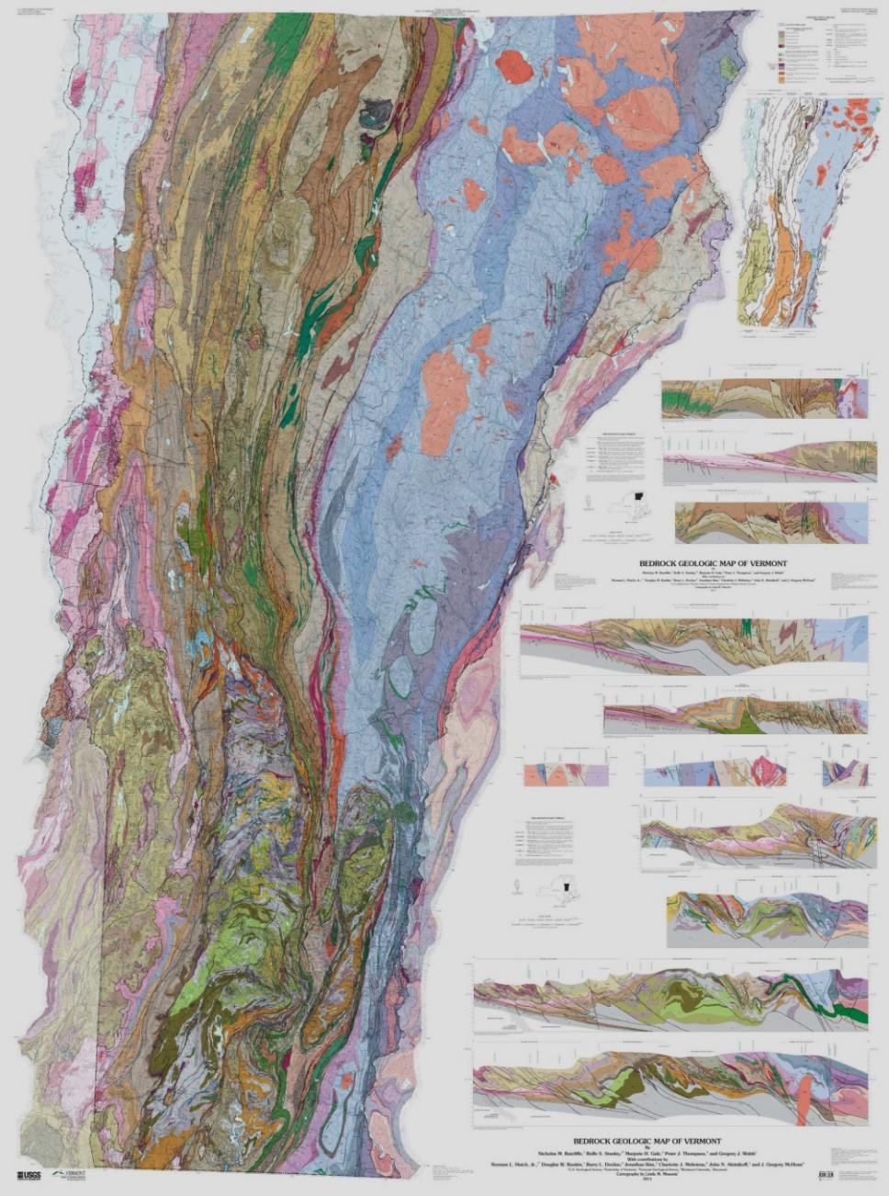
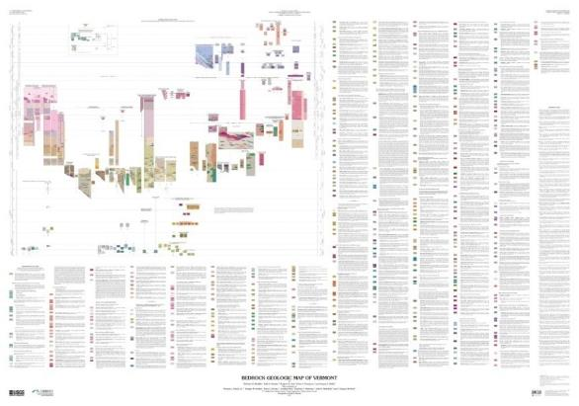
Plate tectonic interpretations
Shows type of bedrock at or near the surface
Predicts geology at depth
Map Elements:
Topographic base map
Bedrock units,
Cross-sections,
Tectonic Map, CMU, DMU, Geochronology, References, &
GIS
BEDROCK GEOLOGIC MAP OF VERMONT, 2011, by N.M. Ratcliffe, R.S. Stanley, M.H. Gale, P.J. Thompson, & G.J. Walsh:
USGS Scientific Investigations Map 3184. With contributions by: Hatch Jr., Rankin, Doolan, Kim, Mehrtens, Aleinikoff, & McHone

Slide 5
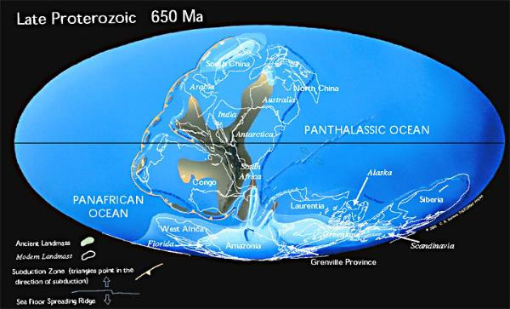
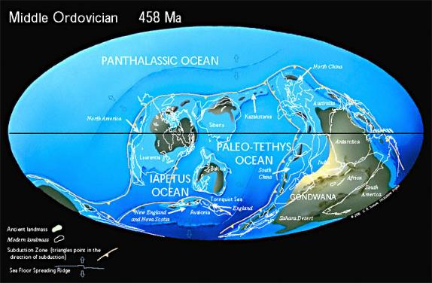
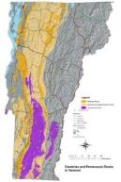
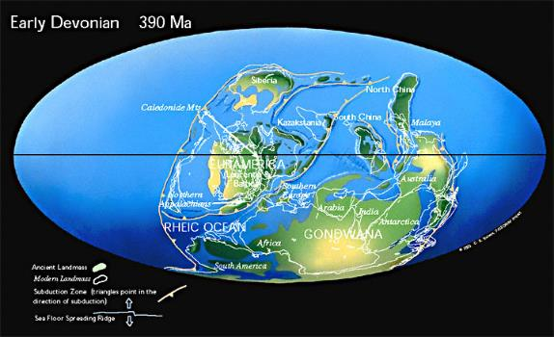
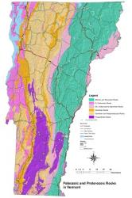
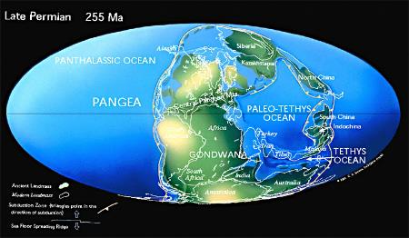
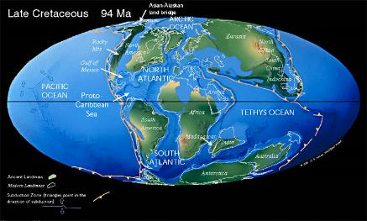
Change is recorded in the rock record:
Glimpses of .95 to 1.4 billion years in Proterozoic
Rocks plus
Vermont as we know it does not exist.
Deposition and deformation
associated with the opening
(deposition) and closing
(deformation) of the Iapetus
Sea from the
Late Proterozoic to Devonian time and….
Opening of the Atlantic

Slide 6
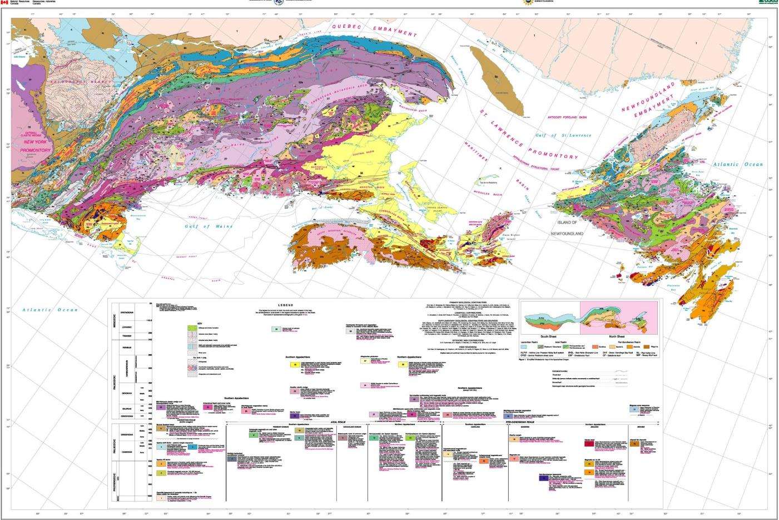
Northern Appalachian map (Hibbard and others, 2006)

Slide 7
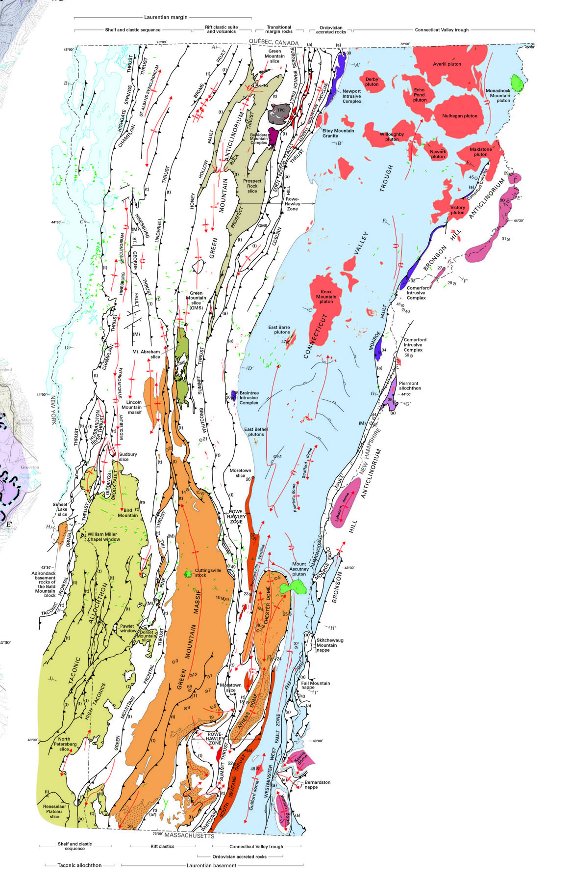
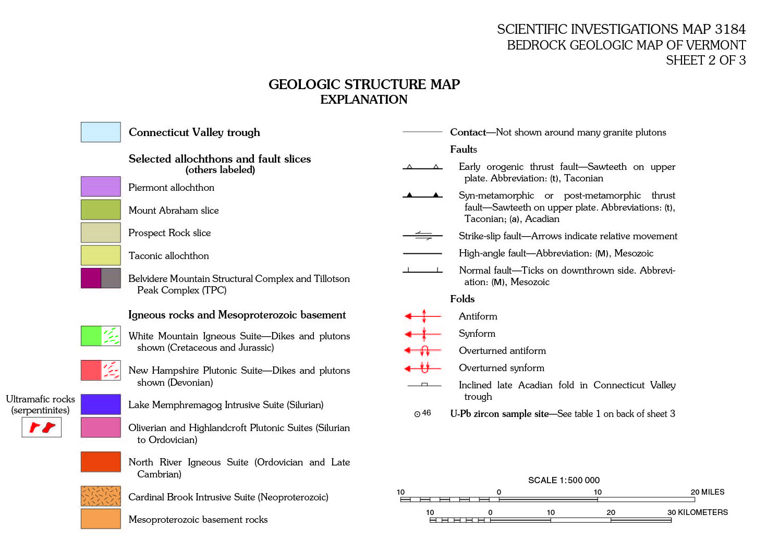
Tectonic elements:
Laurentian margin - Proterozoic basement plus cover rocks (rift clastics & volcanics; quartzites, carbonates, shales of Champlain &VT Valleys)
Transitional margin rocks of the Green Mountain Anticlinorium – Rowe/Stowe/Ottauquechee plus rift to morb
Ordovician accreted rocks of the Moretown-Hawley belt and Bronson Hill arch – metasedimentary rocks and arc volcanics
CT Valley Trough – post Taconian metasedimentary rocks
Intrusive Rocks – Silurian, Devonian and Cretaceous

Slide 8
Lithotectonic packages –
Geology represents fault-bounded slices of rock, the result of plate tectonic collisions
Shows the juxtaposition of rocks from a variety of geologic settings
2. 51 new age dates –
Mesoproterozoic (1.4 billion years) to Miocene (20 million years).
Oldest dated rocks are in S Londonderry, VT; youngest unit is the Brandon lignite, a
deposit of brown coal and clay, dated as 20 mya based on fossil seeds and flora.
3. Rock geochemistry - provided data to discern plate tectonic environments such as rifted
or broken apart continental crust, mid-ocean ridge spreading centers, and volcanic
island arcs.
4. Cross-sections are projected to a depth of 10 km.
Age, geochemistry, structure, and plate tectonic environment impact the
interpretations shown in the cross-sections.

Slide 9
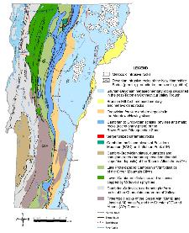
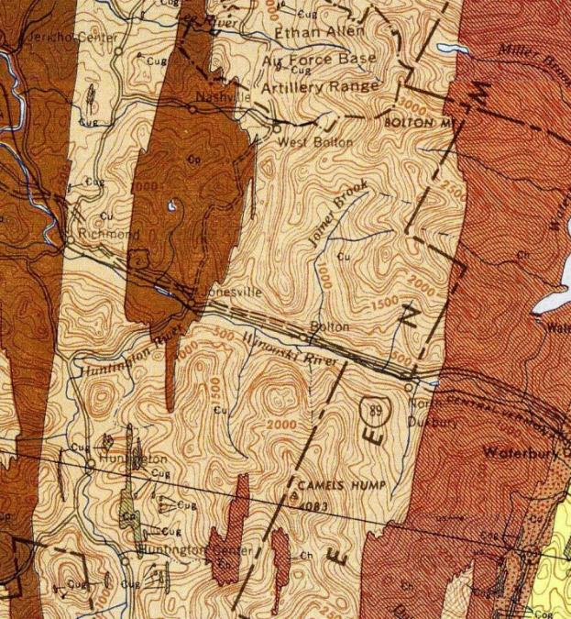
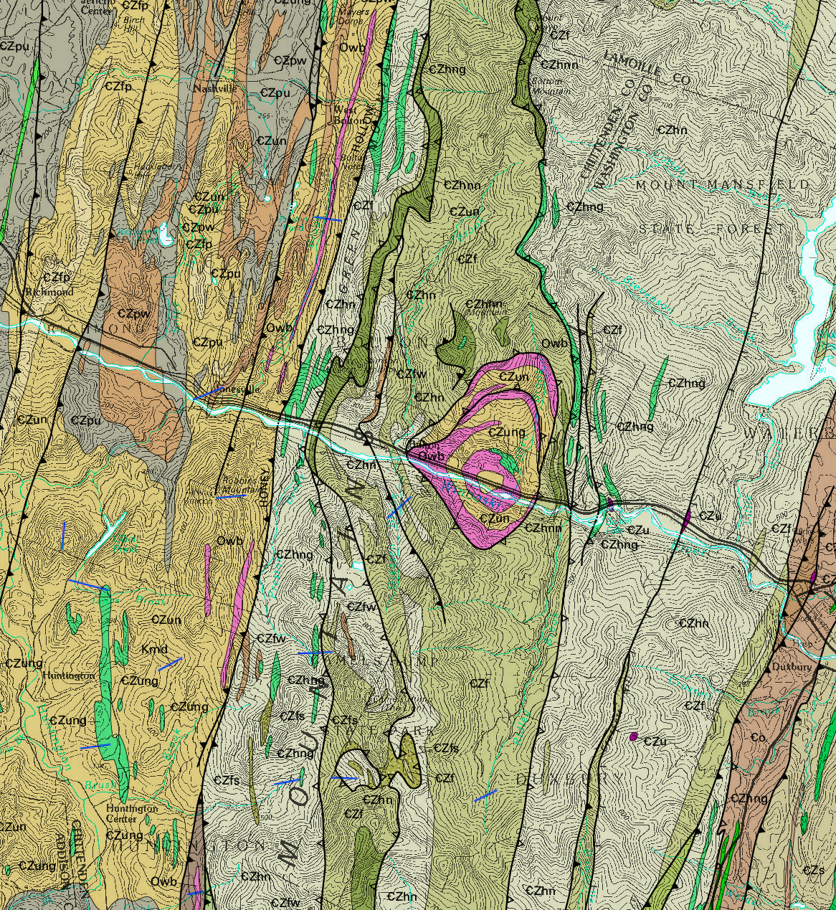
Ex. 1: West Bolton: detailed mapping by Thompson and Thompson; age and fossil data to provide control on faults and stratigraphy
Fault slices, Windows, Conodonts, and Volcanics
Underhill slice, Green Mtn slice
  1961 – Coherent stratigraphy
2011 – Multiple folded thrusts

Slide 10
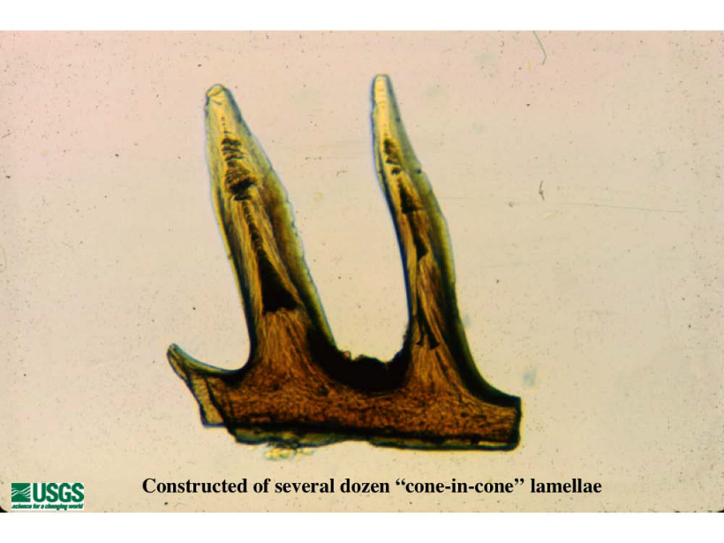
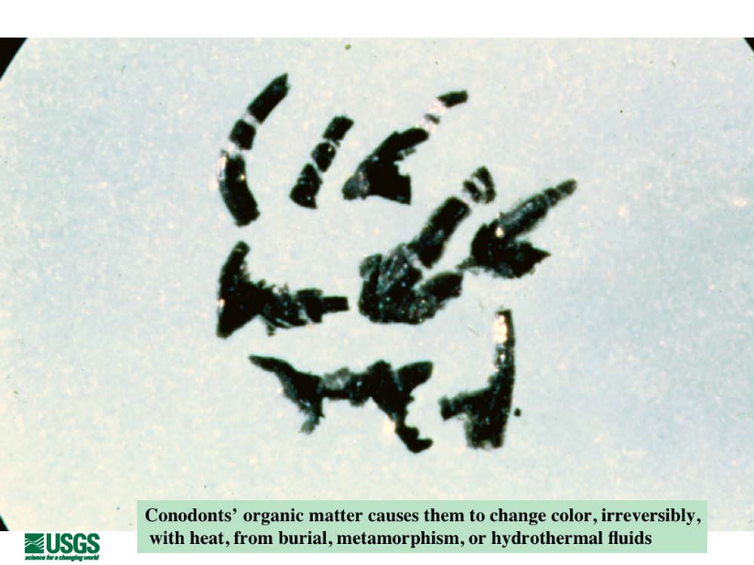
STRATIGRAPHY, STRUCTURE & CONODONTS
Text and photographs from John Repetski, USGS
Mineralized teeth of an extinct marine animal, Most elements are 0.1 – 1 mm long
Used for biostratigraphy since 1920’s
Upper Cambrian – Triassic; organic matter color indicates heat from burial and metamorphism so use for depth estimates, Harris calibrated a Color Alteration Index (CAI)

Slide 11
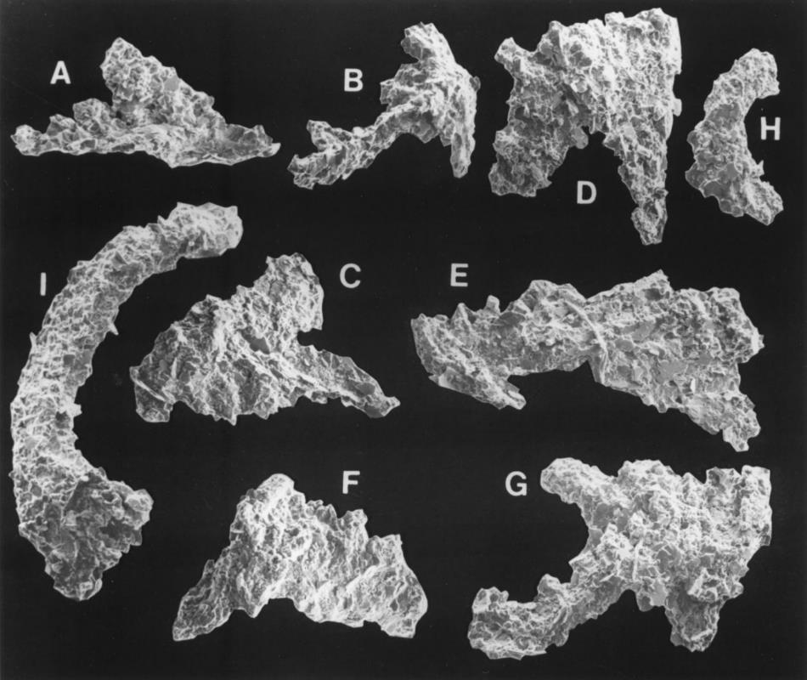
Ratcliffe, Harris and
Walsh, 1999:
Conodonts found
in VT’s deformed,
metamorphic
cover rocks
Middle Ordovician conodonts from a dolostone lens in carbonaceous schist in the
West Bridgewater Fm. A-G: Periodon Aculeatus Hadding? , H-I: Protopanderodus

Slide 12
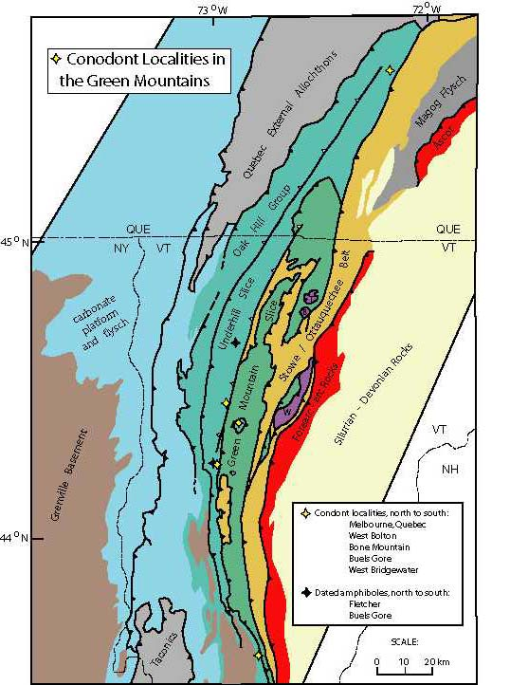
West Bolton
Cahabagnathus chazyensis or
C. sweeti
Buels Gore
Leptochirognathus quadratus.
Both sites
Phragmodus, Plectodina or
Aphelognathus
460 -463 Ma
West Bridgewater 470 - 454
Unconformity at base
Figure from Peter Thompson

Slide 13
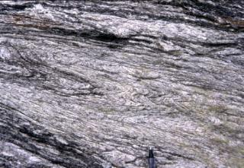
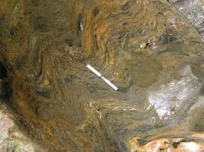
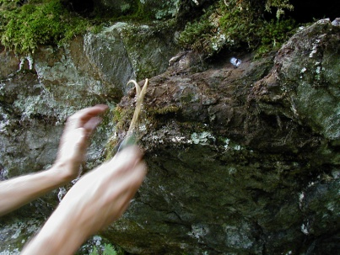
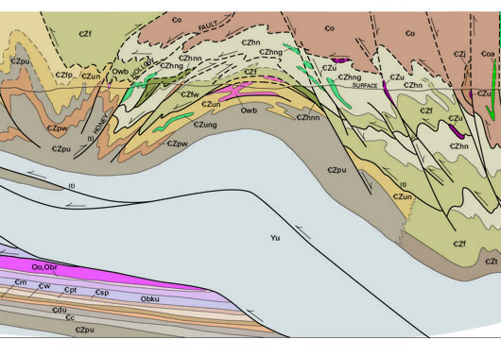
573 Ma volcanic In CZph (CZf, CZhn)
Taconian thrust
Conodont biofacies is 463 to 460 Ma
Rocks are Ordovician not Lower Cambrian

Slide 14
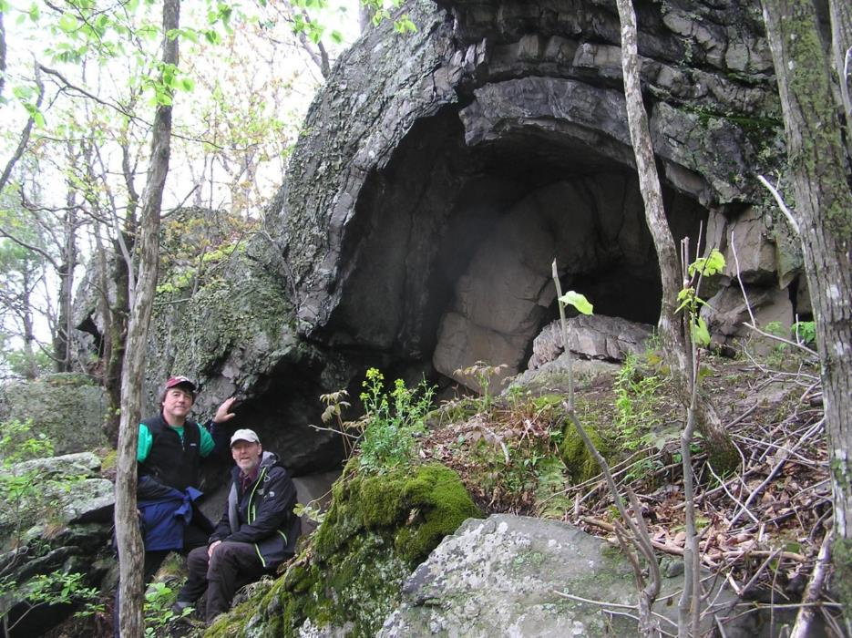
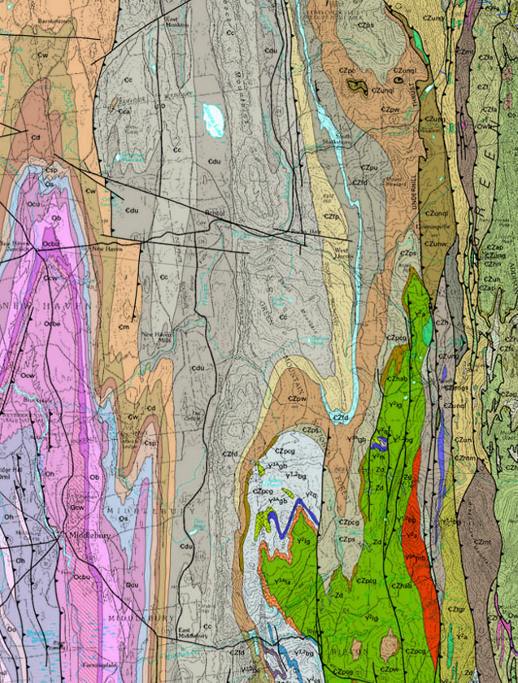
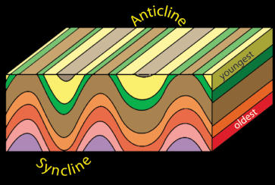
Anticline in the Monkton Quartzite at Raven Ridge,
Monkton, VT
Wildlife corridor, rare or uncommon communities,
142 bird species, home to bobcats, ravens and the
Indiana bat (endangered)

Slide 15
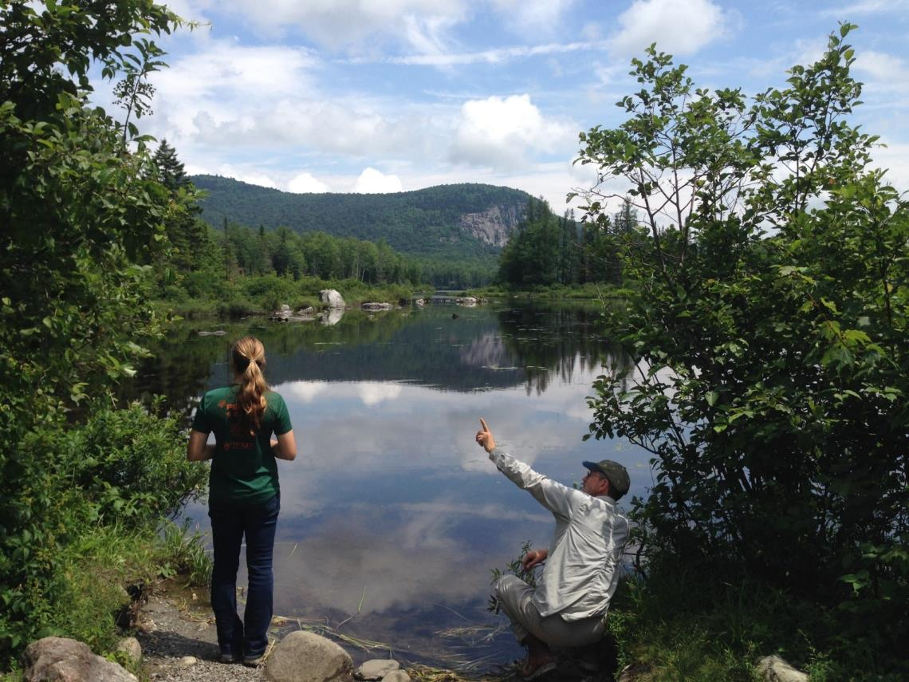
Uses of our maps?
Ecology, LTM of acid lakes, biodiversity, forest health, till model
Marshfield

Slide 16
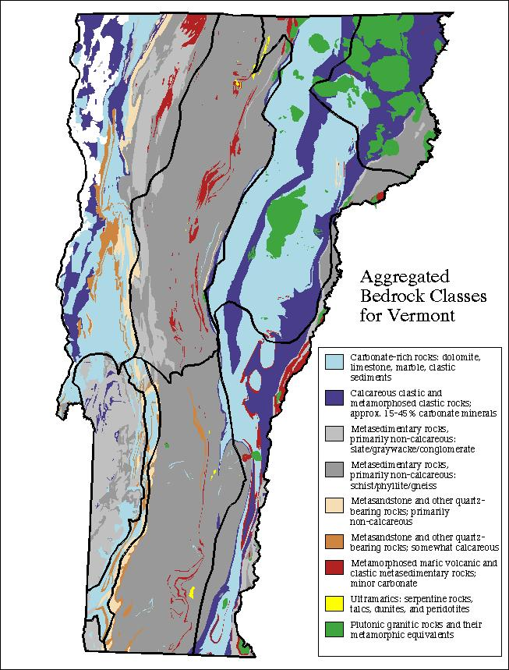
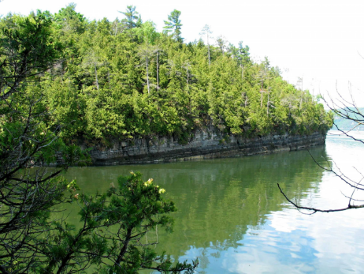
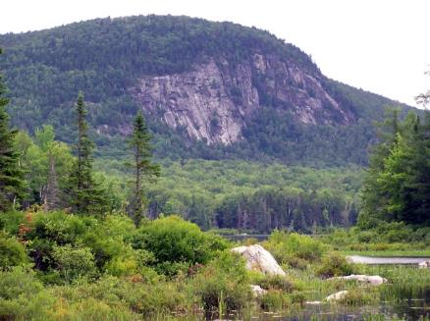
Ecology and Physical Setting:
Limestone Bluff Cedar-Pine Forests occur on
limestone, dolomite, and calcareous shale bluffs
and outcrops along the rocky headlands of
Lake Champlain. Soils are very shallow…
Boreal acidic cliff, Marshfield
Biodiversity is dependent on bedrock

Slide 17
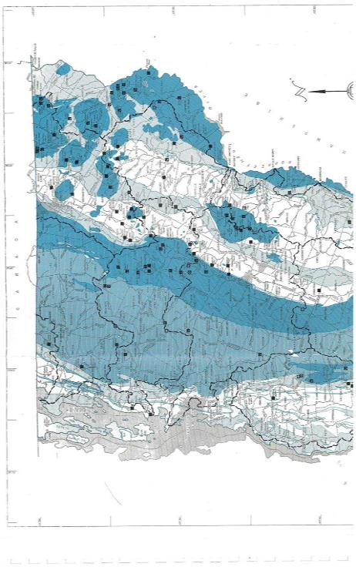
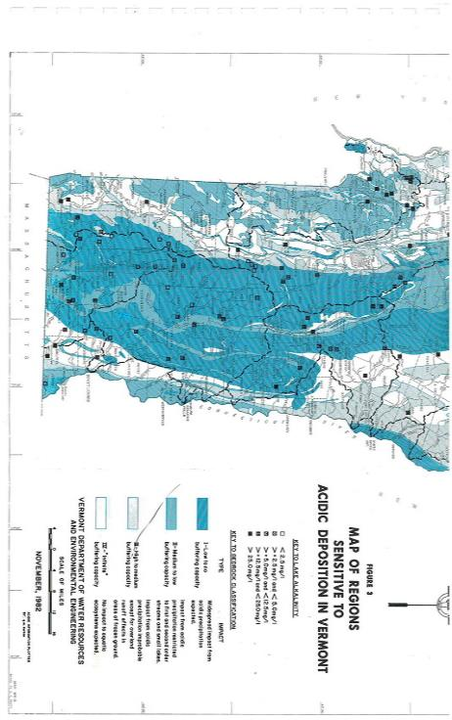
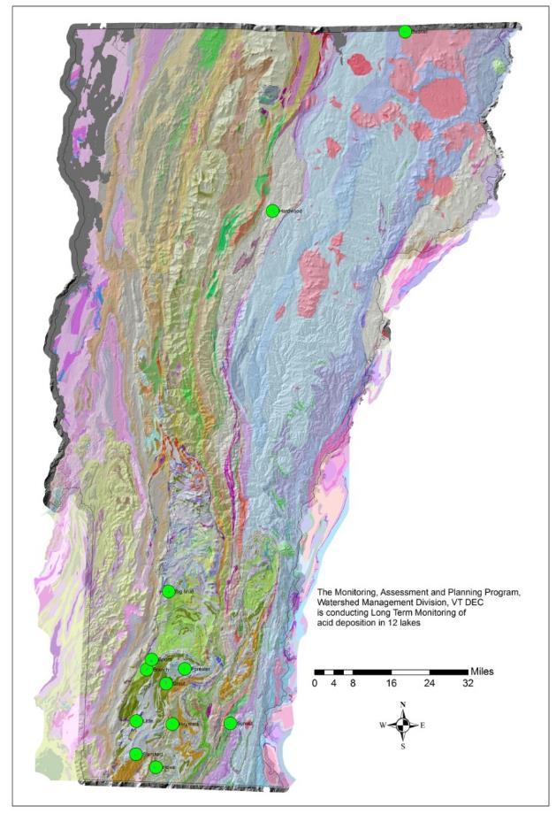
Grout Pond
12 lakes in program
Long Term Monitoring of lakes by Vermont Monitoring, Assessment and
Planning Program, Watershed Management, VT DEC

Slide 18
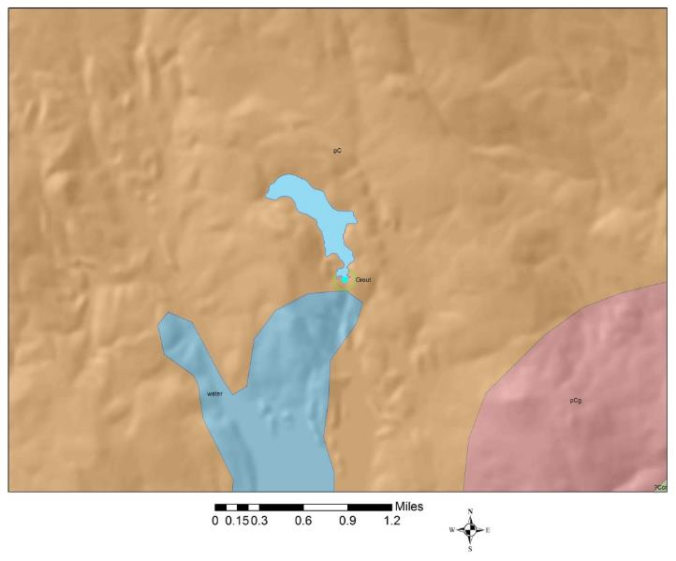
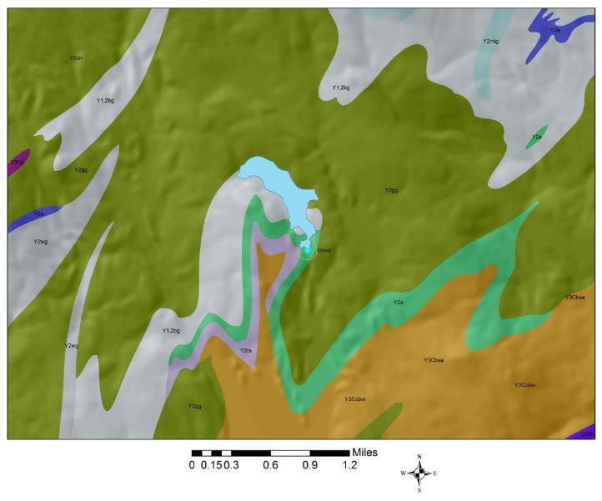
Y1,2bg
pC
Y2gg
Y2a
Y2rs
pCg
Y3Cbsa
Grout Pond on 1961 and 2011 bedrock geologic maps
Site characterization: 4 rock types instead of 1 underlie pond
Why does acid rain affect some lakes more than others?
Lakes most sensitive to acid rain are small, at high elevation, and in areas
with low buffering bedrock. Most of our highly acidic lakes are found in
the southern Green Mountains.

Slide 19
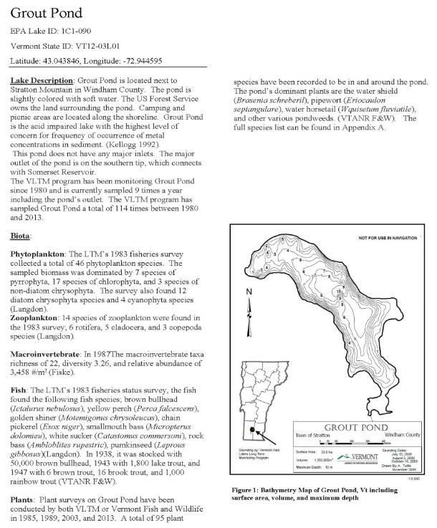
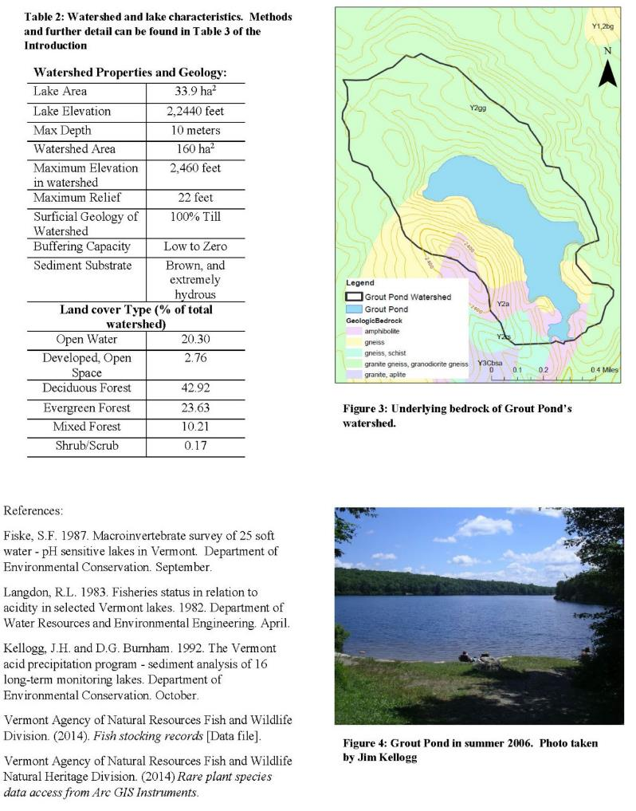
Characterization of 12 lakes –
watershed properties and geology by
Megan Euclide and Jim Kellogg
at VT DEC

Slide 20
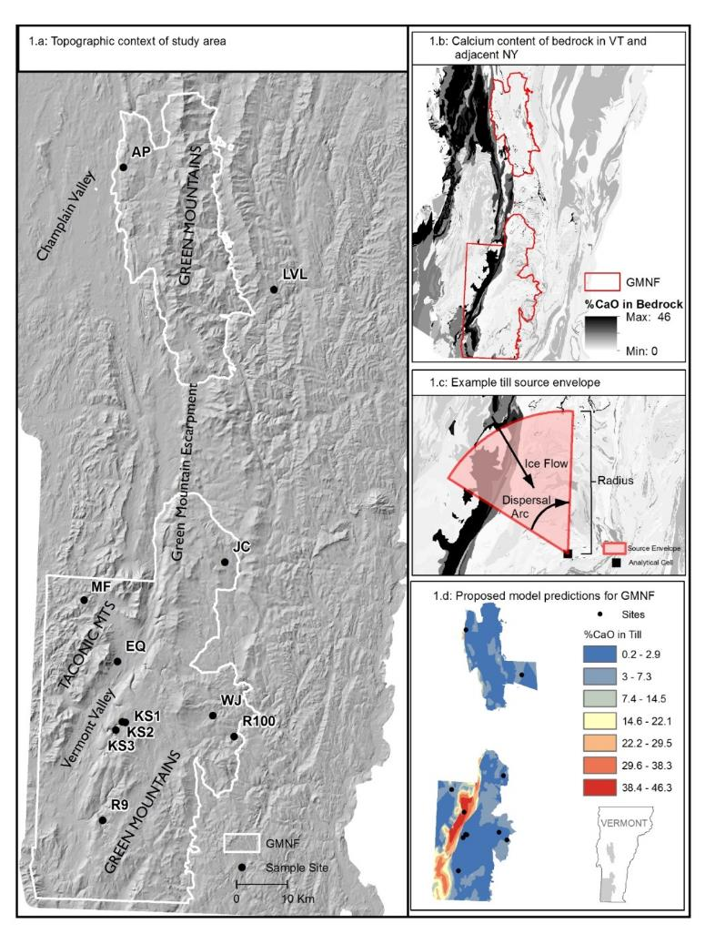
Calcium and forest health
in the GMNF
Gus Goodwin’s study at UVM
USFS
Scott Bailey, Northern Research
Station
Calcium content of regional
bedrock and Till Source Model
predictions for calcium content
of unweathered glacial till
in the Green Mountain
National Forest, VT.

Slide 21
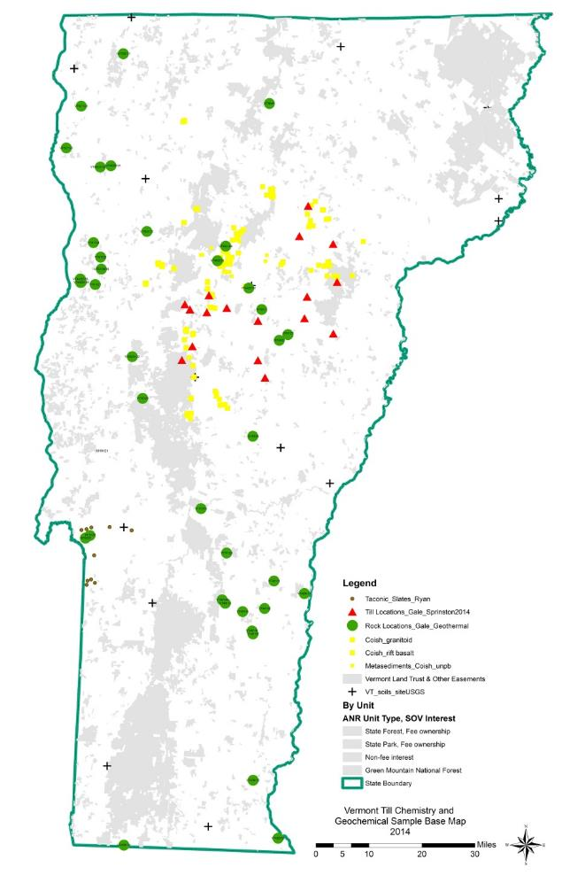
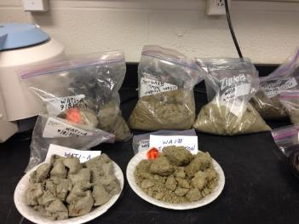
Geochemistry for forest health,
groundwater, surface water,
other ecological and
environmental health studies
Chemistry
Glacial deposits
Bedrock

Slide 22
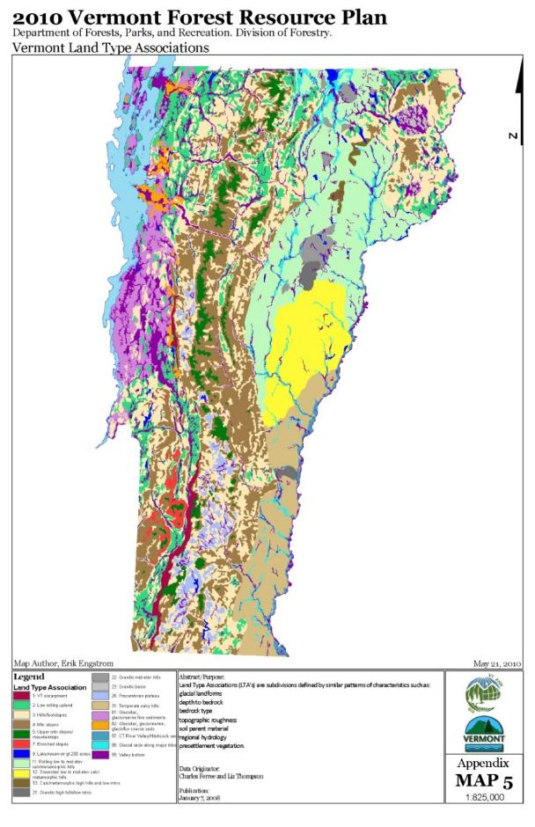
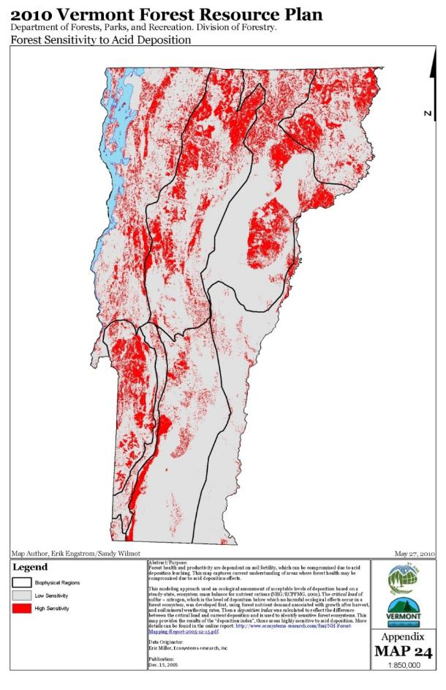
Vermont Land Type Associations
Forest Sensitivity to Acid Deposition

Slide 23
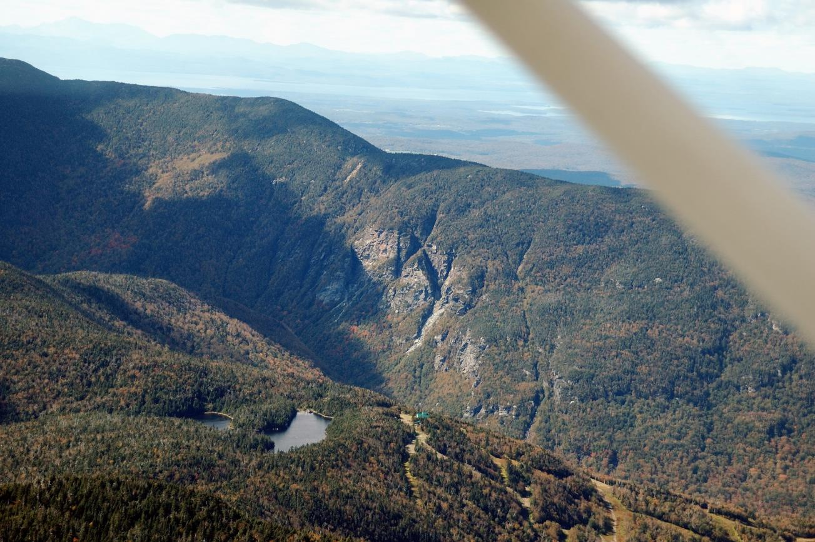
Smugglers Notch, VT
Photo – Tom Eliassen
What lies beneath our forests, lakes and biological communities?

