Slide 1
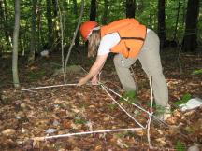
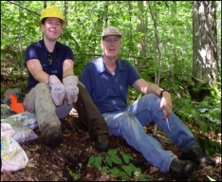
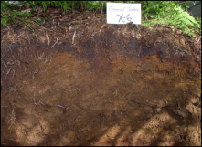


Long-term Ecosystem Monitoring Project
Status Report
Diane Burbank
December 11, 2014

Slide 2
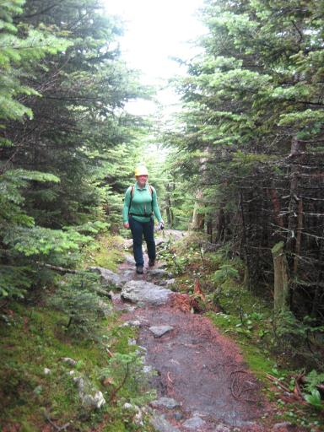
LEMP Overview
Long-term effects of broad-scale environmental changes
50-year monitoring effort
20 plots sampled every 10 years
Sampling of soil, vegetation, lichen, and down woody material
GMNF Partners include
  USFS Northern Research Station
  Natural Resource Conservation Service
  VYCC
  VMC, ANR-FPR

Slide 3
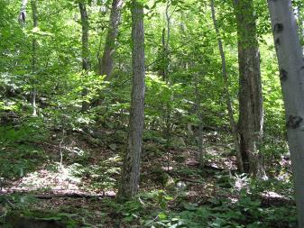
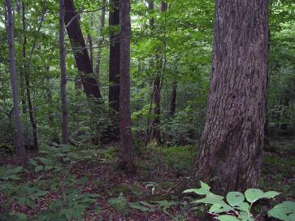
LEMP Site Selection
Dominant Natural Communities
Dominant soil types
Use Reference Area Network
> ½ mile from road, >500 feet from trail
80 + year old stands
Sites with little to no disturbance, past 30 years
No future disturbance anticipated
Range of aspects and elevations

Slide 4
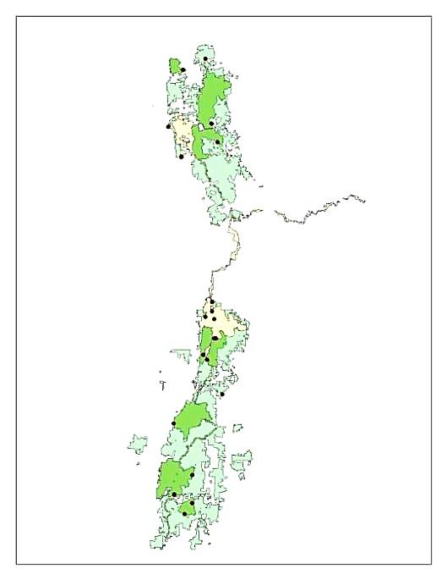
LEMP – Distribution
Most are in Wilderness or NRAs (17/20)
2 in Ecological Special Areas
1 in the Escarpment MA
3 in Northern Green Mountain Biophysical Region; remainder in Southern Green Mountains
All but 1 Landtype Association are represented

Slide 5
LEMP - Distribution

Slide 6
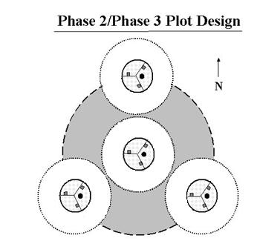
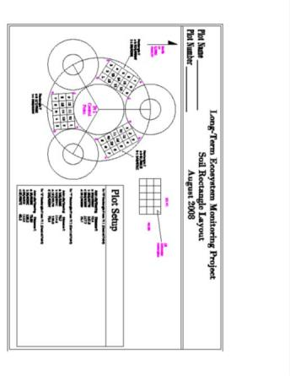
LEMP – Sampling Design
Started with FIA Design
Phase 2 & 3 plot protocols with minor modifications
  Trees
  Vegetation structure, diversity
  Down woody debris
Soil sampling design based on VMC Long-term Soil Monitoring Project protocols
FIA lichen sampling protocols modified to accommodate soil sampling

Slide 7
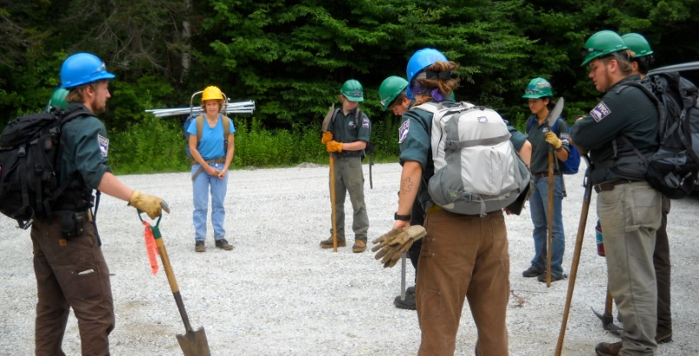
LEMP – Current Status
20 sets of plots established 2008-2011
Soil & vegetation diversity sampling completed on all 20 plots
Tree, sapling, down woody material, and lichen sampling completed on less than half of the plots
All plots permanently monumented
Soil samples dried and shipped to Hubbard Brook for chemical and physical analyses and storage.
Data stored in spreadsheets and on paper.

Slide 8
LEMP - Soils
Approx. Soil Series | # pits
atypical skeletal soils | 3
Berkshire | 2
Brayton | 1
Buckland | 2
Colonel | 3
Dixfield | 1
Dummerston | 2
Fullam | 4
Glebe | 1
Hogback | 6
Lyman | 2
Marlow | 4
Mundal | 5
Peru | 3
Peru or Marlow | 2
Rawsonville | 3
Saddleback | 2
Surplus | 3
Tunbridge or Berkshire | 2
Wilmington | 1
Worden | 7
Worden (Rawsonville) | 1
Worden, Hogback, and Mundal most frequently encountered soils
¼ of pits did not fit well with existing soil series descriptions.
Soil horizon forms for all plots – completed by Thom Villars, NRCS, stored at GMNF-Rutland
Soil reports prepared by Thom for Sites 6-20
Lab analyses completed but not yet summarized.

Slide 9
LEMP - Vegetation
55% sites northern hardwood, with 1-2 sites representing less common forest types
Sugar maple most dominant species in terms of canopy cover
Beech decline due to beech-bark disease apparent at several sites
Missing tree, sapling, and DWM on most plots
Vegetation data not summarized, on paper forms stored at GMNF in Rutland.

Slide 10
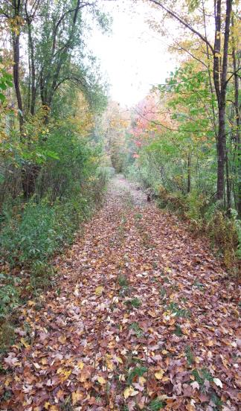
Looking Ahead
Re-sampling scheduled to start in 2018
Lessons Learned/Challenges
  VYCC contribution valuable; safety
  Collaboration among participants valuable
  Schedule coordination very difficult internally
  Missing data
  Lack of analysis and electronic storage
  Soil sampling design will run out of room
  Unable to conduct additional desired sampling – e.g. tree ring, foliar analyses

Slide 11
Looking Ahead
Next steps
  Ensure long-term project viability
    Maintain partnerships
    Solve data/sample storage issue
    Develop funding strategy before 2018
  Address missing data issue
    Gather missing data or defer to next sample period
    Re-evaluate approach to gathering tree, sapling, down woody material, and lichen data.

Slide 12
Better information → Better land management → Healthier ecosystems
Quantify baseline and environmental trends
Adaptive management
Contribute data to regional databases
Contribute to the science

