Slide 1
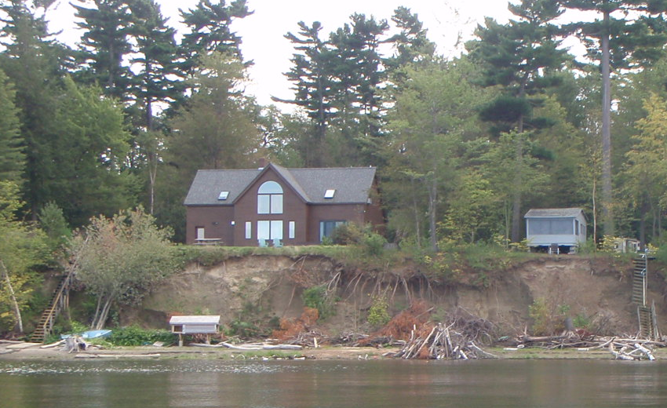
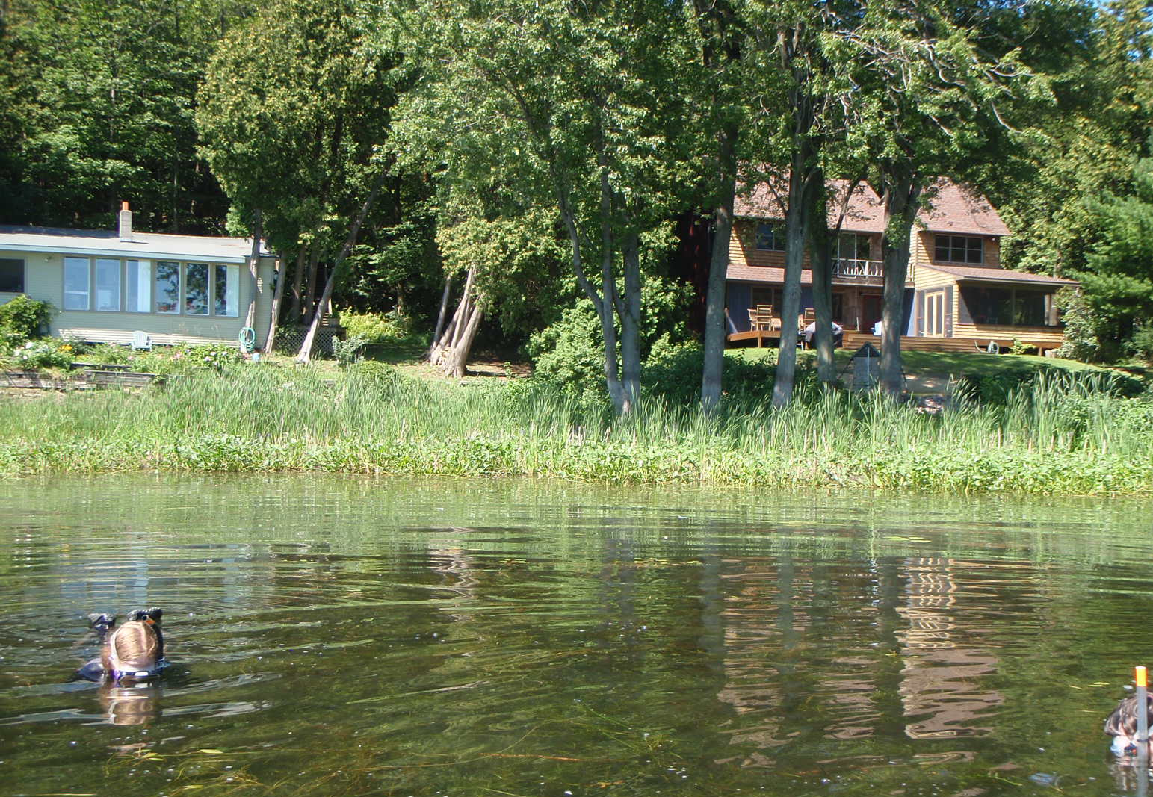
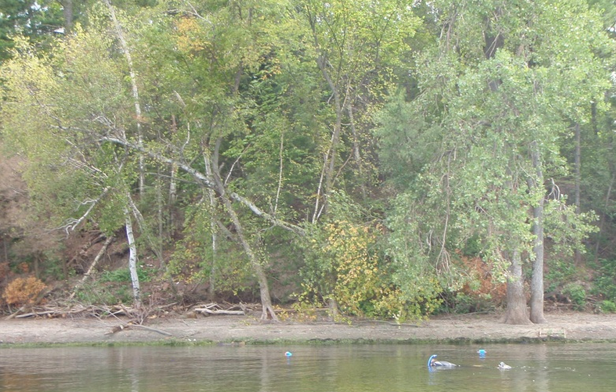
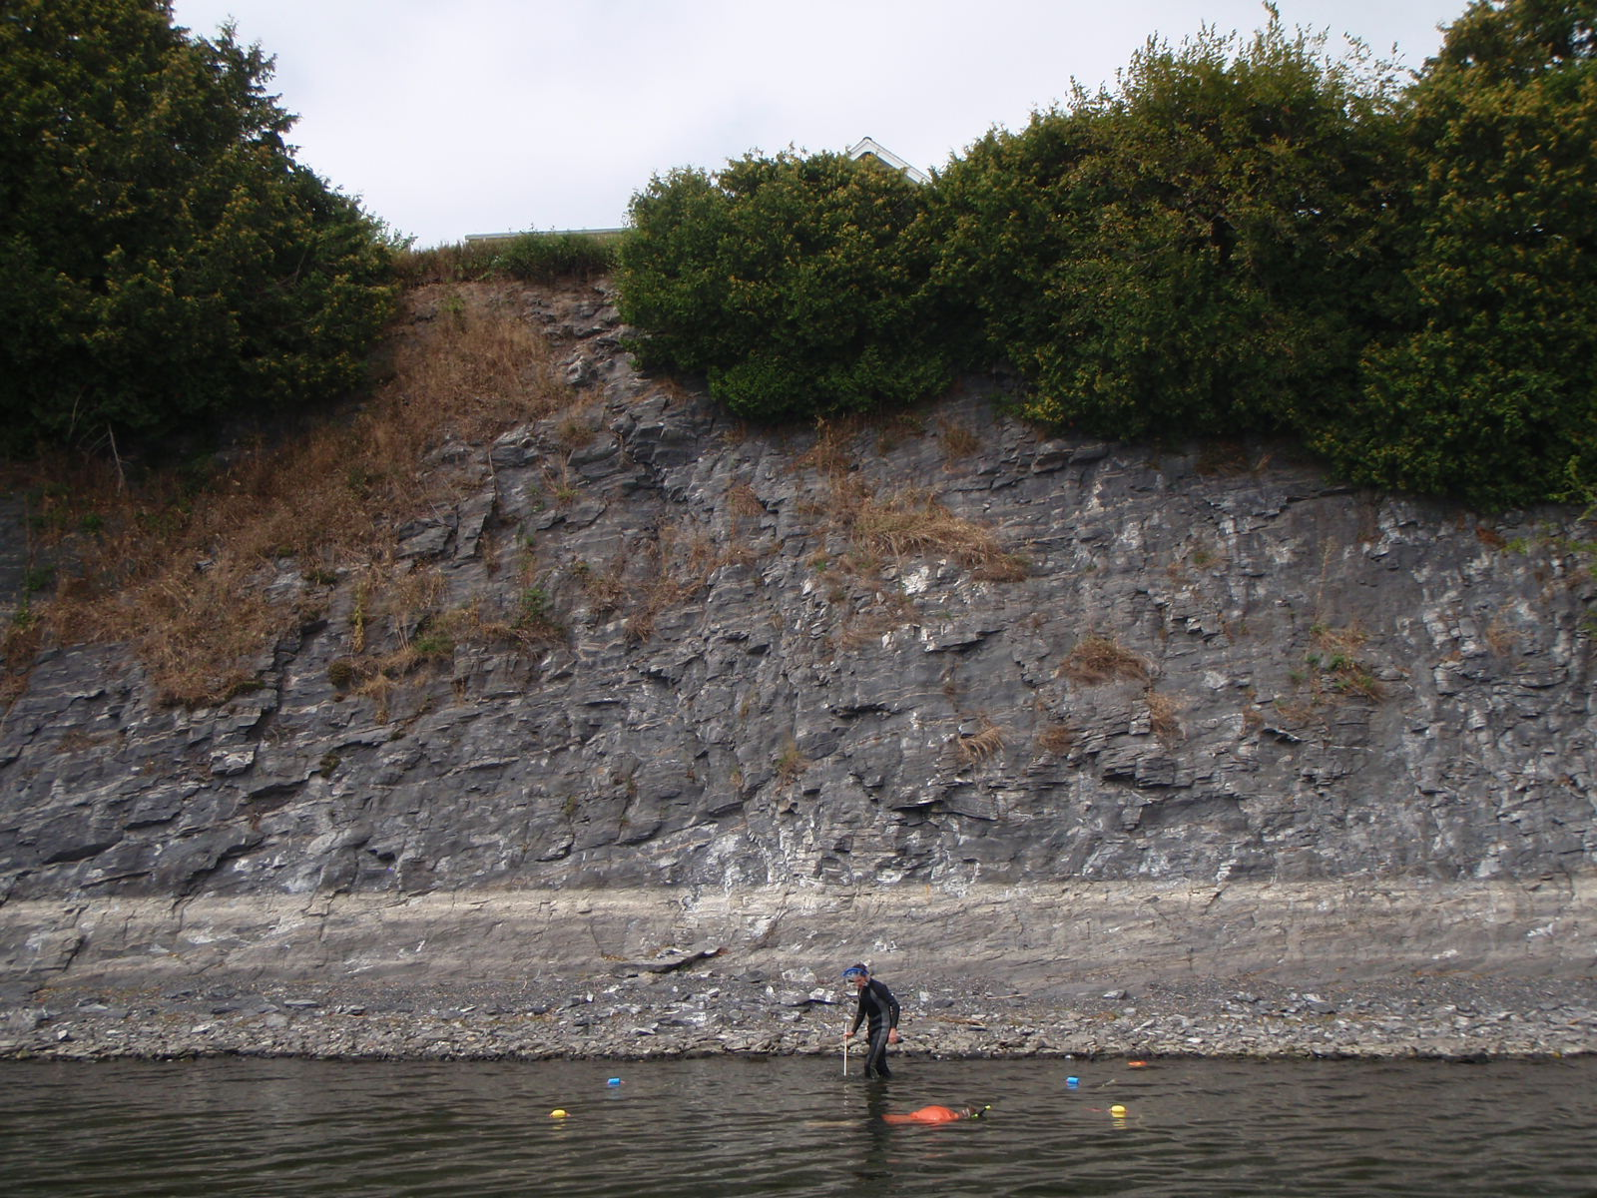
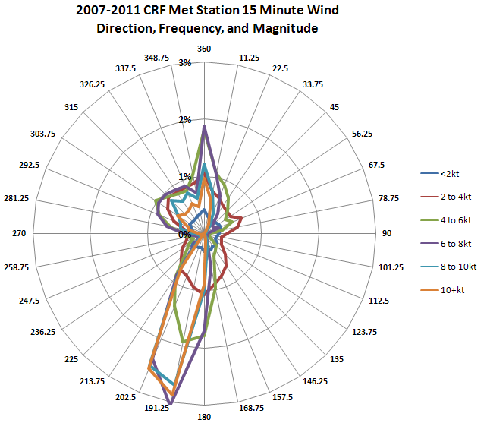
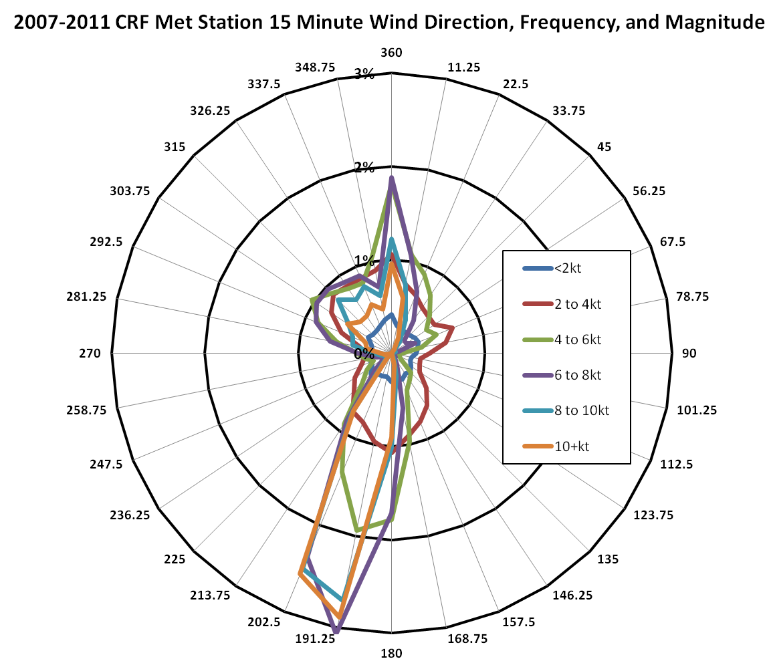
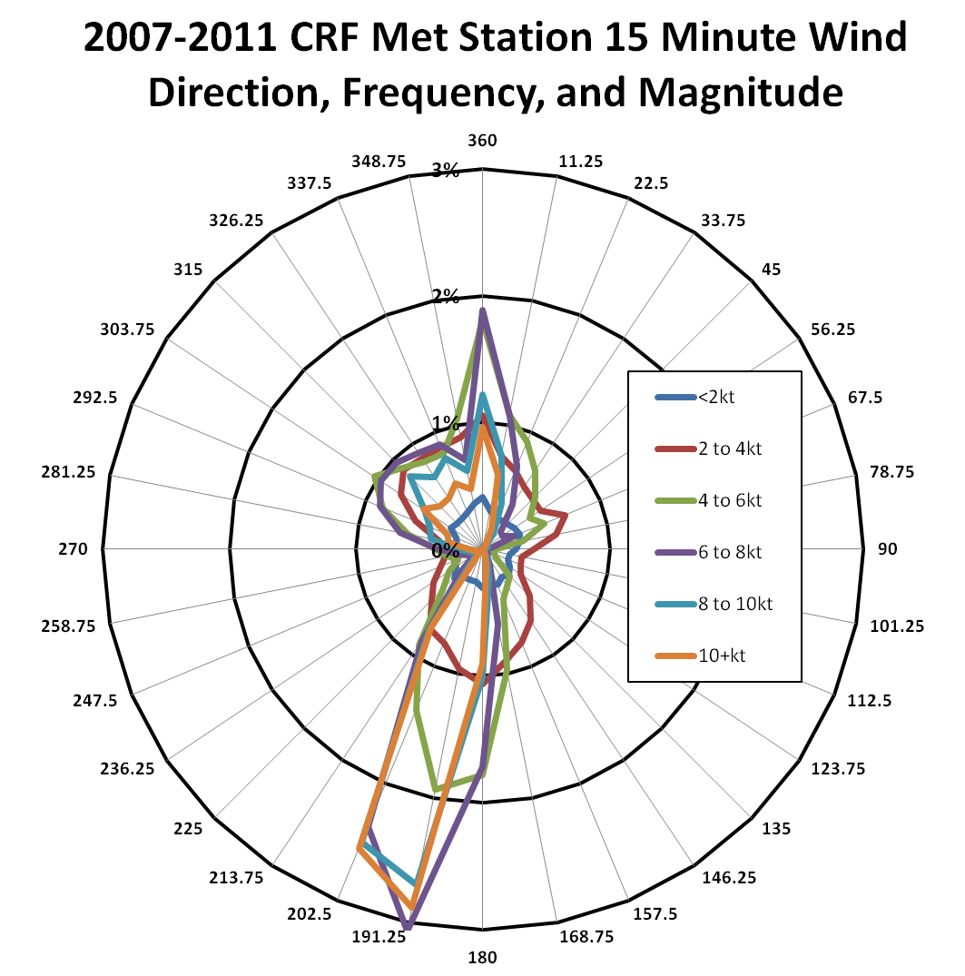
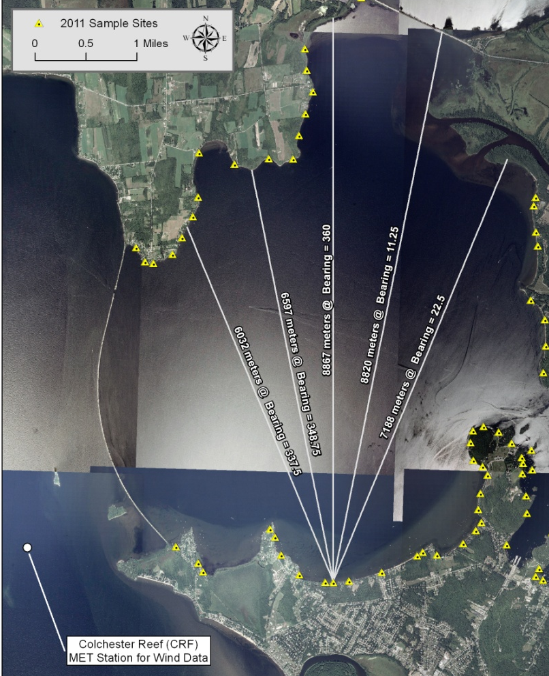
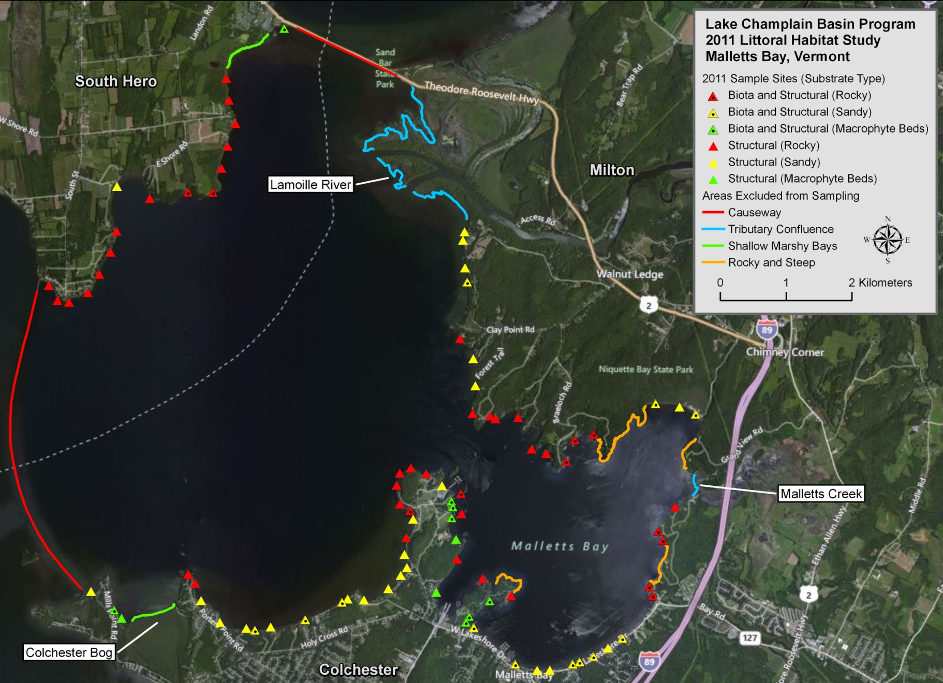
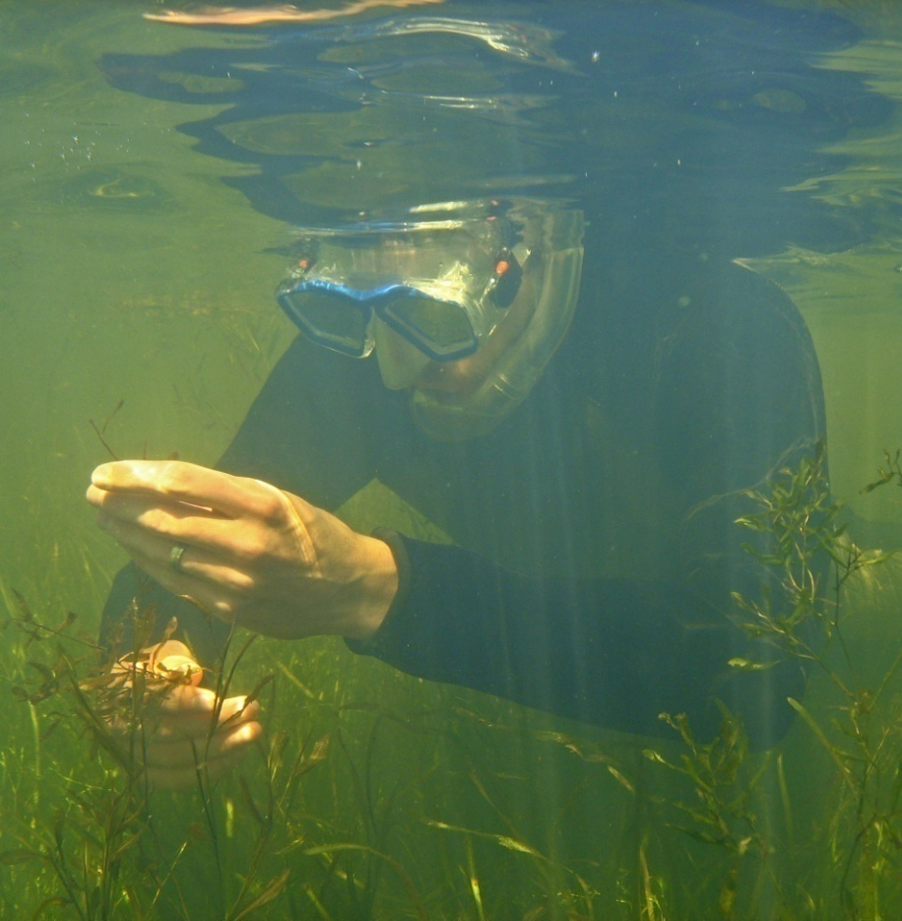
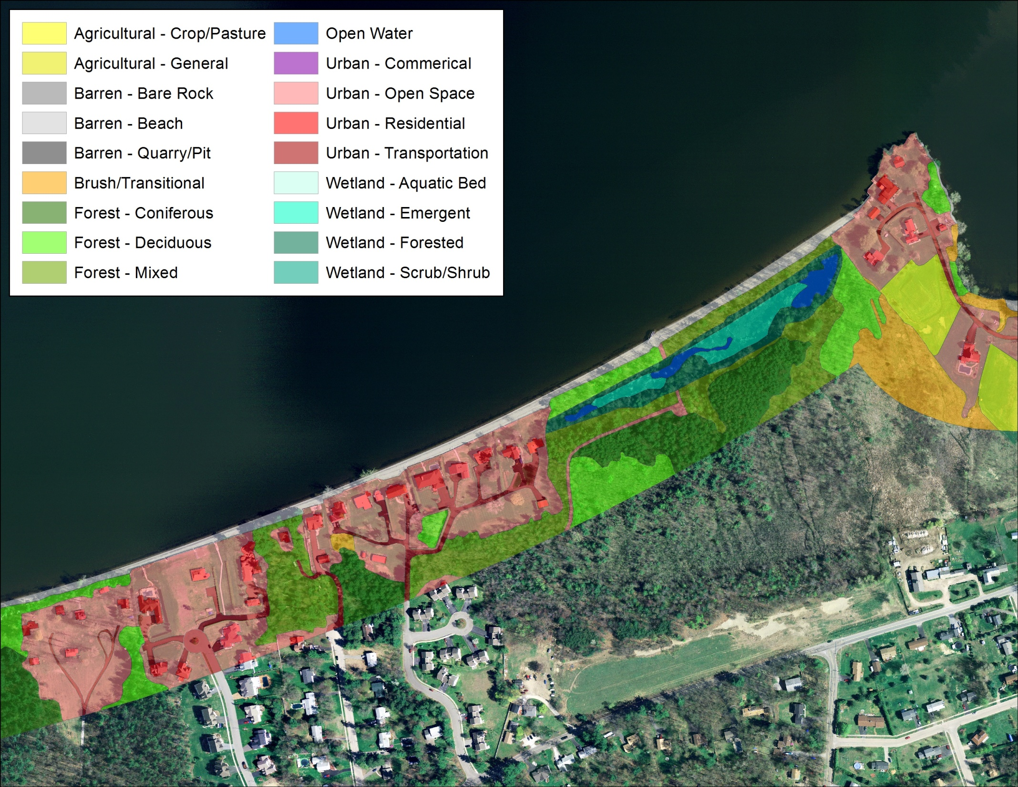
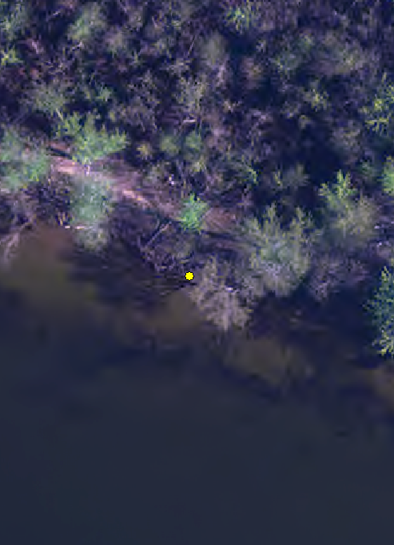




Estimating wind and wave exposure and its effect on shoreline habitat in Malletts Bay
Project Description
Our project goal was to determine the impacts of shoreline development on littoral habitat quality in Lake Champlain.
Malletts Bay study area – representative of the diverse littoral and shoreline conditions throughout Lake Champlain
GIS mapping of shoreline land cover
Field measurements of littoral habitat conditions (90 sites)
  Shoreline, bank, and buffer characteristics
  Physical habitat: substrate, woody debris, and organic detritus
  Biota: aquatic macrophytes, fish, and macroinvertebrates
  Multivariate analysis to test for impacts of shoreline development and other physical factors on littoral habitat and biota
Results
Field Observation: Highly variable shoreline erosion and littoral habitat characteristics, potentially influenced by aspect
Wind/Wave Exposure Methods
5 year dataset from VMC Colchester Reef Station (CRF) 15-minute MET data
  Determined probability of wind driven wave generation based on compass bearing
  Measured unencumbered fetch on 5 vectors over a 45° angle from shore
  Calculated wind erosion potential (WEP) metric:
  WEP =Fetch*Shoreline angle*P wind speed >10kt
Wind/Wave Exposure Methods
5 year dataset from VMC CRF Station – 15minute MET data
  Determined probability of wind driven wave generation based on compass bearing
  Measured unencumbered fetch on 5 vectors over a 45° angle from shore
  Calculated wind erosion potential (WEP) metric:
  WEP =Fetch*Shoreline angle*P wind speed >10kt
Results
Overall project results showed that shoreline development was linked to many of the same littoral habitat impacts that were identified in a comprehensive study of Vermont inland lakes.
However, many of our structural and biotic variables were also correlated with wind erosion potential (WEP), which explained some of the increased variation between shoreline development and littoral habitat quality in Lake Champlain.
Variables significantly correlated with WEP:
Woody debris/organic material±
Macrophyte abundance*
Sensitive macroinvertebrate taxa richness and abundance±
*muck bottom sites only ±muck and rocky bottom sites
Several additional biotic metrics were significant with multiple regressions combining WEP and development.
Biotic richness at rocky sites
Bank and buffer survey area
Littoral Habitat Metric | High Development |  | Low Development
 | High WEP (>20) | Low WEP (<20) | High WEP (>20) | Low WEP (<20)
Macrophyte Richness | Moderate (2) | Highest (13) | Lowest (5) | Moderate (11)
Woody Debris Habitat | Lower (1.1) |  | Higher (2.9)
Biotic Richness | Lowest (3) | Mod-Low (4) | Mod-High (6) | Highest (7)
0.5m depth or
10m distance
1m depth or
20m distance
Summary results matrix for sandy and muck bottom sites

