Slide 1
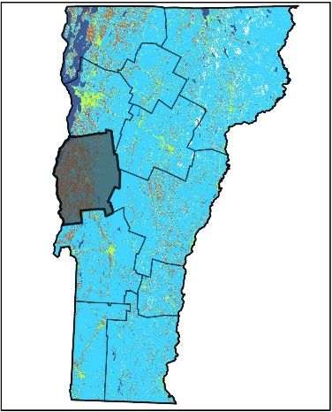
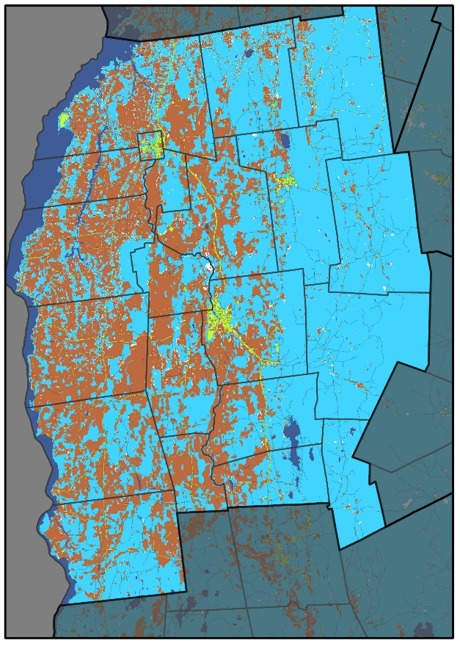
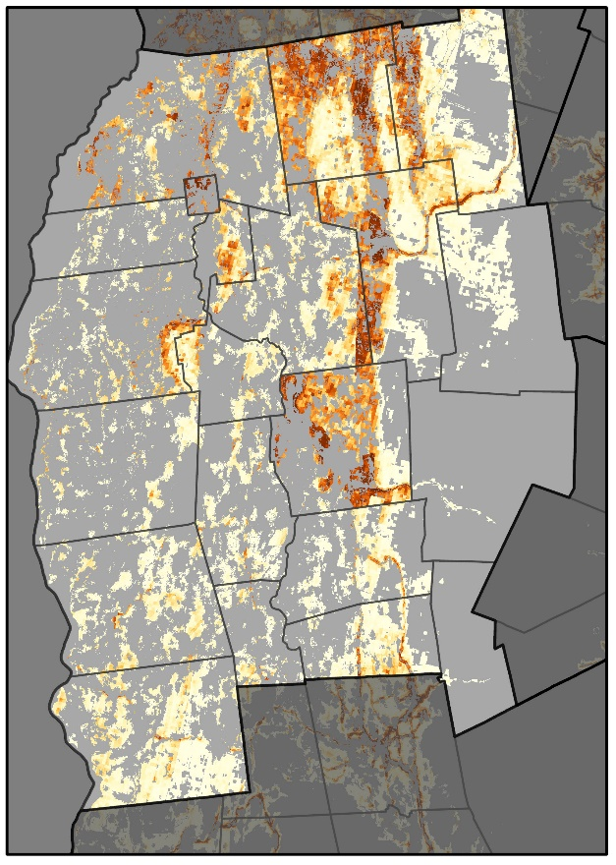
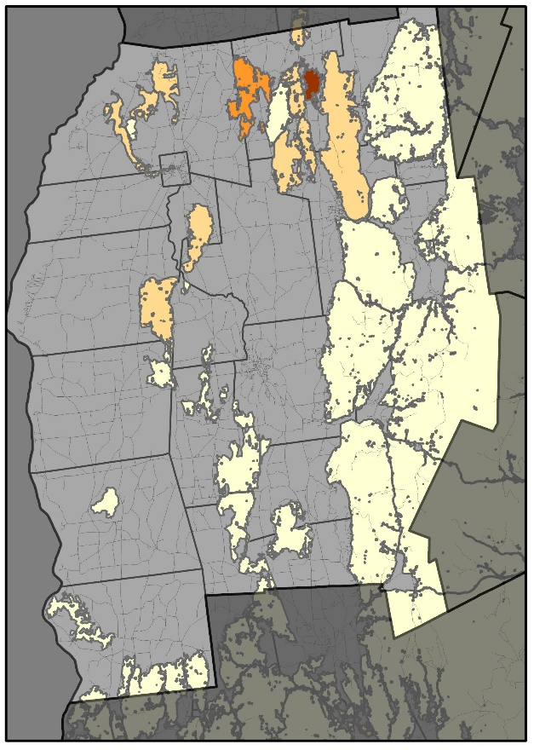
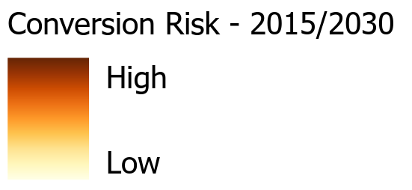
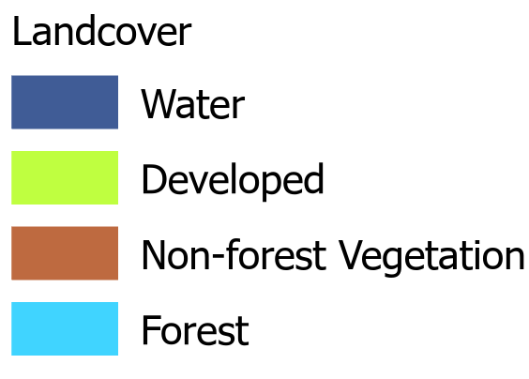
Addison County Regional Planning Commission
The Addison County Regional Planning Commission region has experienced forest loss on par with state-wide averages. While most of this has been concentrated around Middlebury, areas at high risk of conversion extend up through Bristol and Monkton. It is in these towns, were high quality connectivity forest blocks are most are risks. Future projections indicate continued forest area loss, with particular concern for several high quality connectivity blocks.
Forest Cover (2015)
Probability of Conversion (2030)
Risks to High Priority Forests (2030)
Drivers of Conversion
Driver | Rank
Dist. Urban | 1
Dist. Interstate | 2
Elevation | 3
Dist. Major Road | 4
Aspect | 5
Addison County RPC has been losing approximately 0.4% of its forest cover to development each decade.
Areas at highest risk are closest to Middlebury and major roads, but also increases with proximity to the interstate.
Percent Forest Converted to Developed
1985-2000 | 2000-2015
1.9% | 0.2%
While high risk areas are centered around Middlebury, continued fragmentation of high priority forest connectivity blocks highlight other areas that may be a priority for planning efforts.

Slide 2
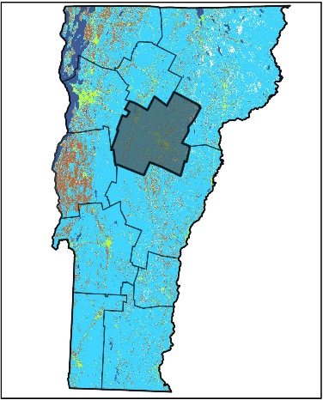
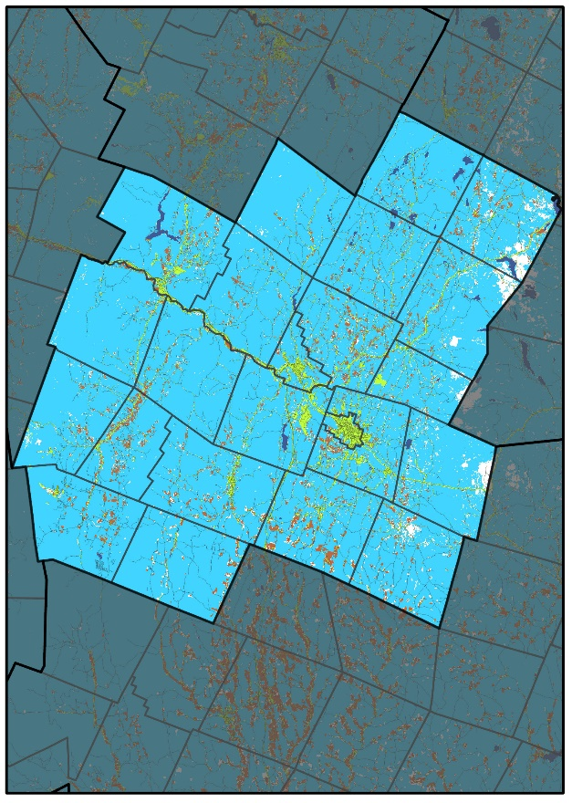
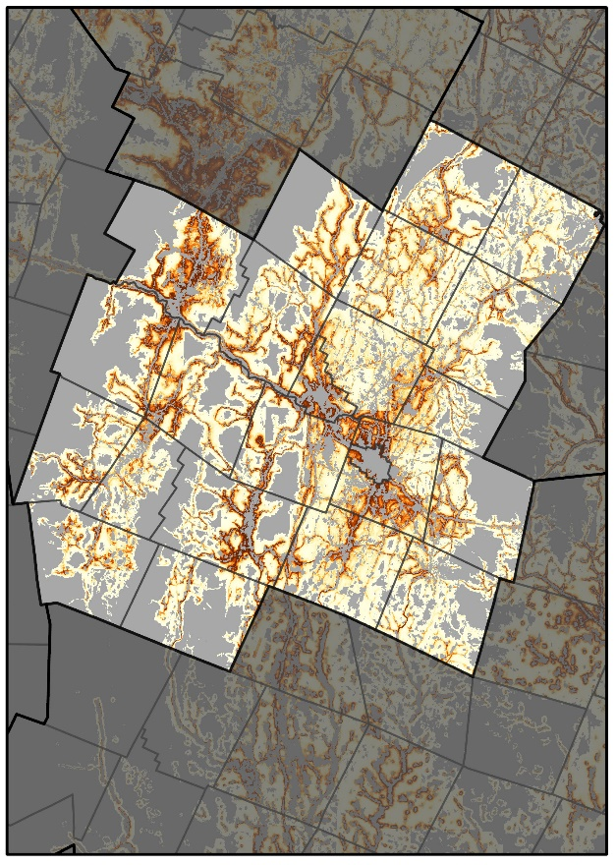
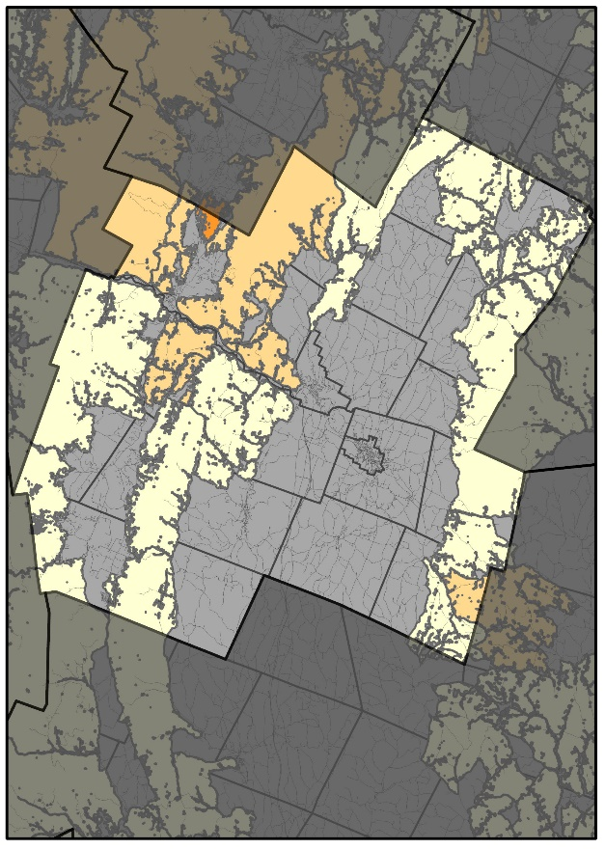
Central Vermont Regional Planning Commission
Central Vermont Regional Planning Commission experienced some of the highest loss of forest in the 1985-2000 period, but slowed significantly in the 2000-2015 economic slump. While its locations of highest conversion risk are centered around Montpelier, high risk/ high quality habitat blocks of particular concern occur primarily in Waterbury, Middlesex and Worcester. Future projections indicate continued forest area and connectivity losses in this region.
Forest Cover (2015)
Probability of Conversion (2030)
Risks to High Priority Forests (2030)
Drivers of Conversion
Driver | Rank
Dist. Urban | 1
Dist. Major Road | 2
Elevation | 3
Dist. Interstate | 4
Dist. Developed LC | 5
The CV RPC has been losing approximately 1% of its forest cover to development each decade.
Areas at highest risk are closest to urban centers, major roads and the instate, as well as lower elevation locations.
Percent Forest Converted to Developed
1985-2000 | 2000-2015
2.8% | 0.4%
While high risk areas are centered around the Montpelier and Waterbury urban centers, continued fragmentation of high priority forest connectivity blocks highlight other areas that may be a priority for planning efforts.

Slide 3
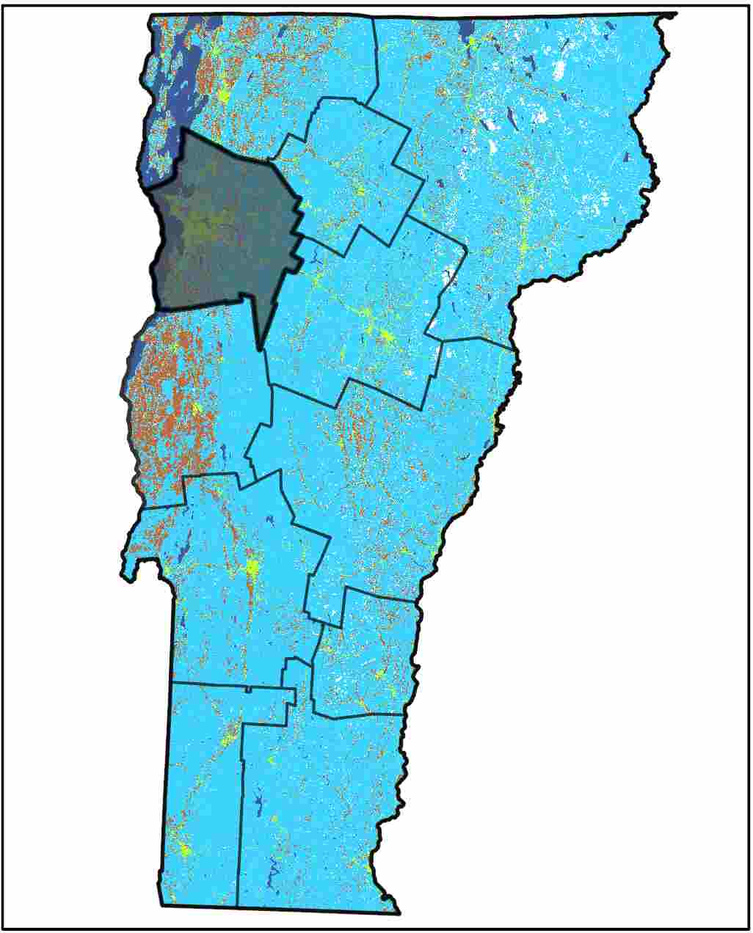
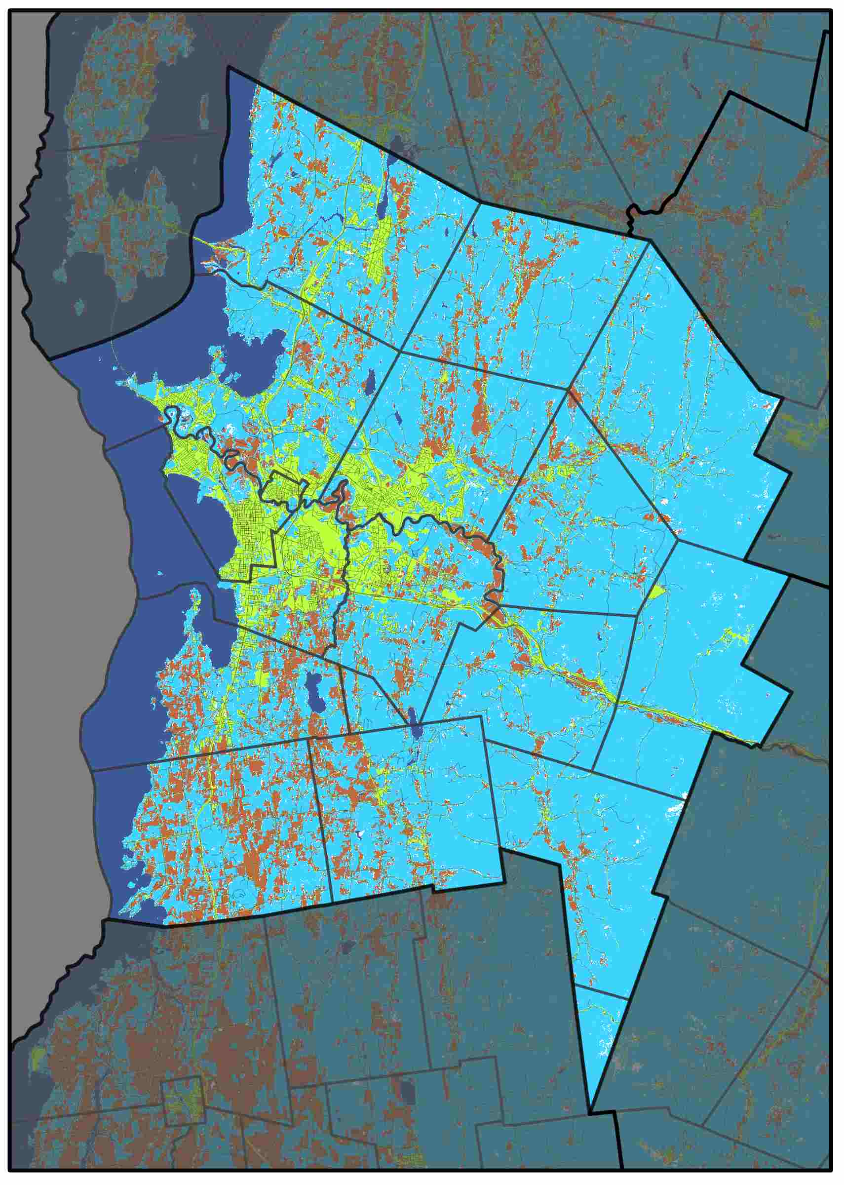
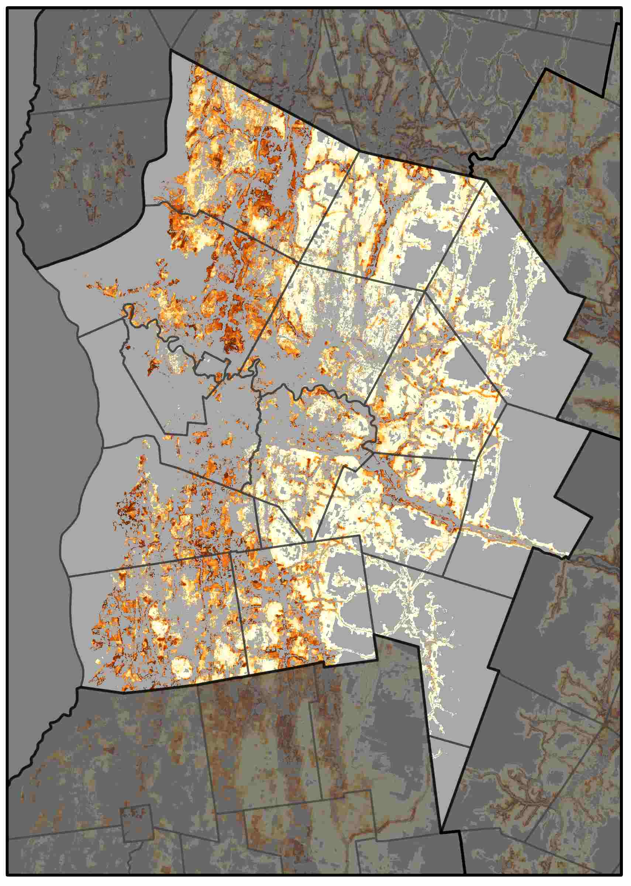
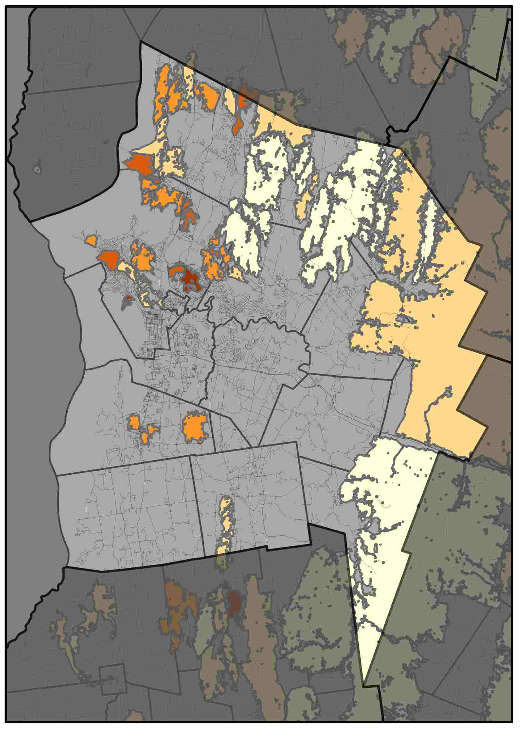
Chittenden County Regional Planning Commission
Central Vermont Regional Planning Commission shows some things, and there can be about four sentences of text here. Central Vermont Regional Planning Commission shows some things. There can be about four sentences of text here. Central Vermont Regional Planning Commission shows some things, and there can be about four sentences of text here. Central Vermont Regional Planning Commission shows some things. There can be about four sentences of text here.
Forest Cover (2015)
Probability of Conversion (2030)
Risks to High Priority Forests (2030)
Drivers of Conversion
Driver | Rank
Dist. Urban | 1
Elevation | 2
Dist. Major Road | 3
Aspect | 4
Dist. Non-Forest LC | 5
The NVDA has been losing approximately 0.4% of its forest cover to development each decade.
Areas at highest risk are dispersed along major roads, particularly near urban centers, as well as lower elevation locations.
Percent Forest Converted to Developed
1985-2000 | 2000-2015
5.4% | 0.7%
Here is some brief statement about these graphs and maps show. Here is some brief statement about these graphs and maps show.

Slide 4
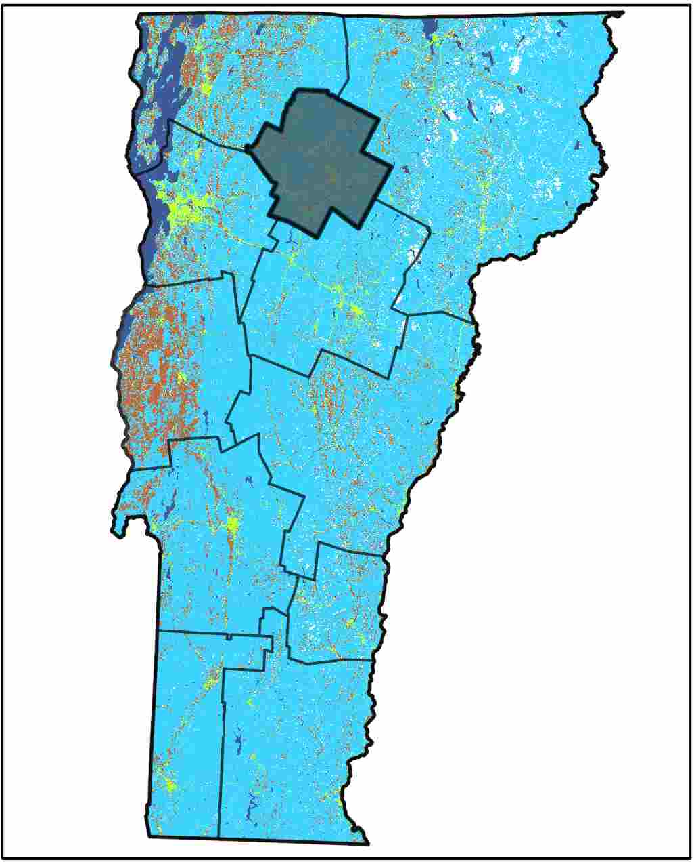
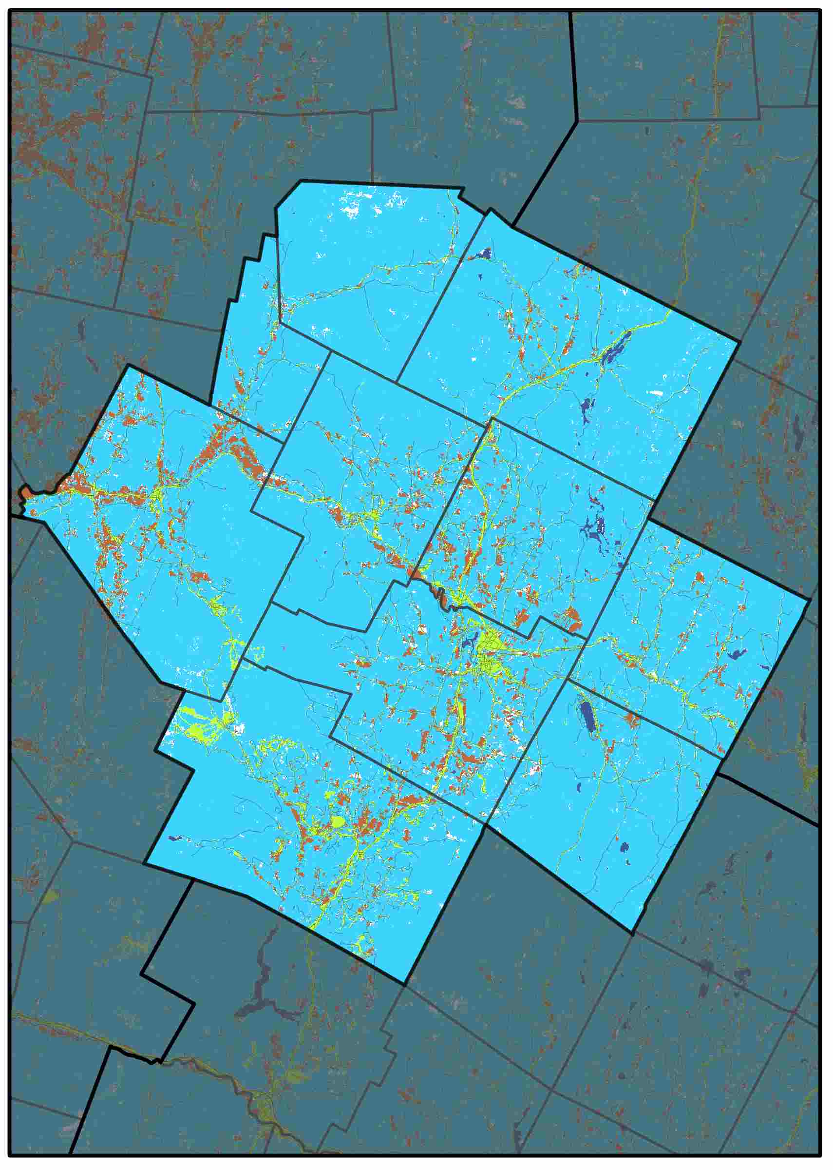
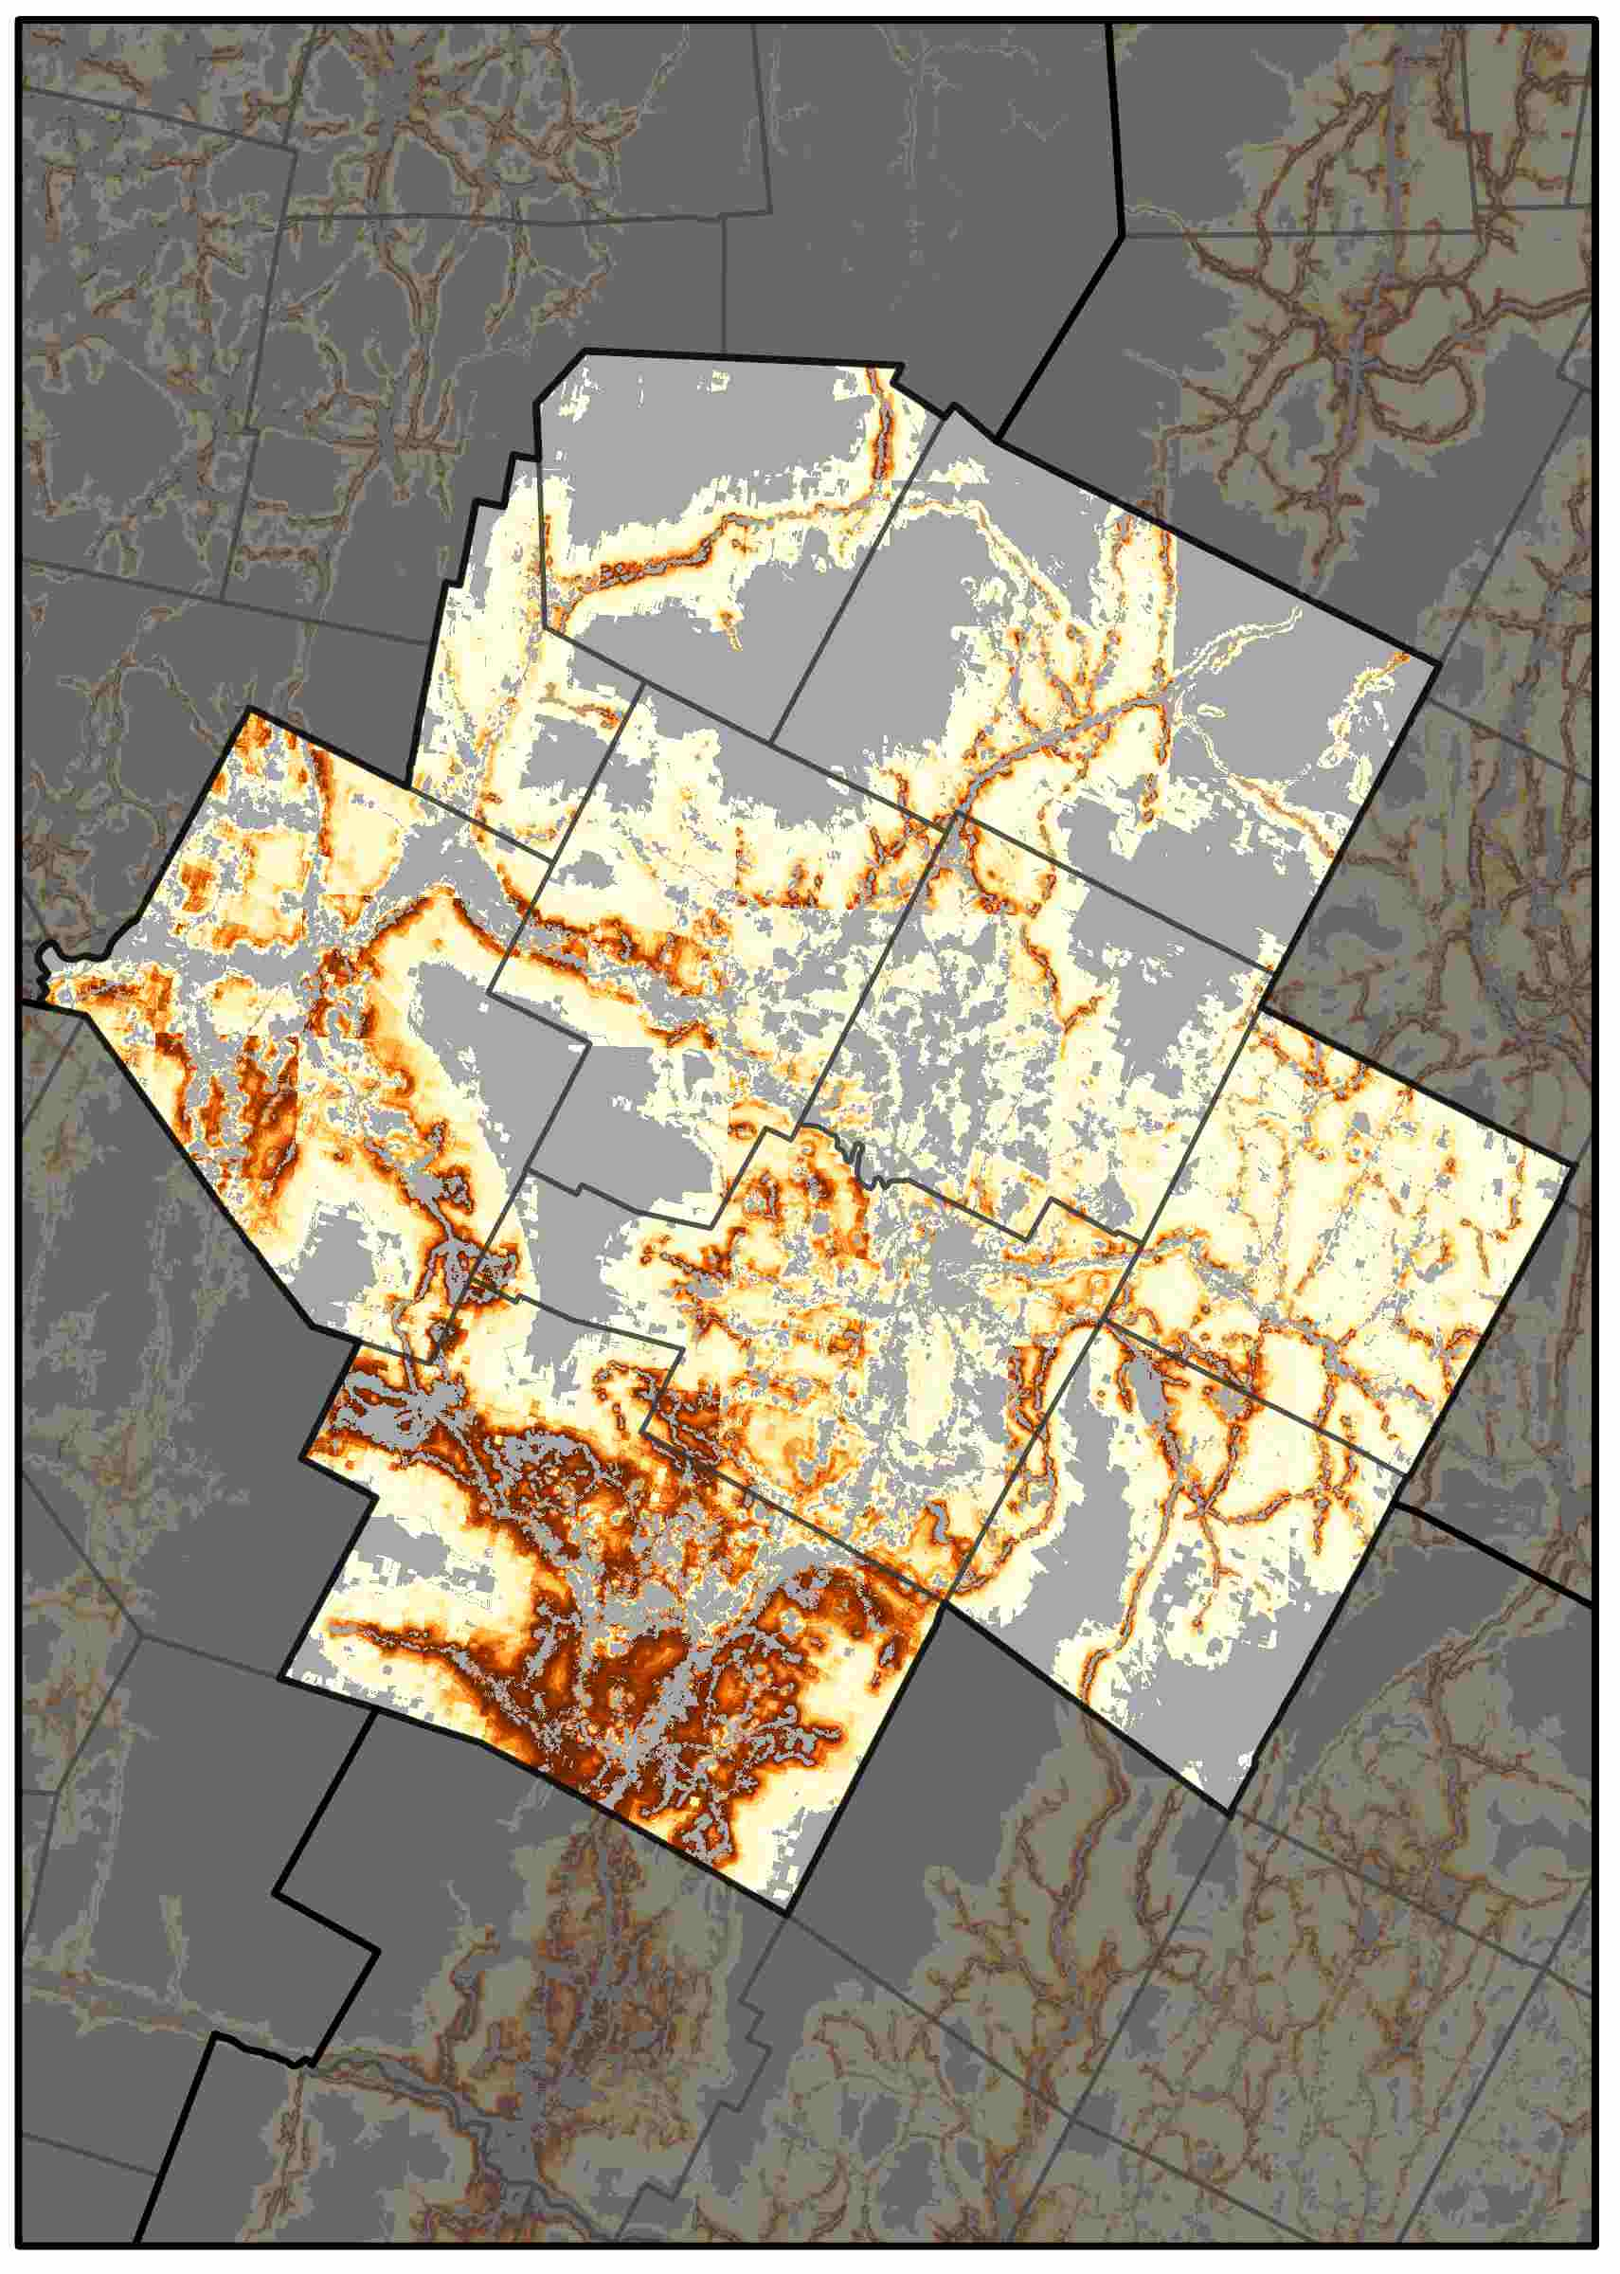
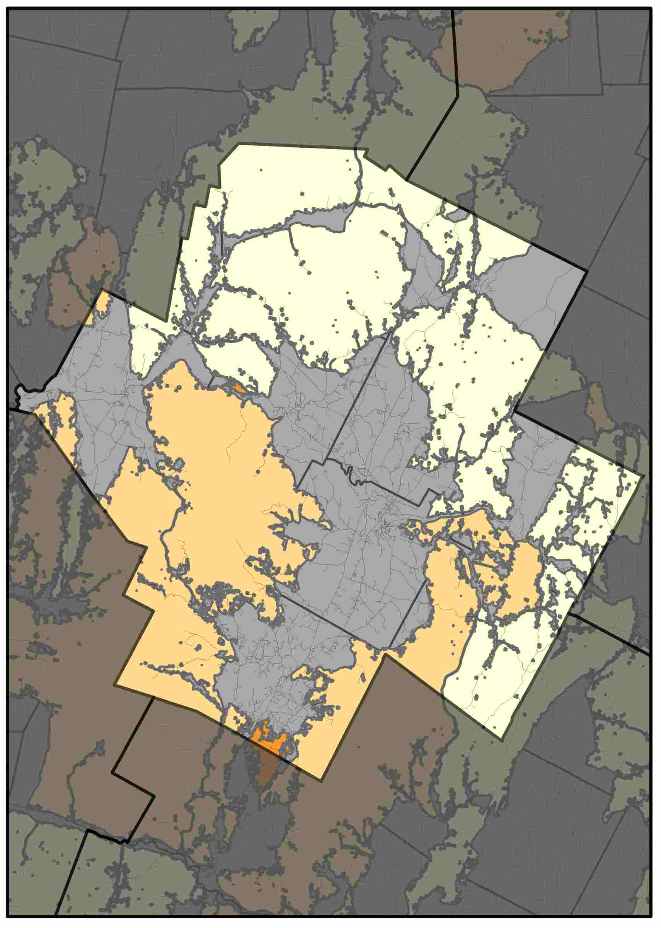
Lamoille County Planning Commission
Central Vermont Regional Planning Commission shows some things, and there can be about four sentences of text here. Central Vermont Regional Planning Commission shows some things. There can be about four sentences of text here. Central Vermont Regional Planning Commission shows some things, and there can be about four sentences of text here. Central Vermont Regional Planning Commission shows some things. There can be about four sentences of text here.
Forest Cover (2015)
Probability of Conversion (2030)
Risks to High Priority Forests (2030)
Drivers of Conversion
Driver | Rank
Dist. Interstate | 1
Dist. Urban | 2
Dist. Major Road | 3
Elevation | 4
Dist. Developed LC | 5
The NVDA has been losing approximately 0.4% of its forest cover to development each decade.
Areas at highest risk are dispersed along major roads, particularly near urban centers, as well as lower elevation locations.
Percent Forest Converted to Developed
1985-2000 | 2000-2015
2.7% | 0.4%
Here is some brief statement about these graphs and maps show. Here is some brief statement about these graphs and maps show.

Slide 5
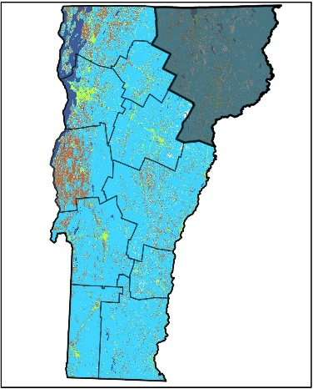
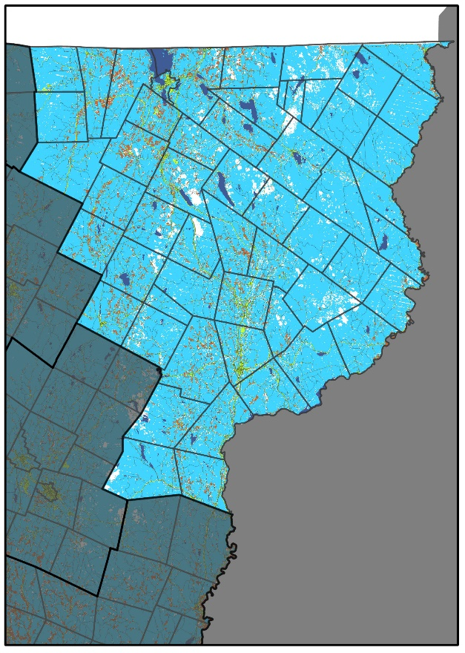
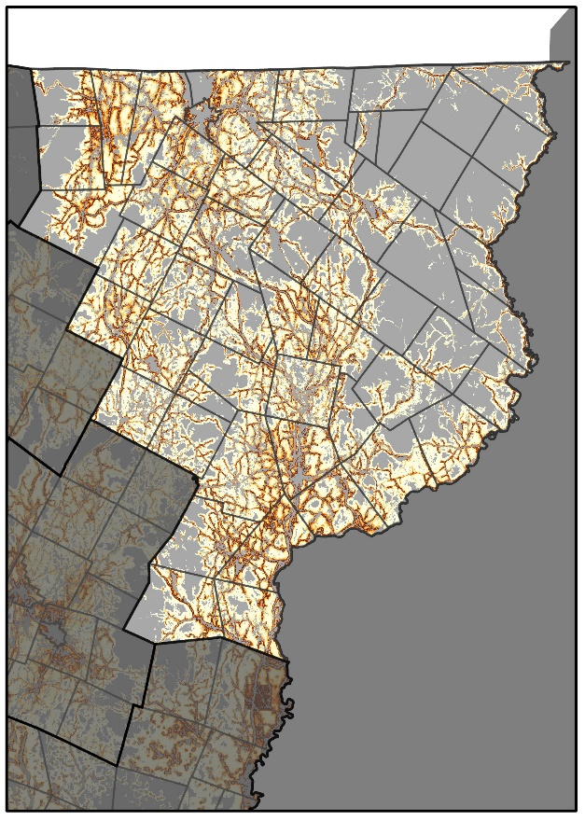
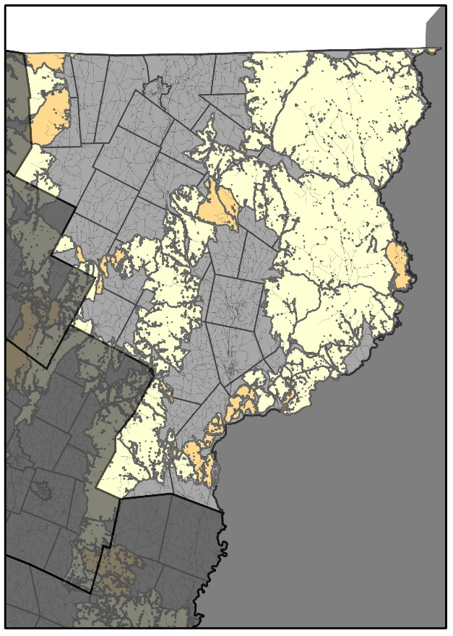
Northeastern Vermont Development Association
The Northeastern Vermont Development Association region has experienced average rates of forest conversion for the state. While its locations of highest conversion risk are focused around major roadways, high risk/ high quality habitat blocks of particular concern occur primarily in Jay/Westfield, as well as Sutton/Westmore and Barnet. Future projections indicate continued forest area and connectivity losses in this region.
Forest Cover (2015)
Probability of Conversion (2030)
Risks to High Priority Forests (2030)
Drivers of Conversion
Driver | Rank
Dist. Urban | 1
Dist. Interstate | 2
Elevation | 3
Aspect | 4
Dist. Major Road | 5
The NVDA has been losing approximately 0.4% of its forest cover to development each decade.
Areas at highest risk are dispersed along major roads, particularly near urban centers, as well as lower elevation locations.
Percent Forest Converted to Developed
1985-2000 | 2000-2015
2.2% | 0.4%
While the risk of forest conversion is relatively diffuse in the NE, the intersection of major roads with large swaths of forest connectivity blocks results in several areas of concern that may be a priority for planning efforts.

Slide 6
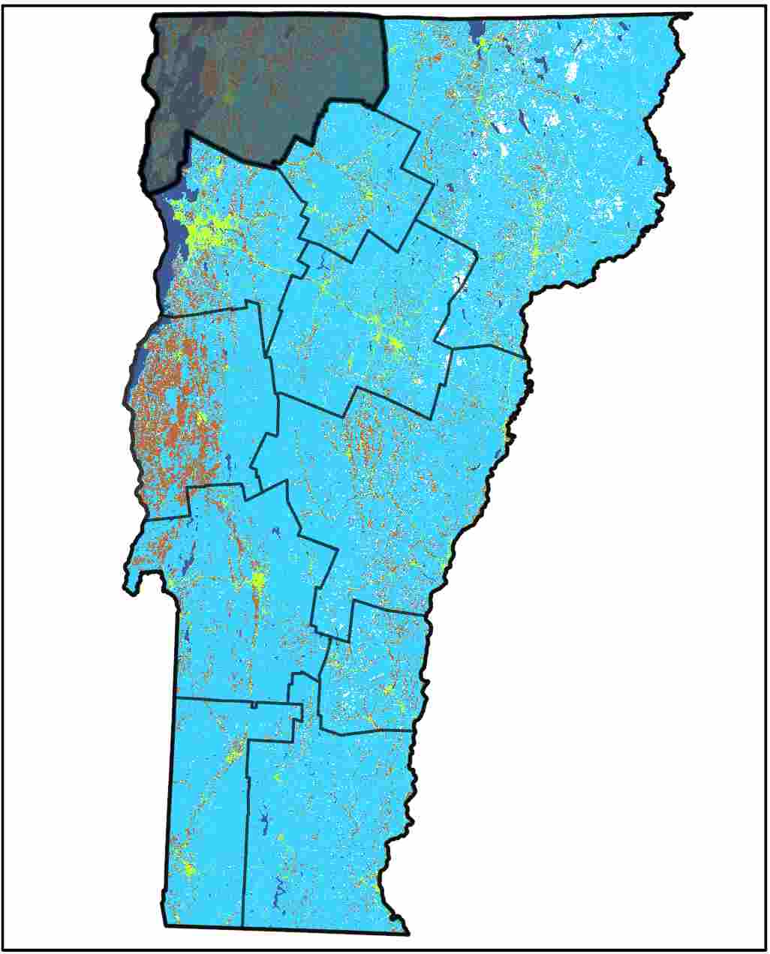
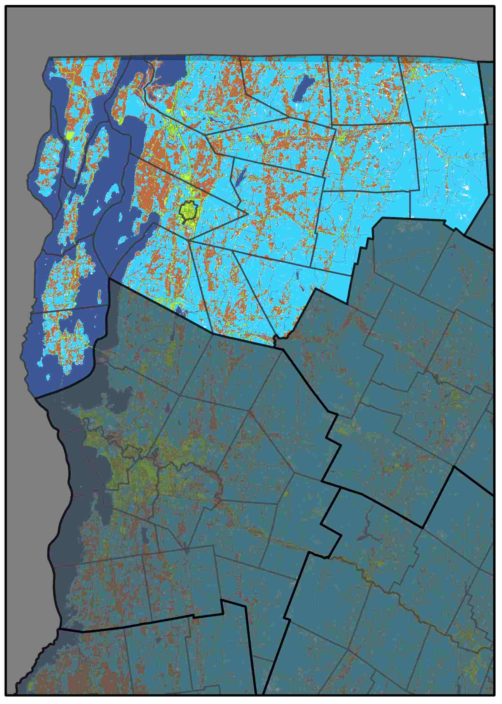
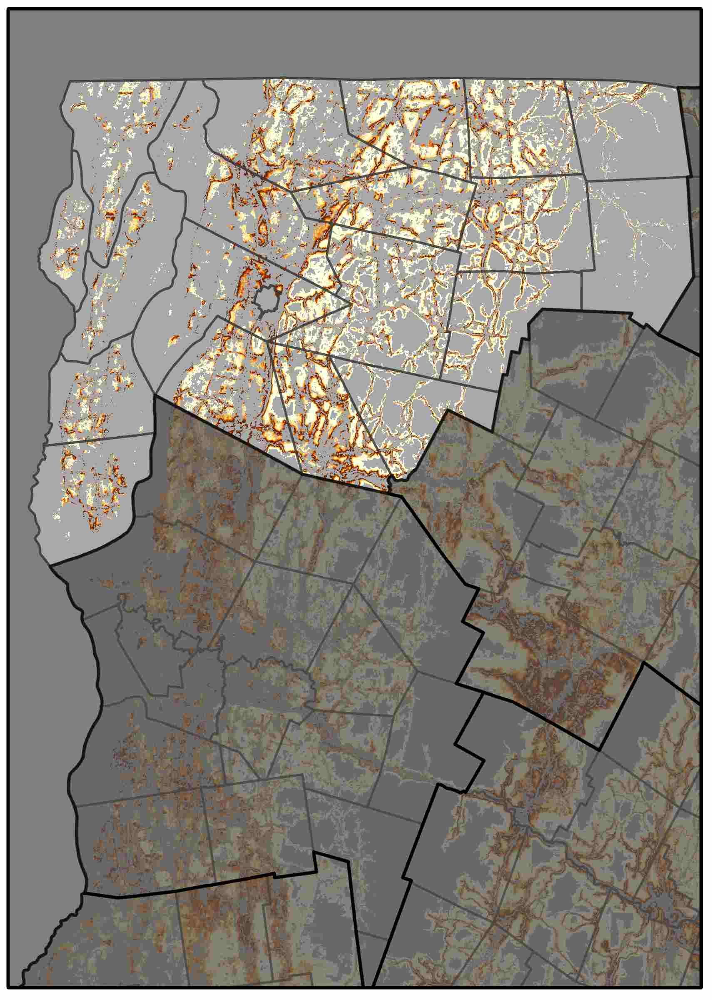
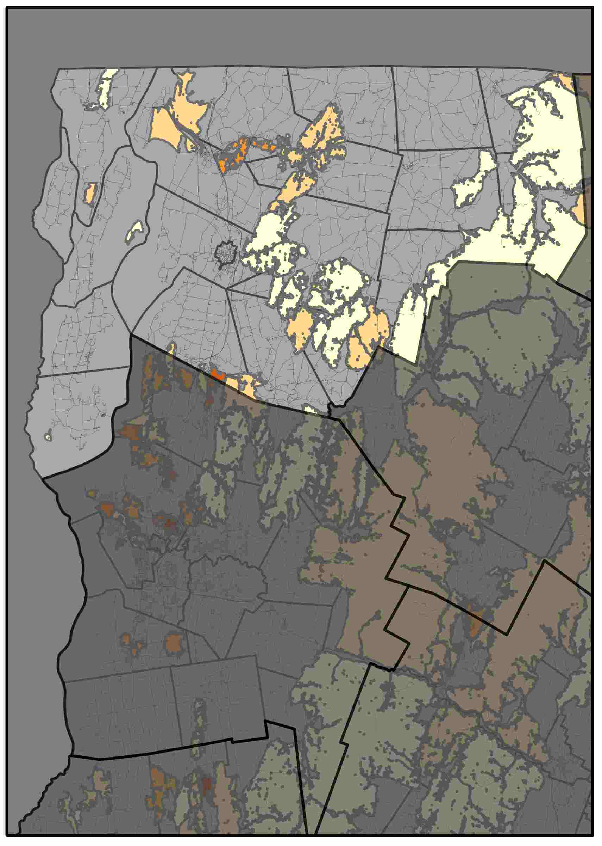
Northwest Regional Planning Commission
Central Vermont Regional Planning Commission shows some things, and there can be about four sentences of text here. Central Vermont Regional Planning Commission shows some things. There can be about four sentences of text here. Central Vermont Regional Planning Commission shows some things, and there can be about four sentences of text here. Central Vermont Regional Planning Commission shows some things. There can be about four sentences of text here.
Forest Cover (2015)
Probability of Conversion (2030)
Risks to High Priority Forests (2030)
Drivers of Conversion
Driver | Rank
Dist. Interstate | 1
Dist. Urban | 2
Dist. Major Road | 3
Elevation | 4
Dist. Developed LC | 5
The NVDA has been losing approximately 0.4% of its forest cover to development each decade.
Areas at highest risk are dispersed along major roads, particularly near urban centers, as well as lower elevation locations.
Percent Forest Converted to Developed
1985-2000 | 2000-2015
4.1% | 0.4%
Here is some brief statement about these graphs and maps show. Here is some brief statement about these graphs and maps show.

Slide 7
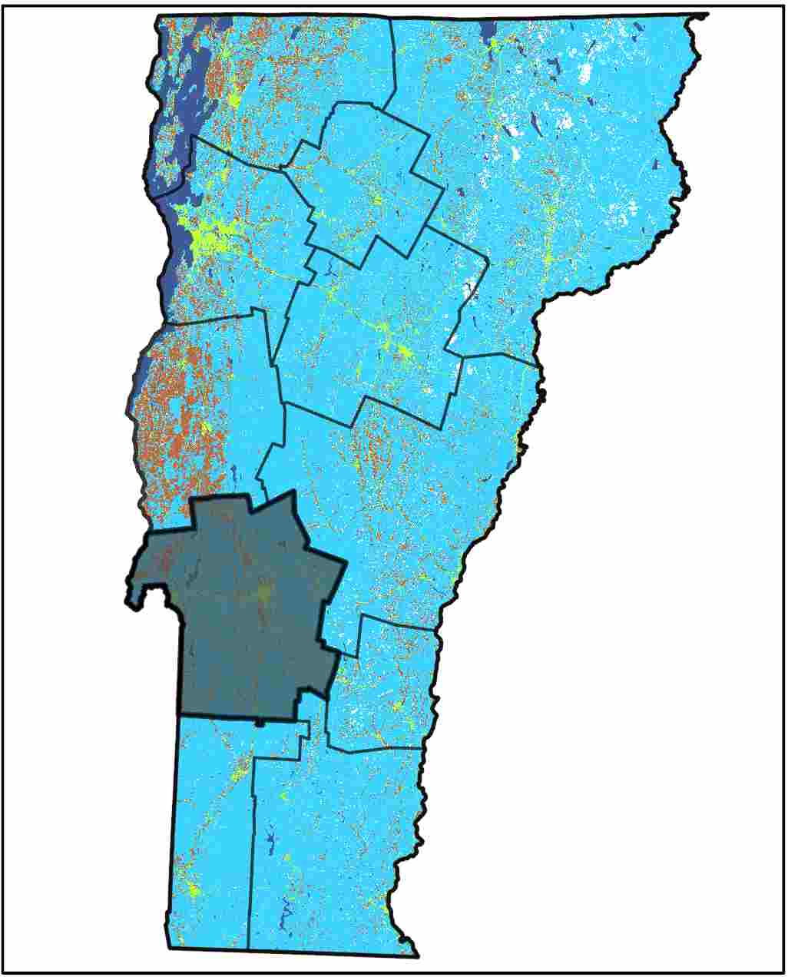
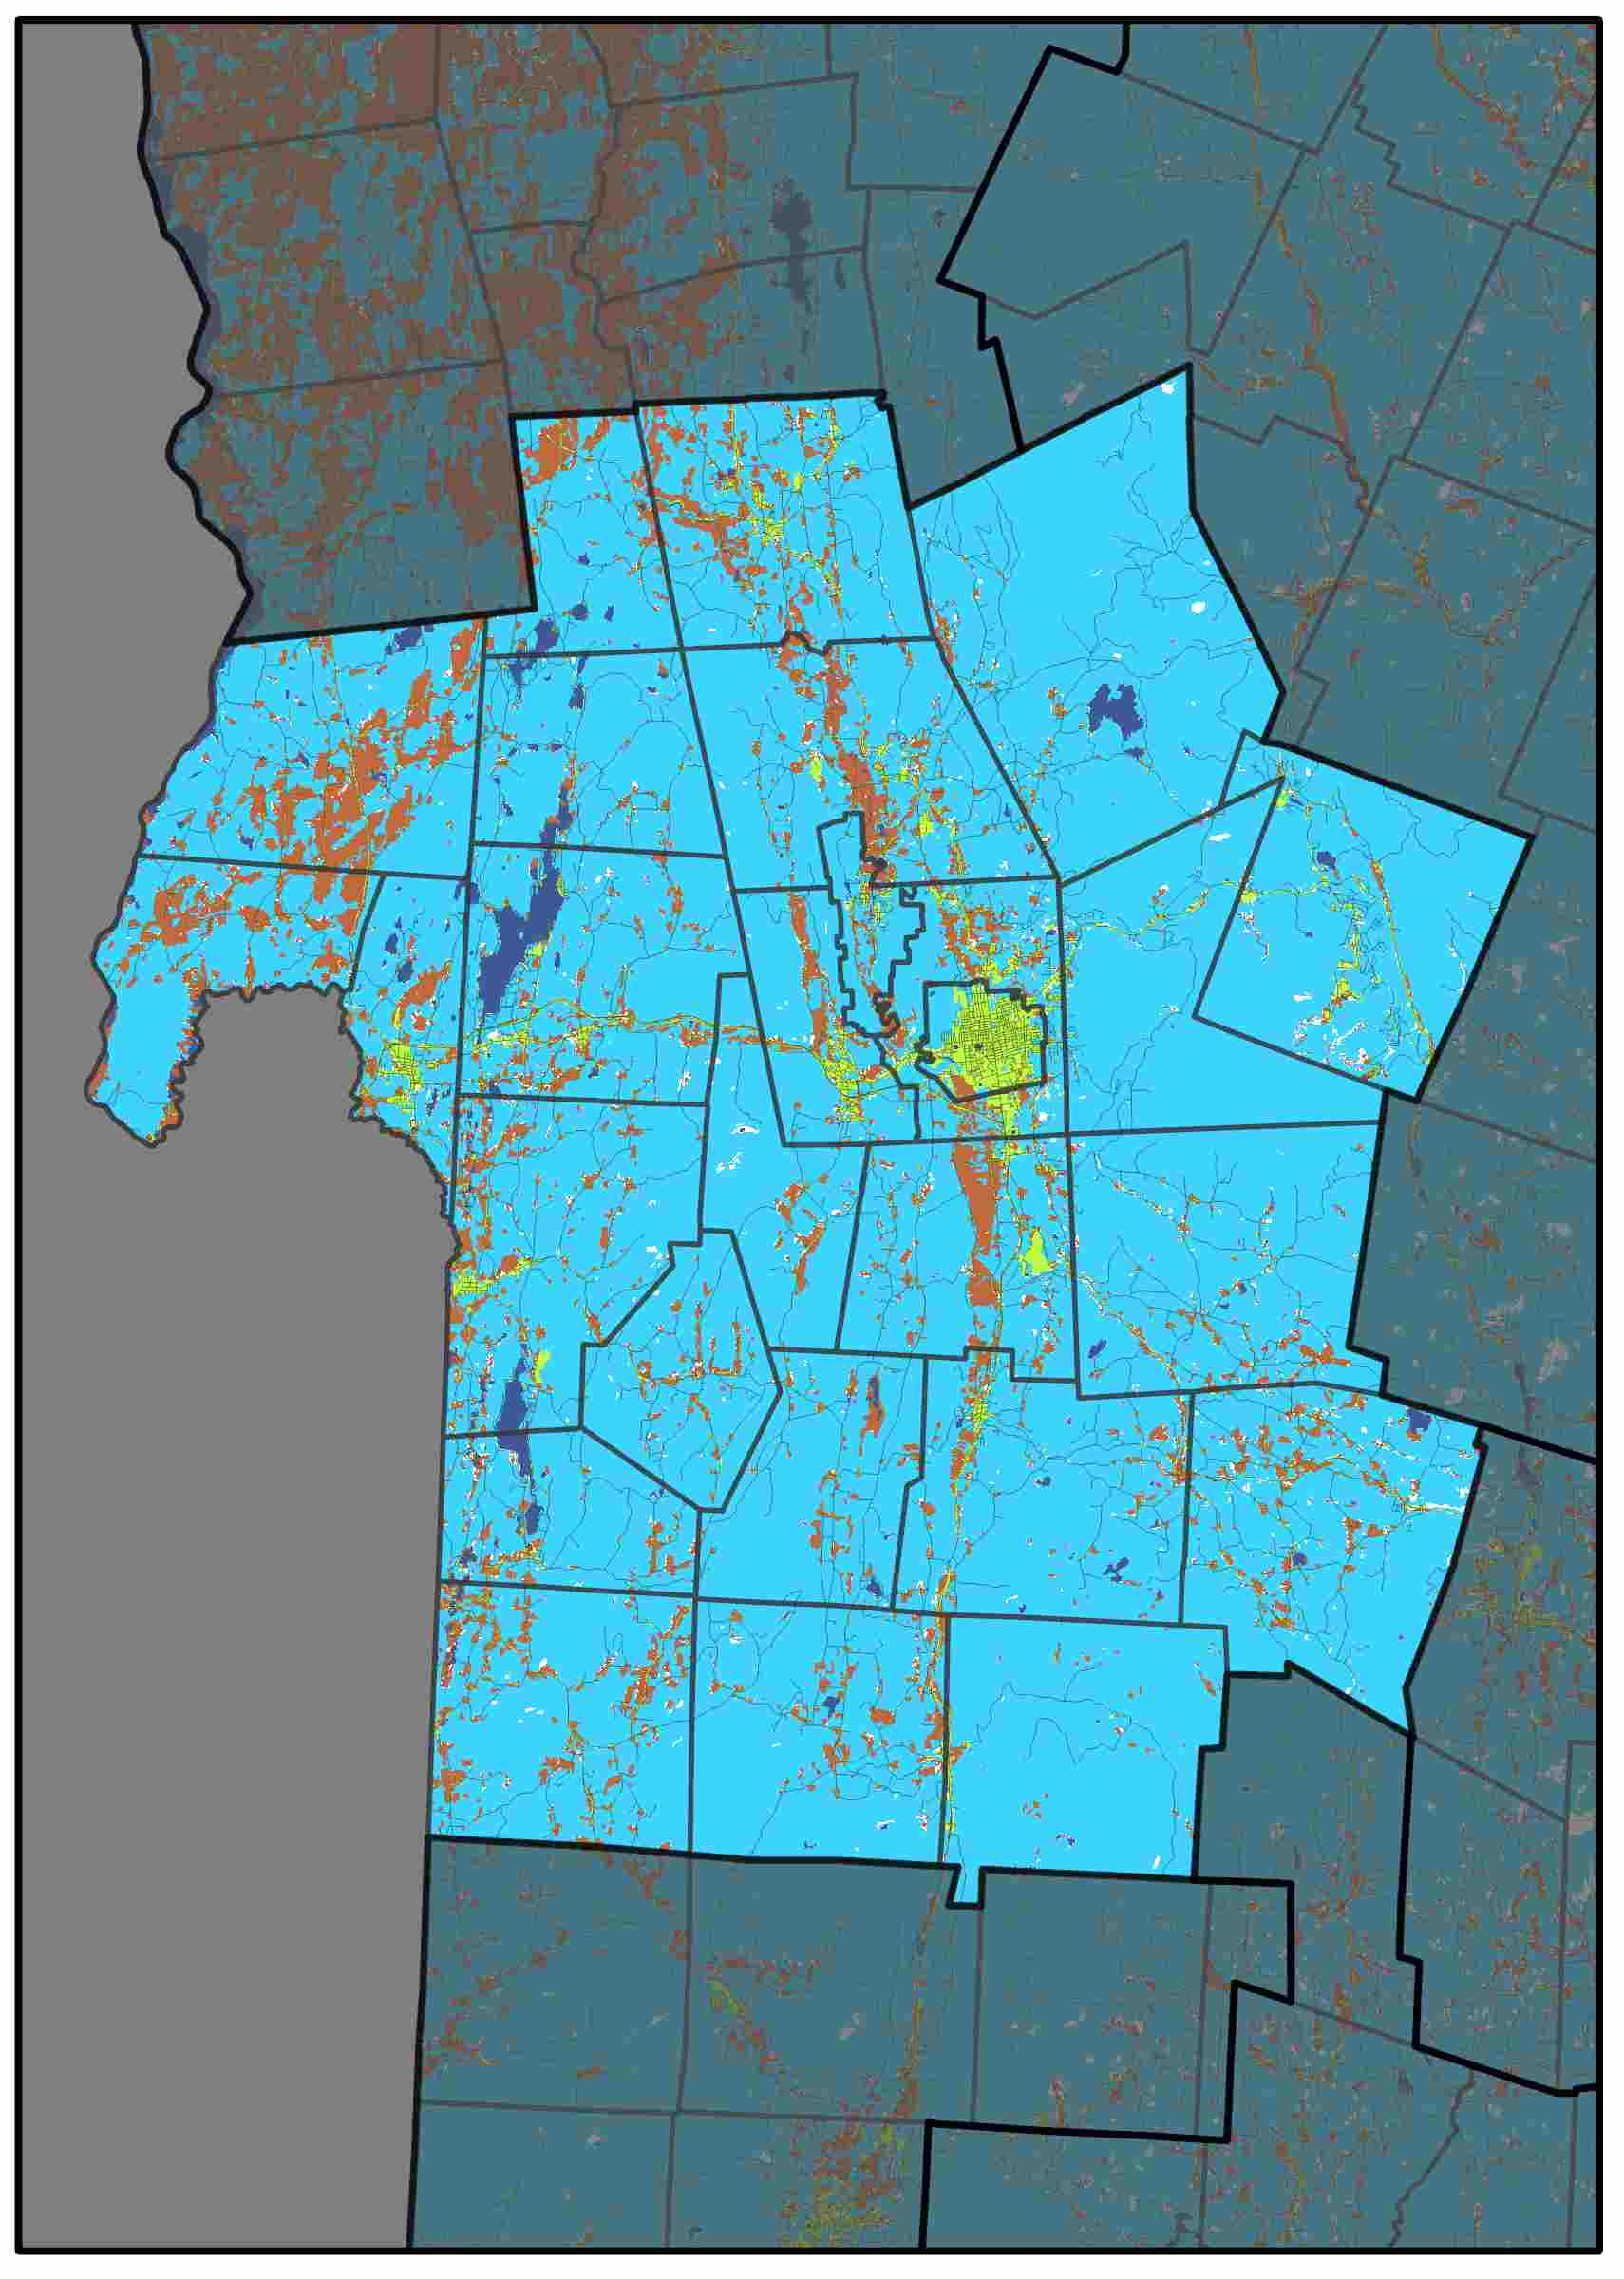
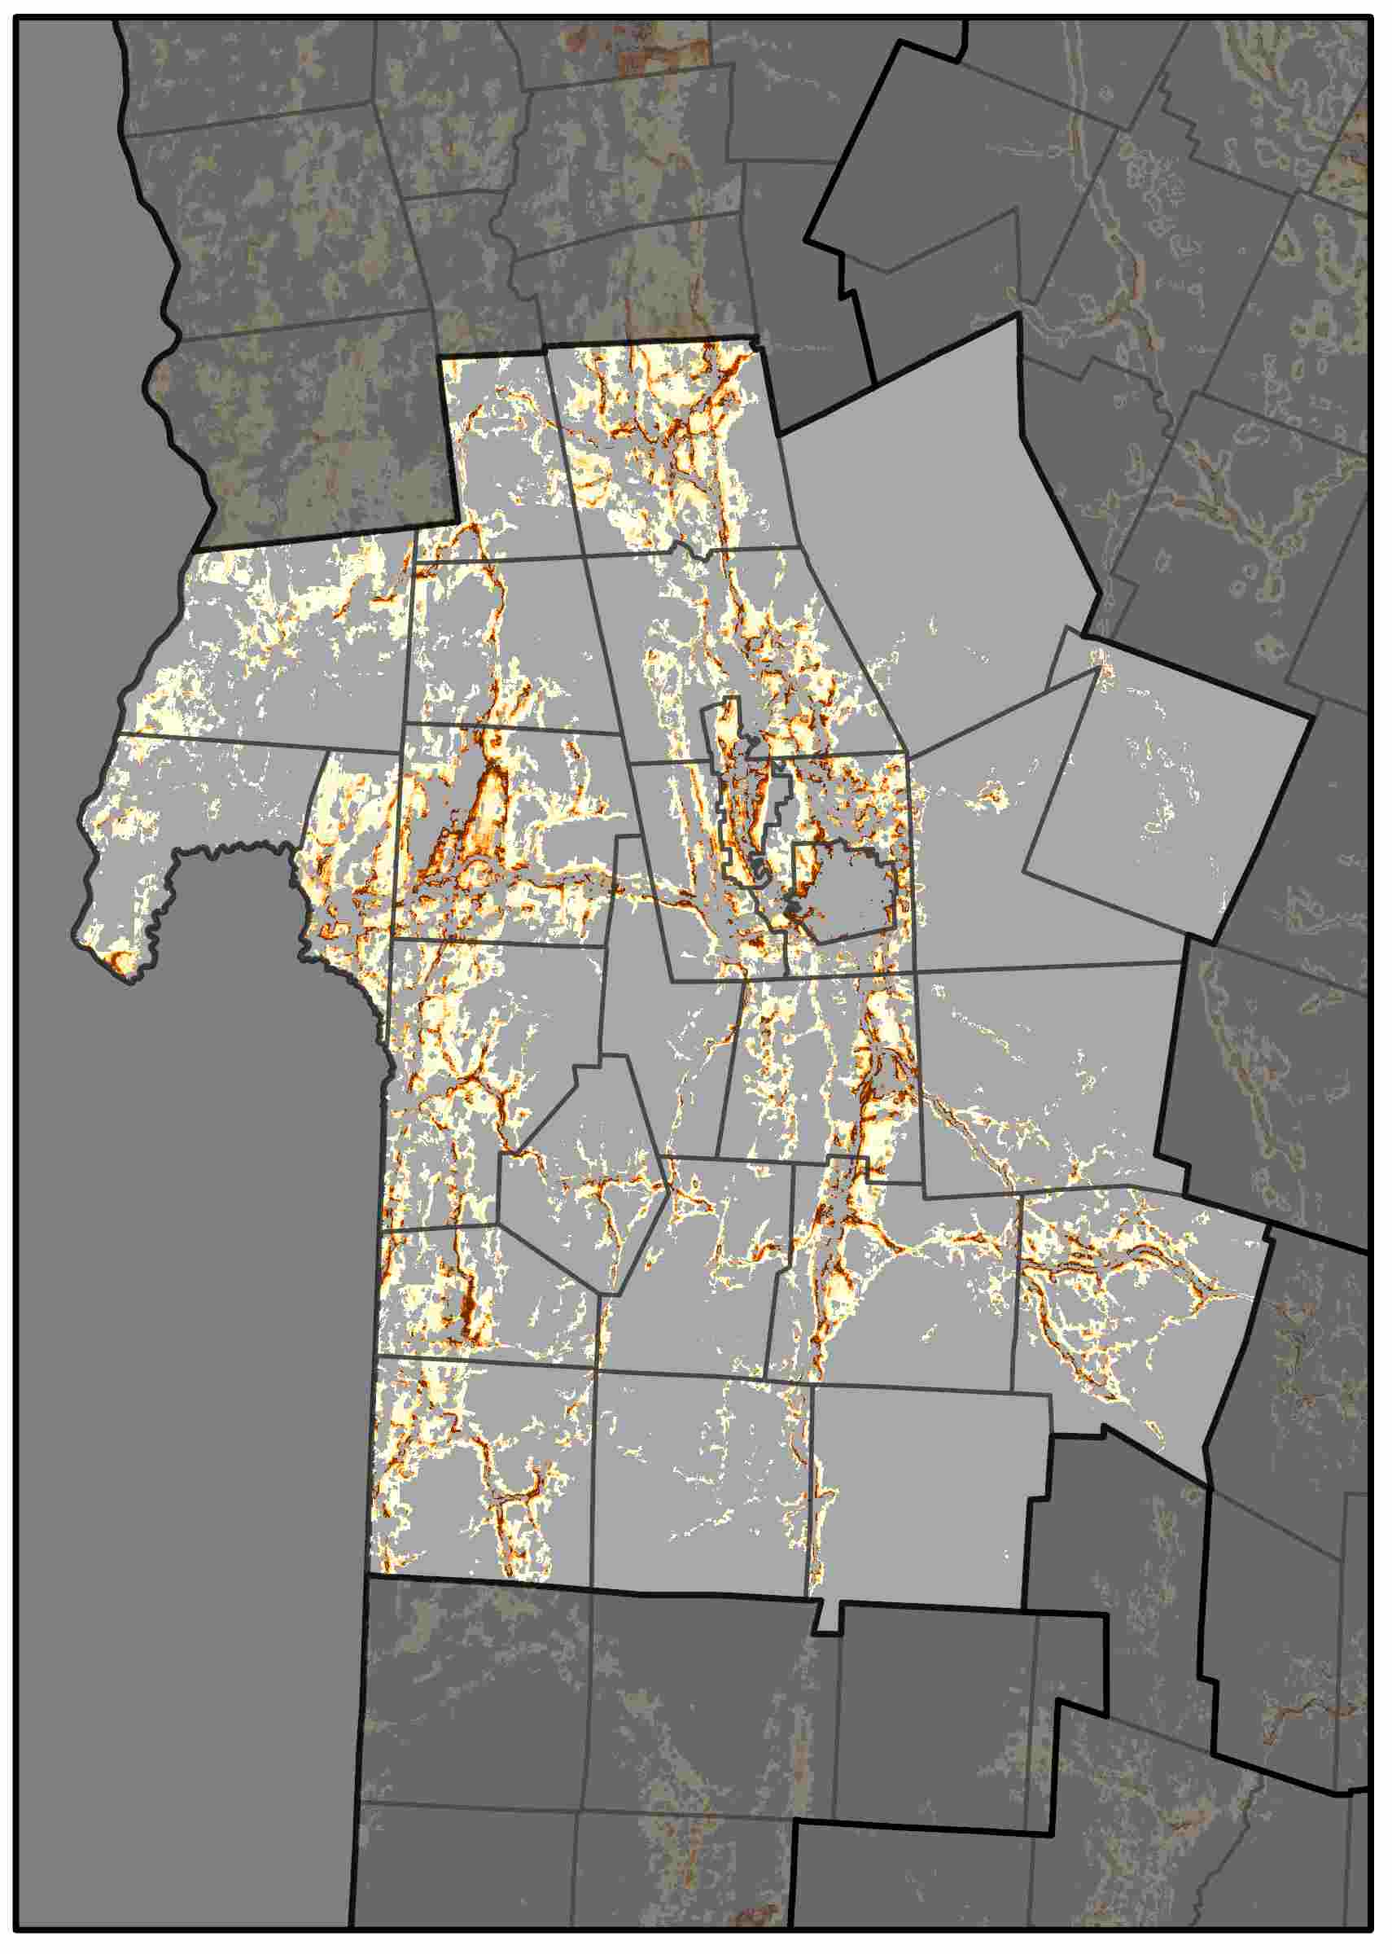
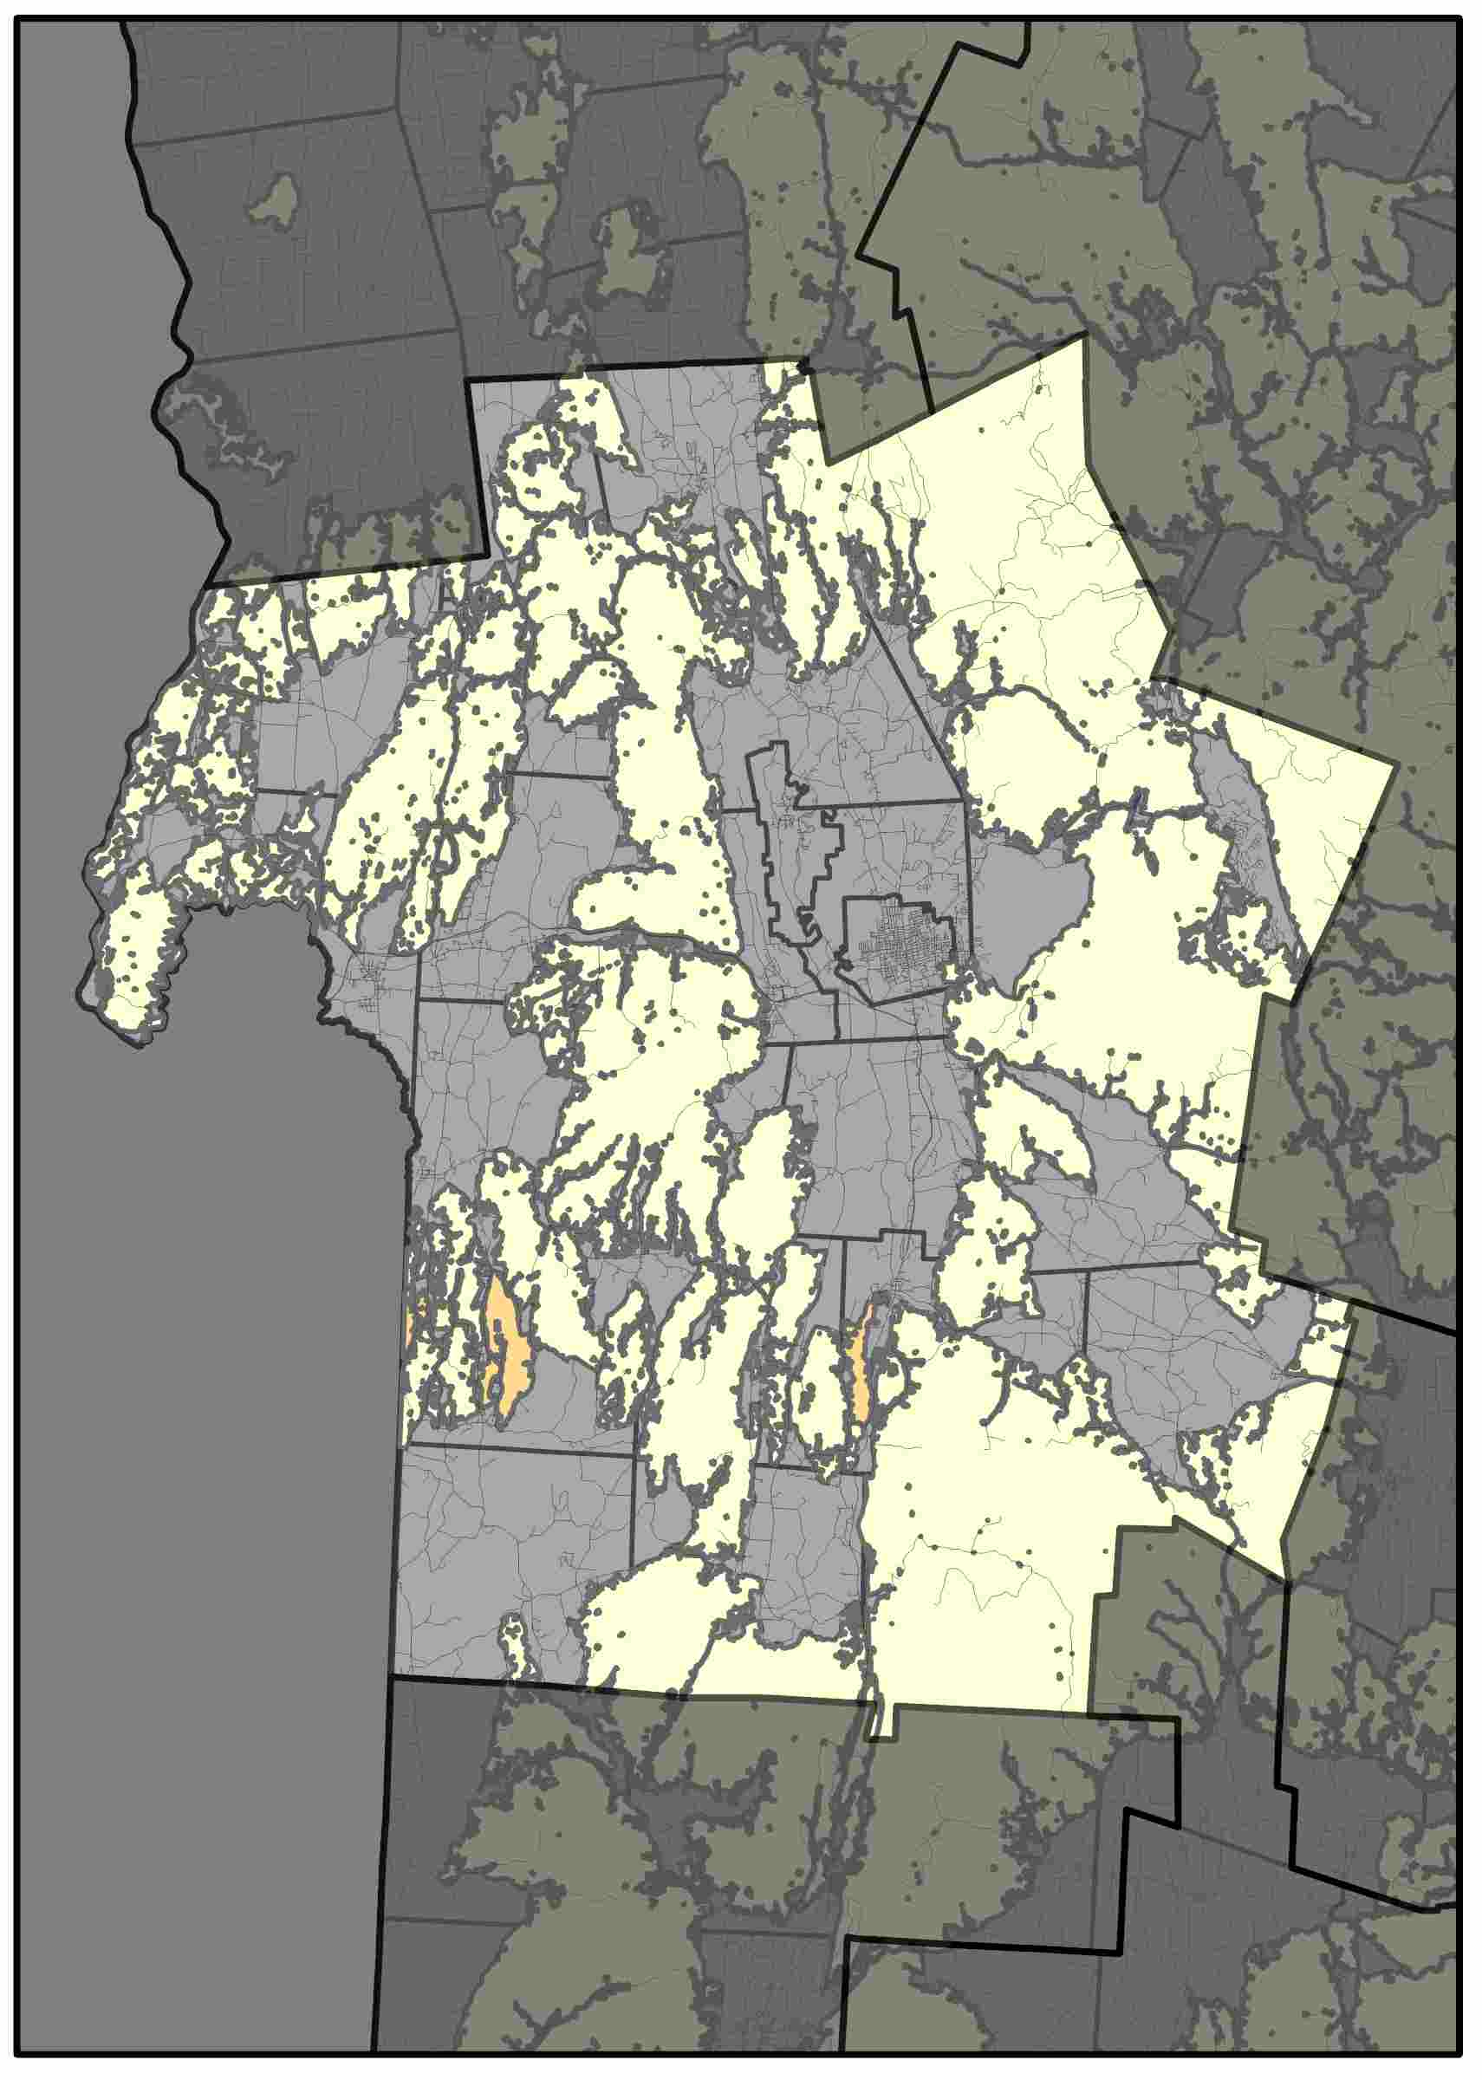
Rutland Regional Planning Commission
Central Vermont Regional Planning Commission shows some things, and there can be about four sentences of text here. Central Vermont Regional Planning Commission shows some things. There can be about four sentences of text here. Central Vermont Regional Planning Commission shows some things, and there can be about four sentences of text here. Central Vermont Regional Planning Commission shows some things. There can be about four sentences of text here.
Forest Cover (2015)
Probability of Conversion (2030)
Risks to High Priority Forests (2030)
Drivers of Conversion
Driver | Rank
Dist. Interstate | 1
Dist. Urban | 2
Dist. Major Road | 3
Elevation | 4
Aspect | 5
The NVDA has been losing approximately 0.4% of its forest cover to development each decade.
Areas at highest risk are dispersed along major roads, particularly near urban centers, as well as lower elevation locations.
Percent Forest Converted to Developed
1985-2000 | 2000-2015
1.3% | 0.6%
Here is some brief statement about these graphs and maps show. Here is some brief statement about these graphs and maps show.

Slide 8
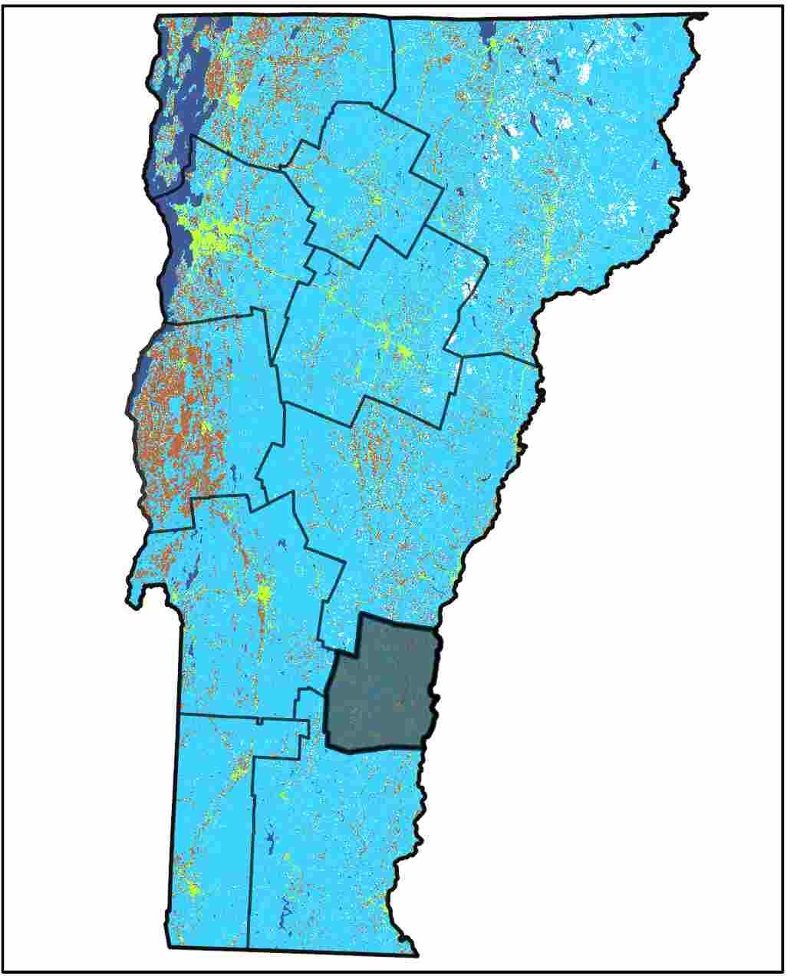
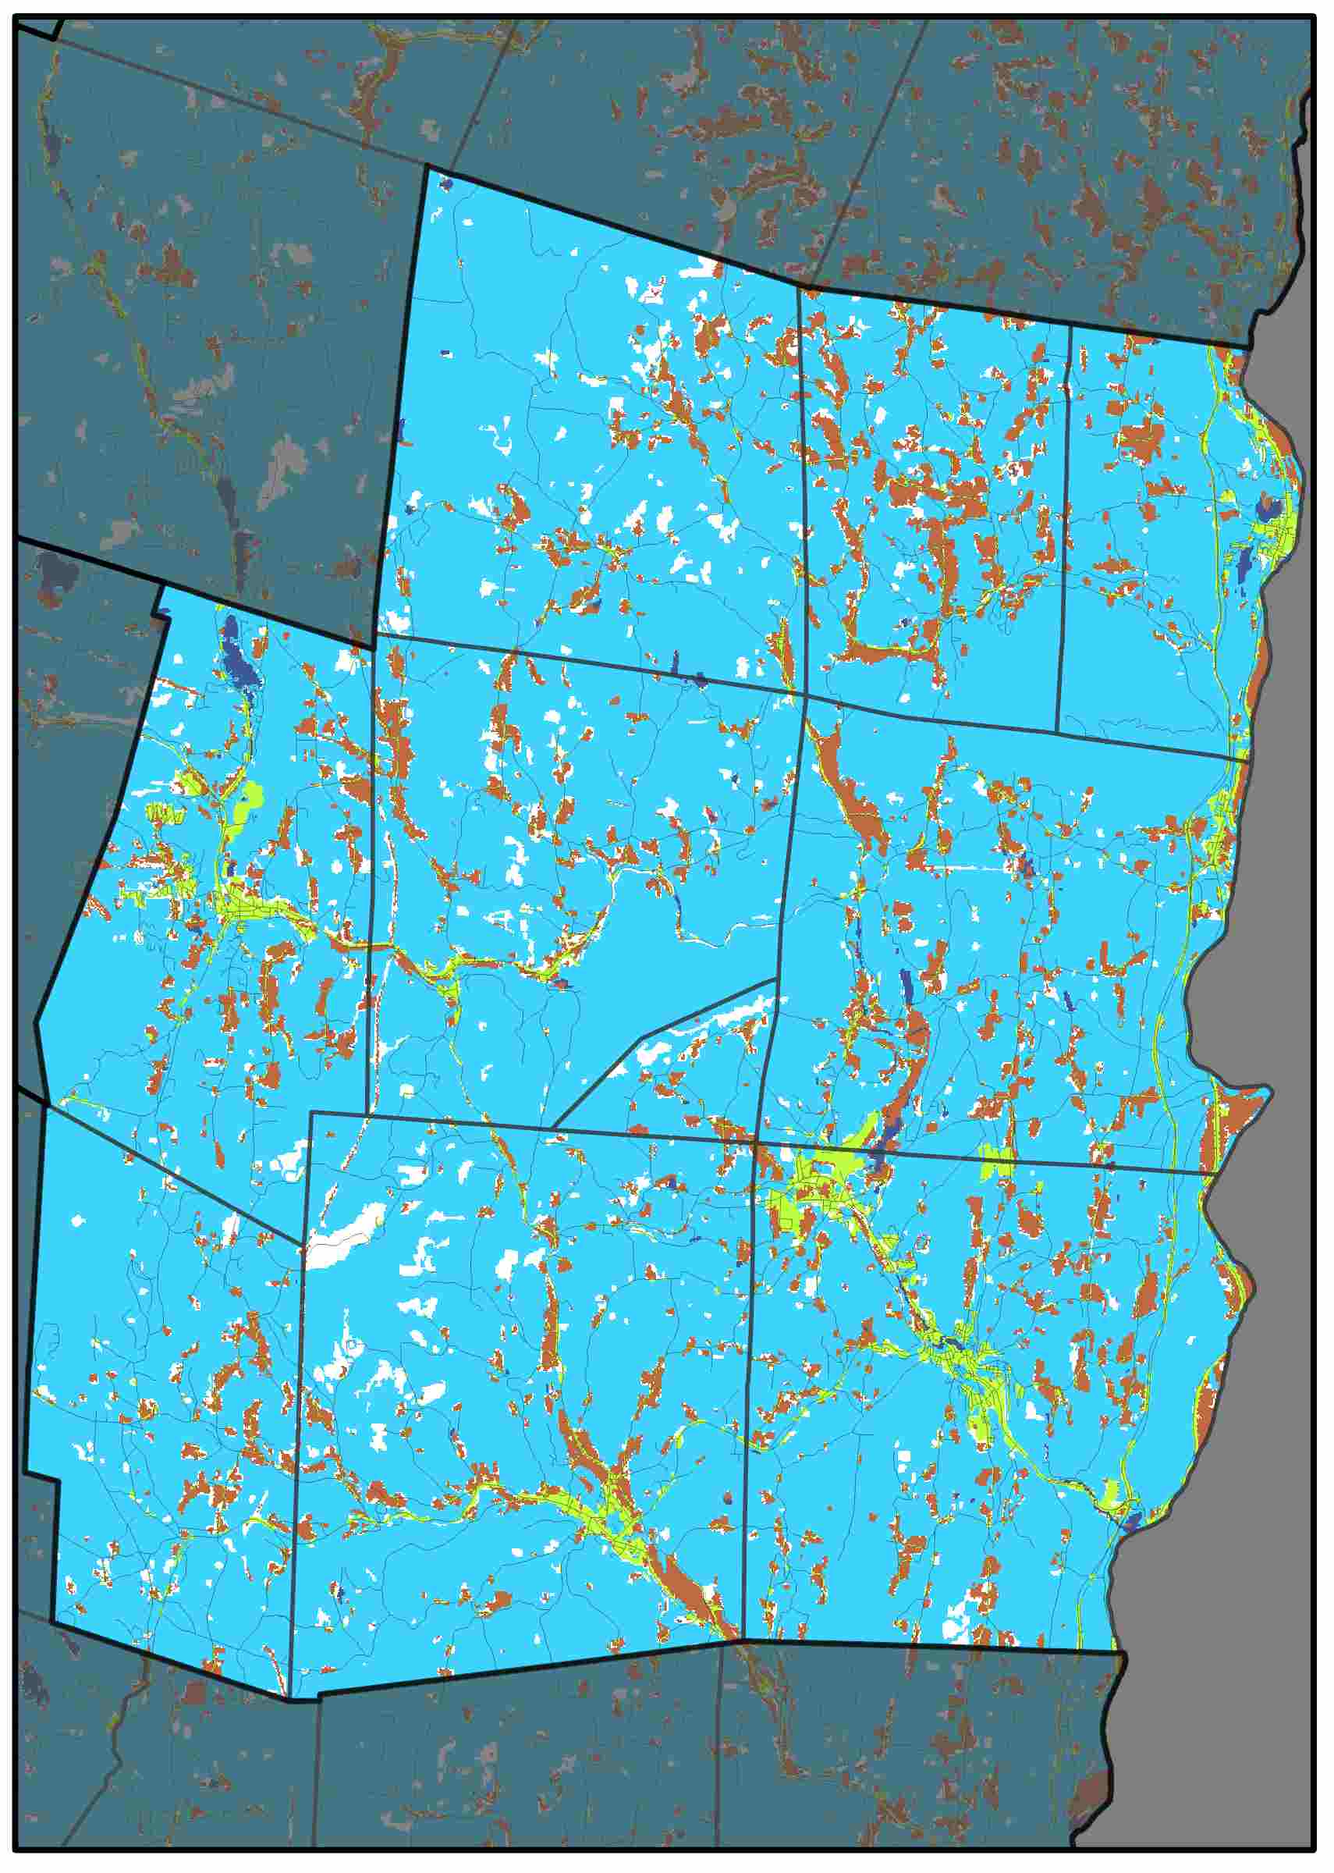
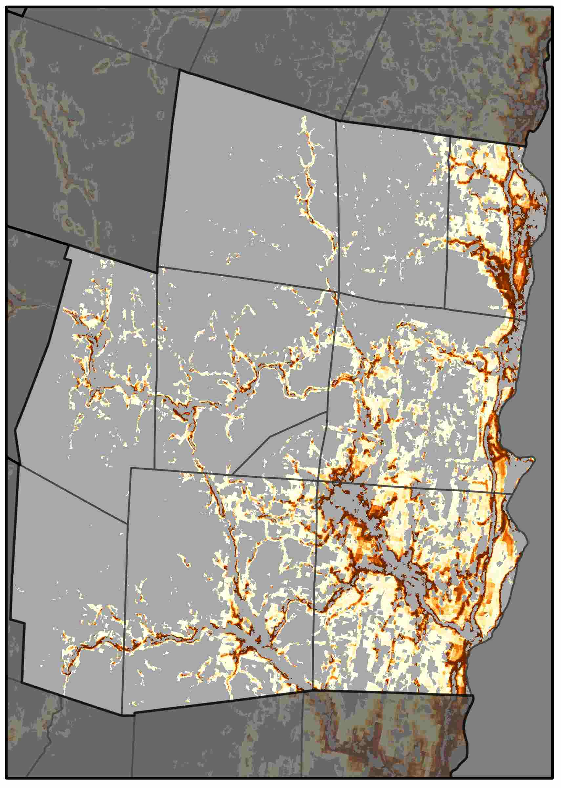
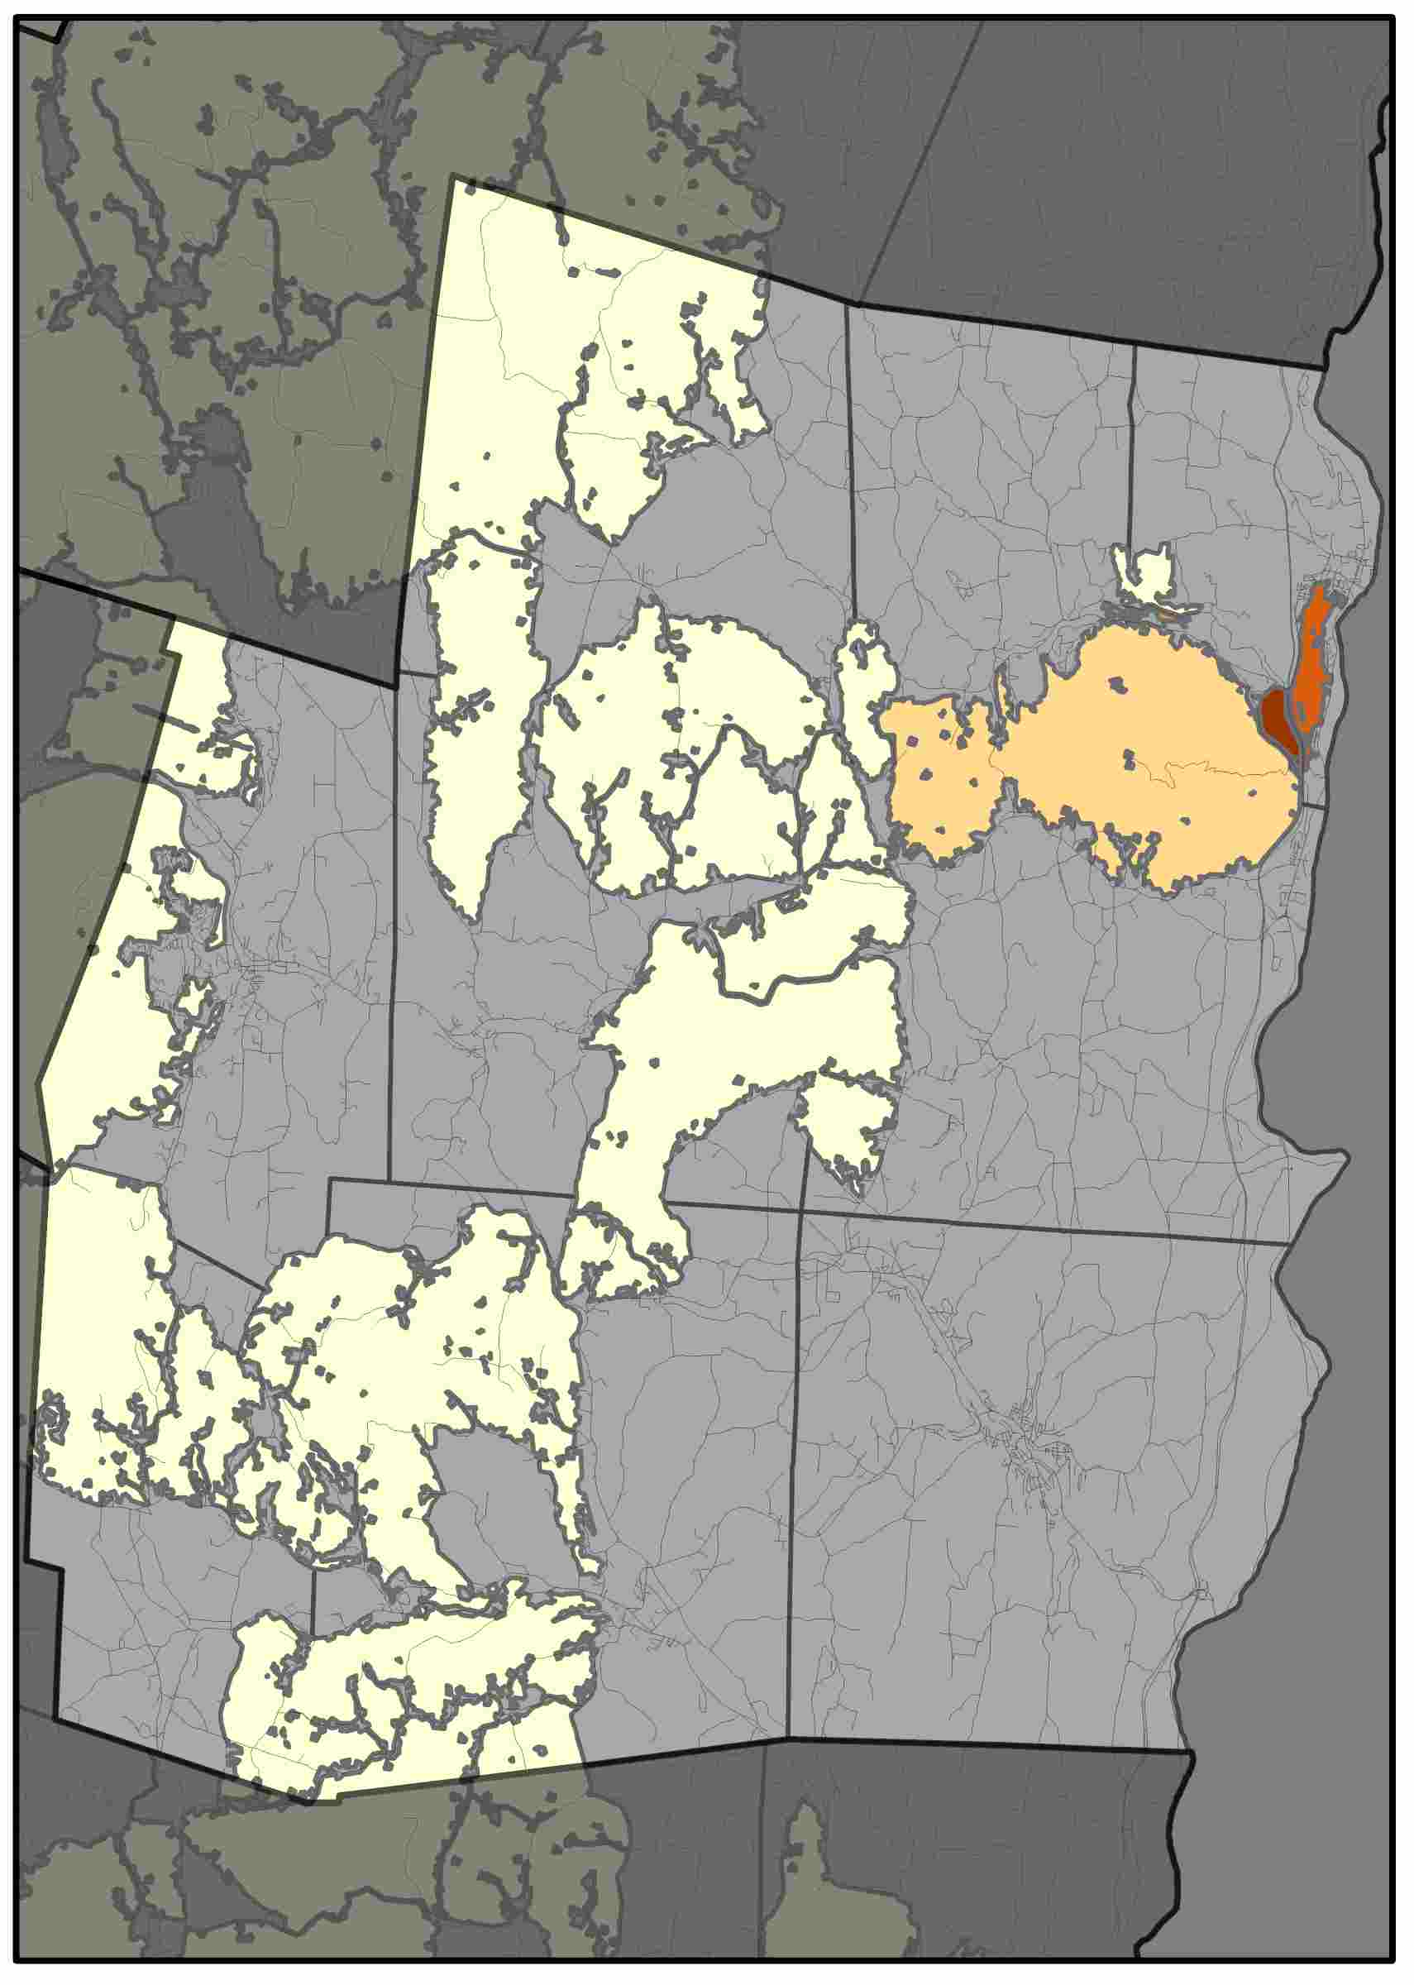
Southern Windsor County Regional Planning Commission
Central Vermont Regional Planning Commission shows some things, and there can be about four sentences of text here. Central Vermont Regional Planning Commission shows some things. There can be about four sentences of text here. Central Vermont Regional Planning Commission shows some things, and there can be about four sentences of text here. Central Vermont Regional Planning Commission shows some things. There can be about four sentences of text here.
Forest Cover (2015)
Probability of Conversion (2030)
Risks to High Priority Forests (2030)
Drivers of Conversion
Driver | Rank
Dist. Interstate | 1
Dist. Urban | 2
Aspect | 3
Elevation | 4
Dist. Major Road | 5
The NVDA has been losing approximately 0.4% of its forest cover to development each decade.
Areas at highest risk are dispersed along major roads, particularly near urban centers, as well as lower elevation locations.
Percent Forest Converted to Developed
1985-2000 | 2000-2015
1.3% | 1.1%
Here is some brief statement about these graphs and maps show. Here is some brief statement about these graphs and maps show.

Slide 9
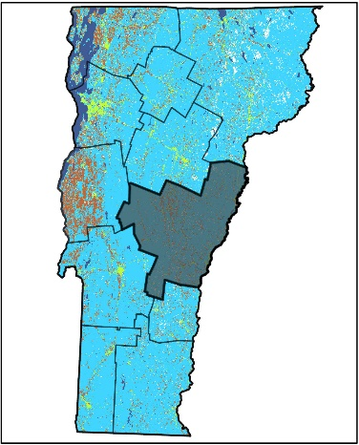
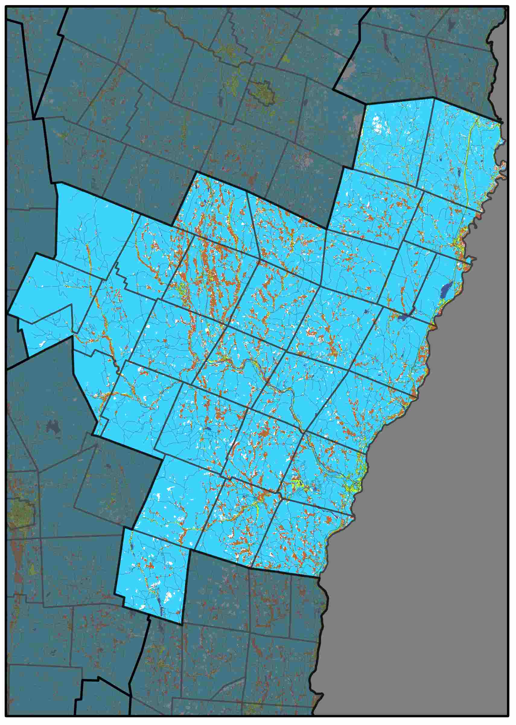
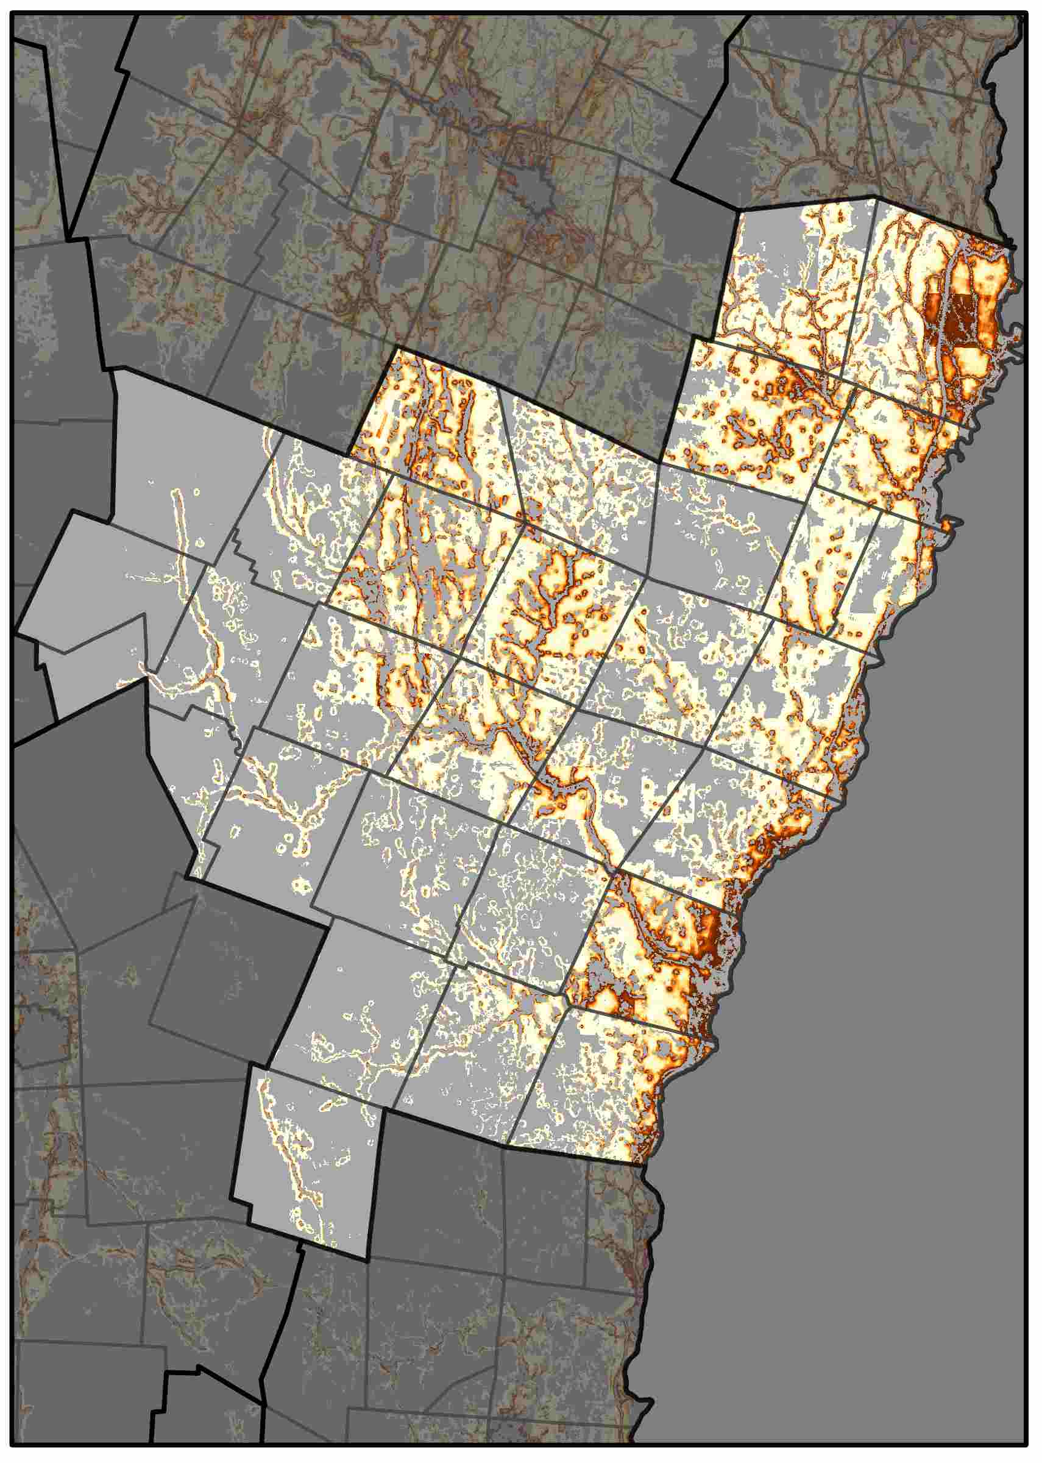
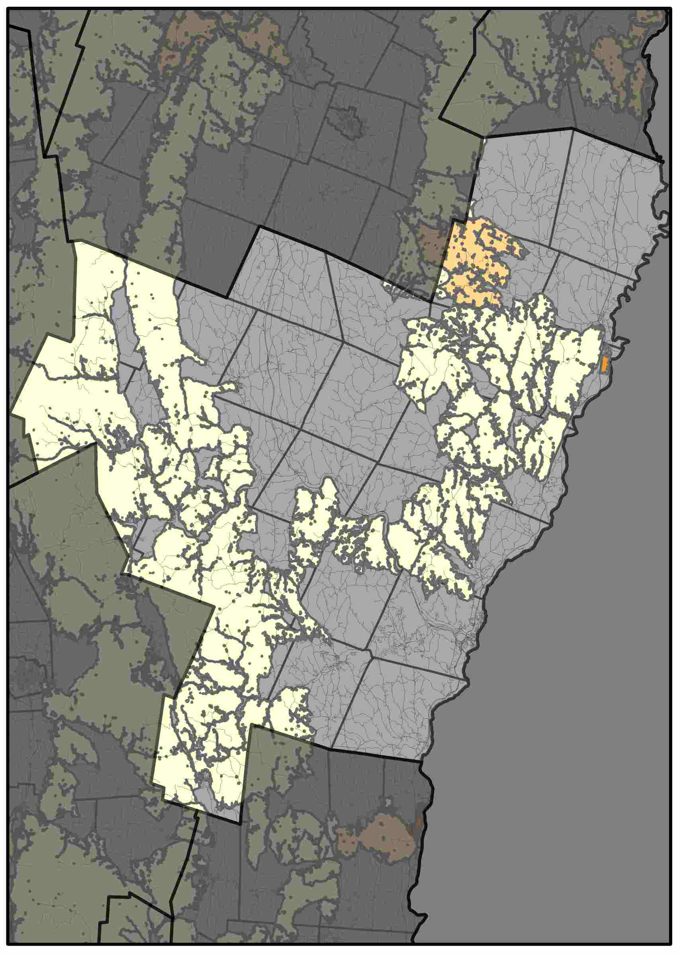
Two Rivers-Ottauquechee Regional Commission
Central Vermont Regional Planning Commission shows some things, and there can be about four sentences of text here. Central Vermont Regional Planning Commission shows some things. There can be about four sentences of text here. Central Vermont Regional Planning Commission shows some things, and there can be about four sentences of text here. Central Vermont Regional Planning Commission shows some things. There can be about four sentences of text here.
Forest Cover (2015)
Probability of Conversion (2030)
Risks to High Priority Forests (2030)
Drivers of Conversion
Driver | Rank
Dist. Interstate | 1
Dist. Urban | 2
Dist. Major Road | 3
Elevation | 4
Pop. Density | 5
The NVDA has been losing approximately 0.4% of its forest cover to development each decade.
Areas at highest risk are dispersed along major roads, particularly near urban centers, as well as lower elevation locations.
Percent Forest Converted to Developed
1985-2000 | 2000-2015
1.5% | 0.6%
Here is some brief statement about these graphs and maps show. Here is some brief statement about these graphs and maps show.

Slide 10
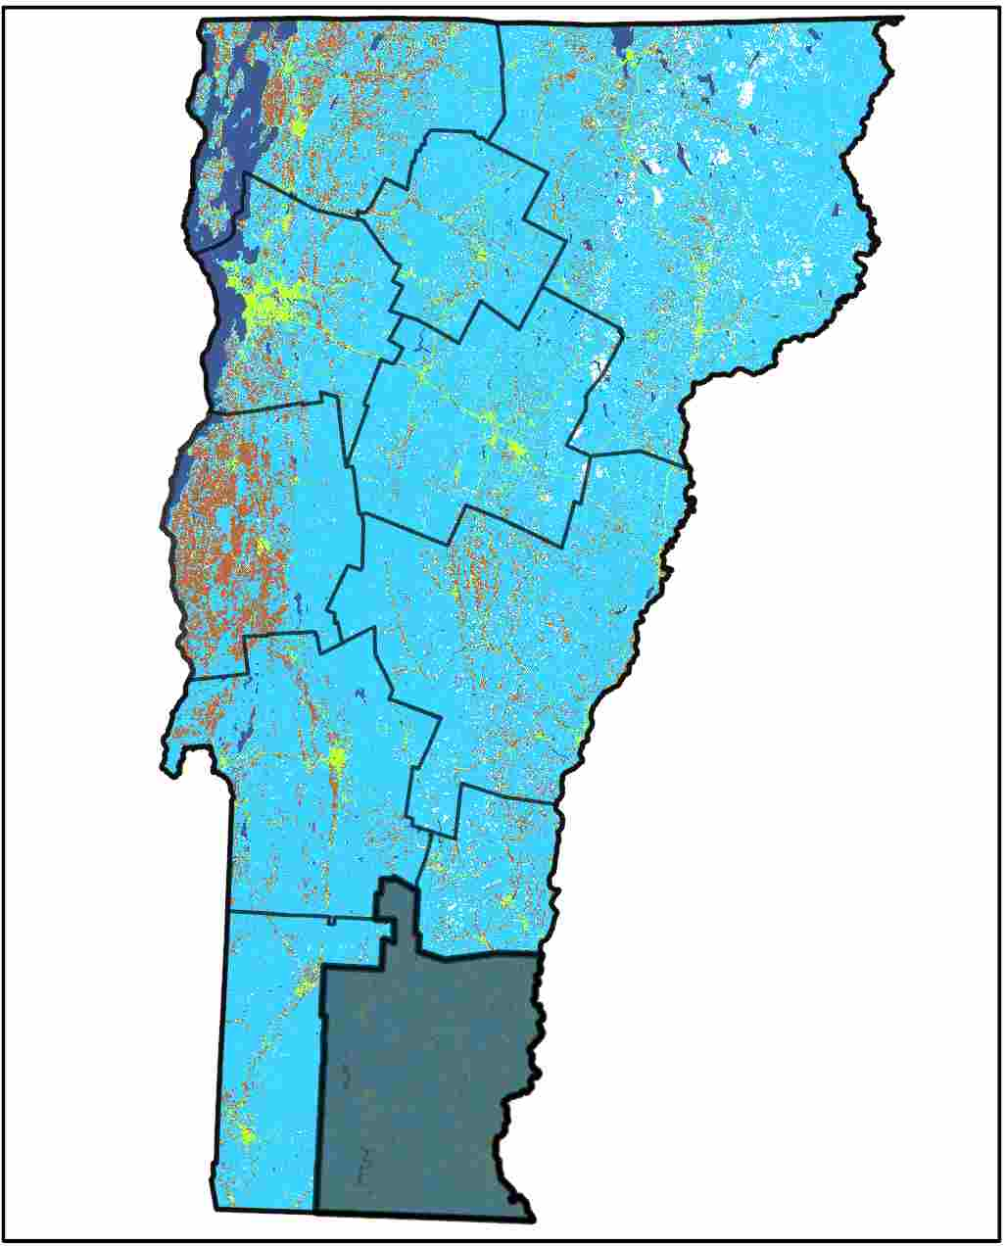
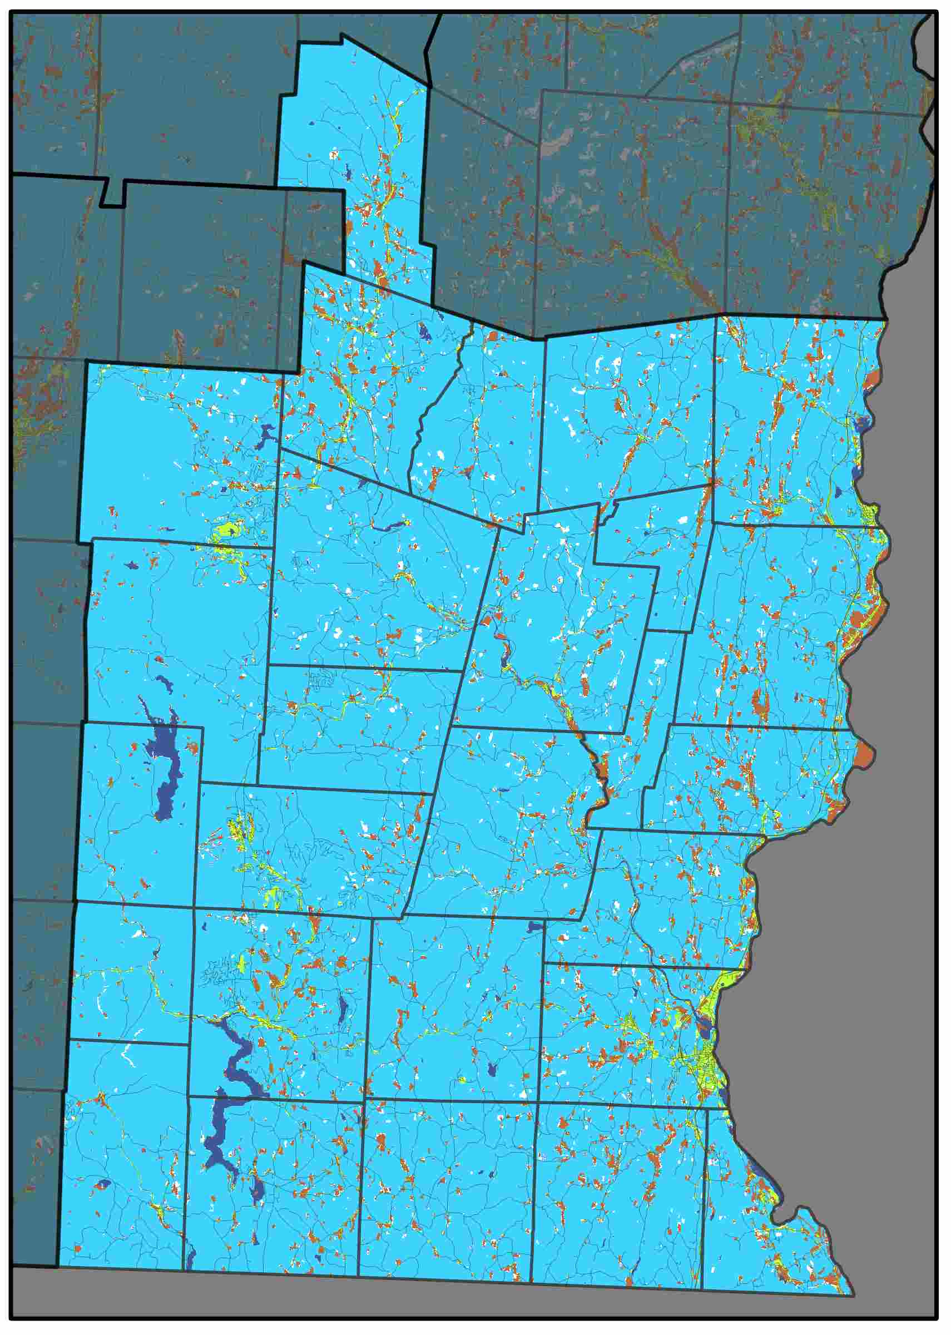
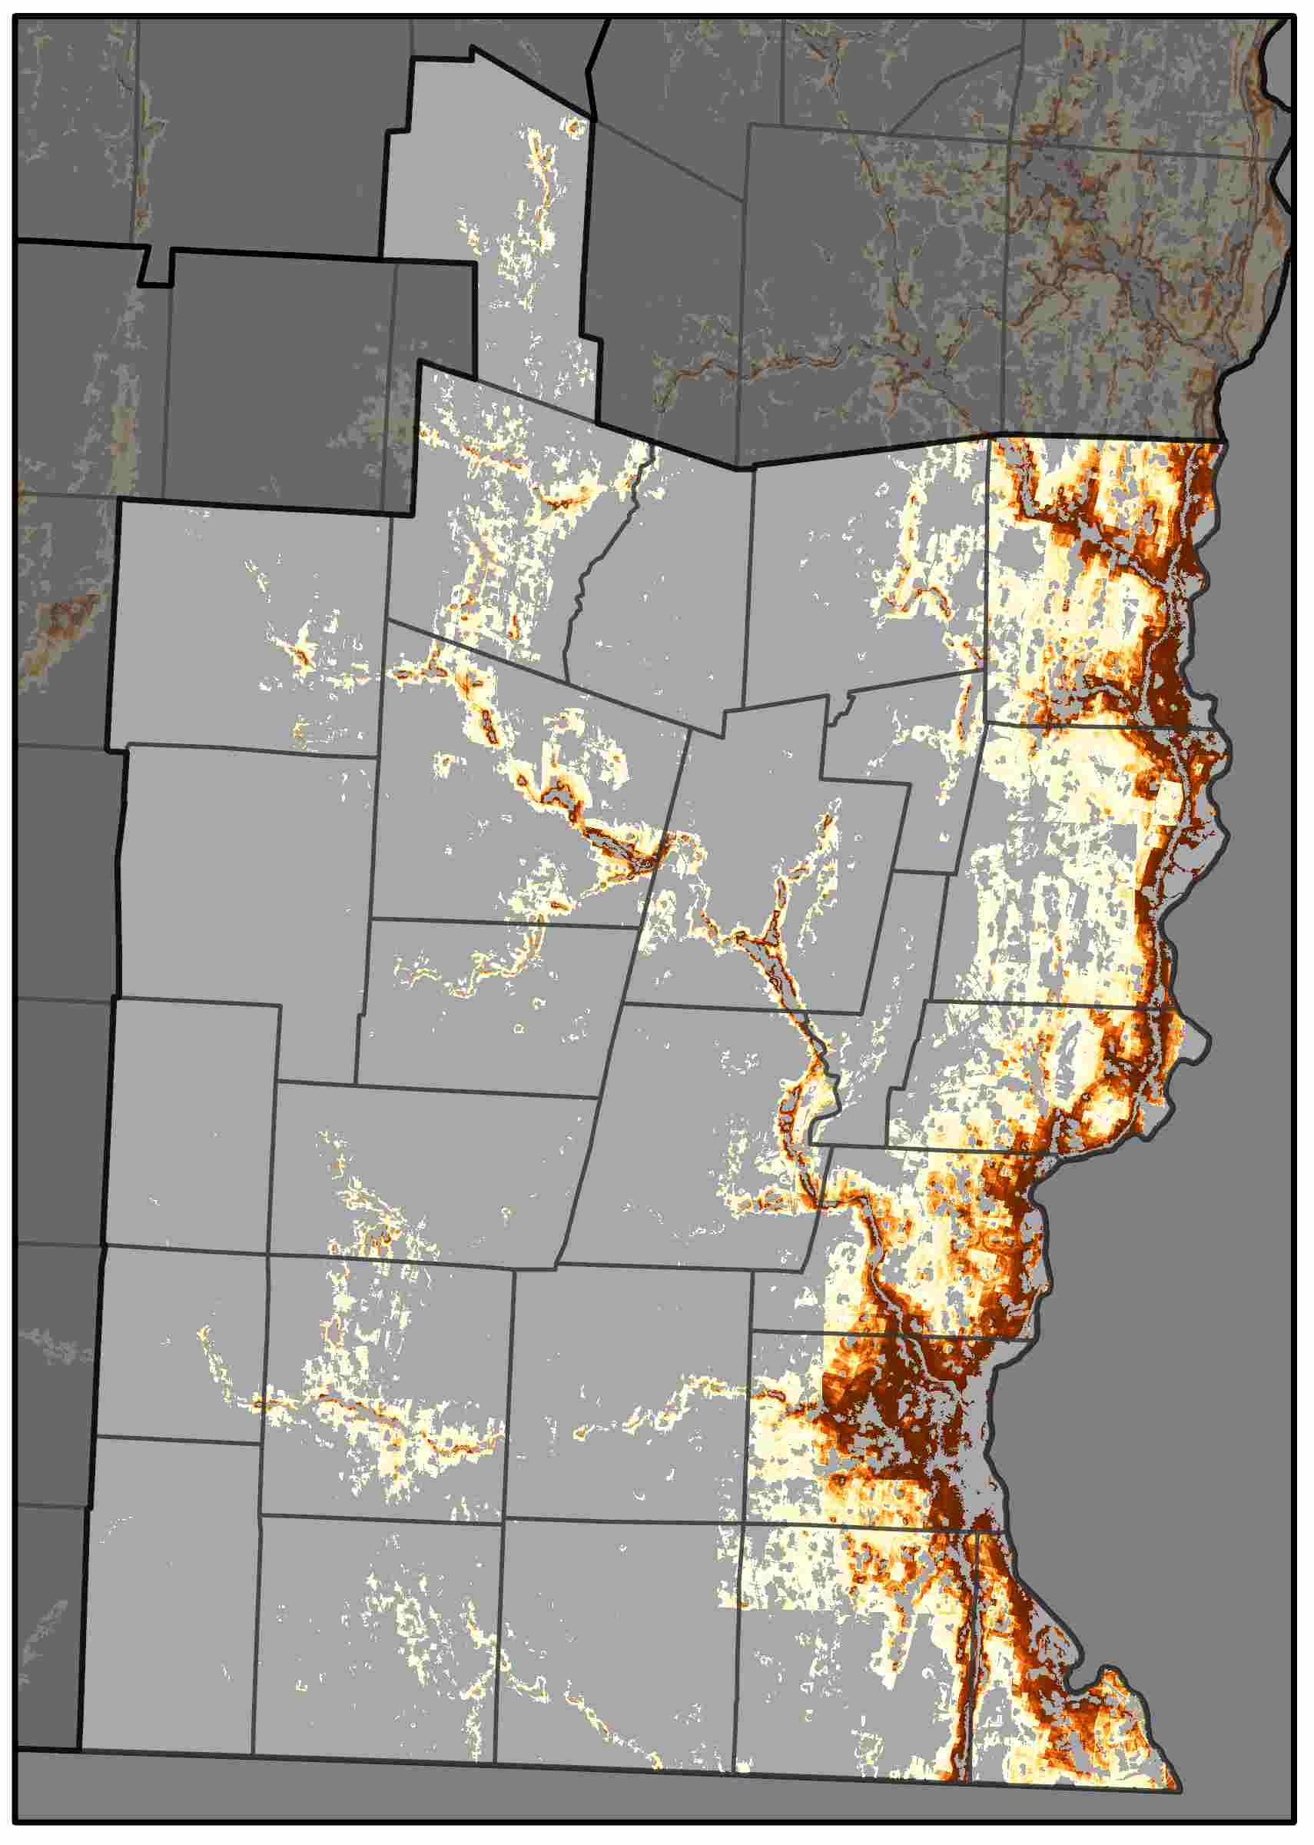
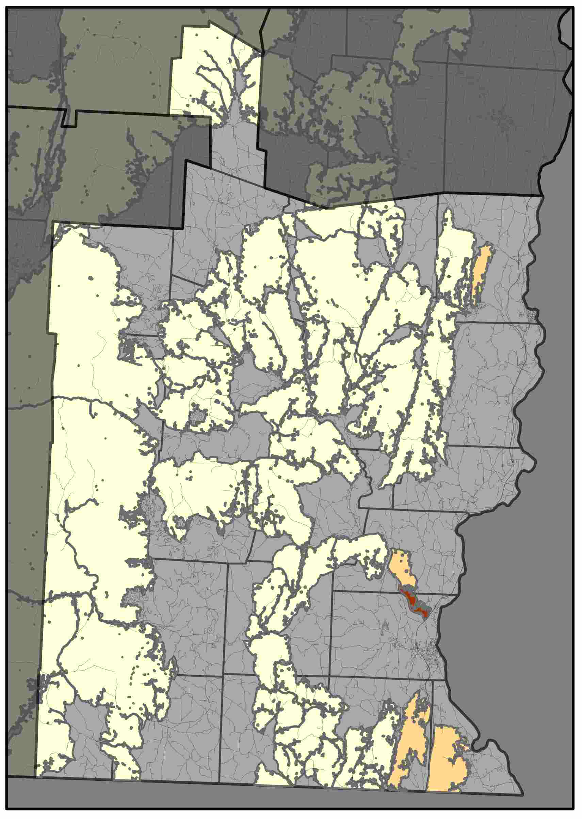
Windham Regional Commission
Central Vermont Regional Planning Commission shows some things, and there can be about four sentences of text here. Central Vermont Regional Planning Commission shows some things. There can be about four sentences of text here. Central Vermont Regional Planning Commission shows some things, and there can be about four sentences of text here. Central Vermont Regional Planning Commission shows some things. There can be about four sentences of text here.
Forest Cover (2015)
Probability of Conversion (2030)
Risks to High Priority Forests (2030)
Drivers of Conversion
Driver | Rank
Dist. Interstate | 1
Dist. Urban | 2
Dist. Major Road | 3
Elevation | 4
Aspect | 5
The NVDA has been losing approximately 0.4% of its forest cover to development each decade.
Areas at highest risk are dispersed along major roads, particularly near urban centers, as well as lower elevation locations.
Percent Forest Converted to Developed
1985-2000 | 2000-2015
0.7% | 0.8%
Here is some brief statement about these graphs and maps show. Here is some brief statement about these graphs and maps show.

Slide 11
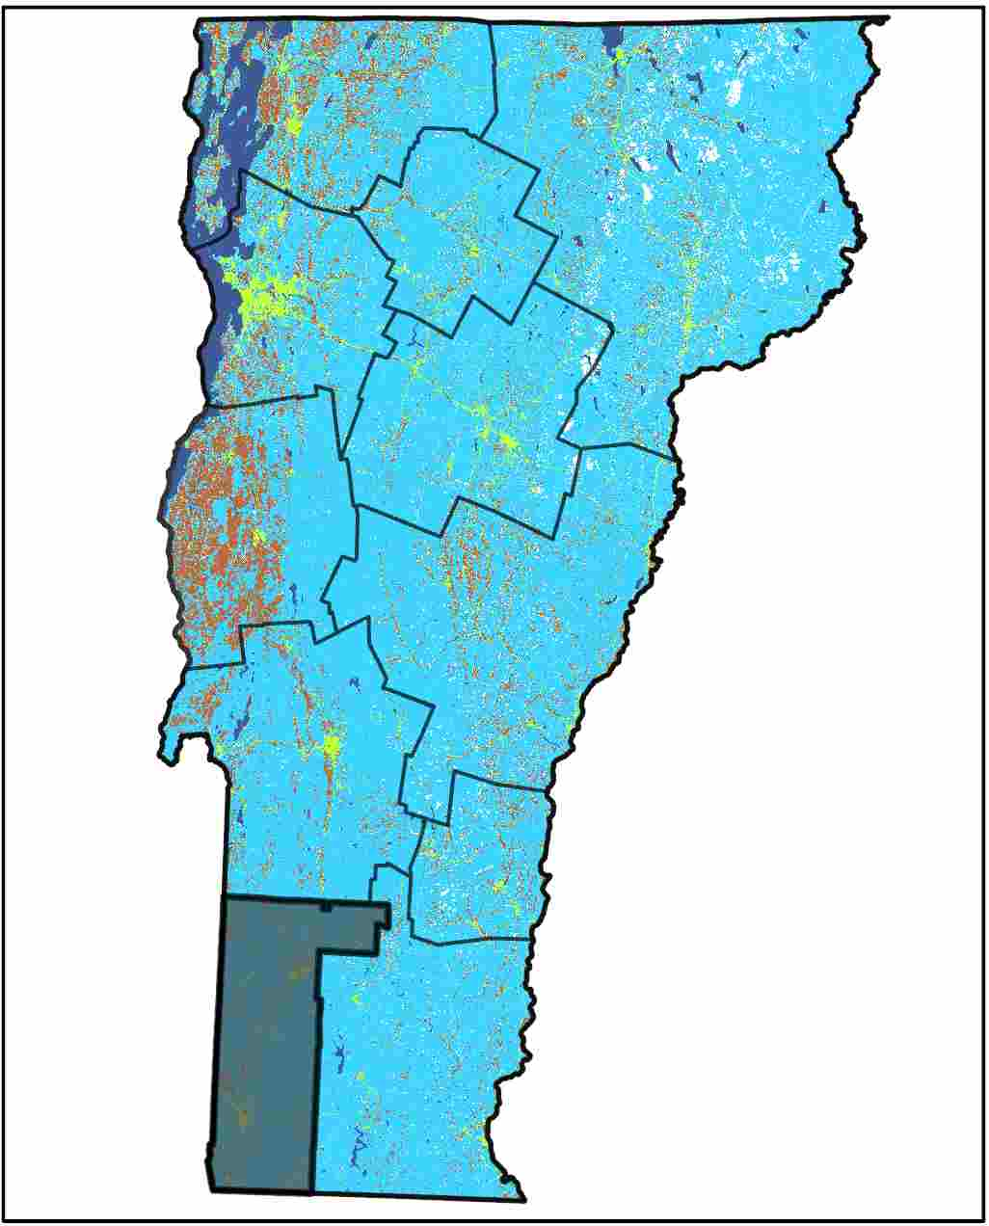
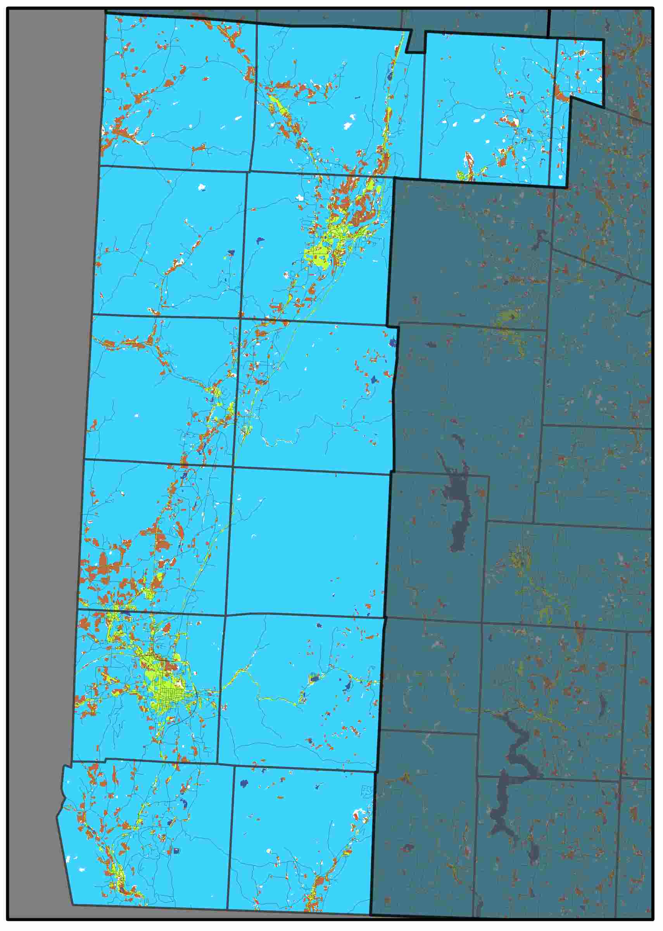
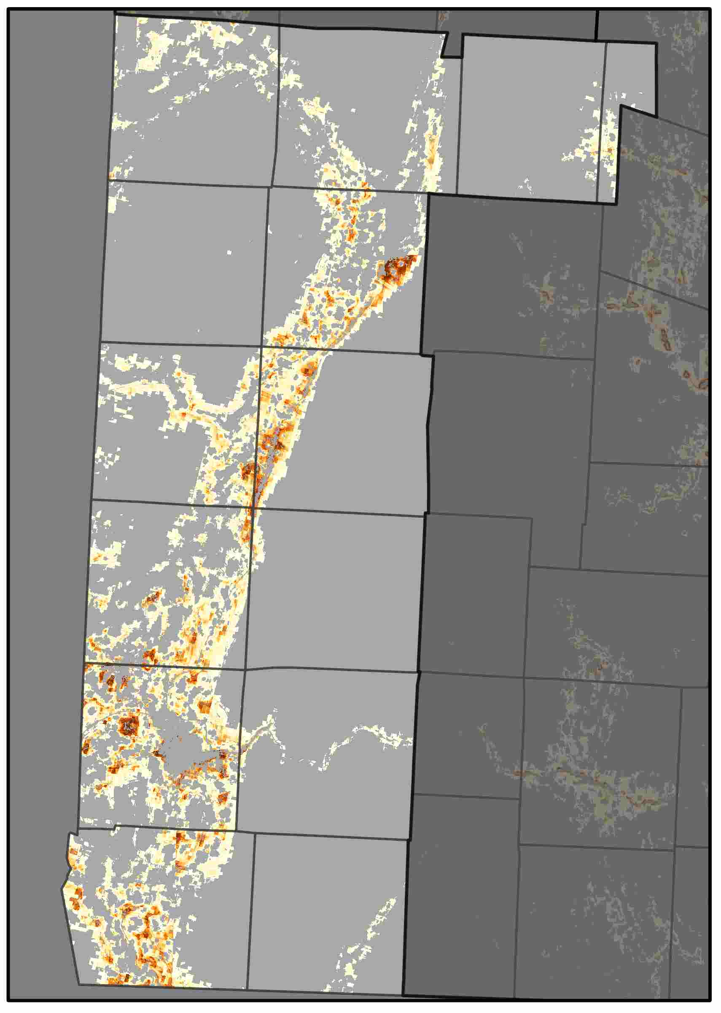
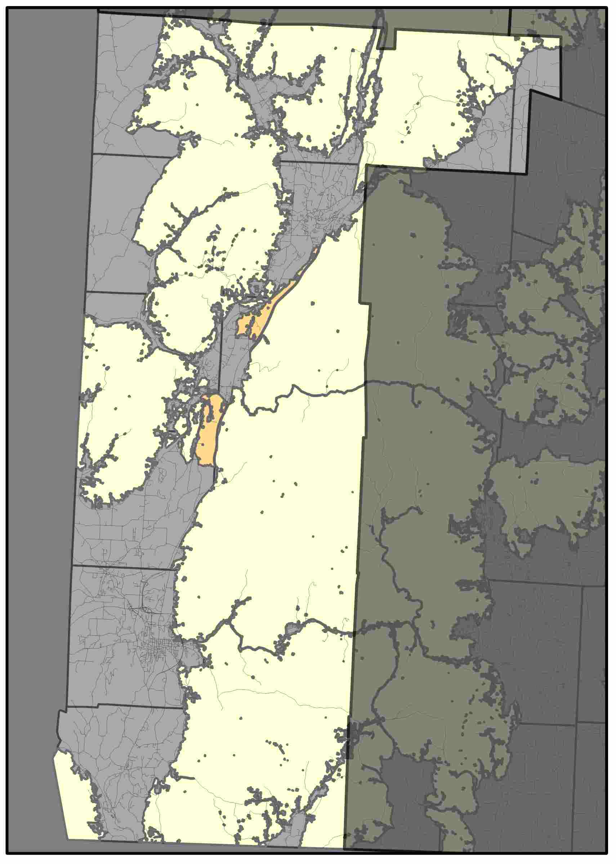
Bennington County Regional Commission
Central Vermont Regional Planning Commission shows some things, and there can be about four sentences of text here. Central Vermont Regional Planning Commission shows some things. There can be about four sentences of text here. Central Vermont Regional Planning Commission shows some things, and there can be about four sentences of text here. Central Vermont Regional Planning Commission shows some things. There can be about four sentences of text here.
Forest Cover (2015)
Probability of Conversion (2030)
Risks to High Priority Forests (2030)
Drivers of Conversion
Driver | Rank
Dist. Urban | 1
Dist. Interstate | 2
Aspect | 3
Dist. Major Road | 4
Elevation | 5
The NVDA has been losing approximately 0.4% of its forest cover to development each decade.
Areas at highest risk are dispersed along major roads, particularly near urban centers, as well as lower elevation locations.
Percent Forest Converted to Developed
1985-2000 | 2000-2015
0.9% | 0.8%
Here is some brief statement about these graphs and maps show. Here is some brief statement about these graphs and maps show.

