Slide 1
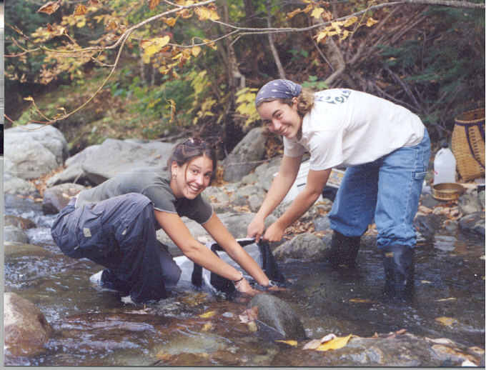
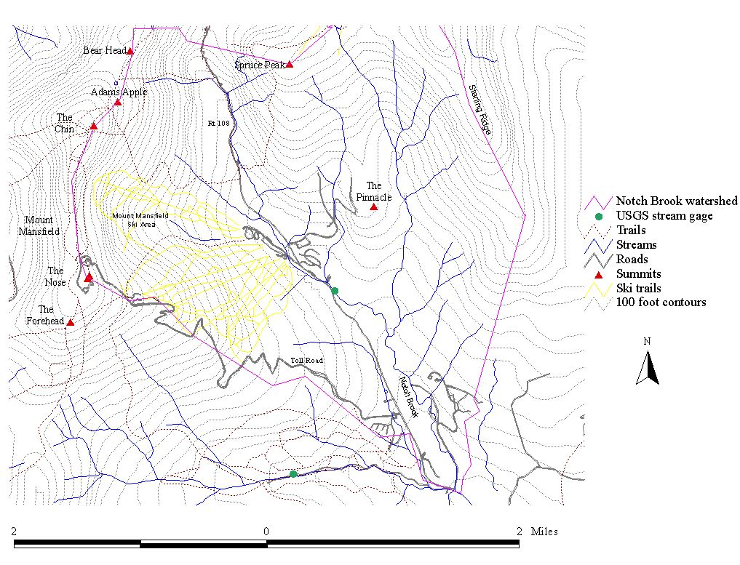
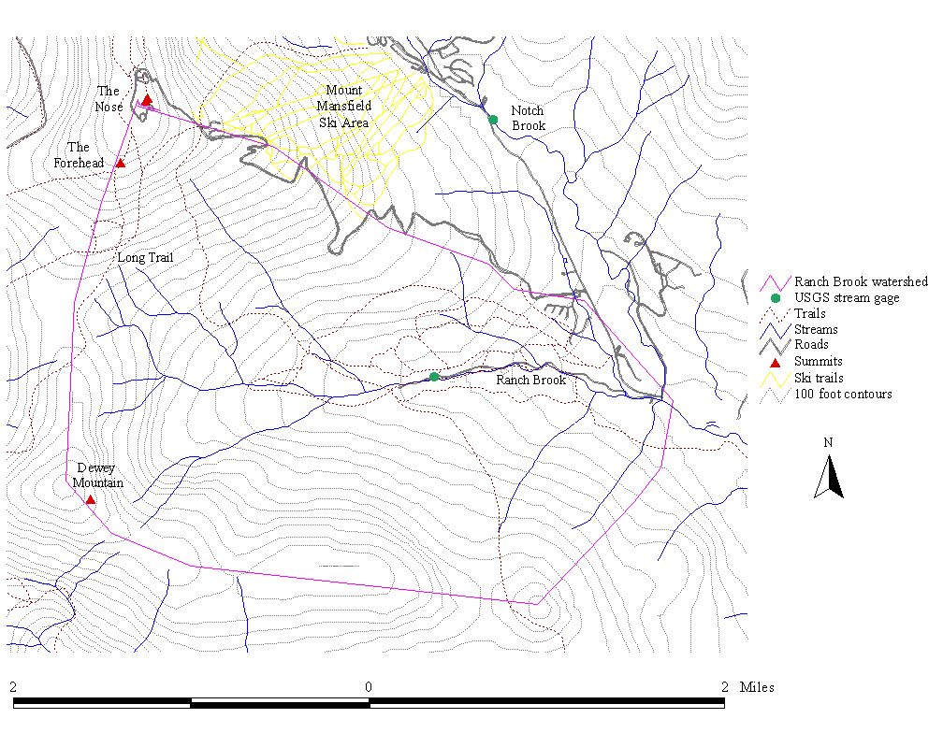
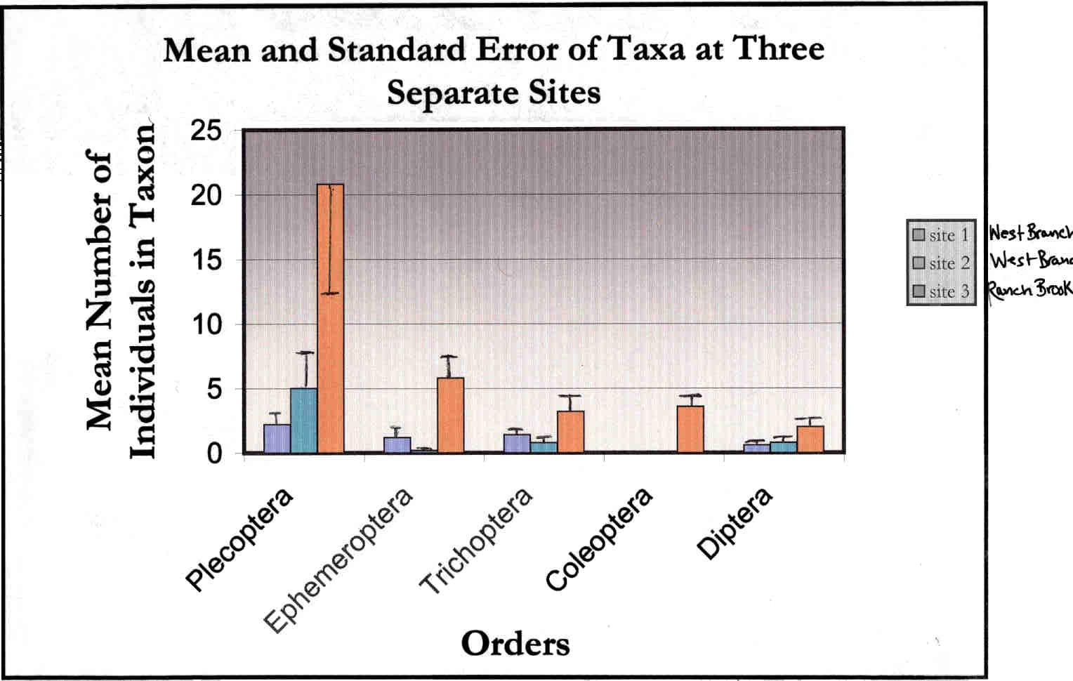
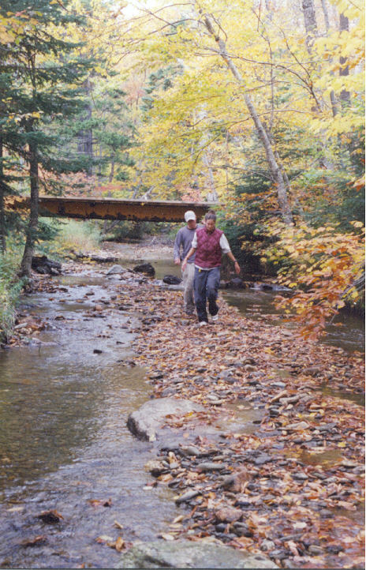
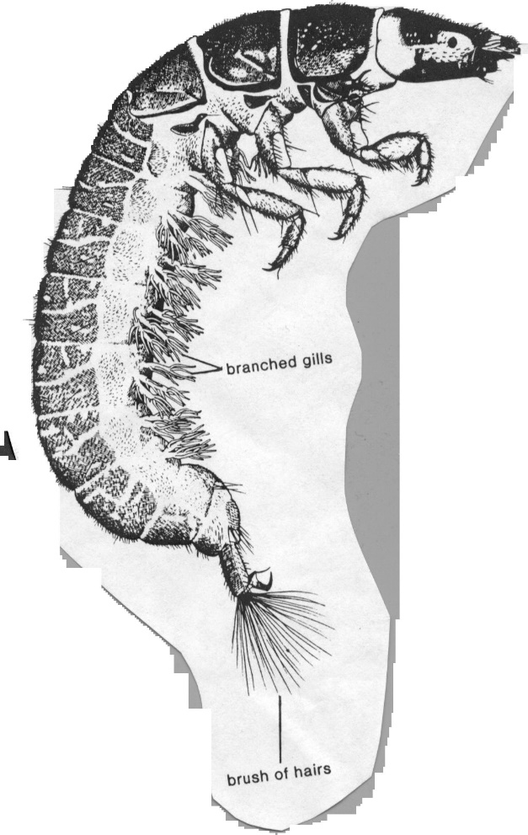
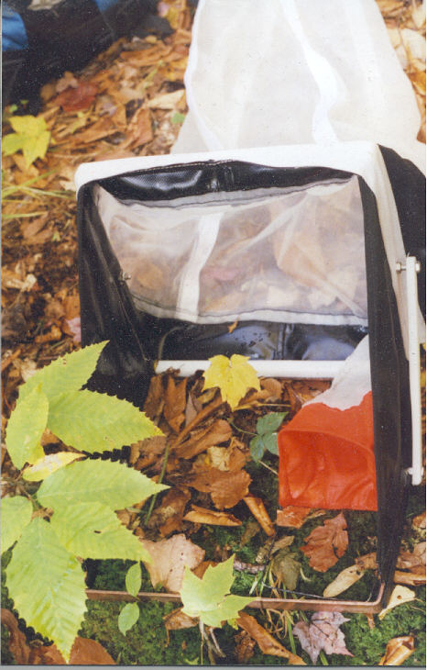
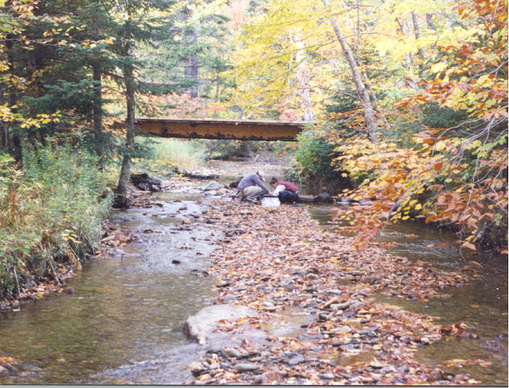
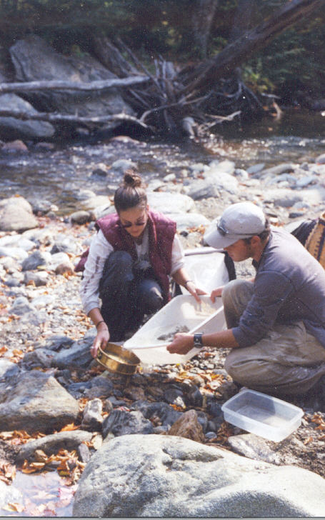
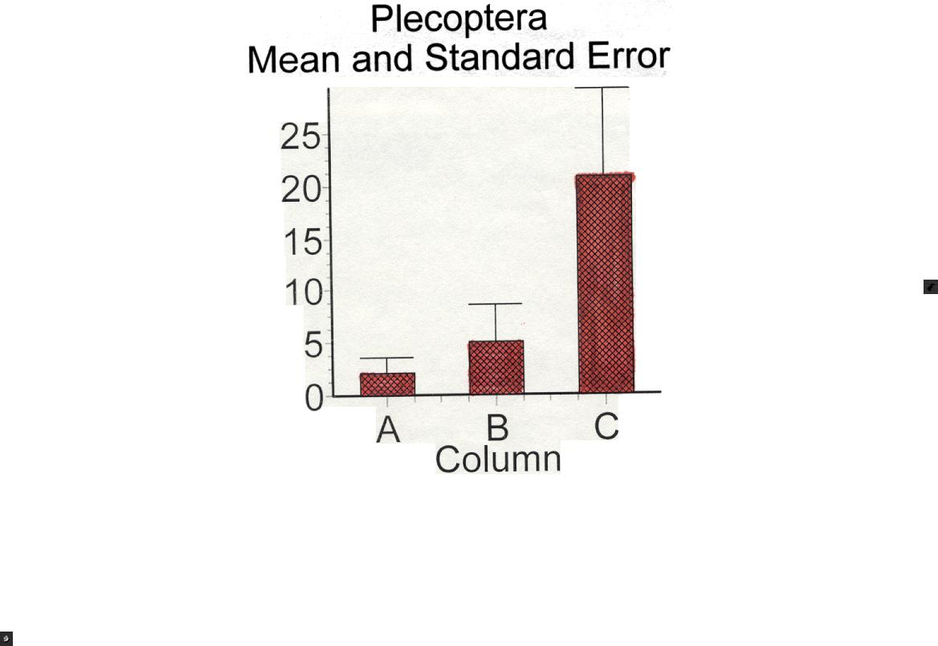
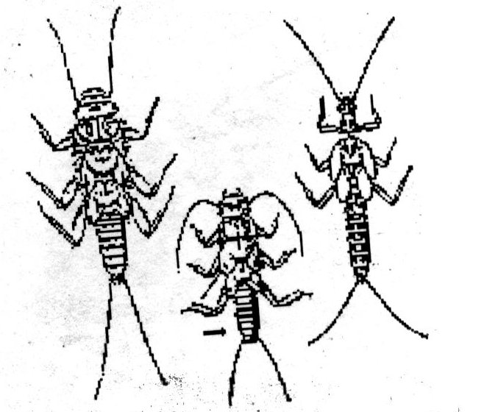
Macroinvertebrates as
Water Quality Indicators on Mount Mansfield
Biological Assessment:
Erin Magoon
Sterling College
Qbjectives
1.)To collect baseline data for continued monitoring of the response of the benthic macro invertebrate community to the expansion of the Stowe Ski Area.
2.)To compare results from different sites on two separate stream channels. Two sites where sampled on an impacted stream, and one on a control.
3.)To calculate the quality of the streams using biotic indices.
Methods
We chose three separate sites. The first two were on the West Branch to compare data from a heavily impacted area, to one less impacted further up stream. The lower site is located right below the snow making pond and a USGS data collection site. The Ranch Brook site is also located at a USGS monitoring site, this was done to deep sites at similar elevation, stream order, and discharge.
In the field:
Starting sampling at the bottom of a riffle and working up, we took a set of five replicates at each site. I chose the Surber sampler as the best sampling device based on previous studies by Sterling students.
In the lab:
After sorting the macroinvertebrates from the other material, they were picked out and separated into groups of the same order. They were placed into a bottle with a label of the site number, the order name, and alcohol. Further identification to family is desirable.
Introduction
Sterling College seniors are required to do a senior project, this particular senior project compares macro invertebrates of Ranch Brook with those of West Branch in Stowe, Vermont. Previous work on Mount Mansfield, and Sterling's involvement with the Vermont Monitoring Cooperative, has made this project possible. Benthic macroinvertebrates are a popular assessment tool when considering water quality.
Preliminarv Conclusions
Based on initial analysis, there appear to be greater percentages of pollution-intolerant taxa, (Ephemoptera,Plecoptera, and Tricoptera) in the Ranch Brook site as compared to West Branch. Interestingly, there does not appear to be a difference in diversity between the two West Branch sites, above and below the ski area.
References
Biological Monitoring of Freshwaters-Benthic Macroinvertebrates-Background.
Diversity & Biotic Indices.
http://www.chebcto.ns.ca/Science/SWCS/ZOOBENTH/biotic.html
Hauer, Richard F. and Gary A. Lamberti. Methods in Stream Ecology. San Diego CA: Academic Press, 1996.
Karr, James R. and Ellen W. Chu. Restoring Life in Running Waters: Better Biological Monitoring. Washington D.C.: Island Press 1999.
Merrit, Richard W. and Kenneth W. Cummins. An Introduction to the Aquatic Insects of North America. Second Edition. Dubuque, Iowa: Kendall/Hunt Publishing Co. 1984.
Mitchell, Mark and William B. Stapp. Field Manual for Water Quality Monitoring:An Environmental Education Program for Schools. Dexter, Michigan: Thomson-Shore, Inc., 1986.
Moulton II, Stephen R., et al., Methods of Analvsis bv the U.S. Geological Survey National Water Quality Laboratory-Processing, Taxonomy and Quality Control of Benthic Macroinvertebrate Samples. U.S. Geological Survey, Denver, CO, 2000.
Peckarsky, Barbara L., Pierre R. Fraissinet, Marjory A. Penton, and Don I. Conklin, Jr. Freshwater Macroinvertebrates of Northeastern North America. Ithaca, New York:Cornell University Press, 1990.
Plafkin, James L., et al., Rapid Bioassessment Protocols for use in Streams and Rivers:Benthic Macroinvertebrates and Fish. U.S. Environmental Protection Agency:Washington D.C., May 1989.
Stowe Mountain Resort: A Community Plan for the Future of the Mountain. Stowe Mountain Resort 2000 Community Planning
Terrell, Charles R. and Dr. Patricia Bytnar Perfetti. Water Ouality Indicators Guide:Surface Waters Second Edition. Dubuque, Iowa:Kendall/Hunt Publishing Company, 1996.
Results
Calculations were made by comparing the different taxa from each sample site using GraphPad Instat. The One-way Analysis of Variance (ANOVA) determines whether the means are significantly different. There were significantly greater densities (p<.O5) of Ephemoptera and Diptera in Ranch Brook as compared to West Branch.
Although biotic indices have not been calculated, there were visible differences. Looking at the graph for Plecoptera, the pattern is what you would expect given the conditions of the sites.
While sampling, it was evident that the amount of sediment in the first site on West Branch was the heaviest; a little less in the second site, and even less in Ranch Brook. In the two West Branch sites there were not many large macroinvertebrates. Within the first sample on Ranch, there was the largest of the Plecoptera, and a small salamander. In general there is a trend toward higher density in Ranch Brook than West Branch across all taxa.

