Slide 1


Community Development
Rubaina Anjum^{1,2}, Benjamin E. K. Ryan^{1,2}, Renata A Lucchesi Kadri^{3,5}, Rodrigo Soares⁴
¹Gund Institute for Environment, ²Community Development and Applied Economics, ³Geography and Geosciences Department, ⁴Department of Agriculture, Landscape & Environment, ⁵Environmental Program
Recommended Citation:
Anjum, R., Ryan, B., Kadri, R., Soares, R., 2026. Chapter 11: Community Development. In Galford, G.L., Balerna, J.A., Turner H.C., Sardonis, A., Peplinski, H. (Eds), The Vermont Climate Assessment 2025. Burlington, Vermont: Climate Measurements Center of Excellence, Gund Institute for Environment at the University of Vermont. DOI: 10.5281/zenodo.20272849. Accessed online at https://vtclimate.org.

Slide 2
11.2 Background

Slide 3
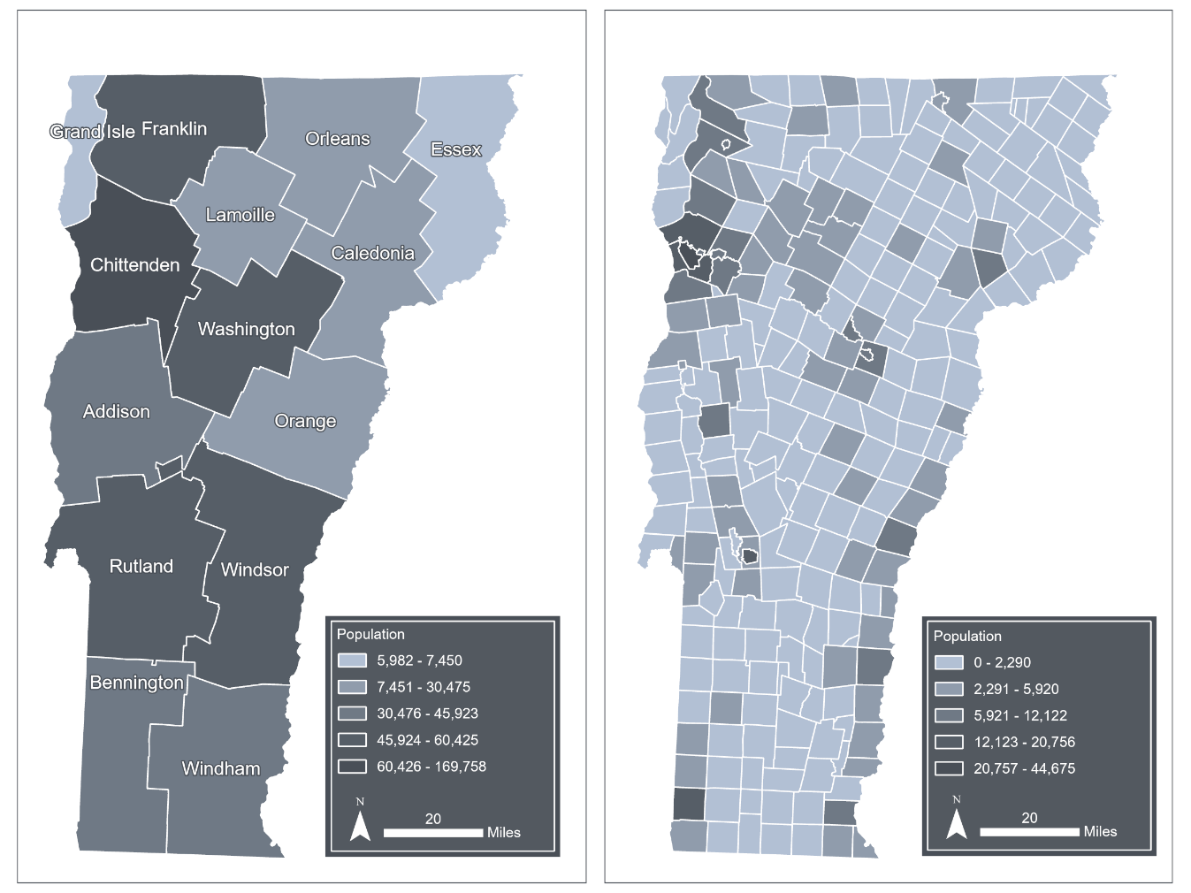
Figure 11-1
Population density by county (left) and population density by town (right) using 2024 American Community Survey (ACS) 5-year estimates
Source: U.S. Census Bureau (2024b)
Note: Visualization by Hannah C. Turner

Slide 4
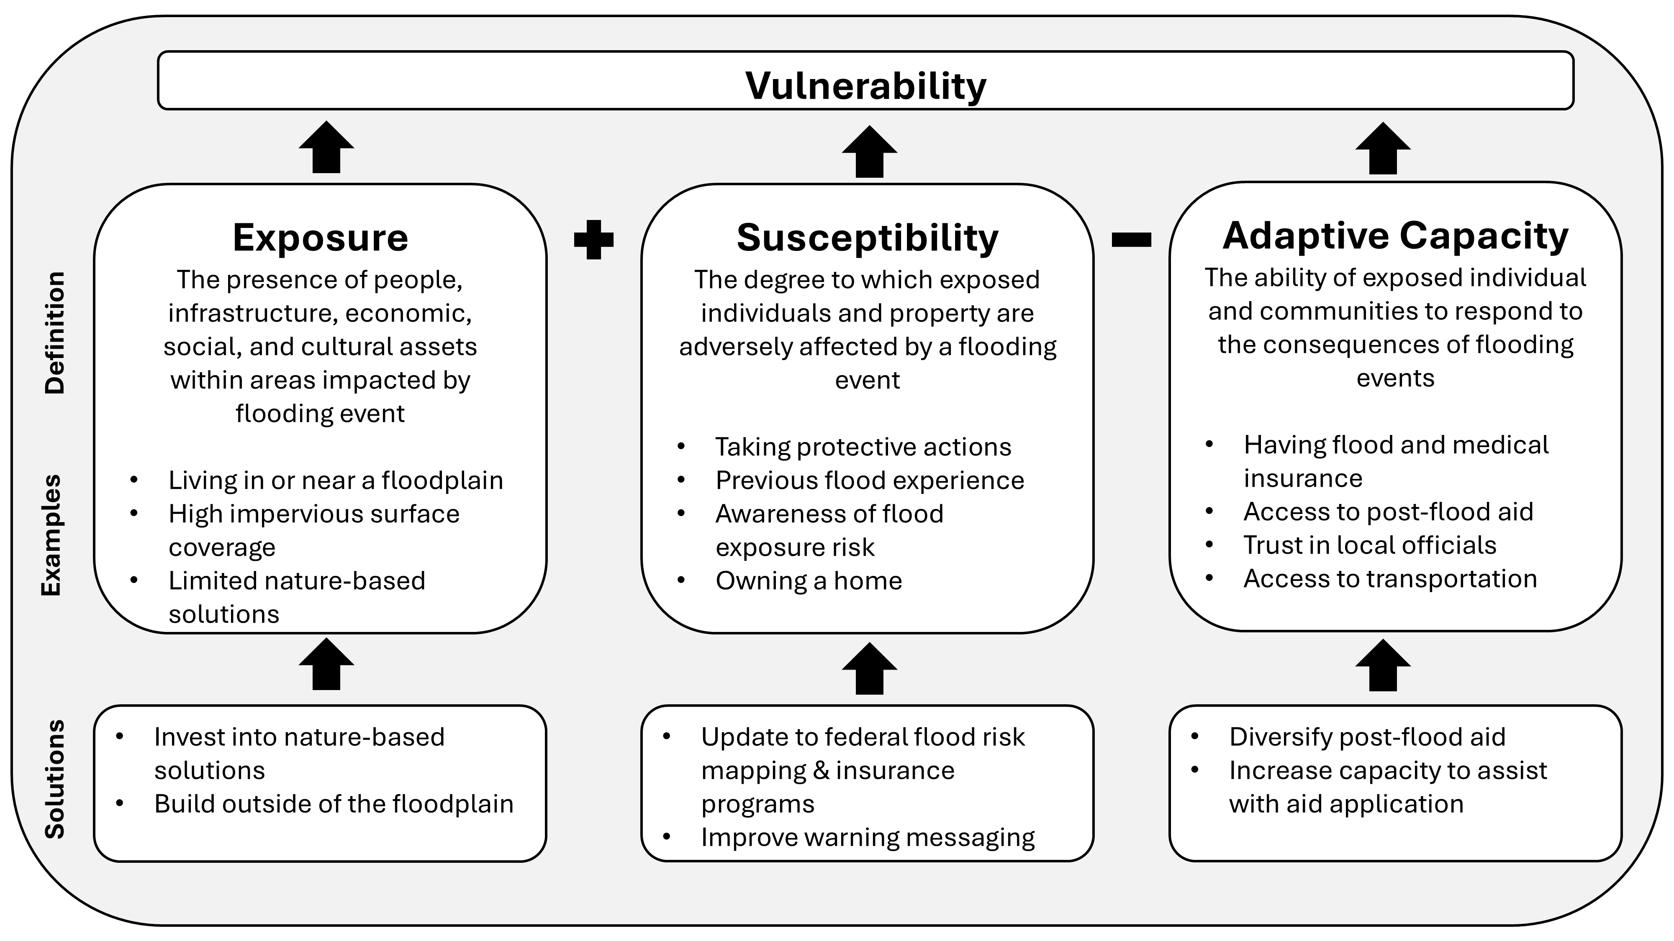
Figure 11-2
Assessing and addressing vulnerability for a flood hazard
Source: Data visualization by authors and Jessica A. Balerna

Slide 5
11.3 Demography

Slide 6
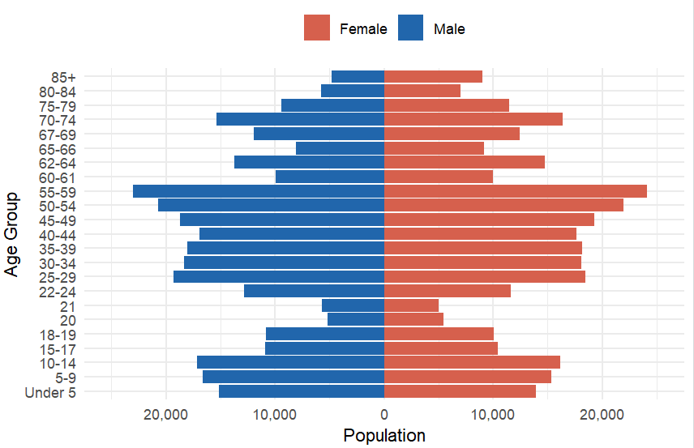
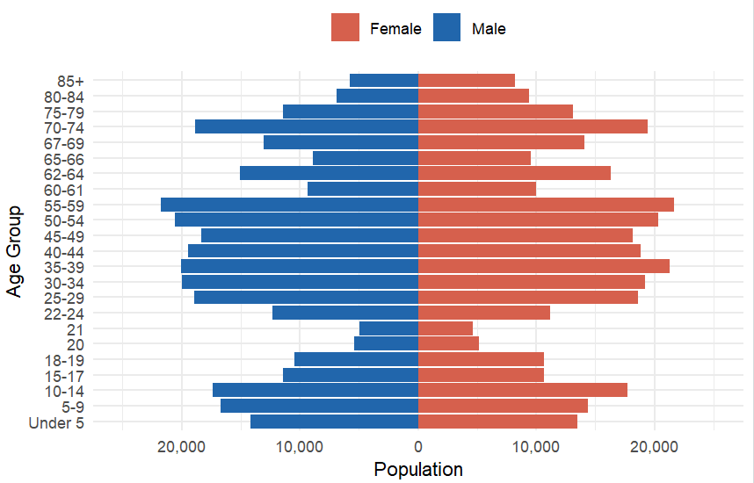
Figure 11- 3
Vermont population pyramids for 2020 (top) and 2024 (bottom)
Source: U.S. Census Bureau (2024b)

Slide 7
Table 11-1
Vermont population by age group in 2020 and 2024
Age group | 2020 | 2024 | Percentage change
0-17 | 115,632 | 115,986 | 0.3%
18-24 | 66,619 | 64,692 | -2.9%
25-39 | 110,439 | 118,031 | 6.9%
40-54 | 115,180 | 115,651 | 0.4%
55-64 | 95,598 | 94,067 | -1.6%
65-79 | 94,275 | 108,433 | 15.0%
80+ | 26,597 | 30,246 | 13.7%
Source: U.S. Census Bureau (2024b)

Slide 8
Table 11-2
Houseless population compared to overall population by race in 2022
Race/ Ethnicity | Vermont population | Percent of total population | Houseless population | Percent houseless population
Asian | 10,824 | 1.70% | 36 | 1.00%
Black | 8,000 | 1.20% | 266 | 7.70%
Latinx | 13,793 | 2.10% | 154 | 4.50%
Native American | 1,336 | 0.20% | 83 | 2.40%
Two or more Races | 25,809 | 3.90% | 69 | 2.00%
White | 594,131 | 90.90% | 2,835 | 82.30%
Total | 653,893 |  | 3,443
Source: Lantieri et al. (2024)

Slide 9
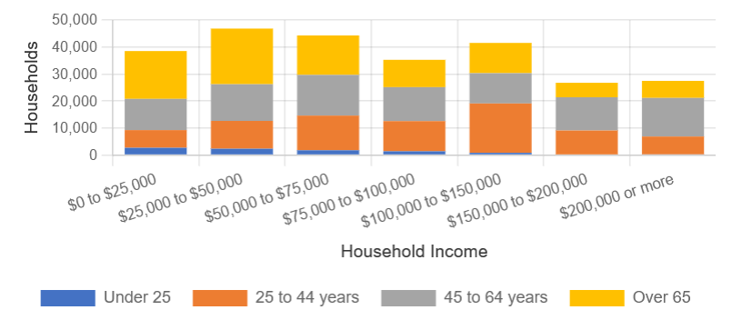
Figure 11-4 Household income distribution in Vermont in 2023
Source: U.S. Census Bureau (2023)
Note: Households can be of any size from one household member and higher

Slide 10
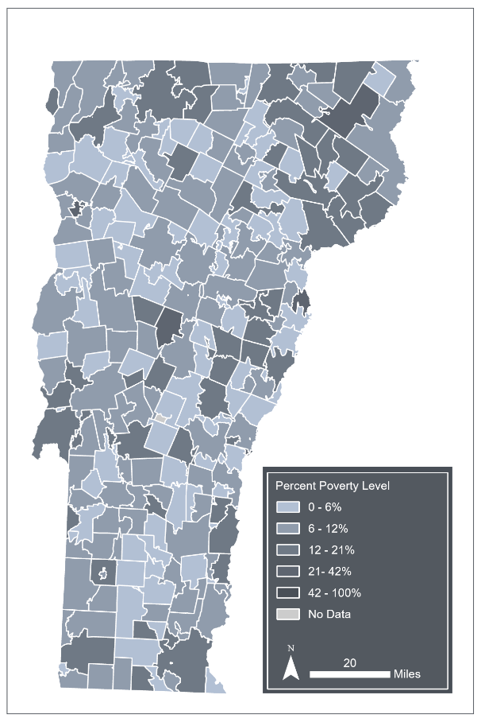
Figure 11-5
Percentage of people living in poverty by Vermont zip code (2024)
Source: U.S. Census Bureau (2024b)
Note: Data visualization by Hannah C. Turner

Slide 11
Table 11-3
 | July 2023 |  | July 2024
County | Own | Rent | Own | Rent
Addison | 520 | 22 | 173 | 6
Bennington | 94 | 6 | 1 | 0
Caledonia | 263 | 15 | 803 | 59
Chittenden | 208 | 10 | 514 | 7
Essex | 8 | 1 | 109 | 5
Franklin | 46 | 2 | 7 | 1
Grand Isle | 4 | 0 | 1 | 0
Lamoille | 268 | 135 | 97 | 3
Orange | 366 | 30 | 26 | 3
Orleans | 361 | 25 | 179 | 2
Rutland | 143 | 17 | 4 | 0
Washington | 1,452 | 230 | 828 | 63
Windham | 188 | 3 | 2 | 0
Windsor | 518 | 22 | 4 | 0
All counties | 4,439 | 518 | 2,748 | 149
Residential properties by county that reported whether they owned or rented their property when reporting damage during the July 2023 and July 2024 flood events
Source: Vermont Emergency Management (2023a)

Slide 12
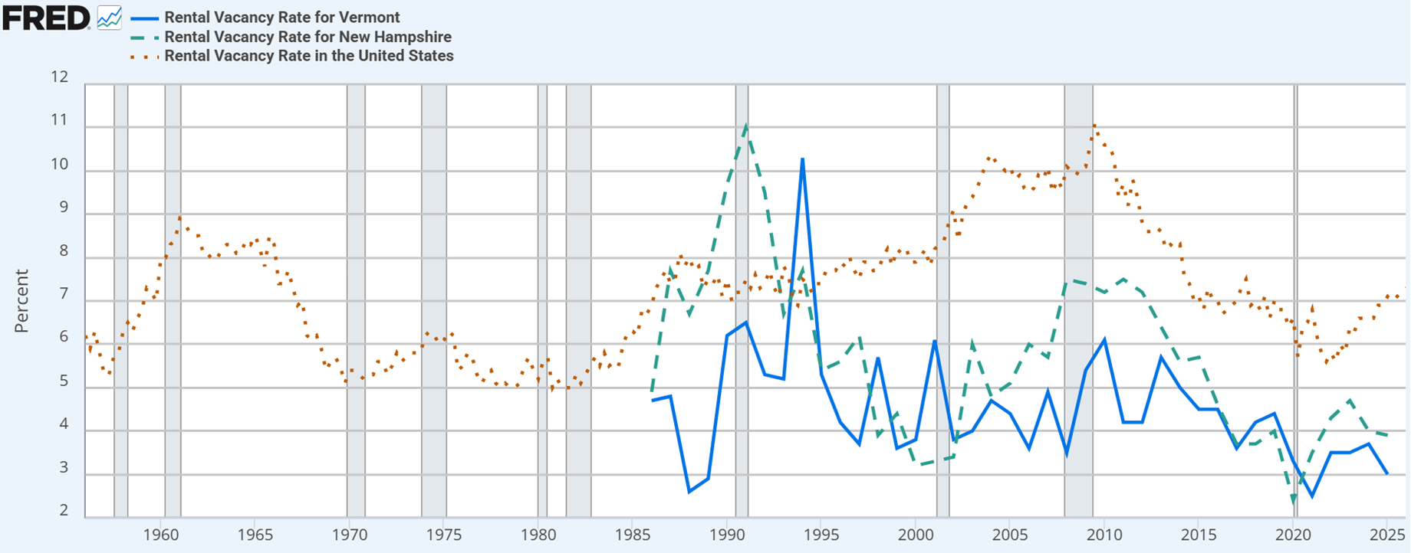
Figure 11-6 Rental vacancy rates for the U.S. (red dots), Vermont (blue solid), and New Hampshire (green dashes) over time. Shaded areas indicate U.S. recessions.
Source: Federal Reserve Bank of St. Louis (FRED, 2025)

Slide 13
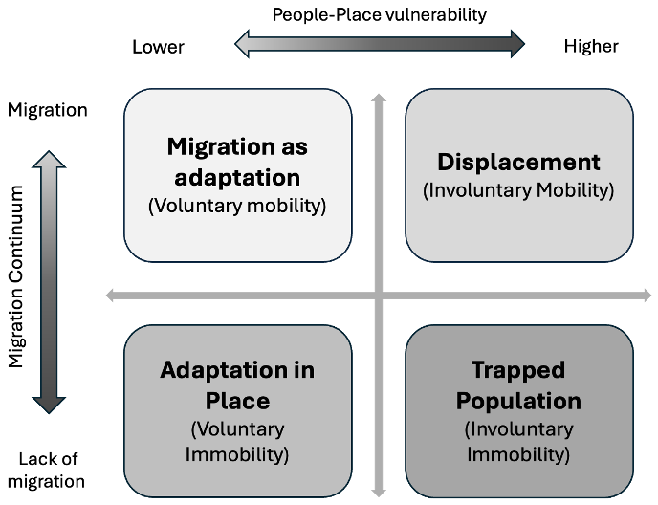
Figure 11-7
The interaction between climate vulnerability and migration
Source: Adapted from Hunter et al. (2021)

Slide 14
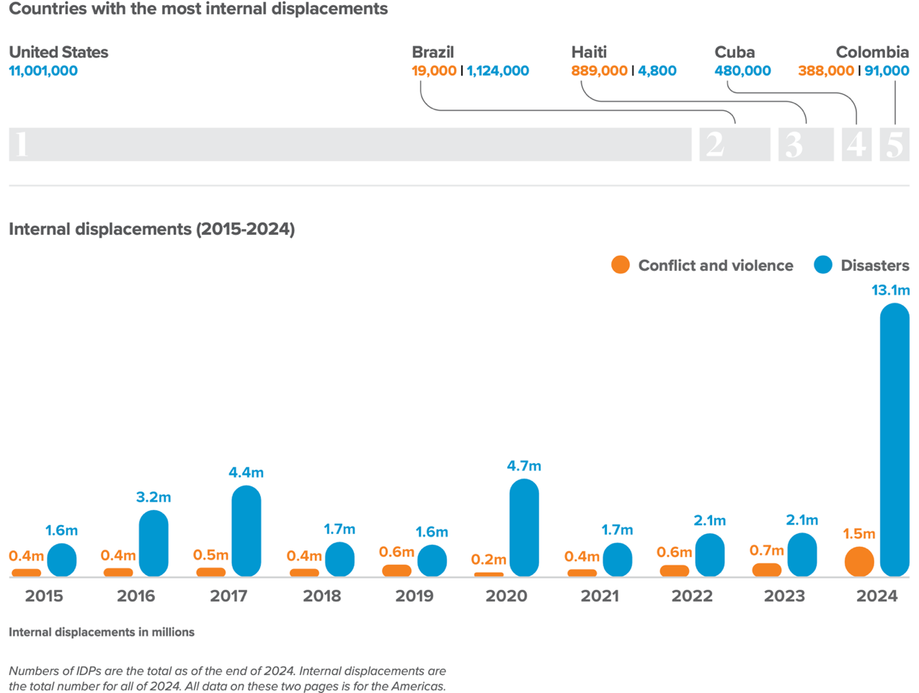
Figure 11-8
Countries in the Americas with the most internal displacements in 2024 (top) and (bottom) internal displacement (millions) in the Americas caused by natural disasters (in blue) and conflict (in orange) between 2015-2024
Source: Global Report on Internal Displacement (GRID, 2025)
Note: Numbers of IDPs are the total as of the end of 2024. Internal displacements are the total number for all of 2024. All data is for the Americas

Slide 15
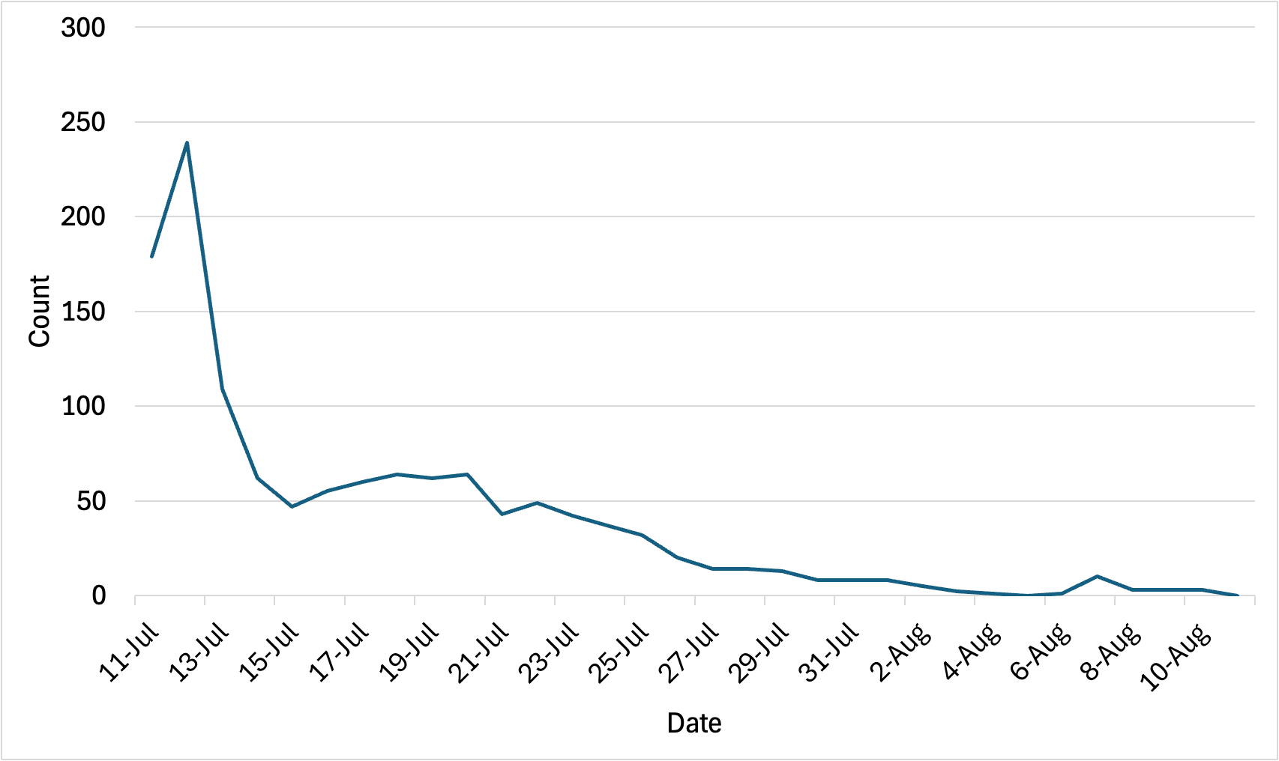
Figure 11-9
Number of people taking shelter at FEMA Mass Care between July 11and August 10, 2023
Source: Kroll & Blondin (2025)

Slide 16
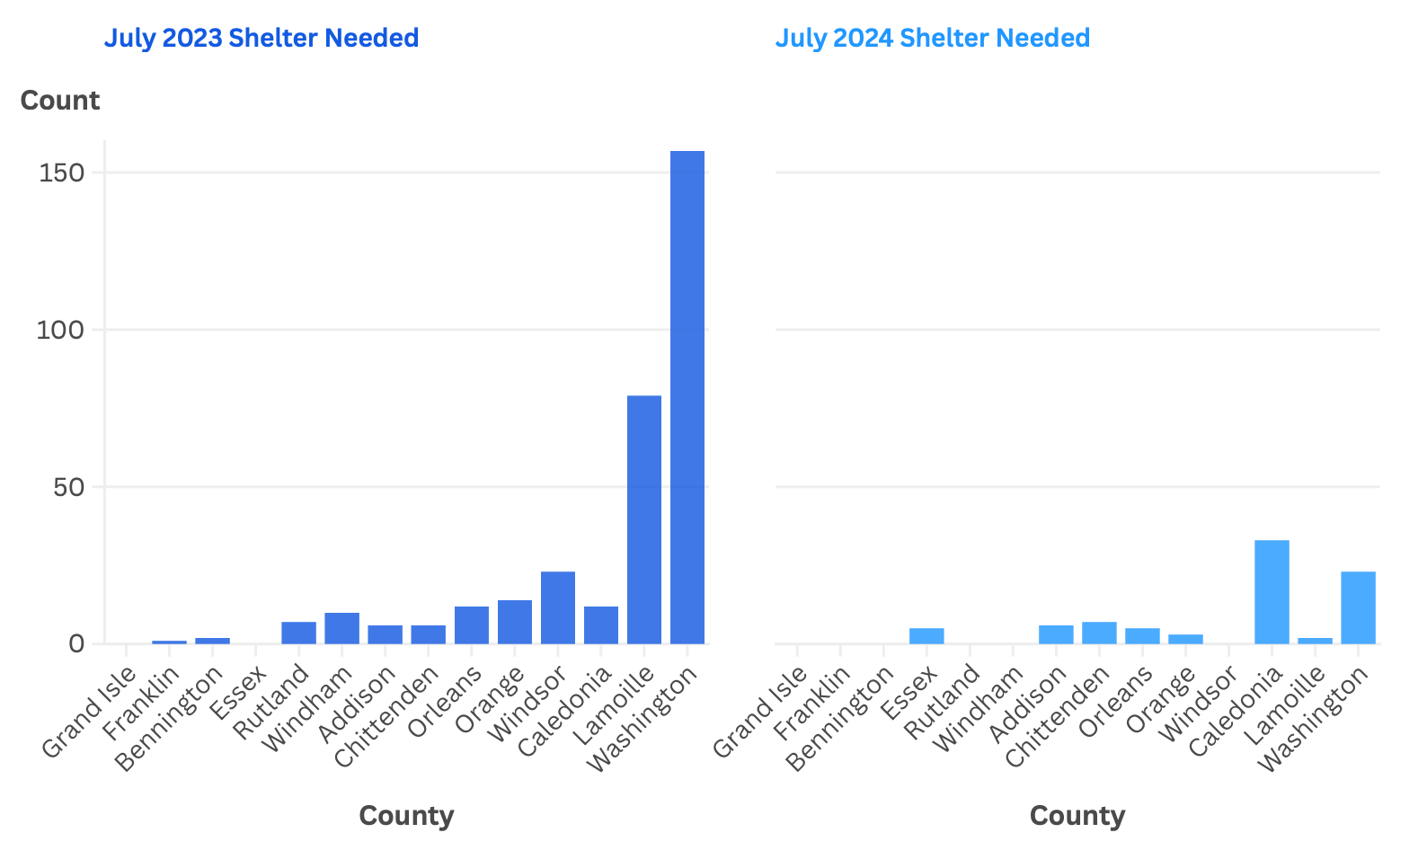
Figure 11-10
Need for shelter by county based on Vermont 211 reports
Source: Vermont Emergency Management (2023a)

Slide 17
Table 11-4
County | July 2023 | July 2024 | All events
Addison | 25 | 11 | 36
Bennington | 6 | 0 | 6
Caledonia | 36 | 93 | 129
Chittenden | 15 | 29 | 44
Essex | 2 | 8 | 10
Franklin | 1 | 0 | 1
Grand Isle | 0 | 0 | 0
Lamoille | 183 | 8 | 191
Orange | 31 | 4 | 35
Orleans | 20 | 13 | 33
Rutland | 16 | 1 | 17
Washington | 364 | 68 | 432
Windham | 17 | 0 | 17
Windsor | 75 | 0 | 75
All counties | 791 | 235 | 1,026
Residential properties by county with Vermont 211 reports of uninhabitable homes after the July 2023 and July 2024 flood events
Source: Vermont Emergency Management (2023a)

Slide 18
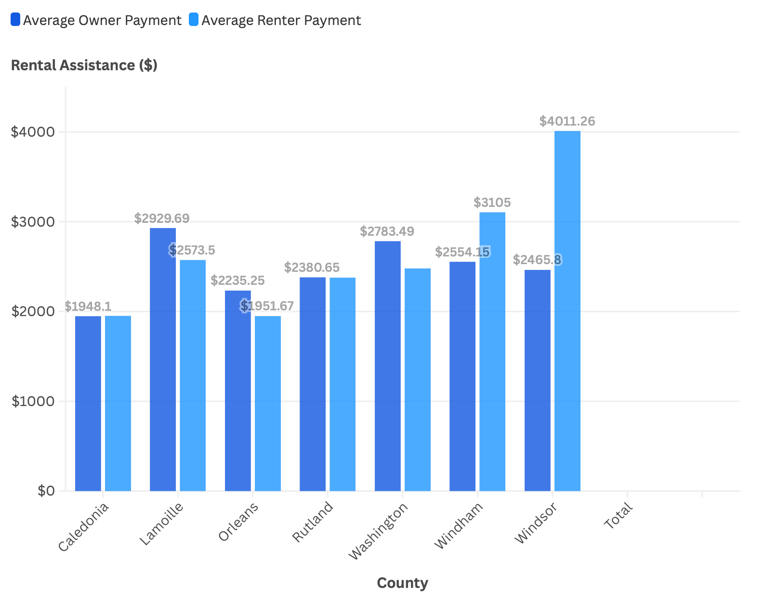
Figure 11-11
11-11 FEMA rental assistance average for owners and renters after July 2023 flooding
Source: Kroll & Blondin (2025)

Slide 19
Table 11-5
County | Amplification due to Population for 2100 under SSP2-RCP4.5 | Displacement due to Population for 2100 under SSP2-RCP4.5 | Projected population change under SSP2- RCP4.5 for 2053
Addison | 0 to –10,000 | 0 to –10,000 | -1% to 0%
Bennington | 0 to +10,000 | 0 to +10,000 | -3% to –1%
Caledonia | 0 to –10,000 | 0 to –10,000 | -1% to 0%
Chittenden | 0 to +10,000 | 0 to +10,000 | 0% to 1%
Essex | 0 to –10,000 | 0 to –10,000 | -3% to –1%
Franklin | 0 to –10,000 | 0 to –10,000 | -1% to 0%
Grand Isle | 0 to –10,000 | 0 to –10,000 | -1% to 0%
Lamoille | 0 to –10,000 | 0 to –10,000 | 0% to 1%
Orange | 0 to –10,000 | 0 to –10,000 | -1% to 0%
Orleans | 0 to –10,000 | 0 to –10,000 | -1% to 0%
Orleans | 0 to –10,000 | 0 to –10,000 | -1% to 0%
Rutland | 0 to –10,000 | 0 to –10,000 | -3% to –1%
Washington | 0 to –10,000 | 0 to –10,000 | -1% to 0%
Windham | 0 to –10,000 | 0 to –10,000 | -3% to –1%
Projected changes in population for 2053 and 2100 under climate change induced sea level rise (SSP2-RCP4.5)
Source: Amplification and displacement for 2100 under SSP2-RCP4.5 (Hauer et al., 2024); project population under SSP2-RCP4.5 for 2053 (Shu et al., 2023)

Slide 20
11.4 Economy

Slide 21
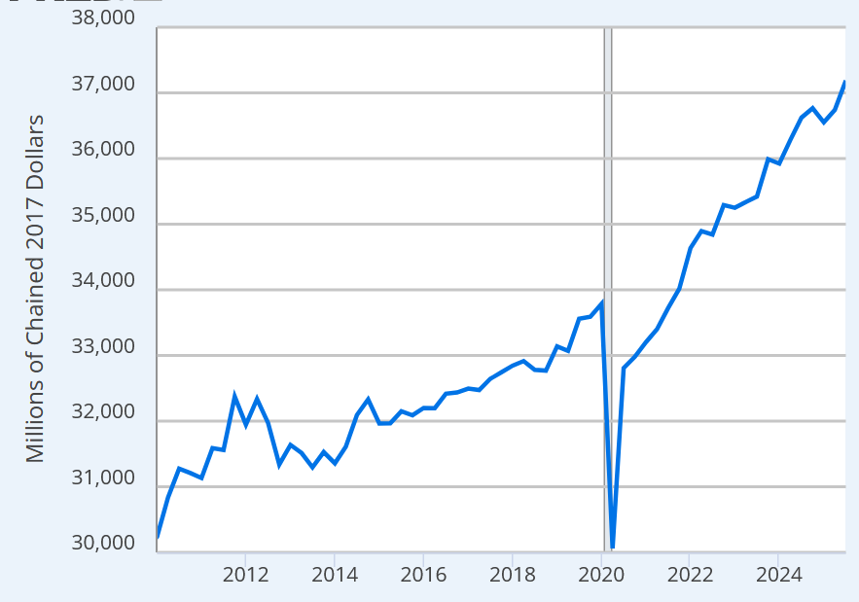
Figure 11-12
Real gross domestic product of Vermont seasonally adjusted and in millions of chained 2017 U.S. dollars
Source: U.S. Bureau of Economic Analysis (2026a)

Slide 22
Table 11-6 (1/2)
Sector | GDP ($million)
Finance, insurance, real estate, rental, and leasing |  | 6,660.20
Finance and insurance |  | 1,753.70
Real estate and rental and leasing |  | 4,908.40
Professional and business services |  | 5,121.90
Educational services, health care, and social assistance |  | 4,971.80
Healthcare and social assistance |  | 4,150.20
Educational services |  | 825.10
Government and government enterprises |  | 4,792.70
Federal civilian |  | 1,059.30
Military |  | 174.70
State and local |  | 3,557.80
Manufacturing |  | 2,638.00
Food and beverage and tobacco product manufacturing |  | 700.00
Wood product manufacturing |  | 82.20
Retail trade |  | 3,125.20
Real gross domestic product by sector in Vermont in 2024 in millions of 2017 dollars
Source: U.S. Bureau of Economic Analysis (2026b)

Slide 23
Table 11-6 (2/2)
Sector | GDP ($million)
Arts, entertainment, recreation, accommodation, and food services | 2,537.90
Arts, entertainment, and recreation | 461.40
Accommodation and food services | 2,077.30
Wholesale trade | 1,465.40
Construction | 1,161.00
Information | 1,389.90
Utilities | 857.00
Other services (except government and government enterprises) | 723.50
Transportation and warehousing | 560.20
Agriculture, forestry, fishing and hunting | 422.70
Farms | 452.00
Forestry, fishing, and related activities | 107.90
Mining, quarrying, and oil and gas extraction | 186.90
All industry total | 36,398.90
Real gross domestic product by sector in Vermont in 2024 in millions of 2017 dollars
Source: U.S. Bureau of Economic Analysis (2026b)

Slide 24
Table 11-7 (1/2)
Sector | Jobs in Vermont | % Jobs in Vermont | National jobs | % National jobs
Public administration | 53,259 | 17.2 | 22,420,669 | 14.5
Federal | 6,859 | 2.2 | 3,001,207 | 1.9
State | 16,127 | 5.2 | 4,819,889 | 3.1
Local | 30,273 | 9.8 | 14,599,573 | 9.4
Health care and social assistance | 51,343 | 16.6 | 22,217,638 | 14.3
Retail trade | 35,820 | 11.6 | 15,479,194 | 10
Accommodation and food services | 30,369 | 9.8 | 14,092,895 | 9.1
Manufacturing | 27,434 | 8.9 | 12,733,350 | 8.2
Professional, scientific, and technical services | 17,851 | 5.8 | 10,781,508 | 7.0
Construction | 16,196 | 5.2 | 8,135,442 | 5.2
Administrative and support and waste management and remediation services | 13,370 | 4.3 | 9,123,838 | 5.9
Educational services | 11,039 | 3.6 | 3,204,582 | 2.1
Employment in select sectors in Vermont and the U.S. in 2024
Source: U.S. Census Bureau of Labor Statistics (2026)
Note: This table follows North American Industry Classification System classifications. Sub-industry disaggregation is included for select relevant sectors.

Slide 25
Table 11-7 (2/2)
Sector | Jobs in Vermont | % Jobs in Vermont | National jobs | % National jobs
Other services (except public administration) | 8,830 | 2.9 | 4,666,503 | 3.0
Wholesale trade | 8,822 | 2.9 | 6,106,692 | 3.9
Finance and insurance | 8,429 | 2.7 | 6,290,311 | 4.1
Transportation and warehousing | 6,411 | 2.1 | 6,562,468 | 4.2
Arts, entertainment, and recreation | 4,914 | 1.6 | 2,605,233 | 1.7
Agriculture, forestry, fishing and hunting | 3,601 | 1.2 | 1,254,363 | 0.8
Real estate and rental and leasing | 3,008 | 1.0 | 2,406,045 | 1.6
Management of companies and enterprises | 2,035 | 0.7 | 2,613,063 | 1.7
Utilities | 1,210 | 0.4 | 589,311 | 0.4
Mining, quarrying, and oil and gas extraction | 629 | 0.2 | 586,238 | 0.4
Information | 0 | 0.0 | 2,904,986 | 1.9
Total employment | 309,138 |  | 154,990,441
Employment in select sectors in Vermont and the U.S. in 2024
Source: U.S. Census Bureau of Labor Statistics (2026)
Note: This table follows North American Industry Classification System classifications. Sub-industry disaggregation is included for select relevant sectors.

Slide 26
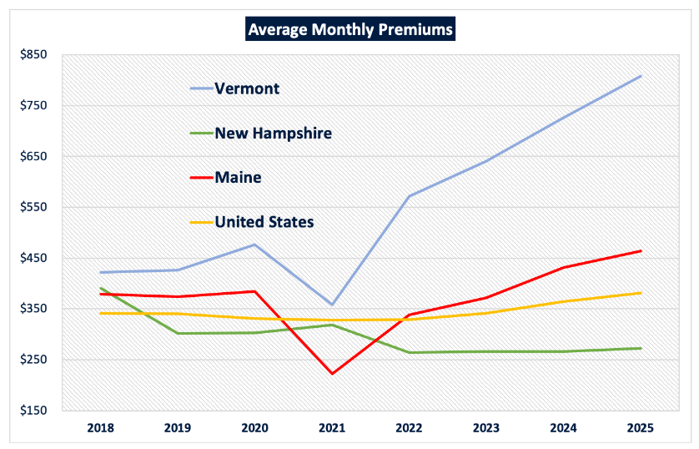
Figure 11-13
Trends in average monthly premiums for Vermont, New Hampshire, Maine, and the U.S. Vermont premiums are higher than all others and have increased substantially since 2021
Source: Vermont Healthcare 911 (2026)

Slide 27
11.5 Disaster Management

Slide 28
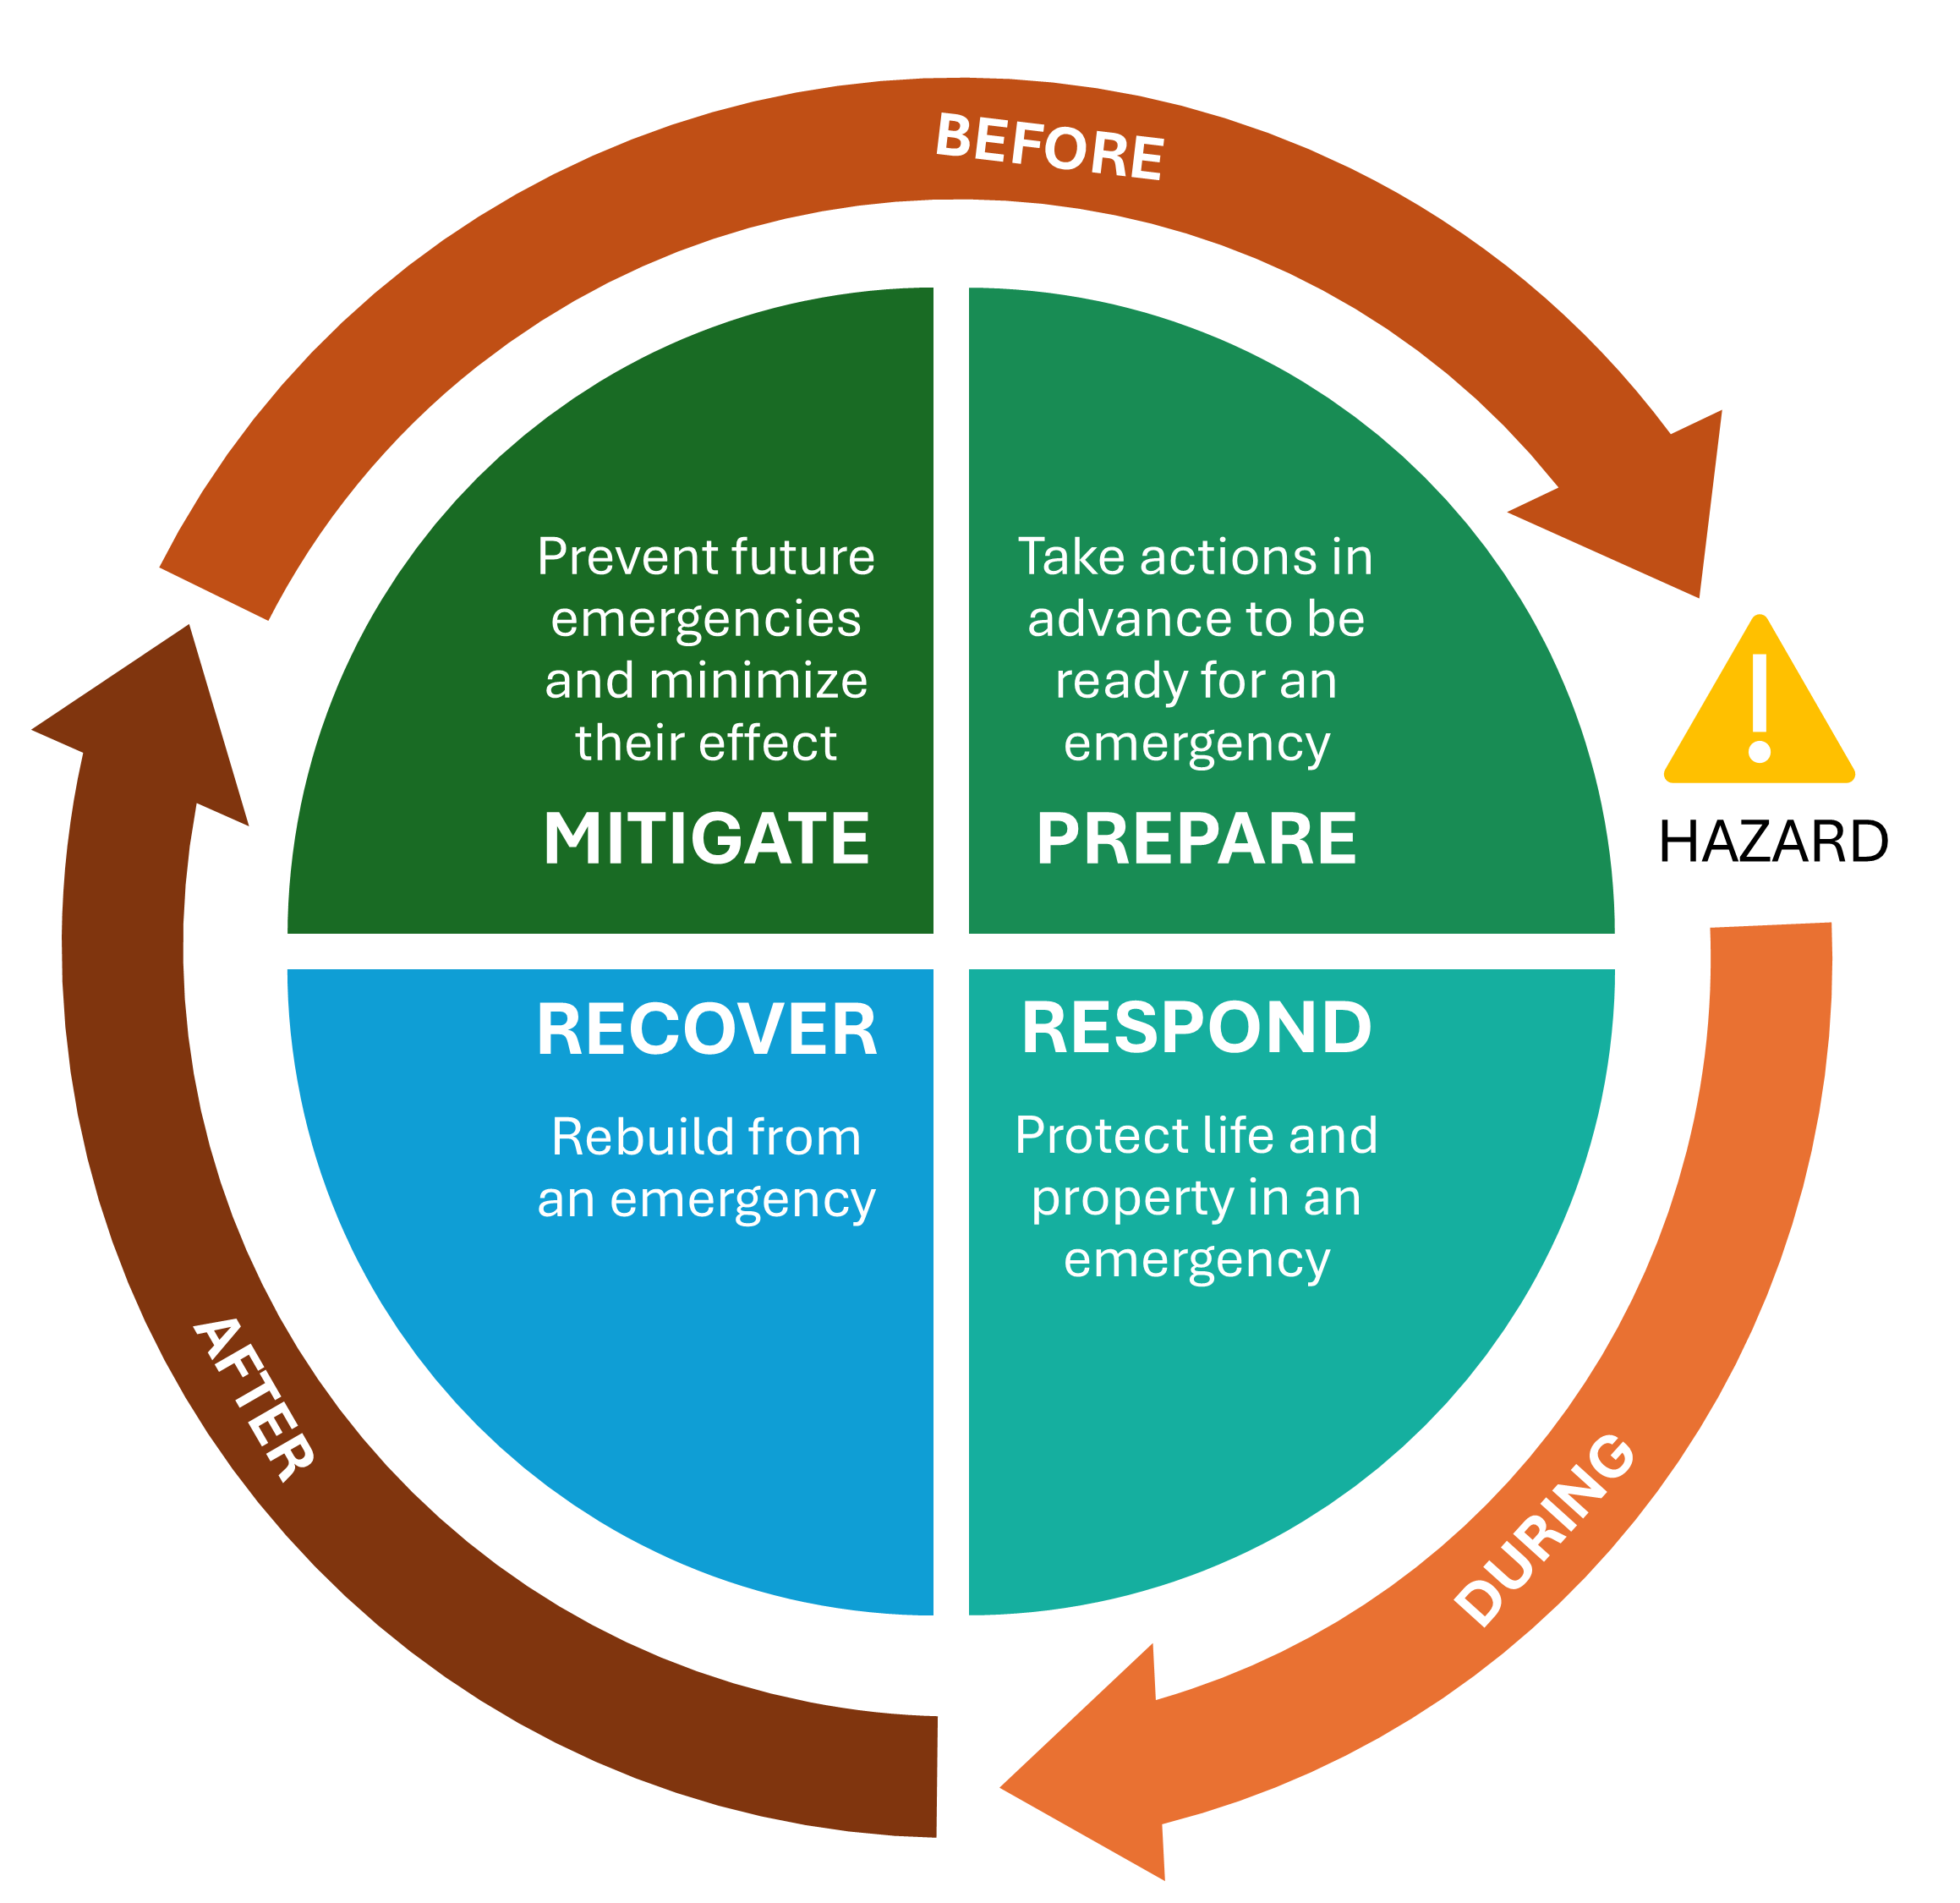
Figure 11-14
Components of the disaster management cycle: preparedness, response, recovery and mitigation.
Source: Fairfax County (2019)

Slide 29
Table 11-8
Hazard/Disaster | FEMA ID* | Frequency/Incident Period | Designated Counties
Severe Storms and Flooding | DR-4816-VT | August 22–August 24, 2024 | Lamoille
Tropical Storm Depression Debby | EM-3609-VT | August 8–August 10, 2024 | All
Severe Storms, Flooding, Landslides, and Mudslides | DR-4826-VT | July 29–July 31, 2024 | Caledonia, Essex and Orleans
Severe Storms, Flooding, Landslides, and Mudslides | DR-4810-VT | July 9–July 11, 2024 | Addison, Caledonia, Chittenden, Essex, Lamoille, Orange , Orleans, Washington
Severe Winter Storm | DR-4770-VT | January 9–January 13, 2024 | Chittenden, Essex, Franklin, Lamoille, and Orleans
Severe Storms and Flooding | DR-4762-VT | December 18–December 19, 2023 | Essex, Lamoille, Orange, Orleans, Rutland, Windham, Windsor
Severe Storms and Flooding | DR-4744-VT | August 3–August 5, 2023 | Addison
Severe Storms, Flooding, Landslides, and Mudslides | DR-4720-VT | July 7–July 21, 2023 | All
Flooding | EM- 3595-VT | July 9–July 17, 2023 | All
Severe Storm and Flooding | DR-4695 | December 22–December 24, 2022 | Chittenden, Essex, Franklin, Grand Isle, Lamoille, Orange, Orleans, Washington
Tropical Storm Henri | EM-3567-VT | August 22–August 29, 2021 | All
Severe Storm and Flooding | DR-4621-VT | July 29–July 30, 2021 | Bennington and Windham
Federal Emergency Management Agency disaster declarations for Vermont (2020-2025)
Source: FEMA (2026a)
Note: *DR signifies Major Disaster Declaration. EM signifies Emergency Declaration

Slide 30
Table 11-9
FEMA Program | Definition | Amount | Status
Individuals and Households Program (IHP) | Financial and direct services to eligible individuals and households affected by a disaster who have uninsured or under-insured necessary expenses and serious needs. | $39,927,573 | Active
Public Assistance (PA) | Supplemental grants to state, tribal, territorial, and local governments and certain types of private non-profits so communities can quickly respond to and recover from major disasters or emergencies. | $258,036,974 | Active
Hazard Mitigation Grant Program (HMGP) | Funding to state, local, tribal and territorial governments to develop hazard mitigation plans and rebuild in ways that reduce or mitigate future disaster losses in their communities. | N/A | No presidential approvals granted as of December 11, 2025
Building Resilient Infrastructure and Communities (BRIC) program | Supports states, local, and territorial governments and Tribal Nations as they work to reduce their hazard risk. | N/A | Cancelled in April 2025, ordered to be reinstated in December 2025 (Raymond, 2025)
National Flood Insurance Program (NFIP) | Flood insurance to property owners, renters, and businesses, to help them recover faster when floodwaters recede. | $50,620,956 | Active
Total amount granted to Vermont under Federal Emergency Management Agency (FEMA) programs from 2021–2025 (status as of December 18, 2025)
Source: FEMA (2026c); Labowitz (2025); Raymond (2025)

Slide 31
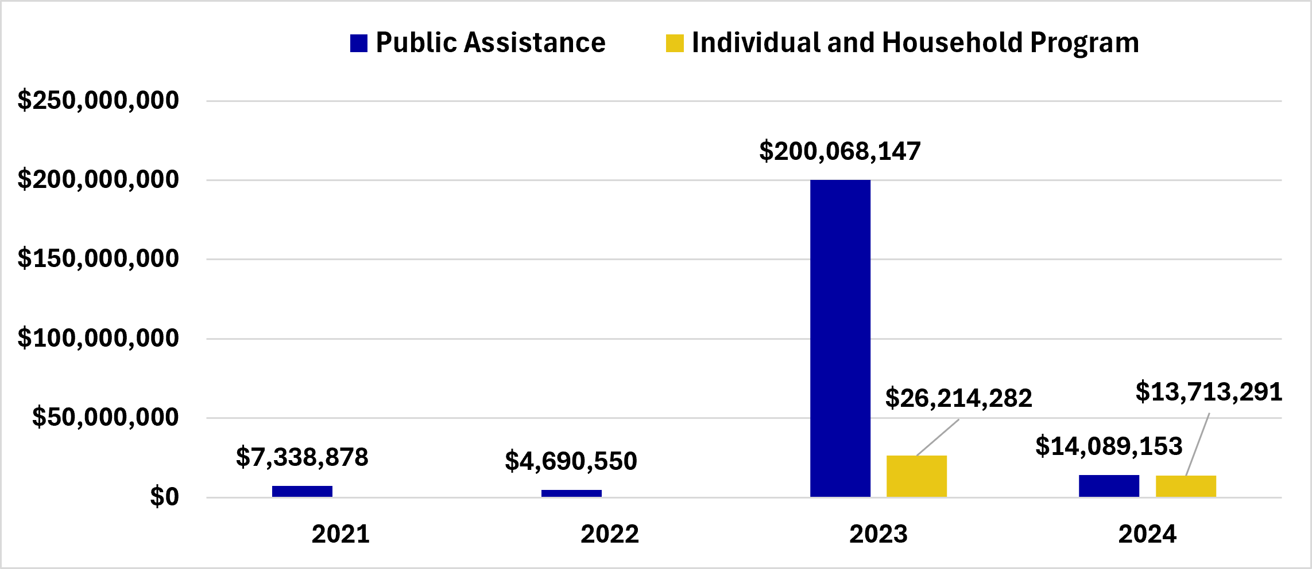
Figure 11-15 FEMA Public Assistance and Individuals and Households Program disbursements to Vermont 2021–2024
Source: FEMA (2026b)

Slide 32
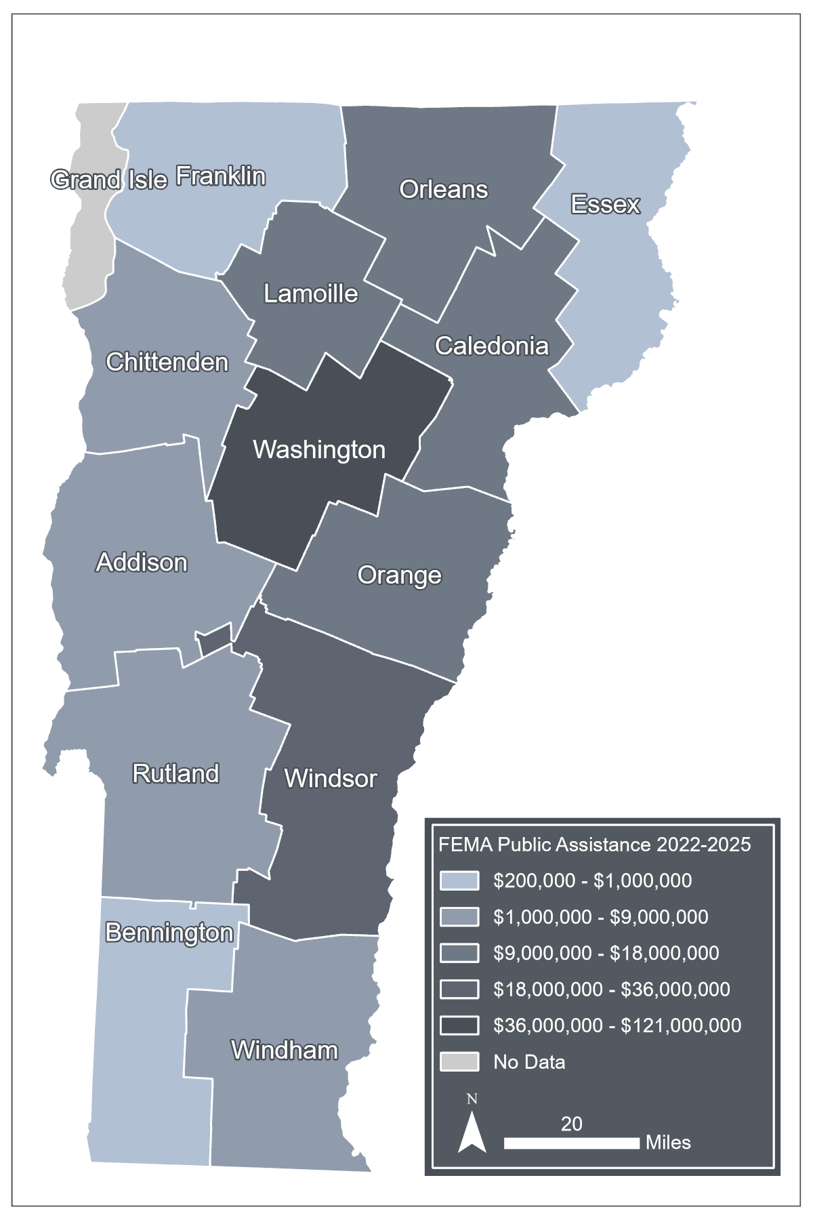
Figure 11-16
Federal Emergency Management Agency Public Assistance awards by county 2022–2025
Source: FEMA (2026c); PolicyMap (2025)
Note: Visualization by Hannah C. Turner

Slide 33
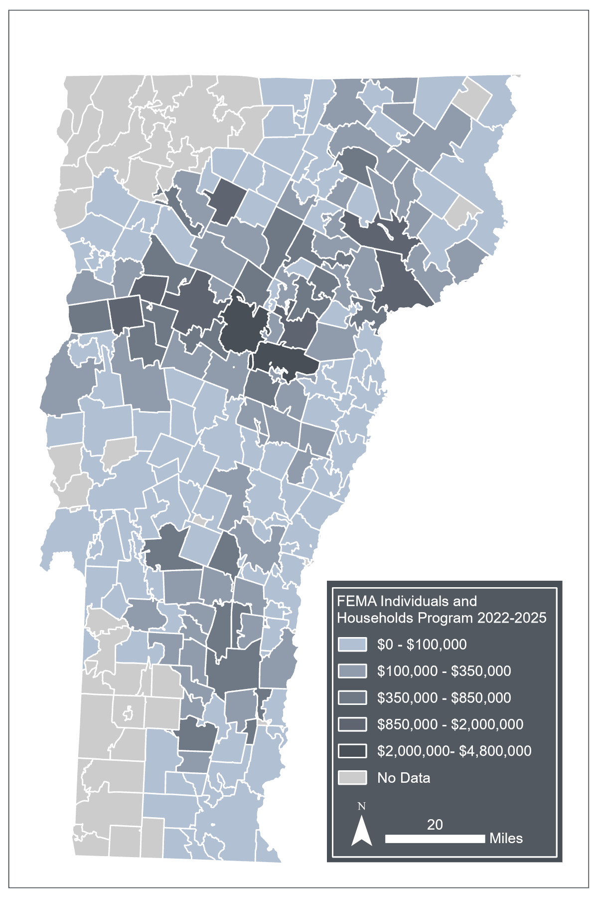
Figure 11-17
Federal Emergency Management Agency Individuals and Households Program assistance by zip code for 2022–2025
Source: FEMA (2026c); PolicyMap (2025)
Note: Visualization by Hannah C. Turner

Slide 34
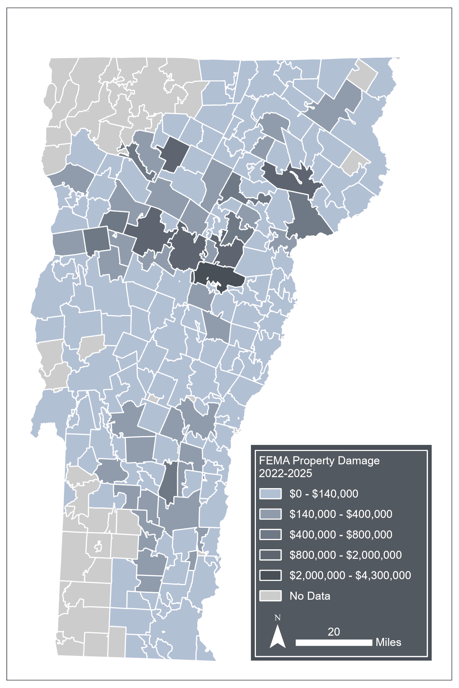
Figure 11-18
Federal Emergency Management Agency records of property damage by zip code for 2022–2025
Source: FEMA (2026c); PolicyMap (2025)
Note: Visualization by Hannah C. Turner

Slide 35
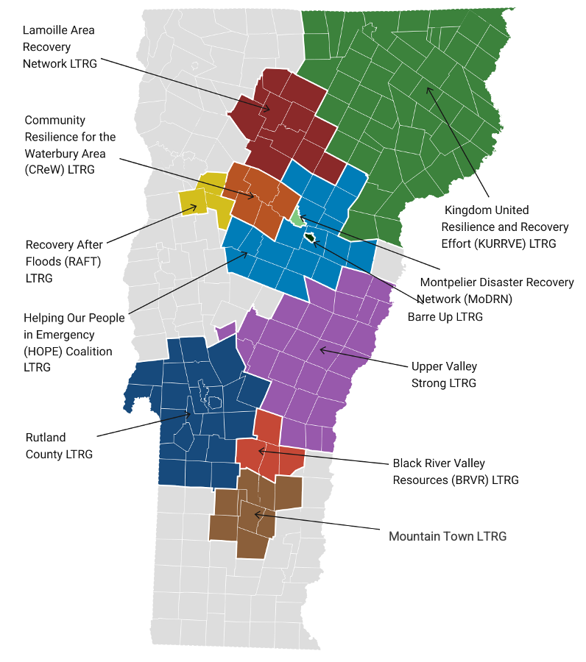
Figure 11-19
Map of long-term recovery groups (LTRGs) in Vermont
Source: Vermont Disaster Recovery (2026)

Slide 36
Table 11-10
 | July 2023 |  |  | July 2024
County | Yes | No | Unknown | Yes | No | Unknown
Addison | 35 | 501 | 15 | 11 | 168 | 0
Bennington | 10 | 90 | 2 | 0 | 1 | 0
Caledonia | 30 | 251 | 3 | 69 | 792 | 2
Chittenden | 34 | 180 | 3 | 52 | 468 | 1
Essex | 0 | 9 | 0 | 2 | 112 | 0
Franklin | 2 | 49 | 1 | 0 | 8 | 0
Grand Isle | 0 | 5 | 0 | 0 | 1 | 0
Lamoille | 38 | 354 | 7 | 9 | 91 | 0
Orange | 32 | 358 | 6 | 3 | 26 | 0
Orleans | 34 | 344 | 9 | 12 | 168 | 1
Rutland | 34 | 125 | 1 | 1 | 3 | 0
Washington | 243 | 1417 | 11 | 116 | 774 | 1
Windham | 27 | 167 | 2 | 0 | 2 | 0
Windsor | 70 | 457 | 11 | 0 | 4 | 0
All counties | 589 | 4,307 | 71 | 275 | 2,618 | 5
Residential properties by county that reported their flood insurance status in Vermont 211 reports for the July 2023 and July 2024 flood events
Source: Vermont Emergency Management (2023a)
Note: Respondents were given the options “Yes”, “No”, and “Unknown”

Slide 37
Table 11-11
 | July 2023 |  | July 2024
County | Yes | No | Yes | No | Unknown
Addison | 4 | 47 | 2 | 10 | 4
Bennington | 1 | 7 | 0 | 2 | 1
Caledonia | 0 | 10 | 16 | 92 | 0
Chittenden | 0 | 14 | 7 | 41 | 0
Essex | 0 | 1 | 0 | 11 | 0
Franklin | 3 | 4 | 0 | 1 | 3
Grand Isle | 0 | 0 | 0 | 1 | 0
Lamoille | 4 | 12 | 0 | 7 | 4
Orange | 2 | 9 | 0 | 7 | 2
Orleans | 5 | 23 | 2 | 13 | 5
Rutland | 0 | 3 | 0 | 0 | 0
Washington | 21 | 64 | 19 | 49 | 21
Windham | 5 | 14 | 0 | 0 | 5
Windsor | 8 | 31 | 0 | 1 | 8
All counties | 53 | 239 | 46 | 235 | 53
Businesses by county that reported their flood insurance status in Vermont 211 reports for the July 2023 and July 2024 flood events
Source: Vermont Emergency Management (2023a)
Note: Respondents were given the options “Yes”, “No”, and “Unknown”

Slide 38
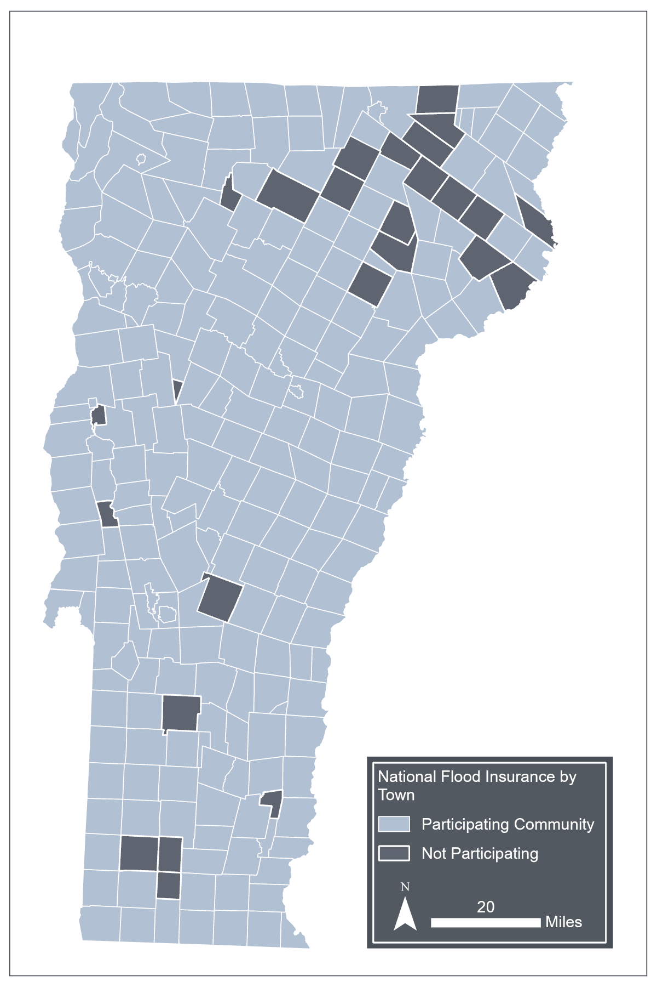
Figure 11-20
Map of National Flood Insurance Program (NFIP) coverage by municipality
Source: Vermont Geoportal (2026)
Note: Visualization by Hanah C. Turner

Slide 39
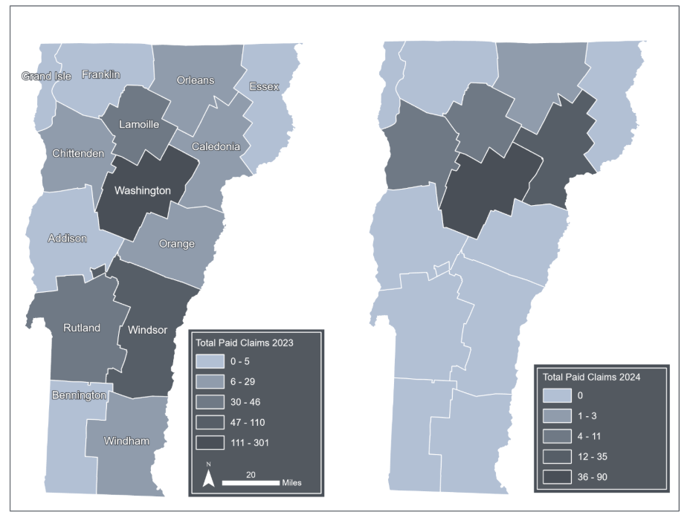
Figure 11-21
National Flood Insurance Program claims paid in 2023 (left) and 2024 (right) in Vermont counties
Source: FEMA (2026a)
Note: Visualization by Hanah C. Turner

Slide 40
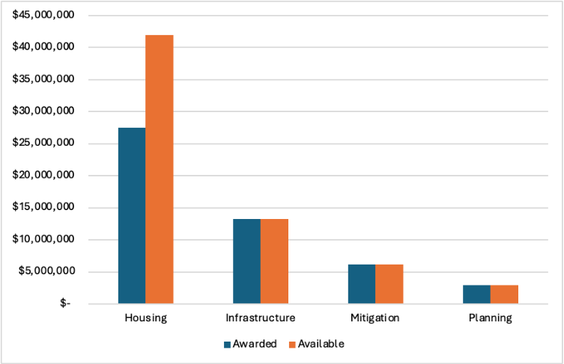
Figure 11-22
Community Development Block Grant funding awarded to the Vermont Agency of Commerce and Community Development and amount available fund by category
Source: Vermont Agency of Commerce and Community Development (2026)

Slide 41
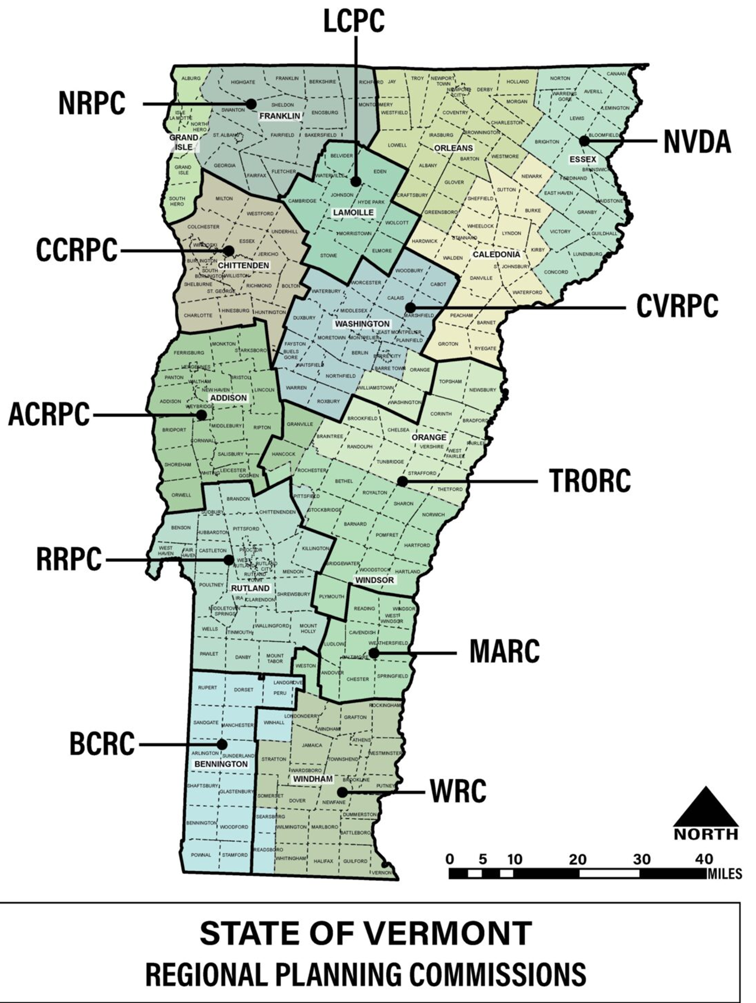
Figure 11-23
Map of the 11 regional planning commissions in Vermont
Source: The Flood Safety Act (2025)

Slide 42
Table 11-12
Hazard | Approved Plans | Percent of Approved Plans
Flooding | 134* | 100.00%
Fluvial Erosion | 125 | 93.30%
Winter Storms | 115 | 85.80%
Ice Storm | 101 | 75.40%
High Wind | 87 | 64.90%
Flash Flood | 69 | 51.50%
Extreme Cold | 62 | 46.30%
Hail | 48 | 35.80%
Wildfires | 47 | 35.10%
Drought | 46 | 34.30%
Thunderstorms | 42 | 31.30%
Hurricanes/Tropical Storms | 39 | 29.10%
Landslides | 38 | 28.40%
Earthquakes | 38 | 28.40%
Infectious Disease Outbreak | 37 | 27.60%
Invasive Species | 36 | 26.90%
Extreme Heat | 36 | 26.90%
Ice Accretion | 33 | 24.60%
Dam Failure | 32 | 23.90%
Tornadoes | 27 | 20.10%
Ice Jams | 26 | 19.40%
Lightning | 26 | 19.40%
Climate-related hazards in approved local hazard mitigation plans as of June 2023
Source: Vermont Emergency Management (2023b)
Note: *134 plans were approved between 2017 and June 2023; some are multi‑jurisdictional

Slide 43
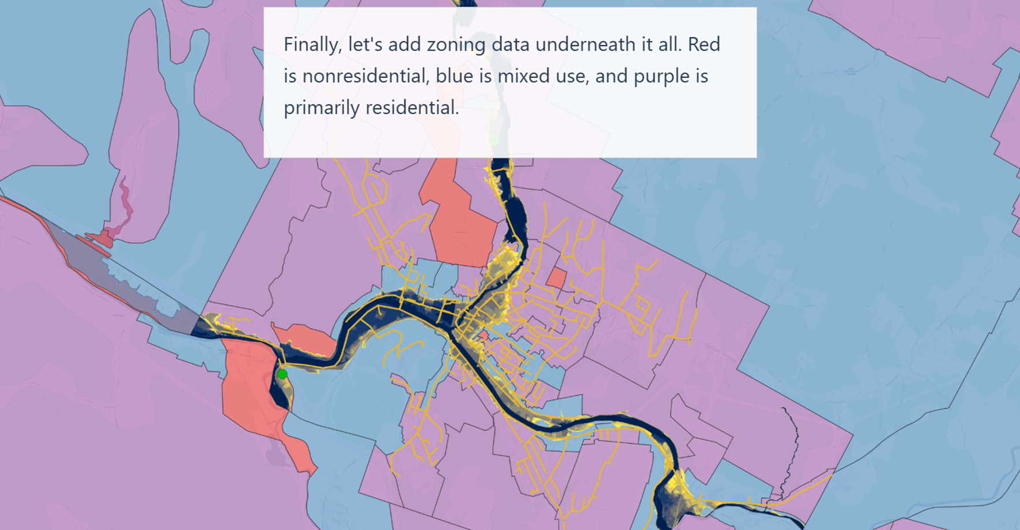
Box 11-3 Vermont Livability Map
Source: Vermont Research Open Source Program Office et al. (2026)

