Slide 1


Human Health
Anna Maassel^{1,2}, Anna Hoppe², Keith Robinson^{3,4}, Christine Vatovec^{1,2,4,5,6}
¹Rubenstein School of Environment and Natural Resources, ²Gund Institute for Environment , ³UVM Medical Center and Children's Hospital, ⁴Larner College of Medicine, ⁵College of Nursing and Health Sciences, ⁶Osher Center for Integrative Health
Recommended citation: Maassel, A.K., Hoppe, A.K., Robinson, K.J., Vatovec, C.M., 2026, Human Health. In Galford, G.L., Balerna, J.A.,. et al.(Eds), The Vermont Climate Assessment 2025. Burlington, Vermont: Climate Measurements Center of Excellence, Gund Institute for Environment at the University of Vermont. DOI: xxxxx
Accessed online at https://vtclimate.org.

Slide 2
10.2 Background

Slide 3
Table 10-1, 1/2
Hazard | Vulnerable Populations | What You Can Do
Extreme heat | Outdoor workers and recreators, outdoor summer athletes, children, elderly, people without air conditioning or access to cool indoor air, especially unhoused. | Check on neighbors, especially those with limited mobility. Limit activity to cooler parts of the day. Stay hydrated.
Warmer winters | Those exposed to ice either on sidewalks/driveways, especially elderly, or recreational users of frozen ponds and lakes. | Shovel walkways and driveways and use salt or sand to melt ice or provide traction. On frozen lakes, test ice before use, and let friends or family know of your plans.
Flooding | People living in flood zones, especially in mobile homes, unhoused populations, those with limited mobility. | Create a flood action plan and check-in on neighbors, consult Vermont Department of Health (VDH) guidelines for safely returning to homes after flooding.
Wildfire smoke | Outdoor workers and recreators, children, elderly, people with chronic respiratory diseases | Monitor air quality (AirNow.gov is a good source), decrease activity levels, stay inside with windows closed if weather allows, utilize air filters indoors.
Pollen | People allergic to pollen, especially those that cannot minimize exposure by staying inside (outdoor workers, recreators). | Work with medical professionals to proactively create a pollen care plan; minimize exposure by staying indoors; protect airways by wearing a mask when outside.
Mold | Flood damaged homes, especially when remediation is complicated by extreme outdoor heat or poor air quality | Prevent mold growth by fixing leaks in homes, improving drainage, and using dehumidifiers. After a flood, clean and dry items and rooms within 48 hours. Consult VHD for more guidelines.
Summary of climate change–related health hazards, key vulnerable populations, and examples of actionable items for protecting Vermonters
Source: This chapter

Slide 4
Table 10-1, 2/2
Hazard | Vulnerable Populations | What You Can Do
Tick-borne diseases | Outdoor workers and recreators, age (various effects by disease), males, location (some counties in Vermont, especially southern Vermont, have higher disease prevalences), people with reduced immune function | Wear long sleeves and pants; use tick repellant; check for ticks after recreating
Mosquito-borne diseases | Outdoor workers and recreators, people with reduced immune function, males, people with diabetes or hypertension | Wear long sleeves and pants; use insect repellant; reduce standing water
Nitrates/nitrites | Infants | Test private wells; support farmers in water quality conservation practices
Increased mercury bioavailability | Children, pregnant/nursing people | Follow VDH’s safe fish consumption guidelines
Cyanobacteria | Children and infants | Check for beach closures before recreating and know how to identify a bloom; participate in cyanobacteria monitoring efforts; reduce runoff through green stormwater infrastructure
Waterborne pathogens | People with reduced immune function | Check for beach closures before recreating; reduce runoff through green stormwater infrastructure; test private wells
Food security | People currently experiencing food insecurity, low-income, rural | Advocate for food security screenings by physicians; support food access programming
Foodborne pathogens | Pregnant people, people with reduced immune function. Different drivers of foodborne disease affect different demographics | Learn proper food safety practices
Summary of climate change–related health hazards, key vulnerable populations, and examples of actionable items for protecting Vermonters (continued)
Source: This chapter

Slide 5


10.3 Temperature

Slide 6
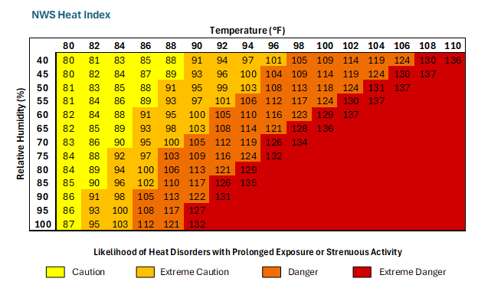
Figure 10-1
Heat index showing how temperature and humidity combine to create elevated likelihood of heat-related health risks
Source: National Weather Service (2025c)

Slide 7
Figure 10-2
2 Heat-related ED visits and excessive heat days in Vermont from 2003-2022
Source: Vermont Department of Health, (2026f)

Slide 8
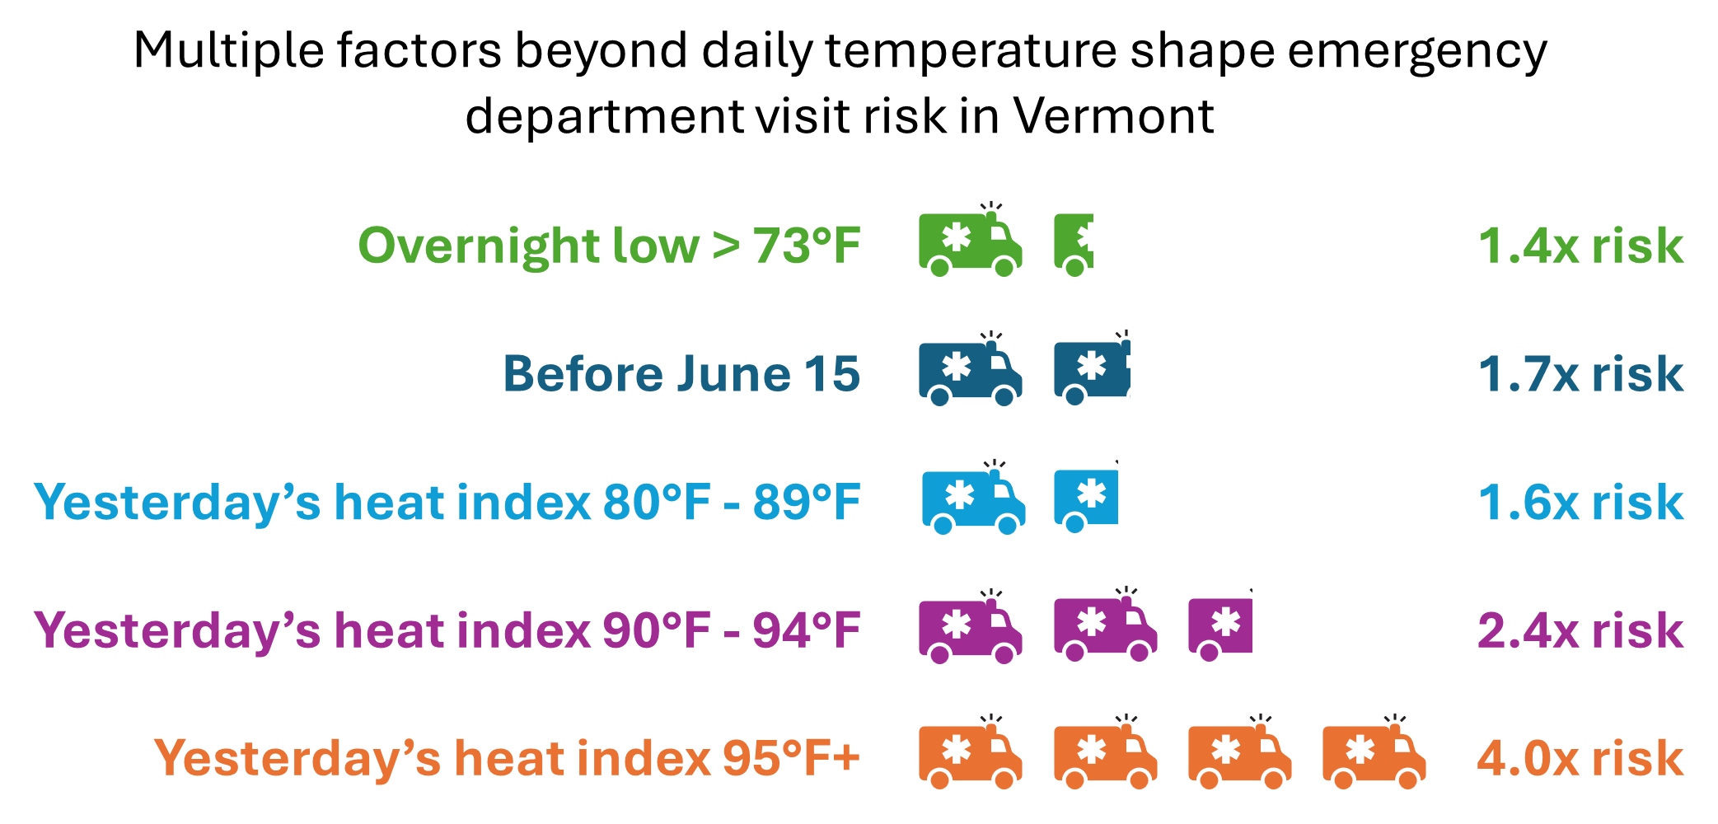
Figure 10-3
Factors outside of daily temperature with impacts on ED visits
Source: Vermont Department of Health (2023)
Note: Factors such as overnight temperature, time of year, and heat index of the prior day contribute to increased risk of all-cause emergency room visits in Vermont. Comparison groups: overnight low greater than 73°F compared to less than 73°F; before June 15 compared to after June 15; all prior day heat index categories compared to heat index less than 80°F. Data collected 2009-2019.

Slide 9
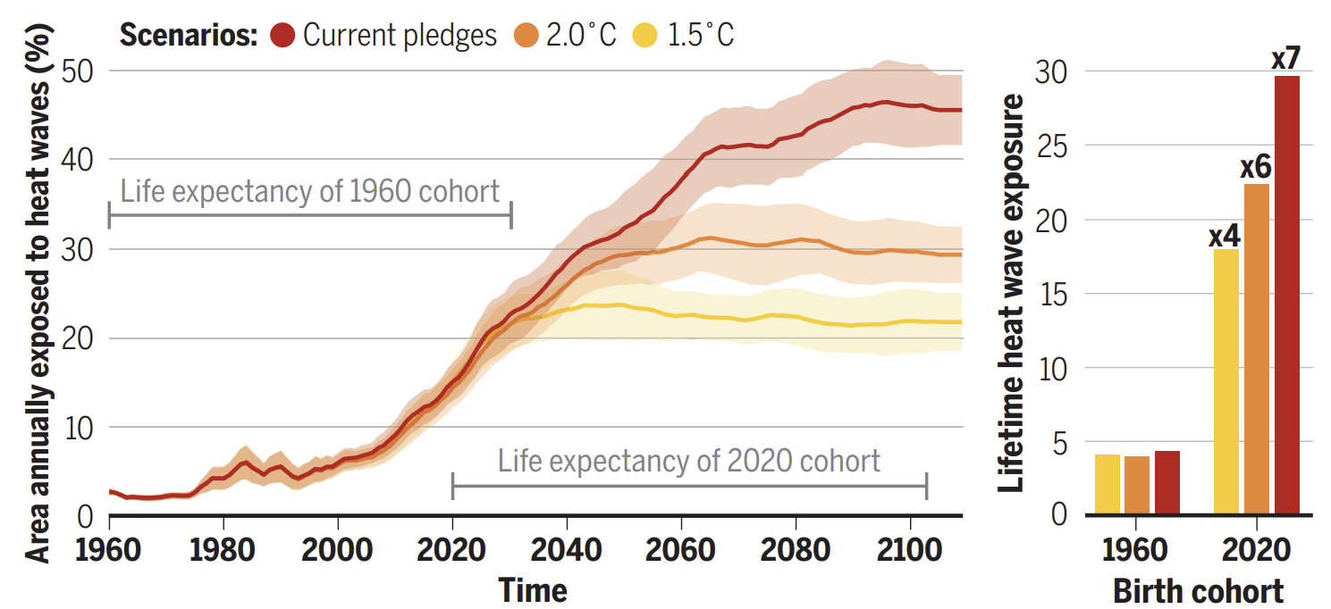
Box 10-2: Children and health impacts of climate change
Lifetime heat exposure of 1960 and 2020 birth cohorts across three warming scenarios. LEFT: Percent of global land area annually exposed to heat waves. Lines are multimodal means of a heat wave index from four global climate models, with uncertainty bands of one standard deviation; RIGHT: Multiplication factors relative to the 1960 birth cohort for lifetime heat wave exposure
Source: Thiery et al. (2021)

Slide 10
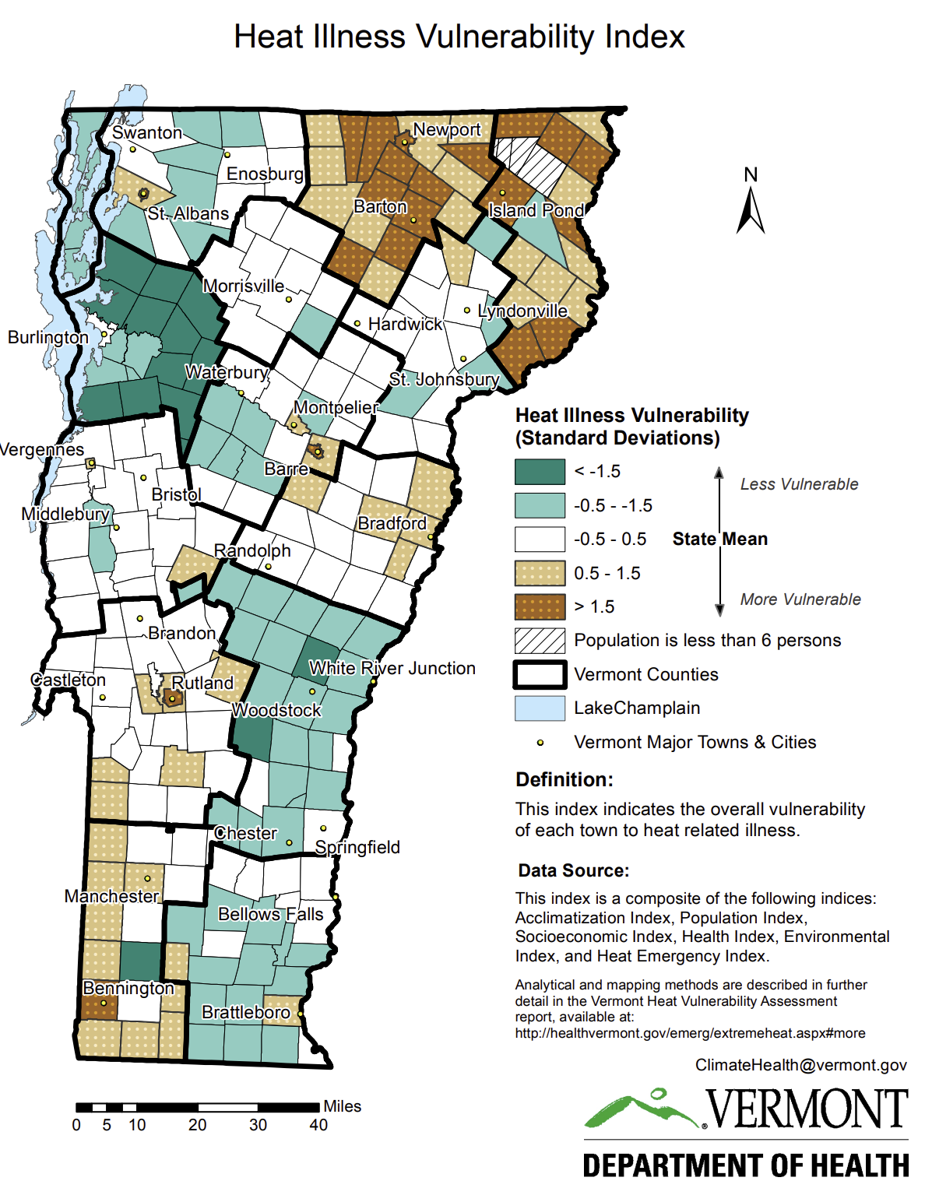
Figure 10-4
Heat illness vulnerability index by town in Vermont
Source: Vermont Department of Health (2016)

Slide 11
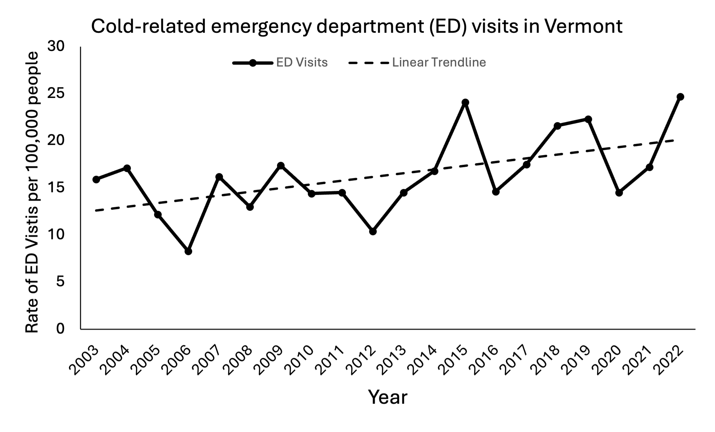
Figure 10-5
Cold-related ED visits in Vermont from 2003-2022
Source: Vermont Department of Health (2026f)

Slide 12
10.4 Extreme Weather

Slide 13
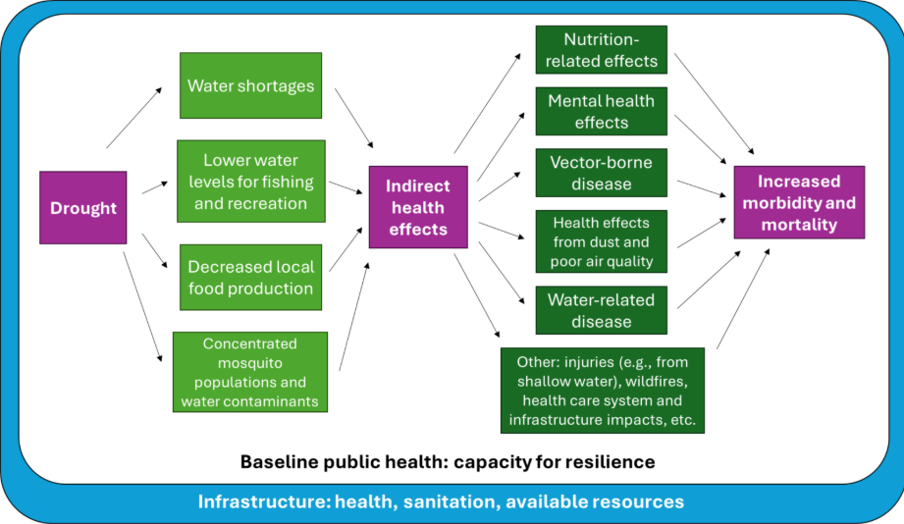
Figure 10-6
Health impacts of drought and related influencing factors
Source: Stanke et al. (2013)

Slide 14
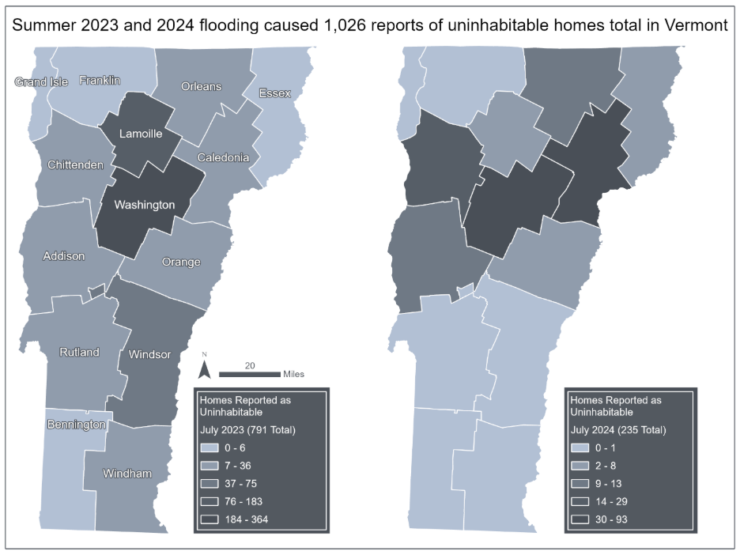
Figure 10-7
Maps of residential properties, by county, that were reported uninhabitable after the July 2023 (left) and July 2024 (right) flood events
Source: Vermont Emergency Management (2023)
Note: Data compiled by Jessica A. Balerna and visualized by Hannah C. Turner
Notes:
Need to add the Hannah Turner acknowledgement in actual chapter version

Slide 15
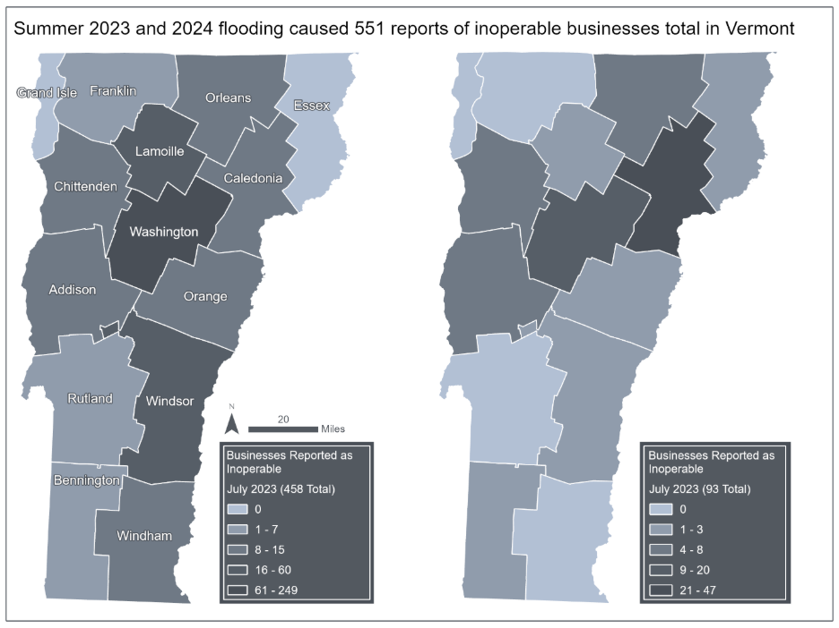
Figure 10-8
Maps of business properties by county that reported their business was inoperable after the July 2023 and July 2024 flood events
Source: Vermont Emergency Management (2023)
Note: Data compiled by Jessica A. Balerna and visualized by Hannah C. Turner
Notes:
Need to add the Hannah Turner acknowledgement in actual chapter version

Slide 16
10.5 Air Quality

Slide 17
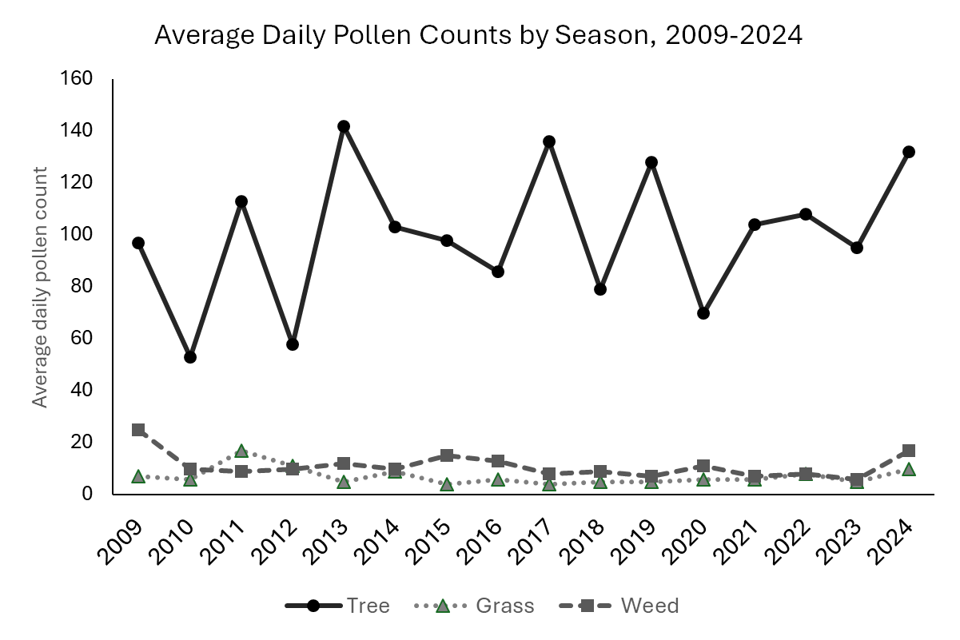
Figure 10-9
Average daily pollen counts for trees, grasses, and weeds over time in Vermont from 2009-2024
Source: Vermont Department of Health (2025f)

Slide 18
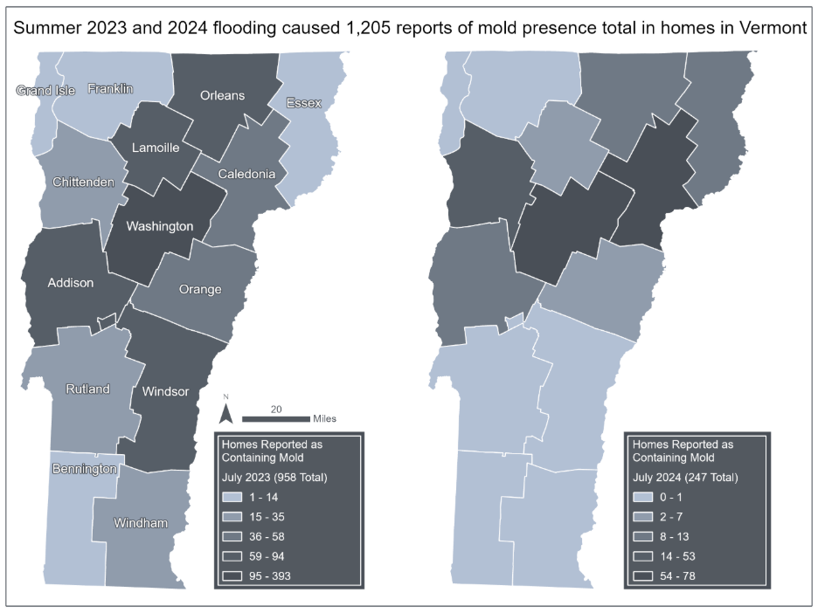
Figure 10-10
Maps of residential properties by county that reported the presence of mold in their home following either the July 2023 (left) or July 2024 (right) flood events
Source: Vermont Emergency Management (2023)
Note: Data compiled by Jessica A. Balerna and visualized by Hannah C. Turner

Slide 19
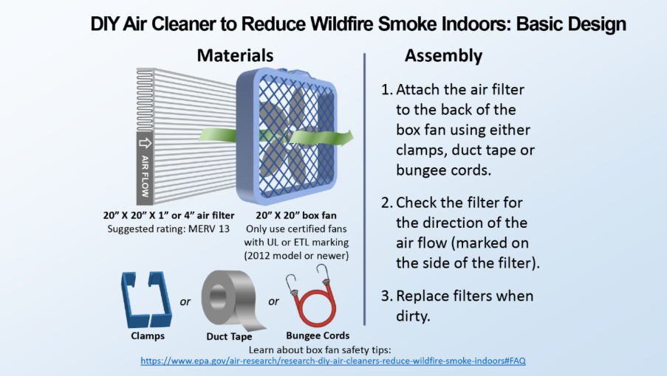
Figure 10-11
An affordable portable air cleaner for filtering particulate matter from indoor air during wildfire smoke
Source: U.S. Environmental Protection Agency (2021)

Slide 20
10.6 Tick and Mosquito-Borne Diseases

Slide 21
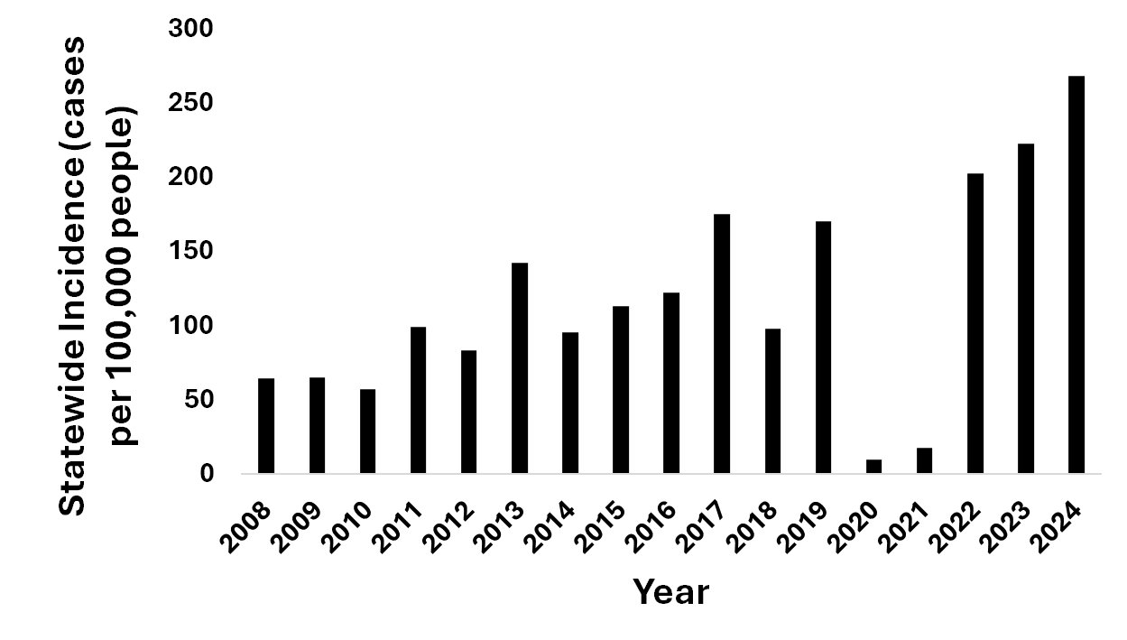
Figure 10-12
Lyme disease incidence in Vermont (cases per 100,000 people), 2008–2024
Data source: Vermont Department of Health (2025m)

Slide 22
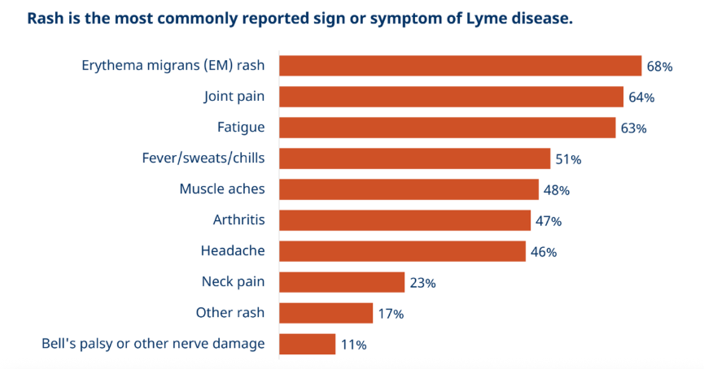
Figure 10-13
Reported signs and symptoms of Lyme disease
Source: Vermont Department of Health (2025i )

Slide 23
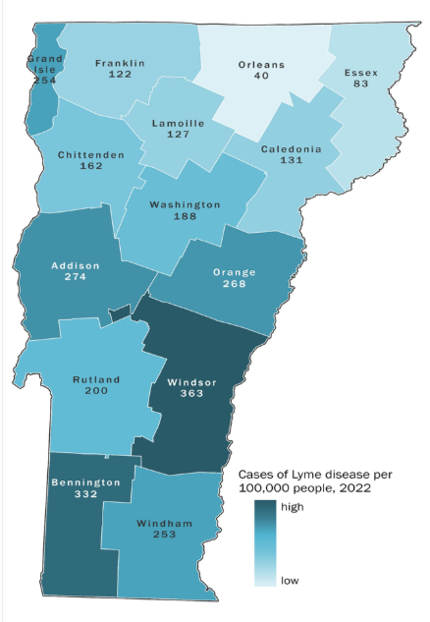
Figure 10-14
Lyme disease incidence (cases per 100,000 people), 2022
Source: Vermont Department of Health (2025i )

Slide 24
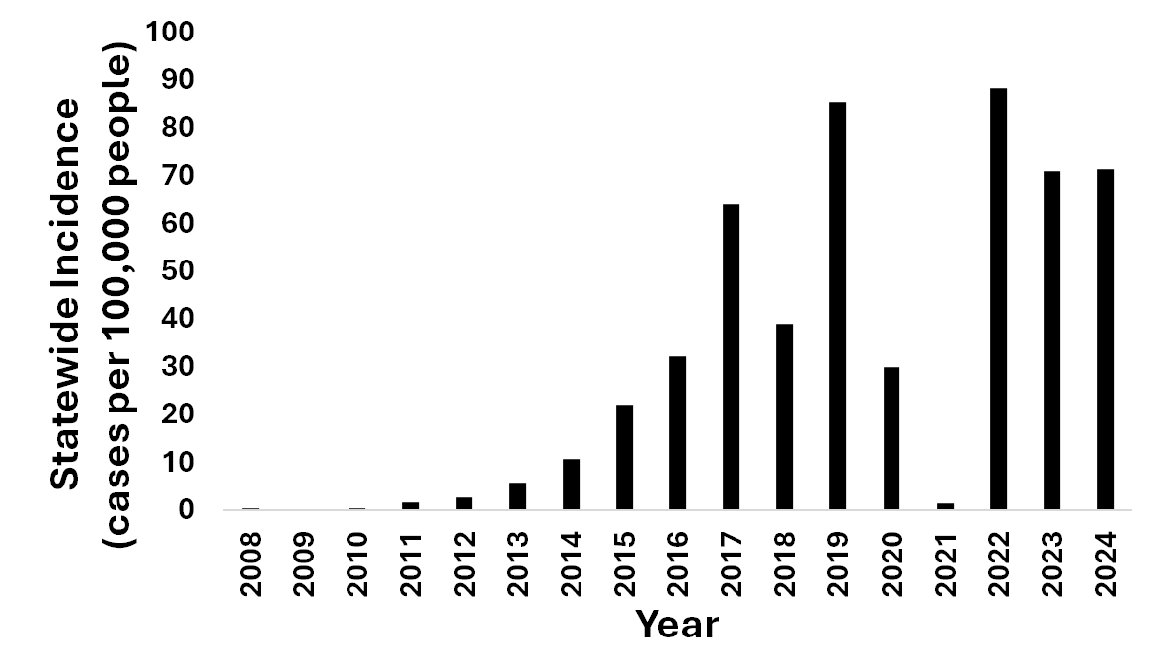
Figure 10-15
Statewide incidence of anaplasmosis in Vermont (cases per 100,000 people), 2008–2024
Source: Vermont Department of Health (2025m)

Slide 25
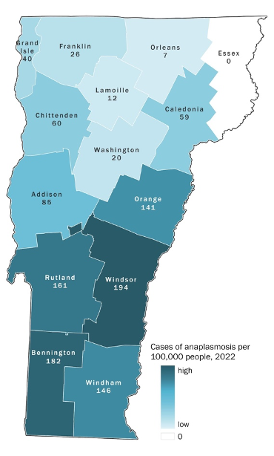
Figure 10-16
Anaplasmosis disease incidence (cases per 100,000 people), 2022
Source: Vermont Department of Health (2025k)

Slide 26
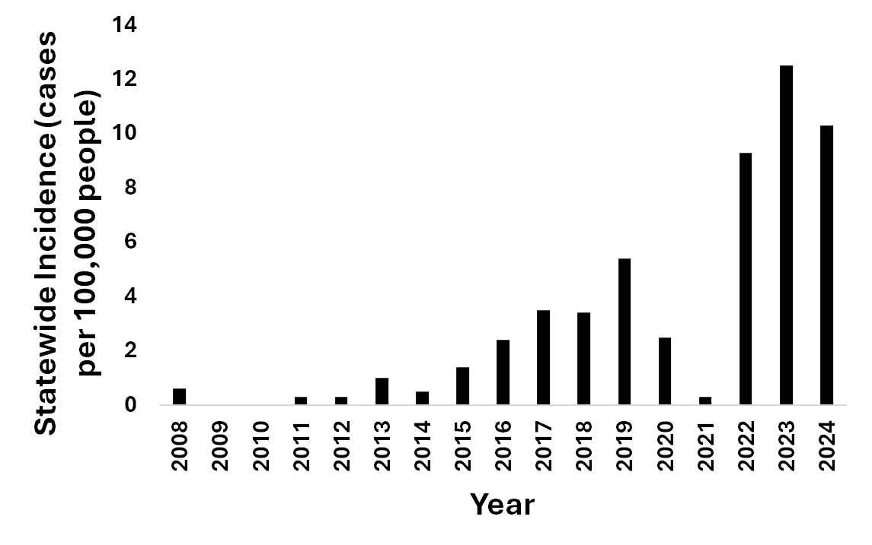
Figure 10-17
Incidence of babesiosis in Vermont (cases per 100,000 people), 2008 to 2024
Source: Vermont Department of Health (2025m)

Slide 27
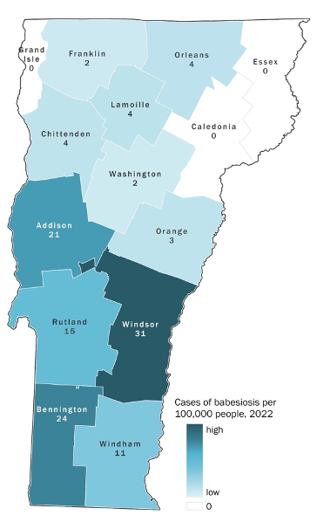
Figure 10-18
Babesiosis disease incidence (cases per 100,000 people), 2022
Source: Vermont Department of Health (2025l)

Slide 28
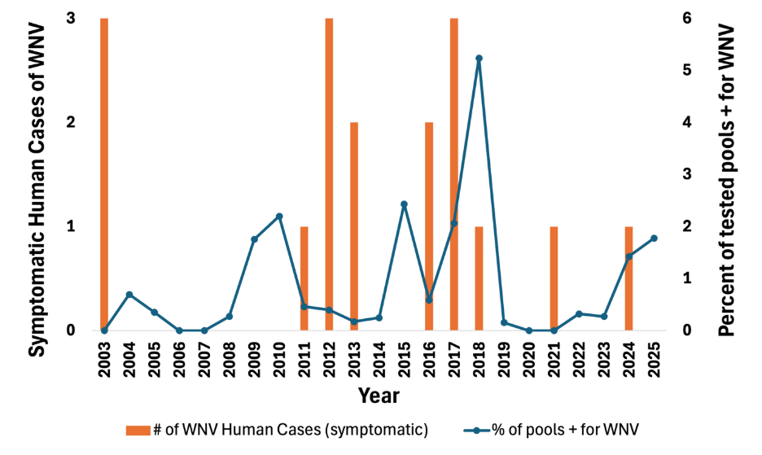
Figure 10-19
Figure 10‑19 Symptomatic human cases of West Nile virus (WNV), 2003–2024 (y-axis, left) and percent of mosquito pools positive for WNV, 2003–2025 (y-axis, right)
Source: Agency of Agriculture Food and Markets (2026); Vermont Agency of Agriculture, Food & Markets & Vermont Department of Health (2024); Vermont Department of Health (2025h, t)
Note: Human cases were counted from VDH-related sources. Cases from 2003–2023 were found in the Arbovirus Surveillance and Response Plan. Cases from 2024 were found in the 2024 Mosquito-Borne Virus Surveillance Report. Cases from 2025 were from the VDH website. The percent of pools that tested positive for WNV was taken from VAAFM’s annual Mosquito Surveillance Reports from 2023–2025.

Slide 29
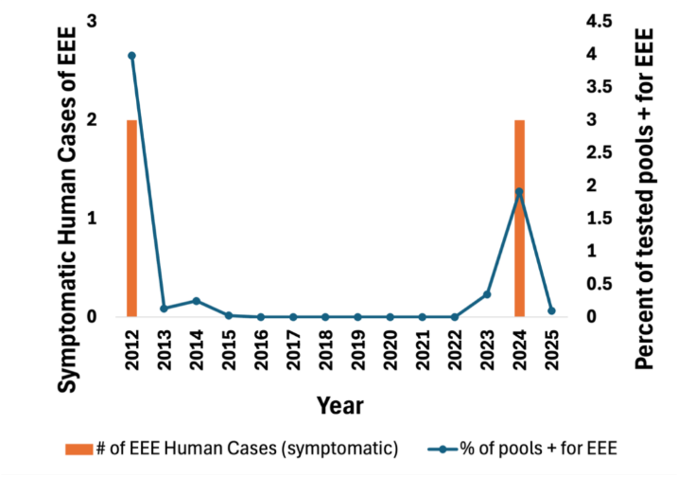
Figure 10-20
Symptomatic human cases of Eastern Equine Encephalitis (EEE) (y-axis, left) and percent of mosquito pools testing positive for EEE, 2012-2025 (y-axis, right)
Source: Agency of Agriculture Food and Markets (2026); Vermont Agency of Agriculture, Food & Markets & Vermont Department of Health (2024); Vermont Department of Health (2025h, t)
Note: Human cases were counted from VDH-related sources. Cases from 2003–2023 were found in the Arbovirus Surveillance and Response Plan. Cases from 2024 were found in the 2024 Mosquito-Borne Virus Surveillance Report. Cases from 2025 were from the VDH website. The percent of pools that tested positive for EEE was taken from VAAFM’s annual Mosquito Surveillance Reports from 2023–2025.

Slide 30
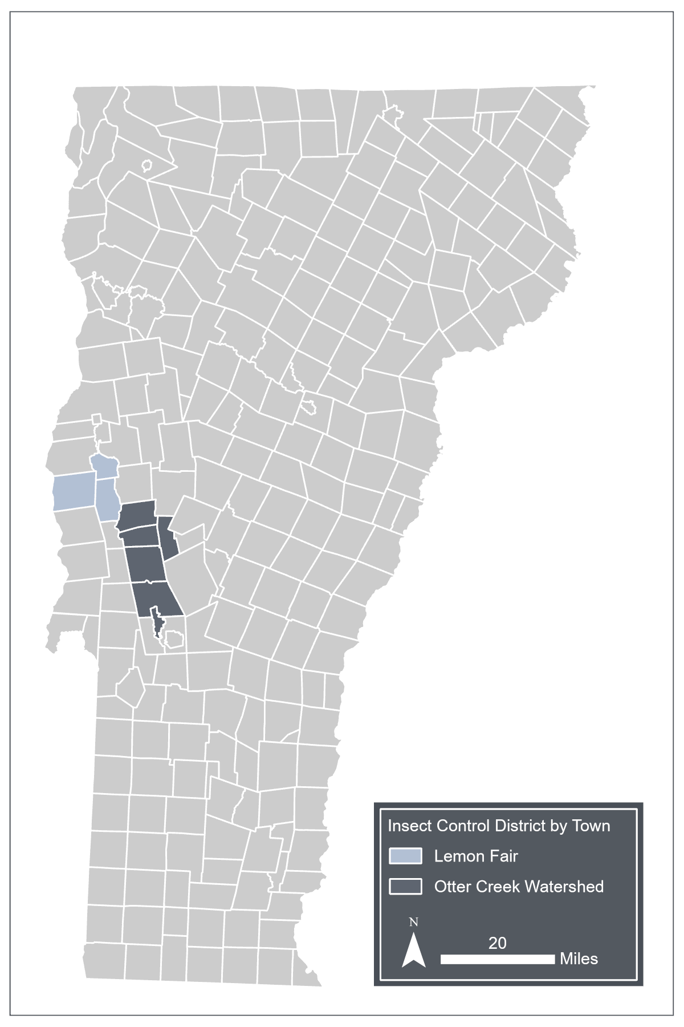
Figure 10-21
Towns that are part of Vermont's two Mosquito Control Districts
Source: Lemon Fair Insect Control District (2026); Otter Creek Watershed Insect Control District (2011); Vermont Agency of Agriculture, Food & Markets & Vermont Department of Health (2024)
Note: Data visualization by Hannah C. Turner
Notes:
Image quality is not so great, see if I can get better

Slide 31
10.7 Water Quality

Slide 32
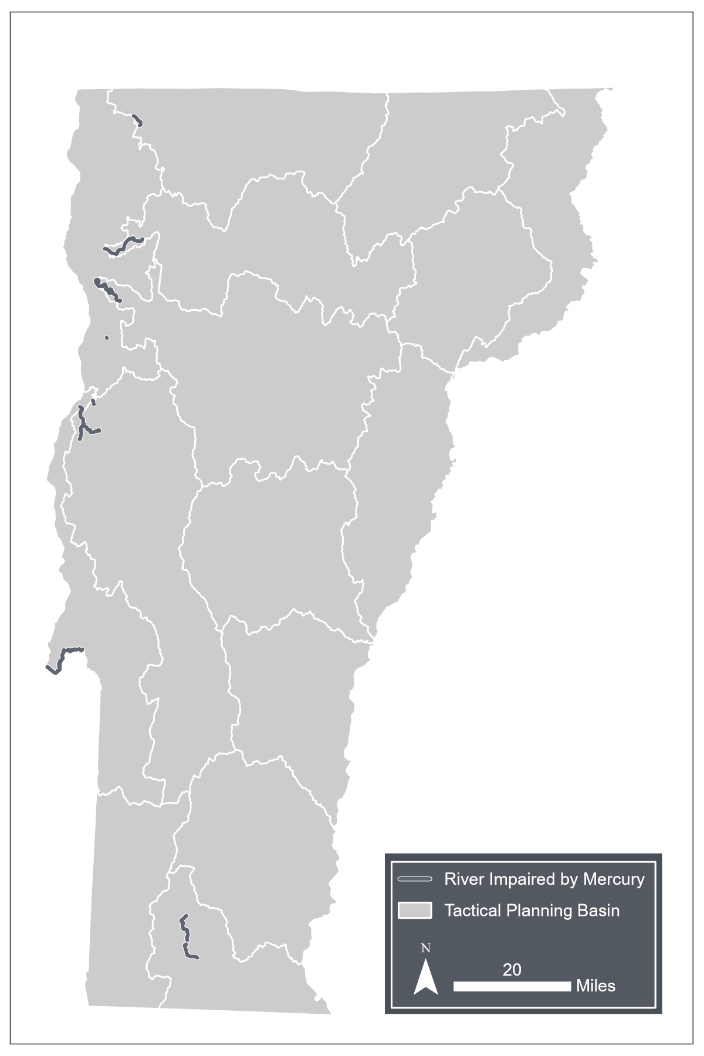
Figure 10-22
Mercury-impaired waterbodies in Vermont
Source: Vermont Department of Environmental Conservation (2025); Vermont Department of Health (2025g)
Note: Data visualization by Hannah C. Turner

Slide 33
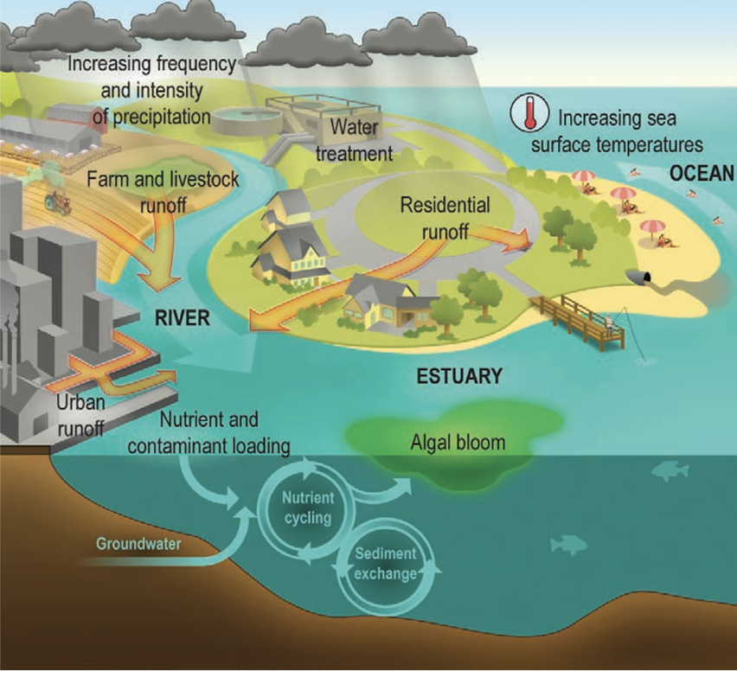
Figure 10-23
Links between climate change, water quantity and quality, and human exposure to water-related illness
Source: Crimmins et al. (2016)

Slide 34
Table 10-2
Toxin | Health effects | WHO Guideline value for recreation (µg/L)
Microcystins (>250 variants) | Acute: Liver damage Chronic: hepatic hypertrophy (liver enlargement); tumor promotion via phosphatase inhibition (IARC describes as “possibly carcinogenic to humans”) | 24
Cylindrospermopsins | Acute: mild skin irritation, liver, kidney, and erythrocyte (red blood cell) toxicity Chronic: genotoxic (limited animal and tissue studies) | 6
Anatoxins | Acute: neurotoxic effects as nicotinic receptor agonist (in humans, headache, confusion, and vision changes have been experienced, can be lethal to dogs) Chronic: no information | *provisional health-based reference value, NOT a guideline value* 58.8
Saxitoxins | Acute: neurotoxic effects via ion channel blocking in neuronal and cardiac cells (twitching, convulsions, paralysis, impaired coordination, tingling, numbness, dizziness, vomiting, nausea, muscle weakness, diarrhea) Chronic: no sufficient information | 30
Anatoxin-a(S) (type of anatoxin) | Acute: neurotoxic effects through acetylcholinesterase inhibition (muscle weakness, convulsions, and respiratory distress that can lead to death) Chronic: no sufficient information | Not sufficient information to develop a guideline value New Zealand’s maximum level for drinking water is 1 microgram/L
Dermatoxins | Little information on dermatoxins produced by temperate cyanobacteria species. | No guideline value because exposure is through contact and not ingestion
Cyanotoxins, their health effects, and World Health Organization (WHO) exposure levels
Source: Water, Sanitation, Hygiene, and Health WHO Team (2021)
Note: The WHO Guideline Value for Recreation is based on a 15kg child swallowing ≤250 mL of water

Slide 35
Table 10-3
Level of potential exposure | Recreational activity | Primary exposure pathway of concern
High | Swimming/wading Diving Water skiing/wake boarding Wind surfing Jet skiing | Ingestion Ingestion Ingestion/inhalation Ingestion/inhalation Ingestion/inhalation
Moderate | Fish consumption Canoeing Paddle boarding Rowing Sailing Kayaking Motor boating | Ingestion Inhalation/skin Inhalation/skin Inhalation/skin Inhalation/skin Inhalation/skin Inhalation
Low/none | Catch and release fishing Hiking Picnicking Sightseeing | Skin Not applicable Not applicable Not applicable
Recreation activities and cyanobacteria exposure risk
Source: Vermont Department of Health (2015)

Slide 36
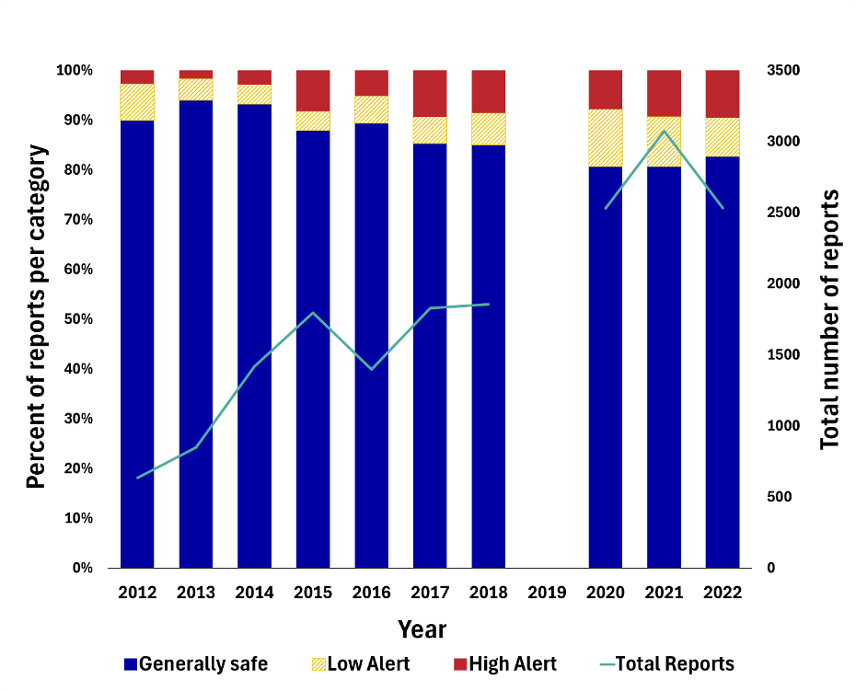
Figure 10-24
Cyanobacteria reports per year, percent per alert category (y-axis, left) and total counts (y-axis, right), 2012-2022
Source: Vermont Department of Health (2026a)
Note: Data from the VDH Cyanobacteria Tracker Season Summaries, 2012–2022; 2019 is excluded because the alert level data for reports is not available.

Slide 37
Table 10-4
Year | Location | Sample collection date | Level (µg/L)
2025 | Derby Center Water System | 9/8/25 | 0.31
2025 | Grand Isle Fire Dist 4 | 8/19/25 | 0.76
2024 | Alburgh Village Water System | 10/22/24 | 0.41
2024 | Alburgh Village Water System | 10/15/24 | 0.57
2024 | Grand Isle Fire Dist 4 | 10/8/24 | 1.9
2024 | Alburgh Village Water System | 10/1/24 | 0.4
2024 | Alburgh Village Water System | 9/17/24 | 0.32
2024 | Alburgh Village Water System | 9/10/24 | 0.5
2024 | Websterville Fire District 3 | 7/8/24 | 0.42
2021 | Alburgh Village Water System | 10/1/21 | 0.33
2021 | Alburgh Village Water System | 9/23/21 | 0.5
2021 | Thompson Pt Assoc | 8/10/21 | 0.74
2020 | Grand Isle Fire Dist 4 | 9/15/20 | 0.45
Raw water samples from public drinking water systems with microcystin levels >0.30 micrograms/liter (μg/L), 2020-2025
Source: Vermont Department of Environmental Conservation (2026c)
Notes:
Need to fix micrograms per L

Slide 38
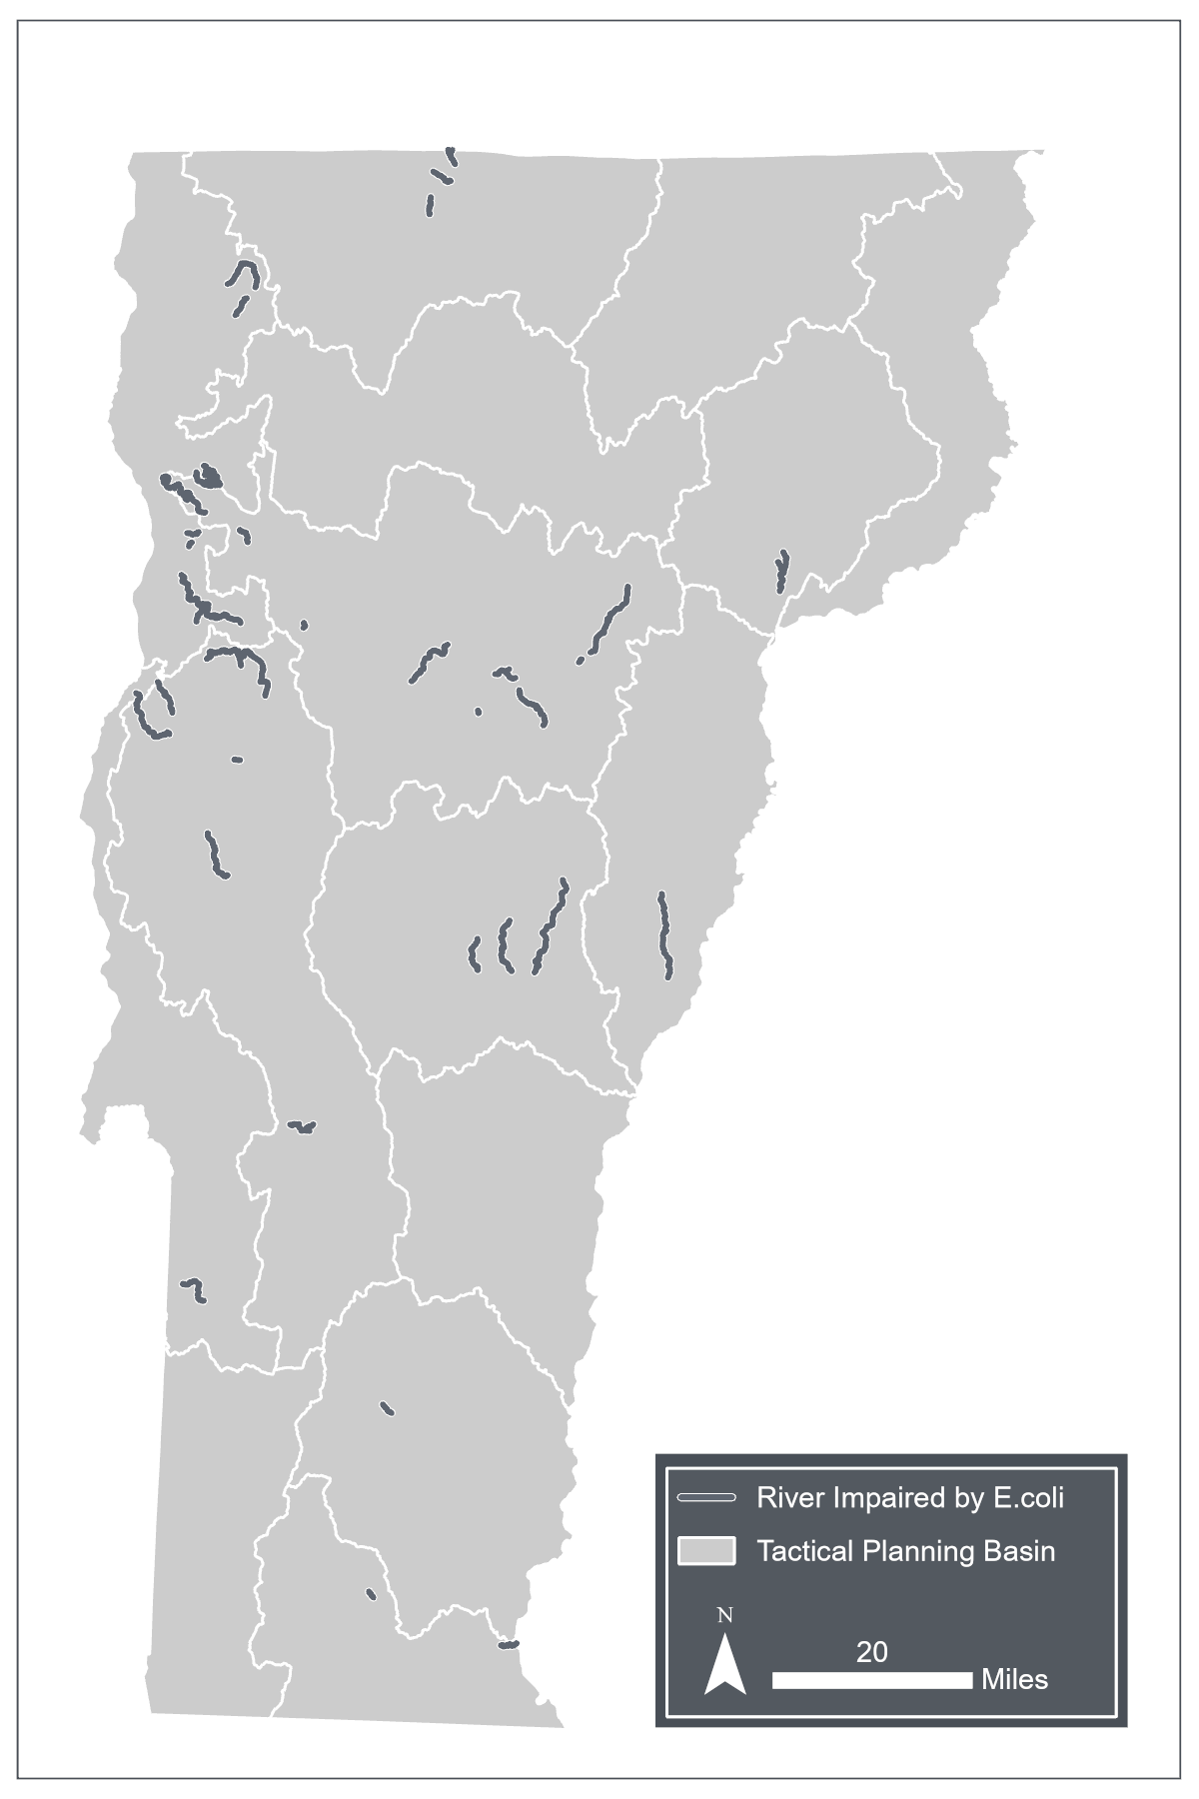
Figure 10-25
River segments impaired by Escherichia coli (E. coli) from the Vermont Department of Environmental Conservation’s (VTDEC) List of Impaired Waters, 2024
Source: Vermont Department of Environmental Conservation (2025)
Note: Data visualization by Hannah C. Turner

Slide 39
Table 10-5
Pathogen | Climate change-related driver | Effect on pathogen
Norovirus | Increased temperatures | Lower viral load
 | Heavy precipitation | Increased levels
Giardia | Increased temperatures | Reduced growth/die-off
 | Flooding | Pathogen spread
Cryptosporidium | Increased temperatures | Reduced growth/die-off
 | Flooding | Pathogen spread
Legionella species | Increased temperatures | Increased growth
Staphylococcus aureus (common cause of otitis externa) | Flooding | Pathogen spread
Top domestically acquired waterborne diseases in the U.S. and climate change-related effects on pathogens
Source: Salubi et al. (2024); Semenza & Ko (2023)

Slide 40
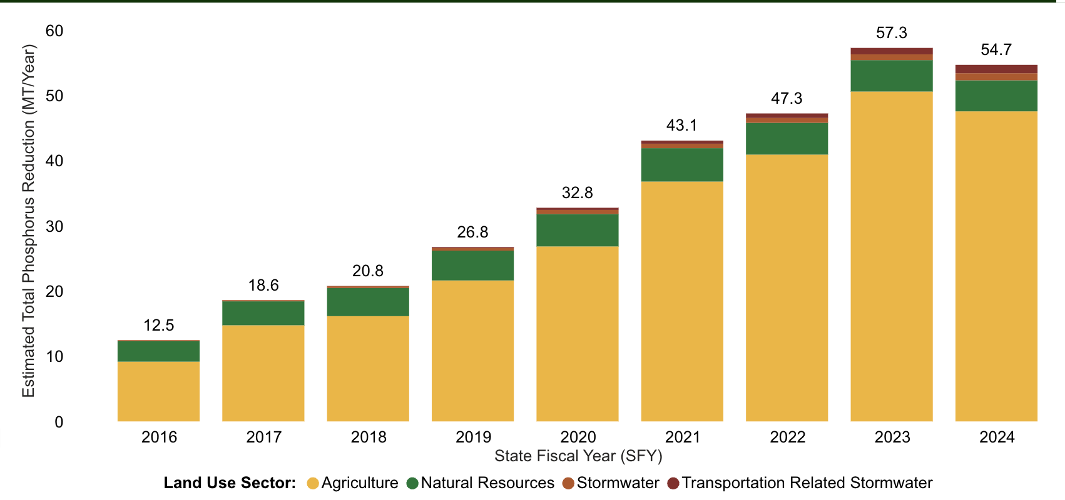
Box 10-3: 10 years of the Vermont Clean Water Act
Annual phosphorus reductions in metric tons in the Lake Champlain basin, 2016-2024
Source: Vermont Department of Environmental Conservation (2026b)

Slide 41
10.8 Food Security

Slide 42
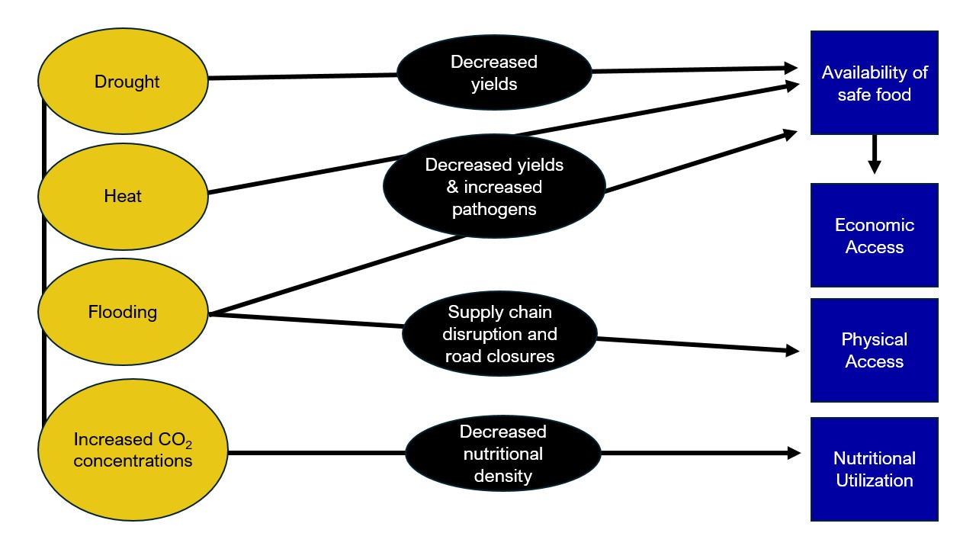
Figure 10-26
Climate change-driven disruptions to food security
Source: Created by Anna Hoppe

Slide 43
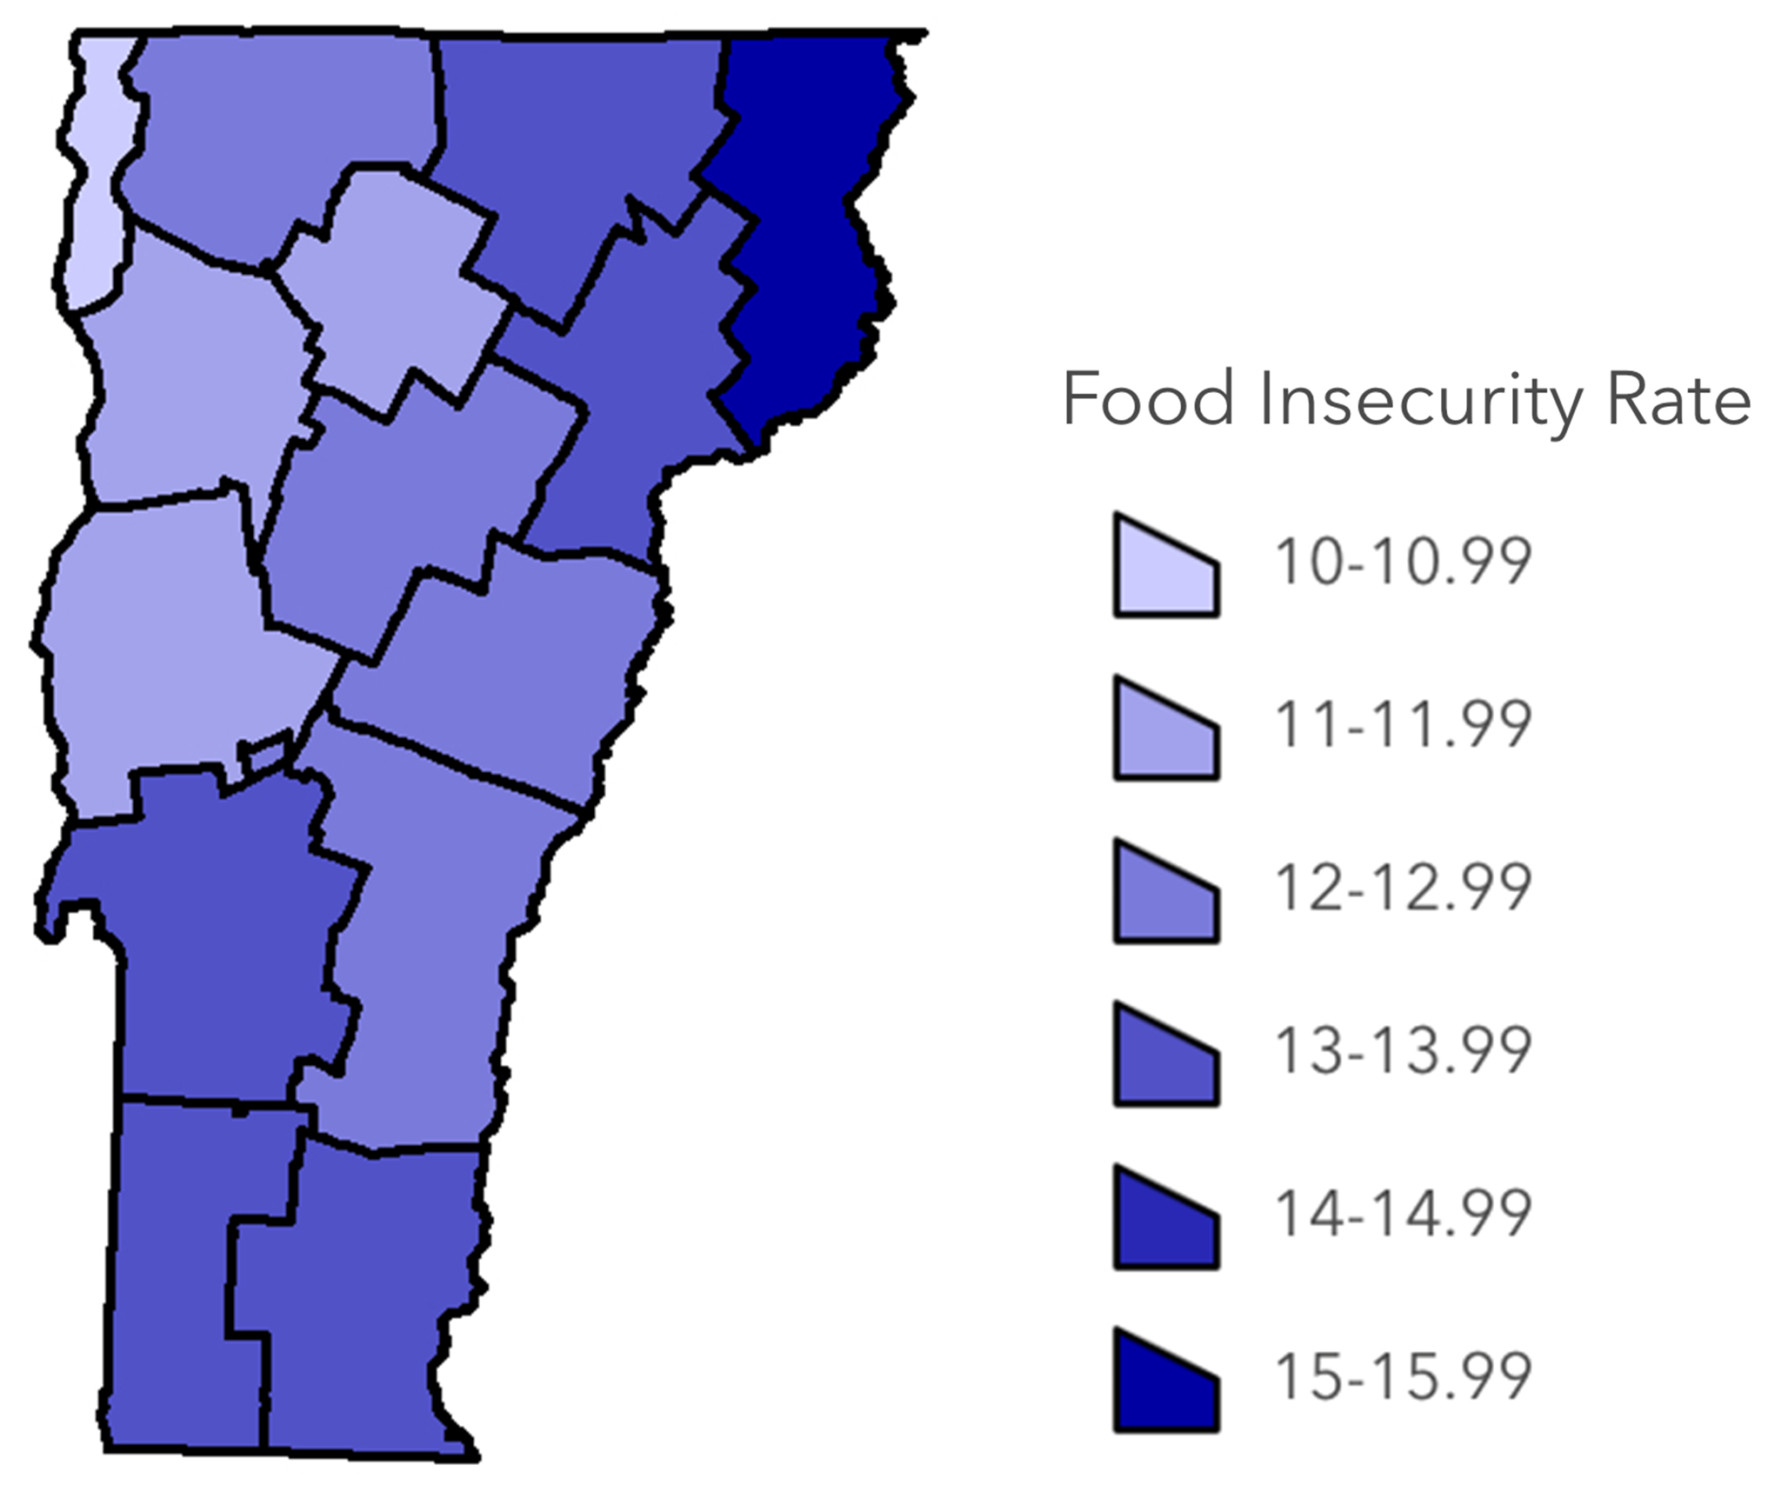
Figure 10-27
Food insecurity rates per county in Vermont, 2023
Source: Feeding America (2026)

Slide 44
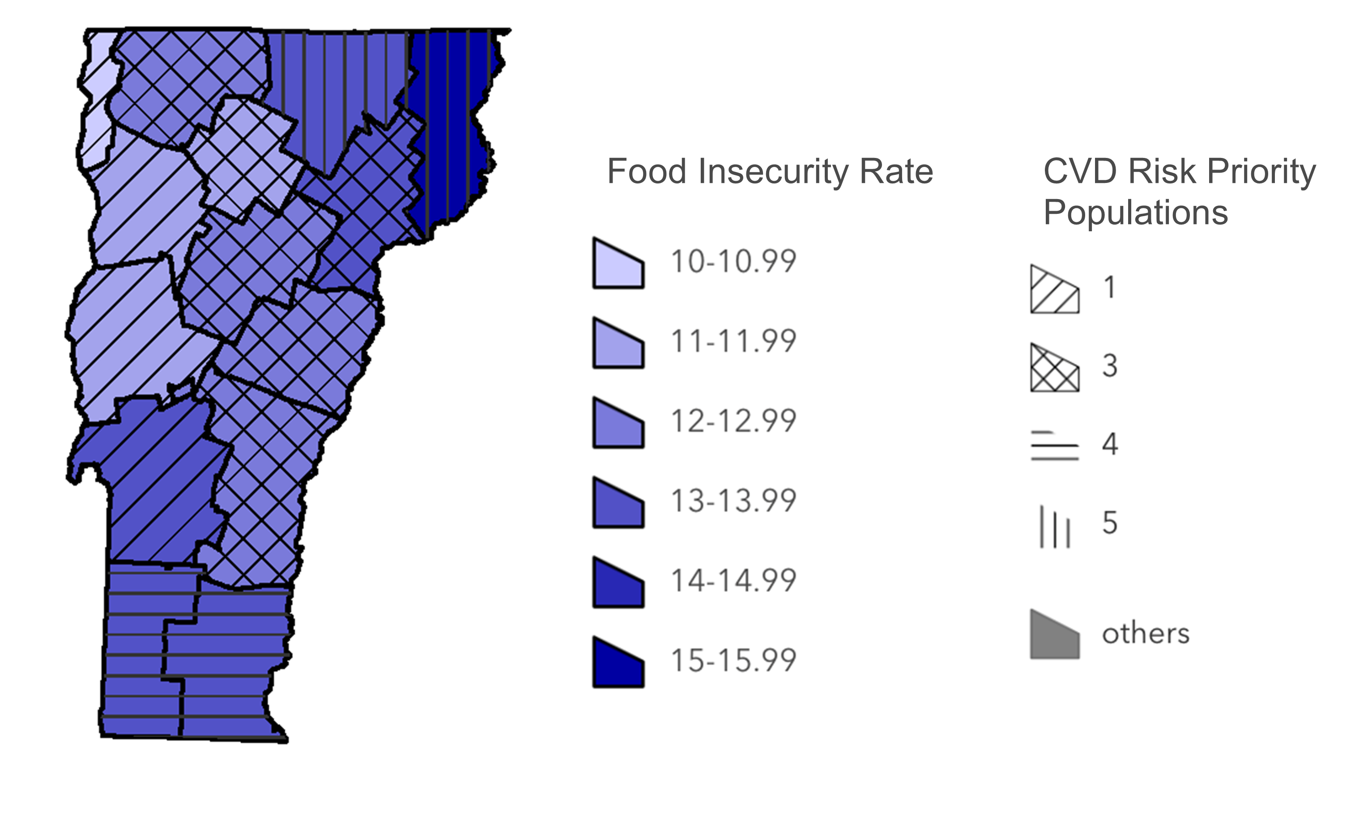
Figure 10-28
Food insecurity rate by county, 2023, and number of priority populations at risk of cardiovascular disease (CVD)
Source: Feeding America (2026); Meddaugh (2023a)

Slide 45
10.10 Cascading Impacts

Slide 46
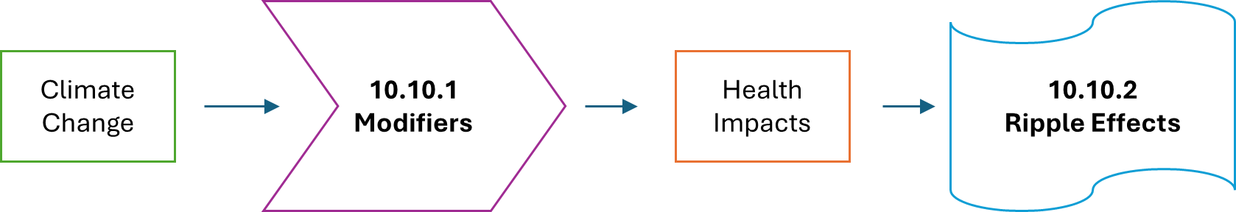
Figure 10-29
Framework for the factors surrounding the impacts of climate change on human health: modifiers and ripple effects.
Source: Created by chapter authors
Notes:
Ripple effects shape looks weird

Slide 47
10.11 Climate & Health Multisolving

Slide 48
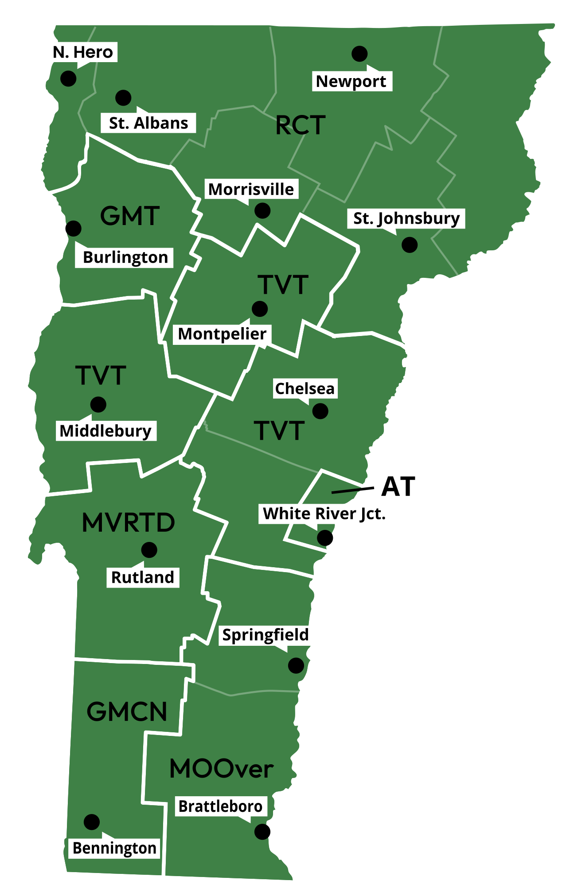
Figure 10-30
Major public transportation provider by county
Source: Go! Vermont (2026)

Slide 49
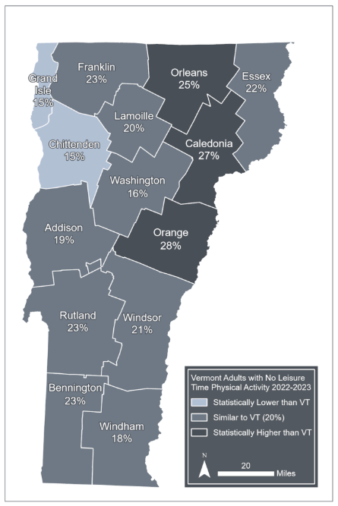
Figure 10-31
Vermont adults with no leisure time physical activity by county, 2022–2023
Source: Vermont Department of Health (2025b)
Note: Visualization by Hannah C. Turner

Slide 50
Table 10-6
Nutrition-related disease | % of Vermont adults reporting lifetime impact in 2023
Obesity | 30% (aged 20 or older)
Cardiovascular disease | 8%
Hypertension | 33%
Diabetes | 9%
High cholesterol | 34%
Lifetime impacts of nutrition-related diseases on Vermont adults
Source: Vermont Department of Health (2025b)

