Slide 1


9 Outdoor Recreation and Tourism
Maura Muldoon^{1,2}, Kathryn Wrigley^{1,3}, Dorothy Chesshire¹, Monika Derrien¹
¹Rubenstein School of Environment & Natural Resources, University of Vermont, Burlington, VT
²Gund Institute for Environment, University of Vermont, Burlington, VT
³Dept. of Forests, Parks & Recreation, Agency of Natural Resources, Essex Junction District Office, VT
Recommended citation:
Muldoon, M., Wrigley, K., Chesshire, D., & Derrien, M. 2026. Chapter 9: Recreation and Tourism. In Galford, G.L., Balerna, J.A., Turner H.C., Sardonis, A., Peplinski, H. (Eds), The Vermont Climate Assessment 2025. Burlington, Vermont: Climate Measurements Center of Excellence, Gund Institute for Environment at the University of Vermont. DOI: 10.5281/zenodo.20272849. Accessed online at https://vtclimate.org.

Slide 2
9.2 Background

Slide 3
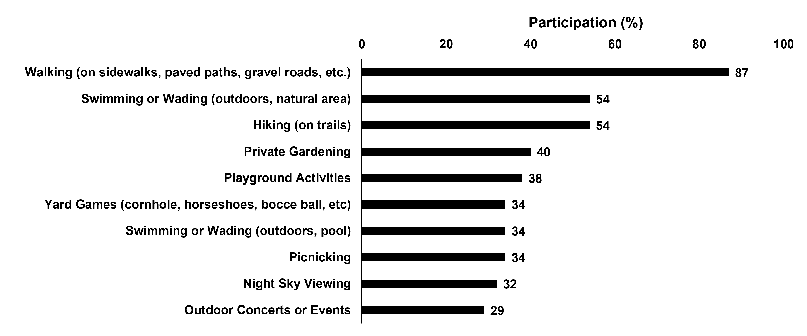
Figure 9-1 Top ten activities by participation according to a representative survey of Vermonters
Source: SCORP (2024)

Slide 4
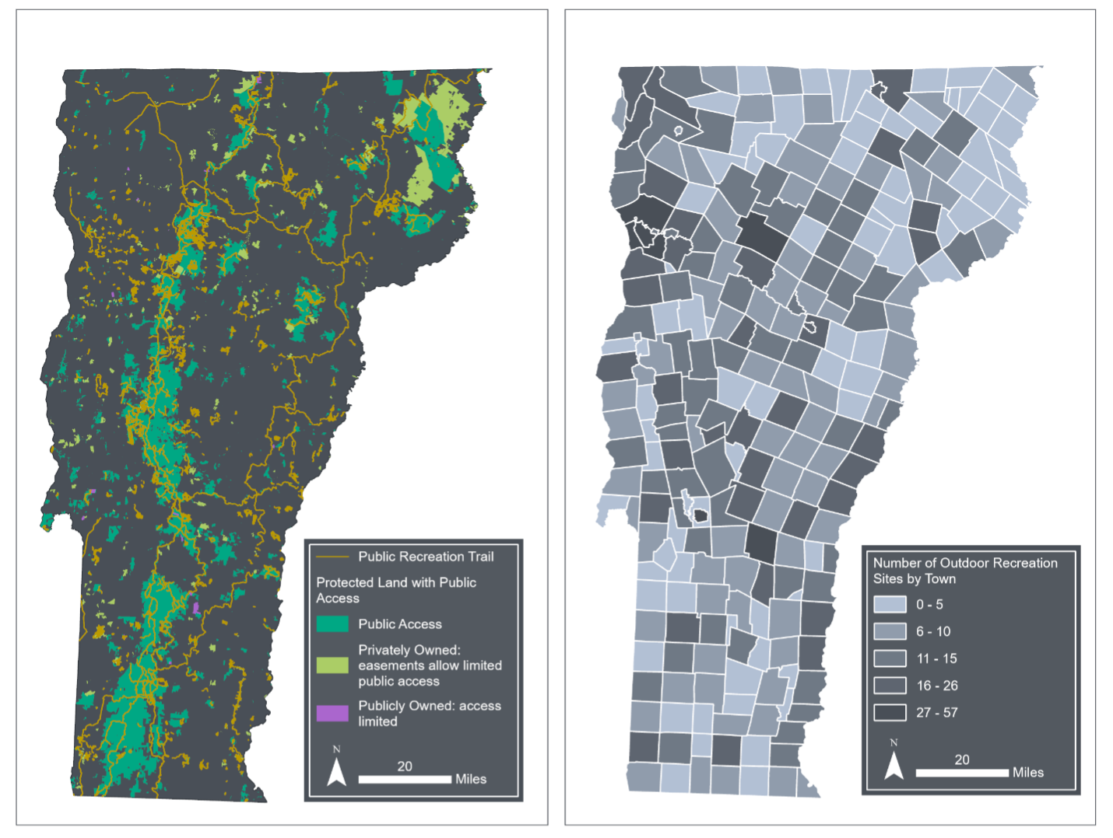


Figure 9-2 Map of VT protected lands, trails, and recreation sites. This geographic representation is intended to highlight how diffuse recreation opportunities are in Vermont
Source: Vermont Agency of Natural Resources (2022); Vermont Center for Geographic Information (2022, 2025)
Note: Visualization by Hannah C. Turner

Slide 5
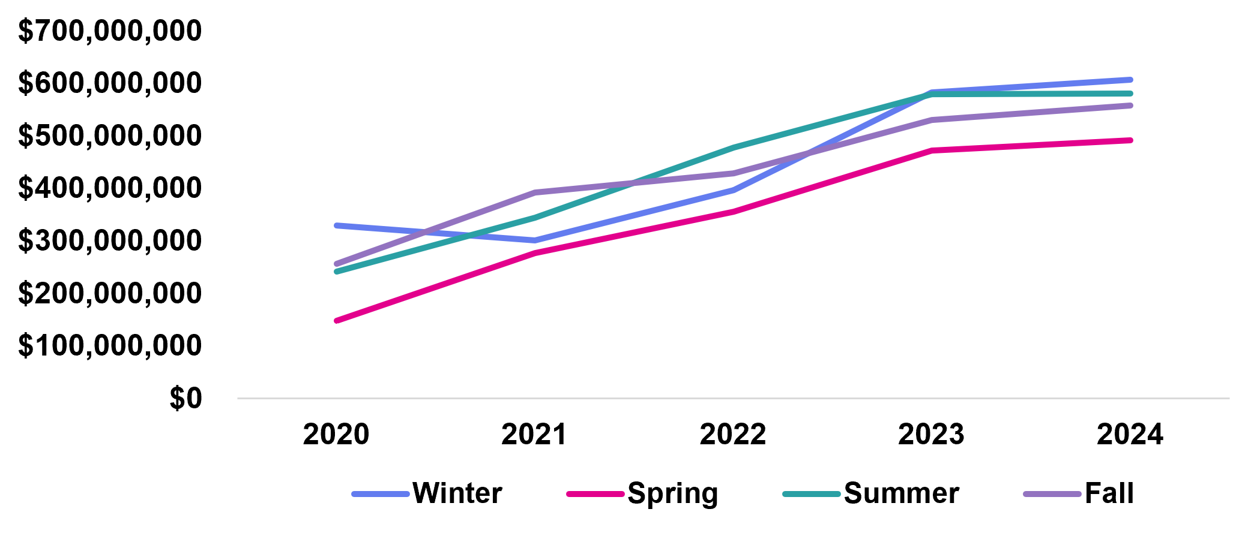
Figure 9-3 Nominal values of Vermont taxable receipts for meals, rooms, and alcohol from 2020-2025 by season
Source: Vermont Department of Taxes (2024)

Slide 6
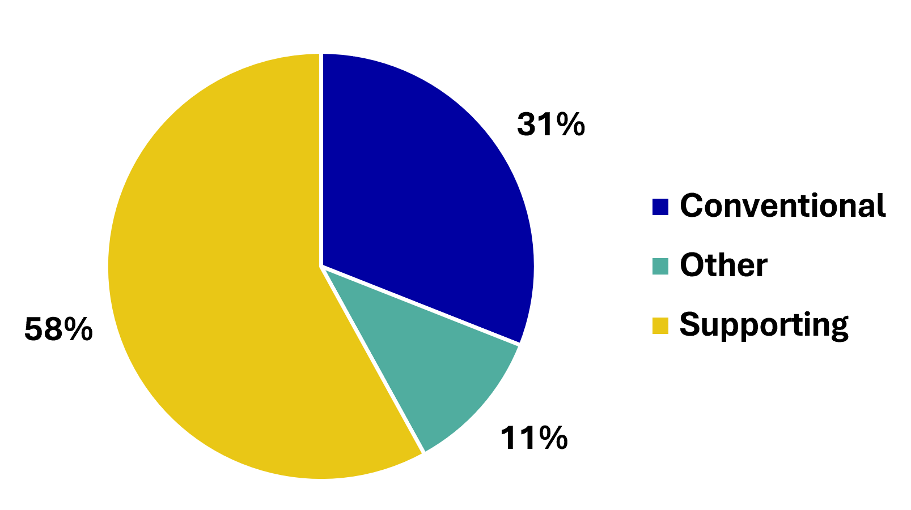
Figure 9-4
Value-Added Composition of Outdoor Recreation Activities in Vermont
Source: Adapted from BEA (2024)

Slide 7
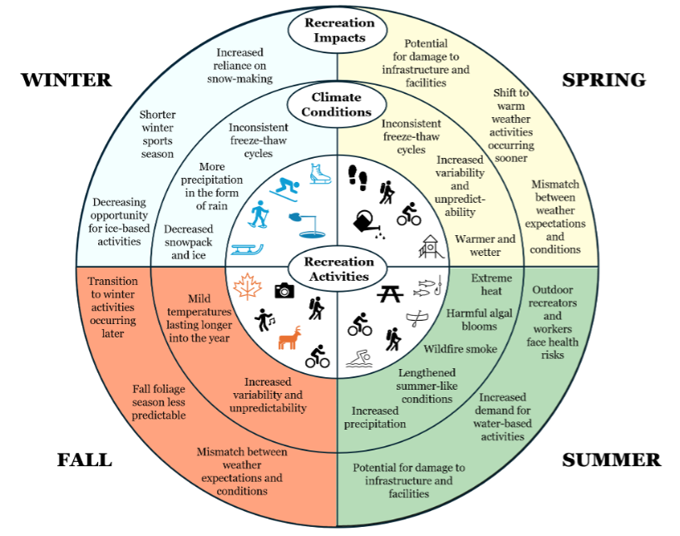
Figure 9-5
Key climate conditions and recreation impacts per season. Blue or orange recreation activity symbols represent season specificity, while all other symbols represent activities that typically take place throughout the year or between spring-fall.
Source: Chapter co-authors

Slide 8
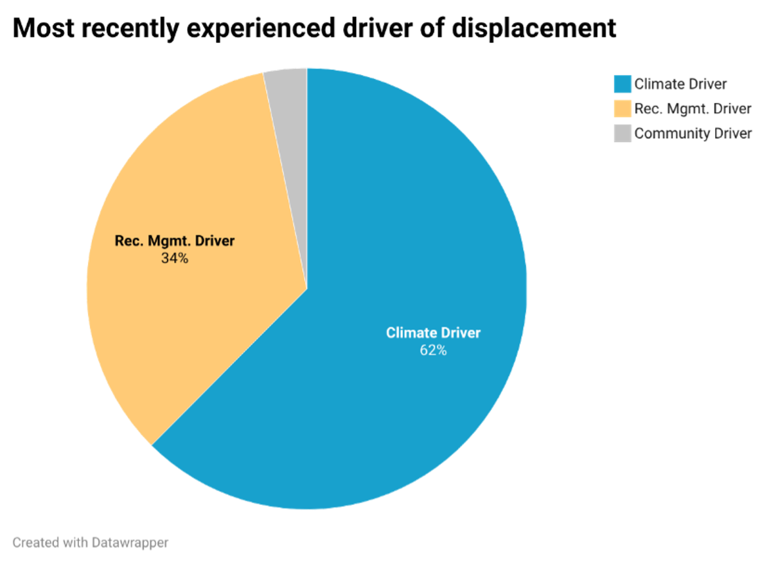
Figure 9-6
Drivers of displaced trail use, or changed plans to utilize a trail, reasons given by users were classified as climate, recreational management and community drivers. The top three most recent drivers of displacement, extreme precipitation, extreme temperature, and wind events, are climate-related, as well as poor air quality, the sixth-most reported reason for displacement
Source: Wrigley & Coleman (2025)
Source: (Wrigley & Coleman, 2025).

Slide 9
9.2 Winter

Slide 10
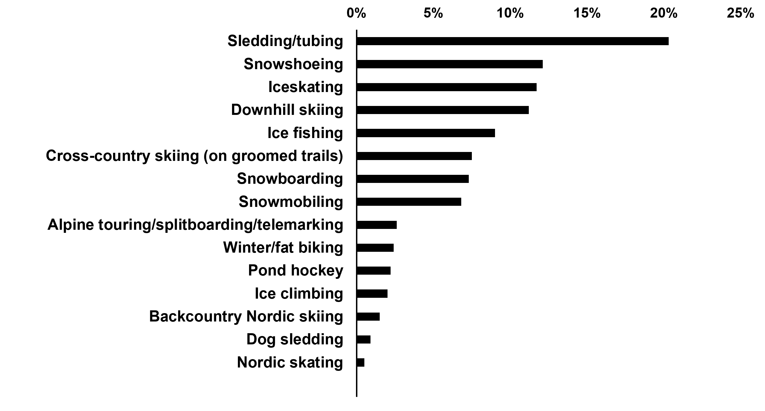
Figure 9-7. Participation by Vermonters in common winter recreation activities, as a percent of respondents
Source: SCORP (2024). Surveys conducted for the Move Forward Together Vermont (MFTV) planning process conducted by the Vermont Department of Forests, Parks, and Recreation, Vermont Outdoor Recreation Economic Collaborative (VOREC), and CRO Planning and Design in support of the Statewide Comprehensive Outdoor Recreation Plan (SCORP)

Slide 11
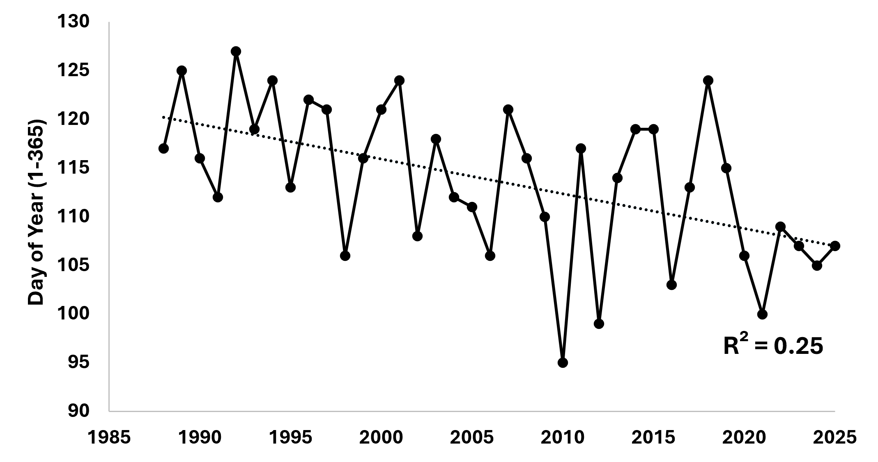
Figure 9-8 Day of the year when the ice at Joe’s Pond melts, as recorded by a citizen-led monitoring system in place since 1988; dotted line shows the linear trend
Source: Joe’s Pond Association (2025)

Slide 12
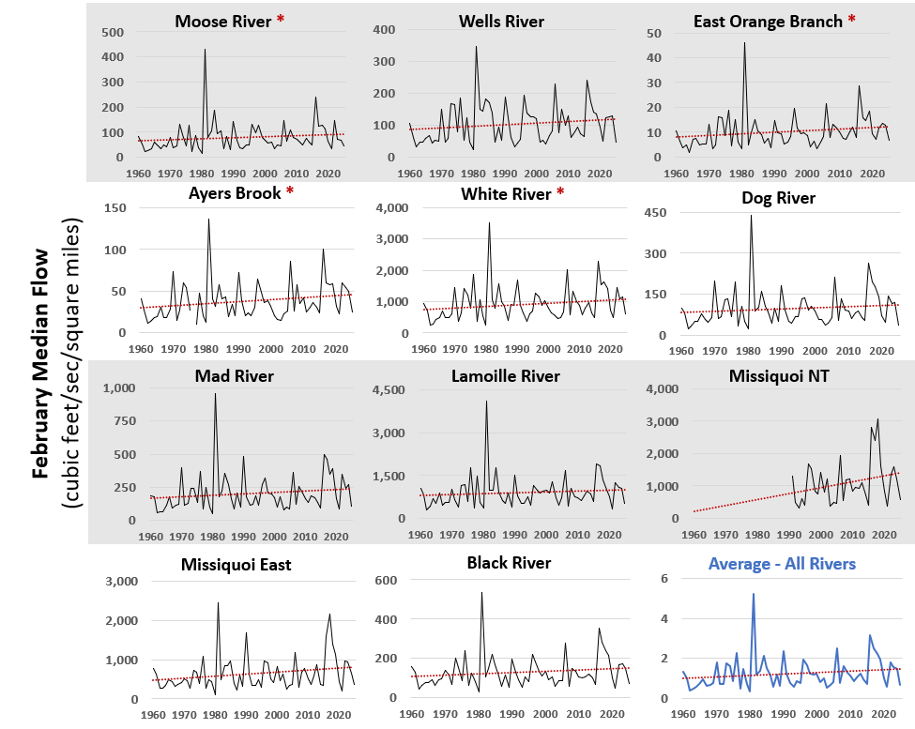
Source: USGS (2026)
Figure 9-9
February median flow (cubic feet per second) in gauged rivers across Vermont (n=11) from 1960–2025. The bottom right panel averaged and normalized February median flow by drainage basin area (square miles) to allow for comparability across all streams. Sen slope calculations with annual data used to determine rate of change, with Mann-Kendall p-value to determine the significance of such trends. Significant trends (p<0.05) were found in the Moose River, Ayers Brook, White River, and the East Orange Branch, as indicated by a red asterisk.
Missisquoi NT
Missisquoi East

Slide 13
9.4 Summer

Slide 14
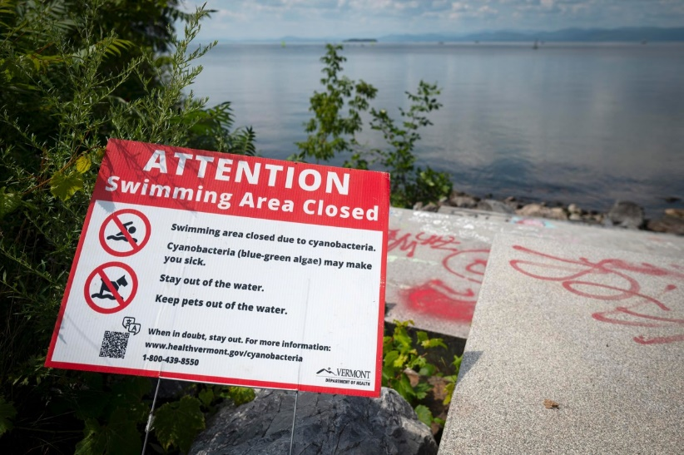
Figure 9-10
A sign communicating that a swimming area is closed due to cyanobacteria
Source: Glenn Russell via VTDigger (2025)

Slide 15
9.5 Fall

Slide 16
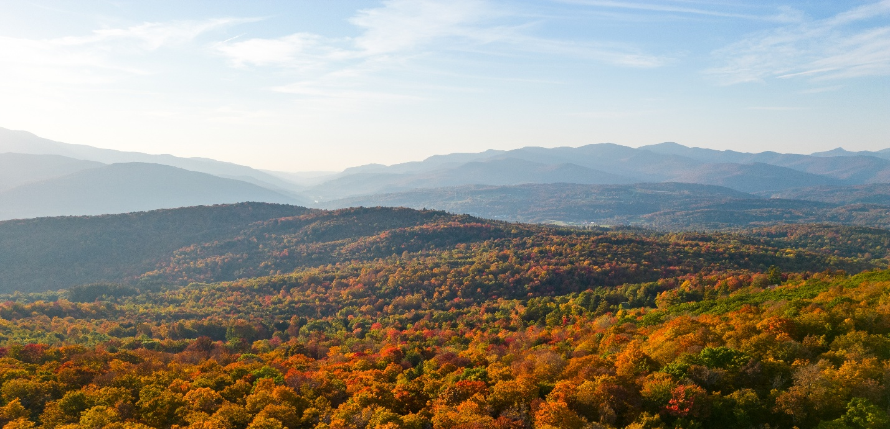
Figure 9-11
Fall foliage in Vermont draws visitors to the state
Source: UVM Spatial Analysis Lab (2023)

