Slide 1


Energy
Shashank Poudel^{1,2}, Peter Fisher³, Emily Narberes^{1,4}
¹College of Agriculture and Life Sciences, University of Vermont, Burlington, VT
²Gund Institute for the Environment, University of Vermont, Burlington, VT
³College of Engineering and Mathematical Sciences, University of Vermont, Burlington, VT
⁴College of Arts and Sciences, University of Vermont, Burlington, VT
Recommended citation for chapter
Poudel, S., Fisher, P., Narberes, E. 2026. Chapter 8: Energy. In Galford, G.L., Balerna, J.A., Turner H.C., Sardonis, A., Peplinski, H. (Eds), The Vermont Climate Assessment 2025. Burlington, Vermont: Climate Measurements Center of Excellence, Gund Institute for Environment at the University of Vermont. DOI: 10.5281/zenodo.20272849. Accessed online at https://vtclimate.org.

Slide 2


8.2 Background

Slide 3
Figure 8-1 A diagram outlining commonalities and differences between Vermont’s Climate Action Plan (CAP) and Comprehensive Energy Plan (CEP)
Climate Action Plan
Comprehensive Energy Plan
Climate adaptation
Non-energy GHG emissions: agriculture, waste, etc.,
Sequestration
GHG Inventory Review
Cost effective GHG reduction targets
Energy sector analysis: policy and technology scenarios and pathways
Public engagement and modelling efforts
Equitable transitions
Renewable energy development
Electric plan including reliability
Energy system planning: adequacy, security, sustainability, affordability, economic viability
Standards for local planning (Act 174)
Source: Vermont Department of Public Service (2022)

Slide 4
Table 8-1 Goals of the 2022 Comprehensive Energy Plan (CEP)
Source: Vermont Department of Public Service (2022)
Sector | 2022 CEP goals
Electricity | - Fully decarbonized and at least 75% renewable by 2032
Transportation | - Zero-emission vehicles account for 100% of light-duty vehicle sales in Vermont by 2035
Thermal and Process Energy | - Increasing renewable thermal and process supply to 30% by 2025, increasing to 45% by 2032 and 70% by 2042 - Weatherizing 120,000 households by 2030, relative to a 2008 baseline - Calls for the formal consideration of a Clean Heat Standard

Slide 5
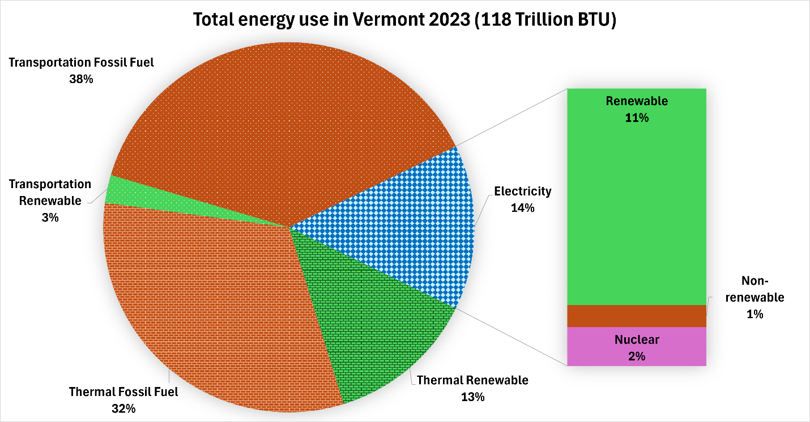
Figure 8-2 Proportion of annual energy usage by sector (electricity, thermal, and transportation), and source (fossil fuel, renewable, and nuclear) in Vermont, 2023.
Source: Adapted from Energy Action Network (2025)

Slide 6
8.3 Energy Use

Slide 7
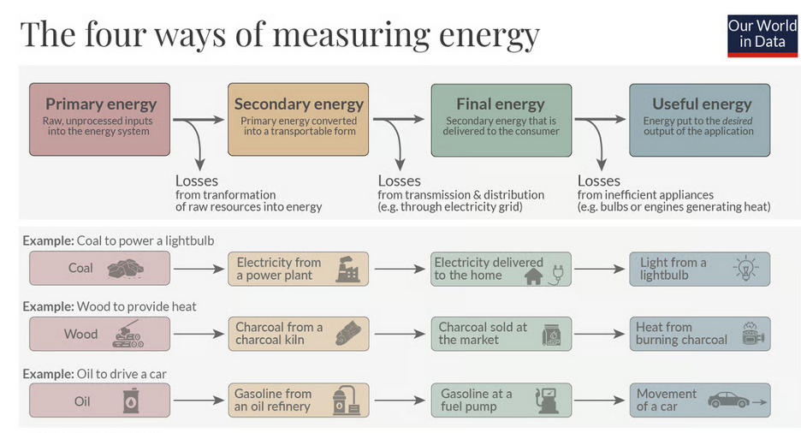
Figure 8-3 Categories of energy sources, conversion, and measurement
Source: Ritchie (2022)

Slide 8
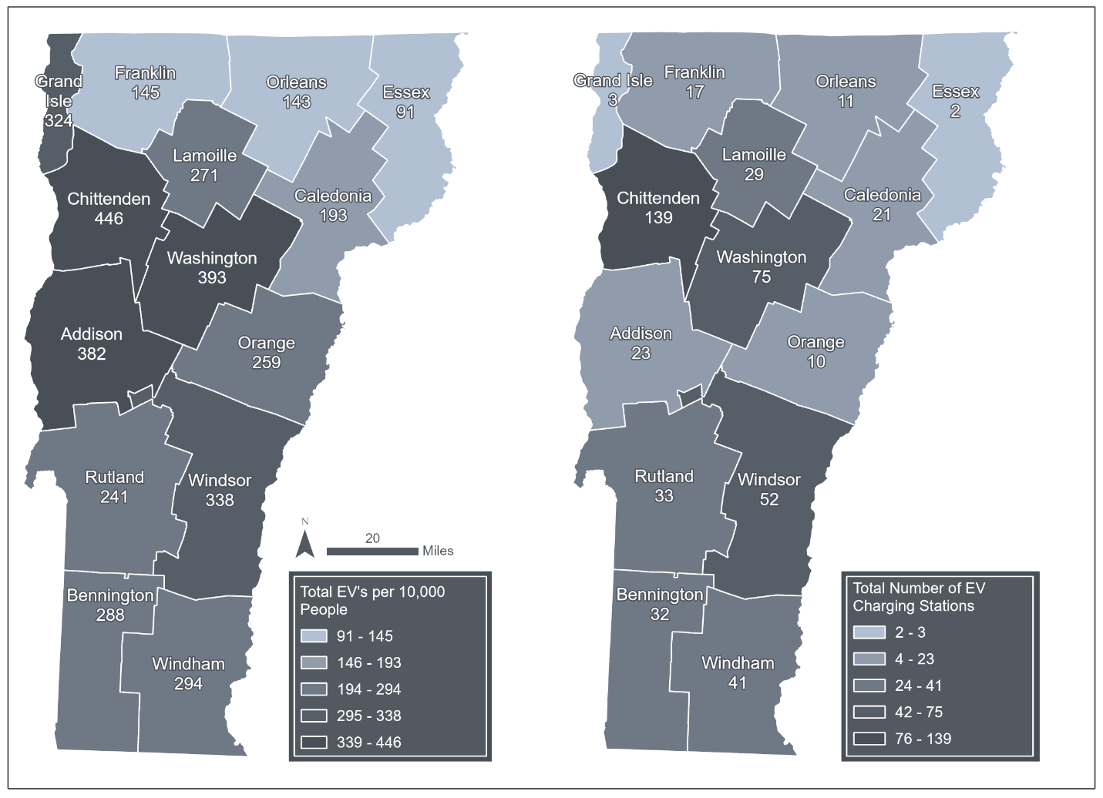
Figure 8-4 Electric vehicles per 10,000 people as of April 2026 (left panel) and total number of electric vehicle charging stations as of January 2022 (right panel) in Vermont
Source: Drive Electric Vermont (2026); VT Agency of Commerce and Community Development (2022)
Note: Visualization by Hannah C. Turner

Slide 9
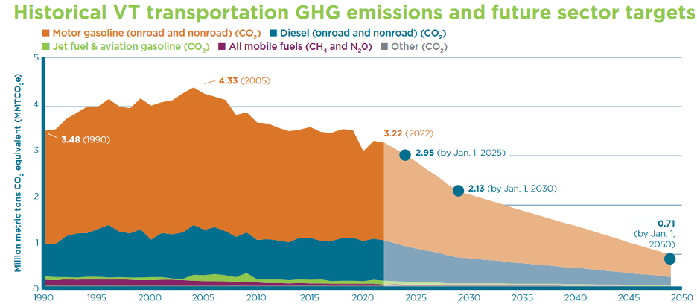
Figure 8-5 Vermont transportation emissions (MMTCO₂e) by type and key future sector targets, 1990-2050
Source: Energy Action Network (2025)

Slide 10
8.4 Energy Infrastructure

Slide 11
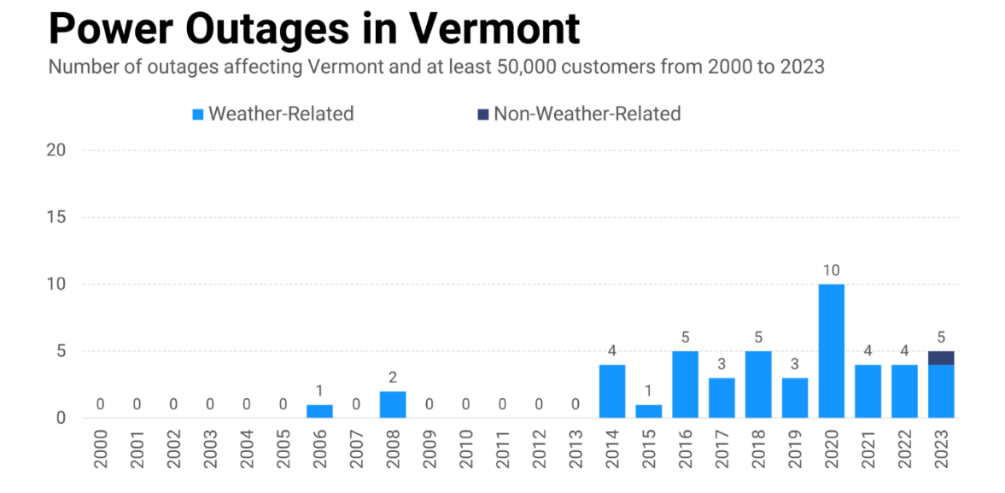
Figure 8-6 Major power outages (effecting at least 50,000 customers) annually in Vermont, 2000-2023
Source: PowerOutage.report (2026)

Slide 12
Table 8-2 A summary of infrastructural risks due to specific weather events
Source: This chapter
Extreme weather | Infrastructure/energy type impact/risks | Demand impact/risks | Possible mitigation/adaptation
Severe storms | Falling trees on power lines leading to localized outages | Outages are more likely, transportation is more difficult | Underground powerlines
Drought | Lower hydropower, cooling requirement risks | Increased demand for irrigation, water pumping, etc. | Demand management
Ice storms and blizzards | Ice accretion, line overloading, icing flashover | Outages are more likely, transportation is more difficult | Grid hardening
Floods | Flash floods, road closures, landslides | Outages are more likely, transportation is more difficult | Grid hardening
Heat waves | Temperature strain on transmission lines and transformers | Cooling related demand increases | Demand management, flexible mix of energy sources

Slide 13
Table 8-3 Dates of peak load for both the ISO New England system and Vermont
Year | ISO New England System | Vermont
2018 | August 29 | July 2
2019 | July 30 | January 21
2020 | July 27 | July 27
2021 | June 29 | August 26
2022 | August 8 | January 29
2023 | September 7 | February 3
2024 | July 16 | June 19
2025* | June 24 | June 23
Source: Vermont Department of Public Service (2026)
Note: *2025 data is preliminary (as of January 16, 2026)

Slide 14
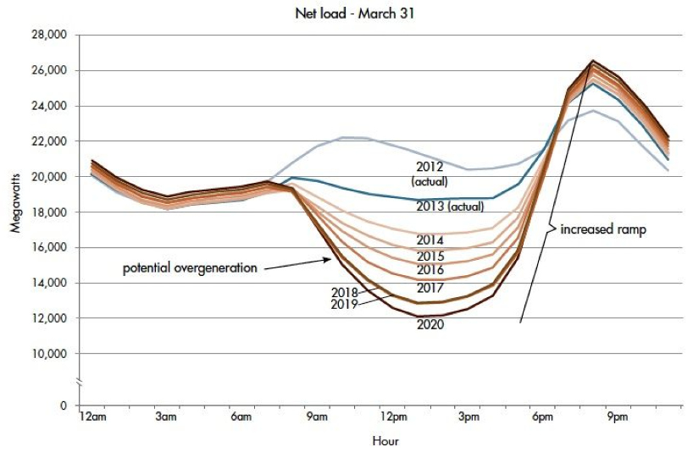
Figure 8-7 Variability in the energy load over a 24-hour daily period (from 2012–2020) showing lowest use periods when energy overgeneration may occur followed by peaks in energy use, labeled “increased ramp.” This mismatch is known as the “duck curve”
Source: Jones-Albertus
(2017)

Slide 15
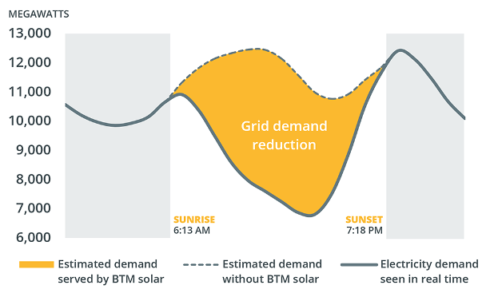
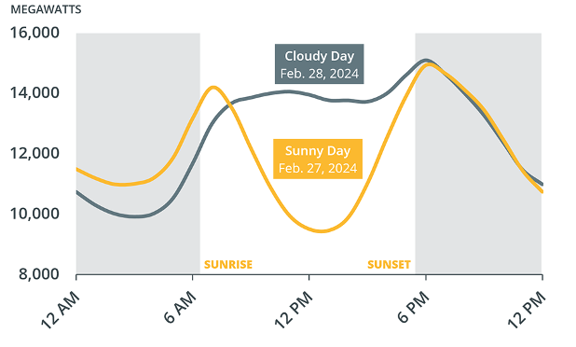
Figure 8-8 Examples of solar irregularity and variable impacts on the grid for behind the meter (BTM) solar
Source: ISO New England (2025)

Slide 16
8.5 Energy Planning and Equity

Slide 17
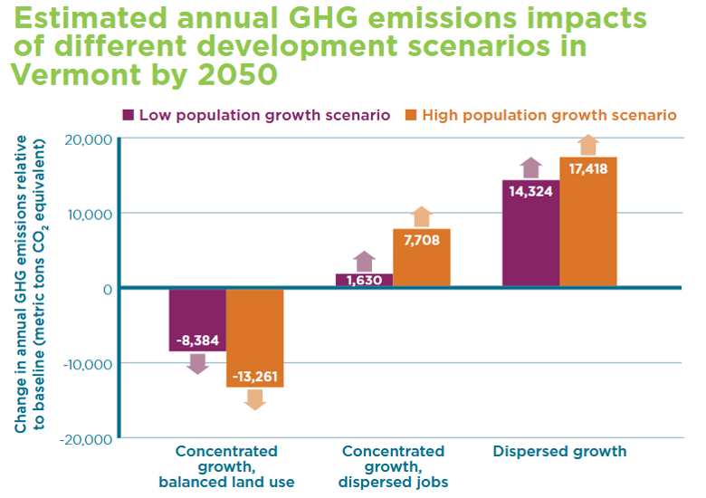
Figure 8-9 Estimated GHG emissions (metric tons CO₂e) in various growth scenarios (low/high population, concentrated/dispersed growth, and balanced land use) by 2050
Source: Energy Action Network (2024)

Slide 18
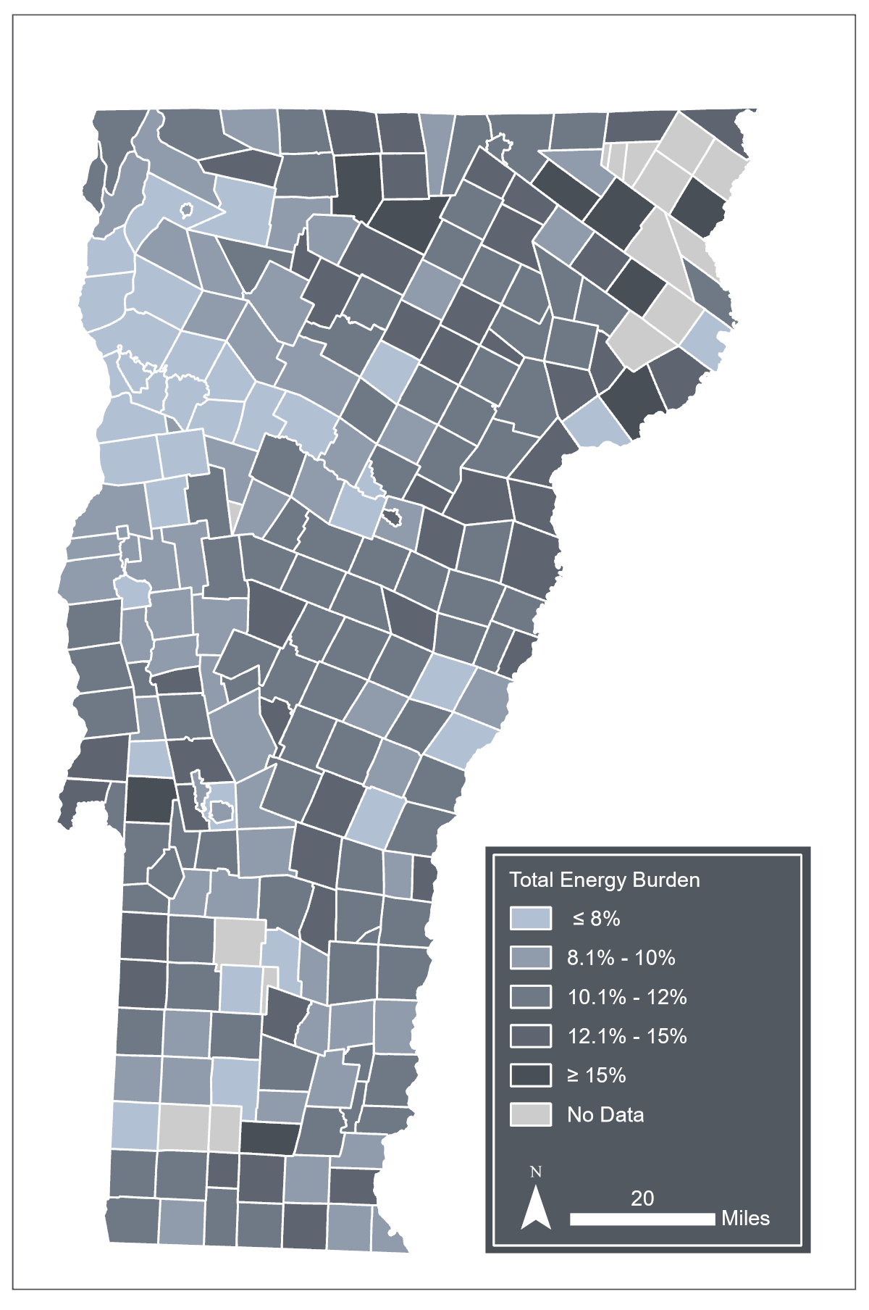
Figure 8-10 Energy burden, or the percentage of annual household income spent on energy (%), by township in Vermont
Source: Adapted from Efficiency Vermont (2023)
Note: Visualization by Hannah C. Turner

Slide 19
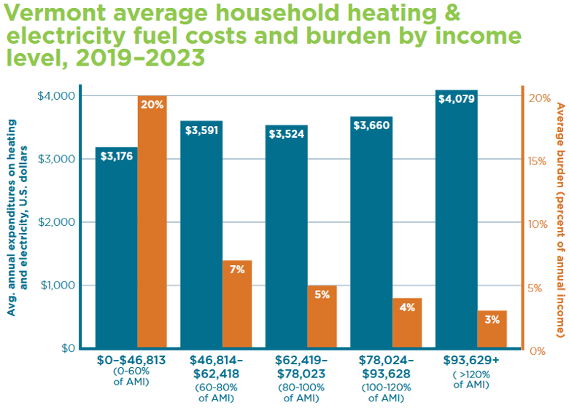
Figure 8-11 Average household heating and fuel costs ($) and energy burden (%) by income level in Vermont, 2019-2023
Source: Energy Action Network (2025)

Slide 20
Table 8‑4 Summary of Vermont home heating sources and their costs per one million British thermal units (MMBtu) of heat delivered
Sources: Energy Action Network (2024), Vermont Department of Public Service (2025, 2026)
Heating source | Typical fuel/ energy cost | Approx. cost per delivered MMBtu | Notes
Natural Gas | ~$1.40 per hundred cubic feet | ~$15/MMBtu | Lowest-cost fossil fuel option where available; limited VT access
Electric Heat Pump | ~$0.18–$0.22 per kWh | ~$18–$22 | Highly efficient; cost rises during very cold weather
Cordwood / Firewood | ~$225 per cord | ~$17–$20 | Cheapest if self-harvested; labor-intensive
Fuel Oil | ~$3.70 per gallon | ~$35–$38 | High price volatility; common in older homes
Wood Pellets | ~$300 per ton | ~$34–$38 | More convenient than cordwood; requires electricity
Propane | ~$3.00 per gallon | ~$30–$33 | Common in rural VT; winter price spikes
Solar (photovoltaic) + Heat Pump | ~$0.06–$0.10 per kWh (levelized) | ~$6–$10 | Lowest long-term cost; high upfront investment

