Slide 1
7 Infrastructure
Luke H. Briccetti^{1,2}, Lily Maenza¹
¹Rubenstein School of Environment & Natural Resources, University of Vermont, Burlington, VT
²Gund Institute for Environment, University of Vermont, Burlington, VT
Recommended citation:
Briccetti, L.H., Maenza, L., 2026, Infrastructure. In Galford, G.L., Balerna, J.A., Turner, H., Sardonis, A., Peplinski, H. (Eds), The Vermont Climate Assessment 2025. Burlington, Vermont: Climate Measurements Center of Excellence, Gund Institute for Environment at the University of Vermont. DOI: 10.5281/zenodo.20272849. Accessed online at https://vtclimate.org.
Notes:
Luke H. Briccetti¹, Lily Maenza²
¹Rubenstein School of the Environment and Natural Resources, University of Vermont, Burlington, VT, USA; Gund Institute for Environment, University of Vermont, Burlington, VT, USA,
²Rubenstein School of the Environment and Natural Resources, University of Vermont, Burlington, VT, USA

Slide 2
7.3 Damage to Roads & Rail
Outdated, undersized, or under-engineered road and rail stream crossings are vulnerable to severe flood events.
Road surfaces are at-risk from intense rains, increasing temperature variability, and extreme heat.

Slide 3
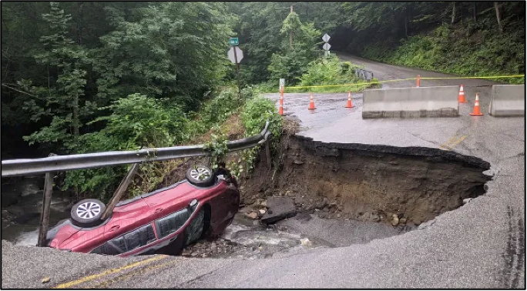
Figure 7-1
Culvert collapse on a road in Brattleboro, Vermont following heavy rain, 2021
Source: Joshua Carnes (2021)

Slide 4
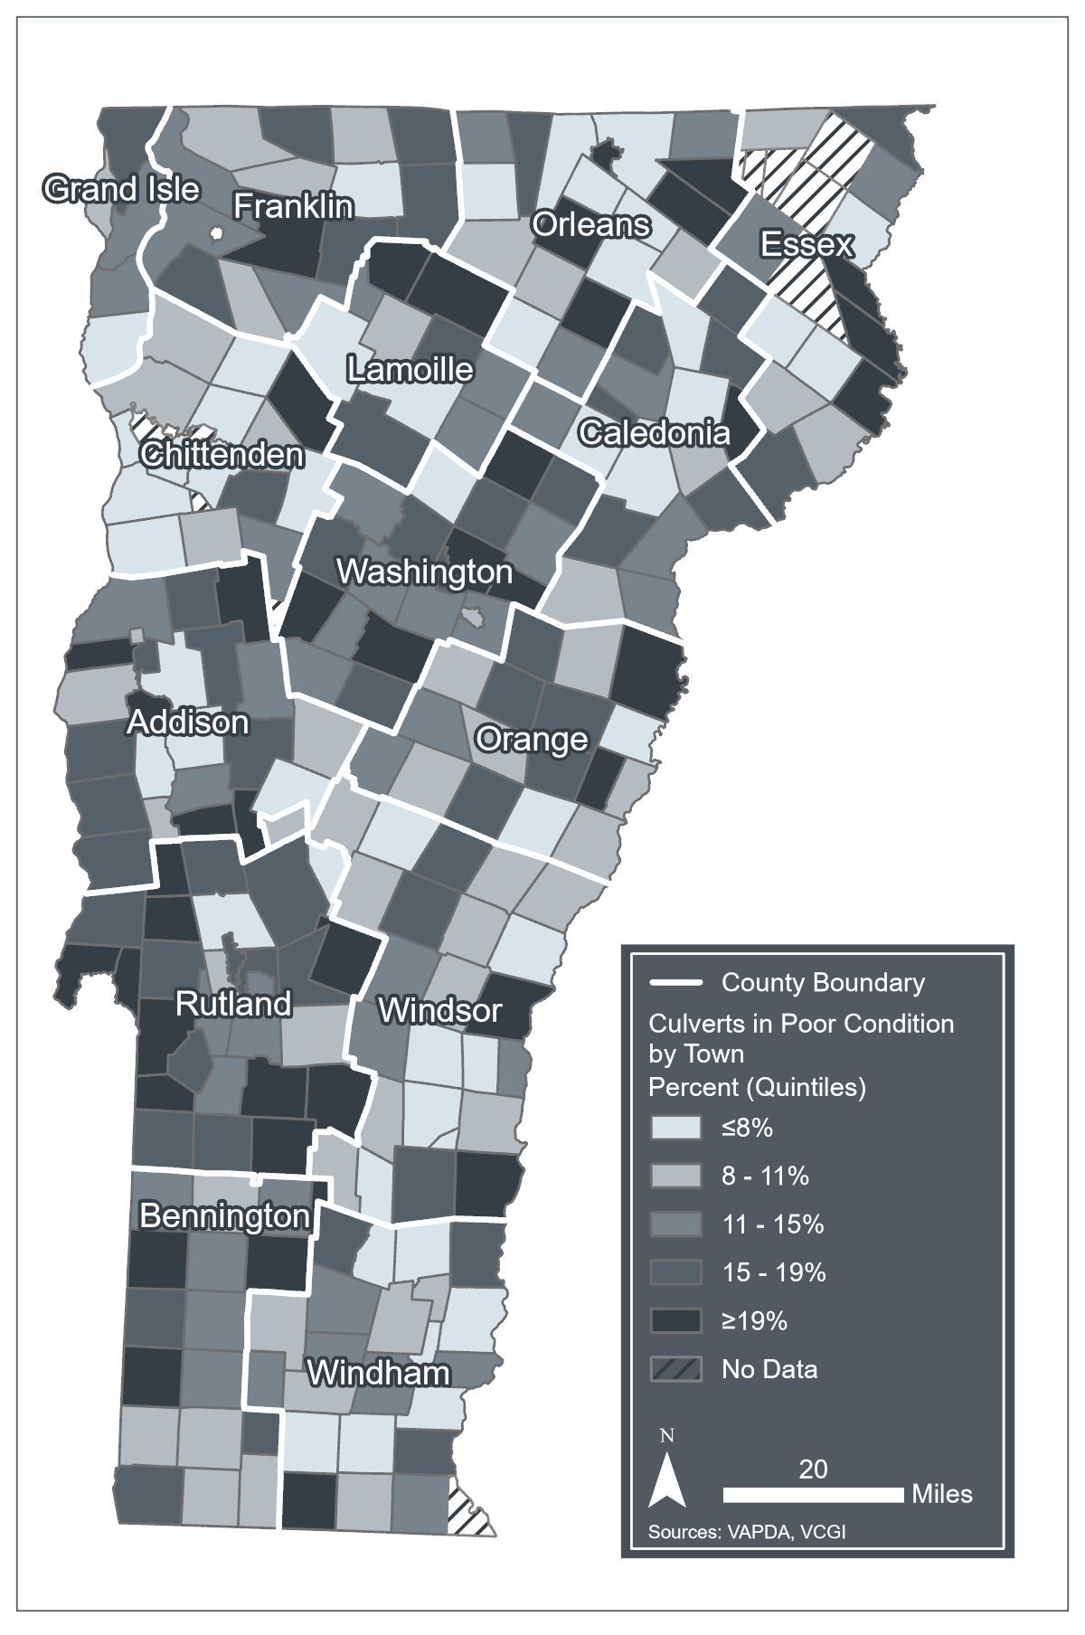
Figure 7-2
Percent of road culverts in poor, critical, or urgent condition by town in Vermont, 2025
Source: The Vermont Association of Planning and Development Agencies (2025), VCGI (2025a, 2025b)
Note: Data visualization by Luke Briccetti and Hannah C. Turner

Slide 5
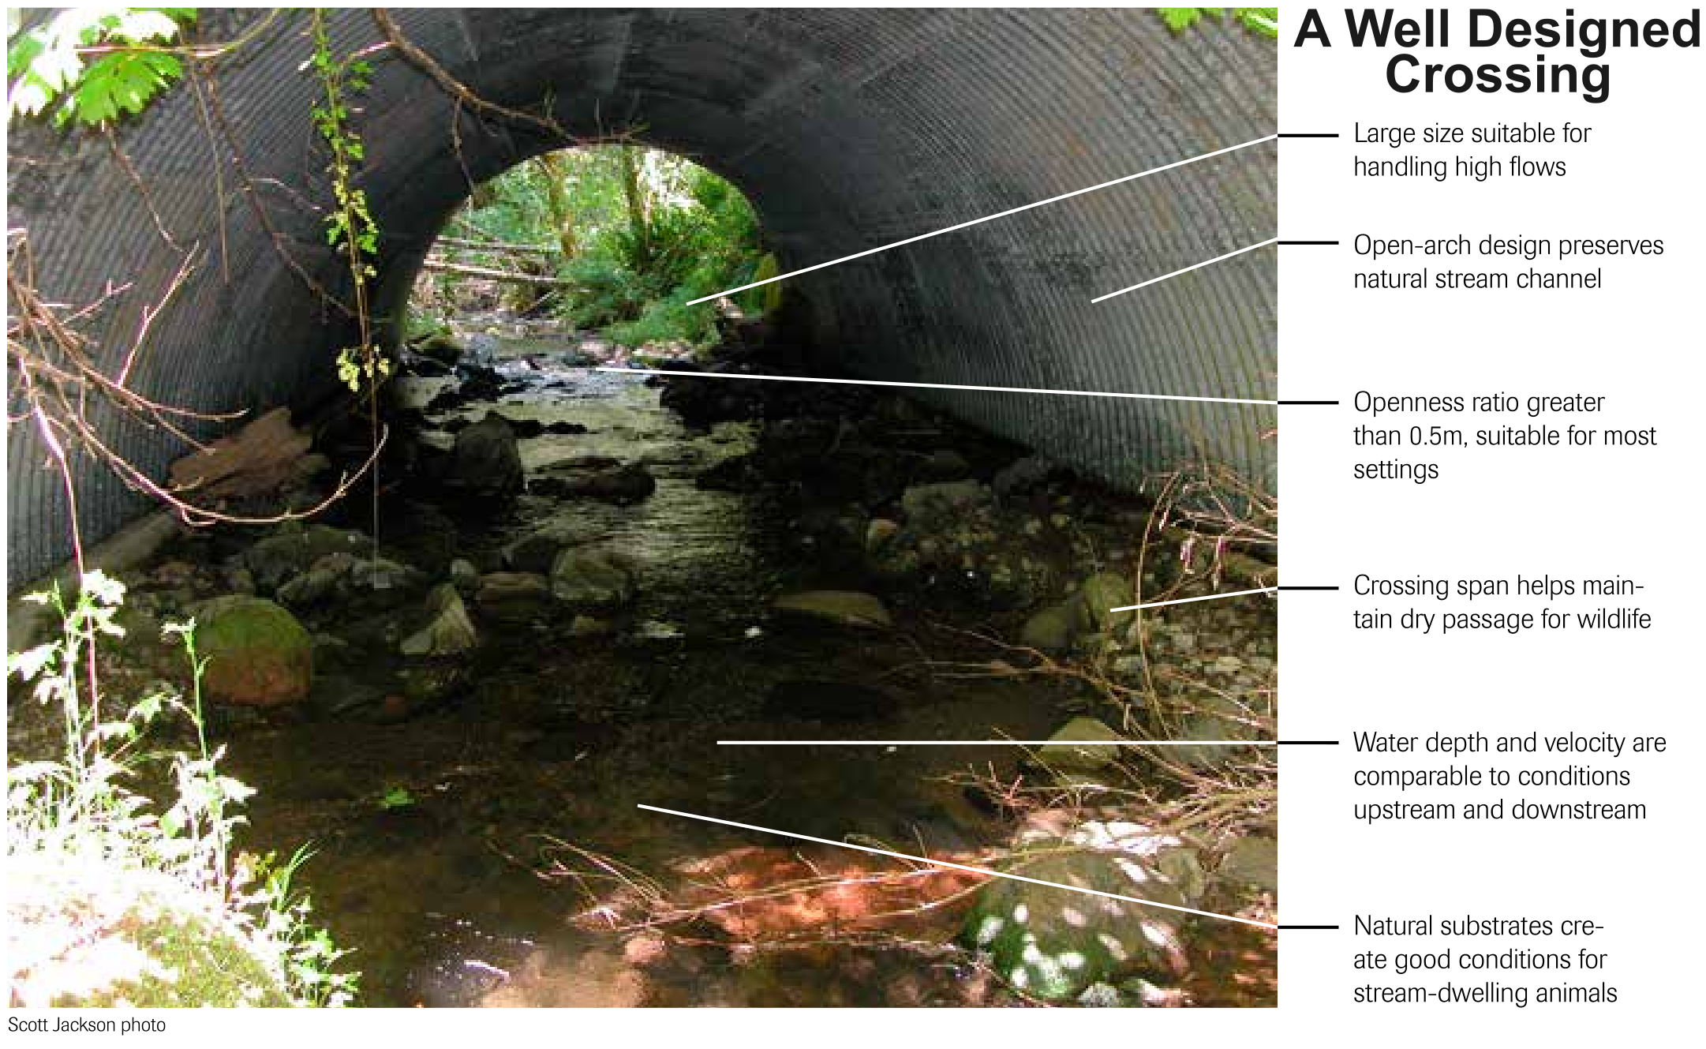
Figure 7-3
Characteristics of a well-designed stream crossing. In addition to the characteristics listed, this structure also shows a crossing width 1.2x stream bankfull width; i.e., 20% wider than the high-water mark
Source: Massachusetts Department of Fish and Game (2018)

Slide 6
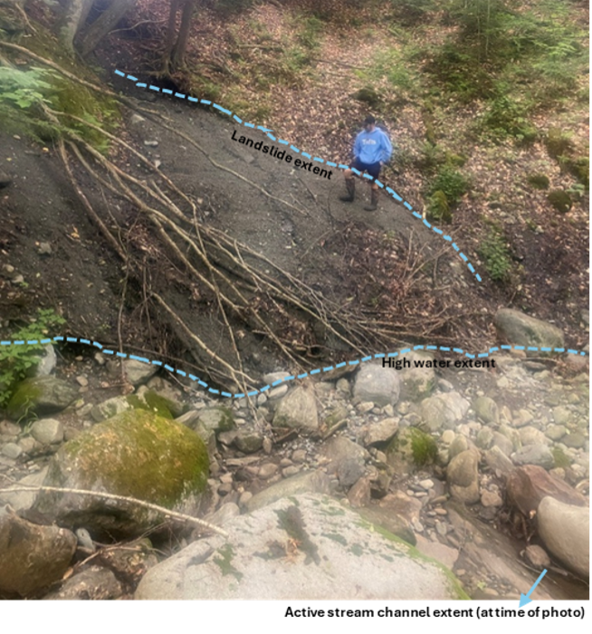
Figure 7-4
An example of mass failure (landslide) from gully erosion in Montgomery, Vermont, June 22, 2021. Dashed blue lines outline the landslide extent and high-water extent
Source: Luke Briccetti (2021)

Slide 7
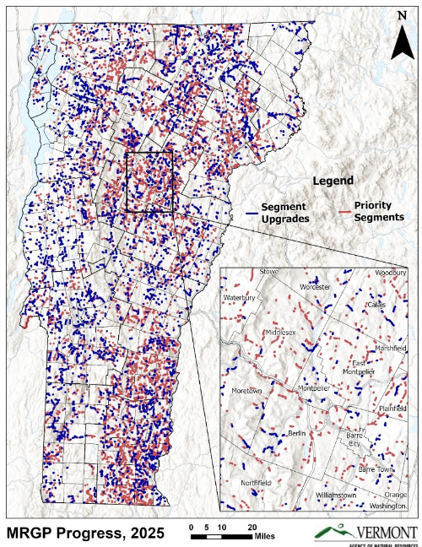
Figure 7-5
Road segments prioritized for upgrade and already upgraded to reach Municipal Roads General Permit (MRGP) compliance; segments upgraded since 2017 are represented by blue lines, and segments prioritized but requiring future upgrades to comply with the MRGP are represented by red lines, inset of central Vermont for more detail, 2025
Source: Chad McGann, Municipal Roads Program Coordinator at VTDEC (2025)

Slide 8
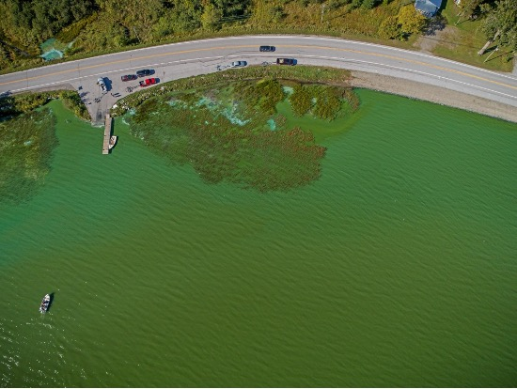
Box 7-1 Image
State Route 120 at the north end of Lake Carmi during a harmful algae bloom event, 2017
Source: County Courier (2017)

Slide 9
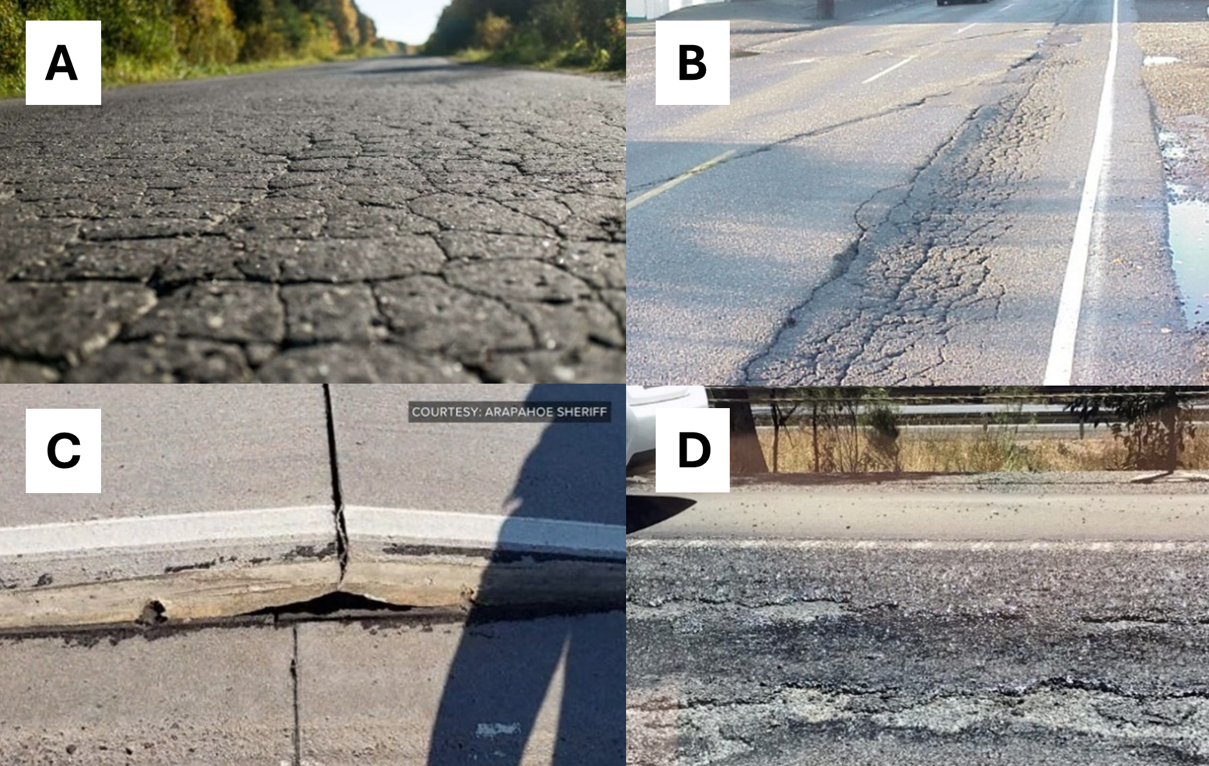
Figure 7-6
Examples of different types of wear and tear due to extreme heat, clockwise from top left: fatigue cracking (a), rutting (b), concrete buckling (c), visible roughness (d)
Source: (a) Alpha Paving (2020), (b) Pavement Interactive (2000), (c) Arapahoe Sheriff via 9News (2018), and (d) Steph Harris via ABC News (2018)

Slide 10
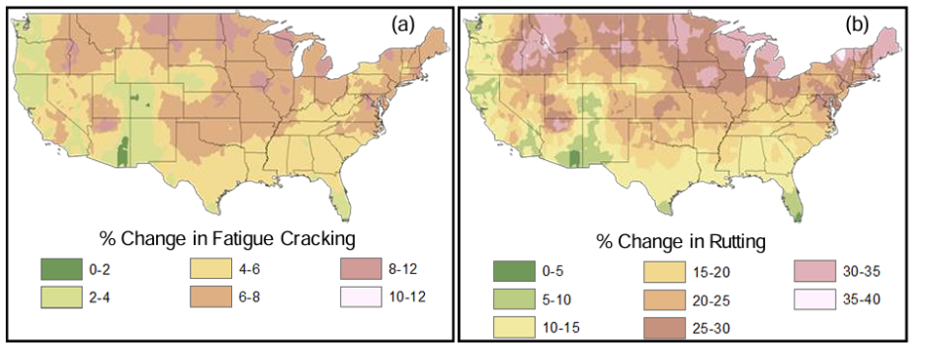
Figure 7-7
Modelled national increases (percent change) in the incidence of a) pavement fatigue and b) cracking and rutting, for the years 2040-2060
Source: Gudipudi et al. (2017)

Slide 11
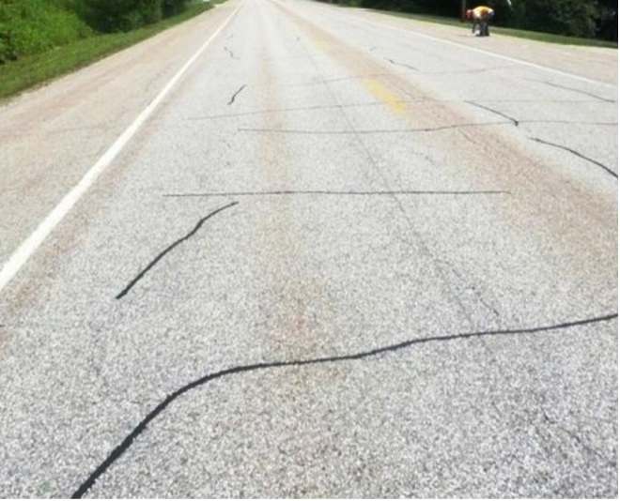
Figure 7-8
Example of a transverse (thermal) cracking of pavement in Dorset, Vermont, 2015
Source: Fitch & Tremblay (2015)

Slide 12
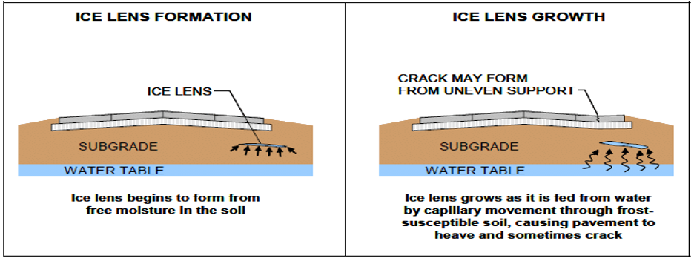
Figure 7-9
Ice lens formation and growth, which results in frost heaves that can damage asphalt pavements
Source: Ahmad & Khawaja (2018)

Slide 13
7.4 Damage to buildings
At least 10,000 buildings are located within the mapped 100-year floodplain, meaning there is a 1% chance that these buildings will experience flood damage each year.
Many of these maps have not been updated to reflect increases in flood frequency and severity in a changing climate, indicating that this number may be an undercount.
Buildings outside of floodplains may also be impacted by flash flooding or by erosion hazards from intense rains.
Older buildings are particularly vulnerable to flooding and may be weakened by more variable temperatures and precipitation regimes. Weatherization can reduce these impacts.

Slide 14
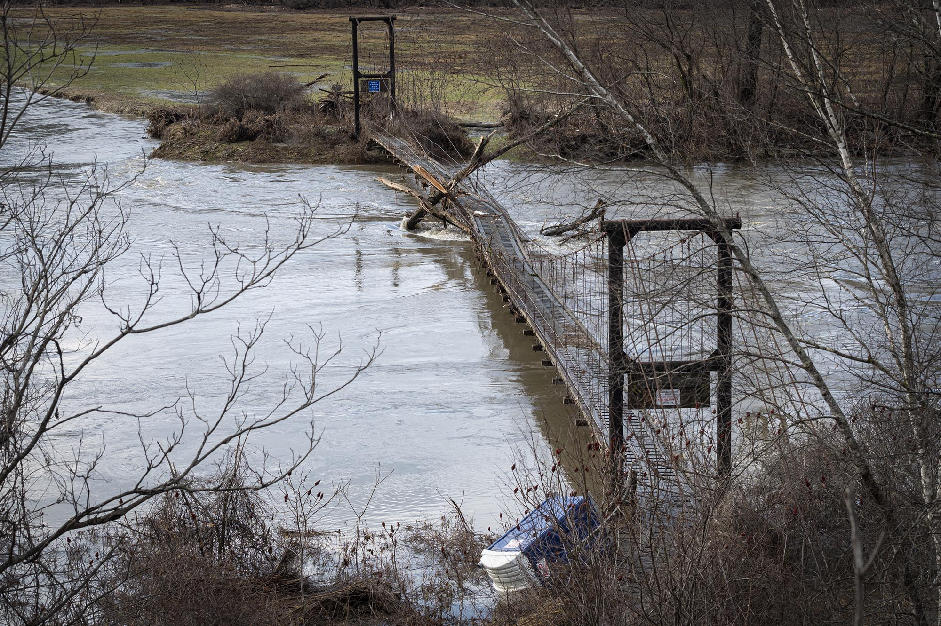
Figure 7-10
Flooding from the Winooski River in Waterbury, Vermont on Dec. 19, 2023
Source: Glen Russell/VTDigger (2023)

Slide 15
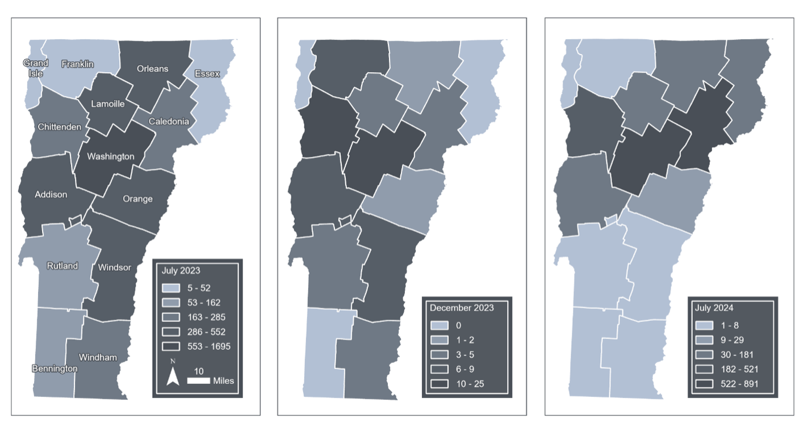
Figure 7-11
Total reports by county to 211 filed by residents and business owners during the July 2023, December 2023, and July 2024 flooding events Source: Vermont Emergency Management (2023a)
Note: Data compiled by Jessica A. Balerna and visualized by Hannah C. Turner

Slide 16
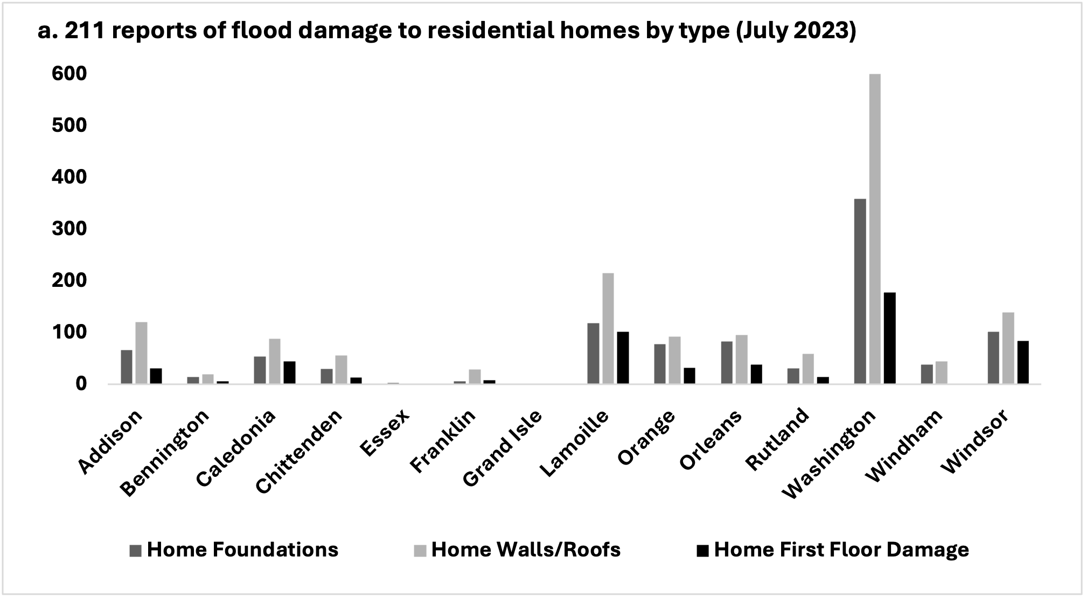
Figure 7-12 a
Reports of damage (by type) to 211 of a) residential property (by type) following the July 2023 and b) following July 2024 flooding events
Source: Vermont Emergency Management (2023a)
Note: Data compiled by Jessica A. Balerna

Slide 17
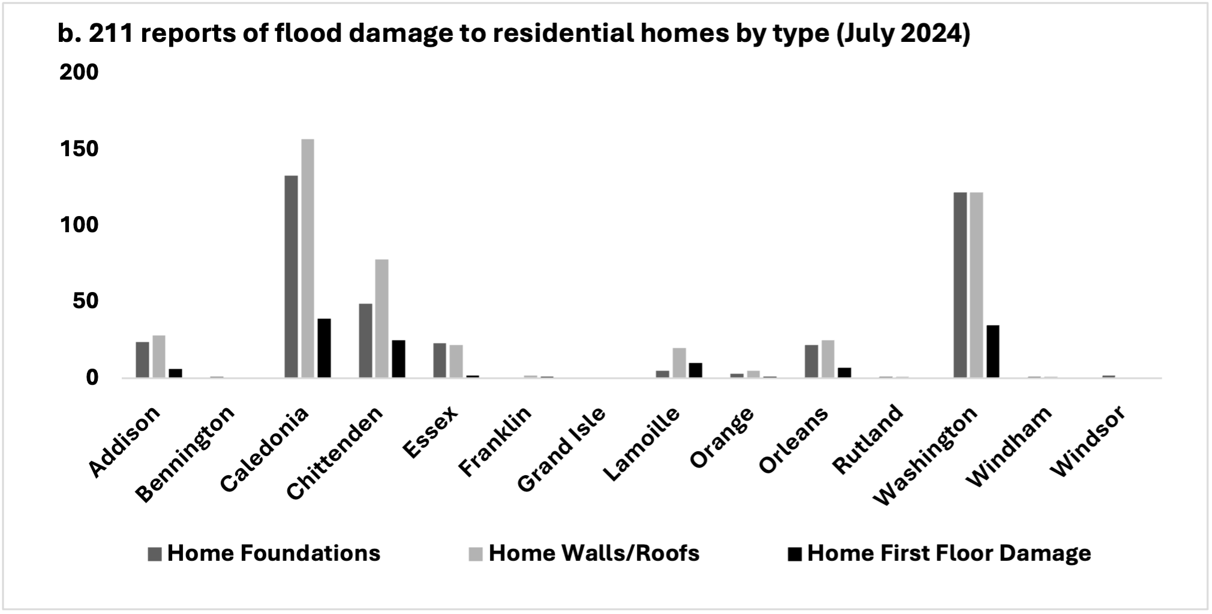
Figure 7-12 b
Reports of damage (by type) to 211 of a) residential property (by type) following the July 2023 and b) following July 2024 flooding events
Source: Vermont Emergency Management (2023a)
Note: Data compiled by Jessica A. Balerna

Slide 18
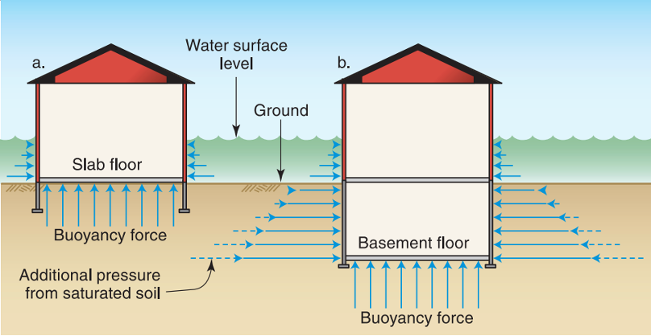
Figure 7-13
Depiction of hydrostatic pressure from saturated soil producing a buoyancy force on a) a structure with slab flooring and b) a structure with a basement level
Source: Federal Emergency Management Agency (2014)

Slide 19
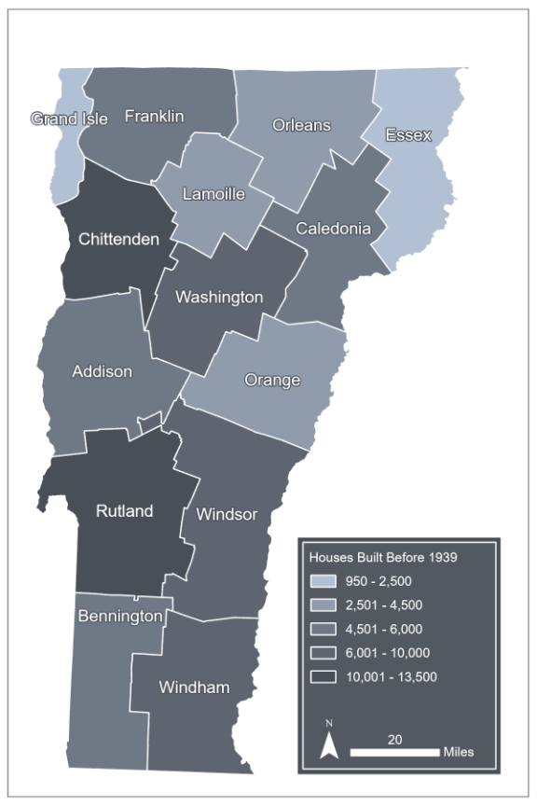
Figure 7-14
Number of homes built in 1939 or earlier by county
Source: Vermont Housing Finance Agency (2023)
Note: Data visualization by Hannah C. Turner

Slide 20
7.5 Damage to utilities
Frequent flood events increasingly endanger the power grid, as well as drinking water, wastewater, and fuel infrastructure.
Of Vermont’s 334 electric substations, at least 34 (or 10.2%) are located in a flood zone.
Wet snow, ice storms, and high wind periods pose additional threats to power grids.

Slide 21
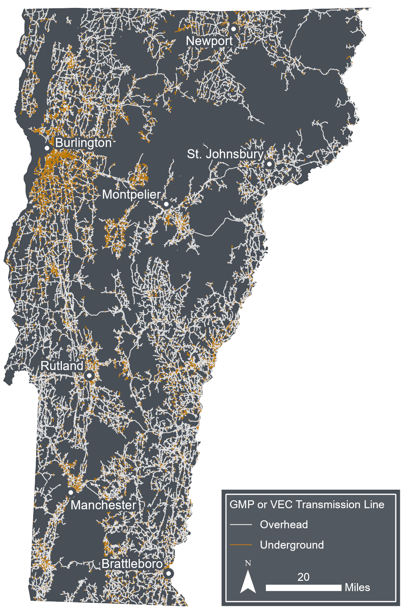
Figure 7-15
Overhead and underground lines for Vermont’s two largest utilities, Green Mountain Power (9/5/2025) and VEC (10/20/2020)
Source: Green Mountain Power (2025), Vermont Electric Cooperative (2020)
Note: Data visualization by Hannah C. Turner

Slide 22
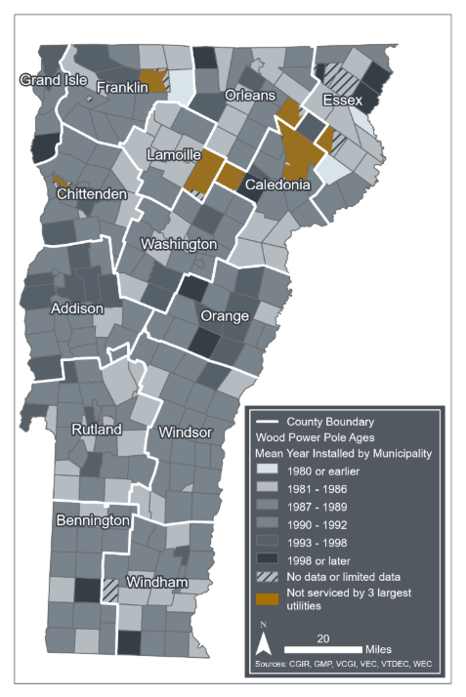
Figure 7-16
Mean age of wood power poles, aggregated to municipality for Vermont’s three largest utility providers: GMP, VEC and WEC, areas shaded with yellow are serviced by one of Vermont’s 14 other utility providers
Sources: Green Mountain Power (2022), VCGI (2025b), Vermont Department of Public Service (2020), Vermont Electric Cooperative, (2020a)
Note: Data visualization by Luke Briccetti and Hannah C. Turner

Slide 23
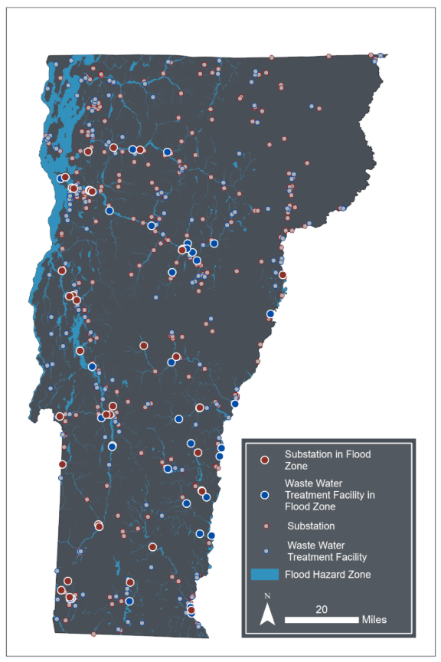
Figure 7-17
Map of electric substations and wastewater treatment facilities, highlighting the 34 substations and 41 wastewater treatment facilities located within flood zones
Sources: Flood maps outside of the Lake Champlain watershed (FEMA 2024); flood maps within the Lake Champlain watershed (VCGI 2022); substations (Vermont Department of Public Service 2021); wastewater facilities (VTANR 2022)
Note: Data visualization by Hannah C. Turner

Slide 24
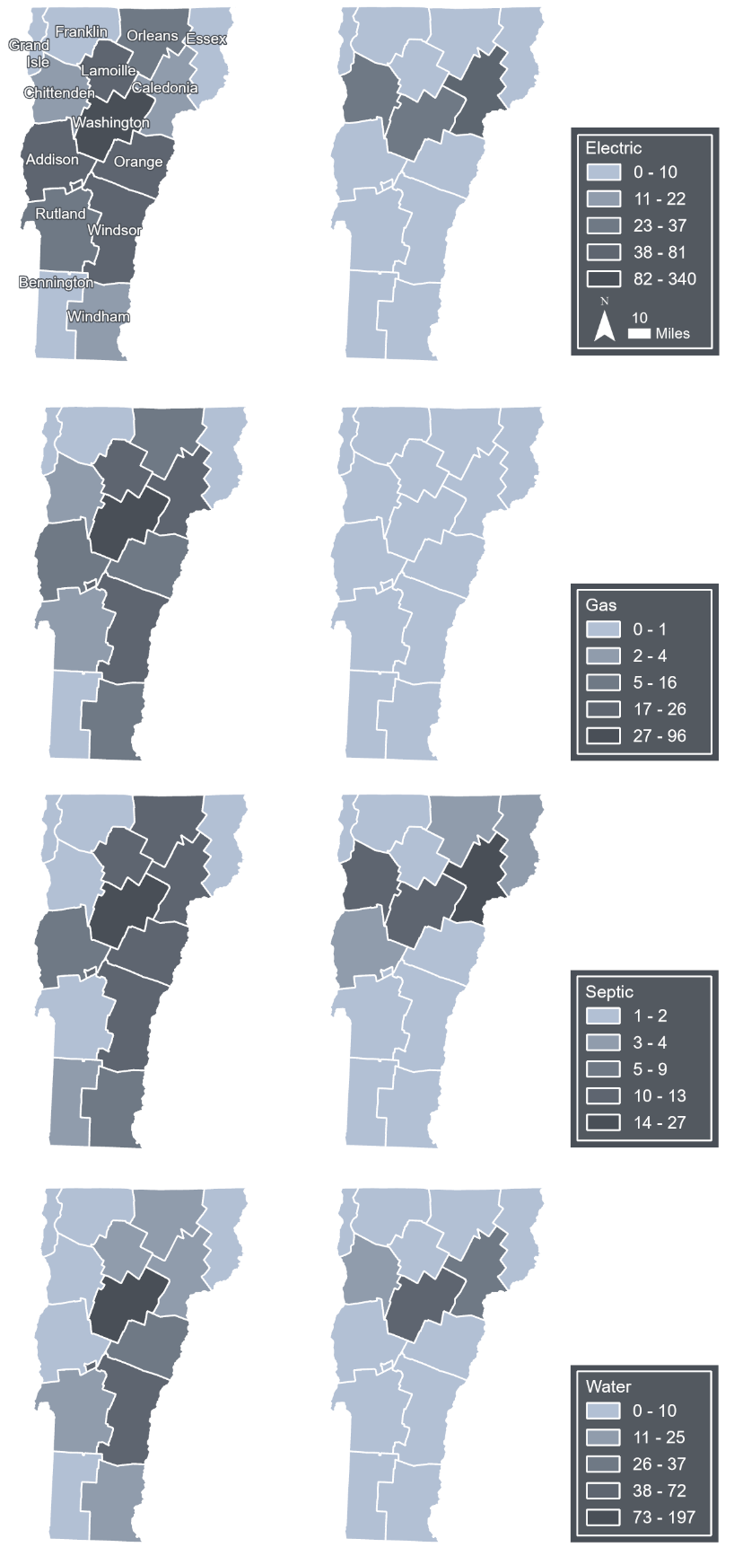
Figure 7-18
July 2023
July 2024
Electric
Total number of 211 reports of damage to residential utilities (electric, gas, septic, and water) aggregated by county following the July 2023 and July 2024 Vermont floods
Source: Vermont Emergency Management (2023a)
Note: Data compiled by Jessica A. Balerna and visualized by Hannah C. Turner and Hannah Peplinski
Gas
Septic
Water

Slide 25
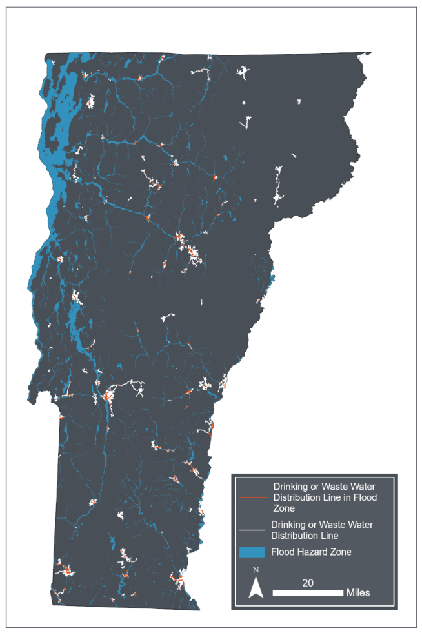
Figure 7-19
Drinking and wastewater distribution lines (including combined sewer systems) located in flood zones in Vermont. Orange areas indicate lines within flood hazard zones, while white areas represent lines outside of flood zones. Note that not all water distribution lines located in flood zones are necessarily flood-vulnerable, and that some areas of Vermont do not have mapped floodplain data
Sources: Flood maps outside of the Lake Champlain watershed (FEMA 2024); flood maps within the Lake Champlain watershed (VCGI 2022); wastewater distribution lines (VTDEC, 2025)
Note: Data visualization by Hannah C. Turner

Slide 26
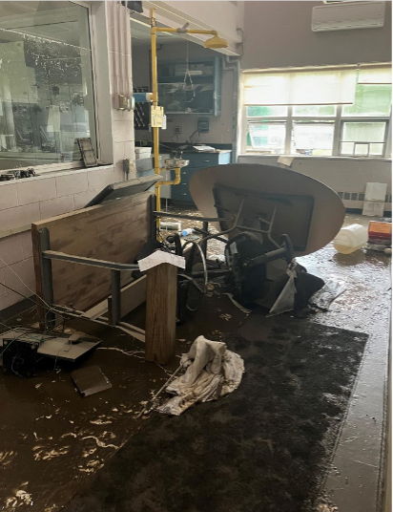
Figure 7-20
Damage to the Johnson Wastewater treatment plant control room after the July 2023 floods. The high-water mark can be seen on the windowpane at the top left corner of the image
Source: VTANR (2023)

Slide 27
7.6 Dam overtopping risk
Vermont has over 1,000 known dams, of which nearly 50% are inactive.
Severe floods can cause water to overtop both active and inactive dams, posing a threat to people and property downstream.

Slide 28
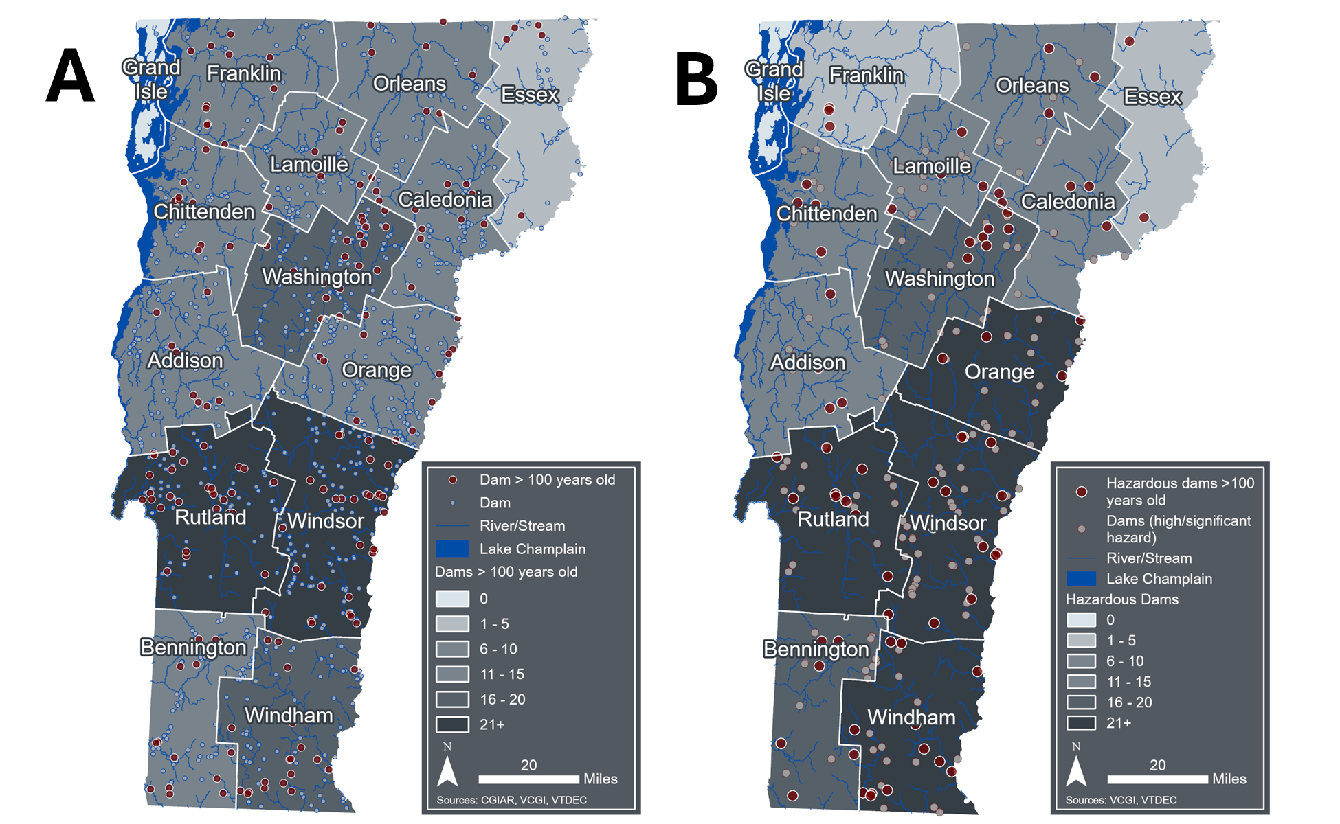
Figure 7-21
Mapped dams in Vermont aggregated to the county level, where white circles are dams that are less than 100 years old and red circles are dams that are greater than 100 years old; and B) dams listed as significant or high potential hazard aggregated to the county level, where pink circles are high hazard dams that are less than 100 years old and red circles are high hazard dams that are greater than 100 years old
Sources: USGS (2023), VCGI (2025a), VTDEC (2022)
Note: Data visualization by Luke Briccetti and Hannah C. Turner

Slide 29
Table 7-1
Dam inspection schedule in the DSR (2020)
Hazard Classification | Frequency
High | 2 years
Significant | 5 years
Low | 10 years
Minimal | None
Note: The first inspection shall be performed when initiated or required by VTDEC and subsequent inspections shall be performed in compliance with the table above

Slide 30
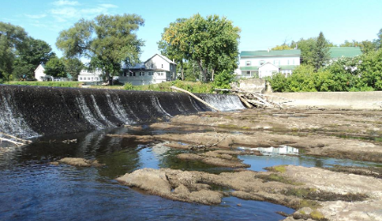
Box 7-3 Image
The Swanton Village Dam in 2015
Source: Vermont Department of Fish & Wildlife (2015)

Slide 31
7.7 A note on transportation emissions

Slide 32
Table 7-2
Transportation emissions (MMTCO2e) for multiple sectors over time
Sector | 1990 | 2005 | 2010 | 2019 | 2020 | 2021 | 2022
Transportation/ mobile sources (MMTCO₂e) | 3.48 | 4.33 | 3.67 | 3.50 | 3.02 | 3.24 | 3.22
Motor gasoline (onroad and nonroad; CO₂) | 2.54 | 3.05 | 2.63 | 2.42 | 2.01 | 2.19 | 2.19
Diesel (onroad; CO₂) | 0.41 | 0.70 | 0.63 | 0.65 | 0.61 | 0.66 | 0.64
Diesel (nonroad; CO₂) | 0.31 | 0.33 | 0.25 | 0.30 | 0.29 | 0.26 | 0.26
Jet fuel and aviation gasoline (CO₂) | 0.08 | 0.13 | 0.07 | 0.07 | 0.06 | 0.09 | 0.09
Other sources (CO₂, CH₄, N₂O) | 0.14 | 0.13 | 0.09 | 0.06 | 0.05 | 0.05 | 0.04
Ethanol (biogenic CO₂)* | 0.00 | 0.01 | 0.17 | 0.17 | 0.14 | 0.16 | 0.16
Biodiesel (biogenic CO₂)* | 0.00 | 0.00 | 0.00 | 0.02 | 0.02 | 0.02 | 0.02
Source: VTANR Climate Action Office (2025)
Note: *Biogenic totals are not included in gross total estimates

