Slide 1


Agriculture and Food Systems
Liliana Bettolo¹, Megan Knight², Heather Darby^{1,2}, Lindsey Ruhl², Vern Grubinger²,
¹University of Vermont, ²University of Vermont Extension
Recommended citation: Bettolo, L., Knight, M., Grubinger, V., Ruhl, L., Darby, H., 2026, Agriculture and Food Systems. In Galford, G.L., Balerna, J.A., et al., (Eds), The Vermont Climate Assessment 2025. Burlington, Vermont: Climate Measurements Center of Excellence, Gund Institute for Environment at the University of Vermont. DOI: xxxxx. Accessed online at https://vtclimate.org.

Slide 2
6.2 Background

Slide 3
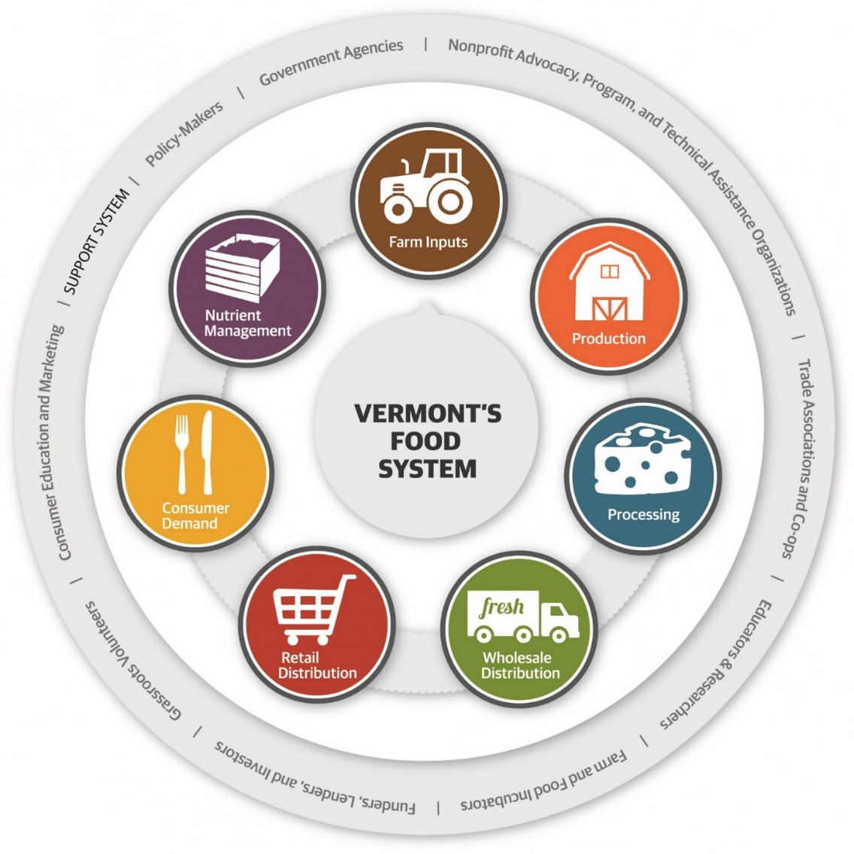


Figure 6-1
Conceptual diagram of Vermont’s food system, showing seven core components of the food supply chain surrounded by support systems
Source: Nottermann (2015)

Slide 4
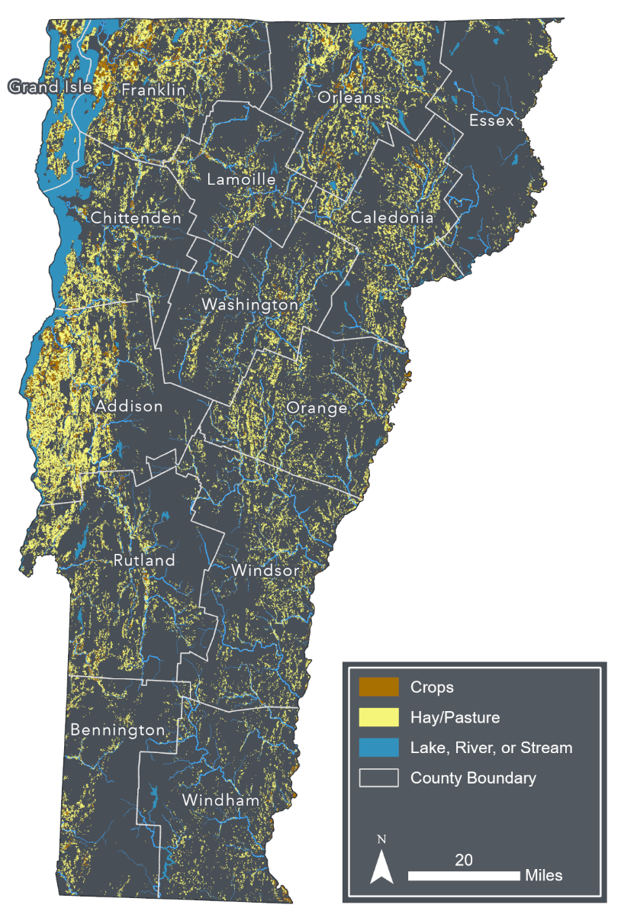
Figure 6-2
Agricultural land use in Vermont by type (crops, hay, and pasture)
Source: Source: U. Vermont Spatial Analysis Lab (202)2
Note: Visualization by Hannah Turner

Slide 5
6.3 Agricultural Sector Impacts and Adaptation Strategies

Slide 6
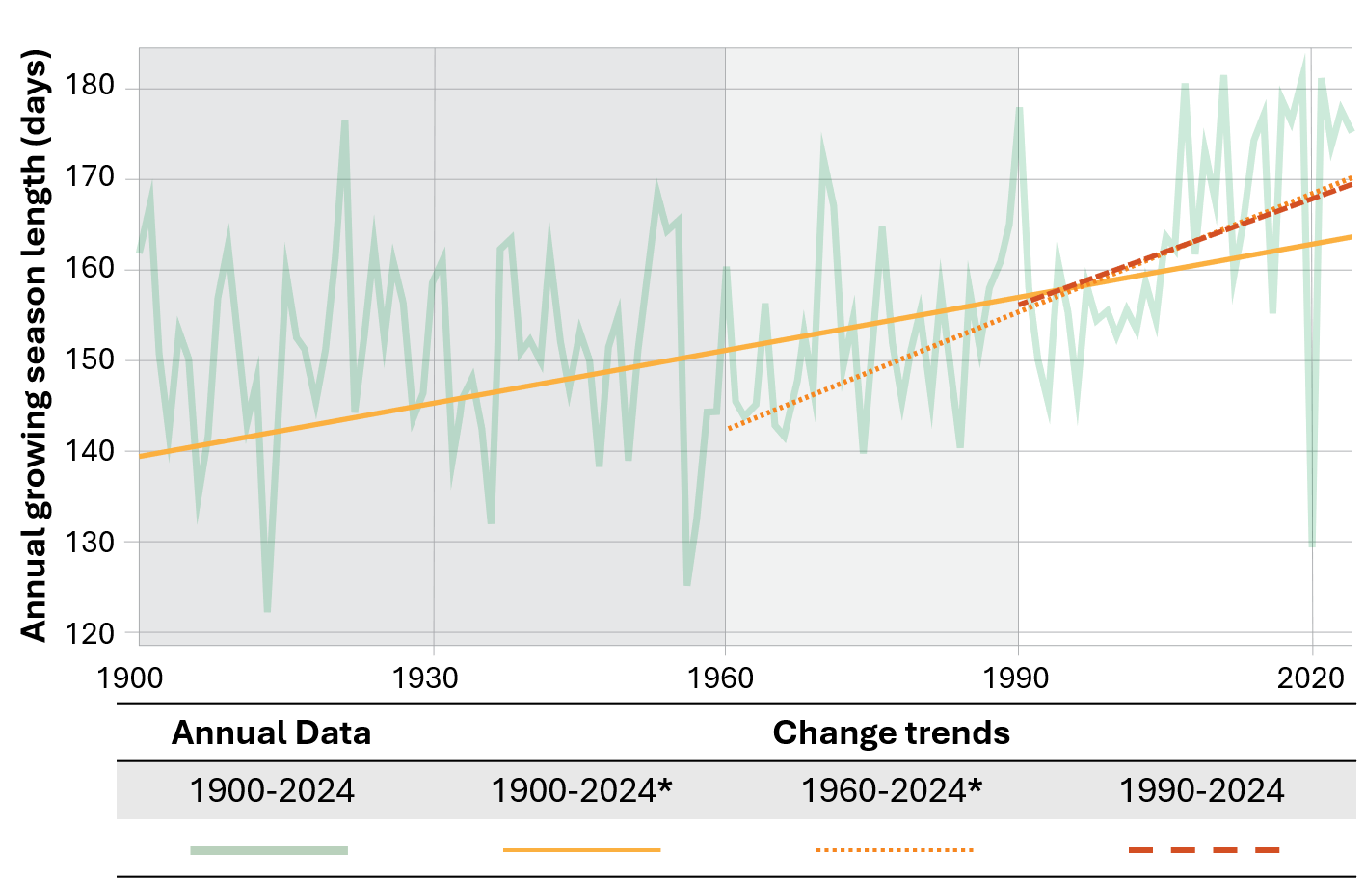
Figure 6-3
(Vermont)

Slide 7
Figure 6-3 (Climate Division-Northeastern)
180
Annual growing season length (days)
160
140
120
1900
1930
1960
1990
2020
Annual Data | Change trends
1900-2024 | 1900-2024* | 1960-2024* | 1990-2024

Slide 8
Figure 6-3 (Climate Division-Western)
200
190
180
Annual growing season length (days)
170
160
150
140
1900
1930
1960
1990
2020
Annual Data | Change trends
1900-2024 | 1900-2024* | 1960-2024 | 1990-2024

Slide 9
Figure 6-3 (Climate Division-Southeastern)
190
180
170
160
Annual growing season length (days)
150
140
130
120
1900
1930
1960
1990
2020
Annual Data | Change trends
1900-2024 | 1900-2024* | 1960-2024* | 1990-2024

Slide 10
Figure 6-3
Growing season length in Vermont from 1900–2025. Despite interannual variability, growing season length has increased across Vermont from 1900–2024, with a greater increase observed in the last 30 years compared to the long-term average.
Source: NOAA NECI (2026)
Note: Original analysis using the NOAA RCC ACIS dataset. Daily temperature data for 15 weather stations across Vermont (see Climate Change in Vermont 2.3) was used to identify the last spring freeze and first fall freeze where minimum temperatures are 32°F (0°C) or below. The fluctuating blue and red lines represent annual first and last freeze dates from 1900–2024. The straight red and blue lines display linear regression trends. Considering most farmers in the state are interested in trends within their lifetime, both the mid-term (1960–2024; dotted red and blue lines), and the near-term (1990–2024; dashed red and blue lines) trends are highlighted in addition to the full-term trend (solid red and blue lines)

Slide 11
6.4 Biophysical Impacts on Agricultural Production

Slide 12
Figure 6-4 (In-chapter)
First and Last Freeze in Vermont (1900-2024)
Later
May-30
Nov-07
May-23
Oct-31
May-16
Oct-24
May-09
Oct-17
May-02
First fall freeze (date)
Last spring freeze (date)
Oct-10
Apr-25
Oct-03
Apr-18
Sep-26
Apr-11
Sep-19
Apr-04
Sep-12
1900
1930
1960
1990
2020
Earlier
 | Annual data | Change trends
 | 1900-2024 | 1900-2024 | 1960-2024 | 1990-2024
Spring |  | * | *
Fall |  | * | *

Slide 13
Figure 6-4 (Climate division-Northeastern)
Later
June-06
Nov-05
May-30
Oct-29
May-23
Oct-22
May-16
Oct-15
First fall freeze (date)
May-09
Oct-08
Last spring freeze (date)
May-02
Oct-01
Apr-25
Sep-24
Apr-18
Sep-17
Apr-11
Sep-10
Earlier
1900
1930
1960
1990
2020
 | Annual data | Change trends
 | 1900-2024 | 1900-2024 | 1960-2024 | 1990-2024
Spring |  | *
Fall |  | * | * | *

Slide 14
Figure 6-4 (Climate division-Western)
Later
May-21
Oct-20
May-14
Oct-13
May-07
Oct-06
Apr-30
Sep-29
First fall freeze (date)
Apr-23
Sep-22
Last spring freeze (date)
Apr-16
Sep-15
Apr-09
Sep-08
Apr-02
Sep-01
Mar-26
Aug-25
1900
1930
1960
1990
2020
Earlier
 | Annual data | Change trends
 | 1900-2024 | 1900-2024 | 1960-2024 | 1990-2024
Spring
Fall

Slide 15
Figure 6-4 (Climate division-Southeastern)
Later
Jun-06
Nov-05
May-30
Oct-29
May-23
Oct-22
May-16
Oct-15
First fall freeze (date)
May-09
Oct-08
Last spring freeze (date)
May-02
Oct-01
Apr-25
Sep-24
Apr-18
Sep-17
Mar-11
Sep-10
1900
1930
1960
1990
2020
Earlier
 | Annual data | Change trends
 | 1900-2024 | 1900-2024 | 1960-2024 | 1990-2024
Spring
Fall |  | * | * | *

Slide 16
Figure 6-4
Trends in first and last freeze dates in Vermont from 1900–2024. The last spring freeze date (left axis, blue lines) is trending earlier, and the first fall freeze (right axis, red lines) is trending later in Vermont. The straight lines highlight decadal trends where a linear regression for the average first spring freeze and last fall freeze date for each decade were plotted to highlight long-term trends. Decadal trendlines are plotted for the long-term (1900-2024), mid-term (1960-2024), and near-term (1990-2024). Statistically significant trends are marked with an asterisk in the legend at a 95% confidence level
Source: NOAA NECI (2026)
Note: Original analysis by Liliana Bettolo using the NOAA RCC ACIS dataset. Daily temperature data for 15 weather stations across Vermont (see Climate Change in Vermont 2.3) was used to identify the last spring freeze and first fall freeze where minimum temperatures are 32°F (0°C) or below. The fluctuating blue and red lines represent annual first and last freeze dates from 1900–2024. The straight red and blue lines display linear regression trends. Considering most farmers in the state are interested in trends within their lifetime, both the mid-term (1960–2024; dotted red and blue lines), and the near-term (1990–2024; dashed red and blue lines) trends are highlighted in addition to the full-term trend (solid red and blue lines)

Slide 17
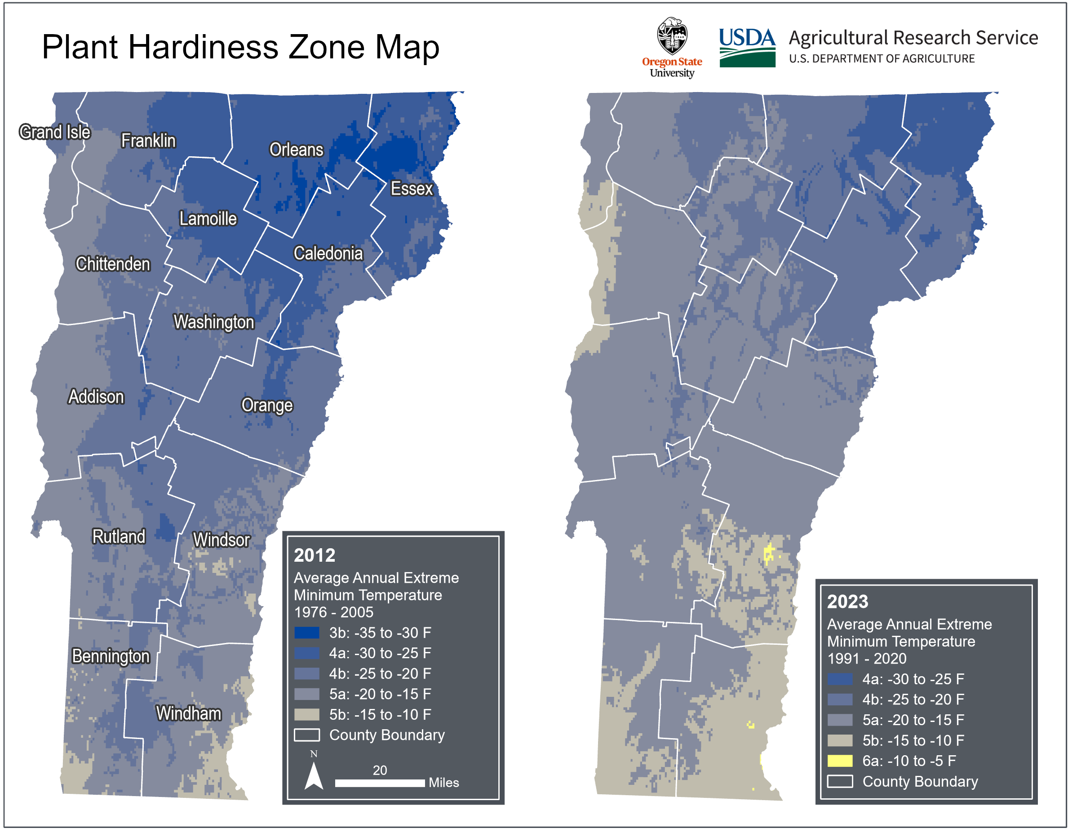
Figure 6-5
USDA Plant Hardiness Zones in Vermont in 2012 (based on data from1976–2005) and 2023 (based on data from 1991–2020). In 2023, most of Vermont was classified as a warmer zone, the coldest zone classification (zone 3b) was no longer applicable, and a new warmest zone (zone 6a) was added in the southeast
Source: Daly et al. (2012)
Note: Visualization by Hannah C. Turner

Slide 18
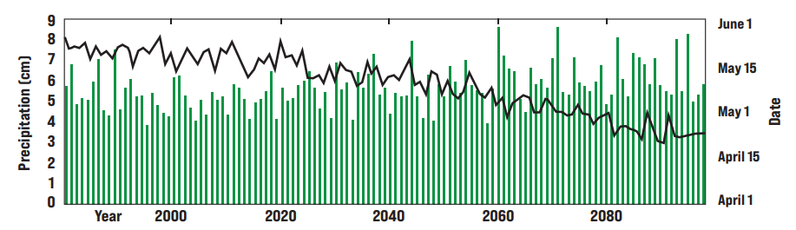
Figure 6-6
Projected increase in precipitation for the 21 days prior to the last spring frost in Burlington, VT, through 2100. Earlier last spring frost (black line) with precipitation in the preceding 21 days (green bars) shows an increase in rainfall, which can limit field access and delay planting as farmers strive to protect soil health
Source: Adapted from Wolfe et al. (2018)
Note: Projections on the impacts on climate change on temperature and precipitation are based on the Coupled Model Intercomparison Project Phase and downscaled to the Northeast U.S. Simulations of historical and future conditions in the 1979–2099 time period were based on a high emissions scenario

Slide 19
Table 6-1 Climate impacts, adaptation and resilience strategies across agricultural sectors
 | Climate Impacts | Adaptation & Resilience
Excess Moisture, Flooding & Wet Soils | -Delayed planting and harvest -Fewer workable field days -Increased erosion, nutrient losses, compaction -Crop damage and losses -Increased disease pressure | -Tile drainage, surface grading, field ditching -Riparian buffers -Shift production to less flood-prone fields -Convert marginal acres to perennial cover -Plan crop placement based on flood risk
Drought & Water Stress | -Increased plant water stress -Reduced crop and forage quality -Unreliable water availability | -Expand irrigation capacity and efficiency (e.g., drip irrigation for vegetables) -Collect and store excess rainfall
Warming & Heat Stress | -Heat stress in livestock -Reduced milk production and calving rates -Reduced crop quality in cool season crops -Greater weed and pest pressure -Earlier start to maple sugaring -Earlier bud break and vulnerability to frost | -Fans, ventilation, misters (livestock) -Shade cloth -High vacuum tubing (maple) -Delayed budbreak varieties, frost protection (fruit) -Heat-tolerant crops and varieties, double cropping -Extended growing and grazing seasons
Note: There are several strategies for managing overall climate impacts and increased uncertainty: protect soil health and water quality, build high tunnels, maintain crop variety and diversify species’ selections, upgrade and maintain equipment, apply integrated pest management, diversify plant breeding, and apply agroforestry practices

Slide 20
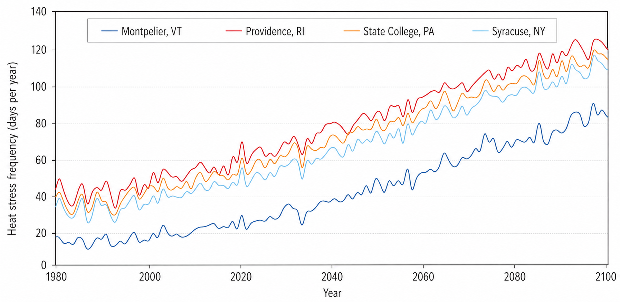
Figure 6-7
Projected increase in heat stress frequency in four locations in the Northeast U.S. assuming a business-as-usual greenhouse gas emissions scenario. Heat stress frequency shown is estimated as the number of days per year with temperature-humidity index (THI) exceeding 70
Source: USDA (2020)

Slide 21
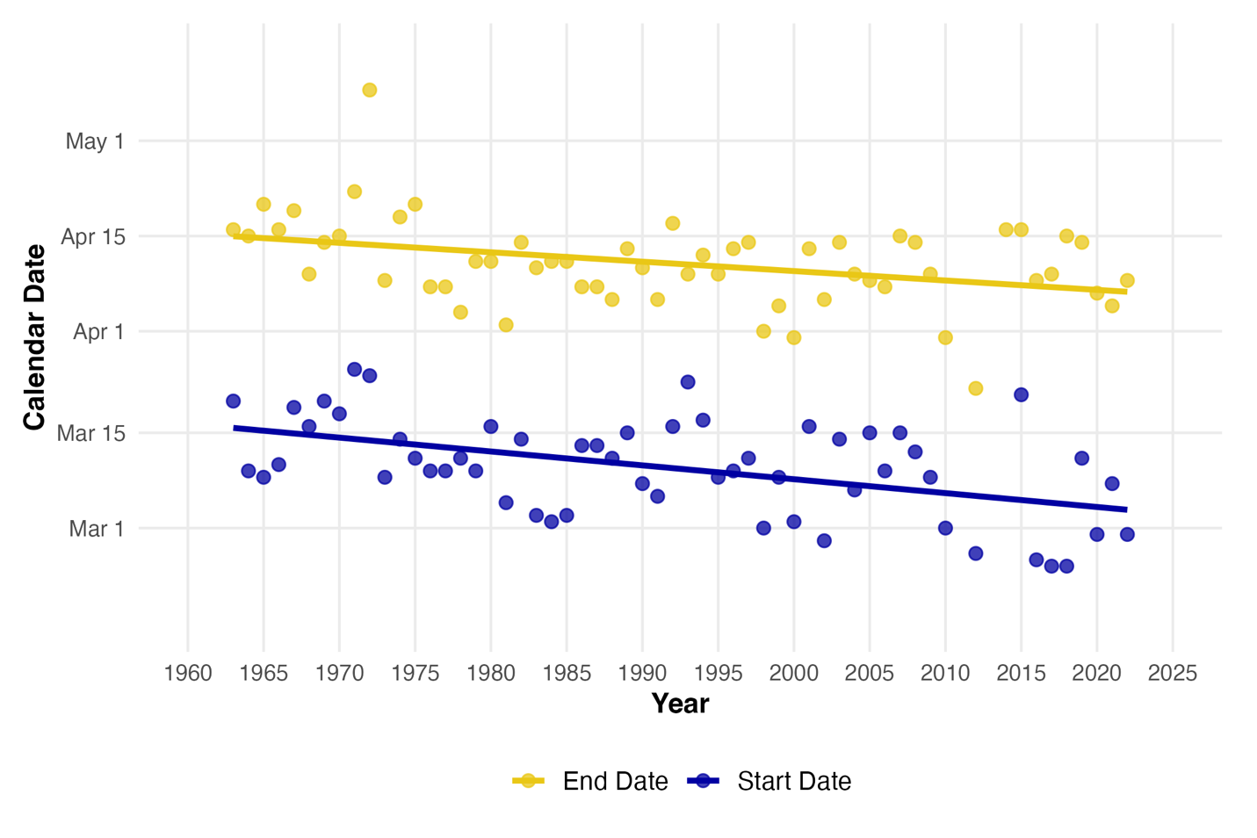
Figure 6-8
Trends in maple sugaring season timing in Vermont, 1963–2022. The average season start date is in dark blue, and the average season end date is in yellow
Source: USDA (2024)
Note: Original analysis by Megan Knight using USDA NASS Maple Syrup Inquiry Survey Data. Data was collected via mail and online surveys followed by interviews. Data were unavailable for season start dates in 2011, 2013, and 2014, and season end dates were unavailable in 2011 and 2013. These years were omitted from the analysis and no extrapolation was performed

Slide 22
6.5 Economic Impacts and Adaptation Strategies

Slide 23
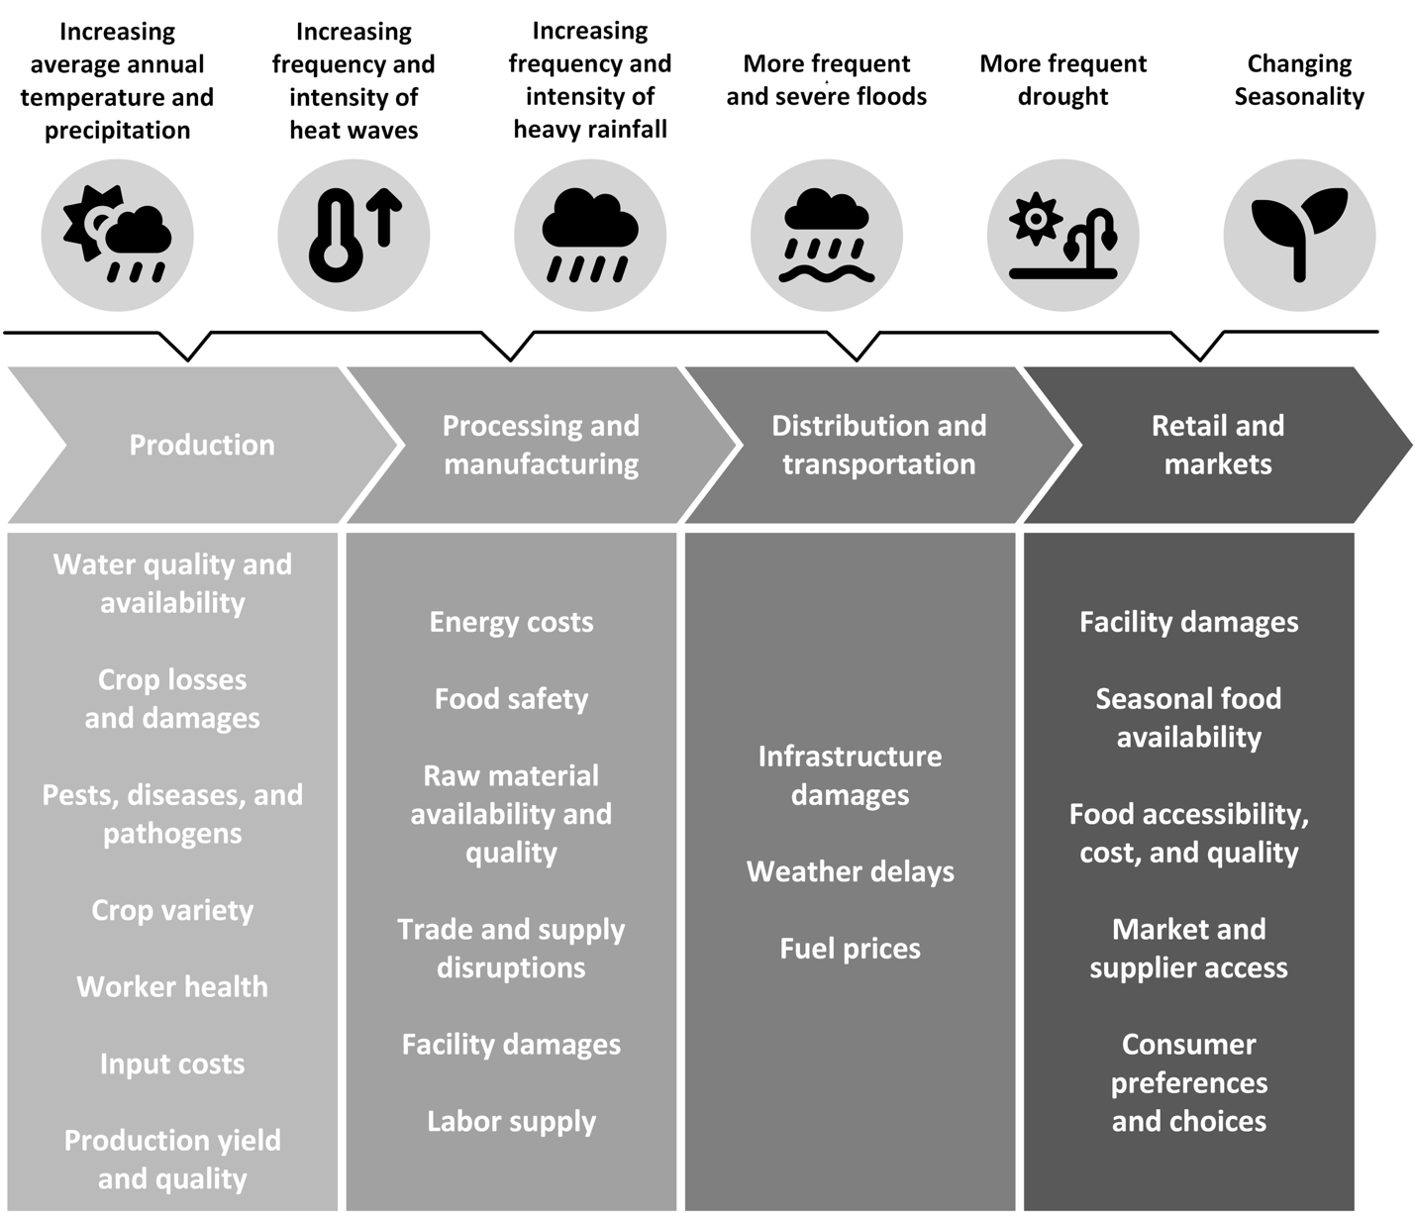
Figure 6-9
Effects of climate change differ between production, processing, distribution, and retail stages of the supply chain
Source: Adapted from (Mitchell et al., 2023).

Slide 24
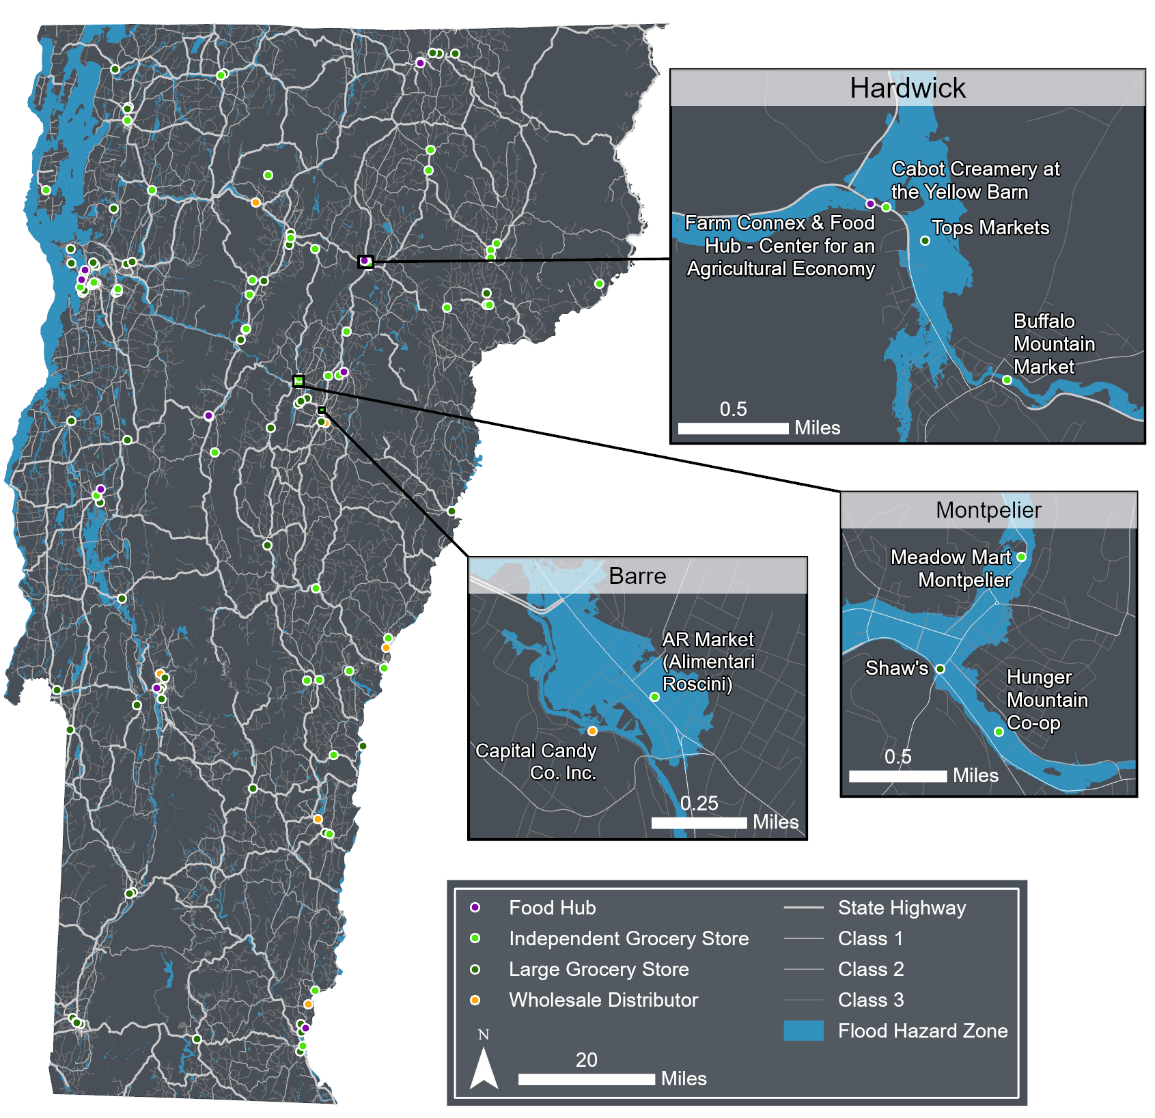
Figure 6-10
Location of major food distribution centers in Vermont relative to flood hazard zones. Food distribution centers (e.g. food hubs, independent grocery stores, large grocery stores, wholesale distributors), state and town highways (white lines, thickest line are state highways and thickness of town highways decreases with increasing class), and flood hazard zone (blue shaded regions). Three towns are highlighted showcasing examples where food distribution centers for the town are within or near current flood hazard zones
Source: Flood hazard zones (FEMA, 2024; VCGI, 2022); Food distribution centers (Farm Connex, 2025; FoodCoDirectory, 2026; A. McCarthy, 2023; USDA, 2026a; VT Farm to Plate, 2026); State and town highways (Vermont Agency of Transportation, 2021)
Note: Visualization by Hannah C. Turner; Geospatial data on flood hazard zones were a combination of the Vermont Center for Geographic Information (VCGI) floodplain layer and the FEMA National Flood Hazard Layer Where the datasets overlapped, the VCGI flood hazard zone layer superseded the FEMA layer; FEMA flood zone data were retained only in areas not covered by the VCGI layer. Highlighted insets were informed by discussions with distribution partners at the Center for Agricultural Economy’s Farm Connex program

Slide 25
6.6 Social Impacts and Adaptation Strategies

Slide 26
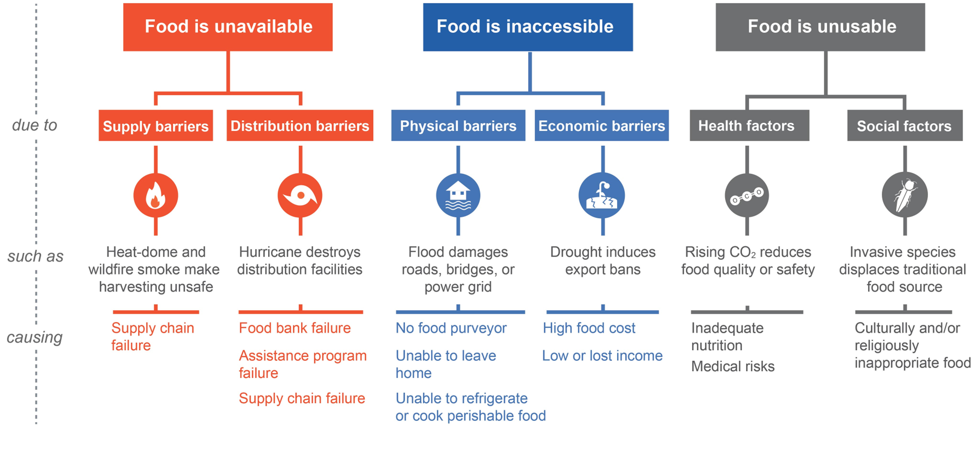
Figure 6-11
Examples of food system failure due to climate change. Climate change may impact food security in a variety of ways; the graphic above shows some of the pathways for climate change to cause food system failures that make food less accessible, available, or usable
Source: Adapted from (Mitchell et al., 2023)

Slide 27
6.7 Food System Emissions and Mitigation

Slide 28
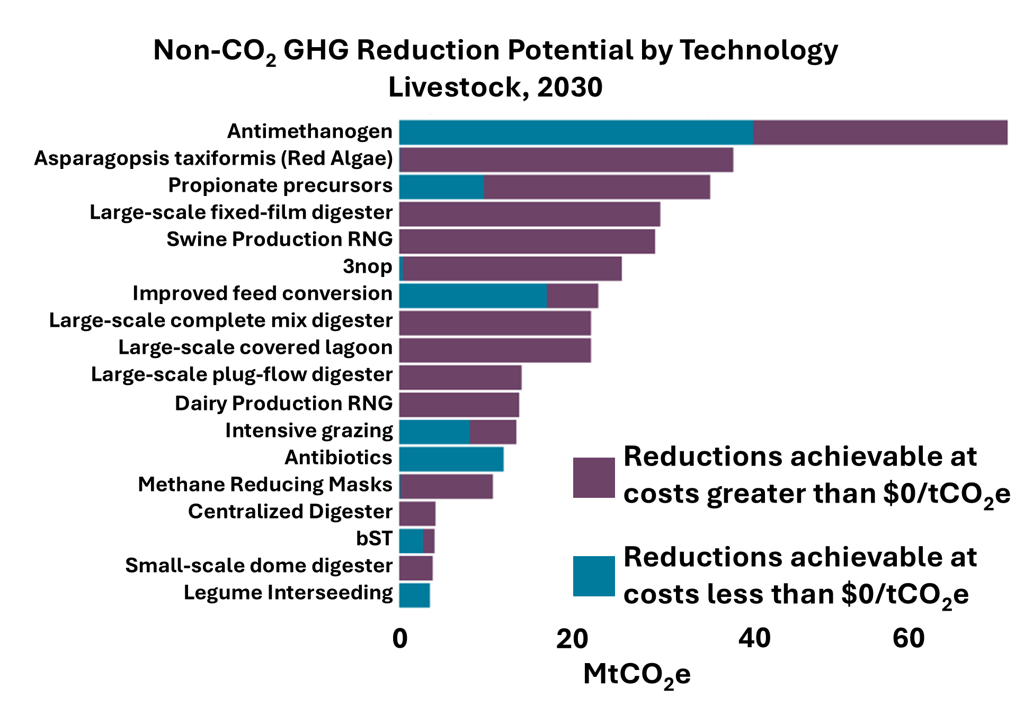
Figure 6-12
CH₄ and N₂O GHG emissions reduction potential and cost by technology for livestock projected to 2030. Bars represent the total mitigation potential (metric tons of carbon dioxide equivalent) for each on-farm action. Purple represents the proportion of emissions reduction that has a cost associated, whereas blue represents reductions achievable at no cost
Source: EPA (2025b)

Slide 29
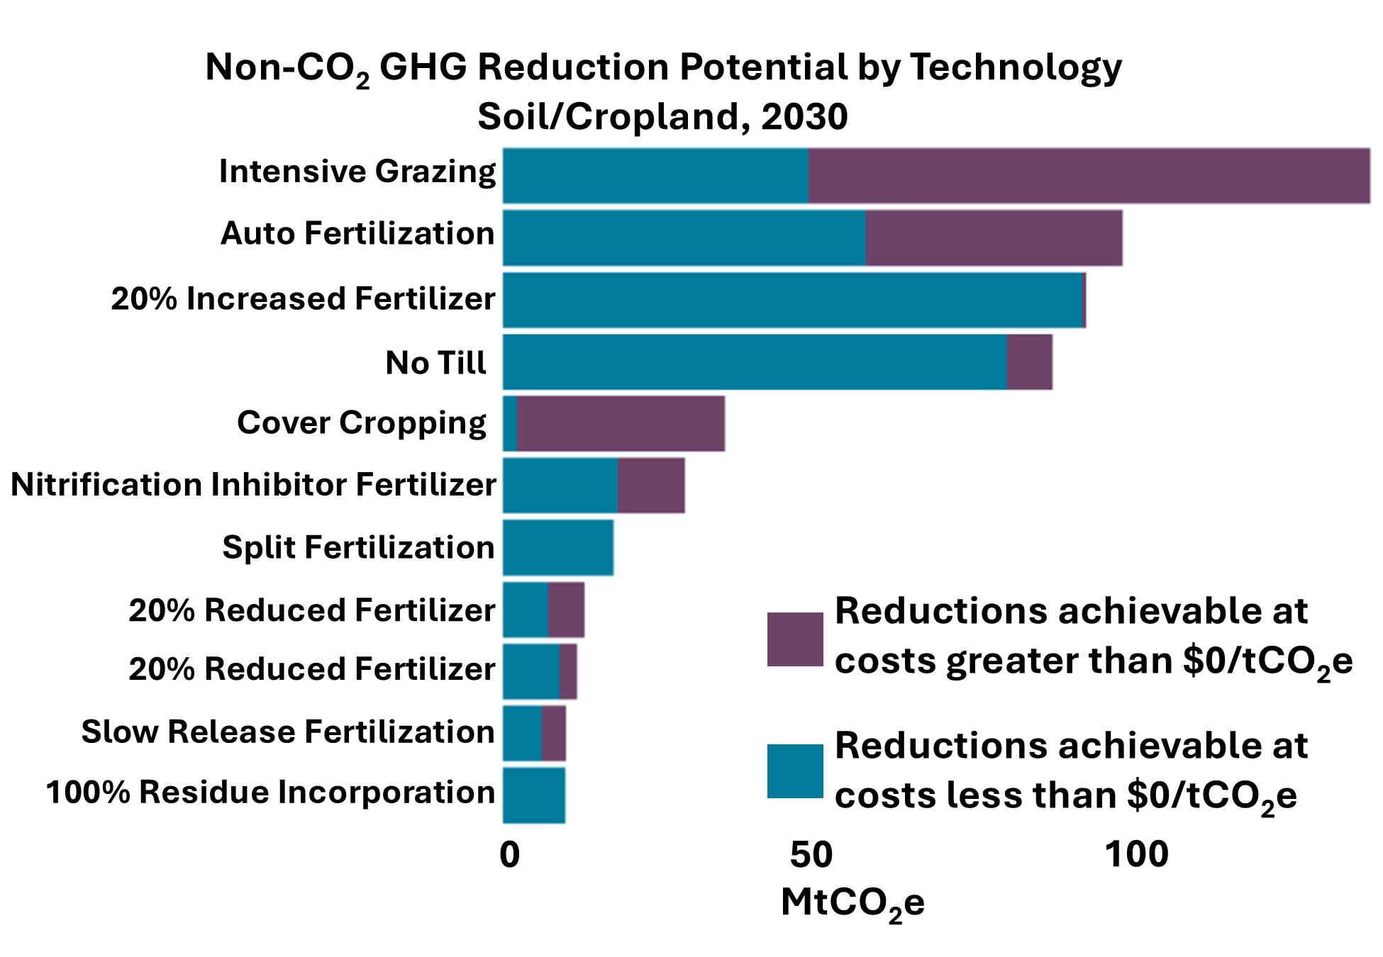
Figure 6-13
CH₄ and N₂O GHG reduction potential and cost by technology for soil and cropland in Vermont projected to 2030. Bars represent the total mitigation potential (metric tons of carbon dioxide equivalent) for each on-farm action. Purple represents the proportion of emissions reduction that has a cost associated, whereas blue represents reductions achievable at no cost
Source: EPA (2025b)

