Slide 1


Water Resources
Madeline Winer^{1,2}, Rae Taylor-Burns^{2,3}, Henry L. Motes¹
¹Rubenstein School of Environment & Natural Resources, ²Gund Institute for Environment, ³University of California Santa Cruz
Recommended citation for chapter
Winer, M., Taylor-Burns, R., Motes, H. L, Turner, H.C. 2026. Chapter 4: Water Resources In Galford, G.L., Balerna, J.A., Turner H.C., Sardonis, A., Peplinski, H. (Eds), The Vermont Climate Assessment 2025. Burlington, Vermont: Climate Measurements Center of Excellence, Gund Institute for Environment at the University of Vermont. DOI: 10.5281/zenodo.20272849. Accessed online at https://vtclimate.org.

Slide 2
Section 4.2 - Background

Slide 3
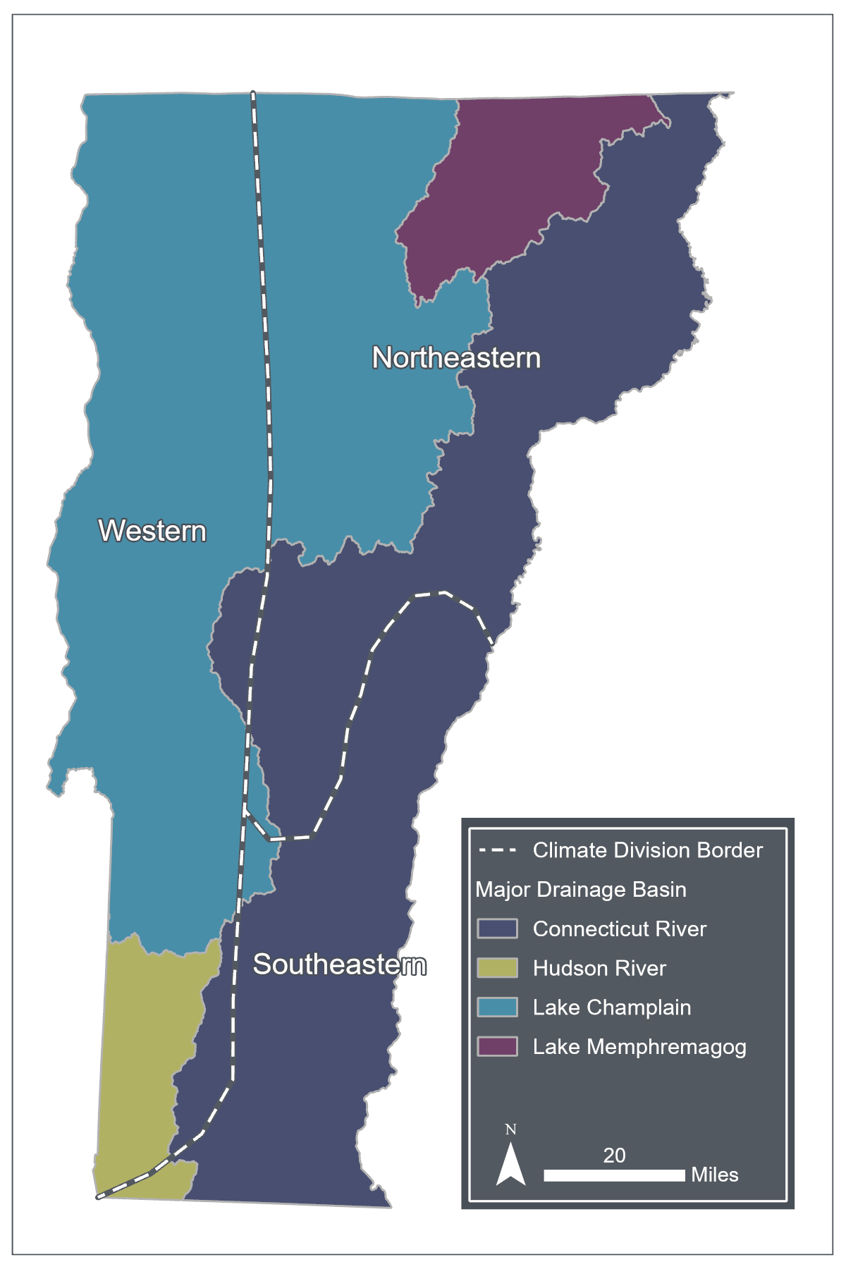


Figure 4-1
Vermont climate divisions (western, northeastern, southeastern) overlaid on the four major drainage basins (Connecticut River, Hudson River, Lake Champlain, Lake Memphremagog)
Source: National Hydrography Dataset (2023) and NOAA’s National Center for Environmental Information Climate Region Dataset (2026)

Slide 4
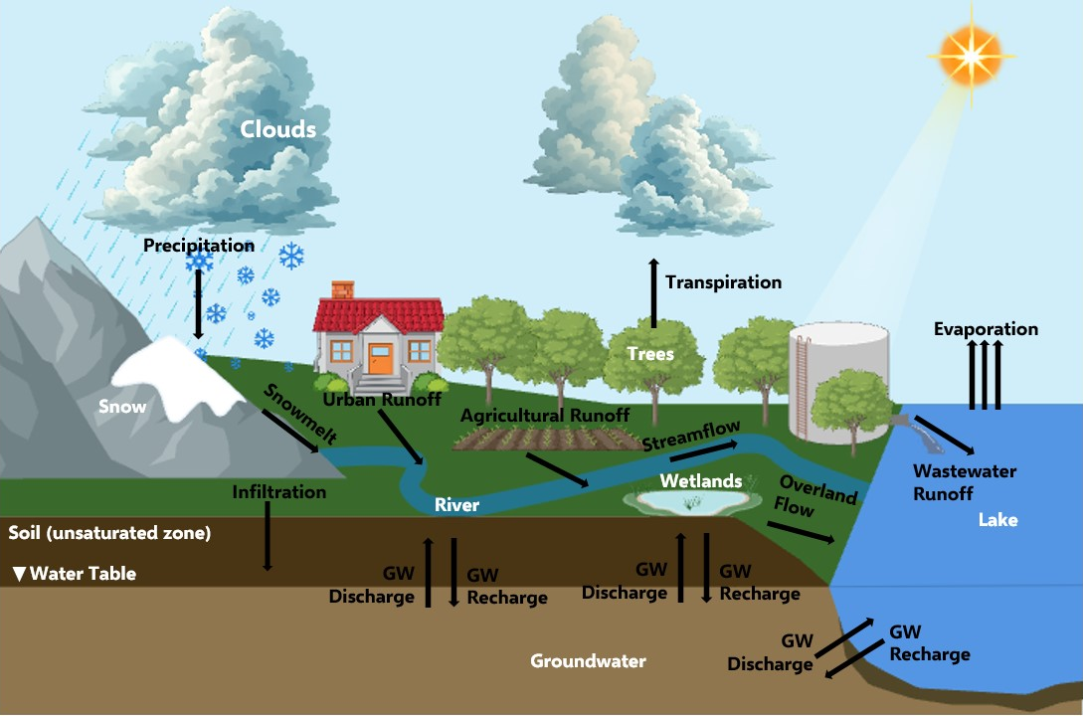
Figure 4-2
Water cycle conceptual model with reservoirs (e.g., clouds, wetlands, river, lake, snow, soil, and groundwater) in white text and fluxes (e.g., precipitation, overland flow, snowmelt, streamflow, runoff, infiltration, groundwater (GW) recharge, GW discharge, transpiration, and evaporation) in black text
Source: BioRender using USGS Water Data for the Nation (2023)

Slide 5
Section 4.3 – Water Availability and Use

Slide 6
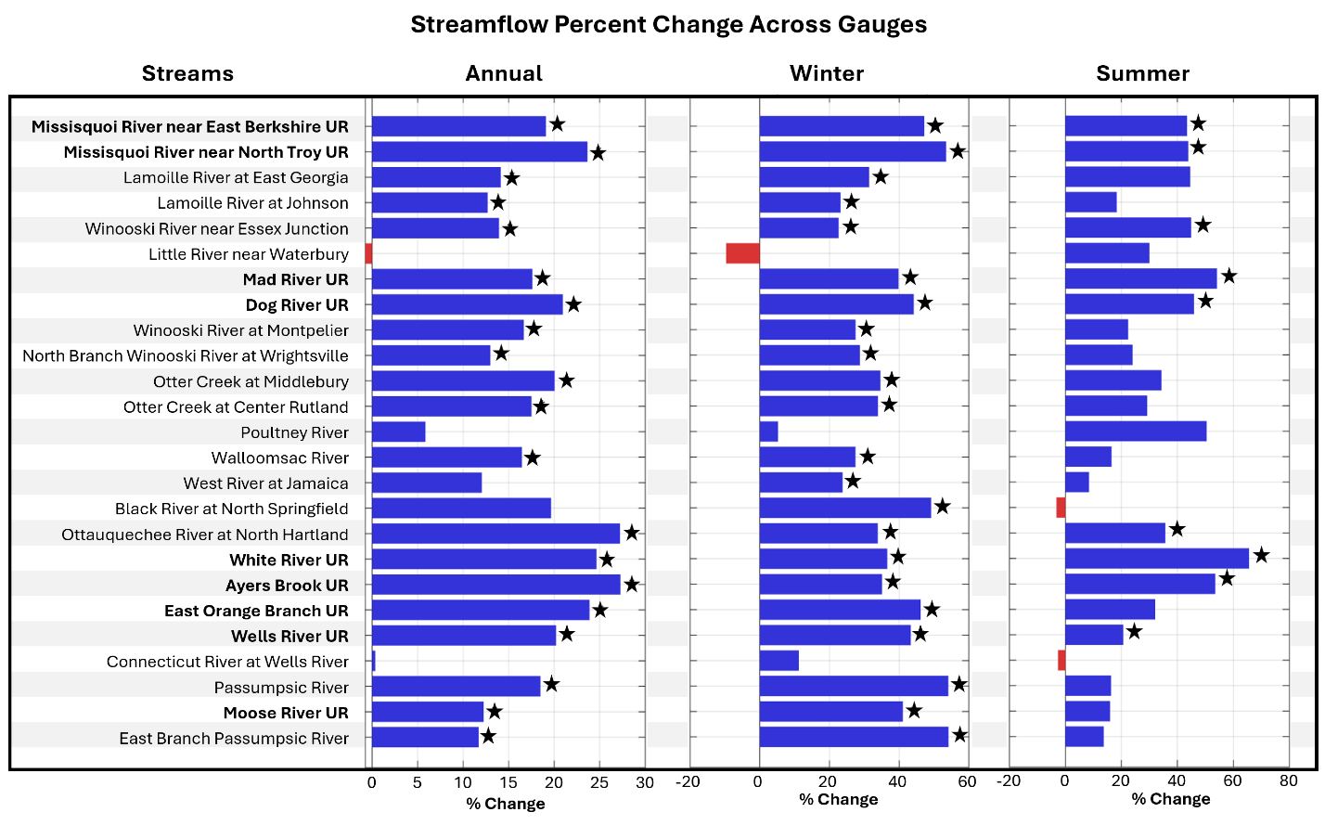
Figure 4-3
Percent change in annual and seasonal streamflow across stream gauges for the 1996–2025 time period compared to the 1966–1995 time period. Positive (blue) bars indicate streamflow has increased between the two time periods, while negative (red) bars indicate streamflow has decreased between the two time periods. “UR” in the stream gauge name signifies that the watershed is unregulated (i.e. no dams or other structures impeding flow). A star denotes statistical significance (p<0.05)
Source: USGS Water Data for the Nation (2026b)

Slide 7
Table 4-1
Average percent change in streamflow metrics from time period 1966–1995 to time period 1996–2025 by Vermont climate division. Only stream gauge sites with significant differences are included in the table
Source: USGS Water Data for the Nation (2026b)
Streamflow metrics | Whole state | Northeastern | Southeastern | Western
Annual flow | 19% | 18% | 26% | 16%
Winter flow | 36% | 41% | 36% | 30%
Summer flow | 45% | 44% | 51% | 45%

Slide 8
Table 4-2
Streamflow thresholds for hydrologic drought and flooding
 | Abnormal | Severe | Exceptional
Drought | <30th percentile | <10th percentile | <2nd percentile
Flooding | >70th percentile | >90th percentile | >98th percentile
Source: United States Drought Monitor (2026)

Slide 9
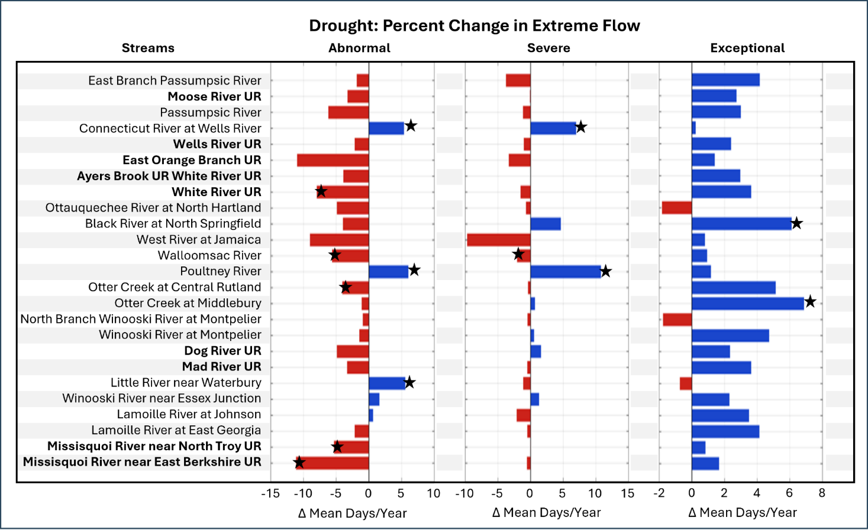
Figure 4-4
Percent change in extreme low streamflow volume across stream gauges for the 1996–2025 time period compared to the 1966–1995 time period. Positive (blue) bars indicate more days of extreme low flow between the two time periods, while negative (red) bars indicate less days of extreme low flow between the two time periods. “UR” in the stream gauge name signifies that the watershed is unregulated (i.e. no dams or other structures impeding flow). A star denotes statistical significance (p<0.05)
Source: USGS Water Data for the Nation (2026b)

Slide 10
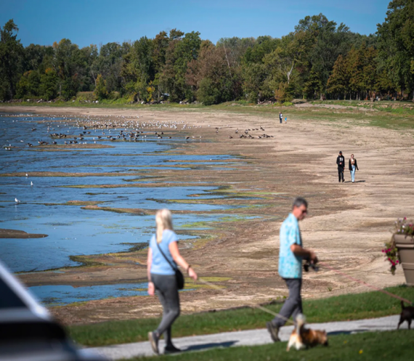
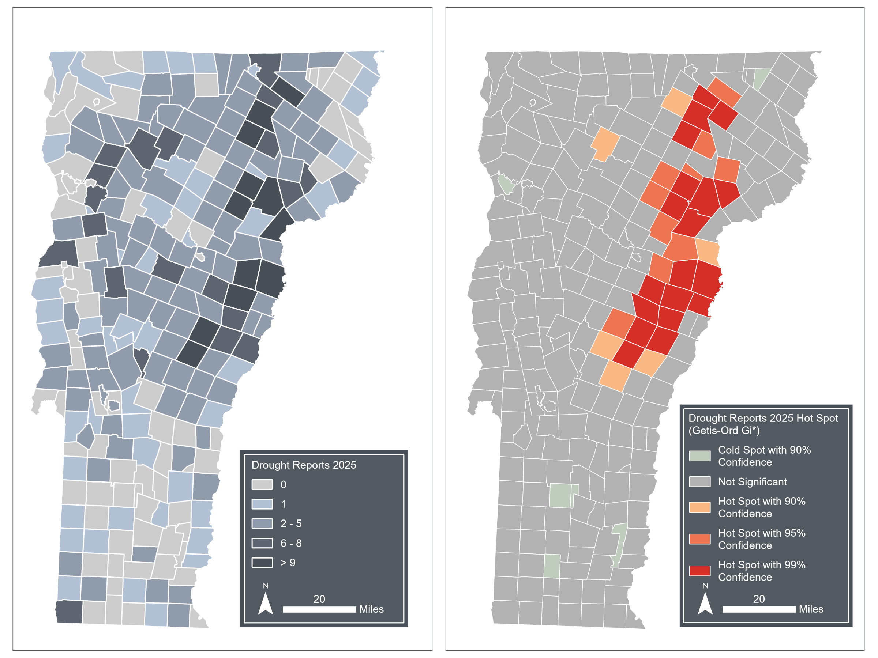
Box 4-1: Summer 2025 drought conditions
A) Lake Champlain low water level at St. Alban’s Bay (September 18, 2025); B) statewide droughts (2025); and C) drought hotspots (summer 2025)
Sources: A) Glenn Russell via VTDigger (2025); B) and C) Vermont Department of Environmental Conservation (2026k)
A
C
B

Slide 11
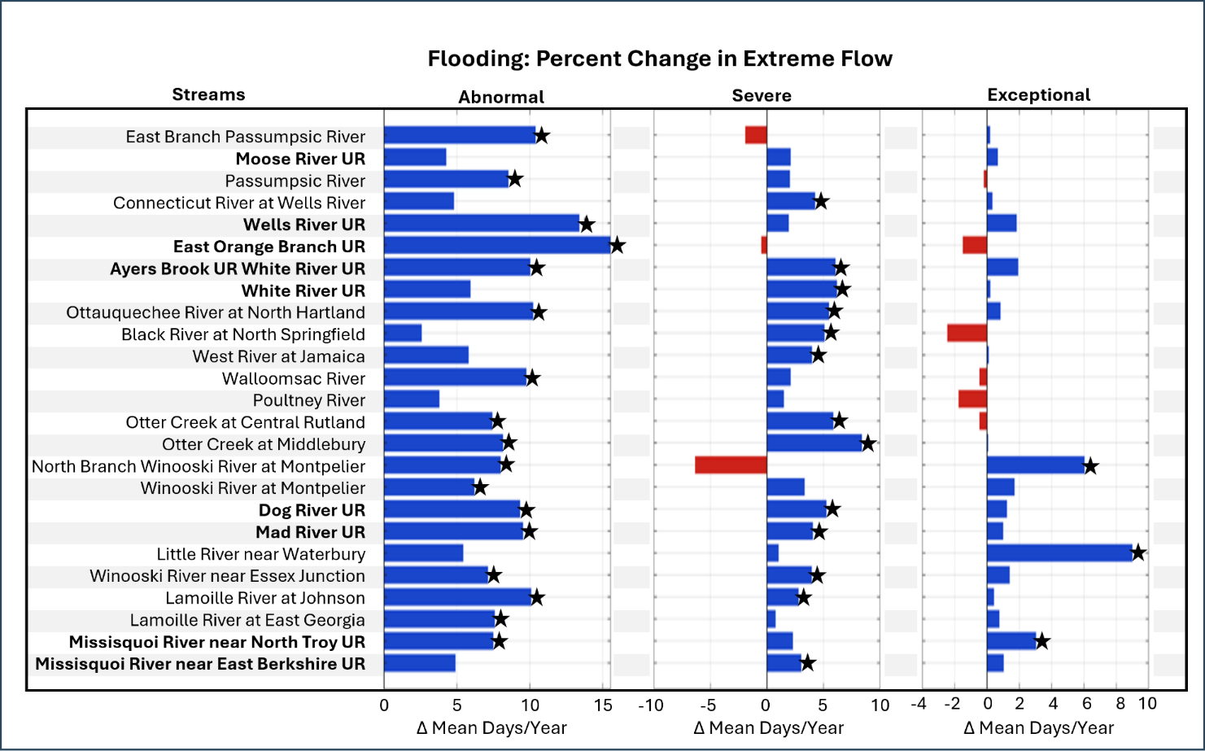
Figure 4-5
Percent change in extreme high streamflow volume across stream gauges for the 1996–2025 time period compared to the 1966–1995 time period. Positive (blue) bars indicate more days of extreme high flow between the two time periods, while negative (red) bars indicate less days of extreme high flow between the two time periods. “UR” in the stream gauge name signifies that the watershed is unregulated (i.e. no dams or other structures impeding flow). A star denotes statistical significance (p<0.05)
Source: USGS Water Data for the Nation (2026b)

Slide 12
Table 4-3
Average change in abnormal and severe flood days from 1966–1995 to 1996–2025 by Vermont climate division. Only stream gauge sites with significant differences are included in the table. The exception flood days metric is excluded because so few sites had significant differences
Source: USGS Water Data for the Nation (2026b)
Streamflow metrics | Whole state | Northeastern | Southeastern | Western
Abnormal flood days | 9.4 days | 9.9 days | 10.2 days | 8.1 days
Severe flood days | 5.0 days | 4.3 days | 5.2 days | 6.1 days

Slide 13
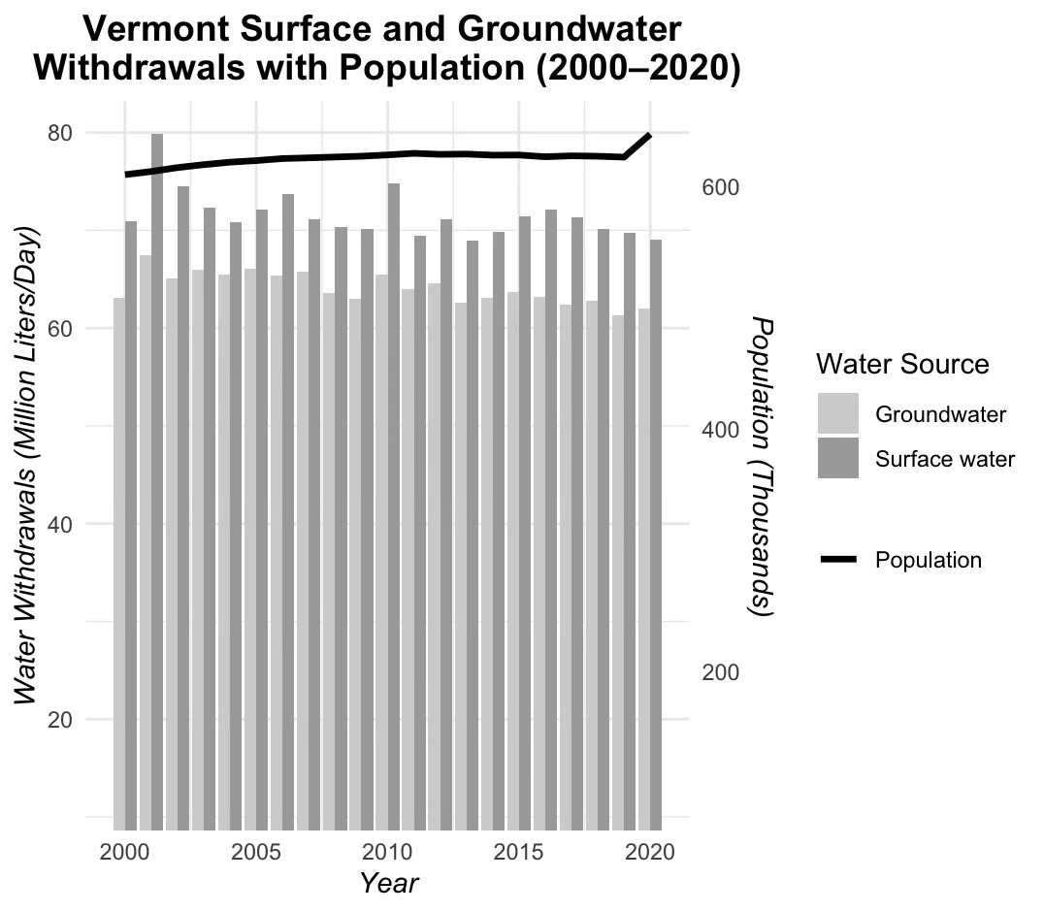
Figure 4-6
Water withdrawals compared with the population of Vermont from 2000–2020. Note the y-axes for water withdrawals and population have an axis break and do not start at zero
Source: USGS Public Supply Withdrawals Water Use Model (2026a) and Federal Reserve Economic Data (FRED) (2026)

Slide 14
Figure 4-7
Reported surface water withdrawals (gallons per day) that met threshold requirements for Act 135 or the 1996 Water Withdrawals for Snowmaking Rule and occurred between January 1–December 31, 2024. Reports filed with both the Vermont Department of Environmental Conservation and the Vermont Secretary of Agriculture, Food, and Markets are included
Source: Vermont Department of Environmental Conservation (2025)
Note: While reporting is in total water withdrawn (gallons) for each activity (e.g., industrial use), data were divided by 365 to show withdrawals in gallons per day

Slide 15
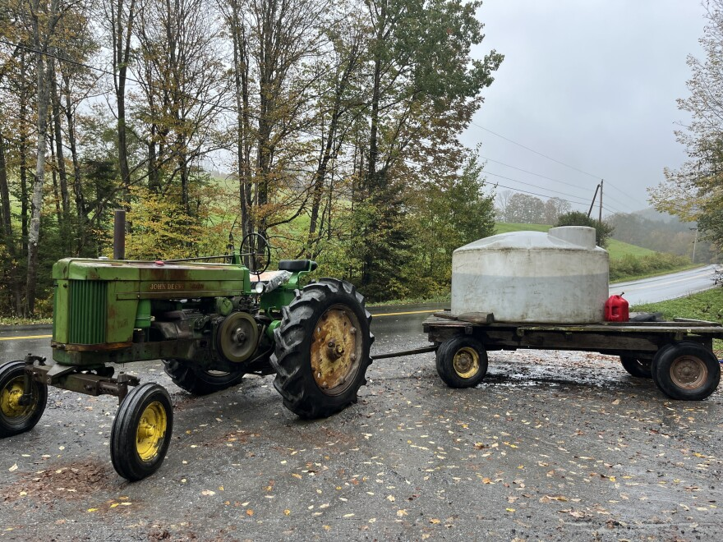
Figure 4-8
Upper Valley, Orange County, hauling water for cows during extreme drought conditions in early October 2025
Source: Photo credit to Sabine Poux, Vermont Public, 2025

Slide 16
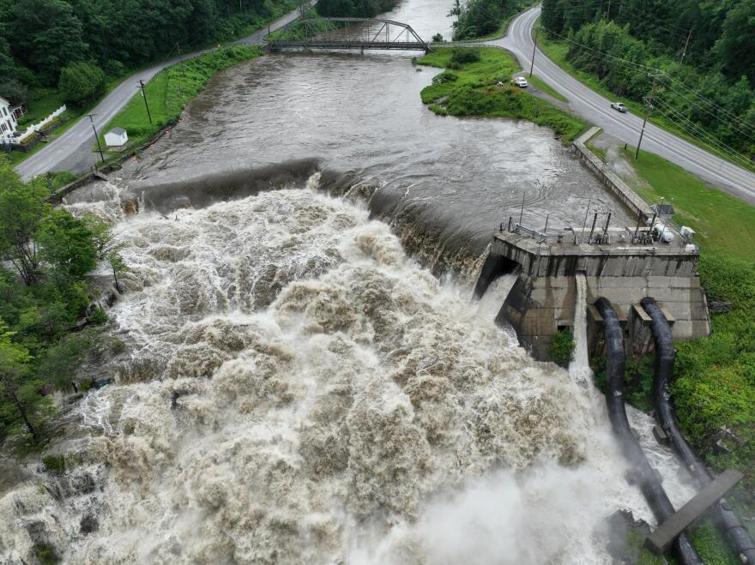
Figure 4-9
Fairfax Falls Hydroelectric Dam Overtopping from July 2023 flooding
Source: Photo credit to University of Vermont Spatial Analysis Lab, the Agency of Transportation, and the Civil Air Patrol, Vermont Public, 2023

Slide 17
Section 4.4 - Flooding

Slide 18
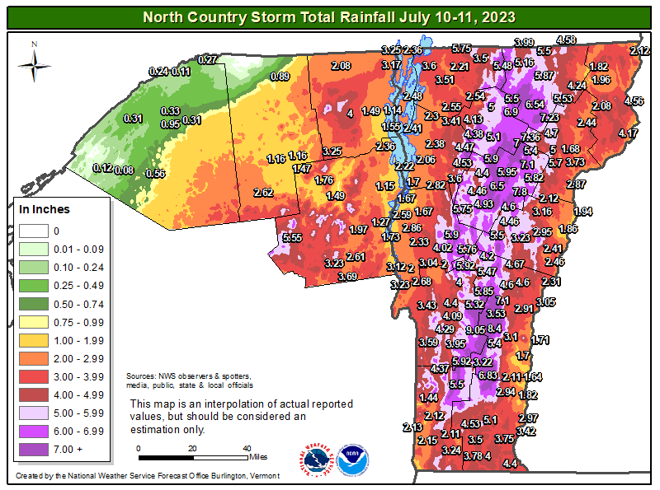
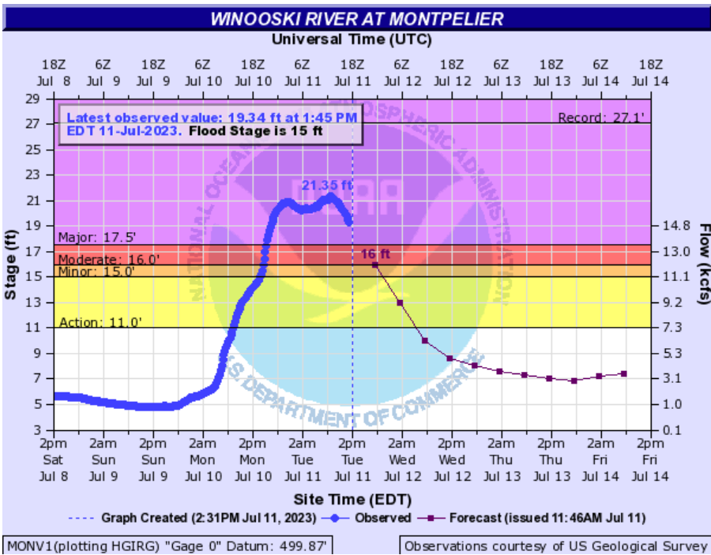
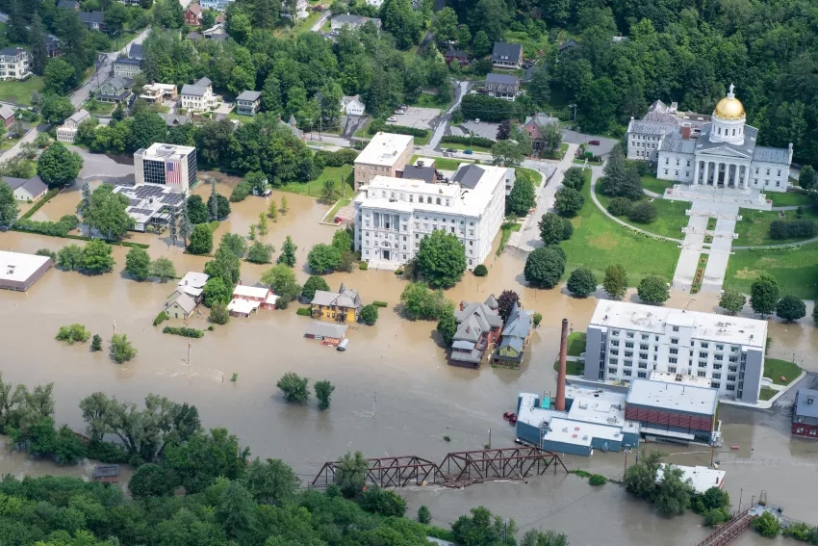
Figure 4-10
(A) Precipitation maps for the flood on July 10-11, 2023. (B) Water levels in the Winooski River at the Montpelier gauge on July 11, 2023. (C) Image of flooding in Montpelier in July 2023
Sources: (A) and (B) Banacos (2023); (C) Photo credit to U.S. Department of Defense, Air Force Senior Master Sgt. Michael Davis, NASA Applied Sciences (2023)

Slide 19
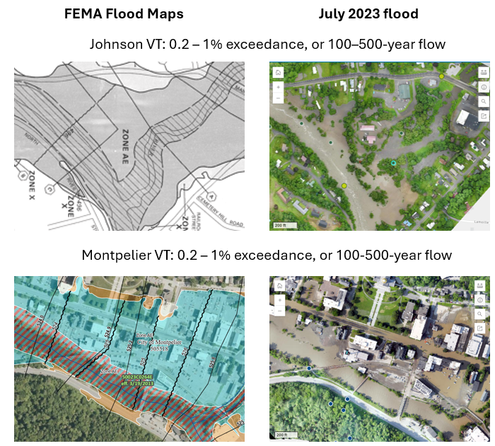
Figure 4-11
Comparison of FEMA flood maps (left) to aerial photos of July 2023 flood extents (right) in Johnson VT (top) and Montpelier VT (bottom). FEMA flood maps represent 100-year flood extents. USGS flood frequency analysis determined that the Johnson and Montpelier stream gauges reached 100-500-year flows
Sources: FEMA (2024); Smith et al. (2025); UVM Spatial Analysis Lab & Vermont Agency of Transportation (2024)

Slide 20
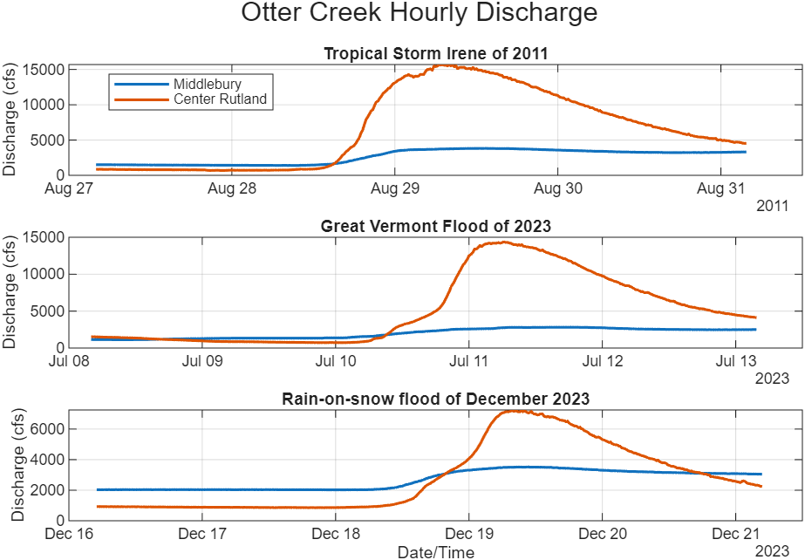
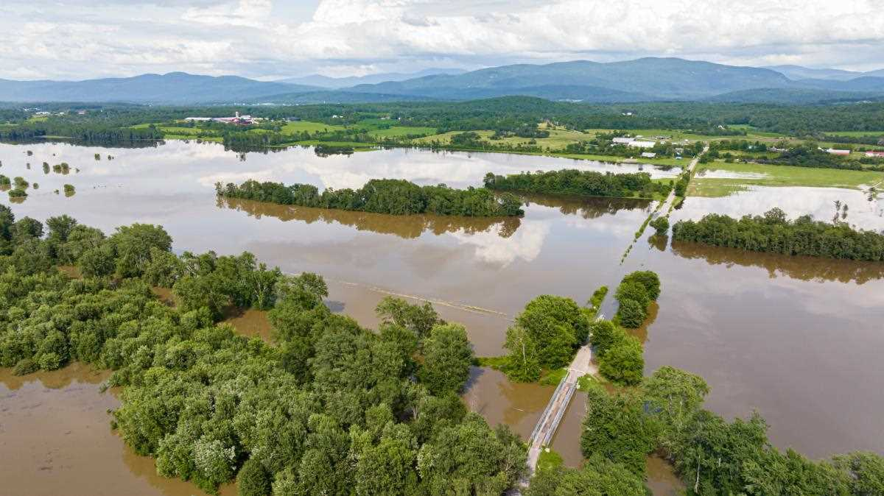
Figure 4-12
A
Depiction of discharge from two USGS stream gauges on Otter Creek: orange shows water levels upstream in Rutland, and blue shows water levels downstream in Middlebury. The three subplots depict water levels during Tropical Storm Irene in 2011, the Great Vermont Flood of 2023, and the rain-on-snow (ROS) event in December 2023. In between the two gauges are extensive wetlands that can absorb water during high flows, resulting in lower peak flows downstream in Middlebury.
B) Image of inundated wetlands connected to Otter Creek along Swamp Road during 2011 Tropical Storm Irene flooding
Source: A) U.S. Geological Survey (2026b); B) Photo credit to Chris Ingram, Fly Fisher (2023)
B

Slide 21
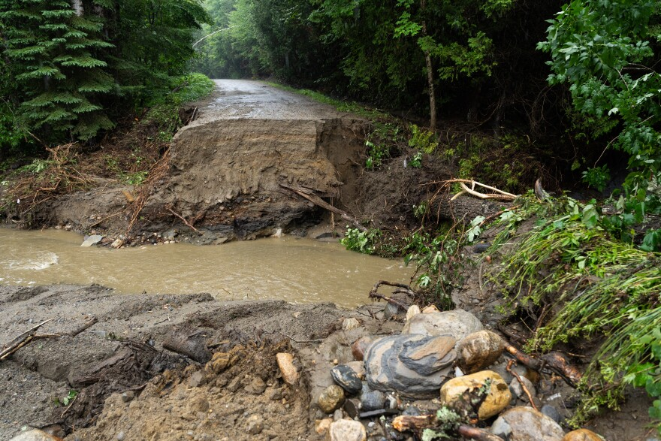
Figure 4-13
Fluvial erosion damage in Addison County from July 2025 flash flooding
Source: Photo credit to Brian Steveson, Vermont Public (2025)

Slide 22
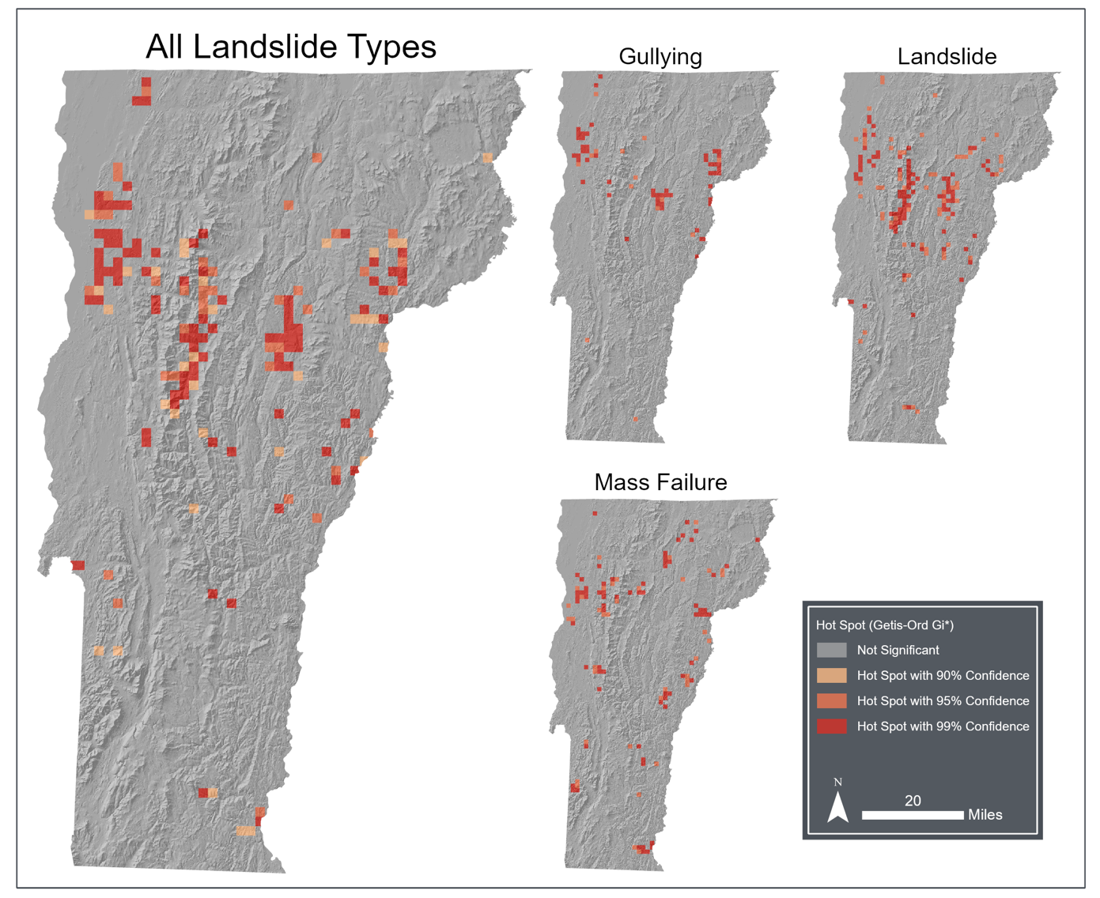
Figure 4-14
Hotspot analysis (Getis-Ord Gi*) of all landslide types in Vermont
Source: VT ANR Open Geodata Portal (2024)

Slide 23
Section 4.5 – Water Quality

Slide 24
Table 4-4
Climate change drivers and associated water quality impacts
Climate Change Driver | Water Quality Impact
Increased water temperatures | Low oxygen conditions, decreased aquatic life habitat suitability, migration of certain aquatic species, increased algal blooms
Increased precipitation and extreme events | Greater transport of nutrients and sediment during events, increased algal blooms
Decreased snowfall | Decreased spring transport of nutrients, colder soils, increased winter transport carrying sediment and nutrients
Increased winter rain | Earlier/midseason transport of nutrients and sediment, increased potential of algal blooms in summer months
Source: This chapter

Slide 25
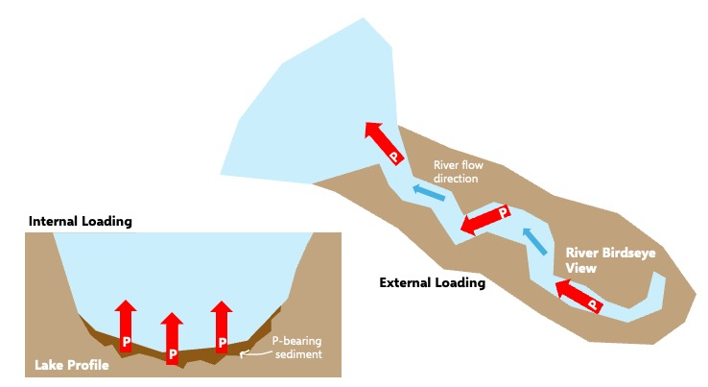
Figure 4-15
Conceptual model of internal and external loading with phosphorus (P). Red arrows represent release (internal loading) and transport (external loading) of phosphorus. Blue arrows represent river flow direction
Source: Lake Champlain Basin Program (2024)

Slide 26
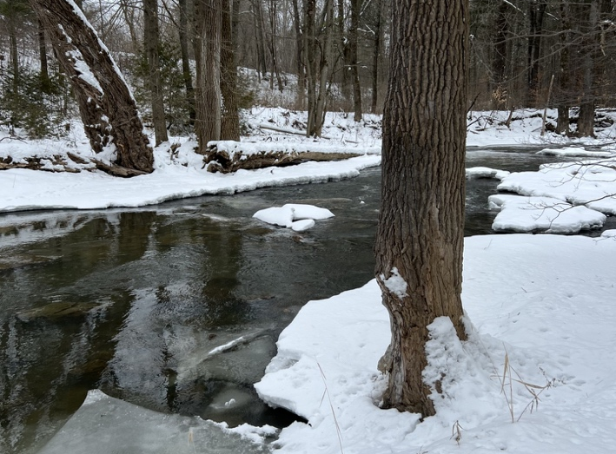
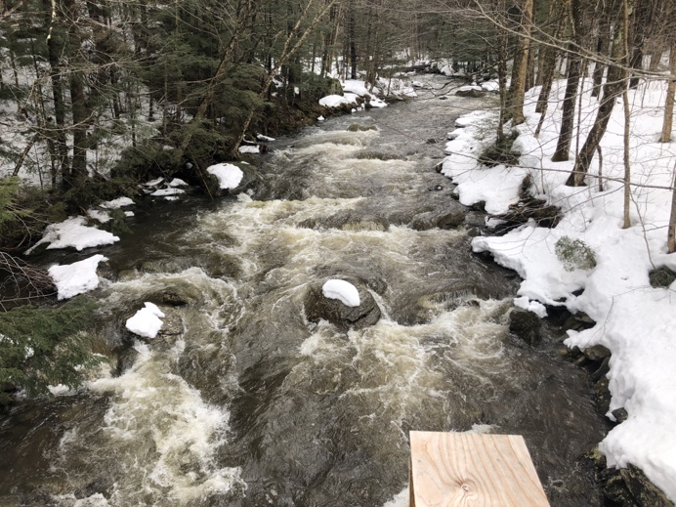
Figure 4-16
Winter flooding carries high nutrient and sediment loads at Mill Brook on January 25, 2023 (top) and Wade Brook on April 6, 2023 (bottom)
Source: Sonya Vogel (2023) and Saul Blocher (2023)

Slide 27
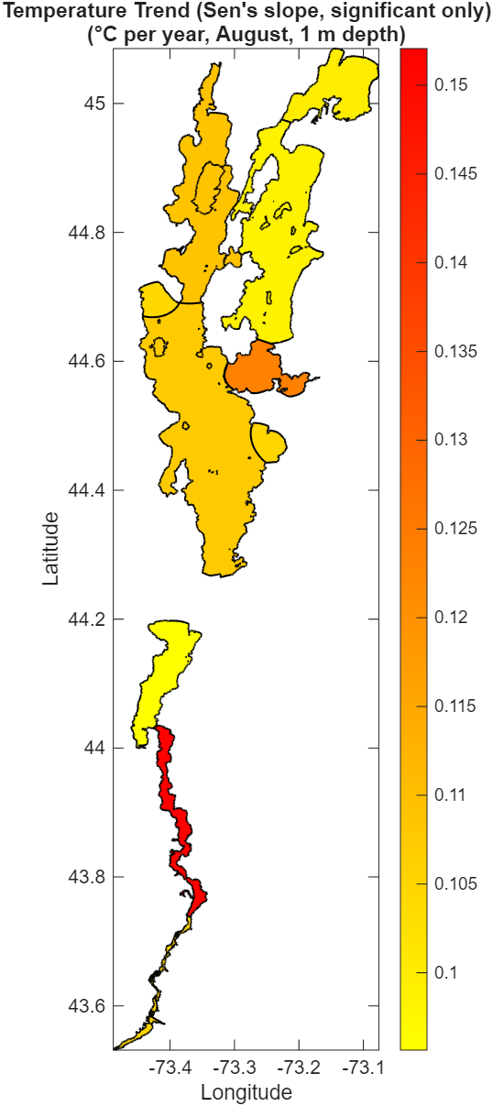
Figure 4-17
Lake Champlain increase in August surface water temperature from 1990-2020. A Mann-Kendall test was conducted on surface temperature data at 1m depth for August sampling. Only lake segment data with statistical significance is included in the figure. The Otter Creek lake segment was removed due to lack of statical significance
Source: Vermont Department of Environmental Conservation (2026h)

Slide 28
Box 4-2: Lake Champlain froze over in 2026 for the first time since March 2019
Surface freeze over on Lake Champlain between 1816–2024
Source: NOAA (2026)
Note: Freeze over dates are compiled from multiple sources; to better understand potential biases and uncertainties associated with each data source, please visit NOAA (2026)

Slide 29
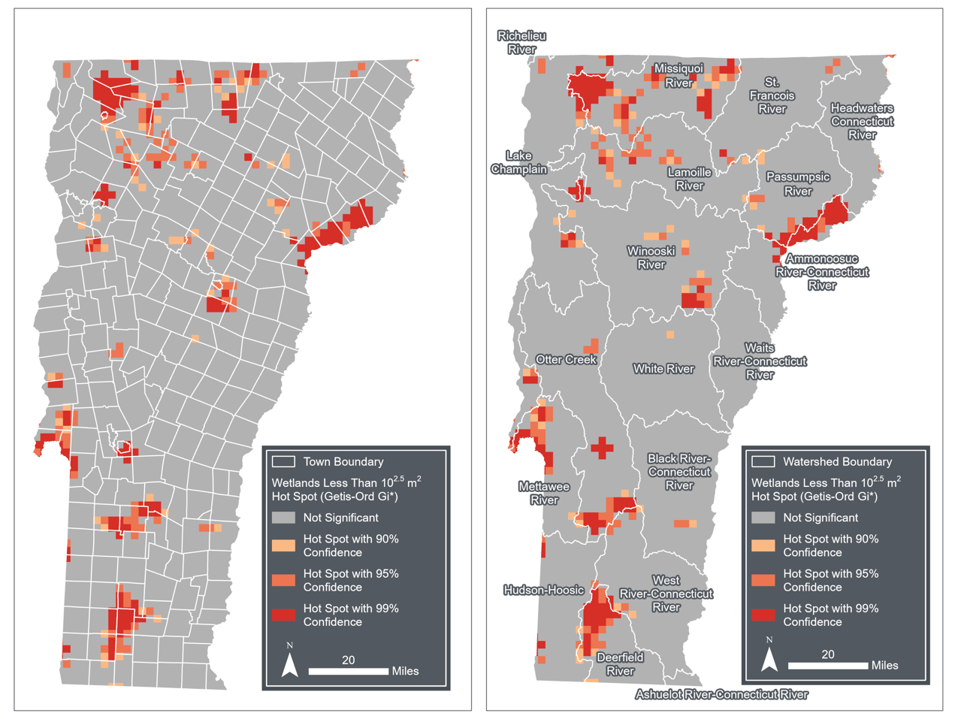
Figure 4-18
Hotspot Analysis (Getis-Ord Gi*) for wetlands less than 10^{2.5} m² (i.e., less than 300m²) in size by town boundary and watershed boundary
Source: VT ANR Wetlands Inventory Map (2026b)

Slide 30
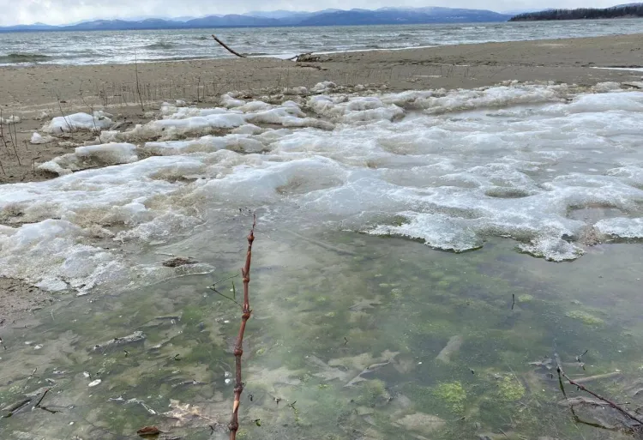
Figure 4-19
Algal growth under ice covered conditions on Lake Champlain in Burlington
Source: Mindy Morales (2023)

Slide 31
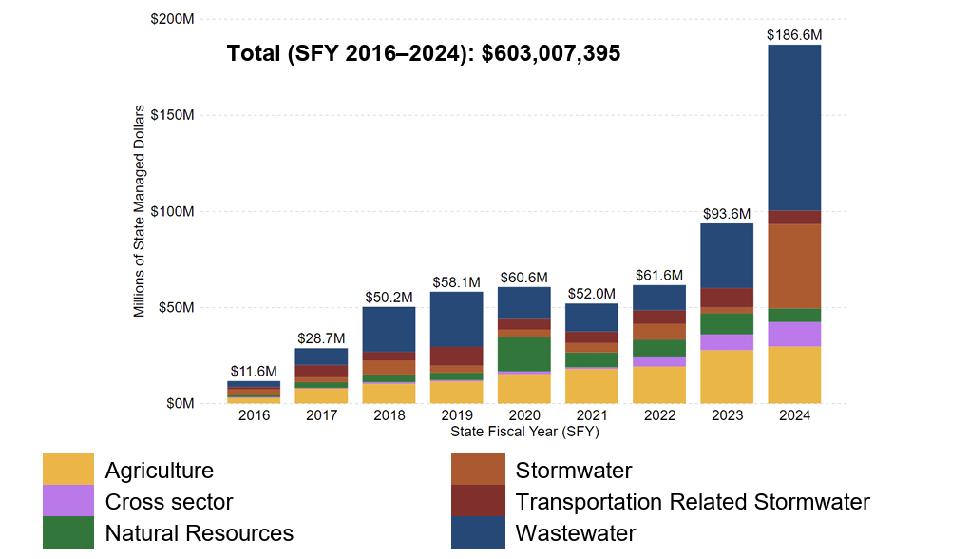
Figure 4-20
Total dollars awarded by state of Vermont agencies to clean water projects by land use sector
Vermont Department of Environmental Conservation (2025b)

