Slide 1


Forests
Garrett Simon¹, Loden Croll¹, Emma van Wagner¹, Maeve Dewey¹, Alexandra Kosiba^{2,1}, Jess Wikle¹
¹Rubenstein School of Environment and Natural Resources, ²Extension Forestry, College of Agriculture and Life Sciences, University of Vermont, Burlington, VT
Recommended citation: Simon, G., Croll, L., van Wagner, E., Dewey, M., Kosiba, A., Wikle, J. 2026, Forests. In Galford, G.L., Balerna, J.A., et al. (Eds), The Vermont Climate Assessment 2025. Burlington, Vermont: Climate Measurements Center of Excellence, Gund Institute for Environment at the University of Vermont. DOI: 10.5281/zenodo.20272849. Accessed online at https://vtclimate.org.

Slide 2
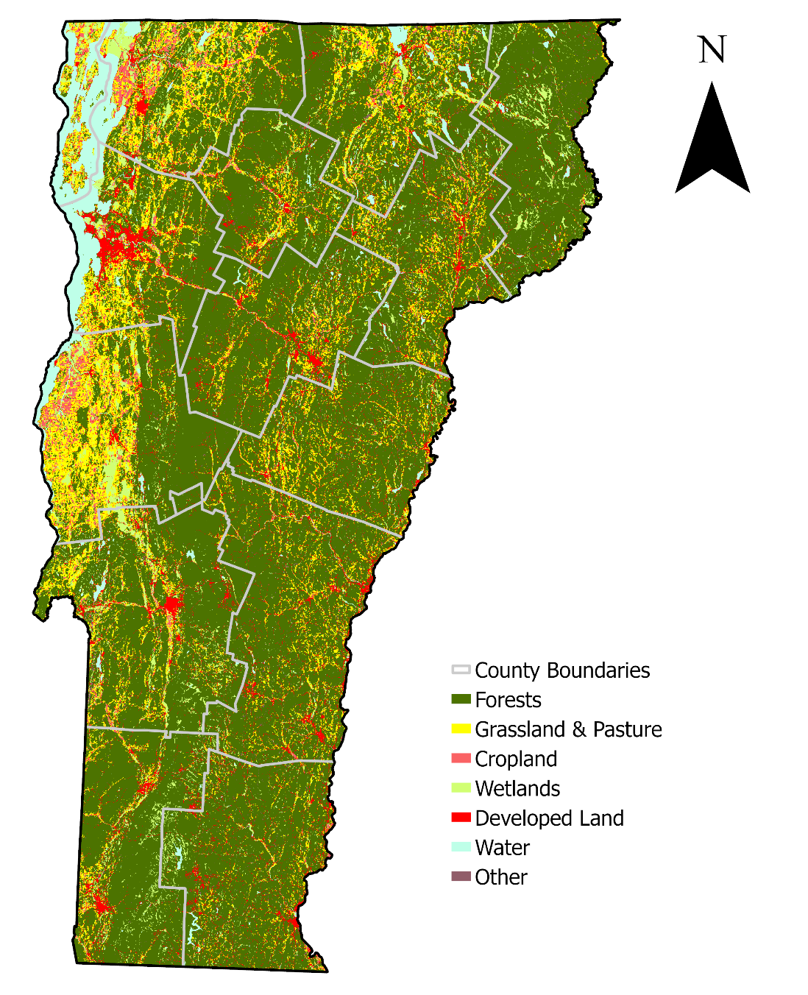


Figure 3-1
Land use and land cover classifications for Vermont in 2021
Source: MRLC (2021)
MRLC. (2021). USA NLCD Land Cover (CONUS) 2021 [Imagery Layer]. Multi-Resolution Land Characteristics Consortium. https://www.arcgis.com/home/item.html?id=3ccf118ed80748909eb85c6d262b426f

Slide 3
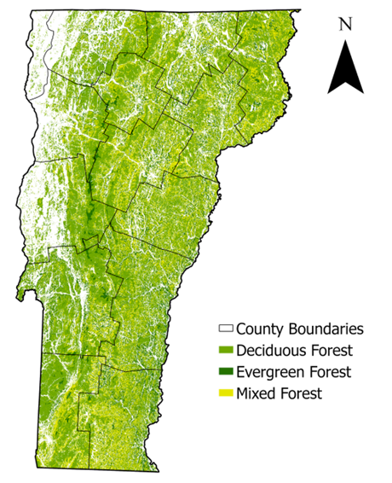
Figure 3-2
Dominant forest cover types for Vermont in 2021
Source: Map derived from MRLC National Land Cover product (MRLC, 2021).
MRLC. (2021). USA NLCD Land Cover (CONUS) 2021 [Imagery Layer]. Multi-Resolution Land Characteristics Consortium. https://www.arcgis.com/home/item.html?id=3ccf118ed80748909eb85c6d262b426f

Slide 4
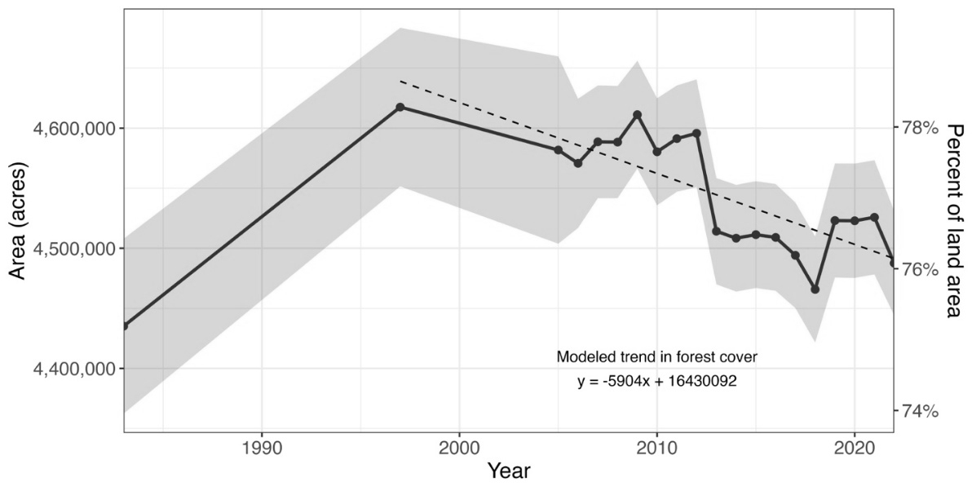
Figure 3-3
Estimated Vermont forest cover over time in acres and as a percentage of total area, shading indicates uncertainty estimates (standard error), and the dashed black line depicts a linear model of forest cover since 1997
Source: Vermont Forest Carbon Inventory (Kosiba, 2025)
Kosiba, A. M. (2025). Vermont Forest Carbon Inventory 2025 (p. 14). University of Vermont Extension, College of Agriculture and Life Sciences.

Slide 5
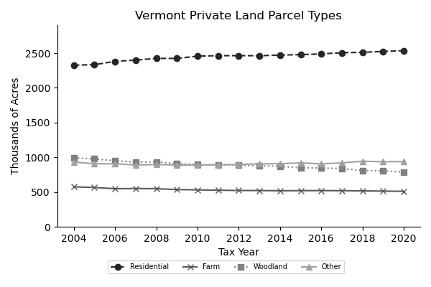
Figure 3-4
Changes in the classification of land area within Vermont’s privately-owned parcels from 2004 to 2020, derived from tax and current use parcel data
Source: Figure adapted from (Fidel, 2023); data from (Vermont Natural Resources Council, 2023).
Fidel, J. (2023). Tracking Parcelization Over Time to Inform Planning and Policy. Vermont Natural Resources Council. https://vtforesttrends.vnrc.org/reports
Vermont Natural Resources Council. (2023). Total Acreage by Parcel Type [XLSX File]. Vermont Parcelization Website. https://vtforesttrends.vnrc.org/downloads

Slide 6
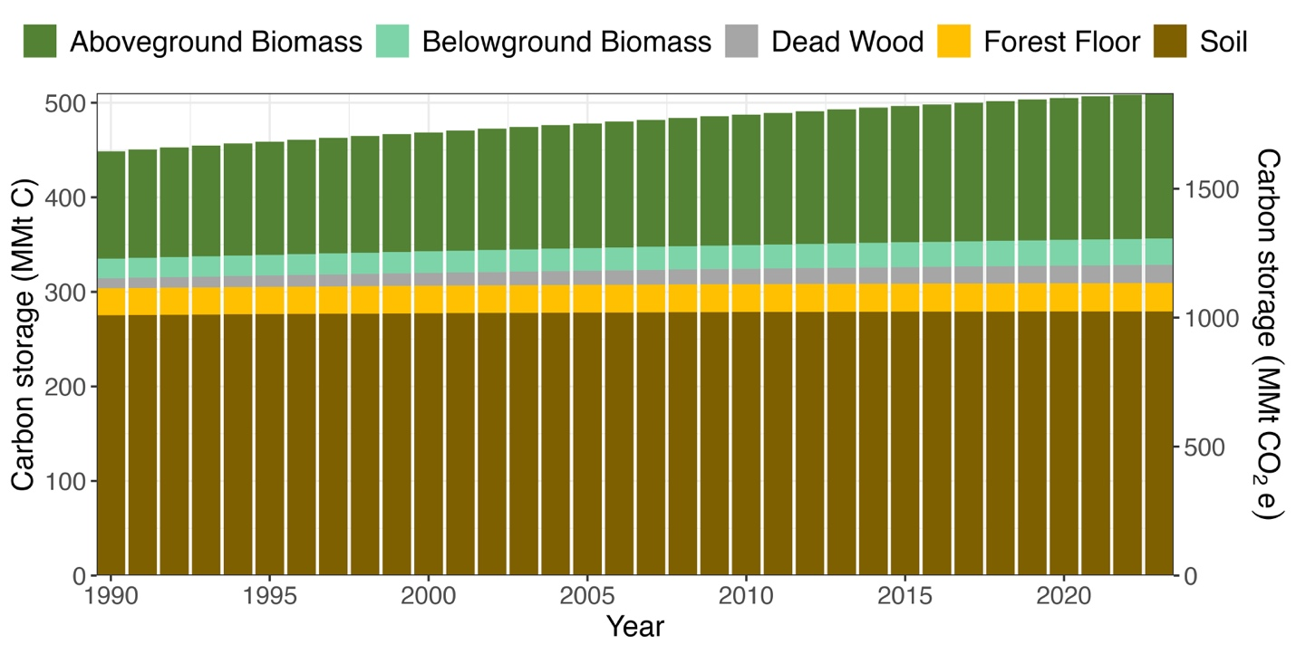
Figure 3-5
Estimated total carbon storage for forests that have remained forests in Vermont, shown annually by carbon pool for 1990-2020, carbon is expressed as million metric tons of carbon (left axis, MMt C) and as carbon dioxide equivalents (right axis, MMt CO₂e)
Source: Vermont Forest Carbon Inventory (Kosiba, 2025)

Slide 7
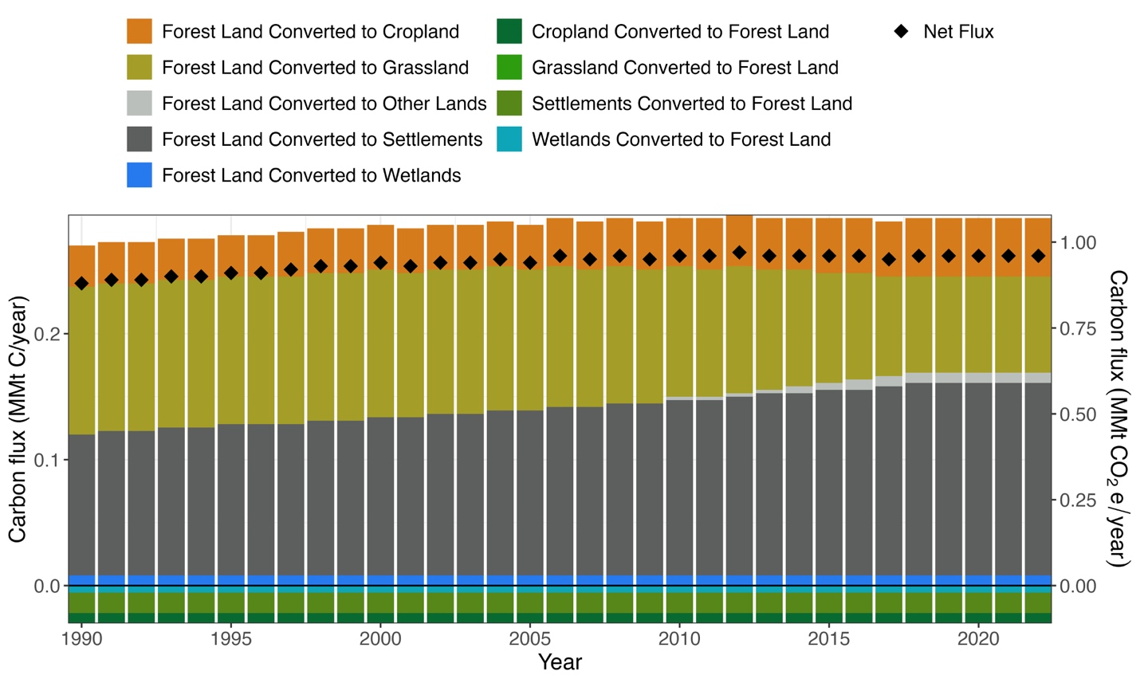
Figure 3-6
Estimated annual carbon flux due to forest-based land use change in Vermont, shown by type of conversion and year (1990-2022), carbon is expressed as a million metric tons of carbon (left axis, MMt C) and as carbon dioxide equivalents (right axis, MMt CO₂e), negative flux values indicate sequestration of carbon dioxide from the atmosphere, and positive values indicate emissions to the atmosphere
Source: Vermont Forest Carbon Inventory (Kosiba, 2025)
Kosiba, A. M. (2025). Vermont Forest Carbon Inventory 2025 (p. 14). University of Vermont Extension, College of Agriculture and Life Sciences.

Slide 8
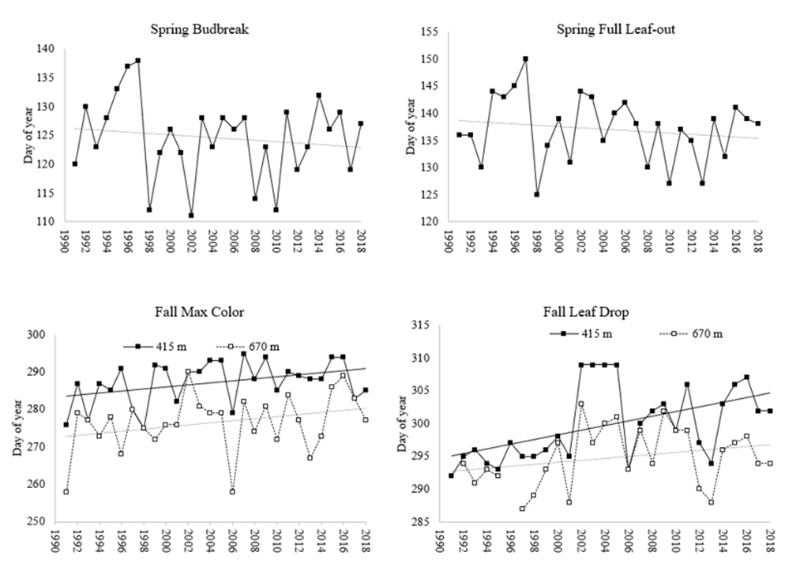
Figure 3-7
Long-term trends in the timing (mean day of year) of spring and fall phenological events for sugar maple on Mt. Mansfield from 1991 to 2018. Spring bud burst (top left) and full leaf out (top right) are assessed yearly at lower elevation (415m), with linear trend line showing an overall decrease. Fall maximum coloration (bottom left) and leaf drop (bottom right) yearly data are shown for sugar maple at two elevations (415m and 670 m) as well as a linear trend line showing an increase in both.
Source: Forest Ecosystem Monitoring Cooperative 2018 Long-Term Update (Nevins et al., 2020)

Slide 9
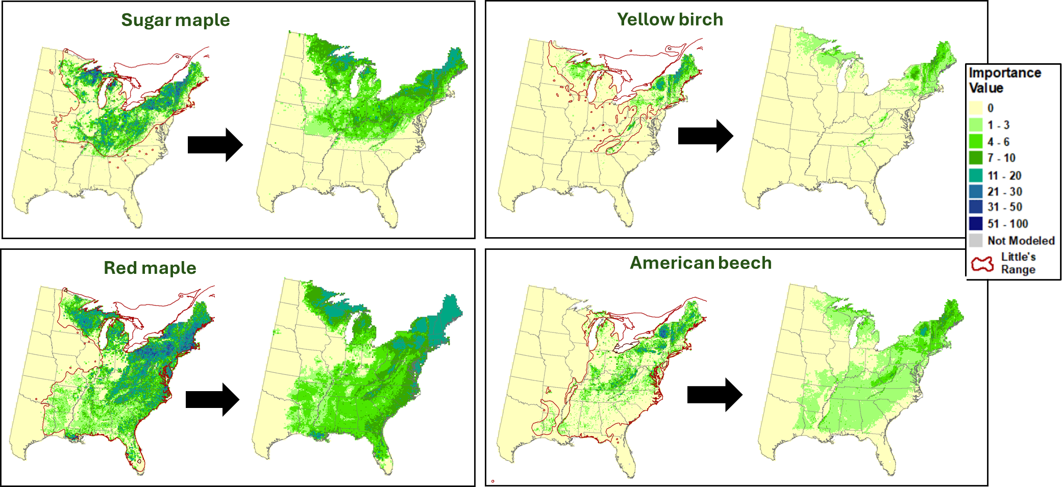
Figure 3-8
Projected species’ suitable habitat shifts for common northern hardwood species from current estimated distributions to a future 2100 distribution for a high emissions climate scenario, using color-coded importance values to represent relative population density
Source: USDA Tree Climate Change Atlas (Iverson et al., 2012; Peters et al., 2020)
Iverson, L. R., Matthews, S. N., Prasad, A. M., & Peters, M. P. (2012). Development of risk matrices for evaluating climatic change responses of forested habitats. Climatic Change, 114(2). https://doi.org/10.1007/s10584-012-0412-x
Peters, M. P., Prasad, A. M., Matthews, S. N., & Iverson, L. R. (2020). Climate change tree atlas (Version 4) [Dataset]. Northern Research Station and Northern Institute of Applied Climate Science, USDA Forest Service. https://www.fs.usda.gov/nrs/atlas/tree/

Slide 10
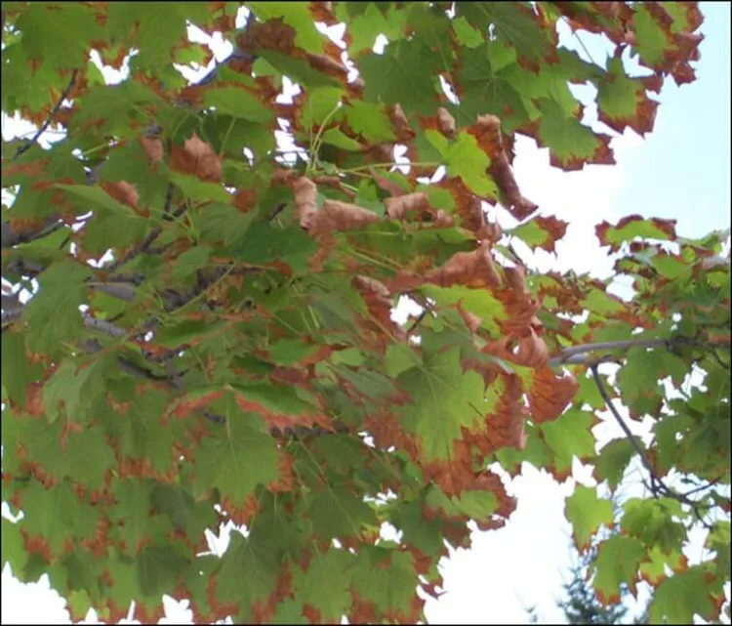
Figure 3-9
Drought-induced marginal leaf scorch on maple trees in Vermont
Source: Ann Hazelrigg, University of Vermont Extension (2025))
Hazelrigg, A. (2025). Drought Stress Affecting Vermont’s Trees and Shrubs. University of Vermont Extension. https://www.uvm.edu/extension/news/drought-stress-affecting-vermonts-trees-and-shrubs

Slide 11
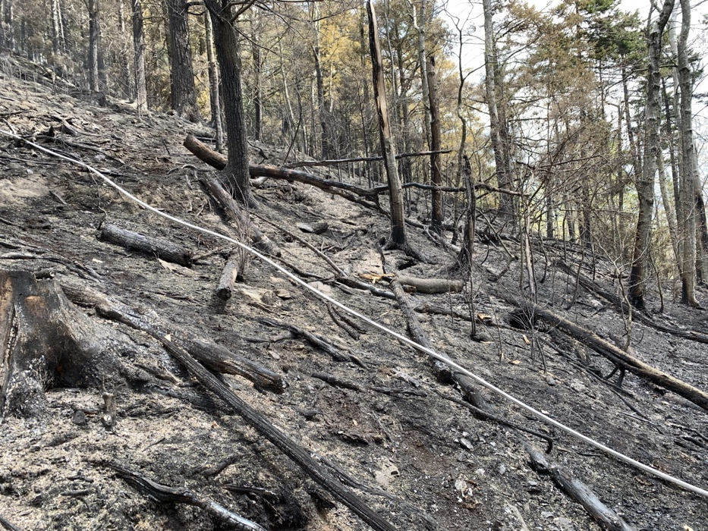
Figure 3-10
A forest after a wildfire in Killington Vermont – this wildfire was human-caused but was likely exacerbated by year-long regional dry conditions
Source: Smith & Wertlieb (2021)
Smith, M. F., & Wertlieb, M. (2021, May 28). As Drought Conditions Persist, Fire Officials Warn Of Lingering Fire Danger. Vermont Public. Vermont Public. https://www.vermontpublic.org/vpr-news/2021-05-28/as-drought-conditions-persist-fire-officials-warn-of-lingering-fire-danger

Slide 12
Figure 3-11
Vermont annual wildfire incidents and acres burned by wildfires from 2006-2024
Source: National Interagency Coordination Center (2006)
National Interagency Coordination Center. (2006). Wildland Fire Summary and Statistics Annual Report (Wildland Fire Summary and Statistics Annual Report) [Dataset]. https://www.nifc.gov/nicc/predictive-services/intelligence

Slide 13
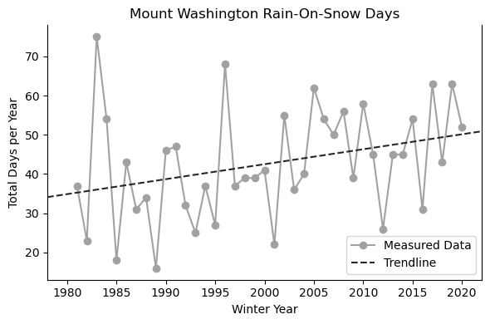
Figure 3-12
Rising occurrences of rain-on-snow events measured in total days, observed at the Mount Washington Observatory, NH from 1980-2020
Source: Data derived from Peachey, 2023; figure adapted from Aldrich, 2025
Peachey, C. (2023). Rain-on-Snow Research. Mount Washington Observatory. https://mountwashington.org/research/current-research-projects/rain-on-snow/
Aldrich, B. (2025, January 29). Forestry Friday: Changing Winters, Evolving Strategies in Forest Winter Operations | Forest Society. https://www.forestsociety.org/blog-post/forestry-friday-changing-winters-evolving-strategies-forest-winter-operations

Slide 14
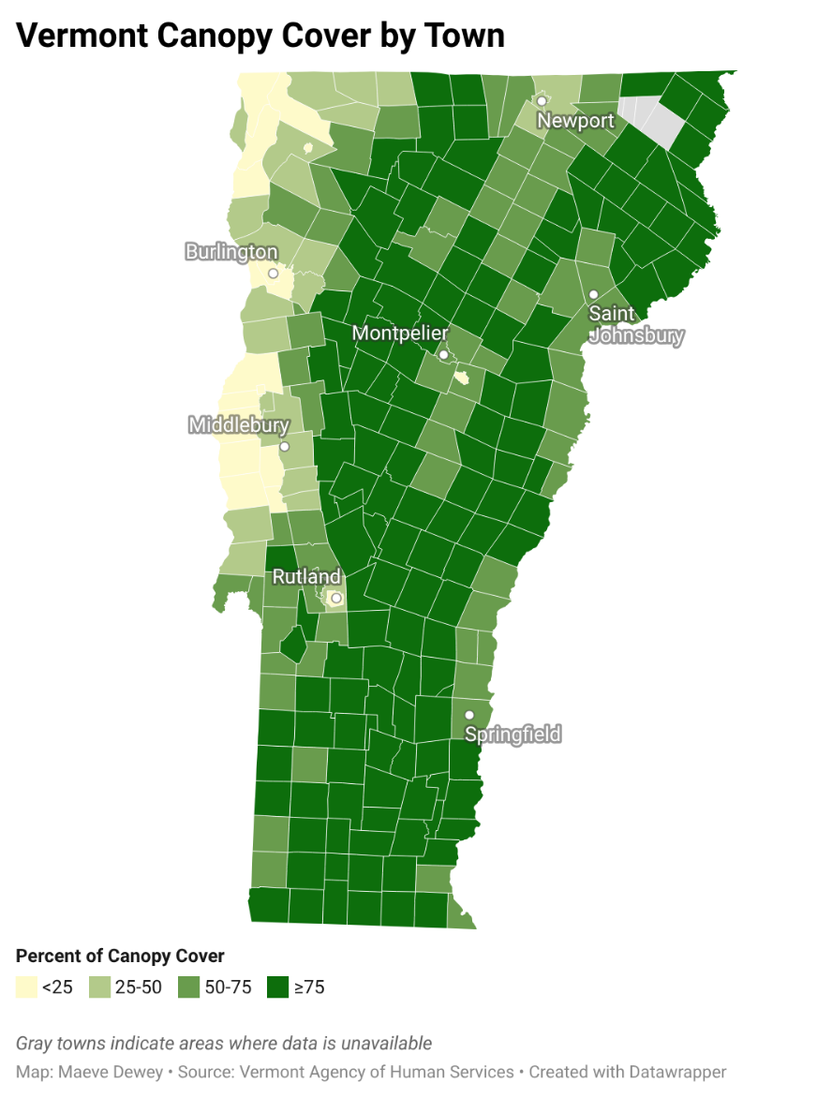
Figure 3-13
Percent of canopy cover in Vermont by town
Source: Vermont Heat Vulnerability Index Feature Layer (VT-AHS, 2023)
Note: Gray towns indicate areas where data is unavailable
VT-AHS. (2023). Heat Vulnerability Index [Feature Layer]. Vermont Open Geodata Portal. https://geodata.vermont.gov/datasets/ahs-vt::vt-data-heat-vulnerability-index/about

Slide 15
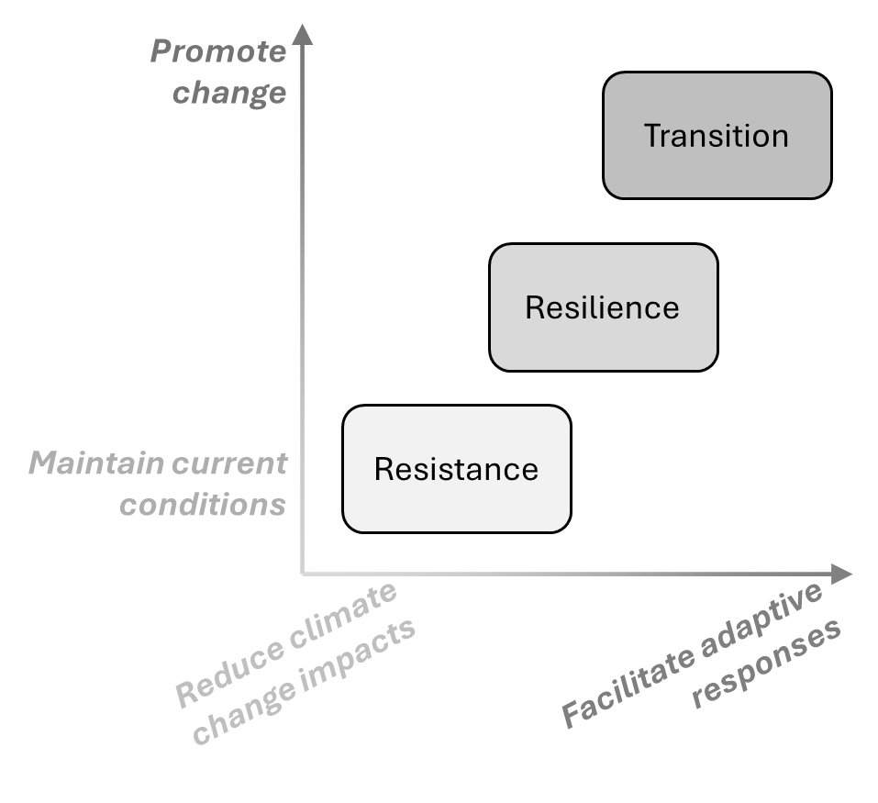
Figure 3-14
Visualization of the Resistance-Resilience-Transition model over two axes – response to climate change (x-axis) and desired future forest state (y-axis)
Source: Figure adapted from similar graphic in (Nagel et al., 2017)
Nagel, L. M., Palik, B. J., Battaglia, M. A., D’Amato, A. W., Guldin, J. M., Swanston, C. W., Janowiak, M. K., Powers, M. P., Joyce, L. A., Millar, C. I., Peterson, D. L., Ganio, L. M., Kirschbaum, C., & Roske, M. R. (2017). Adaptive Silviculture for Climate Change: A National Experiment in Manager-Scientist Partnerships to Apply an Adaptation Framework. Journal of Forestry, 115(3), 167–178. https://doi.org/10.5849/jof.16-039

Slide 16
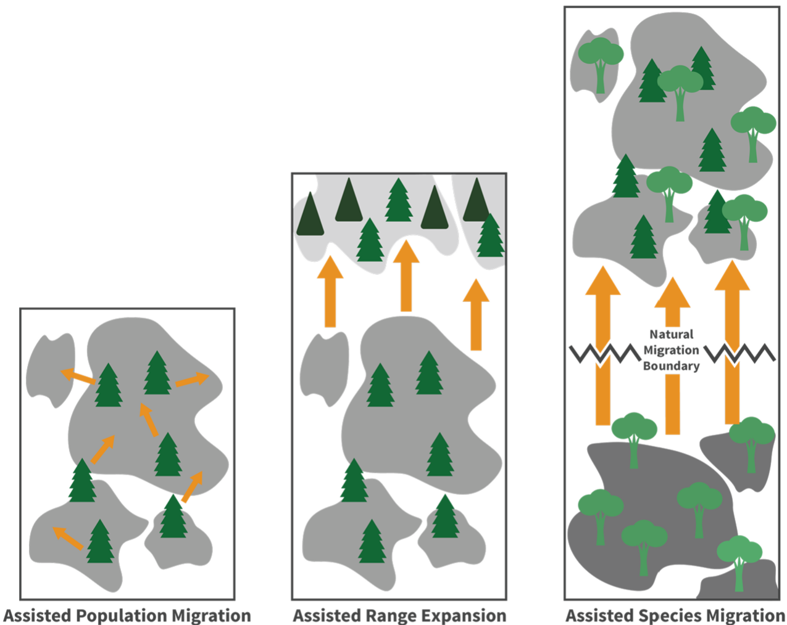
Figure 3-15
Conceptual diagrams of assisted migration techniques
Handler et al. (2023)
Handler, S., Pike, C., St. Clair, B., Abbotts, H., & Janowiak, M. (2023). Assisted Migration. Climate Change Resource Center. https://www.fs.usda.gov/ccrc/topics/assisted-migration

Slide 17
Table 3-1
Productivity factor | Climate change projection and the effect on forests
Nutrient availability | Low nutrient availability slows photosynthesis, reducing growth and resilience. Climate change can intensify nutrient limitations through increased leaching during heavy rainfall events, altered decomposition rates, and shifting nutrient cycling processes. In some ecosystems, warming may accelerate microbial activity and decomposition which temporarily increases nutrient availability, but long-term nutrient depletion may follow.
Water availability | Water shortages reduce productivity by forcing stomatal closure, limiting carbon uptake and nutrient transport, and increasing tree mortality during droughts. Increases in drought frequency and severity will intensify water stress, making water availability one of the strongest predictors of future productivity declines.
Heat stress | Temperatures above physiological tolerance reduce photosynthesis, increase respiration costs, and damage enzymes and cellular structures. Heat stress also intensifies drought by increasing evapotranspiration. Increased temperatures and heat waves from climate change may lead to growth declines, increased carbon losses, and higher tree mortality in heat-susceptible species.
Effects of additional productivity factors beyond growing season length on forests
Sources: Itter et al. (2016); Morin et al. (2018); Norby et al. (2010); Reyer (2015); Thompson (2009); Zhang et al. (2023)

Slide 18
Table 3-2
(1 of 3)
High priority
Insect/Pathogen | Symptoms | Impacted species | Presence in VT | Climate interactions
Asian longhorned beetle (Anoplophora glabripennis) | Bark tunnels, round exit holes, and fallen branches, leading to tree mortality | Hardwood species including maples (Acer spp.), ashes (Fraxinus spp.), birches (Betula spp.), poplars (Populus spp.), among others | Potential threat to VT, but not currently in VT | Suitability in the Northern Hemisphere is predicted to increase
Beech leaf disease (Litylenchus crenatae mccannii) | Premature leaf drop, branch death, and tree mortality | American beech (Fagus grandifolia) | Emerging; detected in four VT counties | Unknown
Butternut canker (Ophiognomonia clavigignenti-juglandacearum) | Cankers cause girdling in twigs, branches, and roots, killing the tree and infecting the nuts | Butternut (Juglans cinerea) | Established; found throughout VT | Climate change exacerbates existing stressors, increasing vulnerability to canker
Emerald ash borer (Agrilus planipennis) | Create S-shaped tunnels behind outer bark and D-shaped exit holes, girdling and killing infected trees | White ash (Fraxinus americana), black ash (Fraxinus nigra), green ash (Fraxinus pennsylvanica) | Established; found throughout VT (except the NE Kingdom) | Northward host species migration due to warming will expand Emerald ash borer range
Hemlock wooly adelgid (Adelges tsugae) | Deplete stored carbohydrate reserves, causing premature needle drop and carbon starvation, leading to tree mortality | Eastern hemlock (Tsuga canadensis) | Emerging; detected in two counties | Expanding range—warmer winters may allow expansion into new habitats, poses severe threat combined with elongate hemlock scale
Invasive insects and pathogens affecting Vermont trees, grouped by priority: high priority threats are either established, likely to emerge, or projected to worsen under climate change and have been highlighted by state or federal agencies, medium are less widespread or damaging but still actively monitored, while low are not widely monitored
Sources: Berrini (2023); Hahn & Krischik (2018); Halman (2024); Keller et al. (2024); Li et al. (2025); Moore et al. (2025); Stephanson & Ribarik Coe (2017); Vermont Invasives (2025); VT Agency of Agriculture (2025); Zhou et al. (2021)

Slide 19
Table 3-2
(2 of 3)
Medium priority
Insect/Pathogen | Symptoms |  | Impacted species | Presence in VT | Climate interactions
Balsam wooly adelgid (Adelges piceae) |  | Stunted tree growth, white woolly tufts, premature needle drop | True firs (Abies spp.), especially balsam and Fraser fir (Abies balsamea, fraseri) | Established; found throughout VT | Controlled by cold temperatures, warmer winters could increase population, impact on firs has a cascading trophic effect
Beech bark disease (Nectria fungi) and beech scale insect (Cryptococcus fagisuga insect) |  | Attacks bark, creating a weak spot for fungus to infect, weakening the tree, often leading to mortality of mature trees, and prolific stump and root sprouting | American beech (Fagus grandifolia) | Established; found throughout VT | Warmer winters and less snowpack will increase survival
Chestnut blight (Cryphonectria parasitica) |  | Spores infect tree through existing wounds, cankers typically kill trees within two years | American chestnut (Castanea dentata) | Established; found throughout VT | Unknown
Dutch elm disease (Ophiostoma novo-ulmi) |  | Blocks water and nutrient flow, girdling and killing the tree | American elm (Ulmus americana) | Established; found throughout VT | Climate change exacerbates existing stressors, increasing vulnerability
Spongy moth (Lymantria dispar dispar) |  | Occur in outbreak cycles, causing heavy defoliation, many consecutive years of defoliation will result in tree death | Deciduous, some conifer, mostly oaks (Quercus spp.) and sugar maple (Acer saccharum) | Established; found throughout VT | Oak populations are shifting northward; drought thought to increase populations, but heavy rain could also decrease them, defoliation combined with drought stress increases chances of oak mortality
Invasive insects and pathogens affecting Vermont trees (continued)
Sources: Berrini (2023); Hahn & Krischik (2018); Halman (2024); Keller et al. (2024); Li et al. (2025); Moore et al. (2025); Stephanson & Ribarik Coe (2017); Vermont Invasives (2025); VT Agency of Agriculture (2025); Zhou et al. (2021)

Slide 20
Table 3-2
(3 of 3)
Low priority
Insect/Pathogen | Symptoms | Impacted species | Presence in VT | Climate interactions
Elongate hemlock scale (Fiorinia externa) | Premature needle drop, branch dieback, and tree mortality | Primarily eastern hemlock (Tsuga canadensis) | Established; found in some counties in VT | Mixed infestation of adelgid and scale can hasten hemlock stand decline, warming winters increase likelihood of overwinter survival and expand northern range
Elm zigzag sawfly (Aproceros leucopoda) | Zigzag patterns in leaves, heavy defoliation over time leaves tree vulnerable and stressed | Elms (Ulmus spp.) | Emerging, threat unclear; found in some counties in VT | Stressed trees are more vulnerable to disturbances such as drought
Red pine scale (Matsucoccus matsumurae) | Feed on wood [phloem] in the crown and can kill tree, heavy infestation appears as a white, cottony mass | Red pine (Pinus resinosa) | Emerging, monitoring priority, co-morbidity for red pine in VT, detected in Washington County as of 2024 | Primarily wind-distributed, intolerant to cold, as winters become warmer, range is expected to spread
Invasive insects and pathogens affecting Vermont trees (continued)
Sources: Berrini (2023); Hahn & Krischik (2018); Halman (2024); Keller et al. (2024); Li et al. (2025); Moore et al. (2025); Stephanson & Ribarik Coe (2017); Vermont Invasives (2025); VT Agency of Agriculture (2025); Zhou et al. (2021)

Slide 21
Table 3-2
(Extended Bibliography)
Berrini, N. (2023, December 14). Hemlock-loving invasive insects are moving north. Vermont Land Trust. https://vlt.org/2023/12/14/hemlock-wooly-adelgid/
Hahn, J., & Krischik, V. (2018). Forest tent caterpillars. University of Minnesota Extension. https://extension.umn.edu/yard-and-garden-insects/forest-tent-caterpillars
Halman, J. (2024). Beech Leaf Disease Expands into Vermont [Press Release]. Department of Forests, Parks and Recreation. https://fpr.vermont.gov/news/beech-leaf-disease-expands-vermont
Keller, A. B., Handler, S. D., USDA Northern Forests Climate Hub, Northern Institute of Applied Climate Science, & Nature Conservancy (U.S.). (2024). Non-native invasive earthworms in the Midwest and Eastern United States: A primer. USDA Northern Forests Climate Hub. https://doi.org/10.32747/2024.8633529.ch
Li, D., Potgieter, L. J., Aronson, M. F. J., Axmanová, I., Baiser, B., Carboni, M., Celesti-Grapow, L., Knapp, S., Kühn, I., Lacerda de Matos, A. C., Lososová, Z., Montaño-Centellas, F. A., Pyšek, P., Richardson, D. M., Trotta, L. B., Zenni, R. D., Cilliers, S. S., Clarkson, B. D., Davis, A. J. S., … Cadotte, M. W. (2025). GUBIC: The global urban biological invasions compendium for plants. Ecological Solutions and Evidence, 6(1), e70020. https://doi.org/10.1002/2688-8319.70020
Moore, C., Aukema, B. H., Leone, J. B., Jetton, R. M., Petrice, T. R., Ambourn, A., & Venette, R. C. (2025). Survival of elongate hemlock scale (Hemiptera: Diaspididae) with prolonged cold exposure: overwintering mortality risk across North America. Environmental Entomology, nvaf096. https://doi.org/10.1093/ee/nvaf096
Stephanson, C. A., & Ribarik Coe, N. (2017). Impacts of Beech Bark Disease and Climate Change on American Beech. Forests, 8(5), 155. https://doi.org/10.3390/f8050155
Vermont Invasives. (2025). Invasive Plants are Spreading into Vermont [Vermont Invasives]. https://www.vtinvasives.org/news-events/news/invasive-plants-are-spreading-into-vermont
VT Agency of Agriculture. (2025). Vermont Introduced Pests. Vermont Agency of Agriculture, Food & Markets. https://agriculture.vermont.gov/public-health-agricultural-resource-management-division/plant-health-and-pest-management/vermont
VT Agency of Agriculture. (2025). Vermont Introduced Pests. Vermont Agency of Agriculture, Food & Markets. https://agriculture.vermont.gov/public-health-agricultural-resource-management-division/plant-health-and-pest-management/vermont

