Slide 1


Climate Change in Vermont
Hannah Peplinski, Atticus Tarleton, Zita Sapir, Sandrine Dincki, Grace McNally, Gillian L. Galford
Recommended Chapter Citation:
Peplinski, H., Tarleton, A., Sapir, Z., Dincki, S., McNally, G., Galford, G.L., 2026, Climate Change in Vermont. In Galford, G.L., Balerna, J.A., Turner H., Sardonis, A., Peplinski, H. (Eds), The Vermont Climate Assessment 2025. Burlington, Vermont: Climate Measurements Center of Excellence, Gund Institute for Environment at the University of Vermont. DOI: 10.5281/zenodo.20272849.
Accessed online at https://vtclimate.org

Slide 2
2.1 Executive Summary

Slide 3
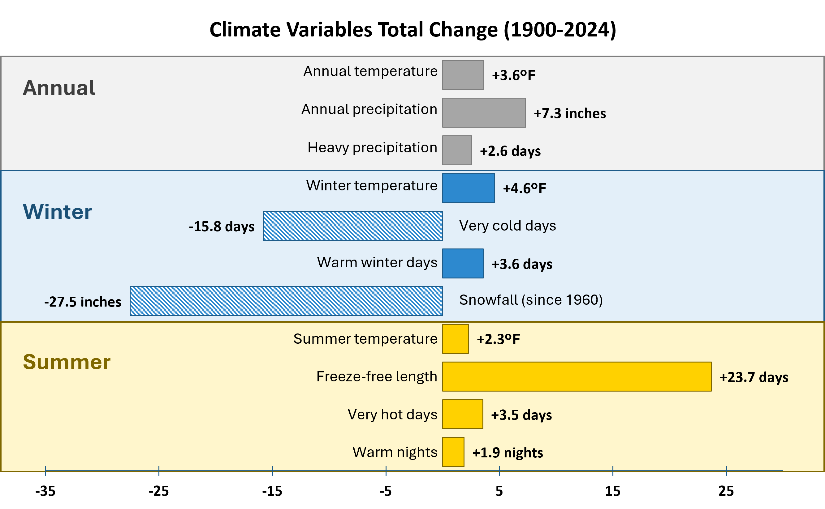
Figure 2-1 Total change of annual and seasonal metrics across Vermont comparing the near-term average (2020–2024) to the long-term average (1900–1909). Metrics with increases in frequency or severity extend right with positive values, while metrics with decreases extend left with negative values. Snowfall is calculated as the mid-term change (1960–2024) due to lack of longer-term data
Source: NOAA Regional Climate Centers (2026)

Slide 4
2.2 Climate Change and Emissions

Slide 5
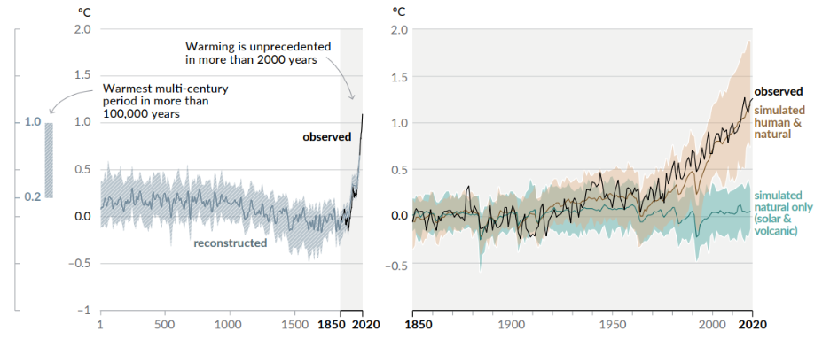
Figure 2-2 (A) Changes in global surface temperature (°C, decadal averages) from reconstructed historical climate data (1AD–2000) and observed data (1850–2020); (B) Observed changes in global surface temperature (°C), 1850–2020 (relative to 1850–1900; annual averages) compared to simulated climate models of natural only and human and natural influences
A.)
B.)
Source: IPCC (2023)

Slide 6
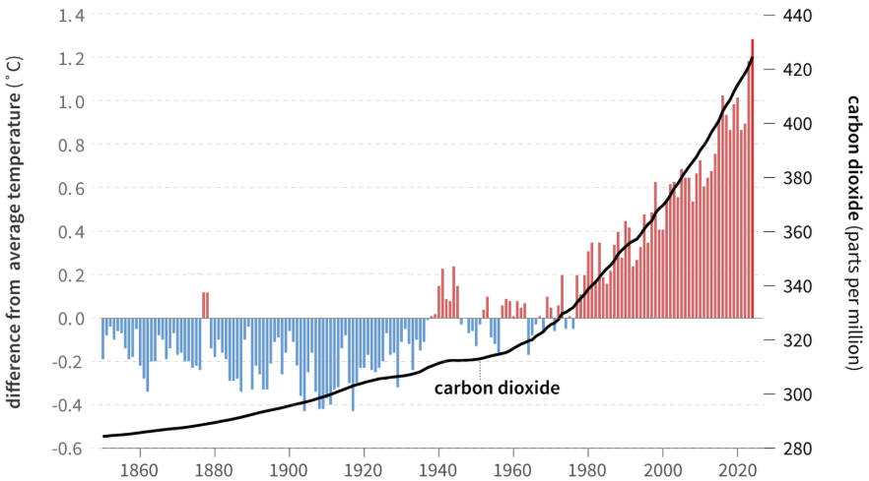
Figure 2-3 Average annual global temperatures (°C) anomalies (y-axis, left). Red bars indicate temperatures that were above the twentieth-century average (i.e., warmer-than-average years), while blue bars indicate temperatures that were below the twentieth-century average (i.e., colder-than-average years). The black line shows atmospheric carbon dioxide (parts per million; y-axis, right) from 1850–2024
Source: NOAA (2025b)

Slide 7
2.3 Methods

Slide 8
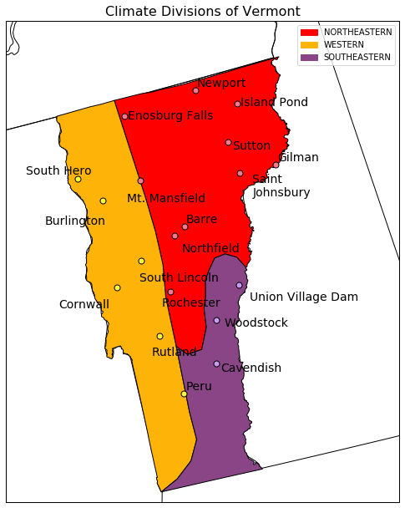
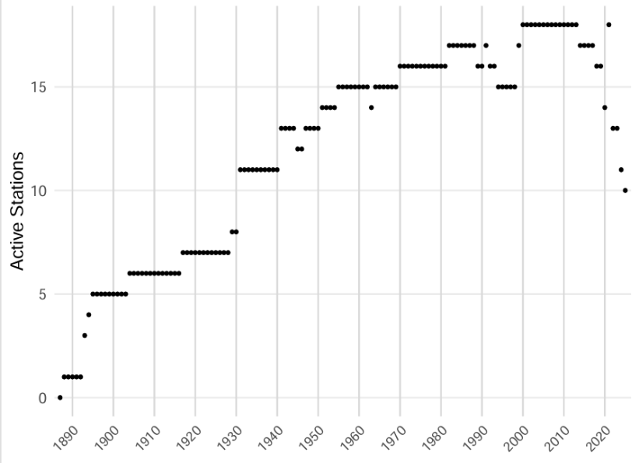
A.) Stations & Climate Divisions
B.) Active NWS Stations (ALL)
Figure 2-4 (A) Vermont station locations, climate divisions, and the cities nearest the station locations. (B) The count of active National Weather Service (NWS) Cooperative Observer Program stations, 1890–2024
Source: NOAA Regional Climate Centers (2026)
Note: Climate divisions are defined by the National Weather Service and indicated by the differently shaded divisions
Climate Division | Counties included
Northeastern | Caledonia, Essex, Orange, Orleans, Washington
Southeastern | Bennington, Windham, Windsor
Western | Addison, Chittenden, Franklin, Grand Isle, Lamoille, Rutland
Table 2-1 Counties located within each NWS climate division
Source: NOAA Regional Climate Centers (2026)

Slide 9
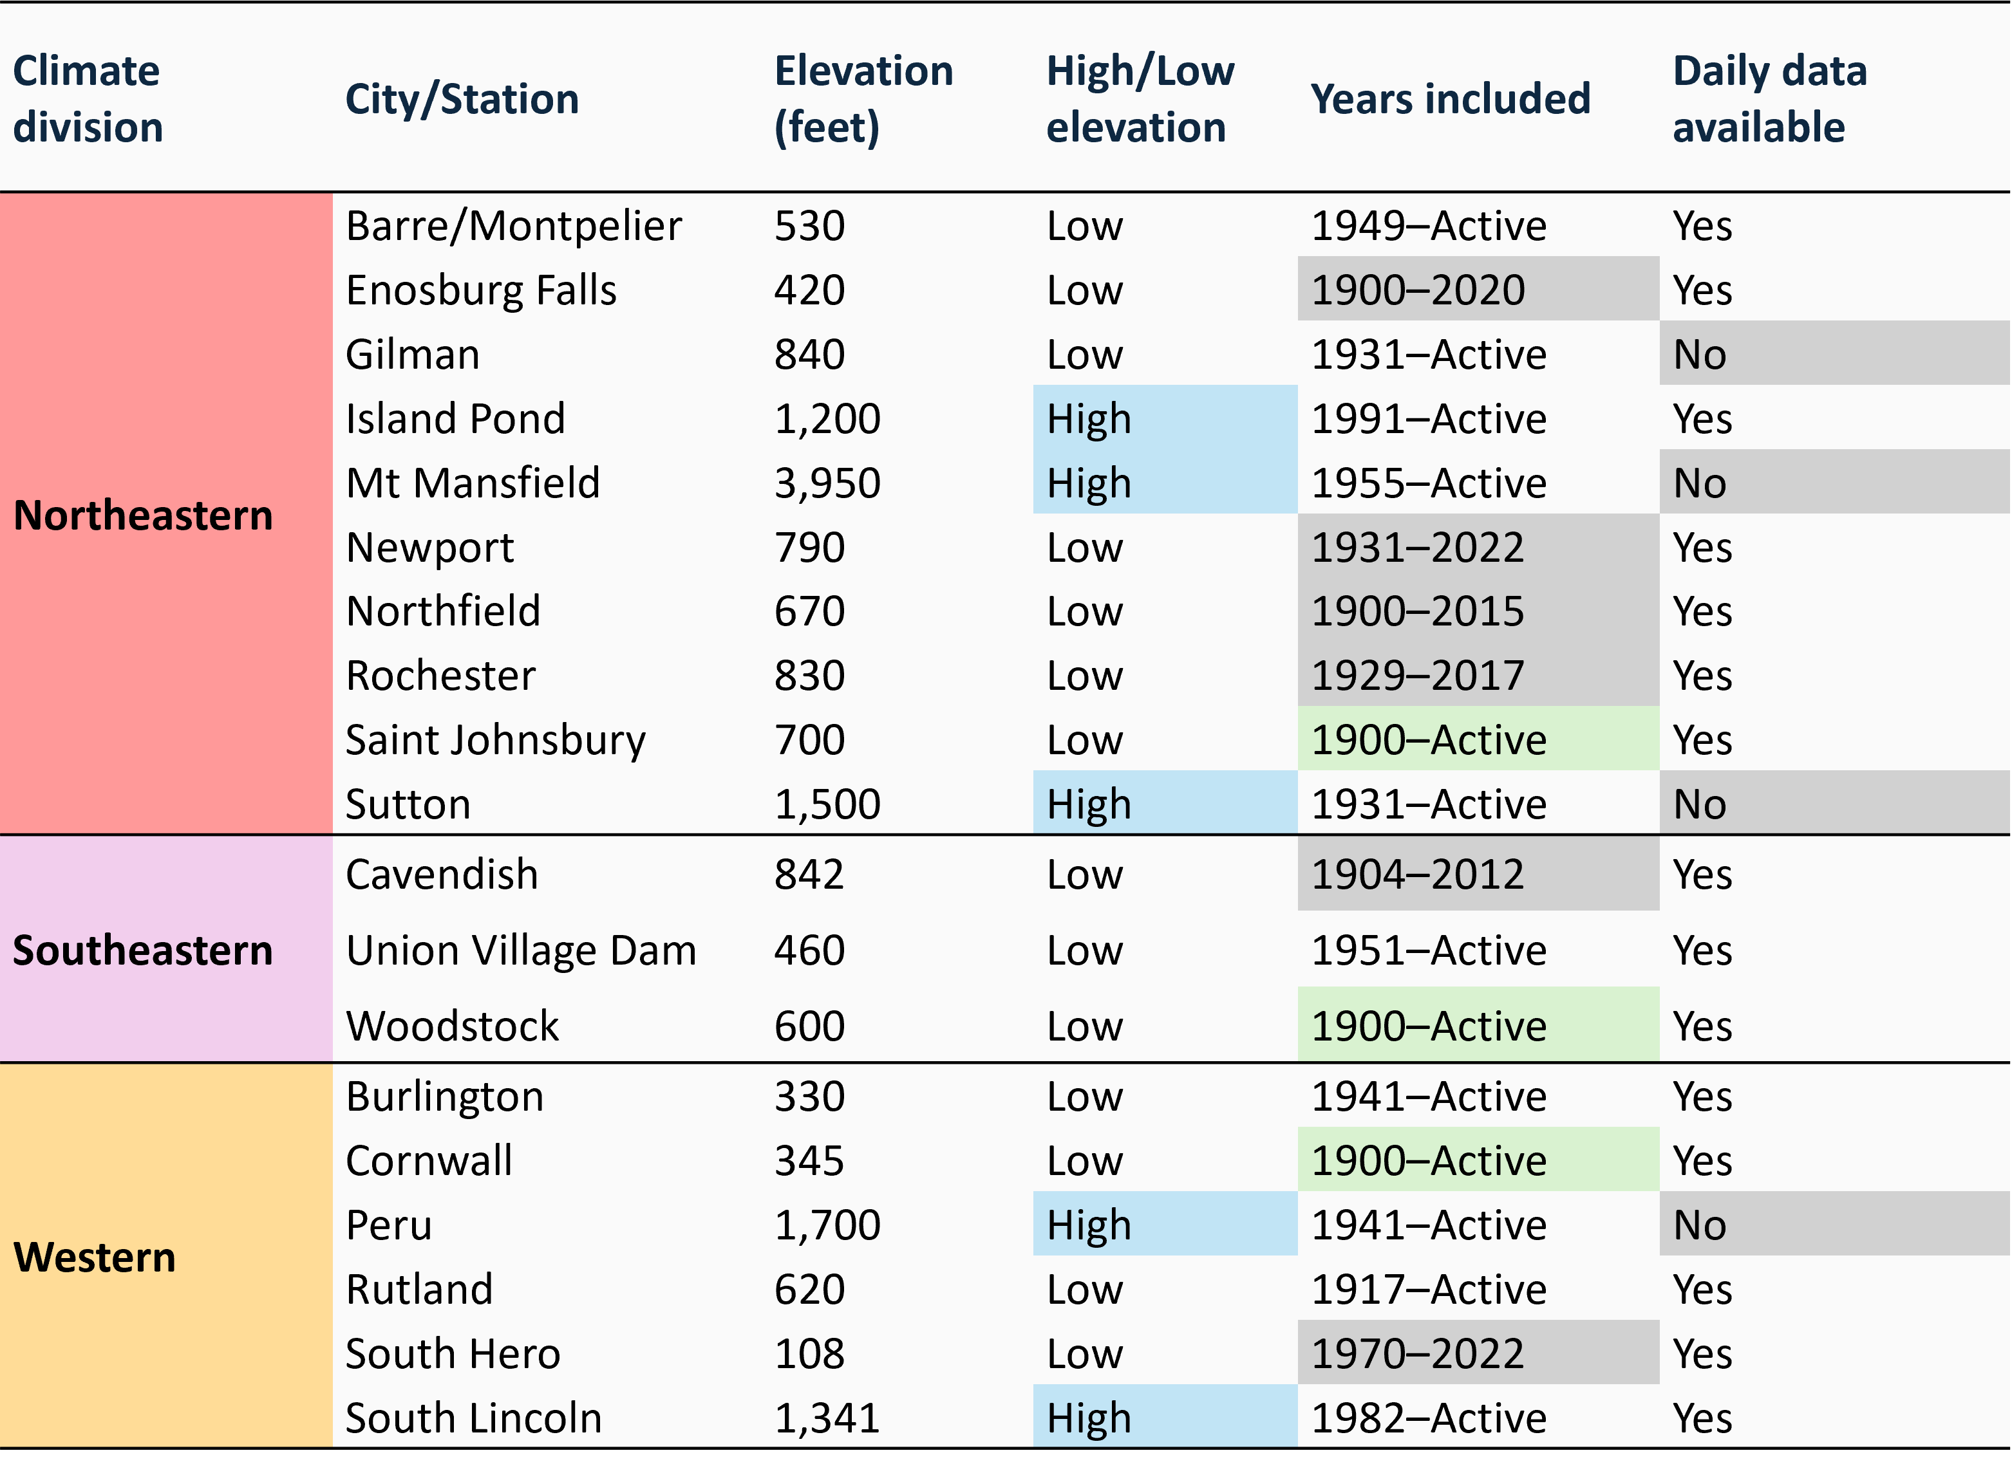
Table 2-2 Characteristics of 19 weather stations in Vermont used for climate analysis
Source: NOAA Regional Climate Centers (2026)
Note: 19 weather stations used in VCA 2021 (Galford et al., 2021) were analyzed in this report. Stations are categorized by their representative climate division, the nearest city/town to the station chosen (often sharing the same name as the station), their elevation, whether that elevation is high (blue) or low (white) based on a 1,000 feet (ft) threshold, and the range of years each station contributed data for use in report analyses. Stations that are currently active and contributed data through 2024 are labelled as “Active,” and those highlighted as green contributed annual data for the entire time period (1900–2024). Gray colored cells under “Years included” indicate the station is no longer active as of 2024. Reliable daily data needed for temperature and precipitation extremes analyses were not available for 4 stations: Gillman, Mt. Mansfield, Sutton, and Peru. Stations were excluded from certain analyses if missing more than 5 days/month, 300 days/year, or 3 years/decade

Slide 10
2.4 Temperature

Slide 11
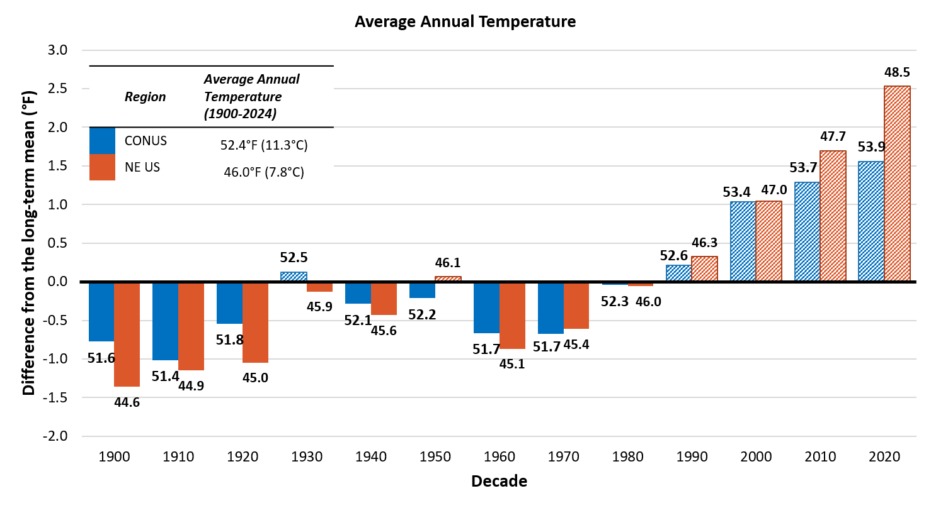
2.4.1 Regional Temperature
Figure 2-5 Average annual temperature (ºF) by decade in the continental United States (U.S.; blue) and Northeast U.S. (orange), and their diversion from the long-term mean (1900-2024).
Source: NOAA NECI, National and Regional Time Series (2026)
Note: Averages calculated using a 12-month timescale annually, then by decade using data consolidated in the Average Temperature parameter with no filters and including all months, years 1900–2024. Long-term average is indicated by the horizontal axis (y=0), for CONUS this axis represents an average of 52.4ºF(11.3ºC), while the axis represents an average of 46.0ºF (7.8ºC). Data labels above each bar indicate the decade’s average value, bar heights reflect precise underlying values; labels are rounded to one decimal place

Slide 12
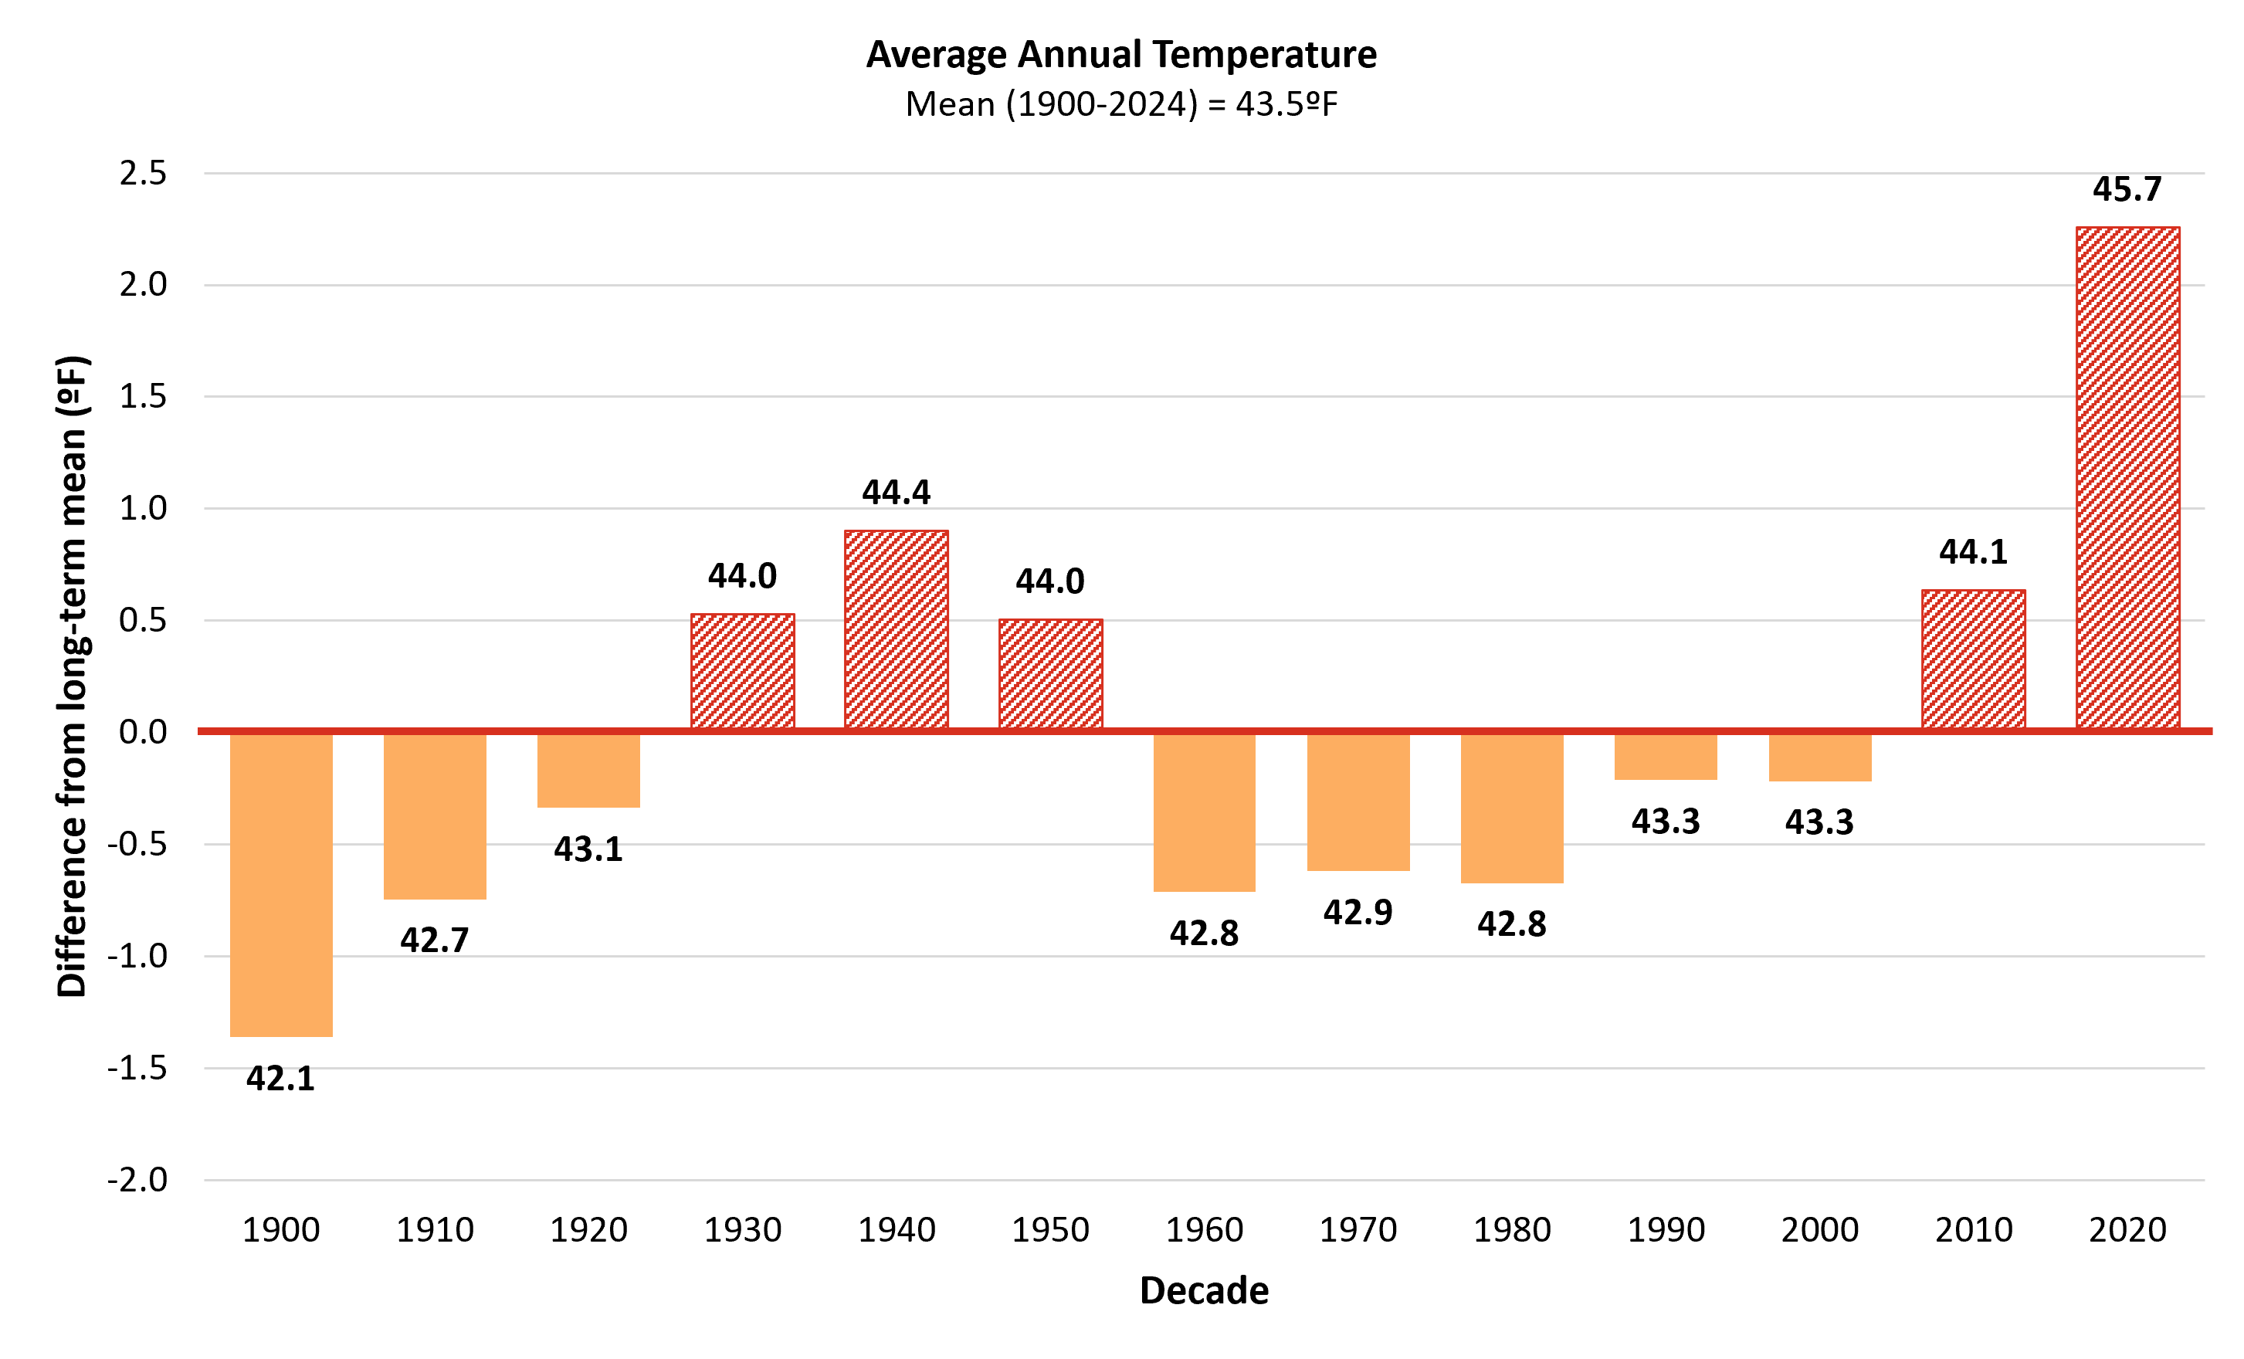
2.4.1 Annual Temperature
Figure 2-6 Decadal average annual temperature compared to the long-term average (1900–2024)
Source: NOAA Regional Climate Centers (2026)
Note: Long-term average annual temperature is indicated by the horizontal axis (y=0), equaling 43.5ºF (6.4ºC). Decades above the long-term average are red and striped, while decades below are orange and solid. Data labels above each bar indicate the decade’s average value, bar heights reflect precise underlying values; labels are rounded to one decimal place

Slide 13
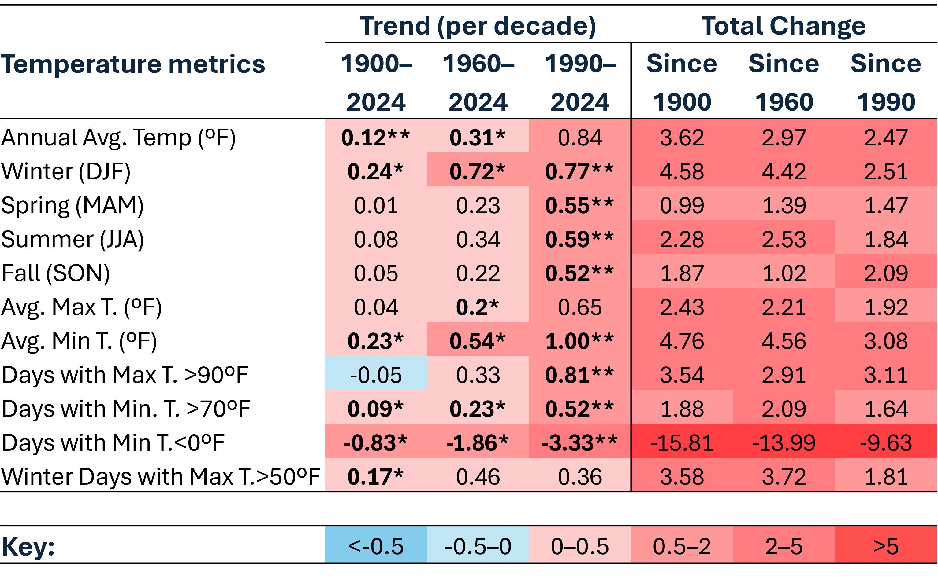
Table 2-3 Temperature trends per decade and total changes (ºF) including average annual and seasonal temperatures and extreme temperature events (1900–2024).
Source: NOAA Regional Climate Centers (2026)
Note: Temperature trends per decade were calculated using Sen’s slope on decadal averages since 1900, 1960, and 1990. Total change in temperature variables was calculated as the difference between the first decade of the targe period (1900–1909, 1960–1969, and 1990–1999), and the most recent half-decade (2020–2024). *=statistically significant at 95% confidence interval; **=statistically significant at 90% confidence interval. Colors inverted for Days with Min T.<0 ºF (cold days) to show warming trend.

Slide 14
2.4.3 Winter Temperature

Slide 15
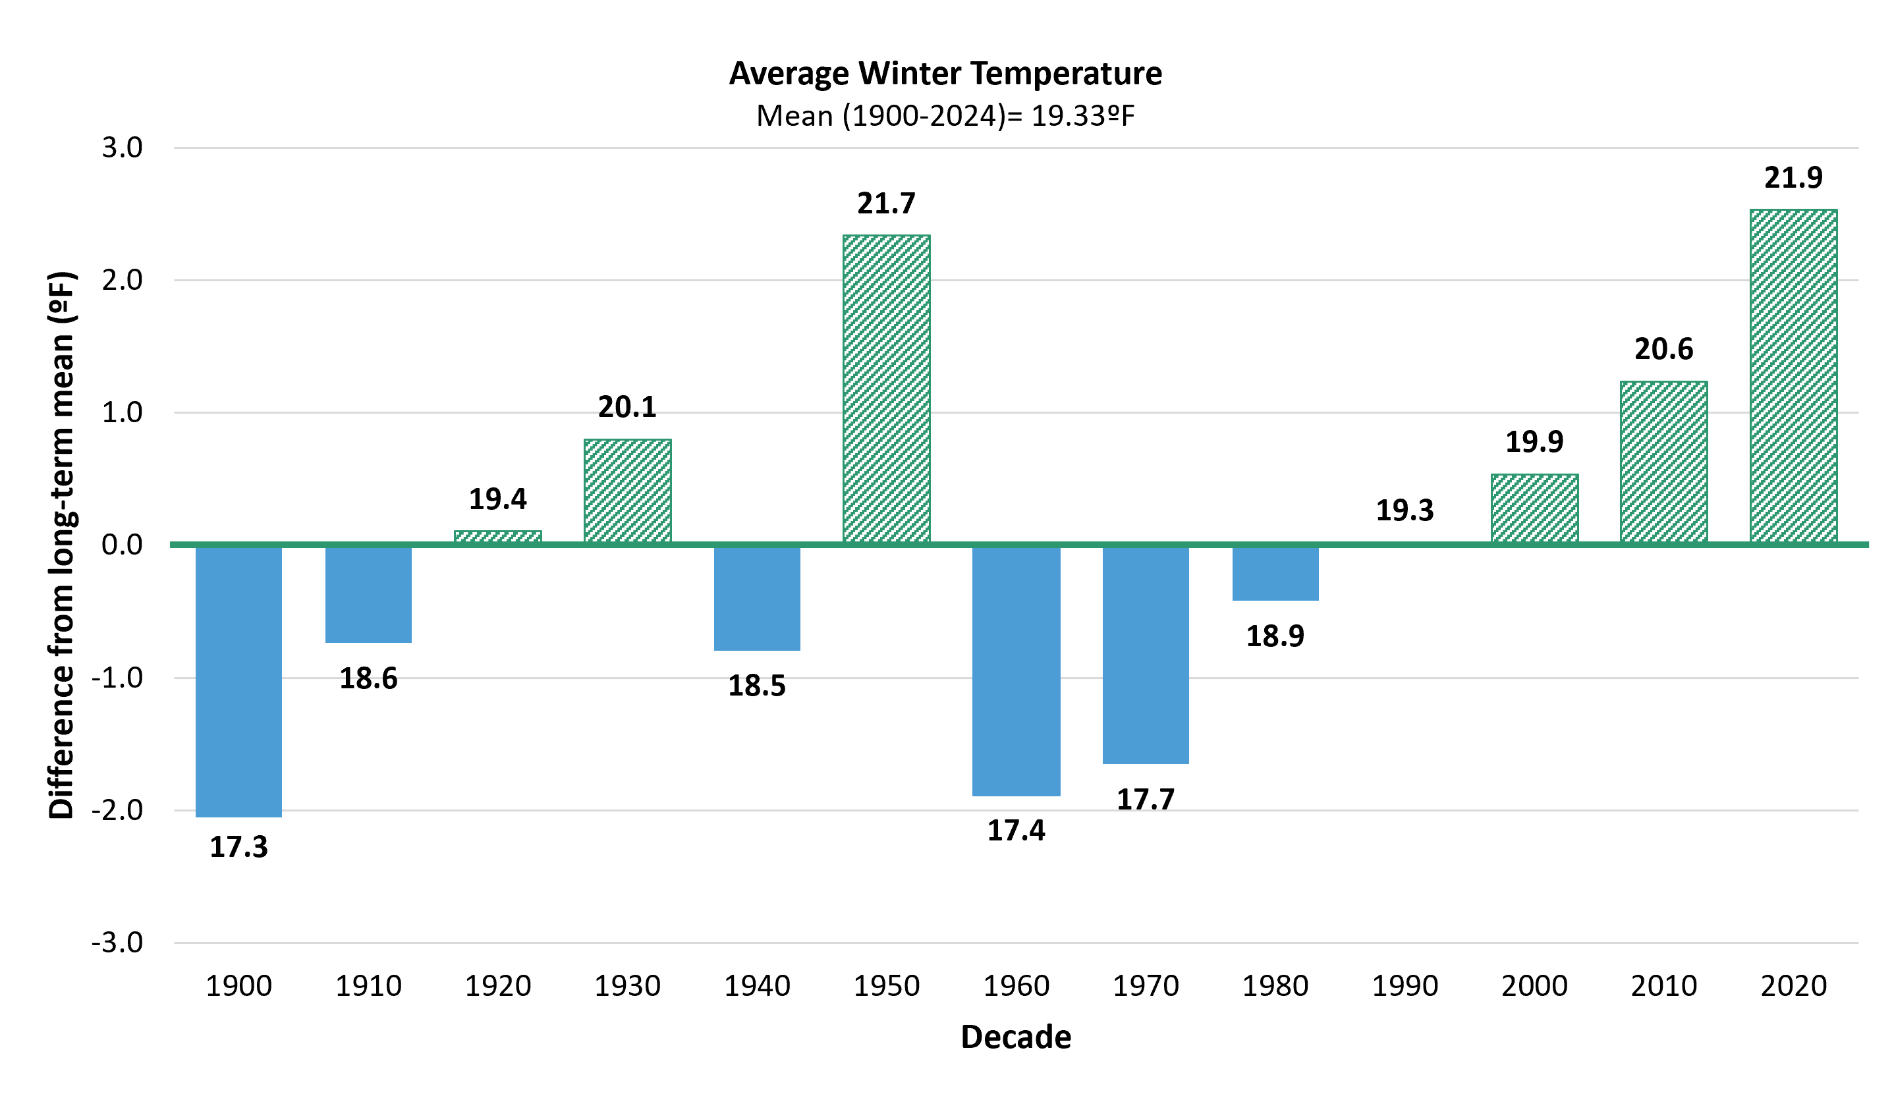
Figure 2-7 Decadal average annual winter temperature compared to the long-term average (1900–2024)
Source: NOAA Regional Climate Centers (2026)
Note: Long-term average winter temperature is indicated by the horizontal axis (y=0), equaling 21.4ºF (-5.9ºC). Decades above the long-term average green and striped, while decades below are blue and solid. Data labels above each bar indicate the decade’s average value, bar heights reflect precise underlying values; labels are rounded to one decimal place

Slide 16
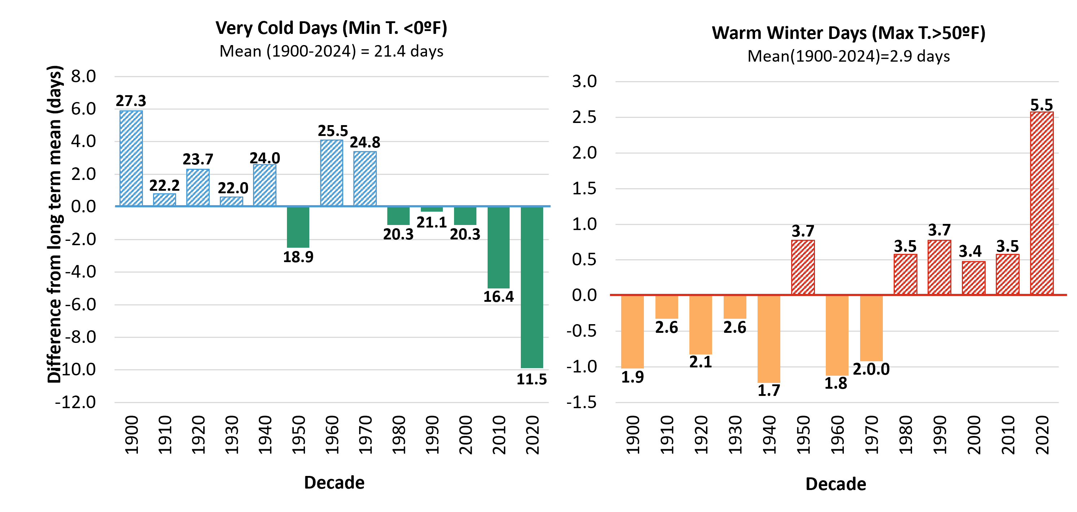
Figure 2-8 Decadal average annual frequencies of winter temperature extremes compared to the long-term average (1900–2024)
Source: NOAA RCC ACIS dataset (accessed 2026)
Note: Long-term average is indicated by the horizontal axis (y=0). For warm winter days this axis represents an average of 2.9 days/year; for very cold days, this axis represents an average of 21.4 days/year. Decades above the long-term average are striped, while decades below are solid. Data labels above each bar indicate the decade’s average value, bar heights reflect precise underlying values; labels are rounded to one decimal place

Slide 17
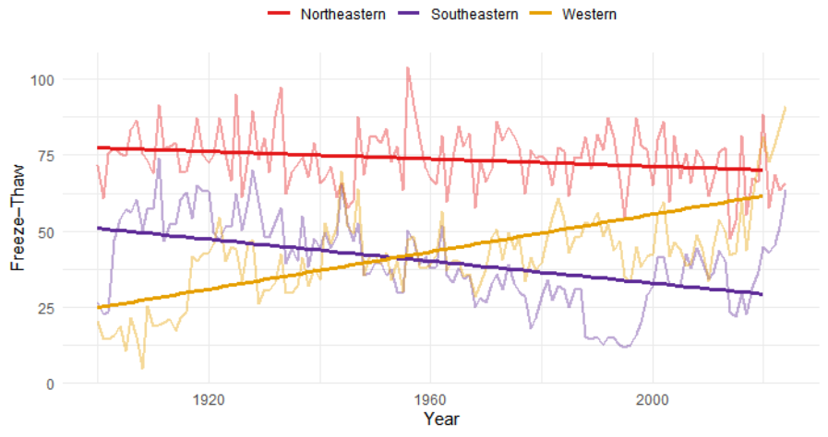
Figure 2-9 Annual frequency of freeze thaw days in Vermont by climate division for the Northeastern (red), Southeastern (purple), and Western (yellow) divisions (1900–2024)
Source: NOAA Regional Climate Centers (2026)
Note: Annual frequency of freeze-thaw days defined when the daily temperature minimum is less than 28ºF (-2ºC), and the daily maximum is greater than 32ºF (0ºC)
Supplemental Table: Trends and total changes of freeze-thaw days
Freeze-thaw trends (first three columns) for each division calculated as the Sen Slope of decadal averages since 1900, 1960 and 1990. Total change in freeze-thaw frequency (last three columns) between the average of each variable across the first decade of the defined annual range (1900-1909, 1960-1969, and 1990-1999), and the most recent half decade (2020-2024). A (*) indicates a significant trend at 95%
 | Trend (per decade) |  |  | Trend change
 | 1900-2024 | 1960-2024 | 1990-2024 | Since 1900 | Since 1960 | Since 1990
ALL Regions | -0.35 | -0.34 | -0.46 | 0.38 | -2.31 | -1.31
Northeast | -0.57 | 0.98 | -2.8 | -6.55 | -3.54 | -7.39
Southeast | -2.35* | 1.69 | 9.62 | 4.14 | 13.86 | 33.66
West | 2.59* | 3.18 | 8.44 | 65.39 | 42.79 | 37.43

Slide 18
2.4.4 Summer Temperature

Slide 19
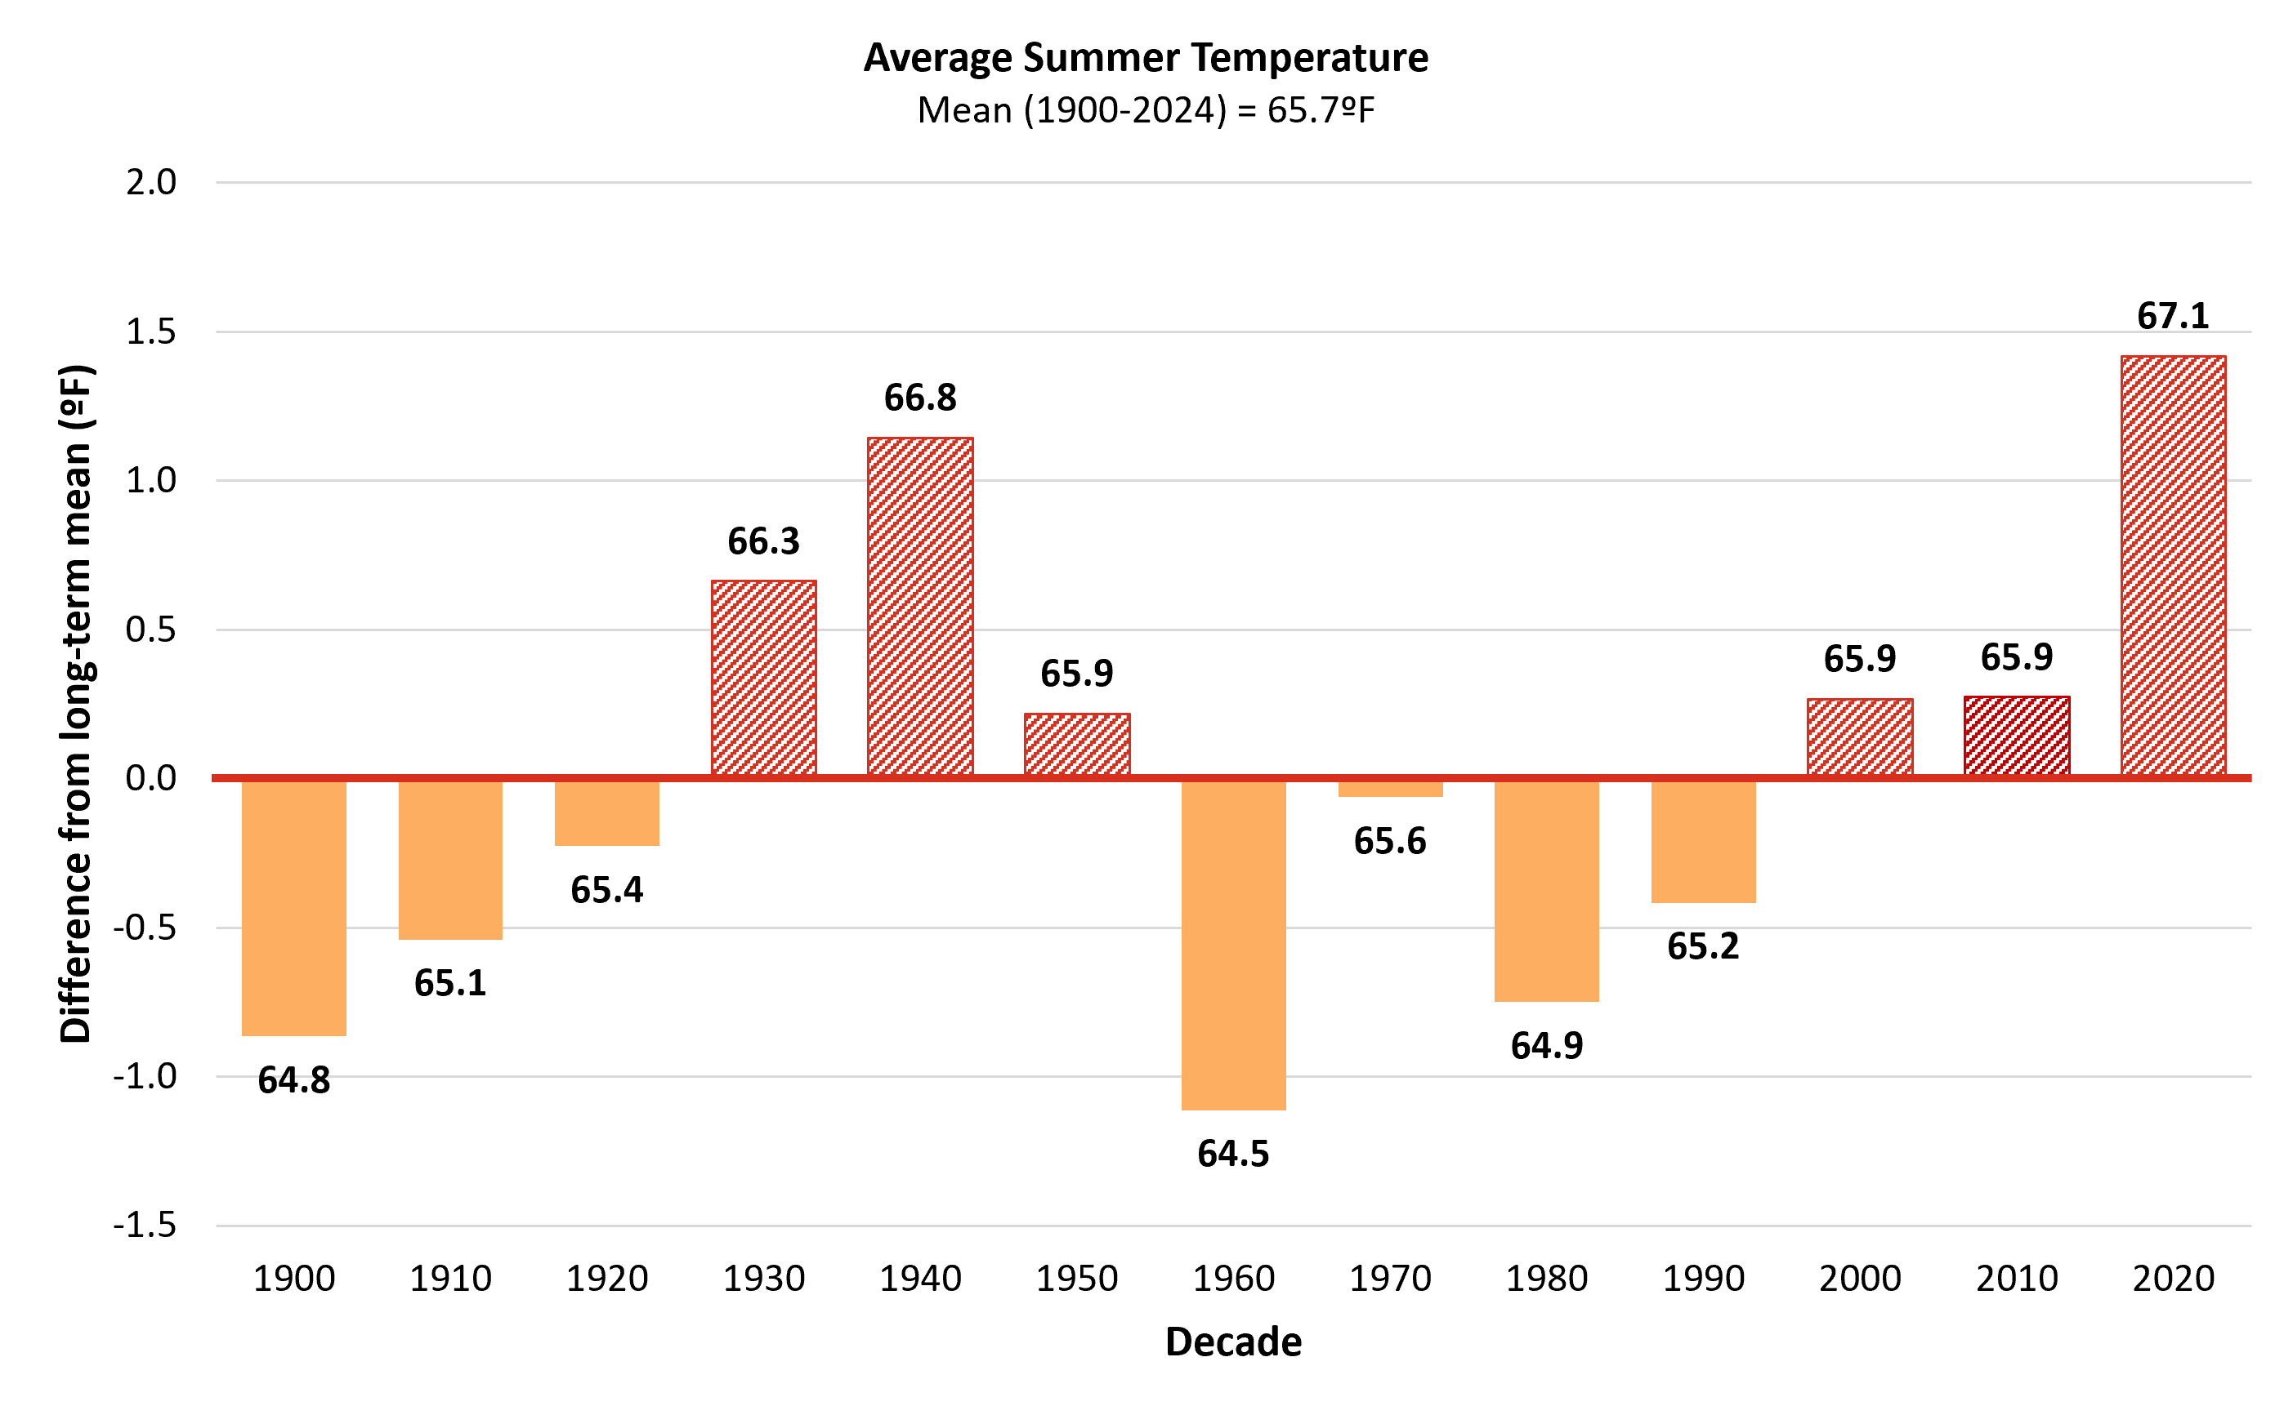
Figure 2-10 Decadal average annual summer temperature (JJA) compared to the long-term average (1900–2024)
Source: NOAA Regional Climate Centers (2026)
Note: Long-term average summer temperature is indicated by the horizontal axis (y=0), equaling 67.5ºF (19.7ºC). Decades above the long-term average are red and striped, while decades below are orange and solid. Data labels above each bar indicate the decade’s average value, bar heights reflect precise underlying values; labels are rounded to one decimal place

Slide 20
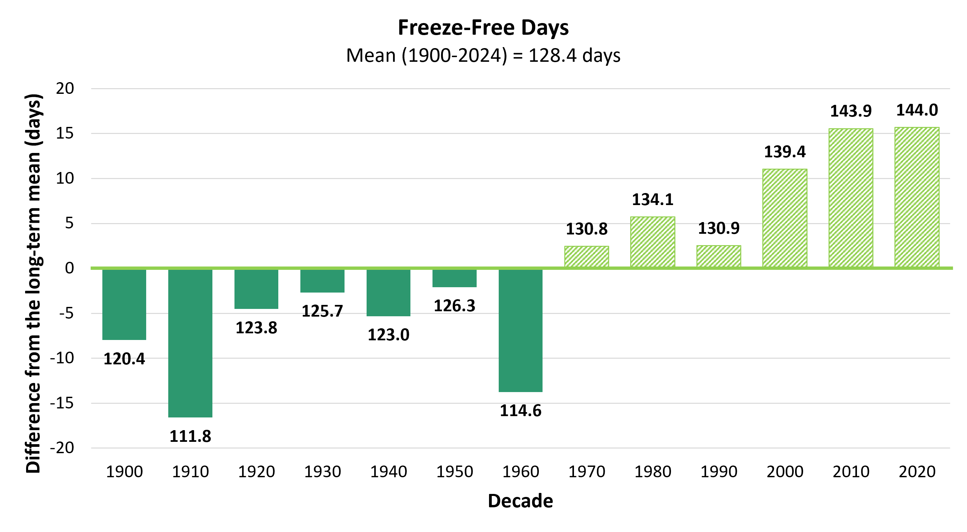
Figure 2-11 Decadal average length of the longest freeze-free period (measured in days) per year in Vermont, the horizontal line is the overall average (128 days per year) from 1900–2024
Source: NOAA Regional Climate Centers (2026)
Note: Long-term average freeze-free length is indicated by the horizontal axis (y=0), equaling 128.4 days. Decades above the long-term average are striped, while decades below are solid. Data labels above each bar indicate the decade’s average value, bar heights reflect precise underlying values; labels are rounded to one decimal place

Slide 21
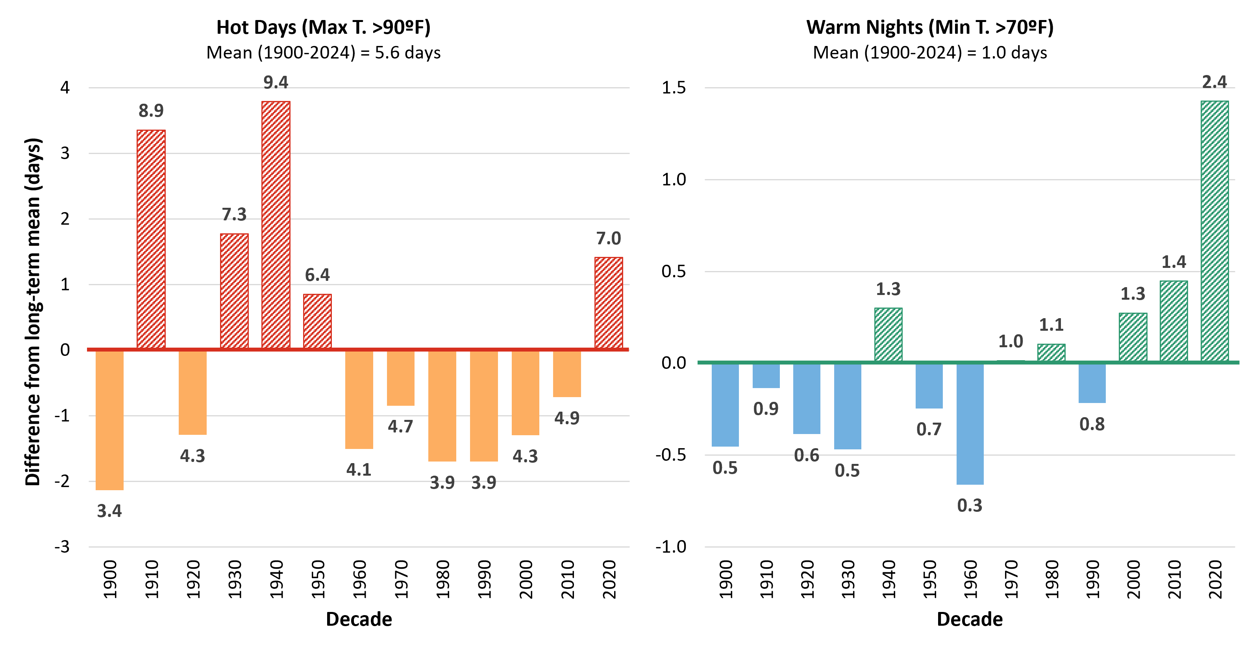
Figure 2-12 Decadal average annual frequencies of summer temperature extremes compared to the long-term average (1900–2024)
Source: NOAA RCC ACIS dataset (accessed 2026)
Note: Long-term average is indicated by the horizontal axis (y=0). This axis represents an average of 5.6 days/year for extremely hot days and an average of 1.0 days/year for warm nights. Data labels above each bar indicate the decade’s average value, bar heights reflect precise underlying values; labels are rounded to one decimal place

Slide 22
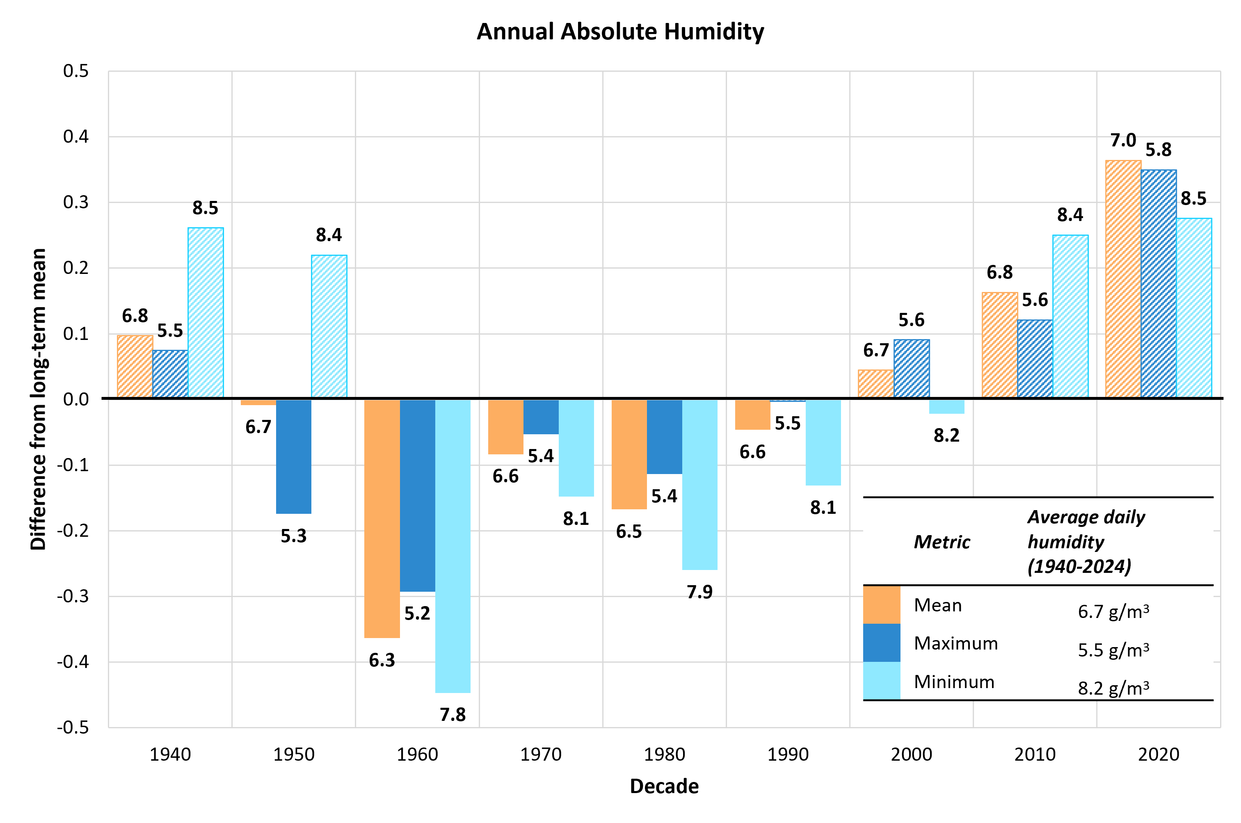
Figure 2-13 Decadal average daily absolute humidity (g/m³) in Vermont, across 3 metrics (mean, maximum, and minimum) compared to the long-term average 1940–2024
Source: Copernicus Climate Change Service (2026)
Note: Long-term average daily humidity is indicated by the horizontal axis (y axis=0). This equals 6.7g/m3 for daily mean absolute humidity, 5.5 g/m3 for daily maximum, and 8.2 g/m3 for daily minimum. Decades with averages higher than the long-term average rise above this line, and those with lower averages descend below it. ERA5 reanalysis data were obtained from the Copernicus Climate Change Service Climate Data Store (C3S, 2017), using the “single levels time series” product. Data labels above each bar indicate the decade’s average daily measure of each humidity metric, bar heights reflect precise underlying values; labels are rounded to one decimal place

Slide 23
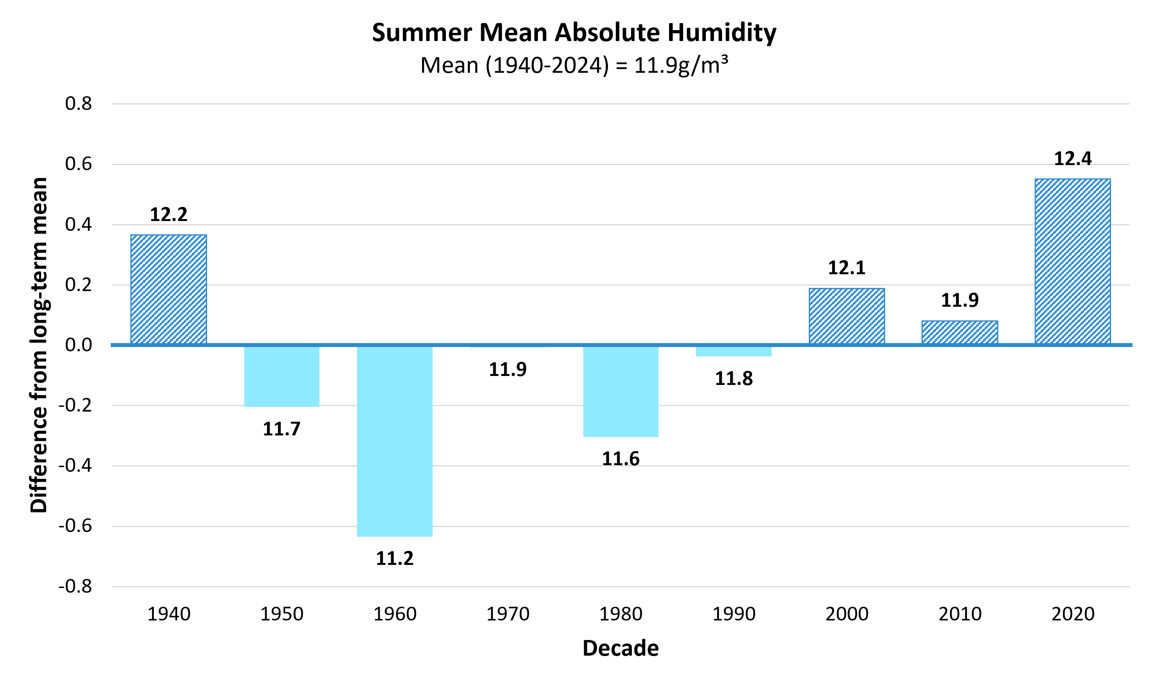
Figure 2-14 Decadal average daily humidity during summer months (JJA) compared to the long-term average (1940–2024) across climate divisions
Source: Copernicus Climate Change Service (2026)
Note: Long-term average daily summer humidity is indicated by the horizontal axis (y axis=0), equaling 11.9g/m3 in the Northeast location, 11.7g/m3 in the Southeast, and 12.2g/m3 in the West. Data labels above each bar indicate the decade’s average daily measure of each location, bar heights reflect precise underlying values; labels are rounded to one decimal place. Summer absolute humidity calculated by summarizing hourly time-series data from 1940–2024 of dewpoints and air temperatures across June, July and August. Data collected across three locations with latitude and longitudinal coordinates representative of NWS station locations rounded to the nearest 0.25. ERA5 reanalysis data were obtained from the Copernicus Climate Change Service Climate Data Store (C3S, 2017), using the “single levels time series” product

Slide 24
Supplemental Figure: Absolute Humidity Statewide
Figure (A) Summer average absolute humidity of three prominent stations
Figure (B) Supplemental Figure: Summer absolute humidity, minimum, maximum and average by climate division station
Summer absolute humidity calculated by summarizing hourly time-series data from 1940-2024 of dewpoints and air temperatures across June, July and August. Data collected across 3 locations with latitude and longitudinal coordinates representative of NWS station locations rounded to the nearest 0.25. Decadal linear trends shown as dotted lines for each station representing the 3 climate divisions, and the solid black line for all station decadal averages averaged together. ERA5 reanalysis data were obtained from the Copernicus Climate Change Service Climate Data Store (C3S, 2017), using the “single levels time series” product
Source: (Copernicus Climate Change Service (2025), 2026).

Slide 25
2.5 Precipitation

Slide 26
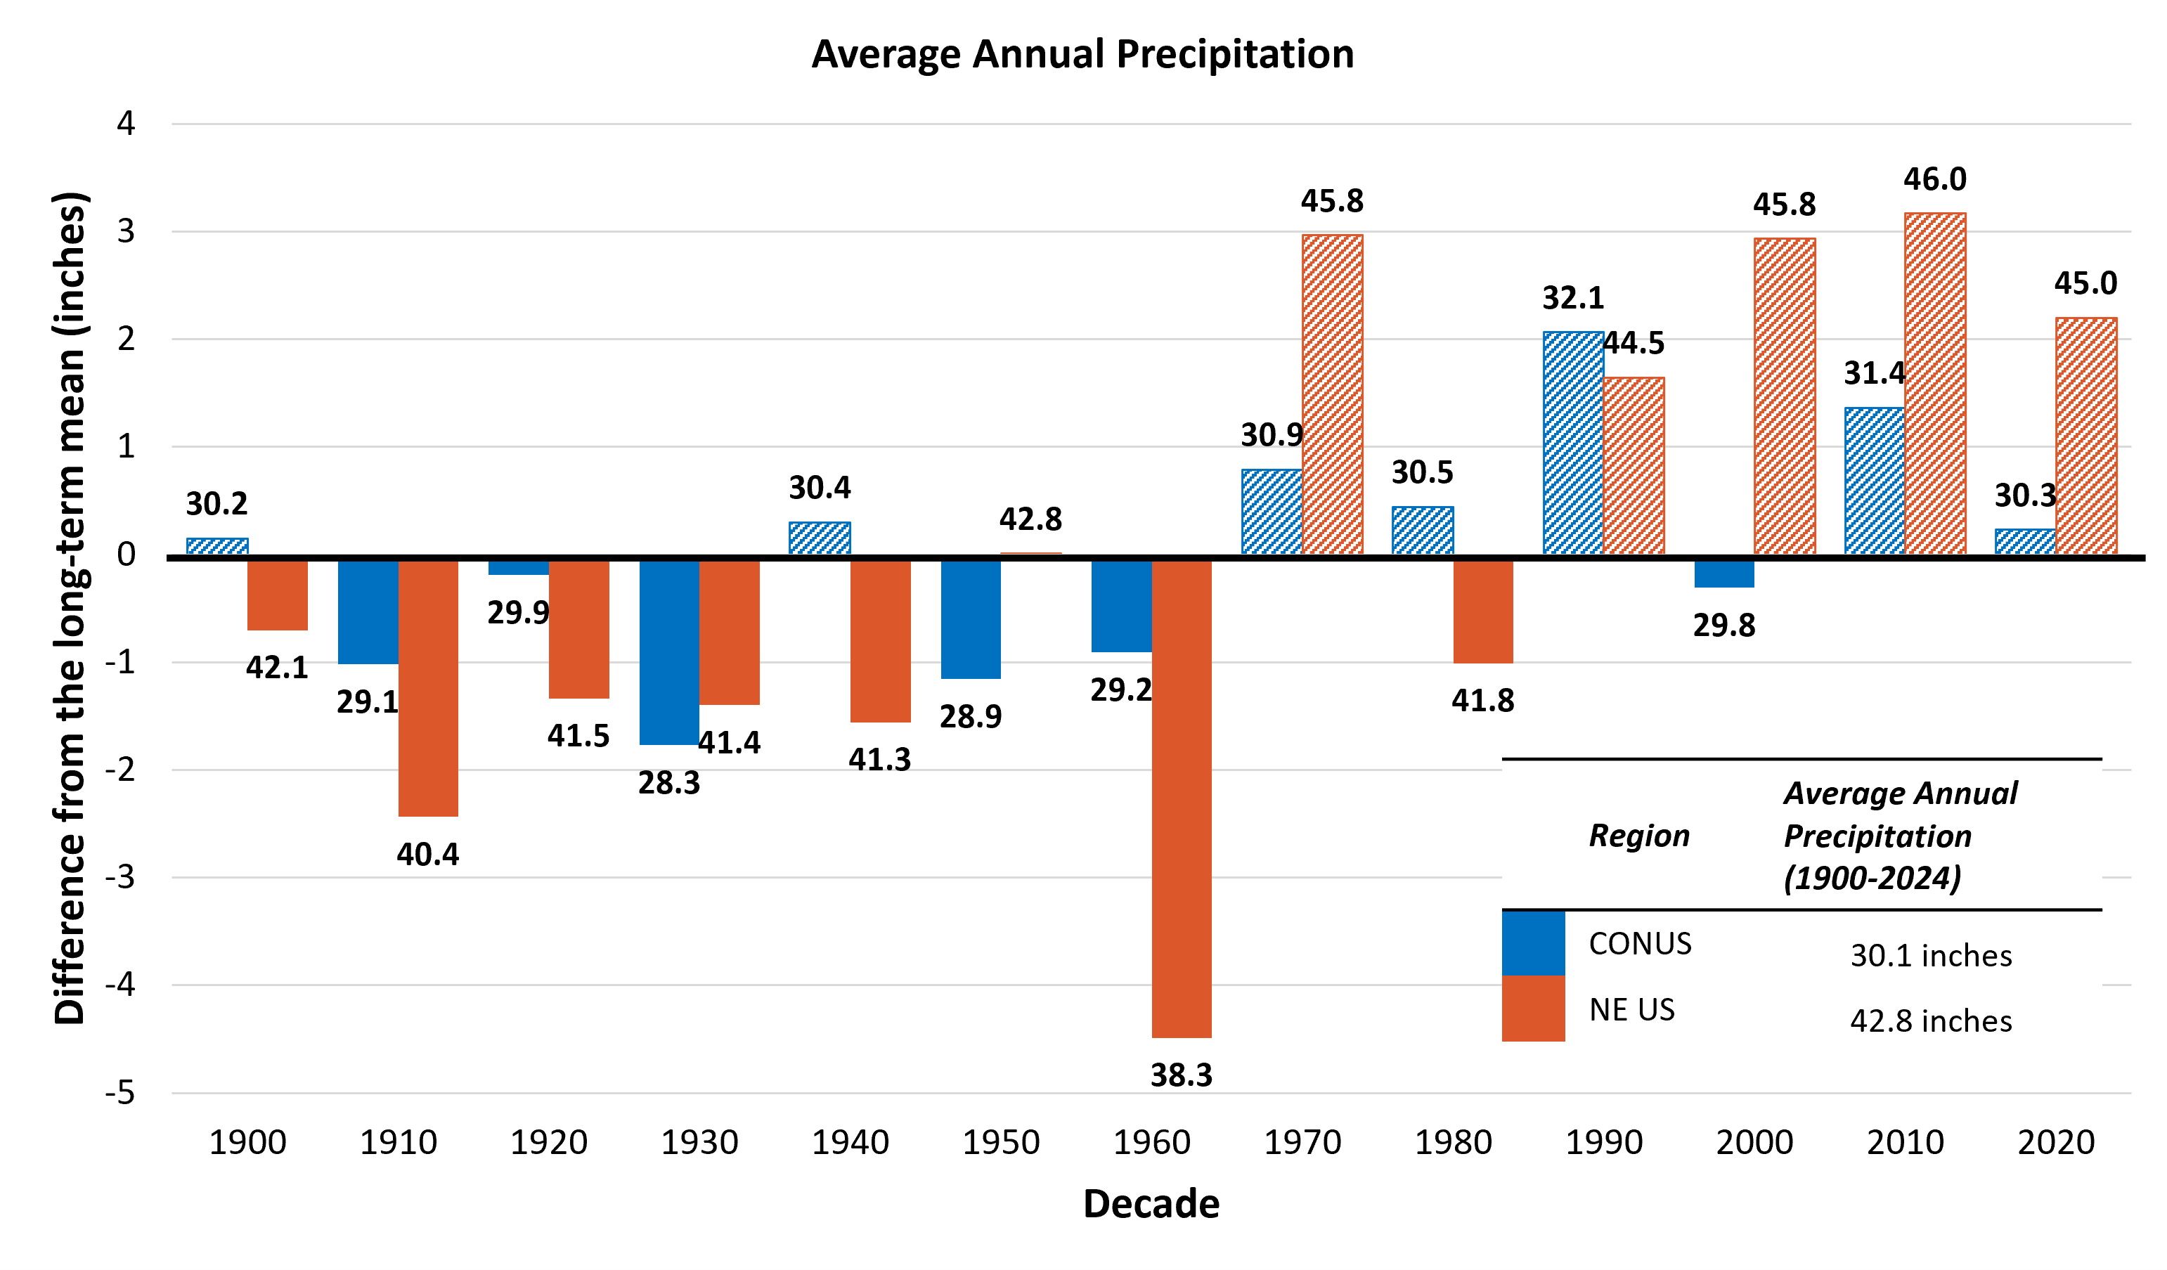
2.4.1 Regional Precipitation
Figure 2-15 Average annual precipitation (inches) by decade in the continental United States (U.S.; blue) and Northeast U.S. (orange), and their diversion from the long-term mean (1900-2024).
Source: NOAA NECI, National and Regional Time Series (2026)
Note: Averages calculated using a 12-month timescale annually, then by decade using data consolidated in the Precipitation parameter with no filters and including all months, years 1900–2024. Long-term average is indicated by the horizontal axis (y=0), for CONUS this axis represents an average of 30.1 inches (76.5cm), while the axis represents an average of 42.8 inches (108.7cm). Data labels above each bar indicate the decade’s average value, bar heights reflect precise underlying values; labels are rounded to one decimal place

Slide 27
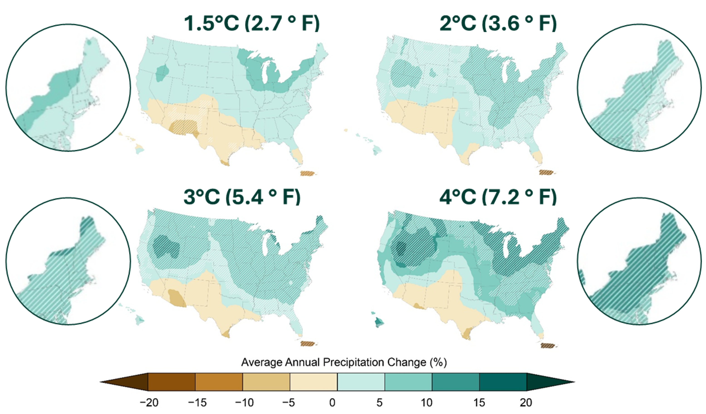
Figure 2-16 Projected annual average percent (%) precipitation changes at 1.5°C, 2°C, 3°C, and 4°C of global warming in the United States (U.S.) and Northeast U.S. (insets). Hashed, overlapping lines indicate the range of precipitation changes
Source:
Cornell University (2023)

Slide 28
2.4.1 Annual Precipitation
Table 2-4 Annual and seasonal trends and total changes in total precipitation (inches) and days with precipitation above one inch (days), negative values are orange and positive values are blue
Source: NOAA Regional Climate Centers (2026)
Note: Total precipitation in inches and days with heavy precipitation (defined as >1 inch or 25.4 mm in 24 hours) are provided numerically. *=statistically significant at 95% confidence interval; **=statistically significant at 90% confidence interval

Slide 29
2.5.3 Winter Precipitation

Slide 30
Figure 2-17 Decadal average annual precipitation (inches), and annual heavy precipitation days (days) compared to the long-term average (1900–2024)
Source: NOAA Regional Climate Centers (2026)
Note: Long-term averages are indicated by the horizontal axis (y=0), which equals 40.3 inches/year (102.4cm) of total annual precipitation and 7.3 days/year of annual heavy precipitation. Decades above the long-term average are striped, while decades below are solid. Data labels above each bar indicate the decade’s average value, bar heights reflect precise underlying values; labels are rounded to one decimal place

Slide 31
Table 2-5 Snowfall (inches) and winter precipitation (inches of liquid equivalent) totals and trends in Vermont statewide and in the three climate divisions (Northeastern, Western and Southeastern). Negative values are orange and positive values are blue (1930–2024)
Source: NOAA Regional Climate Centers (2026)
Note: Winter precipitation is the total annual precipitation across the 3 winter months (December, January and February) in liquid equivalents; therefore, it is the summation of snowfall and any other precipitation that fell. *=statistically significant at 95% confidence interval; **=statistically significant at 90% confidence interval

Slide 32
Figure 2-18 Decadal average seasonal precipitation (inches) compared to the long-term average (1900–2024)
Source: NOAA Regional Climate Centers (2026)
Note: Long-term averages are indicated by the horizontal axis (y=0), equaling 8.0 inches (203 mm) for winter, 9.5 inches (241 mm) for spring, 12 inches (305 mm) for summer, and 10.6 inches (269 mm) for fall of total seasonal precipitation. Decades above the long-term average are striped, while decades below are solid. Data labels above each bar indicate the decade’s average value, bar heights reflect precise underlying values; labels are rounded to one decimal place

Slide 33
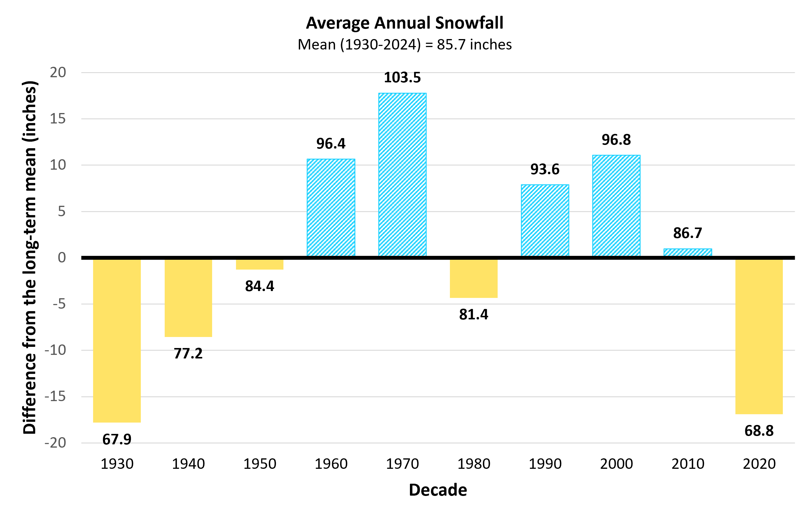
Figure 2-19 Decadal average snowfall (inches) compared to the long-term average (1930–2024)
Source: NOAA Regional Climate Centers (2026)
Note: Long-term averages are indicated by the horizontal axis (y=0), equaling 85.7 inches (2,177 mm). Decades above the long-term average are striped, while decades below are solid. Data labels above each bar indicate the decade’s average value, bar heights reflect precise underlying values; labels are rounded to one decimal place

Slide 34
Figure 2-20: Statewide ratio of cumulative snow (in) to winter precipitation (in) statewide
Source: NOAA Regional Climate Centers (2026)
Note: Each bar represents the average ratio within each decade displayed as it diverts away from the long-term average ratio (1930–2024), represented by the primary x axis (0) and equal to 10.4 inches/in. Decadal ratios above the long-term average are striped, and those below are solid. Each ratio represents how many inches of snow fell compared to every 1 inch of all liquid equivalent precipitation during winter months (DJF). The last bar represents a half-decade average (2020–2024). Data labels above each bar indicate the decade’s average value, bar heights reflect precise underlying values; labels are rounded to one decimal place

Slide 35
2.6 Extreme Weather Events

Slide 36
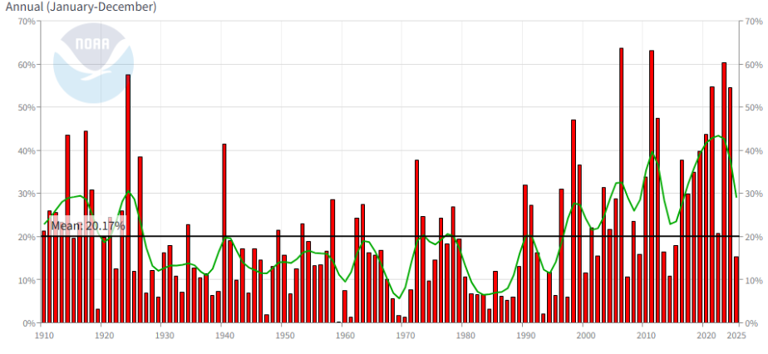
2.6.1 Regional Extreme Weather Events
Figure 2-21 Annual percent area (%) of the continental United States (U.S.) experiencing extreme weather (red bars), the 9-point moving trend (green line), and the mean percent area over the whole period (black line; (1910–2024)
Source: NOAA NECI (2025)
Note: Extreme weather includes maximum temperature, minimum temperature, heavy daily precipitation, days with or without precipitation, and drought

Slide 37
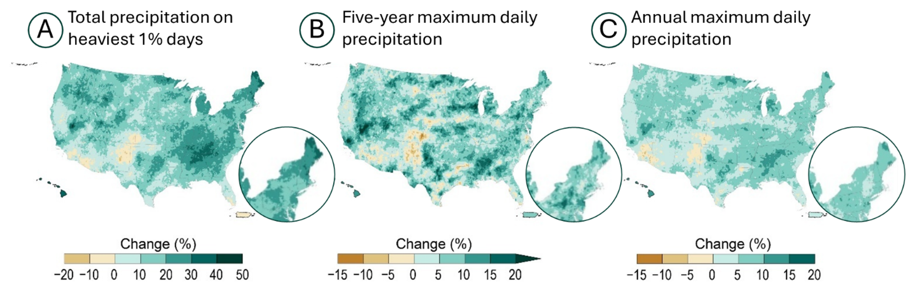
Figure 2-22 Projected changes to precipitation extremes at 3.6°F (2°C) global warming compared to average precipitation, 1991-2020; A) changes in total precipitation during the top 1% of heavy precipitation, B) expected percent change in the 5-year maximum daily precipitation, and C) annual maximum daily precipitation
Source: Cornell University (2023)

Slide 38
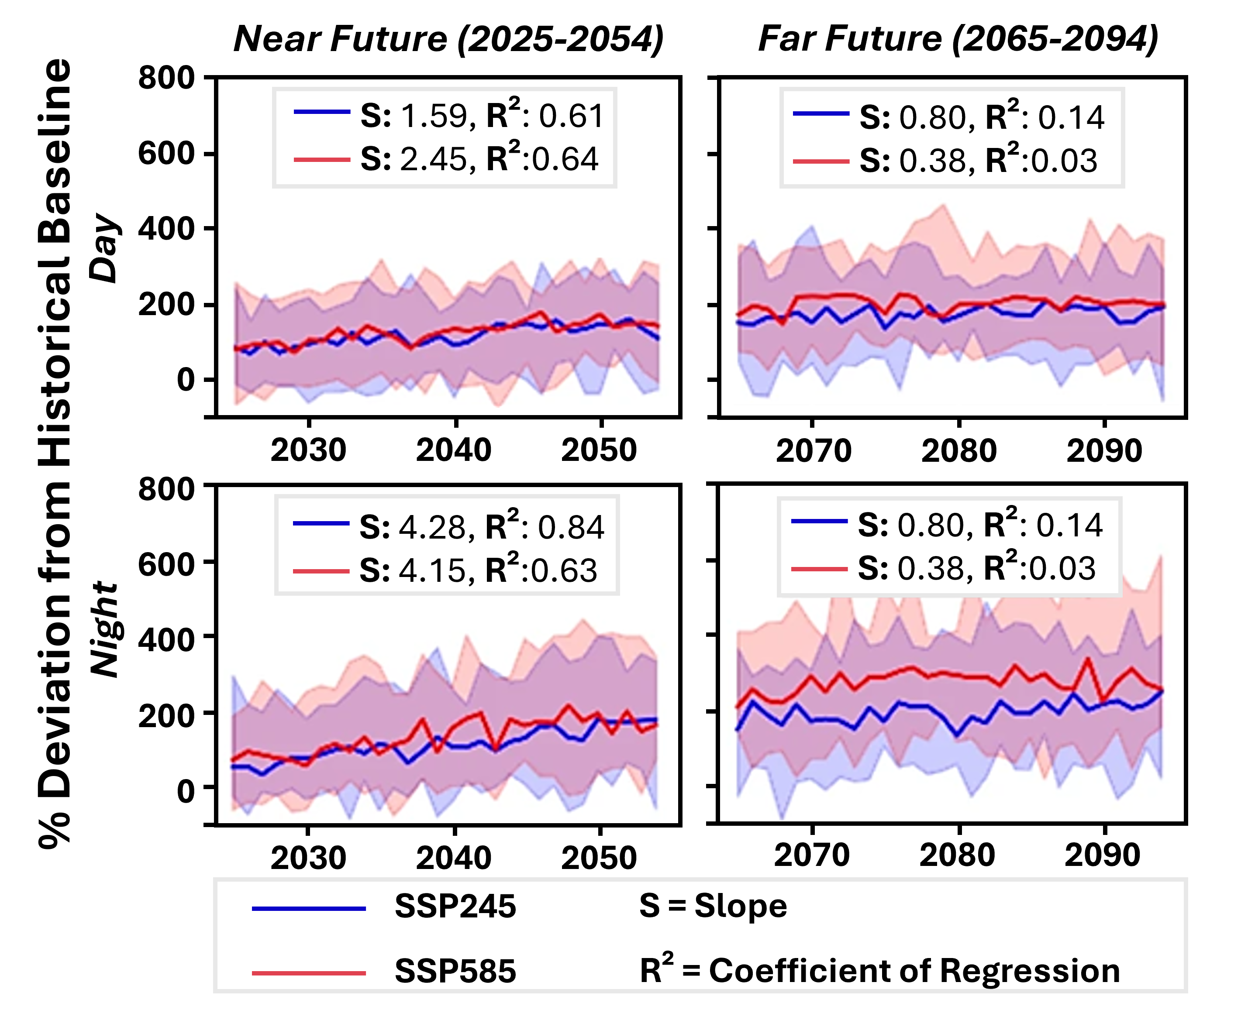
Figure 2-23 Projected change (% deviation) in annual heatwave number for daytime occurrence (top row) and nighttime occurrence (bottom row) across cities in the Northeast U.S. for the Near Future (2025-2054) and Far Future (2065-2094) under the SSP2-4.5 scenario (blue line) and the SSP5-8.5 scenario (red line), calculated relative to the historical baseline (1985-2014)
Source: Bhattarai et al. (2025)

Slide 39
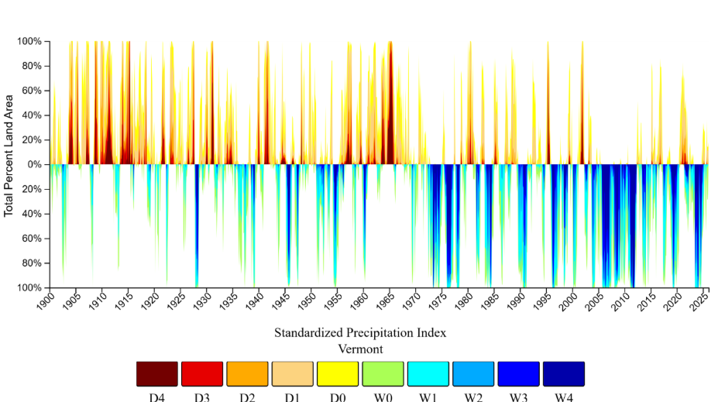
2.6.3 Drought
Figure 2-24 Percent of land area (%) in Vermont with wet and dry conditions based on the Standard Precipitation Index (SPI; 1900–2025)
Source: National Integrated Drought Information System (2026)
Note: Percent area of Vermont experiencing above average dry conditions with drought conditions ranging from D0 (abnormally dry) to D4 (exceptional drought), and abnormally wet conditions classified as W0 (abnormally wet) to W4 (exceptionally wet)
Table 2-6 Trends in the percentage of land area in Vermont with abnormally wet and abnormally dry conditions over three periods, 1900–2024, 1960–2024, and 1990–2024
Source: National Integrated Drought Information System (2026)
Note: Percent area of Vermont experiencing above average dry conditions with drought conditions ranging from D0 (abnormally dry) to D4 (exceptional drought), and abnormally wet conditions classified as W0 (abnormally wet) to W4 (exceptionally wet). All values represent percentages; those with an asterix (*) are statistically significant at a 95% confidence level
 | Trending Dry Conditions |  |  |  |  | Trending Wet Conditions
 | D0 | D1 | D2 | D3 | D4 | W0 | W1 | W2 | W3 | W4
1900-2024 | -3.09* | -2.24 | -0.96 | -0.56 | -0.22 | 3.88* | 3.40 | 2.25 | 1.56 | 0.81
1960-2024 | -3.27* | -1.96 | -1.12 | -0.21 | -0.10 | 5.41* | 4.69 | 3.59 | 2.74 | 1.35
1990-2024 | -0.06* | -0.22 | 0.09 | -0.30 | -0.25 | -2.73* | -0.77 | 0.72 | 1.47 | 1.31

Slide 40
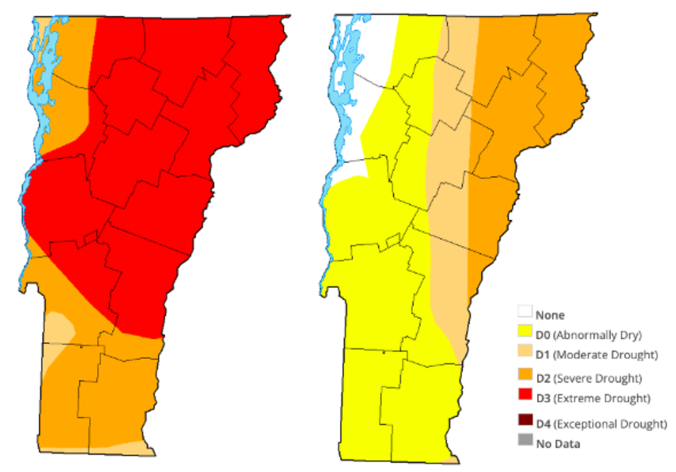
Figure 2-25: Drought monitoring in Vermont: Peak drought (Oct 14, 2025) vs. the end of drought (Nov 18, 2025)
Source: U.S. Drought Monitor (2026)
Note: Map on the left (Oct 14, 2025) shows drought at its peak: 100% of Vermont under drought conditions; 67% under extreme drought (D3 status in red), 33% experiencing severe (D2 status in orange) or moderate drought (D1 status). Map on the right (Nov 18, 2025) shows no extreme drought, 25% of the state under severe drought (D2 in orange), 17% under moderate drought (D1 in tan), and less than 50% remaining abnormally dry

Slide 41
2.7 Vermont’s Future Climate

Slide 42
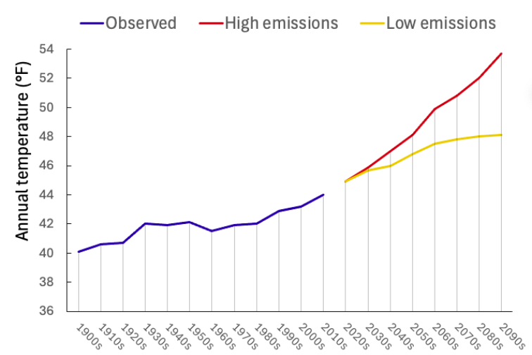
Figure 2-26 Temperature (°F) trends and climate projections in Vermont (1900–2090)
Source: Vermont Climate Council (2025)

Slide 43
2.10 Appendix

Slide 44
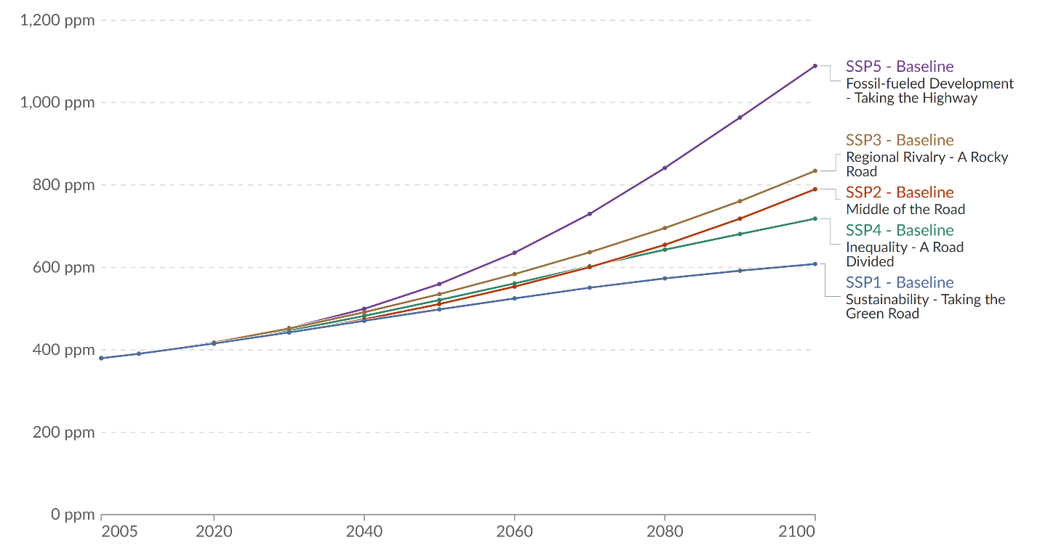
2.10.1 Global Climate Change
Figure 2-27 Observed and projected atmospheric concentrations of carbon dioxide (2000–2100)
Source: Riahi et al. (2017)
Note: Global atmospheric concentrations of carbon dioxide measured in parts per million, observed 2005–2015, and projected 2015–2100

Slide 45
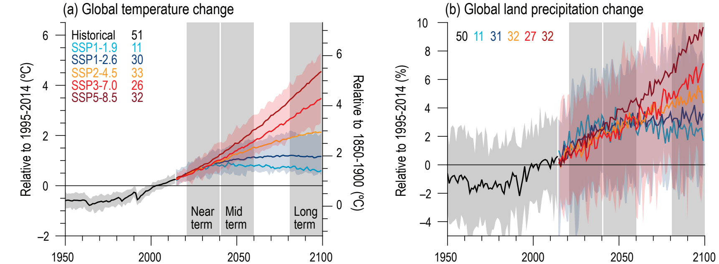
Figure 2-28 Projected global temperature and precipitation change
Source: IPCC (2023)
Note: Selected indicators representing global climate change from CMIP6 historical and scenario simulations. SSP-1, SSP-2, and SSP-3 are projected to reduce emissions, while SSP-4 and SSP-5 are projected to increase emissions, therefore, global temperature and precipitation changes increase accordingly. Change is calculated according to averages between 1995–2014 average (left axis) and 1850–1900 (right axis). Near term, mid-term and long-term projections are shown in gray highlighted areas, variability amongst these projections increases the further you get from historical record, shown by the highlighted areas around each SSP modelled line
Table 2-7 Projected temperature (°F) and precipitation (%) average (min, max) for the five IPCC scenarios where temperature was converted from °C to °F
IPCC Scenario | SSP1 | SSP2 | SSP3 | SSP4 | SSP5
Scenario Name | Sustainability | Middle of the Road | Regional Rivalry | Inequality | Fossil-fueled Development
Temperature (°F) (a)
Mid term | 2.9 (2.2-3.6) | 3.1 (2.3-4.0) | 3.6 (2.9-4.5) | 3.8 (3.1-4.7) | 4.3 (3.4-5.4)
Long term | 2.5 (1.8-3.2) | 3.2 (2.3-4.3) | 4.9 (3.8-6.3) | 6.5 (5.0-8.3) | 7.9 (5.9-0.3)
Precipitation (%) (b)
Mid term | 2.7 (0.6, 5.0) | 2.8 (–0.4, 5.2) | 2.7 (0.3, 5.2) | 2.5 (–0.8, 5.1) | 3.7 (–0.1, 6.9)
Long term | 2.4 (–0.2, 4.7) | 3.3 (0.0, 6.6) | 4.6 (1.5, 8.3) | 5.8 (0.5, 9.6) | 8.3 (0.9, 12.9)

Slide 46
2.10.2 Climate Division Annual Temperatures

Slide 47
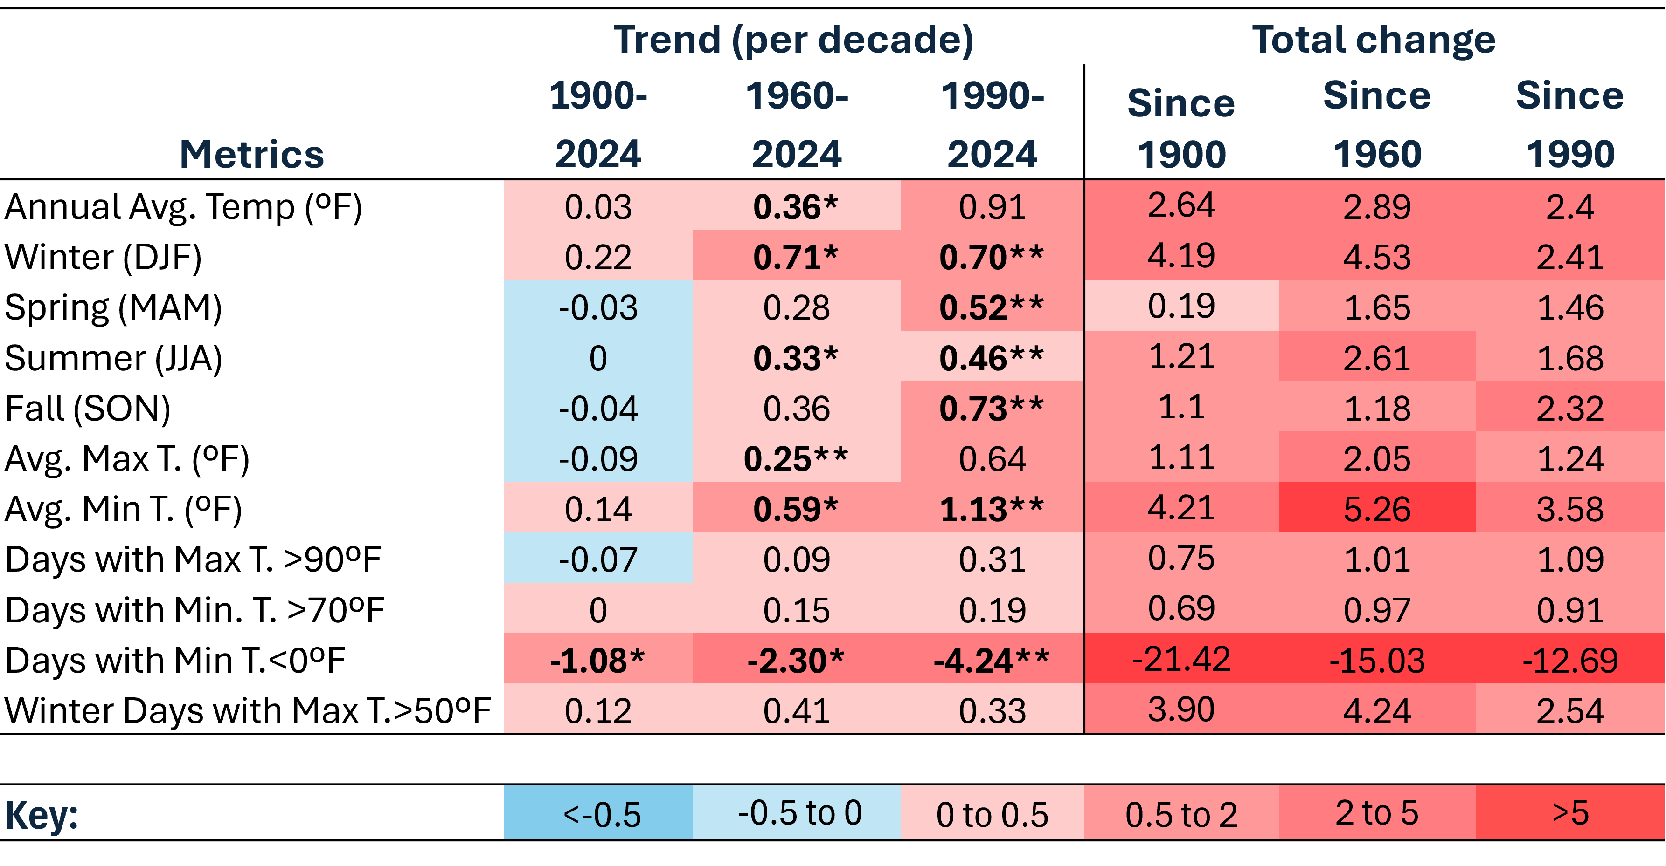
Table 2-8 Northeastern climate division temperature trends per decade and total changes (ºF) including annual average, by season, and for extreme temperature events (1900–2024)
Source: NOAA Regional Climate Centers (2026)
Note: *=statistically significant at 95% confidence interval; **=statistically significant at 90% confidence interval, colors are inverted for Days with Min T. 0 ºF (cold days) to highlight warming trend.

Slide 48
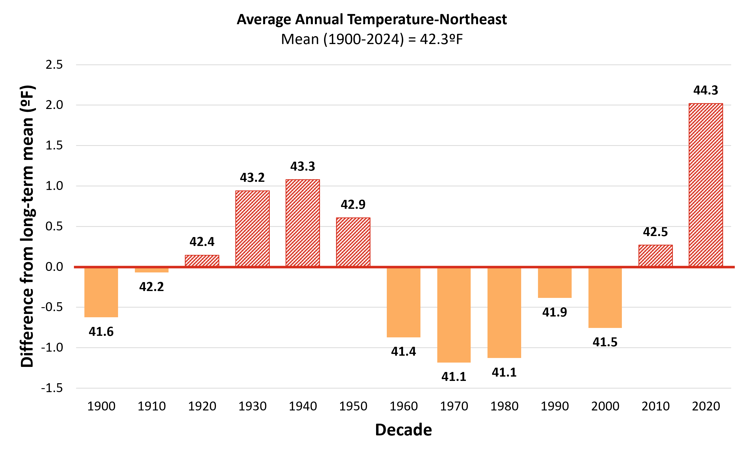
Figure 2-29 Northeast climate division decadal average annual temperature compared to the long-term average (1900–2024)
Source: NOAA Regional Climate Centers (2026)
Note: Long-term average annual temperature is indicated by the horizontal axis (y=0), equaling 42.3ºF. Decades above the long-term average are red and striped, while decades below are orange and solid. Data labels above each bar indicate the decade’s average value, bar heights reflect precise underlying values; labels are rounded to one decimal place

Slide 49
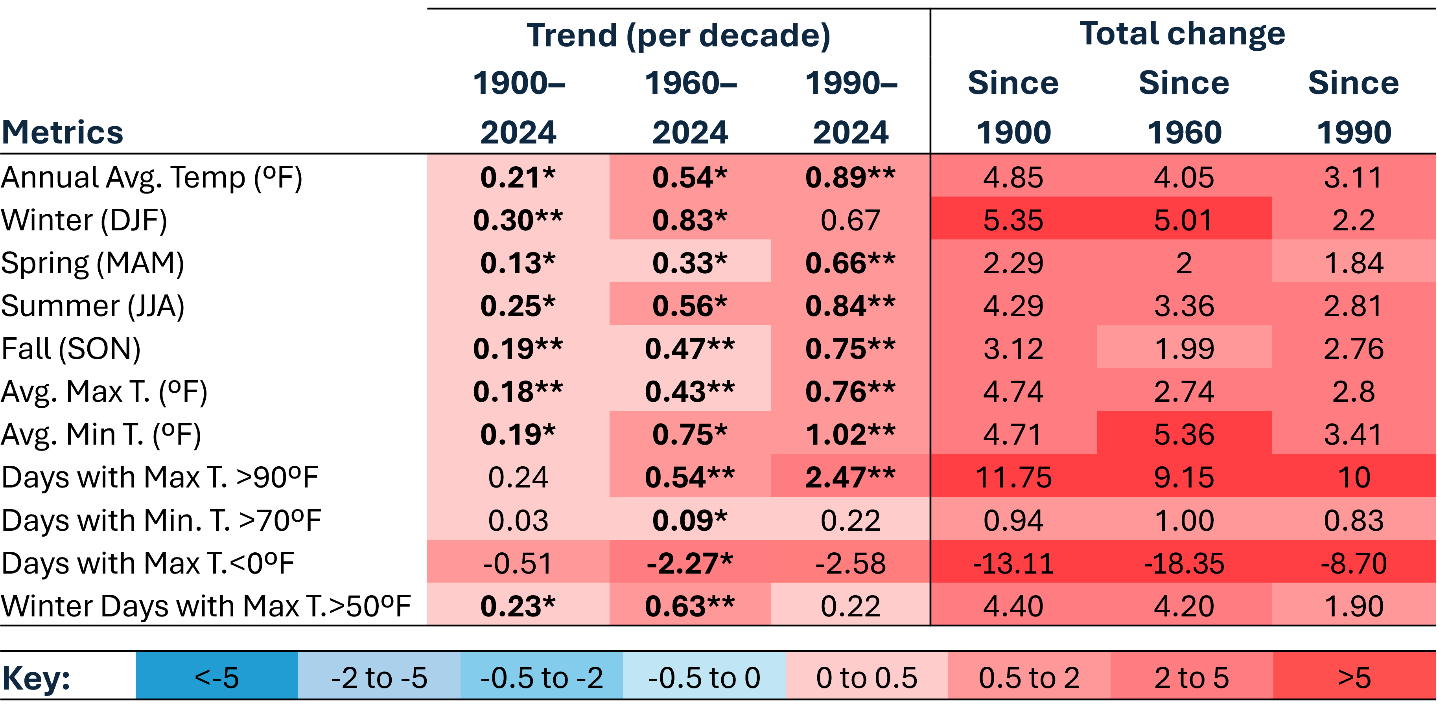
Table 2-9 Southeastern climate division temperature trends per decade and total changes (ºF) including annual average, by season, and for extreme temperature events (1900–2024)
Source: NOAA Regional Climate Centers (2026)
Note: *=statistically significant at 95% confidence interval; **=statistically significant at 90% confidence interval, colors are inverted for Days with Min T. 0 ºF (cold days) to highlight warming trend.

Slide 50
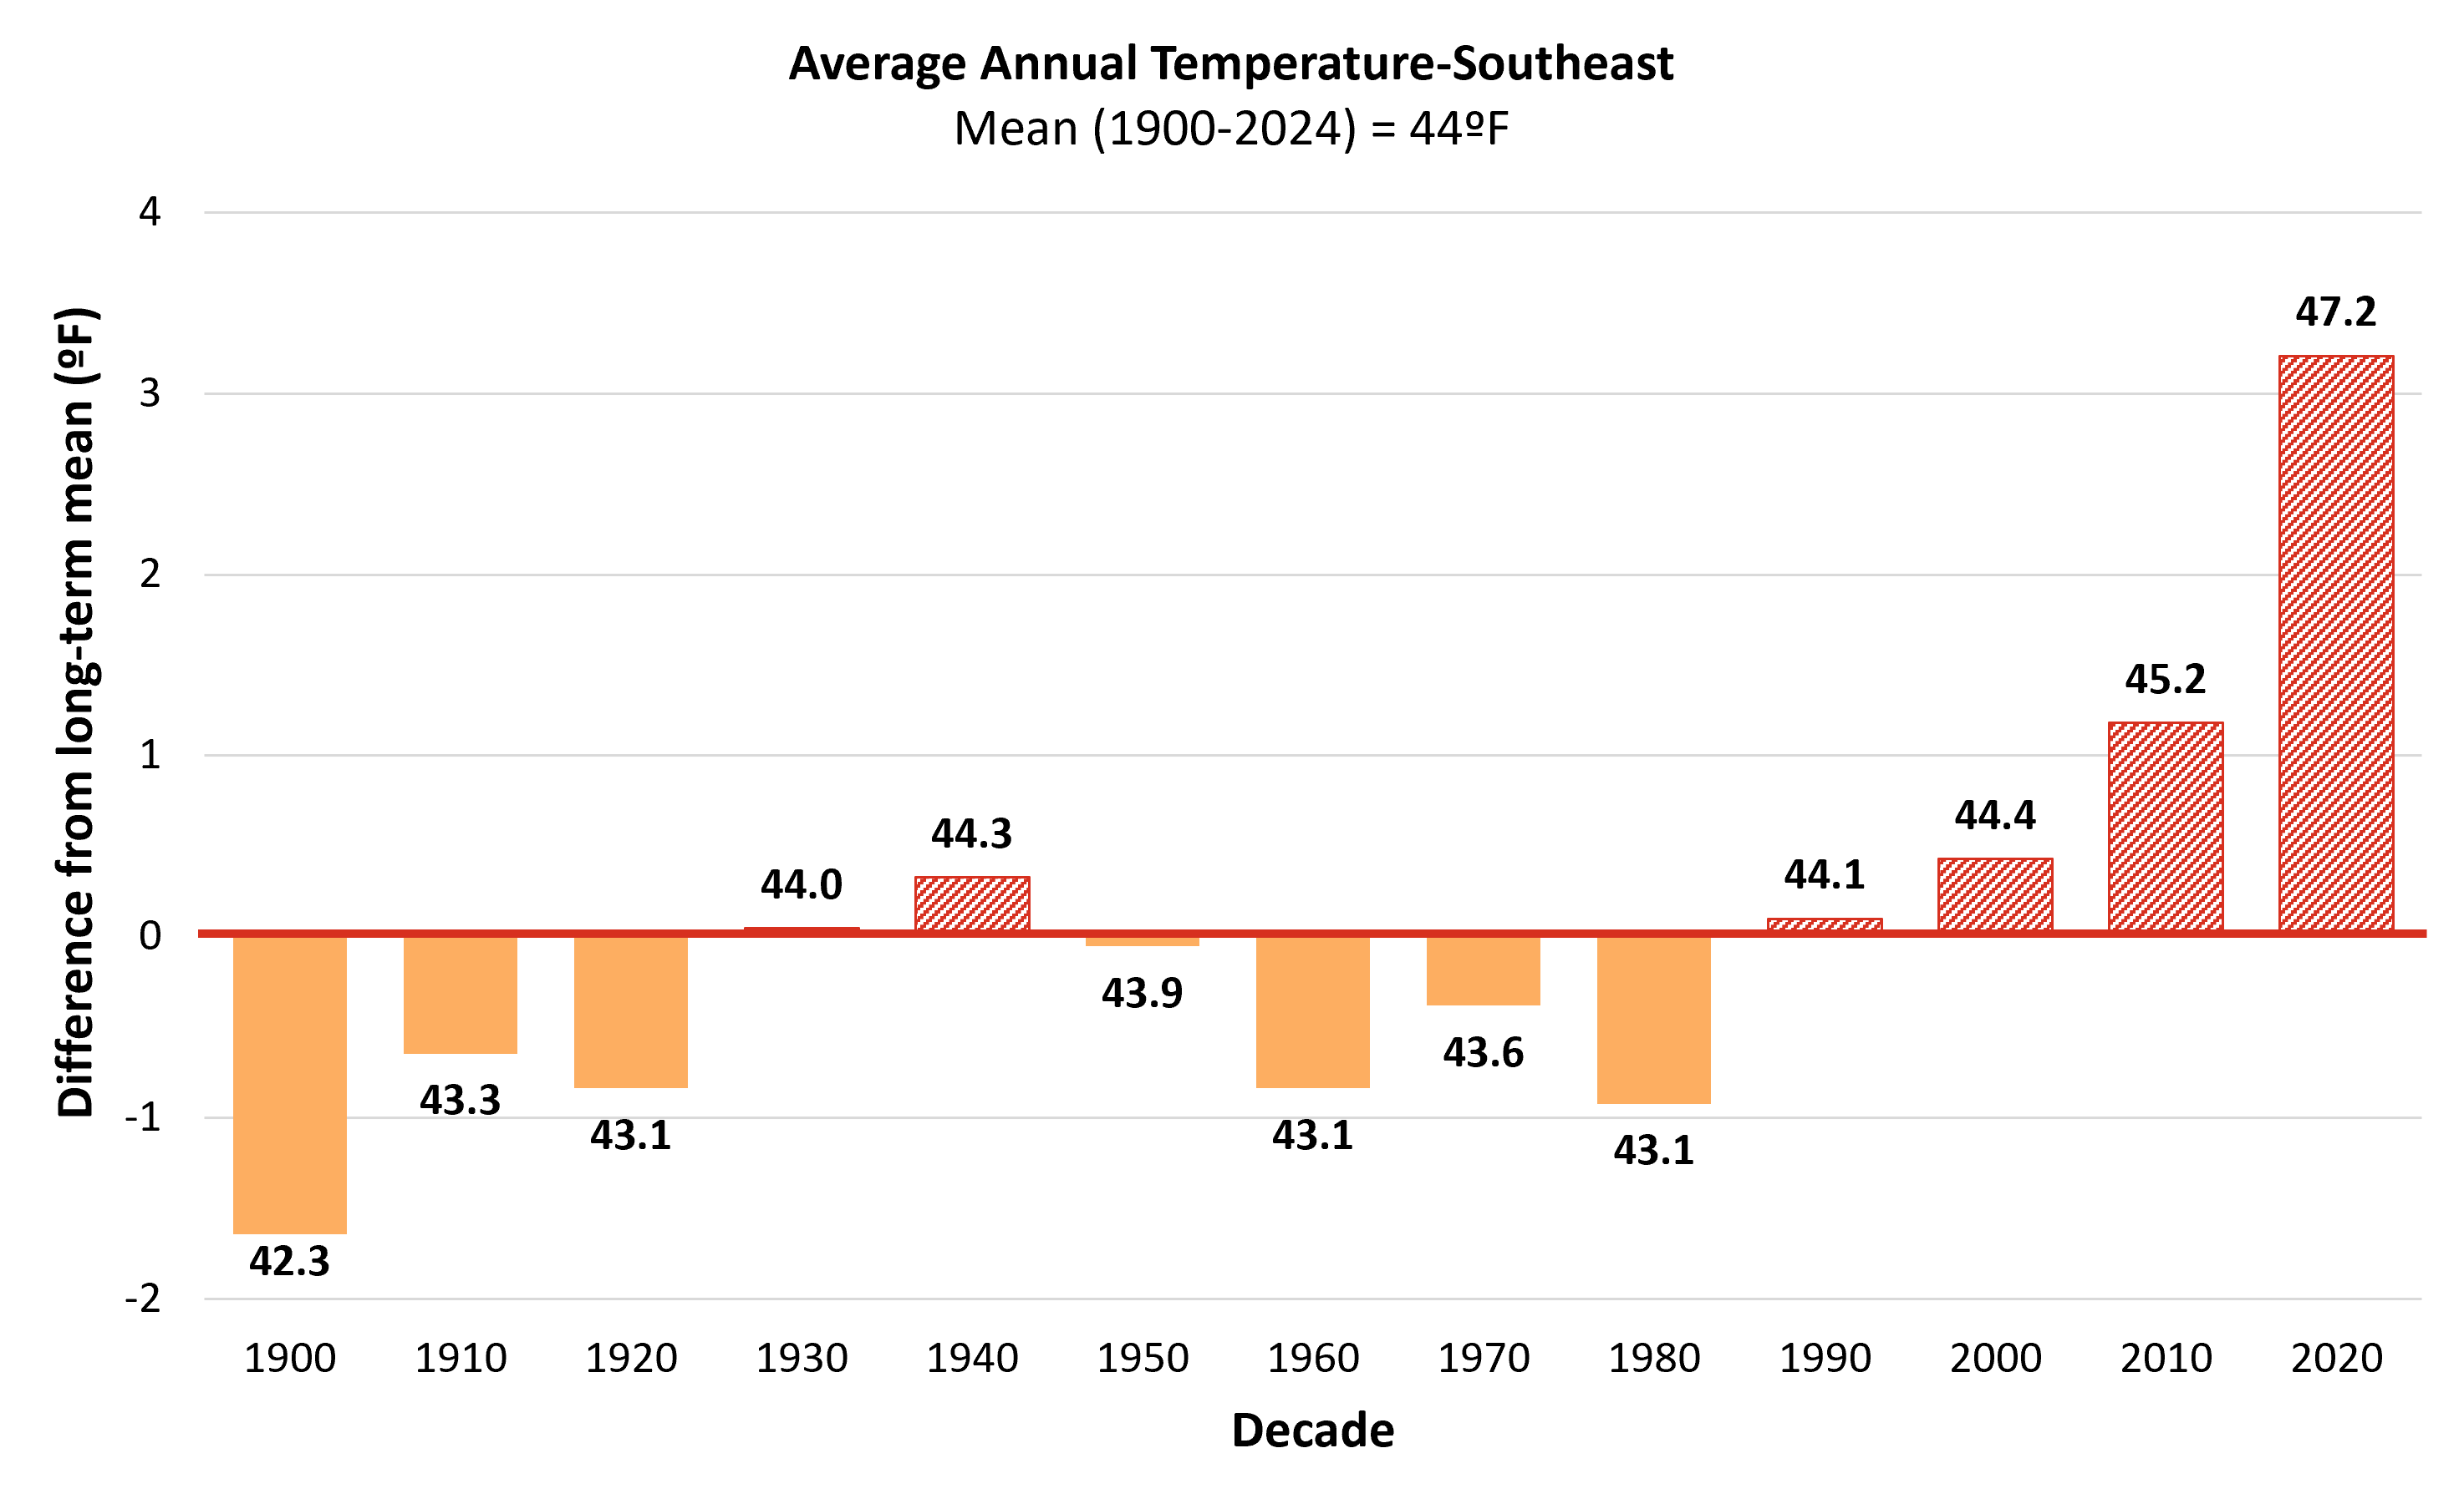
Figure 2-30 Southeastern climate division decadal average annual temperature compared to the long-term average (1900–2024)
Source: NOAA Regional Climate Centers (2026)
Note: Long-term average annual temperature is indicated by the horizontal axis (y=0), equaling 44.0ºF. Decades above the long-term average are red and striped, while decades below are orange and solid. Data labels above each bar indicate the decade’s average value, bar heights reflect precise underlying values; labels are rounded to one decimal place

Slide 51
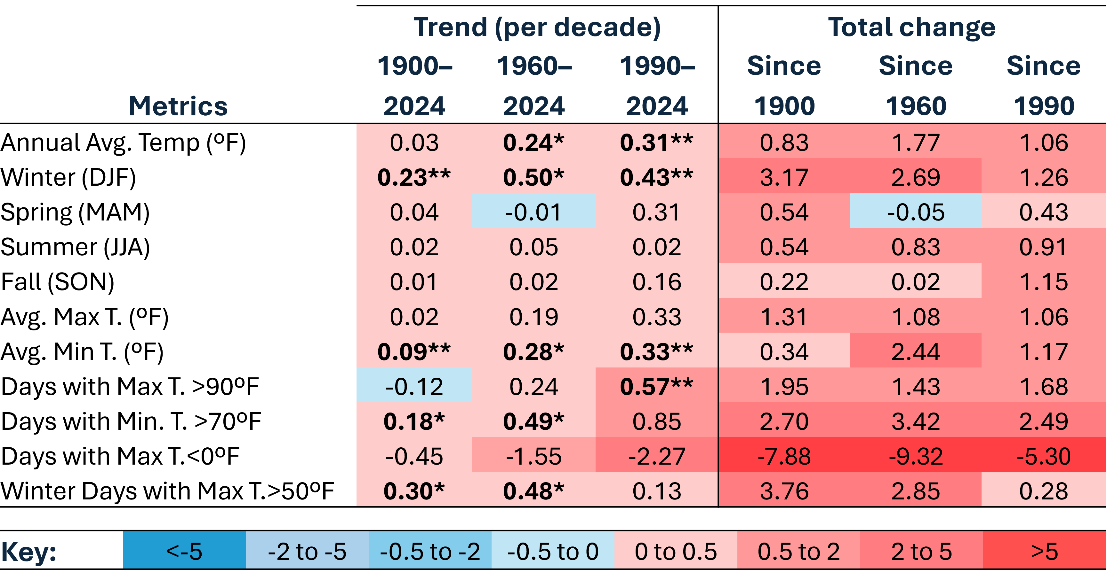
Table 2-10 Western climate division temperature trends per decade and total changes (ºF) including annual average, by season, and for extreme temperature events (1900–2024)
Source: NOAA Regional Climate Centers (2026)
Note: *=statistically significant at 95% confidence interval; **=statistically significant at 90% confidence interval, colors are inverted for Days with Min T. 0 ºF (cold days) to highlight warming trend.

Slide 52
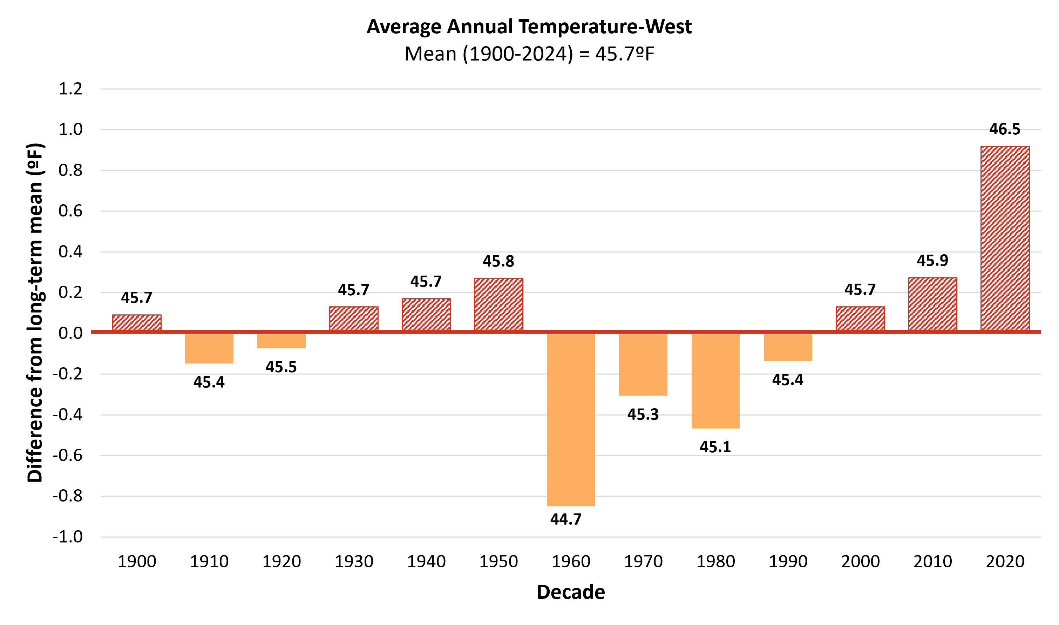
Figure 2-31 Western climate division decadal average annual temperature compared to the long-term average (1900–2024)
Source: NOAA Regional Climate Centers (2026)
Note: Long-term average annual temperature is indicated by the horizontal axis (y=0), equaling 45.7ºF. Decades above the long-term average are red and striped, while decades below are orange and solid. Data labels above each bar indicate the decade’s average value, bar heights reflect precise underlying values; labels are rounded to one decimal place

Slide 53
2.10.3 Climate Division Winter Temperatures

Slide 54
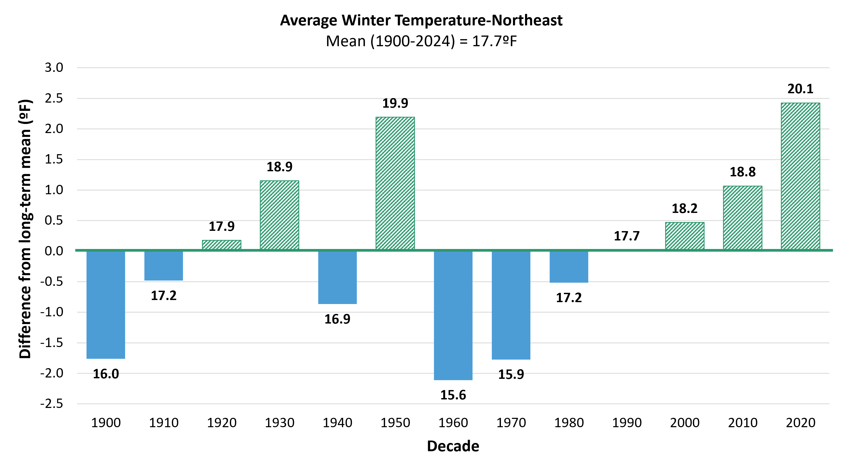
Figure 2-32 Northeastern climate division decadal average annual winter temperature compared to the long-term average (1900–2024)
Source: NOAA Regional Climate Centers (2026)
Note: Long-term average winter temperature is indicated by the horizontal axis (y=0), equaling 17.7ºF. Decades above the long-term average green and striped, while decades below are blue and solid. Data labels above each bar indicate the decade’s average value, bar heights reflect precise underlying values; labels are rounded to one decimal place

Slide 55
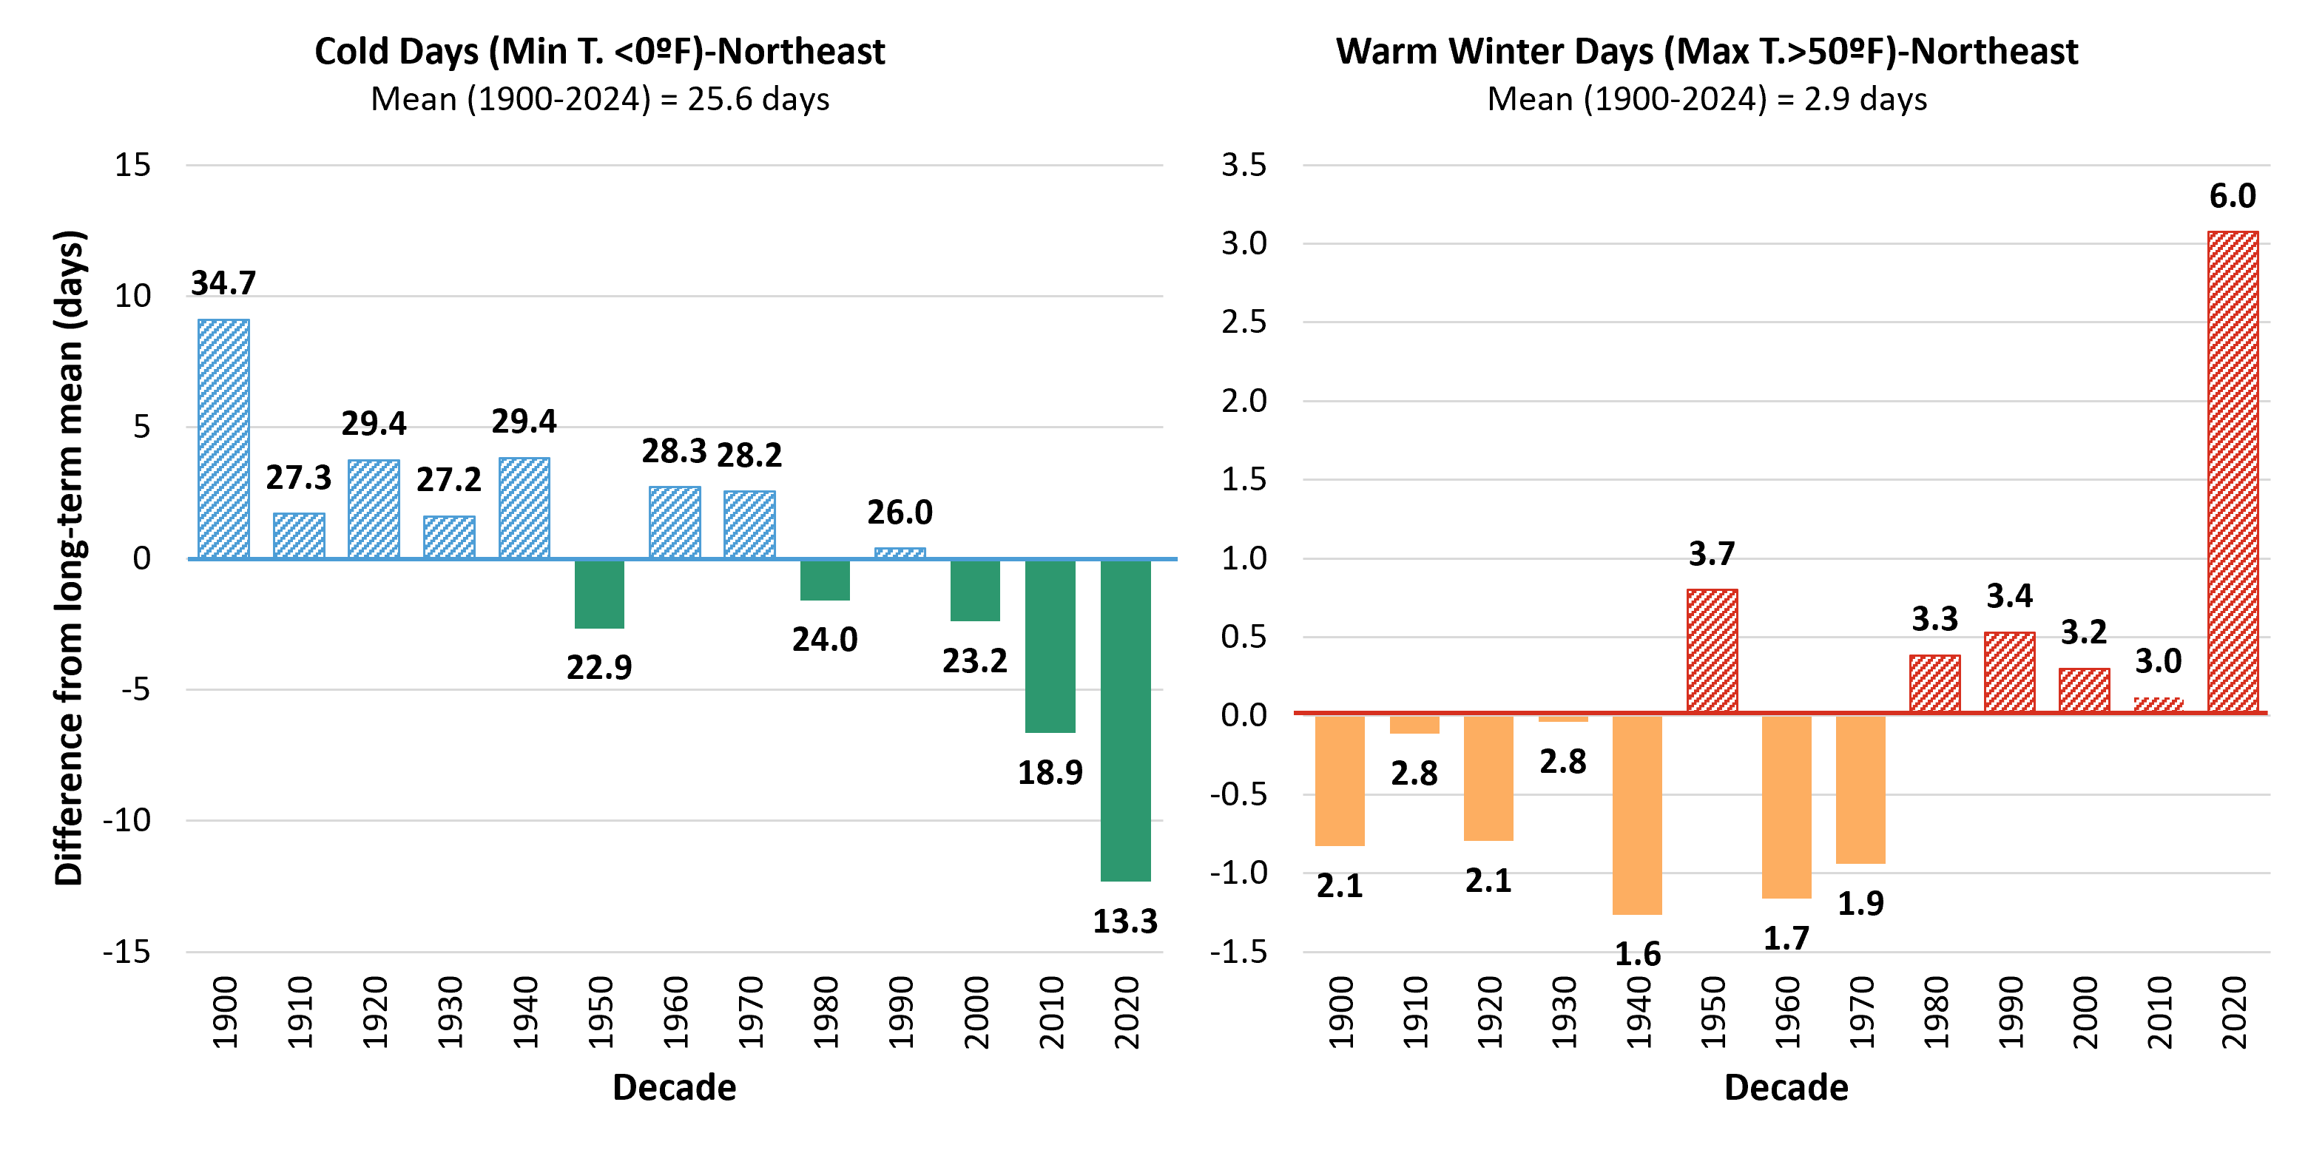
Figure 2-33 Northeastern climate division decadal average annual frequencies of winter temperature extremes compared to the long-term average (1900–2024)
Source: NOAA Regional Climate Centers (2026)
Note: Long-term average is indicated by the horizontal axis (y=0), this axis represents an average of 25.6 days/year for very cold days, while for warm winter days this axis represents an average of 2.9 days/year. Decades above the long-term average are striped, while decades below are solid. Data labels above each bar indicate the decade’s average value, bar heights reflect precise underlying values; labels are rounded to one decimal place

Slide 56
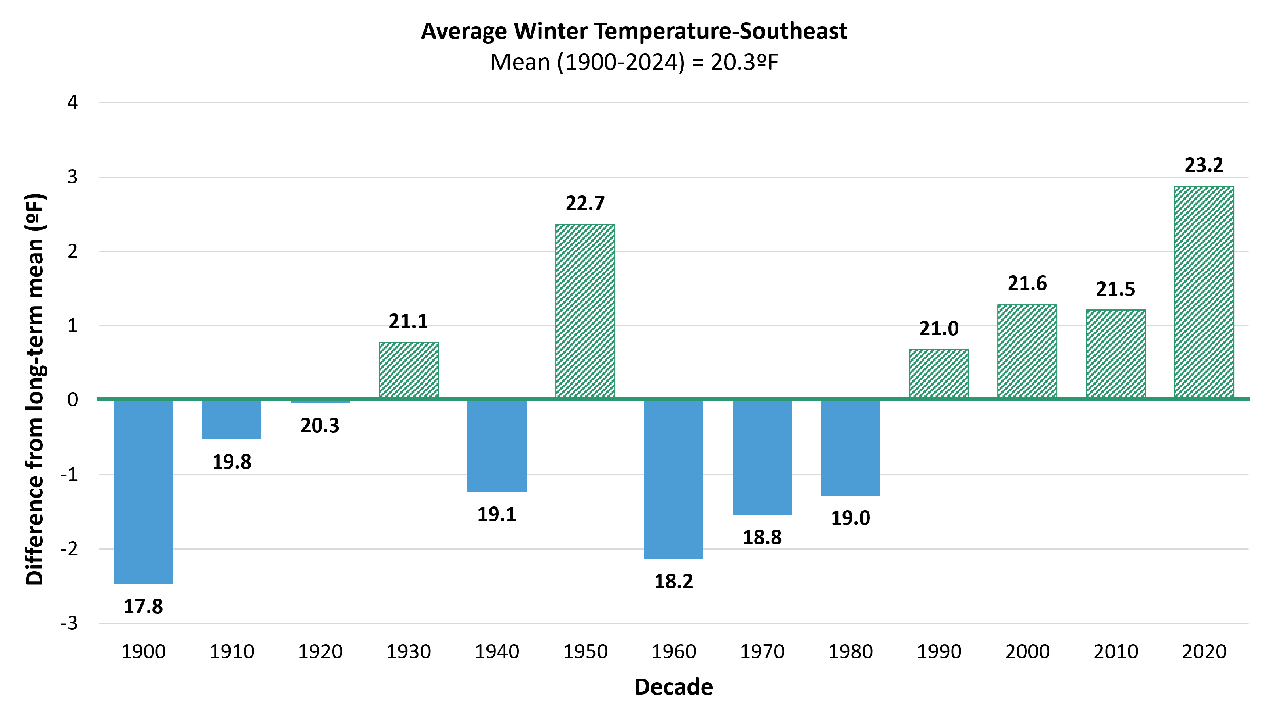
Figure 2-34 Southeastern climate division decadal average annual winter temperature compared to the long-term average (1900–2024)
Source: NOAA Regional Climate Centers (2026)
Note: Long-term average winter temperature is indicated by the horizontal axis (y=0), equaling 20.3ºF (-6.5ºC). Decades above the long-term average are green and striped, while decades below are blue and solid. Data labels above each bar indicate the decade’s average value, bar heights reflect precise underlying values; labels are rounded to one decimal place

Slide 57
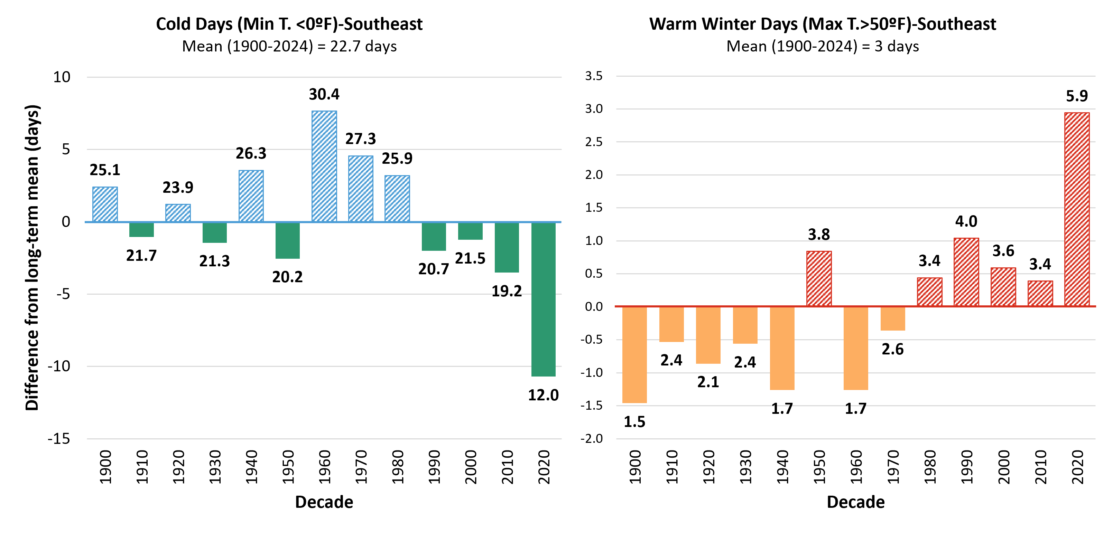
Figure 2-35 Southeastern climate division decadal average annual frequencies of winter temperature extremes compared to the long-term average (1900–2024)
Source: NOAA Regional Climate Centers (2026)
Note: Long-term average is indicated by the horizontal axis (y=0), the axis represents an average of 22.7 days/year for very cold days, while for warm winter days this axis represents an average of 3 days/year. Decades above the long-term average are striped, while decades below are solid. Data labels above each bar indicate the decade’s average value, bar heights reflect precise underlying values; labels are rounded to one decimal place

Slide 58
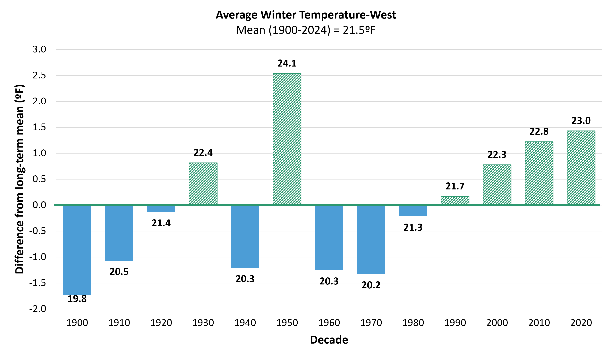
Figure 2-36 Western climate division decadal average annual winter temperature compared to the long-term average (1900–2024)
Source: NOAA Regional Climate Centers (2026)
Note: Long-term average winter temperature is indicated by the horizontal axis (y=0), equaling 21.5ºF. Decades above the long-term average are green and striped, while decades below are blue and solid. Data labels above each bar indicate the decade’s average value, bar heights reflect precise underlying values; labels are rounded to one decimal place

Slide 59
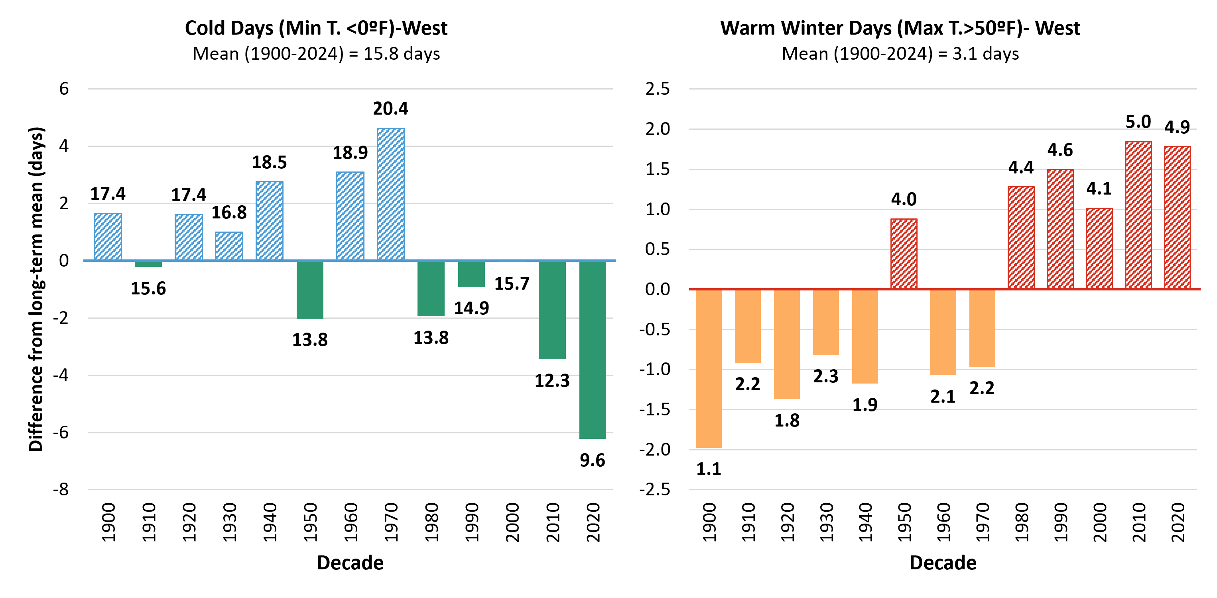
Figure 2-37 Western climate division decadal average annual frequencies of winter temperature extremes compared to the long-term average (1900–2024)
Source: NOAA Regional Climate Centers (2026)
Note: Long-term average is indicated by the horizontal axis (y=0), the axis represents an average of 15.8 days/year for very cold days, while for warm winter days this axis represents an average of 3.1 days/year. Decades above the long-term average are striped, while decades below are solid. Data labels above each bar indicate the decade’s average value, bar heights reflect precise underlying values; labels are rounded to one decimal place

Slide 60
2.10.3 Climate Division Summer Temperatures

Slide 61
Figure 2-38 Northeastern climate division decadal average freeze-free period length compared to the long-term average (1900–2024)
Source: NOAA Regional Climate Centers (2026)
Note: Long-term average freeze-free length is indicated by the horizontal axis (y=0), equaling 124.7 days/year. Decades below the long-term average are dark green, while decades above are light green. Data labels above each bar indicate the decade’s average value, bar heights reflect precise underlying values; labels are rounded to one decimal place

Slide 62
Figure 2-39 Northeastern climate division decadal average annual frequencies of summer temperature extremes compared to the long-term average (1900–2024)
Source: NOAA Regional Climate Centers (2026)
Note: Long-term average is indicated by the horizontal axis (y=0), for hot days this axis represents an average of 4.5 days/year, while the axis represents an average of 0.6 days/year for very cold days. Decades above the long-term average are striped, while decades below are solid. Data labels above each bar indicate the decade’s average value, bar heights reflect precise underlying values; labels are rounded to one decimal place

Slide 63
Figure 2-40 Southeastern climate division decadal average freeze-free period length compared to the long-term average (1900–2024)
Source: NOAA Regional Climate Centers (2026)
Note: Long-term average freeze-free length is indicated by the horizontal axis (y=0), equaling 117.9 days/year. Decades above the long-term average are striped, while decades below are solid. Data labels above each bar indicate the decade’s average value, bar heights reflect precise underlying values; labels are rounded to one decimal place

Slide 64
Figure 2-41 Southeastern climate division decadal average annual frequencies of summer temperature extremes compared to the long-term average (1900–2024)
Source: NOAA Regional Climate Centers (2026)
Note: Long-term average is indicated by the horizontal axis (y=0), for hot days this axis represents an average of 7.7 days/year, while the axis represents an average of 0.3 days/year for very cold days. Data labels above each bar indicate the decade’s average value, bar heights reflect precise underlying values; labels are rounded to one decimal place

Slide 65
Figure 2-42 Western climate division decadal average freeze-free period length compared to the long-term average (1900–2024)
Source: NOAA Regional Climate Centers (2026)
Note: Long-term average freeze-free length is indicated by the horizontal axis (y=0), equaling 141.2 days/year. Decades above the long-term average are striped, while decades below are solid. Data labels above each bar indicate the decade’s average value, bar heights reflect precise underlying values; labels are rounded to one decimal place

Slide 66
Figure 2-43 Western climate division decadal average annual frequencies of summer temperature extremes compared to the long-term average (1900–2024)
Source: NOAA Regional Climate Centers (2026)
Note: Long-term average is indicated by the horizontal axis (y=0), for hot days this axis represents an average of 6.2 days/year, while the axis represents an average of 1.9 days/year for warm nights. Decades above the long-term average are striped, while decades below are solid. Data labels above each bar indicate the decade’s average value, bar heights reflect precise underlying values; labels are rounded to one decimal place

Slide 67
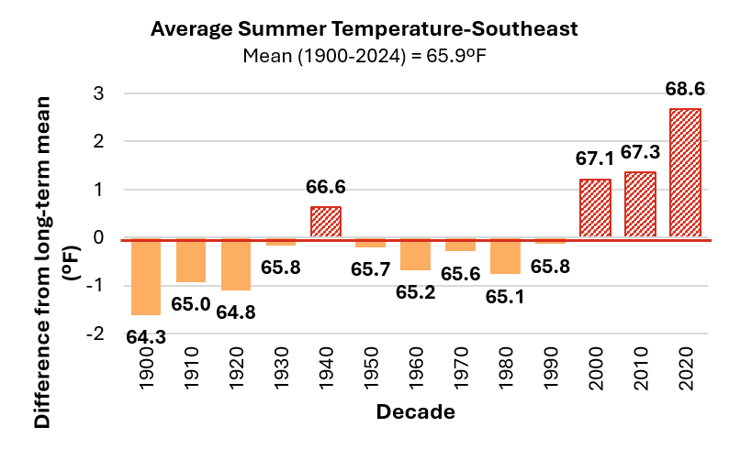
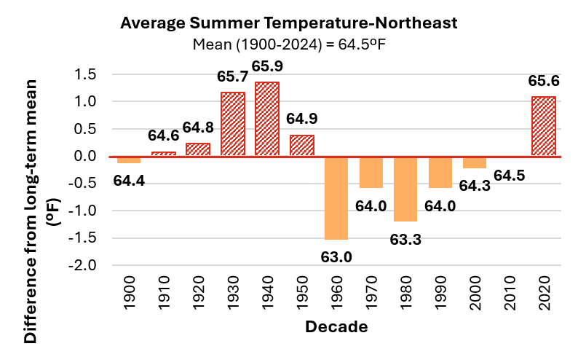
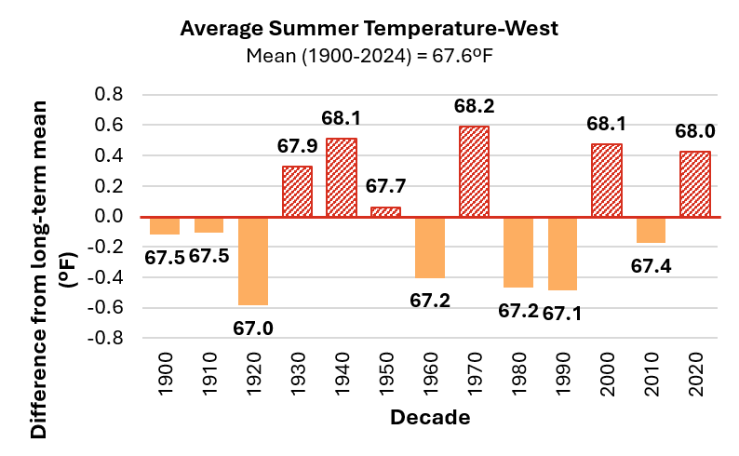
Supplemental Figures: Decadal average annual summer temperature (JJA) compared to the long-term average (1900-2024)
Note: Long-term average summer temperature is indicated by the horizontal axis (y=0). Data labels above each bar indicate the decade’s average annual summer temperature. Decades above the long-term average red and striped, while decades below are orange and solid.
Source: NOAA RCC ACIS (2026)

Slide 68
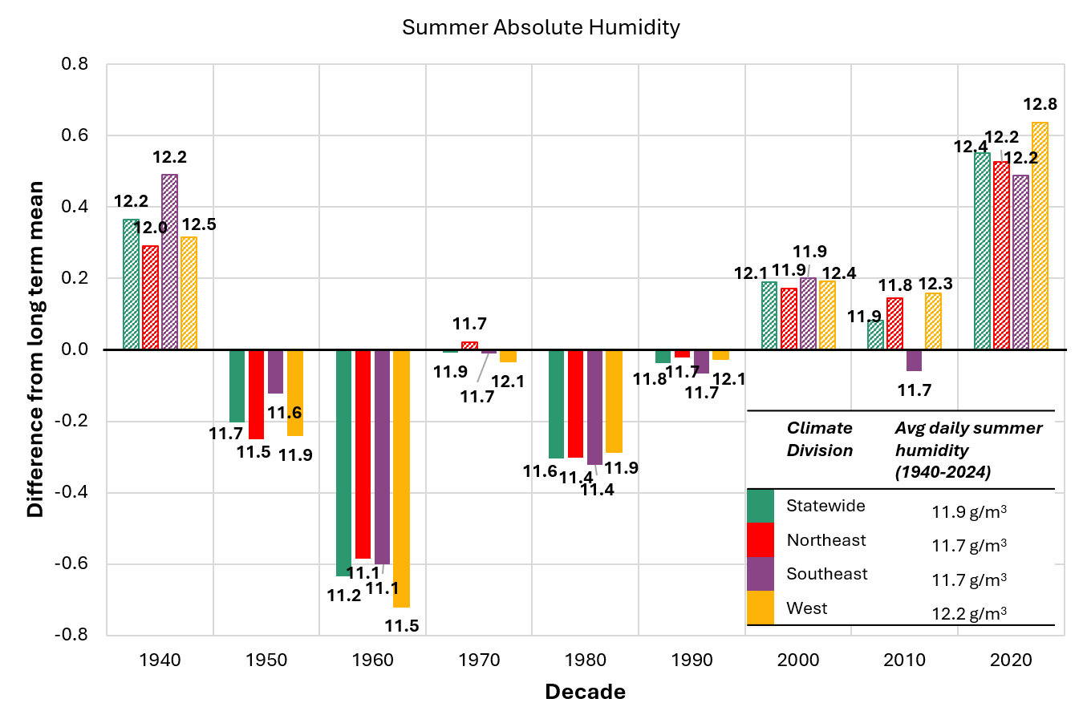
Supplemental Figure: Summer Absolute Humidity by Climate Division
Note: Each bar represents the average humidity within each decade displayed as it diverts away from the long-term average (1940-2024) represented by the primary x axis (0)) which varies by division and is displayed in the table. Absolute humidities above the long-term average are striped, and those below are solid filled. Summer is a combined average of the months June, July and August each year.
Source: Source: Copernicus Climate Change Service (2026)

Slide 69
2.10.3 Climate Division Annual Precipitation

Slide 70
Table 2-11 Northeastern climate division precipitation trends and total change
Source: NOAA Regional Climate Centers (2026)
Note: Precipitation trends per decade and total change annually and by season. Total precipitation in inches and days with heavy precipitation (defined as >1 inch or 25.4mm in 24 hours) are provided numerically, as well as color coordinated from highly negative values (dark orange) to highly positive values (dark blue). *=statistically significant at 95% confidence interval; **=statistically significant at 90% confidence interval

Slide 71
Figure 2-44 Northeastern climate division decadal average annual precipitation (inches), and annual heavy precipitation days (days) compared to the long-term average (1900–2024)
Source: NOAA Regional Climate Centers (2026)
Note: Long-term averages are indicated by the horizontal axis (y=0), equaling 41.5 inches/year (1,054 mm) of total annual precipitation, and 7.1 annual heavy precipitation days/year. Decades above the long-term average are striped, while decades below are solid. Data labels above each bar indicate the decade’s average value, bar heights reflect precise underlying values; labels are rounded to one decimal place

Slide 72
Table 2-12 Southeastern climate division precipitation trends and total change
Source: NOAA Regional Climate Centers (2026)
Note: Precipitation trends per decade and total change annually and by season. Total precipitation in inches and days with heavy precipitation (defined as >1 inch or 25.4mm in 24 hours) are provided numerically, as well as color coordinated from highly negative values (dark orange) to highly positive values (dark blue). *=statistically significant at 95% confidence interval; **=statistically significant at 90% confidence interval

Slide 73
Figure 2-45 Southeastern climate division decadal average annual precipitation (inches), and annual heavy precipitation days (days) compared to the long-term average (1900–2024)
Source: NOAA Regional Climate Centers (2026)
Note: Long-term averages are indicated by the horizontal axis (y=0), equaling 41 inches/year of total annual precipitation, and 9.1 annual heavy precipitation days/year (defined as >1 inch or 25.4mm in 24 hours). Decades above the long-term average are striped, while decades below are solid. Data labels above each bar indicate the decade’s average value, bar heights reflect precise underlying values; labels are rounded to one decimal place

Slide 74
Table 2-13 Western climate division precipitation trends and total change
Source: NOAA Regional Climate Centers (2026)
Note: Precipitation trends per decade and total change annually and by season. Total precipitation in inches and days with heavy precipitation (defined as >1 inch or 25.4mm in 24 hours) are provided numerically, as well as color coordinated from highly negative values (dark orange) to highly positive values (dark blue). *=statistically significant at 95% confidence interval; **=statistically significant at 90% confidence interval

Slide 75
Figure 2-46 Western climate division decadal average annual precipitation (inches), and annual heavy precipitation days (days) compared to the long-term average (1900–2024)
Source: NOAA Regional Climate Centers (2026)
Note: Long-term averages are indicated by the horizontal axis (y=0), equaling 37.1 inches/year of total annual precipitation, and 6.5 annual heavy precipitation days/year. Decades above the long-term average are striped, while decades below are solid. Data labels above each bar indicate the decade’s average value, bar heights reflect precise underlying values; labels are rounded to one decimal place

Slide 76
2.10.3 Climate Division Winter Precipitation

Slide 77
Figure 2-47 Northeastern climate division decadal average seasonal precipitation (inches) compared to the long-term average (1900–2024)
Source: NOAA Regional Climate Centers (2026)
Note: Long-term averages are indicated by the horizontal axis (y=0), equaling 8.1 inches for winter, 9.5 inches for spring, 12.5 inches for summer, and 11 inches for fall of total seasonal precipitation. Decades above the long-term average are striped, while decades below are solid. Data labels above each bar indicate the decade’s average value, bar heights reflect precise underlying values; labels are rounded to one decimal place

Slide 78
Figure 2-48 Northeastern climate division decadal average annual snowfall (inches) compared to the long-term average (1930–2024)
Source: NOAA Regional Climate Centers (2026)
Note: Long-term average is indicated by the horizontal axis (y=0), equaling 94.6 inches/year of total annual snowfall. Decades above the long-term average are striped, while decades below are solid. Data labels above each bar indicate the decade’s average value, bar heights reflect precise underlying values; labels are rounded to one decimal place

Slide 79
Figure 2-49 Northeast climate division ratio of average snowfall (in) to winter precipitation (in)
Source: NOAA Regional Climate Centers (2026)
Note: Long-term average SLR (1930-2024) is indicated by the horizontal axis (y=0), equaling 11.2 inches/inch. Decades above the long-term average are striped, while decades below are solid. Each ratio represents how many inches of snow fell compared to every 1 inch of all liquid equivalent precipitation during winter months (DJF). Data labels above each bar indicate the decade’s average value, bar heights reflect precise underlying values; labels are rounded to one decimal place

Slide 80
Figure 2-50 Southeastern climate division decadal average seasonal precipitation (inches) compared to the long-term average (1900–2024)
Source: NOAA Regional Climate Centers (2026)
Note: Long-term averages are indicated by the horizontal axis (y=0), equaling 8.8 inches for winter, 10 inches for spring, 11.4 inches for summer, and 10.5 inches for fall of total seasonal precipitation. Decades above the long-term average are striped, while decades below are solid. Data labels above each bar indicate the decade’s average value, bar heights reflect precise underlying values; labels are rounded to one decimal place

Slide 81
Figure 2-51 Southeastern climate division decadal average annual snowfall (inches) compared to the long-term average (1940–2024)
Source: NOAA Regional Climate Centers (2026)
Note: Long-term average is indicated by the horizontal axis (y=0), equaling 79.7 inches/year of total annual snowfall. Less than 3 years of data was available within this division for the years 1930–1939, therefore, this decade was omitted from analysis. Decades above the long-term average are striped, while decades below are solid. Data labels above each bar indicate the decade’s average value, bar heights reflect precise underlying values; labels are rounded to one decimal place

Slide 82
Figure 2-52 Southeastern climate division ratio of average snowfall (in) to winter precipitation (in)
Source: NOAA Regional Climate Centers (2026)
Note: Long-term average SLR (1940-2024) is indicated by the horizontal axis (y=0), equaling 8.9 inches/inch. Decades above the long-term average are striped, while decades below are solid. Each ratio represents how many inches of snow fell compared to every 1 inch of all liquid equivalent precipitation during winter months (DJF). Data labels above each bar indicate the decade’s average value, bar heights reflect precise underlying values; labels are rounded to one decimal place

Slide 83
Figure 2-53 Western climate division decadal average seasonal precipitation (inches) compared to the long-term average (1900–2024)
Source: NOAA Regional Climate Centers (2026)
Note: Long-term averages are indicated by the horizontal axis (y=0), equaling 7.1 inches for winter, 8.9 inches for spring, 11.5 inches for summer, and 9.9 inches for fall of total seasonal precipitation. Data labels above each bar indicate the decade’s average value, bar heights reflect precise underlying values; labels are rounded to one decimal place. Decades above the long-term average are striped, while decades below are solid

Slide 84
Figure 2-54 Western climate division decadal average annual snowfall (inches) compared to the long-term average (1930–2024)
Source: NOAA Regional Climate Centers (2026)
Note: Long-term average is indicated by the horizontal axis (y=0), equaling 75.3 inches/year of total annual snowfall. Data labels above each bar indicate the decade’s average value, bar heights reflect precise underlying values; labels are rounded to one decimal place. Decades above the long-term average are striped, while decades below are solid

Slide 85
Figure 2-55 Western climate division ratio of average snowfall (in) to winter precipitation (in)
Source: NOAA Regional Climate Centers (2026)
Note: Long-term average SLR (1930-2024) is indicated by the horizontal axis (y=0), equaling 10 inches/inch. Decades above the long-term average are striped, while decades below are solid. Each ratio represents how many inches of snow fell compared to every 1 inch of all liquid equivalent precipitation during winter months (DJF). Data labels above each bar indicate the decade’s average value, bar heights reflect precise underlying values; labels are rounded to one decimal place

Slide 86
Supplemental Figure: Ratio of average snowfall (in) to winter precipitation (in) statewide and by climate division.
Note: Each bar represents the average ratio within each decade displayed as it diverts away from the long-term average ratio (1930-2024, represented by the primary x axis (0)) which varies by division, and is displayed in the table. Decadal ratios above the long-term average are striped, and those below are solid filled. Each ratio represents how many inches of snow fell compared to every 1 inch of all liquid equivalent precipitation during winter months (DJF).
Source: (NOAA RCC ACIS dataset, accessed 2026).

