Slide 1


Process
Jessica A. Balerna, PhD^{1,2}, Hannah Peplinski^{1,2}, Kacey LaBonte²
¹Climate Measurements Center of Excellence, University of Vermont, Burlington, VT
²Gund Institute for Environment, University of Vermont, Burlington, VT
Recommended citation:
Balerna J.A., Peplinski, H., LaBonte, K., 2026, Process. In Galford, G.L., Balerna, J.A., Turner, H., Sardonis, A., Peplinski, H. (Eds), The Vermont Climate Assessment 2025. Burlington, Vermont: Climate Measurements Center of Excellence, Gund Institute for Environment at the University of Vermont. DOI: 10.5281/zenodo.20272849. Accessed online at https://vtclimate.org.

Slide 2
Table 1-1 Description of Vermont Climate Assessment (VCA) target aspects and the processes that ensured each aspect was achieved
Target aspect | Definition | Processes for achieving this target aspect
Credibility | Audience perceives the report as authoritative, believable, and meeting scientific standards | - Supported by the University of Vermont - Edited by PhDs and professional science copy-editors - Reviewed by external partners - Citation of all data and reference sources - Traceable accounts
Salience | Audience perceives the report as relevant to them | - Conducted a needs assessment - Co-production of research agenda with knowledge brokers - Continuous engagement with knowledge brokers throughout report writing and dissemination
Legitimacy | Audience perceives that the report was produced fairly and considers diverse values and perspectives | - Process chapter explaining development of the report - Co-production of research agenda with knowledge brokers - Continuous engagement with knowledge brokers throughout report writing and dissemination
Accessibility | Audiences of all abilities can access and interact with the report | - Aims to meet WCAG standards - Acronyms and key terms defined throughout - Creation of different research products beyond report (e.g., website, slide decks, social media content)
Source: This chapter

Slide 3
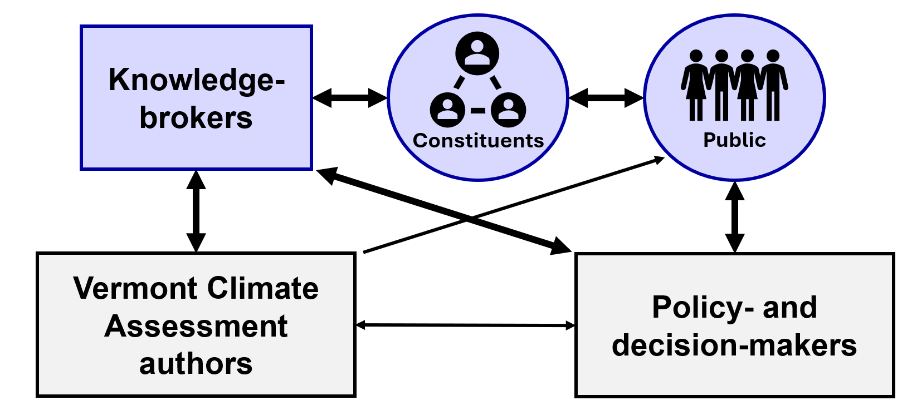
Figure 1-1 Pathways for knowledge co-production in the development of the Vermont Climate Assessment (VCA) and subsequent dissemination of findings. Line thickness indicates the relative frequency and intensity of communication, with thicker lines representing stronger or more frequent interactions
Source: This chapter

Slide 4
1.3 The needs assessment

Slide 5
Table 1-2 Survey responses regarding the thematic group and organizations or types of organizations with whom VCA 2025 knowledge brokers anticipate interacting and sharing information
Theme | Frequency mentioned (%) | Example organizations
Practitioner groups | 14% | Farmers, foresters, stormwater engineers
Practitioner and mission coalitions | 12% | Conservation districts, Deep Root Organic, Renewable Energy Vermont, THRIVE Accountable Community for Health
Non-profit and for-profit organizations | 11% | The Nature Conservancy, Friends of Mad River, New England Forestry Foundation
Municipalities | 10% | Town selectboards, city staff, electric utilities
Public | 9% | Social media, Tribal members, website
Commissions | 8% | Planning, conservation
Professional network | 7% | Staff/colleagues, stakeholders, affiliated organizations
Policymakers | 6% | Advisory groups, legislators, elected leaders
State agencies | 6% | Department of Environmental Quality, Agency of Natural Resources, Agency of Transportation
Land managers | 6% | Landowners, state land managers, forest managers
Committees | 5% | Municipal, energy, climate, zoning
Other | 1–5% | Students, community groups, business owners, research, recreation, emergency management, personal networks
Source: Needs Assessment Survey (2025)

Slide 6
Figure 1-2 Percent (%) of knowledge brokers identifying different desired products for sharing information from VCA 2025 to their respective networks (n=101)
Source: Needs Assessment Survey (2025)

Slide 7
Figure 1-3 Percent (%) of knowledge brokers identifying different levels of engagement with the VCA 2025 process; most knowledge brokers wanted to review chapters or provide data
Source: Needs Assessment Survey (2025)

Slide 8
Figure 1-4 Percent (%) of knowledge brokers that engaged with VCA 2021 and evaluated it in the current needs assessment for its believability, relevance, transparency, and accessibility (n=28)
Source: Needs Assessment Survey (2025)

Slide 9
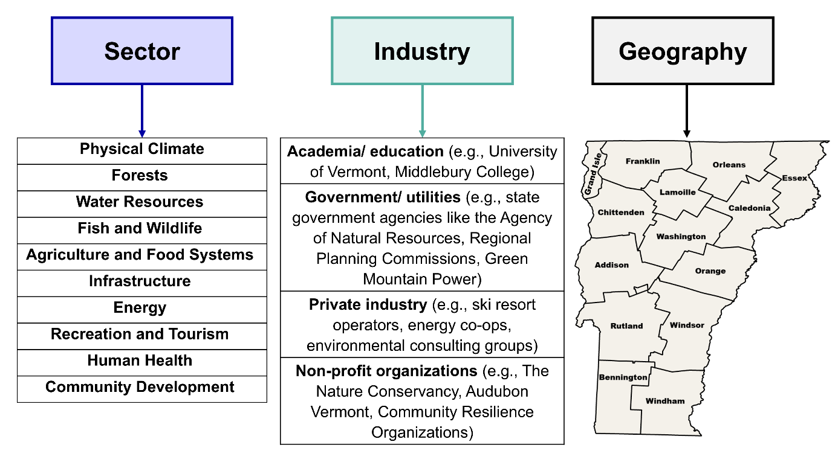
Figure 1-5 Aspects (sector, industry, and geography) used to identify and recruit diverse knowledge brokers
Source: This chapter

Slide 10
Figure 1-6 Percent (%) of knowledge brokers that identify working within each sector; knowledge brokers were able to select all sectors that applied to them (n=101)
Source: Needs Assessment Survey (2025)

Slide 11
Figure 1-7 Percent (%) of knowledge brokers that identify as working within different industries based on their current or most recent employer (n=101)
Source: Needs Assessment Survey (2025)

Slide 12
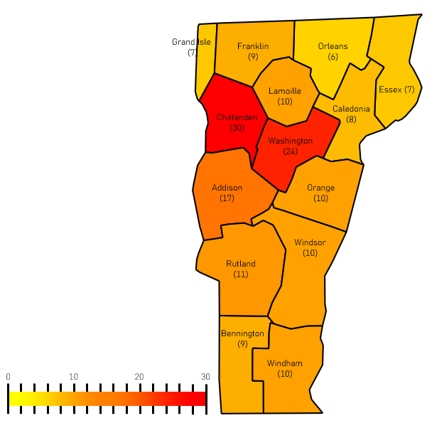
Figure 1-8 Distribution of where knowledge brokers (n=101) stated that they worked by county in Vermont. Shading of county areas increases in redness proportionate to the number of knowledge brokers working there
Source: Needs Assessment Survey (2025)
Note: Knowledge brokers were allowed to select more than one county. Not displayed are the 14 knowledge brokers that reported working outside of Vermont, and the 42 knowledge brokers that reported they worked across the state

Slide 13
Table 1-3 Metric and policy thematic codes created within each sector (or chapter) of VCA 2025
Chapter name | Metric themes | Policy themes
1 Process | NA | NA
2 Climate Change in Vermont | climate metrics, seasonal changes, geographic variability | communication, emissions, modeling
3 Forests | wildfire, forest health, emissions, sequestration | emissions, risk mitigation, land use
4 Water Resources | flooding, surface water monitoring, water availability | adaptive planning, water management
5 Fish and Wildlife | non-invasive species, invasive species | non-invasive species, invasive species
6 Agriculture & Food Systems | extreme weather, production, food security | emissions, management/ resilience
7 Infrastructure | emissions, impacts, urban development | awareness, design/ adaptation, urban development
8 Energy | emissions, impacts, transition | adaptation, emissions, transition, local planning
9 Outdoor Recreation and Tourism | rainfall/temperature, snow, tourism industries, wildlife | planning/budgeting
10 Human Health | impacts, data, disease, mental health, temperature, vulnerable populations, wildlife/ air quality | connection, education, investments
11 Community Development | impacts, vulnerable populations, economics, adaptation, town planning | adaptation, development, economics, local planning, vulnerable populations, migration
Source: Needs Assessment Survey (2025)

Slide 14
1.4 Writing the VCA

Slide 15
Table 1-4 The confidence level (very high, high, medium, or low) is determined using two parameters—evidence level and consensus level—which contribute to the traceable accounts section of each chapter
Confidence level | Very high | High | Medium | Low
Evidence level | Strong evidence: established theory, multiple resources, confident results, well-documented and accepted methods, etc. | Moderate evidence: several sources, some consistency, methods vary, and/or documentation limited, etc. | Suggestive evidence: a few sources, limited consistency, models incomplete, methods emerging, etc. | Inconclusive evidence: limited sources, extrapolations, inconsistent findings, poor documentation and/or methods not tested, etc.
Consensus level | High consensus | Medium consensus | Competing schools of thought | Disagreement or lack of opinions among experts
Source: USGCRP (2023)

Slide 16
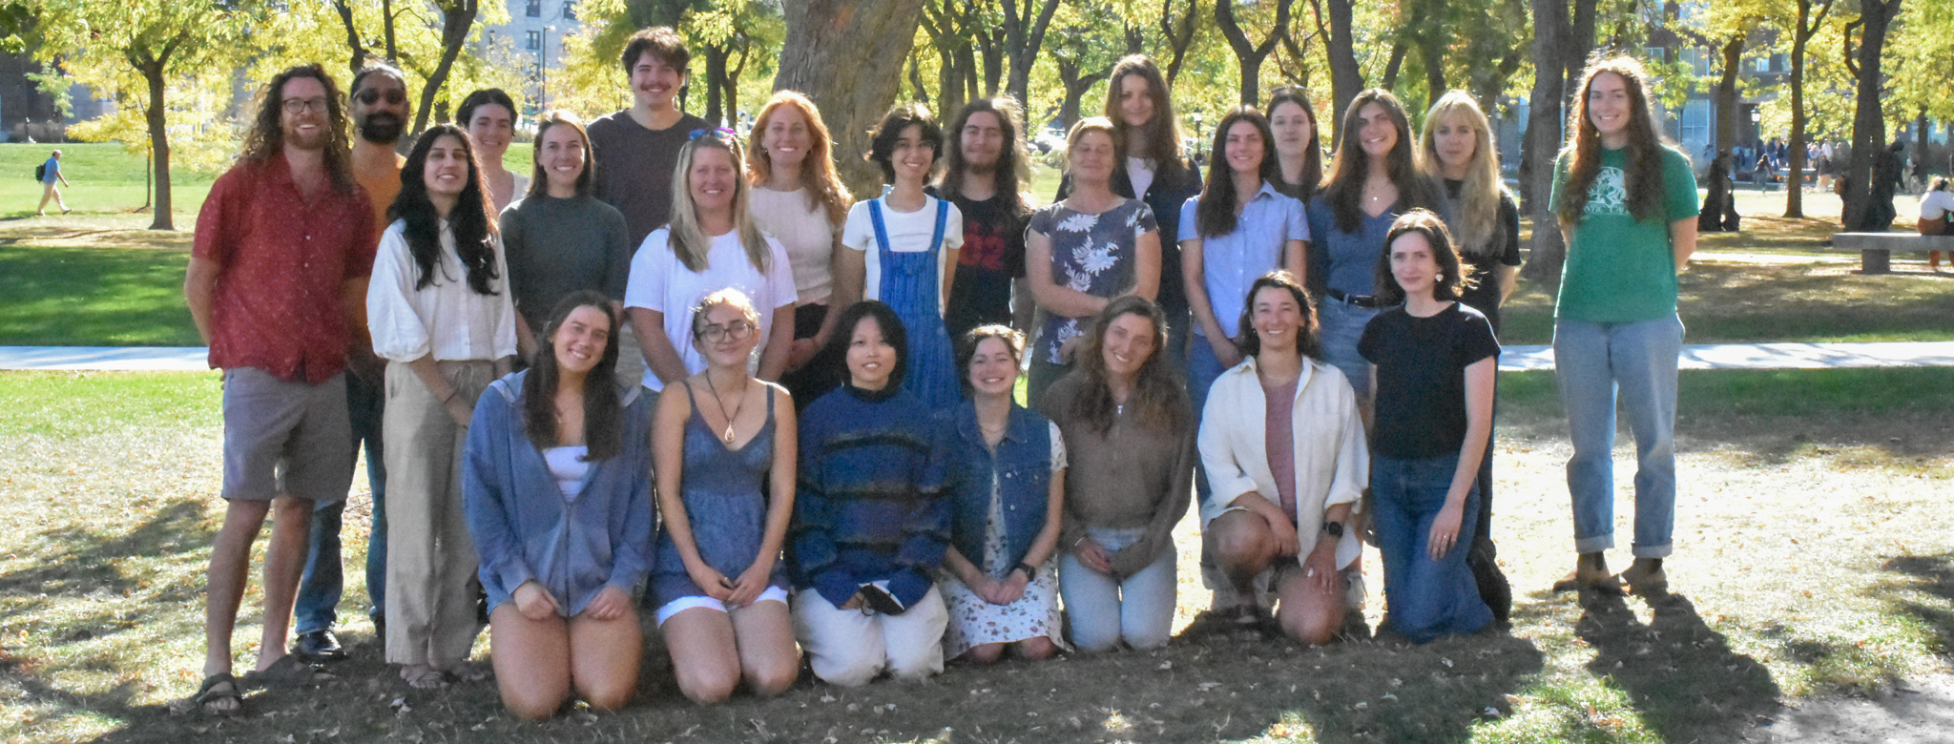
Figure 1-9 Photo of the Vermont Climate Corps (VCC) and Climate Measurements Center of Excellence (CMeC) Director, Dr. Gillian Galford, CMeC Postdoctoral Researcher, Dr. Jessica Balerna, and CMeC Program Manager, Lola Chen
Source: Lauren Milideo (2025)

Slide 17
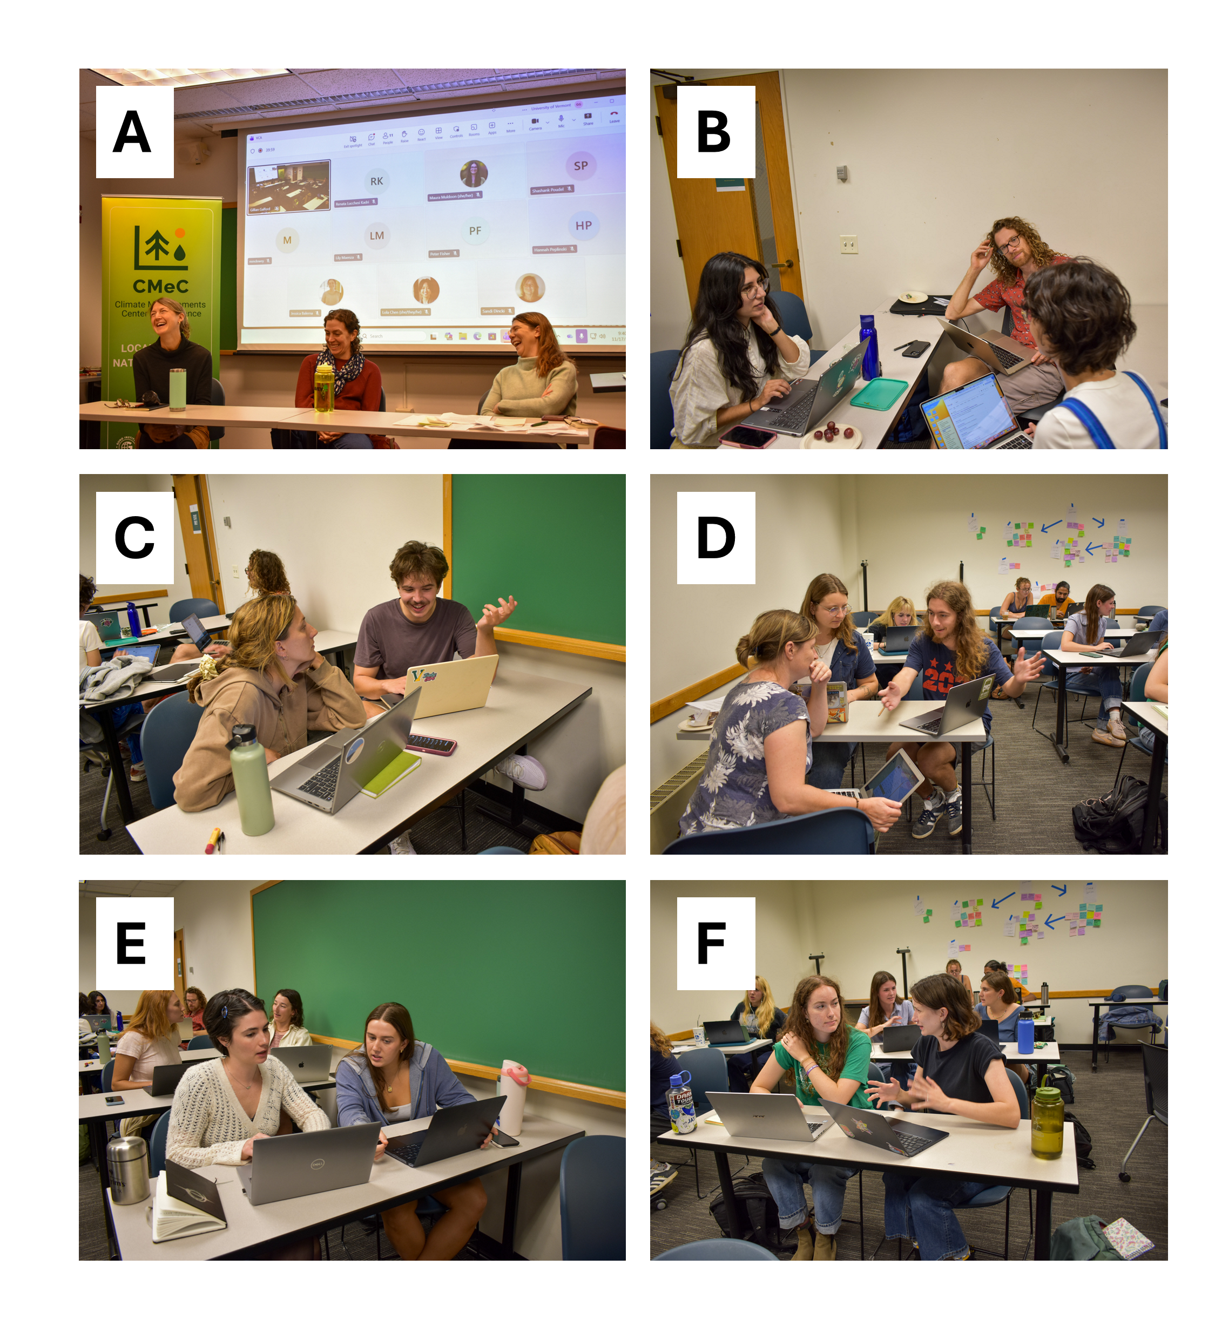
Figure 1-10 Photos from the Climate Assessment Practicum course: photo A) Previous VCA authors Jess Wikle (in-person middle), Ann Telep (in-person, left), and Kristen Underwood (virtual) participating in a panel discussion of their career trajectories after working on a previous VCA chapter; the panel was moderated by Amanda Sardonis (in-person, right); photos B–F) authors engage with one another as they discuss their chapter drafts
Source: Lauren Milideo (2025)

Slide 18
Table 1-5 List of Climate Assessment Practicum course presenters and the skills they shared with students (1/2)
Skills | Presenter
Team-based science: Working effectively and collaboratively on an interdisciplinary team | Dr. Jessica Balerna, Climate Impacts Postdoctoral Fellow with the Climate Measurements Center of Excellence; Former Graduate Fellow with the Socio-Environmental Synthesis Center
Crisis and risk communication: Translating complex climate change impacts and uncertainty into memorable stories | Dr. Rodrigo Soares, Crisis and Risk Communication Postdoctoral Fellow with the Water Resources Institute
Systems thinking: Mapping climate change impacts to specific and salient metrics | Dr. Kate Brauman, Deputy Director of the Global Water Security Center at the University of Alabama
Literature review and citation management: Conducting reviews for report writing and team citation management | Laurie Kutner and Dan Desanto, Information & Instruction Librarians with the Howe Library
Data visualizations and accessibility: Creating message-driven visualizations that meet the needs of all readers | Kristin Florian, Data Visualization Specialist with the Howe Library Audrey Clare Homan, Digital Accessibility Specialist with the Office of Accessibility Services
Reaching policy- and other decision-makers: Connecting the Vermont Climate Assessment to state policy- and other decision-makers | Liz Amler, Climate Planning Administrator with the Vermont Climate Action Office, Agency of Natural Resources
Source: This chapter

Slide 19
Table 1-5 List of Climate Assessment Practicum course presenters and the skills they shared with students (2/2)
Skills | Presenter
Translating the VCC to the job market: How to leverage experiences writing the VCA in future career and research opportunities | Ann Telep, VCA 2014 Chapter Author, Senior Program Manager, The Climate Pledge for Amazon Dr. Jess Wikle, VCA 2021 Chapter Author, Research Forests Manager, University of Vermont Dr. Kristen Underwood, VCA 2014 Chapter Author, Research Assistant Professor, University of Vermont
Crafting communication products: Creating and disseminating communication products designed for diverse audiences | Marsha A. Branch, School of the Arts, University of Vermont; Former Producer, BBC and United Nations Brittany Patterson, Director of Communications, Gund Institute for Environment Lauren Milideo, Strategic Communications Manager, Gund Institute for Environment Amanda Sardonis, Director of Policy and Partnerships, Gund Institute for Environment
Source: This chapter

Slide 20
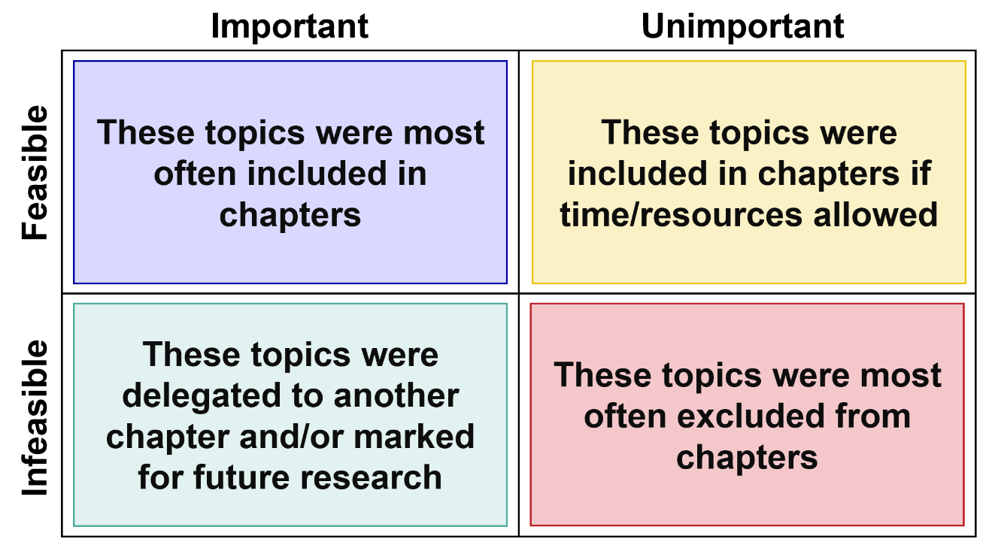
Figure 1-11 The feasibility and importance matrix that VCA 2025 chapter teams used to prioritize topics in their chapter outlines
Source: This chapter

Slide 21
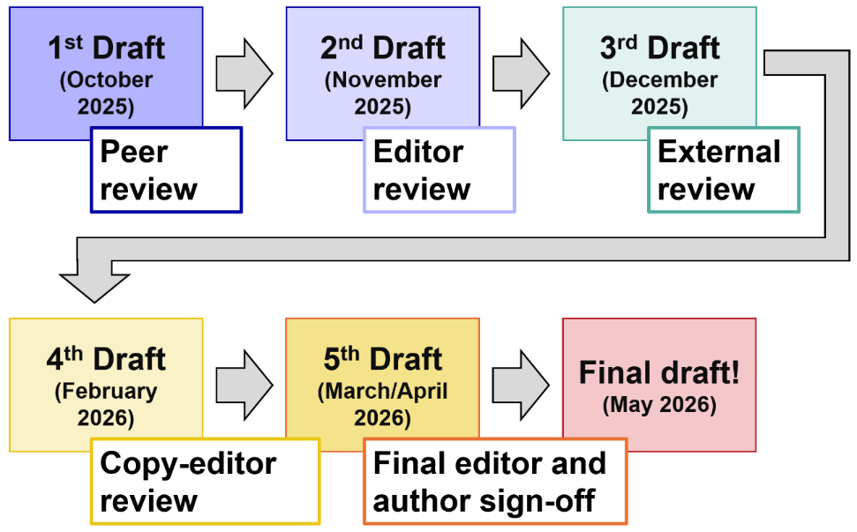
Figure 1-12 Timeline of VCA 2025 chapter draft writing, editing, and review
Source: This chapter

Slide 22
Table 1-6 List of Climate Assessment Practicum course presenters and the skills they shared with students
Chapter name | Number of knowledge brokers engaged
1 Process | 2
2 Climate Change in Vermont | 2
3 Forests | 10
4 Water Resources | 17
5 Fish and Wildlife | 21
6 Agriculture & Food Systems | 29
7 Infrastructure | 13
8 Energy | 6
9 Outdoor Recreation and Tourism | 8
10 Human Health | 10
11 Community Development | 14
Source: This chapter
Note: Some knowledge brokers engaged with multiple chapters and are counted in each chapter they contributed to

Slide 23
1.5 Report limitations and calls to action

Slide 24
Table 1-7 Estimated percentage (%) of the topics requested in the needs assessment that were covered or quantitatively estimated via metrics within each chapter
Chapter name | Topics covered (%) | Topics with metrics (%)
Climate Change in Vermont | 75% | 70%
Forests | 45% | 27%
Water Resources | 70% | 55%
Fish and Wildlife | 70% | 20%
Agriculture and Food Systems | 85% | 30%
Infrastructure | 75% | 50%
Energy | 70% | 50%
Outdoor Recreation and Tourism | 60% | 25%
Human Health | 80% | 80%
Community Development | 70% | 12%
Average across chapters | 70% | 42%
Source: This chapter

