Slide 1
Rodent Anesthesia & Analgesia
Animal User Meeting
February 17, 2022
Ida M Washington, DVM, PhD, DACLAM
University Veterinarian and Director
Office of Animal Care Management
The University of Vermont

Slide 2
OUTLINE
USDA Pain Categories
B → E
Rodent Anesthesia
General Concepts
Rodent Anesthetics
Inhalant
Injectable
Topical
Rodent Analgesia
General Concepts
Rodent Analgesics
Opioids
NSAIDs
Multimodal

Slide 3
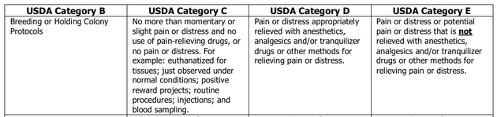
USDA Pain Categories
Examples…

Slide 4
B | C | D | E
Breeding (parents only) | Holding, weighing, PE | Survival or non-survival surgery | Infectious disease or cancer w/ clinical symptoms or death
Holding protocol | Injections, blood sampling, catheter | Laparoscopy, renal biopsy | Eye or skin irritancy testing
 | Tattooing, ear punch | Retro-orbital blood collection | Excessive food or water deprivation
 | Behavior observation | Terminal cardiac blood collection | Unavoidable shock or other noxious stimuli
 | Feeding studies | Exsanguination under anesthesia | Infliction of burns or trauma
 | Humane euthanasia | Induced infections that involve pain | Prolonged restraint
 | Routine ag animal & husbandry procedures | Antibody production that involves pain | Use of paralytics for restraint
 | Live trapping | Any painful procedure | Exposure to extreme environment
 | Positive reward projects |  | Euthanasia by non-AVMA methods
 | Only momentary pain/distress | Above w/ anesthesia +/or analgesia | No anesthesia or analgesia provided

Slide 5
Rodent Anesthesia
• General Concepts
Anesthesia = loss of sensation; insensitivity to pain.
- General Anesthesia = pharmacologic state involving amnesia,
immobility, unconsciousness, and analgesia.
- Local Anesthesia = loss of sensation and nociception
in a discrete area of the body.

Slide 6
Rodent Anesthetics
• Inhalant (gas) anesthetics
- isoflurane
• Injectable anesthetics
- ketamine
- pentobarbital Na
- tribromoethanol
- urethane, chloral hydrate, α-chloralose
• Local anesthetics
- lidocaine, bupivacaine
• Hypothermia
- neonates only

Slide 7
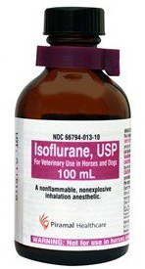
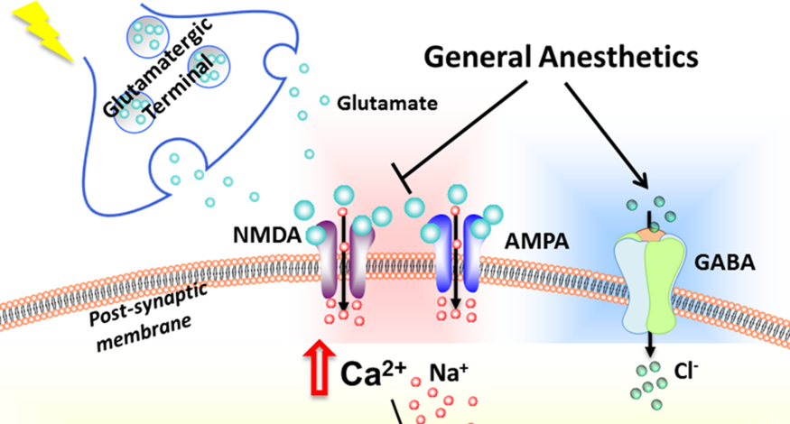
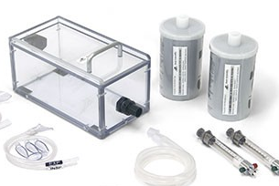
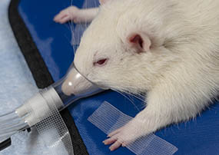
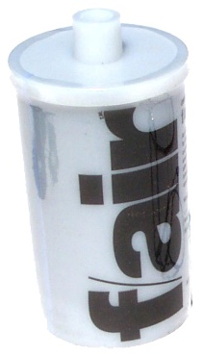
Isoflurane
How it works
binds to GABA, glutamate, glycine receptors
↓ motor function, ↓ pain sensitivity
How to administer
inhalation, 3-5% induction, 1-3% maint in air or O₂
induction chamber, nose cone
“open-drop” method not allowed for anesthesia
Advantages
rapid anesthesia, rapid recovery
can titrate to effect
Disadvantages
no residual analgesia
WAGs – hazardous, must be scavenged

Slide 8
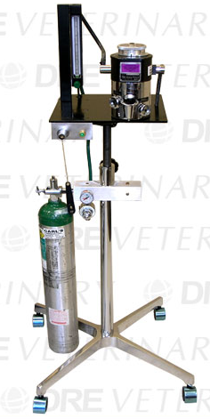
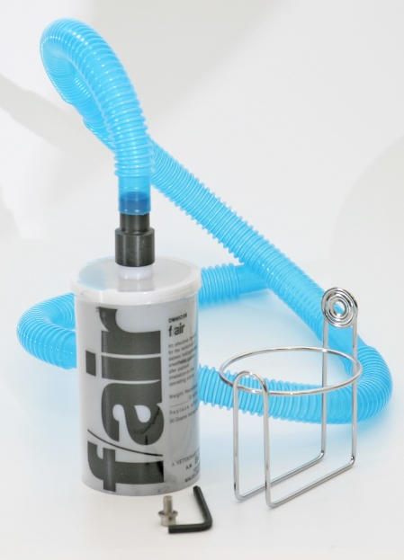
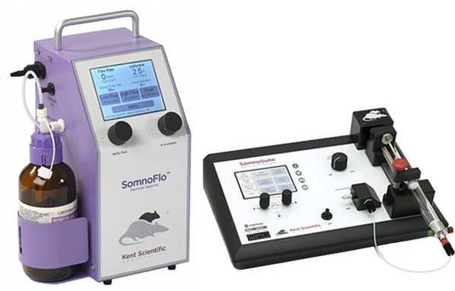
Standard isoflurane machine
- O₂ gas tank
- vaporizer
- O₂ flow meter
- scavenging cartridge
Demo by OACM Vet techs
Low-flow isoflurane machine
- uses room air (can use tank)
- isoflurane in syringe or bottle
- touchpad calculates flow
- no annual certification
- min/no WAG
Rep to visit UVM soon…

Slide 9
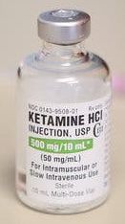
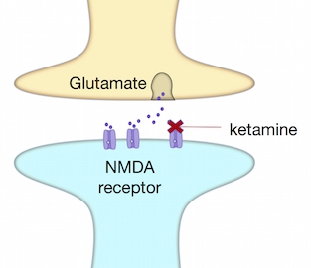
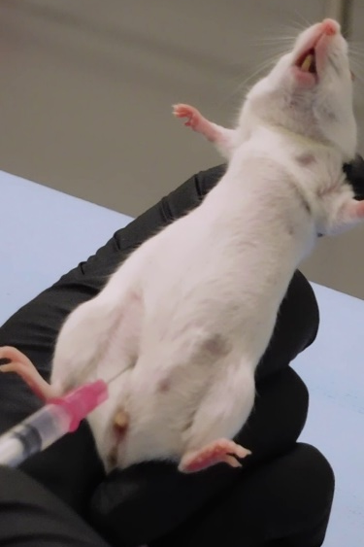
Ketamine
How it works
blocks NMDA channels in CNS
↓ presynaptic glutamate release & action
“dissociative” anesthetic – pain relief, sedation, amnesia
How to administer
usually given IP with α2 agonist (xylazine, medetomidine)
mouse: 100-120mg/kg Ketamine + 10mg/kg Xylazine
rat: 40-80mg/kg Ketamine + 5-10mg/kg Xylazine
Advantages
K: minimal resp depression; stimulates CV system
fairly rapid induction; stable anesthesia; avoids resp tract
K/X: analgesia post-anesthesia; X can be reversed
Disadvantages
limited duration: 30-40 min in rodents, then re-dose (only K); hard to titrate
Insufficient anesthesia in some mouse strains
CS – Schedule III; abused for hallucinogenic & dissociative effects

Slide 10
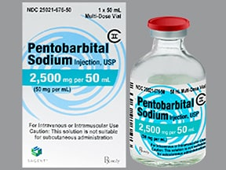
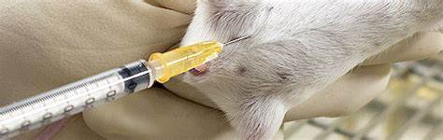
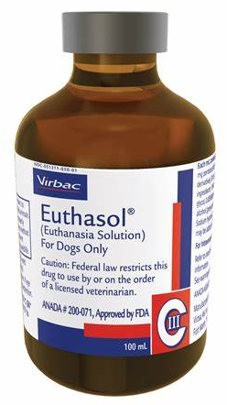
Pentobarbital Na
How it works
short-acting barbiturate
binds to CNS GABA receptors; synaptic inhibition
How to administer
Mouse: 60-80mg/kg IP
Rat: 30-60mg/kg IP
Advantages
30-40 min surgical anesthesia
good for neurophysiology recording, visual/auditory ERs
Disadvantages
CV & respiratory depression; narrow margin of safety
limited supply; expensive; poor analgesia
CS – Schedule II; sedative, highly addictive

Slide 11
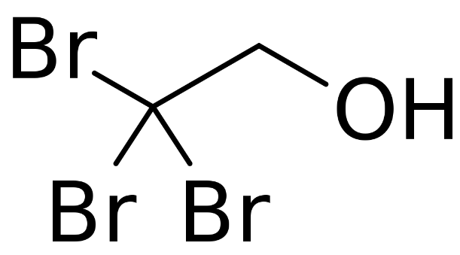

2,2,2-Tribromoethanol (TBE)
How it works
modulates GABA_{A} and glycine receptors
suppresses CNS resp & CV centers
previously sold as Avertin® (no longer available)
How to administer
Mouse: 250mg/kg IP
Rat: can use alone, but best if combined w/ medetomidine
Positives
inexpensive; non-DEA
rapid surgical anesthesia, lasts 15-20 min
Negatives
degrades in heat/light, nephrotoxic, hepatotoxic byproducts; refrigerate/dark
non-pharmaceutical, formulation variable; no residual analgesia
GI effects, peritonitis, high mortality after repeat dosing; no repeat survival Sx

Slide 12
Urothane, Chloral hydrate, α-chloralose
How it works
Exact mechanism unclear; ↑ function of GABA_{A} and glycine receptors
Inhibit NMDA and glutamate receptors
How to administer
Mouse: 1.5g/kg IP
Rat: 1.3-1.5g/kg IP or slowly IV
usually given after induction with isoflurane
Positives
inexpensive; non-DEA
long duration anesthesia (up to 24hr), e.g., for neural recording
preserve autonomic reflexes; minimal depression of resp, CV
Negatives
terminal use only
non-pharmaceutical; variability b/w batches
hazardous chemicals (carcinogen, mutagen); use fume hood

Slide 13
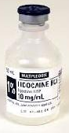
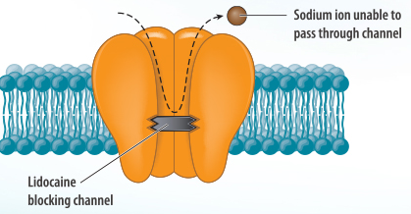
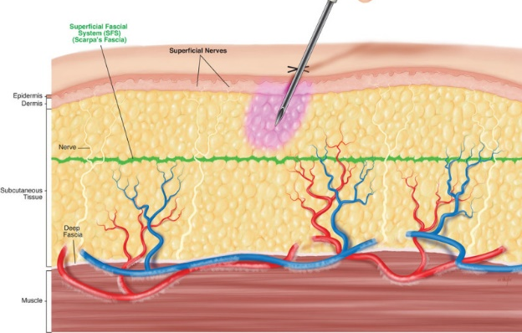
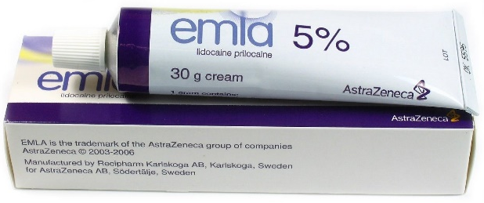
Lidocaine/Bupivacaine
How it works
Blocks Na⁺ passage thru nerve membrane, ↓ local nerve conduction
Lidocaine – fast onset, 1hr analgesia
Bupivacaine – slow onset, 6-8hr analgesia
How to administer
Mouse, rat: SC/intra-incisional - up to 7mg/kg
Topical – EMLA cream (lidocaine-prilocaine)
generic available
Advantages
Augments effect of postop analgesics
Non-DEA
Provides pain relief when other analgesics interfere with research
Disadvantages
Avoid IM/IV – can cause systemic toxicity, CV effects

Slide 14
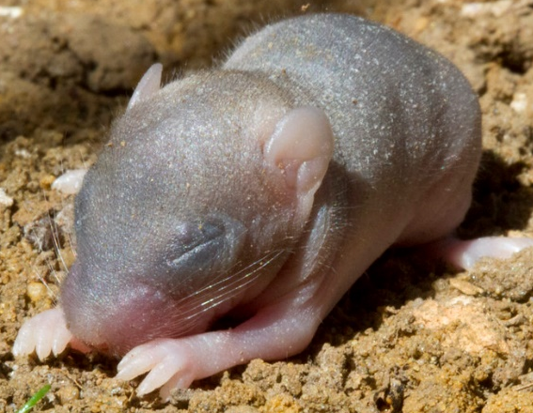
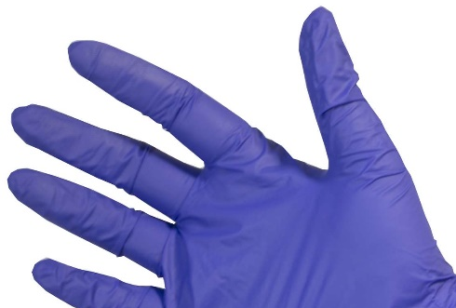
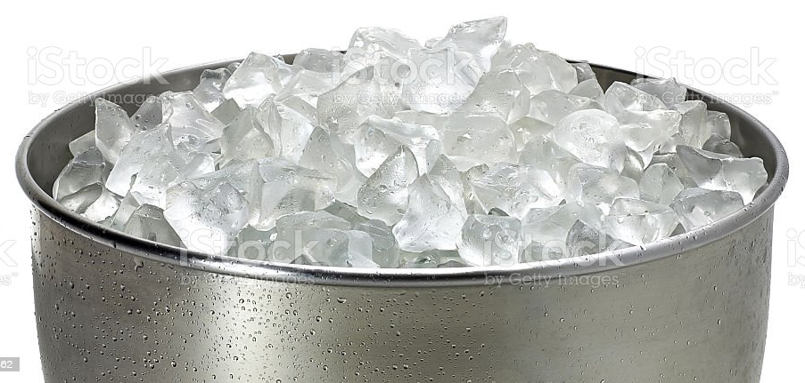
only for neonates ≤6 days old
Hypothermia
How it works
↓ neural conduction
↓ synaptic transmission
How to administer
cut off finger of latex glove, insert pup
place on crushed ice (no direct contact)
rewarm slowly
Advantages
works for short (5-15 min) minor surgical procedures
pups tolerate low temp, min/no long-term effects
no special equipment needed
Disadvantages
poor control of anesthetic depth
potential tissue damage

Slide 15
Rodent Analgesia
• General Concepts
Analgesia = absence of pain sensation.
- If it’s painful for a human, assume it’s painful for an animal.
- Rodents are prey species, instinctively hide signs of pain.
- Non-survival procedure under anesthesia – no analgesics needed.
- Survival procedure under anesthesia:
Pre-emptive analgesia → therapeutic levels at recovery, avoids “ramp-up”
Caution!
K/X anesthesia – don’t give buprenorphine until awake

Slide 16
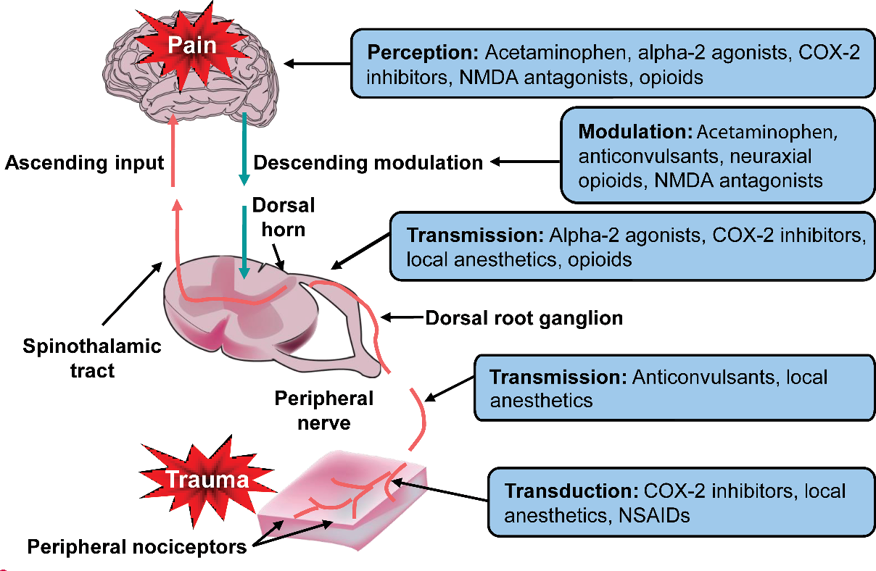

Slide 17
Rodent Analgesics
• Opioids
- buprenorphine
- (butorphanol)
• NSAIDs
- ketoprofen
- carprofen
- meloxicam
• Multi-modal

Slide 18
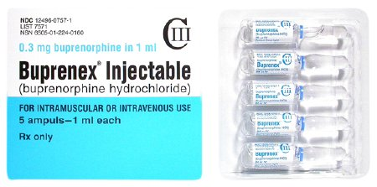
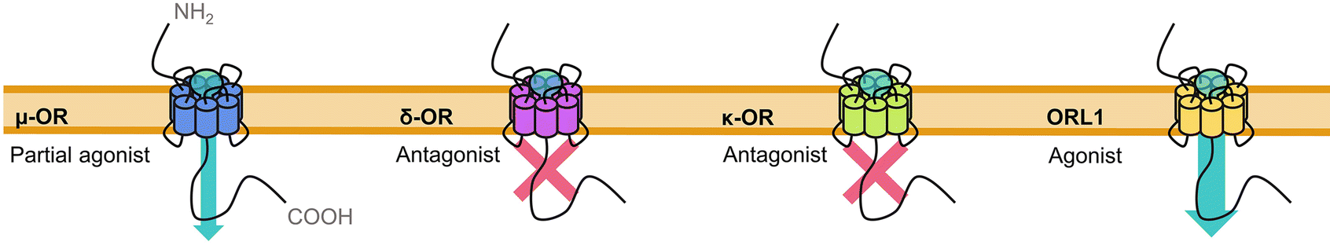
Buprenorphine
How it works
Opioid; mixed agonist/antagonist at different opioid receptors:
partial µ agonist, δ antagonist, κ antagonist, opioid-like receptor agonist
How to administer
Mouse: 0.1 mg/kg SQ or IP
Rat: 0.05 mg/kg SQ or IP
Advantages
Potent analgesic
Use with isoflurane lowers isoflurane requirement
Disadvantages
Respiratory suppression; Pica in rats
Duration 4-6 hr in mice; need slow-release bupe for longer duration
CS – Schedule III

Slide 19
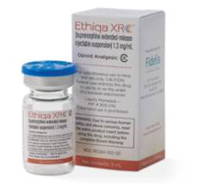
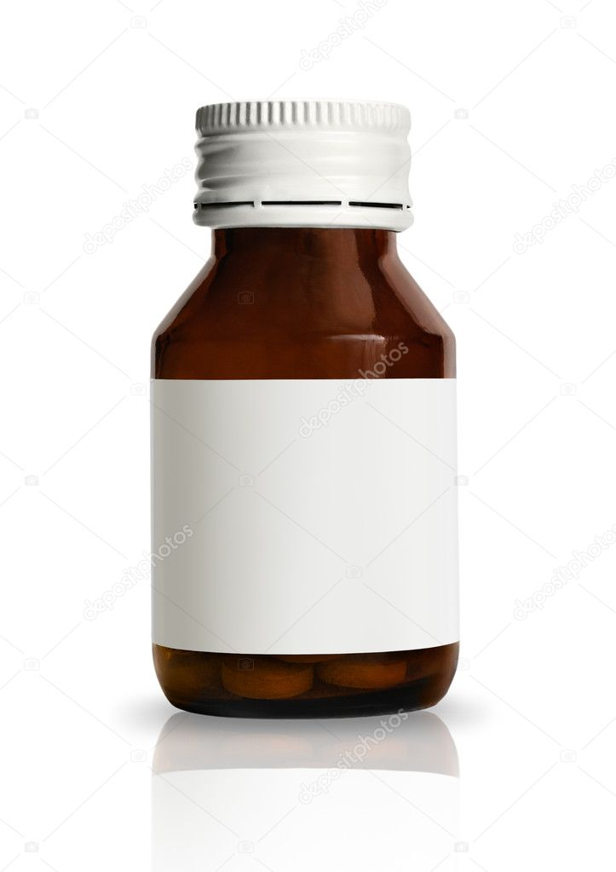
Slow-release Buprenorphine
Mouse, Rat: 1.0 mg/kg SQ – lasts ~48hr
Ethiqa XR
Midwest Veterinary Supply
Buprenorphine-SR-LAB
ZooPharm compounding pharmacy
Viscosity: ++ +++
Refrigeration: no no
20g mouse: $1.92/dose $0.48/dose

Slide 20
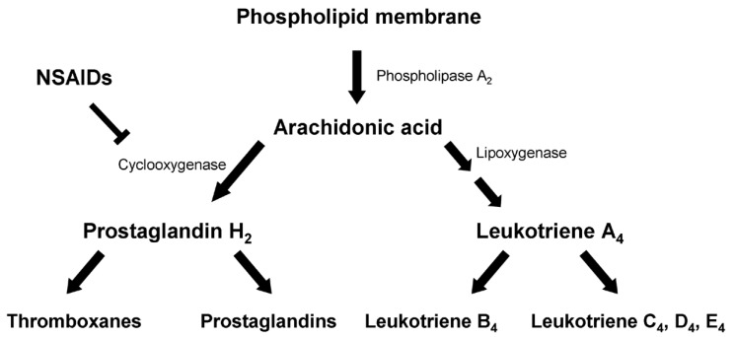
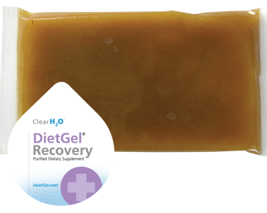
NSAID (ketoprofen, carprofen, meloxicam, etc)
How it works
NSAIDs inhibit cyclooxygenase
COX-1 [constitutive]
COX-2 [induced in inflammation])
COX-2 inhibition:
meloxicam > carprofen > ketoprofen
How to administer
Meloxicam: 5mg/kg (M), 1-2mg/kg (R) SQ, IP, PO
Carprofen: 5mg/kg (M, R) SQ, IP
Ketoprofen: 2-5mg/kg (M), 2-3mg/kg (R) SQ, IP
all q24hr
Advantages
Reduce fever/inflammation, provide analgesia for 24hr/dose
Non-DEA
Disadvantages
Decreases clotting; may interfere with embryo implantation (esp COX-2 inhib)
Can cause gastric ulcers, kidney/liver disease w/ chronic use (esp COX-1 inhib)

Slide 21
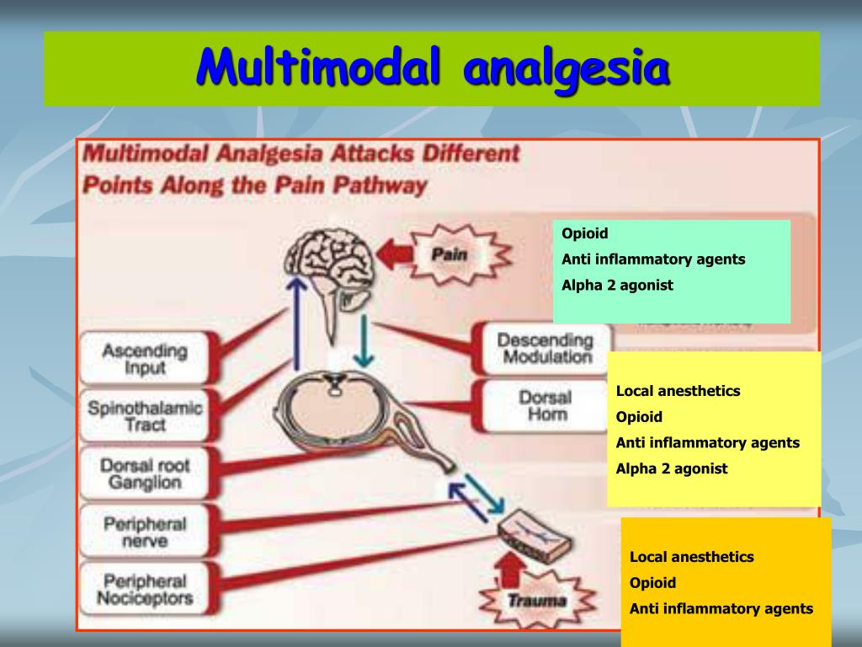
Multimodal analgesia
How it works
Opioid + NSAID (+ local anesthetic)
Act at different points along pain
pathway
How to administer
Provide using standard routes
Can use reduced dose of opioid
Advantages
Multiple mechanisms to reduce pain
Opioid-sparing, increases safety
Disadvantages
More drugs and procedures to manage

Slide 22
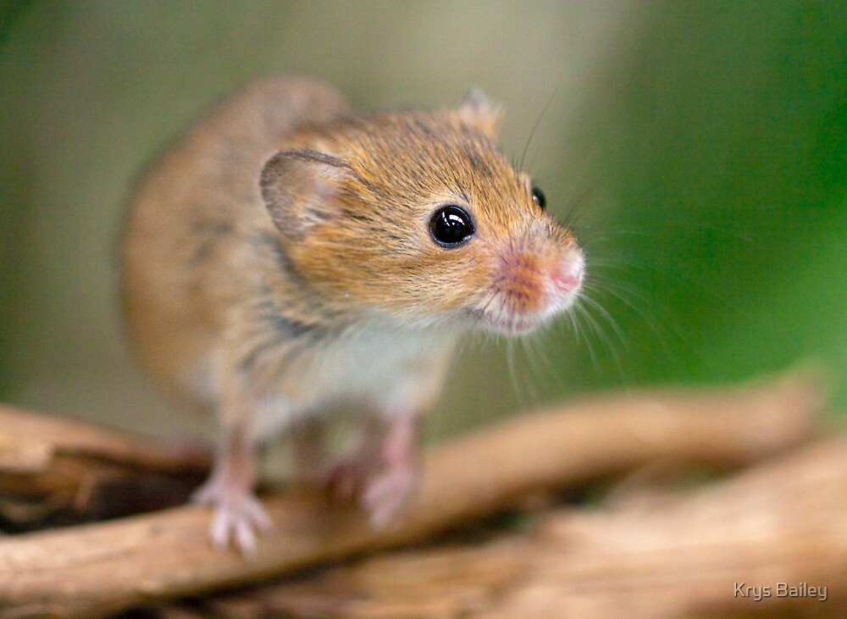
Thank you!

Slide 23



