Slide 1
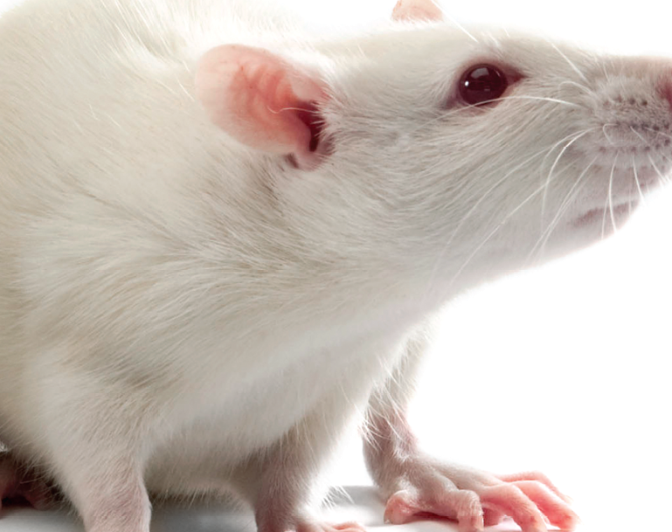
Institutional Animal Care and Use Committee

Slide 2
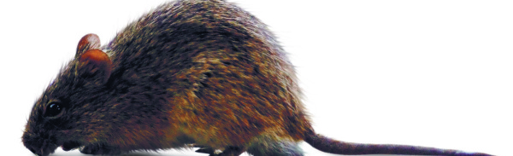
The Basics
At UVM, >97% of the animals used in research are rats and mice.
Members of the IACUC are appointed by UVM’s Vice President for Research
IACUC must review and approve ALL animal use in teaching and research prior to any work with animals.
The IACUC Committee at UVM consists of scientists, non-scientists, biosafety experts, statisticians, community members, and a veterinarian.

Slide 3
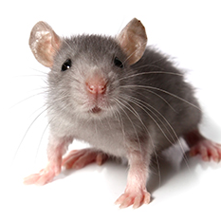
IACUC Purpose and Responsibilities
Oversight of every aspect of animal use for research and teaching at the institution
Maintain and review UVM, state, and government policies regarding use of animals at UVM
Conduct inspections to ensure that all UVM facilities involved in animal use are maintained adequately.

Slide 4
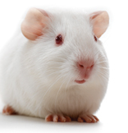
What does the IACUC do?
Meet monthly
Inspect (semiannually) all UVM animal facilities
Review animal welfare concerns
Review and approve all animal use in teaching and research prior to any work being done with animals.
Review each animal use protocol Triennially to ensure all work is conducted appropriately.
Review the entire UVM animal care program on a semiannual basis

Slide 5
IACUC
Oversees and evaluates the institution’s animal care and use program. Ensures compliance with AWA and PHS
AAALAC
Voluntary accreditation that shows an institution has achieved excellence in animal care and use.
Public Heath and Safety (PHS) Provides oversight of all federally funded research projects (NIH, NASA, NFA, FDA). Covers all species
Office of Laboratory Animal Welfare (OLAW)
Administration and coordination of the PHS Policy/oversight of all PHS supported animal research projects.
Animal Welfare Act (AWA)
Sets minimal standards for housing, feeding, handling, and veterinary care. Excludes: rats, mice, fish, reptiles, amphibians, ag animals, and certain birds
USDA/APHIS
Enforces AWA. Conducts yearly unannounced inspections on facilities that use animals covered in the AWA

Slide 6
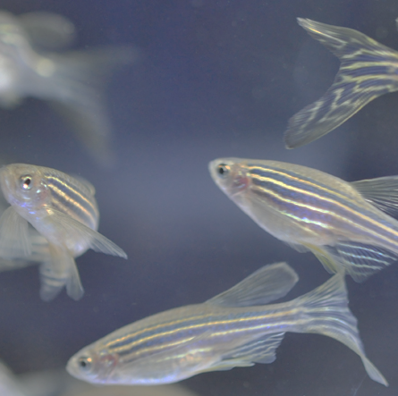
The Three Rs in Animal Research
Reduction
Refinement
Replacement

Slide 7
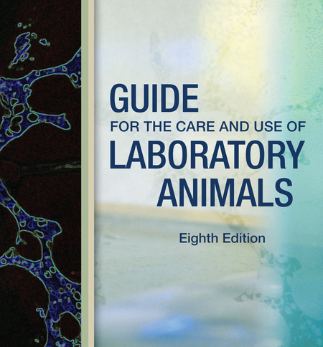
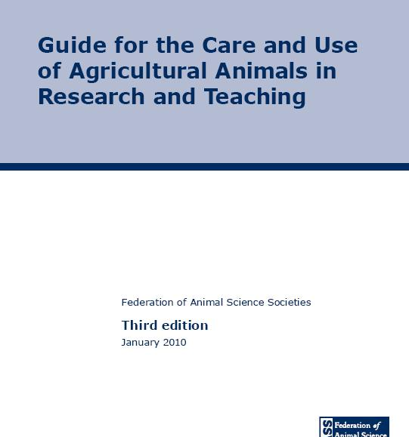

Slide 8
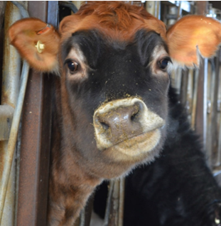

USDA Pain Levels
The USDA has designated pain levels that are used to classify the level of potential pain or distress in an animal use protocol
Pain levels determine the level of review required.
Our IACUC uses these categories regardless of species

Slide 9

Training Requirements
IACUC Training is offered through “CITI” (Collaborative Institutional Training Initiative)
Required Training : Optional Training: Other Requirements:

Slide 10
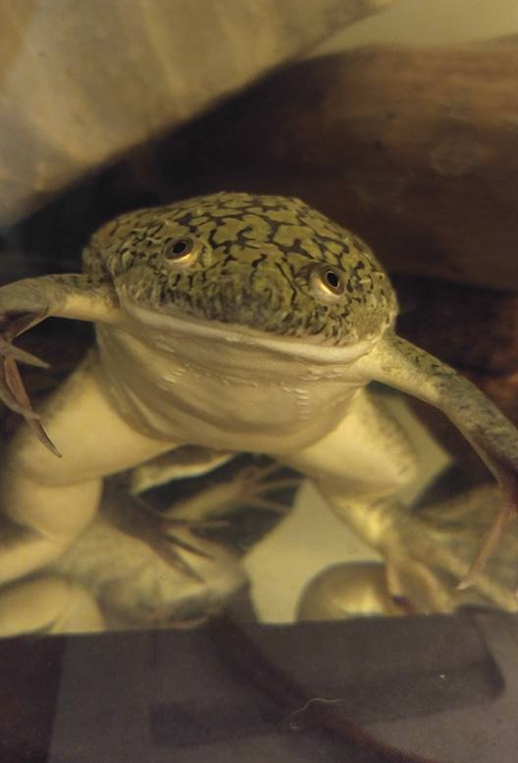
Animal Use Protocol
Document detailing all aspects of the work involving animals
Justification for animal use
Describes species, strains, and numbers of animals to be used
Detailed explanation of procedures
Explains housing, treatment, medications, and care of animals
Details surgery, anesthesia, restraint and euthanasia

Slide 11
Protocol Submission Process
A draft protocol is initially sent to the University Veterinarian for review and approval.
The draft protocol is returned to the investigator with a written review and a copy of
the protocol with tracked changes. The veterinarian must sign the protocol.
After revisions are made, a final document is submitted to the IACUC for review. A grant,
If applicable, must be submitted as well
A pre-review by a research analyst is conducted and the protocol is added to the next available agenda.

Slide 12
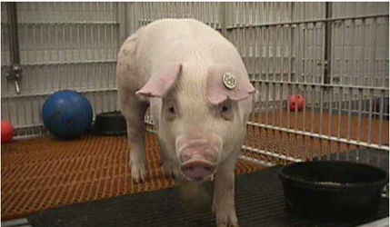




Designated Review Process (pain level B or C)

Slide 13
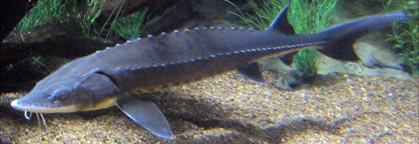





Full Committee Review Process (pain level D or E)

Slide 14
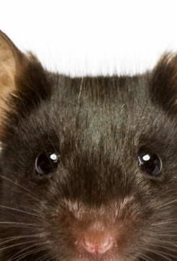
Protocol Maintenance
IACUC protocols require a basic annual review with a more in-depth review triennially.
Any change to the protocol must be submitted on an amendment form to the IACUC for approval before those changes are implemented. An updated/revised protocol must accompany each amendment form.
Key personnel rosters must be kept up to date. Personnel additions to the roster must be submitted and approved by the Committee before those individuals can work in the lab.

Slide 15
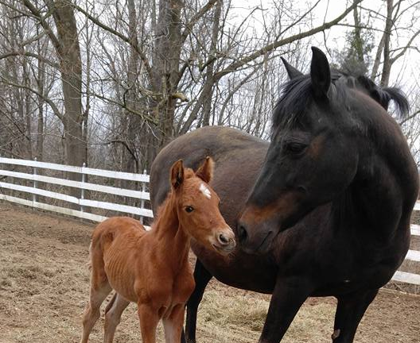
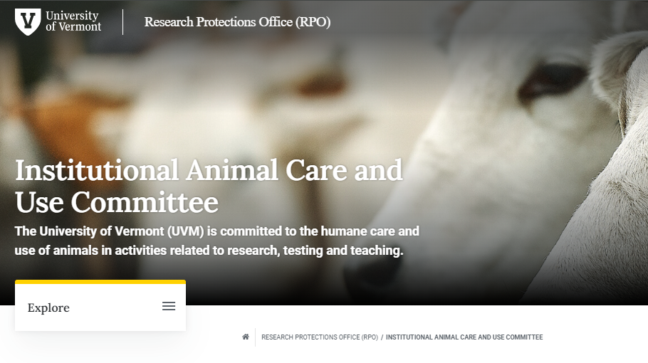
WWW.uvm.edu/rpo/
Additional information, forms,
and contact information is
available on the RPO website

