Slide 1
Controlled Substance Use in Research

Slide 2
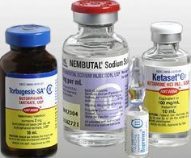
Steps to be approved to use Controlled Substances in Research
First step: Obtain registration from the DEA
Registration is research-specific
Must be renewed annually
Second step: Obtain a UVM CSC Registration

Slide 3
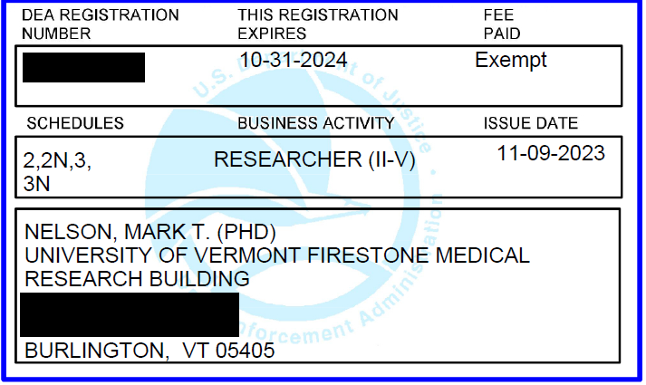
DEA Registration
Registrations expire yearly
Research registrations are exempt from fees
Identifies what schedule (abuse potential) PI is approved for

Slide 4
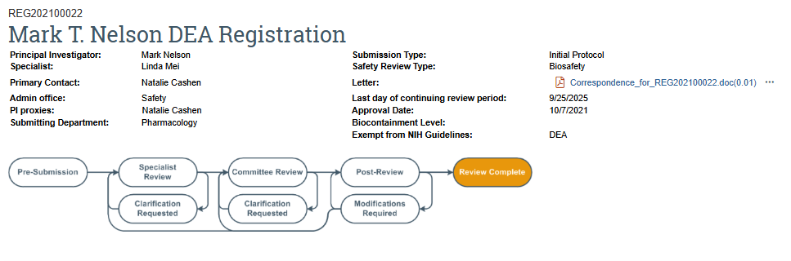
UVMClick: CSC Registration
Includes information such as:
1. Location
2. Approved personnel
3. Approved drug(s)
4. IACUC Protocol Number
5. Expiration date

Slide 5
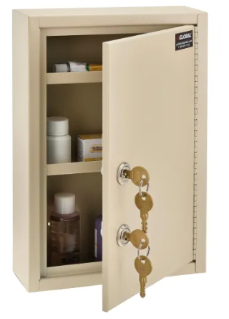
1. Location
Controlled substances must be:
Stored in a double locked box
Stored in the room listed on the CSC and DEA registration
Used in the same building as noted on registration
Stored in a lockbox designated for one PI only
**Most CS are stable at room temperature once diluted

Slide 6
2. Key Personnel
All personnel handling controlled substances MUST be listed on the CSC registration

Slide 7
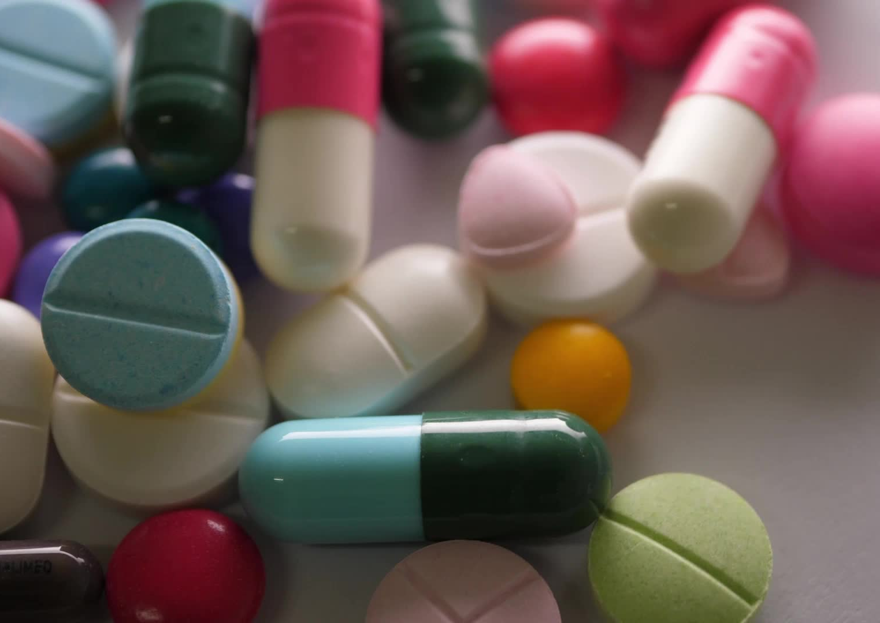
3. Approved Drugs
Only drugs listed on the CSC Registration can be ordered through purchasing
Different formulations will require an amendment.
Drugs must be within date to be used, even for non-survival procedures.
Prohibited by OLAW, USDA, AVMA

Slide 8
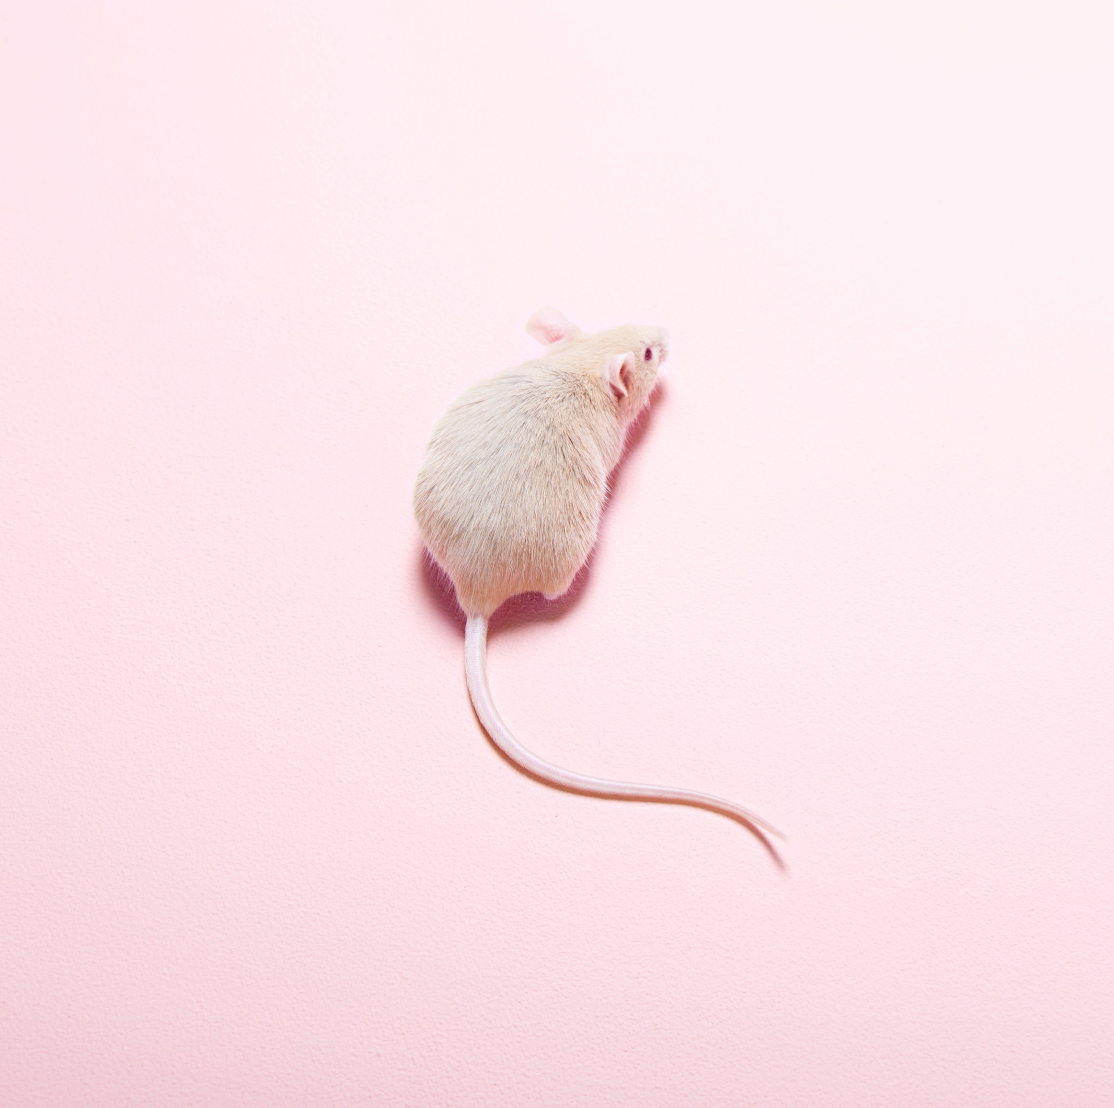
4. IACUC Protocol Number
All related IACUC protocol numbers must be linked
PI on the IACUC protocol must be the same as the CSC
All controlled drugs listed in the CSC registration must be approved on an IACUC protocol

Slide 9
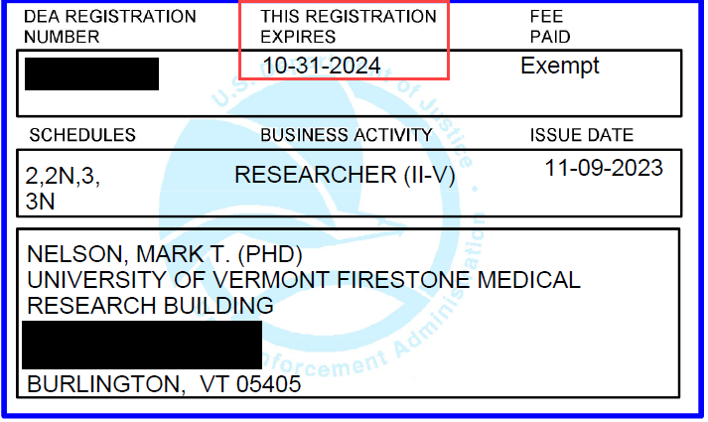
5. Expiration Date
When the DEA registration expires, the CSC registration must be amended with the updated/renewed registration

Slide 10
How to Order Controlled Substances
Purchases MUST be made using a UVM Purchase Order
The Purchasing Department always contacts RPO to ensure the lab has approval
RPO checks the registration, approved drugs, expiration date, and personnel training
When the order comes in, the invoice must be saved

Slide 11
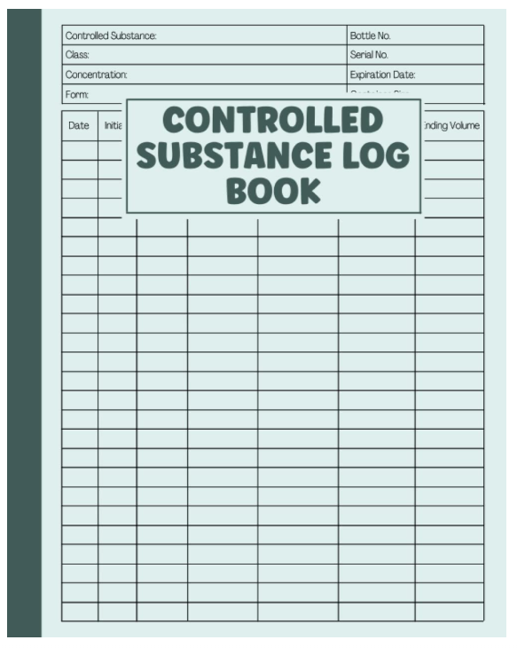
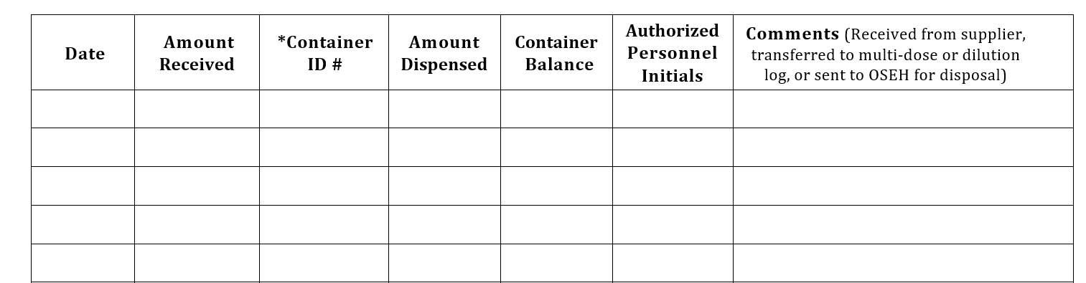
Controlled Substance Logs
A usage log must be kept for controlled substances
A separate log must be maintained for each drug
Separate page for stock bottle and diluted drug
A three-ring binder is acceptable, a fixed page notebook is recommended
Record date used, volume used, remaining volume, and initials

Slide 12
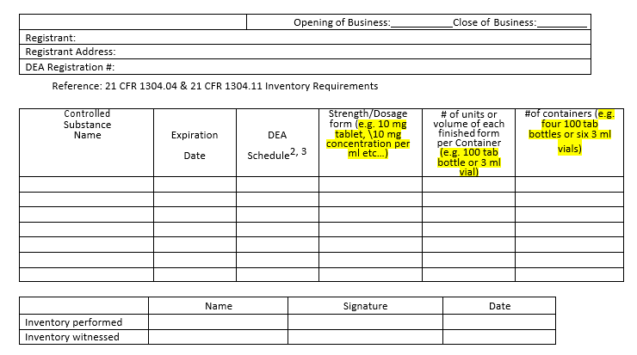
Inventory
The DEA requires an inventory form to be completed every 2 years
For busy labs, this can be completed MONTHLY to help manage expiration dates.

Slide 13
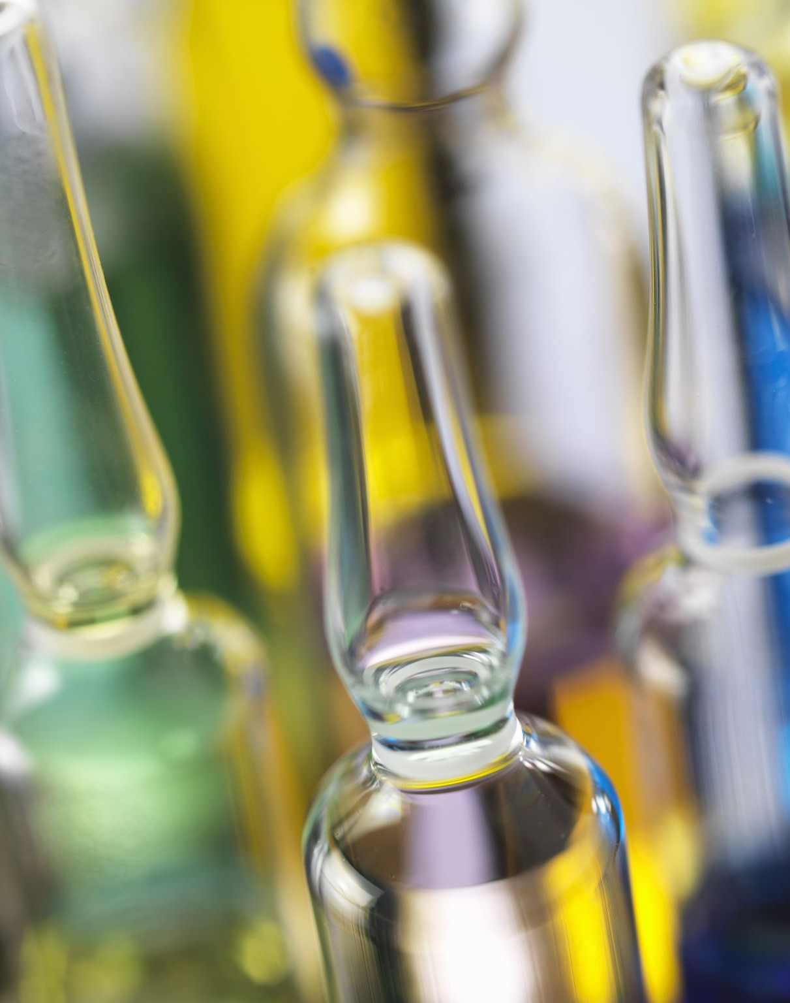
Disposal of Expired Drugs
Expired drugs can be disposed in the following ways:
1. Injection into carcass
2. Destruction
By UVM approved vendor (facilitated by EHS)
On site, using a disposal product (Rx Destroyer)
Reverse Distribution
Must be recorded on drug log with TWO signatures.

Slide 14
New Personnel Must:
Fill out the Questionnaire for Access to CS for Research Purposes by Non-DEA Registration Holders
Take the DEA training online- required every 3 years
Submit an amendment to the CSC Registration

Slide 15

Fill out the Questionnaire for Access to CS for Research Purposes by Non-DEA Registration Holders
These questionnaires contain private information and must be kept locked up in a safe location.

Slide 16
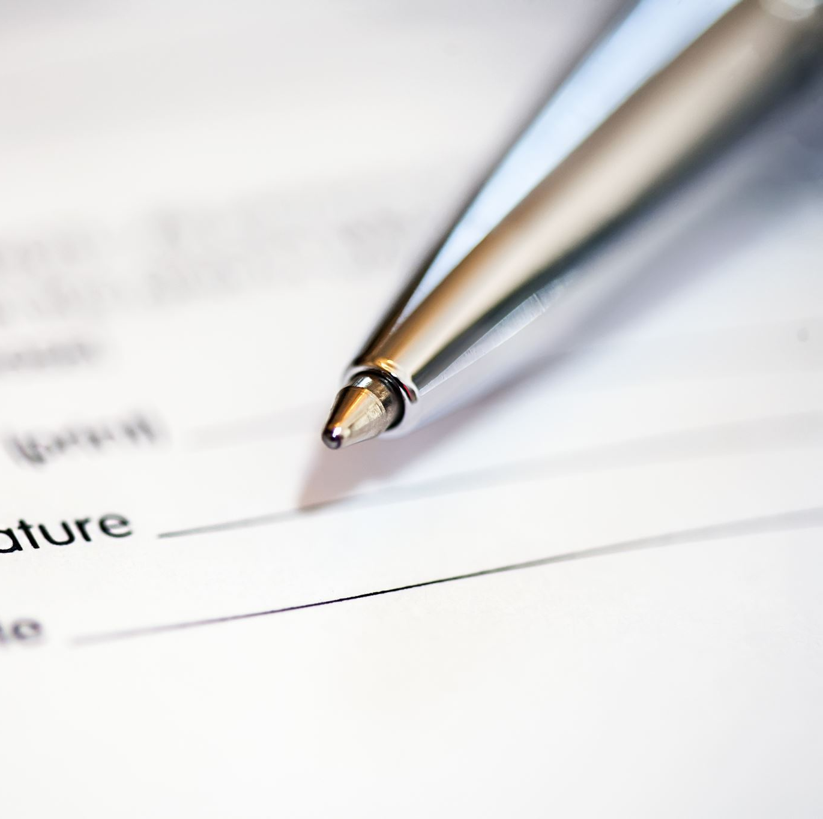
Oversight
Monitoring:
1 Continuing Review per year
2 IACUC visits per year
1 Post Approval Monitoring visit per year
Possible unannounced DEA visits

Slide 17
Monitoring: Continuing Reviews
A brief four question form in UVMClick
CSC Continuing Reviews happen annually
Must be submitted BEFORE the expiration date
A PAM visit is scheduled before approval is issued

Slide 18
Monitoring: IACUC Semiannual Inspections
Twice a year- Firestone is in March and September
Inspect drugs, expiration dates, logs

Slide 19
Monitoring: Post Approval Monitoring (PAM) Visit
Happens Annually
Review of Registration, Policies, and Records to prep for DEA visit
Conduct annual inventory if needed
Check personnel training

Slide 20

Monitoring: DEA Visits
The DEA makes periodic unannounced inspections of registered controlled substance storage locations
Reporting a loss or theft may result in a visit by the DEA
Notify the Research Protections Office immediately if your lab is being subjected to investigation by the DEA.
As specified in 21 C.F.R. §1304.04, the registrant must keep at least two years of inventory records after the final disposition of the controlled substance. All records and logs must be readily available for periodic review by the DEA. Registrants must also maintain associated documents including approval letters, DEA & FDA approvals, certificates of registration, supplemental protocol applications, list of authorized users, purchasing, and destruction documentation. All DEA certificates of registration and all documentation related to the disposal or destruction of the CS must be maintained at each registered location in a readily retrievable manner and kept for official inspection.

Slide 21
Theft, Loss, Diversion, Spills
Any suspicion of inappropriate use of controlled substances MUST be reported
Non-registrants must report concerns to the PI or police services
Registrants must report concerns to the local DEA field office within one day of discovery, as well as the Office of General Council and RPO.

Slide 22
Questions?

