Slide 1
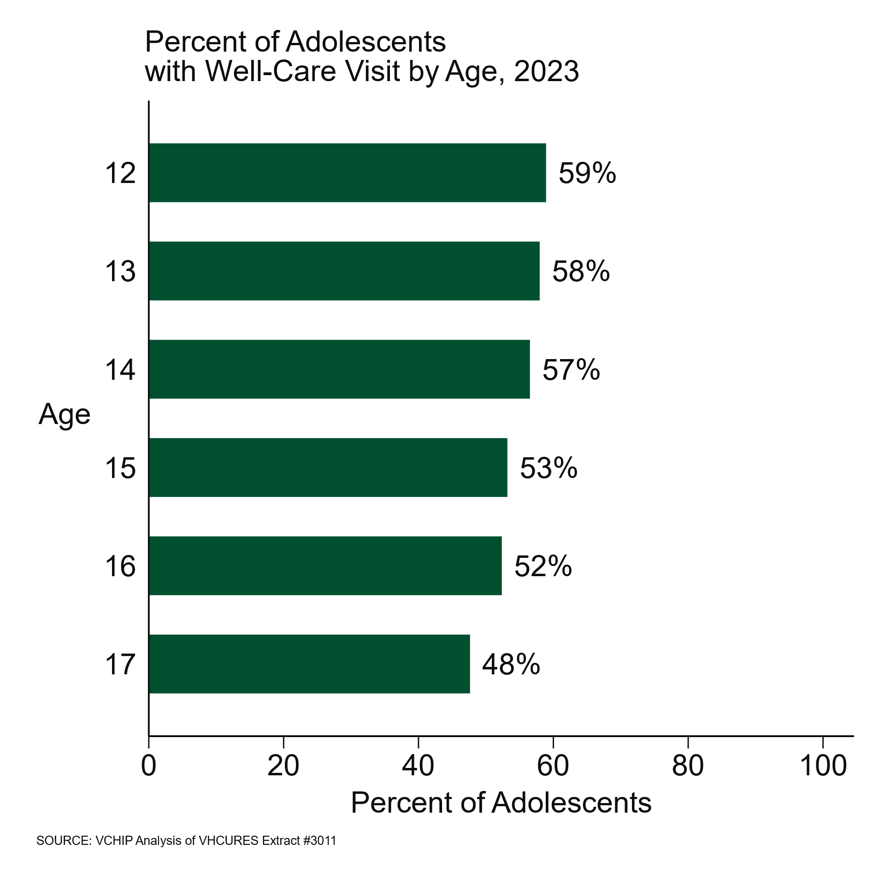
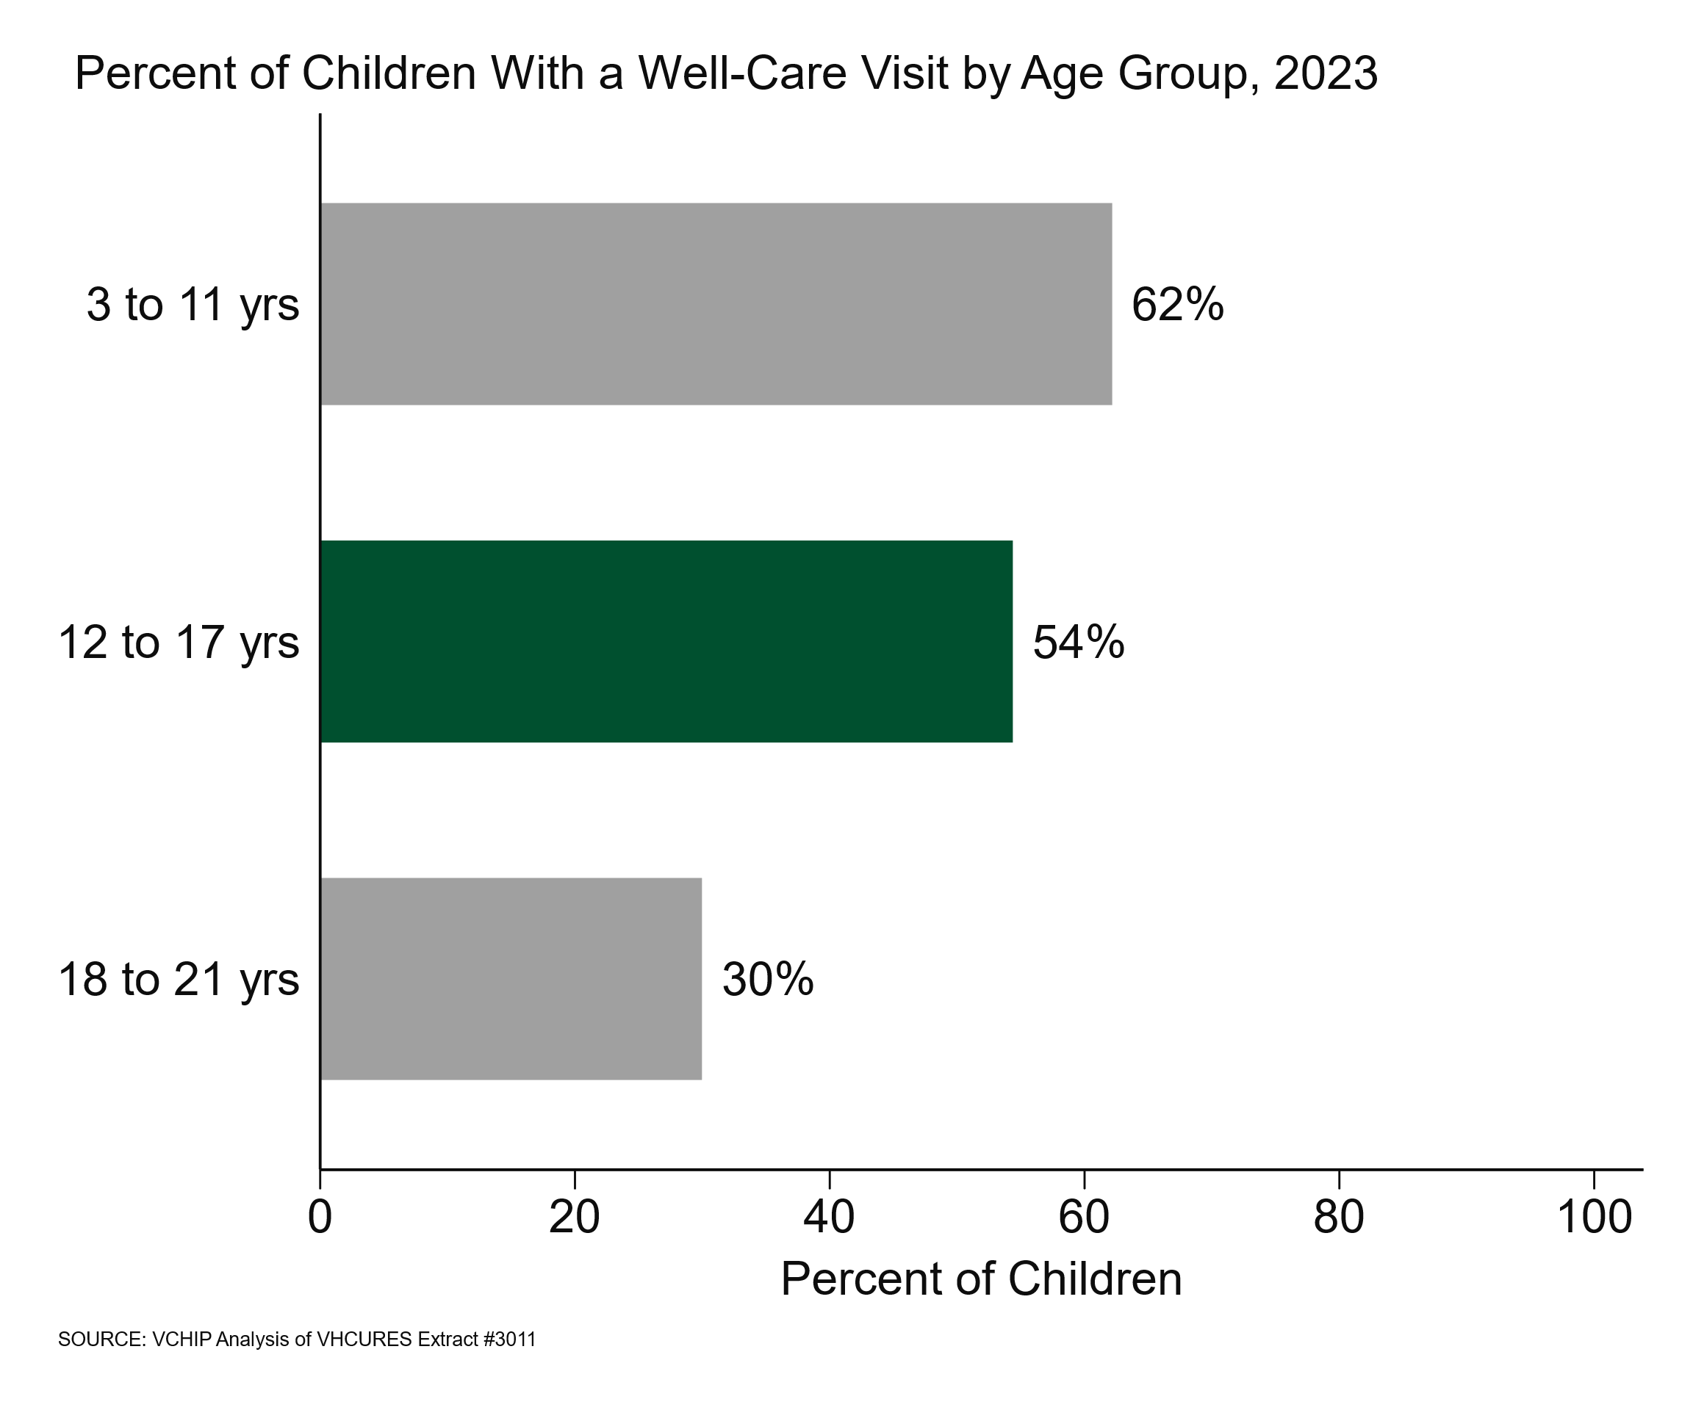
Well-Care Visits Among Vermont Adolescents 12-17 Years Old, 2023
June 2025
Data Report
Introduction
Annual well-care visits are recommended for adolescents to ensure they receive preventive care services, such as development and growth assessments and the administration of recommended vaccinations.^{1,2} Well-care visits provide time for healthcare providers to assess and support positive behaviors. ³ Well-care visits include time to discuss important topics with adolescents, such as driving safety,⁴ mental health,⁵ sexual health,⁶ drug and alcohol use,⁷ school and family connections,⁸ technology and social media,⁹ and transitioning to adult care.¹⁰ Healthy Vermonters 2030 has a goal that 59% of youth aged 12-17 will receive at least one preventive visit in the year.¹¹ This brief reports on the prevalence of well-care visits for adolescents aged 12-17 in Vermont. We also examined the impact of geographic, sociodemographic, health, and other factors that have been shown to be related to receiving preventive care.¹²
Approach
We used the criteria established by Healthcare Effectiveness Data and Information Set (HEDIS) child and adolescent well-care visit measures (WCV) to identify well-care visits among 96,469 children, adolescents, and young adults aged 3-21 years old in December of 2023 using Vermont's all-payer claims dataset (Vermont Health Care Uniform Reporting and Evaluation System; VHCURES).^{13,14} Of those patients, one-third were adolescents aged 12-17 years old (n=32,417). All comparisons reported were made using Chi-Square tests or non-parametric trend analyses, with a significance level set at p<.05 or lower (for tests with multiple comparisons).
Just over half (54%) of adolescents aged 12-17 years had a well-care visit
More adolescents (12-17 years old) had a well-care visit compared to young adults (18-21 years old) (30%), but fewer adolescents had a well-care visit compared to younger children (3-11 years old; 62%). (Figure 1)
There was a negative trend for age among adolescents, with increasing age associated with fewer receiving well-care visits. (Figure 2)
Figure 1
Figure 2
The Vermont Health Care Uniform Reporting and Evaluation System (VHCURES) data are under the stewardship of the Green Mountain Care Board (GMCB). The analyses, conclusions, and recommendations from the VHCURES data are solely those of the study authors and are not necessarily those of the GMCB. The GMCB had no input into the study design, implementation, or interpretation of the findings.

Slide 2
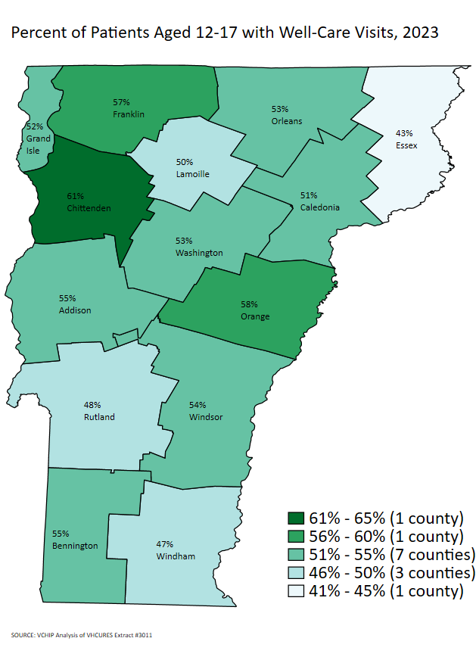
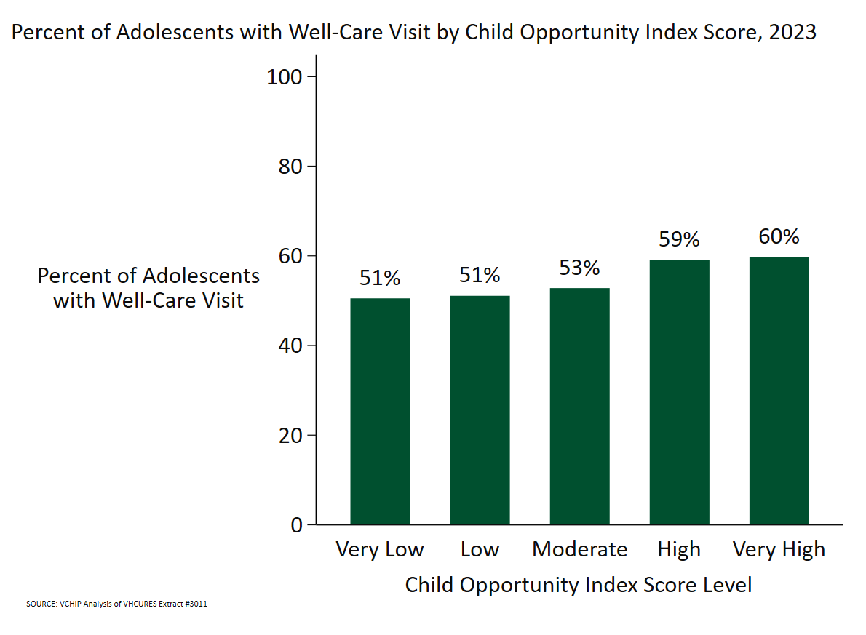
Figure 3
Where Adolescents Lived Mattered
Geography
The percentage of adolescents aged 12 to 17 with a well-care visit ranged from 43% (Essex County) to 61% (Chittenden County). (Figure 3)
Fewer adolescents in Caledonia (51%), Essex (43%), Lamoille (50%), Rutland (48%), and Windham (47%) had a well-care visit compared to the overall state (54%)
Fewer adolescents living in rural counties (as defined by the Federal Office of Rural Health Policy) had a well-care visit (52%) compared to adolescents living in a non-rural county (Chittenden County; (61%)).
Figure 4
Community
The Child Opportunity Index (COI) 3.0 is a child-focused social determinant of health index that uses data from multiple sources to categorize geographical areas by the quality of life in those areas and the resources they offer.¹⁵
As opportunity increased, so did the percentage of adolescents who had a well-care visit. (Figure 4)

Slide 3
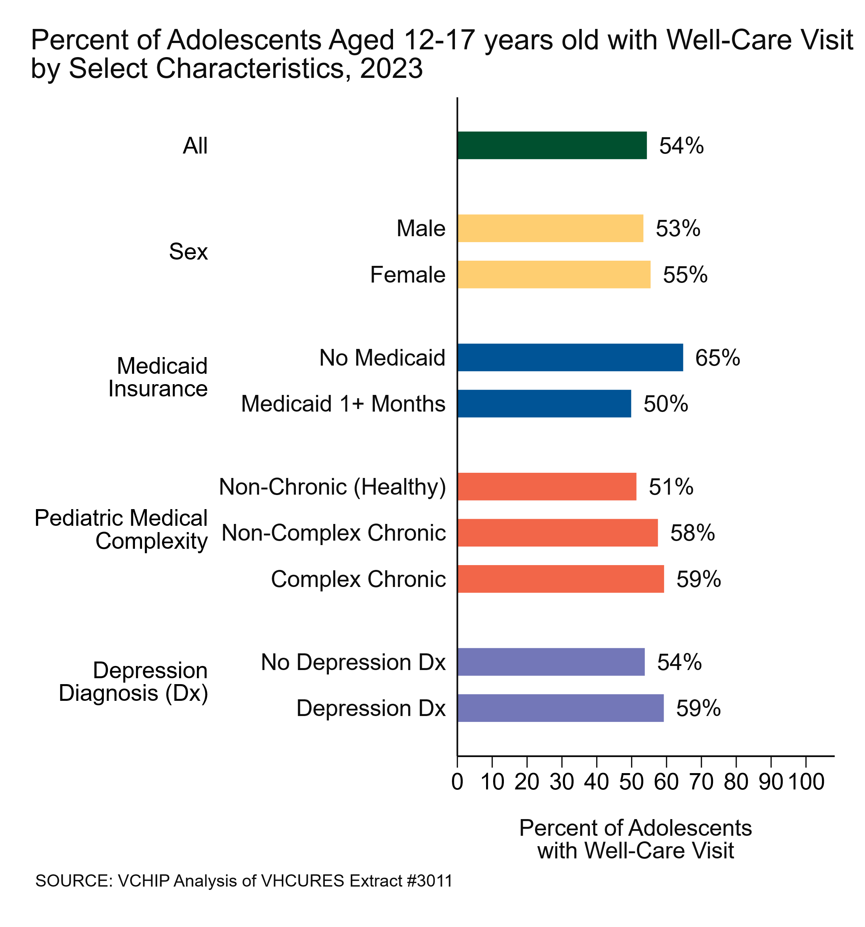
Figure 5
Demographics and health were related to having a well-care visit
Slightly more adolescent females had a well-care visit (55%) compared to males (53%).
Fewer adolescents with Medicaid insurance (One or more months of Medicaid in 2023) had a well-care visit (50%) compared to adolescents with no Medicaid insurance (65%).
Having a well-care visit was related to an adolescent’s medical complexity, as defined by the Pediatric Medical Complexity Algorithm.¹⁶ Fewer adolescents with no chronic health diseases had a well-care visit (51%) than adolescents with one non-complex chronic diseases (58%) or multiple complex chronic diseases (59%).
Just over 1 in 10 adolescents (11%, n=3,572) had a diagnosis of depression. More adolescents with a diagnosis of depression had a well care visit (59%) compared to adolescents without a depression diagnosis (54%).

Slide 4
Figure 6
Where an adolescent received care was related to having a well-care visit
Using medical claims data over two years, we looked at where adolescents received their medical care and assigned them to medical practices. Figure 6 includes adolescents attributed to pediatric and family medicine practices only (N=24,978).
Most adolescents (77%) received their care at pediatric practices (n=17,087) or at family medicine practices (n=7,891).
Overall, more adolescents at pediatric practices had well-care visits (69%) compared to adolescents at family medicine practices (55%).
More adolescents at pediatric practices had well-care visits compared to adolescents at family medicine practices at each single-year age between 12 and 17 years old (Figure 6).

Slide 5

Promoting Well-Care Visits Among Children, Adolescents, and Young Adults in Vermont
The Vermont Department of Health and the Vermont Agency of Education support the Whole School, Whole Community, Whole Child program, which includes support for preventive health services and promotes connection to a medical home.
Through its Education Local Wellness Policy, the Vermont Agency of Education includes optional activity recommendations for local education agencies to support students and families to establish and access a medical home for recommended preventive well-care visits.
As part of Vermont’s Essential School Health Services System, school nurses assess the health of all students each year, including their access to a medical home if they have had an annual well-care visit. School nurses also promote access to Medicaid for eligible students and encourage parents to schedule annual well-care visits. They are also encouraged to collaborate with other school nurses in their district to specifically promote adolescent well-care visits
The Vermont Child Health Improvement Program supports annual well-care and associated services through multiple initiatives including:
Improving health care delivery for children entering foster care.
The VT RAYS, a statewide youth-health advisory council focused on improving the utilization of preventative services for adolescents and young adults, created a tool healthcare providers can use to assess how welcoming their practice is to adolescents and young adults.
Child Health Advances Measured in Practice network has facilitated several quality improvement projects with primary care practices, including adolescent-focused projects.
The School Age and Adolescent Health Initiative (SAAHI) at VCHIP partners with Vermont Afterschool to address adolescent health priorities, enhance youth services, and boost engagement in primary care.
These are just some of Vermont’s statewide initiatives. For more information, use the links above.
Summary
Our measurement of Vermont adolescent well-care visits in 2023 showed that 54% received well-care, approaching the Healthy Vermonters 2030 goal of 59%. Increasing the number of adolescents receiving well-care visits and the services in those visits will require thinking about the unique strengths and challenges related to adolescence. The “Adolescent Champion” model for primary care outlines several strategies to make healthcare visits youth-friendly including how to screen for risky behaviors and navigate issues of confidentiality.¹⁷ Utilizing technologies such as electronic health records to conduct screening and using data from wearable technology to collect information ahead of time may reduce visit time making it easier for adolescents to fit visits into busy schedules.¹⁸
Well-care visits are not the only type of visit adolescents may have with their healthcare provider. Previous research has shown that adolescents have more non-preventive appointments (e.g., acute visits, visits to manage medications, etc.) than preventive appointments. Using a “no wrong door” approach and providing preventive care to adolescents at non-preventive visits may increase the proportion of adolescents receiving preventive services.¹⁹
Prepared by VCHIP’s Health Services Research Team, Susan Richardson & Valerie Harder
www.med.uvm.edu/vchip/

Slide 6
Notes
Age was based on insurance eligibility records, not age at any visit dates during the year. Those with multiple ages more than one year apart over the year was excluded.
Location and rurality was based on the adolescent’s first Vermont ZIP Code from insurance eligibility records. All adolescents included for analysis had at least one Vermont ZIP Code.
Adolescents were categorized as having Medicaid if they had one or more months of Medicaid eligibility during the year.
Additional details of the HEDIS measure can be found here. We did not require continuous enrollment, which is an allowable adjustment. Patients with eligibility records but with no medical claims in VHCURES were counted as not having a well-care visit in the year.
Additional details on Pediatric Medical Complexity can be found here. We reviewed both inpatient and outpatient diagnoses from 2021-2023. Adolescents categorized as non-complex chronic had a chronic condition impacting one body system. Complex chronic adolescents had conditions impacting one or more body systems, or malignancy or dependence on technology. Non-chronic adolescents had only acute or no conditions. Adolescents with no medical claims with diagnoses were categorized as non-chronic. We modified this definition to include anxiety diagnoses.
Diagnoses used for inclusion in the Clinical Classification Software Revised (CCSR v.2023.1) can be found on the H-CUP website. We reviewed both inpatient and outpatient medical claims diagnoses in 2023. Adolescents with no medical claims with diagnoses were coded as not having a depression diagnosis.
Analyses by practice type were limited to adolescents who were attributed to pediatric or family medicine practices.
Analyses by sex excluded adolescents with unknown sex.

Slide 7
References
American Academy of Pediatrics. Bright futures guidelines for health supervision of infants, children, and adolescents. American Academy of Pediatrics; 2017 Feb 17.
Irwin Jr CE, Adams SH, Park MJ, Newacheck PW. Preventive care for adolescents: few get visits and fewer get services. Pediatrics. 2009 Apr 1;123(4):e565-72.
Singh D, Schumacher HK, Pellegrino CA, Holmes BW, Garfield RL, Harder VS. Assessing strengths and well-being in primary care for adolescents with mental health and substance use concerns. Clinical Pediatrics. 2024;64(3):340-347. doi:10.1177/00099228241264769
Irwin CE. Can we fully implement what we know about safe driving during adolescence?. American journal of preventive medicine. 2008 Sep 1;35(3):S313-5.
Gadomski AM, Fothergill KE, Larson S, Wissow LS, Winegrad H, Nagykaldi ZJ, Olson AL, Roter DL. Integrating mental health into adolescent annual visits: impact of previsit comprehensive screening on within-visit processes. Journal of Adolescent Health. 2015 Mar 1;56(3):267-73.
Burstein GR, Lowry R, Klein JD, Santelli JS. Missed opportunities for sexually transmitted diseases, human immunodeficiency virus, and pregnancy prevention services during adolescent health supervision visits. Pediatrics. 2003 May 1;111(5):996-1001.
Monico LB, Mitchell SG, Dusek K, Gryczynski J, Schwartz RP, Oros M, Hosler C, O'Grady KE, Brown BS. A comparison of screening practices for adolescents in primary care after implementation of screening, brief intervention, and referral to treatment. Journal of Adolescent Health. 2019 Jul 1;65(1):46-50.
Coble C, Srivastav S, Glick A, Bradshaw C, Osman C. Teaching SSHADESS versus HEADSS to medical students: An association with improved communication skills and increased psychosocial factor assessments. Academic pediatrics. 2023 Jan 1;23(1):209-15.
Moreno MA, Radesky J. Putting forward a new narrative for adolescent media: The American academy of pediatrics center of excellence on social media and youth mental health. Journal of Adolescent Health. 2023 Aug 1;73(2):227-9.
Schmidt A, Ilango SM, McManus MA, Rogers KK, White PH. Outcomes of pediatric to adult health care transition interventions: an updated systematic review. Journal of pediatric nursing. 2020 Mar 1;51:92-107.
How Are We Doing? Performance Scorecards | Vermont Department of Health [Internet]. www.healthvermont.gov. Available from: https://www.healthvermont.gov/about/how-are-we-doing-performance-scorecards
Garney W, Wilson K, Ajayi KV, Panjwani S, Love SM, Flores S, Garcia K, Esquivel C. Social-ecological barriers to access to healthcare for adolescents: a scoping review. International journal of environmental research and public health. 2021 Apr 14;18(8):4138.
Green Mountain Care Board. Vermont Health Care Uniform Reporting and Evaluation System (VHCURES) 2024 Available from: https://gmcboard.vermont.gov/DATA-AND-ANALYTICS/DATA-COLLECTION/vhcures-vermonts-all-payer-claims-database.
Green Mountain Care Board. VHCURES overview: A guide for data users. Version 1 ed. Montpelier, VT. 2019.
Noelke C, McArdle N, DeVoe B, Leonardos M, Lu Y, Ressler RW, et al. Child Opportunity Index 3.0 Technical Documentation.: diversitydatakids.org, Brandeis University; 2024.
Simon TD, Haaland W, Hawley K, Lambka K, Mangione-Smith R. Development and validation of the Pediatric Medical Complexity Algorithm (PMCA) Version 3.0. Acad Pediatr. 2018 Jul;18(5):577-580. doi: 10.1016/j.acap.2018.02.010.
Riley M, Patterson V, Lane JC, Won KM, Ranalli L. The adolescent champion model: primary care becomes adolescent-centered via targeted quality improvement. The Journal of pediatrics. 2018 Feb 1;193:229-36.
Harris SK, Aalsma MC, Weitzman ER, Garcia-Huidobro D, Wong C, Hadland SE, Santelli J, Park MJ, Ozer EM. Research on clinical preventive services for adolescents and young adults: where are we and where do we need to go?. Journal of Adolescent Health. 2017 Mar 1;60(3):249-60.
Nordin JD, Solberg LI, Parker ED. Adolescent primary care visit patterns. The Annals of Family Medicine. 2010 Nov 1;8(6):511-6.

