Slide 1

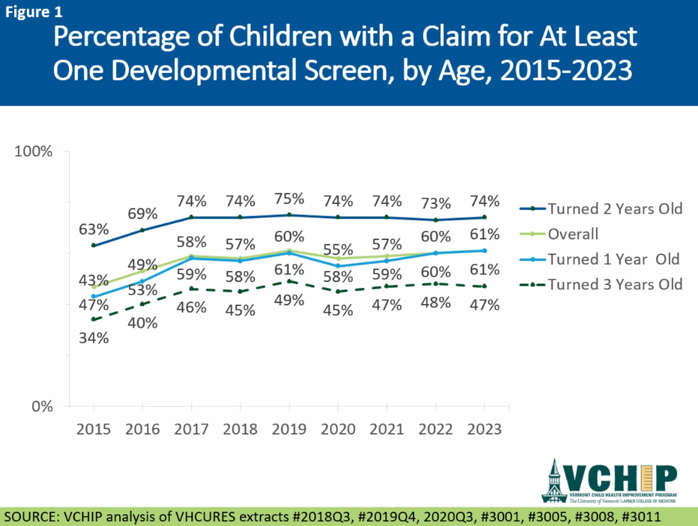
DEVELOPMENTAL SCREENING IN VERMONT
OVER TIME (2015-2023) and by insurance
June 2025
Data Brief
Introduction & Data Notes
Developmental screening provides insight into a child’s early learning, growth, and achievement of milestones during the first three years of life and is used to determine the need for further assessment or developmental services. Developmental screening percentages are also leveraged as an indicator of high-quality health care and tied to quality payment initiatives.
The Health Services Research (HSR) Team at the Vermont Child Health Improvement Program (VCHIP), in collaboration with the Vermont Department of Health (VDH), Family and Child Health (FCH) Division, and partners, identified developmental screening as a priority measurement topic. We measured the percentage of one-to-three-year-old Vermont children with at least one claim for developmental screening from 2015-2023 using the “Developmental Screening in the First Three Years of Life¹“ (DEV-CH) measure. The overall objective of this project was to examine trends over time of the percentage of one-to-three-year-old children receiving developmental screening billed through insurance claims. Additionally, we examined results over time by insurance (Medicaid vs. non-Medicaid).
Our data source was the Vermont Health Care Uniform Reporting and Evaluation System (VHCURES; Vermont’s all-payer insurance claims database). We used Chi-squared statistical tests to compare the percentage of children with a developmental screening over time, overall and within individual ages and insurance groups. For all statistical tests, we used an alpha-level of .05 to indicate statistical significance.
Developmental Screening Over Time, Overall and by Age
Key Findings
Overall, 61% of children one-to-three years old had a medical claim for at least one developmental screening in 2023.
By 2022, developmental screening percentages increased to near pre-COVID-19 pandemic levels.
Two-year-old children had the highest percentage (74%) of developmental screening claims, and three-year-old children had the lowest.
Note: The Vermont Health Care Uniform Reporting and Evaluation System (VHCURES) data are under the stewardship of the Green Mountain Care Board (GMCB). The analyses, conclusions, and recommendations from the VHCURES data are solely those of the study authors and are not necessarily those of the GMCB. The GMCB had no input into the study design, implementation, or interpretation of the findings.
www.med.uvm.edu/vchip/

Slide 2
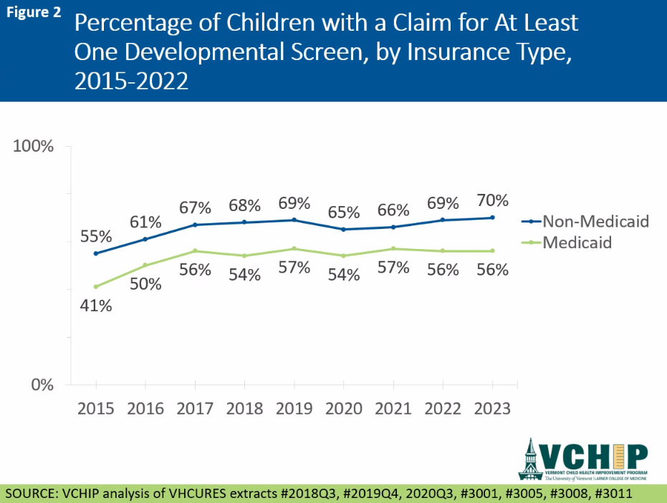
Developmental Screening Over Time by Insurance
Key Findings
Developmental screening claims returned to pre-pandemic levels for both children with Medicaid and non-Medicaid.
Across all years since 2015, children insured by Medicaid were less likely to have a claim for a developmental screening than children with other insurance.
In Vermont, multiple efforts have supported the provision of developmental screenings per American Academy of Pediatrics Bright Futures guidelines, with recent efforts listed below:
Clinical Quality Improvement:
In partnership with the VDH FCH Division, VCHIP and its primary care practice network identify strategies for practice improvement and conduct quality improvement projects. Developmental screening was the focus of quality improvement projects in 2009, 2016, and 2023.
Systems and Technology Improvements:
VDH built the Developmental Screening Registry allowing screening results to be securely shared across clinical and community settings to ensure young children are connected to developmental supports.
Help Me Grow-Vermont, with its mission of promoting universal developmental screening and detection, provides free online Ages and Stages Questionnaires for developmental screening for families: https://www.helpmegrowvt.org/ages-stages-vt
VCHIP became the Touchpoints (https://www.brazeltontouchpoints.org) Center for Vermont, providing a practical, preventive approach that supports professionals in forming strengths-based partnerships with families².
References
Centers for Medicare & Medicaid Services (2025). Core Set of Children's Health Care Quality Measures for Medicaid and CHIP (Child Core Set). Center for Medicaid and CHIP Services. https://www.medicaid.gov/medicaid/quality-of-care/downloads/medicaid-and-chip-child-core-set-manual.pdf
Ayoub, C. & Vele-Tabaddor, E. (2018). Enhancing early care provider’s capacity for building early relationships with families and their children: Touchpoints-informed practice. In A. S. Morris & A. C. Williamson (Eds.), Building early social and emotional relationships with infants and toddlers: Integrating research and practice (pp. 259–275). Springer Nature Switzerland AG. https://doi.org/10.1007/978-3-030-03110-7_11
Prepared by VCHIP’s Health Services Research Team, KC Cousineau, MA & Valerie Harder, PhD, MHS
www.med.uvm.edu/vchip/

