Slide 1
Artificial Intelligence Town Hall

Slide 2
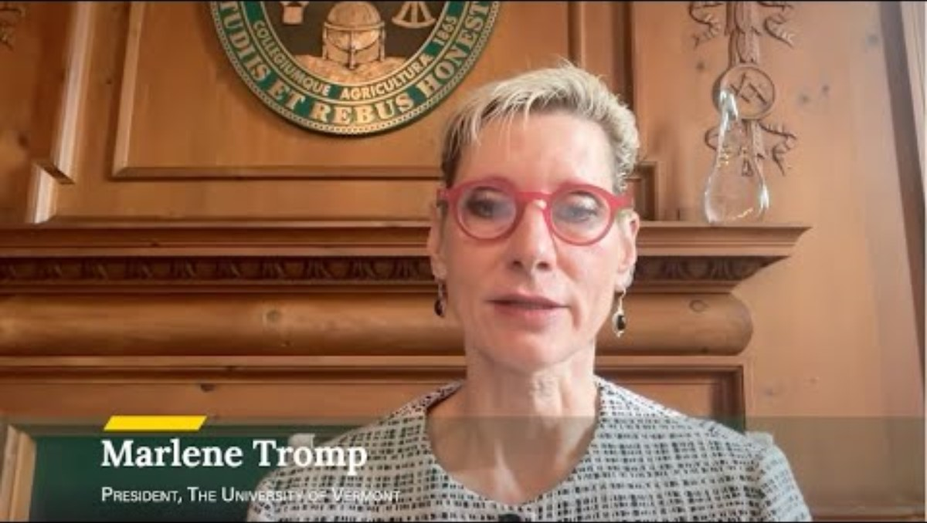
A Message from President Tromp

Slide 3
Overview of the AI Survey Results
Key insights from aggregated survey results:​
High Level of Concern
Interest in AI is Polarized
Request for Support
High level of concern among staff regarding AI's impact on human judgment, ethics, and the environment with 'Extremely concerned' and 'Very concerned' being the most frequent responses across these topics
A significant group is 'Extremely Interested' in training and experimenting with AI, an equally large group is 'Not at all Interested' or expresses discomfort, indicating a divided workforce in terms of readiness and enthusiasm for AI adoption.
Most common support needs relate to training, understanding practical use cases, and guidance on responsible use, as reflected in both open-ended responses and requests for more information and examples.

Slide 4
Overview of the AI Survey Results
These insights suggest that any AI implementation at UVM should prioritize transparent communication, address ethical and environmental concerns, and provide targeted training and support to bridge the gap between enthusiastic and hesitant staff.

Slide 5
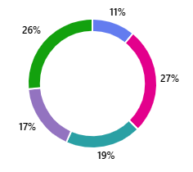
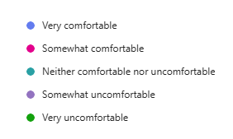
How comfortable is UVM with AI?
How comfortable are you using Generative AI and Large Language Models (LLMs) in the workplace within the official UVM Guidelines?

Slide 6
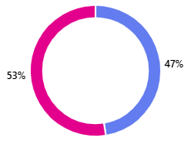

How comfortable is UVM with AI?
Are you using AI in your work?
Tool usage:
Microsoft Co-Pilot (~60%)
ChatGPT (~58%)
Claude (6%)
Gemini, NotebookLM, Perplexity (~6%)
Other specialized AI (~8%)

Slide 7
Top Uses for AI at UVM
What are you using AI for in your work?
Themes from the data:
Writing, editing, and polishing communications (58%)
Summarizing meetings, notes, or documents (25%)
Brainstorming, idea generation, and templates(23%)
Coding and technical support (21%)
Project, organization, and administrative support (tracking tasks, schedules, hiring, proposals) (20%)
Research support (finding sources, data analysis) (18%)
Presentation, design, and creative (slides, graphics, logos, images, video editing) (11%)
Chatbot management and student services automation (2%)
AI adoption is already widespread for core productivity tasks (writing, notes, summaries).
Co-Pilot dominates usage due to licensing/testing at UVM, but staff continue using external tools (ChatGPT, Claude, Gemini) when features feel stronger.
Technical users lean on AI for coding and data work, while faculty/staff emphasize writing and admin.
Risk & governance: A handful are minimizing external LLM use due to data concerns—echoing the need for clear UVM guidance on safe tool use.
Enablement needed: Prompting skills, role-specific examples, and awareness of approved vs. unapproved tools.

Slide 8
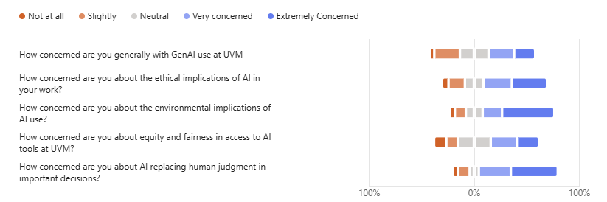
Concerns with AI?

Slide 9
Townhall Panelists
Kirk Dombrowski, Vice President for Research and Economic Development
Kellie Campbell, Chief Information Officer
Susanmarie Harrington, Director, Center for Teaching and Learning
Moderator: Bettyjo Bouchey, Chief Officer for Professional and Continuing Education

Slide 10
Super User Showcase
Mike Austin
Anna Varn
Ian Johnson
Jesse Stein

Slide 11
Microsoft Copilot
Mike Austin

Slide 12
Microsoft Copilot
Microsoft Copilot, UVM’s campus-wide approved AI tool
  Similar to ChatGPT
    uses some of the same language models (GPT-4o/5, DALL-E 3)
  Most AI tools train on your data – UVM’s agreement with Microsoft offers protection here
    Approved for the same UVM data as the rest of M365, if you are logged into your UVM account
UVM IT KB article: https://www.uvm.edu/it/kb/article/microsoft-copilot/
Notes:
A problem with many of these AI tools is data privacy – they train on your data and on your prompts. MS agreement offers some protection here for Copilot, and you can use Copilot with most UVM data other than protected health data as long as you are logged into your UVM account.
We’re trying to be thoughtful partners about where AI makes sense and where it doesn’t, and when investments might be appropriate.
AI makes grand mistakes with extreme confidence.

Slide 13
Copilot Chat
“Web” version available to everyone at UVM now.
  generate text or images
  generate computer code
  transcribe audio files
  translate languages
  brainstorming, discovery, summarizing
  https://copilot.microsoft.com/
    login with your UVM NetID to get data protections

Slide 14
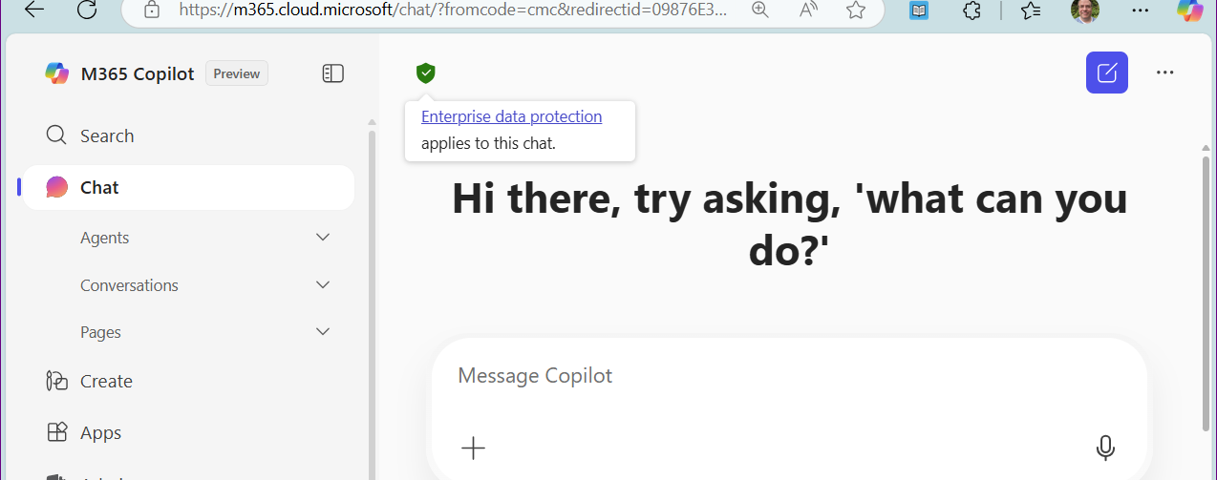

Copilot Web
https://copilot.microsoft.com OR https://portal.office.com OR …
Notes:
Highlighting Copilot interface. Look for the shield, which tells you that your prompts and data are protected.

Slide 15
Copilot 365
Office 365 integrated version available on a limited basis.
  Integration into each of the Office apps, such as Outlook, Teams, Word, Excel, OneNote, etc…
  Additional cost to UVM for these licenses.
  Developing plans around security, funding, governance.
Notes:
Still in pilot, still need to figure out funding. But if you have a good use case for it, let’s talk.

Slide 16
Copilot Agents
We have trained a Copilot Agent on UVM’s IT Knowledge Base.
Responses from the Agent are restricted to the trained dataset.
Working on demo website.
Seeking potential future pilot partners.
Most people can experiment with internal agents today in Copilot.

Slide 17
Copilot Help
Copilot and prompt training this fall
Drop-in Copilot sessions starting soon
Copilot is approved for use for most UVM data other than PHI.
UVM IT KB article: https://www.uvm.edu/it/kb/article/microsoft-copilot/
  Including prompting guidance
Notes:
Keep an eye on the UVM IT website.

Slide 18
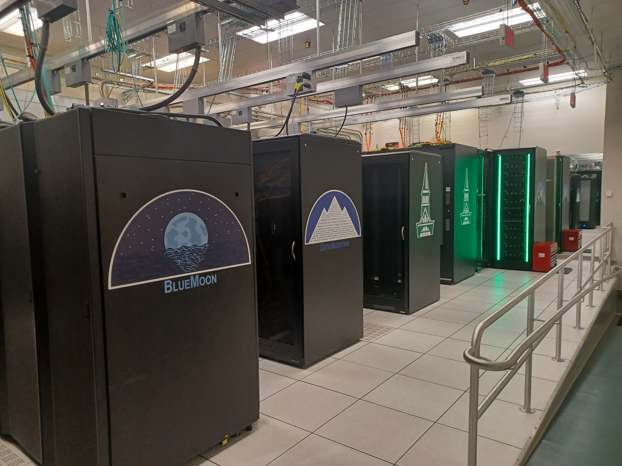
AI Research at UVM
Vermont Advanced Computing Center & Enterprise Technology Services collaborate to provide world-class high-performance computing systems to UVM Researchers, including systems specifically to support AI research.
  Also used in courses/academics
Our GPU clusters enable advanced AI research across a range of domains, including support for custom hosting of new large language models.
  New IceCore cluster coming 2025
Notes:
This isn’t really the point of today’s presentation about AI tools, but I thought I’d talk about it for 1 minute given many of you have been involved in writing news articles about the great research at UVM, so of which involves AI research
Exciting research from a wide range of areas:
Language analysis, sentiment, mental health markers from language use
Evolutionary robotics, xenobots
Computational ethics, social impacts of AI
Security and privacy around AI generated content
Infectious disease modeling and exploration
Environmental challenges, impacts on groundwater, cyanobacteria bloom analysis
Power grid improvements
Etc.. Exciting stuff.

Slide 19
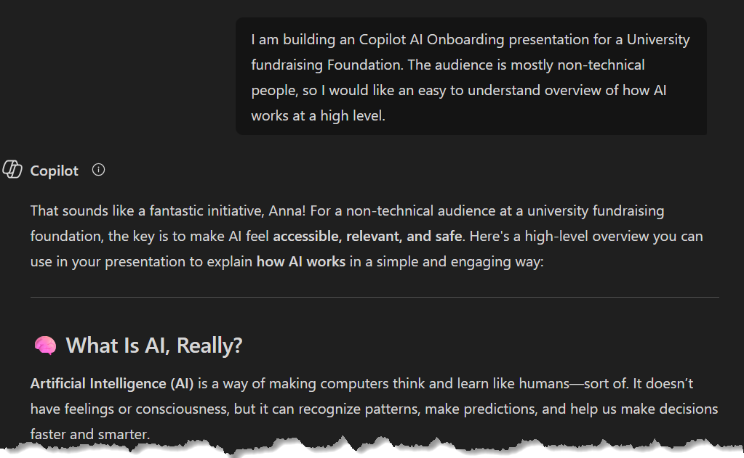
Using Copilot to Create Training with Anna Vann
Notes:
The UVM Foundation IT department identified a need to make artificial intelligence (AI) accessible, relevant, and safe for our users at the UVM Foundation.
Having a background in technical training development, I was curious to see the ways that Copilot AI could automate some common tasks associated with building AI training content.
These slides cover some ways in which Copilot helped develop this and other training assets that have been created for the UVM Foundation.

Slide 20
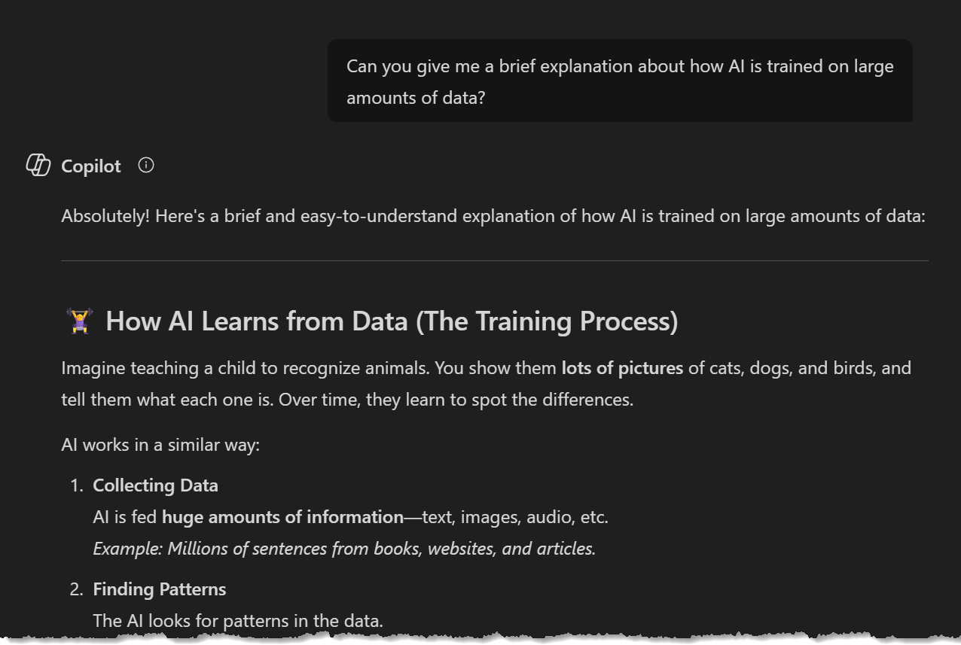
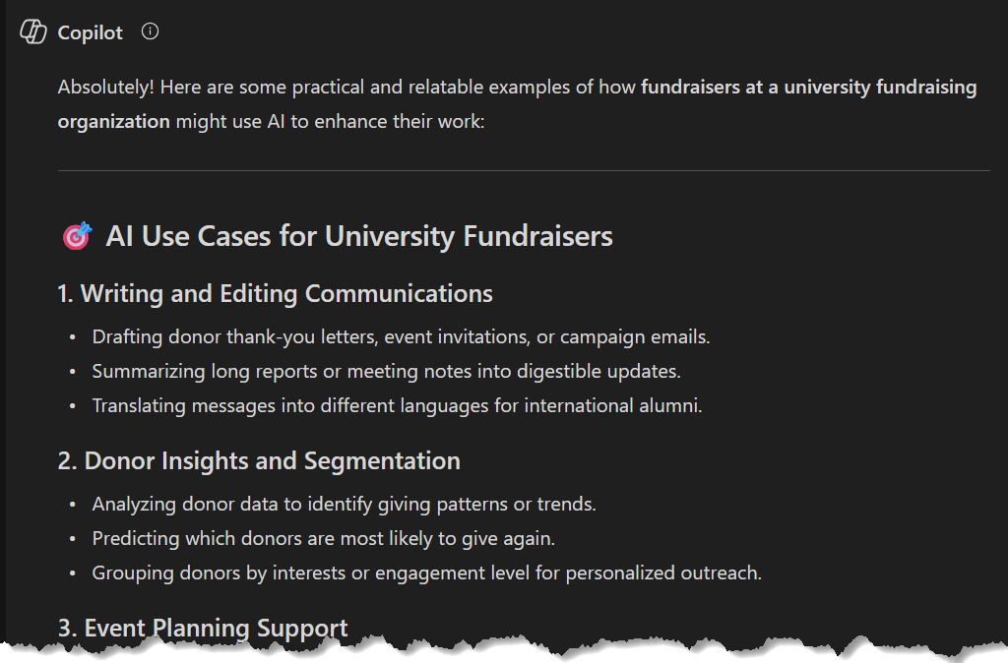
Researching Subject Matter
Notes:
A common use for AI is researching subject matter.
Copilot assisted greatly with filling in knowledge gaps during the training content creation process.
It was useful to reference this information in context, as Copilot helped with other aspects of the training material.

Slide 21
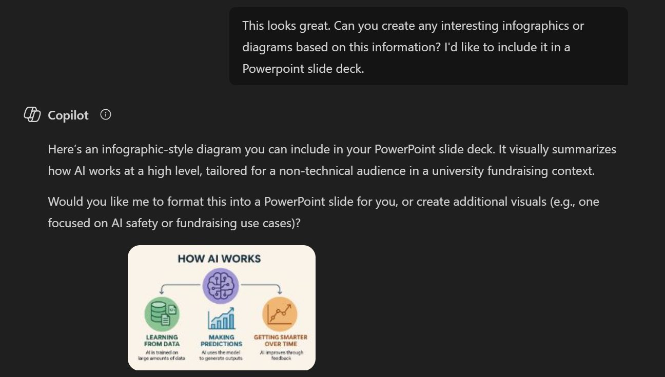
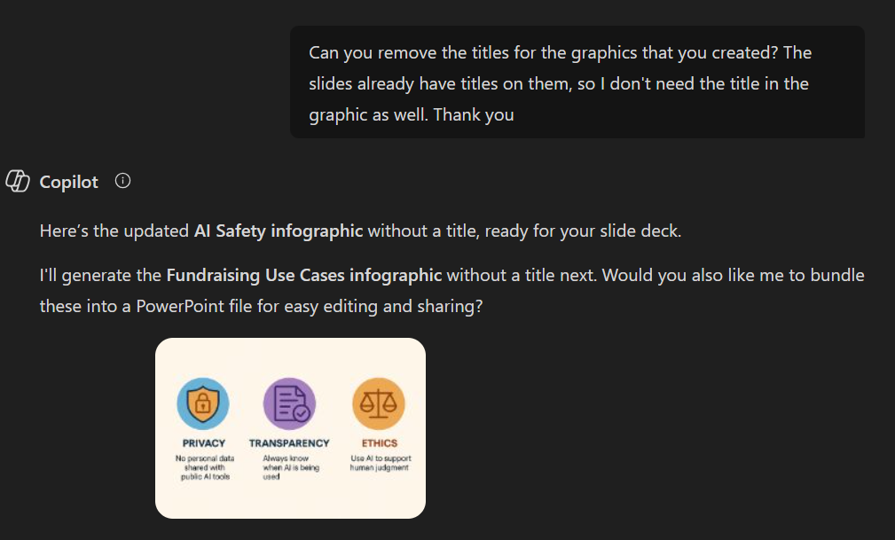
Generating and Refining Graphics
Notes:
Copilot helped to quickly enhance the quality of the training material delivered by developing graphics on demand.
It was also able to make simple adjustments to these graphics as needed (such as removing a title, etc).

Slide 22
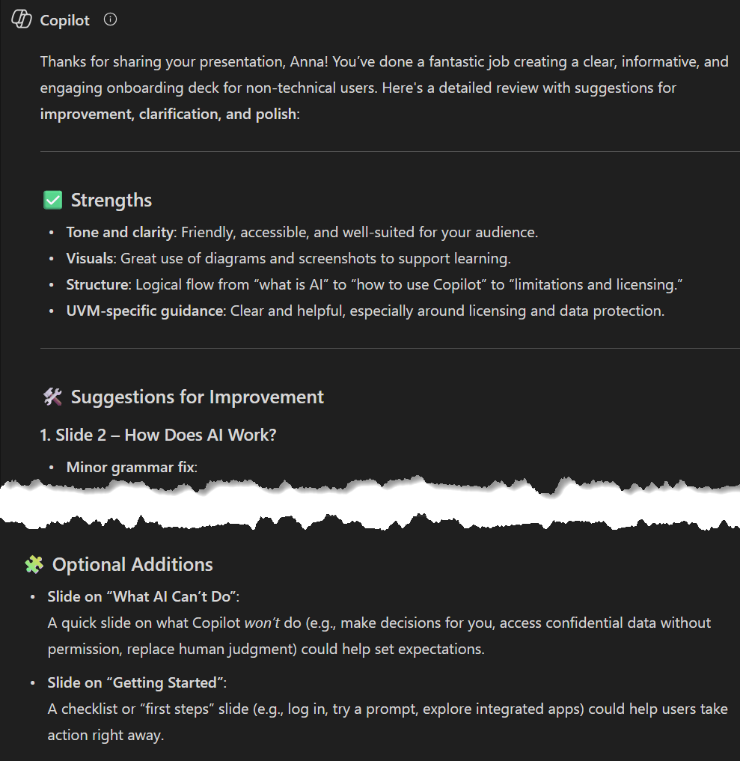
Using Copilot for Content Review
Copilot review feedback included:
Typos, Grammar, and formatting fixes
Tone and meaning clarification
Presentation improvements (adding graphics, visual cues, or reorganizing information)
Suggestions for additional material and topics to cover that may have been missed
Notes:
Copilot may not be a substitute for peer reviews, but it is a helpful option for a quick and on demand supplemental review of material.
In addition to basic “Spell Check” grammar, spelling, and formatting fixes, Copilot was also able to provide feedback on clarifying and reorganizing information.
Copilot even provided relevant suggestions for additional material and topics that may have been missed.

Slide 23
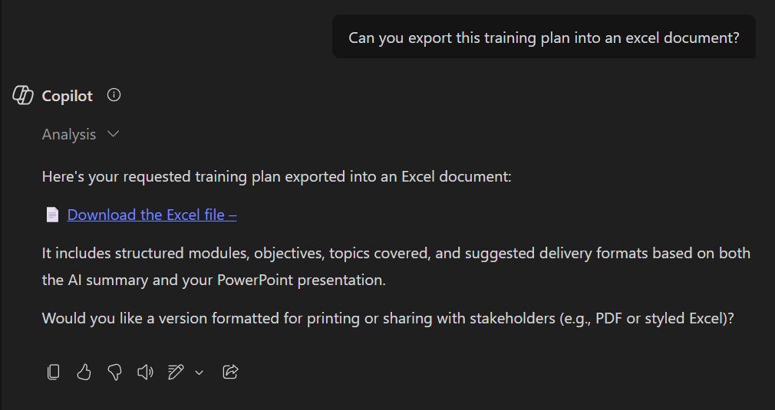
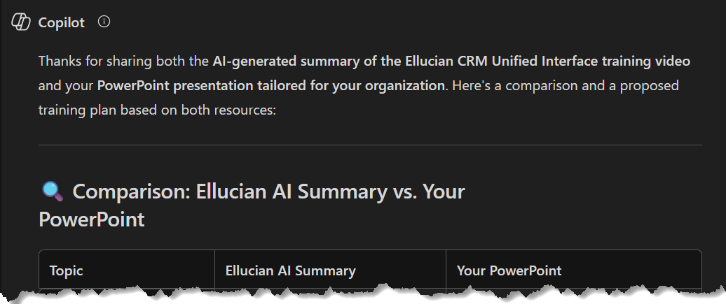
Other Copilot Capabilities
Exporting content into supported File types
May not work when using templates
Analyzing and integrating external source material
Beware of supported file types
Notes:
Some examples of additional Copilot capabilities that help with building training include:
1.) Analyzing and Integrating external source material
Avoid spending time re-consuming source material that has already been covered such as meetings, videos, or long documentation. Instead, provide the source material to Copilot for analysis.
In this example, Copilot was given the transcript for a training video and a draft presentation to check for any discrepancies between them.
2.) Exporting content into supported file formats
Copilot excels at converting content to supported file types, saving time exporting content from prompt outputs into a desired final format.
In summary, Copilot is not a substitute for thoughtful and comprehensive training development. However, it can serve as a useful tool to automate many tasks associated with developing training content.

Slide 24
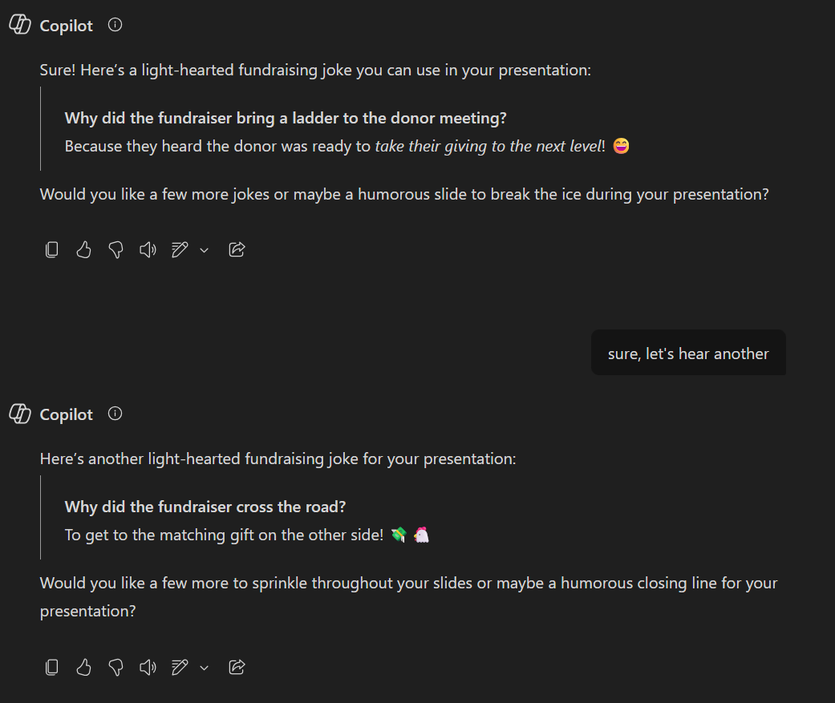
Wrapping Up
Other Useful Copilot Functionality:
Analyzing external material (meeting notes, documentation, and so on) for use in training content
Exporting all or parts of generated content to various file formats (PowerPoint, Word, and so on)
Notes:
Copilot can often contribute to content generation in unique and unexpected ways such as writing a joke as a lighthearted ending note for a presentation. Other useful functions of Copilot that were not used in this specific example are the ability to analyze external materials and the ability to export generated content to various supported file formats.

Slide 25
LLM-Assisted Position Description Analysis
Extracting Core Skills from Staff Position Descriptions
Ian Johnson
Department of Human Resources, University of Vermont
October 6, 2025

Slide 26
The Problem
What are the core skills required for any given staff position on campus?
The Challenge
  ~2600 active staff positions with unique position descriptions (PDs)
  ~1.1 million words of unstructured data
  Avg 450 words per PD
  Information trapped in unstructured open-field text
Additional Complexity
  Evolving PD standards over time
  Wide Variation in detail and structure

Slide 27
The Solution
Using LLM Technology for Skill Extraction
Why LLMs Work Here
  Effective at summarizing and extracting information from natural language text
  Works with existing PD information – No external data or data generation needed
  Each PD fits comfortably within context length limits
Key Advantages
  Model ‘reasoning’ can be exported and reviewed
  Fine-tuned programmatically assembled system prompts
  Single PD + Prompt per API call keeps things simple

Slide 28
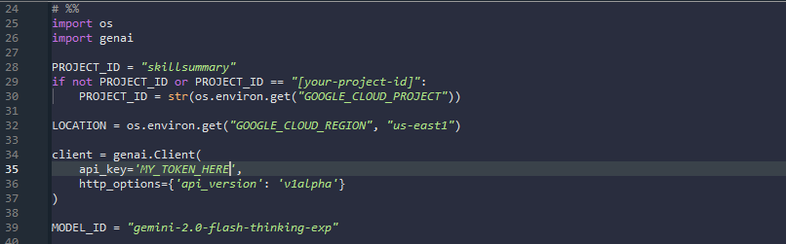
Technical Implementation
  Programmatic approach using Python and Google’s Gemini API
  Note genai is Google’s provided SDK to integrate their generative models into Python applications. See https://pypi.org/project/google-genai/

Slide 29
Technical Implementation
  Programmatic approach using Python and Google’s Gemini API
  Extension of basic analysis procedures
    Text cleaning via Beautiful Soup. (Remove HTML tags)
    Standardize Boolean and NA values
    Extract PDs alongside meaningful characteristics such as Department, Job Title, FTE, FLSA Exemption etc.

Slide 30
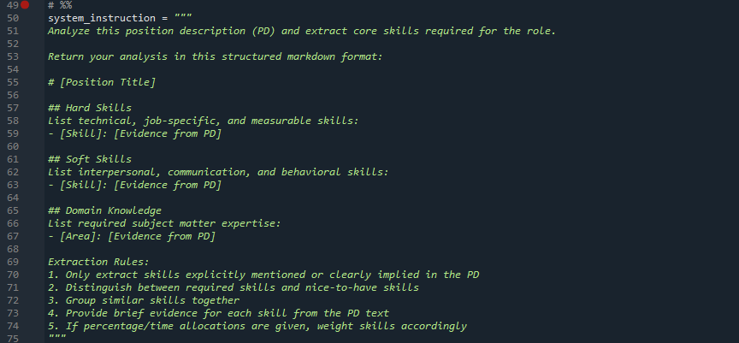
Technical Implementation
  Programmatic approach using Python and Google’s Gemini API
  Extension of basic analysis procedures
  Define the ‘system instruction’:

Slide 31
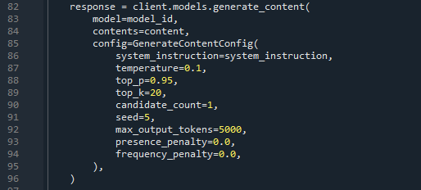
Technical Implementation
  Programmatic approach using Python and Google’s Gemini API
  Extension of basic analysis procedures
  Define the ‘system instruction’
  Define model parameters:

Slide 32
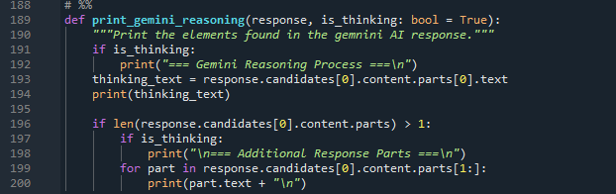
Technical Implementation
  Programmatic approach using Python and Google’s Gemini API
  Extension of basic analysis procedures
  Define the ‘system instruction’
  Define model parameters
  Test and Refine System Instruction and Parameters

Slide 33
Technical Implementation
  Programmatic approach using Python and Google’s Gemini API
  Extension of basic analysis procedures
  Define the ‘system instruction’
  Define model parameters
  Test and Refine System Instruction and Parameters
  Parse LLM output into analyzable data
  Validate random sample of PDs and LLM responses

Slide 34
Questions?

Slide 35
Evaluating AI Enhanced
Technology Commercialization
Jesse Stein
UVM Innovations

Slide 36
Research IP Protection & Commercialization
Significant people time
  Is it patentable?, What markets?, Which partners?, What value?
Frequently involves costly external resources or tools
Significant ROI risks.
Process is often slow and time consuming
Capacity and resources constraints

Slide 37
AI Opportunity
Offload/Jumpstart time-consuming research tasks
Draft Non-scientific and summarized descriptions
Search utility, novelty and non-obviousness (patentability)
Identify potential markets, partners, use cases, and competitors
Identify regulatory, go-to-market, and or investment hurdles
Draft out-reach communications
We will still want Human(s) to validate accuracy and completeness

Slide 38

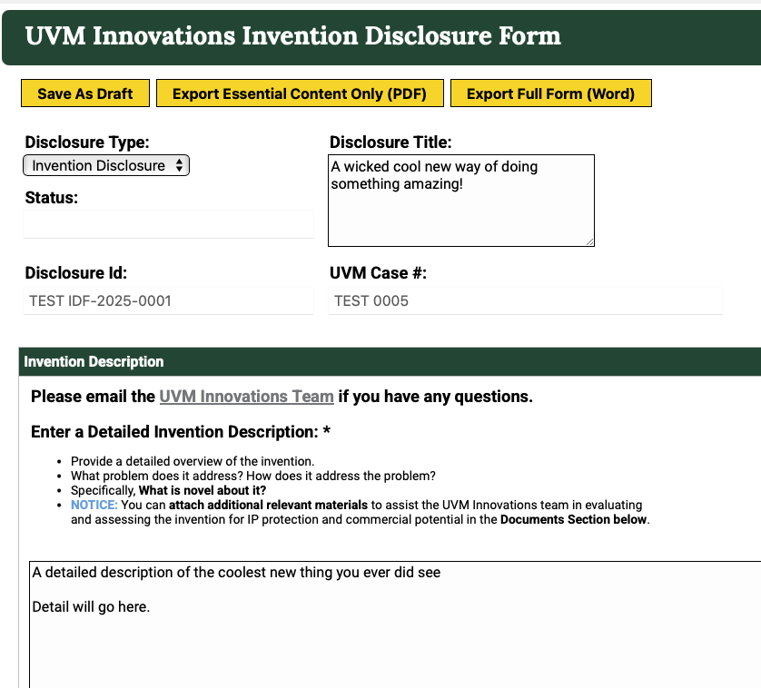

Invention Disclosure Form

Slide 39
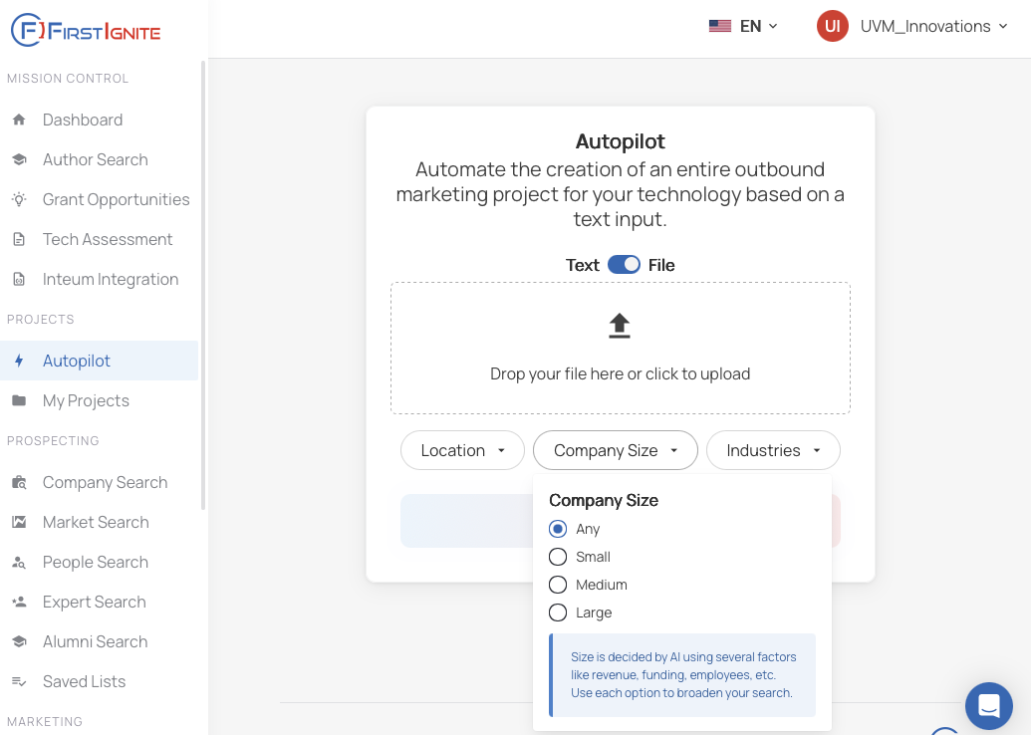
FirstIgnite: AI Marketing Project

Slide 40
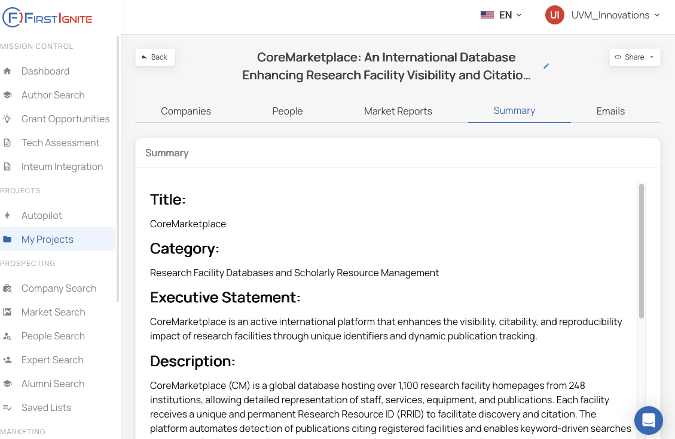
Technology Summary

Slide 41
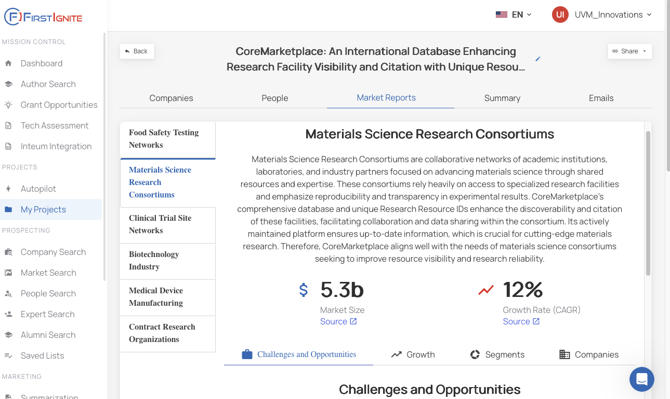
Prospective Markets and Market Analysis

Slide 42
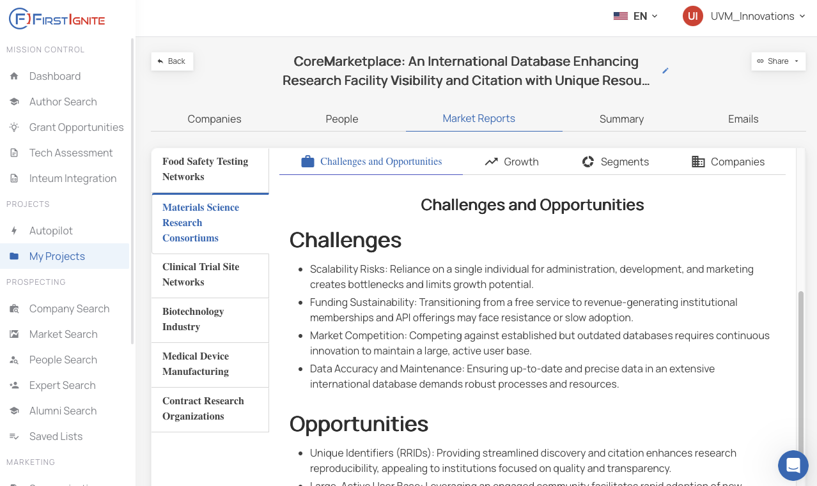
Market Challenges and Opportunities

Slide 43
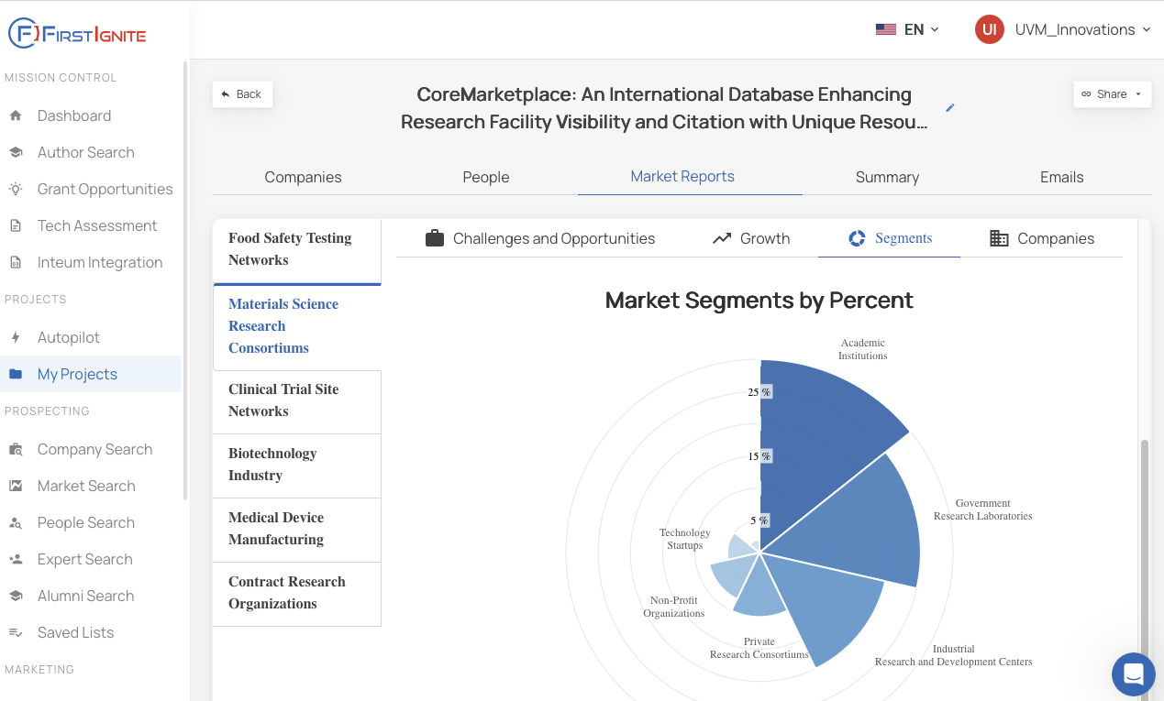
Market Segments

Slide 44
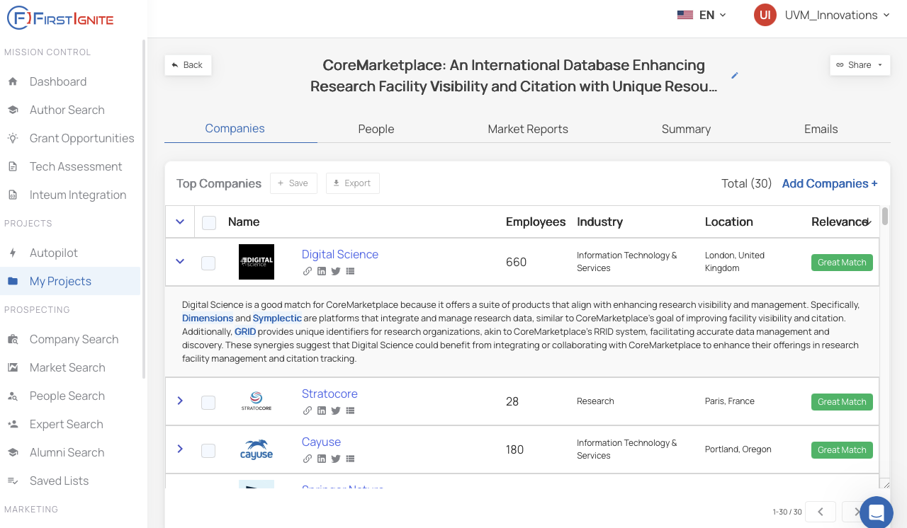
Target Companies (& Why)

Slide 45
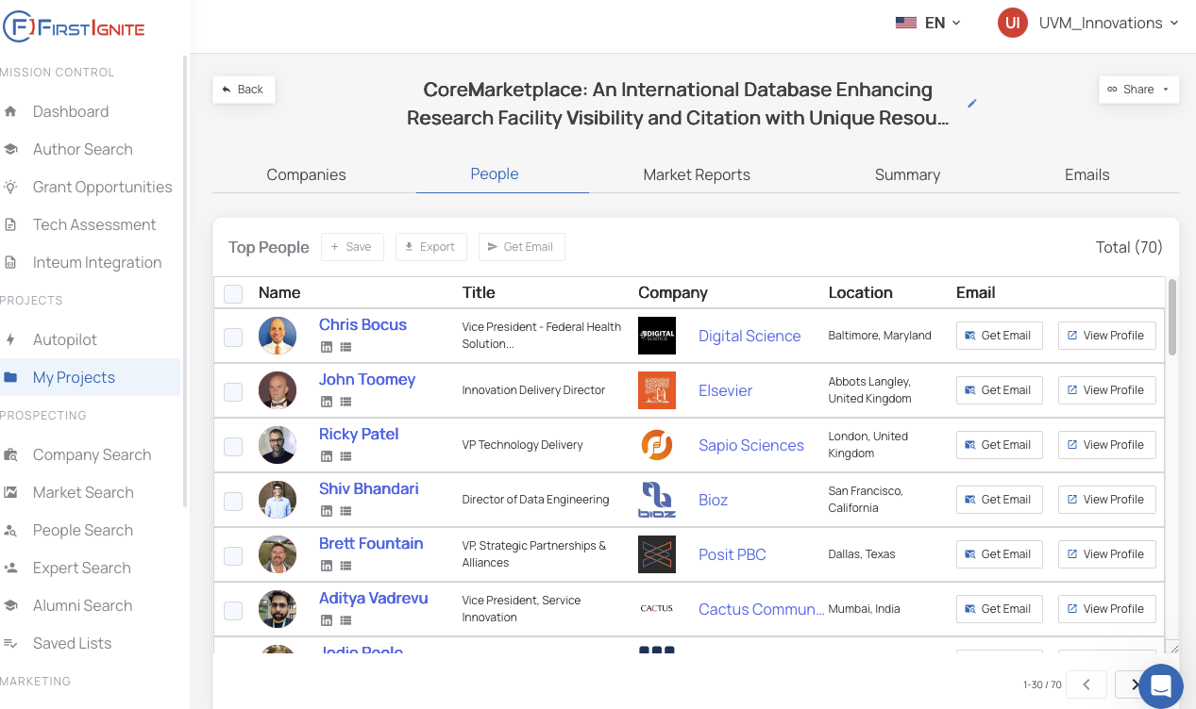
Company Contacts (& Emails*)

Slide 46
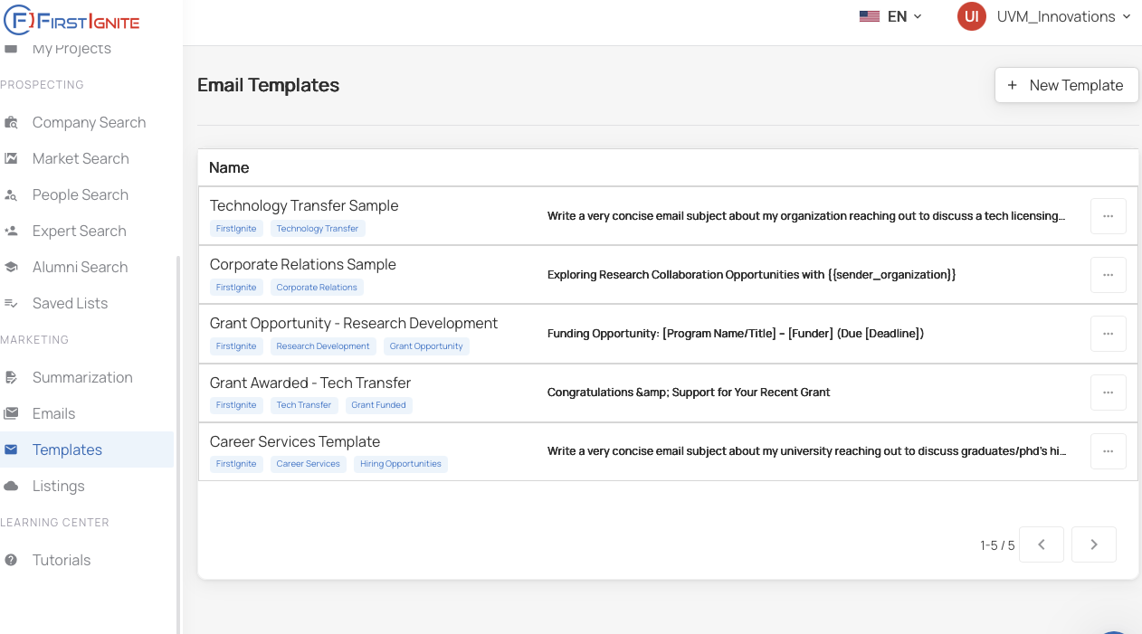
Email Templates

Slide 47
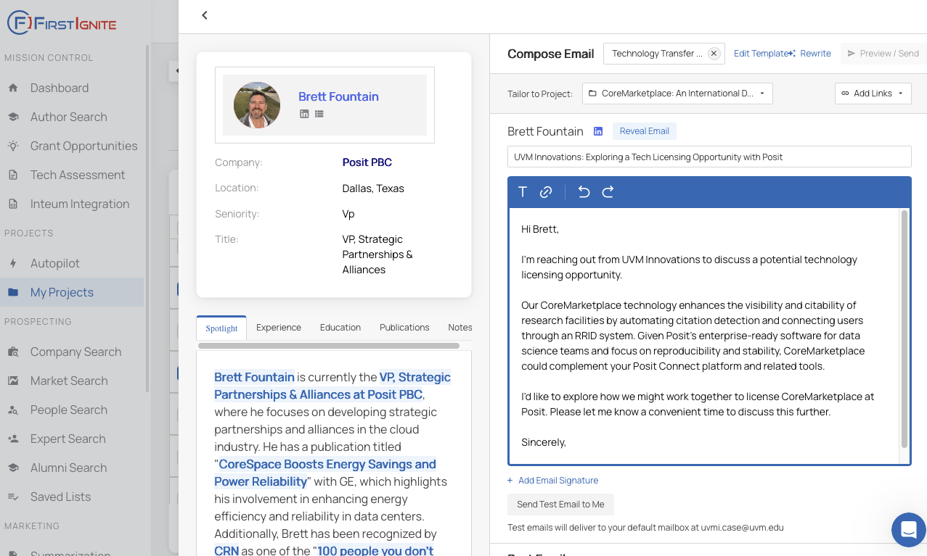
Email Templates

Slide 48
Upcoming Feature
Technology Assessment

Slide 49
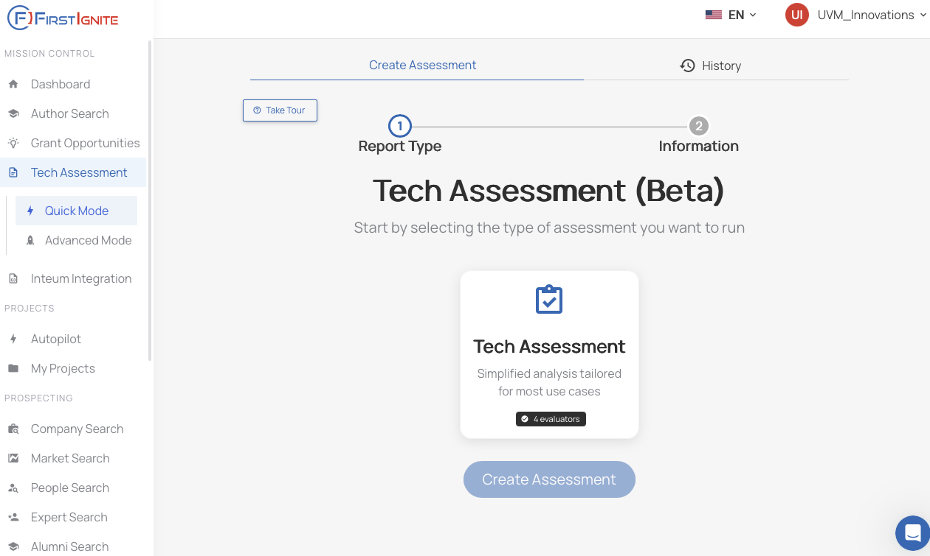
Feature Preview: Technology Evaluation

Slide 50
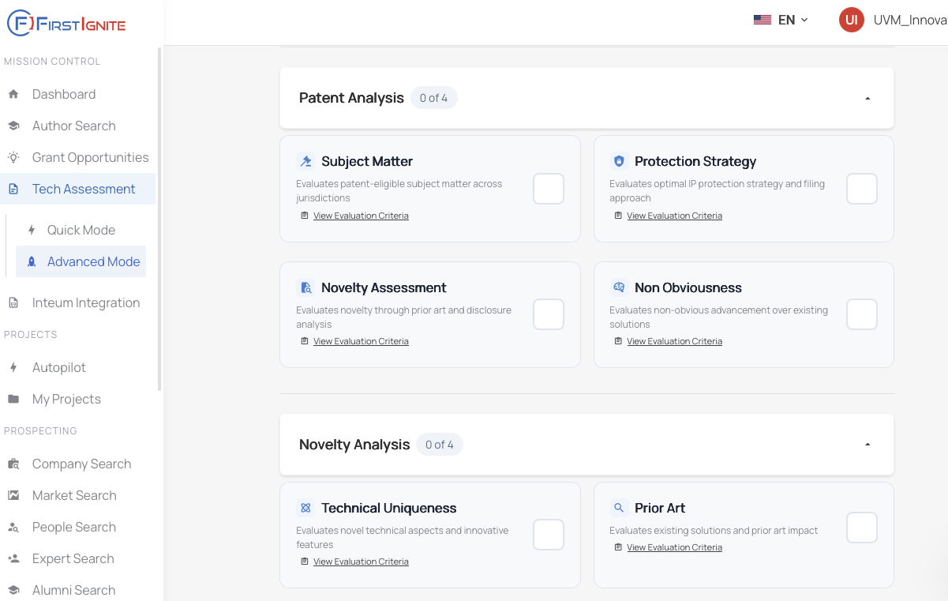
Customize Evaluation Criteria

Slide 51
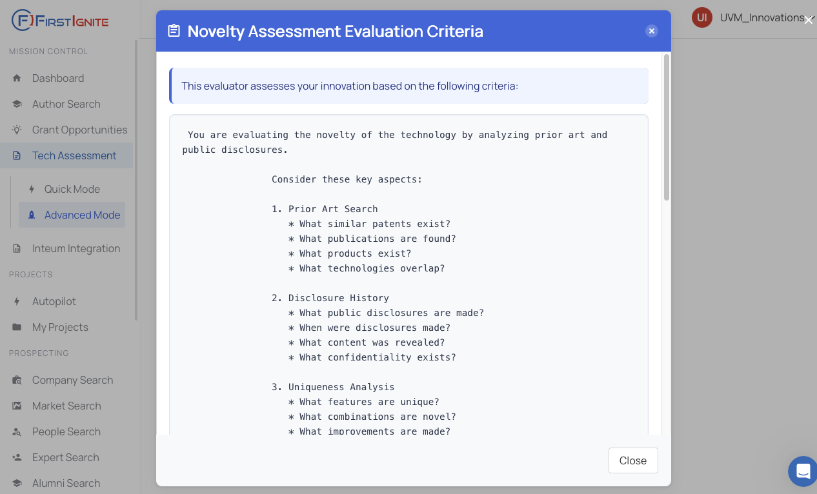
Evaluation Criteria: Preview Prompts and Scoring

Slide 52
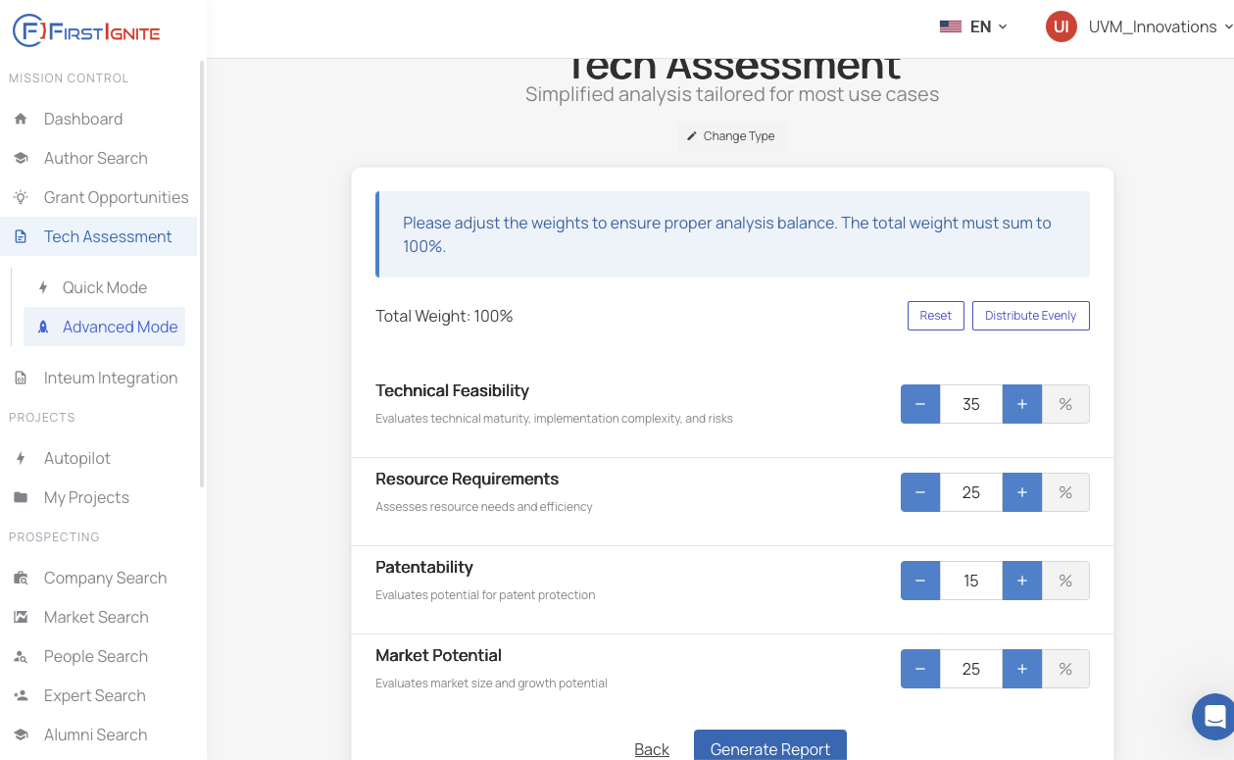
Evaluation: Customize Criteria Weighting

Slide 53
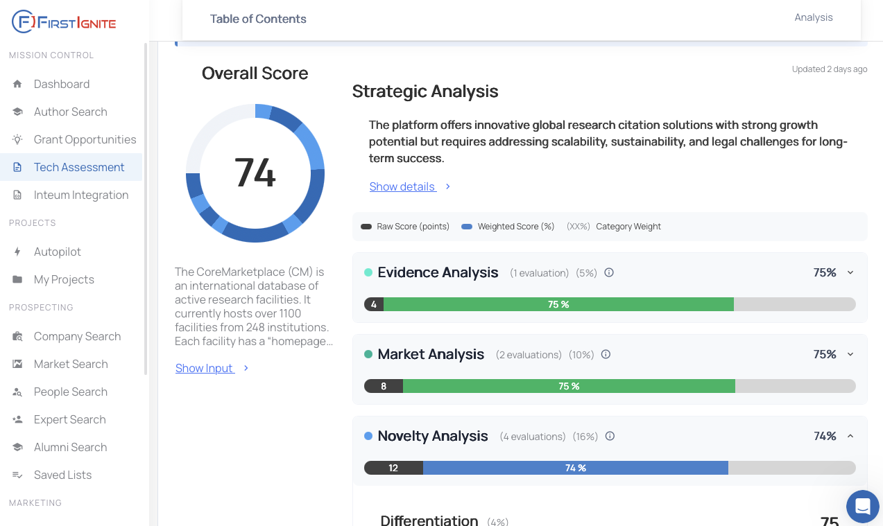
Evaluation Report and Scorecard

Slide 54
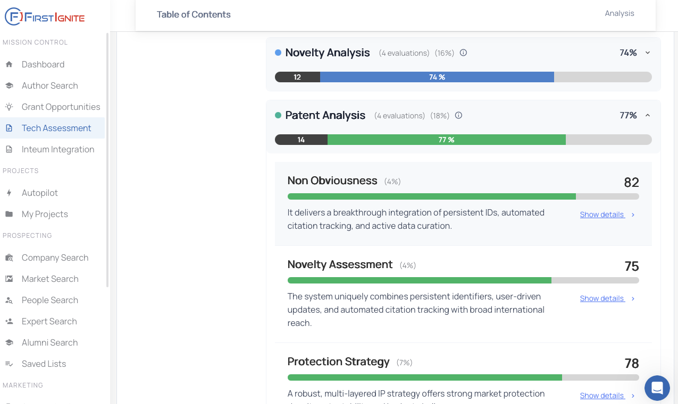
Evaluation: Dive into details

Slide 55
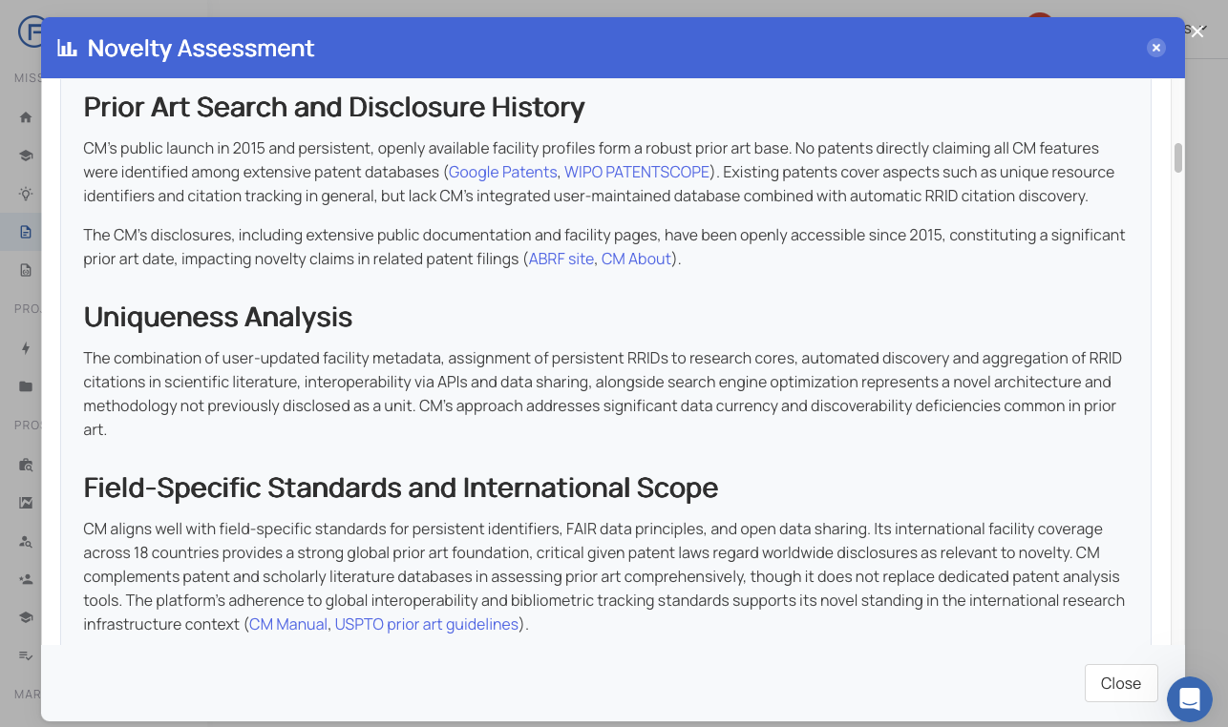
Evaluation: Dive into details

Slide 56
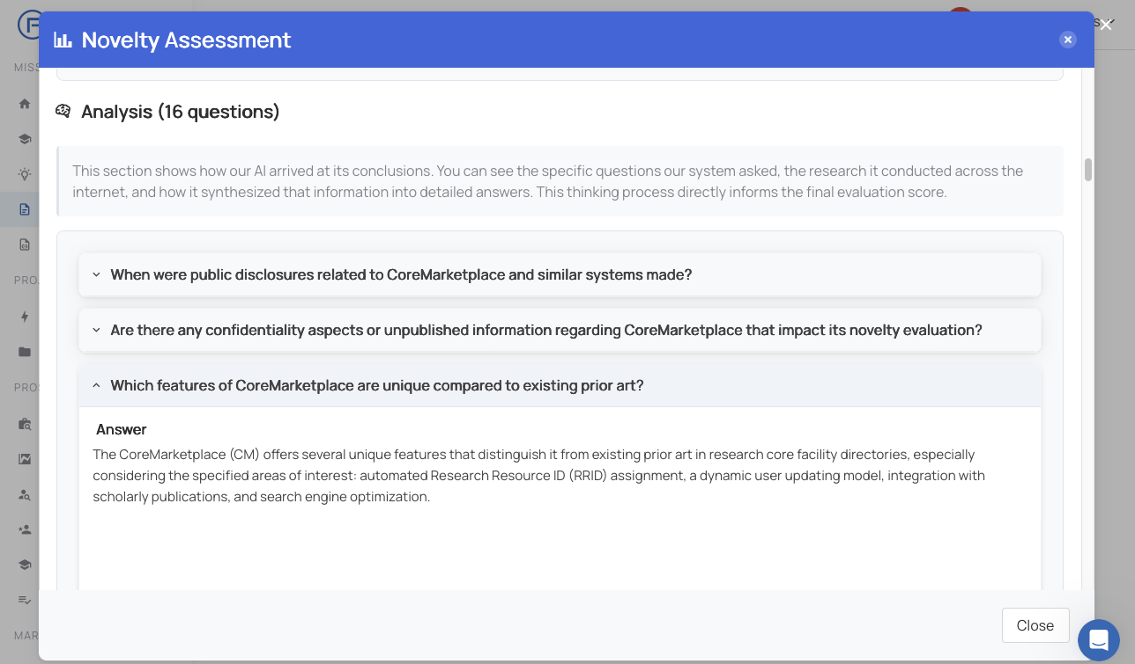
Evaluation: Detail into Prompt/Response

Slide 57
Benefits / Risks
Benefits
Risks
Automates of workflow and evaluation research
Weeks to hours
Asks multiple questions with multiple sources
Tries to give insight into why the AI supplies a result
Leverage single expense across multiple projects
Deeper and more visual analysis presentation
Typical AI accuracy/completeness concerns
If NOT setup securely there would be confidentially risks (mitigated)
Our instance is NOT used for training or improving their LLM (mitigated)
Human SME and insight vs machine coded prompts (we won’t be using AI output without Human oversight)
Their workflow uses the same research sources / prompts regardless of input

Slide 58

Thank You
Jesse.Stein@uvm.edu
UVM Innovations
https://www.uvm.edu/uvminnovations
innovate@uvm.edu Patrick Leahy Budling
802-656-8780 105 Carrigan Drive
Leahy Building, 101
Burlington, VT 05405

