Slide 1
Spaced Repetition Career Information Session #1

Slide 2
Agenda
Why do these sessions?
Meet the Team
Advisors and Career Counselors
Residency Application
Academic Support
Step 1
Office of Medical Education

Slide 3
Why these sessions?
Provides increase visibility and accessibility of career counseling faculty
  Especially important for students who don’t have family or close friends in medicine
Improve visibility of extra-curricular scholastic opportunities
Moderate Step 1 stress with early discussion and information about school resources
Student data indicates dissatisfaction with career information in pre-clinical years of medical education
We want these to be useful!
  Please provide feedback if you have thoughts
Office of Medical Education

Slide 4
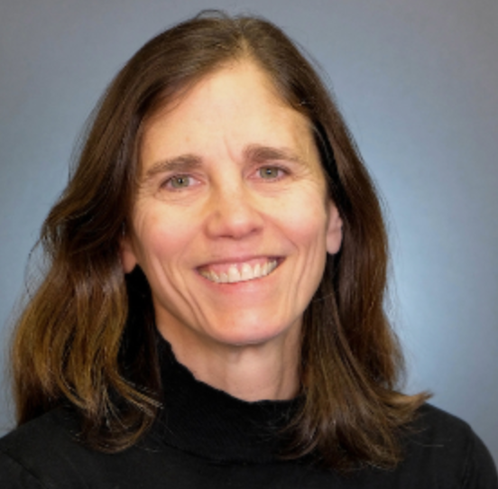
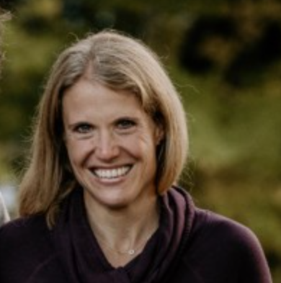
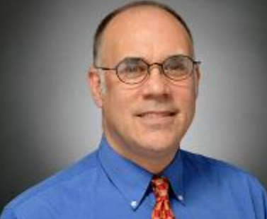
Who is on the team?
Dr. Karen George
OBGYN
Associate Dean for Students
Dr. Katie Dolbec
Emergency Medicine
Assistant Dean for Students
Dr. Lee Rosen
Psychiatry
Director of Student Wellbeing
Office of Medical Education

Slide 5

Advisors and Career Counselors
PCR facilitators are your first stop advisors
Students meet with PCR facilitators throughout Foundations and Clerkship
  Backup is Office of Medical Education (OME)
  LCOM specialty advisors
Specialty Advising starts December/January of Third Year
Explore specialties now using AAMC Careers in Medicine
Peer Support also available through LCOM Connect!
Office of Medical Education

Slide 6
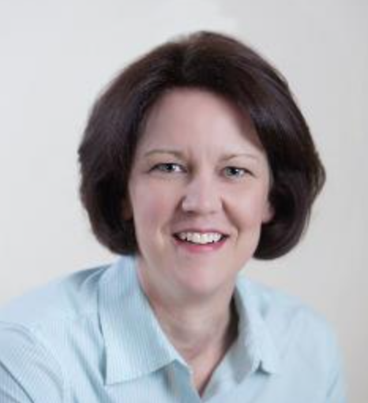
Residency Applications
Applications submitted in just over 3 years from now
Attend Careers in Medicine Lunch Series
Research Info coming soon!
Research Contact: Dr. Renee Stapleton
Student data indicates dissatisfaction with career information in pre-clinical years of medical education
Office of Medical Education

Slide 7
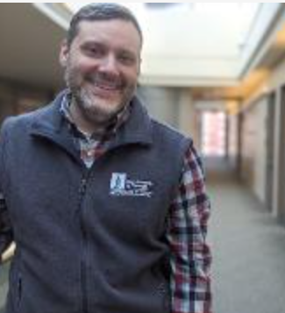
Academic Support
Academic Achievement Contact: Dr. Tim Moynihan
  Support Students in Optimizing Learning and Retention Strategies
  Individualized Support
  Connect with Peer tutors for:
    Class work
    Anatomy lab
    Anki tutorials
    Test taking strategies and more!
Office of Medical Education

Slide 8

Step 1
Students take Step 1 in February / Early March of 2nd year
School provides UWorld access starting summer before 2nd year
Factors associated with being prepared for Step 1
  Class attendance and engagement
  Managing stress around exams
  Use of Uworld resource
Step1 is one part of residency application but there is much more to your application and to becoming a doctor
  Leadership Experience
  Community Service
  Research
  Step 2 (actually has a score)
  Letters of Recommendation
Office of Medical Education

Slide 9
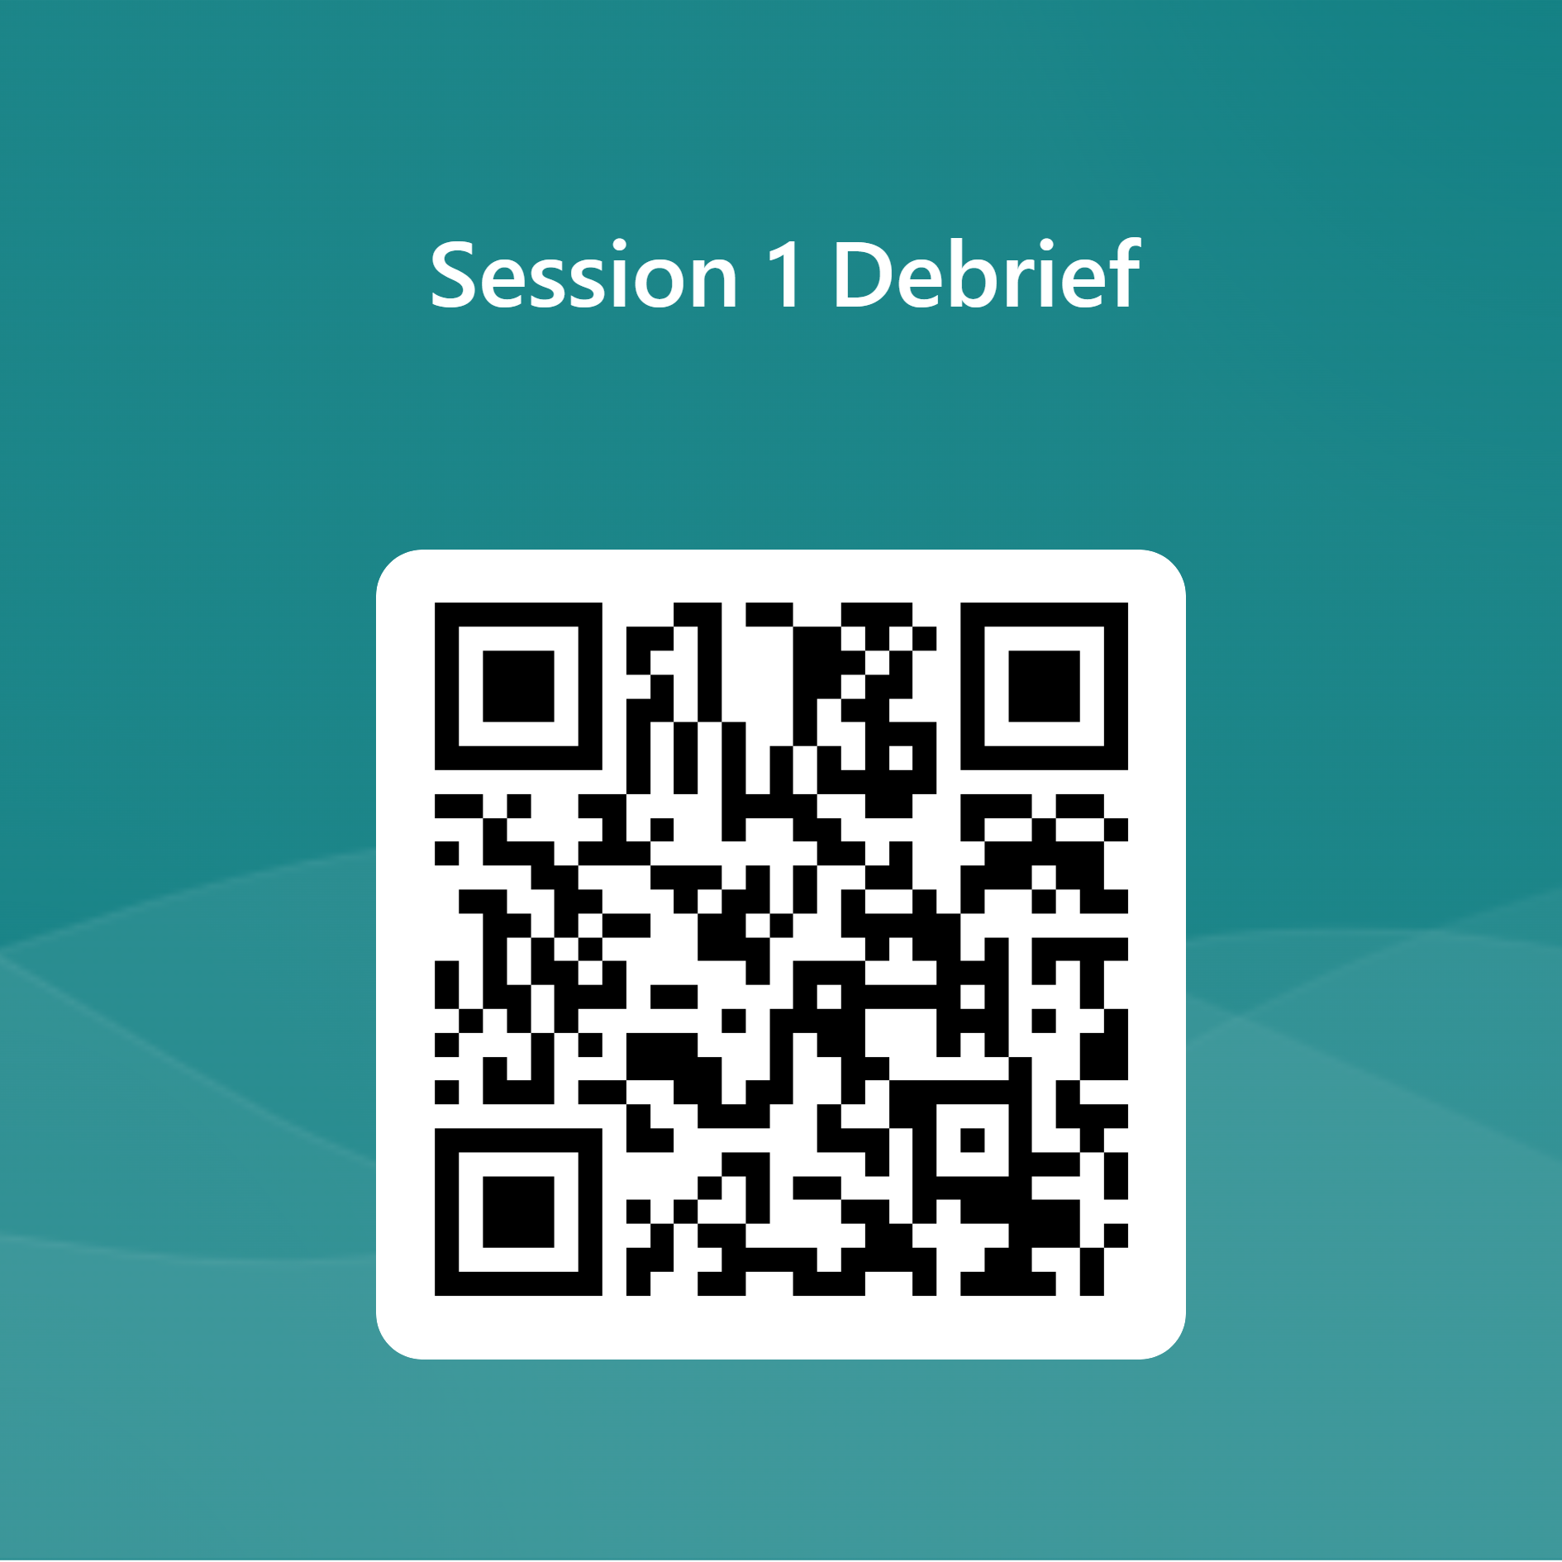
Debrief Session w/ Student Education Committee
Office of Medical Education

Slide 10
Questions?
Office of Medical Education

