Slide 1
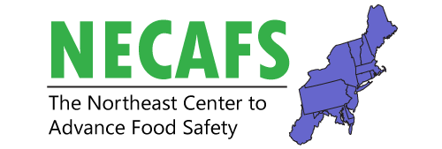
NECAFS Regional Roundtable
Food Safety Projects throughout the Northeast
Welcome and Thanks for Joining the Webinar
October 14, 2016
The NECAFS Project Team
Elizabeth Newbold (UVM)
Chris Callahan (UVM)
Betsy Bihn (Cornell)
Amanda Kinchla (UMass)
Luke LaBorde (Penn State)
Chris Walsh (UMD)

Slide 2
Get Connected to NECAFS
Visit the NECAFS website: http://www.uvm.edu/extension/necafs
Subscribe to the NECAFS Listserv through the website
Subscribe to the NECAFS Monthly Newsletter through the website
Like us on Facebook: www.facebook.com/necafs/
Follow us on Twitter: @necafs

Slide 3
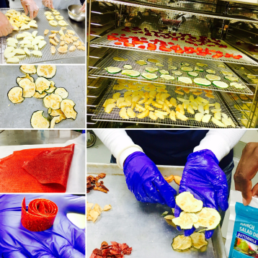
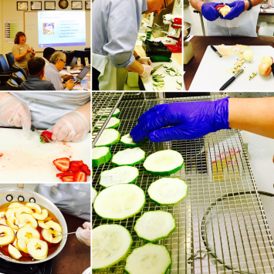
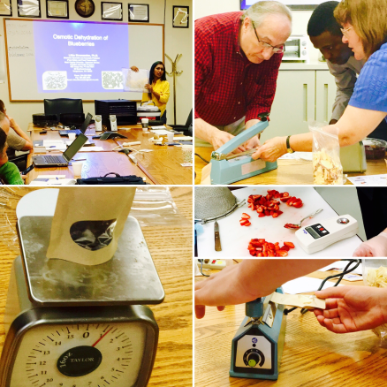
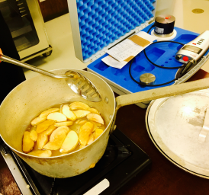
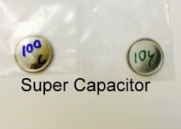
Commercialization of Fruit & Vegetables Drying and Byproduct Utilization
Litha Sivanandan, West Virginia University (WVU) Extension Service, Litha.Sivanandan@mail.wvu.edu; Winifred McGee, Penn State Extension, wwm1@psu.edu; Kaushlendra Singh, WVU, Kaushlendra.Singh@mail.wvu.edu
{Funded by: Northeast Extension Risk Management Education, WVU ADVANCE grant}
Active
Problem Statement / Issue Definition:
Although the Penn State Food For Profit workshop has been offered in Pennsylvania and West Virginia since 2011, this class only provides basic start-up information for food businesses. As such, it does not address farmers’/processors’/agricultural providers’ demand (demonstrated through an end-of-session survey) for specific information about producing value-added products (from unsold fruits and vegetables). This pointed to a need for hands-on production training to address food safety, risk management, and usage of shared commercial kitchens and co-packers. WVU launched a fruit drying training based on research results in 2011, eventually diversifying the value added products for sustainability. An additional step, yet to be explored, is to provide a scientific explanation of processes through internet animations and videos.
Approach / Methods:
The project teaches limited resource and specialty crop producers to add value and process byproducts. Production (economic impact of diversification), marketing (choosing direct sales strategies) and legal (ensuring food safety) risks can be effectively identified and addressed when farmers collaborate with other producers, or technical school students, in a shared commercial kitchen. Educational materials are being developed/pilot tested with farmers and collaborators, equipping producers to determine probable levels of excess fruit/vegetables, explore the feasibility of adding value, and plan individualized adoption strategies. Information about this process is being disseminated through meetings and internet modules.
Images from hands-on training workshop on fruits/vegetables drying and food safety testing and a non-food product developed from the fruit waste.
Results / Outcomes:
A pilot project was launched at Greater Johnstown Career and Technology Center (GJCTC) in September 2016; two more locations (TBD - one in WV and one in PA) will demonstrate feasibility of replication; students in the CTCs are taught commercial food drying and food safety testing methods, as well as cost-effective, safe co-packing and marketing strategies. Assuming a successful pilot, collaborators at replication centers will be assisted in setting up a program in their communities. As a result of this research and education project, more farmers will begin adding value to “excess” produce by drying commercially and utilizing by-products. This will lead for additional demand for dried products research, training, and educational materials development (i.e., animations) which were identified as needed by survey results/feedback of participants.
Regional Roundtable – October 14, 2016

Slide 4
“Develop and implement a hybrid workshop in FSMA produce safety and preventive controls rules for stakeholders engaged in growing and processing high-risk produce”
Active
Rohan Tikekar (PI), University of Maryland, rtikekar@umd.edu
Justine Beaulieu (Key Personnel), University of Maryland, jbeauli1@umd.edu
USDA NIFA FSOP
Problem Statement / Issue Definition:
There is a specific need to develop a training program for the farmers who are not only growing produce, but also processing it and may be required to adhere to both the produce safety and preventive controls rules.
Approach / Methods:
Three trainings throughout the state that combine produce safety and preventive controls rules curricula to meet the needs of this niche group of farmers who are also processors.
Results / Outcomes:
Reduce costs and training time for participants while offering a more comprehensive understanding of good food safety practices for growing and processing high risk produce.
Regional Roundtable – October 14, 2016

Slide 5
CONSERVE: A Center of Excellence at the Nexus of Sustainable Water Reuse, Food, and Health
Sarah Allard, Ph.D., University of Maryland School of Public Health, sallard@umd.edu
USDA-NIFA-AFRI
Active
Problem Statement / Issue Definition:
The goal of one of the CONSERVE projects is to survey nontraditional irrigation water sources (e.g. brackish water, river water, processing plant wash water, reclaimed water) for microbiological, chemical, and physical characteristics. After the initial survey, we plan to develop and implement economical on-farm water treatment solutions to make these sources safe for irrigation of food crops.
Approach / Methods:
Across the Mid-Atlantic and Southwest U.S., we have begun collecting and analyzing water samples for:
Chemical and physical water quality
Bacterial indicators of fecal contamination
Bacterial pathogens
Total bacterial communities (using next-generation sequencing)
PPCPs (Pharmaceuticals and personal care products)
Results / Outcomes:
Sampling began in September 2016 and will continue throughout the duration of the grant (4 years). In Spring 2017, we will begin field studies using nontraditional irrigation water to grow food crops.
http://conservewaterforfood.org
Regional Roundtable – October 14, 2016

Slide 6


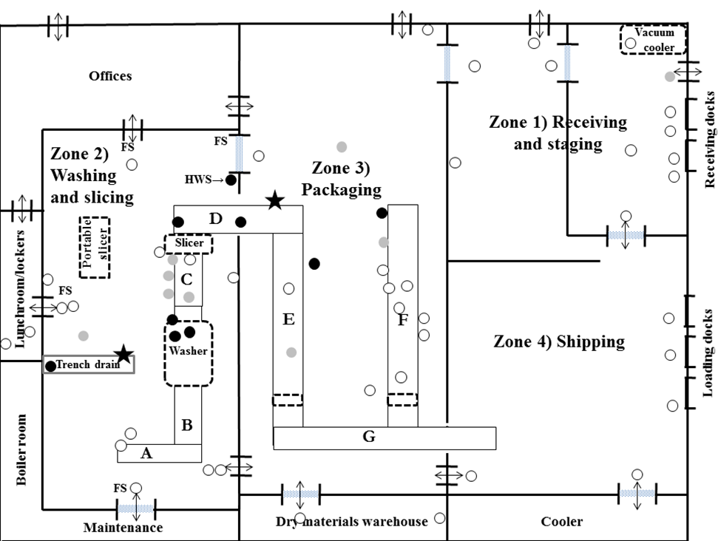


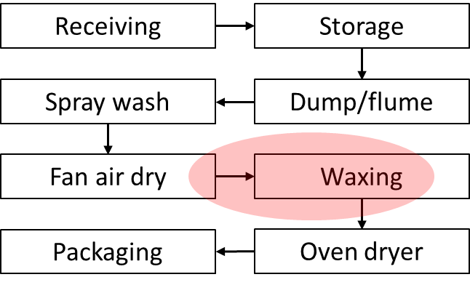
“Occurrence of Listeria monocytogenes in produce packing and processing facilities”
Luke F. LaBorde, Penn State Food Science Dept., lfl5@psu.edu
Funding: Mushroom and apple commodity orgs., USDA SCBG, FDA
Completed and in progress
http://foodscience.psu.edu/directory/lfl5
Issue: Listeriosis outbreaks and recalls traced to fresh produce contaminated with Listeria are increasing. We need to understand how this pathogen gets into facilities, where it becomes established, and how to eradicate it.
Methods: NFC surfaces were sampled at multiple sites over a 1 year period. L. monocytogenes occurrence was determined using standard enrichment and plating procedures.
Results: 1) 2)
1) 18.8% of mushroom facility samples (N=255) were positive for L. monocytogenes. A single Lm clone was predominant (93.6%) and persistent at a trench drain and in a wet floor crack. Sanitation improvements between period 2 and 3 led to a significant decrease in Lm + sites.
2) Preliminary studies showed 10-50% of tree fruit packing house NFC surface samples were positive for L. monocytogenes. A follow-up year long microbial survey is under way at 3 tree fruit packing houses in PA.
Extension training on sanitation is planned for 2017.
Predominance and distribution of a persistent Listeria monocytogenes clone in a commercial fresh mushroom processing environment. 2015. J. Food Protect. 78:1988-1998.
Preliminary higher frequency locations for L. monocytogenes
Regional Roundtable – October 14, 2016

Slide 7
Expanding Food Safety Outreach and Education to Small and Mid-sized Farms in NY and VT
Andy Fellenz, NOFA-NY, andy@nofany.org
USDA-NIFA, FSOP
Active
Problem Statement / Issue Definition:
Provide fresh produce farms with farm food safety training as outlined by FSMA. Expand educational outreach to small and midsized farms, including FSMA exempt farms. Provide training to fresh produce buyers for smaller organizations. Identify synergies between the NOP, FSMA, GAPs, and VT CAPs. Train Organic inspectors in VT CAPs to enable dual inspections
Approach / Methods:
A collaborative initiative between NOFA-NY, Cornell, UVM and NOFA-VT to build a strong network of educators, FSMA compliant training materials, resources and curricula to deliver education and technical assistance to the identified target audiences of small and mid-sized farms, food and farm Co-ops, food hubs and other programs.
Results / Outcomes:
Work is just beginning and resources are being mobilized
Regional Roundtable – October 14, 2016

Slide 8









Local Food Producer Outreach, Education, and Training to Enhance Food Safety and FSMA Compliance
Roger Noonan, New England Farmers Union; roger@newenglandfarmersunion.org
Funding: Food and Drug Administration (FDA)
Problem / Purpose: Local food producers and processors need food safety education and training on regulatory requirements of applicable FSMA rules (a) relevant to their scale of production and management practices and (b) that addresses their limited access to adequate and affordable food safety training, education, outreach, and technical assistance.
Approach / Methods:
Conduct needs assessment: national survey + regional listening sessions
Develop a national framework for communication with collaborators and local food producers
Develop a national training plan
Develop and distribute supplementary educational materials
Outreach to increase awareness, participation
Results / Outcomes: Improved stakeholder awareness, compliance, and implementation of FSMA regulatory requirements, leading to decreased costs for stakeholders and improved public health and safety
Regional Roundtable – October 14, 2016

Slide 9



FSMA Producer Outreach in Connecticut
Roger Noonan, New England Farmers Union; roger@newenglandfarmersunion.org
Funding: USDA-AMS, Specialty Crop Block Grant (SCBG)
Problem / Purpose: Minimize impacts to small farms due to FSMA compliance requirements to promote the continued growth of CT’s local food system. New FSMA regulations put small entities at a competitive disadvantage.
Goals: Increase awareness of FSMA compliance requirements and facilitate adoption of PSA training and USDA-GAPs.
Approach: Develop/disseminate educational materials (articles, guidebook, etc.), and conduct group meetings in each CT county.
Results / Outcomes: Forthcoming via pre- and post-meeting survey and on-farm visit feedback form. Impact of outreach will be evaluated on a continuous basis to improve the delivery system.
Regional Roundtable – October 14, 2016

Slide 10
Produce Safety Alliance (PSA) Training for FDA Regulatory Compliance
Lori F Pivarnik, University of Rhode Island, lpivarnik@uri.edu
USDA/RIDEM-Division of Agriculture: Specialty Crop
Crops
Active
Problem Statement / Issue Definition:
For over 12 years, RIDEM/URI have implemented a RI GAP certification program. However, FDA’s produce safety rule requires mandated training for compliance. To maintain RI agricultural viability, RI based PSA training for farmers will be implemented to meet regulatory compliance mandates and/or buyer requirements.
Approach / Methods:
Train-the trainer for URI personnel – Lead trainers
Offer PSA sanctioned training for those RI farmers that must comply
Extend PSA training to farmers not specifically required but interested in attending
Continue RI GAP program
Evaluation – self-assessed knowledge understanding and implementation
Connecticut/RI collaboration
Results / Outcomes:
Complete train the trainer – anticipation of lead instructor assignment
Offer at least two PSA trainings with additional workshops if interest.
  Evaluations reflecting positive knowledge gain and implementation awareness
Coordination of training opportunities with University of Connecticut
Regional Roundtable – October 14, 2016

Slide 11
Rhode Island’s Plan to Implement the Produce Safety Rule Lori F Pivarnik, University of Rhode Island, lpivarnik@uri.edu
FDA: State/Territory Coop. Agreement to Enhance Produce Safety in Prep. of Implementation of FDA's Rule
Active-New
Problem Statement / Issue Definition:
To achieve and sustain full conformance with the Produce Safety Rule so that RI will have a quality produce safety program with a system in place for continuous improvement. RI implementation of the rule will impact food safety as it aligns the state with the national initiative.
Approach / Methods:
Assessment of current regulations, staff and programmatic needs. Adoption of rule.
Regulator training for enforcement and compliance activities as well as technical assistance to farmers
Farm inventory – URI/RIDEM/Div. Agriculture partnerships with RIDOH – farm size, produce, harvest practices, volume of production etc.
Farm readiness review – pre assessment checklist for compliance program
Communication, information and resource sharing with local, state and federal partners
Results / Outcomes:
Compliance and enforcement, with continuous improvement and outreach to farmers – for those who must comply and those who do not. As part of the 5-year program will be the development of a sustainable, continuing farm inspection program that ensures compliance as well as outreach resources.
Regional Roundtable – October 14, 2016

Slide 12

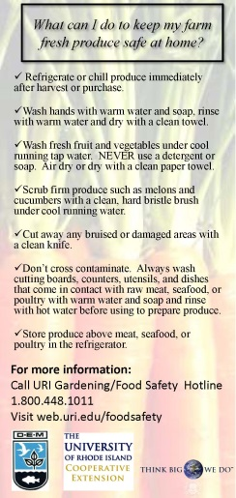
Food Safety: From Farming to Direct Marketing
Lori F Pivarnik, University of Rhode Island, lpivarnik@uri.edu
USDA/RIDEM-Division of Agriculture: Specialty Crop
Crops
Active
Problem Statement / Issue Definition:
Past emphasis of RIGAP to provide training/support to certified in program. Although FDA produce safety rule was announced, many RI farmers will either not be covered or would obtain a qualified exemption and directed product to the local market. This project 1) targeted farmers who where interested in training but not in official certification, 2) provided FSMA update; 3) engaged farmers market managers and vendors regarding produce safety handling
Approach / Methods:
Updated RI GAP training and certification/recertification
  Evaluations for usefulness and understanding
“Advanced GAP” workshops – Food Safety Plan Development – Partner UConn
  Evaluations for usefulness and understanding
Training developed and implemented for Farmers Market Managers and Vendors
Develop and implement FSMA produce safety rule update for farmers
Continue development of marketing resources for RI GAP farmers
Results / Outcomes:
RI GAP Trainings ongoing – evaluations 4.0 ± on 5 point Likert scale.
35 RI GAP farms
Update – PS and PC rule – 62 attended; more planned
New “bookmark” developed and distributed
Manager trainings successful – 16+ attendance, better practices developed
  Recorded training posted on-line, new website presence
Working with Farm Fresh RI for better outreach to vendors
Regional Roundtable – October 14, 2016

Slide 13
Developing a strategy for optimizing regional support for new and very small local value added food processors
Nicole L Richard, University of Rhode Island, nicolerichard@uri.edu
NEED-NERA Planning Grant Program
The approaches and strategies identified by the planning grant team members will be used to apply for external funding.
Crops
Active
Problem Statement / Issue Definition:
New England food entrepreneurs that add value to local agricultural products face challenges navigating regulations and developing a safe, high quality product. Educators need information regarding the challenges and opportunities facing this audience necessary to optimize programming. The project goal is to initiate a planning meeting of experts/stakeholders to discuss methods for conducting a needs assessment that will help enhance regional training and research strategies.
Approach / Methods:
Coordinate meeting of experts/stakeholders from the NE region- team members
Outlining protocol for developing/conducting a needs assessment of NE entrepreneurs to determine training and resource needs.
Developing methodology for conducting research-based validation studies for scheduled processes to promote best practices and regulatory compliance
Building a strategy to enhance and expand regional programming and training that maximizes collaborative efforts
Results / Outcomes:
Regional Roundtable – October 14, 2016

Slide 14
Assessment of preparation methods to create a postharvest wash water model for food safety validation
Paola A. Martinez Ramos, Thomas Carlisle, Amanda Kinchla , Grad Student UMass, pmartinezram@umass.edu
USDA NIFA, National Needs Graduate Fellowship Grant Program
Problem Statement / Issue Definition:
Farmers using turbidity as a point of change for wash water.
Lack of knowledge for preferred sanitizer
Approach / Methods:
Design an appropriate experimental model
Explore efficacy of different commercial sanitizers
Results / Outcomes:
Previous work:
Analysis of 10 farms Pioneer Valley area (Turbidity, Total organic carbon, microbial load)
Use of low and high organic Load values: 112.2mg/L and 8.124mg/L (Paddle mixing vs homogenized leafy matter)
Future direction:
Appropriate experimental design model for sanitizer screening
Regional Roundtable – October 14, 2016

Slide 15
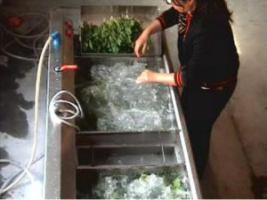
Optimizing Triple Wash Sanitization to Enhance Produce Quality
Tiah Ghostlaw & Amanda Kinchla, University of Massachusetts, tghostlaw@umass.edu
Massachusetts Agricultural Experiment Station, Federal Hatch Funding
Problem Statement / Issue Definition:
Produce sanitizers are known to reduce food safety risk, yet many growers do not adopt the practice. Therefore new extension strategies are needed to influence change.
Approach / Methods:
Evaluate impact of water with sanitizer placement within the 3 water bays.
Using commercial produce sanitizers,
  Measure the microbial load in water and on produce.
  Evaluate overall quality of produce.
Results / Outcomes:
Recently active.
Overall goal is to determine if there are quality benefits through use of sanitizer to promote the adoption of practice.
Regional Roundtable – October 14, 2016

Slide 16
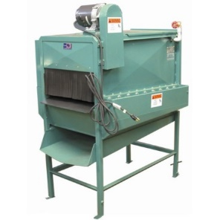
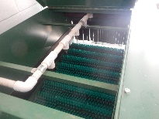
Developing a Sanitation Standard Operating Procedure for a Produce Brush Washer
Kelsi Harper, Amanda Kinchla, University of Massachusetts, Amherst kcharper@umass.edu and kinchla@foodsci.umass.edu
Massachusetts Department of Agriculture Resources, USDA Specialty Crop Block Grant Program
Active
Problem Statement / Issue Definition:
Small farms in our area use machines like this produce brush washer, but these are difficult to clean and sanitize. This study aims to find an SSOP for such machines.
Approach / Methods:
Sanitize machine with 10 gallons 200ppm bleach, let dry overnight
Inoculate rollers 1 and 3 with nonpathogenic E. coli, let dry 45 minutes
Run machine with water for 30 seconds
Douse inside chamber with 5 gallons of 25ppm, 50ppm, 100ppm, and 200ppm chlorine bleach, rotate rollers halfway
Run machine for 30 seconds, sit 2 minutes
Enumerate E. coli from swab samples
Results / Outcomes:
30 second water rinse reduced E. coli levels by less than 1 log CFU/96cm².
E. coli reductions per 96cm² area after 200ppm, 100ppm, 50ppm, and 25ppm chlorine treatments were 4.31, 3.53, 2.68, and 1.78 log CFU per third of roller, respectively.
The use of 200ppm and 100ppm chlorine sanitizer solutions help to significantly reduce the amount of E. coli on brush roller surfaces
Regional Roundtable – October 14, 2016

Slide 17

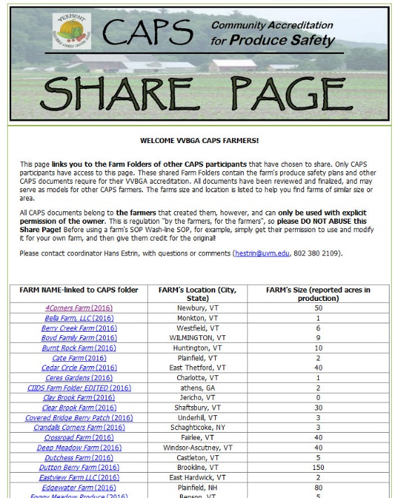
CAPS: Community Accreditation For Produce Safety
Hans Estrin, UVM Extension, hestrin@uvm.edu
NIFA, VVBGA, UVM EXT, VAAFM, NGOs, Buyers,
In-Progress!
Problem Statement / Issue Definition:
--PS Landscape Changing, Most VT growers do not fall under FSMA but need access to wholesale markets.
--Waiting in fear for FSMA to HIT is a VERY BAD idea, especially for VT or NE produce industry.
Approach / Methods:
--Proactively develop optional, farmer-crafted PS Accreditation based on USDA GAP practical standards
--Cost-effective modular design for scaling to support FSMA compliance
--Farm Folder and Share Page regulate and educate!
Results / Outcomes:
--2015 pilot with 25 farms; team-craft 18 requirements
--2016—95 farms write PS plans, 68 farms pay $100 for CAPS!
--2016—VAAFM co-develops field audit; 5 farms pilot CAPS Scalability with Hannaford; “Turbo” CAPS subs for USDA GAP
Regional Roundtable – October 14, 2016
Notes:
Post Harvest Team; 1 slide :3 minutes
Situation:
Idea born out of questions from VT farmers. Ginger visits farms to consult on infra structure imp. For PS. But ginger needed to know more about business plans before see could answer ?? and there were many tech questions that she would need to get engineering help with. It was inefficient for the farmer and the service providers
Need one-stop shopping. Could be more efficient with them.
Team consult—how can we work together to provide maximum benefit to farms and helpful resource for future farmers and service providers.

Slide 18
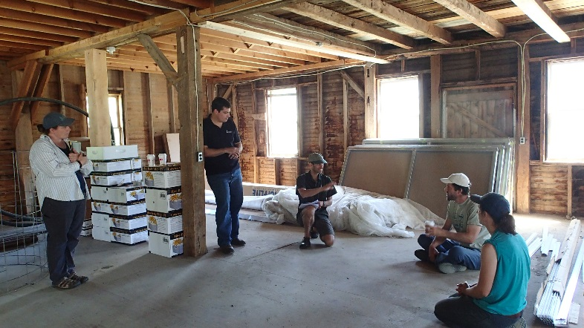
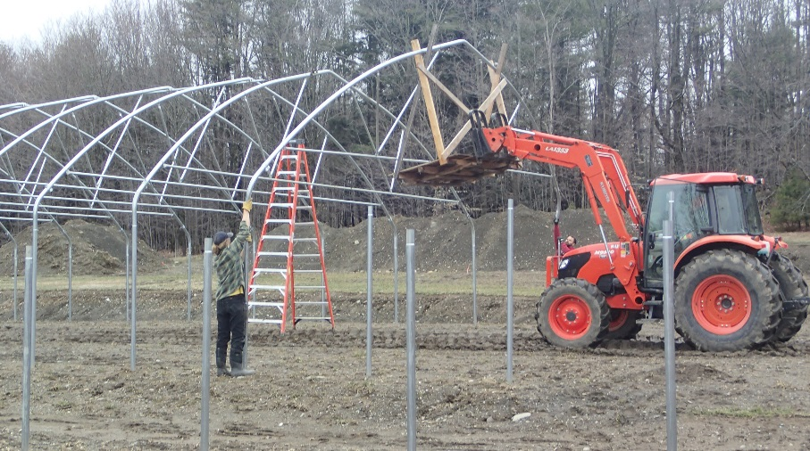
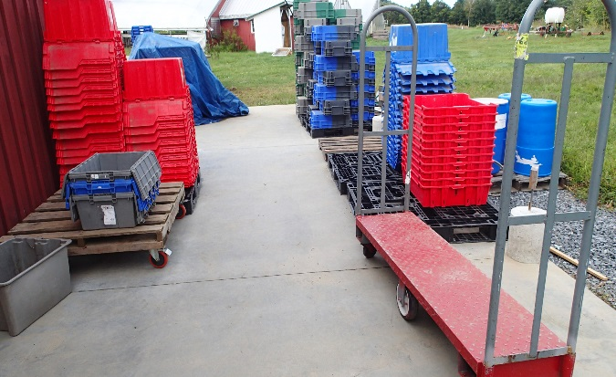
Post Harvest Team; One-Stop Consulting!
Hans Estrin, UVM Extension, hestrin@uvm.edu
AMS/USDA, Specialty Crop Block Grant
In-Progress!
Problem Statement / Issue Definition:
--Struggle to consult on produce safety construction projects without clear business plan and ag. engineering expertise.
--Complex coordination for farmer and service providers.
Approach / Methods:
--One-stop consulting could be effective, efficient, and generate integrated resources/case studies.
--0.1 FTE PHT coordination, team visits, shared folders
Results / Outcomes:
--5 out of 6 PHT farms in-progress: Dutchess, Root 5, Intervale, Sunrise, Roots Too.
--PHT communication and folders developed (Outlook, dropbox)
--Resource output “portal” design in progress (photos, tech resources, case studies)
Regional Roundtable – October 14, 2016
Notes:
Post Harvest Team; 1 slide :3 minutes
Situation:
Idea born out of questions from VT farmers. Ginger visits farms to consult on infra structure imp. For PS. But ginger needed to know more about business plans before see could answer ?? and there were many tech questions that she would need to get engineering help with. It was inefficient for the farmer and the service providers
Need one-stop shopping. Could be more efficient with them.
Team consult—how can we work together to provide maximum benefit to farms and helpful resource for future farmers and service providers.

Slide 19
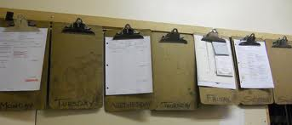
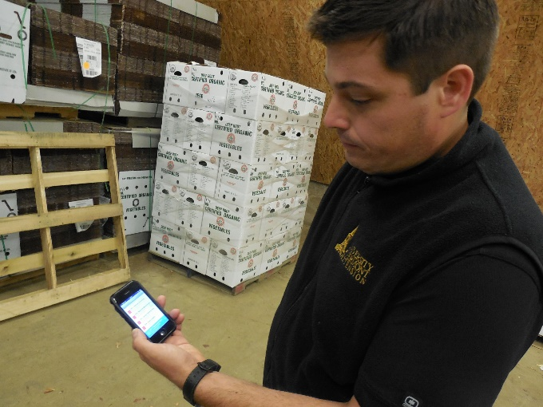
Vermont Produce Tracking and Traceability Study
Chris Callahan, UVM Extension, chris.Callahan@uvm.edu
VAAFM SCBG & VHCB
ACTIVE
Problem Statement / Issue Definition:
Effective food traceability is increasingly important for Vermont produce growers. Large wholesale buyers have begun to demand produce traceability systems, and many additional grocery stores and distributors are expected to require produce traceability over the next few years. These market demands for traceability are being driven by federal legislation in the form of the Food Safety Moderation Act (FSMA) and food safety concerns as well as ingredient certifications.
Not specifically required! Yet.
PSR: Subpart O §112.61.
Comments 78, 138, 308, & 367.
Approach / Methods:
Analyze & Summarize: Grower surveys, Buyer interviews, List of digital technologies.
Identify Potential Traceability Solutions: Short list of technology solutions including paper-based, DIY spreadsheet, and commercially available software.
Pilot: Six farmer partners. Demonstration project. Screen for functionality and ease of use.
Report & Share: Report. Fact sheets outlining basic requirements for produce tracking. Share with produce and service-provider networks.
Results / Outcomes:
Grower surveys complete. Project is being transitioned from prior PI to current team. Assessing prior surveys or growers. Building list of options. Will engage grower participants this Winter for Pilot.
Regional Roundtable – October 14, 2016

Slide 20

Produce Safety Infrastructure Improvement Program
Kristina Sweet, Vermont Agency of Agriculture, kristina.sweet@vermont.gov
Administered by the Vermont Agency of Agriculture, Food & Markets
Funded (if approved) through a request to the Vermont State Legislature
Proposed
Problem Statement / Issue Definition:
The goal of this program is to provide cost share payments and technical assistance to produce operations seeking to improve on-farm food safety capabilities. Priority will be given to operations seeking to meet federal food safety requirements.
Approach / Methods:
If funding is secured, we will release an RFP in early 2018. Participants selected to receive grants will be required to provide a 1-to-1 match (up to 50% in-kind). Producers will be able to apply for up to $15,000 in grant funds, and up to $50,000 will be utilized for producer technical assistance.
Total annual request: $200,000
Funding reserved for TA: $50,000
Total available for grants: $150,00
Results / Outcomes:
This program, if successful, will allow Vermont produce growers to meet produce safety requirements and maintain access to critical wholesale and retail markets. Ongoing infrastructure support to the industry will be assessed following this two-year pilot to determine its long-term utility.
Regional Roundtable – October 14, 2016

Slide 21
Questions?
Regional Roundtable – October 14, 2016

Slide 22
Thank You!
Please help us improve by completing this short survey:
https://goo.gl/forms/Y8OrVM60JzOxtFYQ2
Regional Roundtable – October 14, 2016

