Slide 1
Driving Down the Cost of Production on Dairy Farms
VERMONT financial workshop
Joanna Lidback, MBA, CAC

Slide 2
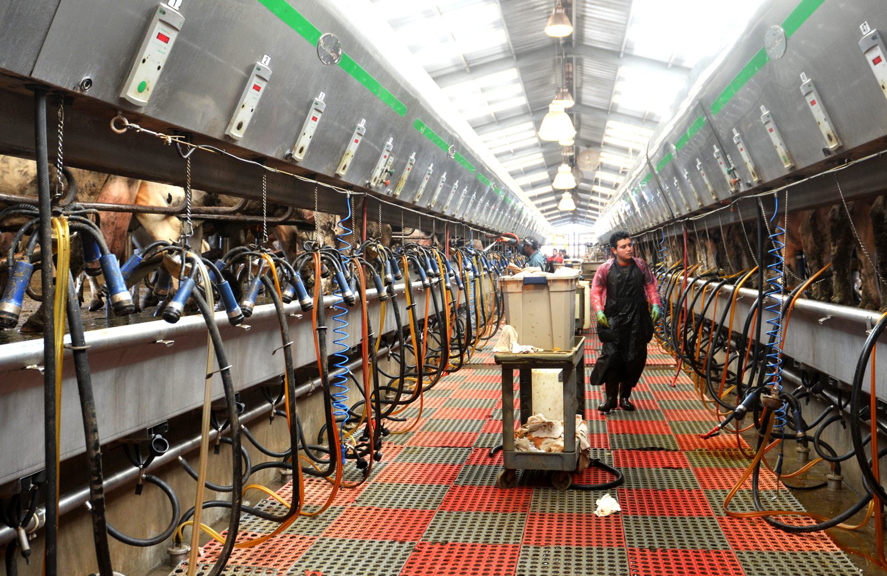
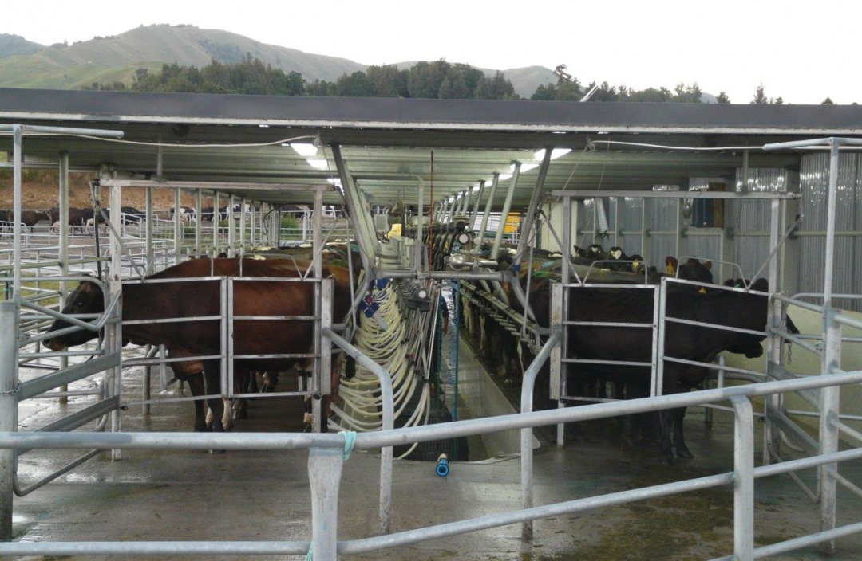
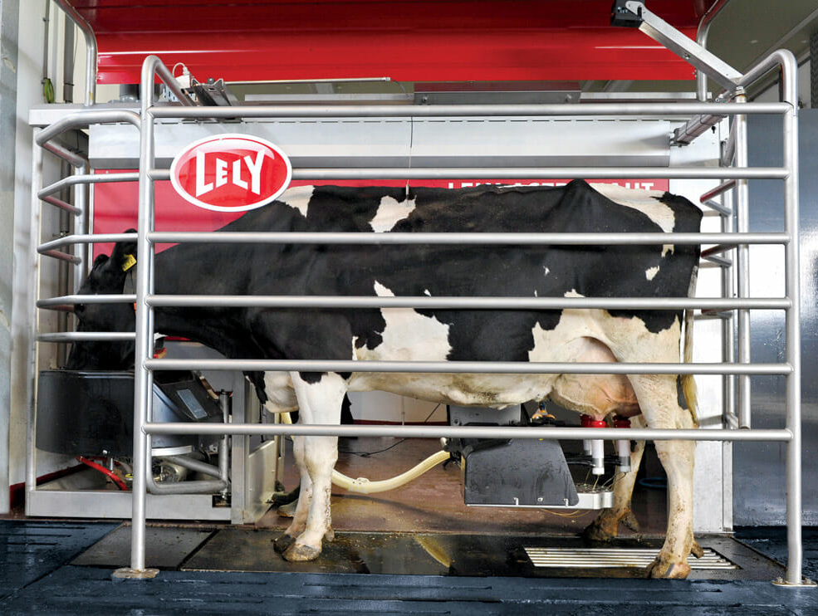
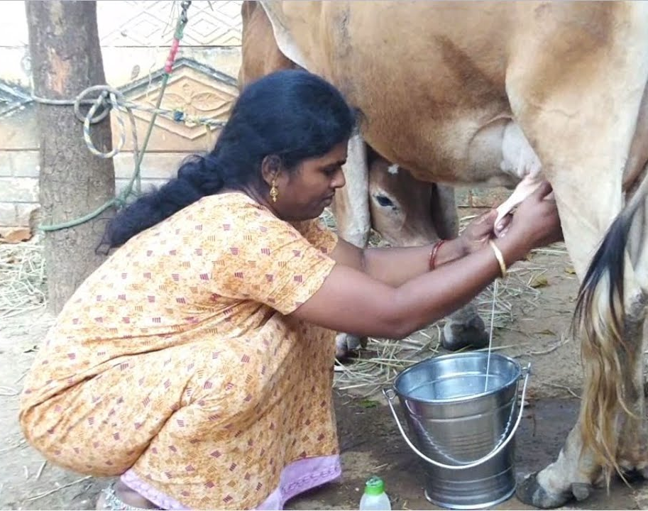
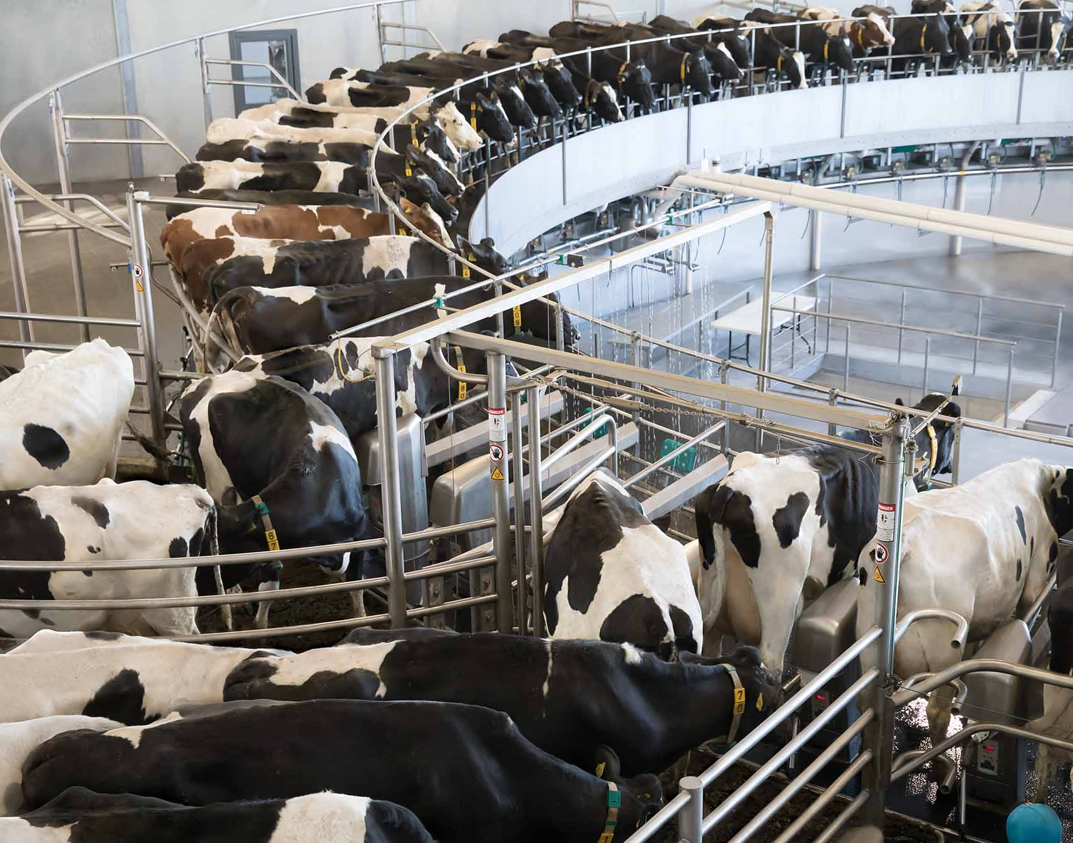

Slide 3
What is the Cost of Production on a Dairy Farm?
Direct expenses or variable expenses?
Overhead expenses
Depreciation?
Return to labor?
Cash or accrual?
Pay attention to the details. Make sure you are comparing apples to apples!

Slide 4
Three Basic Financial Statements Keep Score for Businesses.
Balance Sheet
Income Statement
Cash Flow Statement

Slide 5
The Balance Sheet is a Snapshot in Time
Taken on a single date – “As of December 31, 2023”
Lists assets and liabilities of the business
Calculates the owner’s equity
Based on the balance sheet equation:
Assets – Liabilities = Owner’s Equity

Slide 7
The Income Statement Tracks Over Time
Tracks income and expenses over a specific period:
  January 1, 2023 – December 31, 2023
Operating expenses
May or may not include the “family draw” – check!
Income Statement Equation:
Income – Expenses = Net Income (or Loss)

Slide 9
The Cash Flow Statement Ties it All Together
Also record for a specific time period:
  January 1, 2023 – December 31, 2023
Starts with net income
Demonstrates sources & uses of cash
Beginning Cash as of 1/1/2023 + Sources of Cash
- Uses of Cash = Ending Cash as of 12/31/23

Slide 10
Sources and Uses Examples
Sources
Net Income
Borrowing Cash
Sales of Capital Assets
Paid-in Capital
Increasing Accounts Payable
Accounts Receivable Receipts
Depreciation
Uses
Principal Payments
Purchasing Capital Assets
Distributing Capital
Paying down Accounts Payable
Increasing Accounts Receivable

Slide 11
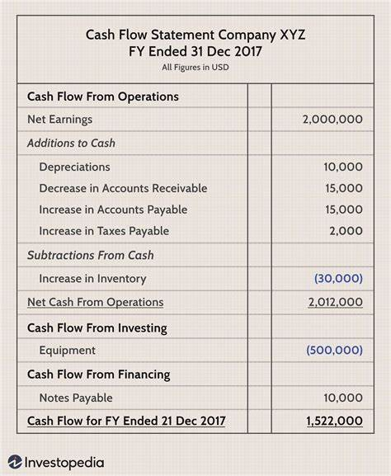

Slide 12
Cash is Quick, Accrual is More Accurate
Farmers are cash-based taxpayers.
  Income and expenses are recognized or deducted when cash is received, or an expense is paid for.
Accrual records offer a more accurate picture.
  Income and expenses are recognized or deducted when the work is completed (and invoiced) or the goods/service used.

Slide 13
Why isn’t this Farm Doing Better?
Info Shared:
1000-cow dairy
85-pound herd average
$7 feed cost per cwt (2018)
1,400,000 pounds milk shipped per worker
Milk price is $18
Breakeven milk price is $17
Missing info:
Feed bill (accounts payable) increased from Jan 1 to Dec 31, effectively adding $1.50 per cwt to overall feed expense.

Slide 14
Per Unit Analysis Allows for Apples-to-Apples Comparison
Removes noise of herd-size, other factors.
Allows for better comparison with industry benchmarks, historical performance.
Industry benchmarks available: Pro-Dairy’s Dairy Farm Business Summary, Farm Credit’s Northeast Dairy Farm Summary, NOFA-VT Organic Dairy Cost Study

Slide 15
Remove the Most Noise with per Unit Analysis, Realistically
Per Farm
Per Cow
Per CWT
Per ECM CWT
Per 150-day ECM CWT
Be realistic about what information is available.

Slide 16
Income Over Feed Asks if the “Juice is Worth the Squeeze”
Basic form: Milk income per cwt (Milk Price) less Purchased feed costs per cwt
Other iterations: Crop-related income and inputs, energy corrected cwts, per cow per day
Difference between nutritionist and checkbook is theoretical vs actual dollars
Whichever way you choose, be consistent.

Slide 17
Labor Efficiency is another Area for Impact
Measured in cows per worker, milk sold per worker, percent labor expense of total revenue
First step, gather worker equivalents
Divide expense or output by worker equivalents

Slide 18
Many Factors Influence Worker Efficiency and/or Productivity
Working environment/facility
Pay and benefits
Culture – respectful treatment
Job security
Leadership/skills opportunity
Support
Empowerment

Slide 19
Lunch Time!

Slide 20
“Profits cure a lot of ills,
But cash flow pays
The bankers’ bills.”
- Dean Duelke
Revenues/Income
Expenses
Net Income
Family
Draw
Princ.
Pay
Cap. Repl.

Slide 21
What Does Cost of Production Tell You?
Cash number, usually
Covers
  Operating expenses
Missing?
  Family draws
  Principal payments
  Capital expenses
  Depreciation

Slide 22
What Does Net Cost of Production Tell You?
Cash number, usually
Covers
  Operating expenses
Homes in closer to milk price comparison
Missing?
  Family draws
  Principal payments
  Capital expenses
  Depreciation

Slide 23
Cost of Production vs. Net Cost of Production
Usually quoted on per Cwt.
Cost of Production = Total Operating Expenses/CWTS
Gross Income
Operating Expenses
  Net Income
  Can include depreciation
Net Cost of Production Takes out Non-milk Income to Home in on Milk Price Comparison
(Operating Expenses
- Non-Milk Income)
/ CWTS
= Net Cost of Production
Notes:
Not much you can do with this except say whether you made money or not for your cash-based taxes.
Accrual records are a different story, and incredibly useful but for today we are going to stick with cash needs.

Slide 24
What Does a Break-Even Milk Price Tell You?
Cash number
Covers
  Operating expenses
  Family draws
  Principal payments
Missing?
  Capital expenses
  Depreciation

Slide 25
Break-Even Milk Price vs. Net Cost of Production
Usually quoted on per Cwt.
Net Cost of Production
(Operating Expenses
Non-Milk Income)
/ CWTs =
  Net Cost of Prodcution
Break-Even Milk Price
(Operating Expenses
+ Family Draw
+ Principal Payments
- Non-Milk Income)
/ CWTS =
Break-Even Milk Price
Notes:
Not much you can do with this except say whether you made money or not for your cash-based taxes.
Accrual records are a different story, and incredibly useful but for today we are going to stick with cash needs.

Slide 26
Required Elements for Breakeven Milk Price
Operating Expenses
Family Living/Draw
Principal Payments
Non-Milk Income
Milk Production – Pounds to Cwt.

Slide 27
Operating Expenses per 15,000 Annual Cwts.
Feed - $120,000
Labor - $60,000
Livestock Supplies - $22,500
Fuel - $9,000
Crop Inputs/Custom - $45,000
Marketing/Hauling - $33,750
IRTI- 5 - $35,000
Utilities - $7,500
Total Operating Expenses per Cwt
$8.00
$4.00
$1.50
$0.60
$3.00
$2.25
$2.33
$0.50
$22.18
Notes:
$334,000

Slide 28
Other Cash Needs per 15,000 Annual Cwts.
Operating Expenses - $334,000
Family - $45,000
Principal Payments - $24,000
“Check-writing Number”
$22.18
$3.00
$1.60
$26.78

Slide 29
Non-Milk Income per 15,000 Annual Cwts.
Cull Cow Sales - $12,000
Beef Calves - $3,000
Rental Income - $9,600
Other Farm Enterprise (Compost) -$5,000
Off-farm Employment - $45,000
Total Non-Milk Income
$0.80
$0.20
$0.64
$0.33
$3.00
$4.97

Slide 30
Drum Roll Please…
Cash Requirements
Less Non-Milk Income
Break-Even Milk Price
$26.78
$4.97
$21.81

Slide 31
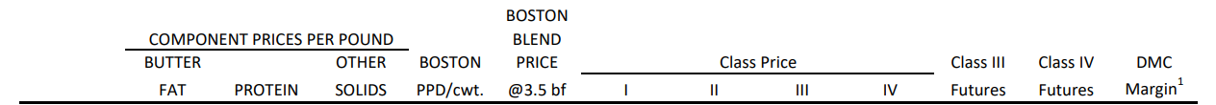
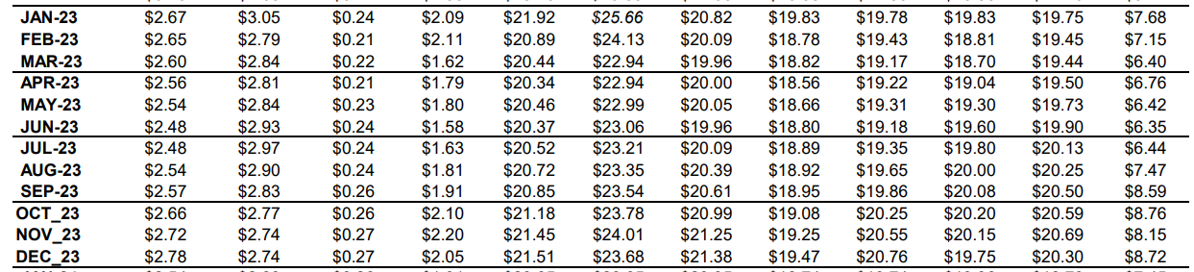
Using Agri-Mark’s Forecast to Plan Ahead

Slide 32
Use Your Basis to Determine Estimated Farm Gate Milk Price for 2023
Average: $27.16
Average: $22.76

Slide 33
Looking Like a Cash Flowable Year in 2023
$22.76
$21.81
$0.95
$14,250
Estimated Farm Gate Milk Price
Less Break-Even Milk Price
Net Cash Flow Excess/(Deficit)
Whole Dollar

Slide 34
Strategies to Lower Break-Even Milk Price
Lower Operating Expense
Lower Family Draw
Maintain Low Debt
Increase Non-Milk income
Increase/Improve Production

Slide 35
Example: Increase Production, Same Operating Expenses
Per 15,000
Per 16,000
Feed - $120,000
Labor - $60,000
Livestock Supplies - $22,500
Fuel - $9,000
Crop Inputs/Custom - $45,000
Marketing/Hauling - $33,750
IRTI- 5 - $35,000
Utilities - $7,500
Total Operating Expenses per Cwt
$8.00
$4.00
$1.50
$0.60
$3.00
$2.25
$2.33
$0.50
$22.18
$7.50
$3.75
$1.41
$0.56
$2.81
$2.25
$2.19
$0.47
$20.94

Slide 36
Example: Increase Production, Same Cash Requirements
Per 15,000
Per 16,000
Operating Expenses - $334,000
Family - $45,000
Principal Payments - $24,000
“Check-writing Number”
$22.18
$3.00
$1.60
$26.78
$20.94
$2.81
$1.50
$25.25

Slide 37
Example: Increase Production, Non-Milk Income
Per 15,000
Per 16,000
Cull Cow Sales - $12,000
Beef Calves - $3,000
Rental Income - $9,600
Other Farm Enterprise (Compost) -$5,000
Off-farm Employment - $45,000
Total Non-Milk Income
$0.80
$0.20
$0.64
$0.33
$3.00
$4.97
$0.75
$0.19
$0.56
$0.31
$2.81
$4.62

Slide 38
Example: Increase Production, Lower Break- Even
Cash Requirements
Less Non-Milk Income
Break-Even Milk Price
$26.78
$4.97
$21.81
$22.76
$0.95
$14,250
$25.25
$4.62
$20.63
$22.76
$2.13
$34,080
Per 15,000
Per 16,000
Estimated Milk Price
Net Cash Flow Excess/(Deficit)
Whole Dollar

Slide 39
Robots vs Parlors: Where is the Opportunity for Lower COP/Breakeven?

Slide 40
Initial Assumptions
Same down payment - $750,000
No additional capital expenditures
7-year payment terms for robots.
Debt capital for barn construction and 20 years.
4% interest rate, monthly payments.
$18.00 milk price
Kept cow numbers the same in both scenarios, 550 total cows, 480 cows in milk.

Slide 41
Assumptions for the Scenarios
8 box robots; new barn
$1.4 mm robots
$2.5 mm barn
Milk per cow 80 to 85 lbs per day
Service contract $12k monthly
Worker equivalent – (3) but + $10k per worker
Total annual milk pounds 14,850,000
New parlor; new barn
$750k parlor
$2.0 mm barn
Double 20 parallel parlor
Worker equivalent – (0.5), $ same per worker
Total annual milk pounds 14,173,200

Slide 42
 | Robots |  | Parlor
 | Whole dollar | Per Cwt. | Whole Dollar | Per Cwt.
Revenue | $3,053,960 | $20.57 | $2,912,659 | $20.55
Cost of Goods Sold
Gross Margin
Overhead
Net Profit
Cash Needs
Excess/Deficit

Slide 43
Cost of Goods Sold are Variable Expenses
Variable expenses change with level of production.
  Feed
  Labor
  Livestock expenses – supplies, breeding, vet/med, bedding, DHIA
  Milk marketing
  Crop inputs
  Fuel

Slide 44
 | Robots |  | Parlor
 | Whole dollar | Per Cwt. | Whole Dollar | Per Cwt.
Revenue | $3,053,960 | $20.57 | $2,912,659 | $20.55
Cost of Goods Sold | $2,281,696 | $15.36 | $2,378,623 | $16.78
Gross Margin | $772,264 | $5.21 | $534,036 | $3.77
Overhead
Net Profit
Cash Needs
Excess/Deficit

Slide 45
Overhead Costs are Fixed Expenses
Fixed expenses do not change with level of production.
  Depreciation
  Insurance
  Interest
  Taxes
  Rent
  Repair
  Administrative Costs

Slide 46
 | Robots |  | Parlor
 | Whole dollar | Per Cwt. | Whole Dollar | Per Cwt.
Revenue | $3,053,960 | $20.57 | $2,912,659 | $20.55
Cost of Goods Sold | $2,281,696 | $15.36 | $2,378,623 | $16.78
Gross Margin | $772,264 | $5.21 | $534,036 | $3.77
Overhead | $590,943 |  | $476,602
Net Profit | $181,321 |  | $57,434
Cash Needs
Excess/Deficit

Slide 47
“If your outflow exceeds your inflow, your upkeep will be your downfall.”
Cash needs:
  Principal Payments
  Capital Replacement
  Partner’s Draw?

Slide 48
 | Robots |  | Parlor
 | Whole dollar | Per Cwt. | Whole Dollar | Per Cwt.
Revenue | $3,053,960 | $20.57 | $2,912,659 | $20.55
Cost of Goods Sold | $2,281,696 | $15.36 | $2,378,623 | $16.78
Gross Margin | $772,264 | $5.21 | $534,036 | $3.77
Overhead | $590,943 | $3.98 | $476,602 | $3.36
Net Profit | $181,321 | $1.22 | $57,434 | $0.41
Cash Needs (Principal Only) | $165,422 | $1.11 | $68,315 | $0.48
Excess/Deficit | $15,899 | $0.11 | ($10,880) | ($0.07)

Slide 49
Breakeven Milk Price Robots vs. Parlor
Cash Requirements
Less Non-Milk Income
Break-Even Milk Price
$20.46
$2.57
$17.89
$20.63
$2.55
$18.08
Robots
Parlor

Slide 50
Other Considerations
Labor pool – availability, skill level, pay requirements
Base production restrictions
Cow numbers
Flexibility
Facility

Slide 51
Glossary
Assets – Things the business owns.
Liabilities – Debt the business owes.
Owner’s Equity – What’s left after debts are paid.
Income – Money received for goods or service.
Expenses – Money spent in the course of producing goods or services.
Operating Expenses – Ongoing business expenses incurred through normal operations.
Net Income – Income minus expenses
Capital Asset – Asset with useful life >1 year used in a business.
Paid In Capital – Outside money contributed to the business.
Accounts Payable – Accounts that are owed.
Accounts Receivable – Accounts that are being held waiting for receipt of sale.
Depreciation – A non-cash expense to record the using up of a capital asset.
Worker equivalent – Equalizing the hours worked on a farm to a full-time equivalent.
Principal Payments – The portion of a debt payment that reduces the amount of debt outstanding, that is not the interest expense.

Slide 52
Resources
Benchmarks
  Northeast Dairy Farm Summary – FarmCreditEast.com
  Cornell’s Dairy Farm Business Summary- CALS.Cornell.edu/pro-dairy
My Contact:
  joanna@adkmanagement.net
  Adkmanagement.net
  DairyDividends.com
  Find me on Facebook and LinkedIn! @joannalidback

