Slide 1
Tumors of the Nervous System (Session)
Neural Sciences (Course)
Facilitator Name
May 12, 2019 (Date)
Notes:
This template is designed to:
encourage consistent delivery of curriculum
create clear expectations
keep everyone on track in class
highlight key teaching points
ensure materials are ADA accessible
Faculty can modify this template, or provide slides to the Curriculum Team (activelearning@med.uvm.edu) for formatting
Note the visible title at the top of every slide, and the limited amount of information presented at once.

Slide 2
In-class Learning Objectives
Evaluate blood gas measurements in a clinical scenario and formulate a differential diagnosis.
Compare and contrast the choice of antiseizure drugs based on diagnosis and possible side effects.
Determine the etiology of hypoxemia based on clinical presentation and review of clinical data.
Recognize pain types in patient presentations including the differences between acute pain and chronic pain and nociceptive and neuropathic pain.
Propose treatment modalities for each pain type including pharmacologic and non-pharmacologic forms of treatment
Notes:
Objectives should be consistent with our Guide to Writing Learning Objectives at the LCOM.
https://commons.med.uvm.edu/groups/al/FacultyResources/A%20Guide%20to%20Writing%20Learning%20Objectives%20at%20LCOM%207-18.pdf

Slide 3
Take Home Points (from pre-session material)
Tumors of the nervous system can be broadly characterized as primary or metastatic and benign or malignant.
Brain metastases are the most common central nervous system tumors.
Meningiomas are the most common primary brain tumors.
Glioblastomas are the most common primary malignant brain tumors.
Notes:
“Slide from Alissa Thomas, MD. and Argirios Moustakas, MD. - Neural Science course faculty”
- Provide some key points students should know prior to session. This is not an opportunity to lecture; rather, it is a chance to mention, or even merely show, 5-7 key points.
- Results of a readiness quiz (RQ) can be obtained from the Curriculum Team prior to session. Please email active.learning@med.uvm.edu

Slide 4
Instructions
1. There are three teams:
2. For the purpose of the activity, make sure you ONLY answer the questions related to your team name and color.
3. Each of the teams will be reporting out their findings and recommendations for the patient.
Team Saturated Fat (yellow)
Team Sugar (pink)
Team Fiber (blue)
Notes:
“Slide from Catherine McIsaac, RD, NMGI course faculty”
- It is important to explain how a session will be conducted. This is one example of an instructions slide. Providing clear written instructions reduces the cognitive load associated with understanding what needs to be done and allows students to focus more on application of content. The next slide provides another example.

Slide 5
Instructions
Answer each multiple choice question individually with your clicker (30 sec)
If >80% are correct, I will randomly ask one table for a brief explanation and move on (1 min)
If <80% are correct, table groups will discuss and re-vote with clickers (2 min)
If still <80% are correct, I will provide an explanation (2 min)
Notes:
This is a second example of an instructions slide. Brief instructions, such as “answer individually with clicker” can also be included in a box on question slides.

Slide 6

Timer 01
01 minute
Notes:
Timers are a visual reminder for students and faculty, and keep sessions moving at an appropriate pace. Students have shared with us that they feel many session run too slowly. If you need help with timers, reach out to activelearning@med.uvm.edu.
Timer duration: 01 minute (01:00 seconds)

Slide 7
Timer 02
45 seconds
End
Notes:
This ‘sand timer’ will start on a mouse click anywhere on the slide. The ‘sand’ will drain from the top section to the lower section and when completed will show the word ‘End’.
To change the timings of this timer, you need to enter the animation settings, and change the timings for the Isosceles Triangles. There will be 2 that need changing (to the same amount) – one animates the top triangle emptying, whilst the other animates the bottom triangle filling.
When you change the timings these have to entered as a number of seconds.
Timer duration: 45 seconds (00:45 seconds)

Slide 8
Timer 03
30 seconds
Notes:
These timers appear initially as a cream, coloured circle. This timer will start on a mouse click inside the light green circle which will fill up in a clockwise direction with the color you see above.
At the end of the time, a bell will sound.
It is possible to change the timings of the timers by entering the animation settings and changing the timings of the relevant ‘Oval’. Note the timings have to be entered in seconds.
It is possible to have multiple timers on the same slide as these work independently of each other.
Timer duration: 30 seconds (00:30 seconds)

Slide 9
Timer 04
End
2 minutes
Notes:
This bar timer, will start when anywhere on the slide is clicked. The bar will move from left to right and the word ‘End’ will appear at the end, accompanied by a ‘Deep Gong’ sound. It is possible to change the duration of this timer to any time, by entering the animation settings, and changing the timing for ‘rectangle 3’. Note the time has to be entered as a number of seconds – so if you want 2mins & 30secs – this is entered as 150 (60X2 + 30 = 150).
Timer duration: 2 minutes (02:00 seconds)

Slide 10
A. Short case + MCQ + Timer + Concept Slides
SY is a 52 year old lifelong nonsmoker with a history of mild intermittent asthma who was diagnosed with a lung cancer after having a chest x-ray during a prolonged respiratory illness. The patient undergoes a right upper lobectomy that is successful at removing the cancer. After recovery, she notes feeling short of breath much more than she anticipated. A repeat CT scan showed that the right middle and lower lobes have shifted within the thorax more than expected and resulting in a severe narrowing of the interlobar pulmonary artery and the bronchus intermedius. A ventilation perfusion study (V/Q scan) is performed with results shows below. An arterial blood gas is also performed and shown below.
V/Q results | Right lung | Left lung
Perfusion | 10% | 90%
Ventilation | 30% | 70%
Arterial blood gases (room air)
Pre-surgery: pH 7.38 pCO₂ 40 P_{a}O₂ 88 HbO₂ 98%
Post-surgery: pH 7.38 PCO₂ 38 P_{a}O₂ 72 HbO₂ 95%
Question 1: What mechanism explains the decline in hemoglobin saturation and P_{a}O₂ compared to pre-surgery? Explain your answer, please. (1 minute)
Hypoventilation
Reduced ambient partial pressure of oxygen
Diffusion impairment
Ventilation/perfusion (V/Q) mismatch
Shunt physiology
30 seconds
Notes:
“Slides 10-12 from Garth Garrison, MD and David Kaminsky, MD. - CRR course faculty”
- Slides 10-24 would be used for a case-based learning session. The SOP is located at https://commons.med.uvm.edu/groups/al/SOPs/SOP%20Final%207-19%20Case-Based%20Learning.pdf
This slide is useful because it introduces the case and provides information needed on one slide, rather than requiring multiple slides to present one case vignette. The question stem could also be used for subsequent questions about the same case.
Timer duration: 30 seconds (00:30 seconds)

Slide 11
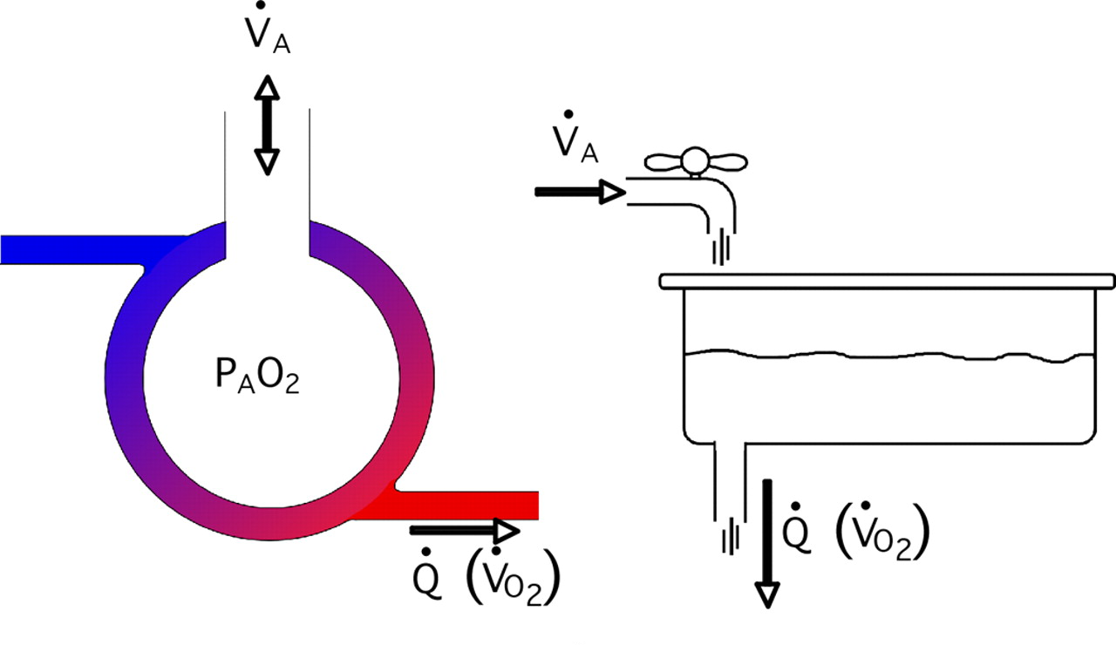
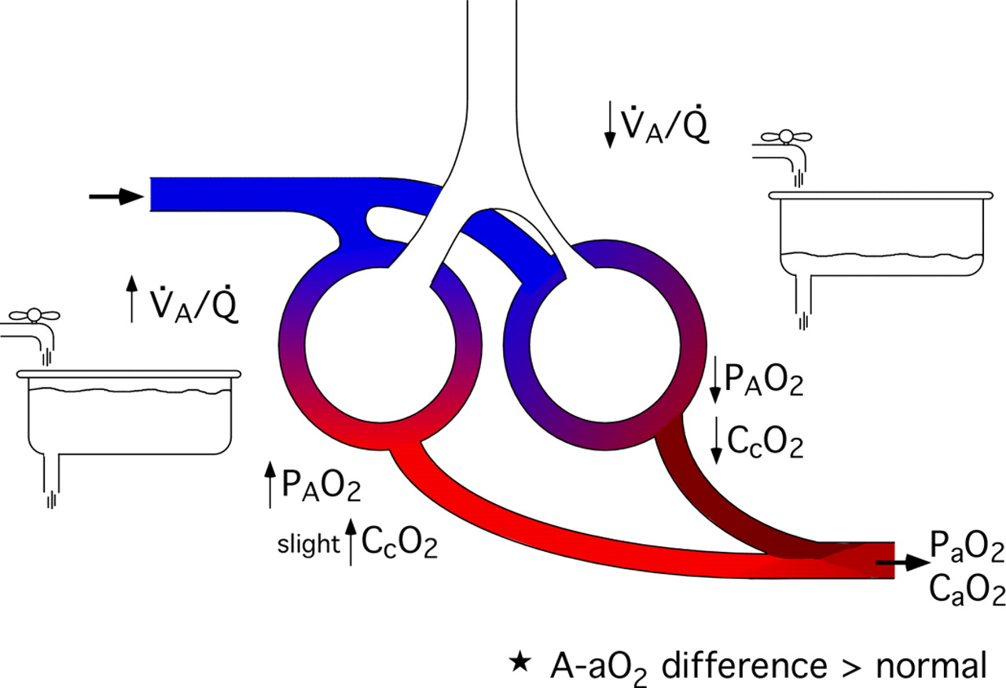
Ventilation perfusion relationships
Efficient transfer of oxygen requires entry of oxygen into the alveolus and a “matched” capacity of blood to carry the oxygen away (V/Q = 1)
If V/Q declines (either decreased ventilation OR increased perfusion) → oxygen content draining from those alveoli will be reduced
Notes:
This is an example of a concept slide that is used during the explanation for the previous question. A concept slide is concise (not busy) and easy to understand. Images and text for concept slides may be taken from the pre-session materials, from other sources, or may be original work.
If outside sources are used, they should be cited appropriately. Contact active.learning@med.uvm.edu for citation support.

Slide 12
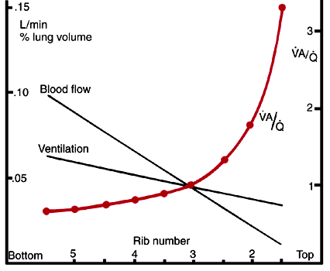
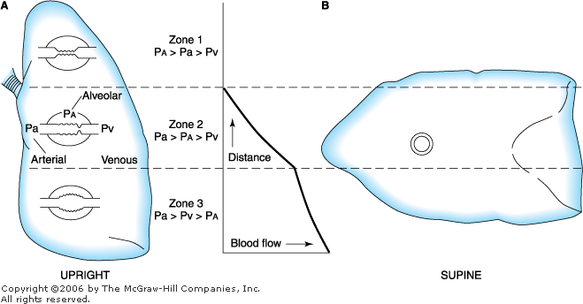
Ventilation perfusion relationships
Gradient of V/Q exists in the thorax due to effects of gravity and breathing mechanics.
Alveolar gas content (normal)
West Lung Zones
P_{A}O₂ (mmHg) | P_{A}CO₂
150 | 0
100 | 30
70 | 50
If MORE blood heads to low V/Q areas, P_{a}O₂ will decrease
Giving extra oxygen will significantly improve P_{a}O₂ and oxygen saturation
Notes:
This is another example of a concept slide. The title at the top gives the topic or concept covered. The green callout box at the bottom indicates the take-home point.

Slide 13
B. MCQ + Detailed answers + Timer + Concept slide
A 24 year old develops fatigue, headache and nausea 8 hours after arriving at Breckenridge, Colorado (9600 ft). Which of the following will help treat these symptoms? Explain your answer, please. (45 seconds)
inhaled salmeterol
oral acetazolamide
oral nifedipine
inhaled nitric oxide
Answer: B. Acetazolamide (Diamox) is indicated for the treatment of AMS.
- Inhaled salmeterol may prevent HAPE.
- Nifedipine is indicated to treat HAPE.
- There is no clinical role for inhaled NO.
45 seconds
Notes:
“Slides 13-14 from David Kaminsky, MD. - CRR course faculty”
This is another example of a concept slide. This slide includes the original question, and explains the correct and incorrect responses. This slide is effective because it provides a visual cue for people with hearing loss, and helps all learners in a big, noisy classroom to know which answer is correct.
Timer duration: 45 seconds (00:45 seconds)

Slide 14
TREATMENT
Acetazolamide (Diamox)
Notes:
This concept slide presents information with only a title and a visual component.

Slide 15
C. Case + MCQ + Timer + Image question
You are doing your clerkship on Labor and Delivery and are called to see a 25 year old G1 P0 woman at 38 weeks and 4 days gestation who arrived on the floor with regular contractions. She is visiting from MA . She states that she went to her scheduled prenatal visits and had ultrasound at 16 weeks and all was OK. Her pregnancy has gone well. Her plan was to have a home delivery attended by a midwife and to have no analgesic medications.
Her labor progresses well and she delivers a 3407g male infant with Apgar scores of 8 and 9. The placenta is delivered and looks complete and has no abnormalities. One day after the delivery the infant becomes irritable. He is not breastfeeding well. His temperature is 38.5 and he has a respiratory rate of 70.
Notes:
“Slides 15-17 from Christina Wojewoda, MD. - HDRH course faculty”
- These three slides present a case, a multiple choice case question with a timer, and an image-based multiple choice question.

Slide 16
Based on mom’s history, what was the most likely mode through which the infection was transmitted (1 minute).
A. Ascending from the cervix to the amniotic membranes
B. Hematogenous transmission
C. Transmission of infection by hospital staff after birth
D. Transmission during passage through the birth canal
E. Reactivation of dormant infection
1 minute
End
Notes:
Timer duration: 1 minute (01:00 seconds)

Slide 17
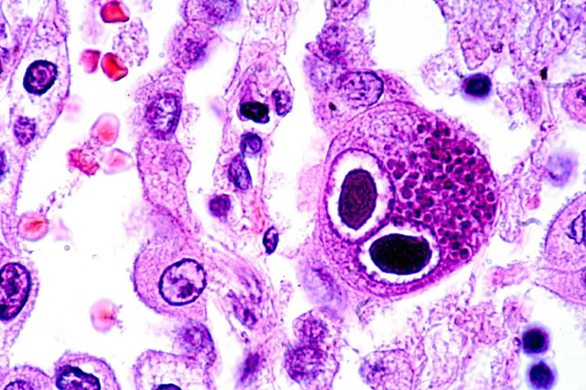
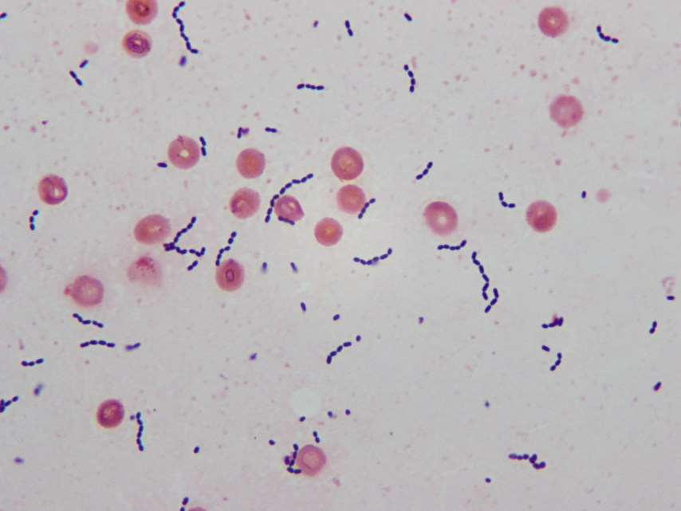
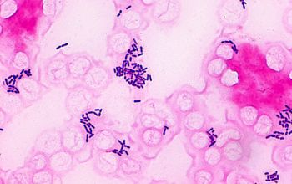
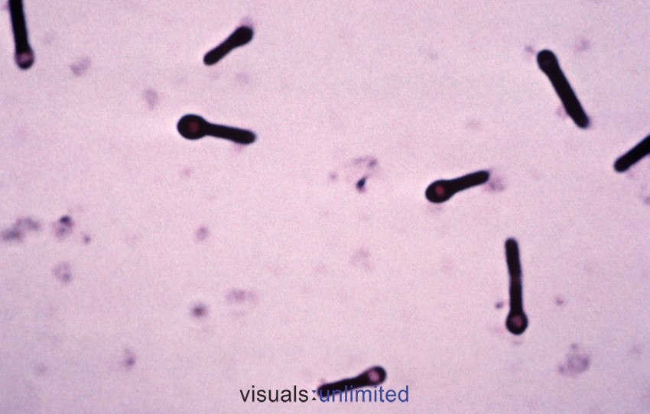
Central spinal fluid was obtained and sent for gram stain. Based on your suspicion for the cause of this illness, what would you expect to find? Explain your answer, please.
A
C
B
D
Notes:
This is a great example of a multi step question and building bridges between clinical and basic science.

Slide 18
D. Case + Discussion questions + Timer + Concept slides + Teaching Point
Eric is a 21-year-old right-handed man who is enrolled at Plattsburgh State University as a Biology major. He presents to the emergency room at the Champlain Valley Physicians Hospital (CVPH) having experienced a sudden loss of consciousness with total body shaking that lasted approximately three minutes. He presently reports a mild headache and feeling of fatigue. This represents his first such "spell" of this nature, however, he has had episodes of tremulousness involving his left leg and arm while working out at the gym during the past three months.
History
Physical exam
Neurological exam
Notes:
“Slides 18-22 from Alissa Thomas, MD. and Argirios Moustakas, MD. - Neural Science course faculty”
- These five slides present a case, and include open-ended, time-bound discussion questions. Concept slides and a slide with a key teaching point conclude this series.
- In a student version of these slides, the discussion points and key teaching point would not be included. The Curriculum Team can help you create a student version of your materials (activelearning@med.uvm.edu)

Slide 19
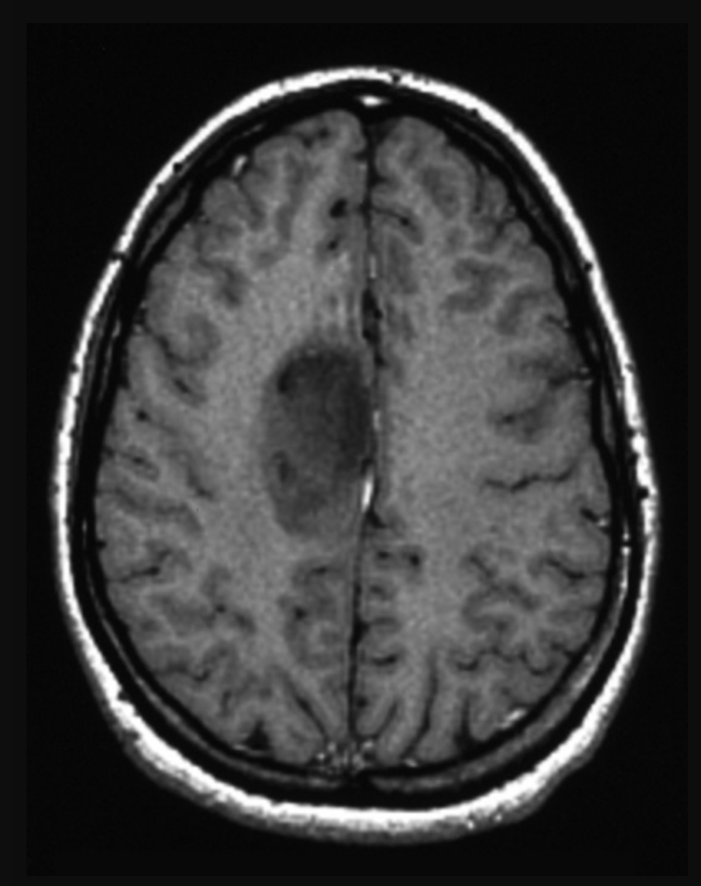
Discussion Questions
You obtain an MRI of the brain as post of the work up for seizure. How would you describe (location) the MRI findings?
What is the differential diagnosis?
What is the next step in management (plan)? Based on the anatomic location, is there a role for surgery or biopsy? (2 minutes)
End
2 minutes
Notes:
Timer duration: 2 minutes (02:00 seconds)

Slide 20
Discussion Points
CT | MRI
Better bony resolution | Better soft tissue resolution
New onset seizures without a clear provoking factor (for example, alcohol withdrawal) should prompt brain imaging.
Description: Axial T1 post-contrast image shows an ovoid mass in the medial right frontal lobe.
Location: The mass is deep to the central sulcus, and therefore deep to the motor and pre-motor cortex. There is no enhancement and a paucity of mass effect, suggesting a slow growing tumor.
Differential diagnosis: Differential should be low grade glial tumors. For adults, this includes oligodendrogliomas and astrocytomas. For children, this would also include gangliogliomas and dysembryoplastic neuroepithelial tumors (DNET), which can be considered in a 21 year old patient.
Management/Plan: Surgical resection

Slide 21
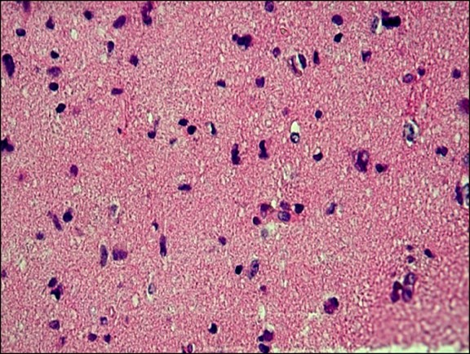
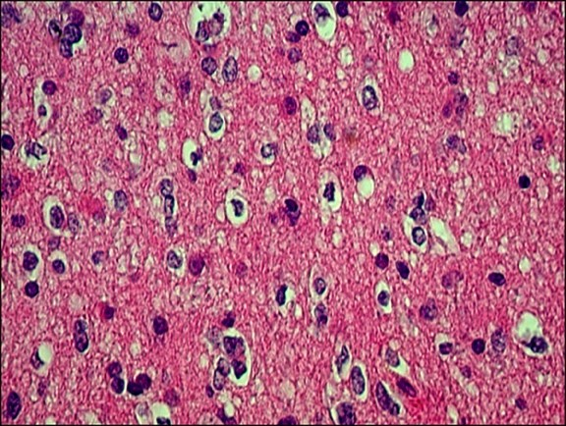
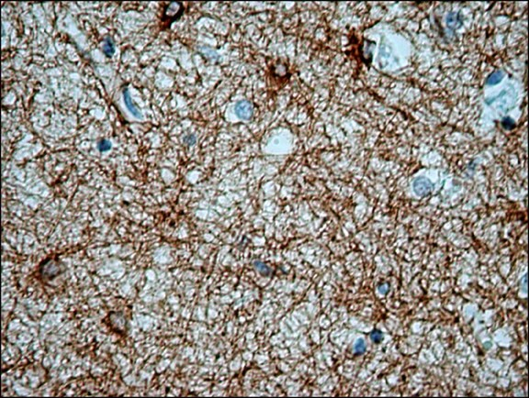
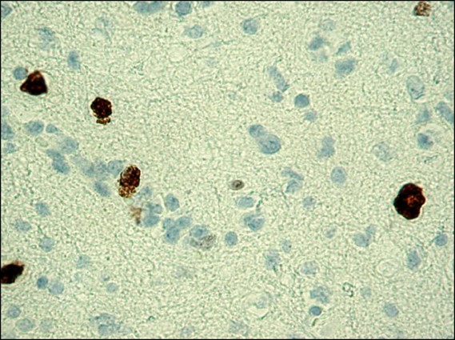
Eric undergoes a right frontal craniotomy and resection of the mass.
The pathology shows the following:
Surgical Pathology Report
Name: Eric Case #:12345
DOB:xx/xx/1981
Final Pathologic Diagnosis:
Brain, right frontal tumor
Anaplastic oligodendroglioma/astrocytoma (WHO Grade III).
H&E stains
H&E stains
GFAP Stain
MIB-1 Stain

Slide 22
Teaching Point
In 2002, gliomas were diagnosed based on histologic findings alone. This sometimes led to a non-specific or mixed diagnosis of an oligo astrocytoma, as in this case.
As of 2016, gliomas are diagnosed based on integrated molecular and histological criteria, giving more specificity.

Slide 23

E. Discussion questions + Timer + Video
Talk about the material about stuttering in the pre-session learning for 2.5 minutes.
- Identify any typical disfluencies you heard in your discussion.
2.5 minutes
Notes:
“Slides 23 -24 from Patricia Prelock and Michael Cannizzaro - Neural Science course faculty”
These two slides present an opportunity for student to engage with the content through timed discussion and video.
Timer duration: 2.5 minutes (02:30 seconds)

Slide 24

2. In the second video clip, you will be identifying when you hear repetitions, blocks and prolongations on sounds, words, phrases.
- Try to detect whether the children are prolonging sounds, blocking or repeating sounds, syllables and words. (1 minute)
1 minute
Notes:
This video should be closed captioned for people with hearing loss. Videos need to be shared at least 2 weeks ahead of time with active.learning@med.uvm.edu so closed captioning can be completed in time for the session.
Embedded videos allow students to engage with content using both text and audiovisual inputs, which promotes learning. If you want to see the captions of the video, copy and paste this link: file:///H:/Active%20Learning%20Resources/Case%202.2%20captions/Case%202.2%20captions.html
Timer duration: 1 minutes (01:00 seconds)

Slide 25
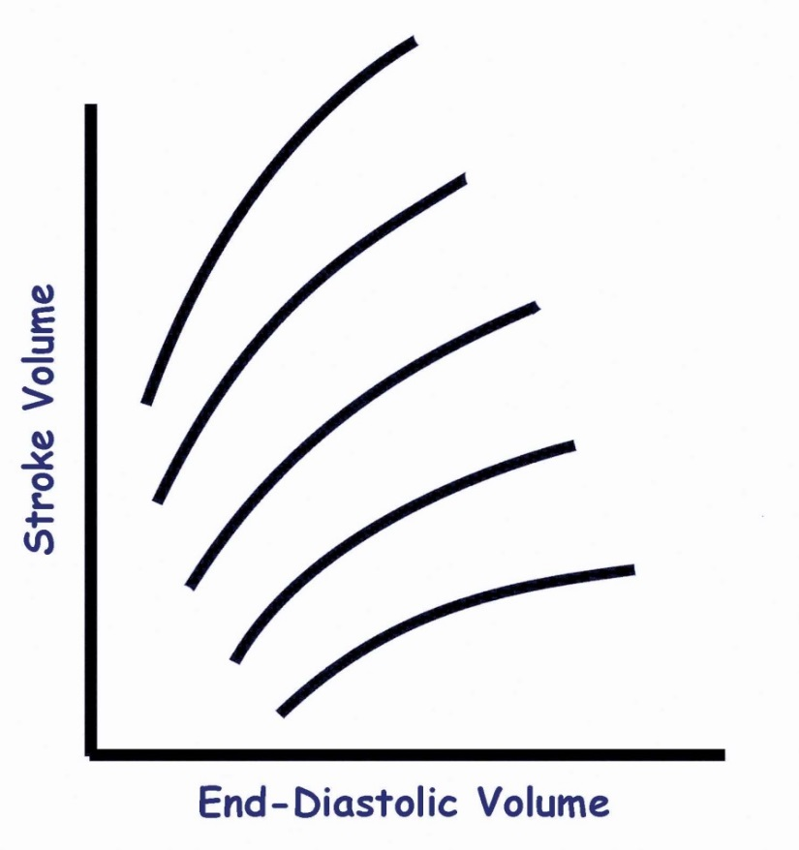
Foundations of Clinical Sciences
Workshop 5: Circulation
*Don’t advance your slides*
2 minutes
2 minutes
F. Workshop activities + Timer
End
Using Frank-Staring curves, sketch and describe what happens over time to your preload, stroke volume, heart rate, and blood pressure after you give a unit of blood (590 mls).
Be comprehensive in your analysis!
Notes:
“Slides 25-28 from William Hopkins, MD. FoCS/CRR course faculty”
Slides 25-29 would be used for Workshop. The SOP is located at https://commons.med.uvm.edu/groups/al/SOPs/SOP%20Final%207-19%20Workshop.pdf
- Workshop activities vary, but are not case-based. This slide includes visual instructions, a timer, and a question. Note that students can choose how to “sketch and describe.” Allowing choice empowers students to select a preferred tool to answer this question.

Slide 26

Concept Slide
Sketch and describe what happens over time to your preload, stroke volume, heart rate, and blood pressure after you give a unit of blood (590 mls).
  ↓ Preload
  ↓ Stroke volume
  ↓ blood pressure
Notes:
This is an example of a concept slide using image and text animations.

Slide 27
Foundations of Clinical Sciences
Workshop 5: Circulation
*Don’t advance your slides*
3 minutes
3 minutes
G. Workshop activities + Timer
End
Draw/sketch the pressure waveform in the aorta, then explain the clinical reporting of blood pressure.
Calculate the pulse pressure and mean arterial pressure if the blood pressure is 120/80.
Compare and contrast the different flow velocities from the aorta to the capillaries.
Compare and contrast laminar and turbulent flow.
Notes:
This slide includes written instructions, a timer, and four questions. Is three minutes enough time? Student feedback on what makes an active learning session effective has been consistent about not giving too much time for a question. When given too much time groups of students tend to lose their focus and it can be challenging to re-engage the class. Better to give a shorter amount of time, then check with the class to see if they need more!

Slide 28
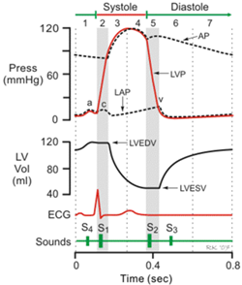
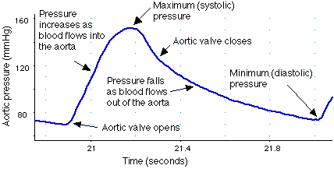
Concept Slide
Clinical blood pressure
  Systolic pressure → peak pressure
  Diastolic pressure → nadir pressure
  Pulse pressure → systolic pressure – diastolic pressure
  Mean arterial pressure (MAP) – next slide
Notes:
This is a concept slide to inform discussion of the previous question.

Slide 29
Summary
5 Mechanisms of Hypoxemia:
  Reduced inspired partial pressure of oxygen
    Think: high altitude
  Alveolar hypoventilation → must have high PCO₂
    Check A-a gradient to see if something else is contributing
  Ventilation/perfusion mismatch → more low v/q ratio units
    Most commonly seen: COPD, ILD, PH and others
    Responds to oxygen
  Shunt physiology → blood bypasses functional alveoli
    Can be intrapulmonary: bad pneumonia, ARDS; pulmonary AVMs
    Can be extrapulmonary: right to left shunt
    Poor response to oxygen
  Diffusion impairment → slow diffusion
    Think: ILD
    Worse hypoxemia with more rapid blood flow
Notes:
“Slide from Alissa Thomas, MD. and Argirios Moustakas, MD. - Neural Science course faculty”
- This slide presents the summary of an entire session. Pick 3-5, big take-home points students should understand at the completion of the session.

Slide 30
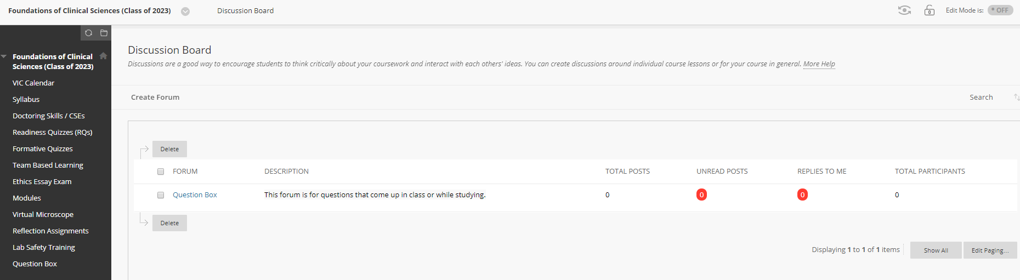
Wrap up
Thank you for your effort and attention.
If you have additional questions, please contact me via email. I will do my best to respond within 48 hours.
  John Doe, MD John.Doe@uvmhealth.org
If you have additional questions, please leave them in the question box on VIC Portal.
Notes:
This would be the final slide in the presentation. It promotes rapport with students by thanking them for their time.
This slide also tells students how to get their questions answered. The question box (see screenshot on slide) is an online discussion board created in response to student feedback. The course director or course TAs can forward questions to faculty.

