Slide 1
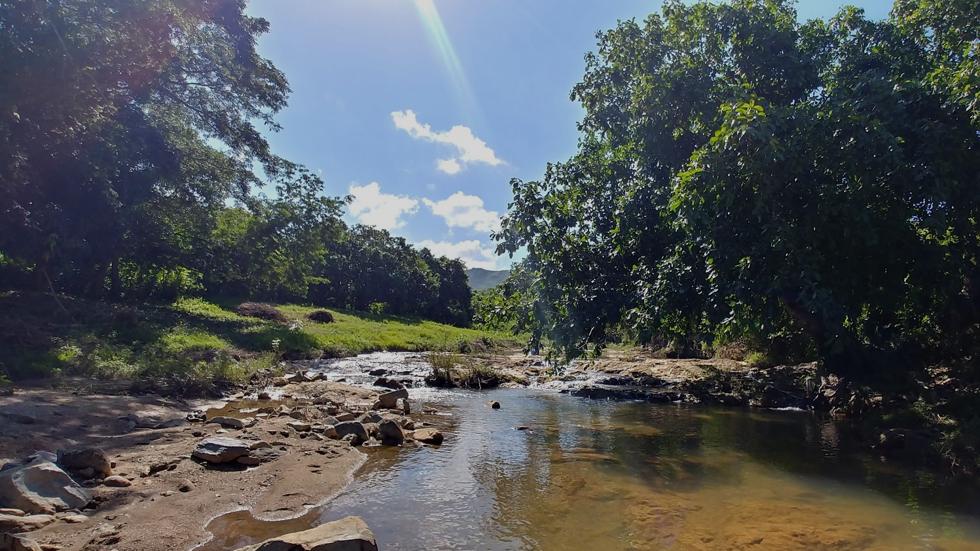
Using X-ray diffraction of stream sediment to better understand the geology and weathering environment of central Cuba
Landon Williamson
Undergraduate Thesis Defense
April 29th, 2020

Slide 2
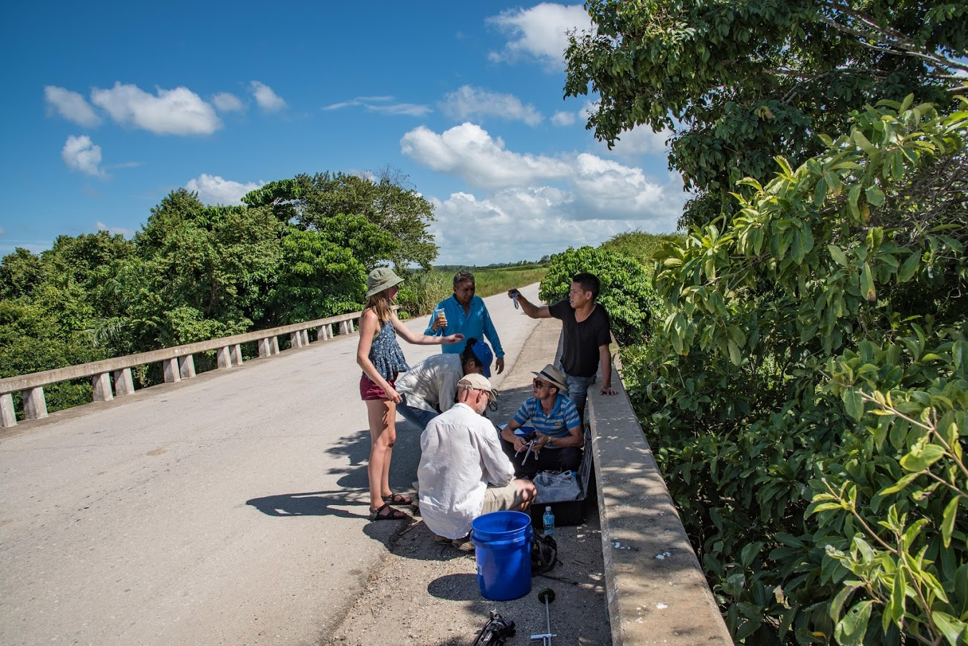
Introduction – A large, collaborative effort (15+ researchers!)
Data sources:
  ¹⁰Be-derived erosion rates (Campbell et al., 2019)
  Water chemistry (Bierman et al., 2020)
  Bedrock lithology (Case and Holcombe, 1980)
  X-ray fluorescence-derived sediment elemental composition (personal communication, Yoelvis Bolanos)
  X-ray powder diffraction-derived sediment mineralogic composition (this study)
The big goal: quantify the landscape-effects of the transition from Soviet-era industrial agriculture to soil conservation efforts and organic agriculture.

Slide 3
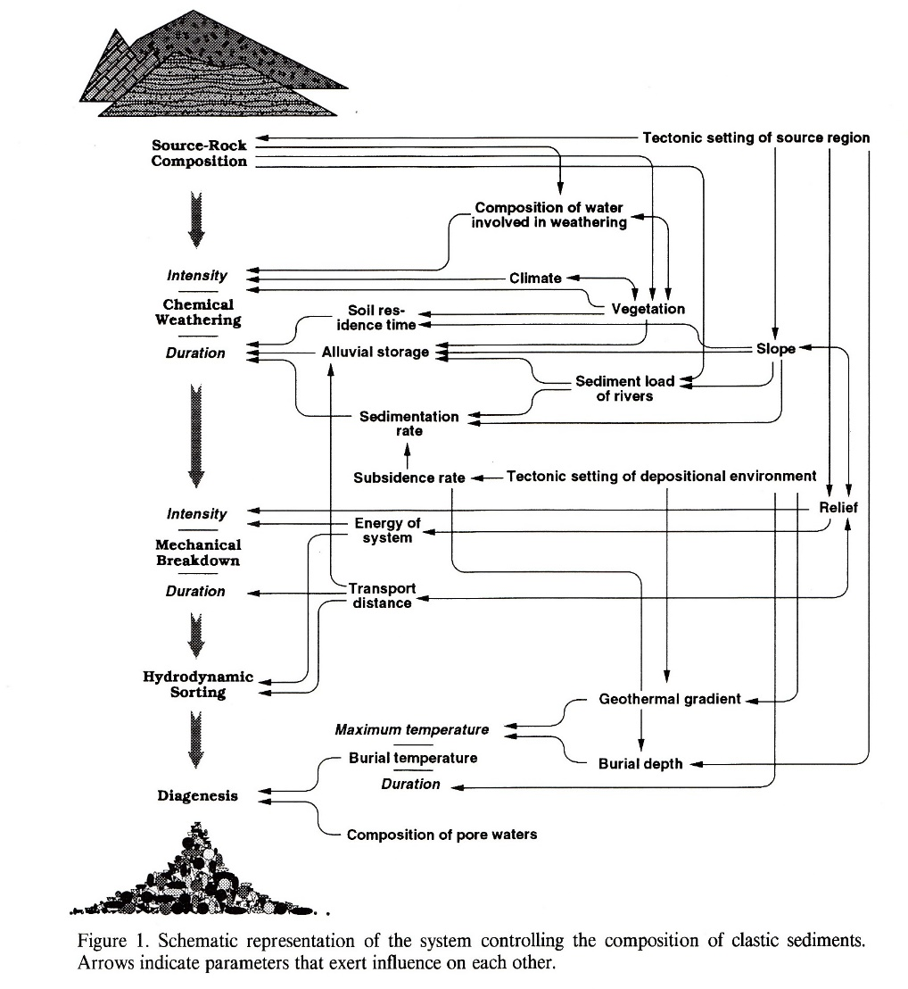
Introduction – How this project fits in
Stream sediment mineralogy is determined through X-ray powder diffraction.
We use stream sediment mineralogy to:
  Indirectly sample exposed bedrock for entire watersheds
  Provide insight into weathering processes
Precisely quantifying bedrock composition based on these sediments is difficult and uncertain due to a multitude of factors (Fig. 1; Schock and Steidtmann, 1976; Johnsson, 1993).
Figure 1, adapted from Johnsson (1993)

Slide 4
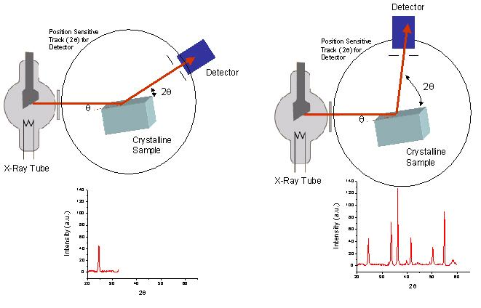

Introduction – X-ray diffraction (XRD)
Figure 2,
https://www.asdlib.org/onlineArticles/ecourseware/Bullen_XRD/XRDModule_Theory_Instrument%20Design_3.htm
Bragg’s Law: λ=2dsinϴ

Slide 5
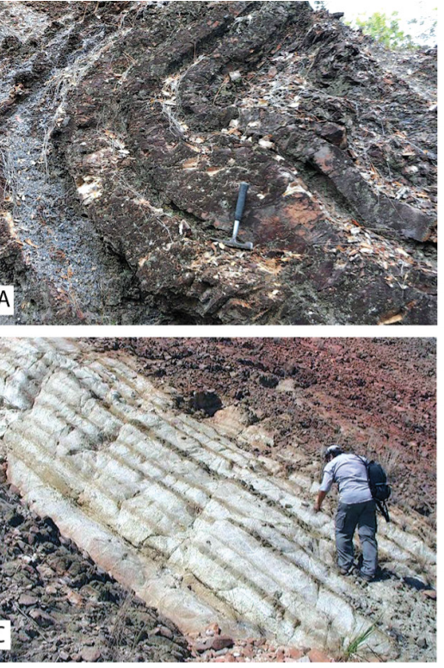
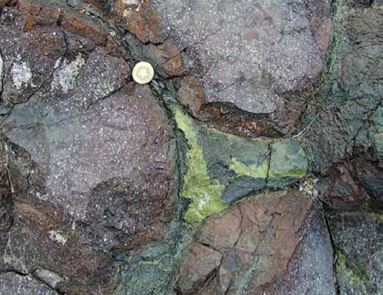
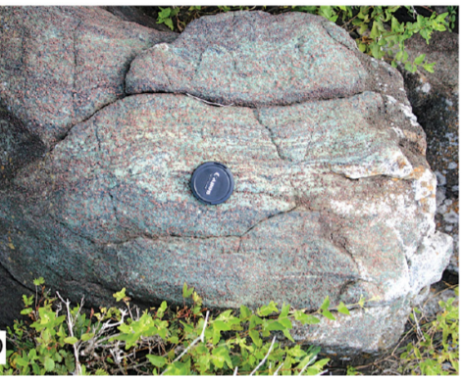
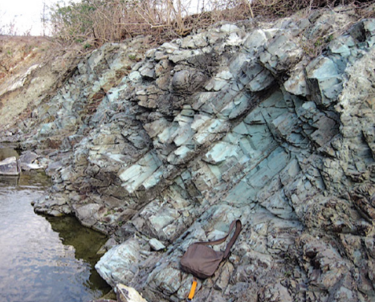
Background - Geology
Cuba emerged ~135 ma, just after the breakup of Pangea due to subduction of the North American Plate under the Caribbean plate.
Volcanic history – igneous rock (mafic and felsic composition)
Used to be an ocean basin – marine sedimentary rock (high calcite content)
Active plate boundary – metamorphic rock (metaigneous and metasedimentary)
Case and Holcombe, (1980); French and Schenk, (2004); Iturralde-Vinent et al. (2016)
Images: Iturralde-Vinent et al. (2016)

Slide 6
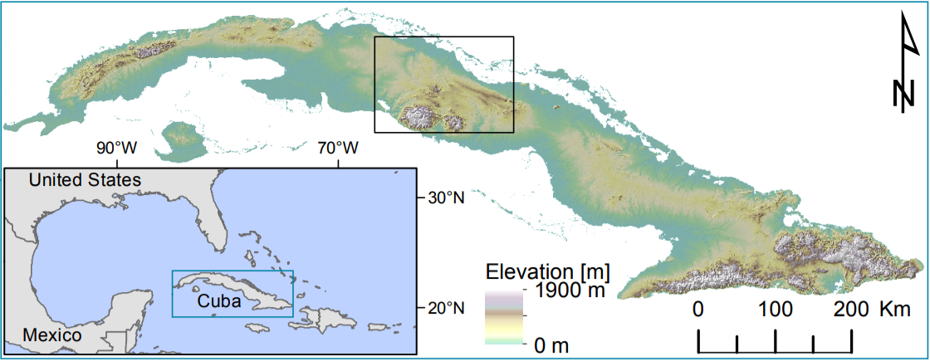
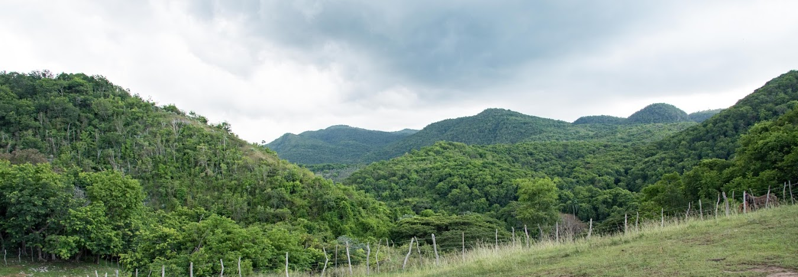
Background – Geography
This study focuses on central Cuba (Fig. 3).
Mostly low-lying with some mountainous regions.
Climate: low areas are tropical savanna and tropical monsoon, high peaks are temperate (Beck et al., 2018).
Vegetation is dense, with forests, swamps, savannas, grasslands, mangroves, scrublands, and farmed plains (Prance and Borhidi, 1993).
Figure 3, Adapted from: Bierman et al. (2020)

Slide 7
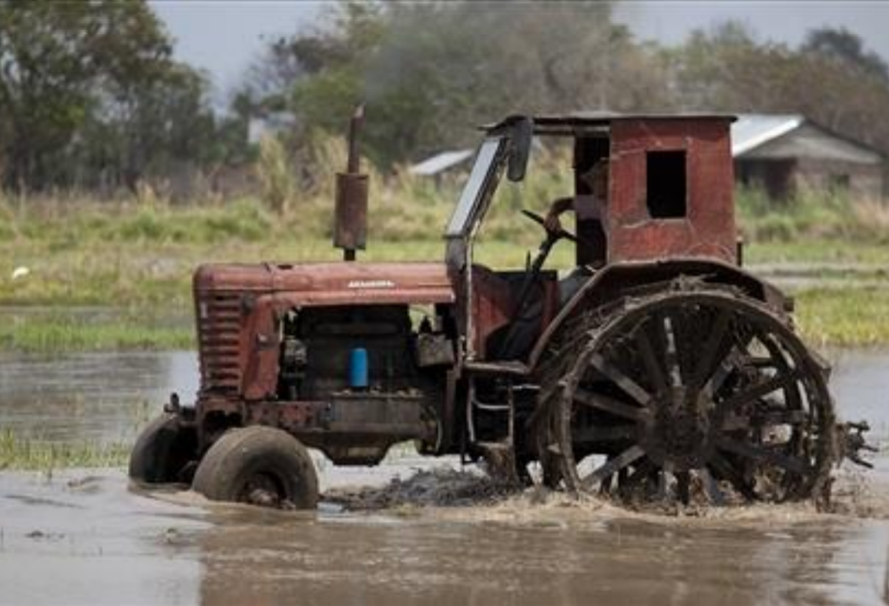
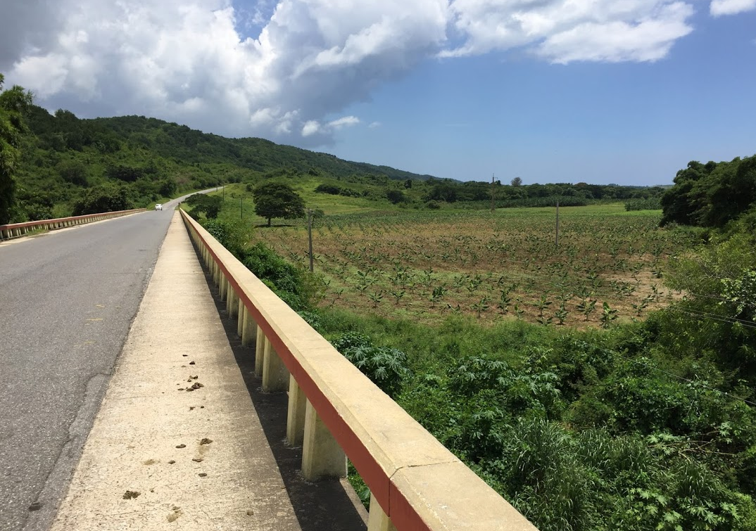
Background – Land use
92-95% forests and woodlands prior to 1492
Woodland and forest cover plummeted to 8-13% from the start of the 19th century through the 20th century as land was cleared for agriculture, including:
  Sugar cane-production
  Cattle breeding
  Tobacco production
Industrial agriculture continued through the Soviet era (1959-1991).
After soviet support ceased in 1991, small scale, organic conservation agriculture has been practiced.
(Borhidi and Muñiz, 1980)
Image: Chrismaki (2010)

Slide 8
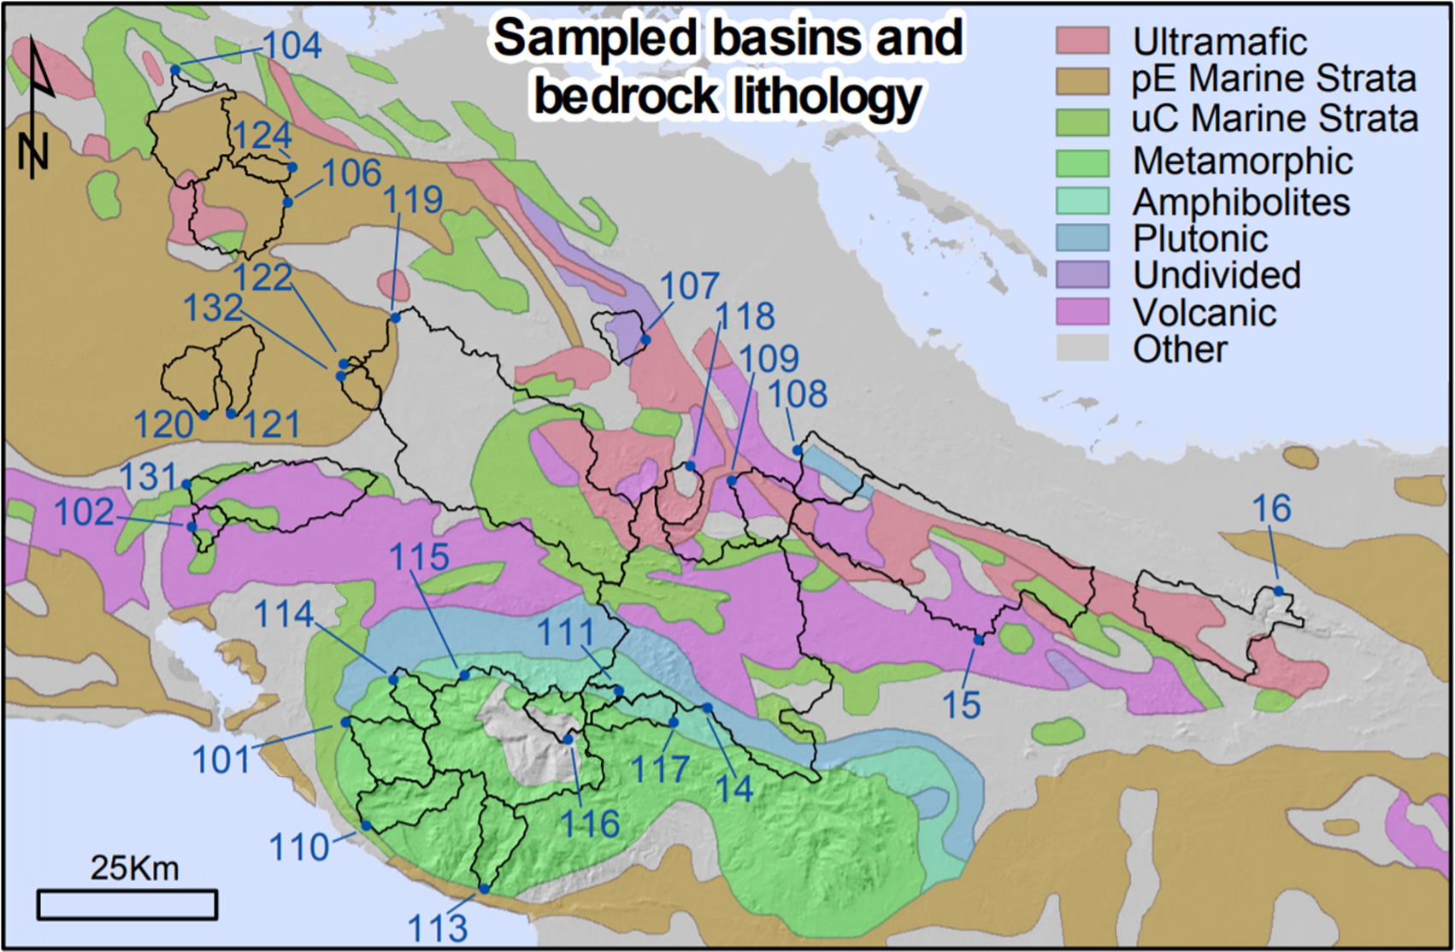
Methods – Sample area and collection
Stream sediment samples were collected in 2018 from 26 watersheds in central Cuba
Adapted from: Bierman et al. (2020)
Modified from: Bierman et al. (2020); Bedrock data from: Case and Holcombe (1980)

Slide 9
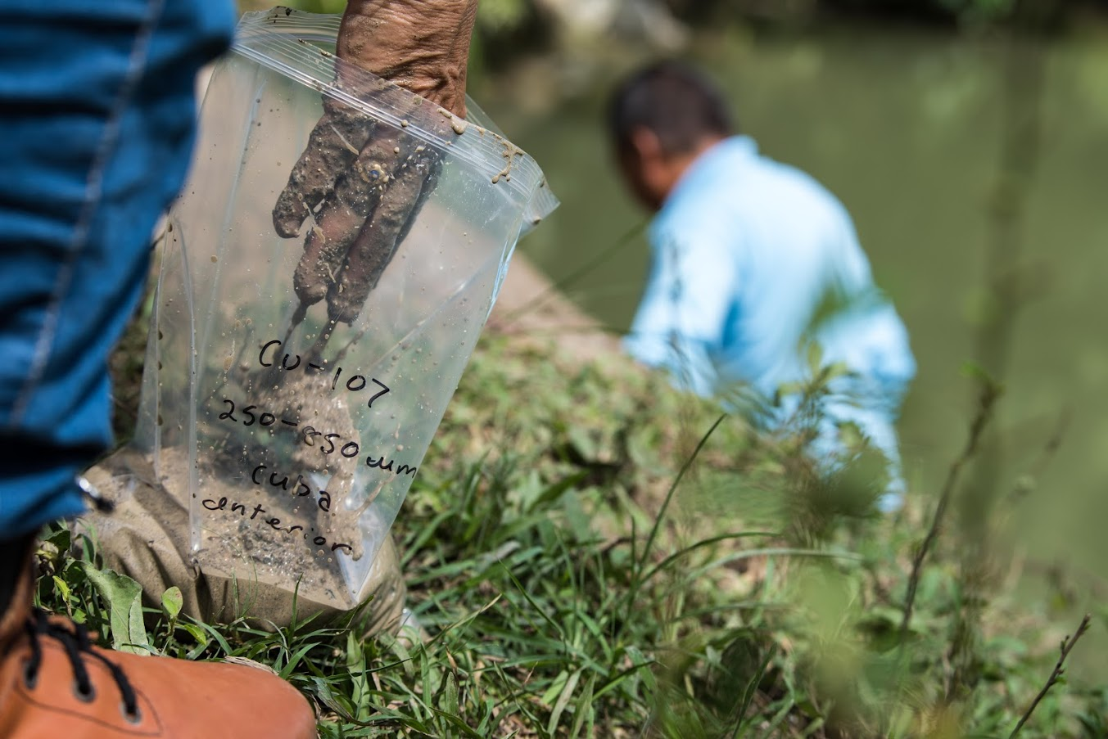
Methods – Sample prep
1) Wet sieved into two grain sizes (250-850 µm and <63 µm) to normalize for hydrodynamic sorting.
2) Air dried at 65° C
3) Ground into a powder (<2 µm)
4) Mounted on a standard glass slide to be scanned

Slide 10

Methods – Scans of sieved sediment
Performed from 5-55° (2ϴ) at 2°/minute using a Rigaku MiniFlex II diffractometer.
1) Standard scan
2) Rinsed with tap water, air dried at 18° C
3) Washed scan
104 scans total (26 samples, 2 grain sizes per sample, two scans per grain size).
Diffractograms were analyzed and quantified for mineral abundances using the Rietveld module in Rigaku PDXL (version 1.6.0.0).

Slide 11
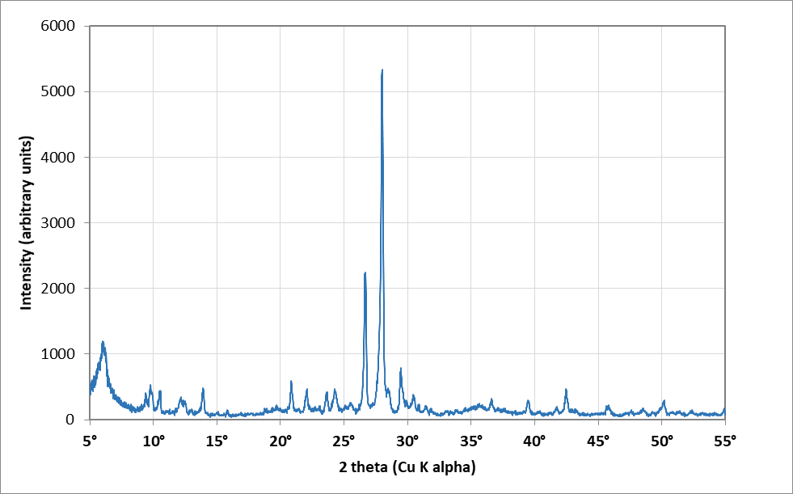
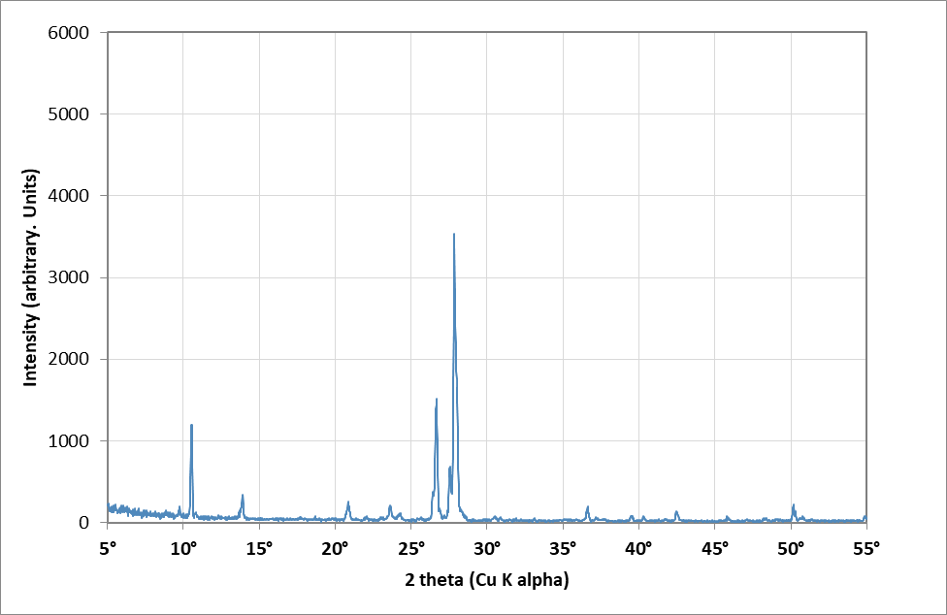
Methods – The purpose of washed scans
CU-14 250-850 µm
CU-14 250-850 µm washed

Slide 12
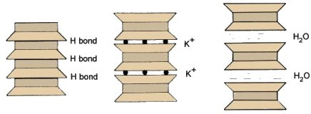
Methods – Heat treatment tests
Used to more precisely identify clay minerals, scans were from 3-25° (2ϴ) at 1°/minute.
1) The <55 µm fraction was isolated from 12 bulk samples by placing samples in tubes filled with ethanol, shaking them, and using Stokes’ law to determine how long to sonicate the samples before pipetting off the suspended material
2) Air dried at 18° C and mounted on a glass slide using acetone
3) Scanned
4) Heated to 400° C for 30 minutes
4) Scanned
5) Heated to 550° C for 30 minutes
6) Scanned
https://echo2.epfl.ch/VICAIRE/mod_3/chapt_1/pictures/fig1_3.jpg

Slide 13
Methods – Analytical regressions
Correlation coefficients and 2-tailed p values were determined in excel to compare:
Stream sediment mineralogy (XRD)
Vs.
Underlying bedrock
(Case and Holcombe, 1980)
Weathering rates (Campbell et al., 2019)
Stream water chemistry (Bierman et al., 2020)
Stream sediment elemental data (XRF)

Slide 14
Results – Quantification of sieved samples

Slide 15
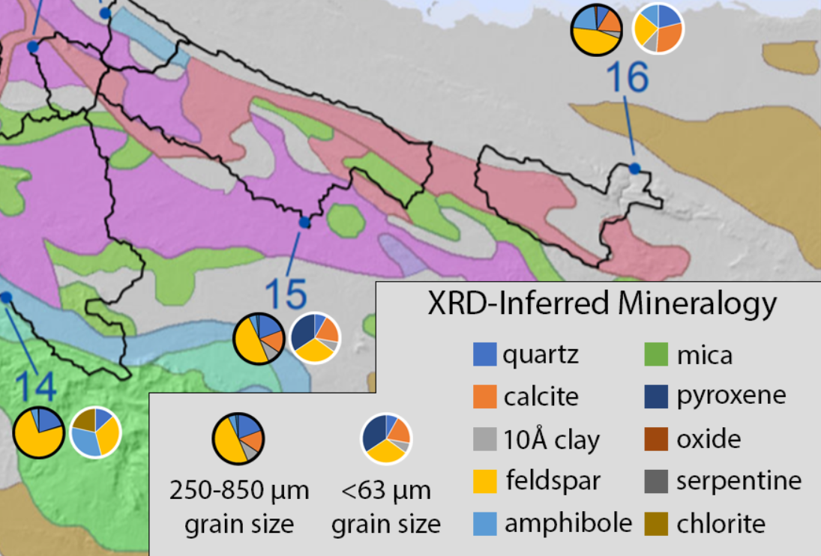

Slide 16
Results – Quantification of sieved samples

Slide 17
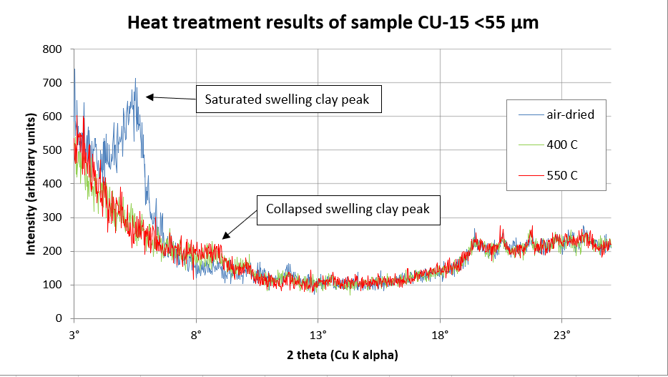
Results – Heat treatment tests
9/12 scans yielded results.
Swelling clays are present in all 9 as montmorillonite and/or vermiculite (Brindley, 1952).

Slide 18
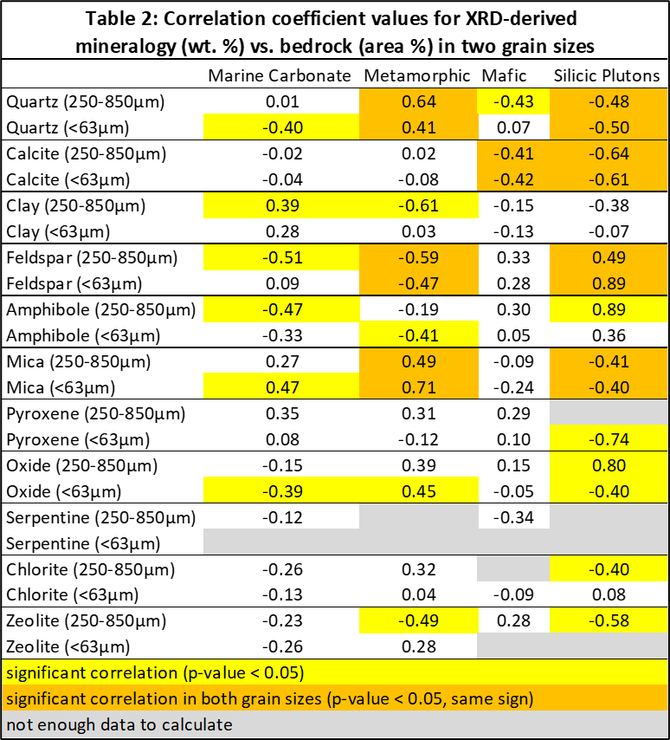
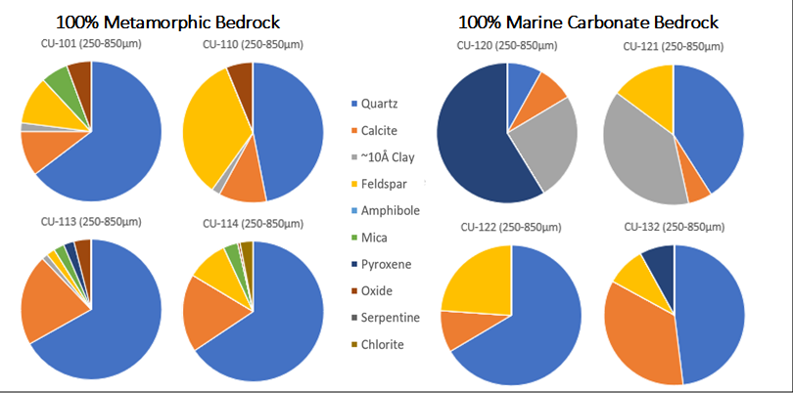
Results – Bedrock vs. mineralogy
Correlations
(positive, negative, p < 0.05)
Silicic plutons:
  feldspar, amphibole, quartz, calcite, mica, clay, pyroxene
Mafic:
  feldspar, pyroxene, amphibole, calcite, clay, mica
Metamorphic:
  quartz, mica, oxide, feldspar
Marine carbonate:
  clay, mica, amphibole

Slide 19
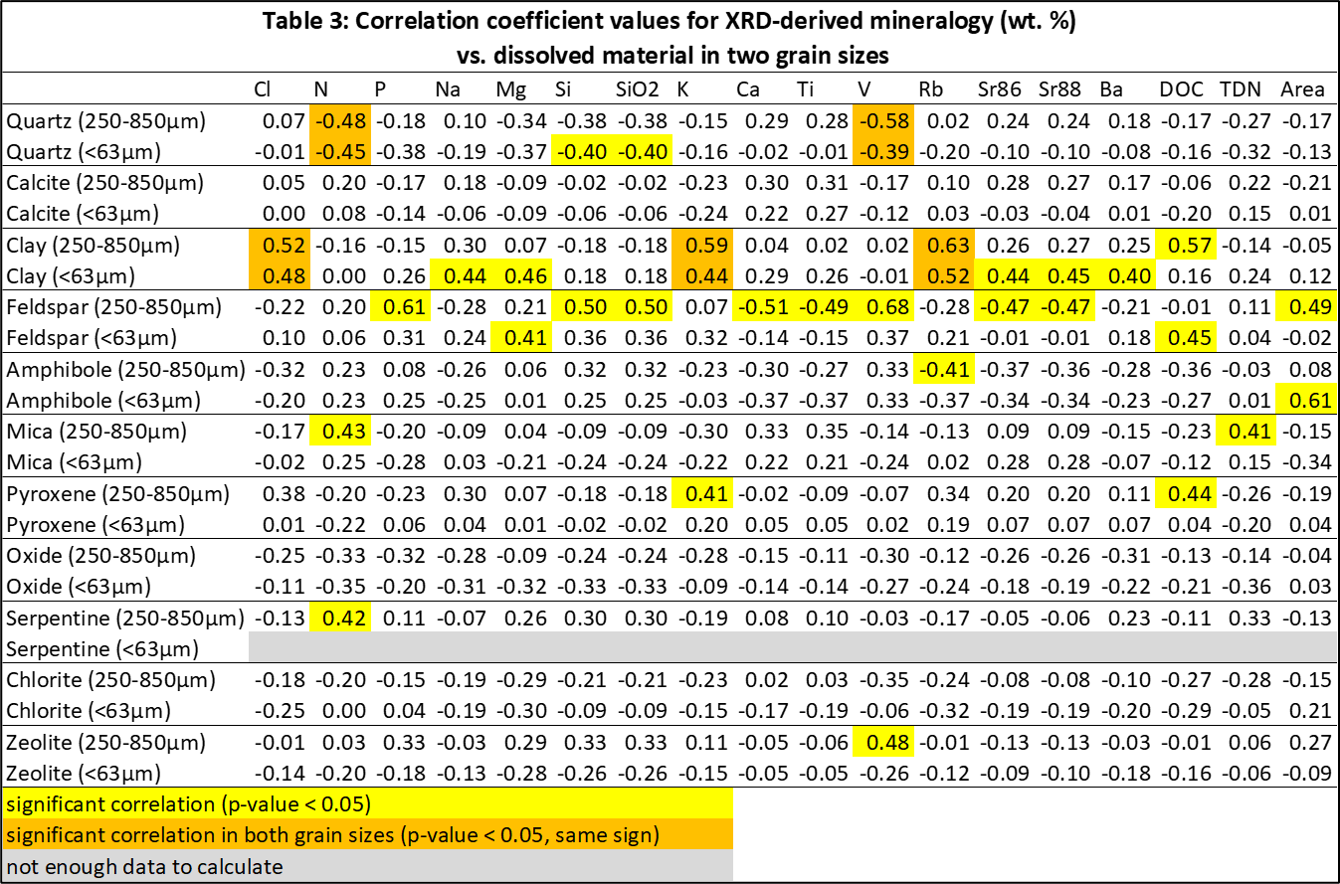
Results – Water chemistry vs. mineralogy

Slide 20
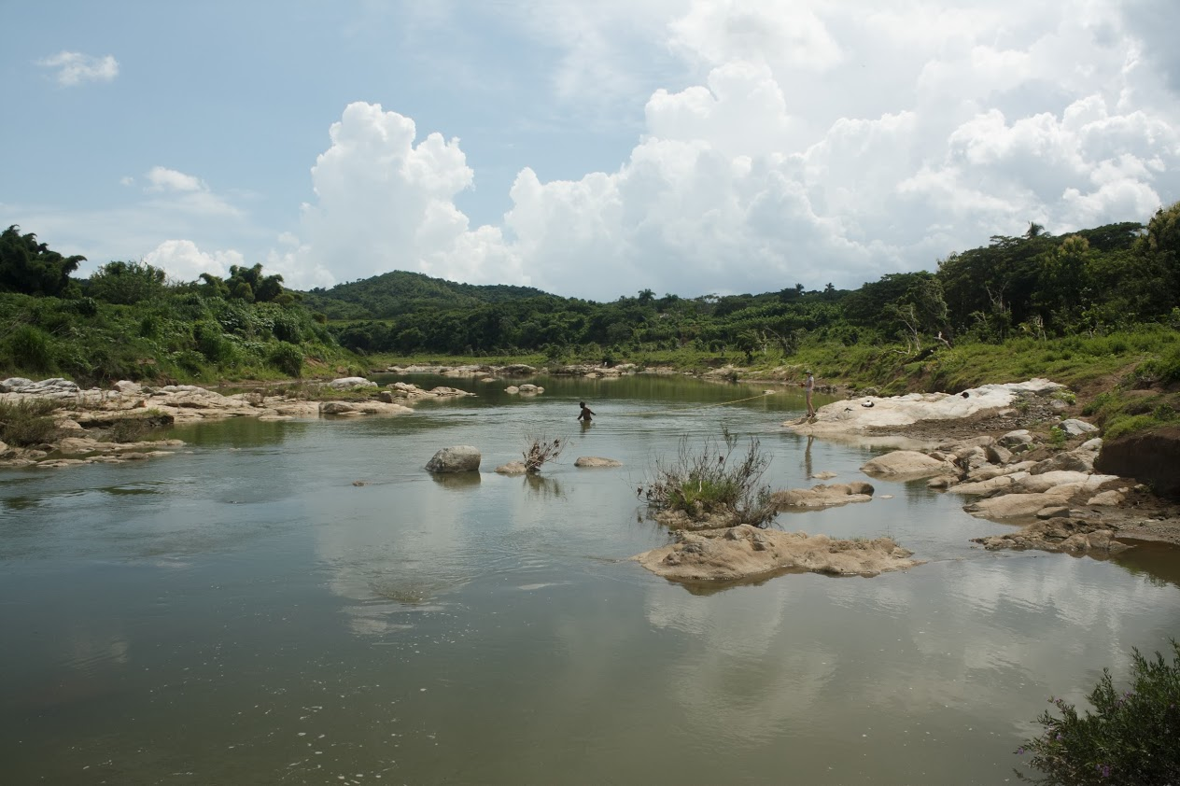
Results – Elemental composition vs. mineralogy
Correlations are generally weak (average coefficient of 0.22).
Notable positive correlations (p < 0.05):
Ca with calcite
Na with feldspar
Fe with amphibole

Slide 21
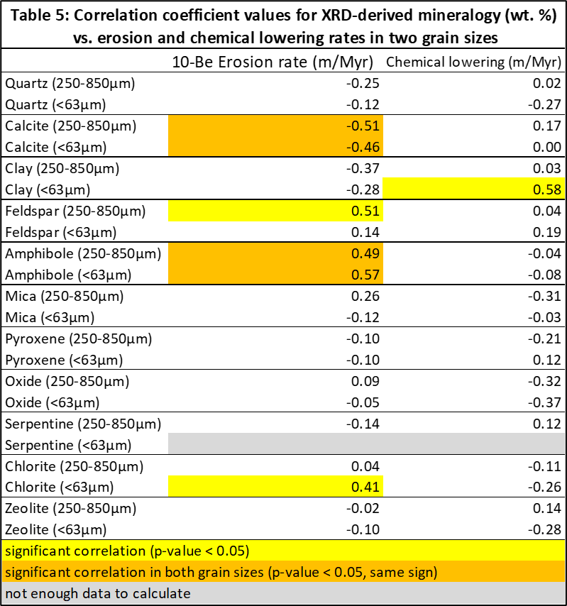
Results – Weathering vs. mineralogy
Related: quartz is positively correlated with mean basin slope (p values: 0.036 in the fine fraction, 0.055 in the coarse fraction).

Slide 22
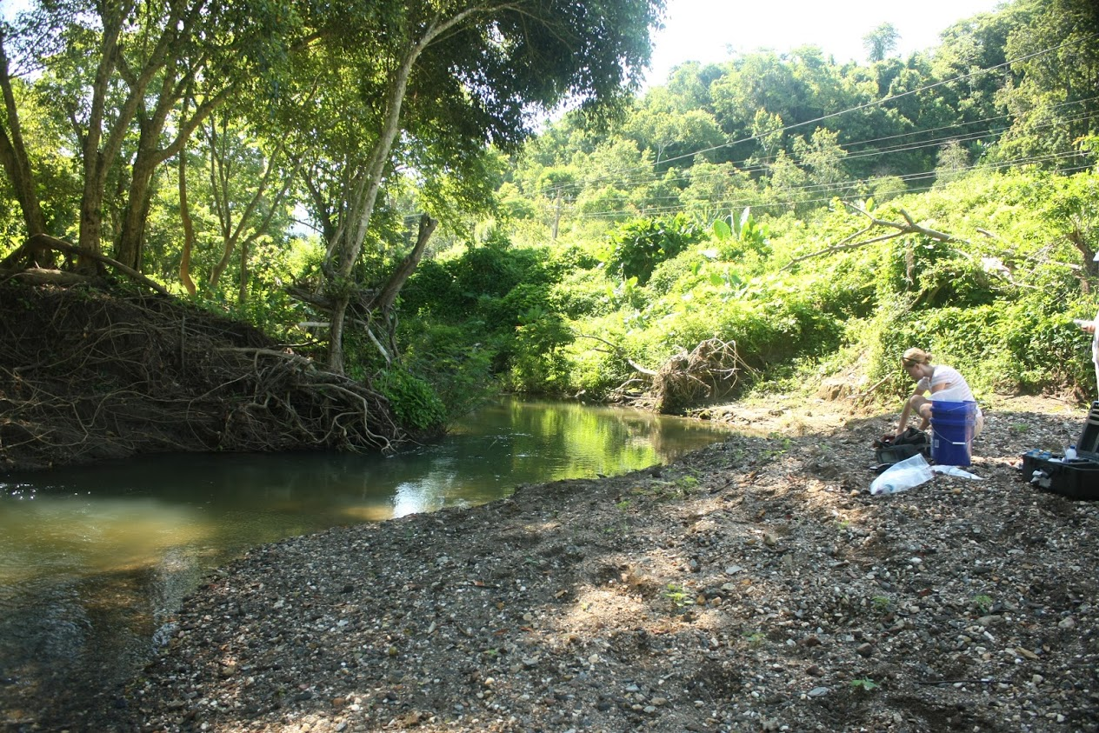
Discussion – Stream sediment indicates lithology?
Quartz is more present than mapping suggests.
Correlations are too weak to quantify bedrock from stream sediment mineralogy.
There are significant compositional variations across grain sizes.
Variable weathering rates of different lithologic units likely play a role (Palomares and Arribas, 1993).
Indicators:
  feldspar and amphibole indicate igneous
  quartz and oxide indicate metamorphic
  clay indicates marine carbonate

Slide 23
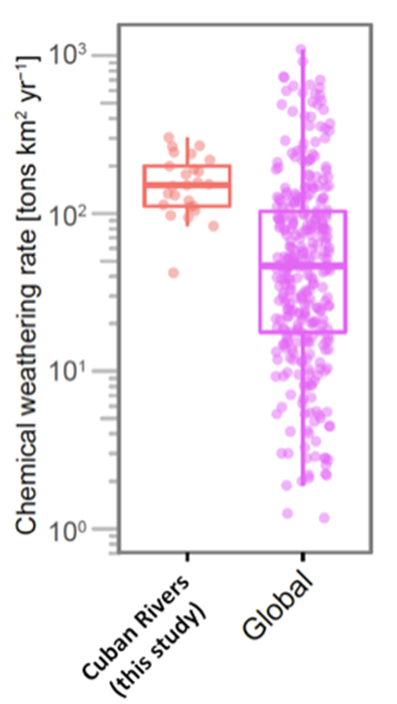
Discussion – A transport limited environment
The presence of swelling clays indicates significant weathering (Reynolds, 1971; Liu et al., 2009).
Quartz correlations suggest a transport-limited stream system:
  No correlation between quartz and weathering
  Positive correlation between quartz and slope
The following minerals are indicative of weathering rates:
  calcite – erosion (negative correlation)
  clay – erosion and chemical weathering (negative correlations)
  amphibole – erosion (positive correlation)
  feldspar – erosion (positive correlation)
Figure 4, adapted from: Bierman et al, (2020), data are from Rad et al. (2013)

Slide 24
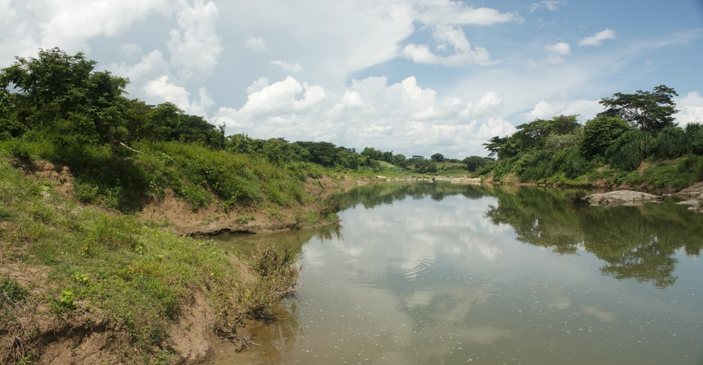
Discussion – Water quality markers
Minerals indicative of water chemistry parameters:
  calcite – dissolved Ca
  clay – dissolved Cl, Mg, Na, K, and DOC
  feldspar – dissolved Si and SiO₂
  quartz – dissolved N (inversely)
Since these watersheds are transport limited, these data shows that sediments are indicative of water quality over longer periods of time than individual water samples.

Slide 25
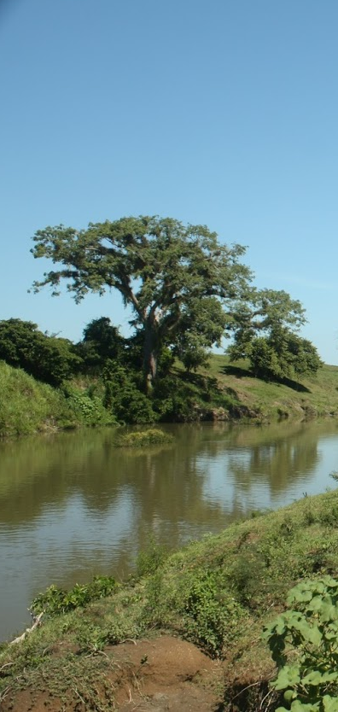
Conclusion and future work
Central Cuba is a transport-limited environment with significant weathering.
Mineralogy data of stream sediments from central Cuba can be used to infer basin-scale:
  Bedrock unit presence, but not quantification (in agreement with Palomares and Arribas, 1993 and Johnsson, 1993).
  Weathering intensity
  Water chemistry parameters, perhaps over longer periods of time than traditional water samples
Future progress could entail:
  More detailed analysis of the 26 samples studied here
  A similar analysis of additional watersheds to expand the current data set

Slide 26
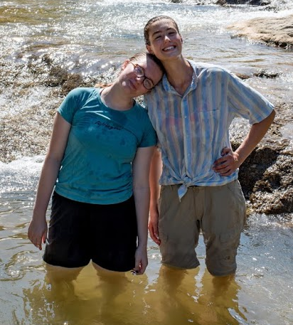
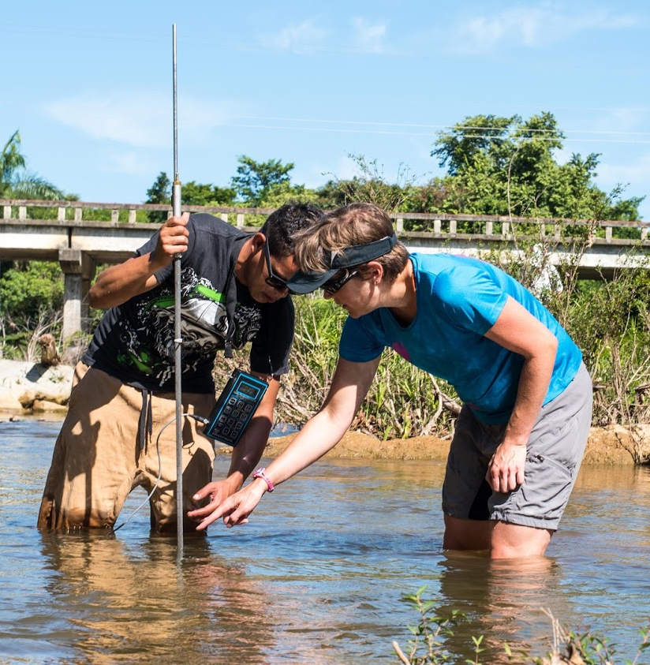
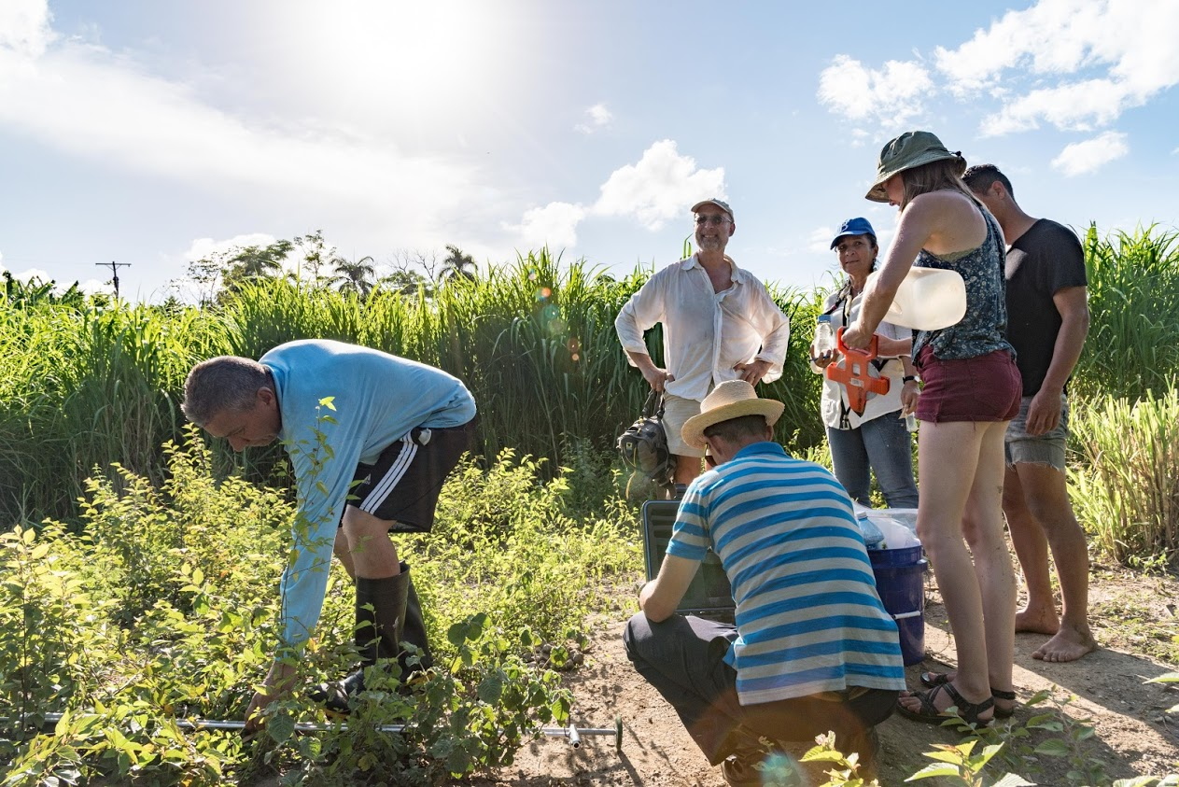
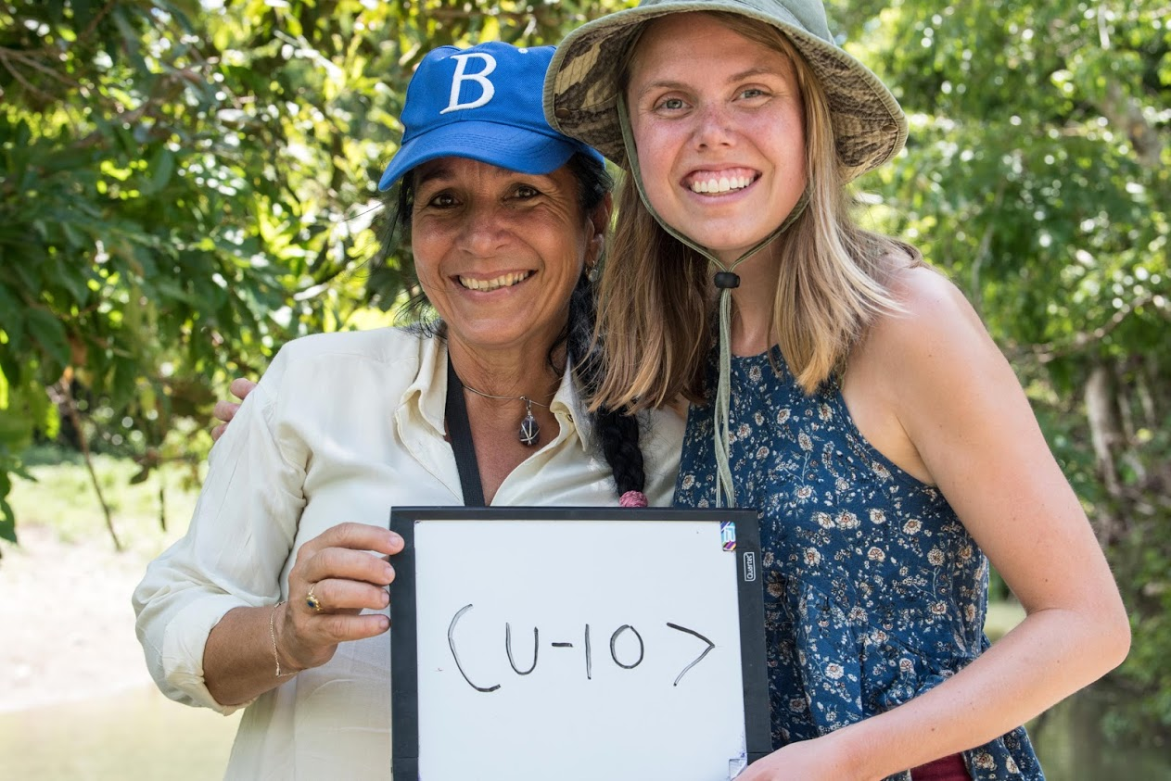
Acknowledgements
People!
Grants: UVM FOUR Summer Undergraduate Research Fellowship (SURF); Hawley Undergraduate Research Award; APLE Summer Stipend Award (declined for SURF)

Slide 27
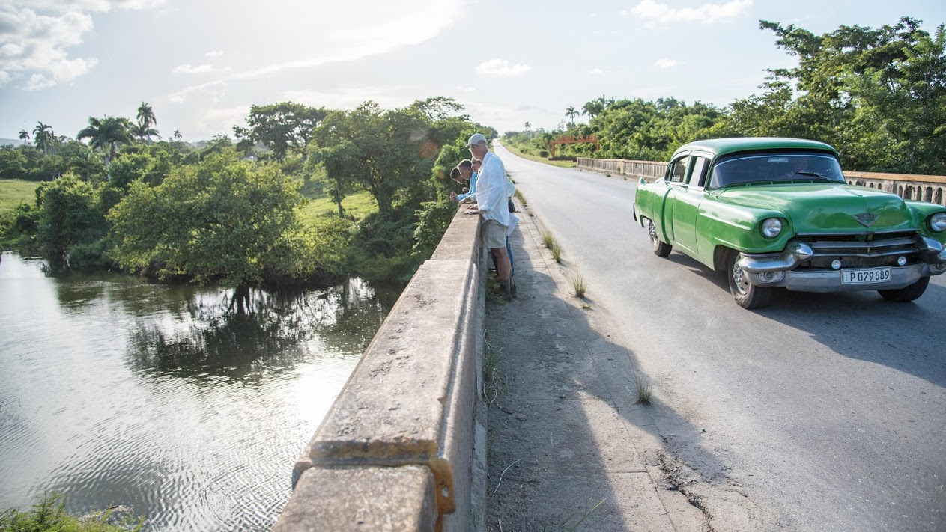
Thanks!
Questions?

Slide 28
References
Beck, H., Zimmermann, N., McVicar, T. et al. Present and future Köppen-Geiger climate classification maps at 1-km resolution. Sci Data 5, 180214 (2018). https://doi.org/10.1038/sdata.2018.214
Bierman, P. R., Hernández, R. Y. S., Schmidt, A. H., Aguila, H. A. C., Alvarez, Y. B., Arruebarrena, A. G., Dethier, D., Dix, M., Massey-Bierman, M., Moya, A. G., Racela, J., and Alonso-Hernández, C. (2020) ¡Cuba! River Water Chemistry Reveals Rapid Chemical Weathering, the Echo of Uplift, and the Promise of More Sustainable Agriculture. GSA Today, v. 30, no. 3-4, pp. 4-10.
Borhidi, A. and Muñiz, O. (1980). Die Vegetationskarte von Kuba. Acta Botanica Hungarica. 26. 25-53.
Brindley, G.W. Identification of Clay Minerals by X-Ray Diffraction Analysis. Clays Clay Miner. 1, 119–129 (1952). https://doi.org/10.1346/CCMN.1952.0010116
Campbell, M. K., Bierman, P., Schmidt, A. H., Sibello Hernández, R. Y., García Moya, A., Cartas Aguila, H., Bolaños Alvarez, Y., Guillén Arruebarrena, A., Dethier, D., Dix, M., Massey-Bierman, M., Corbett, L., Caffee, M., and Alonso-Hernández, C. (2019) First denudation rate estimates for river basins in central Cuba from geochemical, cosmogenic isotope, and sediment yield data. Geological Society of America Abstracts with Programs. Vol. 51, No. 5. doi: 10.1130/abs/2019AM-336639
Case, J. E. and Holcombe, T. L. (1980) Geologic-tectonic map of the Caribbean region. U.S. Geological Survey
Chrismaki, 2010, My Photo scholarship 2010 entry, Volume 2016.
French, C. D., and Schenk, C. J., 2004, Map showing geology, oil, and gas fields, and geologic provinces of the Caribbean Region.
Iturralde-Vinent, M., García-Casco, A., Rojas-Agramonte, Y., Proenza, J., Murphy, J., and Stern, R., 2016, The geology of Cuba: A brief overview and synthesis: GSA Today, v. 26, no. 10. doi:10.1130/GSATG296A.1
Johnsson MJ (1993) The system controlling clastic sediments. In: Johnsson MJ, Basu A (eds) Processes controlling the composition of clastic sediments, vol. 284. Special Paper of the Geological Society of America, London, pp 1–19
Liu, Z., Zhao, Y., Colin, C., Siringan, F., Wu, Q., 2009. Chemical weathering in Luzon, Philippines from clay mineralogy and major-element geochemistry of river sediments, Applied Geochemistry, Volume 24, Issue 11, Pages 2195-2205, ISSN 0883-2927, https://doi.org/10.1016/j.apgeochem.2009.09.025.
Palomares, Marta, and José Arribas. “Modern Stream Sands from Compound Crystalline Sources: Composition and Sand Generation Index.” Processes Controlling the Composition of Clastic S\ediments, by Mark J. Johnsson and Abhijit Basu, vol. 284, Geological Society of America, 1993, pp. 313–322.
Prance, Ghillean and Borhidi, Attila. (1993). Phytogeography and Vegetation Ecology of Cuba. Kew Bulletin. 48. 620. doi: 10.2307/4118727.
Rad, S., Rivé, K., Vittecoq, B., Cerdan, O., and Allègre, J C. (2013) Chemical weathering and erosion rates in the Lesser Antilles: An overview in Guadeloupe, Martinique and Dominica. Journal of South American Earth Sciences. V. 45, pp. 331-344, https://doi.org/10.1016/j.jsames.2013.03.004
Reynolds, R.C. Clay Mineral Formation in an Alpine Environment. Clays Clay Miner. 19, 361–374 (1971). https://doi.org/10.1346/CCMN.1971.0190604
Schmidt, A. H., Snyder, P. L. and Bierman, P. R. (2016) Collaborative Research: The Cuban landscape, quantification of the effects of industrialized agriculture flowed by countries around soil conservation using isotopes associated with sediment. NSF RUI proposal.
Schock, W. W. and Steidtmann, J. R. (1976) Relations between stream sediment and source-rock mineralogy, Piney Creek Basin, Wyoming. Sedimentary Geology. Volume 16, Issue 4, Pages 281-297, ISSN 0037-0738, https://doi.org/10.1016/0037-0738(76)90003-8

