Slide 1
Mineral dissolution/precipitation
To determine whether or not a water is saturated with an aluminosilicate such as K-feldspar, we could write a dissolution reaction such as:
KAlSi₃O₈ + 4H⁺ + 4H₂O ↔ K⁺ + Al³⁺ + 3H₄SiO₄⁰
We could then determine the equilibrium constant:
from Gibbs free energies of formation. The IAP could then be determined from a water analysis, and the saturation index calculated.

Slide 2
INCONGRUENT DISSOLUTION
Aluminosilicate minerals usually dissolve incongruently, e.g.,
2KAlSi₃O₈ + 2H⁺ + 9H₂O
↔ Al₂Si₂O₅(OH)₄ + 2K⁺ + 4H₄SiO₄⁰
As a result of these factors, relations among solutions and aluminosilicate minerals are often depicted graphically on a type of mineral stability diagram called an activity diagram.
Notes:
In any event, writing a congruent dissolution reaction for aluminosilicates does not make a whole lot of sense, because at the pH values of most natural waters, these phases dissolve incongruently, producing clay minerals such as kaolinite, gibbsite or smectite.
Because of all these problems, relations among solutions and aluminosilicate minerals are usually handled using a different approach. This involves the calculation of a type of phase diagram called an activity diagram.
An activity diagram typically has activities of selected dissolved species as its coordinates, and it shows graphically the solution conditions under which selected phases are stable.

Slide 3
ACTIVITY DIAGRAMS: THE
K₂O-Al₂O₃-SiO₂-H₂O SYSTEM
We will now calculate an activity diagram for the following phases: gibbsite {Al(OH)₃}, kaolinite {Al₂Si₂O₅(OH)₄}, pyrophyllite {Al₂Si₄O₁₀(OH)₂}, muscovite {KAl₃Si₃O₁₀(OH)₂}, and K-feldspar {KAlSi₃O₈}.
The axes will be a _{K+}/a _{H+} vs. a _{H4SiO40}.
The diagram is divided up into fields where only one of the above phases is stable, separated by straight line boundaries.
Notes:
We will illustrate the construction and interpretation of activity diagrams by plotting the fields of stability of the phases listed in this slide as a function of the coordinates a_{K+}/a_{H+} vs. a_{H4SiO40}, i.e., a_{K+}/a_{H+} on the y-axis and a_{H4SiO40} on the x-axis. Activity diagrams consist of a series of straight lines which separate fields where only one of the aluminosilicate phases is stable. Along these straight lines, or phase boundaries, two of the aluminosilicate phases coexist in equilibrium. At this point it may be helpful to cheat a little and take a peak at the final diagram to see what the goal is.

Slide 4
Activity diagram showing the stability relationships among some minerals in the system K₂O-Al₂O₃-SiO₂-H₂O at 25°C. The dashed lines represent saturation with respect to quartz and amorphous silica.
Notes:
This is what we will end up with after all the calculations and plotting are through. To calculate the positions of each of the boundaries shown above, we need to have thermodynamic data so we can calculate equilibrium constants for the reactions that occur at each of the boundaries. For example, along the boundary between the stability fields for the phases gibbsite and kaolinite, a reaction takes place involving these two phases. If we cross this boundary from the gibbsite field into the kaolinite field, the reaction is one in which gibbsite is converted to kaolinite. The thermodynamic data we require for this exercise are given in the following table.

Slide 5
Aluminum
Notes:
Al3+ + 3 H2O → AlOH3 + 3H+ → write mass action, convert to log K, expression in pH and log[Al3+]
Al(OH)2+ + 2 H2O → AlOH3 + 2 H+
Al(OH)2+ + H2O → AlOH3 + H+
Al(OH)30 → AlOH3(gibbsite)
Al(OH)4- → AlOH3 + OH-
Al(OH)4- + H+ → AlOH30 + H2O
Al(OH)30 + H+ → Al(OH)2+ + H2O
Al(OH)2+ + 2H+ → Al3+ + 2 H2O

Slide 7
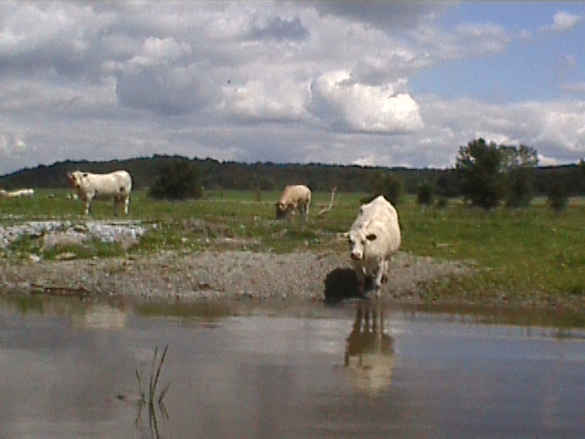
P cycling and sediment microbes
Linking nutrient cycling and redox chemistry in fresh water lakes
PO₄³⁻
PO₄³⁻
Iron reducers
PO₄³⁻
PO₄³⁻
FeOOH
Fe²⁺
PO₄³⁻
PO₄³⁻
H₂S
PO₄³⁻
FeS₂
Sulfate Reducers
Blue Green Algae blooms?
N cycling and sediment microbes
Ammonifying
bacteria
NO₃⁻
NH₄⁺

Slide 8
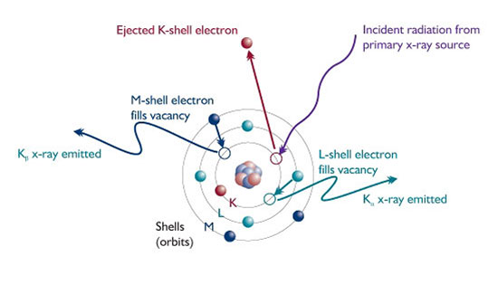
Solid State Analysis
X-Ray Fluorescence Spectroscopy (XRF)
X-ray Diffraction (XRD)

Slide 9
Extractions
Using selected acids, bases, organics, chelators to dissolve a subset of minerals
Many possibilities for this
We will look at 2 used to investigate Fe, Mn, P:
  Aqua Regia – Combination of Nitric Acid and Hydrochloric acid, heated to just below boiling – dissolved most stuff (but not all!!)
  Ascorbic Acid extraction – Combination of ascorbic acid and bicarbonate

Slide 10
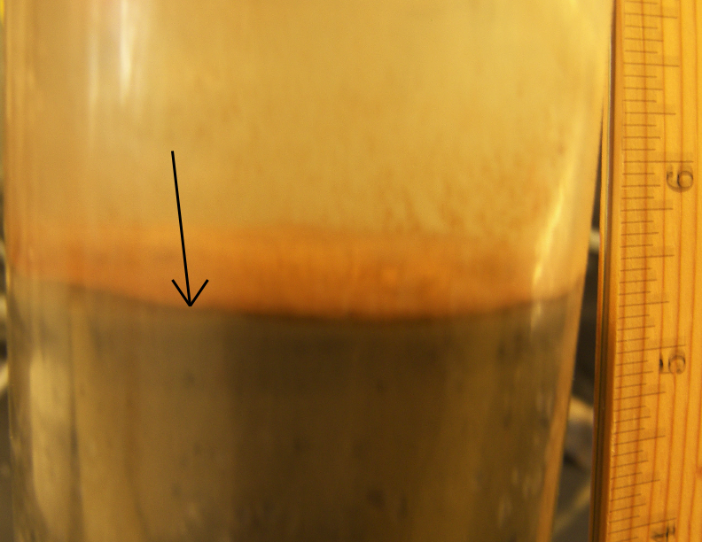
FeOOH/MnOOH in sediments
Ascorbic acid extraction technique specific to ‘reactive’ Fe and Mn (Kostka and Luther, 1994)
XRD data confirms reactive stuff is ferrihydrite
Size is nanloparticulate, sensitive to degree of recycling!

Slide 11
Where is the Phosphorus?
P mobility measured through hundreds of sediment digests for samples in Missisquoi Bay collected at different times, places, and depths
Only strong and consistent correlation is with reactive Fe, present predominantly as nanoparticulate FeOOH particles
2008 Sediment Extraction Correlation Statistics
 | Ascorbic Acid (reactive) |  |  | Aqua Regia (total)
 | R² | p-value | n | R² | p-value | n
P vs. Fe | 0.8952 | 6.4 x 10⁻¹⁰⁰ | 202 | 0.1940 | 3.5 x 10⁻¹⁰ | 185
P vs. Mn | 0.6561 | 3.1 x 10⁻⁴⁸ | 202 | 0.3026 | 5.0 x 10⁻¹⁶ | 185
P vs. Ca | 0.6895 | 2.7 x 10⁻²⁷ | 184 | 0.1709 | 5.0 x 10⁻⁹ | 185
P vs. Al | 0.4653 | 1.5 x 10⁻²⁶ | 184 | 0.6883 | 3.4 x 10⁻⁴⁸ | 185

